Slide 2
Maker x Backup x Sharing x Work x Entertainment everywhere
Thin & light; use it everywhere
740g / 1.63lbs
Light weight for portability
B5 size
30 x 230 x 165 mm
1.18 x 9.06 x 6.50 inch (H x W x D)

Slide 3
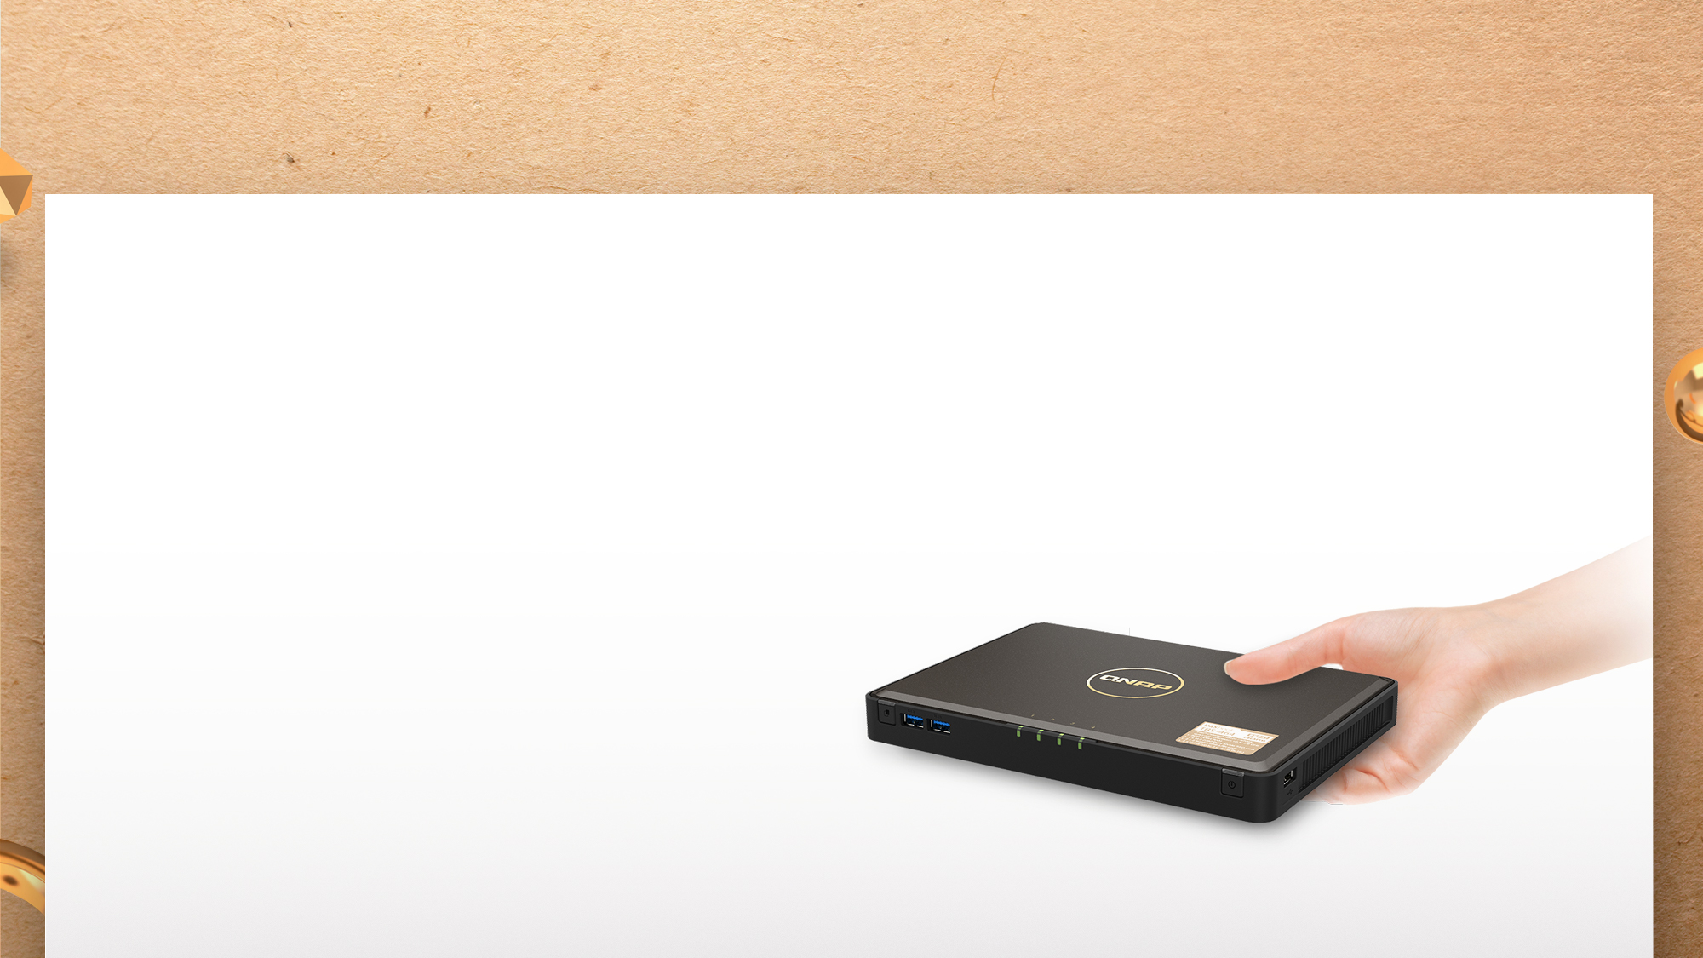
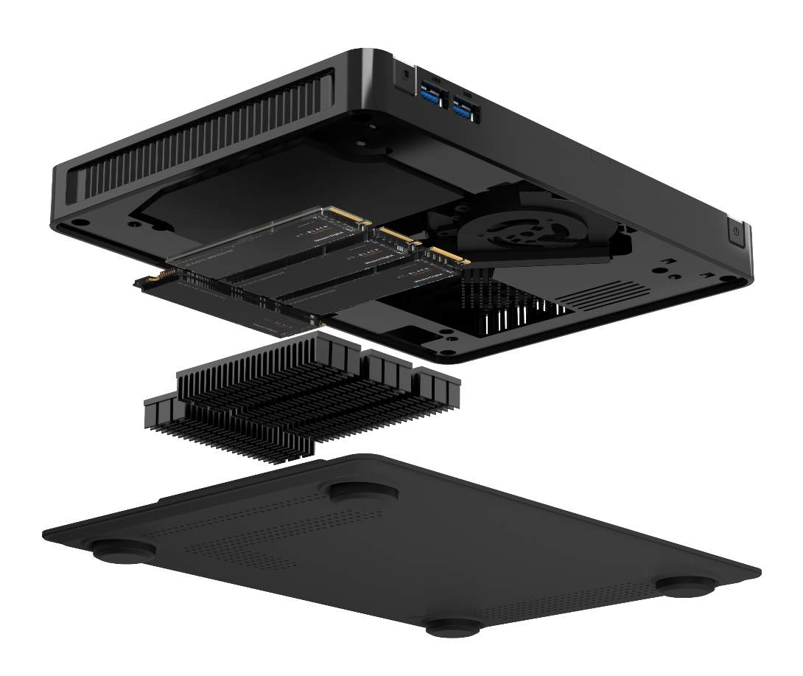
M.2 SSD for the best performance
4 x M.2 2280 NVMe Gen 3 x 2 SSD slots
(optional SSD purchase)

Slide 4

QTS 5.0 + Linux kernel 5.10
To provide the best performance of Intel® Celeron® N5105/N5095, TBS-464 is shipped with QTS 5.0, using the new Linux kernel 5.10. QTS 5.0 optimizes overall system performance and NVMe SSD over-provisioning & cache performance to enhance TBS-464 functionality.
AES-NI encryption
Volume & folder support
GPU up to 800 MHz
UHD Graphics
N5105/ N5095
Jasper Lake
4-core
4-thread
2.9GHz
Burst

Slide 5

What is SSD over-provisioning
SSD Over-provisioning reserves space in the SSD to decrease write amplification & increase consisted performance and endurance.
Reason: to avoid Garbage Collection in any giving point of time
With limited OP, 4 more write is needed. With more OP the GC is not required.
N | New Data
D | Valid Data
 | Invalid Data
 | OP
 | OP
N | N
N | N
N | N
D | D
D | D
D
D
D | D
D | D
D | D
D | D
N | N
N | N
N | N
6 pages of new data cannot all be stored to the SSD
Unless the SSD conduct GC internally first
With more reserved block, the GC is not required

Slide 6

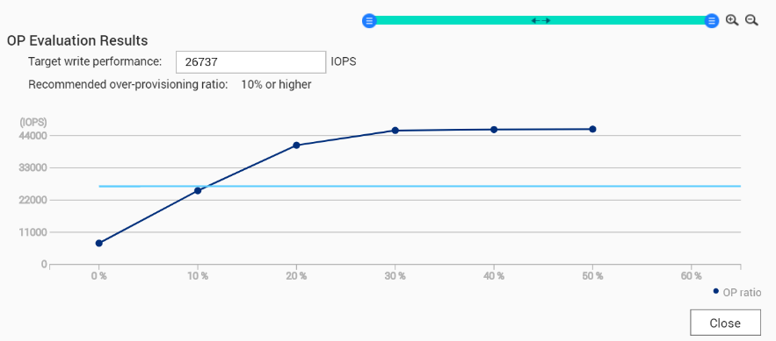
Choosing SSD is hard, choosing QNAP is simple
SSD consisted performance can only be observed after long time of usage.
QNAP has provided the unique SSD Profiling Tool to help user measure the performance difference with different over-provisioning amounts.
Not just IT manager, home user can also evaluate the capability of SSD.
Using SSD Profiling Tool to identify the best OP amount.

Slide 7




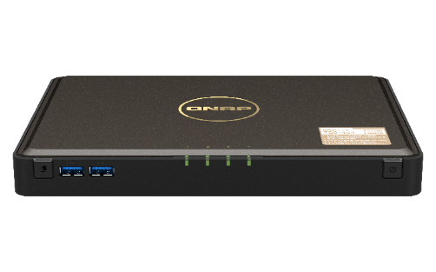

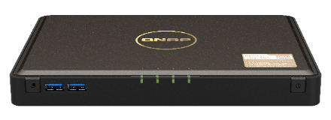

Create a tighter hybrid cloud system
Light storage in NAS + Unlimited storage in Cloud
= Everything is Possible
Capacity
HybridMount
VJBOD Cloud
Unlimited Expansion
File-level Gateway
Block-level Gateway
HybridMount
VJBOD Cloud

Slide 8



















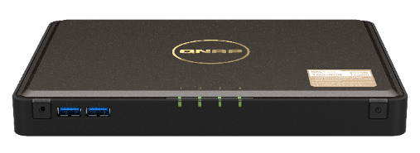















HybridMount: enable cache to enhance cloud experience
Mount space of 20 cloud providers​​
Enjoy QTS applications with your cloud data
File Management
Editing Tool
Multimedia
Application
Access with
Network Protocol

Slide 9


VJBOD Cloud + public cloud frees the private cloud from its limitation
Using the public cloud storage space just like a volume (or iSCSI LUN) on the NAS.
Compared to file-level HybridMount, the block-level VJBOD Cloud increase the efficiency of transferring random data and large files to the cloud to provide business-level gateway solution.
In file-level, a modified file need to be re-upload in full.
Oringial Data
Modified Data
In block-level, only the modified block needs to be uploaded to the cloud.
With Block-level solution， the uploaded data cannot be recongized by the cloud or its applications

Slide 10



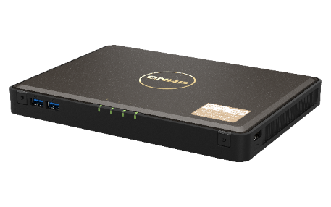



Using VJBOD Cloud to create a reliable database
Even the best RAID protection cannot stand again physical shock!
For files, they can be upload to cloud, how about iSCSI LUN?
With VJBOD Cloud, an iSCSI LUN can be created at Cloud and shared via NAS. Using the edge solution to accelerate performance while allowing new device to connect & share the LUN at any time!
Having a reliable database backup solution for your application
Using Different NAS to share the LUN when needed
Cloud LUN as Object
* One Cloud LUN can only be connected by one NAS at a time

Slide 11
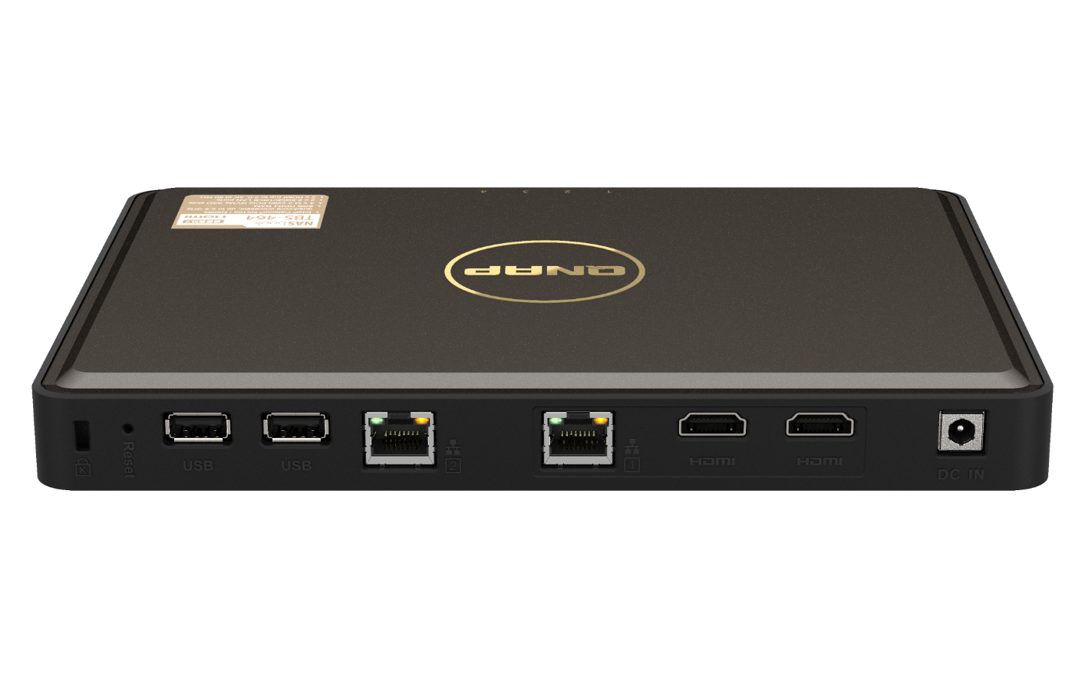
2.5GbE Bandwidth brings out SSD potential
700
600
500
586
574
400
300
200
294
287
100
0
Upload
Download
Upload
Download
(MB/s)
1 x 2.5GbE
2 x 2.5GbE port trunking
Test environment: TBS-464: 4 x Seagate Ironwolf 510 M.2 2280 NVMe SSD, RAID 5, QTS 5.0, onboard 8GB RAM
Client PC: Windows Server 2019, Intel Xeon W-1250, 32GB RAM, onboard 2.5GbE (Intel i225)

Slide 12

TBS-464 front view
USB OTC button
IR receiver
USB 3.2 Gen 1 ports
M.2 SSD status LEDs
Power button and status LED

Slide 13
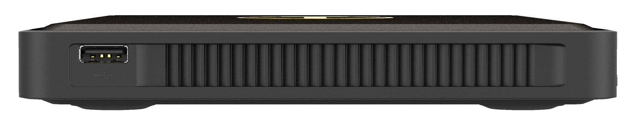
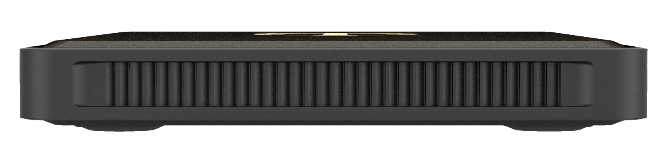
TBS-464 side views
USB 2.0 Port
USB 2.0 port
Right side
Left side

Slide 14
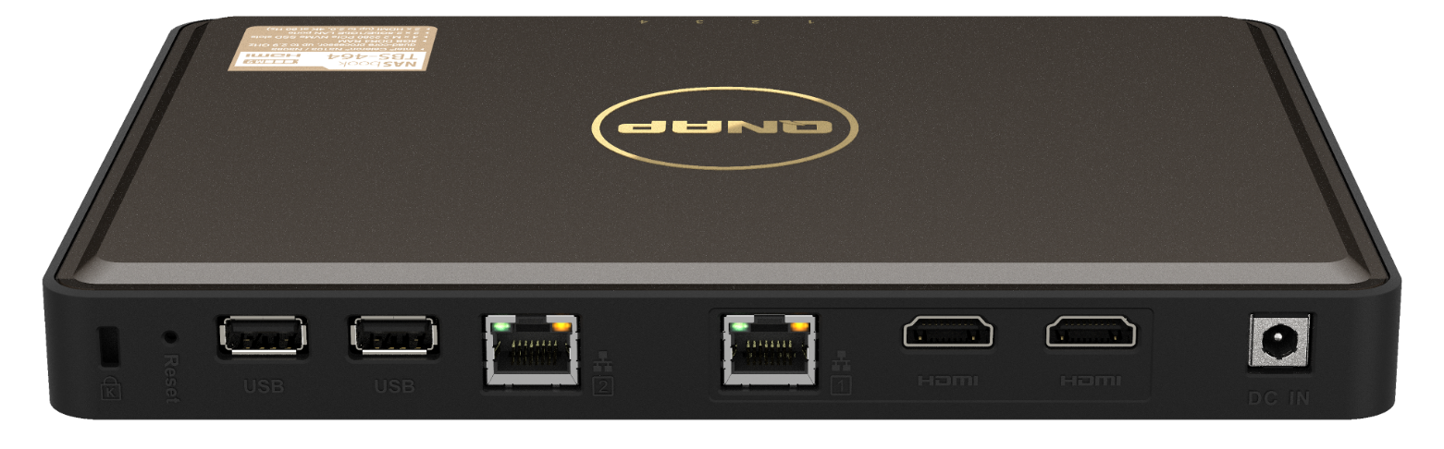
TBS-464 rear views
USB 2.0 ports
HDMI ports (up to 2.0)
2.5GbE ports
Kensington lock
reset
Power input

Slide 15
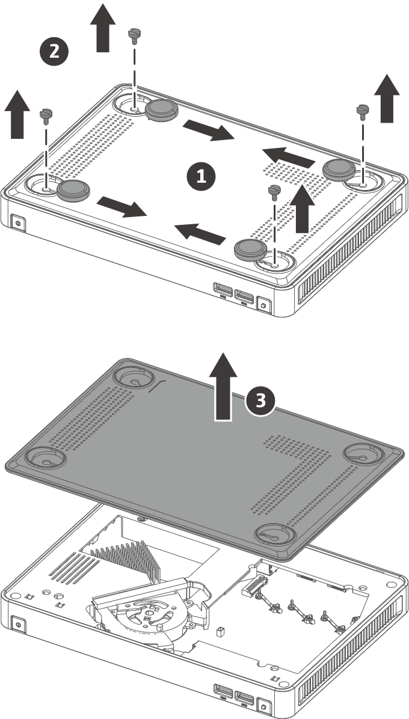
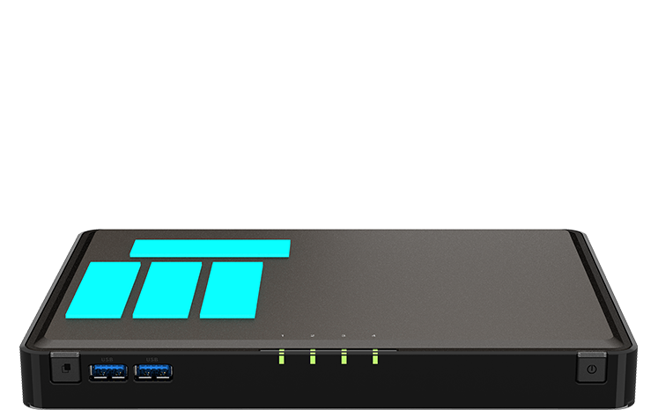
M.2 NVMe SSD installation
4 x M.2 2280 NVMe
SSD slots
(SSDs not included)

Slide 16
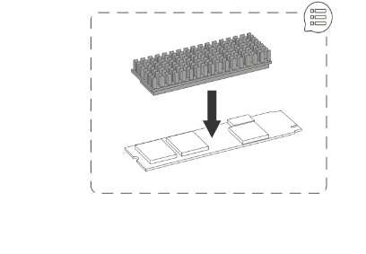
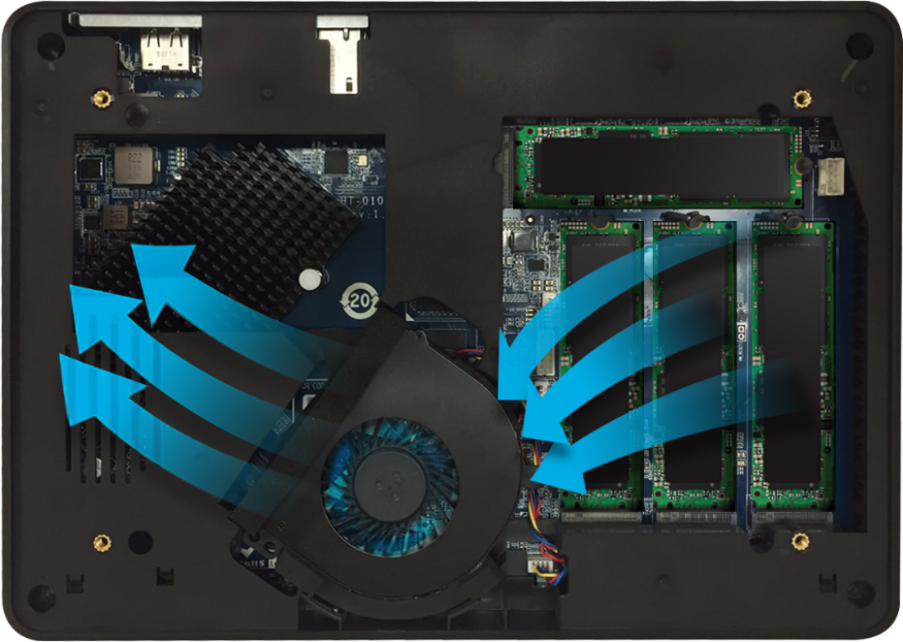
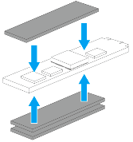
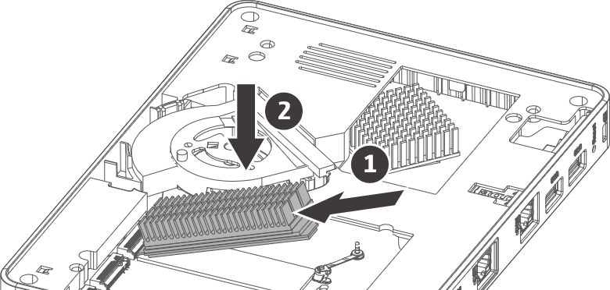
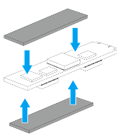
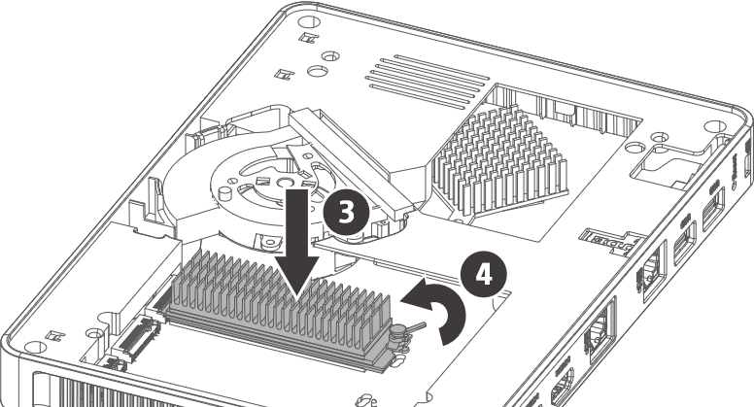
Smart ‘n quiet fan with optimal thermal design
Include thermal pads for single & dual-sided M.2 SSD
Air flow brings out excessive heat
Brand new M.2 SSD heatsink

Slide 17


HDMI 2.0 4K 60FPS sharp picture quality

Slide 18

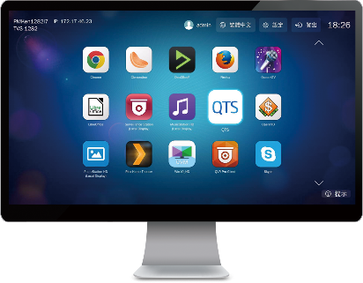


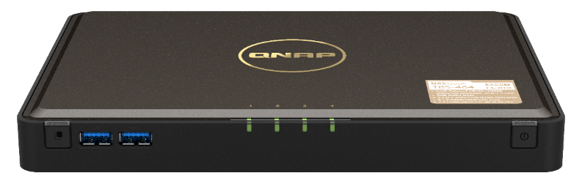
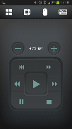
HybridDesk Station for various A/V needs
USB
HDMI
Mouse &
Keyboard
Network
Qremote App

Slide 19


Versatile HybridDesk Station apps
System Mgmt.
Surveillance
Comm. & Social
QTS
FileStation HD
QVR Pro Client
Skype
Facebook
Multimedia
Multimedia Mgmt.
Browser & Productivity
HD Player
Clementine
Spotify
TuneIn Radio
PhotoStation HD
VideoStation HD
MusicStation HD
Chrome
Firefox
LibreOffice

Slide 20
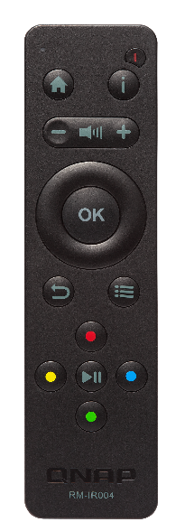





Qbutton: customize remote button actions
Optional purchase of QNAP RM-IR004
IR remote control
Play your favorite music playlist with a single button or set other buttons to play the previous or next song
View pre-selected channels on Surveillance Station for quick surveillance monitoring
Set a button to restart or power off your NAS for greater convenience

Slide 21
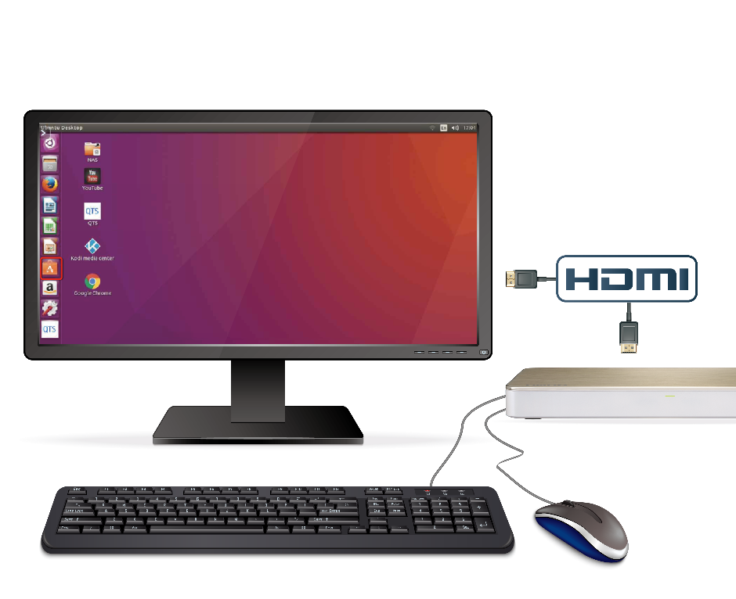
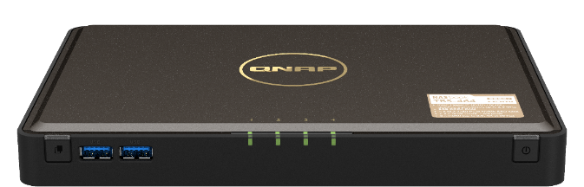
Linux Station turns NAS into a Ubuntu PC
1
HDMI output from NAS to a monitor
Multi-version Ubuntu
Ubuntu 18.04
Ubuntu 20.04
2
Connect a USB keyboard and a mouse to the NAS to start using Ubuntu

Slide 22





Streaming & accelerated transcoding
4K H.264 decoding & encoding for real-time or offline 4K video transcoding on various client players for smooth playback and support more clients
HDMI output for 4K Ultra HD (3840 x 2160, 60FPS) content
Stream content through DLNA, AirPlay, Chromecast and Plex

Slide 23









Use PLEX to stream media collections
Players
TV & PC
SmartTV
PC
Mobile
Phone
Tablet

Slide 24
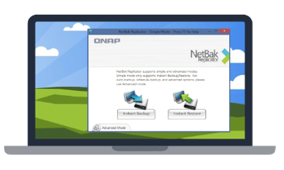


Backup or sync data at your choice
macOS
Protection against ransomware!
Time Machine
Qsync
Windows
NetBak Replicator
Qsync
Scheduled or real-time backup/sync

Slide 25
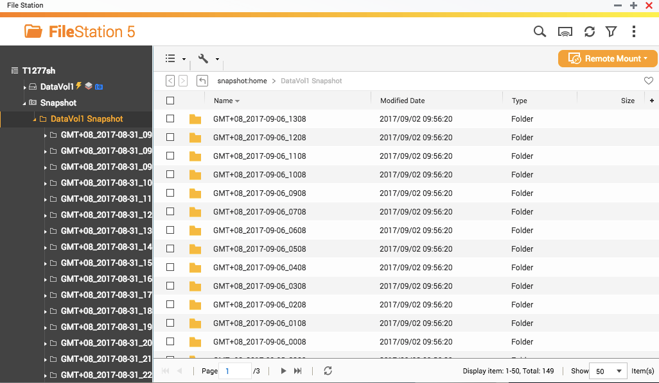


Business-level snapshot
Snapshot # per NAS
1024
---------------------------------------------------------
Snapshot # Volume/LUN
256
Best
choice!

Slide 26




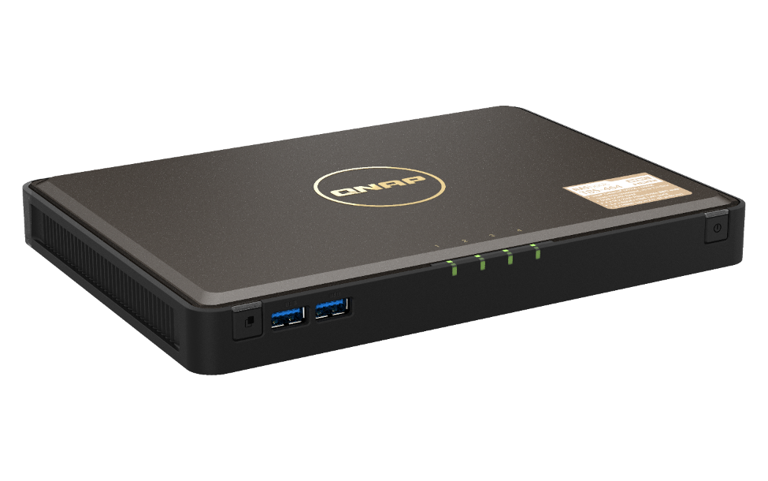











Backup the NAS data
Hybrid Backup Sync
Remote
Local
Cloud

Slide 27
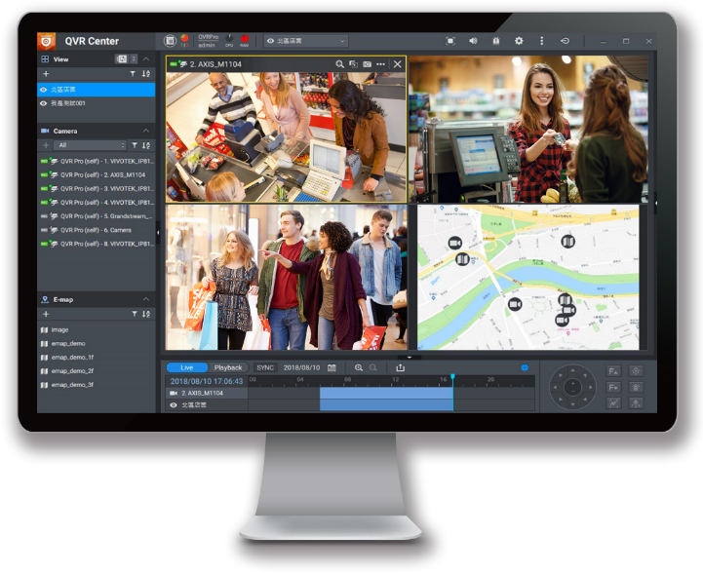


QVR Pro 24/7 surveillance solution
6,000+ IP cameras
8 free channels
128 ch max channels (license)
QUSBCam2 for webcam recording

Slide 28



Expand storage via VJBOD
Max 8 remote NAS
iSCSI
10GbE / 1GbE mount
iSCSI
2.5GbE
VJBOD
Use other NAS capacity to expand own capacity via network connection

Slide 29

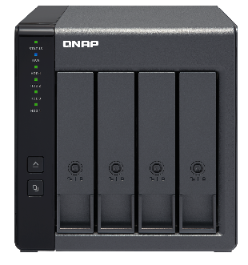







TR-004 RAID box for expansion or data sharing
Two use cases:
1. NAS, Windows, macOS & Linux cross-platform external device mode
2. QNAP NAS capacity expansion mode
Two modes
USB 3.0
USB 3.0
External
device
Pool
TBS-464
TR-004

Slide 30












QuMagie
What is QuMagie?
  QuMagie is an AI-powered photo management solution with flexible storage space
  QuMagie is a free application within QNAP NAS system
QNAP NAS
Mobile
Mobile
Browse, Manage Photos
Upload, Backup Photos
PC
手持裝置
手持裝置
Camera
QuMagie
Share Photos
Social Media
手持裝置
PC
QNAP AI Core

Slide 31
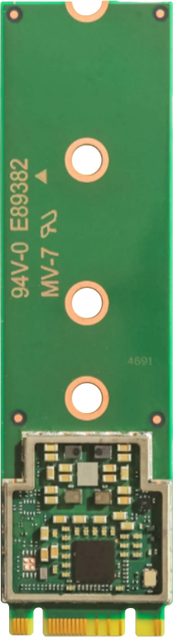
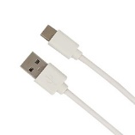

Coral M.2 Accelerator B+M key
Coral M.2 Accelerator B+M key
  Coral P/N: G650-04686-01
  4 TOPS total peak performance (int8)
  2 TOPS per watt (TOPS = trillion operations per second)
  M.2 2280 B+M key form factor
  PCIe Gen 2 x 1 interface
QNAP P/N: G650-04686-01-QNAP
  Package contents
    Coral M.2 Accelerator B+M key
    QNAP Heatsink
    NAS Installation guide

Slide 32
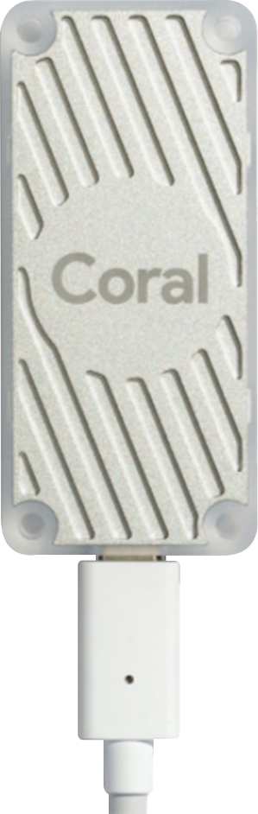

Coral USB Accelerator
Coral USB Accelerator
  Coral P/N: G950-06809-01 & G950-01456-01
  4 TOPS total peak performance (int8)
  2 TOPS per watt (TOPS = trillion operations per second)
  No extra power adapter needed
  USB 3.2 Gen 1 (USB 3.0) Type-C interface (data/power)
QNAP P/N: G950-06809-01-QNAP
  Package contents
      Coral USB Accelerator
      NAS installation guide
30 mm (1.18 inches)
65 mm
(2.56 inches)

Slide 33



QVR Face / Human
QVR Face helps users build intelligent face recognition
QVR Human proactively calculates the number of people passing through a specific region

Slide 34
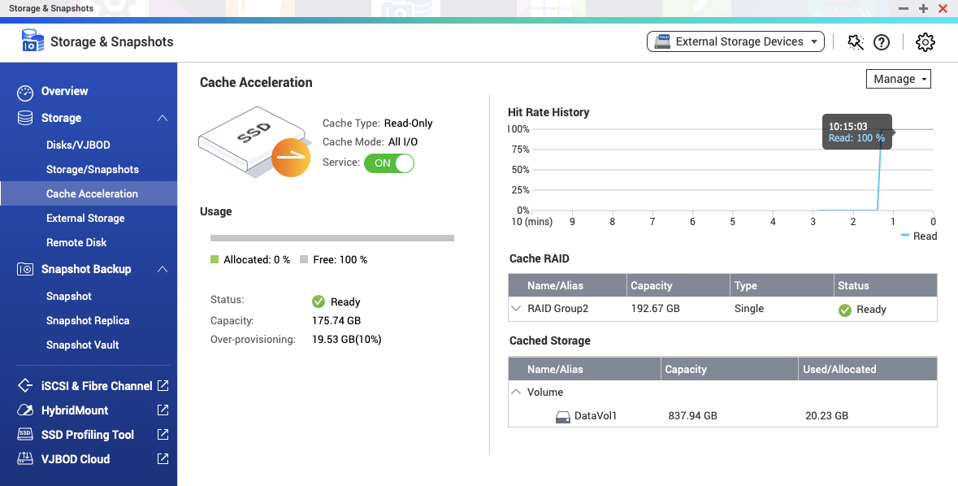
Improve NVMe SSD Performance
With the new kernel, NVMe usage efficiency is greatly improved
Optimized cache module, SSD space can be used more efficiently, and memory usage is less then before
Improve the efficiency of multi-users access to the same folder

Slide 35


Increase the level of security
Support TLS 1.3
The admin account is disabled by default
Advanced encryption suite support
adjusted safety settings and more stronger safety protection options
SSH Key login
Firmware automatic updates (recommended updates, automatic updates)
App automatic updates (recommended updates, automatic updates)

Slide 36

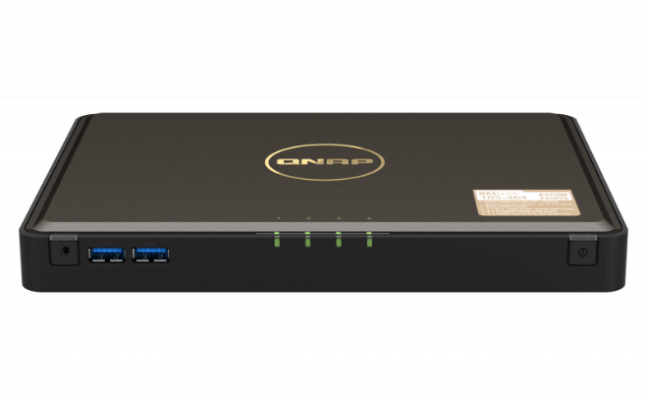
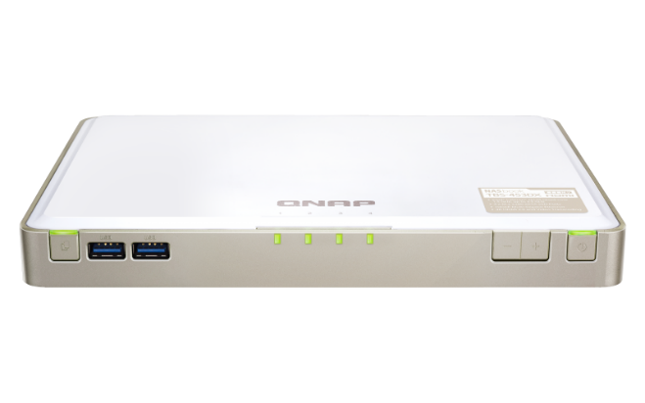
TBS-464 v.s. TBS-453DX
Model | TBS-464 | TBS-453DX
CPU | Intel® Celeron® N5105/N5095 4-core/4-thread processor, burst up to 2.9 GHz | Intel® Celeron® J4115 4-core/4-thread processor, burst up to 2.5 GHz
M.2 slots | 4 x M.2 2280 NVMe Gen3 x2 slots | 4 x M.2 2280 SATA 6Gb/s slots
Ethernet ports | 2 x 2.5GbE | 1 x 10GbE 1 x 1GbE
HDMI output | 2 x HDMI (up to 2.0 resolution 3840 x 2160 @ 60Hz) | 1 x HDMI 2.0 (up to resolution 3840 x 2160 @ 60Hz)

Slide 37
Copyright© 2021 QNAP Systems, Inc. All rights reserved. QNAP® and other names of QNAP Products are proprietary marks or registered trademarks of QNAP Systems, Inc. Other products and company names mentioned herein are trademarks of their respective holders.

