Slide 2
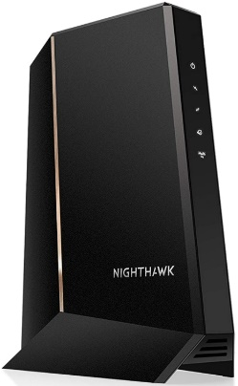
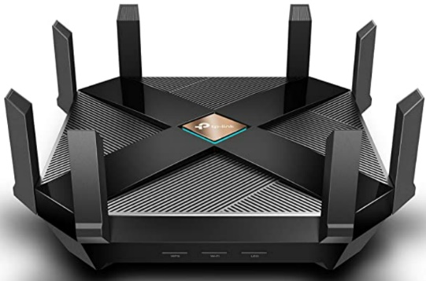
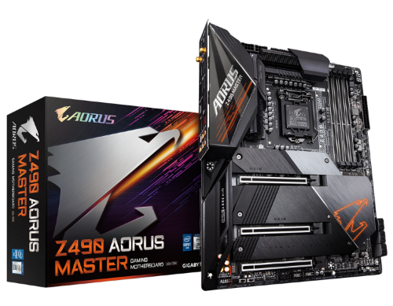
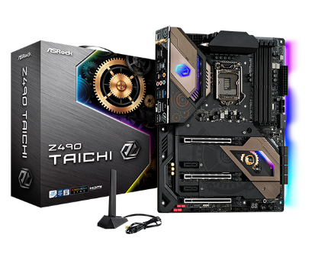
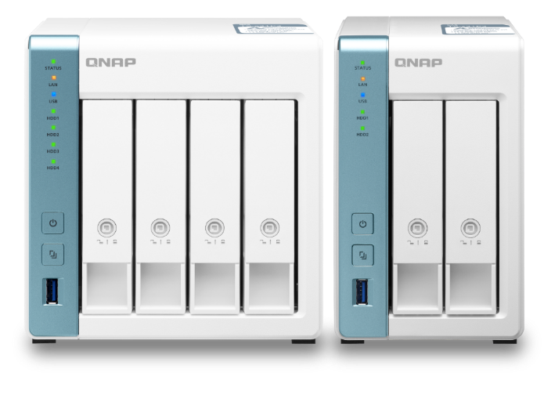
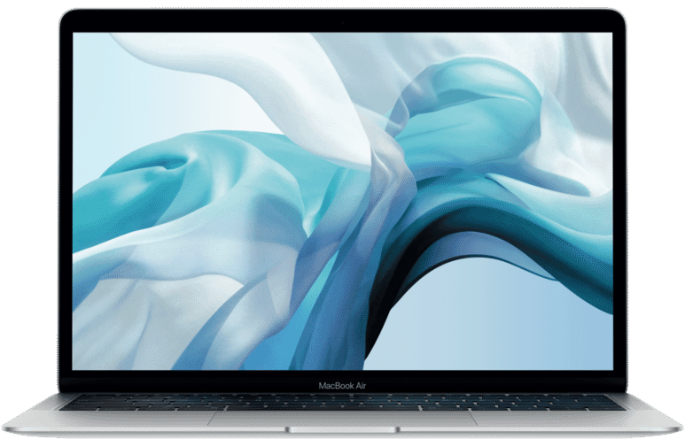
1GbE目前夠用, 以後呢?
越來越多設備配備2.5GbE
購買交換器，與其之後受限， 不如一次到位2.5GbE
Netgear CM2000
TP-Link Archer AX6000
Gigabyte Z490 AORUS MASTER
Apple MacBook
Asrock Z490 Taichi
QNAP TS-431P3
QNAP TS-231P3

Slide 3
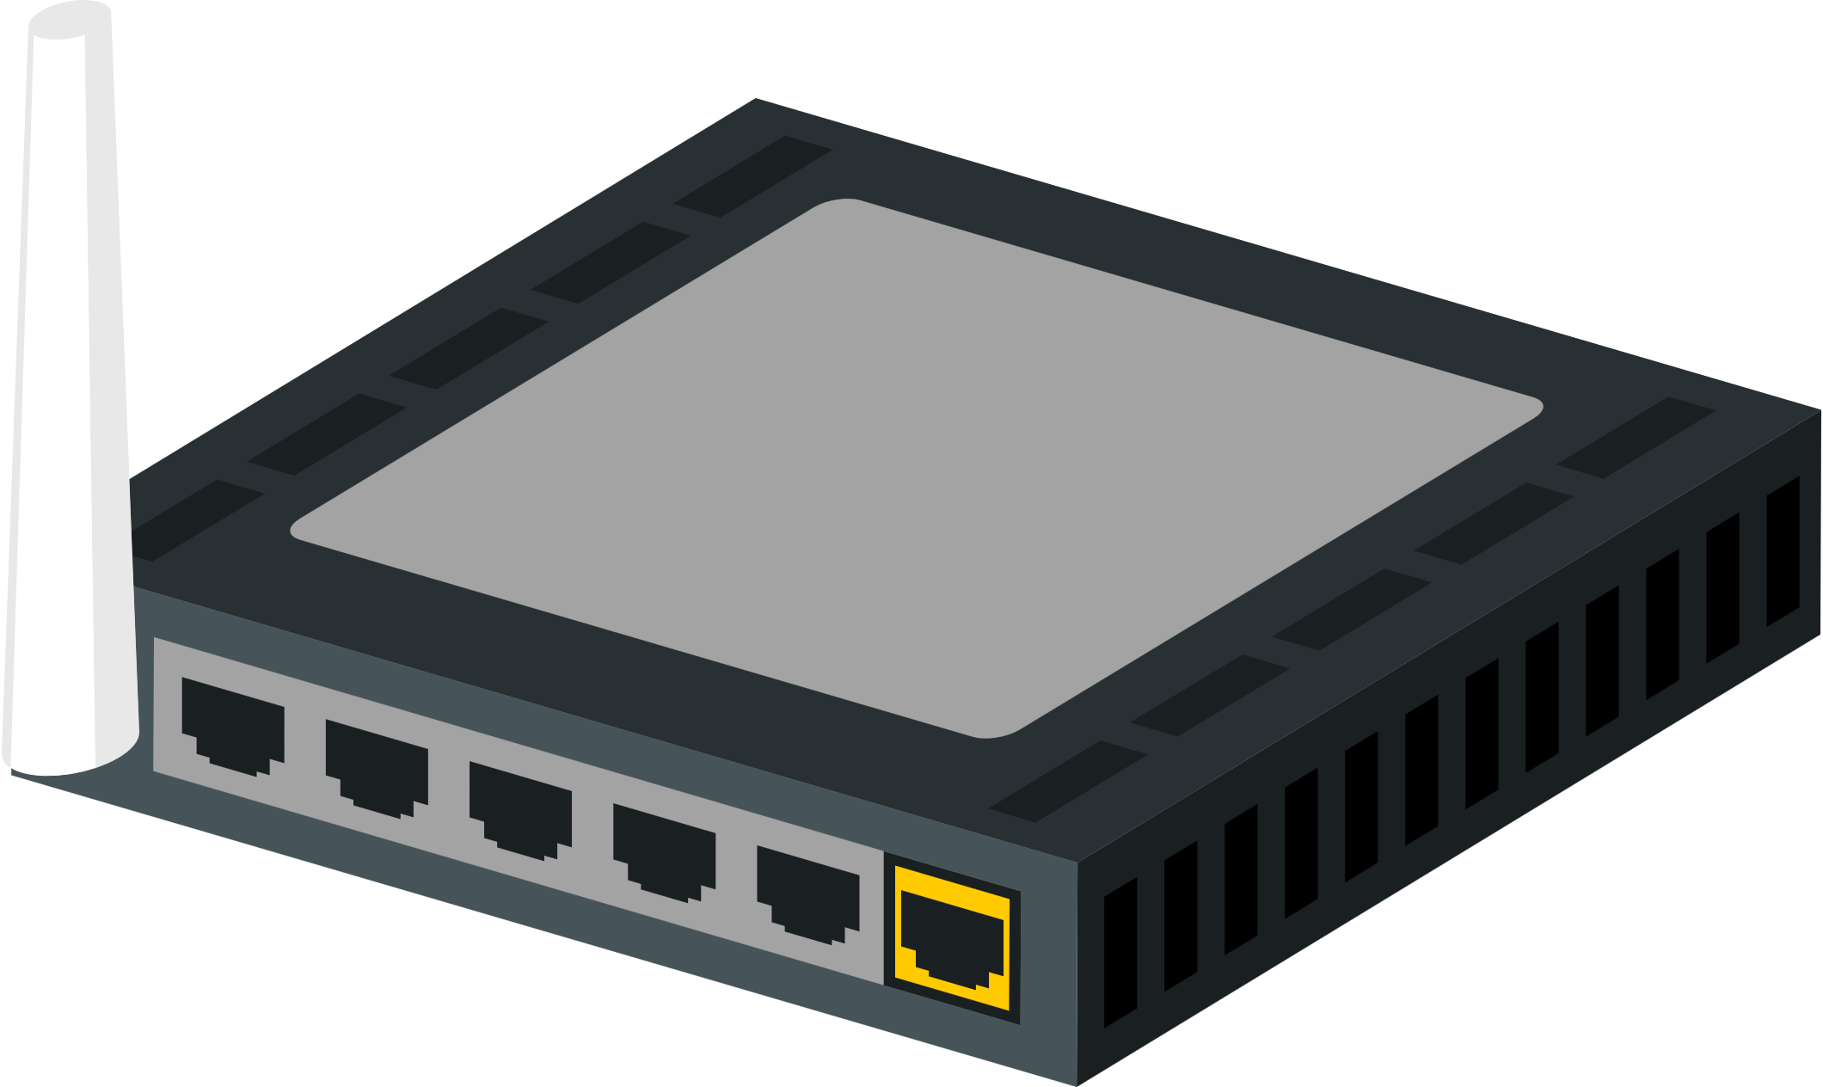
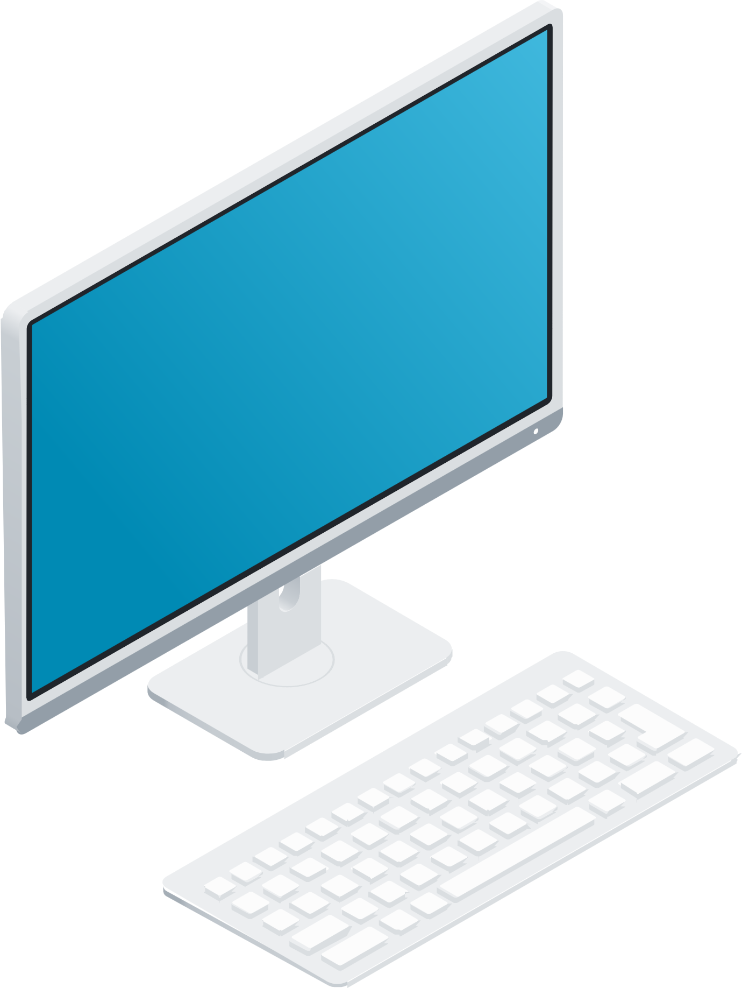
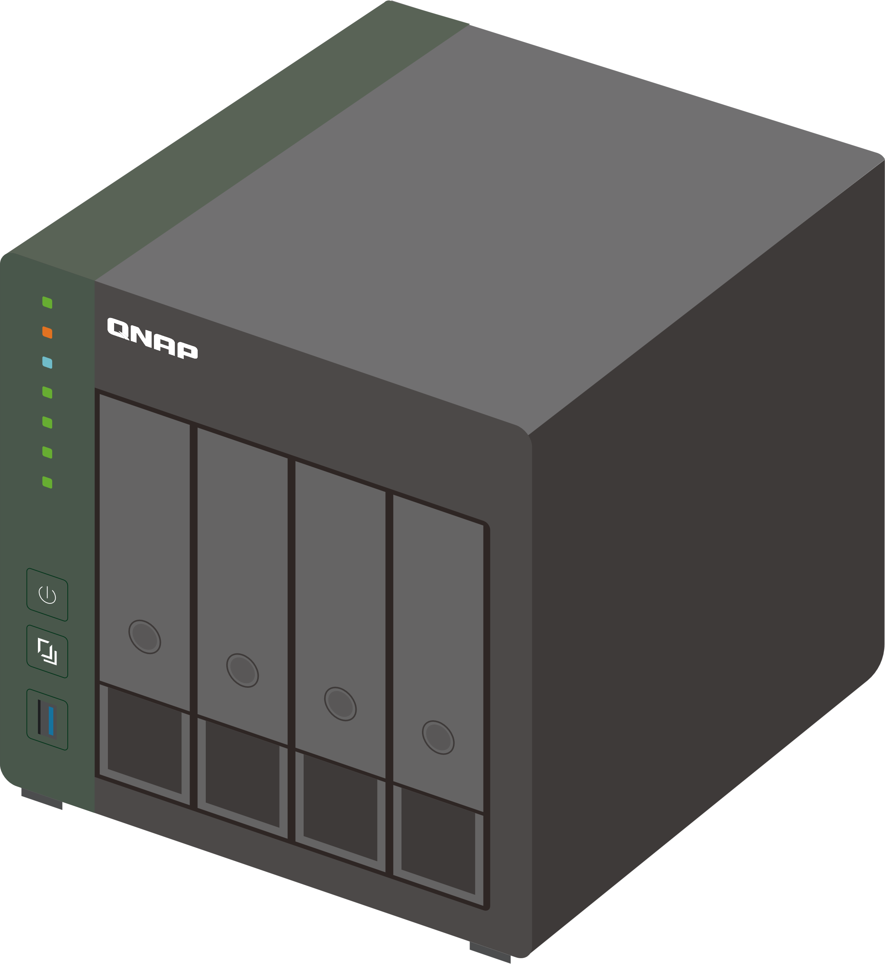
別讓交換器成為網路瓶頸
1GbE

Slide 4
換交換器的考量
10GbE?
2.5GbE?
價錢?
既有的設備也要升級?
線路重拉?

Slide 5
最實惠的網速升級-2.5GbE
要花 $$$ 買到 10GbE 交換器?
要花 $$$ 升級環境網路佈線?
Device cost
Cable cost
Device cost
Cable cost
1GbE → 2.5GbE
1GbE → 10GbE

Slide 6
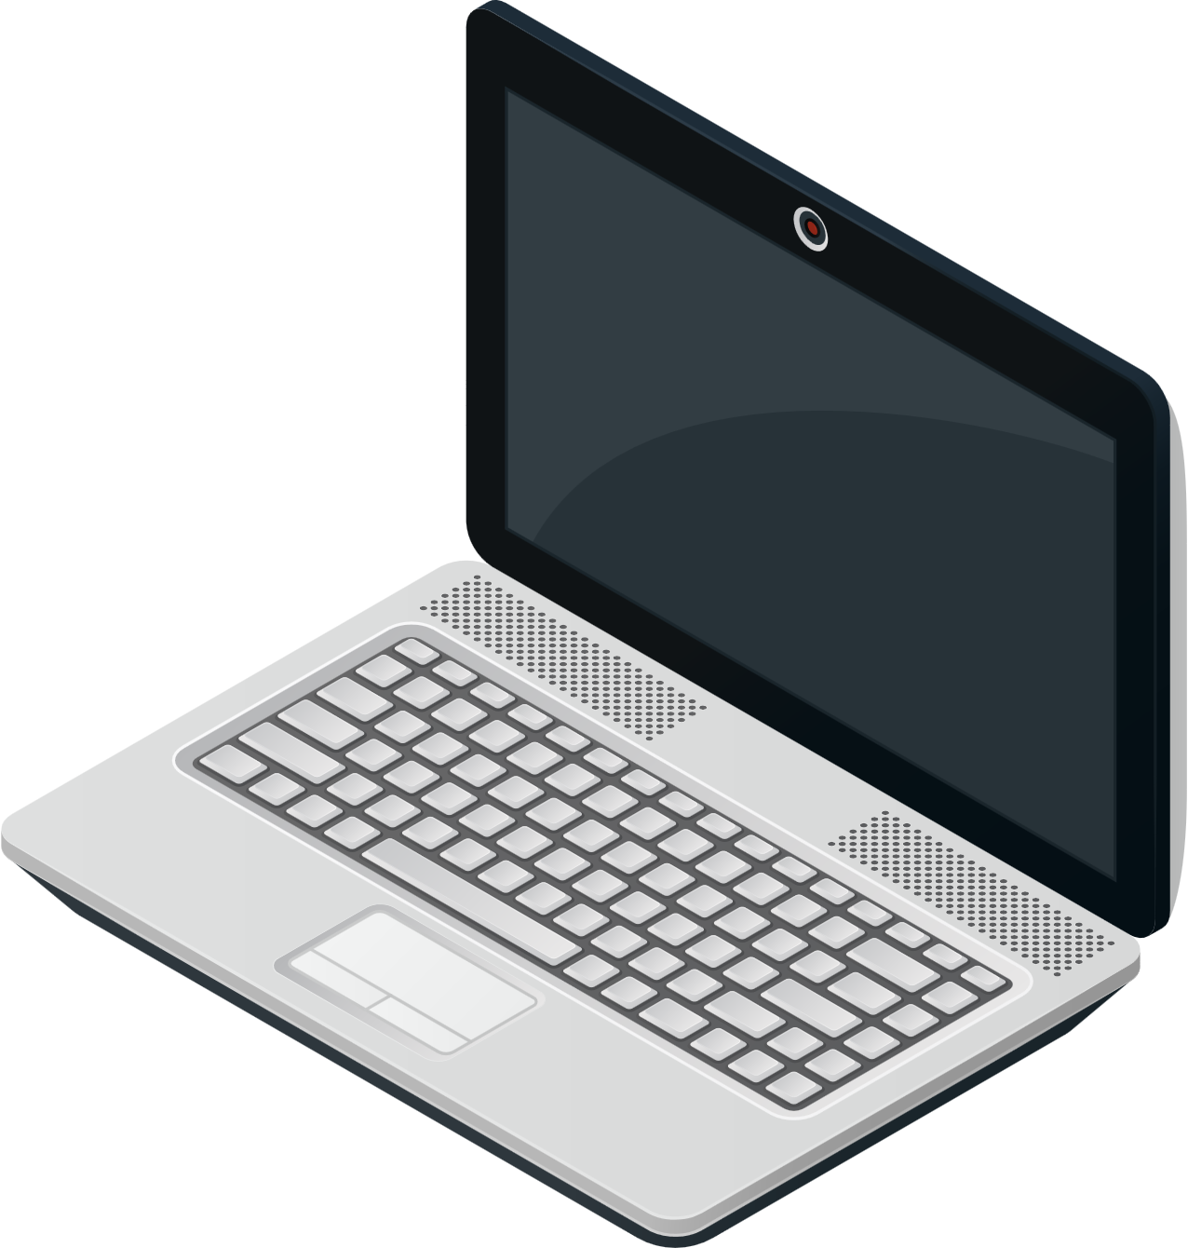
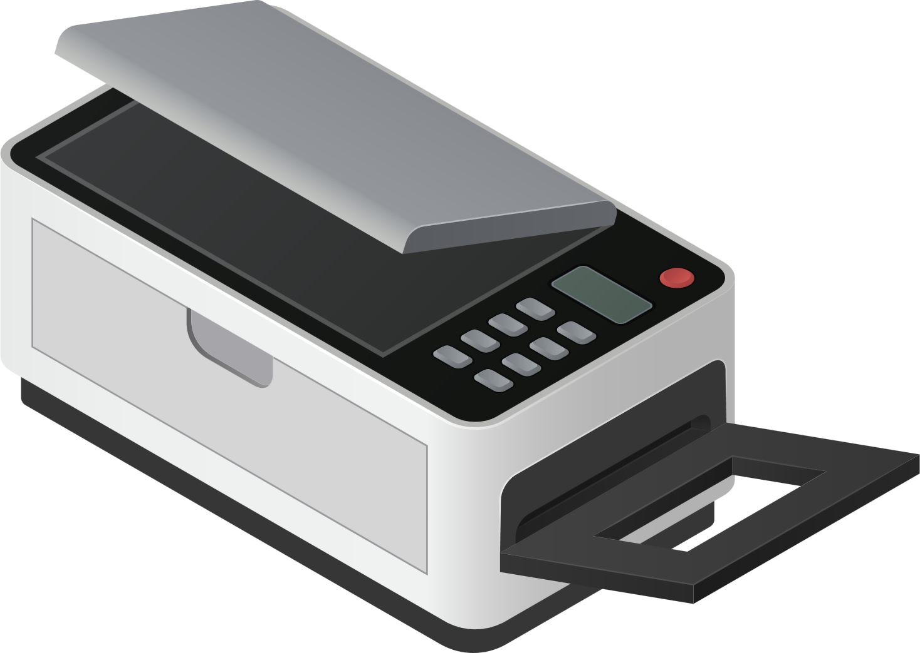
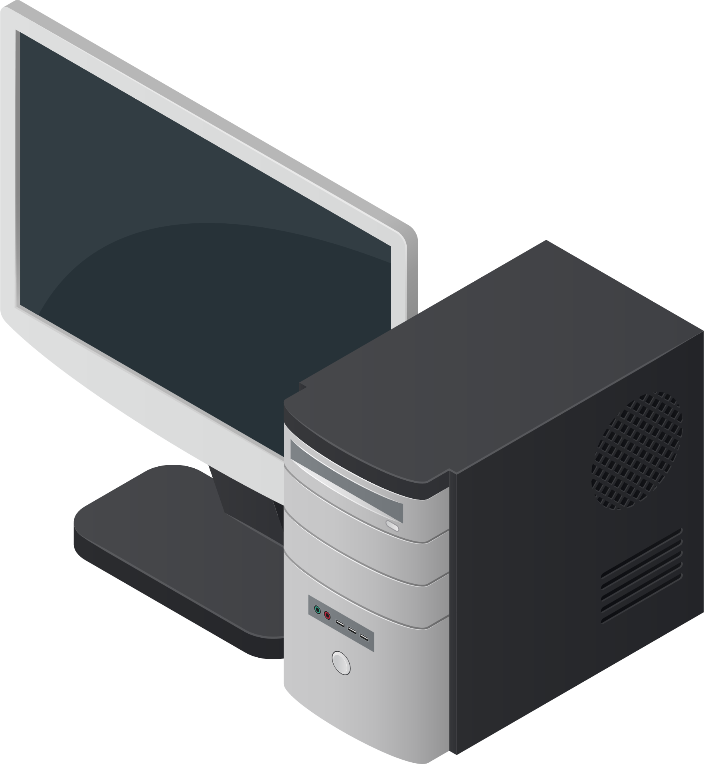
自由搭配現有網速的設備
如果現有網路設備只有1GbE或甚至100MbE，
一樣可以無痛直連
2.5GbE
100MbE
1GbE

Slide 7
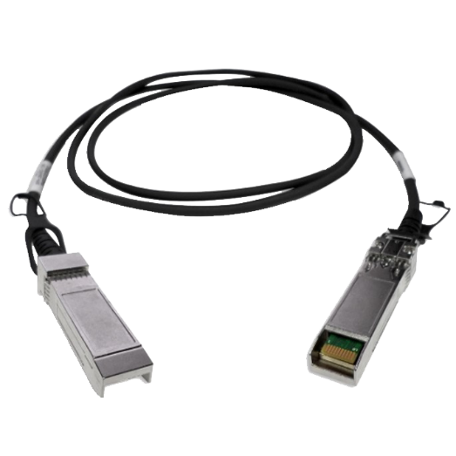
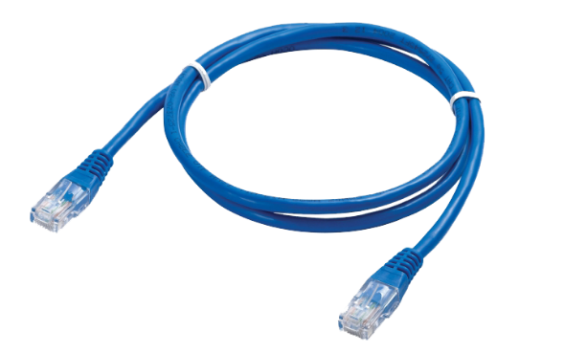
交換機升級了那網路線呢?
交換機都換一台了，那是不是網路線也要跟著換才有辦法把網速也提升?

Slide 8
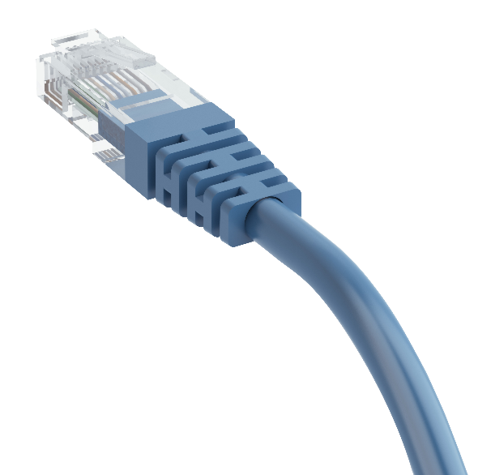
2.5GbE是可以直接使用 原本Cat5e的網路線
省去重新拉線佈線的麻煩
 | CAT 5e | CAT 6 | CAT 6A
100M | ✓ | ✓ | ✓
1G | ✓ | ✓ | ✓
2.5G | ✓ | ✓ | ✓
5G | ✓ | ✓ | ✓
10G | X | ✓(55m) | ✓

Slide 9
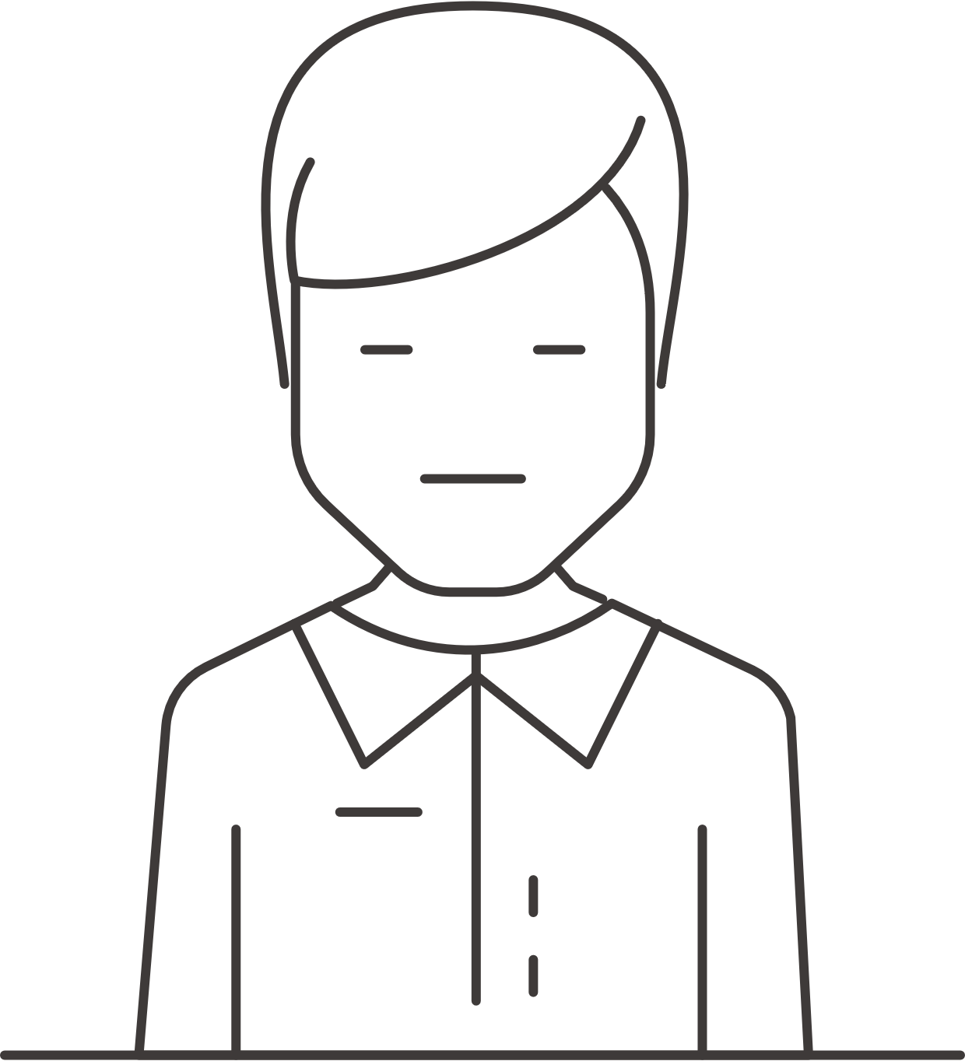
比1GbE快2.5倍
備份1 TB所需預估時間
條件:Effective Data Rate 95%, Payload Data Rate (w/ Overhead) 90%
2.5Gbps
1h8m35s
1Gbps
2h51m28s
100Mbps
1d4h34m38s

Slide 10
最實惠的網速升級 - 2.5GbE
2.5 倍網速
價格親民
無痛升級

Slide 11
升級網速不用花大錢， 隨插即用，輕鬆升級2.5GbE
低價位全2.5G switch, 讓使用者可以在提升線路速度跟布建成本間取得平衡
可直接使用現有RJ45 Cat5e線路, 節省重新佈線成本
2.5GbE solution
10GbE solution

Slide 12
QSW-1108-8T
Loop indicator
Port LED
8x 2.5GbE RJ45
power LED
QSW-1108-8T
2.5GbE RJ45 (backward compatible with 1G/100M) | 8
MAC table | 16K
Packet buffer size | 12Mbit
Jumbo Frame | 12Kbytes
Switching Bandwidth | 40Gbps
Fan | Fanless

Slide 13
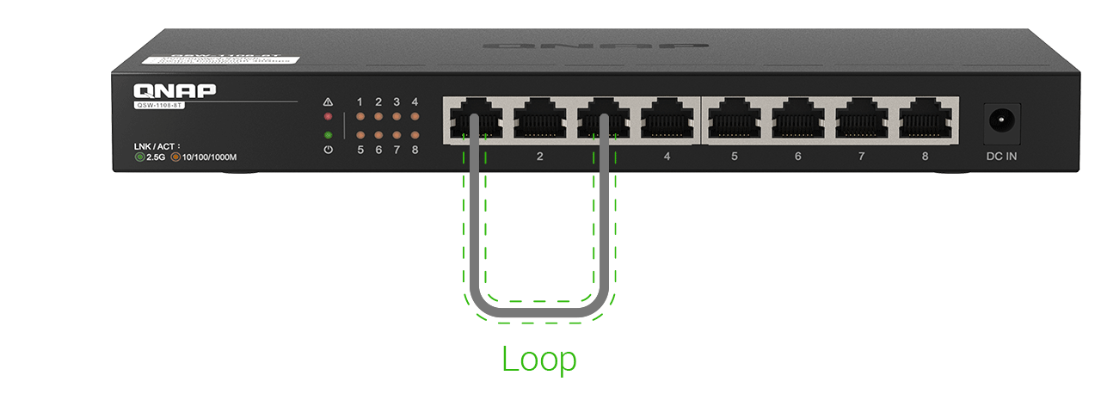
防迴圈功能避免不小心接錯網路線
通常是高階有管理介面的交換機才支援
內建自動迴圈偵測，不用擔心迴圈讓整個網路癱瘓
Loop時警示燈會恆亮

Slide 14
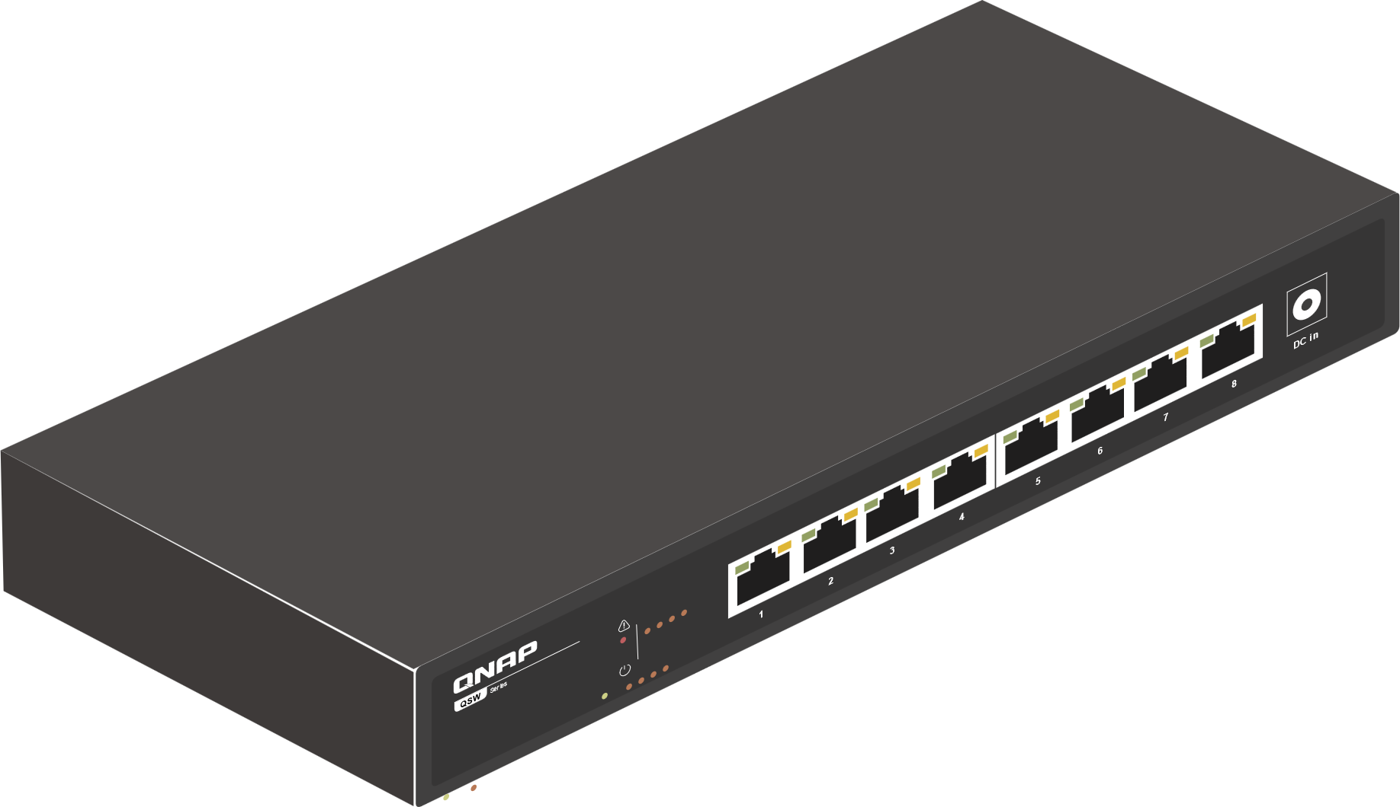
無風扇設計讓你不受噪音干擾
桌上型無風扇設計
擺在家裡室內也不擔心噪音問題

Slide 15
全自動設計不需設定
隨插即用不需設定
簡單到任何人都可以操作

Slide 16
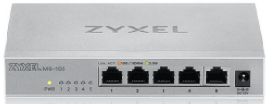
五埠2.5GbE 交換器
 | QSW-1105-5T | ZyXEL MG-105 | ASUSTOR ASW205T | TP-Link TL-SG105-M2 | TRENDnet TEG-S350
Management | Unmanaged | Unmanaged | Unmanaged | Unmanaged | Unmanaged
Switch Chipset | Broadcom | Realtek | Realtek | Realtek | Realtek
Number of Ports | 5 | 5 | 5 | 5 | 5
1GbE RJ45 | - | - | - | - | -
2.5GbE RJ45 | 5 | 5 | 5 | 5 | 5
Switching Capacity (Gbps) | 25 | 25 | 25 | 25 | 25
Loop detection and blocking | Yes | NA | NA | NA | NA
Packet buffer size​ | 6.1Mbit | 12Mbit ​ | 4.1Mbit | 1.5 Mb | 12Mbit ​
Jumbo Frame​ | 9Kbytes ​ | 12Kbytes ​ | 12Kbytes ​ | 10Kbytes | 12Kbytes ​
MAC table | 16K​ | 6K | 16K​ | 16K​ | 16K​

Slide 17
八埠2.5GbE 交換器
 | QSW-1108-8T | ZyXEL MG-108 | TRENDnet TEG-S380 | TP-Link TL-SG108-M2
Management | Unmanaged | Unmanaged | Unmanaged | Unmanaged
Switch Chipset | Realtek | Realtek | Realtek | Realtek
Number of Ports | 8 | 8 | 8 | 8
1GbE RJ45 | - | - | - | -
2.5GbE RJ45 | 8 | 8 | 8 | 8
10GbE SFP+ | - | - | - | -
10GbE RJ45 | - | - | - | -
Switching Capacity (Gbps) | 40 | 40 | 40 | 40
Loop detection | Yes | NA | NA | NA
Packet buffer size​ | 12Mbit ​ | 12Mbit ​ | 12Mbit ​ | 1.5 Mb
Jumbo Frame​ | 12Kbytes ​ | 12Kbytes ​ | 12Kbytes ​ | 10Kbytes
MAC table | 16K​ | 6K | 16K​ | 16K​

Slide 18
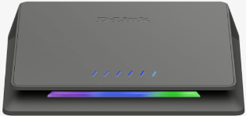
10GbE+2.5GbE交換器
 | QSW-2104-2S | QSW-2104-2T | Zyxel XGS1010-12 | D-Link DMS-106XT
Management | Unamaged | Unamaged | Unamaged | Unamaged
Switch Chipset | Broadcom | Broadcom | Realtek | Broadcom
Number of Ports | 6 | 6 | 12 | 6
1GbE RJ45 | - | - | 8 | -
2.5GbE RJ45 | 4 | 4 | 2 | 5
10GbE SFP+ | 2 | - | 2 | -
10GbE RJ45 | - | 2 | - | 1
Switching Capacity (Gbps) | 60 | 60 | 66 | 45
Loop detection and blocking | Yes | Yes | NA | NA
Packet buffer size​ | 6.1Mbit | 6.1Mbit | 12Mbit ​ | 6.1Mbit
Jumbo Frame​ | 9.7Kbytes | 9.7Kbytes | 12Kbytes ​ | 9.7Kbytes
MAC table | 16K​ | 16K​ | 16K​ | 4K

Slide 19
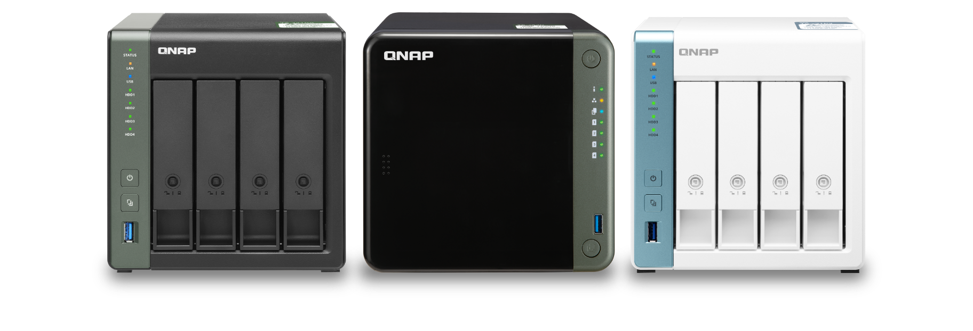
QNAP提供完整2.5GbE方案， 讓您一次購足邁入 2.5GbE 世代

Slide 20
QNAP 2.5GbE交換器
Managed switches
16x 2.5GbE RJ45 with 802.3at(30W)
2x 10GbE RJ45 with 802.3 bt(90W)
2x 10GbE SFP+
Layer 2 Management
Rackmount design
8x 2.5GbE RJ45
2x 10GbE SFP+/RJ45 combo (2C)
2x 10GbE SFP+ (2S)
Layer 2 Management
Desktop design
QSW-M2108-2C
QSW-M2116P-2T2S
8x 2.5GbE RJ45
2x 10GbE SFP+/RJ45 combo
Layer 2 Management
Rack mount and 2 for 1 design
QSW-M2108-2S
QSW-M2108R-2C
Unmanaged switches
8x 2.5GbE RJ45
Auto loop detected
Desktop design
Fan less design
4x 2.5GbE RJ45
2x 10GbE RJ45 (2T)
2x 10GbE SFP+ (2S)
Auto loop detected
Desktop design
Fan less design
QSW-1108-8T
QSW-2104-2T
5x 2.5GbE RJ45
Auto loop detected
Desktop design
Fan less design
QSW-1105-5T
QSW-2104-2S

Slide 21
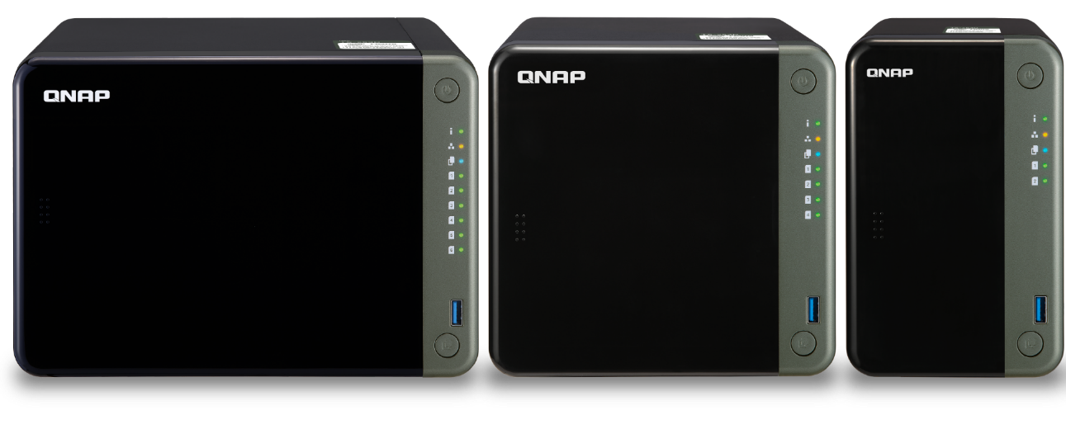
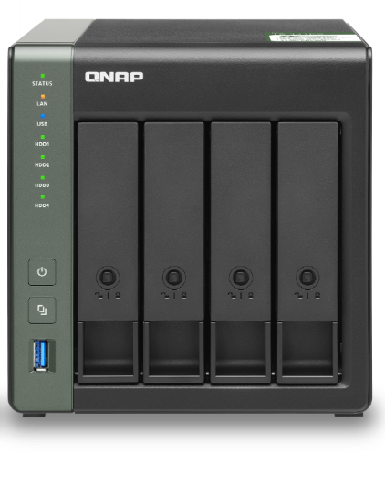
QNAP 2.5GbE NAS
專業人士高效存取
數位家庭高品質影音享受
Intel Celeron J4125 四核 2.0GHz, 2 x 2.5GbE,
PCIe 擴充 M.2 NVMe/ SATA SSD 或 10GbE
Annapurna Labs AL-314 四核 1.7GHz, 1 x 10GbE SFP+, 1 x 2.5GbE
Annapurna Labs AL-314
四核 1.7GHz, 1 x 2.5GbE
TS-653D
TS-453D
TS-253D
TS-431X3
TS-431P3
TS-231P3

Slide 22
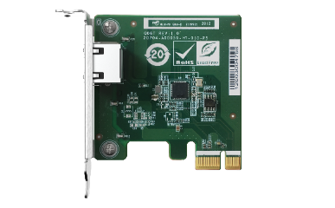
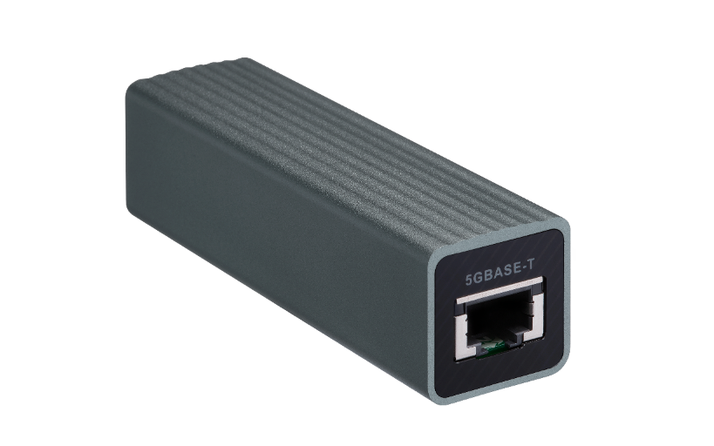
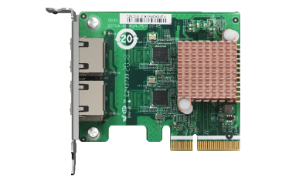
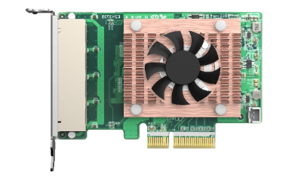
PCIe與攜帶式網路擴充卡
5GbE USB dongle
2.5GbE series
QXG-2.5G Family
QNA-UC5G1T
1 x RJ45
2 x RJ45
USB 3.2 Gen 1
RJ45 NBASE-T
4 speed: 5G/2.5G/1G/100M
Upgrade your laptop or PC to 5GbE with portable USB dongle
4 x RJ45
https://www.qnap.com/en/product/qna-uc5g1t

Slide 23
如果2.5GbE不夠用, 預算又足夠, 您可以選擇全10GbE交換器
Managed switches
3 x powers with redundant design
4 x10GbE SFP+
8 x10GbE SFP+/RJ45 combo
Layer 2 management
Rackmount
Fan less
8x 10GbE SFP+
4x 10GbE SFP+/RJ45 combo
Layer 2 Management
Rack mount design
QSW-IM1200-8C
QSW-M1204-4C
4x 10GbE SFP+
4x 10GbE SFP+/RJ45 combo
Layer 2 Management
Rack mount design
4x 10GbE SFP+
8x 10GbE SFP+/RJ45 combo
Layer 2 Management
Rack mount design
QSW-M804-4C
QSW-M1208-8C
Unmanaged switches
4x 10GbE SFP+
8x 10GbE SFP+/RJ45 combo
Rack mount design
QSW-1208-8C

Slide 24
輕鬆升級頻寬又不必花大錢
8 埠 2.5GbE 無網管型交換器
©2021著作權為威聯通科技股份有限公司所有。威聯通科技並保留所有權利。威聯通科技股份有限公司所使用或註冊之商標或標章。檔案中所提及之產品及公司名稱可能為其他公司所有之商標。

