Slide 1
What’s new for QuWAN 2.1
Making flexible QuWAN + QVPN more flexible

Slide 2
Agenda
What’s new for QuWAN 2.1
Key feature introduction:
QVPN server on QuWAN
Hub capable
Duplicated IP detect
Other features

Slide 3
What’s new for QuWAN 2.1

Slide 4
Enhancement in QuWAN 2.1
QVPN server on QuWAN
Server setting, choose the Hub device in the org for QVPN server
Privilege, create/managed account and sending login information to user
Online user monitor, checking the QBelt user login information
Quick start for introducing QVPN server
Hub capable
Private IP can be Hub role
Including NAT check function
Duplicate IP detect
Notice user for wrong/duplicate IP address
Can setup segment for source IP in firewall rule
Assign Service Class for QoS default rule
Reporting time period enhancement
Page change will not change time period setting
Default report display time period change to 1 week
QVPN server on QuWAN
Server setting, choose the Hub device in the org for QVPN server
Privilege, create/managed account and sending login information to user
Online user monitor, checking the QBelt user login information
Quick start for introducing QVPN server
Hub capable
Private IP can be Hub role
Including NAT check function
Duplicate IP detect
Notice user for wrong/duplicate IP address
Can setup segment for source IP in firewall rule
Assign Service Class for QoS default rule
Reporting time period enhancement
Page change will not change time period setting
Default report display time period change to 1 week

Slide 5
Enhancement in QuWAN 2.1(con’t)
QuWAN/device service port management(QNE/QTS/vRouter only)
UX enhancement
Change the color of icon on the map makes more clear
Device connection health display
Log message enhancement
VPN server user friendly wording for VPN connection status
VPN server format changing for user account/password changing log

Slide 6
Key feature introduction: QVPN server on QuWAN

Slide 7
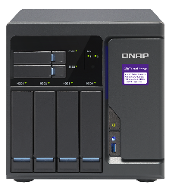
QuWAN is the most platform flexible SD-WAN solution
QNAP QMiroPlus wifi mesh solution
QNAP NAS storage
QNAP QMiro wifi mesh solution
Not Router only!
QNAP QGD smart switch
QNAP QHora high speed router
QNAP QuWAN virtual machine solution

Slide 8
QVPN can expend QuWAN coverage
QNAP QMiroPlus wifi mesh solution
QVPN
QVPN
QNAP NAS storage
QNAP QMiro wifi mesh solution
QVPN
QNAP QGD smart switch
QVPN
QNAP QHora high speed router
QNAP QuWAN virtual machine solution
QVPN

Slide 9
For QTS you need setup QBelt by yourselves under QuWAN deployment
QVPN
Enter server IP
Service port
PSK
.
.
.
Install QVPN service
Find the IP address
Setup firewall/NAT on QuWAN
Setup for client
Check the routing
.
.
.

Slide 10
What if need multiple QTS with VPN connections?
I need to setup multiple connections for back up
QVPN
Adding server A config…
Adding server B config…
Adding server C config…

Slide 11
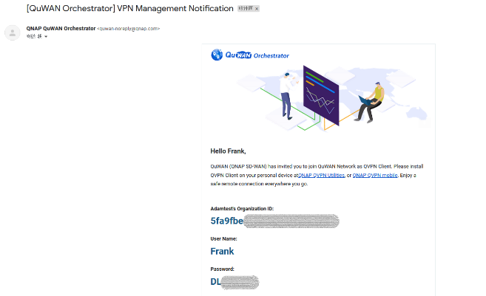
We can make QuWAN + QVPN more flexible now, help mobile device setup QBelt from cloud
Great! I don’t need setup a lot and don’t need to decide which server I have to connect.
QVPN
Hey, use this config

Slide 12
The advantage of QVPN server on QuWAN
Can centralized user account management
Can setup multiple QVPN server at the same time
Can manage QVPN server at the same time
Can monitor client's connection info on cloud directly
User don’t need to remember a lot of IP address for server
Auto health check to decide which server is suitable for QVPN client
Keep manual options for user to choose which QVPN server they like to connected(on QVPN client)
Notice:
QuWAN 2.1 QVPN server support on the QNE/QTS and QuWAN vRouter currently

Slide 13
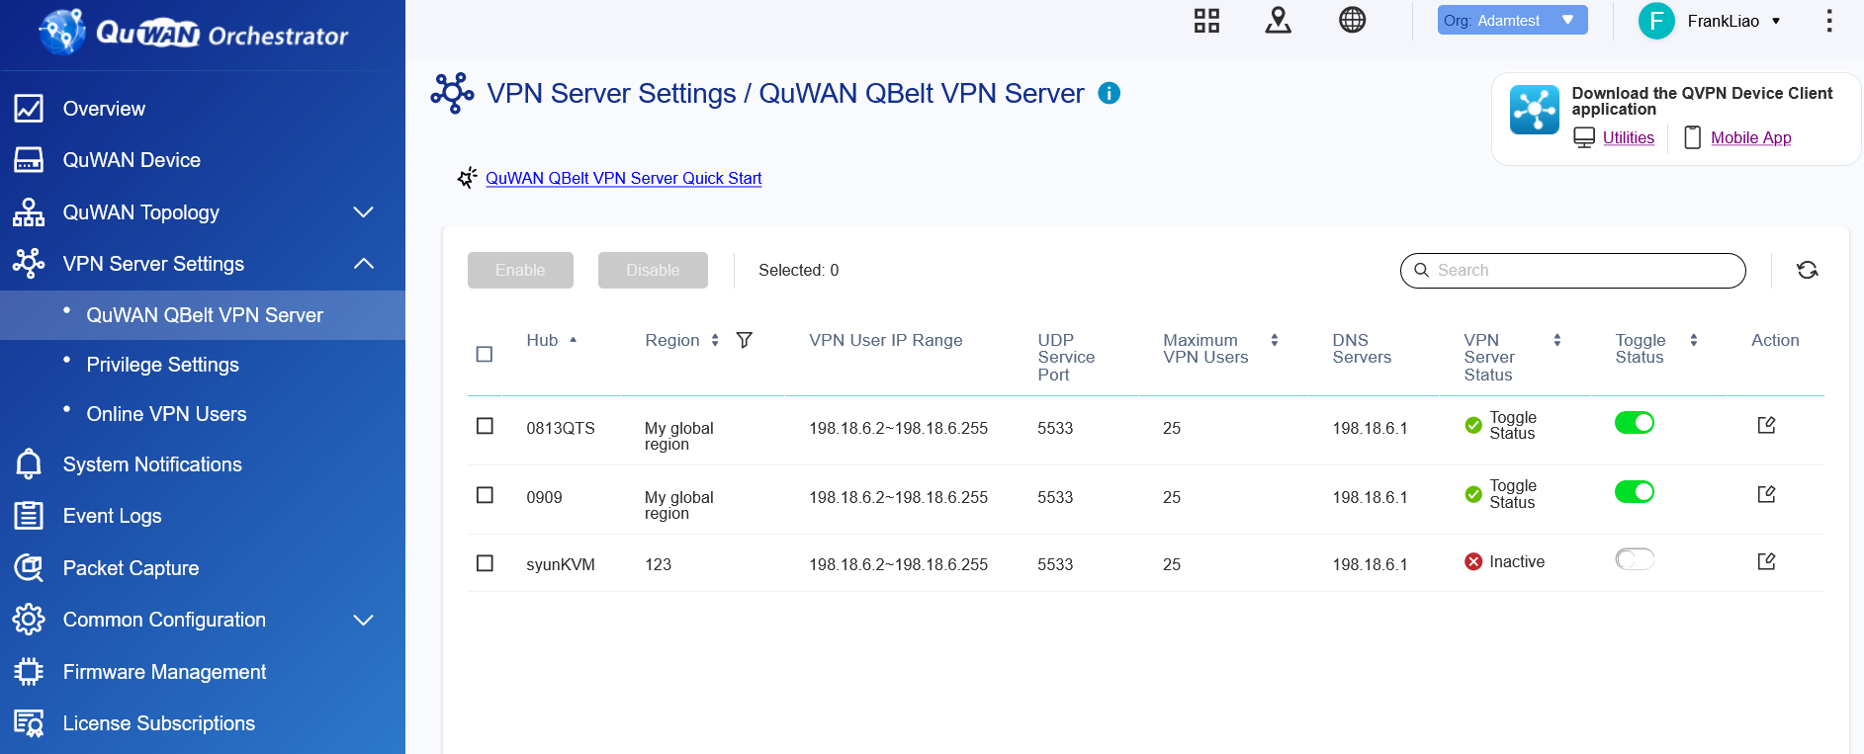
GUI introduction

Slide 14
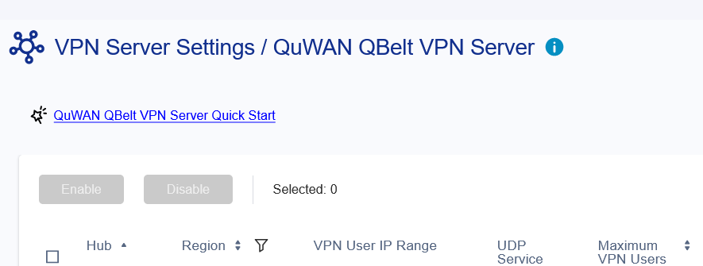
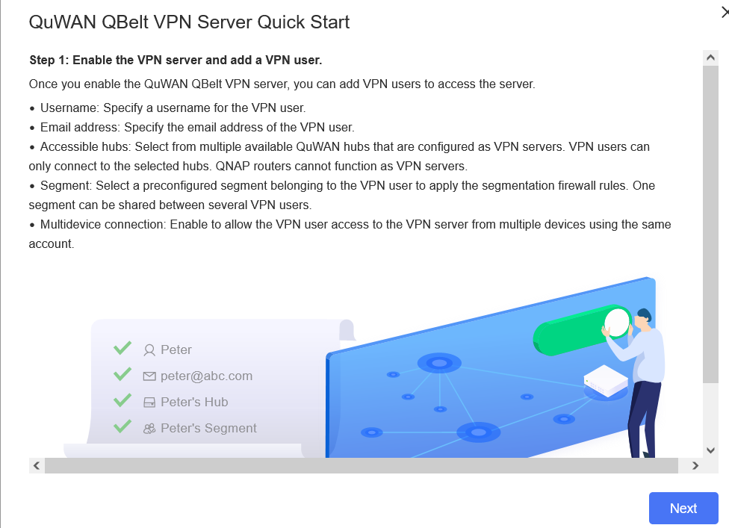
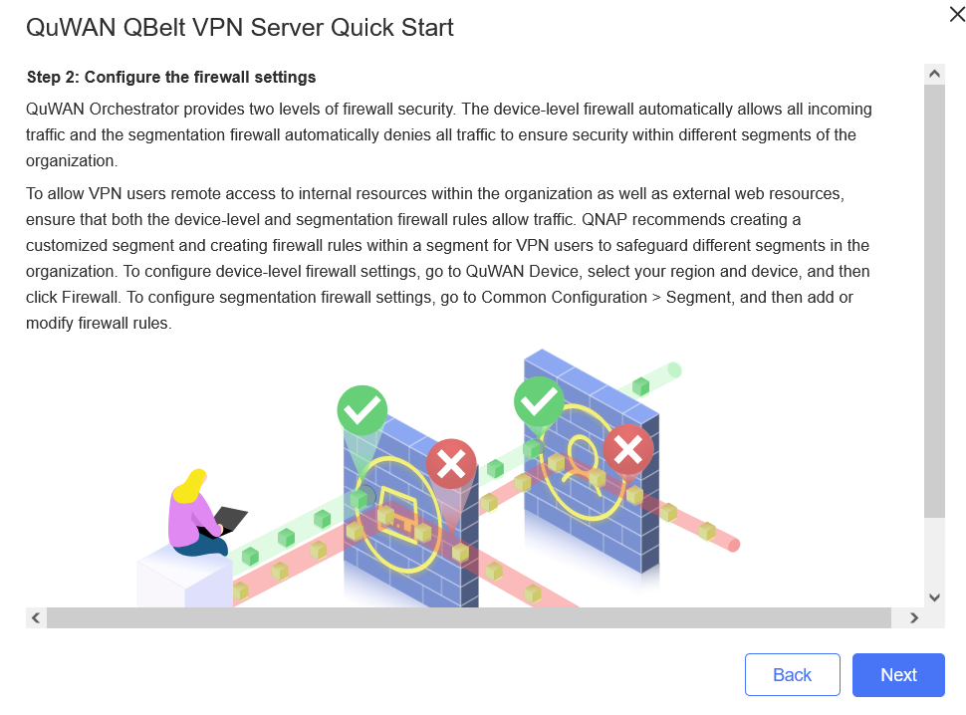
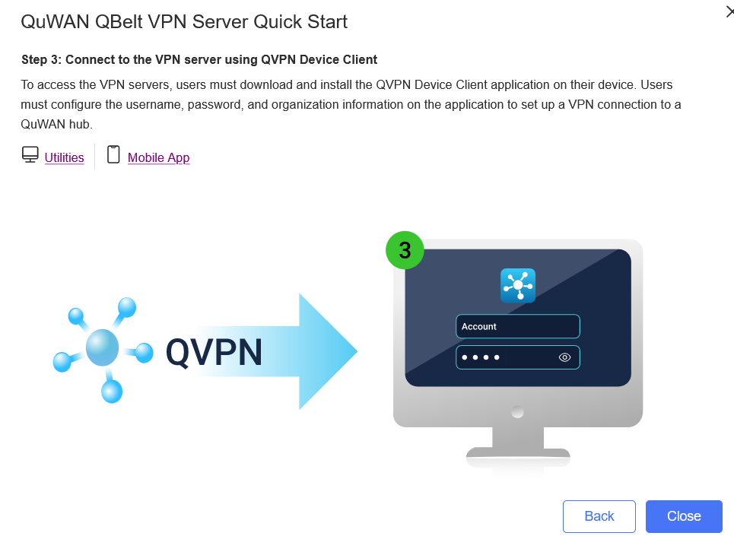
Quick start introduction for QuWAN QVPN
Guiding user to know how to setup the QVPN server on QuWAN

Slide 15
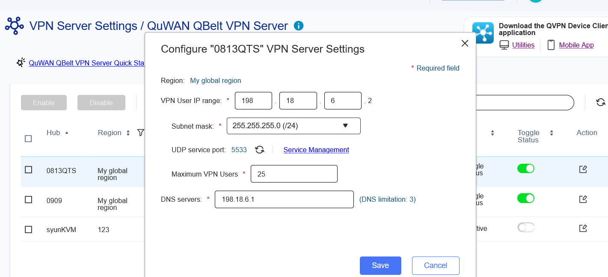
Setup QVPN server on QuWAN
Press Action for each QVPN server for editting the setting

Slide 16
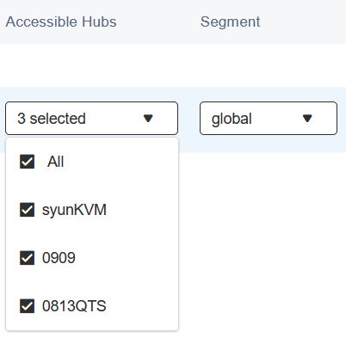
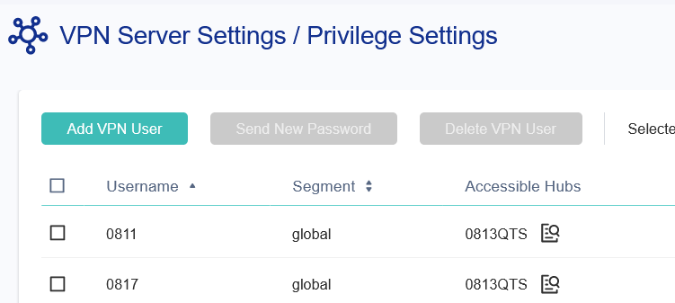
Create QVPN QBelt user on QuWAN
Add QVPN QBelt user on the Privilege setting

Slide 17
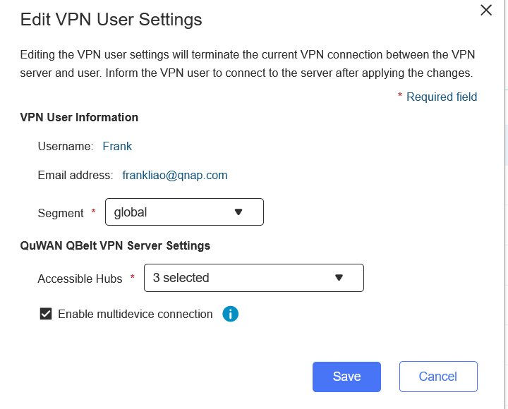
Managed QVPN QBelt client on QuWAN
Managed QVPN QBelt user on the Privilege setting

Slide 18
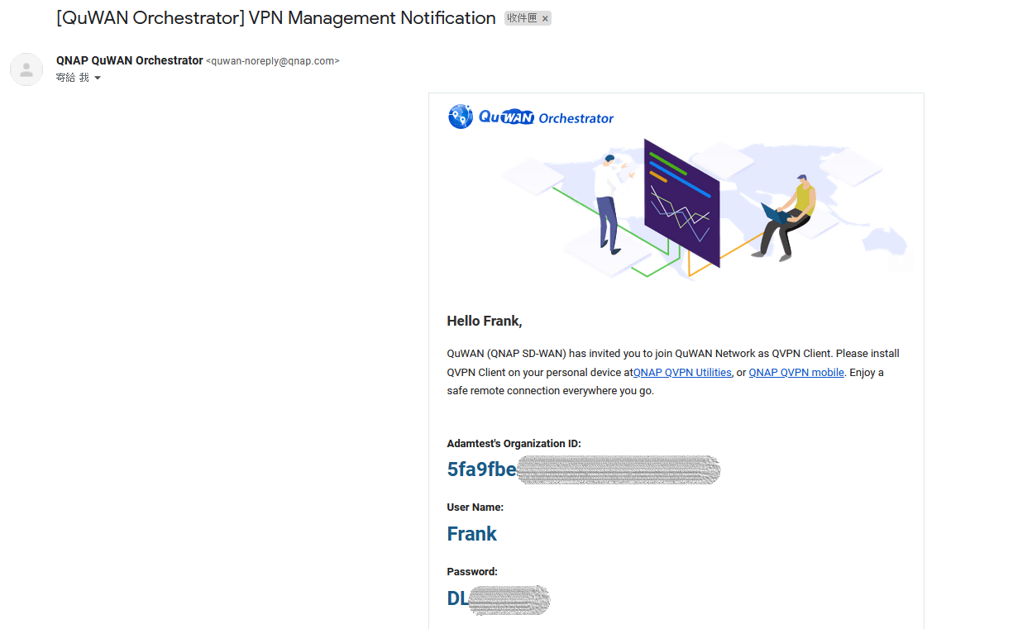
QuWAN QVPN notification mail
Send out the user notification mail from QuWAN directly

Slide 19
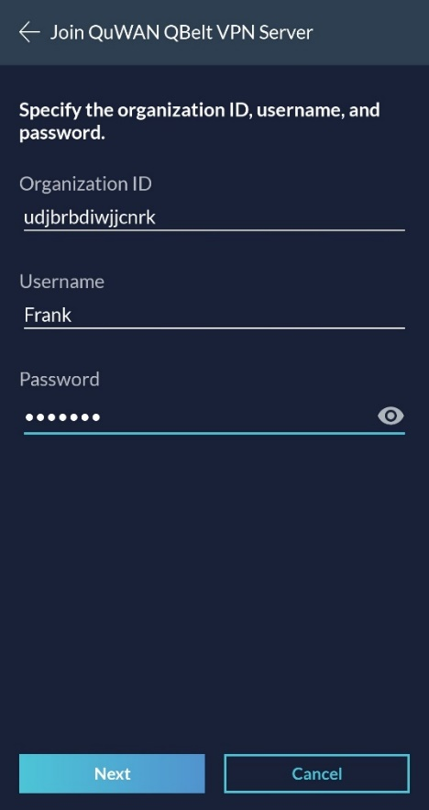
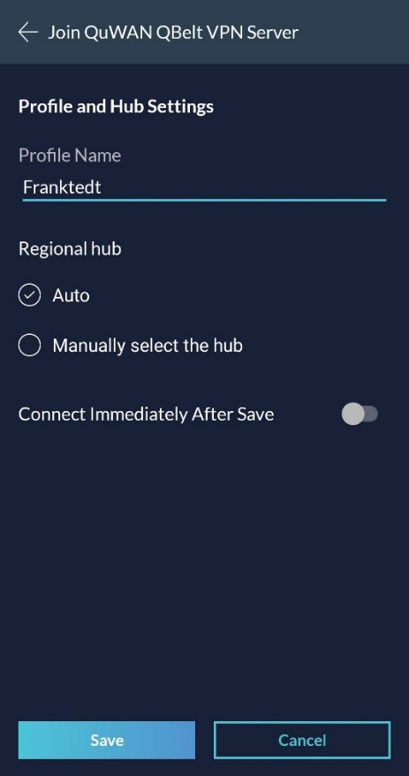
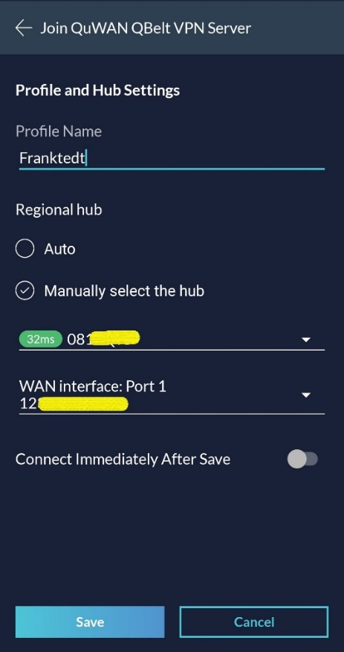
Setup QBelt for QuWAN on the QVPN client
Copy and past the QBelt info on the notifcation email to QVPN client

Slide 20
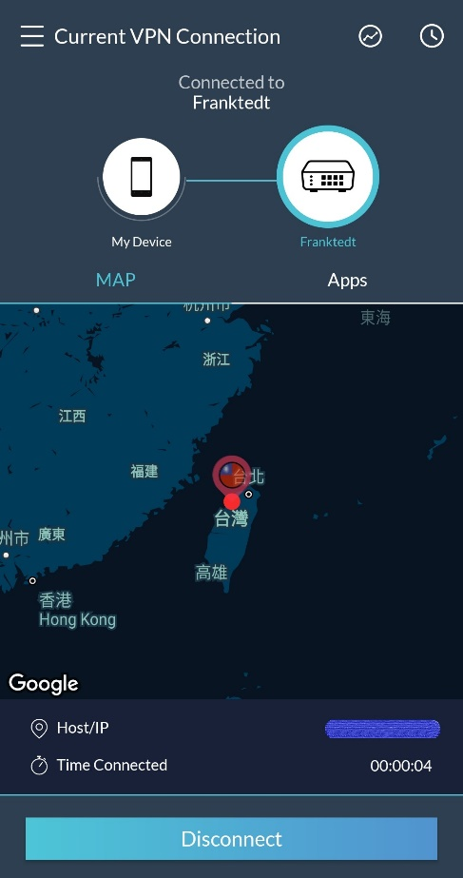
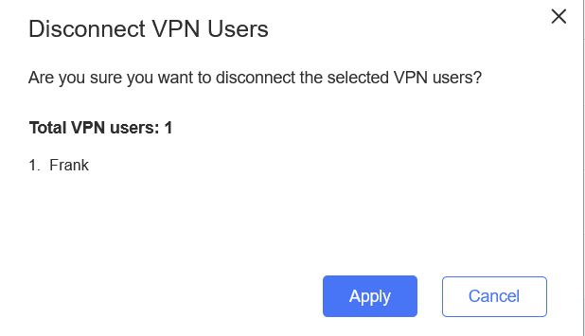
QBelt on QuWAN online user info
Check QBelt connection info on QuWAN

Slide 21
Key feature introduction: Hub capable

Slide 22
Why we need Hub capable?
Some devices can only be setup behind NAT. Before they can only be Edges but now they can be Hubs, to be additional nodes for Edges.
I want to be Hub
I don't know who you are.
Before
QNAP device
NAT router
I want to be Hub
Sure welcome
QuWAN 2.1
QNAP device
NAT router
Note: NAT router need setup port forwarding rule for QuWAN service

Slide 23
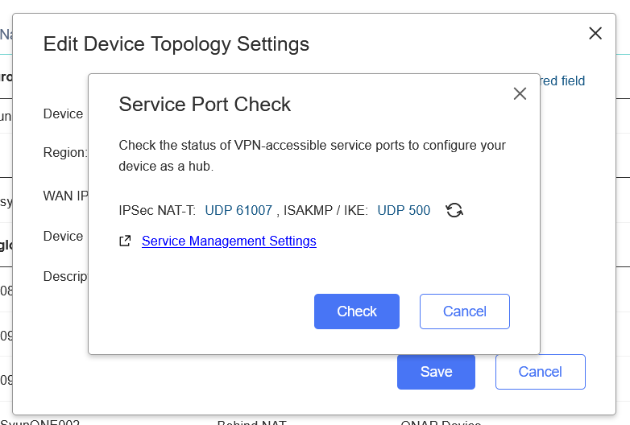
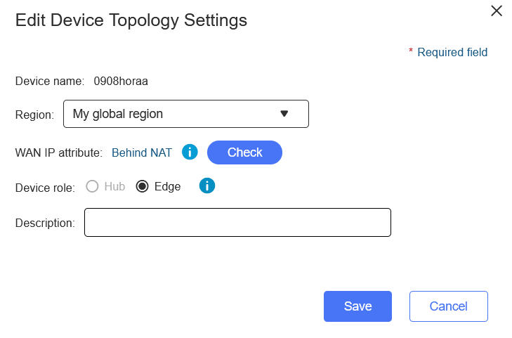
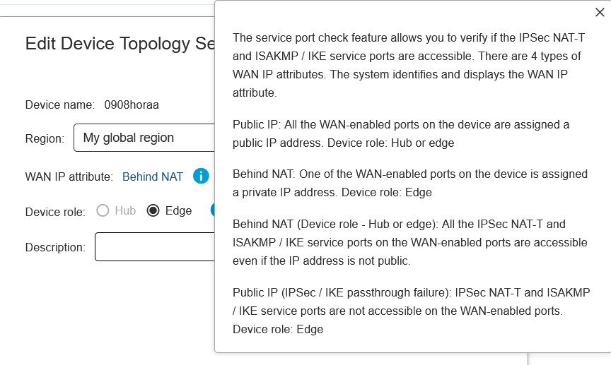
Can change role from Edge to Hub on the QuWAN, also provided port forwarding check

Slide 24
Key feature introduction: Duplicated IP detect

Slide 25
Why we need duplicated IP detect?
Why can’t I finish the IP setup? it is supposed to be right.
OK, now I know the setup conflicted, but with which one?

Slide 26
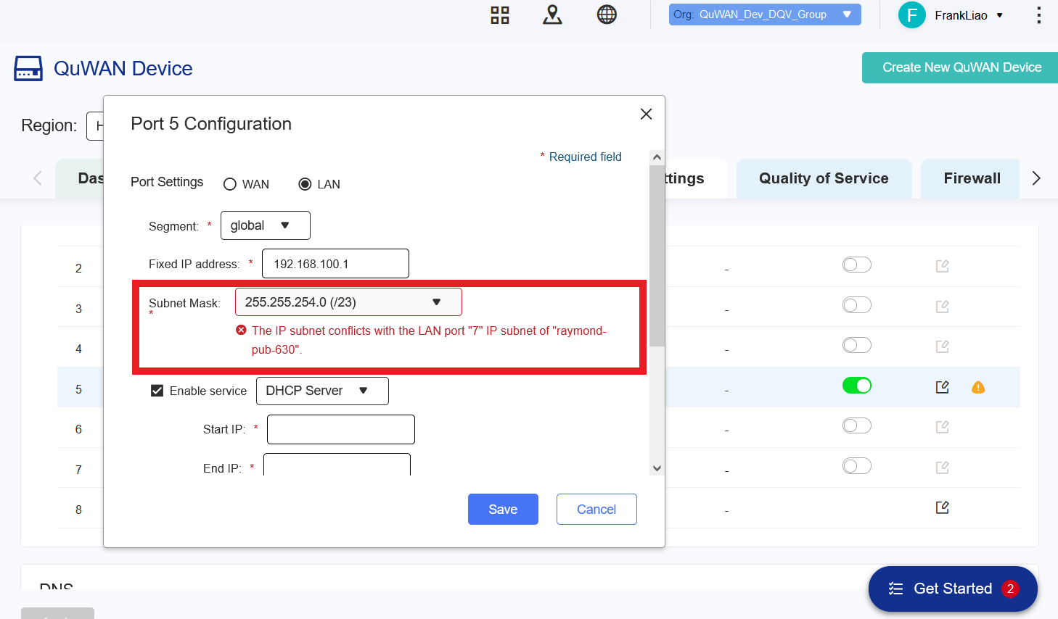
Show you the conflicted IP/device info for the setting

Slide 27
What QuWAN going to check
WAN/LAN/VLAN interface
VPN server
Static route
Reserved IP pool check
127.0.0.0/8
169.254.0.0/16

Slide 28
Other features

Slide 29
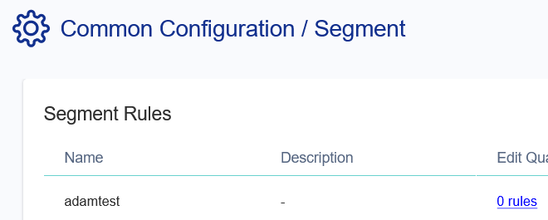
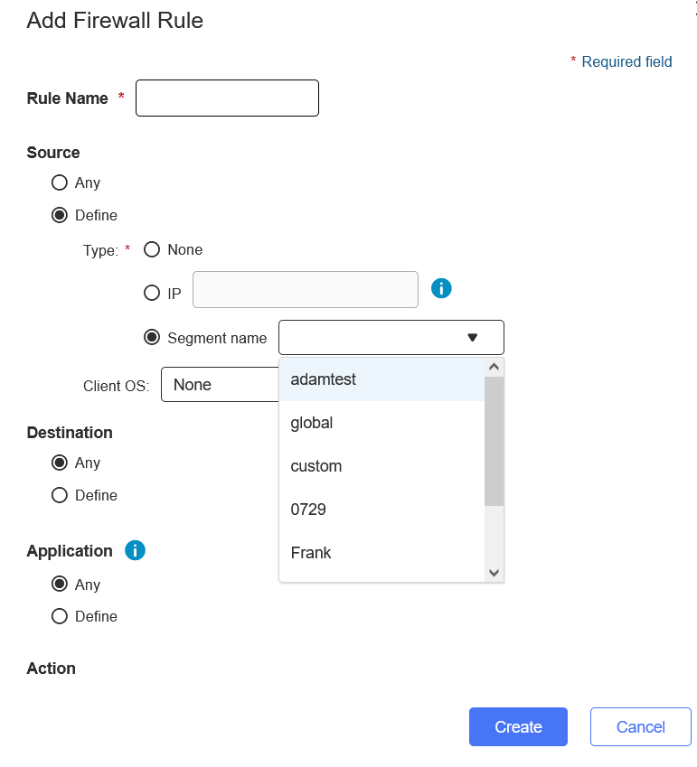
Can setup segment for source IP in firewall rule

Slide 30
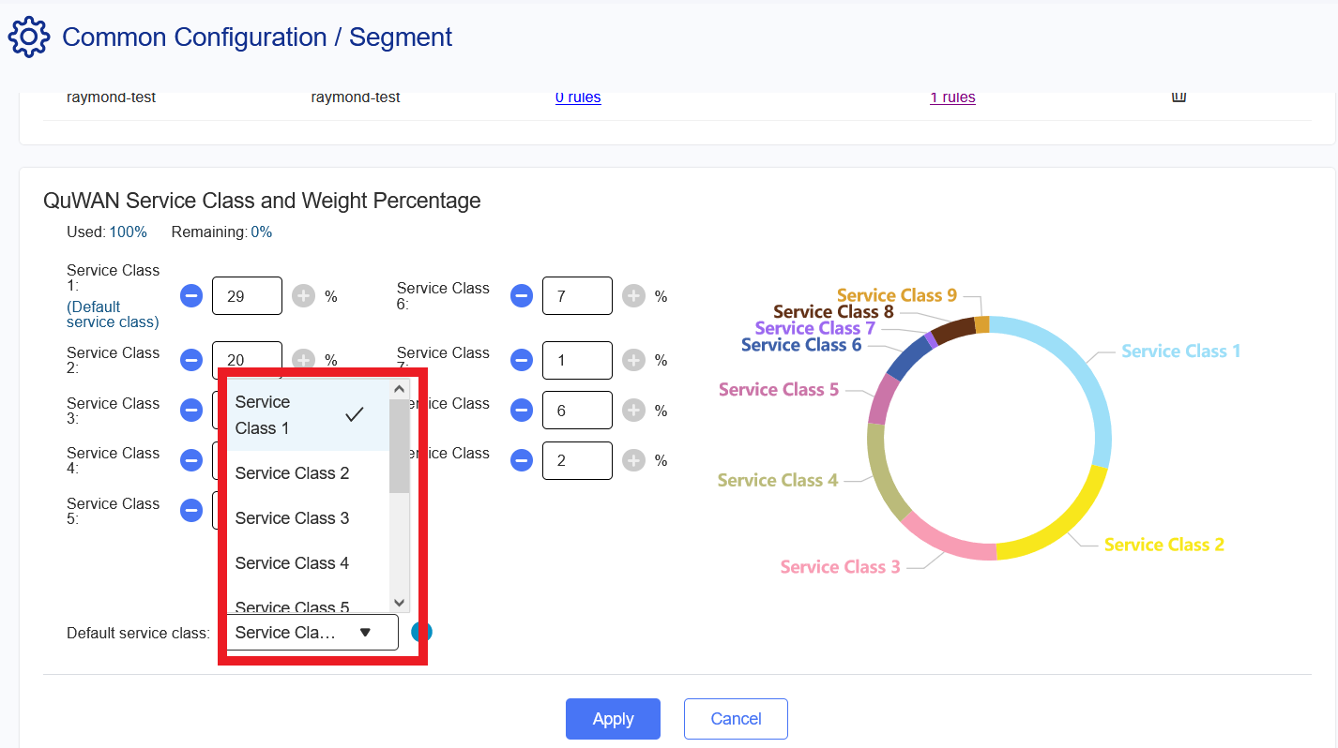
Assign Service Class for QoS default rule

Slide 31
Reporting time period enhancement

Slide 32
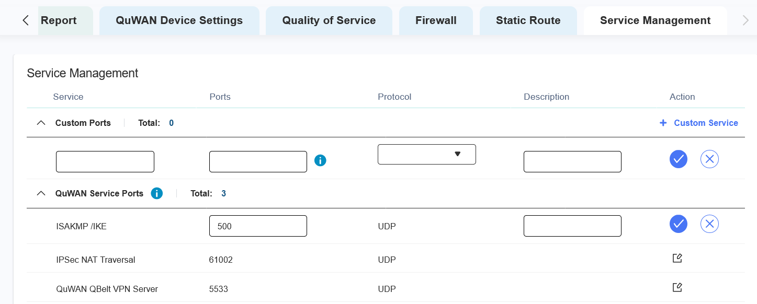
QuWAN/device service port management (QNE, vRouter only)

Slide 33
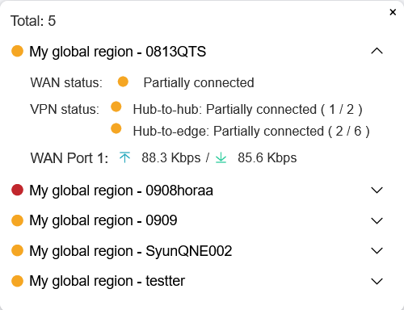
UX enhancement

Slide 34
Log message enhancement

