Slide 1

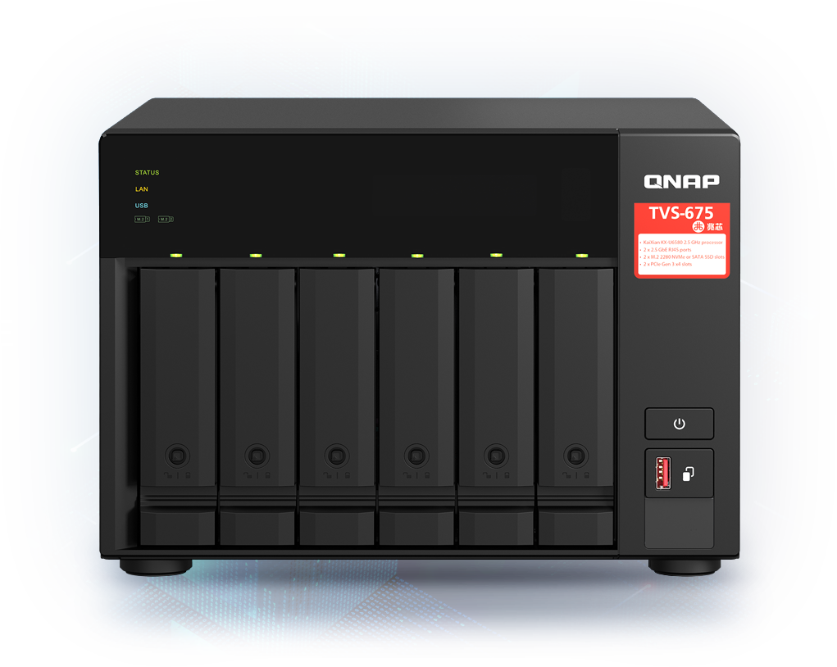

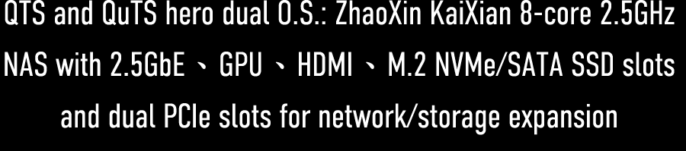


Slide 2


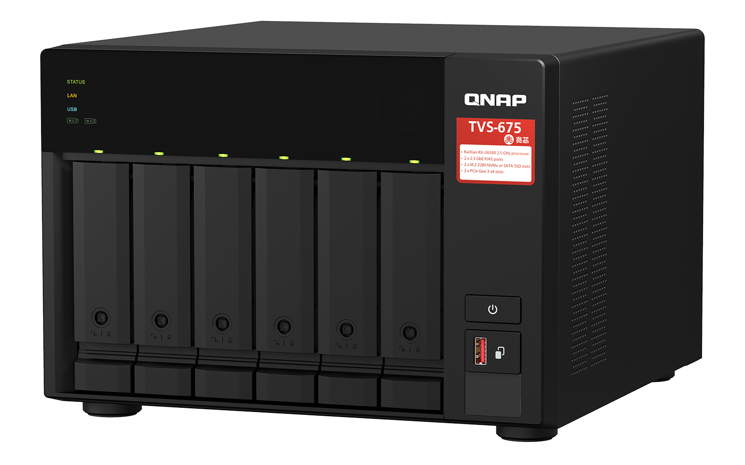
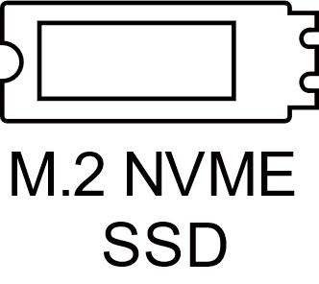
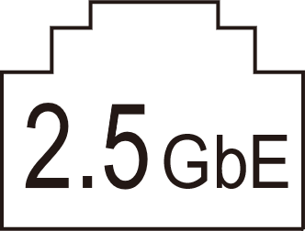
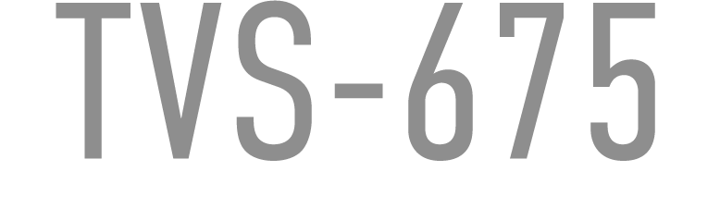
TVS-675 the 8-core SMB NAS with 4K graphics
Dual Opreation Systems
Pre-installed QTS, optional entrprise ZFS QuTS hero
Zhaoxin Kaixian U6580 8C / 8T 2.5GHz SoC
8-core/8-thread x86 processor, built in graphic processor
2 x M.2 PCIe NVMe/SATA SSD slots
Dual M.2 2280 NVMe/SATA SSD to boost performance
2 x 2.5GbE RJ45 (1Gb/100Mb ethernet support)
Dual 2.5GbE LAN ports w/ link aggregation
2 x PCIe 3.0 x4 Slots
Dual PCIe 3.0 x4 slots for network, storage, or M.2 SSD expansion

Slide 3
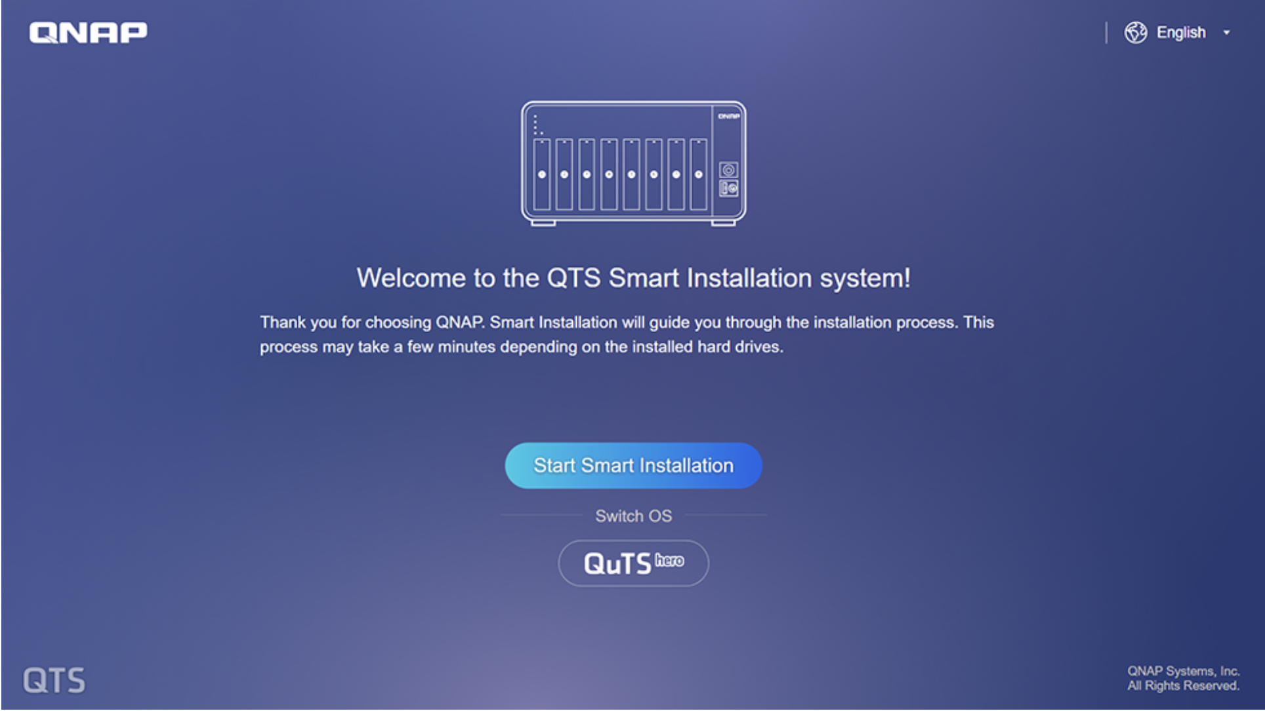
QTS / QuTS hero dual operating systems for powerful and secure NAS applications services
The QTS operating system is preloaded by default. Businesses can switch to ZFS-based QuTS hero operating system with greater reliability based on the needs of different applications at any time.
Attention：
1. Since QTS and QuTS hero use different file systems, users must not insert the old hard disks between different operating systems to avoid data loss.
2. When using QuTS hero, we recommend to use SSD as your system drives to gain better performance.
Hot swap drives by installing 2.5” SATA SSD in two 3.5” drive bays
M.2 NVMe SSD slots on motherboard do not supprt hot-swapping

Slide 4
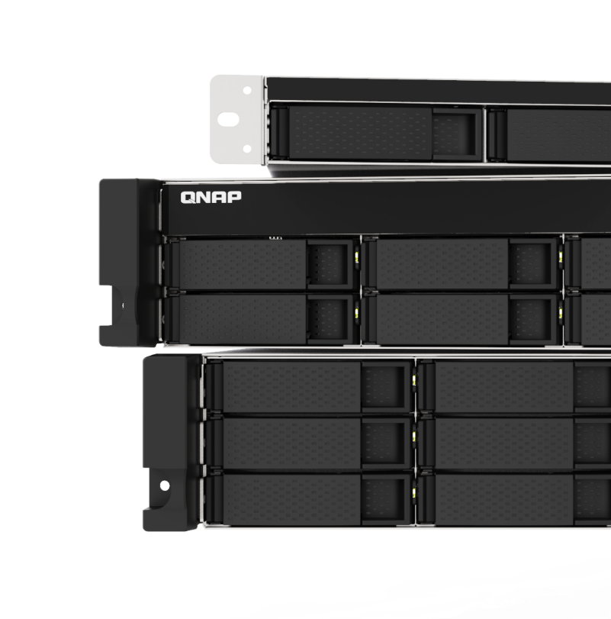
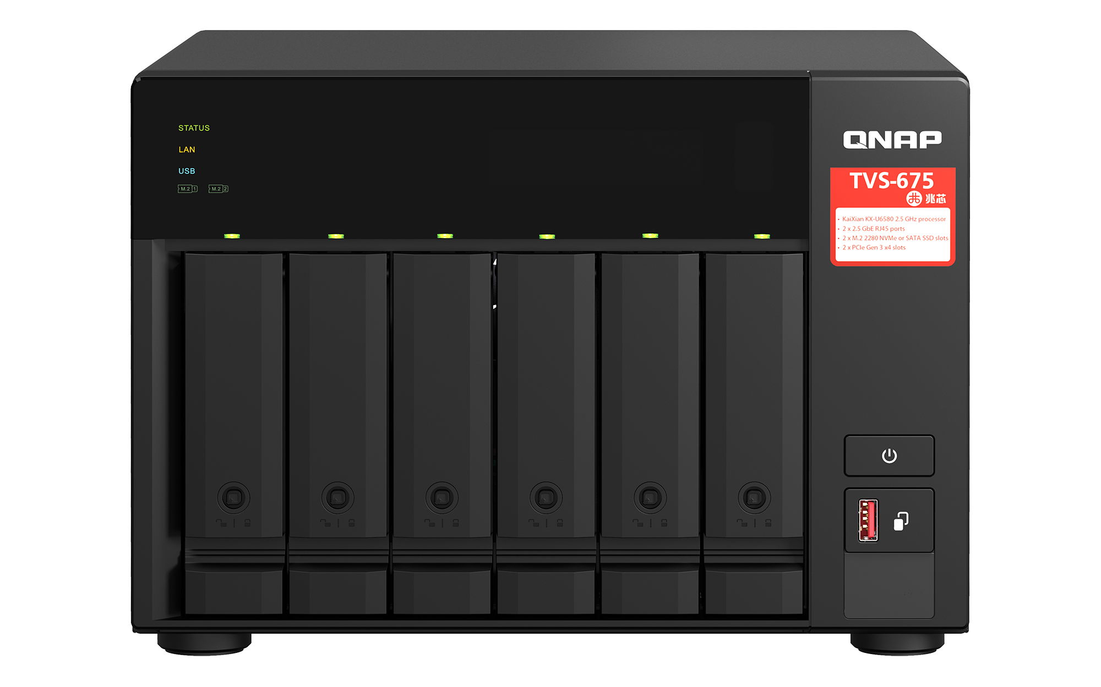
TVS-675 NAS with 8-core 2.5GHz CPU, 8MB L2 cache,
GPU with 4K transcoding and video output via HDMI 2.0
TVS-675
 | Color
CPU model | KX-U6580
# of core | 8
# of thread | 8
Base frequency | 2.5 GHz
Burst frequency | ---
L2 cache | 8MB
VT-x / IO virtualization | Supported
Memory | DDR4
GPU | C960 chipset: HDMI 2.0@4k
CPU architecture | X86
Made in Taiwan

Slide 5



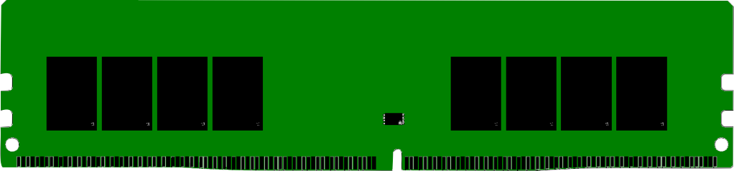









Advanced 8-core 2.5GHz SoC with integrated 4K video graphics and multiple I/O lanes
The Zhaoxin 8C/8T KX-U6580 has lower latency while running multi-task application.
Multi-core graphic processing unit to provide 4K video transcoding and HDMI output with HDMI 2.0.
8-core CPU suited for multiple virtual machines (VM) with the VT-x and IO virtualization support
DisplayPort
VGA
HDMI2.0
PCIe x8
DDR4
PCI Express 3.0
DDR4
LPC
Super
I/O
HD Audio
HD Audio
Codec
TPM
SPI
SPI
ROM
Gigabit
Ethernet
NIC
PCIe x1
SATA
SATA
PCIe x2
PCIe
N
A
N
D
PCI Express 3.0
C
o
F
l
a
s
h
n
t
r
o
l
l
e
r
M.2 Device
USB 3.1
Gen1
USB2.0
USB2.0
USB2.0
USB2.0
“made using (Taiwan) TSMC’s 16 nm technology” - AnandTech
Reference: https://www.anandtech.com/show/13388/zhaoxin-shows-x86-compatible-kaixian-kx6000

Slide 6


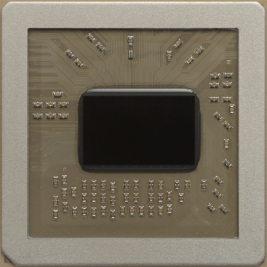
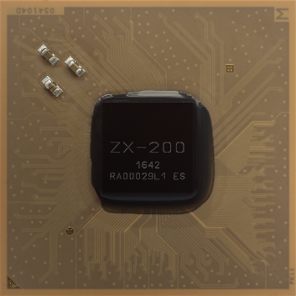
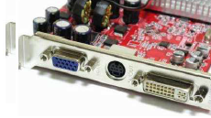
Background and core technology of Zhaoxin CPU
Zhaoxin Inc.
Founded in 2013, based on technologies from VIA
3 key technology
Zhaoxin has core CPU and chipset (South-bridge) technology, also integrated graphics chipset.
CPU
Chipset
GPU

Slide 7
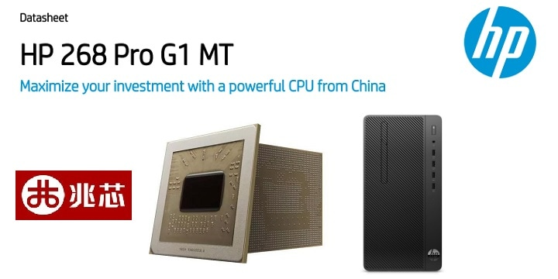
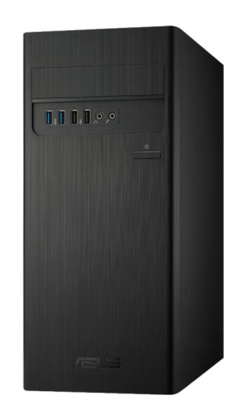


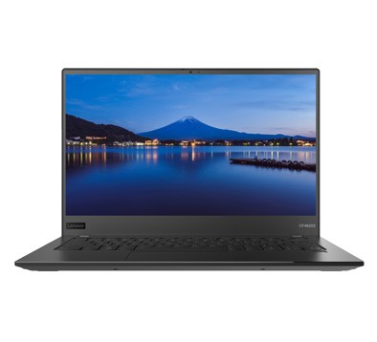
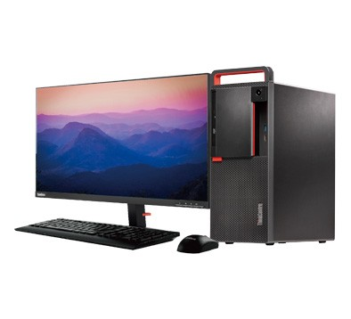
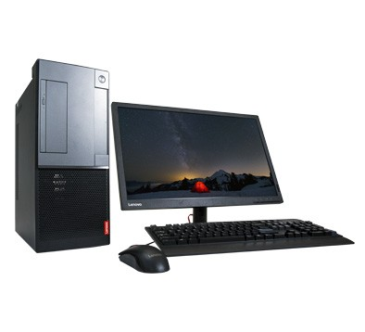
Trusted by the PC industry leaders. Many business-oriented desktops and laptops based on Zhaoxin solutions.
ASUS D349SD desktop
Zhaoxin KX-5000 series CPU
Lenovo CF4620 laptop
Zhaoxin KX-6000 series CPU
Lenovo M630 desktop
Zhaoxin KX-6000 series CPU
Lenovo S620 desktop
Zhaoxin KX-5000 series CPU

Slide 8

TVS-675 Front view
Lockable drive
Trays
(2 keys are included)
LED:
Status、Network、
HDD、M.2 SSD
6 x 3.5"/2.5” SATA 6Gb/s
HDD/SSD slots
Power button
USB 3.2 Gen 2 Type-A 10Gbps port and copy button

Slide 9

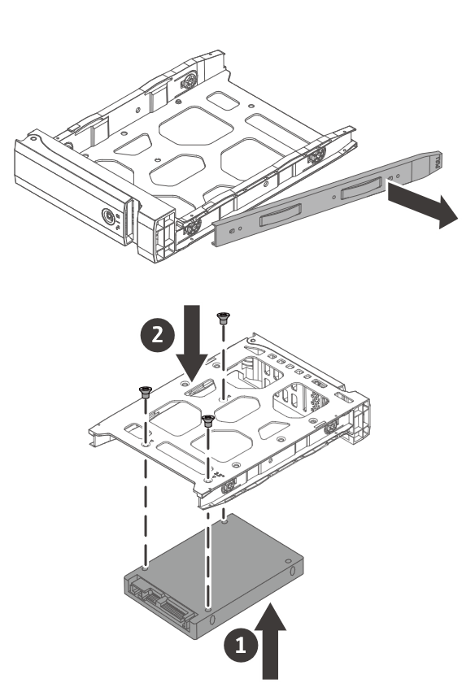
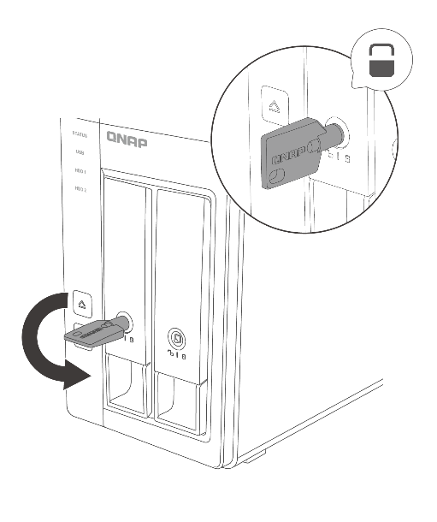
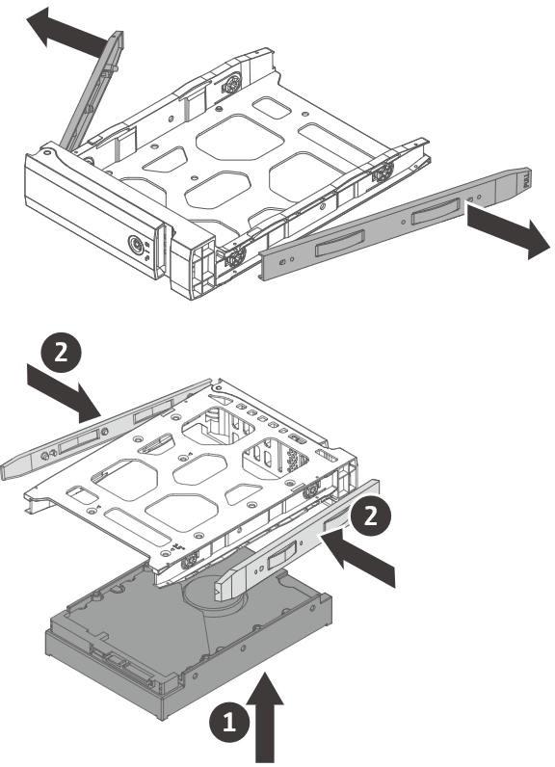
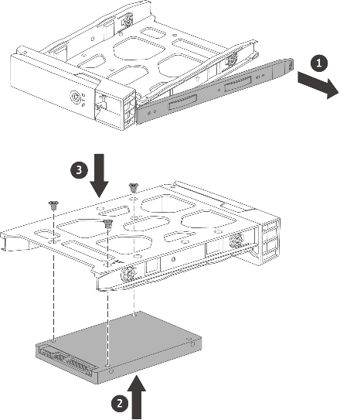
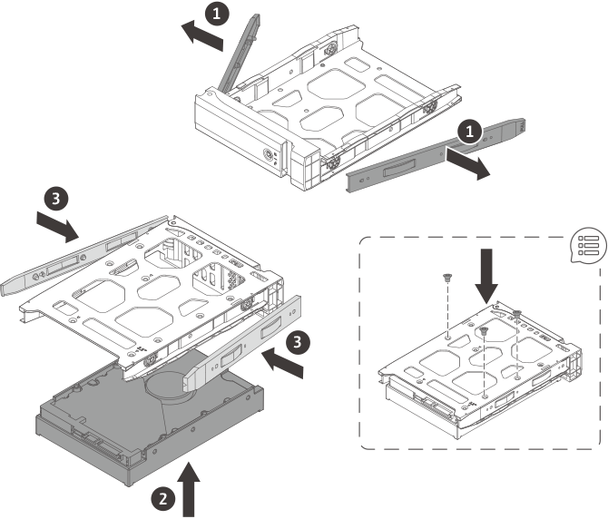
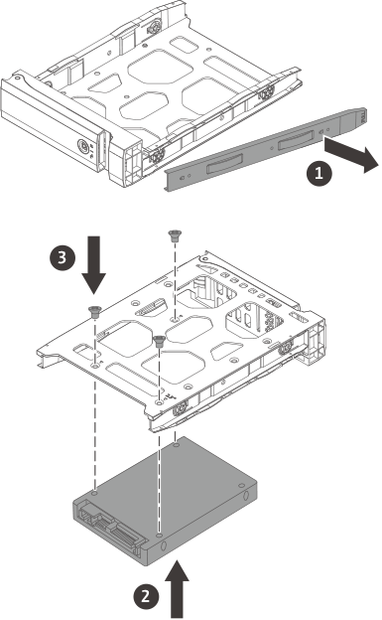
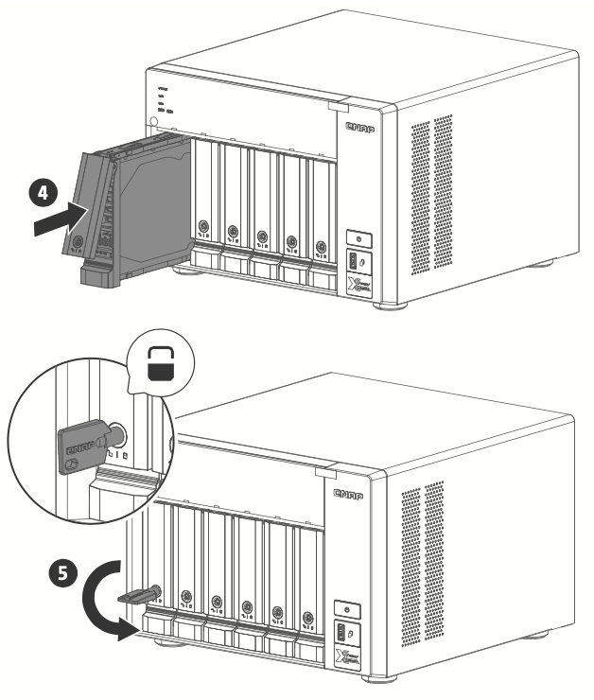





Easy installation of disks and lockable trays
3.5-inch HDD
2.5-inch SSD / HDD
Tool-less installation of 3.5-inch HDDs
注意：運送時或是使用震動較大的硬碟時請使用螺絲固定住．

Slide 10
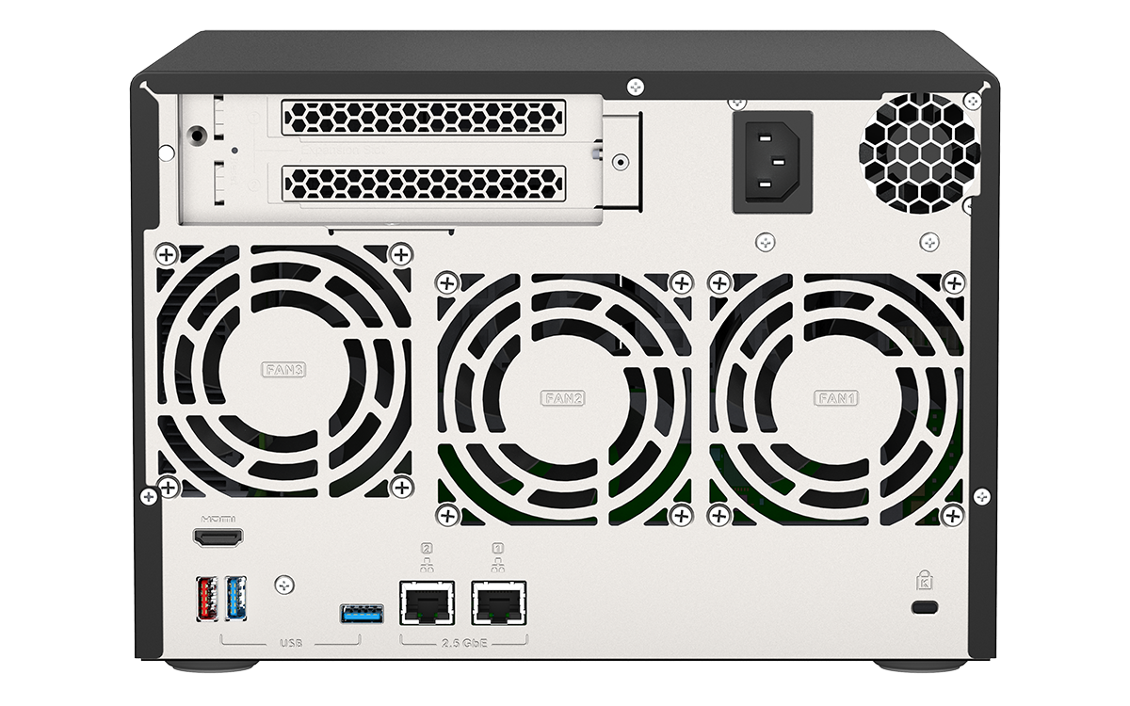
TVS-675 Rear view
2 x PCIe Gen3 x4
Full-height slots
250W 100-240VAC PSU
(10GbE/5GbE/2.5GbE、QM2 SSD、Fibre channel、SATA、SAS PCIe cards)
Fan:
6CM CPU fan +
2 x 9CM system & disk fan
1 x HDMI 2.0 port
Support HDMI 2.0@4k
1 x USB 3.2 Gen2 10Gbps Type-A port
Kensington
K-lock
2 x USB 3.2 Gen1 5Gbps Type-C port

Slide 11
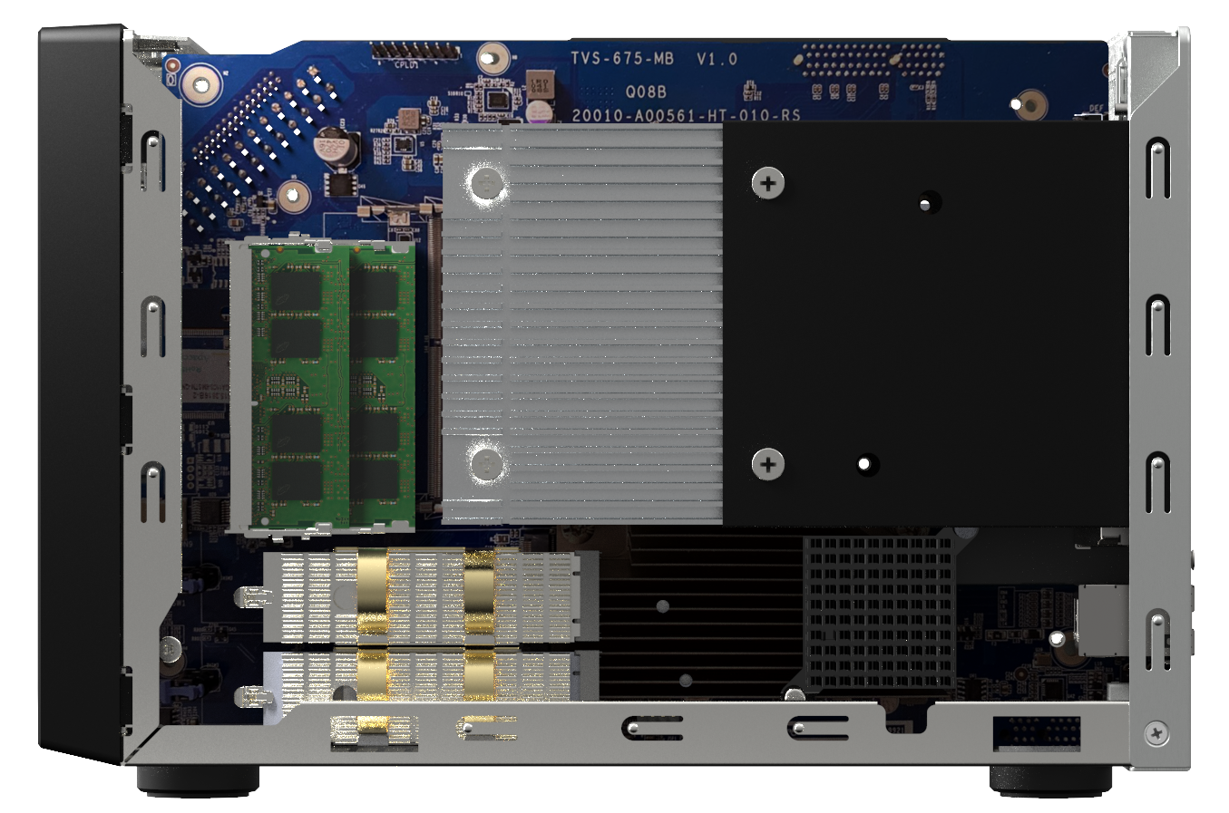
TVS-675 Side view for RAM and M.2 SSD upgrades
High
quality
CPU
heatsink
2 x DDR4
SO-DIMM slots
2 x M.2 2280 NVMe PCIe Gen3 x1 / SATA 6Gb/s SSD slots

Slide 12
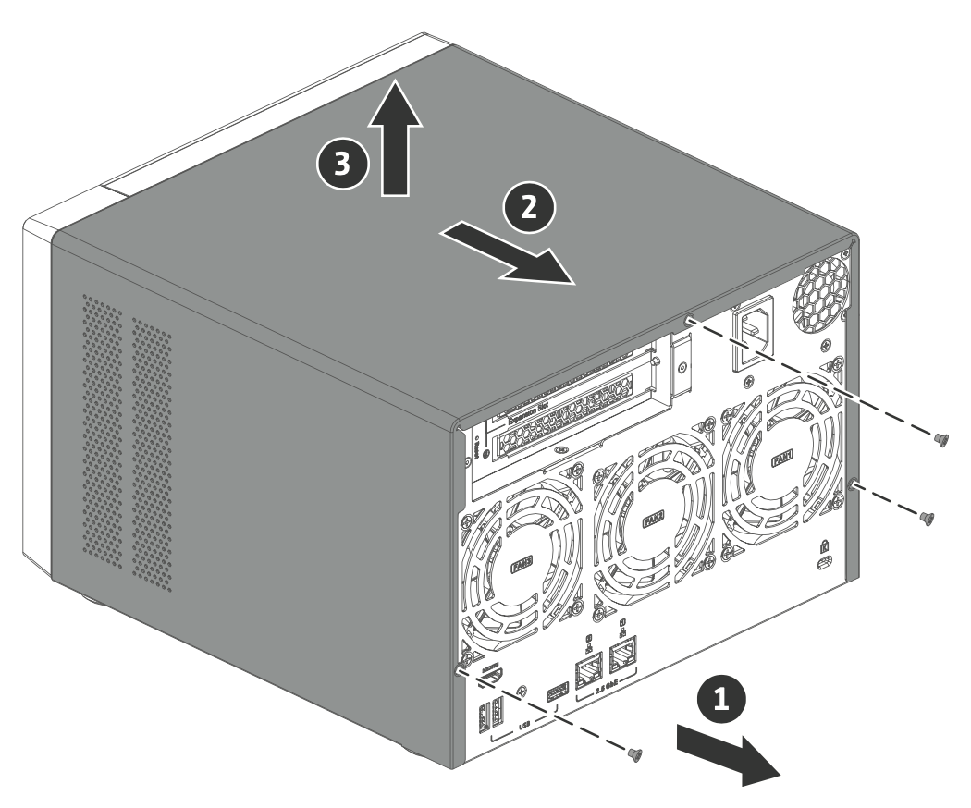
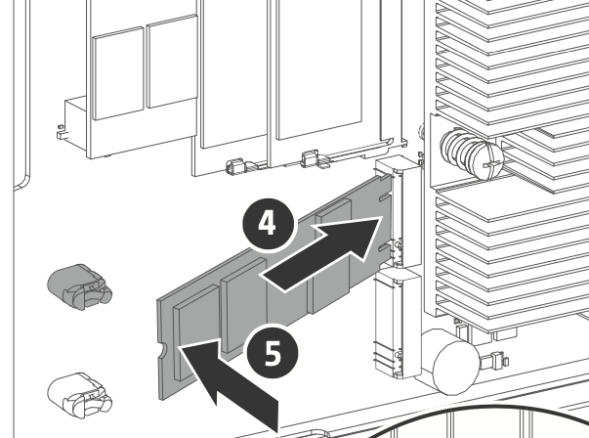
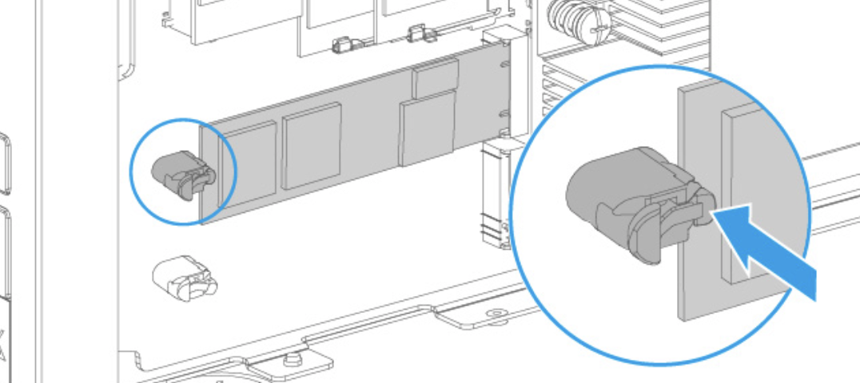
2 x M.2 NVMe PCIe / SATA SSD slots supporting SSD cache or Qtier auto tiering
2 M.2 2280 NVMe PCIe Gen3 /SATA NVMe SSD for SSD cache or Qtier auto tiering performance enhancement.
1. Remove screws and cover
2. Install M.2 SSD
Improve random data access speeds with an SSD cache
SSD caches accelerate IOPS performance and reduce latency for storage volumes. They are perfect for IOPS-demanding applications (including databases and virtualization) and can significantly improve overall workflows.
Maximize the value of SSDs with Qtier Technology
Qtier™ Technology empowers the NAS with auto tiering that helps continuously optimize storage efficiency by automatically moving data between M.2 SSDs, 2.5-inch SSDs, and high-capacity HDDs based on the data's access frequency. Qtier™ 2.0 features IO-awareness that empowers SSD-tiered storage with a cache-like reserved space to handle burst I/O in real time, greatly maximizing the advantages of SSDs.
Note: Qtier is only supported in the QTS OS, not in the QuTS hero OS.
3. Tool-less M.2 SSD installation

Slide 13
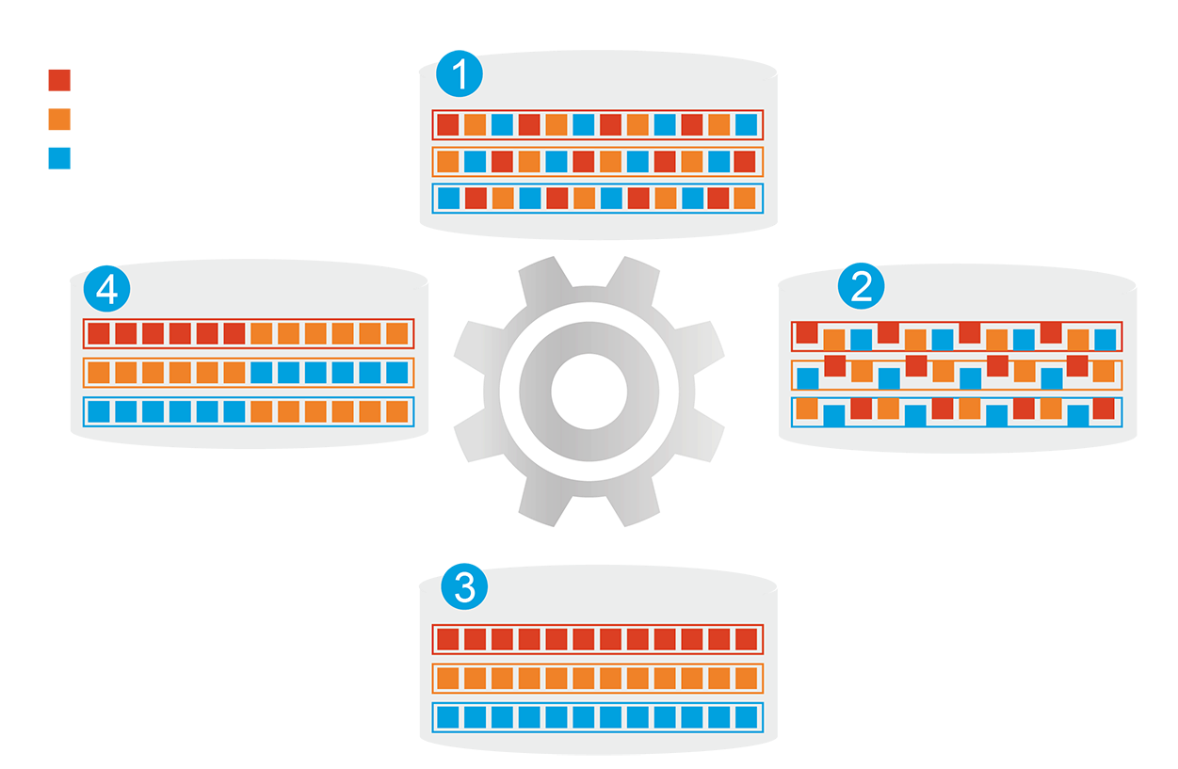









M.2 NVMe/SATA SSD and Qtier auto-tiering for speed and capacity​
1
分層前
頻繁存取資料效能未優化
Qtier
engine
Hot data
Automatically moves data between different tiers​
熱資料
分層前
頻繁存取資料效能未優化
Warm data
SSD tier capacity is not limited by RAM size​
暖資料
Cold data
冷資料
4
資料存取行為改變
2
開始分層
Qtier
引擎
開始分層
Before tiering
Frequently accessed data is not optimized.
Start tiering
After tiering
Data is optimized
Changes in data access pattern
3
分層後
頻繁存取資料效能已優化
分層後
頻繁存取資料效能已優化
Note: Qtier is only supported in the QTS OS, not in the QuTS hero OS.

Slide 14

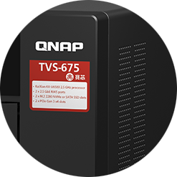
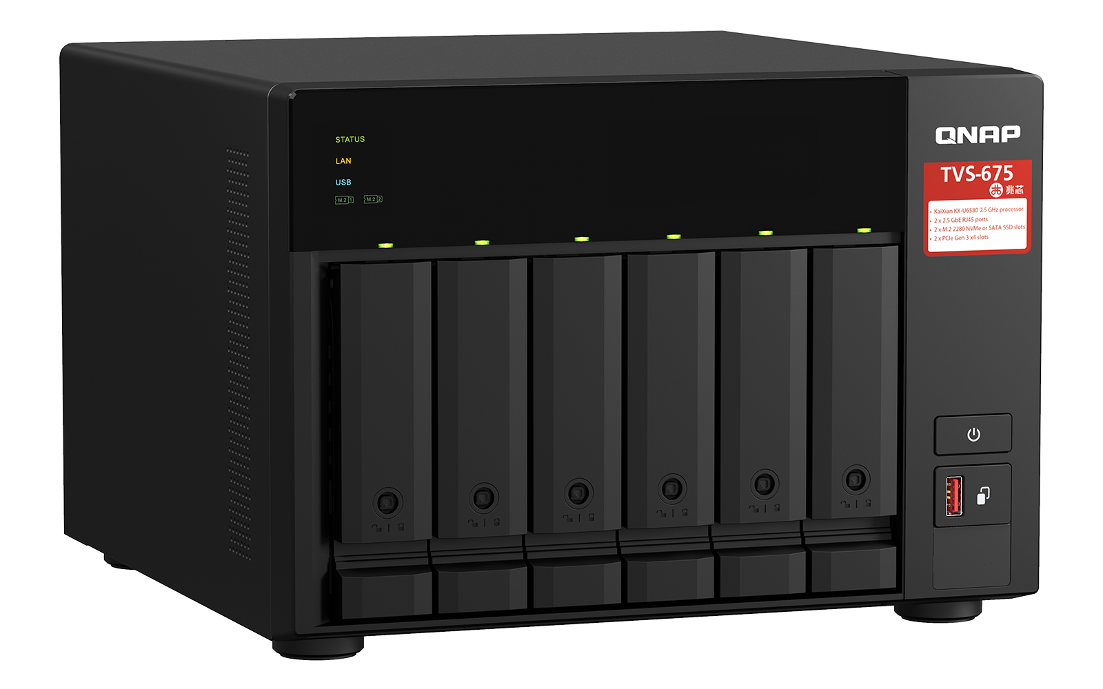

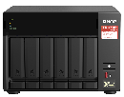
Compartmentalized smart cooling
Enhanced design over the previous generation to separately detects the CPU and hard drive temperatures for dynamically adjusting separate fan speeds for an quieter operations in the office.
Roadside
70
Loud speak
60
Quiet office
CPU side
HDD side
50
Library
40
Quiet outdoor
30
23
TVS-675: 23 dB
Broadcast room
20
TVS-675
Noise Test：Sound pressure is measured at the front bystander position with low fan speed.
Soud pressure (dB)

Slide 15

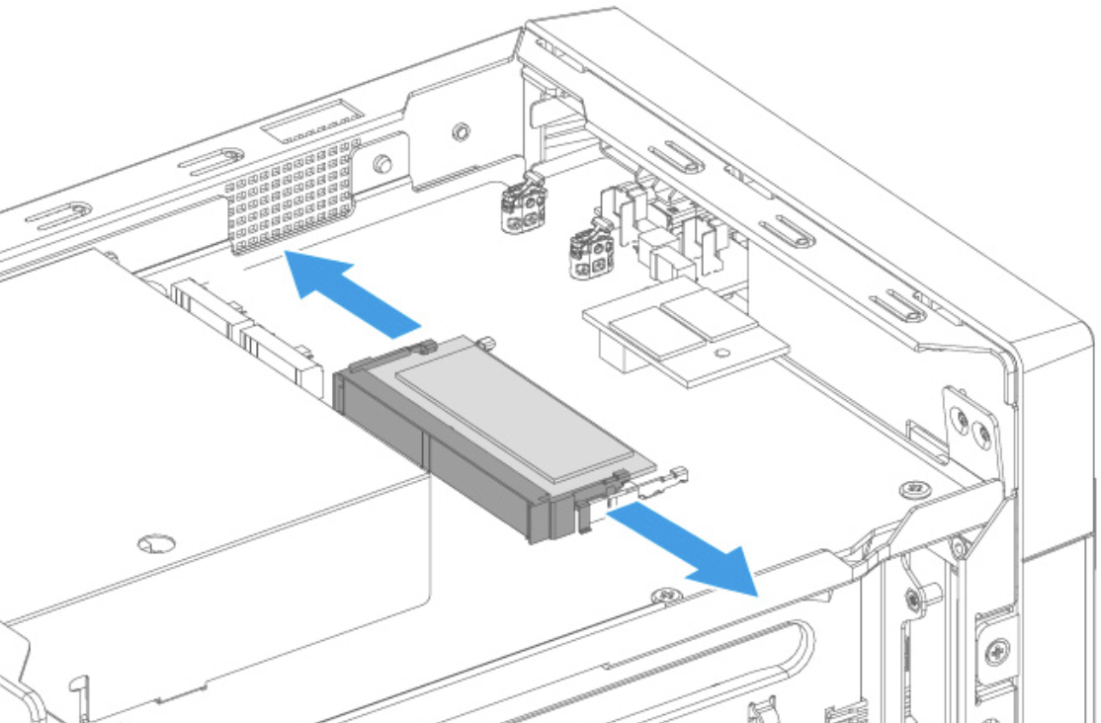
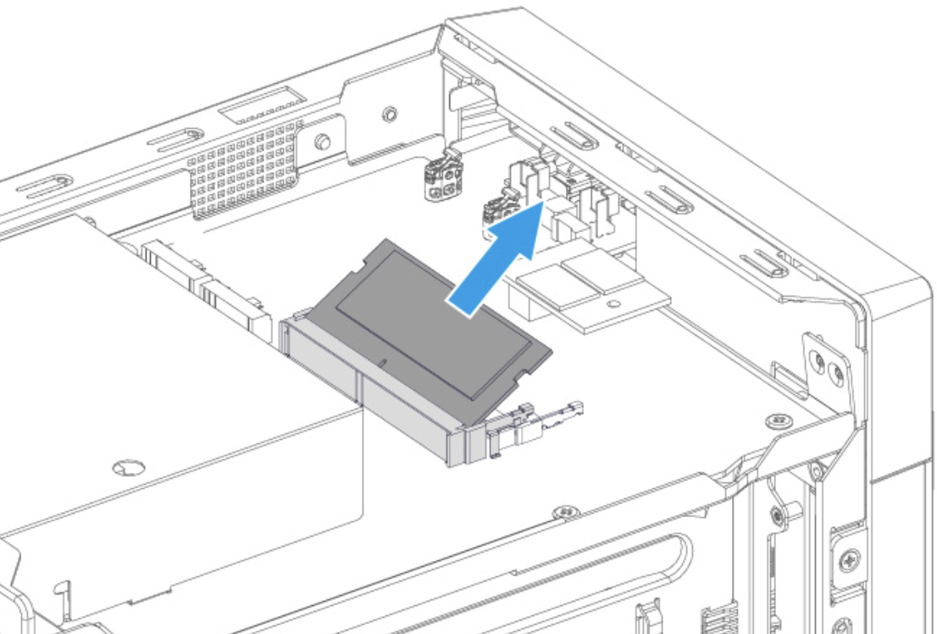
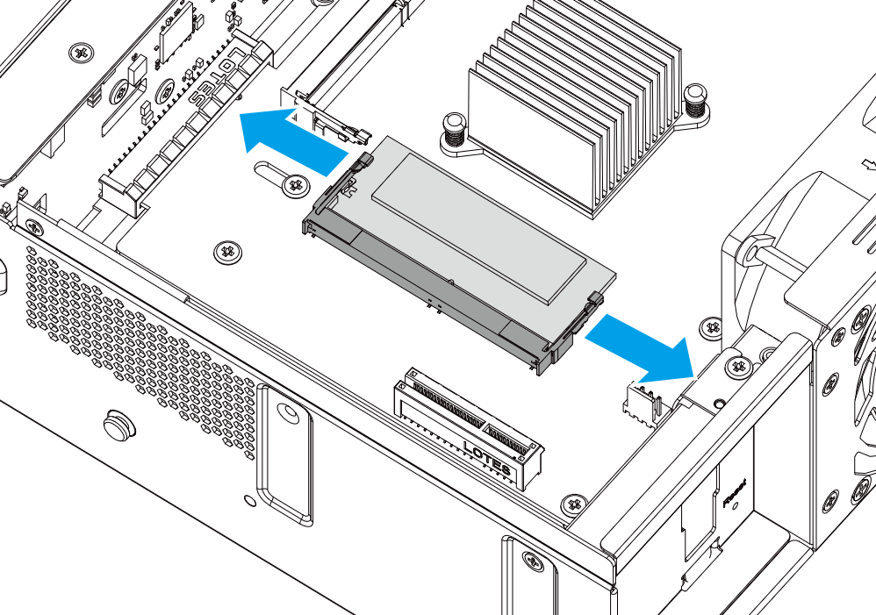
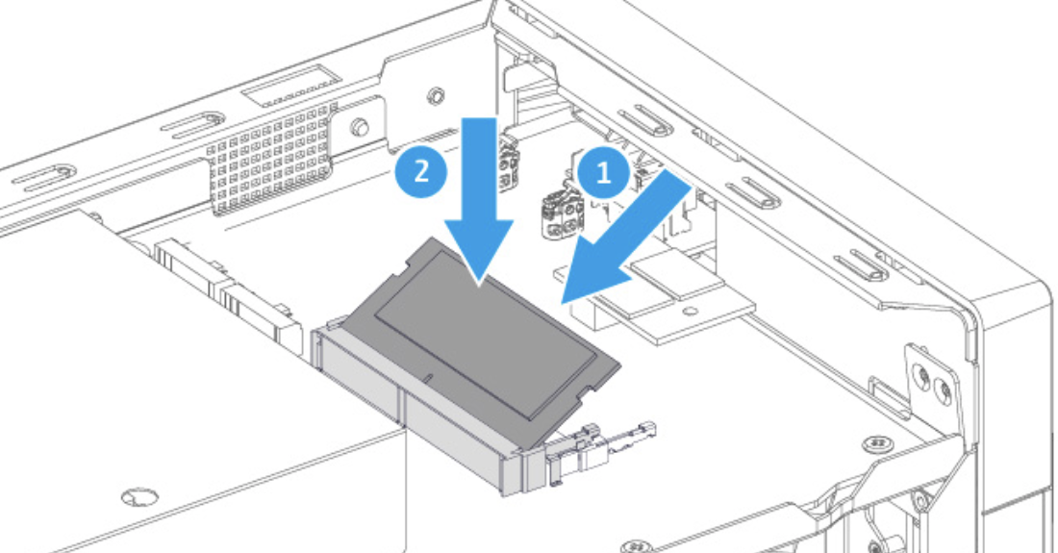
Large 8GB DDR4 memory, ready for any app, and upgradeable to max 64GB RAM
1. Remove the cover
2. Remove the old RAM (optional)
NAS Model Number:
TVS-675-8G
8 GB RAM (1 x 8 GB)
2 x DDR4 SO-DIMM RAM slots for a max of 64 GB (2 x 32 GB), dual-channel support
QNAP 8/16/32 GB RAM modules for easy upgrade and better multi-app or multi-user usage.
3. Install the new RAM

Slide 16



2 x 2.5 GbE LAN ports supporting link aggregation for maximum 5Gbps combined bandwidth
2.5GbE-supported motherboards, Wi-Fi 6 AP, switches, and LAN cards are now becoming popular
2.5GbE benefits
2.5X the speed
Same cable
2 x 2.5GbE LAN ports (also 1GbE/100M)
1GbE to 2.5GbE
Huge leap in performance
Use the same Cat.5e/ Cat.6 / Cat. 6A
LAN cables

Slide 17

Powerful integrated graphics processing unit to support 4K video transcoding and HDMI output
KX-6580 with C-960 graphic chipset, provide high performance transcoding and original 4k video output ability.
Built in C-960 graphics
Support 4K video
Hardware transcoding
HDMI 2.0 port
4K
h.264/265
Support h.264/265
Hardware transcoding
4k video output

Slide 18
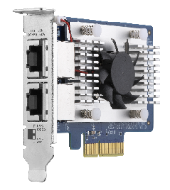
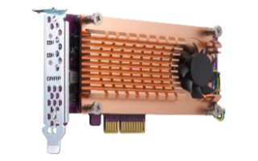
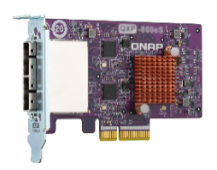
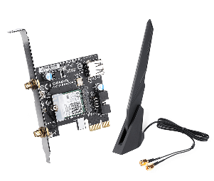
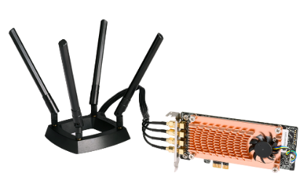
2 x PCIe slots for network, storage, and more
2 x PCIe Gen3 x4 expansion slots for various QNAP PCIe cards for more value-added applications.
QXG 10GbE/5GbE/2.5GbE
Network Interface Card
2 x PCIe Gen3 x4
QM2 M.2 SSD expansion card
QXP SAS、SATA、USB
expansion card
QXP Wi-Fi 6 and FC expansion card
QWA-AC2600 Wi-Fi AP card
Wi-Fi 5 2.4GHz/5GHz wireless AP

Slide 19
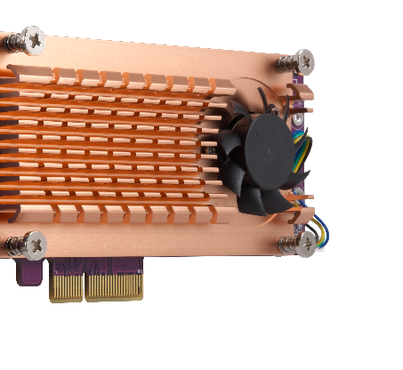
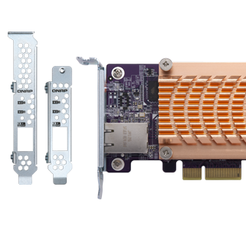
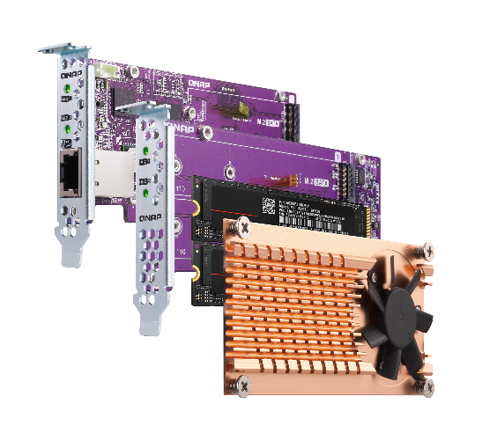
QM2 cards add support for SSD caching and 10GbE connectivity
QM2 M.2 SSD PCIe cards allow adding 2 or 4 M.2 NVMe / SATA SSDs to TS-x73A. Enable SSD caching or create RAID 5 group with the two on-board M.2 NVMe SSDs using Qtier.
Maximize the storage capacity and performance without occupying any 3.5” drive bays. Some QM2 models even combine M.2 SSD and 10GBASE-T connectivity into one solution.
Active cooling module
Compatible with
standard PCIe slots
Thermal sensors allow real-time temperature monitoring and adjust fan rotation speed
Low-profile PCIe card
including full-height bracket

Slide 20
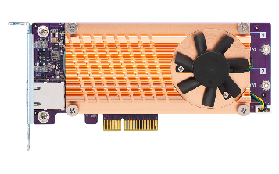
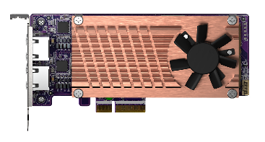
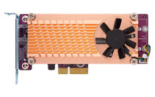
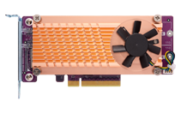

QM2 Series - Add more M.2 SSD slots to TVS-675
NEW
QM2-2S10G1TA
QM2-2P10G1TA
QM2-2P2G2T
2 x M.2 SSD
+ 10GbE or 2.5GbE
Bandwidth: PCIe Gen2 x4
2 x M.2 SATA 6Gbps
+ 1 x 10GBASE-T
Bandwidth: PCIe Gen2 x4
2 x M.2 PCIe Gen2 x2
+ 1 x 10GBASE-T
Bandwidth: PCIe Gen3 x4
2 x M.2 PCIe Gen3 x2
+ 2 x 2.5GbE
QM2-2P-344
QM2-2P-384
2 x M.2 SSD
Bandwidth: PCIe Gen3 x4
2 x M.2 PCIe Gen3 x4
Bandwidth: PCIe Gen3 x8
2 x M.2 PCIe Gen3 x4
QM2-4P-342
QM2-4P-384
4 x M.2 SSD
Bandwidth: PCIe Gen3 x8
2 x M.2 PCIe Gen3 x4
Bandwidth: PCIe Gen3 x8
4 x M.2 PCIe Gen3 x4

Slide 21






Budget-friendly unmanaged switches for multi-user environment
Fanless & metal housing
QSW-1105-5T (Unmanaged)
5 x 2.5GbE Multi-Gig RJ45
QSW-2104-2S (Unmanaged)
2 x 10GbE SFP+ / 4 x 2.5GbE Multi-Gig RJ45
QSW-2104-2T (Unmanaged)
2 x 10GbE RJ45 / 4 x 2.5GbE Multi-Gig RJ45
QSW-1208-8C (Unmanaged)
QSW-308-1C (Unmanaged)
8 x 10GbE Multi-Gig RJ45 / SFP+ combo
4 x 10GbE SFP+
1 x 10GbE Multi-Gig RJ45 / SFP+ combo
2 x 10GbE SFP+
8 x 1GbE RJ45

Slide 22







Layer-2 managed switches for multi-user environment and efficient deployment
QSW-M1208-8C (Managed)
QSW-M1204-4C (Managed)
Keep existing wiring for 2.5GbE
8 x 10GbE Multi-Gig RJ45 / SFP+ combo
4 x 10GbE SFP+
4 x 10GbE Multi-Gig RJ45 / SFP+ combo
8 x 10GbE SFP+
 | CAT 5e | CAT 6 | CAT 6A
100M | ✔ | ✔ | ✔
1G | ✔ | ✔ | ✔
2.5G | ✔ | ✔ | ✔
5G | ✔ | ✔ | ✔
10G | X | ✔(55m) | ✔
QSW-M804-4C (Managed)
QSW-M408-4C (Managed)
4 x 10GbE Multi-Gig RJ45 / SFP+ combo
4 x 10GbE SFP+
4 x 10GbE Multi-Gig RJ45 / SFP+ combo
8 x 1GbE RJ45
QSW-M408-2C (Managed)
QSW-M2108-2C (Managed)
2 x 10GbE Multi-Gig RJ45 / SFP+ combo
2 x 10GbE SFP+
8 x 1GbE RJ45
2x 10GbE Multi-Gig RJ45 / SFP+ combo
8 x 2.5GbE RJ45
QSW-M2108-2S (Managed)
QSW-M2108R-2C (Managed)
2 x 10GbE SFP+
8 x 2.5GbE RJ45
2x 10GbE Multi-Gig RJ45 / SFP+ combo
8 x 2.5GbE RJ45

Slide 23
Optional 10GbE NIC for fast performance
SMB file transfer
SMB file transfer
2 x PCIe Gen3 x4 slots for
10GBASE-T & 10GbE SFP+ cards
1 x 10GbE
2 x 10GbE
2000
2000
2216
1600
1600
1200
1200
1131
1118
800
832
800
400
400
0
Read
Write
0
Read
Write
(MB/s)
(MB/s)
Test Environment:
NAS | TVS-675-8G, QTS 4.5.1, 8 x Samsung 850 Pro 512GB SSD, RAID 5, , LAN-10G2SR-MLX
Client PC | Windows 10 Pro, Intel Core i7-6700 3.4 GHz, 64GB RAM, LAN-10G2SR-MLX.

Slide 24





Network accessories - NIC
10GbE NIC
5GbE NIC
1/2/4 x RJ45
2 x RJ45
1 x RJ45
2 x RJ45
QXG-5G1T-111C
QXG-5G2T-111C
QXG-5G4T-111C
QXG-10G2T-107
QXG-10G1T
LAN-10G2T-X710
2.5GbE NIC
2 x SFP+
2 x RJ45
1/2/4 x RJ45
QXG-2G1T-I225
QXG-2G2T-I225
QXG-2G4T-I225
QXG-10G2SF-CX4
LAN-10G2T-X550

Slide 25


QNAP 16Gb/s Fibre Channel card for FC SAN
QXP-16G2FC
Dual-port 16Gbps
FC card with 16Gb FC transceivers
Manage Fibre Channel connection using iSCSI & Fibre Channel app
16Gb FC transceiver (spare parts)
TRX-16GFCSFP-SR
  16Gb/8Gb/4Gb

Slide 26




QNAP QXP-W6-AX200 Wi-Fi 6 card connects
NAS wirelessly to a Wi-Fi 6 AX network
QNAP TVS-675 NAS
Install the QXP-W6-AX200 PCIe Wi-Fi 6 card
QNAP QHora-301W
Wi-Fi 6 10GbE SD-WAN router

Slide 28






Connect to Dropbox, OneDrive,
Google Drive and more
手機瀏覽
網頁瀏覽
Qfile
File Station
Local
NAS
Remote NAS
Cloud Storage

Slide 29











Easily make NAS your team collaboration portal with File Station
 | Edit with Office Online | View in Google Docs | Open with Google Chrome Extension
Requirement | CloudLink needs to be enabled | CloudLink needs to be enabled | Use Chrome with extension “Office Editing for Docs, Sheets & Slides” to open
Supported formats | .docx, .pptx, .xlsx | .doc, .ppt, .xls .docx, .pptx, .xlsx | .doc, .ppt, .xls .docx, .pptx, .xlsx
Capabilities | •File collaboration •Auto save to NAS in real time | •Document preview •Convert to Google docs for editing & saving in your Google Drive | •Document preview •Convert to Google docs for editing & saving in your Google Drive
Select the default open action based on your preference in Settings > Documents.
Save to NAS in real time
Multi-user online editing
檔案即時同步並回存至NAS中
支援多人線上編輯
 | 以 Office Online 編輯 | 在 Google Docs 中檢視 | 以 Google Chrome 擴充功能開啟
必要設定 | 啟用 MyQNAPCloud CloudLink | 啟用 MyQNAPCloud CloudLink | 以 Chrome 瀏覽器開啟，並安裝擴充功能：Office Editing for Docs, Sheets & Slides
支援格式 | .docx, .pptx, .xlsx | .doc, .ppt, .xls .docx, .pptx, .xlsx | .doc, .ppt, .xls .docx, .pptx, .xlsx
支援能力 | 文件共同編輯與同步至 NAS 檔案 | 文件檢視 可轉成 Google 文件進行編輯 | 文件檢視 可轉成 Google 文件進行編輯
到 設定>文件 裡，選擇你習慣的預設開啟方式吧！

Slide 30




Qsync 5.0 – Cross-device file sync for individuals and teams
Windows &
macOS
Space-Saving Mode!
If you own many devices, any file changed on one device will be automatically synchronized with the others.
For team works, any file changed will be automatically distributed to your teams’ devices, accelerating and streamlining your workflows.

Slide 31


















Complete backup with 3-2-1 HBS 3
HBS 3 (Hybrid Backup Sync 3)
From local NAS
(via HBS 3)
From remote NAS
( via File Station )
Carry and use
(QuDedup Extract Tool)
Backup/Restore
.qdff
Tokyo
Taipei
.qdff
TCP BBR
File Station with QuDedup
.qdff
NewYork
.qdff
CIFS / NFS / FTP
.qdff
Taipei
File Station with QuDedup
Access from Cloud
Beijing

Slide 32





















HybridMount provides two modes for file-based cloud storage gateway
 | Network Drive Mount | File Cloud Gateway
Setup Method | Mount cloud drives and file servers | Select “File Cloud Gateway” mode and create a dedicated cache space
Connections | No limit | 2 free and perpetual connections. Purchase license for more connections
Access Performance | Depends on network speed | High performance thanks to caching
Access in File Station | Supported | Supported
Access through SMB / NFS / AFP | Not supported | Supported
Sync with the cloud | Sync only when browsing | Sync constantly for quick access
Integration with QTS apps | Not supported | Supported ...
Online collaboration
File data analysis
Slower
Internet
NAS
cache
1
2
3
META
DATA
LAN
Faster
Notes:
網路磁碟 雲端掛載：Network Drive for Cloud Mounting
通過雲端認證建立網路磁碟雲端掛載：Mount a cloud storage with authorization

Slide 33






Hyper Data Protector : All-in-one active backup solution for virtual machines
Supports VMware and Microsoft Hyper-V
Unlimited VM backups and license-free
Active backup solution
Restore at any time point
Constant monitoring
Hyper Data Protector
Microsoft Hyper-V

Slide 34





Boxafe: Comprehensive Backup Solution for Google Workspace and Microsoft 365
Keep important data in your hands
Move older data out of the cloud to reduce cost
Google™ Workspace
Microsoft 365®
Gmail
Backup all your emails and attachments in Gmail
Outlook
Backup all your emails and attachments in Outlook
Google Drive
Backup all your file versions in Google Drive and supports My Drive and Shared Drive
Contacts (People)
Backup all your contacts in Outlook People
Calendar
Backup all your events and attachments in Outlook Calendar
Contacts
Backup all your contacts in Google Contacts
OneDrive
Backup all your files in OneDrive and support SharePoint
Calendar
Backup all your events and attachments in Google Calendar

Slide 35



HybridMount - Cascade share the access permission to remote devices
The remote data mounted by SMB/NFS can be shared with other devices with folder permission to achieve a cascade share architecture.
To avoid local users accessing the remote data by VPN and to reduce the security concern and risk of VPN.
No longer need to manage user accounts in the remote server. The local admin retains full control over assigning different permissions to local users.
SMB/NFS
Notes:
Title: Hybridmount – Cascade share the access permission to remote devices
The remote data mounted by SMB/NFS can be shared with other devices by users with folder permission to achieve a cascade share architecture.
To avoid local users access the remote data by VPN and to reduce the security concern and risk of VPN.
No longer need to manage user accounts in the remote server. The local admin retains full control over assigning different permissions to local users.

Slide 36

QmailAgent – email backup solution
Best Email Retention Solution
Collectively manage and back up your personal and business emails.
Easily auto back up all your emails and attachments.
Quickly search and gain access to specific messages.
Back up emails for disaster recovery.
Encryption service protects backed up private emails.

Slide 37








All-in-one 8-core server with max 64GB RAM to host virtual machines and containers
Virtualization Station
Container Station
Supports to run the Virtual machine such as Windows, Linux® , UNIX® and Android.
QNAP’s Container Station exclusively integrates LXC and Docker lightweight virtualization technologies, allowing you to download apps from the built-in Docker Hub Registry.
Container Station
Container
Application
Application
Application
Filesystem
Filesystem
Filesystem
Host OS
Hardware

Slide 38












Establish and run dual systems -
Ubuntu & QuTS hero
Ubuntu Linux Station
INTERNET
Run QuTS hero and Ubuntu dual system, dual system application to enjoy.
One-click installation of multiple versions Ubunutu: 16.04 / 18.04 / 20.04
Ubuntu Software Center enjoy a variety of application downloads
Remotely access the Ubuntu Linux desktop through a browser /
Install a PCIe graphic card to add an HDMI output screen, and use a USB keyboard and mouse with it.

Slide 39


Smart and automatic file management
Qsirch 5
Qfiling 3
Automatically filing and archiving
A powerful, Google™-like search tool
Search image, music, video, document, and email by keyword and filters.
5 advanced image search: search by face, text in image, things, color and map.
Supports Qfiling to perform archival tasks based on your search criteria.
2 type of task: filing task, recycling task
3 type of scheduling rule: one-time, scheduling, real-time
9 editing module: AI face blur, encryption and decryption, video transcoding and so on
Source
Scheduling
Filter
Editing
Destination

Slide 40










Notification Center - diversity of active notification
Centralized
setting
Multiple notification methods
Highly flexible
rule setting
Multi-language support
Double insurance
One interface to integrate all notification settings and operations
Meet your various notification scenarios
Easily filter important messages
Support 23 language & composed by professionals
Notification history and test function

Slide 41

QuLog Center proactively analyze and monitor connections
  Proactive analysis
  List the top 5 Applications for Error/Warning Logs
  System access statistics such as connection types and logged in IP
  Quick filtering
  Categorize by APP name or date
  Customize labels/styles/flags for advanced search
  Real-time monitoring
  View the online members and their connection types
  Unified management
  Consolidate detailed local and remote NAS record files
  Set the size of the space for the record
  Send NAS log files to a standard Syslog server
  Notify specified notifications by Notification Center

Slide 42





Brand new surveillance app
QVR Elite
Channel License Type Unlimited
QVR Pro Client
QVR Elite is subscription-based, with monthly, yearly, and 3-year subscription plans. You can build a robust surveillance system with a low-cost monthly price of US $1.99 per channel. You can alter the subscription based on your needs to reach higher cost efficiency.
Supported by the QVR Pro Client same as QVR Pro's client
Same features include Dynamic View Layout, Live and Playback at the same time, and e-map event display
Standard MP4 file
Performance Evaluation
Supported by both QuTS hero and QTS
Record standard MP4 format, allowing for smooth playback on all devices
At initial version, max recording channel is 128 channels, the next version we will increase it to 192 channels.
Notes:
https://www.qnap.com/zh-tw/software/qvr-elite

Slide 43





High-performance multimedia streaming platform
QuMagie AI smart photo albums and auto classification
Plex Server media streaming
*Transcoding will support in Aug/2021
CAYIN MediaSign Player
HEVC (H.265) video transcoding
Use Cinema28 for
multi-room streaming

Slide 44
Enterprise-level OS
ZFS-based QuTS hero

Slide 45







Powerful data reduction – Extend the SSD endurance
It only works with inline processing before writing
ZFS file system with inline deduplication compression feature
It's the best choice to pair with the all-flash and SSD storage because it reduces the data size and pattern that need to be written to the SSD directly.
Write
Deduplication
Min Requirement：
16GB RAM
A
B
C
D
A
B
C
D
D
C
A
B
A
B
C
D
D
C
A
B
Original Data
Compressed Data
Deduplicated Data
SSD Pool
Compression
Deduplication
Write to SSDs as sequential as much as possible.

Slide 46




Silent data corruption & self-healing
Application
Application
Application
ZFS RAID
ZFS RAID
ZFS RAID
Avoid data silent corruption that occurred on running system

Slide 47





Three-layer backup solution
Builds the most complete data backup protection
HBS 3 :
File level, multi-version management
RPO : daily / schedule
Snapshot & Replica:
File level, multi-version management.
The most lightweight snapshot without affecting storage performance.
RPO : hourly / 24hr / 365 day
SnapSync*:
Block level, Mirror the data copy and always kept up to date.
RPO : real-time
*SnapSync will be available on QuTS hero h4.5.2

Slide 48



SnapSync
The most cost-effective backup, data protection and disaster recovery solution
Schedule Snapsync: 5min~60min
Realtime Snapsync: RPO=0
Normal
Normal
Disaster Recovery (RPO=0)
By schedule
Snapshot send
Real-time Snapshot
Secondary NAS
Secondary NAS
Primary NAS
Primary NAS
(Round Trip Latency < 5ms)

Slide 49
Multiple Storage
Expansion Solutions

Slide 50




Storage expansion: TR-002 / TR-004 USB RAID units
NAS with a USB port can support TR USB RAID enclosures
Integrated USB Type-C port for plug & play, supporting USB Type-A & Type-C hosts
NAS can connect max. 2 of TR-002/TR-004 enclosures
included
USB 3.2 Gen 1 or Gen 2 Type-C to Type-A cable
included
Type-C to Type-C cable
TR-002
TR-004
USB 3.2 Gen2 10Gbps
USB 3.2 Gen1 5Gbps

Slide 51

Storage expansion：TL-D800C USB JBOD unit
NAS with a USB port can support TL USB JBOD enclosures
USB Type-C provide speed up to USB 3.2 Gen 2 10Gb/s
included
USB 3.2 Gen1 or Gen 2 Type-C to Type-A cable
included
Type-C to Type-C cable
TL-D800C

Slide 52



High-speed storage expansion with
PCIe to multi-channel SATA enclosures
Install a QNAP QXP SATA HBA on NAS to access the TL expansion units via PCIe Gen3 bandwidth
Each SFF-8088 cable provides 4 x SATA 6Gb/s = 24 Gb/s bandwidth. Connect multiple cables for up to 64 Gb/s performance
TL-D400S
TL-D1600S
TL-D800S

Slide 53








QXP SATA HBA and cables are included in the
TL-D400S/D800S/D1600S JBOD
+
+
+
+
TL-D400S
1 x QXP-400eS-A1164
PCIe to 4 x SATA 6Gb/s
1 x 1M SFF-8088
cables
TL-D800S
1 x QXP-800eS-A116
PCIe to 8 x SATA 6Gb/s
2 x 1M SFF-8088
cables
+
+
TL-D1600S
1 x QXP-1600eS
PCIe to 16 x SATA 6Gb/s
4 x 1M SFF-8088 to SFF-8644 cables

Slide 54





3-year standard warranty and extend it up to 5 years via an optional purchase
3 years of standard warranty
3-year standard warranty service that comes in effect at the time of purchase.
Free repair and part replacement for products under normal use during warranty period. (Spare parts and consumables are excluded)
可選 2 年超值延長
保固、共5年保沒煩惱
Optional 2 years of extended warranty
Extending your warranty with this paid service, available within 270 days of the initial unit purchase.
Offers identical service to standard warranty.
Part number: EXTW-ORANGE-2Y
Notes:
保固比較
Lacie: 5y
G-technology: 5y
Promise: 3y

Slide 55


TVS-675 provides the best cost-performance ratio combing 8-core computing power and 4K graphics
EOL
TVS-675
TS-673A
TVS-673e
Processor
Zhaoxin KX-U6580
AMD V1500B
AMD RX-421BD
Cores
8
4
4
Threads
8
8
4
Base frequency
2.5 GHz
2.2 GHz
2.1 GHz
Turbo frequency
──
──
3.4 GHz
L2 cache
8MB
2MB
2MB
Max RAM
64GB
64GB
64GB
M.2 2280 SSD slots
2 x M.2 NVMe / SATA
2 x M.2 NVMe
2 x M.2 SATA
Integrated graphics
4K HDMI 2.0
──
4K HDMI v1.4b
Warranty
3 years
3 years
2 years

Slide 56

ZhaoXin KaiXian KX-U6580 8C / 8T 2.5GHz
Dual 2.5GbE、M.2 NVMe/SATA SSD slots, PCIe 3.0 x4 slots
Copyright© 2021 QNAP Systems, Inc. All rights reserved. QNAP® and other names of QNAP Products are proprietary marks or registered
trademarks of QNAP Systems, Inc. Other products and company names mentioned herein are trademarks of their respective holders.​​​
Notes:
Brand new 8-core SMB dual OS NAS
ZhaoXin KaiXian KX-U6580 8C / 8T 2.5GHz
Dual 2.5GbE、Dual PCIe 3.0 x4 slots

