Slide 2
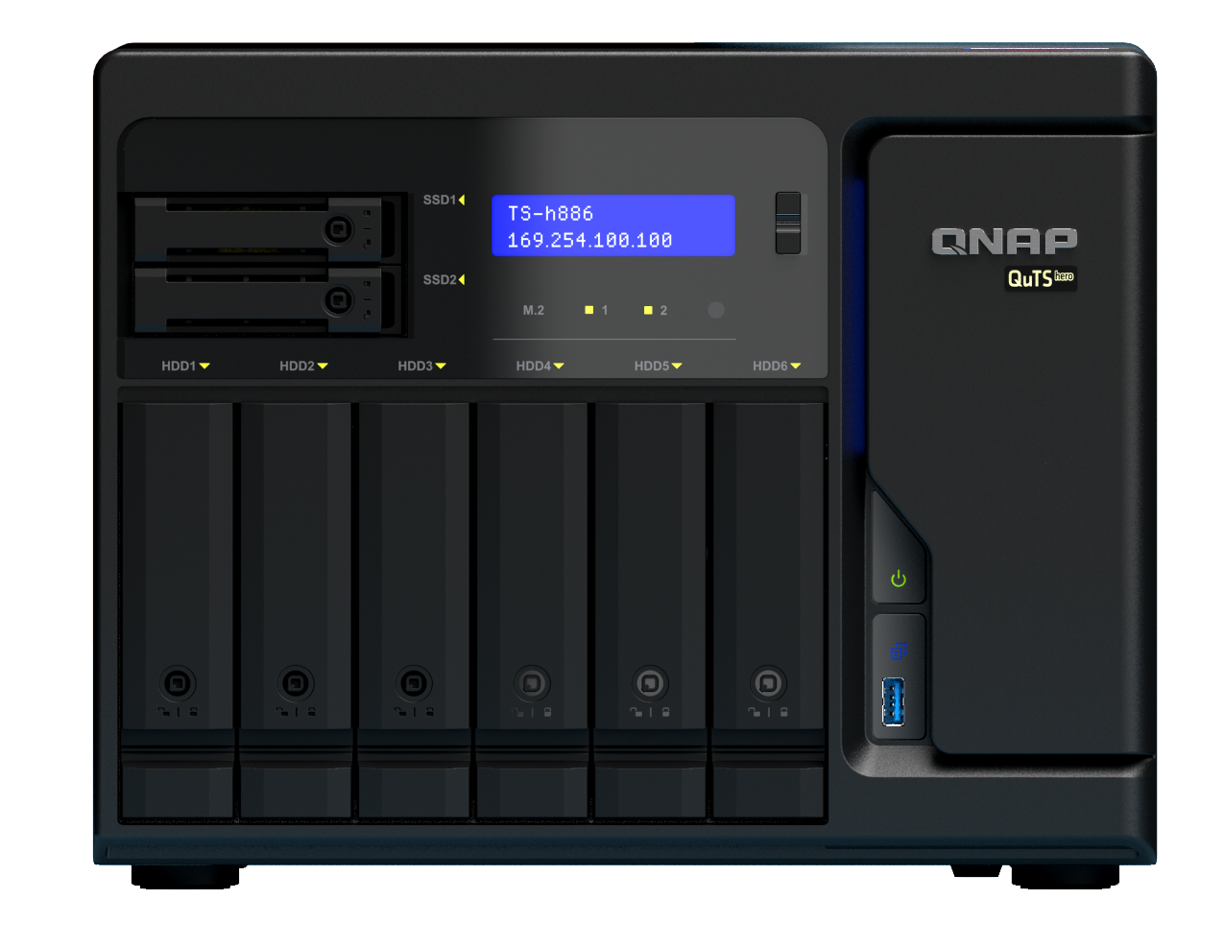
The latest version of QTS 5.0 brings a whole new experience to NAS users, strengthening the system from the kernel and optimizing the UI interface. Starting with the installation, a significant adjustment is made, and after the installation is complete, a guidance instruction is given to assist the user in completing the necessary operations and safety settings. The new cache module allows NVMe SSDs to take advantage of high-speed access. Need faster applications? Let AI accelerate to help, combined with Coral Edge TPU, photo management and surveillance systems to help users achieve tasks more effectively.

Slide 3
FOCUS
Upgrade Kernel 5.10 LTS Optimize QTS management UI Improve NVMe and SSD cache performance Increase the level of security Faster WireGuard VPN service

Slide 4
Upgrade Kernel 5.10 LTS
New kernel upgrades that dramatically improve kernel security, enhance performance, improve AMD processor efficiency, and support next-generation hardware platforms and built-in graphic chips
*Due to architectural limitations, some models will not be able to upgrade.

Slide 5
Benefits of Kernel 5
Improve kernel security Enhance effectiveness Improve AMD processor efficiency Supports next-generation hardware platforms and built-in graphic chips Built-in WireGuard VPN

Slide 6
Comparison Test TS-h2490FU (AMD EPYC 7302P)
Protocol | Unit | IO Access | Real Performance
 |  |  | QTS 5.0.0 Normal LUN / Folder |  |  | QTS 4.5.3 Normal LUN / Folder
 |  |  | 1 host 25GbEx2 | Latency (ms) | NAS CPU % | 1 host 25GbEx2 | Latency (ms) | NAS CPU %
 |  |  |  | Avg. |  |  | Avg.
iSCSI | Throughput (MB/s) | SW-1M | 2575 | 6 | 36% | 2181 | 7 | 13%
 |  | SR-1M | 5642 | 3 | 23% | 5036 | 3 | 17%
 |  | SW-512K | 2598 | 3 | 33% | 2182 | 4 | 13%
 |  | SR-512K | 5591 | 1 | 19% | 4248 | 2 | 10%
 | IOPS | RW-4K | 96,734 | 1.00 | 33% | 89,043 | 1.00 | 17%
 |  | RR-4K | 171,989 | 0.00 | 36% | 164,891 | 0.00 | 33%
SMB | Throughput (MB/s) | SW-1M | 2210 | 7 | 22% | 2067 | 8 | 19%
 |  | SR-1M | 5219 | 3 | 12% | 4651 | 3 | 9%
 |  | SW-512K | 2077 | 4 | 22% | 2018 | 4 | 18%
 |  | SR-512K | 5265 | 2 | 12% | 4496 | 2 | 8%
 | IOPS | RW-4K | 73,954 | 1 | 22% | 86,384 | 1 | 19%
 |  | RR-4K | 157,138 | 0 | 44% | 100,837 | 1 | 30%
NAS Configuration:
Model | TS-h2490FU
CPU | AMD EPYC 7232P 3.1GHz (8C/16T)
RAM | DDR4-2666 64GB (8GB x8)
F/W | QTS 5.0.0 20210520
F/W | QTS 4.5.3 20210515
SSD | Micron 7300 3.8TB NVMe x12
Pool RAID type | RAID5
Pool OP | 10%
NIC | QNAP QXG-25G2SF-NXE 25GbE

Slide 7
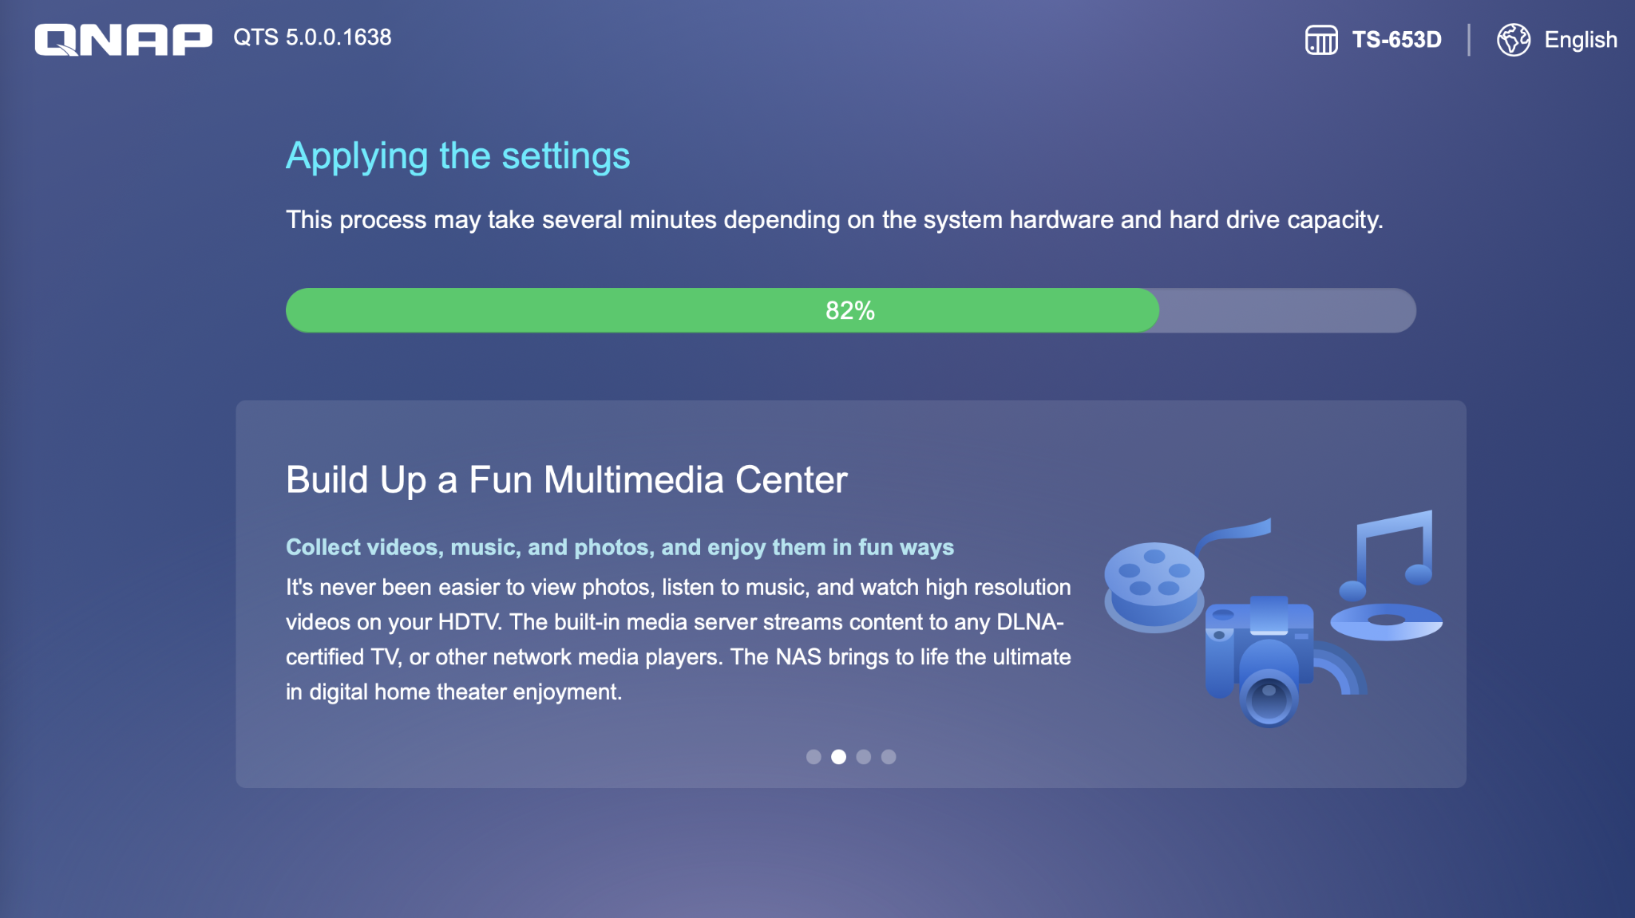
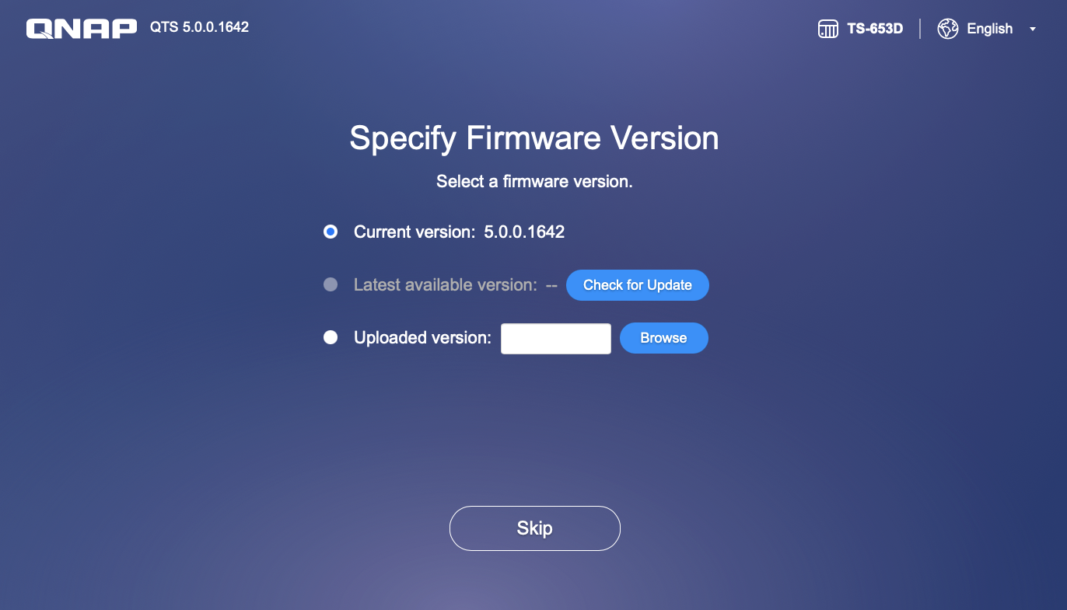
A new version Installation Wizard
Simplify the steps Initialization and update the latest version firmware at the same time Create a new administration account

Slide 8
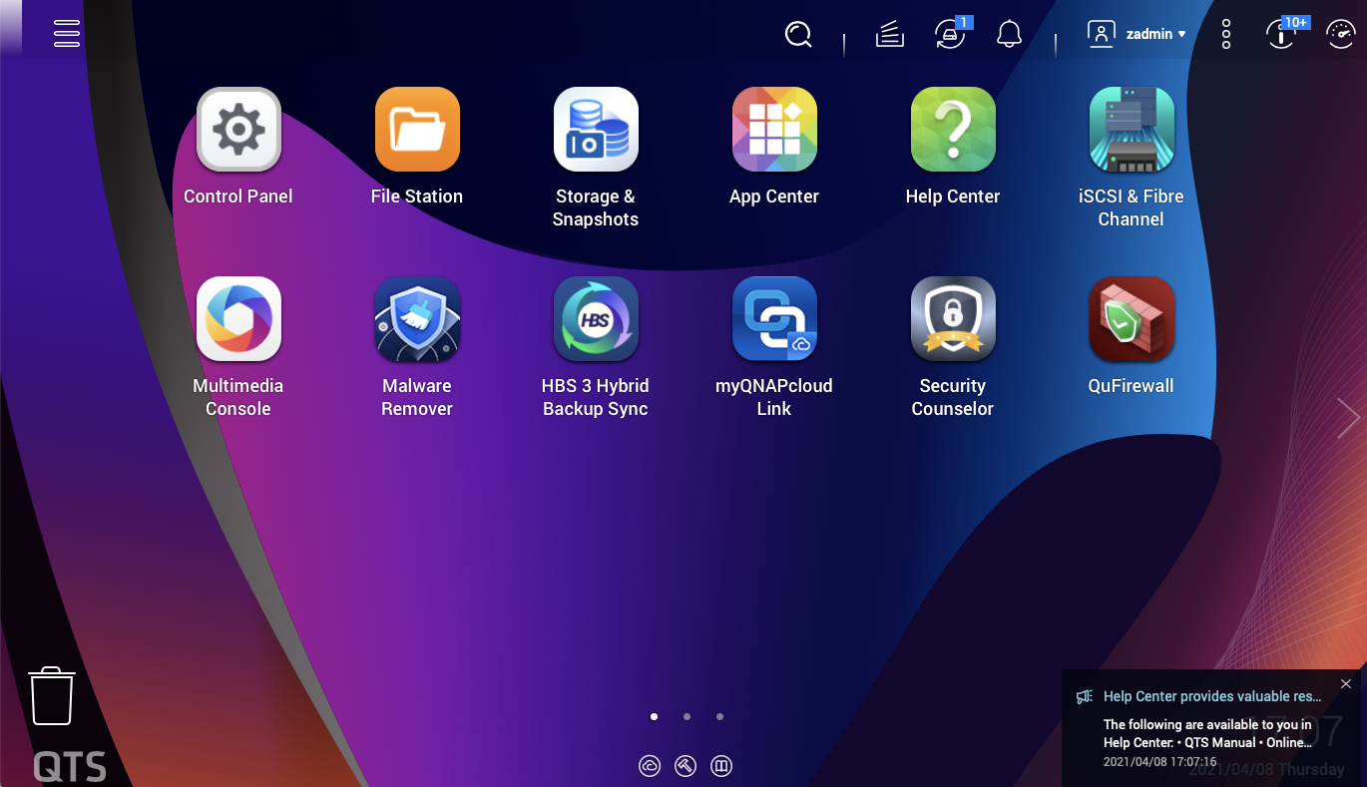
Optimize QTS UI management operations
Simplify the procedure, improve visual comfort and reaction speed, redesign the installation wizard, and post-installation guidance tips to make initial setup easier.

Slide 9
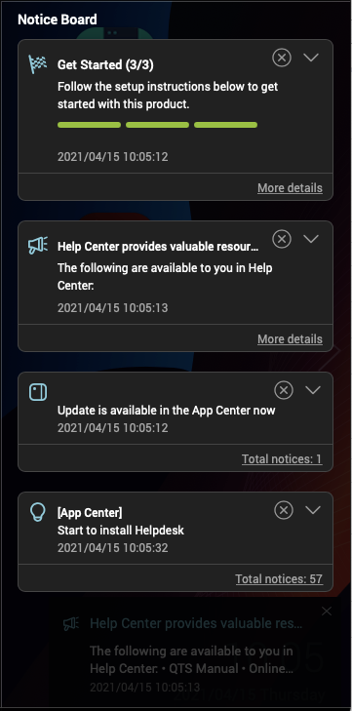
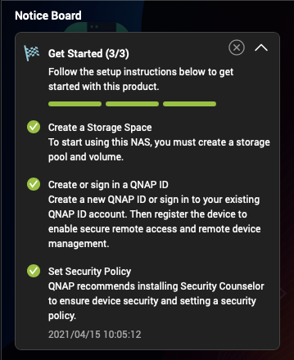
Notification Board
Use the guide for the first time The notification information will be communicated into multiple categories to apply the overall display

Slide 10
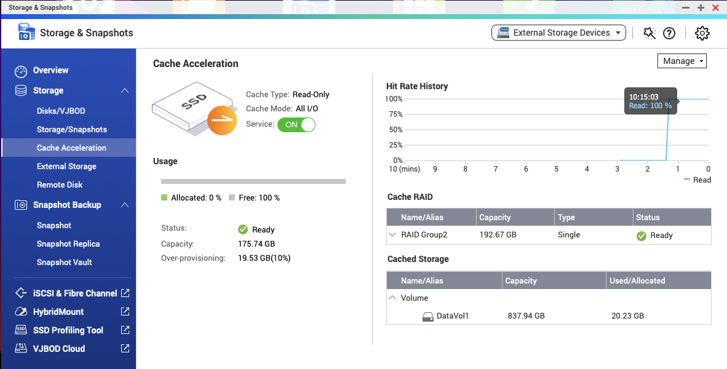
Improve NVMe SSD Performance
With the new kernel, NVMe usage efficiency is greatly improved Optimized cache module, SSD space can be used more efficiently, and memory usage is less then before Improve the efficiency of multi-users access to the same folder Not only NVMe SSD, SATA or M.2 SSD have also been promoted

Slide 11
Increase the level of security
Support TLS 1.3 The admin account is disabled by default Advanced encryption suite support adjusted safety settings and more stronger safety protection options SSH Key login Firmware automatic updates (recommended updates, automatic updates) App automatic updates (recommended updates, automatic updates) Reverse proxy (TBD)

Slide 12
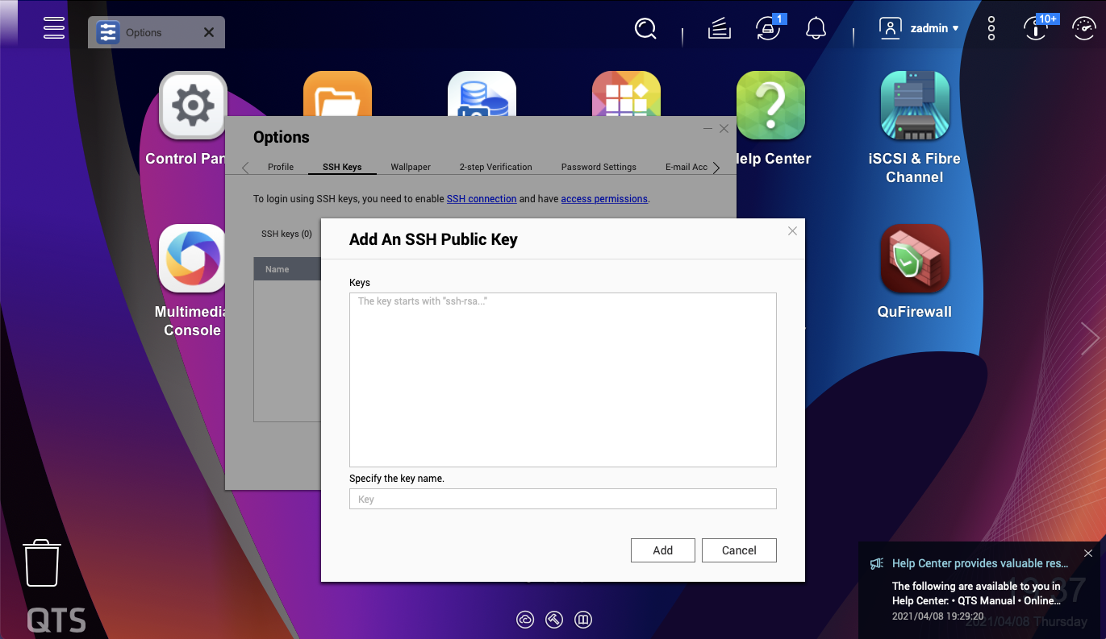
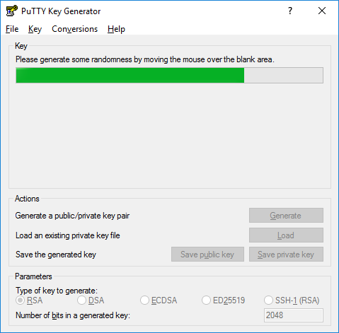
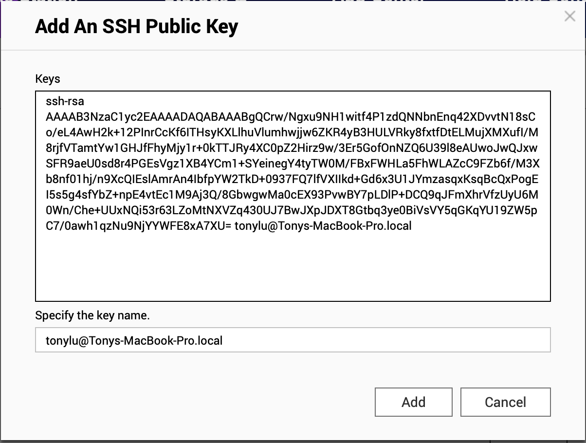
More secure to manage login by SSH Key

Slide 13
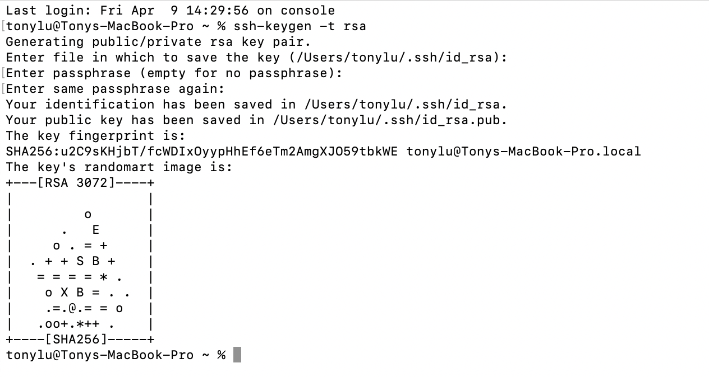
Generate SSH key
in macOS
#ssh-keygen -t rsa
#pbcopy < ~/.ssh/id_rsa.pub

Slide 14
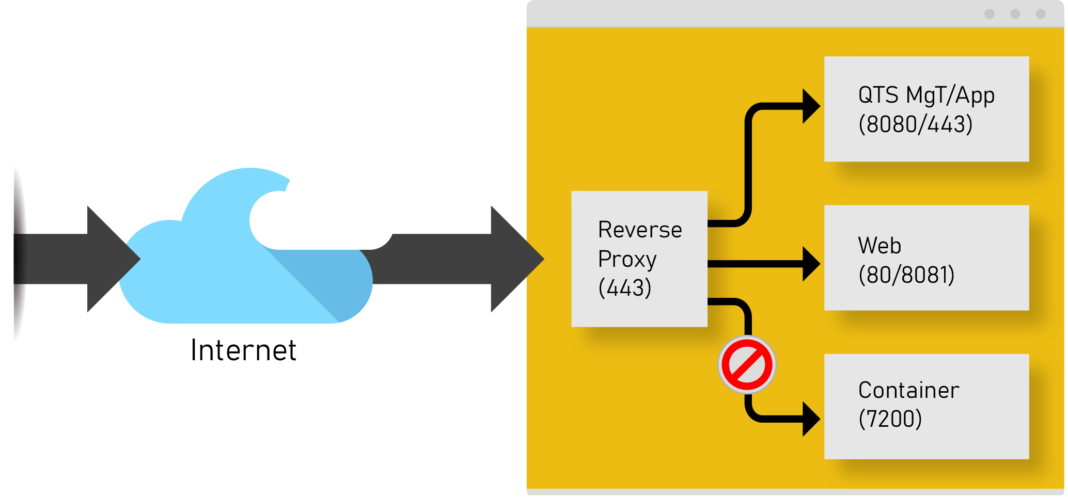
Reverse Proxy (Coming)
Improve the security of web access services, especially over the Internet Use Reverse Proxy to hide sensitive service network ports to avoid potential risks

Slide 16
Strengthen File services
The new QuFTP service brings more features Enhanced SMB/NFS performance, faster transfer of large files

Slide 17
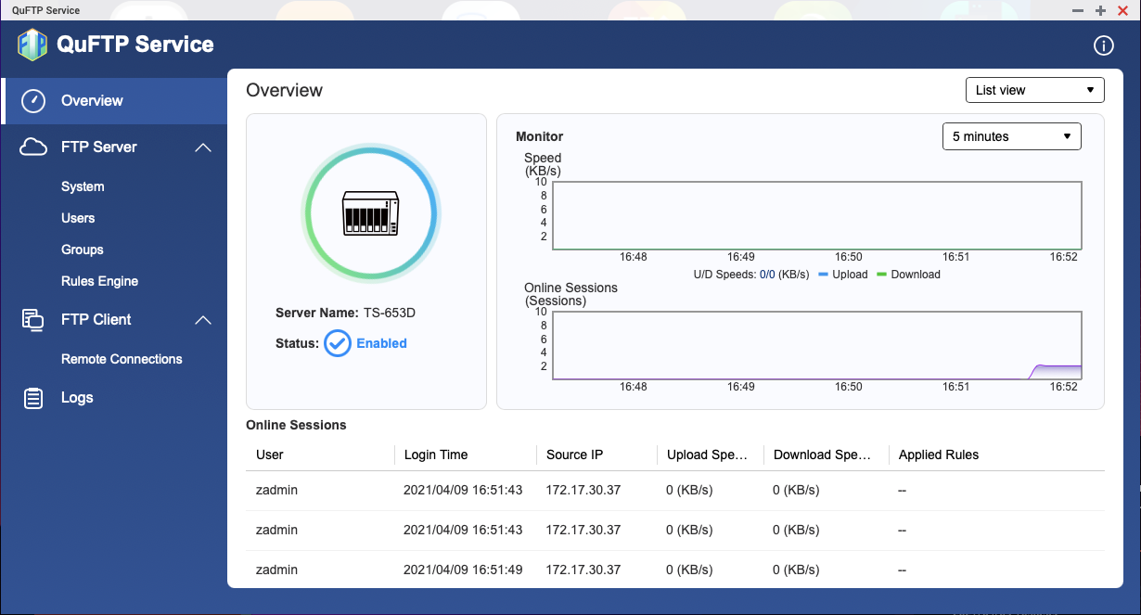
QuFTP Service
Can be updated independently FTP server is supported Support TLS settings Support QoS Settings Support for FTP clients

Slide 18
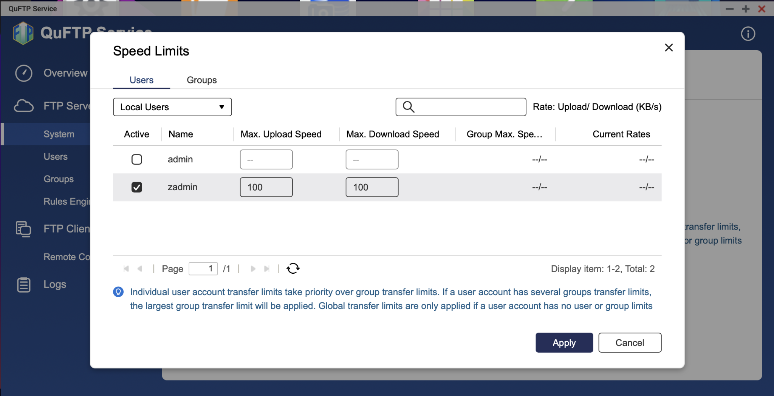
QoS Settings
Based on user settings Limit upload and download speeds

Slide 19
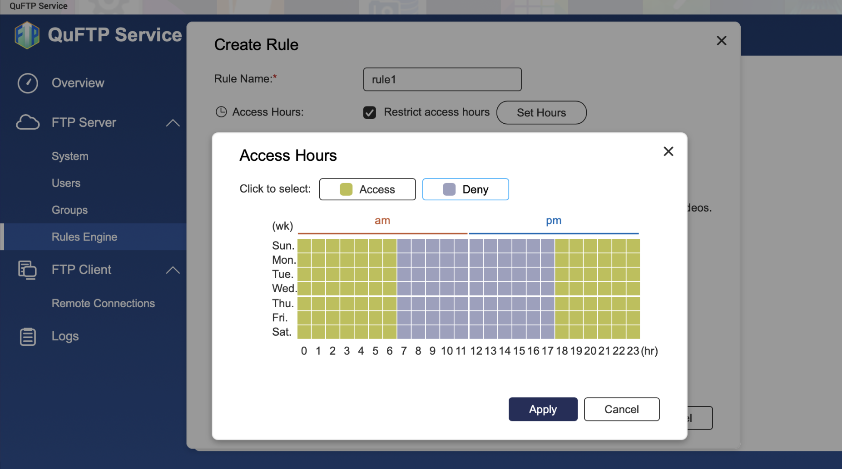
Rule Settings
Condition-based setting Time to allow access or denial of use

Slide 20
Improve AI acceleration
With Coral Edge TPU, you can organize your photos, increase object recognition performance several times, and dramatically reduce the processor resources you need for processing Officially launches disk AI prediction service

Slide 21
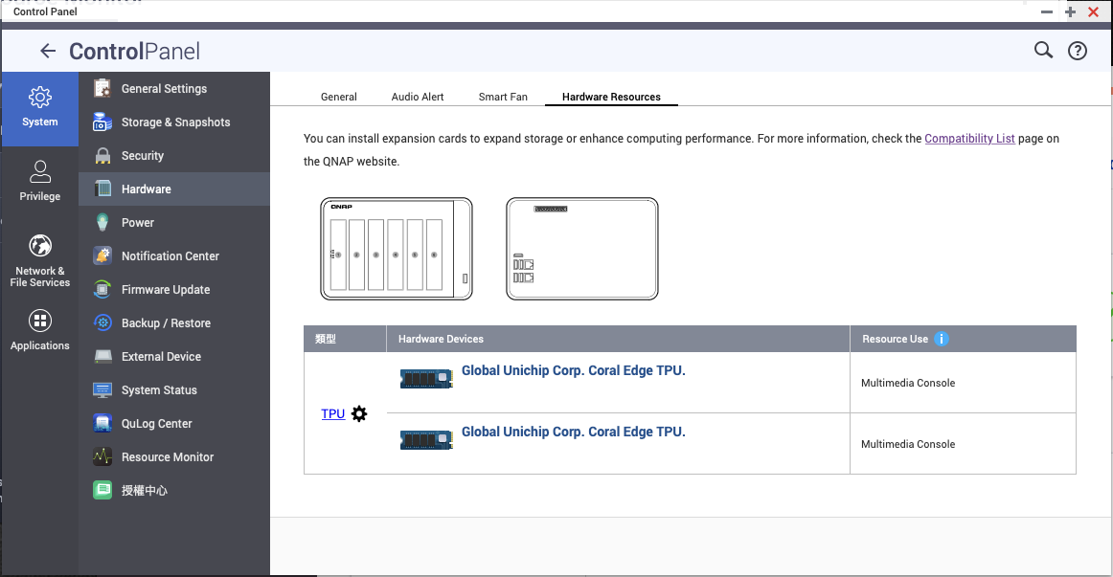
Coral Edge TPU
Supports a variety of TPU devices Multiple sets of TPU appliances can be supported at the same time

Slide 22
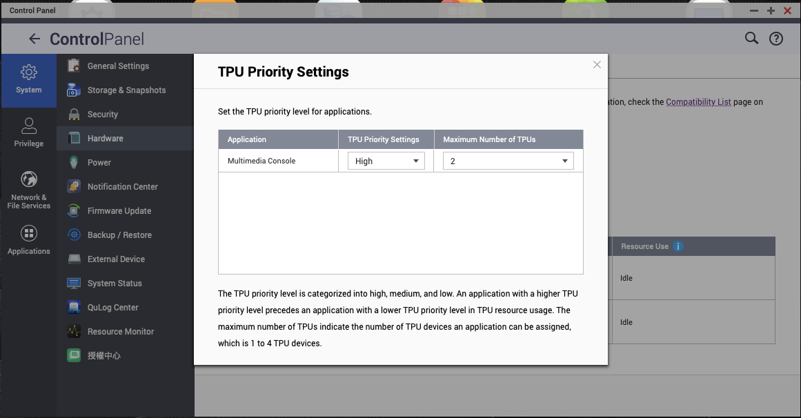
Dynamically Adjust TPU Priority
TPU priority can be specified in different level TPU device can be assigned to a specific application

Slide 23
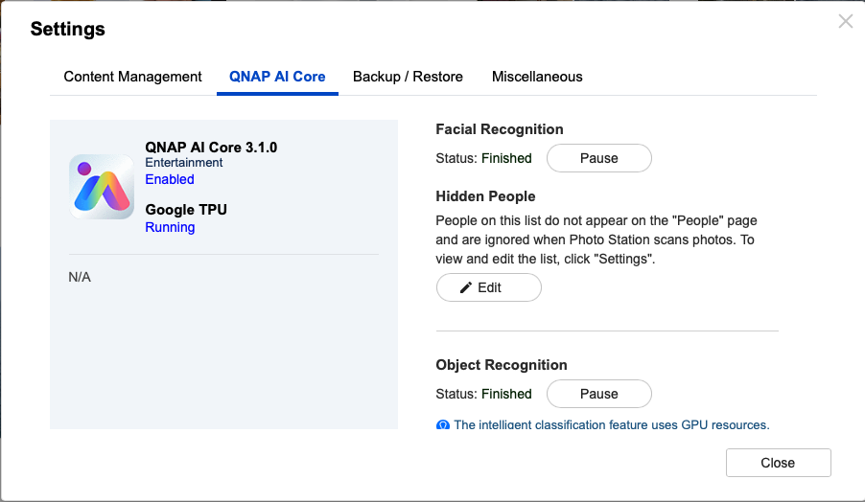
QuMagie Support Enhancement AI Core
QuMagie 1.5.1
Support Coral Edge TPU

Slide 24
QVR Face / Human
QVR Face helps users build intelligent face recognition QVR Human proactively calculates the number of people passing through a specific region

Slide 25
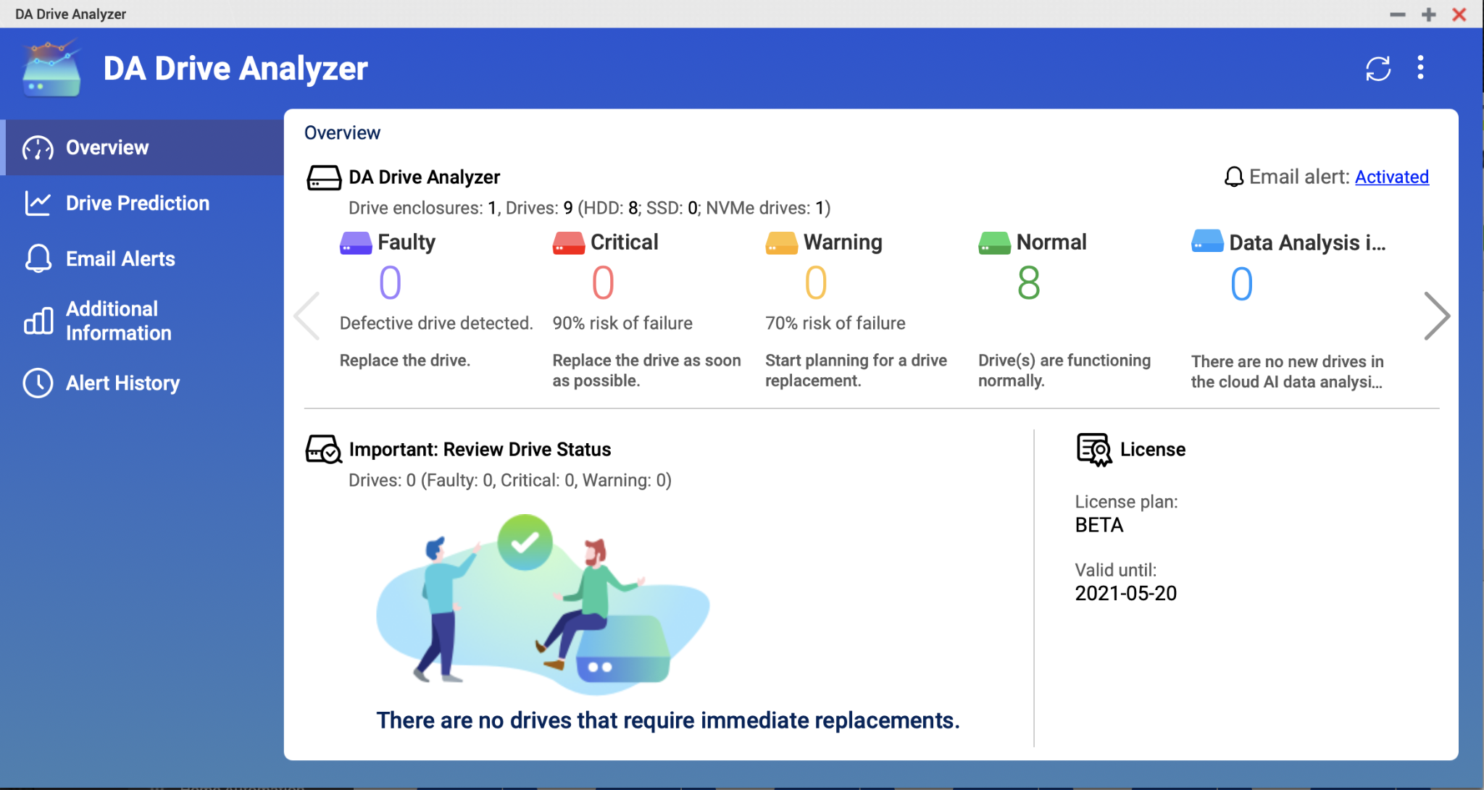
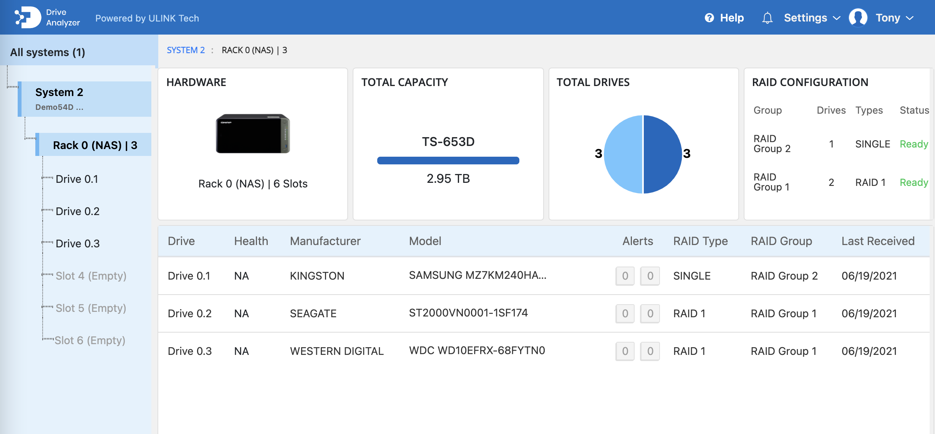
Disk AI
Official release Subscription Workload-based analysis Preventive maintenance replacement

Slide 26
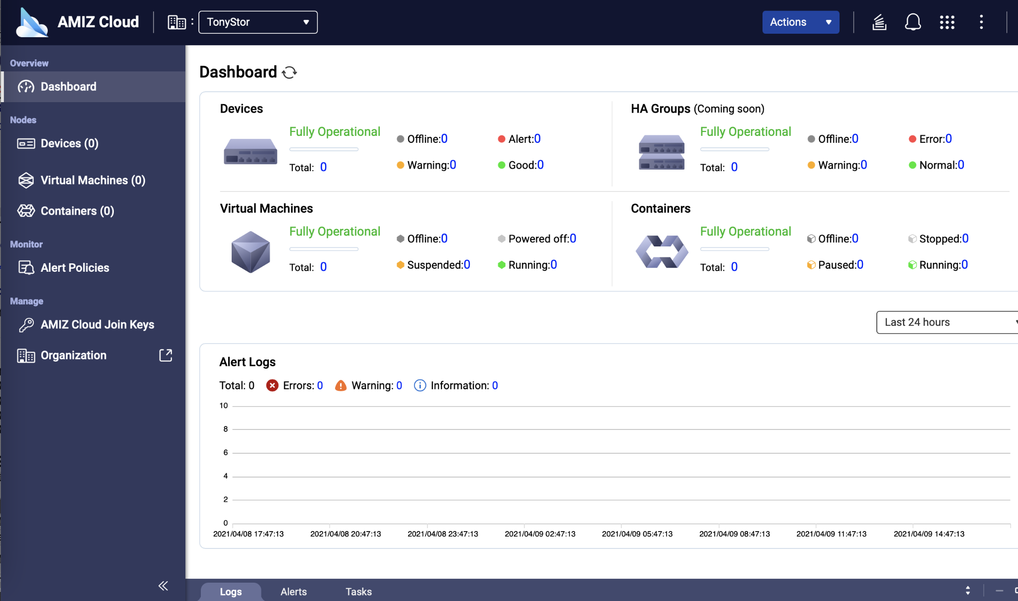
Cloud Central Control, Stay in Control (TBD, RC)
Add NAS to AMIZ Cloud Central Control and stay on top of NAS status through AMIZ Cloud Services.

Slide 27
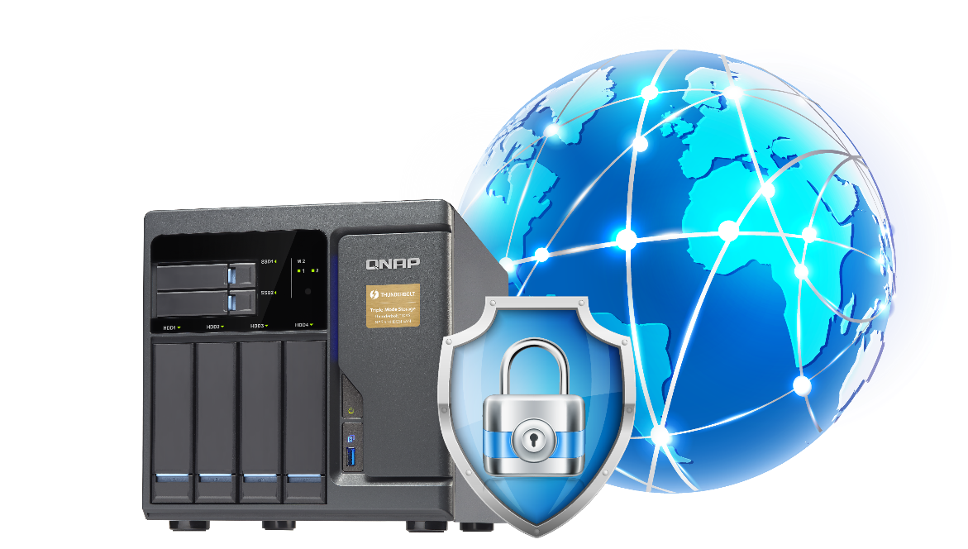
Lighter, faster VPN services
The new QVPN's WireGuard VPN, lighter, easier to set up, supports a variety of platforms, speed greatly improved, is an essential tool for individual users, working from home. Connecting NAS is safer and easier.

Slide 28
QTS 5.0 Beta program
Duration 6/28~7/24
Support models
Known issues
TS-x51D2 (&TS-x51B)
TS-x53D (&TS-x53B)
HS-453DX
TS-x73A (&TS-x73)
TS-451DeU
TS-x83XU
RDMA driver [CX3]
QAT driver
Marvell 1475 driver performance
TS-873A QXG-5G2T-111C Port performance
Partial 3rd-paryt Apps

Slide 29
Copyright© 2021 QNAP Systems, Inc. All rights reserved. QNAP® and other names of QNAP Products are proprietary marks or registered trademarks of QNAP Systems, Inc. Other products and company names mentioned herein are trademarks of their respective holders.​​​​​​​​​

