Slide 2
The demand of network speed is getting higher at home or office

Slide 3
Faster network speed is necessary for large data size files transferred
Network efficiency will get worse without high network speed if file sizes getting larger.

Slide 4
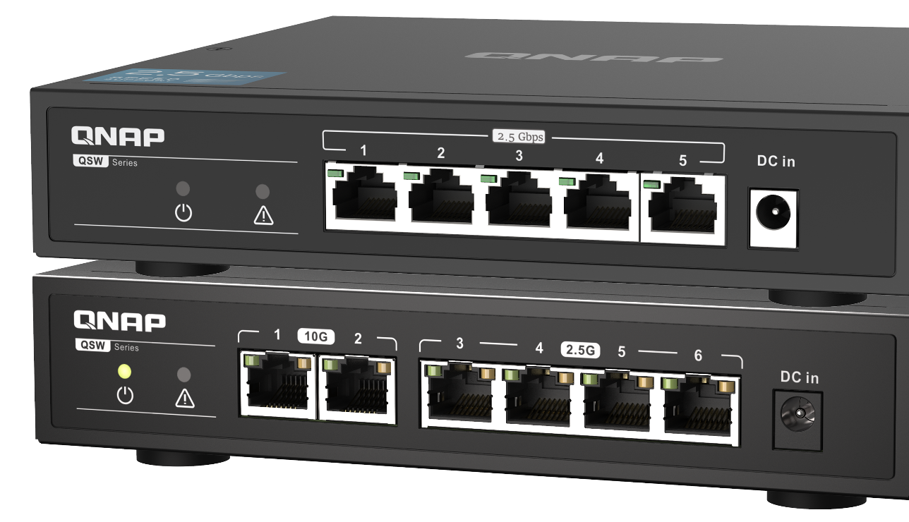
Cat5e cable can be used directly for 2.5GbE network speed
Don’t need to worry about change the cables
 | CAT 5e | CAT 6 | CAT 6A
100M | V | V | V
1G | V | V | V
2.5G | V | V | V
5G | V | V | V
10G | X | V (55m) | V
QSW-1105-5T
QSW-2104-2T
QSW-2104-2S

Slide 5
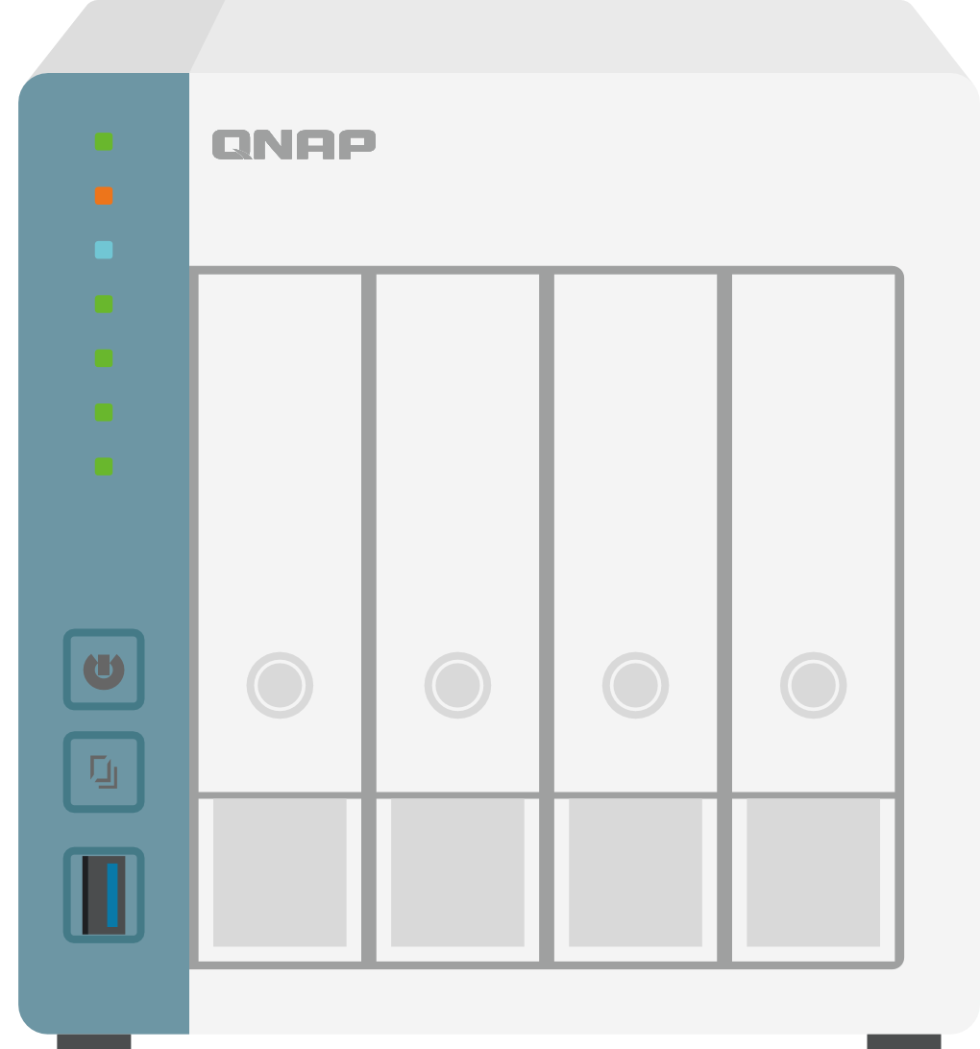
Getting faster without getting more expensive, why don’t you upgrade to 2.5GbE?
1GbE
TV
Slow…….
8K Full HD video
2.5GbE
TV
YA! that’s what I talking about.
8K Full HD video

Slide 6
The profolio of QNAP 2.5GbE switch for current
QSW-M2108 Series
Managed
QSW-M2108-2S
QSW-M2108-2C
QSW-M2108R-2C
QSW-2104 Series
Unmanaged
QSW-2104-2S
QSW-2104-2T
QSW-1105-5T
2.5GbE+10GbE
Full 2.5GbE

Slide 7
Why we also need 10GbE on the 2.5GbE switch?

Slide 8
Can fully upgrade our backbone network speed!
10GbE lead transmit to next level
Transfer duration
10GbE
43 Sec
50G
Blue-ray video
1GbE
429 Sec
100
200
300
400

Slide 9
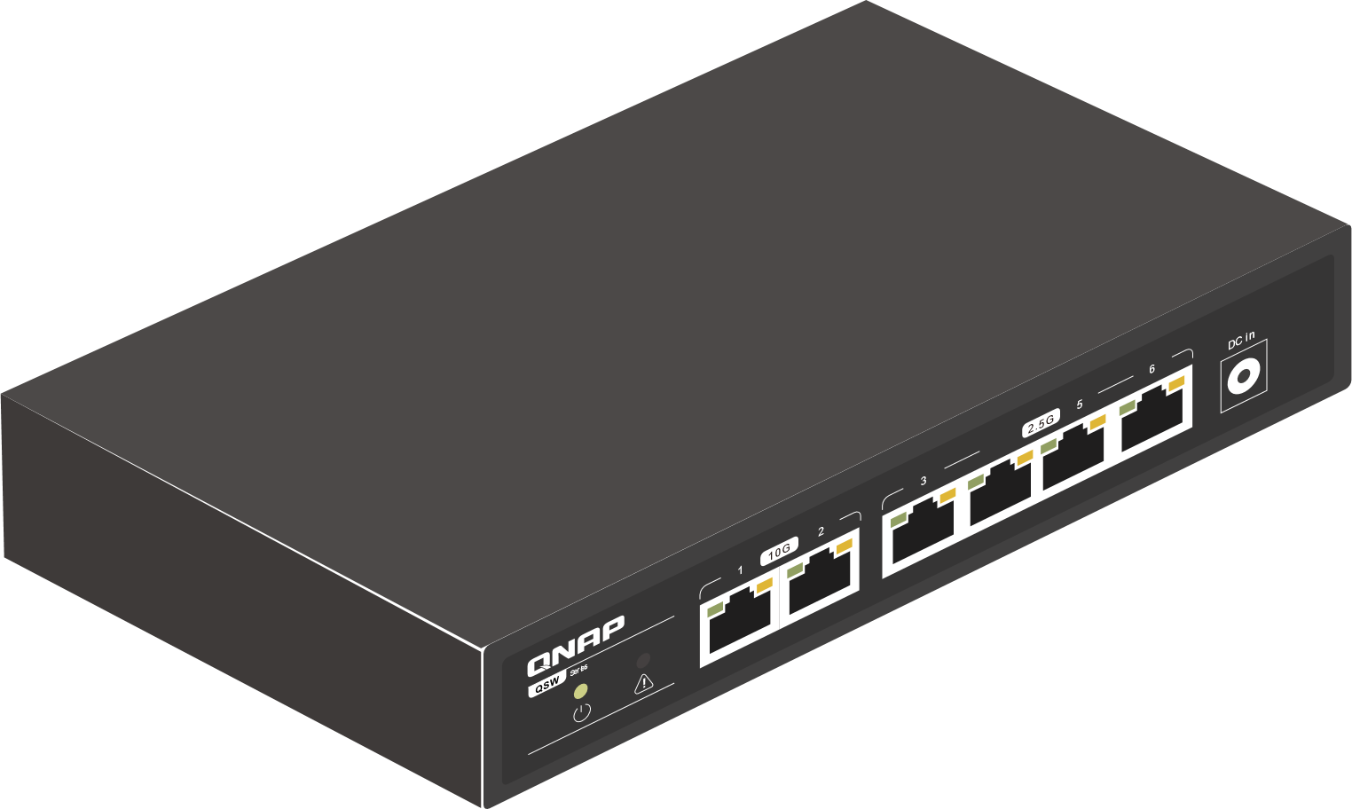
SOHO/SMB need to have 10GbE backbone
Edge speed can upgrade from 1GbE to 2.5GbE
Uplink goes to 10GbE
Upgrade backbone to 10GbE
Connected 10GbE NAS to extend 10GbE port
Plug and play
10GbE
2.5GbE
Internet

Slide 10
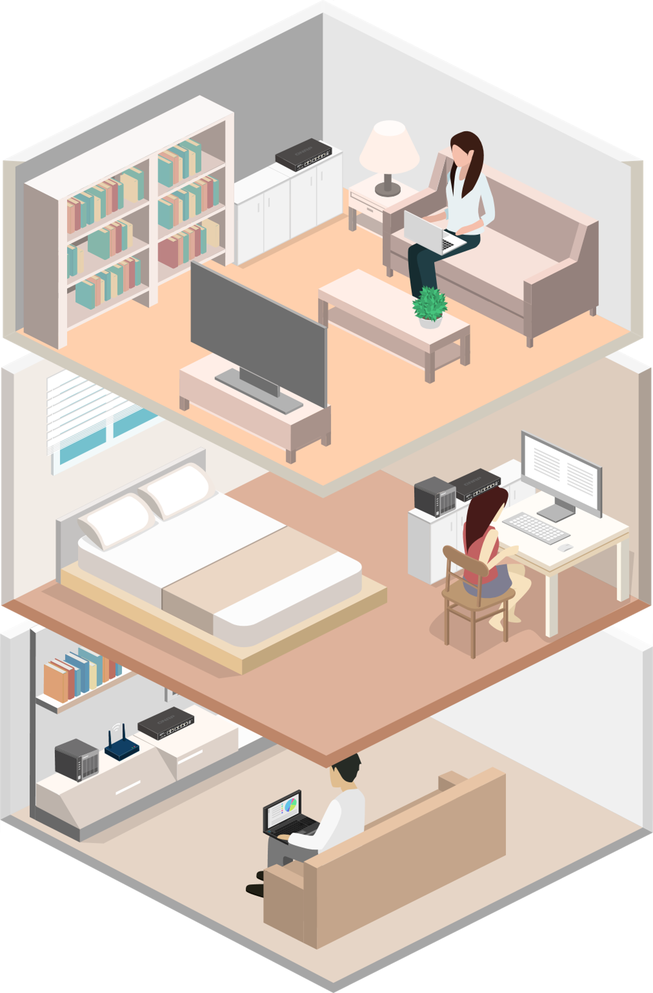
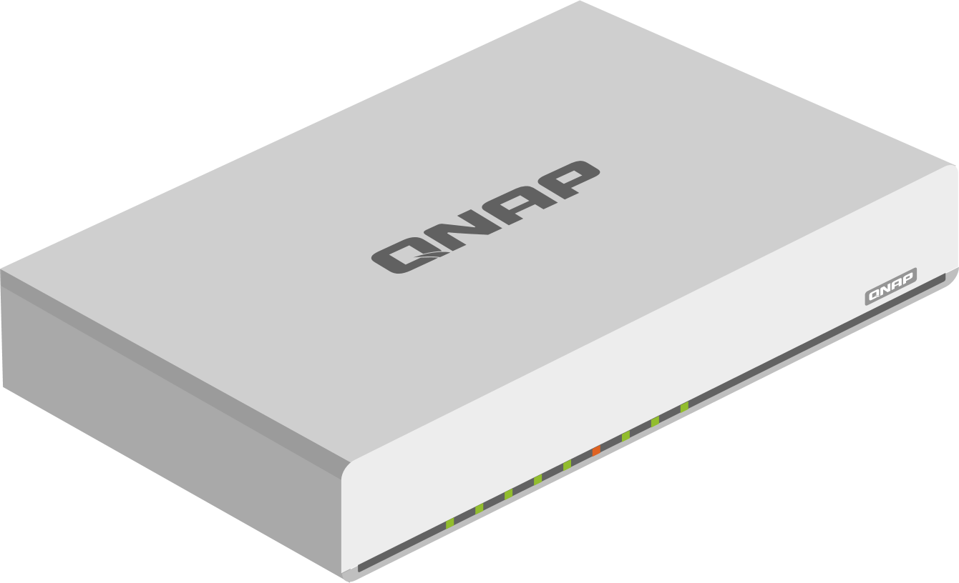
Upgrade your home backbone to 10GbE
Edge speed can upgrade from 1GbE to 2.5GbE
10GbE NAS or PC can connect and enjoy high network speed
In series of QSW-2104 increased the connection to edge devices
Plug and play
Compact housing let you can put into distribute box at home easily
3F
2F
1F
10GbE
QHora-301W
2.5GbE

Slide 11
How do we choose the unmanaged 2.5GbE solutions?

Slide 12
The number of network devices is not so much and neither have 10GbE demanded
Can use QSW-1105-5T already on the market
QSW-1105-5T

Slide 13
With 10G​bE demanded or multiple QSW usaged
QSW-2104 series will be your best choice
1GbE-->2.5GbE and 10GbE
Two connector options of 10GbE, RJ45 and SFP+
Unmanaged
QSW-2104-2S
QSW-2104-2T

Slide 14
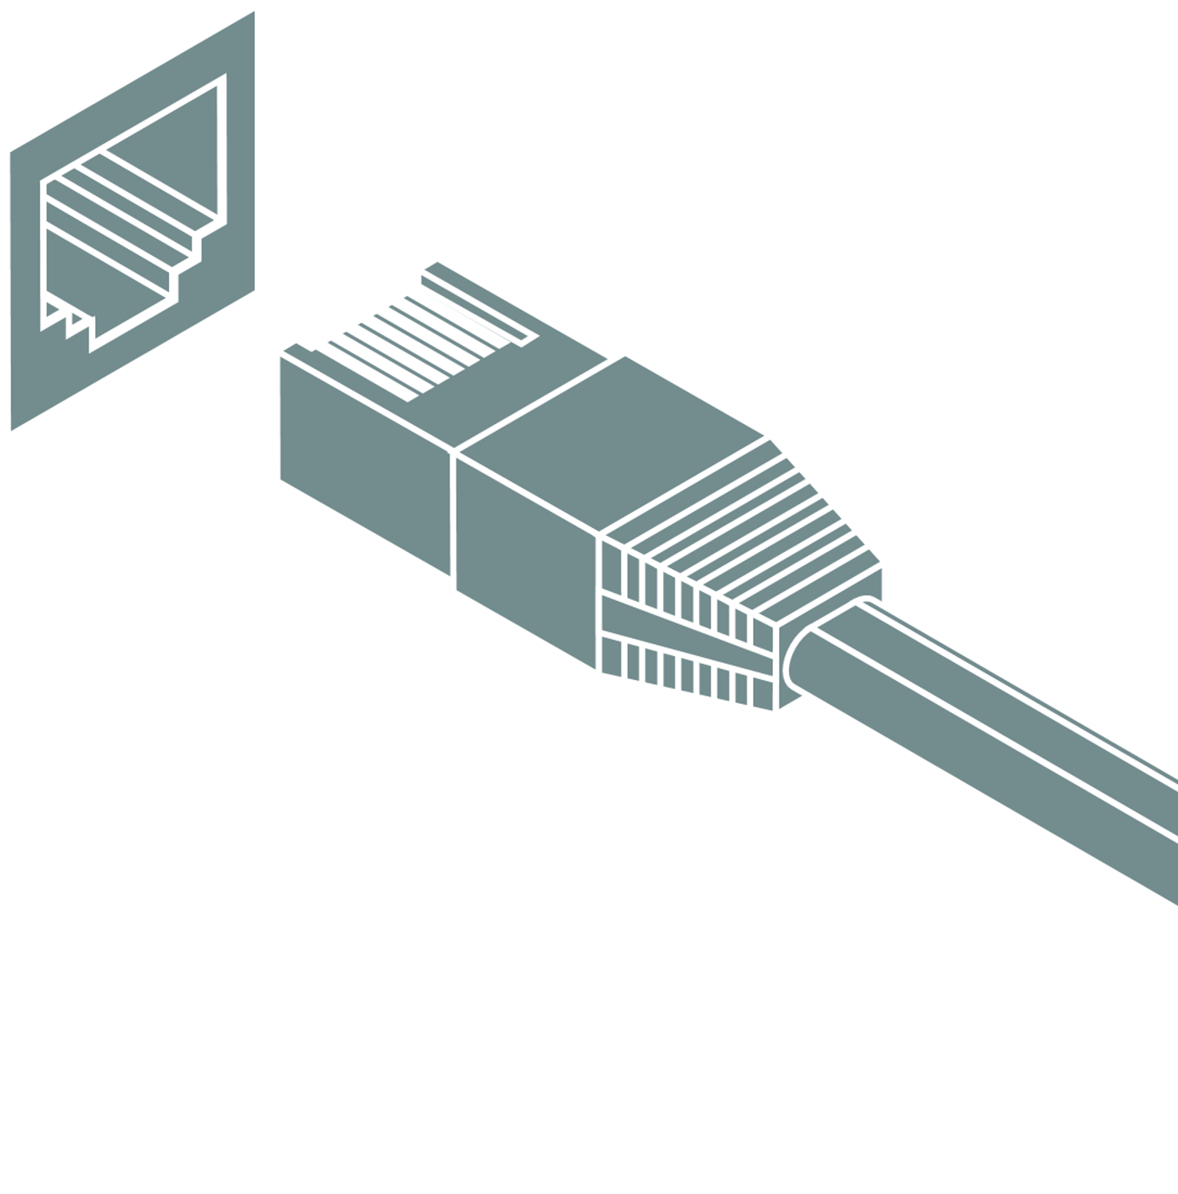
QSW-2104 series easily brings you upgrade to 2.5GbE and 10GbE at the same time
Have 2.5GbE and 10GbE at the same time
Two kind of connector options for 10GbE
Plug and play without any configurations

Slide 15
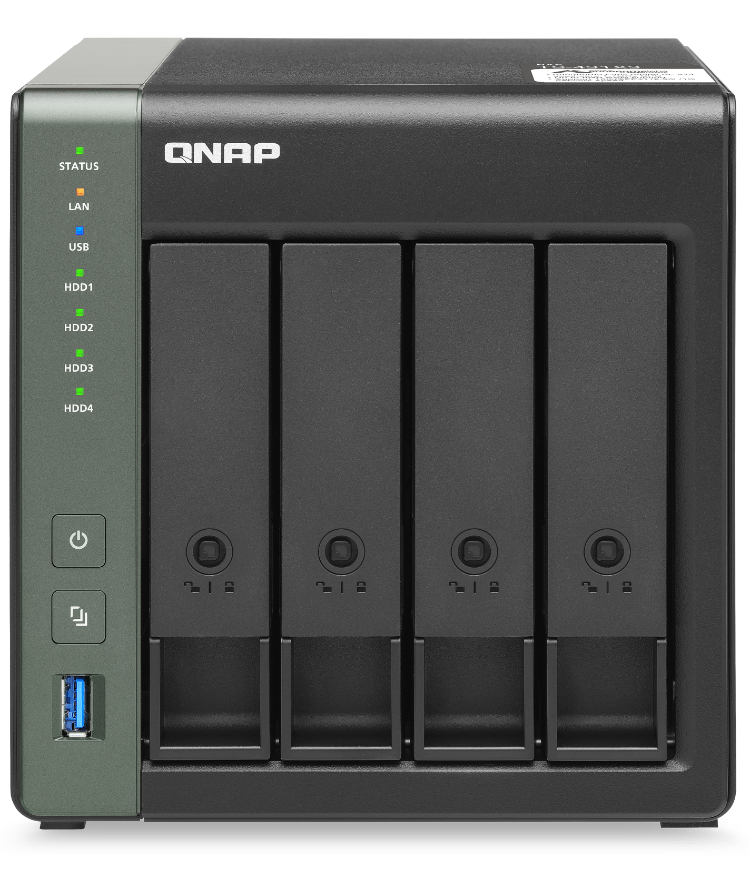
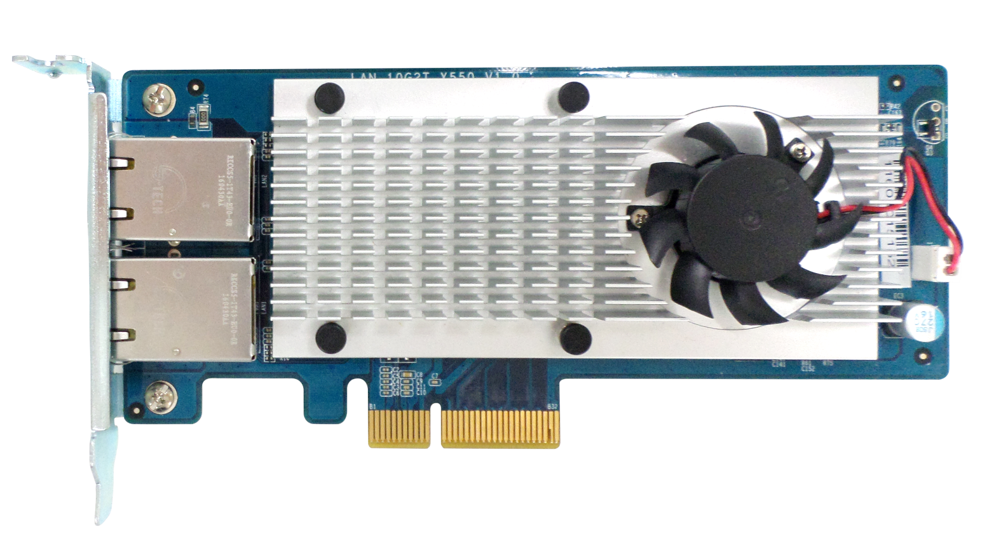
To go with these 10GbE devices
QNAP 10GbE Router QHora-301W
QNAP 10GbE NAS
QNAP 10GbE NIC

Slide 16
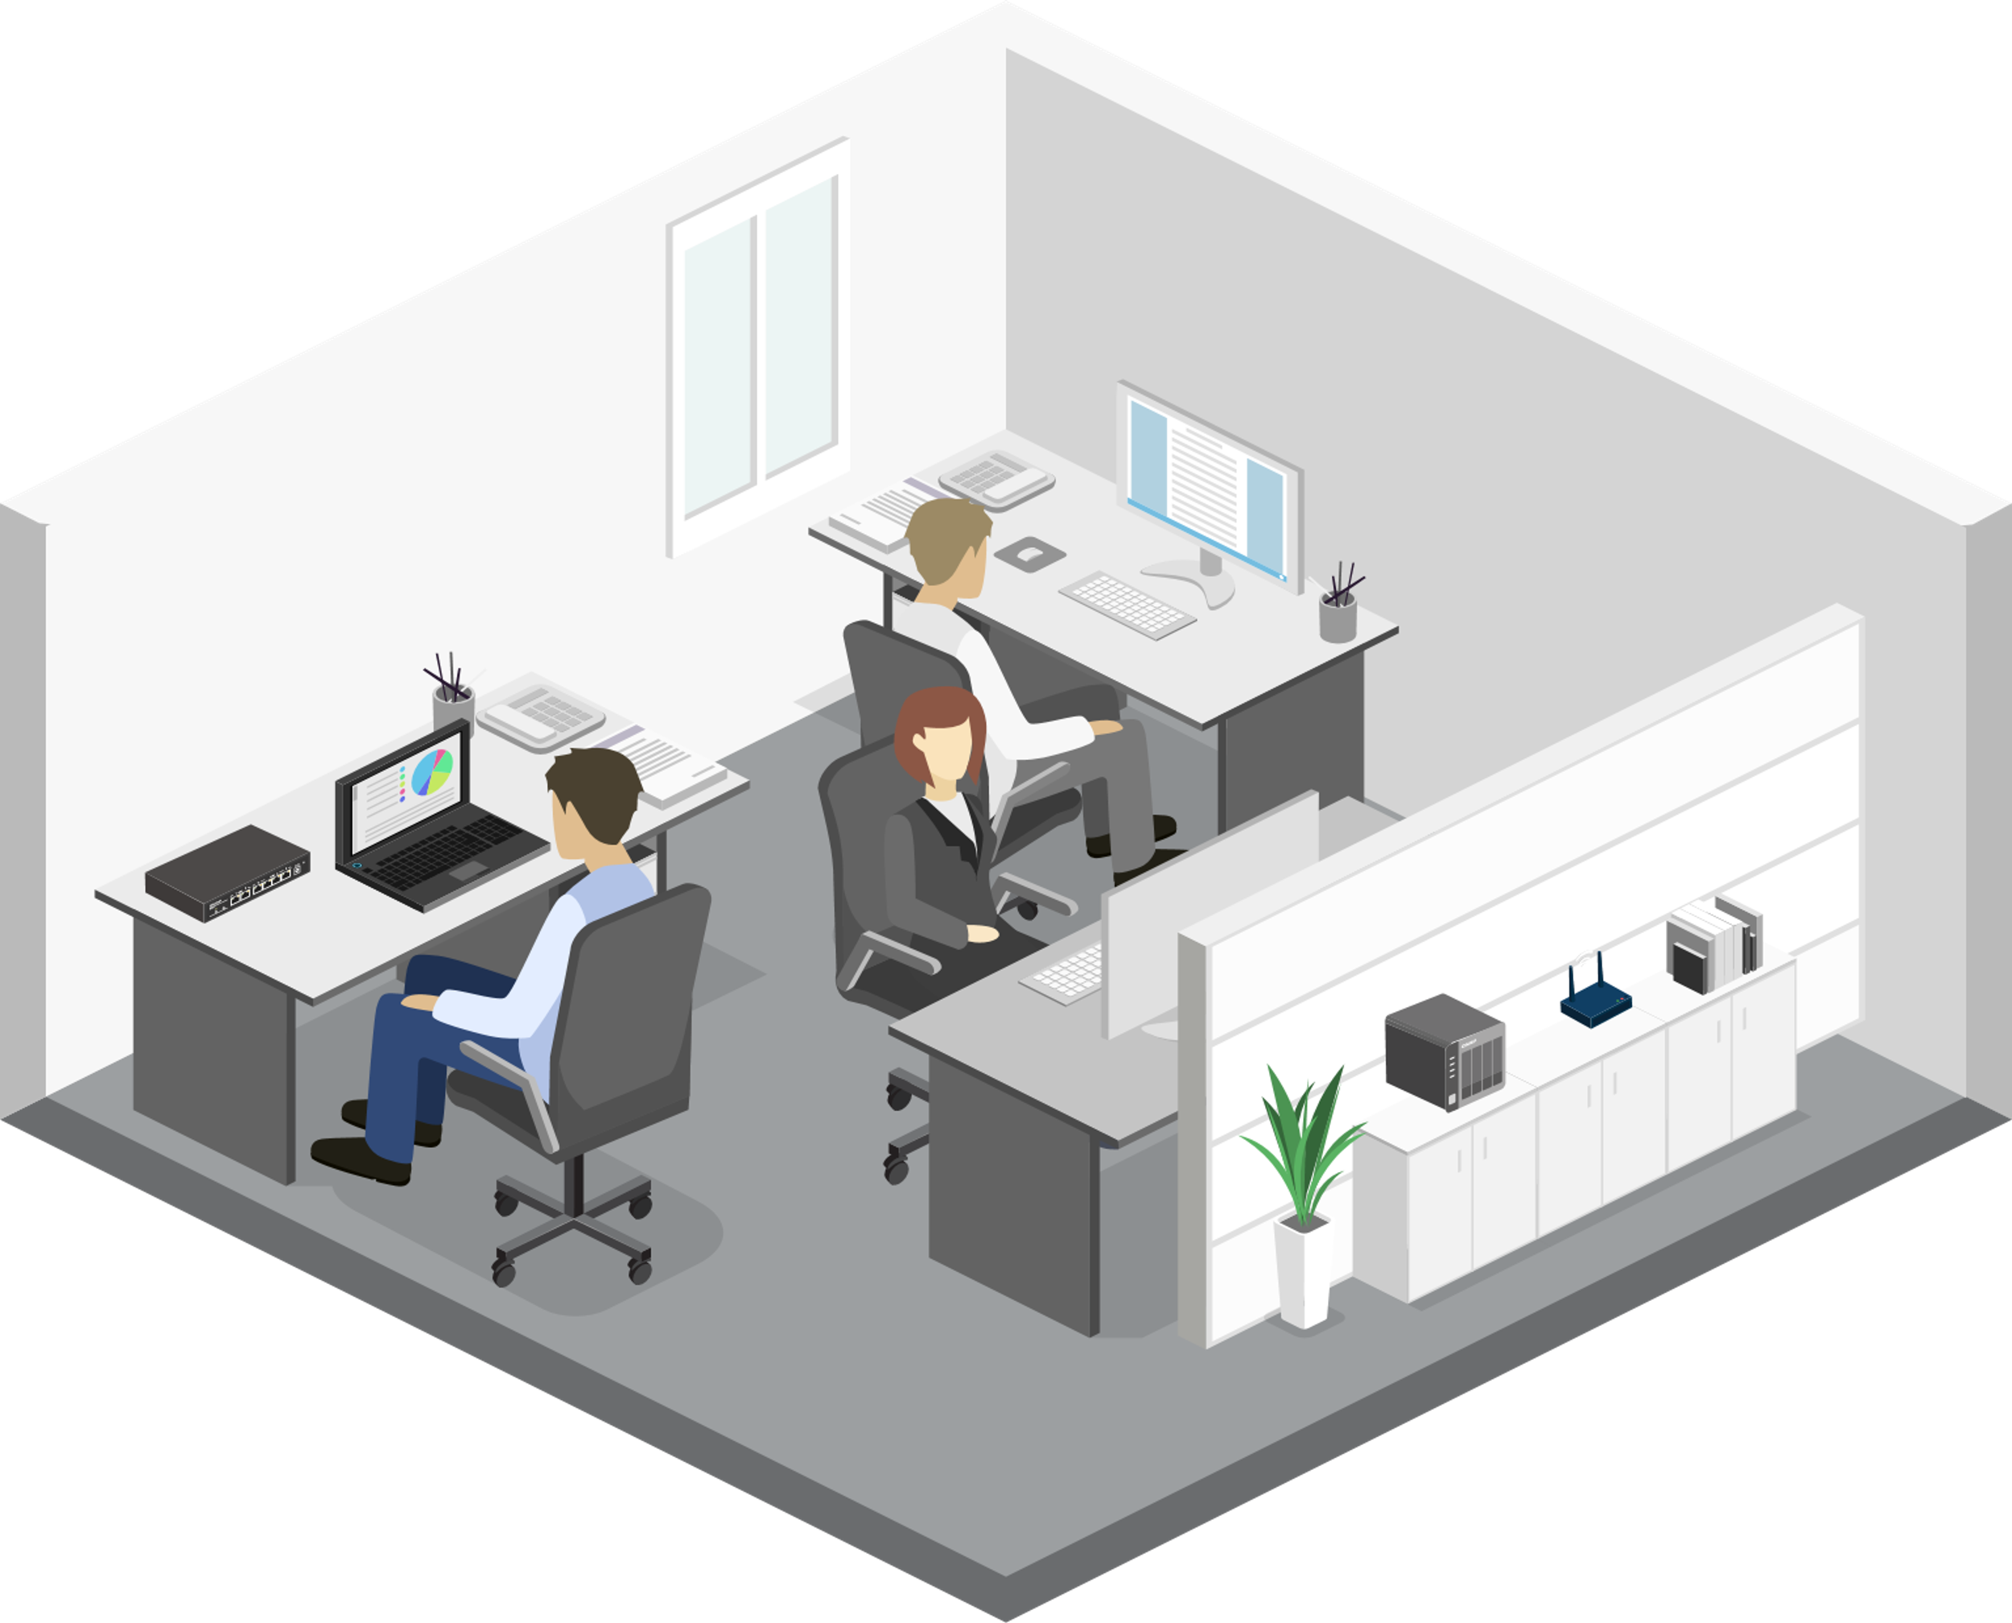
Single QSW-2104 in SOHO/SMB network
Edge speed can upgrade from 1GbE to 2.5GbE
Uplink goes to 10GbE
Connected 10GbE NAS to extend 10GbE port
Plug and play
Internet
10GbE
2.5GbE

Slide 17
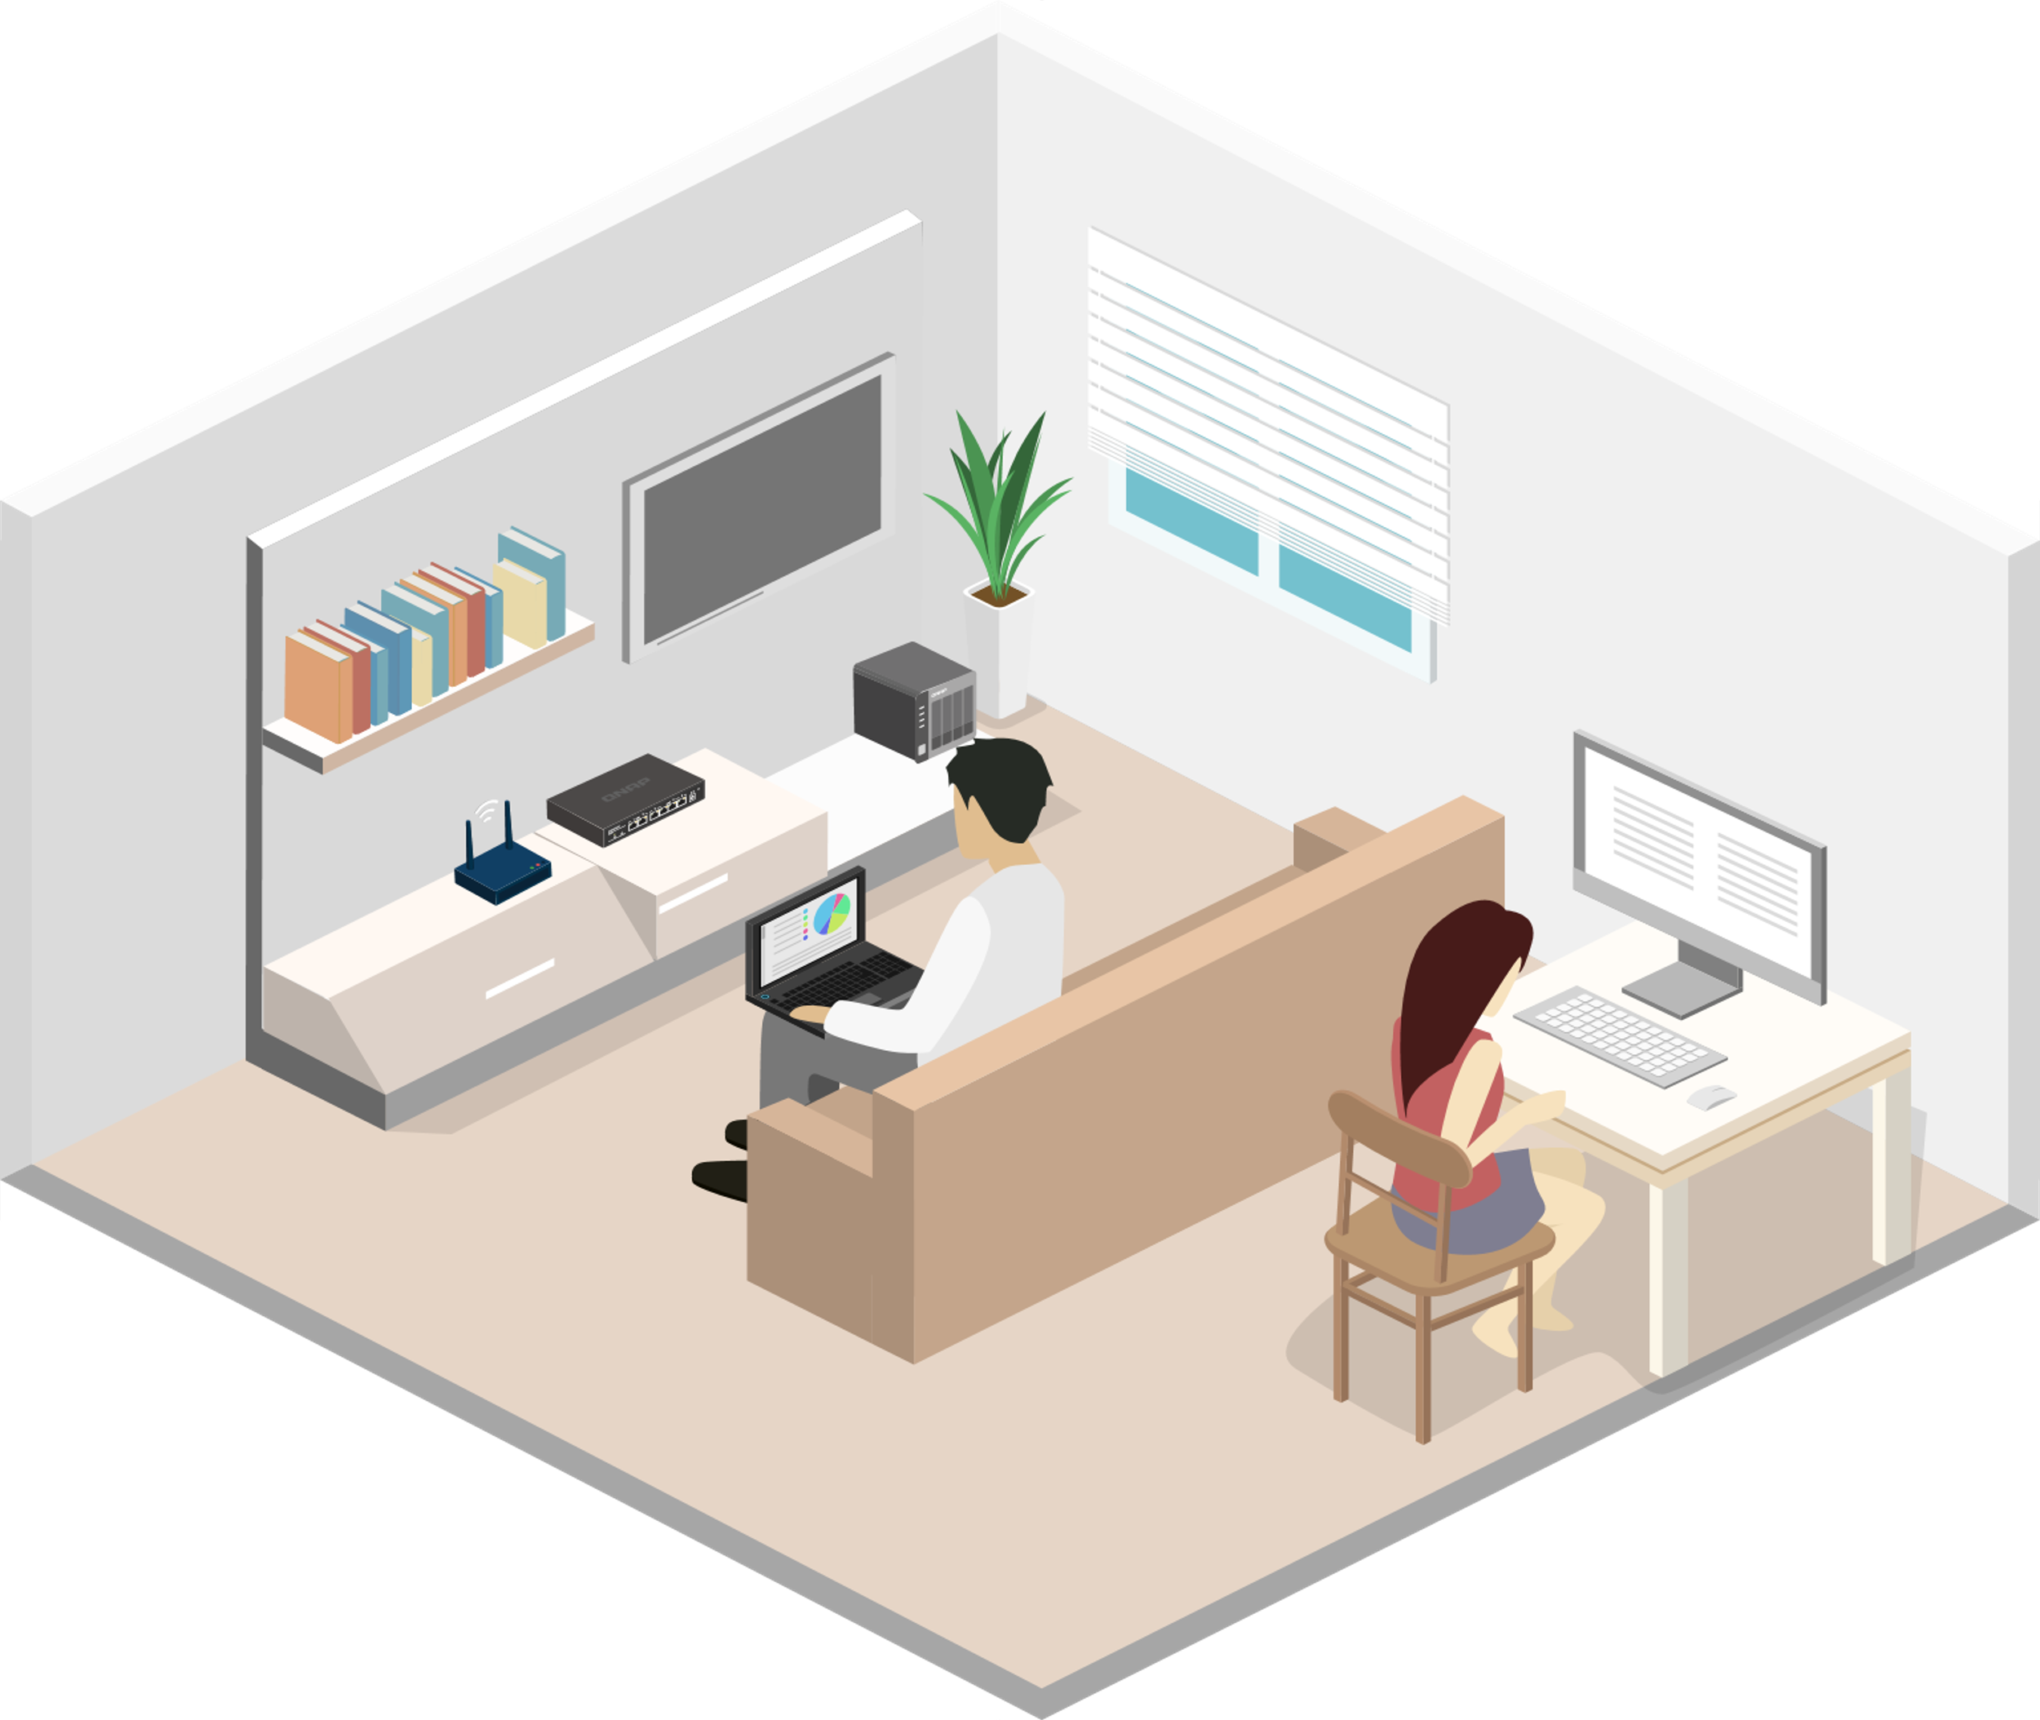
Single QSW-2104 in at home
Edge speed can upgrade from 1GbE to 2.5GbE
10GbE NAS or PC can connect and enjoy high network speed
Plug and play
Compact housing let you can put into distribute box at home easily
QHora-301W
10GbE
2.5GbE

Slide 18
HW spec

Slide 19
HW comparism
 | QSW-2104-2S | QSW-2104-2T | QSW-1105-5T
2.5GbE RJ45 | 4 | 4 | 5
10GbE SFP+ | 2 | - | -
10GbE RJ45 | - | 2 | -
Fan | Fan less | Fan less | Fan less
Loop detection | Yes | Yes | Yes

Slide 20
QSW-2104-2S HW Panel
Status LED
Loop indicator
10GbE SFP+ ports
2.5GbE RJ45

Slide 21
QSW-2104-2T HW Panel
Status LED
Loop indicator
10GbE RJ45 ports
2.5GbE RJ45

Slide 22
Fan less design, without noising
Desktop with fan less presenting high quality of housing design
Enjoy the relax at home without any noise

Slide 23
QSW-2104 have more

Slide 24
Loop is not going happen on QSW-2104
HW loop guard helps to do that, and it is usually supported on high level managed switch

Slide 25
Plug and play without any configurations
Any one can set it up

Slide 26
Perfect with QNAP high network speed solution

Slide 27
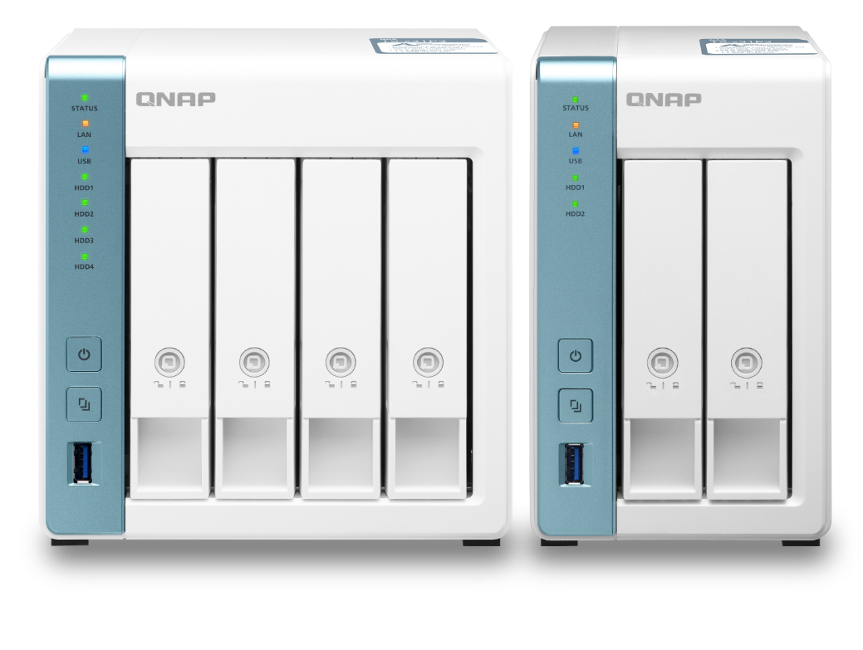
QNAP 2.5GbE teams give you perfect experience of high speed network
Digital home with high quality of streaming
Professional high efficiency network storage
Intel Celeron J4125 4 cores 2.0GHz, 2 x 2.5GbE,
PCIe extend M.2 NVMe/ SATA SSD or 10GbE
Annapurna Labs AL-314 4 cores 1.7GHz, 1 x 10GbE SFP+, 1 x 2.5GbE
Annapurna Labs AL-314
4 cores 1.7GHz, 1 x 2.5GbE
TS-653D
TS-453D
TS-253D
TS-431X3
TS-231P3
TS-431P3

Slide 28
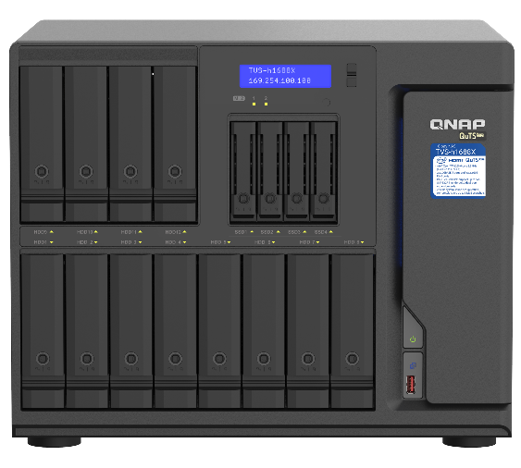
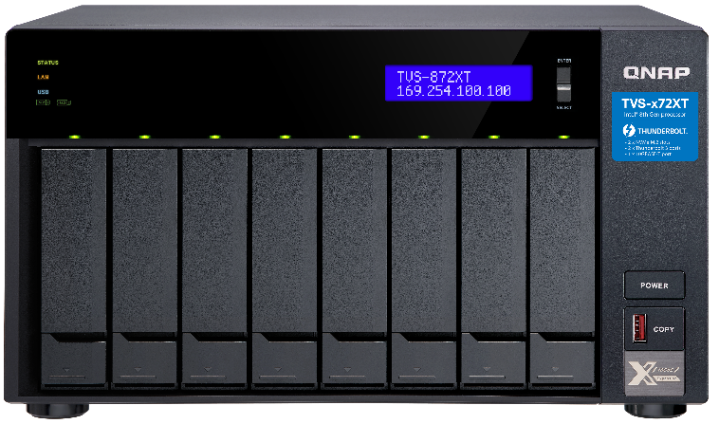
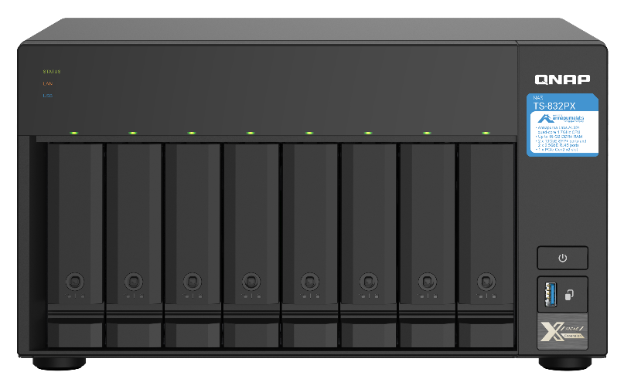
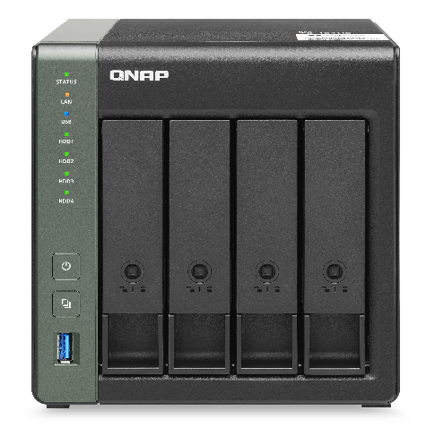
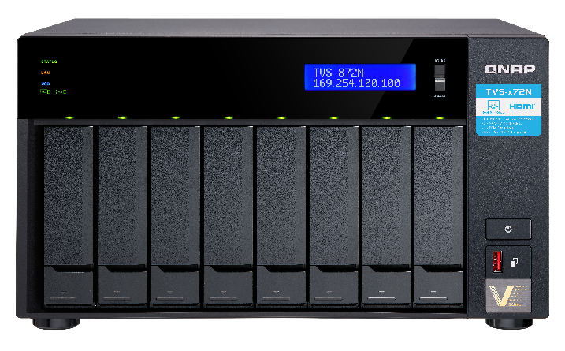
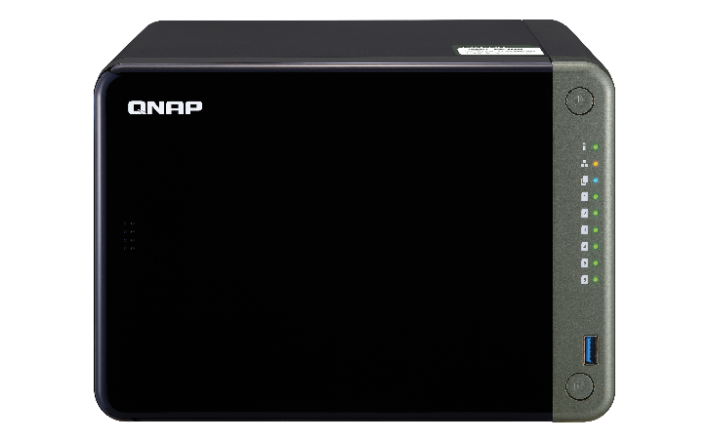
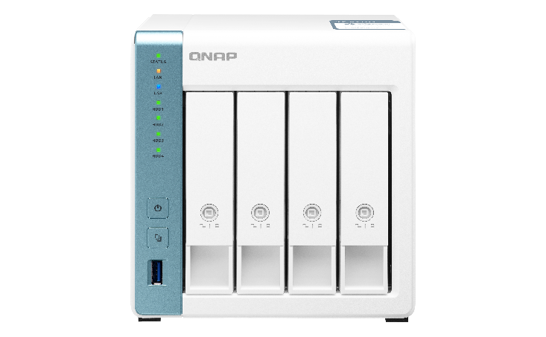
Embedded 2.5/5/10GbE desktop NAS
With 10GbE BASE-T
｜
With 10GbE SFP+
TVS-h1688X /TVS-h1288X
TVS-872XT / TVS-672XT / TVS-472XT
TS-832PX
TS-431X3
10GbE + 2.5GbE
With 5GbE BASE-T
With 2.5GbE BASE-T
TVS-872N / TVS-672N
TS-h886 / TS-h686
TS-653D / TS-453D / TS-253D
TS-431P3 / TS-231P3

Slide 29
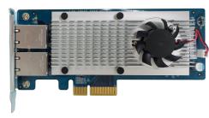
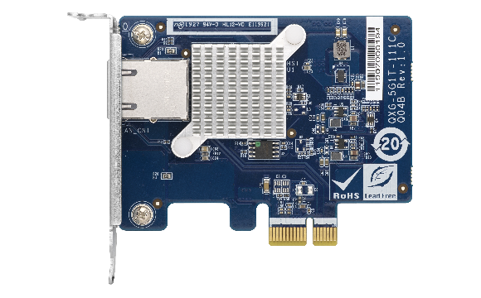
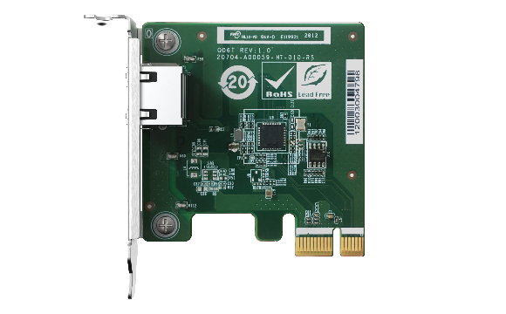
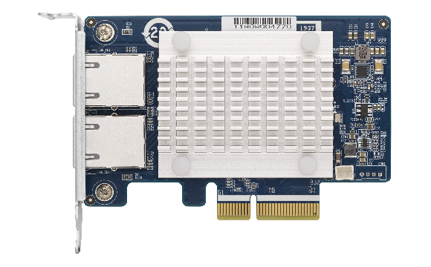
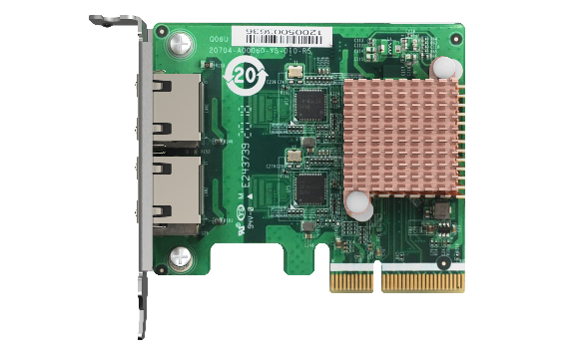
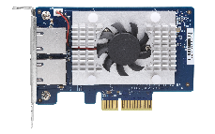
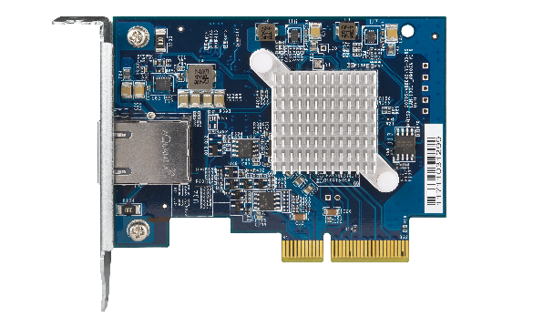
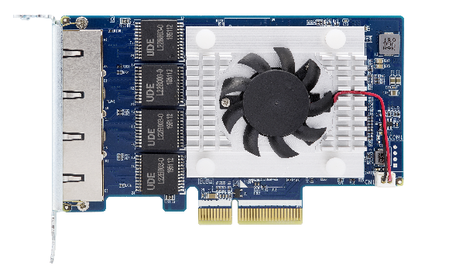
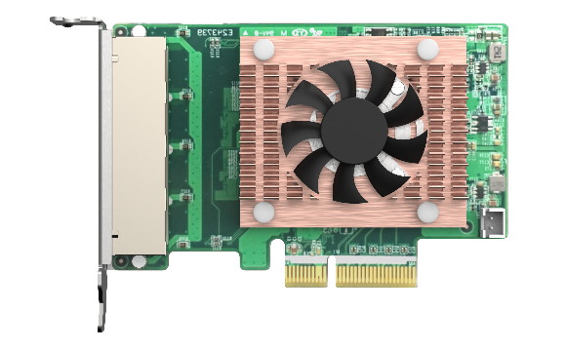
Network extend：rich PCIe extension card
10GbE network extension card
5GbE series
2.5GbE series
QXG-10G2SF-CX4
LAN-10G2T-X550
QXG-5G Family
QXG-2.5G Family
1 x RJ45
1 x RJ45
2 x SFP+
2 x RJ45
2 x
RJ45
2 x
RJ45
QXG-10G2T-107
QXG-10G1T
4 x
RJ45
4 x
RJ45
2 x RJ45
1 x RJ45

Slide 30
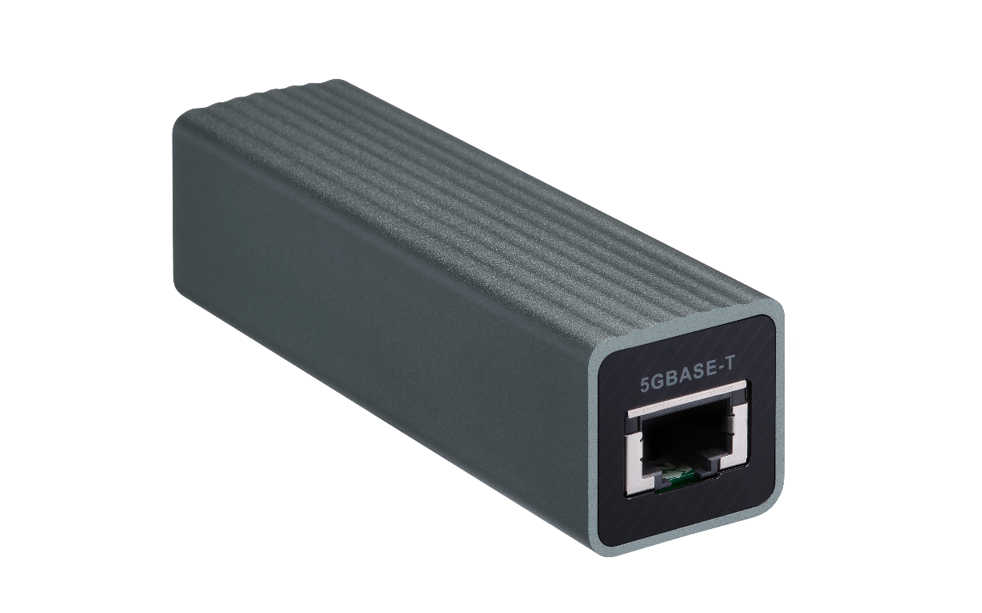
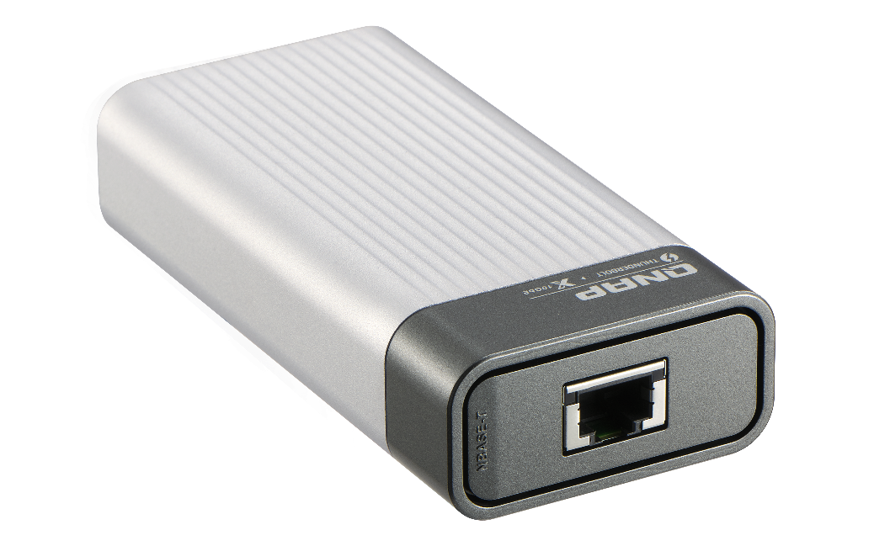
Network extend ：Portable network extension card
QNA-UC5G1T
QNA-T310G1T
USB 3.2 Gen 1
Thunderbolt 3
RJ45 NBASE-T
4 speed: 5G/2.5G/1G/100M
10GbE NBASE-T port
5 speed: 10G/5G/2.5G/1G/100M
Upgrade your laptop or PC to 10GbE with portable USB dongle by using Thunderbolt
Upgrade your laptop or PC to 5GbE with portable USB dongle
https://www.qnap.com/en/product/qna-uc5g1t
https://www.qnap.com/en/product/qna-tb-10gbe
Notes:
QSW-308

Slide 31
Copyright © 2021 QNAP Systems, Inc. All rights reserved. QNAP® and other names of QNAP Products are proprietary marks or registered trademarks of QNAP Systems, Inc. Other products and company names mentioned herein are trademarks of their respective holders.

