Slide 2
Build your 10G environment with NEW QNAP NIC

Slide 3
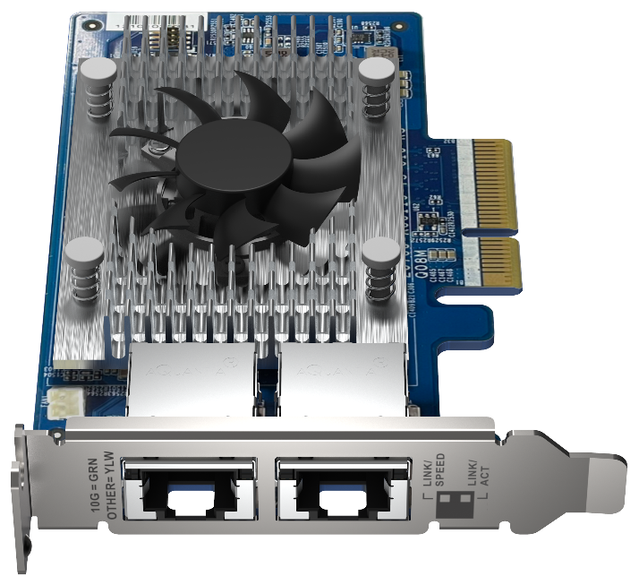
QNAP New 10GbE Network Interface Card QXG-10G2T-X710
QXG-10G2T-X710
Dual-port 10GbE BASE-T low profile NIC
Intel
Ethernet Controller 700
2 x RJ45 10GBASE-T
5-speed; 10/5/2.5/1GbE, 100M
SR-IOV
Intel® Data Direct I/O Technology

Slide 4
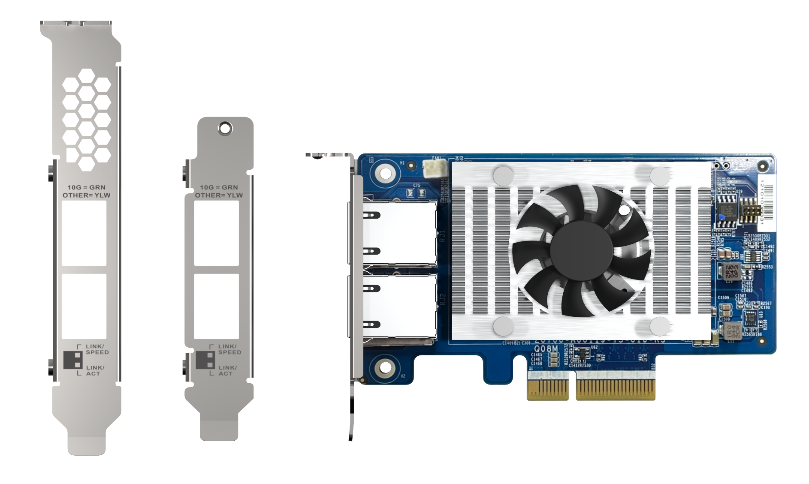
QXG-10G2T-X710 10GbE NIC overview
OK
Dual-port 10GbE (BASE-T) connector
(10/5/2.5/1G,100M)
Heatsink & fan for controller chipset
Pre-install Low profile bracket
include Full height special bracket for selected QNAP NAS
PCIe Gen3 x4 interface

Slide 5
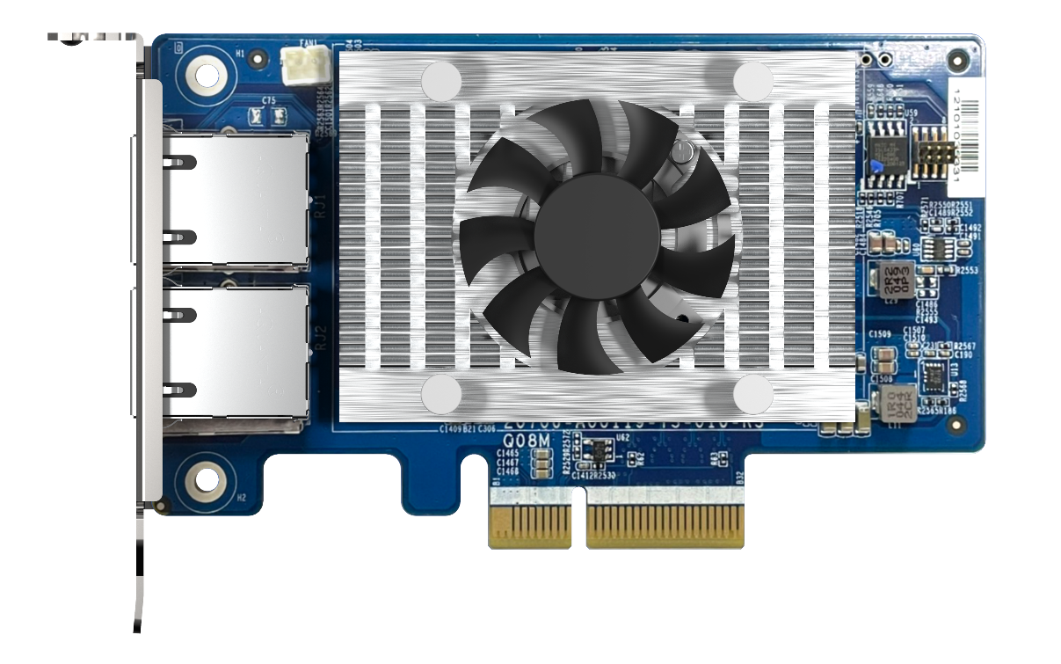
QXG-10G2T-X710 Hardware specification
 | QXG-10G2T-X710
網路控制晶片 | Intel Ethernet Controller 700
傳輸速度 | 10/5/2.5/1GbE, 100M
連接埠 | NBAST-T; RJ45
埠數 | 2
支援 QNAP 作業系統 | QTS 4.5.2 或之後的版本 QuTS hero 4.5.1 或之後的版本
支援其他作業系統 | Windows/Windows Server/Linux
PCIe 介面 | PCI Express 3.0 x4
包裝內容 | 1 x QXG-10G2T-X710 1 x QIG (快速安裝指南) 3 x 擋版 (出貨時預先安裝短擋版於網路擴充卡上)
 | QXG-10G2T-X710
Ethernet Controller | Intel Ethernet Controller 700
Transmission Speed | 10/5/2.5/1GbE, 100M
Connector | NBAST-T; RJ45
Port# | 2
Support QNAP OS | QTS 4.5.2 and later QuTS hero h4.5.1 and later
Support 3rd party OS | Windows/Windows Server/Linux
PCIe interface | PCI Express 3.0 x4
Package content | 1 x QXG-10G2T-X710 1 x QIG (Quick Installation Guide) 3 x brackets (pre-install half-height on NIC when shipping)

Slide 6
SR-IOV advantages and benefits for user
Advantage
Let the services on your virtual machine enjoy the physical network speed.
Benefits
If you need real-time service needs, such as ticket booking service, cash flow service, audio-visual service, you can directly enjoy the speed of the hardware network card, reducing network delay.
Reduce the usage of the host's CPU.
Increase network efficiency by at least 20%.

Slide 7
SR-IOV Support list
SR-IOV support model list and BIOS Version:
TS-h686(Q05SAR01)/TS-h886(Q05SAR01)
TS-1886XU-RP(Q047AR03)/ TS-h1886XU-RP(Q047AR03)
TDS-16489U(QX31AR19)/TDS-16489U-R2(QX31AR19)
QGD-1602P(Q03OAR05)
TS-h2490FU(Q03XAR15)
QAT support model:
QGD-1602P
NICs:
Intel: LAN-10G2T-X550/QXG-100G2SF-E810/QXG-10G2T-X710
Mellanox:LAN-10G2SF-MLX/LAN-40G2SF-MLX
Mellanox:QXG-10G2SF-CX4/QXG-25G2SF-CX4/QXG-25G2SF-CX6

Slide 8
SR-IOV notice
SR-IOV needs to be matched with a supported model, BIOS version and supported network card to support it.
SR-IOV support SW version QTS 4.5.2 & QVS 3.5.3 .
QAT needs to install the corresponding virtual function driver in the Guest OS
*Currently, the downloadable driver version on the official website is Linux and FreeBSD Intel driver download link - https://01.org/intel-quick-assist-technology/downloads
The VM Live Migration function cannot be used when using SR-IOV (Device Passthrough) Because the physical device used by the VM will not recognize the original physical device ID after VM Live migration.

Slide 9
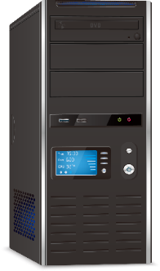
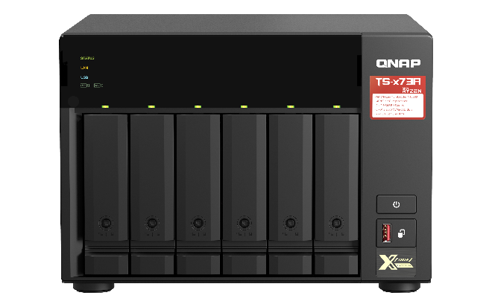
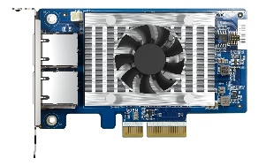
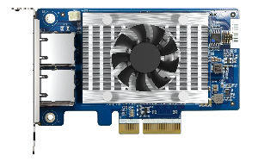
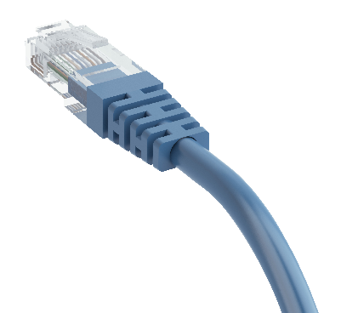
Easily upgrade to 10GbE environment with BASE-T connector
10GBASE-T recommend use CAT 6 cable！
Support Multi-Gigabit
NBASE-T Standard
CAT 5e
1/2.5/5 Gbps
 | CAT 5e | CAT 6 | CAT 6A
100M | V | V | V
1G | V | V | V
2.5G | V | V | V
5G | V | V | V
10G | X | V (55m) | V
TS-x73A
10GbE
NIC
CAT 6
10Gbps
TS-x73A

Slide 10
Build your 10GbE environment easily across multiple Operating System
OK
Download Windows Driver
Download Linux Driver
Ubuntu 18.04 and later
QTS 4.5.2 and later
QuTS hero h4.5.1 and later

Slide 11
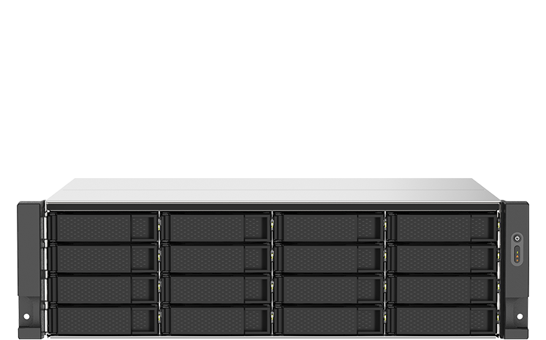
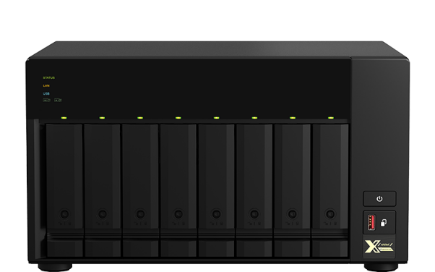
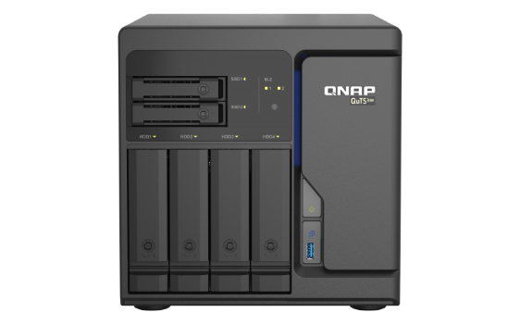
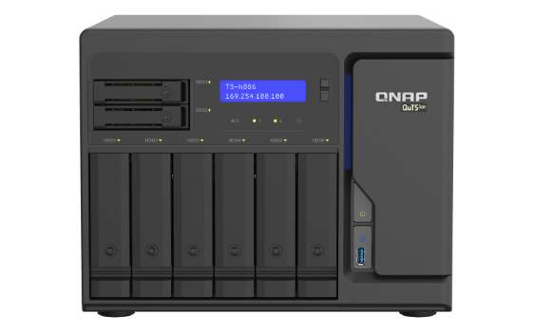
Extend your QNAP NAS with 10GbE NIC
OK
TS-873AU/1273AU/1673AU
TS-473A/673A/873A
TS-h686
TS-h886
AMD Ryzen™ V1500B quad-core
2 x 2.5GbE ports (2.5/1GbE, 100/10M)
AMD Ryzen™ V1500B quad-core
Built in 2.5GbE port
Intel Xeon D series
4 x RJ45 2.5GbE ports
Slot 1: PCIe Gen3 x4
Slot 2: PCIe Gen3 x4
Slot 1: PCIe Gen 3 x4
Slot 2: PCIe Gen 3 x4
Slot 1: PCIe Gen3 x8 Slot 2: PCIe Gen3 x8
*Find out supported QNAP model on our Compatibility list.
Notes:
3088xu 83xu
URL

Slide 12
Up to 1000+MB/s Read/Write performance
PC install QXG-10G2T-X710 transfer file to TS-977
PC spec:
1. CPU: Intel (R) Xeon W
2. OS: Windows Server 2019
3. Memory: 64 GB.
4. 1GbE NIC On board
5. 10GbE NIC: QXG-10G2T-X710
Download:
118MB/s
1GbE
Upload:
118MB/s
Download:
1103MB/s
10GbE
Upload:
1127MB/s
MB/s
Notes:
PC安裝QXG-10G2T-107 透過QSW-1208-8C傳輸10GB檔案至TVS-672N,
CPU: Intel (R) Core(TM) i7-6700 CPU@ 3.40GHz. 2. OS: Windows 10. 3. Memory: 64 GB. 4. 1GbE NIC On board 5. 10GbE NIC: QXG-10G2T-AQC107

Slide 13
LAN-10G2T-X550 vs. QXG-10G2T-X710
 | LAN-10G2T-X550 | QXG-10G2T-X550
PCIe express | Gen3 x4 | Gen3 x4
Ethernet Controller | 500 Series | 500 Series
SR-IOV | Supported | Supported
Power consumption | Higher | Higher
Support Speed | 5-speed; 10/5/2.5/1G, 100M
 | LAN-10G2T-X550 | QXG-10G2T-X710
PCIe express | Gen3 x4 | Gen3 x4
Ethernet Controller | 500 Series | 700 Series
SR-IOV | Supported | Supported
Power consumption | Higher | Lower
Support Speed | 5-speed; 10/5/2.5/1G, 100M | 5-speed; 10/5/2.5/1G, 100M
MB/s
1159
1170
1103
1127
Notes:
PC安裝QXG-10G2T-107 透過QSW-1208-8C傳輸10GB檔案至TVS-672N,
CPU: Intel (R) Core(TM) i7-6700 CPU@ 3.40GHz. 2. OS: Windows 10. 3. Memory: 64 GB. 4. 1GbE NIC On board 5. 10GbE NIC: QXG-10G2T-AQC107

Slide 14
QXG-10G2T-X710 vs. QXG-10G2T-107
 | QXG-10G2T-107 | QXG-10G2T-X550
PCIe express | Gen2 x4 | Gen3 x4
Ethernet Controller | Marvell AQC107 | Intel 700 Series
SR-IOV | Not-supported | Supported
Support OS | Windows 8/10 Linux | Windows 8/10 Windows Server Linux Ubuntu RHEL
Support Speed | 5-speed; 10/5/2.5/1G, 100M
 | QXG-10G2T-107 | QXG-10G2T-X710
PCIe express | Gen2 x4 | Gen3 x4
Ethernet Controller | Marvell AQC107 | Intel 700 Series
SR-IOV | Not-supported | Supported
Support OS | Windows 8/10 Linux | Windows 8/10 Windows Server Linux Ubuntu RHEL
Support Speed | 5-speed; 10/5/2.5/1G, 100M | 5-speed; 10/5/2.5/1G, 100M
MB/s
1103
1127
1134
1157
Notes:
PC安裝QXG-10G2T-107 透過QSW-1208-8C傳輸10GB檔案至TVS-672N,
CPU: Intel (R) Core(TM) i7-6700 CPU@ 3.40GHz. 2. OS: Windows 10. 3. Memory: 64 GB. 4. 1GbE NIC On board 5. 10GbE NIC: QXG-10G2T-AQC107

Slide 15
Windows file transfer – 10GB file

Slide 16
QNAP Multi-Gig NIC, switch and accessories

Slide 17
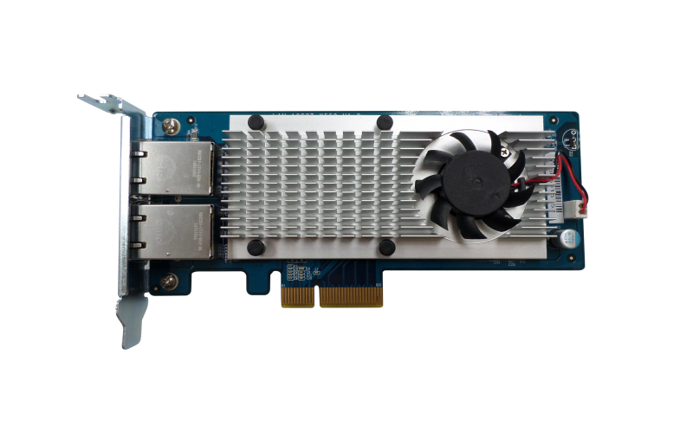
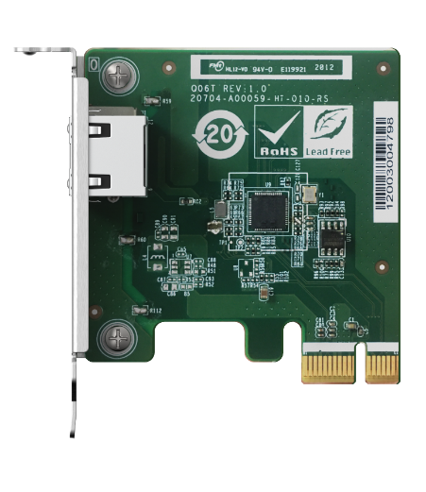
QNAP Multi Gig NICs – Intel
5-speed Multi- Gig
4-speed Multi- Gig
QXG-2G1T-I225
QXG-2G2T-I225
QXG-2G4T-I225
LAN-10G2T-X550
Intel X550
Dual-port 10GbE NBase-T
PCIe Gen3 x4
Low Profile
Intel I225-LM
1/2/4-port 2.5GbE NBase-T
PCIe Gen3x1, Gen3 x2, Gen3 x4
Low Profile
10GbE
2.5GbE

Slide 18
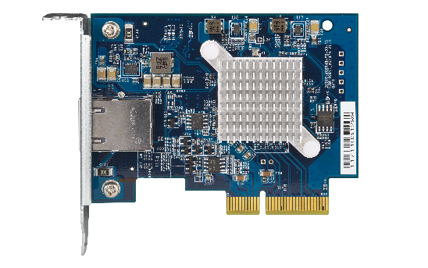
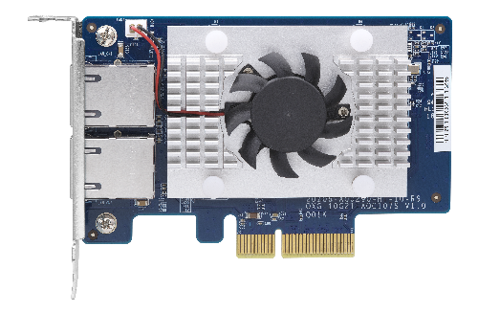
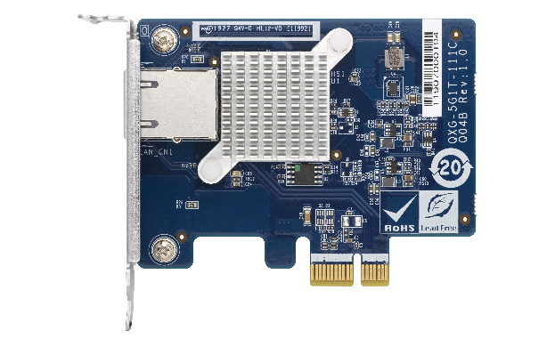
QNAP Multi Gig NICs – Marvell Aqtion
5-speed Multi- Gig
4-speed Multi- Gig
QXG-5G1T-111C
QXG-5G2T-111C
QXG-5G4T-111C
QXG-10G1T
QXG-10G2T-107
AQtion AQC107
Single-port 10GbE NBase-T
PCIe Gen3 x4
Low Profile
AQtion AQC107S
Dual-port 10GbE NBase-T
PCIe Gen2 x4
Low Profile
AQtion AQC111C
1/2/4-port 5GbE NBase-T
PCIe Gen2 x1, Gen3 x2, Gen3 x4
Low Profile
10GbE
5GbE

Slide 19
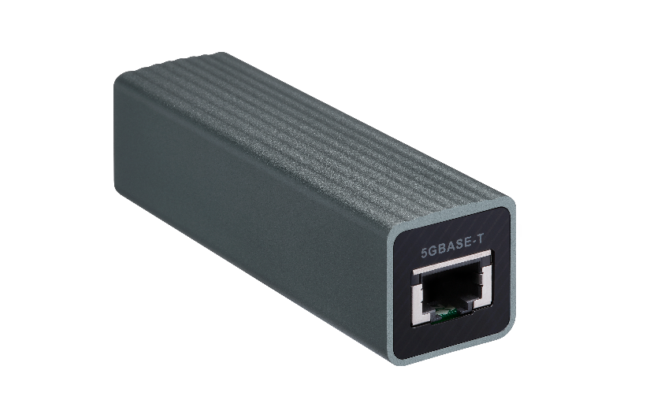
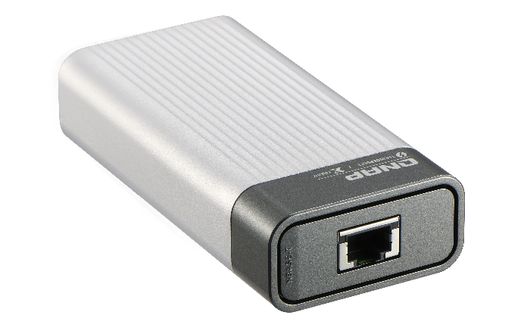
QNAP Multi Gig Accessories
QNA-UC5G1T
QNA-T310G1T
Host with USB 3.2 Gen1
Host with Thunderbolt 3
5G/2.5G/1G/100M 4-speed
RJ45 NBASE-T connector
10G/5G/2.5G/1G/100M 5-speed
RJ45 NBASE-T connector
For PC and laptops, upgrade to 5Gbps ethernet with USB 3.2 Gen 1
For Thunderbolt3 Ｍac/PC upgrade to 10Gbps ethernet easily.
Notes:
QSW-308

Slide 20
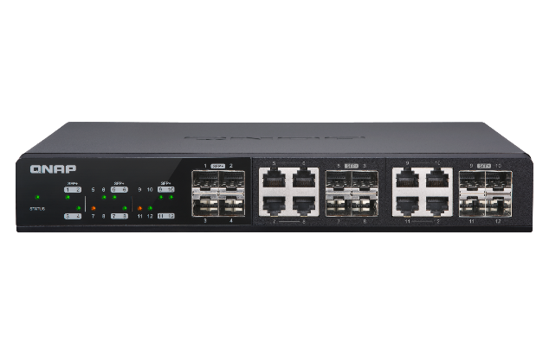
Faster, and faster!
1/2.5GbE switch
1GbE
Cat 5e
1GbE
Cat 5e
TS-x73A
1GbE
Cat 5e
PC+ 10G2T-X710
10GbE
10GbE
10GbE switch
QXG-10G2T-X710
or QNA-T310G1T/1S
Cat 6
10GbE
10GbE
Cat 6
QSW-M1208-8C
Web-management 10GbE switch
10GbE
Cat 6
Upgrade to 10GbE
Upgrade to 10GbE

Slide 21
Build your 10G environment with switch
OK
搭配交換機打造 10GbE 環境

Slide 22
QNAP QSW-M1208 managed 10GE switch for multi-10GbE aggregated multi-user editing
4 x 10GbE SFP+ ports
8 x 10GbE SFP+ & RJ45 Combo ports
QSW-M1208-8C
8 x 10GbE SFP+ ports
4 x 10GbE SFP+ & RJ45 Combo ports
4 x 10GbE SFP+ ports
4 x 10GbE SFP+ & RJ45 Combo ports
QSW-M1204-4C
QSW-M804-4C

Slide 23
QHora-301W
New Generation WiFi 6 and Dual 10GbE SD-WAN Router
Wireless connectivity: support WiFi 6 (802.11ax)
Dual-port 10GbE flexible for WAN/LAN
Optimized Eight omnidirectional internal high gain antenna
Enable subscription-free QNAP SD-WAN on QHora-301W

