Slide 2
Over 300 thousands downloads! What are you waiting for?
In general, QmailAgent is actually pretty good. Both mobile and web version.
I use it on gmail with IMAP, all my IMAP folders and settings are there, I don't feel like I'm missing anything.
Search works fine. It detects attachments fine and shows them in mail list as buttons below mail title - so it's easy to notice and you can for instance do a quick look at a PDF attached.
It integrates with QContacts well.
I’ve now downloaded QmailAgent. It does take a while to sync everything but once that is done, it’s pretty good.
Real comments from Reddit.

Slide 3
We heard your voices!
I want to transfer my mailbox from NAS to NAS.
I want to archive the old emails.
After QmailAgent reinstall, how can I recover my old mail to QmailAgent?

Slide 4
QmailAgent 3.0 for archiving and recovering mails

Slide 5
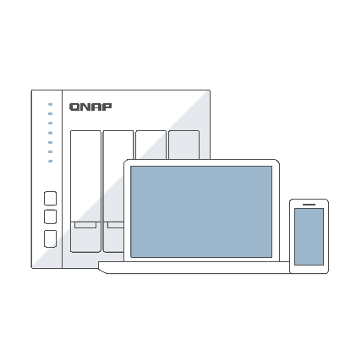
QmailAgent safeguard and manage your mailboxes
Sync
Backup / Restore
Archive / Recover
Backup emails and attachments
...
...
Manage multiple mailboxes
Backup all data in mailboxes
Receive and compose email
Search archived mail
Search email and attachment
Recover from the archives

Slide 6
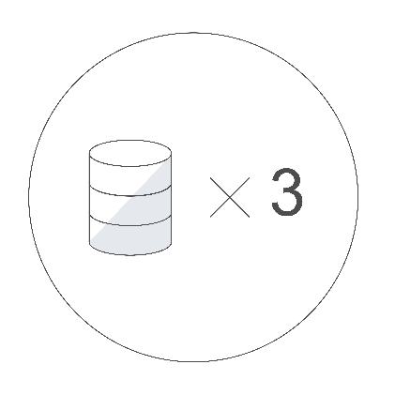
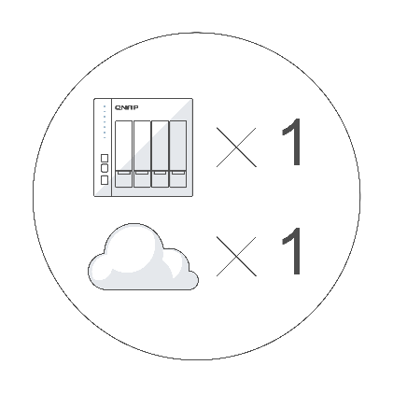
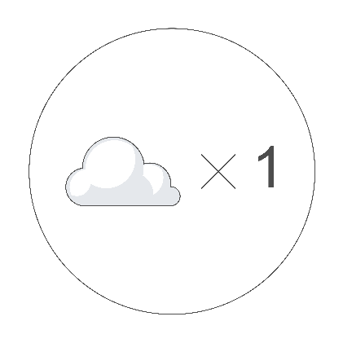
Backup 3-2-1 rule keeps your data safe
With QmailAgent 3.0, archive and backup all mail data to public cloud to realize backup 3-2-1 rule and keep the mail data more secure.
3 copies:
Mail server
NAS
Remote cloud
2 medias:
On-premise NAS
Cloud
1 offsite:
Data in cloud is offsite

Slide 7
Backup all data in mailbox
Securely backup your emails and attachments to the remote cloud with advanced options:
Incremental / Sync backup type
Scheduled backup
Client-side encryption
Data compression
Only “admin” acount can manage the backup/restore job.

Slide 8
Archive mails to public cloud via HybridMount
Install HybridMount, you can archive and backup your mails and attachments to the public cloud.
Cloud Drive
Object Storage
HybridMount
➔ Archive old mails to less expensive cloud storage.

Slide 9
Search archived mails for granular restore
Quickly search the email by keyword and date from the archives.
Select the mails to restore to the NAS or mail server.

Slide 10
Recover mail account from archives
Create the restore job to restore the mail account:
Mailbox’s configuration
Email (All mail or mail in time interval)
Address book

Slide 11
Use Case

Slide 12
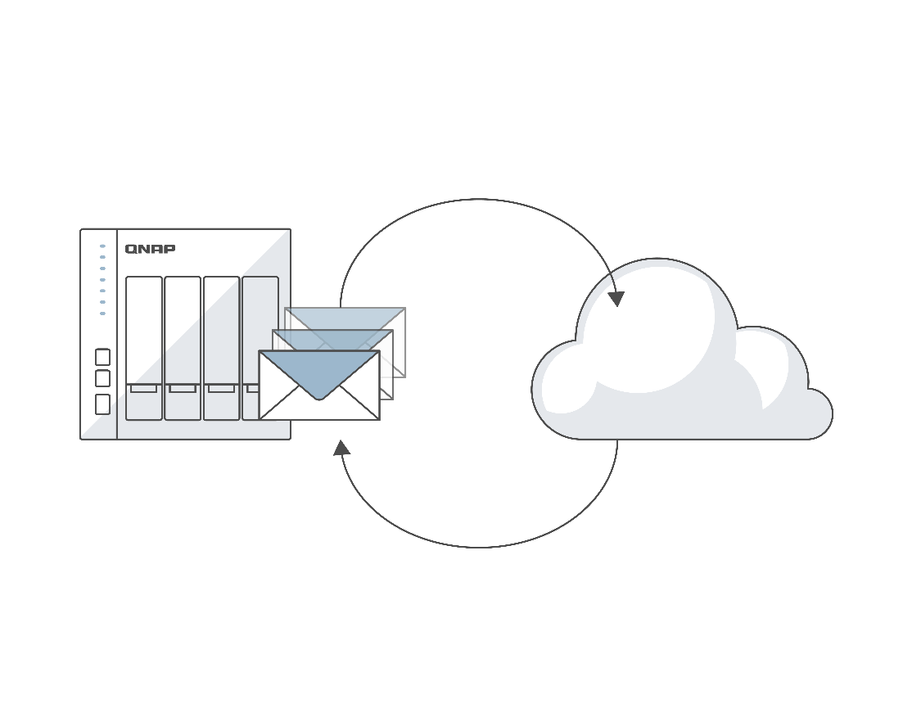
Archive the old mails
When the NAS is out of the space, archive the old mails to the cloud storage. Keep the recent mail in the NAS.
When you need the old mails, it’s easy to search them from the archives and restore them to NAS.
Archive
I want to archive the old emails.
Search and Restore

Slide 13
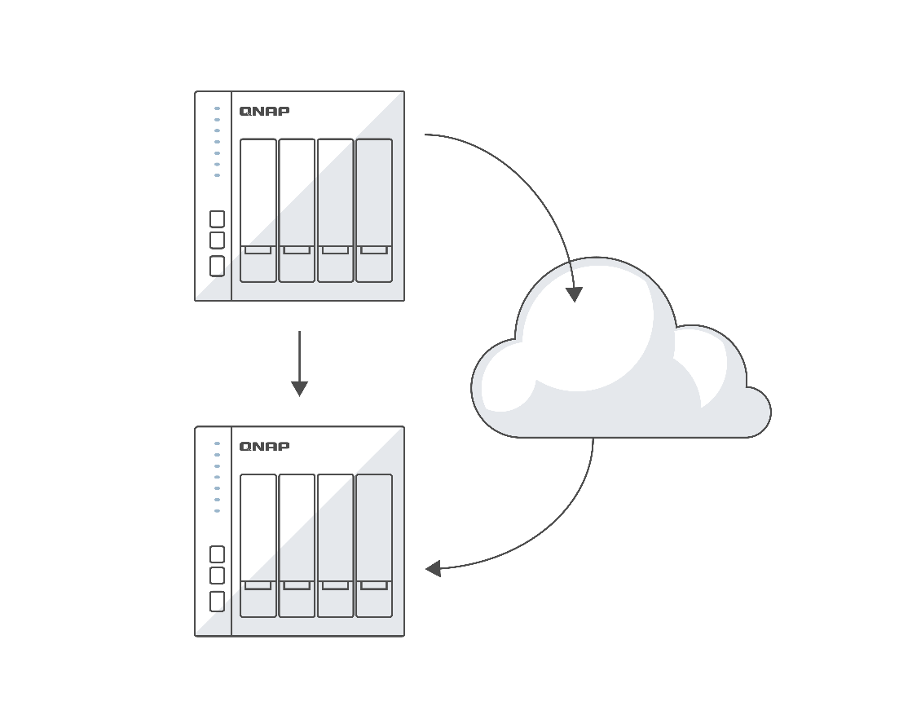
Restore the account when upgrading the NAS
When you upgrade the NAS, you can easily restore all mails from the old NAS to the new NAS.
Backup
After QmailAgent reinstall, how can I recover my old mail to QmailAgent?
Upgrade
Restore
New NAS

Slide 14
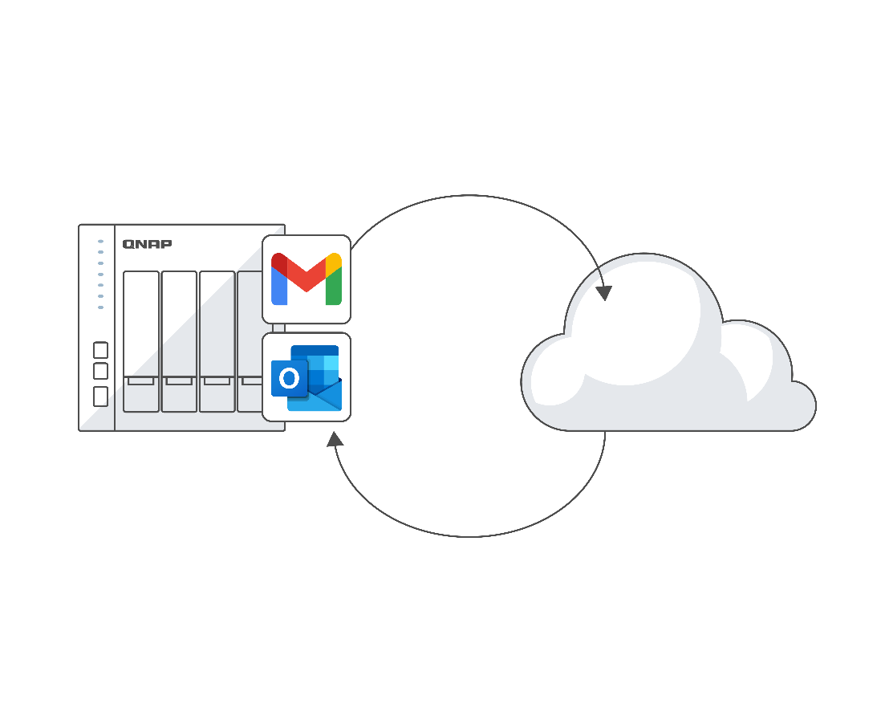
Migrate the mails to another mailbox
When restoring archived mails, you can restore the selected mails to another mail account.
Backup
Restore

Slide 16
QNAP NAS File Services for Gmail add-on
Useful tool

Slide 17
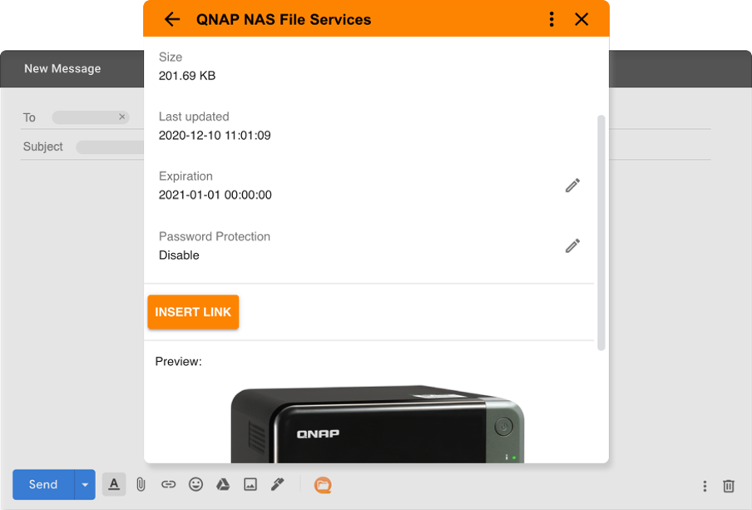
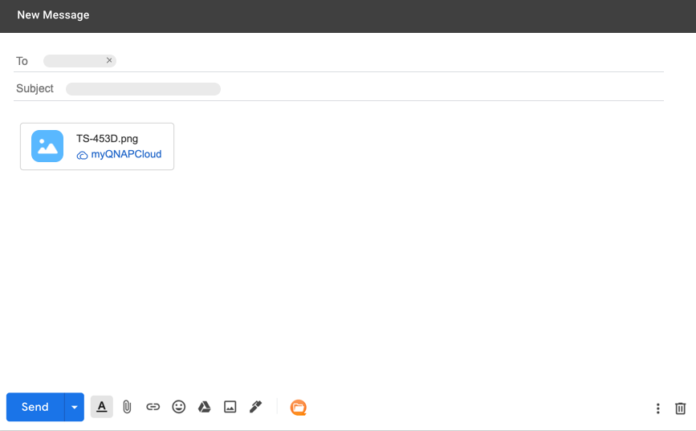
QNAP integrates with your workflow for Gmail
Inserts a NAS file or folder as a share link to your email without leaving Gmail.
Compatible with any browser and Gmail applications for Android and iOS devices.

Slide 18
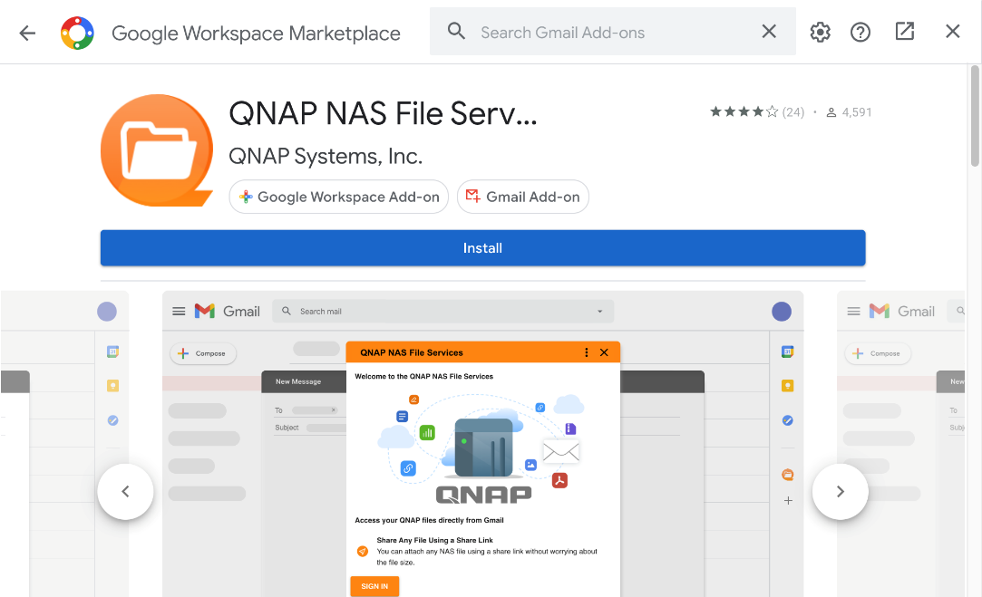
Get the QNAP NAS File Services from Google Workspace marketplace
Click “Get Add-ons”.
Search “QNAP” and install the add-on.

Slide 19
QNAP’s Email Solution
Sync
Backup / Restore
Archive / Recover
...
Backup emails and attachments
...
Manage multiple mailboxes
Backup all data in mailboxes
QNAP NAS File Services for Gmail add-on
Receive and compose email
Search archived mail
Easily attach files from your NAS.
Search email and attachment
Recover from the archives

Slide 20
QmailAgent 3.0 beta program Get the license for free before 2021/5/31
 | Lite | Premium
 | Free | Free Trial Now (~2021/5/31)
Synchronize emails | V | V
Backup and restore emails and attachments | V | V
Archive and backup email accounts, account configurations, and emails to the cloud |  | V
Backup emails to another email account |  | V

