Slide 1
QuWAN vRouter Edition
新增支援 VMware ESXi 虛擬化平台
解決中小企業自動組網、雲端管理以及智慧路由的需求

Slide 2
Overview
Install ＱuWAN vRouter Edition on VMware ESXi
The Market Exclusive Economy SD-WAN Solution
Set up QuWAN vRouter Edition in Five Steps
QuWAN Fulfills The Next Generation Networking Needs
vRouter Edition

Slide 3
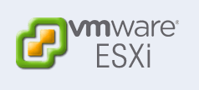
InstallＱuWAN vRouter Edition on VMware ESXi
負擔體
QuWAN vRouter Edition allows you to setup QNAP SD-WAN when there is no QNAP device at hand!
vRouter Edition

Slide 4
QuWAN vRouter Edition is suitable for all environment
Flexible allocation of hardware resources (eg CPU, memory, network ports, etc.)
Different throughput subscription plans.
Device | Environment | Support Form | Setup Method | Subscription
VMware ESXi v7.0 | All | QuWAN vRouter Edition | Join Key and QuWAN vRouter Edition | Subscribe based on required throughput
QHora-301W | SMB Office | Embedded Feature | QuWAN enable page | Subscription-Free
QMiro Series | Home Office | Embedded Feature | QuWAN enable page | Subscription-Free
Guardian Series PoE Switch | Retail Store | QuWAN vRouter | QuWAN Agent | Subscription-Free
QuCPE | Enterprise HQ | QuWAN vRouter | Service Composer | Subscription-Free
NAS | Branch Office | QuWAN vRouter | QuWAN Agent | Subscription-Free

Slide 5
ZTP for Fast Multi-Site Remote Provisioning
Create multiple vRouter devices at QuWAN Orchestrator and email the network setting values to site owner via Join Key in email
Site owner enter Join Key to enable QuWAN vRouter on VMware ESXi.
Taipei
vRouter A Join Key
Japan
vRouter B Join Key
vRouter C Join Key
Singapore

Slide 6
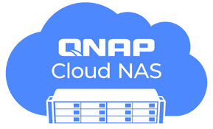
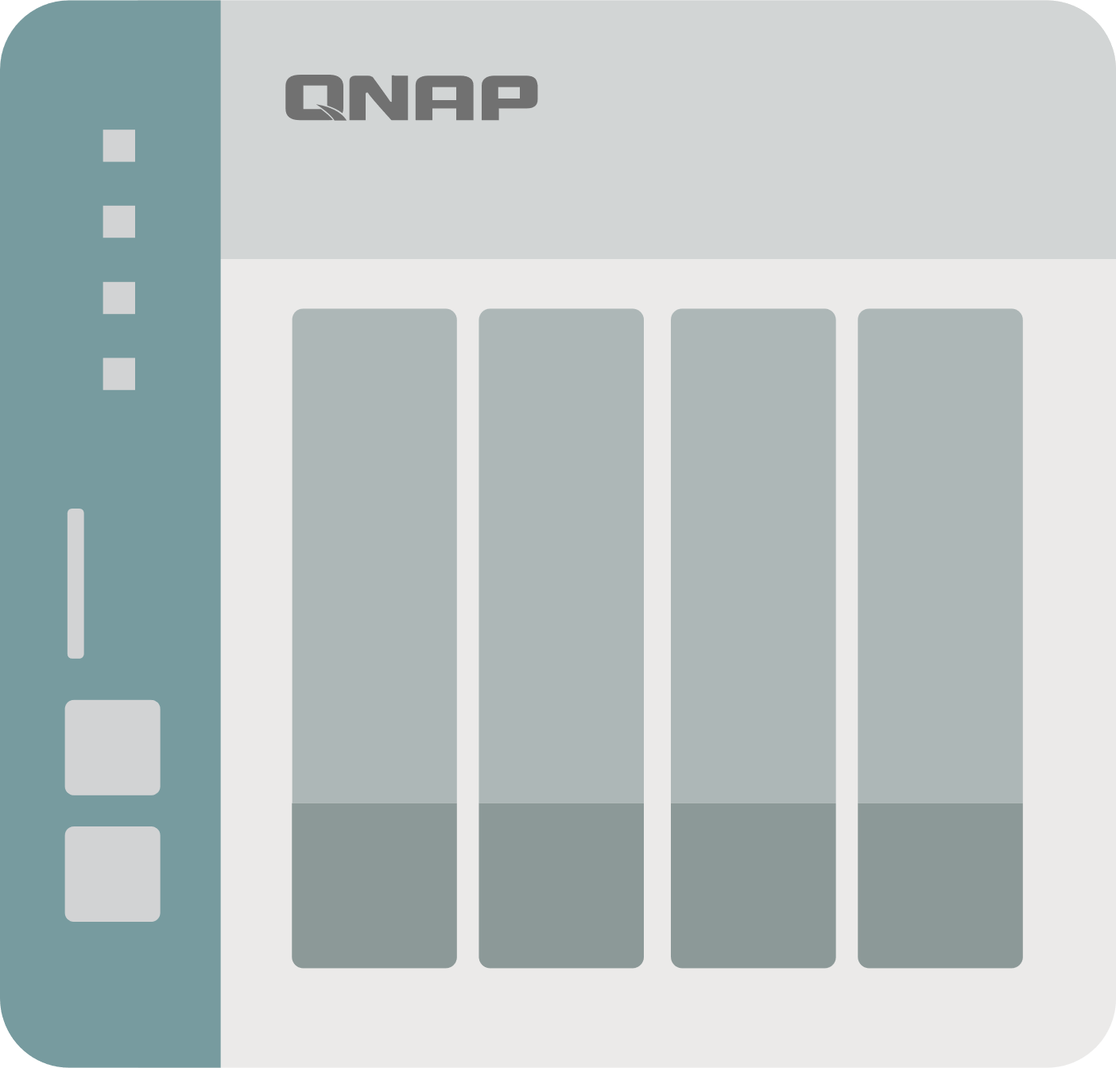
QuWAN vRouter Edition can be a strong firewall for other ESXi VMs.
QuWAN vRouter Edition provides L7 firewall and QoS, allowing ESXi VM traffic to be analyzed by QuWAN vRouter, blocking blacklisted applications and reserved bandwidth for designated applications to protect your data!
QuWAN WAN
QuWAN WAN

Slide 7
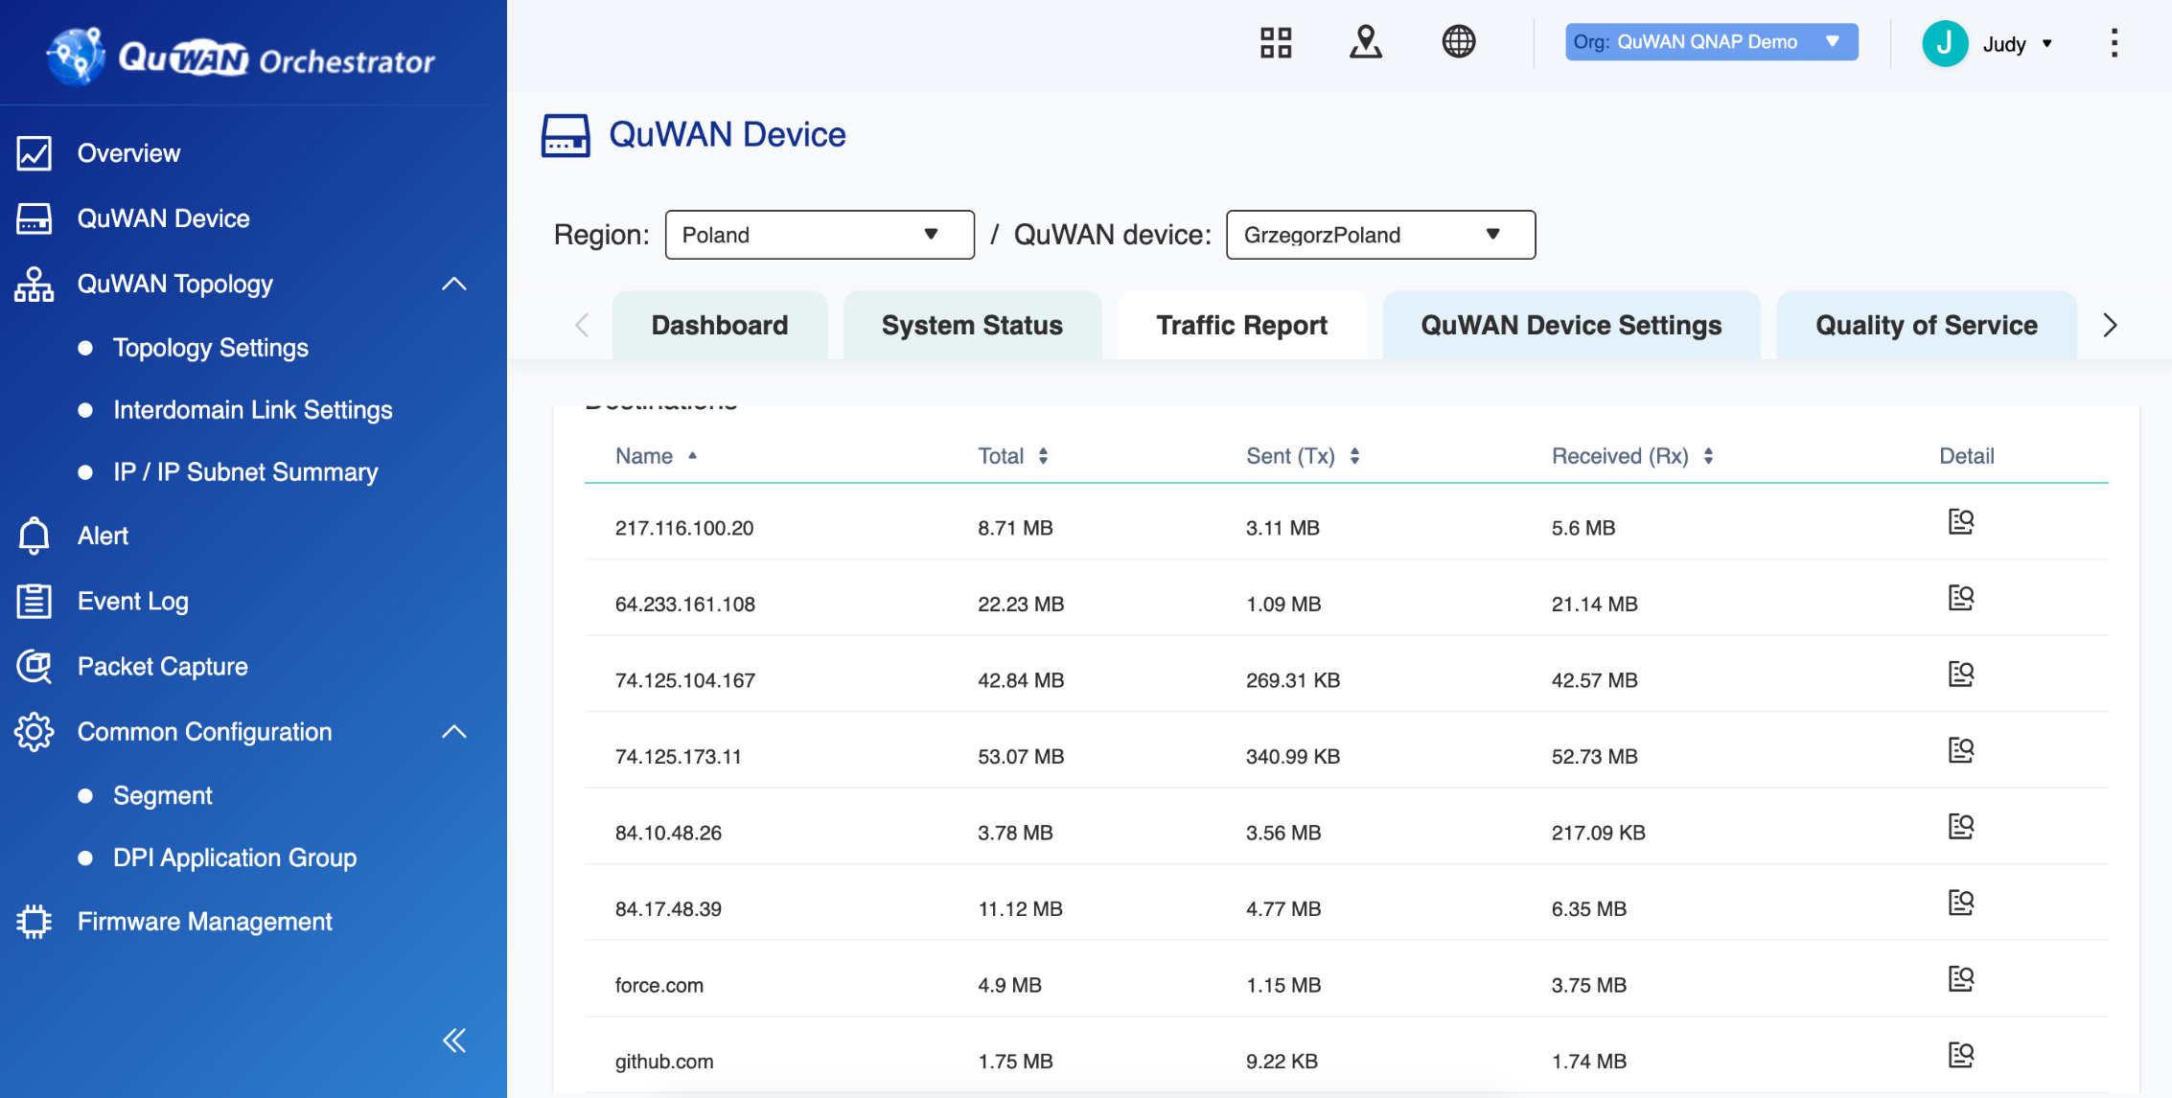
Manage network traffic of other ESXi VMs via QuWAN Orchestrator
Manage traffic status and connection destinations.

Slide 8
The Market Exclusive Economy SD-WAN Solution
市場唯一
經濟型 SD-WAN
訂閱方案

Slide 9
QuWAN vRouter Edition Subscription
Subscribe QuWAN vRouter Edition on QNAP Software Store ​ Select subscription based on demanded total WAN throughput One subscription can enable one QuWAN vRouter Edition​. To enable multiple QuWAN vRouter Edition, multiple subscriptions need to be purchased.
Annual Subscription
15Mbps
特價零元！
Annual Subscription
30Mbps
USD $7.99
Annual Subscription
50Mbps
USD $11.99
Annual Subscription
100Mbps
USD $14.99
Special Offer USD $0
Annual Subscription
250Mbps
USD $28.99
Annual Subscription
350Mbps
USD $33.99
Annual Subscription
500Mbps
USD $39.99
Annual Subscription
1Gbps
USD $49.99

Slide 10
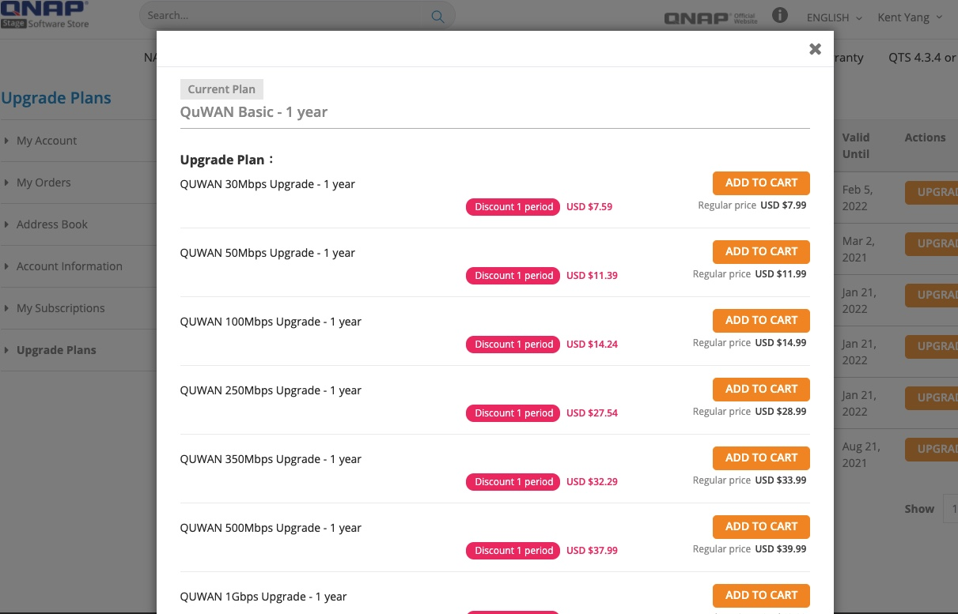
Upgrade your subscription sooner to enjoy discounts
Upgrade your subscription directly in the QNAP Software Store, for selected subscriptions, upgrade sooner to enjoy up to 20% off for the first year!
Up to
20%Off

Slide 11
Fast and Easy! Set up QuWAN vRouter Edition in Five Steps
超簡單快速啟用四步驟

Slide 12
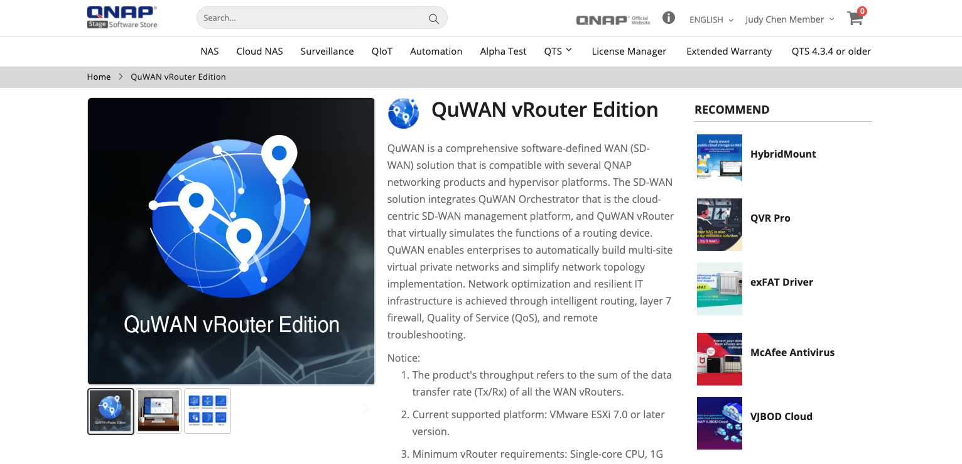
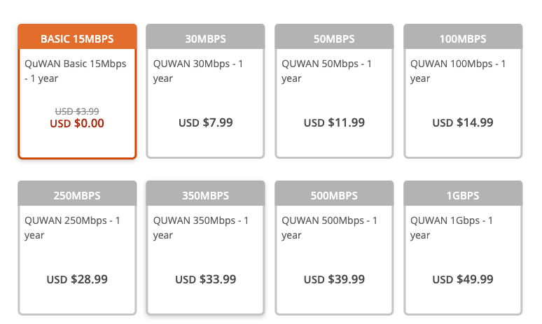
Step 1 – Subscribe QuWAN vRouter Edition
Subscribe QuWAN vRouter Edition at QNAP Software Store
website: software.qnap.com/quwan.html

Slide 13
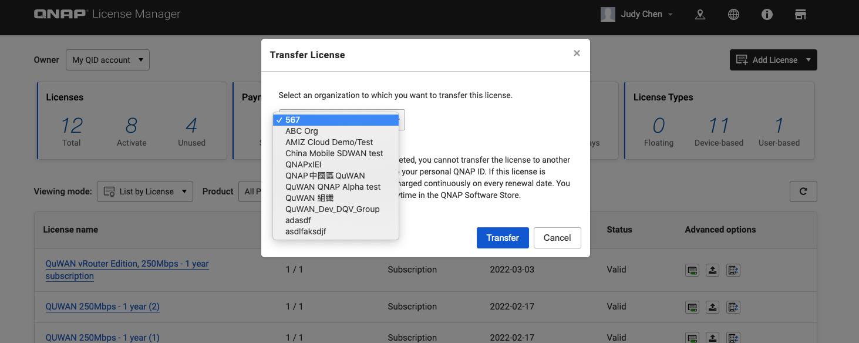
Step 2 – Transfer Subscription to QuWAN Organization
Transfer subscription at QNAP License Manager

Slide 14
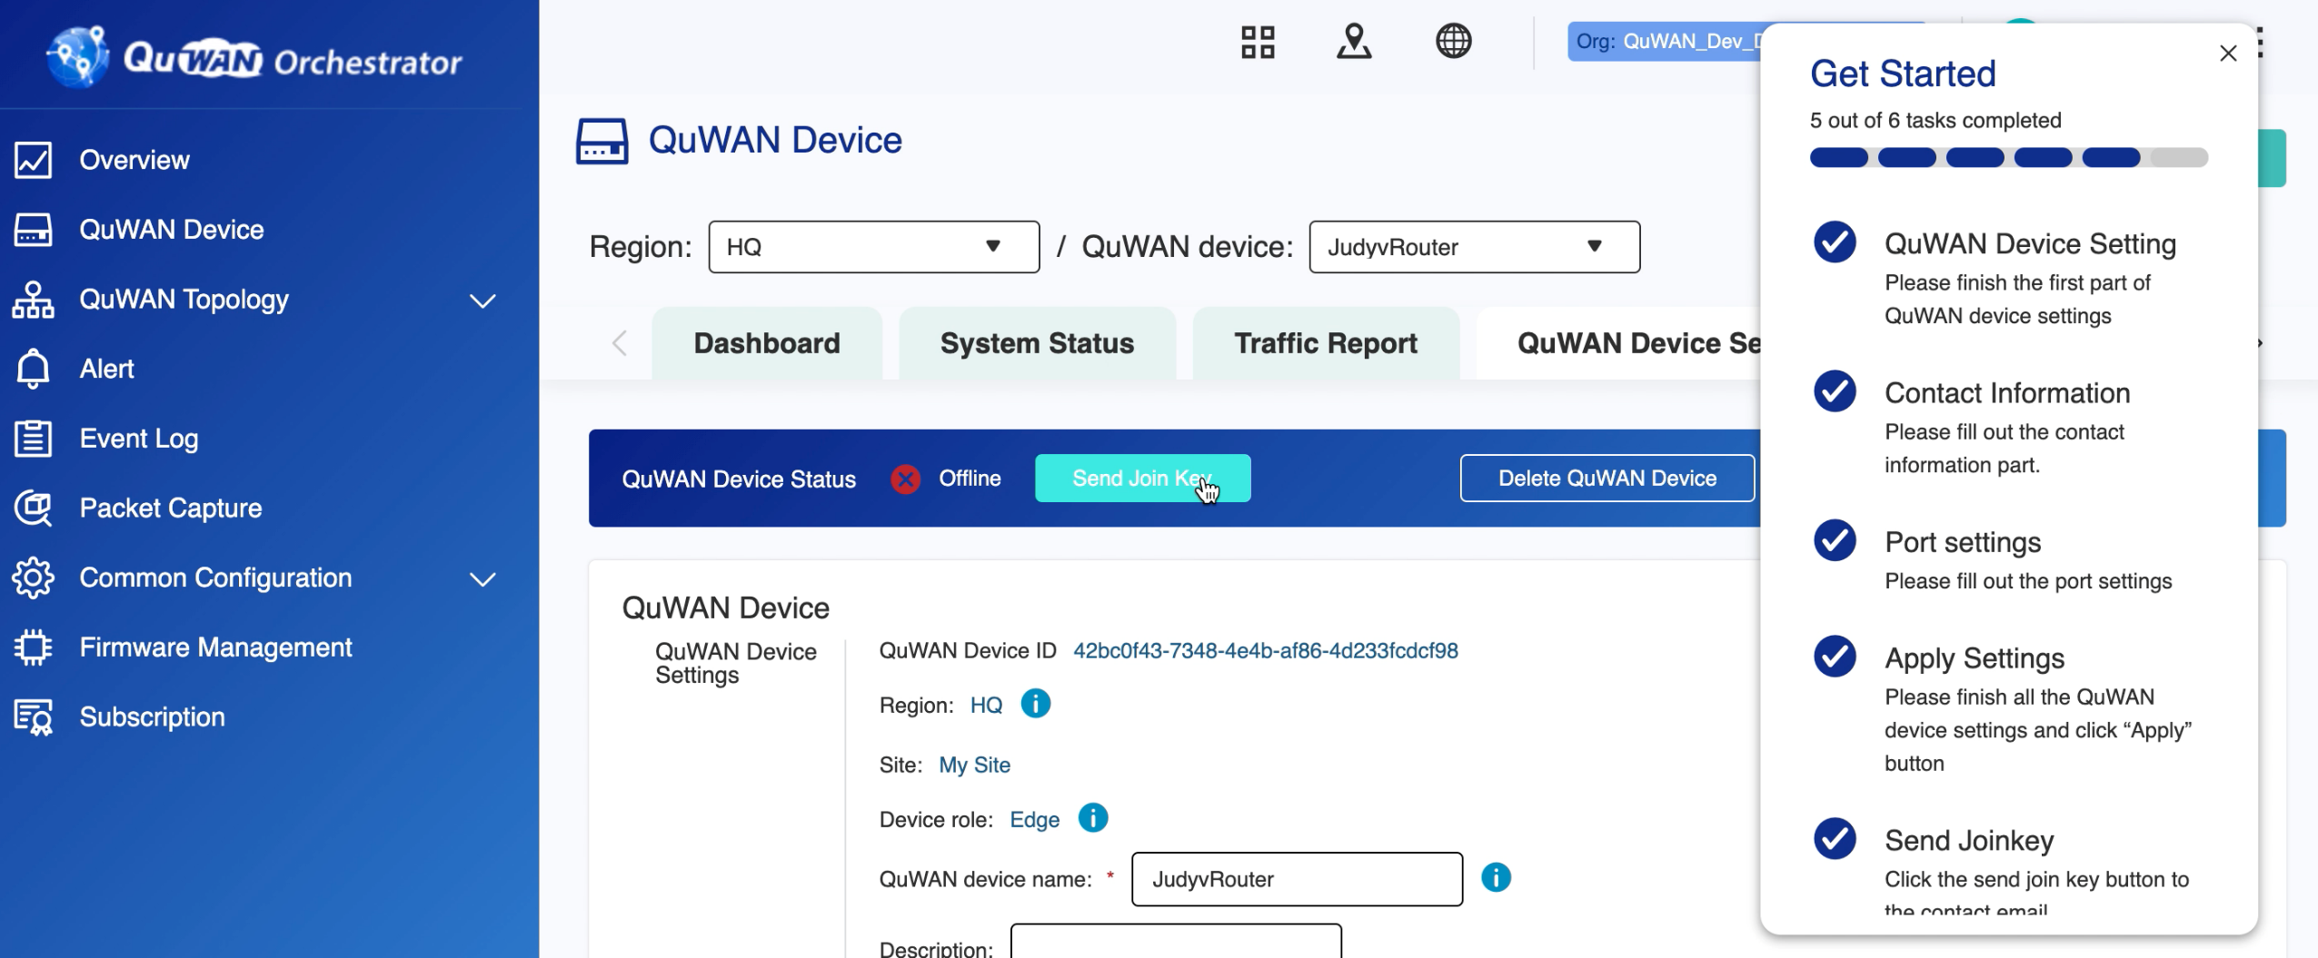
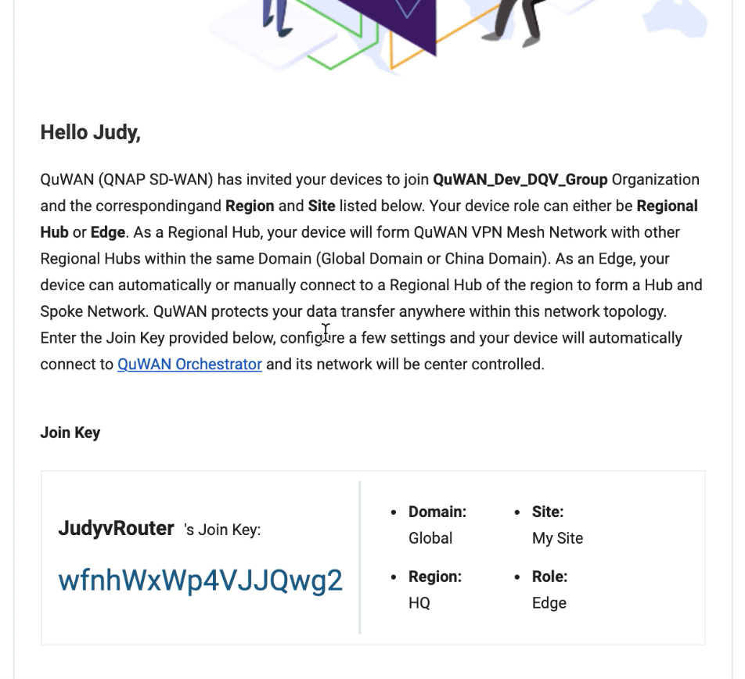
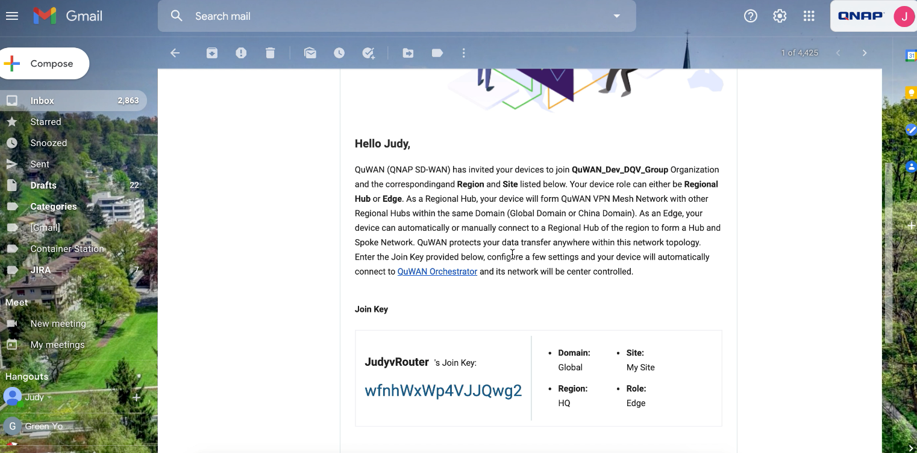
Step 3 - Create QuWAN vRouter Join Key
Add a new device to QuWAN Orchestrator and enable subscription​ Send the configured subscription, device and network information to the e-mail box via Join Key​

Slide 15
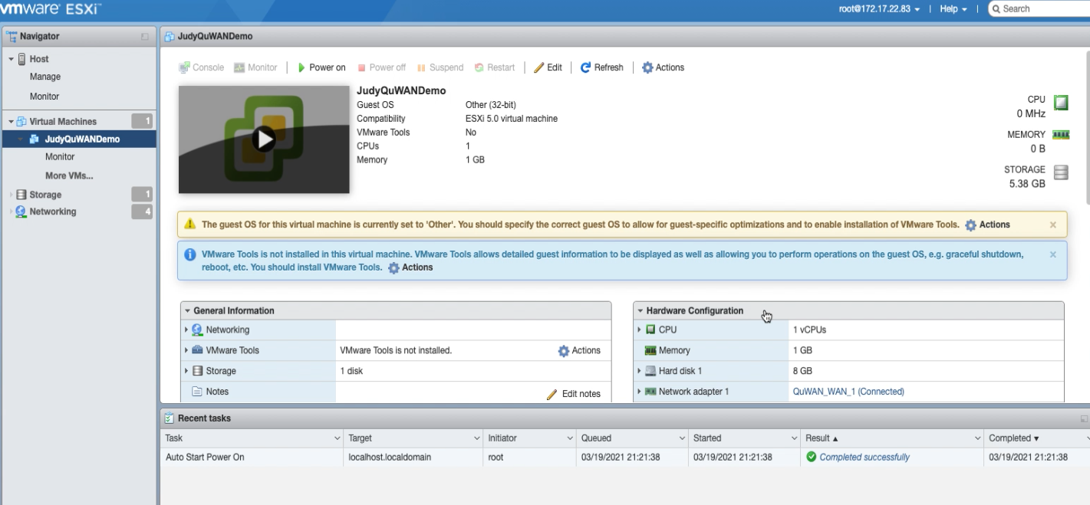
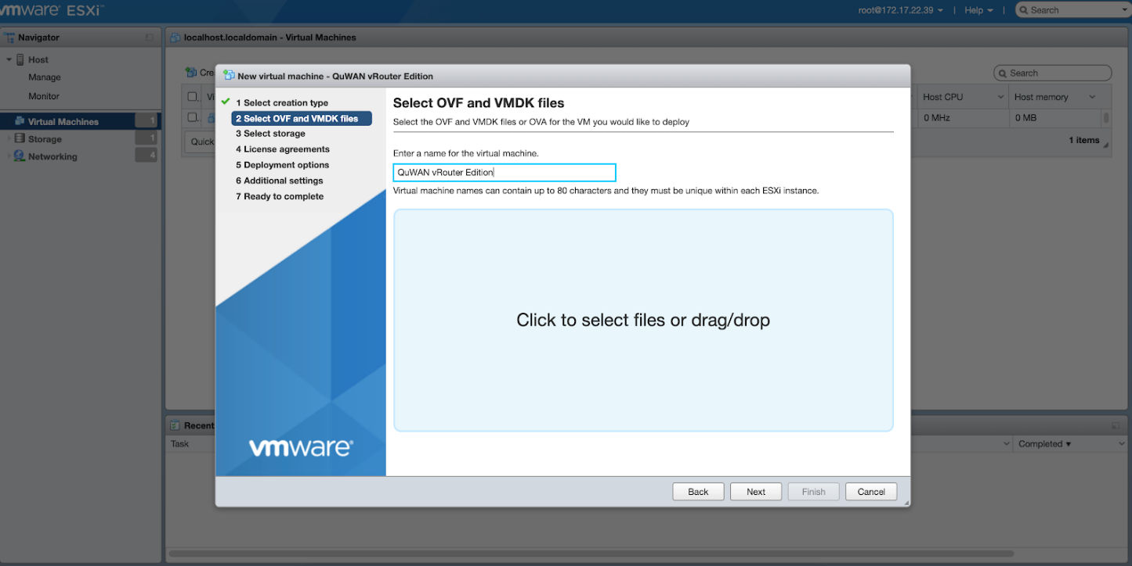
Step 4 - Install QuWAN vRouter on ESXi
Go to QNAP Download Center to download vRouter VMware ESXi package
Create QuWAN vRouter VM，and set corresponding Virtual Switch and Port Group
QuWAN vRouter default settings: Port 1 is WAN, Port 8 is LAN

Slide 16
Concept of QuWAN vRouter on ESXi
VMware ESXi Server
Other virtual systems
Other virtual systems
QuWAN LAN
Adapter 8
QuWAN_LAN_8
Default LAN
QuWAN LAN_8
Phy NIC
vmnic0
Adapter 7
Adapter 6
QuWAN_Dummy_LAN
Configurable
QuWAN
Dummy_LAN
Phy NIC
vmnic1
PC Connection
Adapter 5
QuWAN WAN
Adapter 4
QuWAN_WAN_1
Default WAN
vSwitch0
Phy NIC
vmnic2
Adapter 3
Port Group
Virtual Switch
Phy NIC
vmnic3
ISP Internet
Adapter 2
Adapter 1

Slide 17
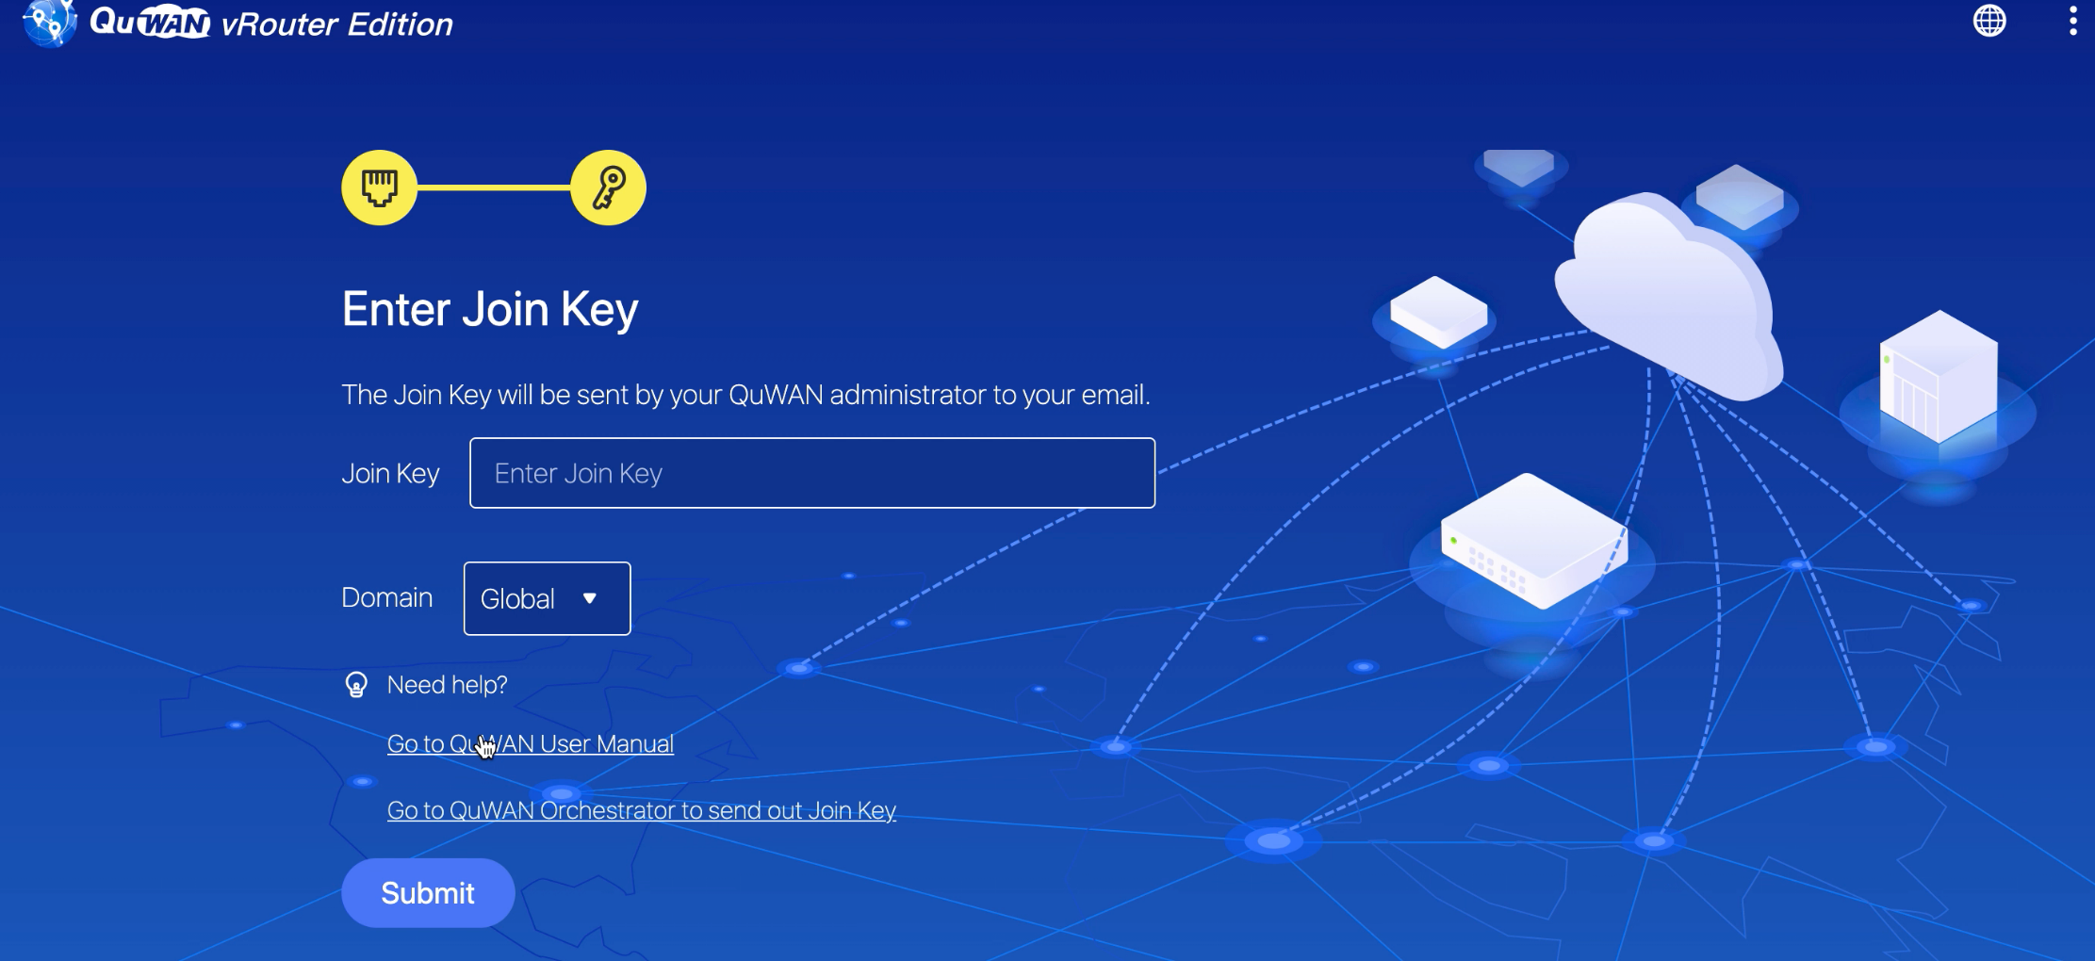
Step 5 - Enter Join Key
Connect PC to QuWAN vRouter LAN and enter [ local.quwan ] in a new browser
Open vRouter local page, set network, and enter Join Key

Slide 18
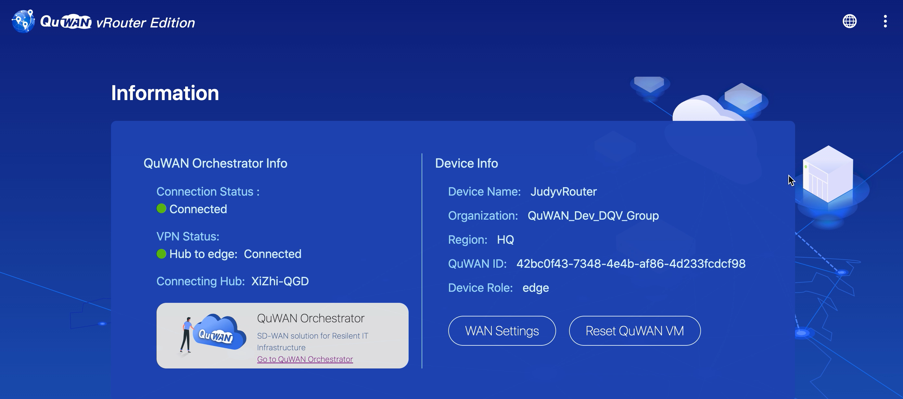
Finished！

Slide 19
QuWAN Fulfills The Next Generation Networking Needs
QuWAN 滿足中小企業新時代組網需求

Slide 20
Site-to-site VPN were only used by a few branches and remote officers​
Intranet
Extranet
HQ
VPN
Remote Worker
Tokyo
Taipei
Remote Worker

Slide 21
HQ VPN resource cannot afford the spike of connection demand from distributed remote users and devices
Extranet VPN Connection
HQ
VPN
Remote Workers
Tokyo
Taipei
WFH
Remote Workers

Slide 22
More work-from-home More distributed remote workers
More network stability & reliability issues resulted from the overloaded VPN router in HQ.
Intranet
Extranet
VPN
Server connects via VPN
VPN
Designer store files and images
VPN
PM get data
HQ
VPN
Sales use ERP
VPN Connection
Collapse
RD uses server to develop software
VPN
VPN
Purchasing dept. use ERP

Slide 23
Lack of effective ways to manage large number of external devices
IT administrators cannot manage equipment usage and connection status
Not every remote worker has the knowledge to set up and maintain the on-prem devices
Device & network troubleshooting can be time-consuming
Intranet
Extranet
IT Overload
VPN
Server connects via VPN
VPN
Designer store files and images
VPN
VPN
PM get data
HQ
VPN
Sales use ERP
VPN
RD uses server to develop software
VPN
Purchasing dept. use ERP

Slide 24
Setting up site-to-site VPN is time and labor consuming
Employees who need to exchange data frequently within the group would need to create site to site VPN network by themselves . But setting up VPN is not easy, and special equipment may be required, hence, deploying a large mesh VPN solution can be very time and labor consuming.
Employee Productivity ​
Decreased! ​
??
??
Router
Router
Router
Router
Employee
Productivity Decreased! ​
Router
Router

Slide 25
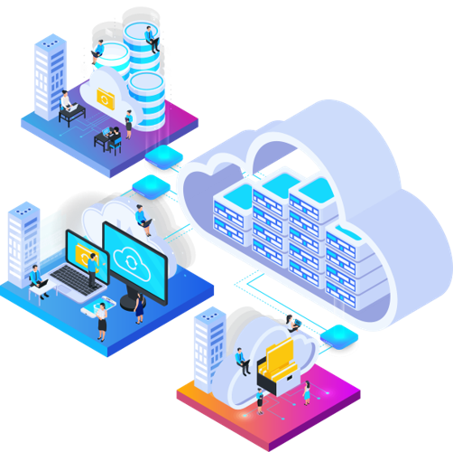
Enterprise level VPN solution is expensive
SMB start to look for VPN solutions on the market to solve these problems, but not every SMB can afford the high cost for extending or building a complete VPN solution.
$$

Slide 26
Features that SMB need for the next generation networking
Flexible
Topology
Design
Fast
Deployment
Easy Setting
An Affordable
Solution
Supports multiple site and multiple equipments connection.
Support different topology style
Effectively disperse network traffic
Deploy via virtual network functions.
Centrally manageable
Easy deployment
Low implementation cost
Cost for solution is transparent and manageable

Slide 27
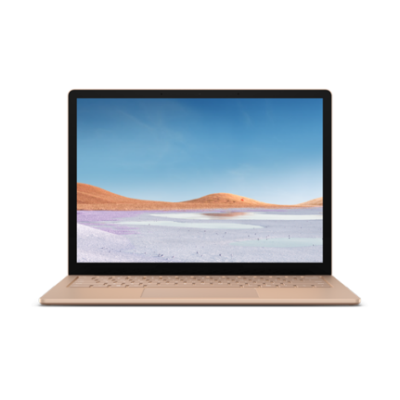
QNAP SD-WAN solution meets the next generation networking needs
QNAP QuWAN is a complete SD-WAN solution that provides enterprise IT managers with a simple, fast, secure and efficient network connection structure. You can easily and quickly build a multi-site VPN network and centrally manage it from a cloud platform.
自動組網
Auto VPN Network
QHora-301W
QVPN
QHora-301W

Slide 28
Efficiently build multi-site VPN
Each department sets up a private network and uses the Internet as a private network.
Protect corporate network activities, confidential files, voice and image transmission
影像或圖檔
材料製造站點
Material creation site
Germany
取用素材
Germany
存取資料
Data sharing
分享編輯素材
Japan
使用材料運算
軟體開發
材料編輯人員
Development Site
Editing Site

Slide 29
Flexible VPN Topology Mesh VPN
Mesh VPN topology is suitable for a network architecture that requires fast and multiple route network.
Need to use Public IP for being a Hub.
Hub can automatically form Mesh VPN with all other Hubs in the same domain.
Mesh VPN
HQ
Branch Office
Mesh
Hub
Hub
QHora-301W
Branch Office
Branch Office
Hub
Hub

Slide 30
Flexible VPN Topology: Hub & Spoke
Hub & Spoke topology is suitable for a network architecture that requires fast deployment, extension and backup route.
All data transmission between edges will go through a hub
If your device uses private IP, it can connect to network topology as Edge
Hub & Spoke topology is suitable for a network architecture that requires fast deployment, extension and backup route.
All data transmission between edges will go through a hub
If your device uses private IP, it can connect to network topology as Edge
Hub & Spoke
Hub
QHora-301W
Edge
Hub
Edge
Edge
Edge

Slide 31
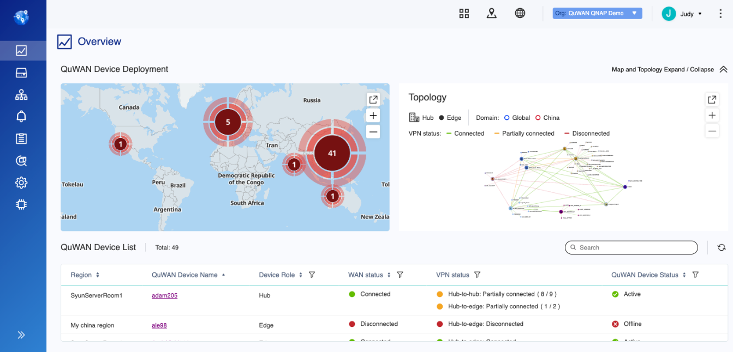
A centrally managed platform solves the management issues of multiple devices
Instant Notification
04
01
Intuitive graphical user
interface
Simultaneously
execute various parameter settings
02
Geological location of each device
05
Set once and apply to all. Save time to set device one by one.
06
Remote
troubleshooting (e.g. packet capture)
03
Overview
connection status of all devices

Slide 32
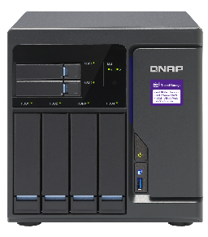
WAN aggregation to improve data transmission rate
WAN aggregation is effective in achieving a faster data transmission for remote backup and remotely mounted file system
​
ISP WAN 2
WAN Aggregation
ISP WAN 1

Slide 33
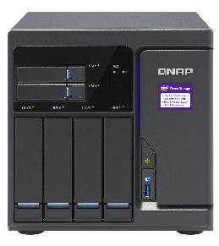
WAN Failover
Multi-site connection can form a backup system automatically that allow uninterrupted collaborative operations.
The central management platform sends warnings and notifications in real time
Automatic failover can be achieved by combining multiple WAN connections from different ISPs for the mesh VPN network. When one of the ISP WAN connections goes down, the traffic will automatically be switched to another active path to ensure continuous connection.
ISP WAN 2
ISP WAN 2
10 G
10 G
Qhora-301W
Qhora-301W
ISP WAN 1
ISP WAN 1

Slide 34
WAN Load Balancing
Using Multipath TCP (MPTCP) technology to automatically detect current network jitter, delay, and packet loss conditions, so that each packet takes the best network path to the destination, so as to achieve intelligent routing and uninterrupted connection for transmission
Maintain long-term and efficient transmission by distributing traffic through multiple WANs
Ｇood！
ISP WAN 1
ISP WAN 2
ISP WAN 2
Unstable！

Slide 35
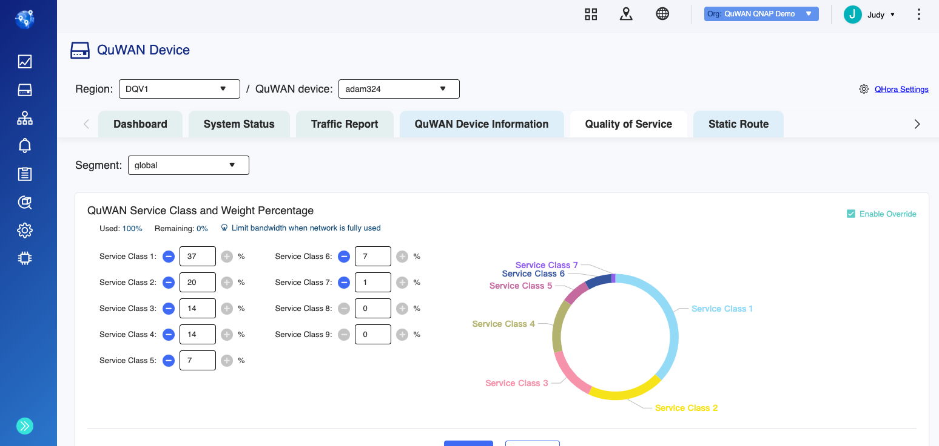
QuWAN QoS reserves bandwidth for important applications
No interruption during streaming or data backup even when bandwidth usage is full.
Set application service level on QuWAN Orchestrator.
QuWAN vRouter has built-in DPI engine to automatically detect and distinguish applications, and reserve bandwidth for important applications.
QoS
50% VoIP
30% ERP
20% File transfer

Slide 36
Protects your data
Through using deep packet inspection technology, it can identify and control network services based on the characteristics of the application layer to achieve L7 firewall and intelligent QoS functions.
Blacklist specific applications to protect corporate network security.
Found blacklist packet
Match:
Pattern 3
Match:
Pattern 2
Match:
Pattern 1
DPI engine for content inspection
…
Packet Flow

Slide 37
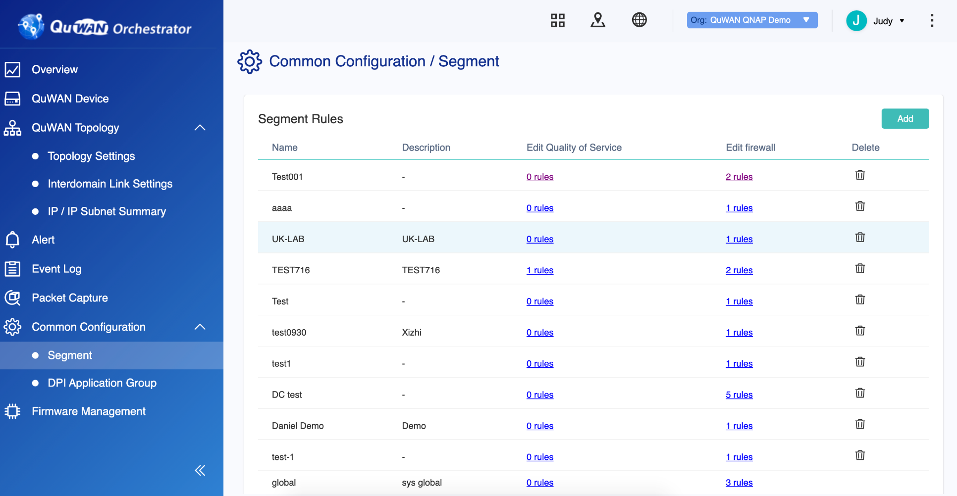
QuWAN provides organization wise firewall settings
A set of firewall and business policy rules can be set in one segment and be applied universally across domains. Easy to manage network using behavior and data transmission security!

Slide 38
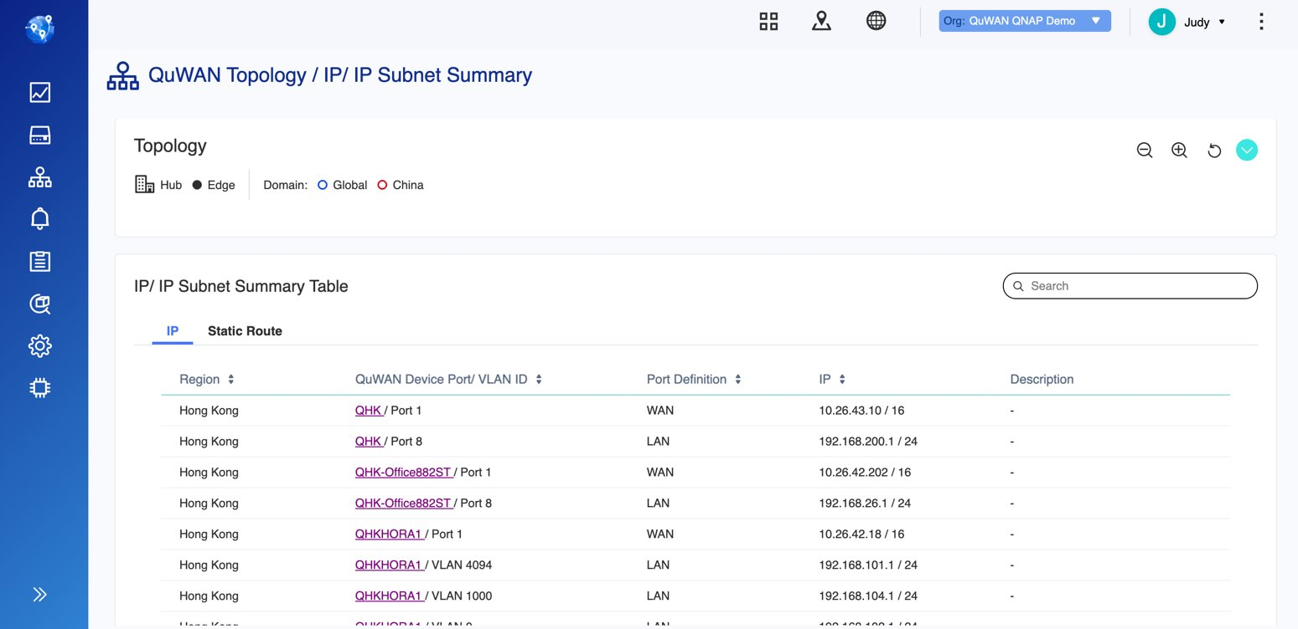
Organizational IP Segment Allocation

Slide 39
QuWAN Network Topology
Organization
Domain
Region
One company can be an organization
QuWAN network is divided into two main domain: Global and China
Multiple regions can be created inside a domain.
Organization
Global Domain
China Domain
USA
Japan
Beijin
Chongqing

Slide 40
QuWAN Network Topology
Site
Usually One office or a smaller area within a region is called site.
Device
Each site can have one QuWAN
router enabled.
Organization
Global Domain
China Domain
USA
Japan
Beijing
Chongqing
Site
Site
Site
Site
Site
Site
Device
Device
Device
Device
Device
Device
Site
Site
Site
Site
Site
Site
Device
Device
Device
Device
Device
Device

Slide 41
QuWAN Network Topology
All Hubs under the same domain automatically form Mesh VPN connections.
Public IP is required for a device to be Hub.
First device deployed in a region needs to be a Hub. This Hub will serve as the primary Hub.
Hub
Organization
Global Domain
China Domain
Beijing
Chongqing
USA
Japan
Site
Site
Site
Site
Site
Site
Hub
Hub
Hub
Hub
Site
Site
Mesh
Site
Site
Mesh
Site
Site
Hub
Hub
Hub
Hub

Slide 42
QuWAN Network Topology
A device can connect to QuWAN network as an Edge using private IP.
An Edge needs to connect to a Hub under Hub & Spoke network structure.
Edge automatically connects to the primary Hub.
All data will be transferred through Hub.
Edge
Organization
Global Domain
China Domain
USA
Japan
Beijin
Chongqing
Site
Site
Site
Site
Site
Site
Edge
Hub
Hub
Hub
Hub
Edge
Site
Mesh
Mesh
Site
Site
Site
Site
Site
Edge
Hub
Hub
Hub
Hub
Edge
Hub & Spoke
Hub & Spoke

Slide 43
QuWAN Network Topology
Inter-Domain Link
To comply to China network regulation, user needs to apply for Inter-Domain Link by his or herself for the two domain to have VPN connection.
Inter-domain Link can only be set on hub.
Organization
Global Domain
China Domain
USA
Japan
Beijin
Chongqing
Site
Site
Site
MPLS
Site
Site
Site
Edge
Hub
Hub
Hub
Hub
Edge
Site
Mesh
Mesh
Site
Site
Site
Site
Site
Edge
Hub
Hub
Hub
Hub
Edge
Hub & Spoke
Hub & Spoke

Slide 44
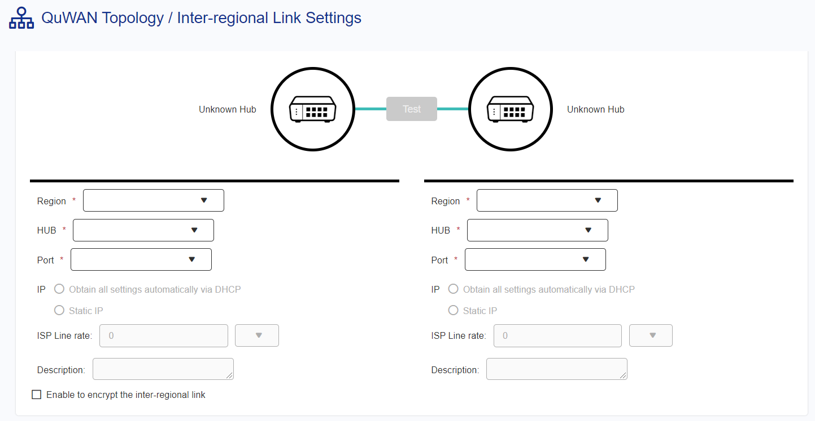
QuWAN Inter-Domain Link
QuWAN 專線設定
Set the applied MPLS to QuWAN Inter-Domain Link to establish a cross china and global domain private network between the two QuWAN Hubs

