Slide 2
01. QNAP high-speed NIC products,
lead to next generation of faster ethernet
02. Specification & Features
03. QTS / QuTS hero support FEC configuration
04. Build up 25GbE environment

Slide 3
QNAP high-speed NIC products,
lead to next generation of faster ethernet

Slide 4
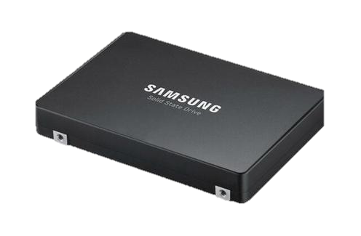
Fast growing market and performance of SSD
OK
More and more NVMe SSDs are launched.
Speed of Internet should be also increased as the bandwidth of SSD doubles!
SAMSUNG PM9A3 U.2 SSD
Read 6,800MB/s, Write 4,000MB/s
QNAP All-Flash Array
TS-h2490FU / TS-h3088XU-RP
All-flash array provides hundreds of thousands of IOPS, but do you get your I/O devices up to speed?
SAMSUNG 980 PRO
Read 6,200MB/s, Write 4,900MB/s

Slide 5
SSD generation comes! PCIe 4.0 doubles the bandwidth
2020 Global Shipments of SSDs Surpassed HDDs for First Time!
PCIe Gen4 doubles the speed of Gen3
Solid-state drive shipments surpassed those of traditional hard drives by a significant margin in 2020 but spinning media retained the crown in terms of overall capacity served. As pricing continues to plummet and capacity increases, we can expect to see the ratio become even more skewed.
According to data storage research and consulting firm TrendFocus (per Storage Newsletter), manufacturers shipped 333.12 million solid-state drives in 2020 – an increase of 20.8 percent year-over-year. Hard drive shipments, meanwhile, were down 18 percent annually to 259.81 million units.
32 GT/s
PCIe 3.0 standard bandwidth: 8 GT/s
PCIe 4.0 standard bandwidth: 16 GT/s
16 GT/s
8 GT/s
Source: techspot
PCIe 3.0
PCIe 4.0
PCIe 5.0

Slide 6
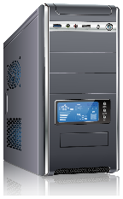
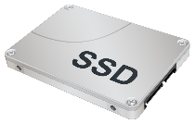
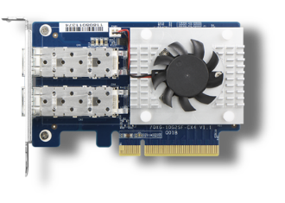
Bottleneck for 10GbE high-speed transmission among multiple users
OK
10GbE
Transmission
Enterprise U.2 NVMe SSD or PCIe Gen4 SSD
10GbE Card
10GbE
Transmission
Bottleneck
Hundreds of thousands of IOPS
10GbE
Transmission
QNAP All-Flash Array
TS-h2490FU / TS-h3088XU-RP
PC/workstation

Slide 7
Strength of 25GbE – easily upgrade to 50/100GbE
OK
Lower bandwidth than 40GbE, but more easily upgrade to 50/100GbE
High Speed Adapters 2017
25G+ Segment Growing at 38% CAGR
2%
2%
2%
11%
21%
22%
55%
7%
Of total Market
Of total Market
15%
45%
78%
2%
15%
Source：Mellanox
Notes:
網址

Slide 8
OK
Specification &
Features

Slide 9
Brand new QNAP 25GbE NIC – QXG-25G2SF-CX6
OK
QXG-25G2SF-CX6
Dual-port 25GbE SFP28 NIC
Mellanox
ConnectX®-6 Lx Controller
2 x SFP28 connectors
Support 2-speed 25GbE / 10GbE
Support iSER / RoCE offloads

Slide 10
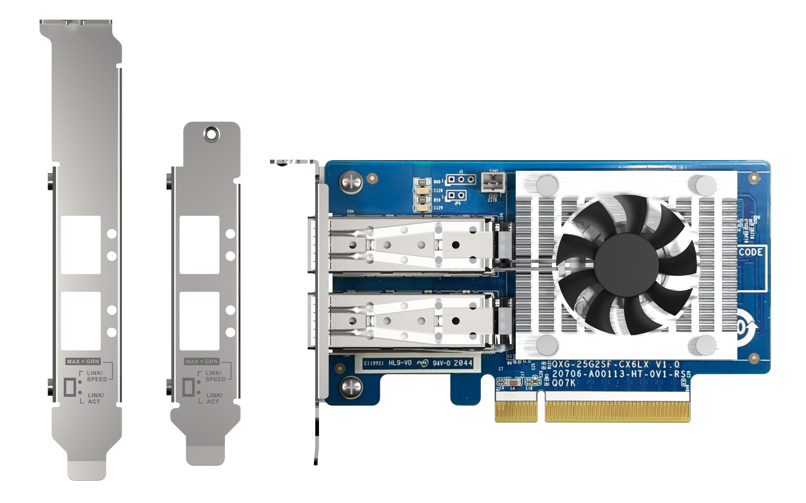
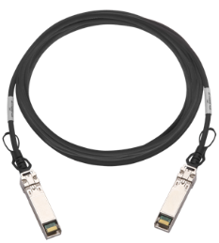
QXG-25G2SF-CX6 25GbE hardware specfication
OK
Dual-port 25GbE (SFP28) ports
Active heatsink for controller chip
Optional accessory
25GbE SFP28 DAC
PCIe Gen4 x8 interface
up to 128Gbit/s bandwidth
Low-profile bracket pre-installed;
full-height and specialized (for selected QNAP NAS) brackets are bundled

Slide 11
Support multiple OS to deploy your 25GbE environment
OK
Download Windows Driver
Download Linux Driver
Ubuntu 18.04 and later
QTS 4.5.2 and later
QuTS hero 4.5.2 and later

Slide 12
QXG-25F2SF-CX6 v.s QXG-25G2SF-CX4
 | QXG-25G2SF-CX4 | QXG-25G2SF-CX6
PCIe express | Gen3 x8 | Gen4 x8
Message Rate | 70Mpps | 75Mpps
PTP (1588) | N/A | Supported
Secure boot | N/A | Supported
VirtIO acceleration | N/A | Yes
RoCE v1/v2 | Supported | Supported
RDMA | Supported | Supported
SR-IOV | Supported | Supported

Slide 13
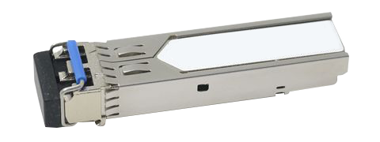
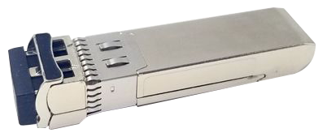
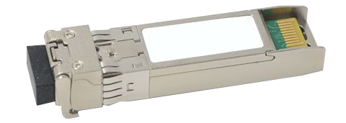
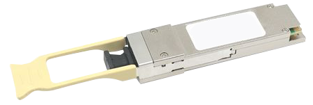
Connector's form-fact from 1GbE to 100GbE
OK
1 GbE
10 GbE
25 GbE
40 GbE
100 GbE
SFP
SFP+
SFP28
QSFP+
QSFP28

Slide 14
Experience the fastest performance with PCIe 4.0 NAS
TS-h2490FU-7302P-128G
AMD EPYC 16core/32thread, 3.0 GHz (Max. 3.3GHz)
128GB DDR4 RDIMM ECC memory (8 x 16GB)
4 x SFP28 25GbE ethernet ports (25GbE/10GbE/1GbE)
TS-h2490FU-7232P-64G
AMD EPYC 8coew/16thread, 3.1 GHz (Max. 3.2GHz)
64GB DDR4 RDIMM ECC memory (8 x 8GB)
2 x SFP28 25GbE ethernet ports (25GbE/10GbE/1GbE)
Slot 1: PCIe Gen4 x4 Slot 2: PCIe Gen4 x8 or x4 Slot 3: PCIe Gen4 x4 Slot 4: PCIe Gen4 x8 Slot 5: PCIe Gen4 x16 or x8
TS-h2490FU
*Slot 4 and Slot 5 are preinstalled with 25GbE network adapters. Please reserve these slots for the 25GbE adapters for the best performance. **Slot 2 provides the width of PCIe Gen4 x8 when Slot 3 is not in use, and provides the width of PCIe Gen4 x4 when Slot 3 is in use. ***Slot 5 provides the width of PCIe Gen4 x16 when Slot 4 is not in use, and provides the width of PCIe Gen4 x8 when Slot 4 is in use.
Notes:
實際效能

Slide 15
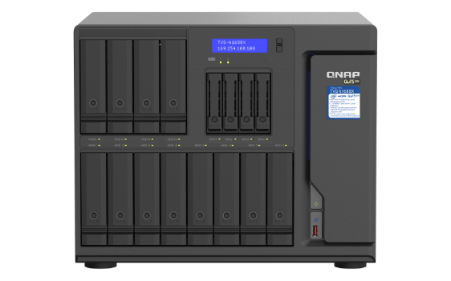
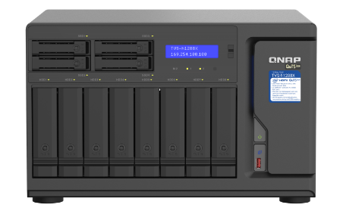
Upgrade you QNAP High-end NAS with PCIe 3.0 for faster ethernet experience
OK
TS-h3088XU-RP
TS-hx83XU
TVS-h1288X
TVS-h1688X
Intel Xeon W 1250 /1270
2 x SFP28 25GbE ethernet ports (25GbE/10GbE/1GbE)
Intel Xeon E series
2 x SFP+ 10GbE ethernet ports (10GbE/1GbE)
Intel Xeon W 1250 /1270
2 x RJ45 10GbE ethernet ports (10GbE/5GbE/2.5GbE/1GbE/100M)
Slot 1: PCIe Gen3 x8 or x4 Slot 2: PCIe Gen3 x4 Slot 3: PCIe Gen3 x4
1U: Gen3 x16 (CPU)
2U & 3U : Slot 2 with Gen3 x8 (CPU)
4U: slot 4 with Gen3 x8 (CPU)
Slot 1: PCIe Gen3 x8 Slot 2: PCIe Gen3 x4 Slot 3: PCIe Gen3 x4
*Find out full compatibility list on our website!
Notes:
3088xu 83xu
URL

Slide 16
Offload tasks from CPU with iSER
OK
*iSER will support in QTS / QuTS hero later
iSER allows data to bypass general network drivers, the socket layer, and to directly enter memory buffers of the server and storage.
Increasing performance, lower CPU loading
Without iSER
With iSER

Slide 17
OK
QTS / QuTS hero support FEC configuration

Slide 18
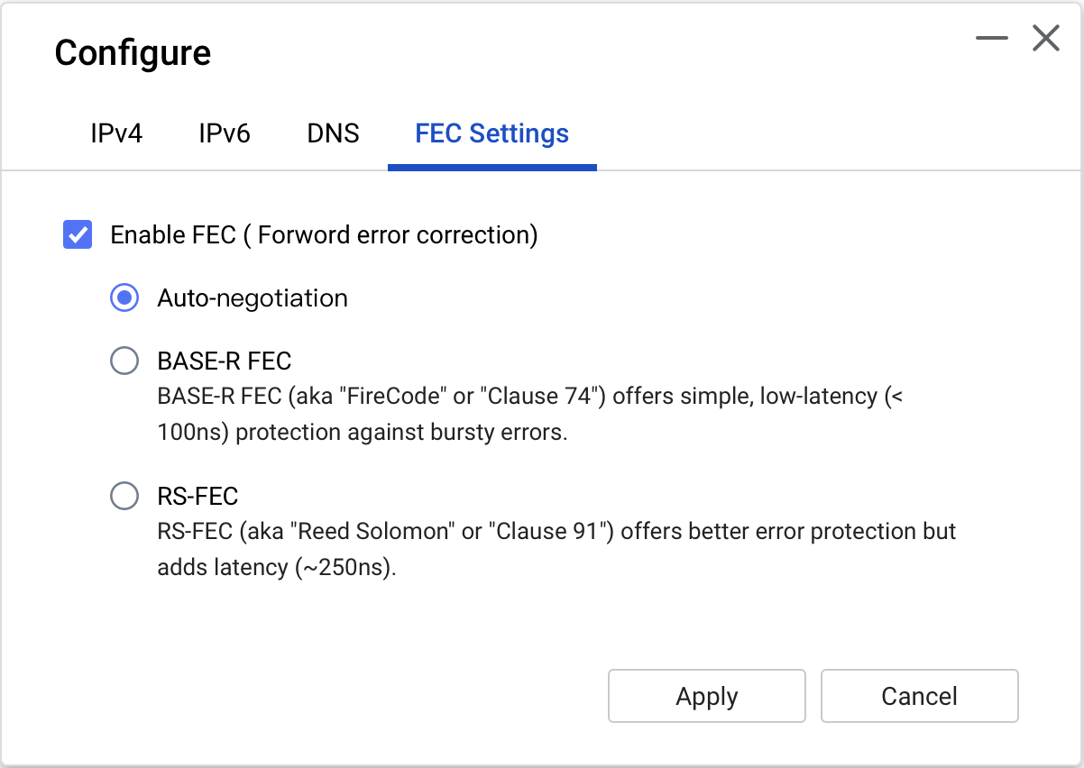
Ensure data correction during transmission with FEC
OK
FEC (Forwarded-error-Correction) controlling errors in data transmission over unreliable or noisy communication channels.
FEC must configured the same mode for both switch and NIC side.
Enable FEC (To turn on/off FEC)
Auto-negotiation
(Follow the sequence to negotiation from RS-FEC -> Base-R FEC -> Disable FEC -> 10GbE)
BASE-R FEC (Enable BASE-R FEC)
aka Firecode or Clause 74. Offers simple, low-latency (<100ns) protection against bursty errors.
RS-FEC (Enable RS-FEC)
aka Reed Solomon or Clause 91. Offers better error protection but adds latency (~250ns)
Configure FEC option require QTS 4.5.3 / QuTS hero 4.5.2 and later
*Older QTS/QuTS hero, FEC are set as Auto-negotiation.
*Switch and NIC require the same FEC configure in order to work properly.

Slide 19
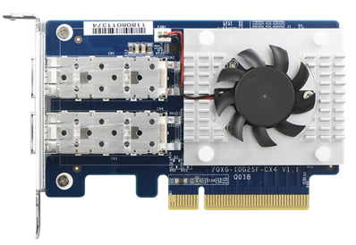
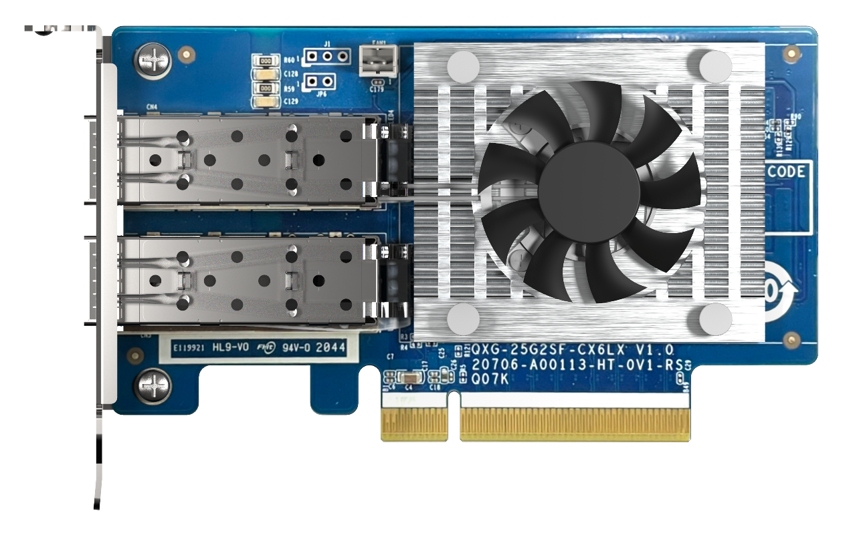
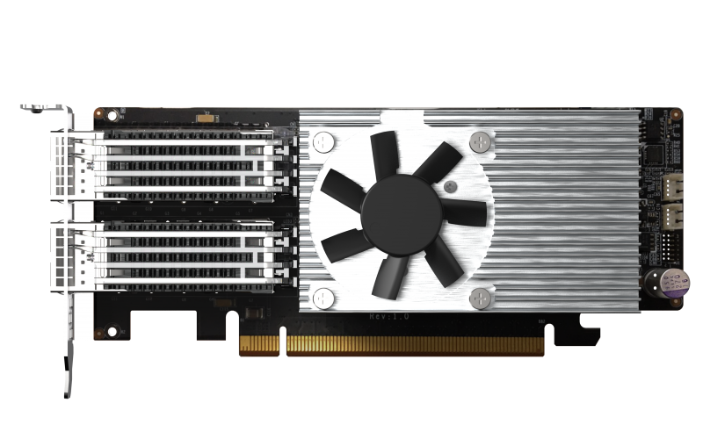
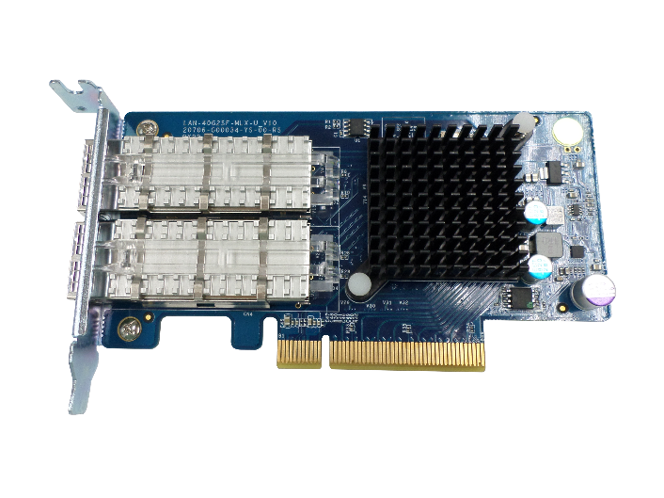
Support FEC configuration for all models above 25GbE
OK
For QTS 4.5.3 / QuTS hero 4.5.2 and later, you could configure FEC mode depends on your network environment in NIC setting page
QXG-10G2SF-CX4
QXG-25G2SF-CX4
QXG-25G2SF-CX6
QXG-100G2SF-E810
LAN-40G2SF-MLX

Slide 20
Configure FEC mode with ethtool in Windows / Linux
OK
Show current FEC mode
ethtool --show-fec devname
configure FEC mode
Auto: ethtool --set-fec devname encoding auto
Off: ethtool --set-fec devname encoding off
RS-FEC: ethtool --set-fec devname encoding rs
BASE-R FEC: ethtool --set-fec devname encoding baser
＊Driver for Windows / Linux are required.
Windows: https://www.mellanox.com/products/adapter-software/ethernet/windows/winof-2
Linux: https://www.mellanox.com/products/infiniband-drivers/linux/mlnx_ofed

Slide 21
OK
Performance

Slide 22
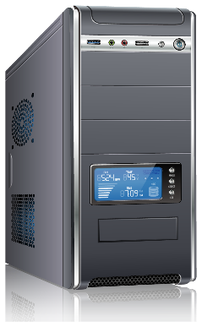
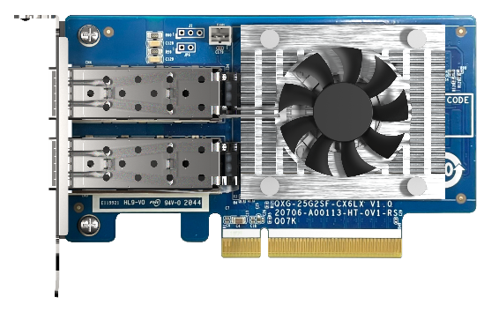
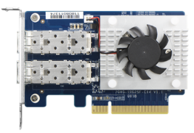
25GbE Performance
TS-x83XU
PC:
Intel® CoreTM i7-6700 3.40GHz.
Windows 10, 64GB RAM, QXG-25G2SF-CX4 on board,
Samsung SSD 960 PRO 1TB NVMe
NAS:
1283XU. Intel® Xeon® E-2124 CPU @ 3.30GHz.
QTS 4.3.6.0805, 4GB RAM, QXG-25G2SF-CX4 on board,
Samsung SSD850 Pro 512GB*12 (RAID 0)

Slide 23
OK
Build up 25GbE environment

Slide 24
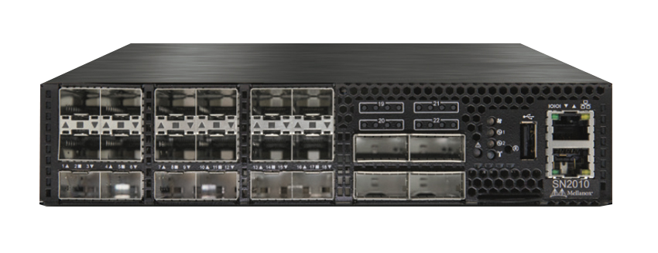
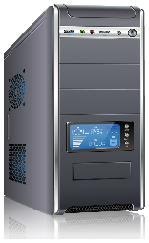
QNAP makes your network environment faster!
OK
Mellanox SN2010 25/100 GbE switch
18x 10/25GbE SFP+/28 ports
4x 40/100GbE QSFP+/28 ports
QNAP 100GbE NIC
QXG-100G2SF-E810
25 GbE
25 GbE
25 GbE
100 GbE
QNAP High-end NAS
Or Server
VM
Media Workstation

Slide 25
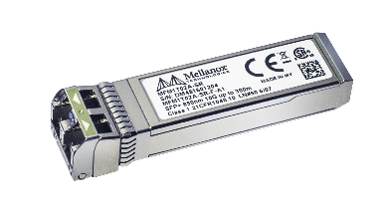
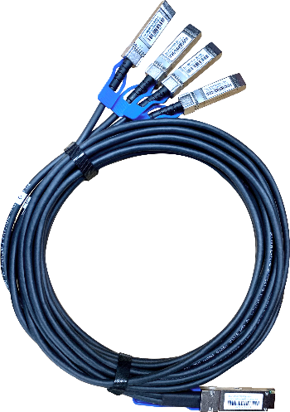
Connect to 100GbE/50GbE environment with break-out cable
OK
4 x 100GbE ports
4 x SFP28 connector
Compatible 10GbE Transceiver
10GbE SR Transceiver
TRX-10GSFP-SR-MLX
QSFP28 break-out cable
Support 25GbE Transceiver
25GbE SR Transceiver
TRX-25GSFP-SR

Slide 26
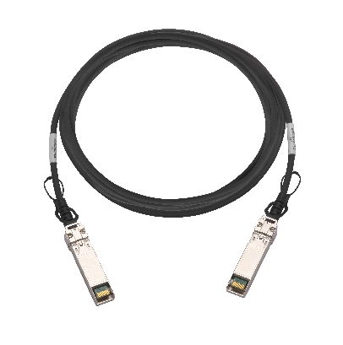
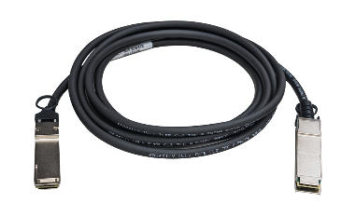
Accessories for 10GbE / 25GbE / 100GbE
OK
QXG-25G2SF-CX6
25GbE SFP28 DAC
CAB-DAC30M-SFP28
CAB-DAC15M-SFP28
10GbE SR Transceiver
TRX-10GSFP-SR-MLX
QXG-100G2SF-E810
100GbE QSFP28 DAC
CAB-DAC15M-QSFP28
CAB-DAC15M-QSFP28-B4
25GbE SR Transceiver
TRX-25GSFP-SR

Slide 27
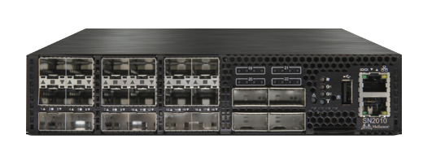
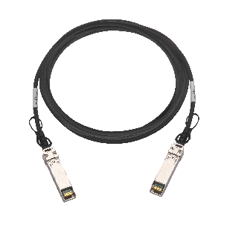
Upgrade to 25GbE environment now!
OK
1
2
3
QNAP
High-end NAS
QXG-25G2SF-CX6
Mellanox SN2010 25/100 GbE switch
OR Server
CAB-DAC30M-SFP28
Upgrade to 25GbE / 100GbE now!

Slide 28
Your best choice!
Copyright © 2021 QNAP Systems, Inc. All rights reserved. QNAP® and other names of QNAP Products are proprietary marks or registered trademarks of QNAP Systems, Inc. Other products and company names mentioned herein are trademarks of their respective holders.

