Slide 2
What is Qmiix ?
Why need Qmiix ?
What can Qmiix do ?
Who can use Qmiix ?
How to use Qmiix ?
Supported Applications
Cross-platform automation makes NAS and cloud task management so easy

Slide 3
What is Qmiix ?

Slide 4
What is Qmiix ?
Qmiix is a solution that connects your apps and devices to automate your everyday tasks
Manages your small tasks so that you can focus on the bigger ones

Slide 5
STEP
STEP
1
Qmiix can connect different applications
2
Create workflows to boost productivity
New presentation file uploaded in a specific folder.
Backup the file on my NAS.
Additionally backup the file to my Dropbox.

Slide 6
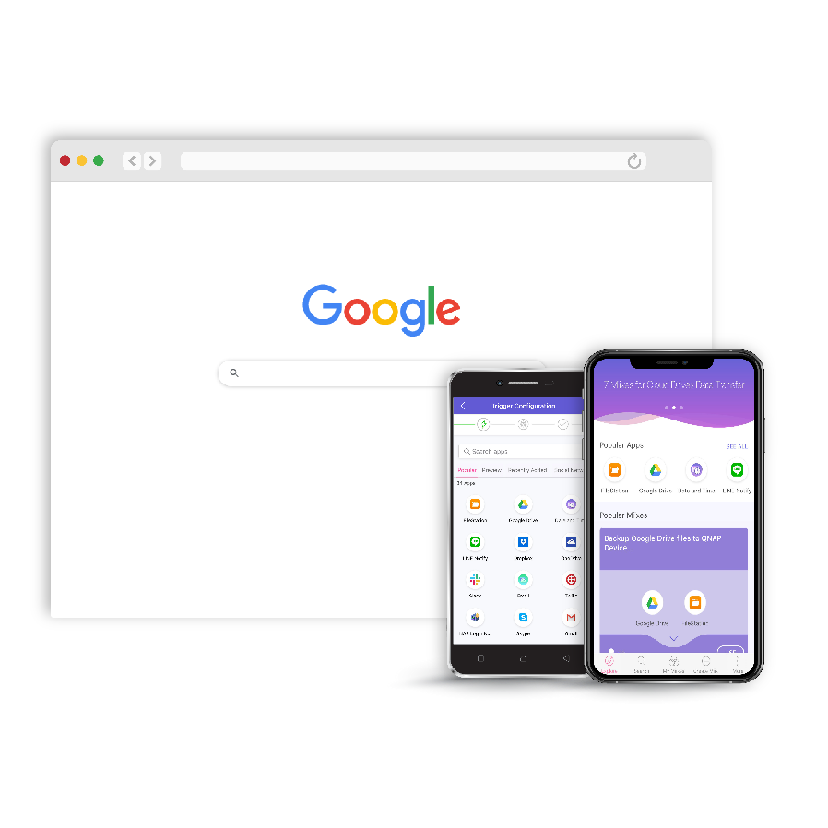
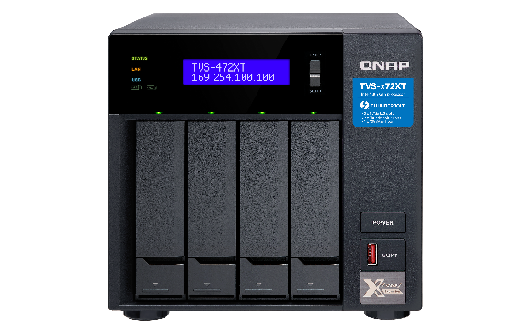
Supported Platforms
Web
QNAP NAS
Android
iOS

Slide 7
Why Need Qmiix ?

Slide 8
Qmiix brings different apps and devices together and hence bridges the gap
Notes:
Replace:
1. Surveillance with Twilio
2. Replace Smart Home with Slack
3. Replace Entertainment with Dropbox
4. Replace Social Media with Line
5. Replace Smart Car with Google Drive

Slide 9
Why need Qmiix ?
Upload the photo in my Dropbox folder
Backup the photo to my Google Drive Account 2
New photo added to my Google Drive Account 1
Qmiix
Share the file link on our team Slack channel
Saves precious time and supercharges productivity
Gets more work done with fewer workflows
Connects multiple accounts and devices

Slide 10
What Can Qmiix Do ?

Slide 11
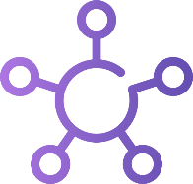
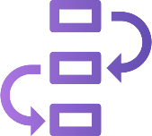
What Can Qmiix Do ?
Centralized Management
Advanced Workflows
Near-Zero Latency
Multiple Connections
Manage all your workflows or miixes from Web, Android or iOS
Create workflows with one Trigger and up to 5 actions
Real-time execution of your workflows
Connect with multiple accounts of the same app
Notes:
NO NEED TO CHANGE

Slide 12
Who Can Use Qmiix ?

Slide 13
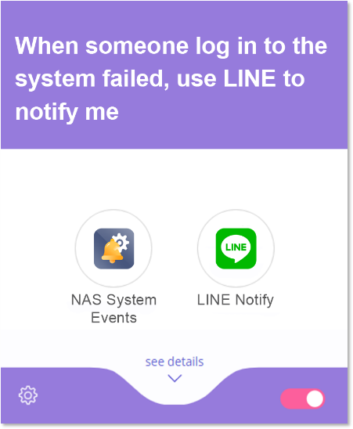
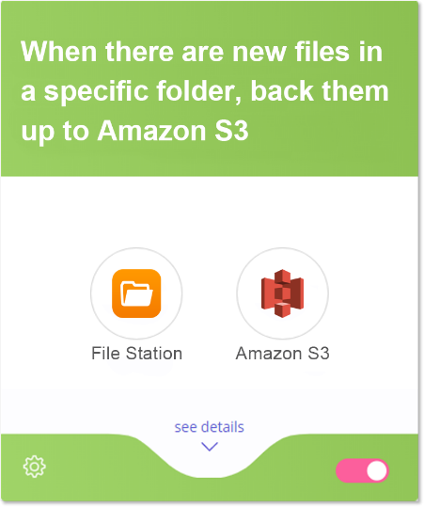
NAS Users
…
…
Check the system event at any time
Automatic backup of important files

Slide 14
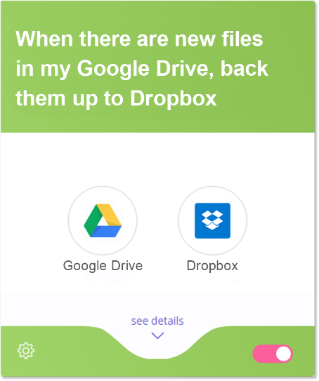
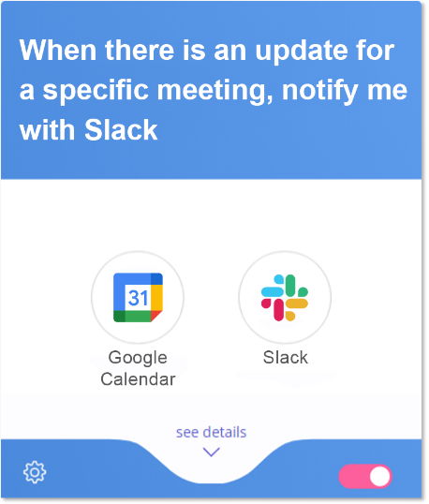
Google Services
…
…
Sync your data between different platforms
Track meeting information

Slide 15
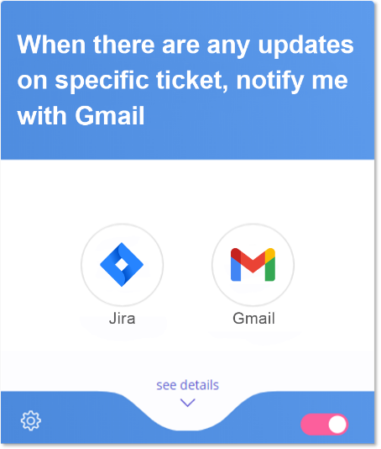
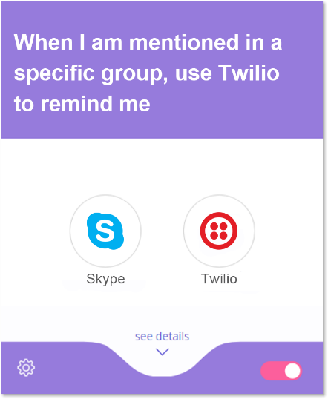
Collaboration team
Follow the task status
Never miss a message

Slide 16
How to Use Qmiix ?

Slide 17
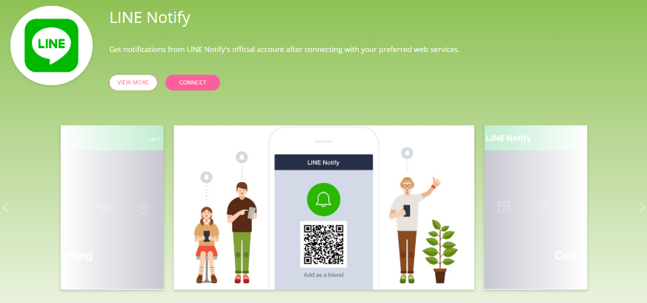
Account Management
Single-click app authentication
Multiple accounts supported for each application

Slide 18
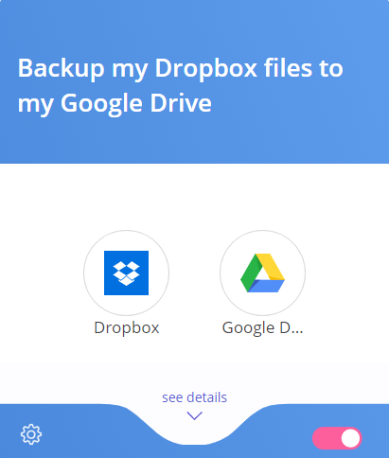
Miix
A Miix is a combination of a Trigger and one or more Actions
Trigger
Action(s)
from one app
from anther or same app
New file added to a specific folder in Dropbox
Download file to Google Drive

Slide 19
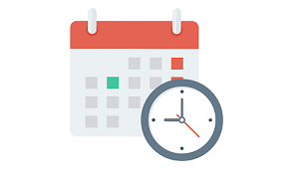
Qmiix Triggers
Trigger is a pre-defined condition which tells Qmiix to execute an action
App
Microsoft
OneDrive
Date and Time
NAS System
Trigger
Sample
New file uploaded in a specific folder
Every day at
8 A.M.
Someone log in to NAS failed
Notes:
NO NEED TO CHANGE

Slide 20
Qmiix Actions
Action is an execution of pre-defined task within the specified app
App
LINE Notify
File station
Jira
Action
Sample
Post a message
using LINE
Download a file from the URL
Create a new ticket
Notes:
NO NEED TO CHANGE

Slide 21
Advanced Miix
Get more work done with fewer miixes with AND
Ensure execution of critical cases with OR
Backup the file to my NAS
Inform me by sending a Line notification to myself
AND
Backup the file to my Dropbox
OR
AND
Inform me by sending a SMS to my phone via Twilio
New image file added to my Google Drive folder
Backup the file with my team members on Slack
New message from my boss on Slack

Slide 22
Supported Applications

Slide 23
Communication
Mobile
Email
Gmail
Twilio
Skype
Mobile
Device
Mobile
Media
Slack
Line
Teams
Zoom
Mobile
Location
Mobile
Notification
Coming Soon
Coming Soon
Notes:
Tile Color: #917ed6

Slide 24
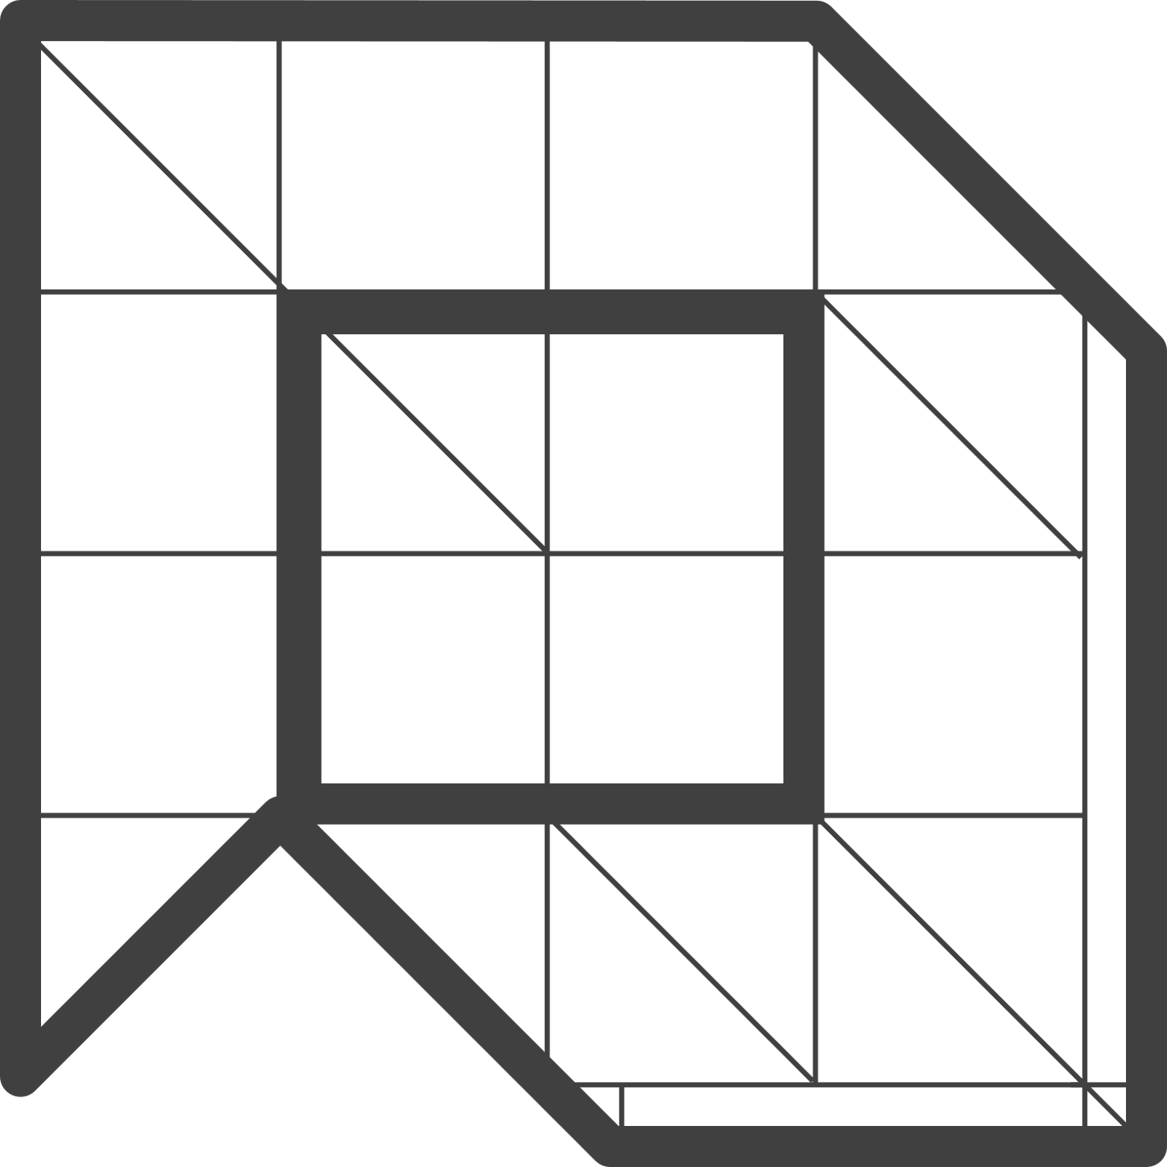
Cloud Service
NAS
Amazon S3
Oracle Cloud
Storage
Wasabi Cloud
Storage
Digital
Ocean
NAS
Control
NAS
Notification
Dropbox
Microsoft
OneDrive
Google
Drive
Google Cloud
Storage
QVR
QHora
Coming Soon
Coming Soon
Notes:
Tile Color: #917ed6

Slide 25
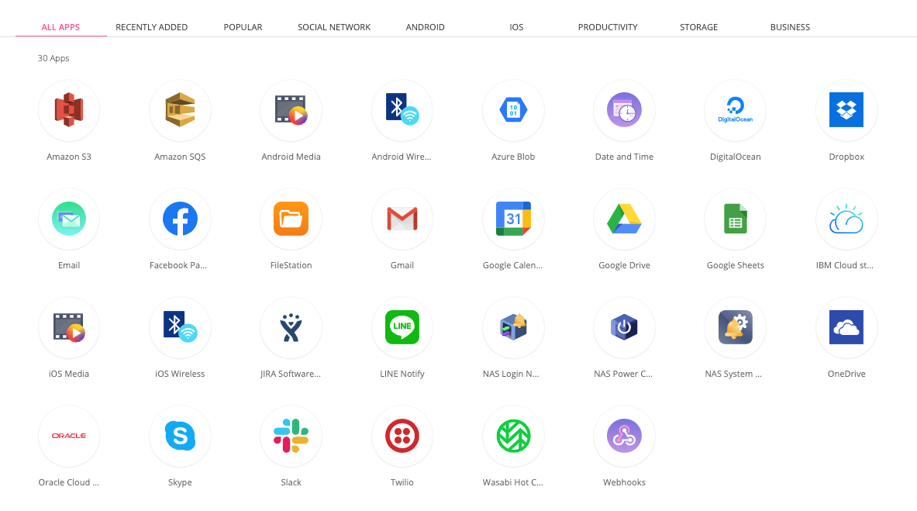
And more...
Notes:
Tile Color: #917ed6

