Slide 1
Notes:
https://www.qnap.com/zh-tw/utilities#f8_08

Slide 2
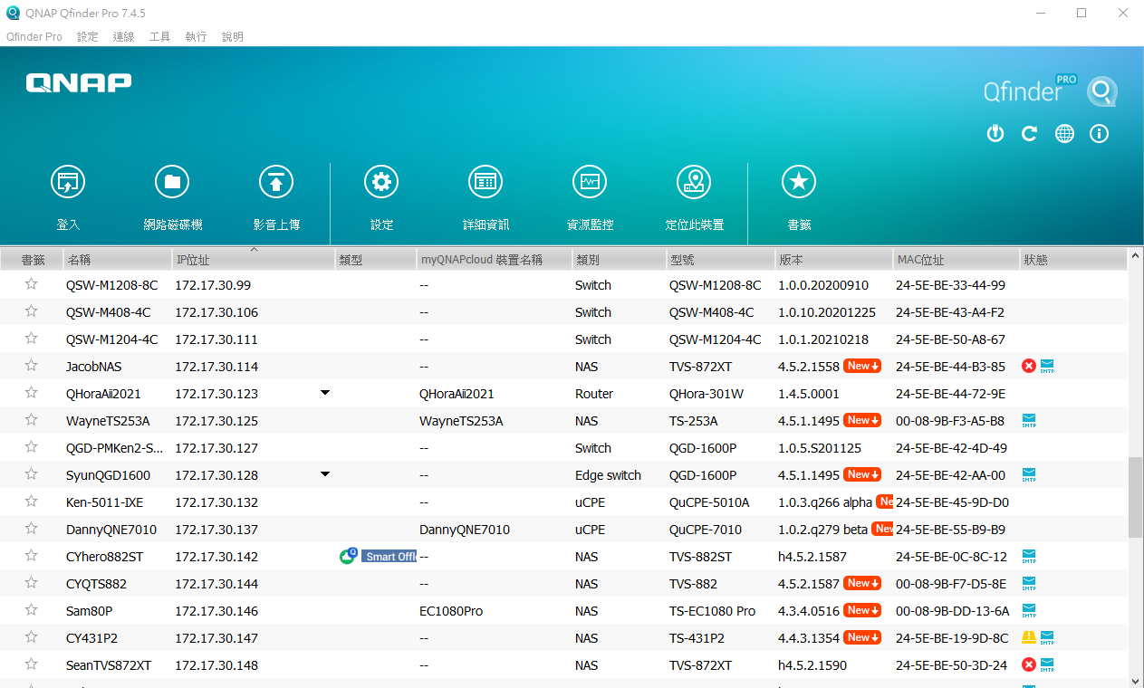
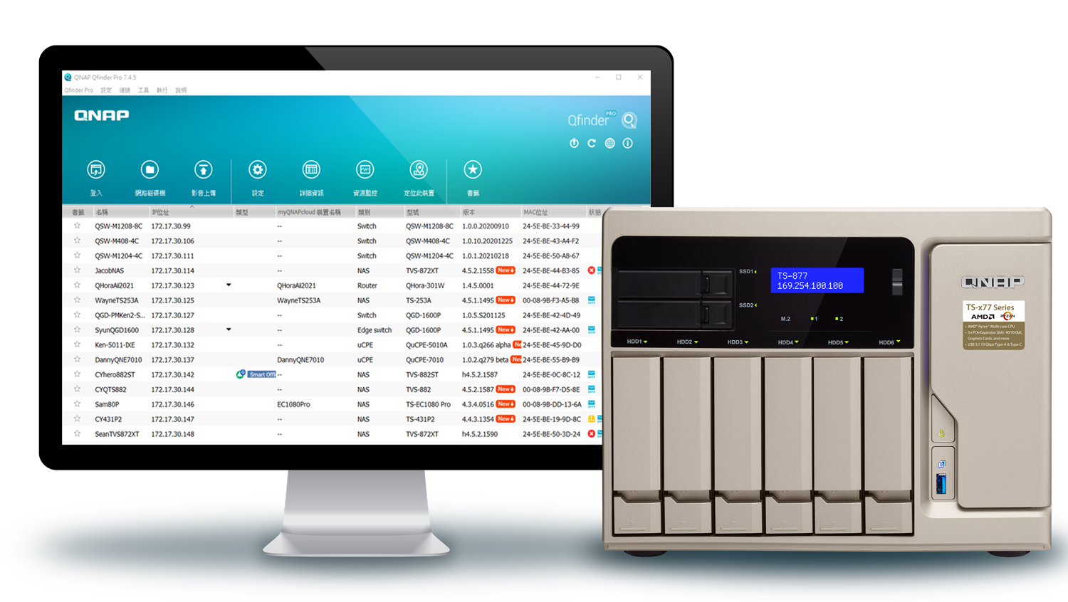
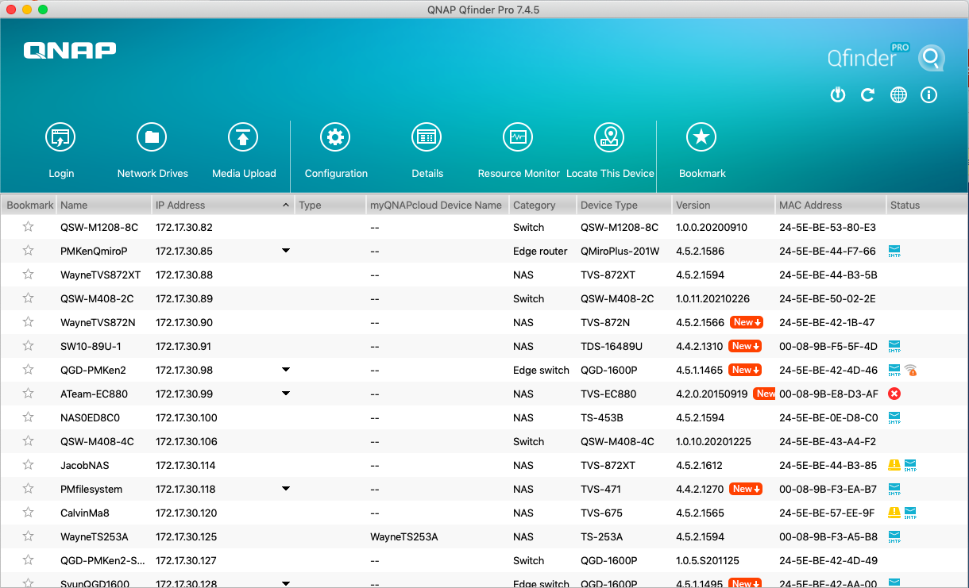
Qfinder Pro Easily find and configure NAS
更易找到 NAS，進行連線與設定

Slide 3
The Qfinder Pro you already knew…
Use Qfinder Pro to connect to QNAP NAS and perform initializations
Find and access all QNAP NAS over the same LAN

Slide 4
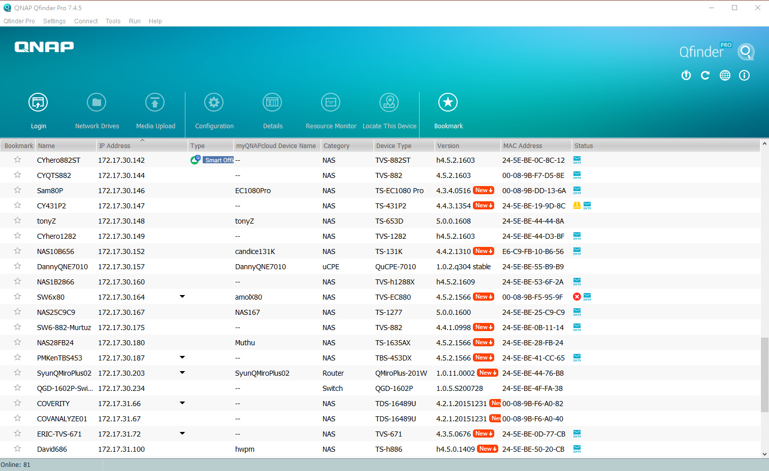
The Qfinder Pro you didn’t know…
Notes:
放各個功能的icon圖
但別小看Qfinder Pro

Slide 5
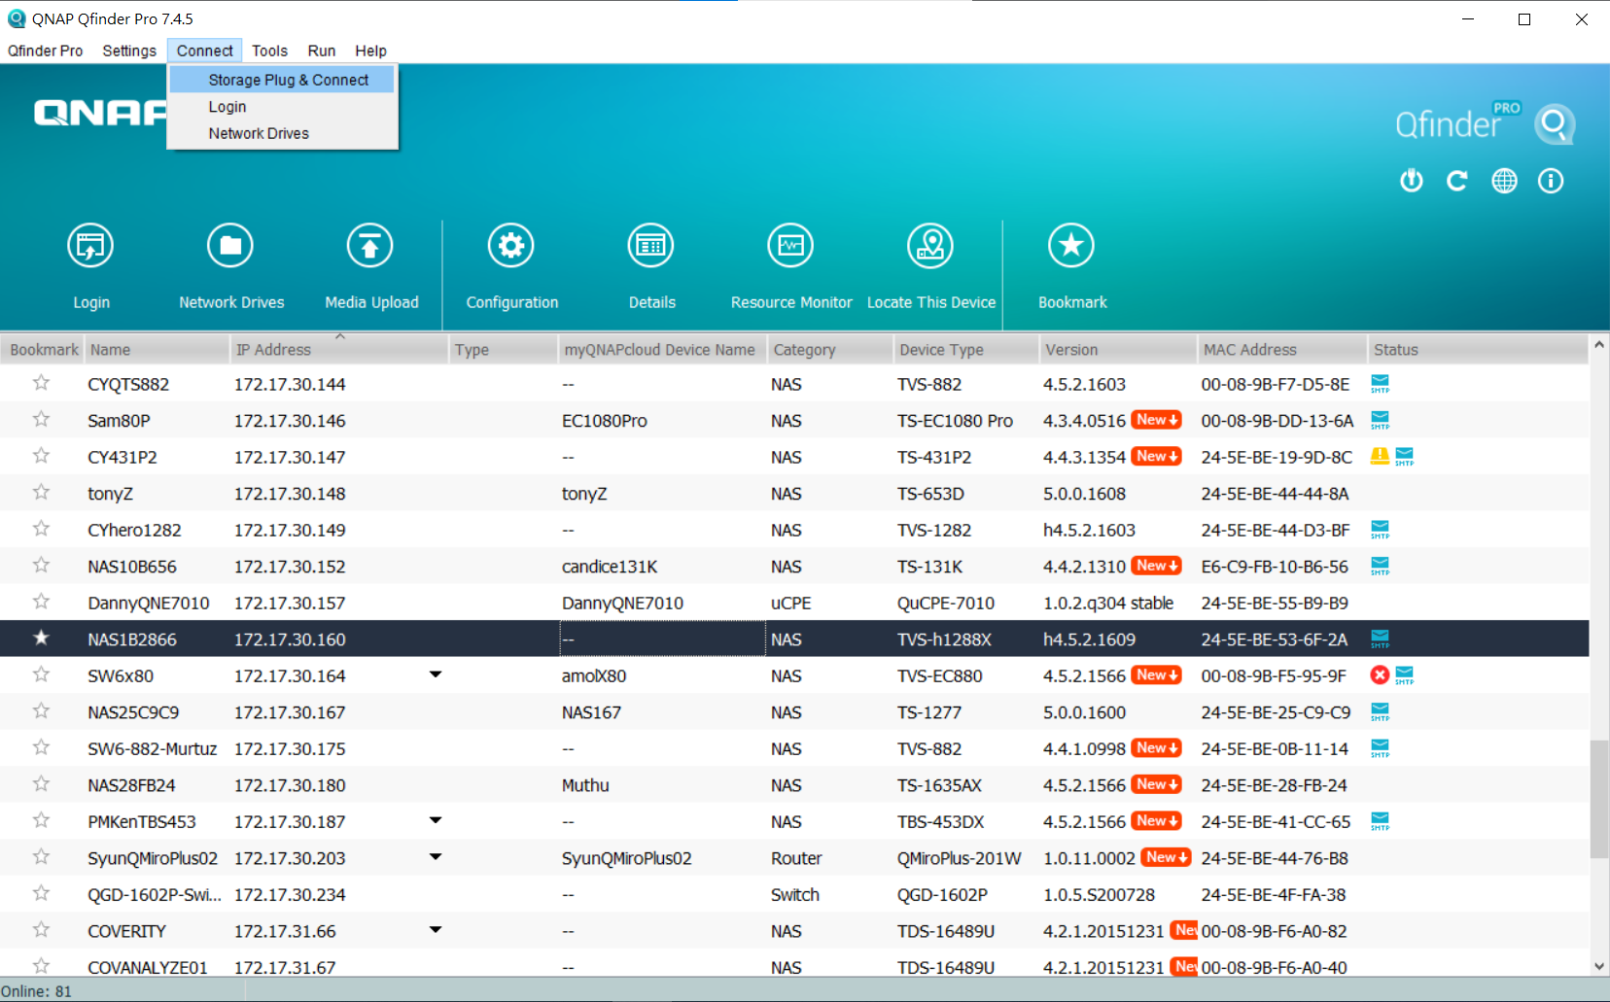
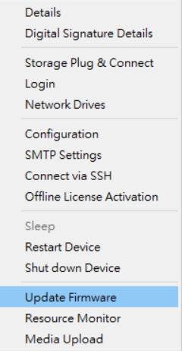
The Qfinder Pro you didn’t know…
1
Mount folders
Wake on LAN)
1
2
2
3
Firmware update
Right-click to select the option
3
Notes:
放各個功能的icon圖
但別小看Qfinder Pro

Slide 6
The Qfinder Pro you didn’t know…
QNAP Qfinder Pro
Other Assistant
Search and access to NAS
Network Drives
Wake on LAN
Search and access to NAS
Network Drives
Wake on LAN
Printer Device
NAS configuration
Resource monitor
Software update
Live update
Media upload
Mount folders
More functions
魔鬼藏在細節中....
Notes:
照片上傳
影片轉檔設定
資源監控
CPU 使用率
記憶體使用率
區域網路
儲存空間

Slide 7
Qfinder Pro Exclusive Functions
Insiders
only!

Slide 8
NAS overview on Qfinder Pro main page
透過Qfinder Pro主畫面就可以清楚與快速的看到NAS的資訊與狀態，包含：
Basic info
IP address
List all available IPs of selected NAS so users can access NAS via different routes.
Status
Quick view
New firmware available for this NAS
HDD nearly full or in abnormal state
NAS fatal error
NAS not initialized
SMTP notification not set
1
2
3
1
2
3
Notes:
放各個功能的icon圖
但別小看Qfinder Pro

Slide 9
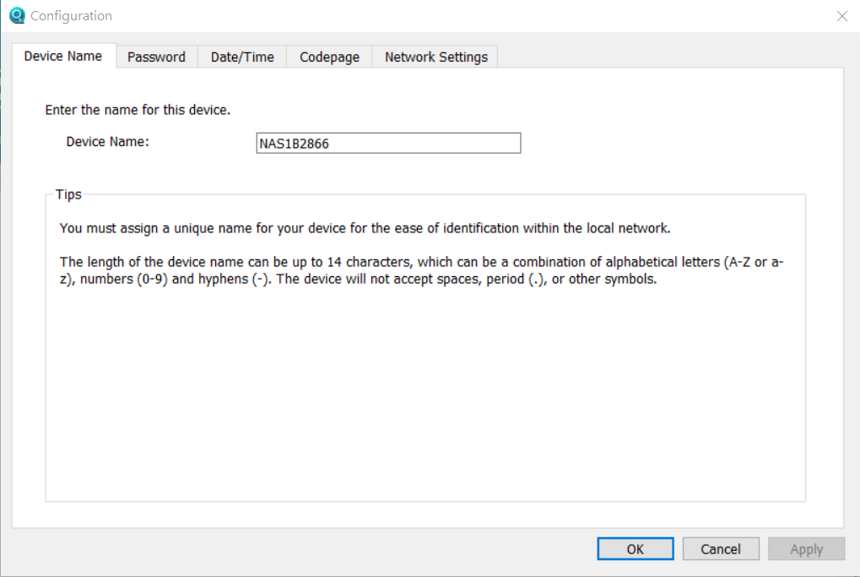
NAS Settings
Directly configure settings in Qfinder Pro, such as
General Settings
Device name
Password
Date / Time
Codepage
Network settings
SMTP Settings
Via SSH connection
Offline activate license

Slide 10
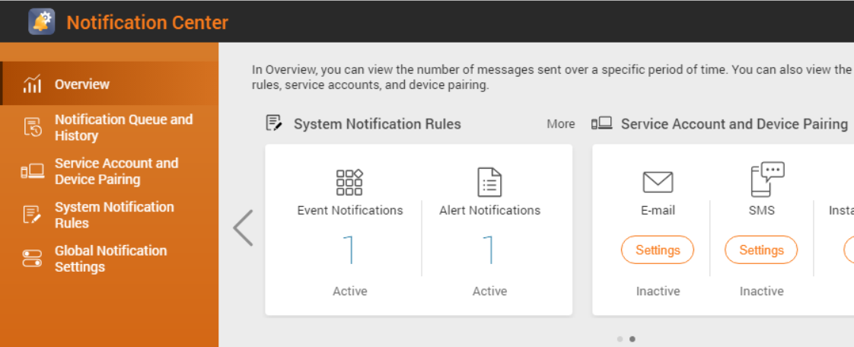
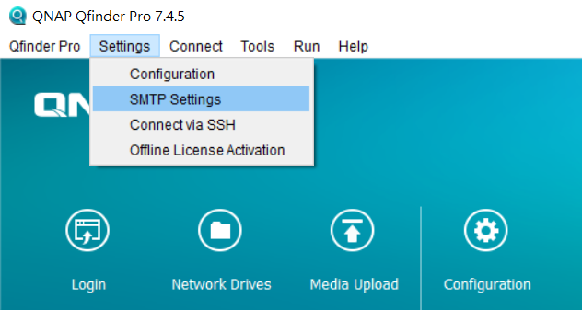
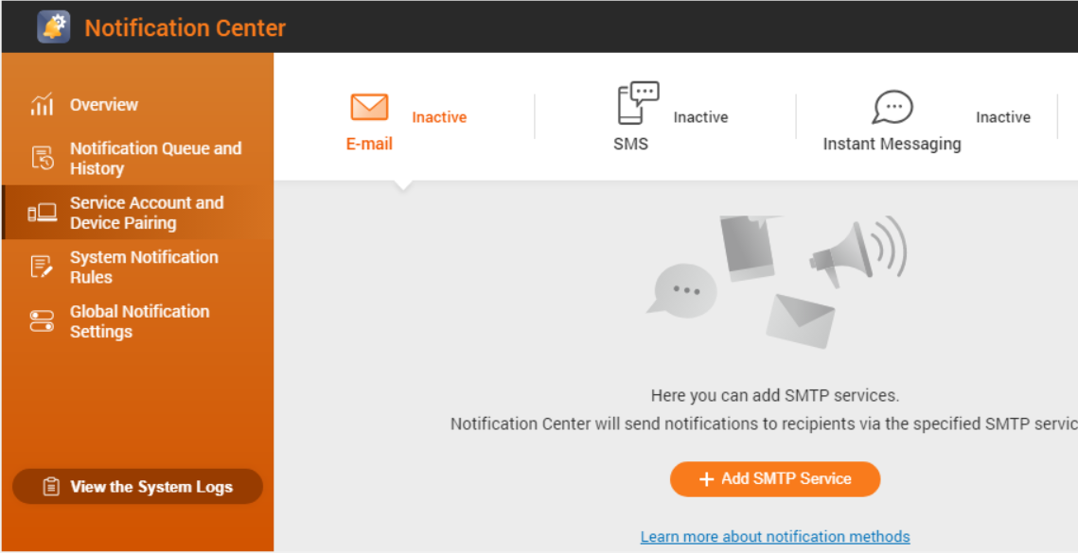
Quickly configure NAS SMTP notification
Directly configure SMTP settings in Qfinder Pro
1
Login NAS admin account
2
Enter SMTP account
3
Enable SMTP notification

Slide 11
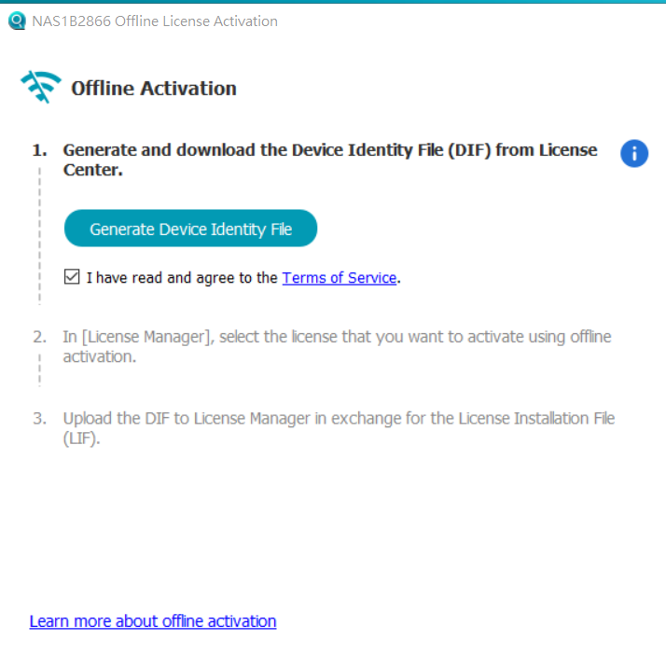
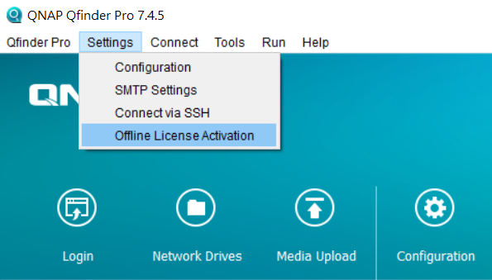
Offline Activate License
Directly download DIF file in Qfinder Pro
1
Login NAS admin account
2
Generate and download device identification file (DIF)
3
Upload DIF to license center and download License Installation File (LIF), then upload LIF to NAS in Qfinder pro

Slide 12
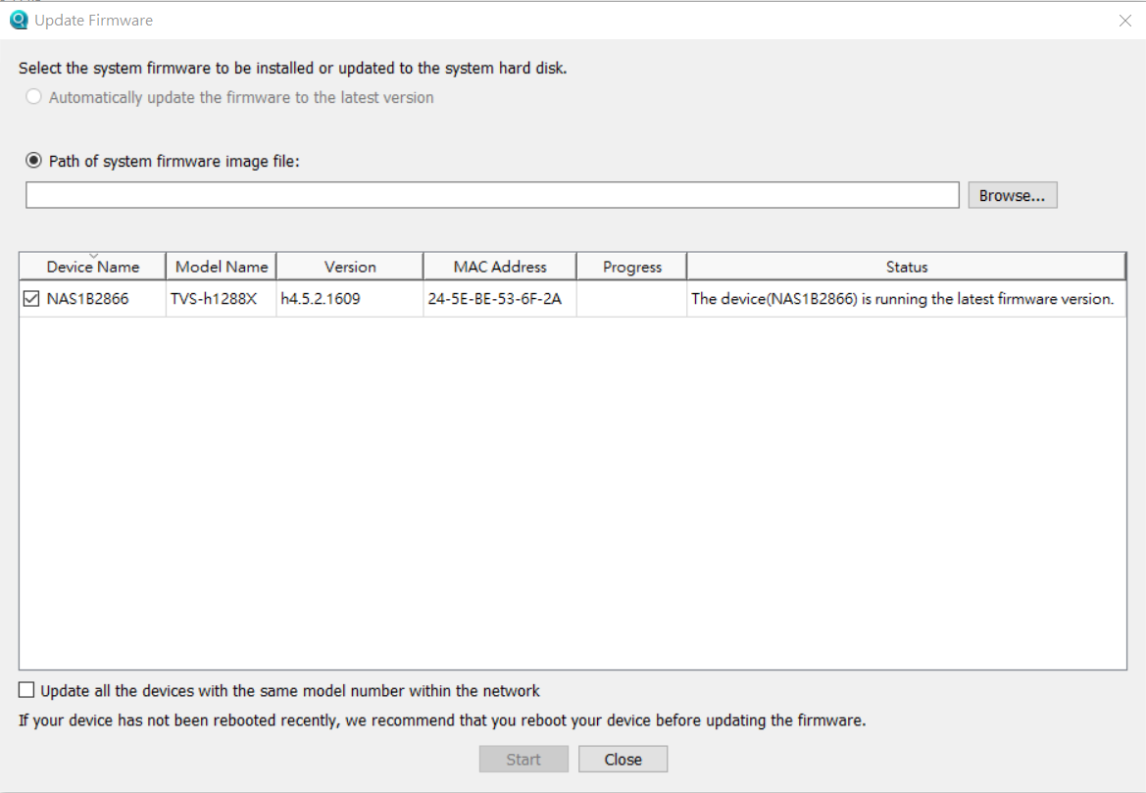
QTS Update
Use Qfinder Pro to update QTS directly without logging in to web interface
1
1
Live update (system firmware image file)
2
2
Manually upload (system firmware image file)
3
3
Update all NAS of the same model name within the network

Slide 13
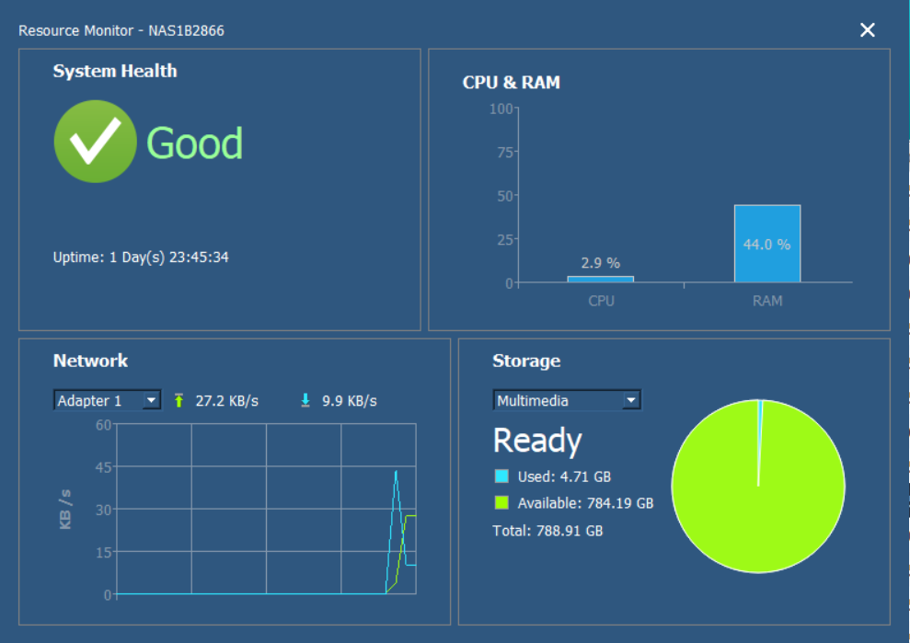
Resource Monitor
Quick overview of utilizations of NAS, CPU and memory. Also, learn about if NAS is in normal state or not.
Notes:
Resources monitoring helps you to find out the allocation of resources of your NAS.

Slide 14
Media Upload
Batch Upload local files (photos or videos)
Perform local transcoding/conversion, then upload to NAS. This solves the problem that some entry-level ARM-based models don't support hardware transcoding

Slide 15
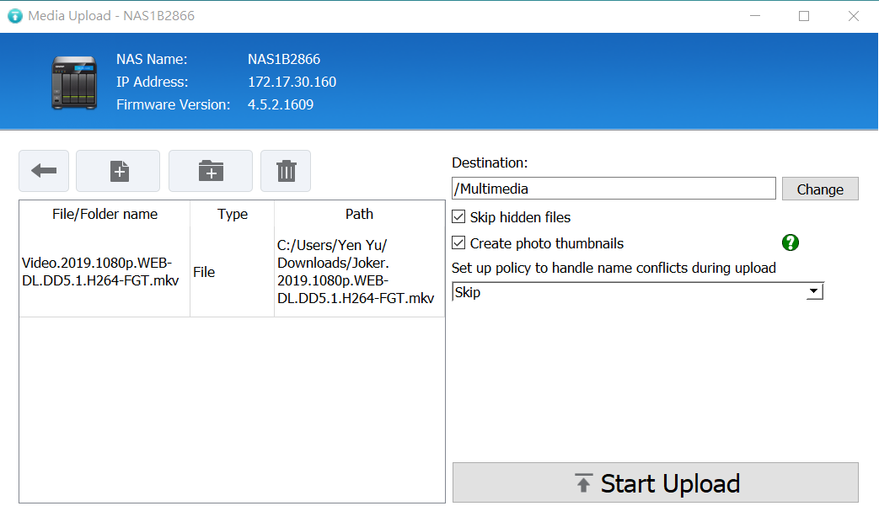
Media Upload – Advanced Settings
Photo thumbnails
File Conflict Policy
1
1
2
2

Slide 16
Mount Folders- Windows
Mount NAS folders in Windows File Explorer, allowing you to save time from having to log into QTS and access files
Create a Network Drive
Map the Network Drive
Create a new shared folder and mount it
Directly mount the selected shared folder
Notes:
您可以透過Qfinder Pro Windows的Storage Plug & Connect功能將NAS上的資料夾掛載到Windows的檔案總管。這是一個很方便的功能，掛載資料夾後，您不必登入QTS系統也可以由Windows檔案總管瀏覽並存取NAS上的資料。
請注意：Storage Plug & Connect目前只支援Qfinder Pro Windows版本。

Slide 17
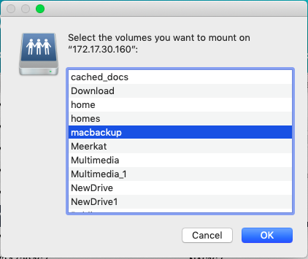
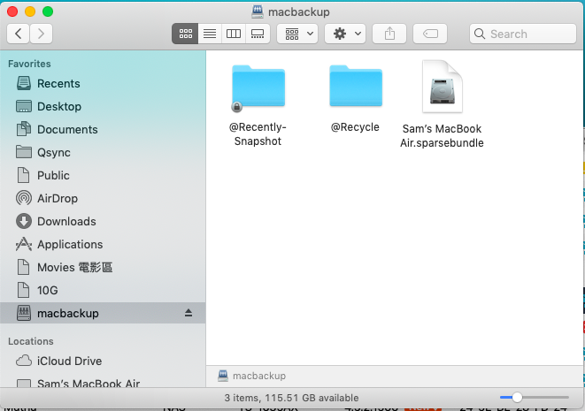
Mount Folders- MacOS
Mount NAS folders in macOS Finder. Even you restart the computer, mounted folders are still there.
Auto configure appropriate system settings and enhance transmission efficiency of SMB connections in macOS.
1
2
Notes:
MAC也可以

Slide 19
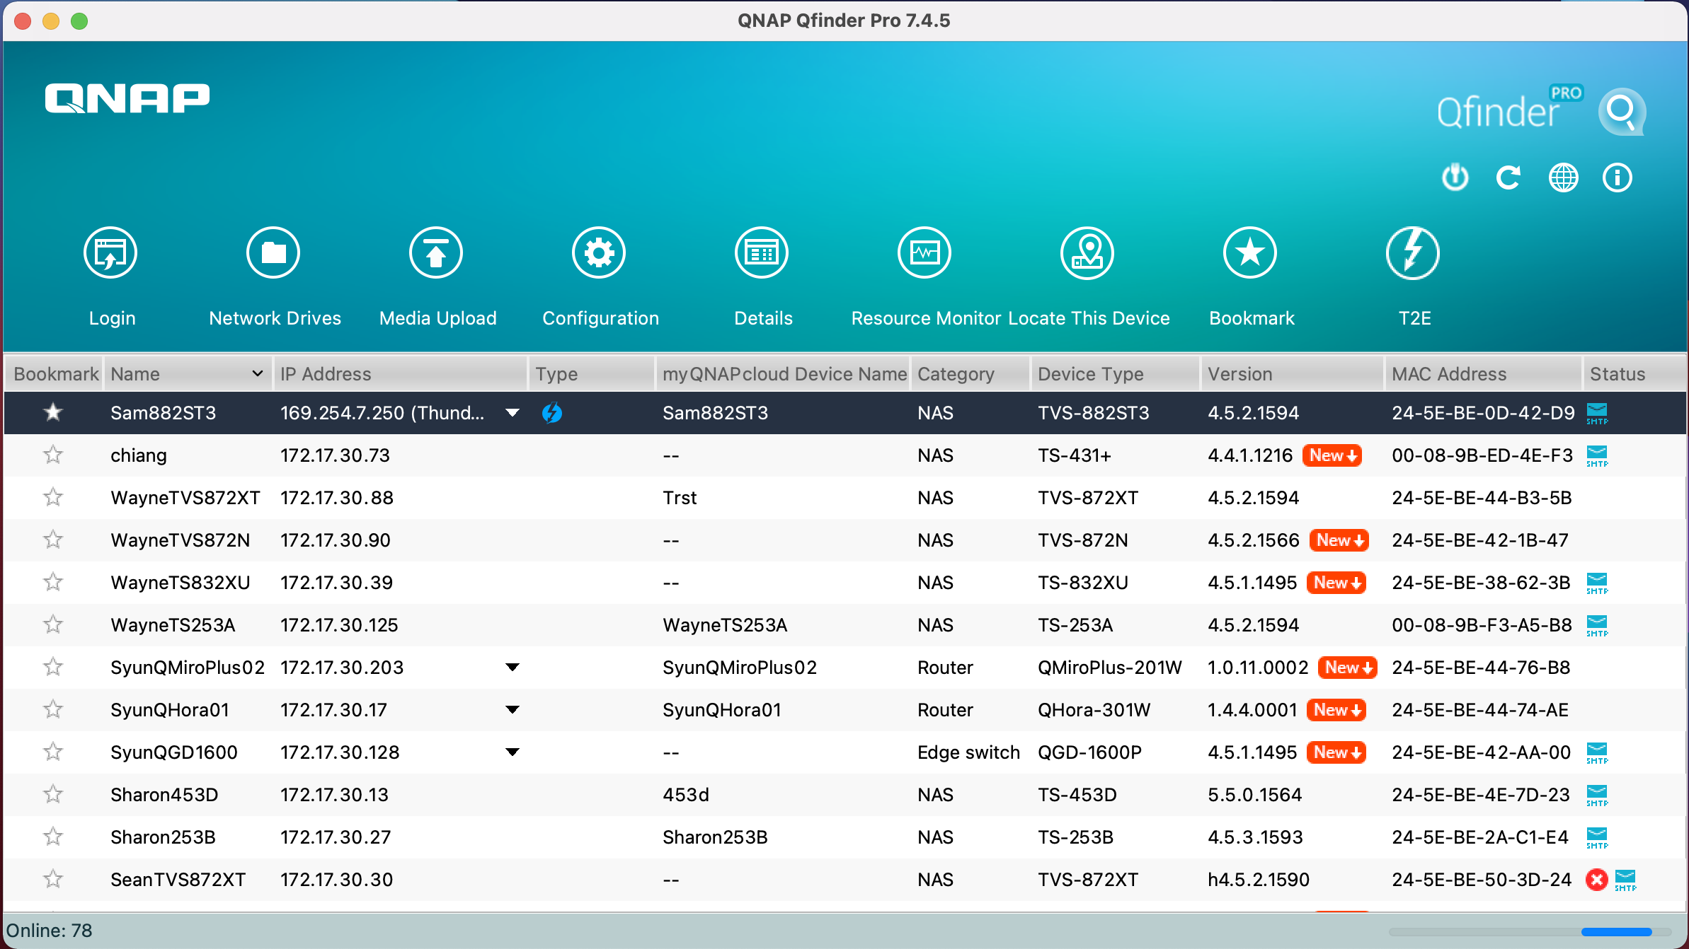
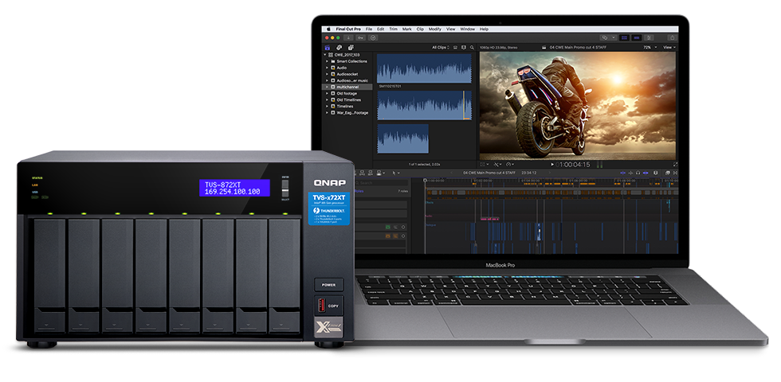
Search Thunderbolt NAS and Create Connection
Quickly find Thuderbolt NAS

Slide 20
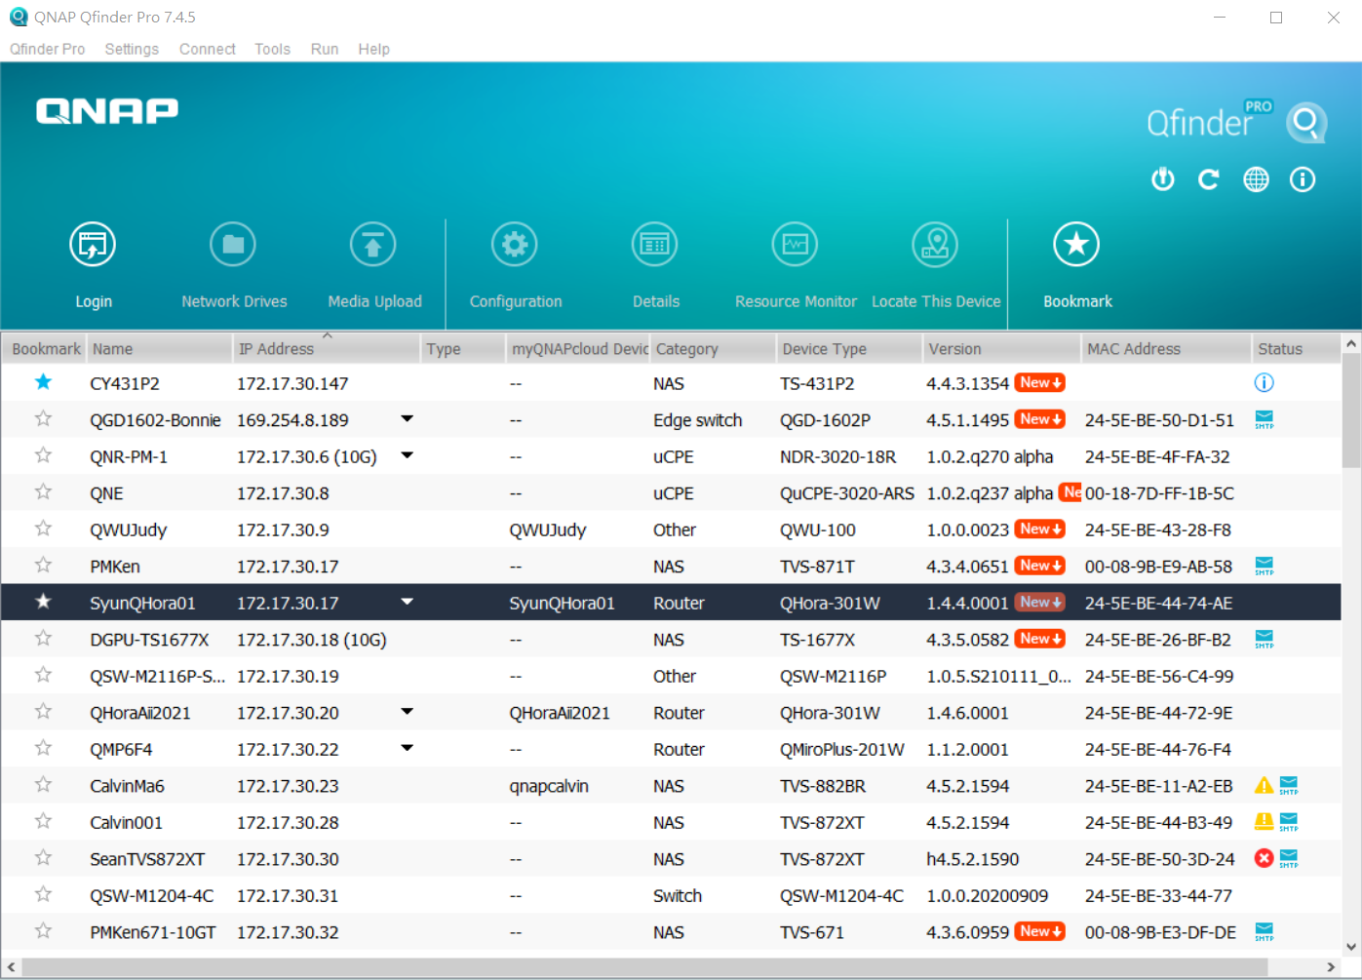
Search Wifi NAS
Quickly search Wifi NAS
QHora-301W
QMiro-201W

Slide 21
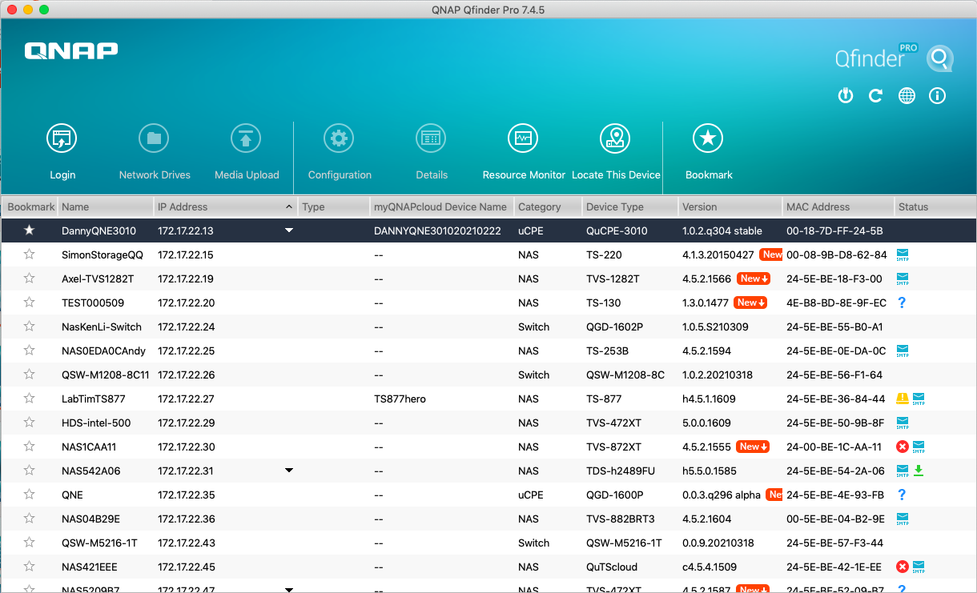
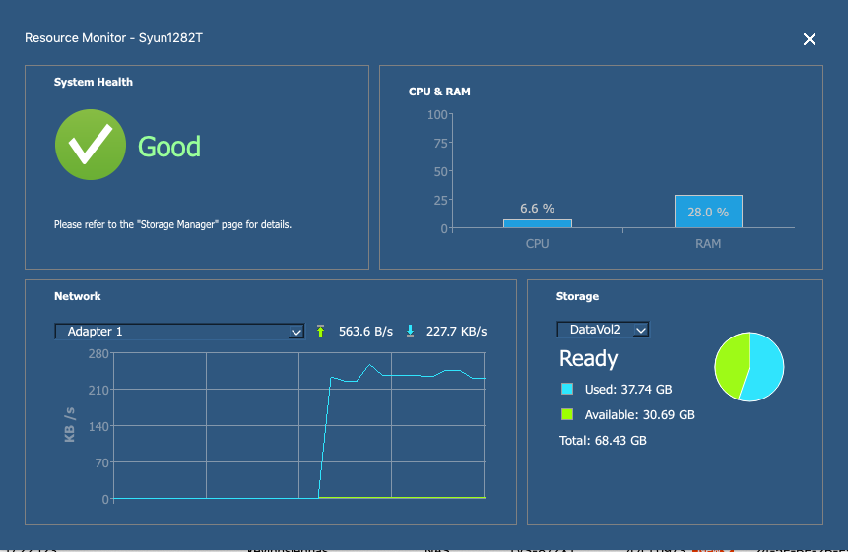
Search QuCPE Devices
2
1
Search QuCPE devices
Display resource monitor
1
2

Slide 22
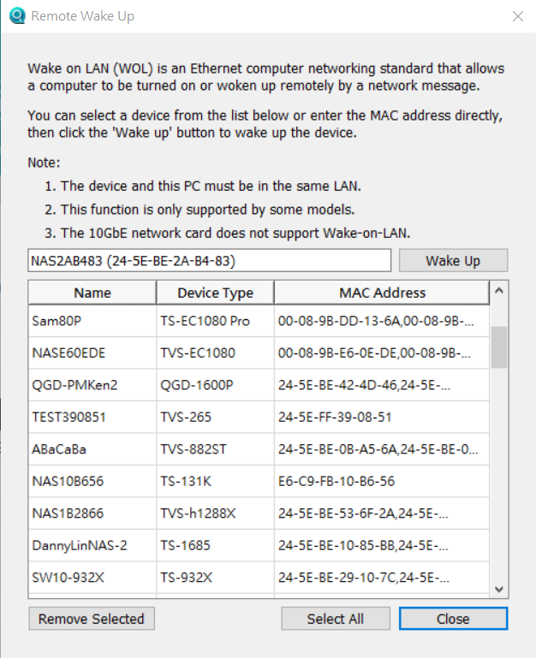
Wake On LAN
Shut down NAS and save power when not used. Remotely wake up NAS in sleep mode when you need to use NAS through Wake on LAN.
Qfinder Pro
Function Highlight
Memorize NAS that was previously found. Even it is not found now, it can be still woken up.

Slide 23
Qfinder Pro version check and live update
Qfinder Pro automatically check for new versions and show a notification that there is a new version available. Update now to enjoy new functions and better user experience!
Notes:
Qfinder Pro version inspection and online update
Qfinder Pro automaticlly inspect and remind you if there is a updated version. In that case, you could use the newest and best version of Qfinder Pro and yet have a perfect experience.

Slide 24
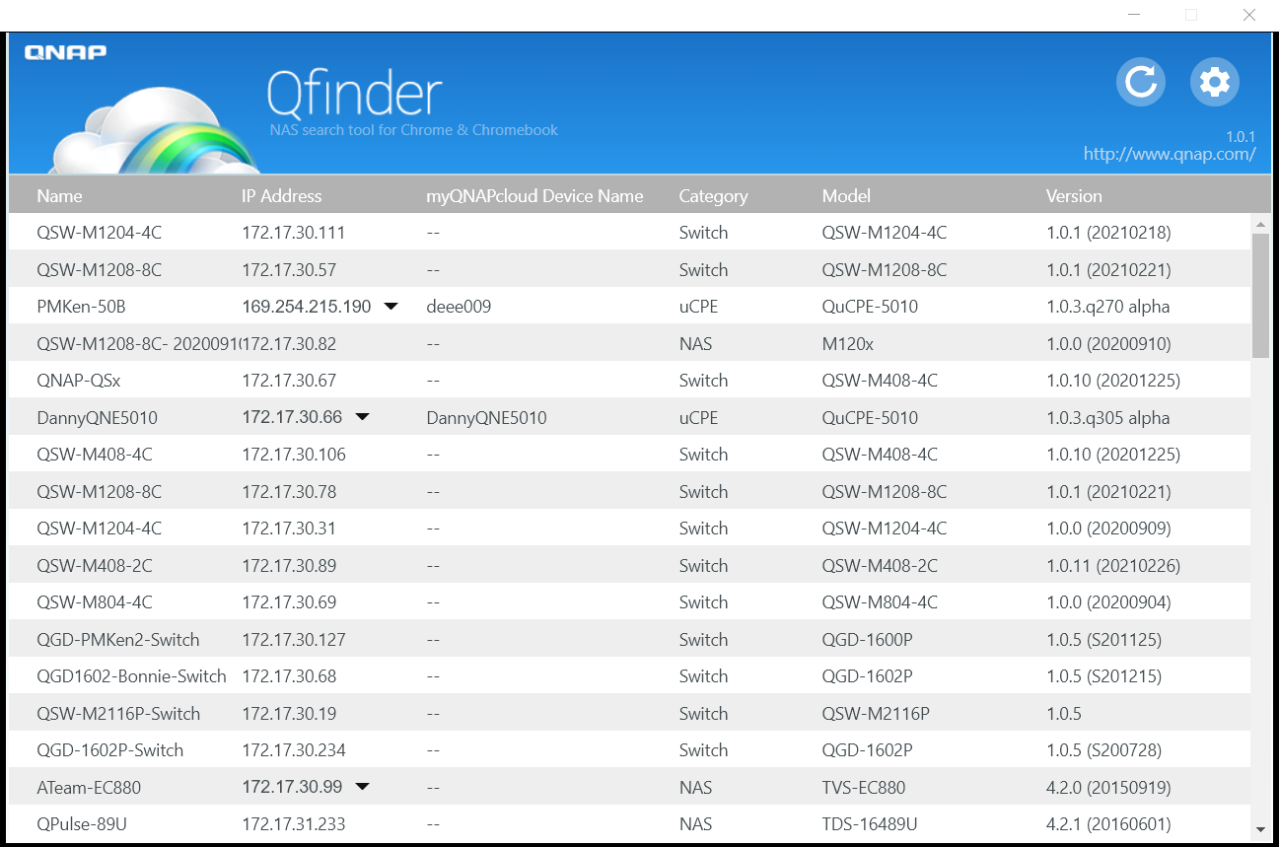
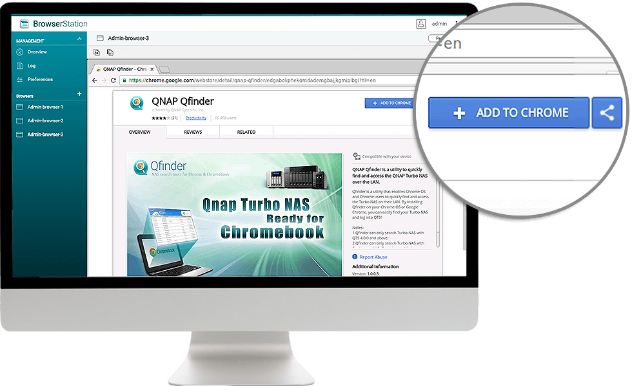
Qfinder Pro for Chrome & Chromebook
Install QNAP Qfinder browser extension for Chrome to quickly find and access QNAP NAS on the LAN

