Slide 2
Have you ever wanted this?
How to play multimedia contents stored on my NAS on TV?
Surf the website ?
View IP cam feeds on TV?
Access VM on my NAS and display it on TV?

Slide 3
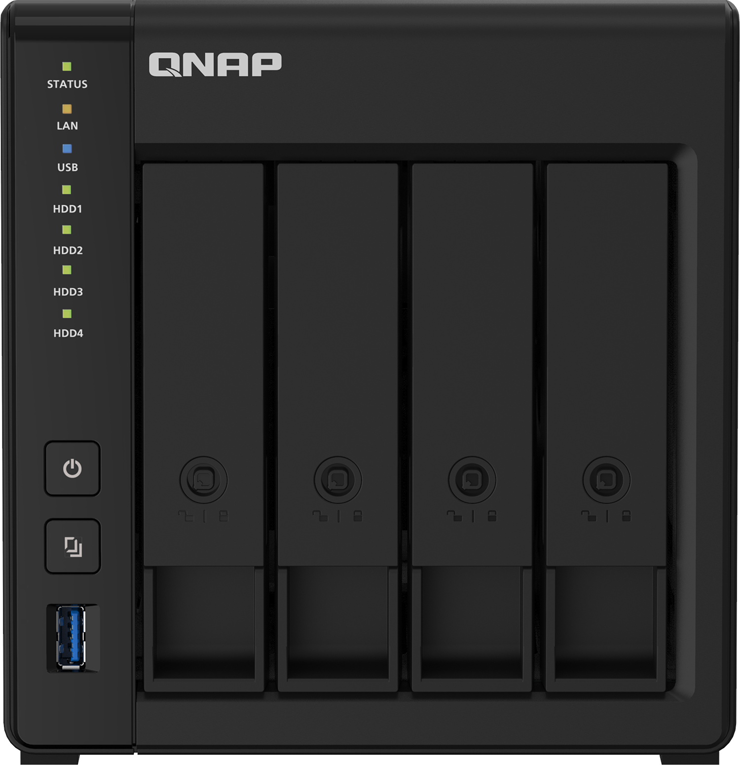
One NAS solves it all, period.
Versatile configuration for a cost effective solution
Use Windows utilities
View surveillance feeds
Surf the web
View photos/videos, listen to music
NAS management
Note: only supported on x86 processor NAS

Slide 4
HD Station – Top installed app
Local display - Why is it different from others
Function | QNAP | S brand | A brand
Local display | v | x | v
Multimedia playback | v | x | x
Surveillance feed playback | v | x | x
Virtual machine desk | v | x | x

Slide 5
All about the HD Station
Architecture
Configuration
introduction
Local display technology
Various configuration method for your need
Simple platform,
easy to use
Applications
Demo

Slide 6
HD Station Architecture

Slide 7
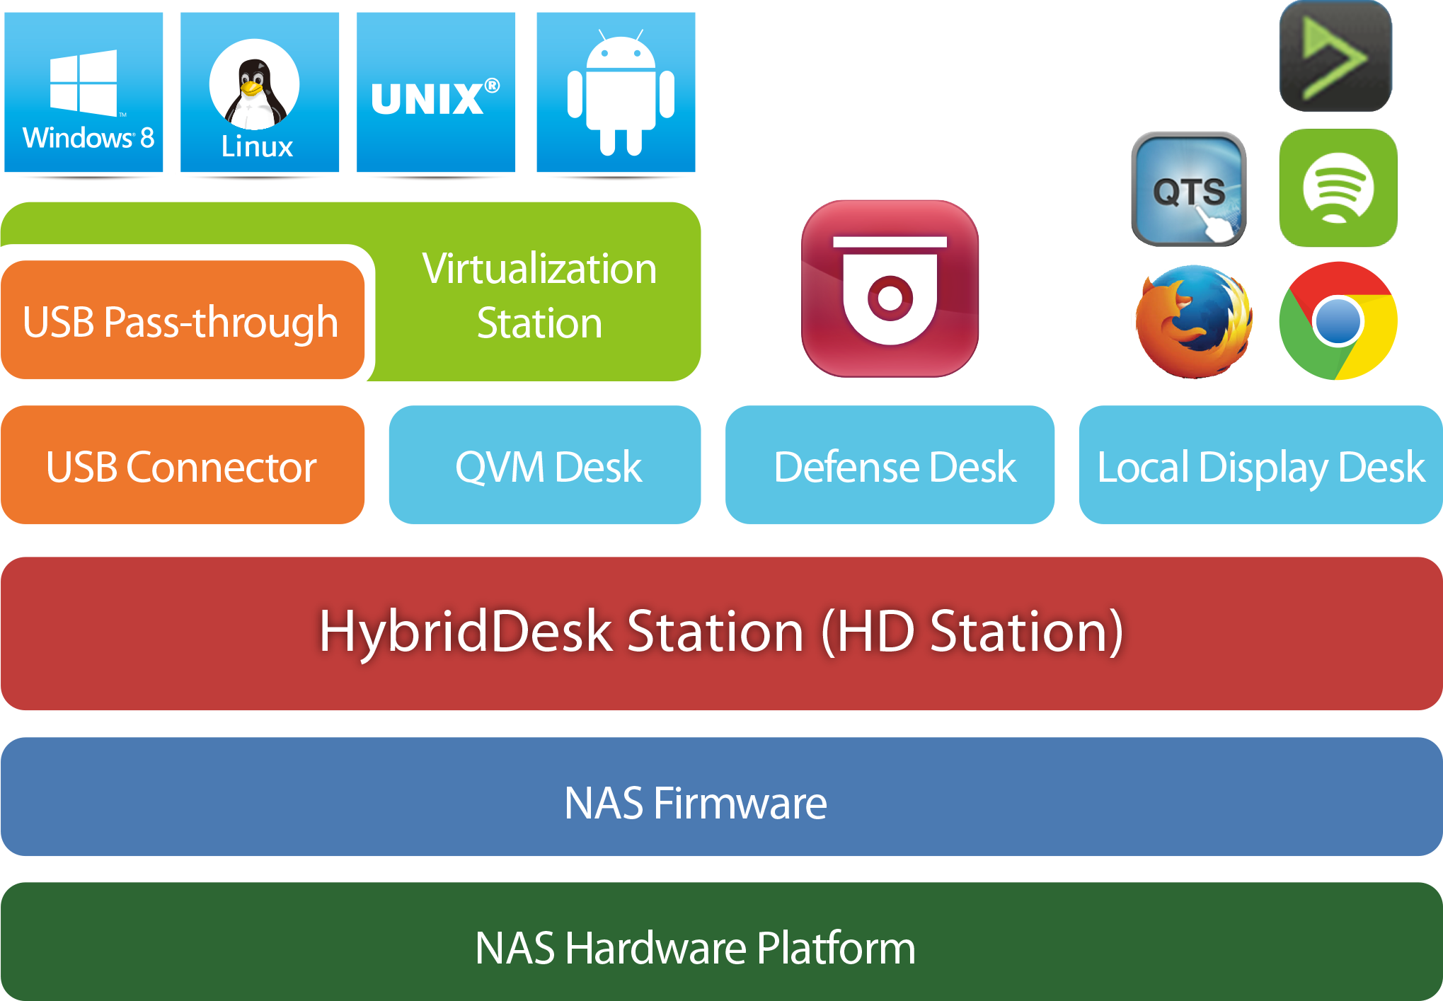
HD Station
Surveillance Desk
QTS/ QuTS hero Operating system
NAS with integrated GPU or discrete GPU
Notes:
NAS firemware - > QTS/ QuTS hero Operating system
NAS hW -> NAS with integrated GPU or discrete GPU

Slide 8
Models with Built-in HDMI
Flexible, cost saving
TS-451D2
Mouse &
Keyboard
TV remote controller
Qremote App
Recommanded models : x53D, TBS-453DX. x72X/x72XT, h1688X/h1288X

Slide 9
Models using discrete GPU
Mouse &
Keyboard
TS-x73A series
NVIDIA graphics card
TV remote controller
Qremote App
Recommanded models : x73A, h686/h886
Note: Need to install NVIDIA GPU Driver which can be found in app center

Slide 10
Basic Operations

Slide 11
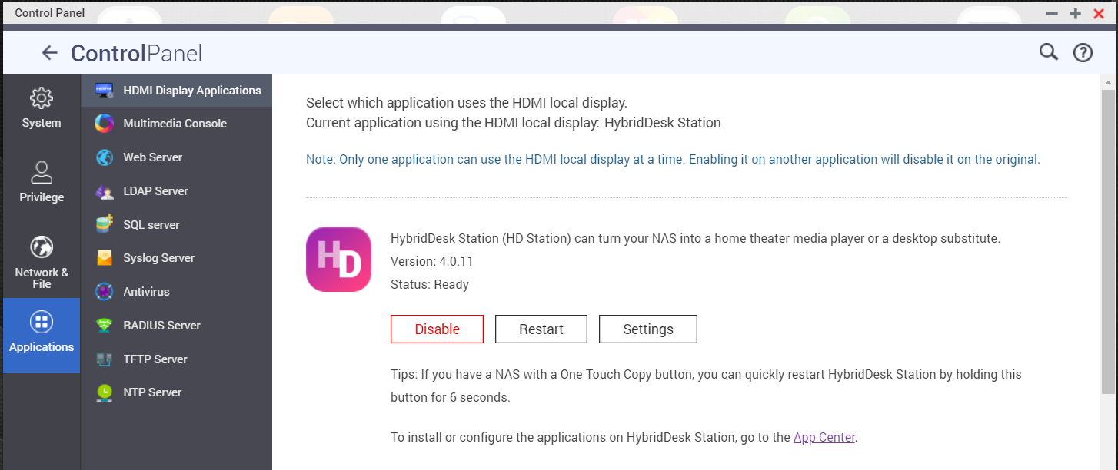
Install/Update the Application
Manage HD Station via QTS

Slide 12
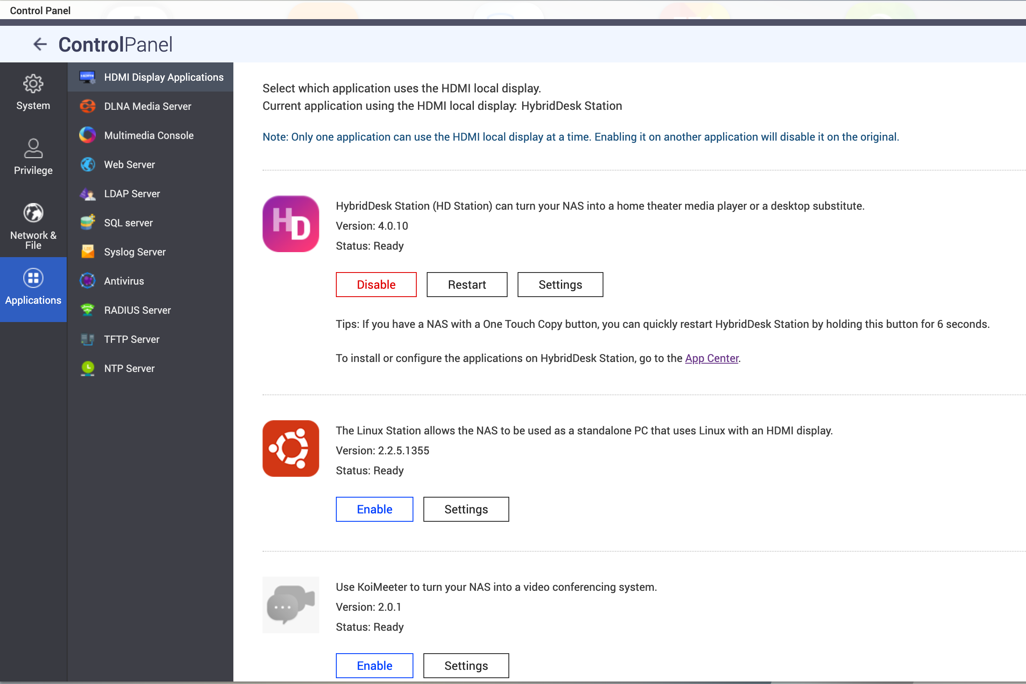
Allocate GPU/HDMI output
Local display exclusive allocation
HD station
Linux Station
KoiMeeter

Slide 13
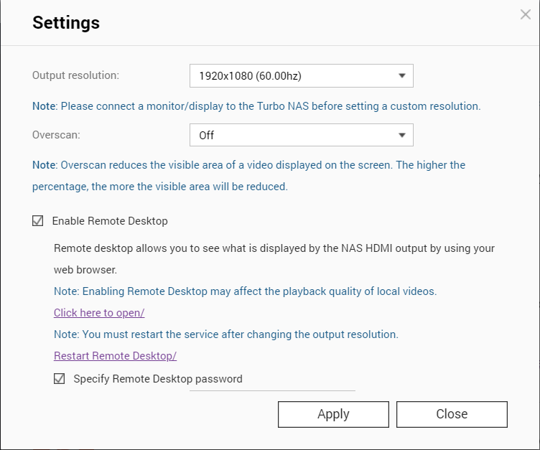
QTS - HD Station Setup
Set up HD Station via QTS
Resolution: set the resolution, just like using a PC
Overscan: Adjust the screen display size
Remote desktop: Allow you to view the HD Station display via web browser.

Slide 14
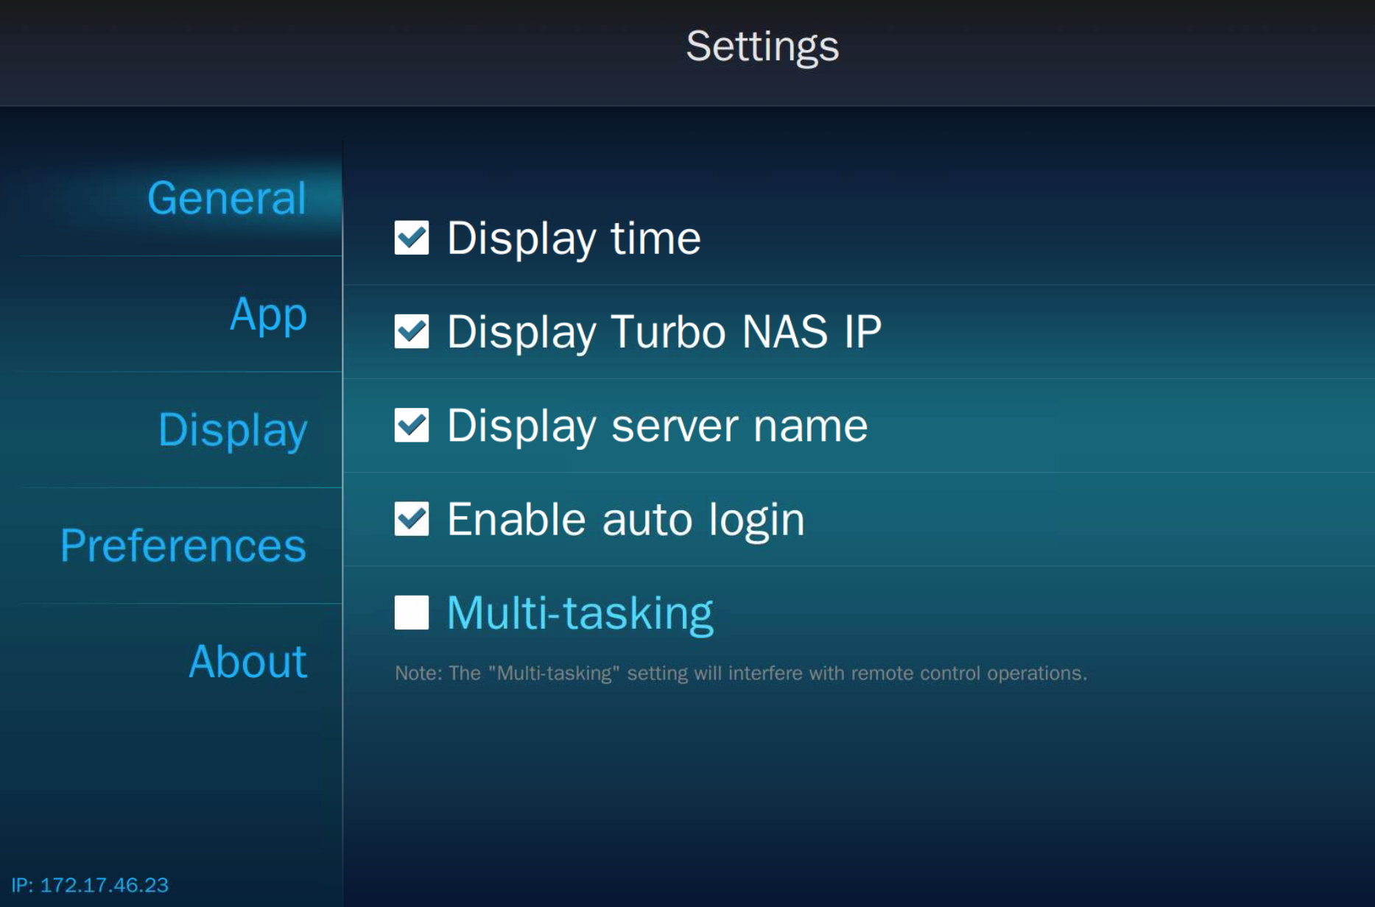
Local Display - General Settings
Various functions and settings
General settings
Display time
Display NAS IP
Display server name
Enable auto login
Multi-tasking
* Some apps are not designed for
multi-tasking.

Slide 15
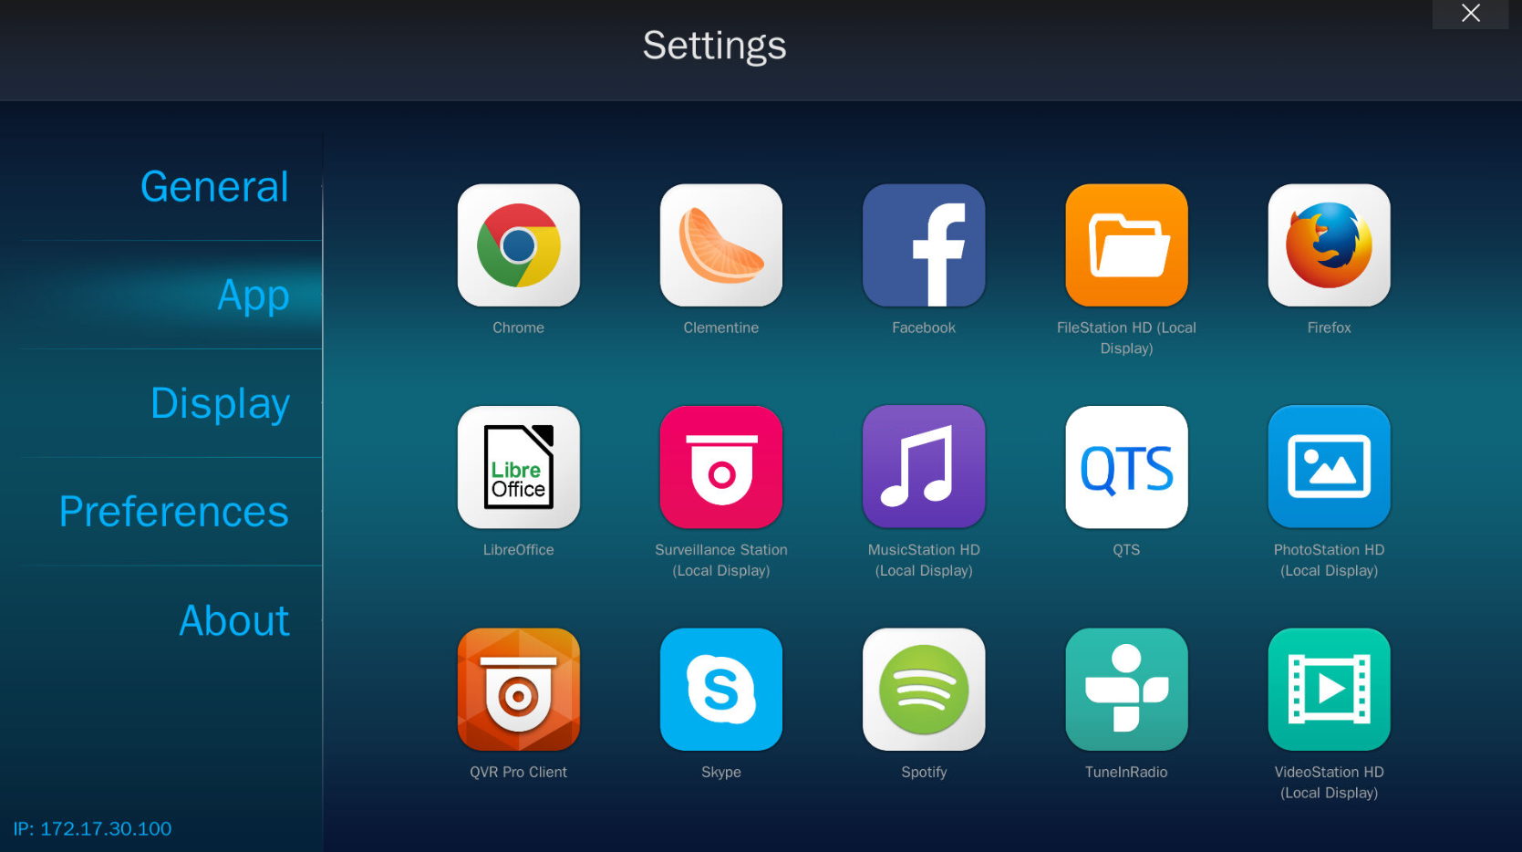
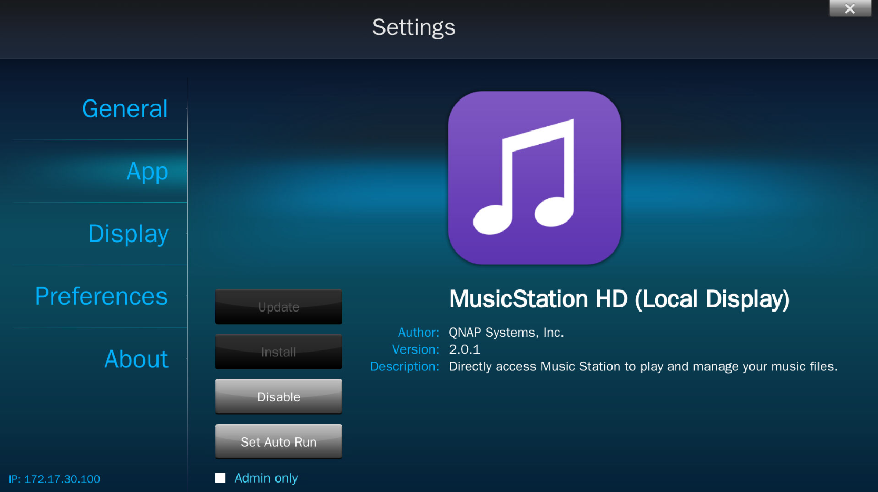
HD Station Settings - Applications
Manage applications for HD Station

Slide 16
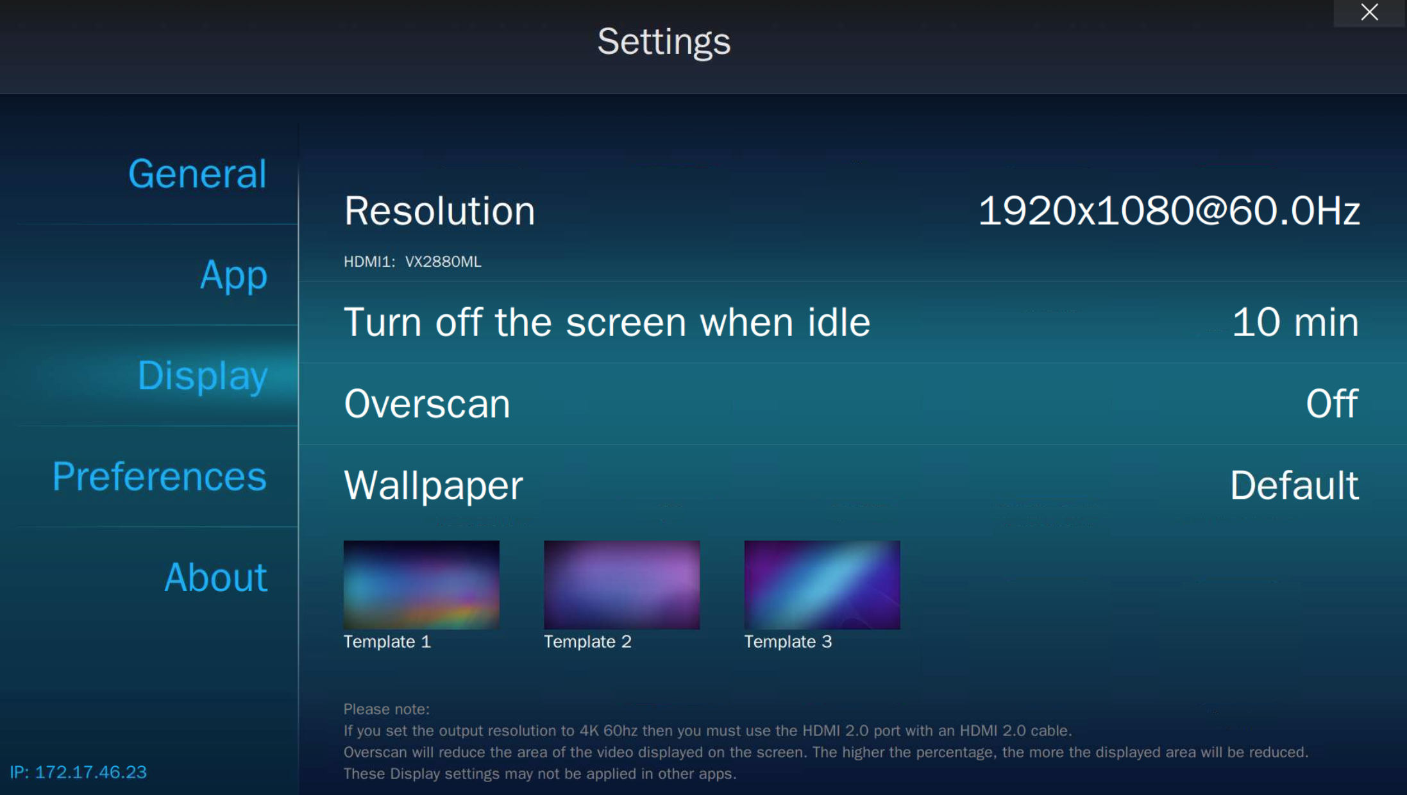
HD Station Settings - Display
Manage display settings
Manage display settings:
Resolution
Turn off the screen when idle
Overscan
Wallpaper

Slide 17
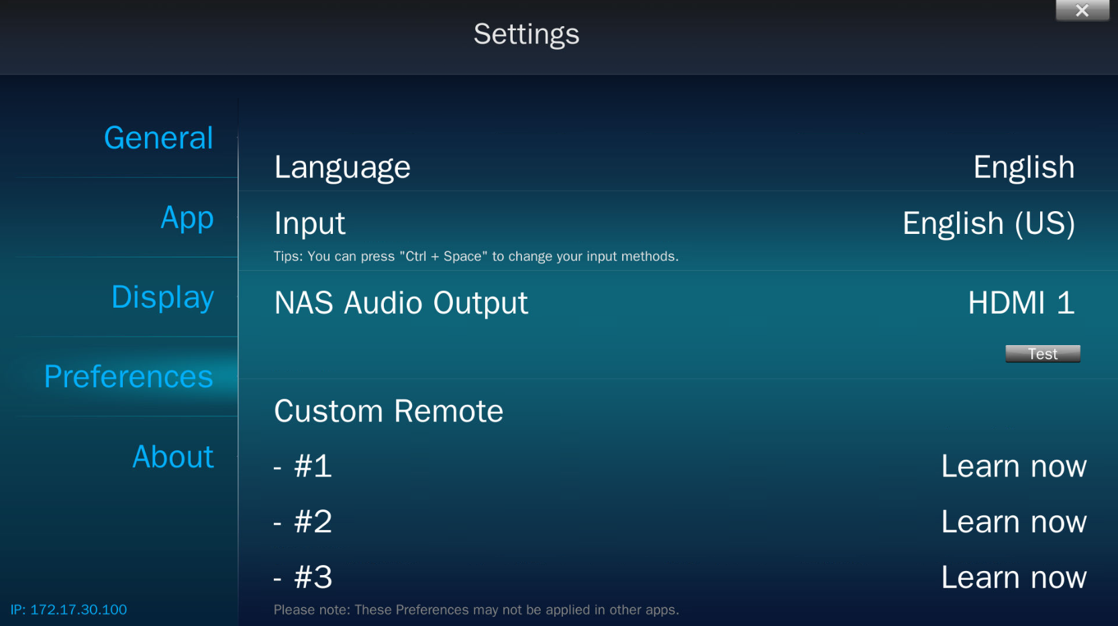
Preferences
Various configurable functions
Preferences：
Languages
Input
Audio output: Define the NAS audio output
Custom remote: Use other remotes for HD Station

Slide 18
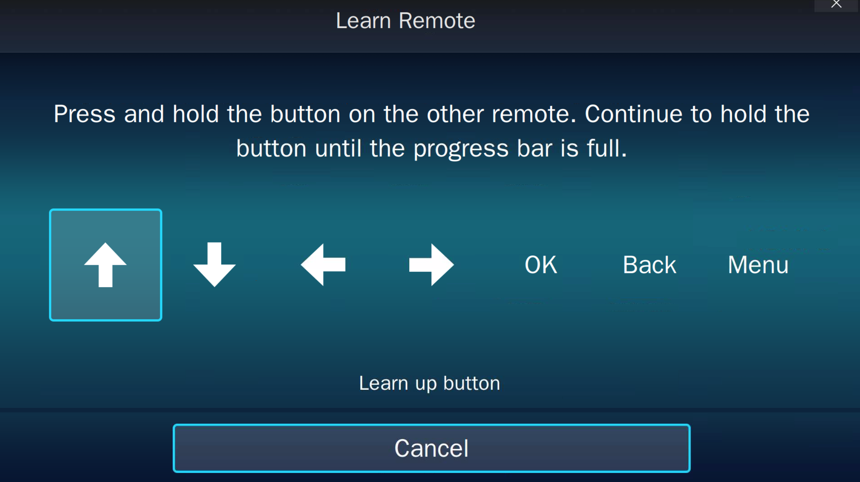
Remote learning
Using a remote that you already have
TV remote controller
* Only supported models which included the IR sensor

Slide 19
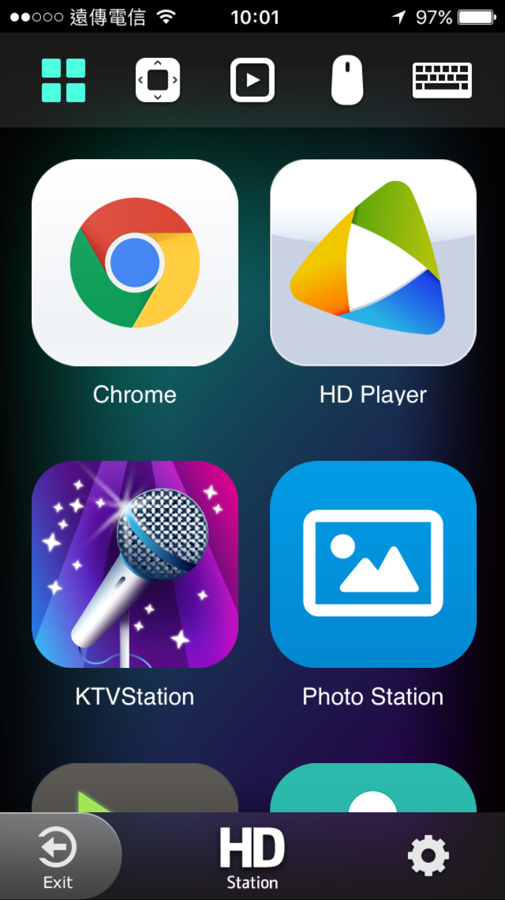
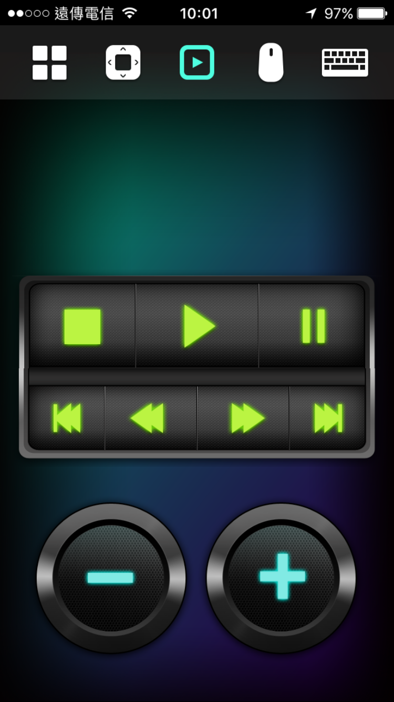
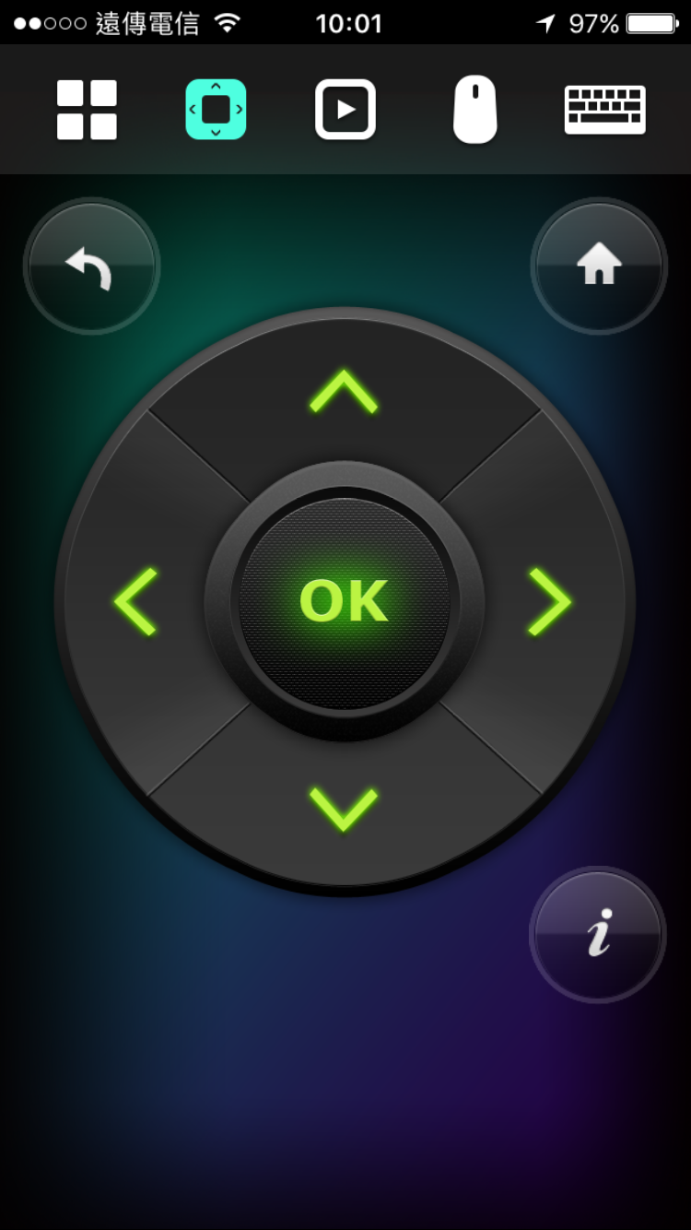
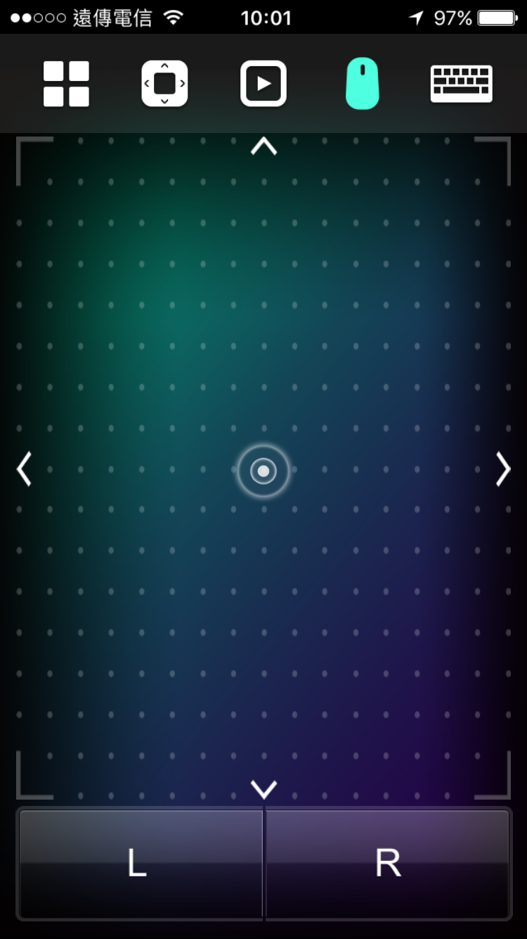
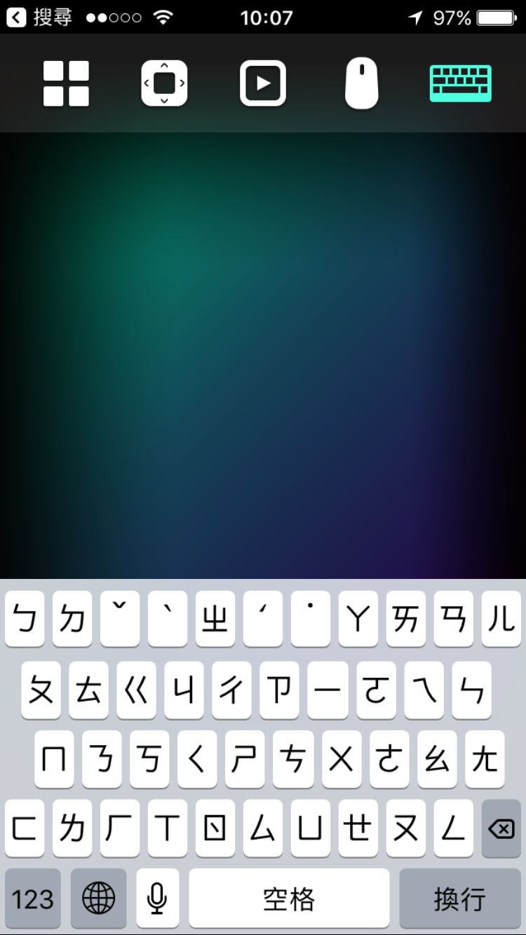
Qremote
Using Qremote on smart devices
* Supports iOS & Android devices.

Slide 20
Rich Applications

Slide 21
Rich Applications
QTS
Management
Browser, Communication
& Office tools
Multimedia Applications
QTS
QTS
FileStation HD
PhotoStation HD
VideoStation HD
MusicStation HD
QVR Pro Client
Browsers
Chrome
Firefox
Communication
Skype
Facebook
Office tools
LibreOffice
Multimedia
HD Player
Clementine
Spotify
TuneInRadio
Meet almost all your needs

Slide 22
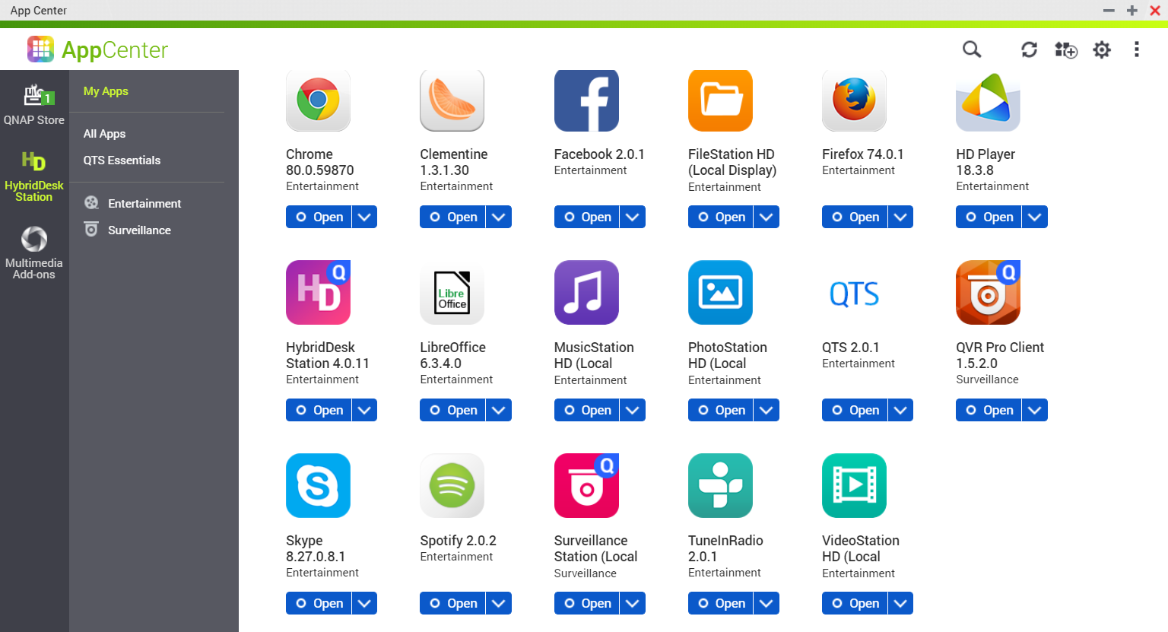
HD Station Official Apps

Slide 23
Third Party Applications
https://hk.xfastest.com/100983/nas-user-guide-add-app-repository-into-qnap-app-center/

Slide 24
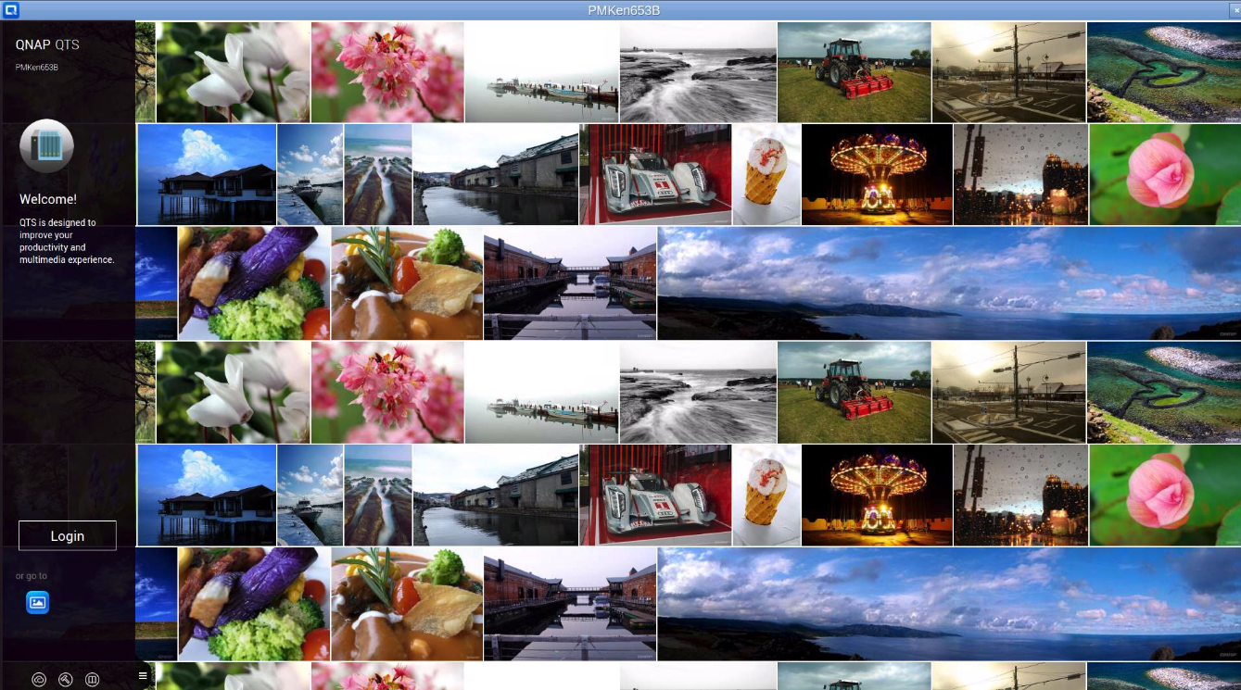
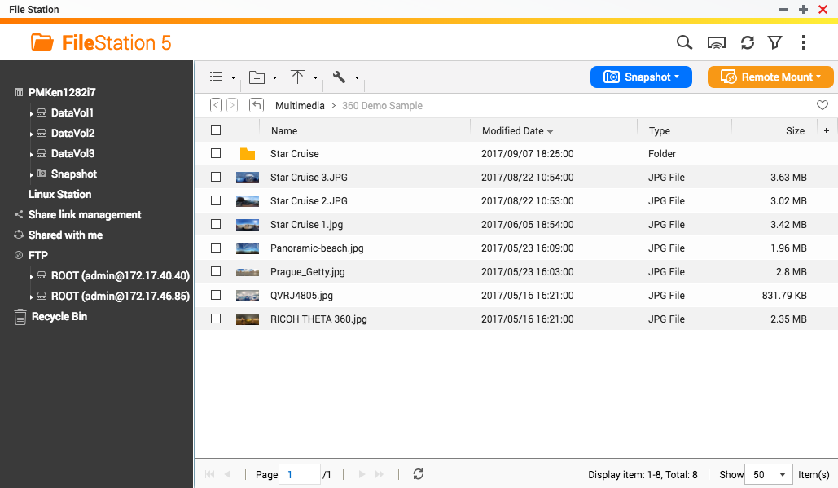
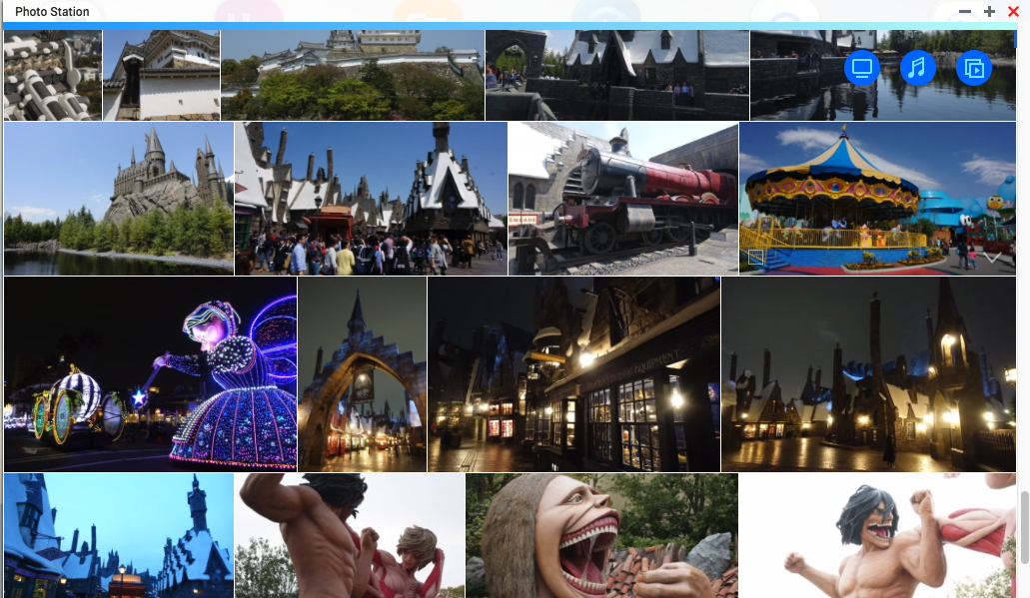
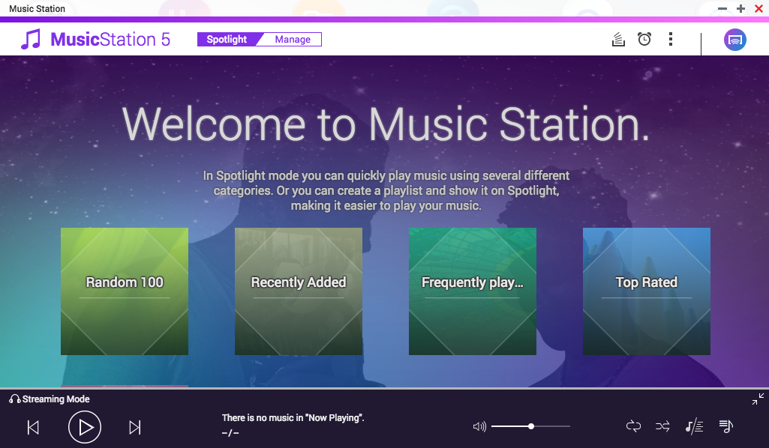
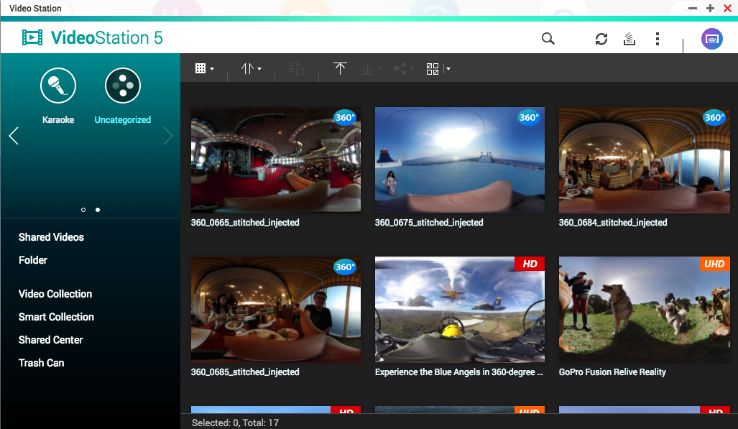
QTS Management on HD Station
Various shortcuts to QTS applications.
QTS
File Station
Photo Station
Music Station
Video Station

Slide 25
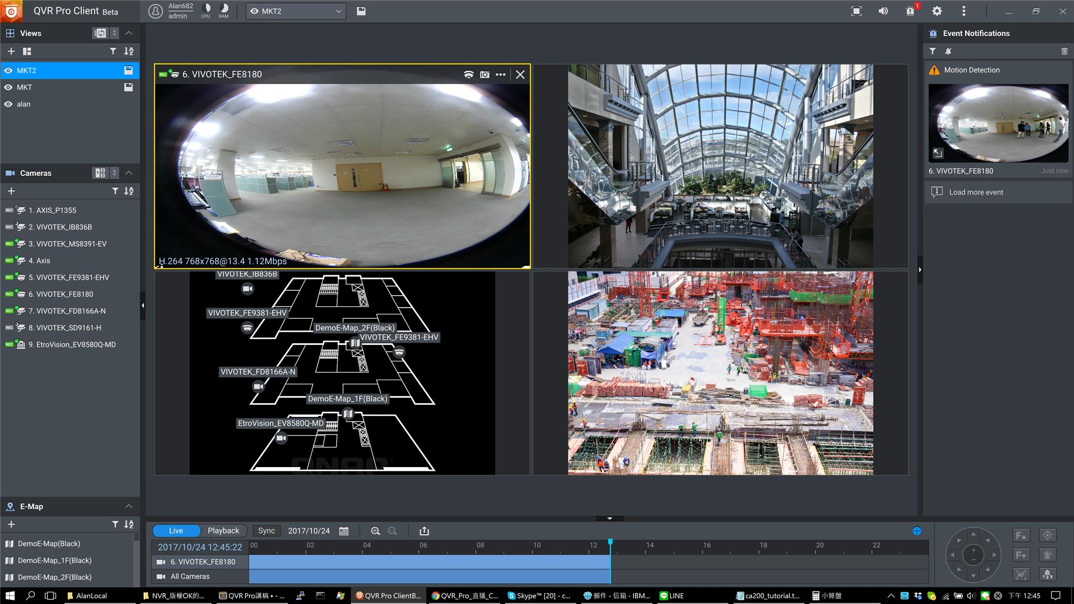
QVR Pro Client
Live view on TV directly

Slide 26
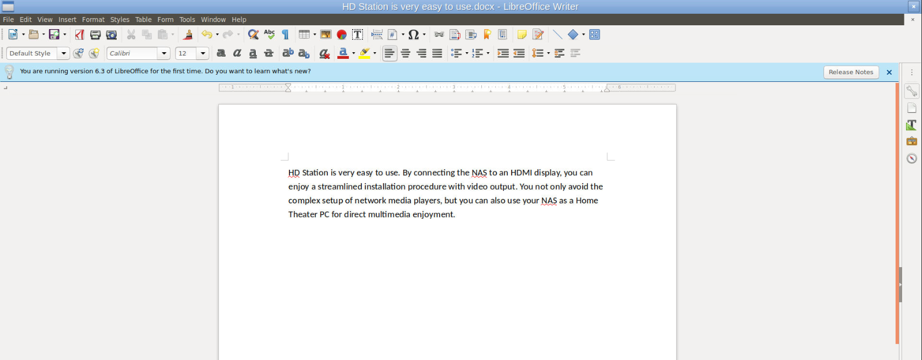
LibreOffice
LibreOffice is a powerful office suite

Slide 27
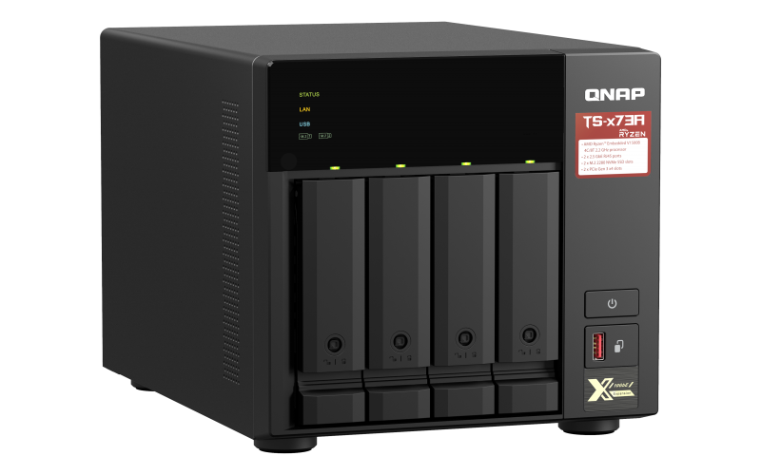
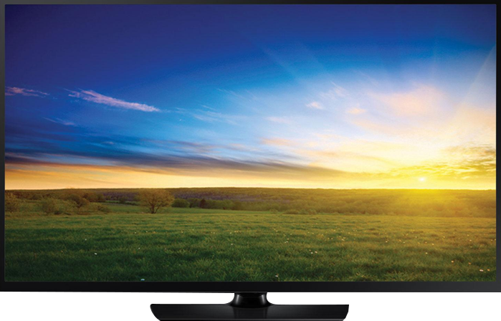
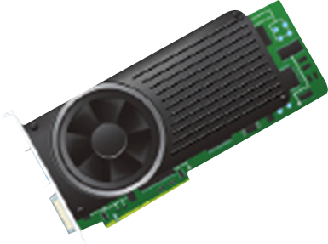
QNAP NAS vs Home Theater
QNAP NAS
Home Theater System
HD TV
Ultimate Theater Experience Combining QNAP NAS and Home Theater System for Unparalleled AV Experience

Slide 28
HD Player
HD Player allows you to watch multimedia contents on TV directly
Photo Station
Video Station
Music Station
HD Player
Play directly on TV

Slide 29
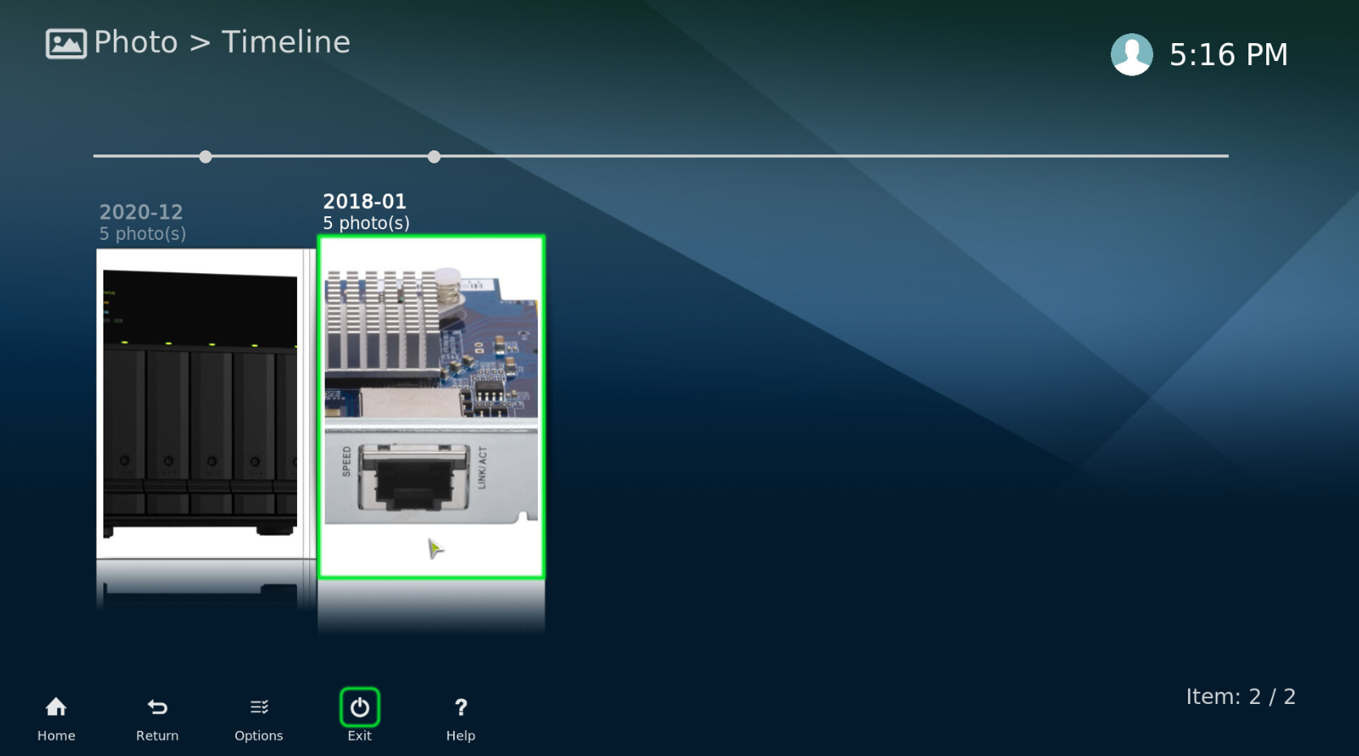
HD Player - Photo
View photos stored on NAS on TV directly.

Slide 30
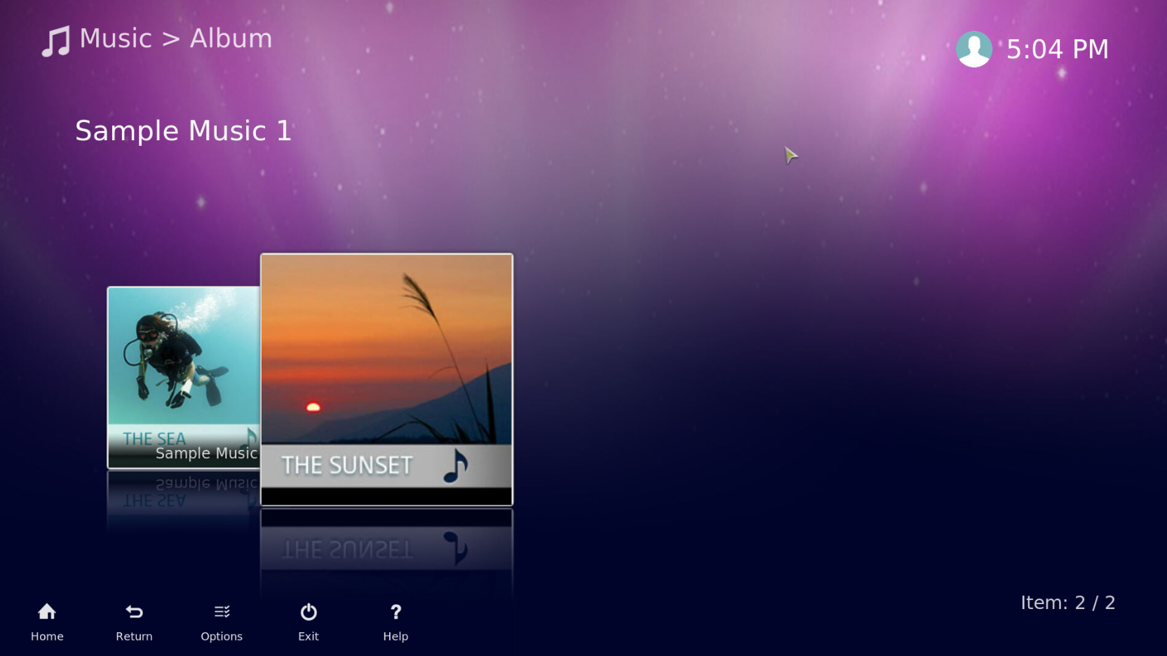
HD Player - Music
Listen to music on your NAS on your TV

Slide 31
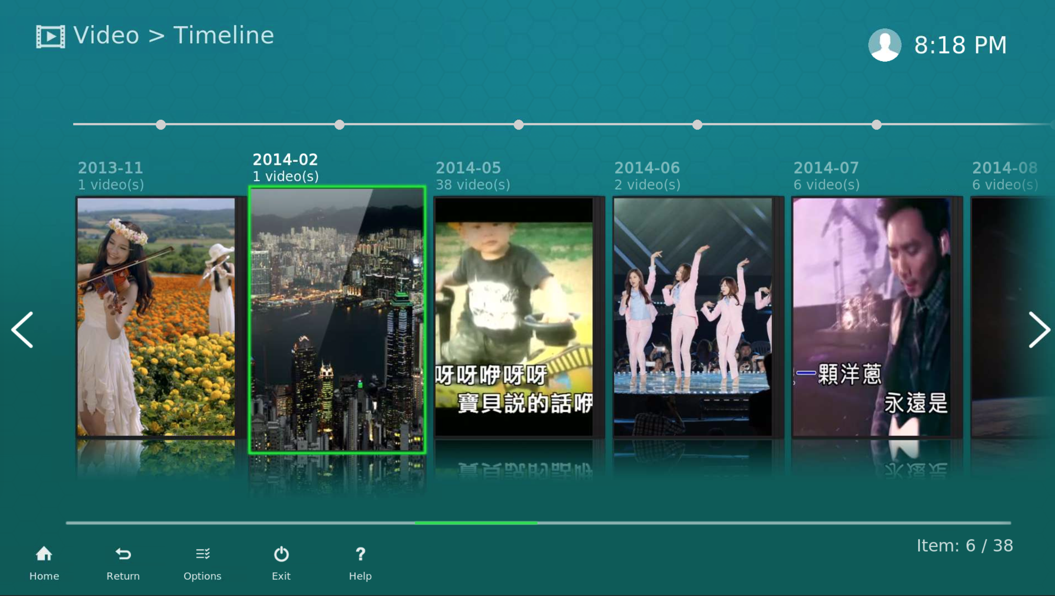
HD Player - Video
Playback the video which stored at your NAS on TV.

Slide 32
Audio Passthrough
Connect with your home theater system
Video
AV Receiver
HDMI
HDMI
Audio
Speaker

Slide 33
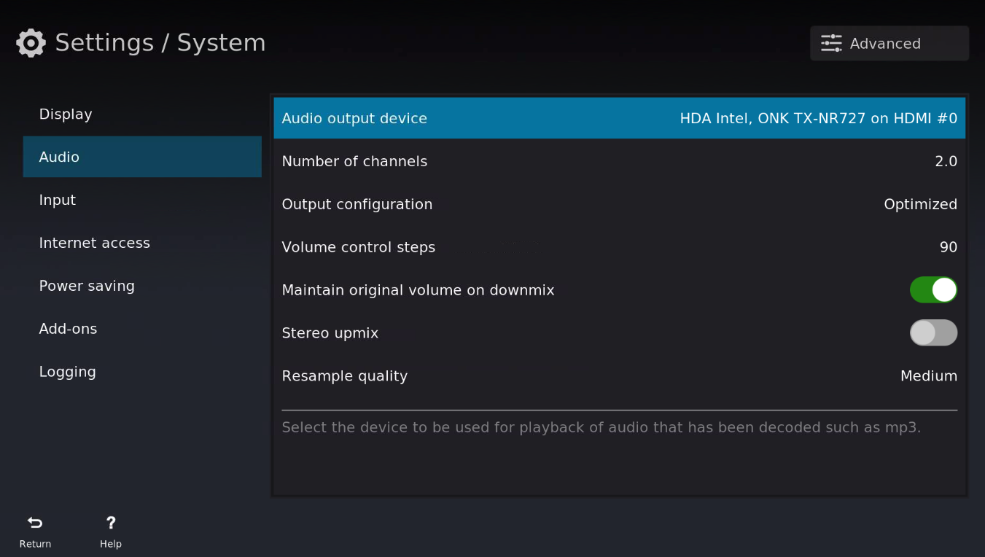
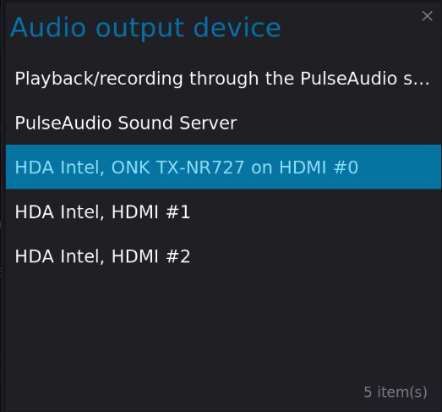
HD Player – Audio Passthrough setup 1
HD Player “Settings” -> “System“ -> “Audio”
1. Select the audio output device

Slide 34
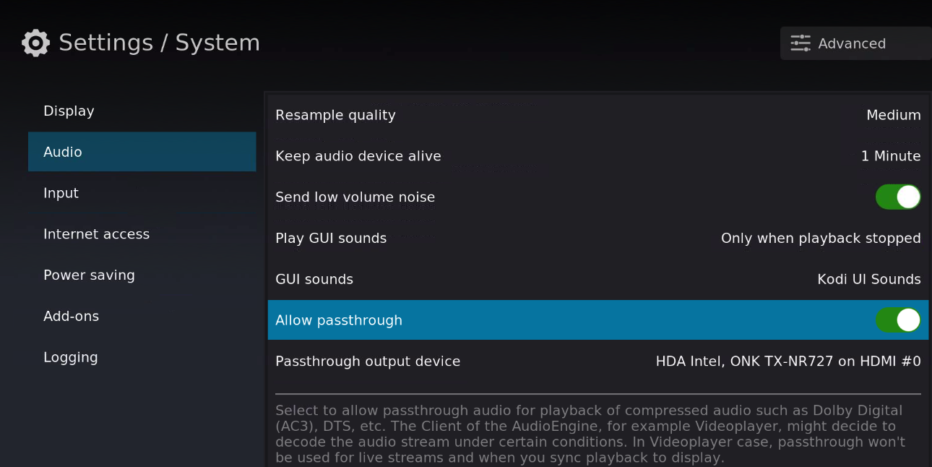
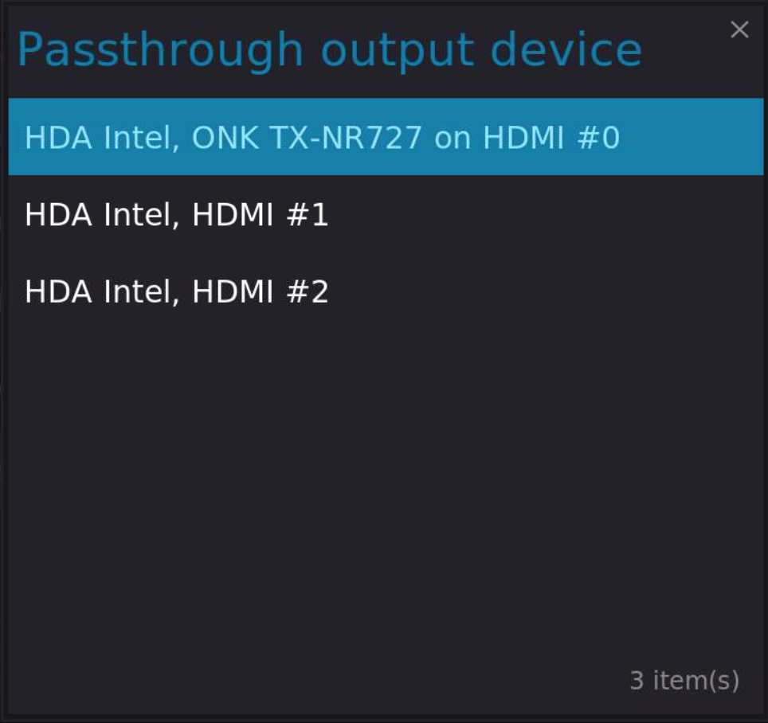
HD Player – Audio Passthrough setup 2/3
Enable “Allow passthrough”
Set the passthrough output device

Slide 36
Utilize the power of HDMI local display
Copyright© 2021 QNAP Systems, Inc. All rights reserved. QNAP® and other names of QNAP Products are proprietary marks or registered trademarks of QNAP Systems, Inc. Other products and company names mentioned herein are trademarks of their respective holders.​​​​​​​​

