Slide 1
Notes:
https://docs.google.com/presentation/d/1a75aTMFQwMG4bN_D1lQRbiw_q4jMQXUZ50ch26ah1ro/edit?usp=sharing

Slide 2
Agenda
Multimedia Console Introduction
Multimedia Console Features
User Story - Multimedia Console x Hybrid Mount
Live Demo
Notes:
Multimedia Backend Services
Multimedia Console Introduction
The drawback without Multimedia Console
The benefit with Multimedia Console
Content Source Management
Indexing
Thumbnail Generation
Transcoding
Multimedia App Suite
AI Engine
Overview Panel

Slide 3
Multimedia Console Introduction

Slide 4
Multimedia Backend Services
Common functionalities used by various QNAP applications
Content Source
Indexing
Thumbnail
Transcode
AI Engine
Set the source folder for multimedia application to show content within the folder
Create index for contents in source folder
Preview multimedia files without opening them
QuMagie Core recognizes People, Object, Similar Photos for you
View media files in MPEG-4 format

Slide 5
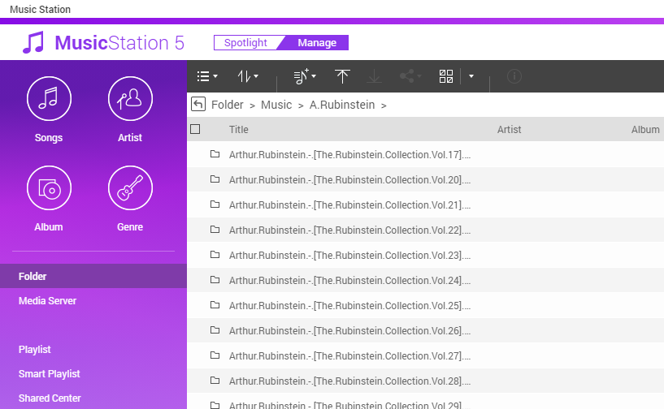
Multimedia Backend Services
Content Source
Indexing
Set the source folder for multimedia application to show content within the folder
Create index for contents in source folder

Slide 6
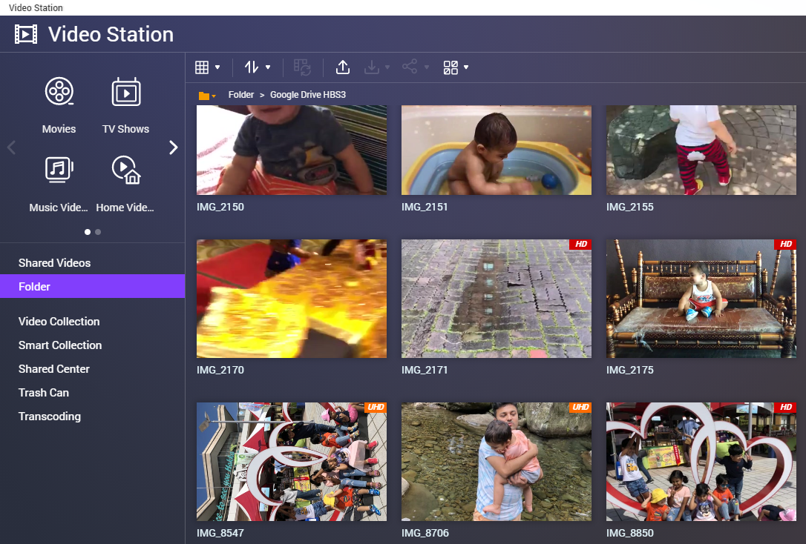
Multimedia Backend Services
Transcode
View media files in MPEG-4 format

Slide 7
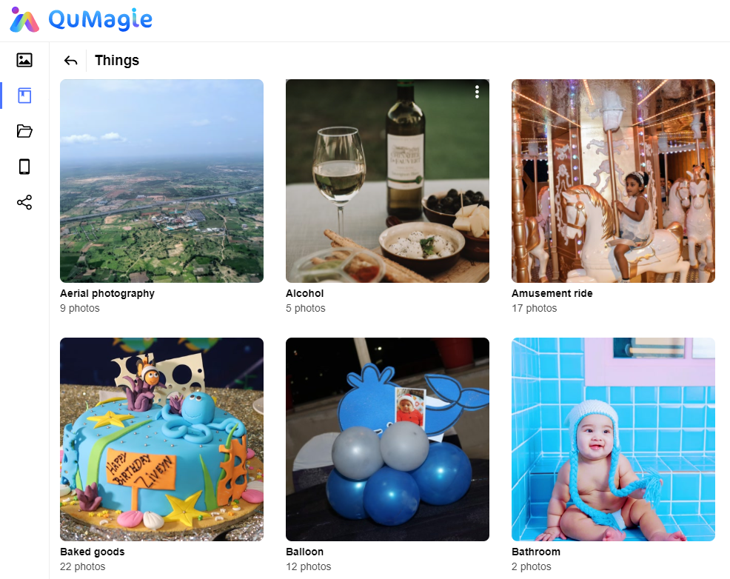
Multimedia Backend Services
AI Engine
QuMagie Core recognizes People, Object, Similar Photos for you
Thumbnail
Preview multimedia files without opening them

Slide 8
Multimedia Console Introduction
Multimedia Console consolidates all of the multimedia backend services within QNAP NAS applications into one app
Multimedia Console is a pre-loaded application within QNAP NAS system
QuMagie
Video Station
Qsirch
Photo Station
Music Station
DLNA

Slide 9
Advantages of using Multimedia Console
Avoids decentralized management
User doesn't have to go through same setup process within each individual application
Music
Photos
Content Source
Indexing
Thumbnail
Content Source
Indexing
Thumbnail
Transcode
AI Engine
Videos
Files
Content Source
Indexing
Thumbnail
Transcode
Content Source
Indexing
Thumbnail
AI Engine

Slide 10
Advantages of using Multimedia Console
Centralized management
Easier control within the single application
Music
Videos
Photos
Files
Content Source
Indexing
Thumbnail
Transcode
AI Engine
Centralized
Management
Multimedia Console

Slide 11
Multimedia Console Features

Slide 12
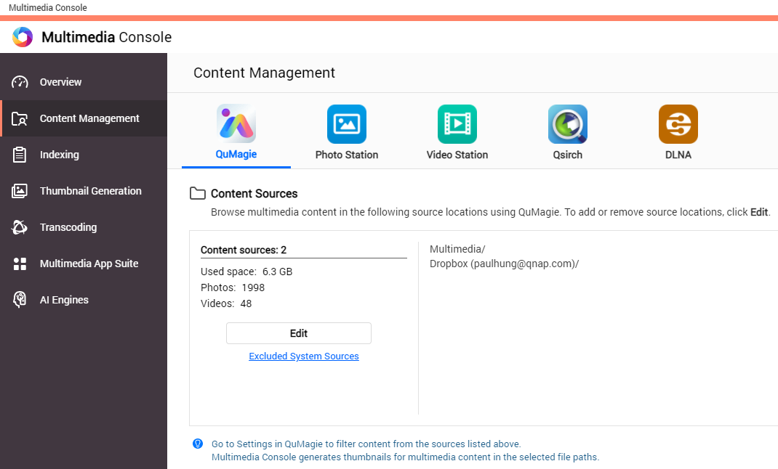
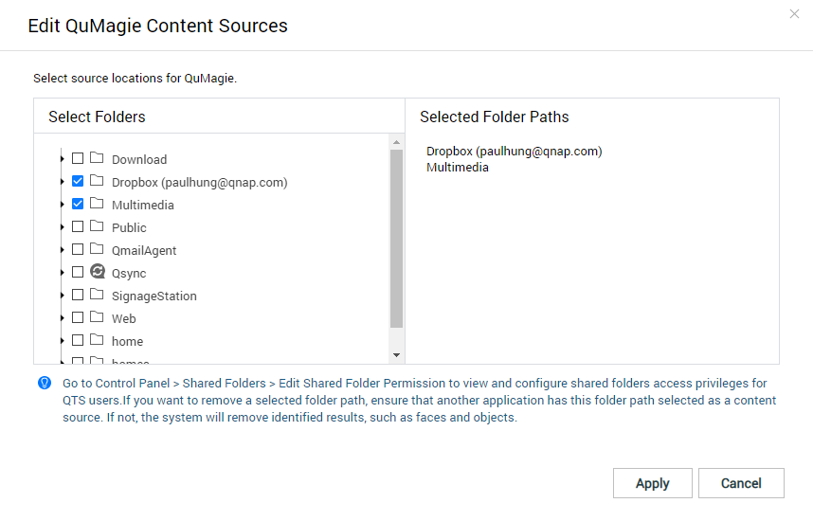
Multimedia Console Features
Managing Content Source
Define source folder access permission for each multimedia application in your QNAP NAS

Slide 13
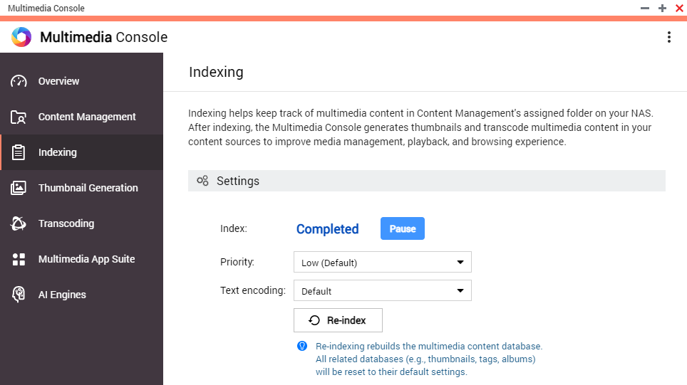
Multimedia Console Features
Indexing
Generate Index within the content source folder, also generate thumbnails and transcode multimedia content
You can monitor and Control
The priority of indexing among system tasks
The text encoding when parsing metadata

Slide 14
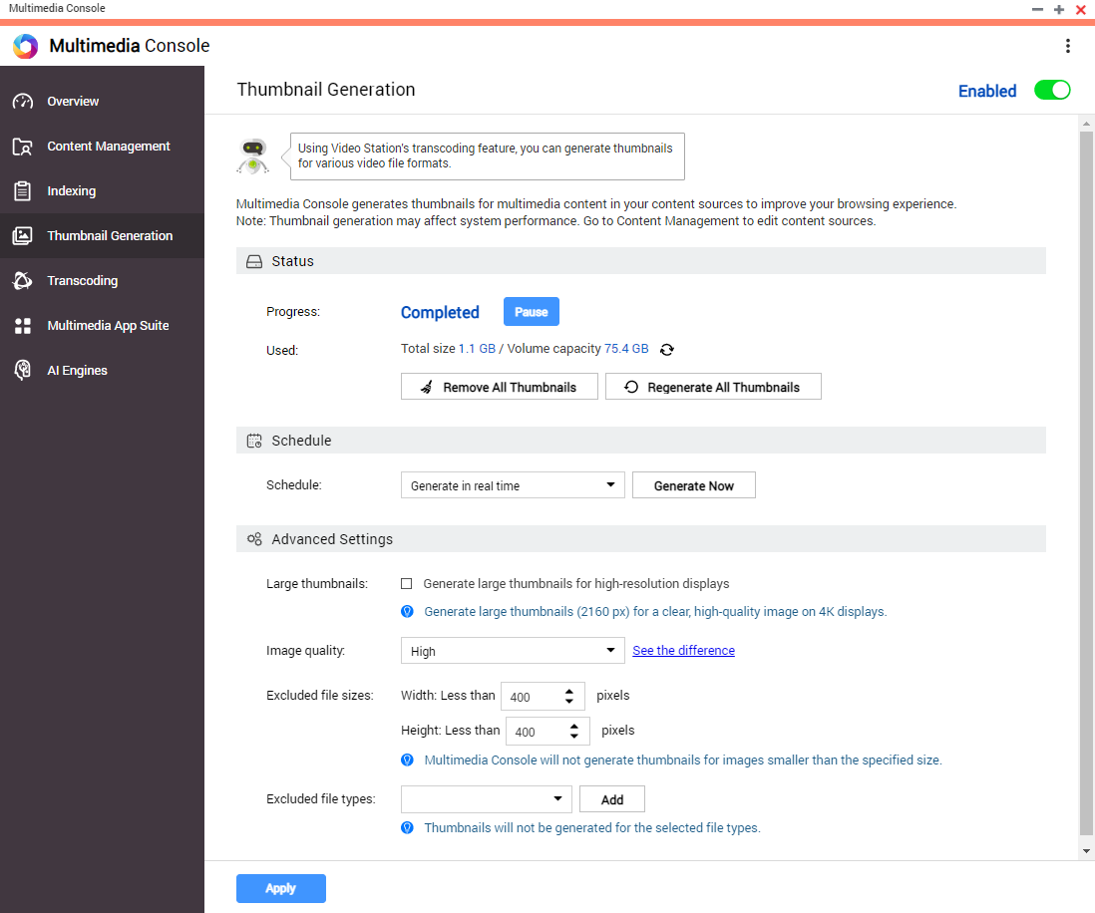
Multimedia Console Features
Thumbnail Generation
Previewing multimedia content without actually opening them one by one
You can Monitor and Control
Thumbnail Generation progress
Schedule Thumbnail Generation
Advanced settings
Large Thumbnail Generating Details

Slide 15
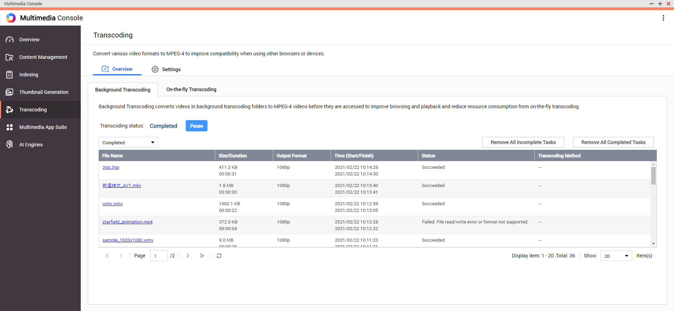
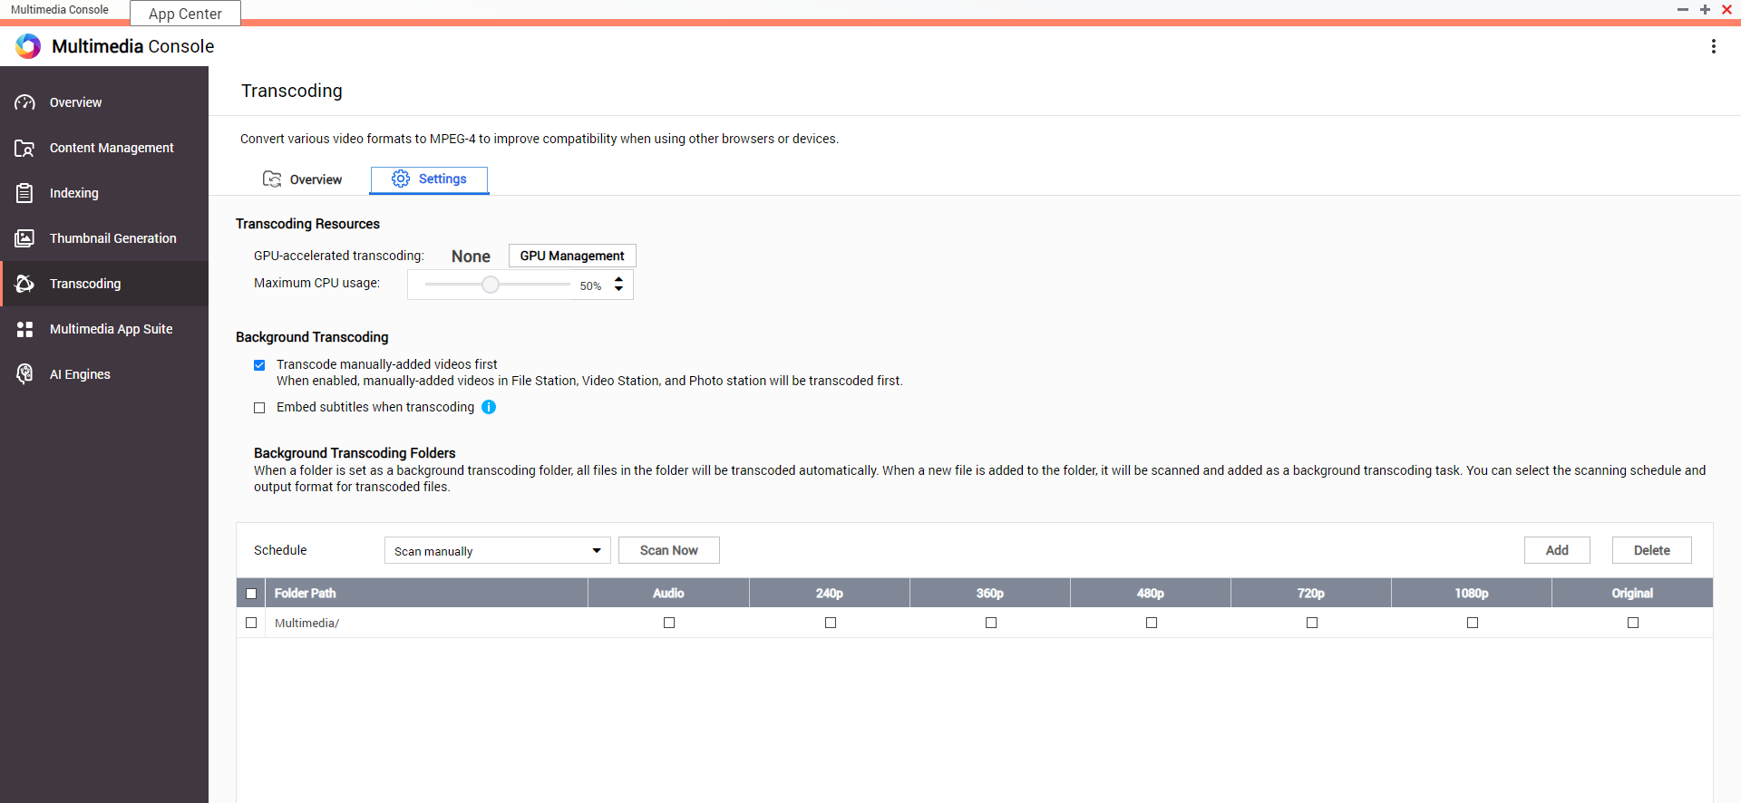
Multimedia Console Features
Transcoding
Convert various video formats to MPEG-4 for better viewing experience
You can Monitor and Control
Background Transcoding
On-the-fly Transcoding
Transcoding Resource
Background Transcoding folder
Notes:
Convert various video formats to MPEG-4, so that they can be played on different devices.

Slide 16
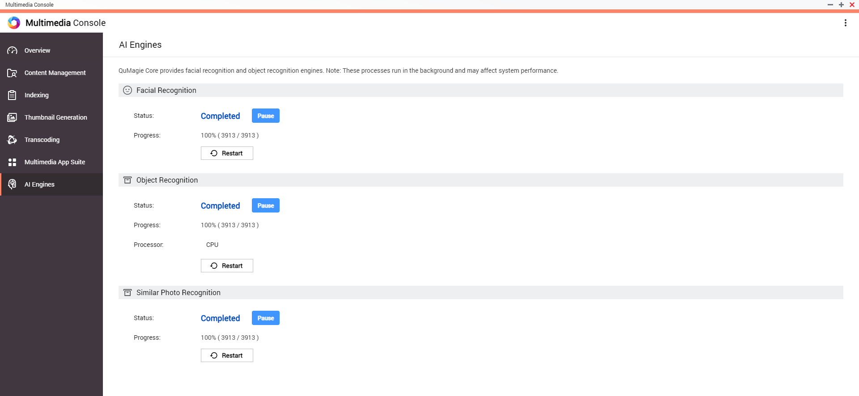
Multimedia Console Features
AI Engine
QuMagie Core’s AI Engine is capable of performing
Facial Recognition
Object Recognition
Similar Photo Recognition
You can Monitor and Control
Reached Progress
Hardware resources
Pause or Restart

Slide 17
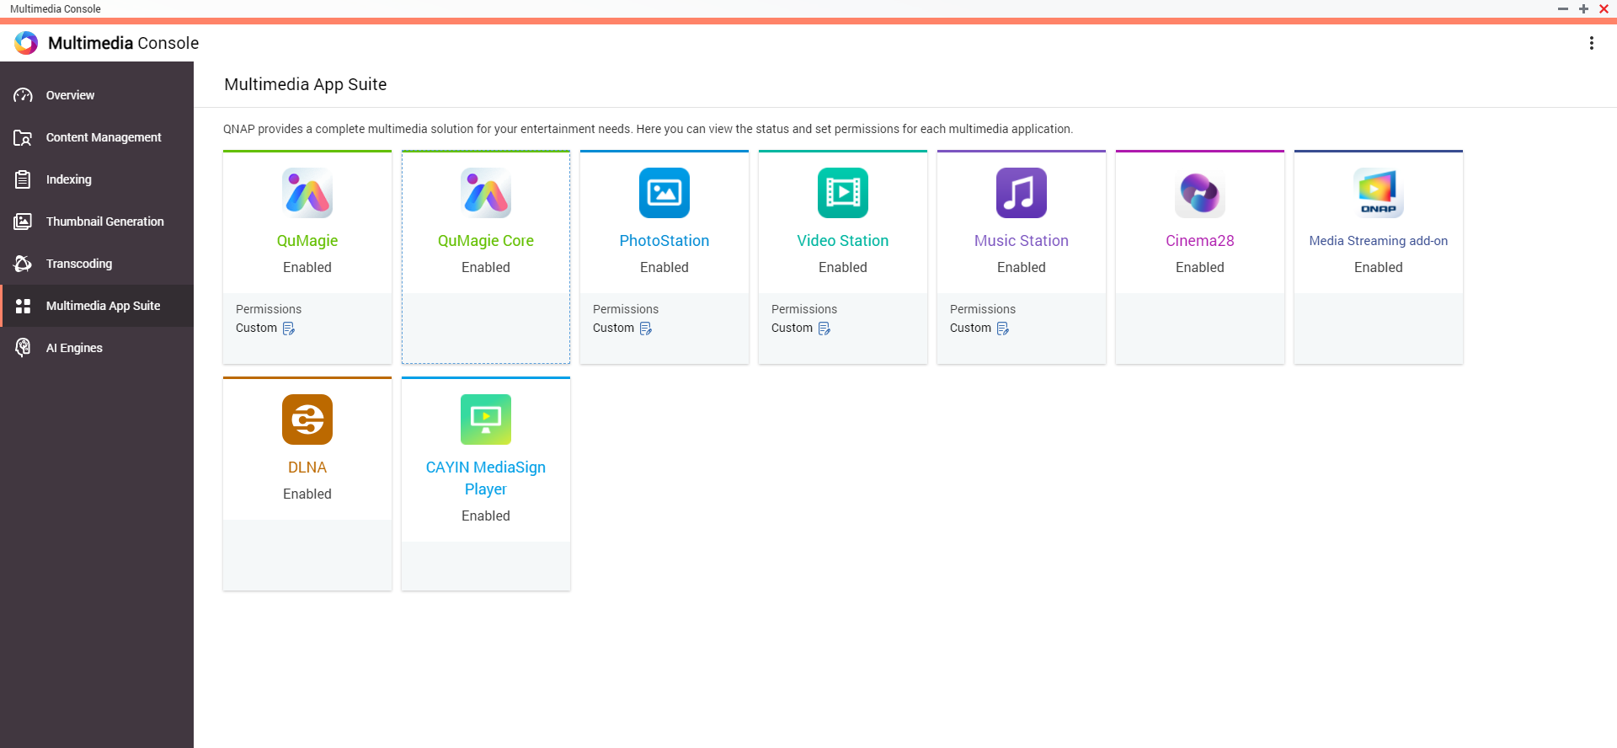
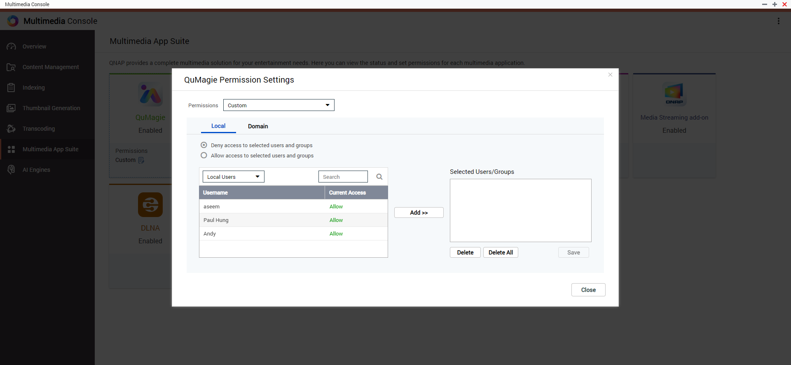
Multimedia Console Features
Multimedia App Suite
Overview installation, enablement and permission settings of all multimedia applications in a single page
You can monitor and control
Enable status for all multimedia App within QNAP NAS
Define individual account accessibility permission for QuMagie/PhotoStation/Video Station/Music Station

Slide 18
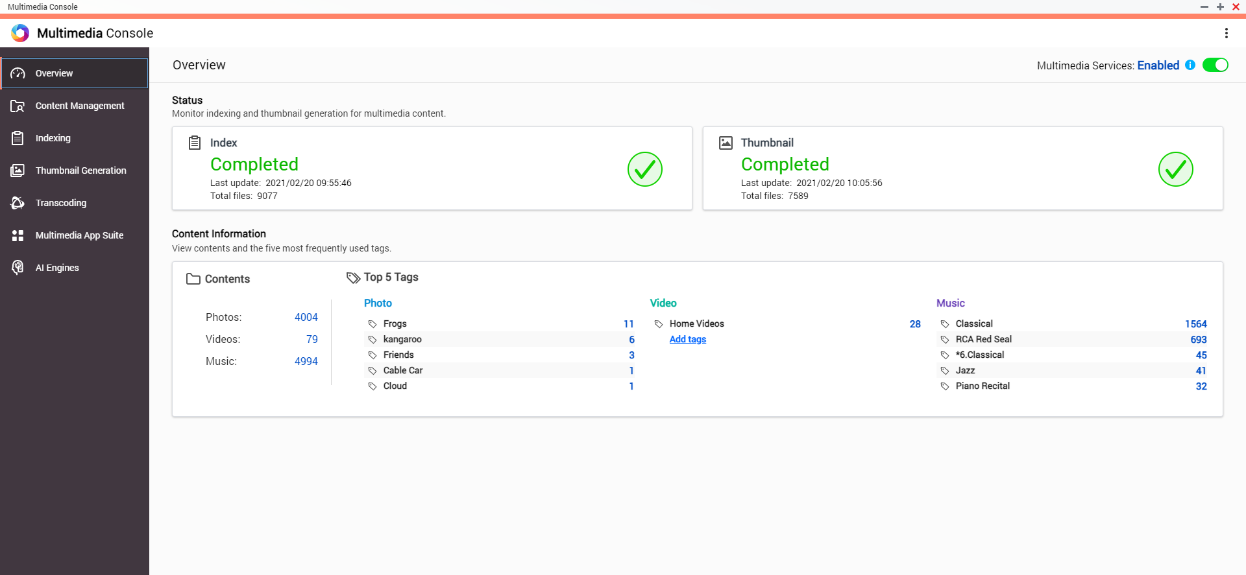
Multimedia Console Features
Overview Panel
Overview all multimedia Services
You can monitor and control
Enable or Disable all multimedia services
View Indexing and Thumbnail Generation process easily
View the most used tags for Photo, Video, and Music portion

Slide 19
User Story
Multimedia Console x Hybrid Mount

Slide 20
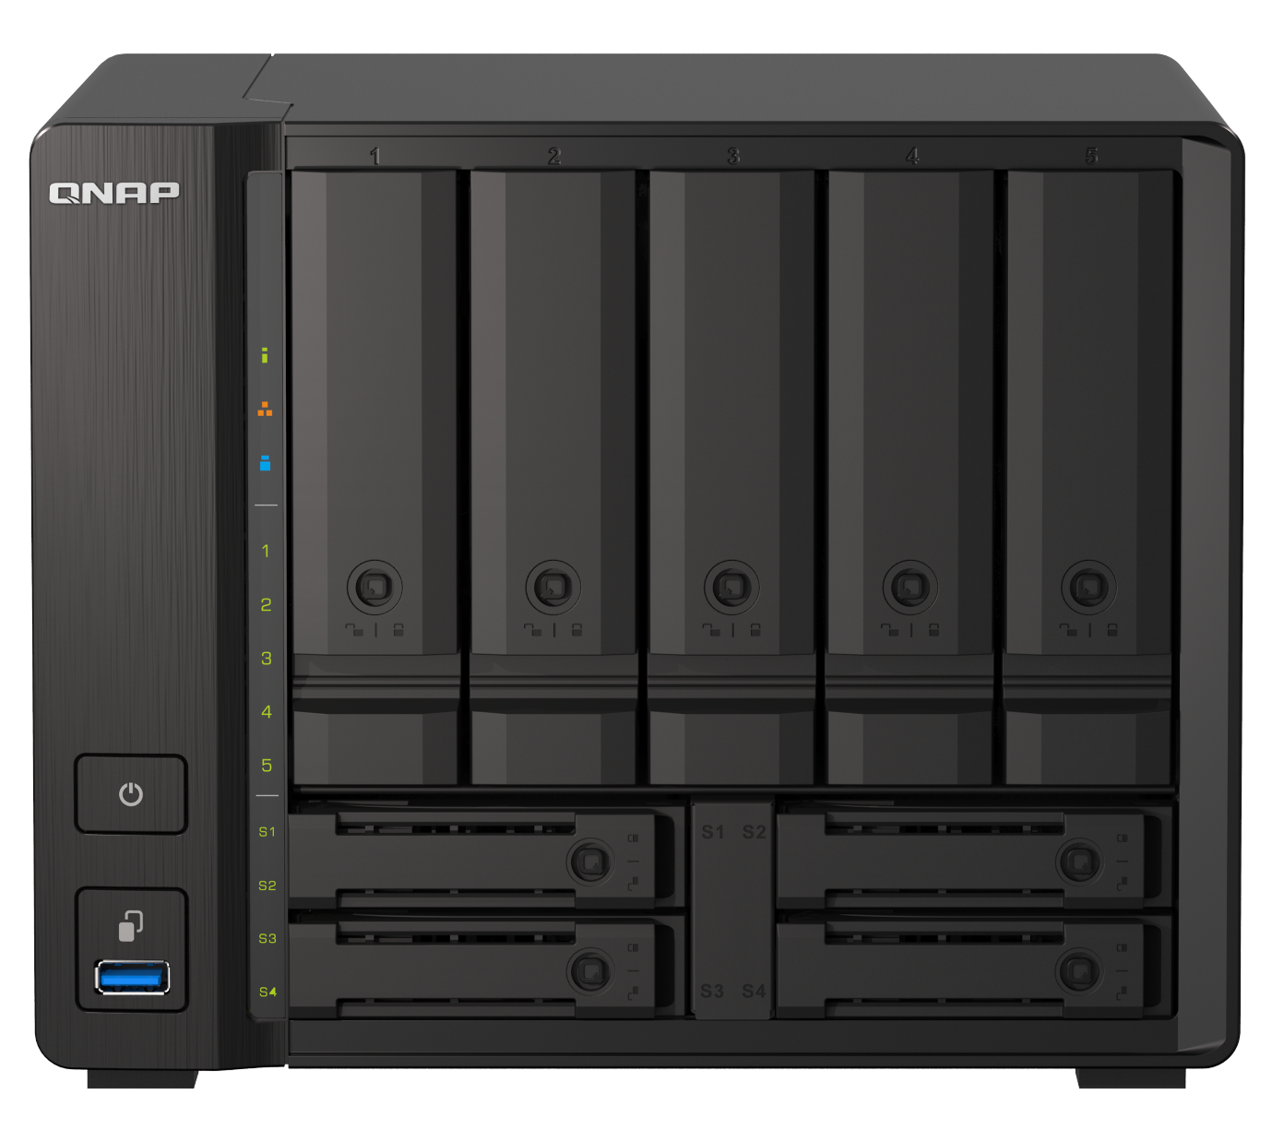
User Story - Problem Faced
How can I manage all the multimedia files which stores on my various cloud services with QNAP NAS altogether?

Slide 21
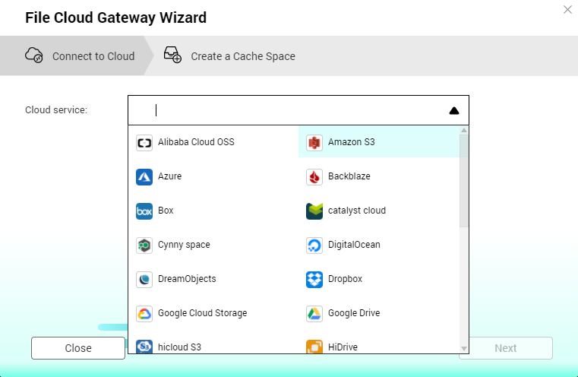
User Story - Solution
Set up a File Cloud Gateway by connecting QNAP NAS to cloud drives with HybridMount, then access the cloud drive in fast transferring performance

Slide 22
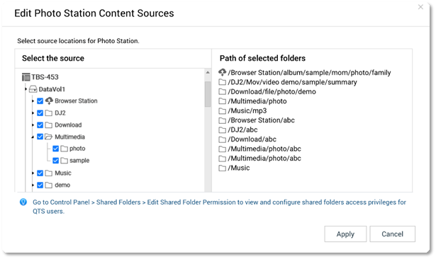
User Story - Solution
Set the HybridMount Volume as a content source, and you can browse contents on the cloud in multimedia applications

Slide 23
User Story - Solution
Enjoy large storage space on cloud drives and various multimedia services on QTS:
Use QuMagie to smartly organize your photos
Build your video library with Video Station
Stream videos to different displayers with DLNA Server

Slide 24
Multimedia Console Live Demo

Slide 25
Copyright © 2021 QNAP Systems, Inc. All rights reserved. QNAP® and other names of QNAP Products are proprietary marks or registered trademarks of QNAP Systems, Inc. Other products and company names mentioned herein are trademarks of their respective holders.

