Slide 1
Notes:
QTScloud
A cloud-based OS let users quickly own a NAS service with cloud servers at any time.

Slide 2
1
Introduction
2
Case Study
3
Live Demo
4
Features

Slide 3
Introduction to
QNAP Cloud NAS

Slide 4
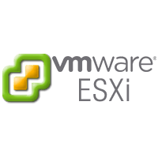
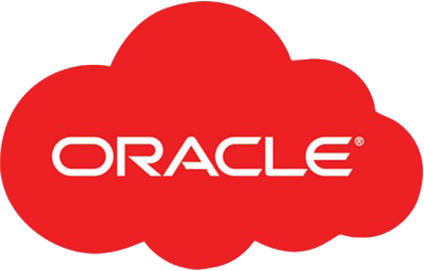
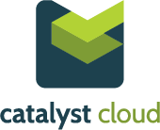
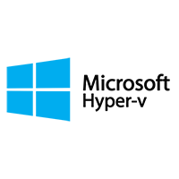
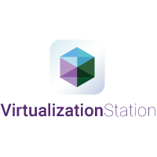
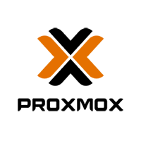
What is a Cloud NAS
A virtual appliance designed to work with and leverage cloud-based storage to give the functionality of a premise-based NAS
Uses cloud computing to simplify infrastructure and provide flexible deployment options while reducing costs.
AFP
Cloud NAS Solution
Virtual
CIFS/SMB
Machine
NFS
iSCSI
Compute
Storage

Slide 5
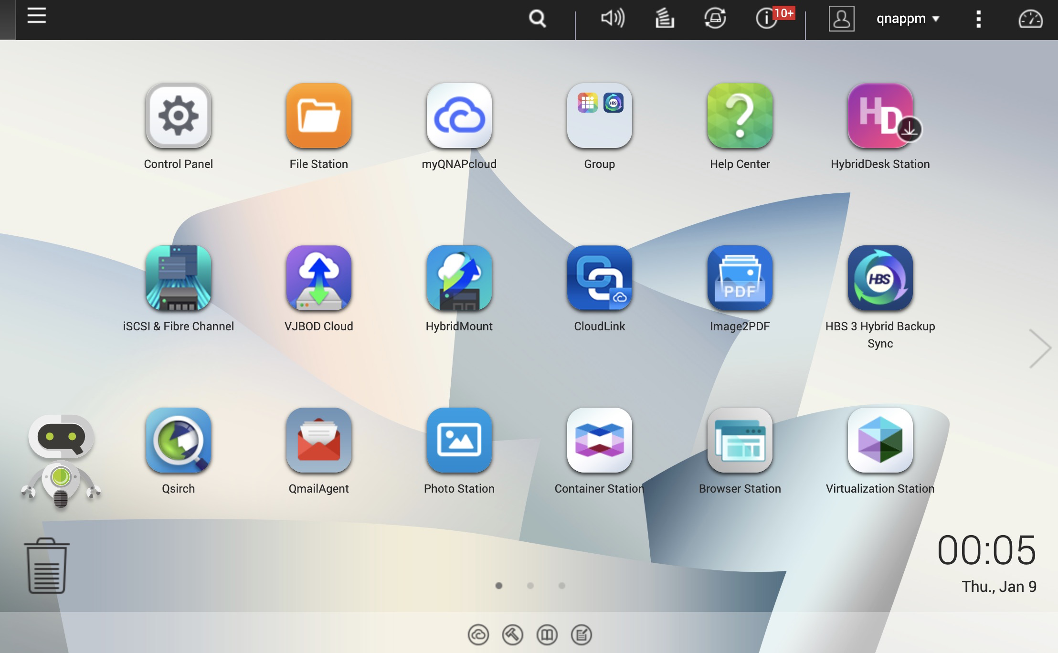
QuTScloud brings all the QTS experiences
QuTScloud Operating System
OS
Multimedia
Mobile Apps
Storage
IoT
WIN/MAC Utilities
Network
Notification
Full-text Search
Security
Licenses
& More…

Slide 6
Helps to optimize your data usage
Before
After
Download file with Share Link or FTP
External
Customers
Branches
* Access data with File station or standard
protocols: SMB/ ClFS, NFS, AFP, iSCSl
Share
Browse
Download
Search
* Make data searchable on object storage
with Qsirch.
* Pubilsh/Share photo/video contents
with QuMagie.
Internet
（via http/ https）
AWS, Azure,
AliCloud, DigitalOcean
AWS, Azure,
AliCloud, DigitalOcean
Backup & Sync
Backup & Sync
QNAP NAS
Local PC
QNAP NAS
Local PC
HQ

Slide 7
Support Platform
On-premise
Virtualization Platforms
Cloud Platforms

Slide 8
Storage Pass-through
Use virtual disk
Use pass-through disk
Virtual Disk
Virtual Disk
Physical Disk
Physical Disk
Physical Disk
Physical Disk
Storage Pools
Storage Pools

Slide 9
Use cases
Notes:
QTScloud
A cloud-based OS let users quickly own a NAS service with cloud servers at any time.

Slide 10
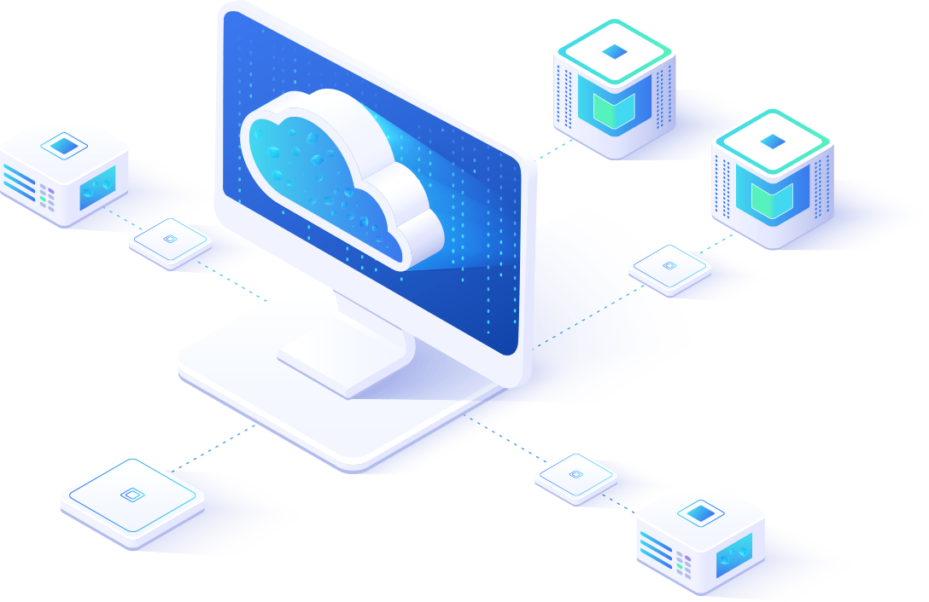
Quickly recover data encrypted on the disk array
Case
1
Users need to spend several weeks downloading terabytes of backup data from the cloud
Cloud Backup
few weeks
New Machine

Slide 11
Quickly recover data encrypted on the disk array
Case
1
Install QuTScloud on the local server and mount the disk array, the original data can be accessed immediately after decryption
Attach
few hours
Storage from
non-bootable NAS
On-premise hosting
New Machine

Slide 12
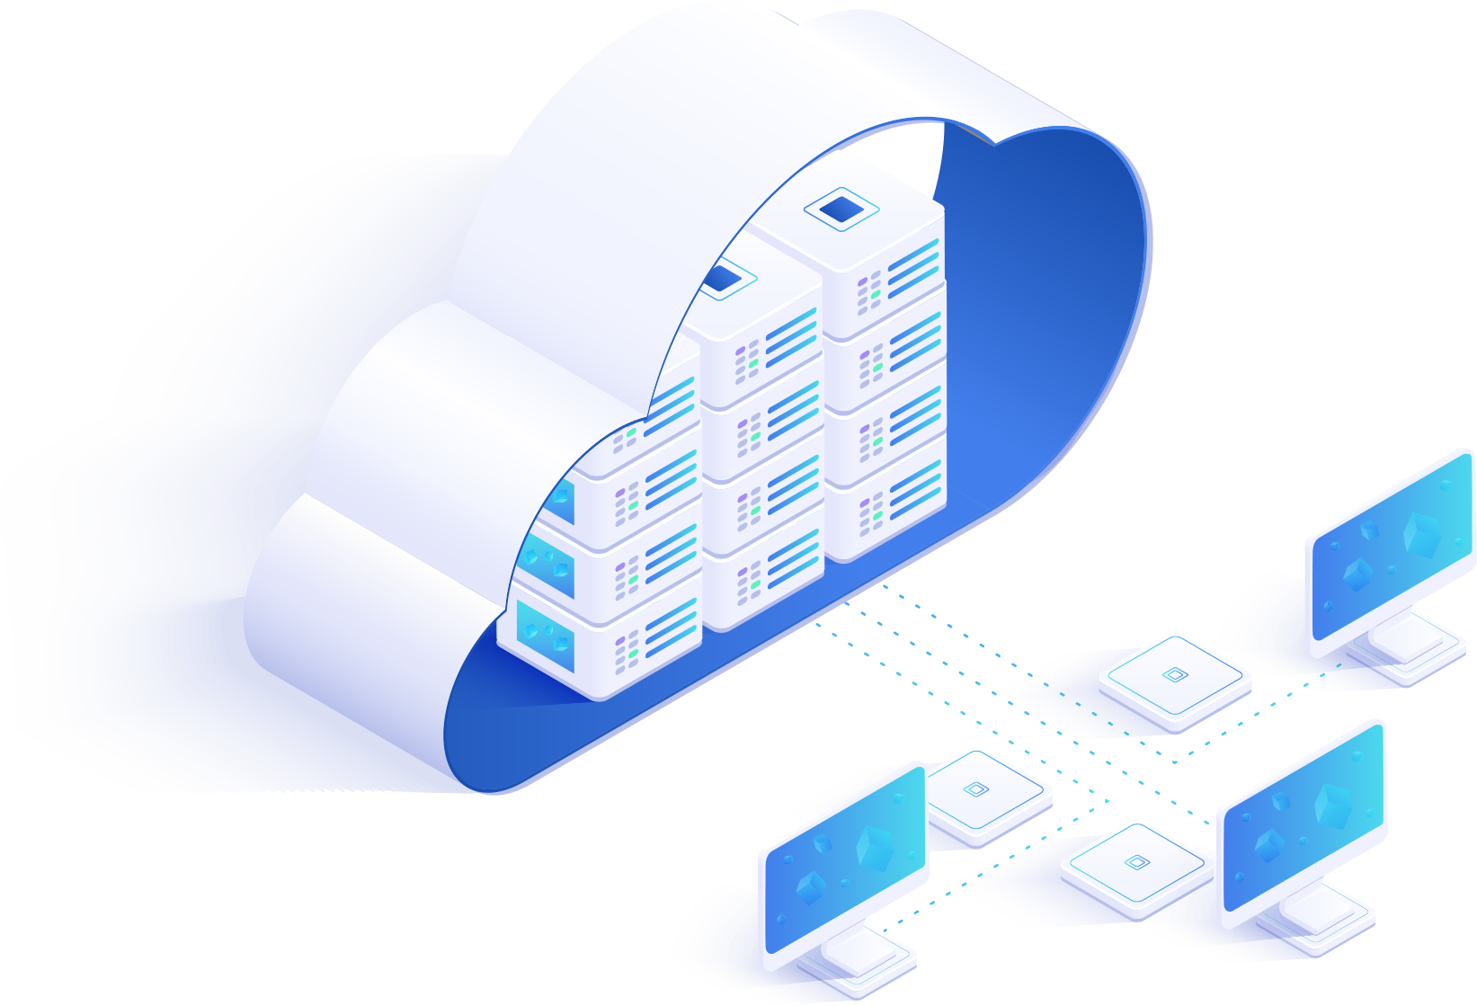
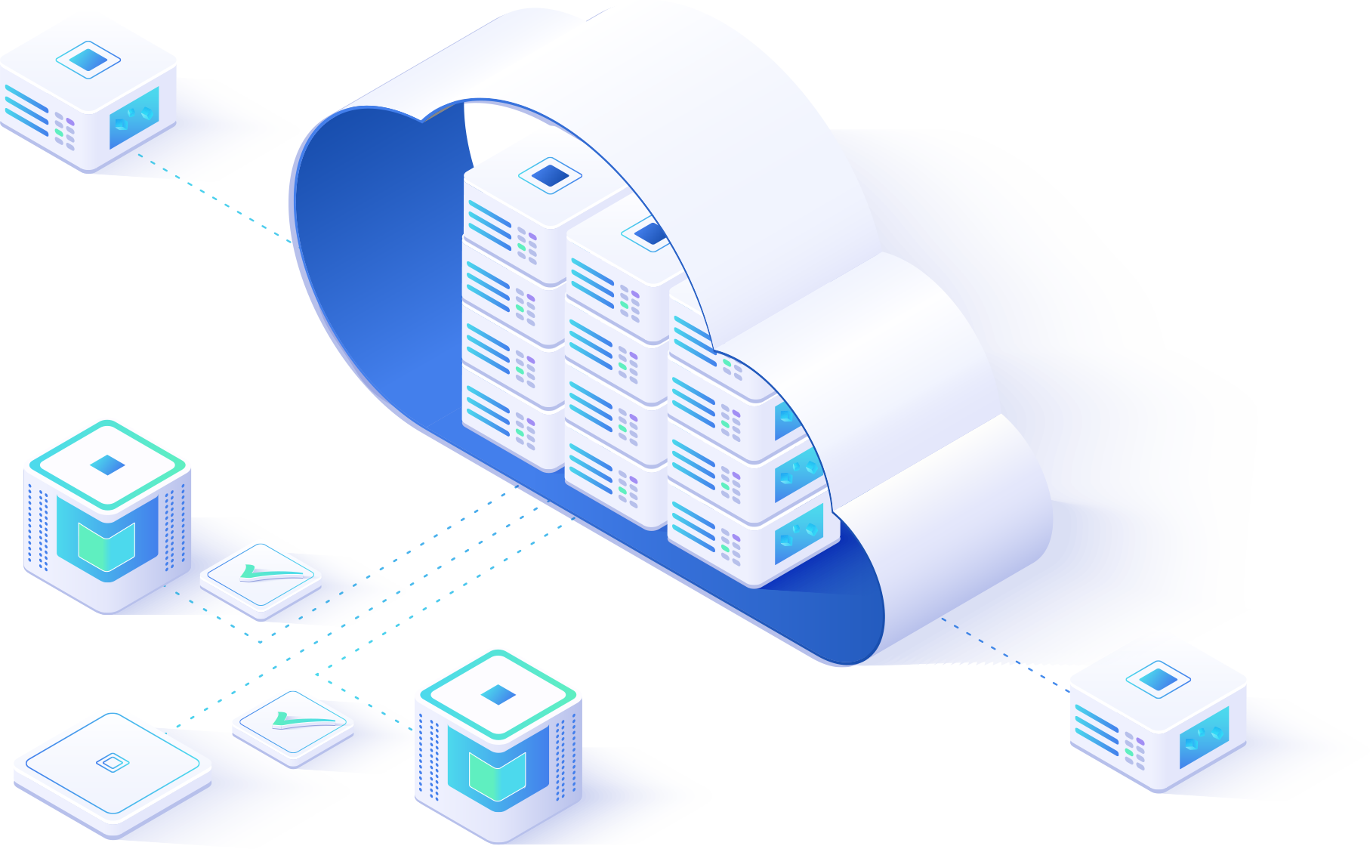
New way to experiment with QTS
Case
2
New user want to try feature of QTS

Slide 13
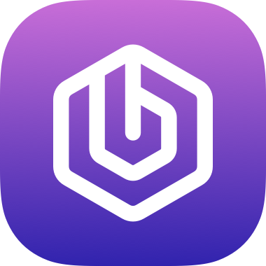
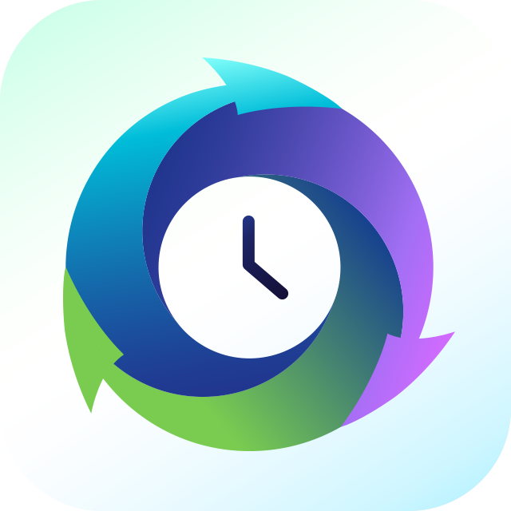
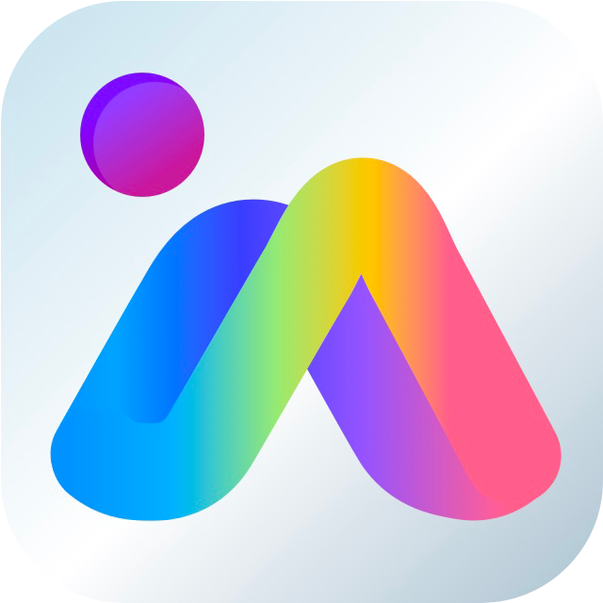
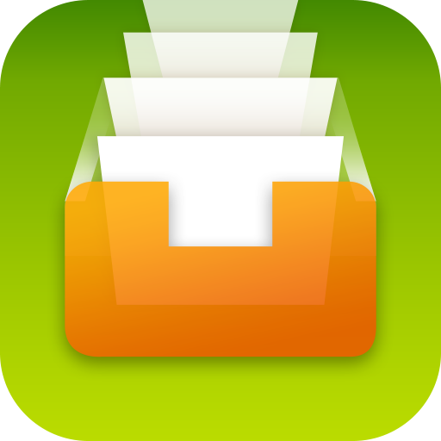
New way to experiment with QTS
Case
2
QuTScloud provides users to try the features of QTS without purchasing hardware devices.
Cloud Hosting

Slide 14
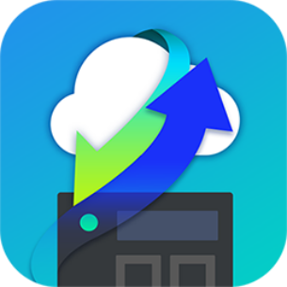
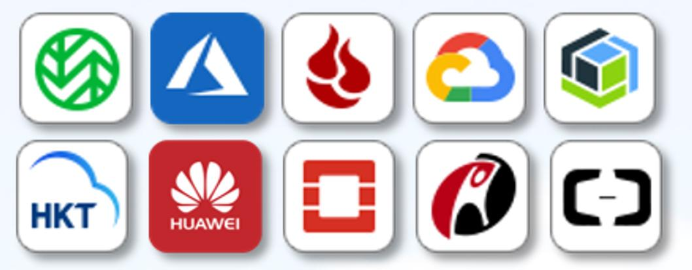
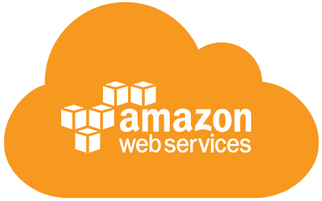
Centralized storage server on the cloud
Case
3
IT admins want to extend their infrastructure to the cloud to centrally store, manage and share all of their dissipated data
QuTScloud is a complete storage and file sharing on cloud that supports file sharing protocols like CIFS/SMB, NFS and iSCSI. The HybridMount acts a gateway to all the cloud storage platforms, allowing users to access all their dissipated data from within QuTScloud. Using Qfile mobile app, the user can access data at their fingertips.
Mount
Cloud File Storage
CIFS/SMB
NFS 存取
Application and Data Servers
Volume
CIFS,NFS, iSCSI
CIFS,NFS, iSCSI
Cloud Object Storage
Storage Pools
Mount
User desktops and devices

Slide 15
Success Story – qibb (Germany)
Background
Challenge
qibb provides online video editing solution (SaaS) hosted in AWS
Use Adobe Premiere running in a Windows VM on AWS
The videos are large in size. They want to drag and drop the videos into the Adobe Premier
Storing videos in S3 is not feasible as reading from S3 is extremely slow

Slide 16
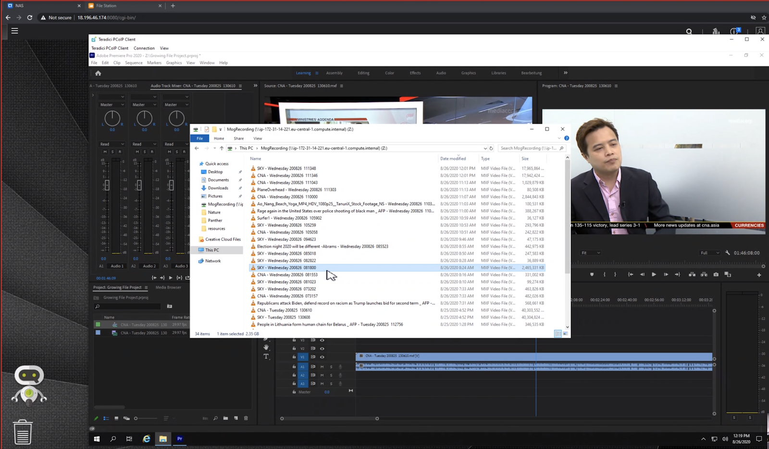
Success Story – qibb (Germany)
Solution
Looking for a Cloud NAS solution that can help to store and read the videos from the AWS EBS volumes
Using QuTScloud on AWS and then using SMB to mount the storage to windows interface
Drag and Drop the videos to Adobe Premier. 100 Mbps read speed demonstrated.
Want to integrate QuTScloud APIs within their ecosystem

Slide 17
Live Demo
Notes:
QTScloud
A cloud-based OS let users quickly own a NAS service with cloud servers at any time.

Slide 18
Live Demo
1
How to use storage
pass-through on QuTScloud
2
How to deploy QuTScloud
on OVHcloud
Notes:
Notification Center Provide you with a variety of delivery options, allowing you to choose the most appropriate notification method based on different messages and use cases!

Slide 19
Features
Notes:
QTScloud
A cloud-based OS let users quickly own a NAS service with cloud servers at any time.

Slide 20
Main features and benefits of QuTScloud
1
Storage Expansion
5
Real-time Mobile Notifications
2
Data Sharing and Management
6
Productivity apps for backup, management, and multimedia
3
Data Efficiency
7
Subscription-based Pricing
4
Data Protection and Security

Slide 21
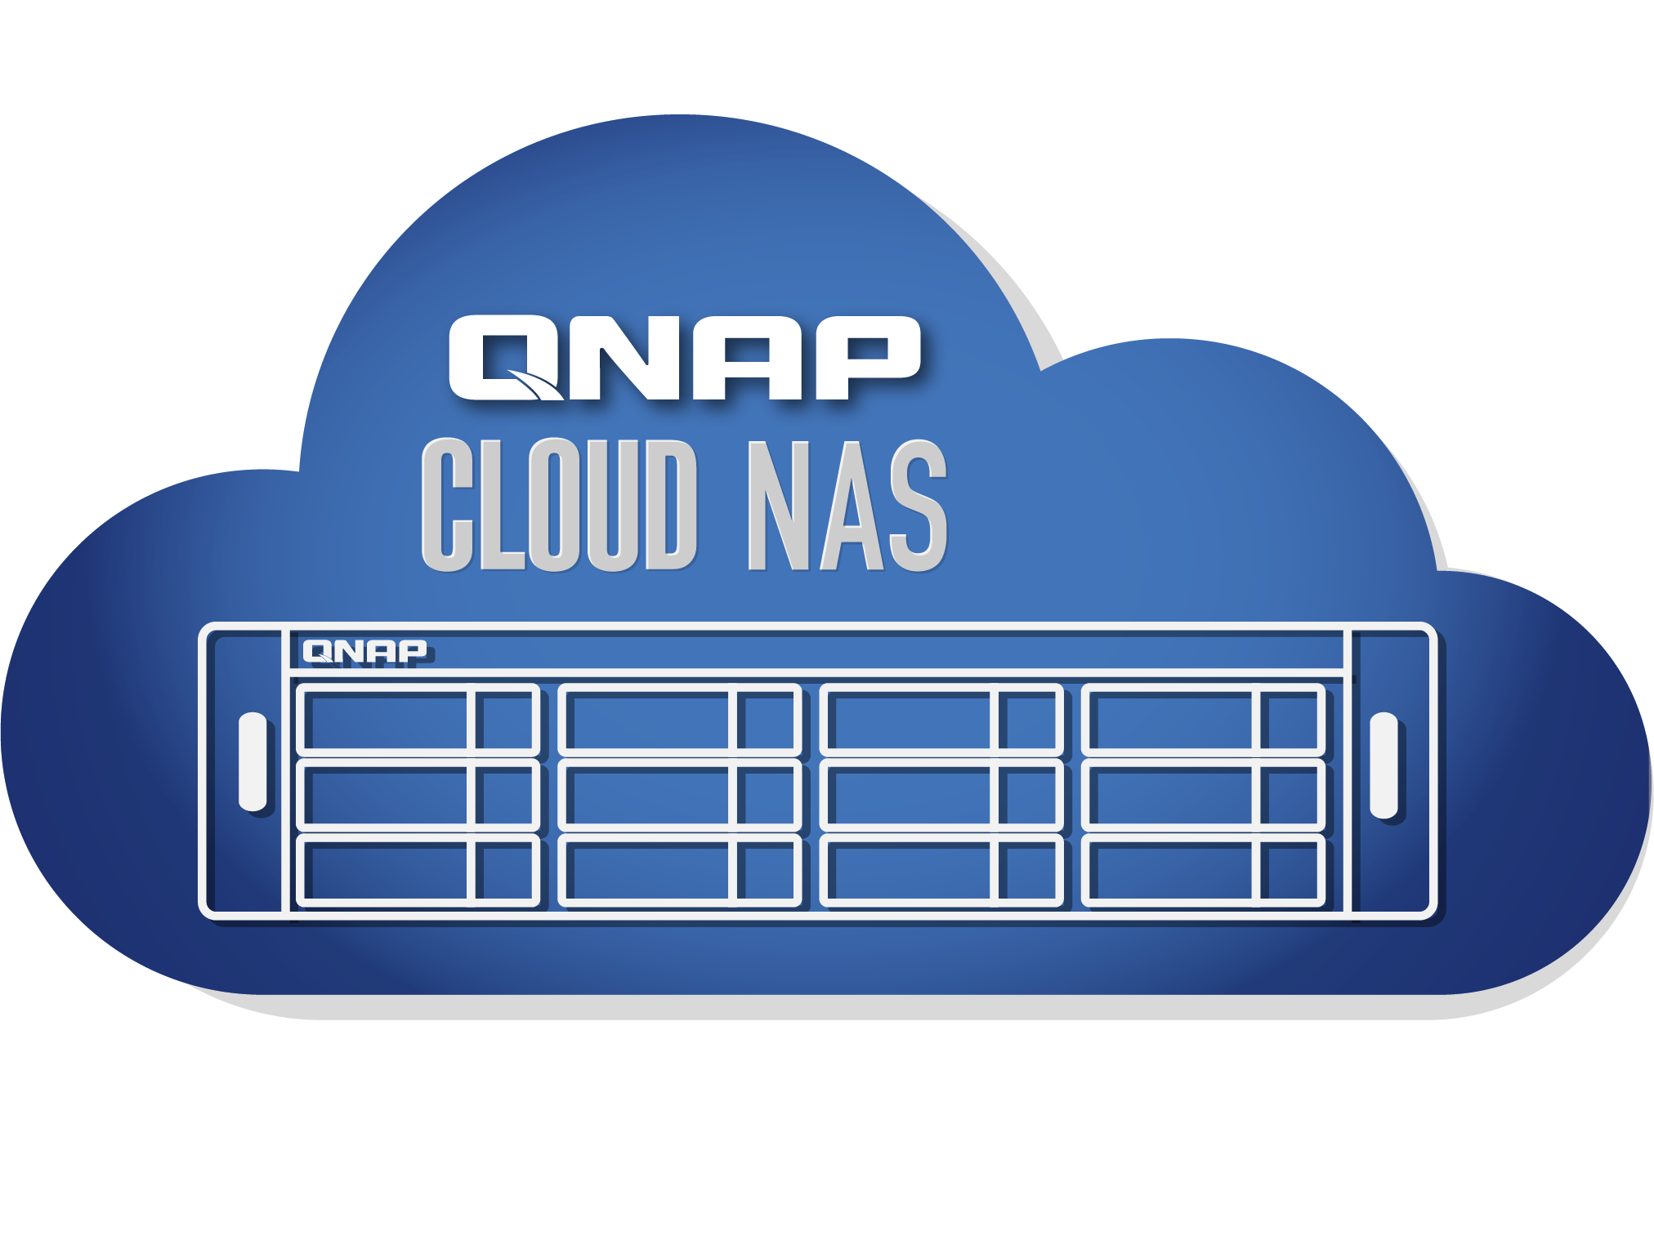
Storage Expansion with HybridMount for cost saving
Mount external storage to QuTScloud
Cloud File Storage
AWS
Mount external storage
Cloud Object Storage
With HybridMount
EBS
S3
Glacier
AWS Local Storage
Unified dashboard to manage all cloud storage

Slide 22
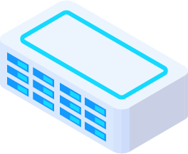
Data sharing and management
Data sharing
Privilege management
SMB/CIFS
NFS
AFP
iSCSI
Basic
1. NAS local users
Standard protocols
Active Directory authentication
LDAP authentication
Domain Security
Social Media
Security – Password, Valid Date
SmartShare
Instant file sharing
File Preview
Online Office, Google Doc
Multimedia files

Slide 23
Data efficiency with deduplication
HBS 3 features QuDedup technology that empowers backup tasks with
source-side deduplication for greater time and storage savings.
Without QuDedup
With QuDedup
Notes:
The HBS3 application of QTScloud has QuDedupe functionality which deduplicates the data before performing the backup. So, if the customer uses HBS to backup data from QTScloud to any other destionation, then the network throughput will be lot more. Not just that, it will also save the space for the end customer as there won't be any duplicate data.

Slide 24
Data protection and security
Snapshots and versioning
1. Fully supports all storage configurations at the storage pool level.
2. Uses the mature ext4 file system for “out of volume”
Ransomware cannot overwrite snapshots which are stored out of volume
QNAP VPN Service
1. Use QVPN to build a secure connection between your
on-premises devices and your Cloud NAS.
2. Supports versatile VPN protocol and QNAP's(Qbelt).
QNAP's proprietary VPN protocol to decrease the chance of being detected.

Slide 25
Real-time status notifications at your fingertips
Notification Center
Consolidates event and alert notification
Double assurance with notification history
Flexible to filter important messages
Multi-language support
Notifications via email, SMS, instant message, and push notifications.
Notes:
Notification Center Provide you with a variety of delivery options, allowing you to choose the most appropriate notification method based on different messages and use cases!

Slide 26
Productivity apps for backup, management, and multimedia
Backup
Management
Multimedia
HBS 3
Qsirch
QuMagie
Multi-site, multi-cloud backup streamlines 3-2-1 backup strategy
A powerful Google like full-text search engine
AI-powered intelligent photo management
Boxafe
Qfiling
Backups up Office 365 & Google G Suite data
Automates your file organization

Slide 27
Subscription-based Pricing
1
Core
2
Cores
4
Cores
6
Cores
8
Cores
12
Cores
16
Cores
24+
Cores
Monthly
$ 8.99
Monthly
$ 11.99
Monthly
$ 19.99
Monthly
$ 29.99
Monthly
$ 39.99
Monthly
$ 69.99
Monthly
$ 99.99
Monthly
$ 129.99
Yearly
$ 89.99
Yearly
$ 119.99
Yearly
$ 199.99
Yearly
$ 299.99
Yearly
$ 399.99
Yearly
$ 699.99
Yearly
$ 999.99
Yearly
$ 1299.99
Recommended for:
Recommended for:
Recommended for:
Recommended for:
Recommended for:
Recommended for:
Recommended for:
Recommended for:
Total NAS Users: 1-5
Concurrent Connections: Up to 10
Total NAS Users: 6-10
Concurrent Connections: Up to 10-20
Total NAS Users: 10-20
Concurrent Connections: 20-50
Total NAS Users: 20-50
Concurrent Connections: 50-100
Total NAS Users:
50-100
Concurrent Connections: 100-200
Total NAS Users:
100-200
Concurrent Connections:
200-500
Total NAS Users:
200-500
Concurrent Connections:
500-1000
Total NAS Users: 500+
Concurrent Connections:
1000+

Slide 28
Copyright© 2021 QNAP Systems, Inc. All rights reserved. QNAP® and other names of QNAP Products are proprietary marks or registered trademarks of QNAP Systems, Inc. Other products and company names mentioned herein are trademarks of their respective holders.​​​

