Slide 1
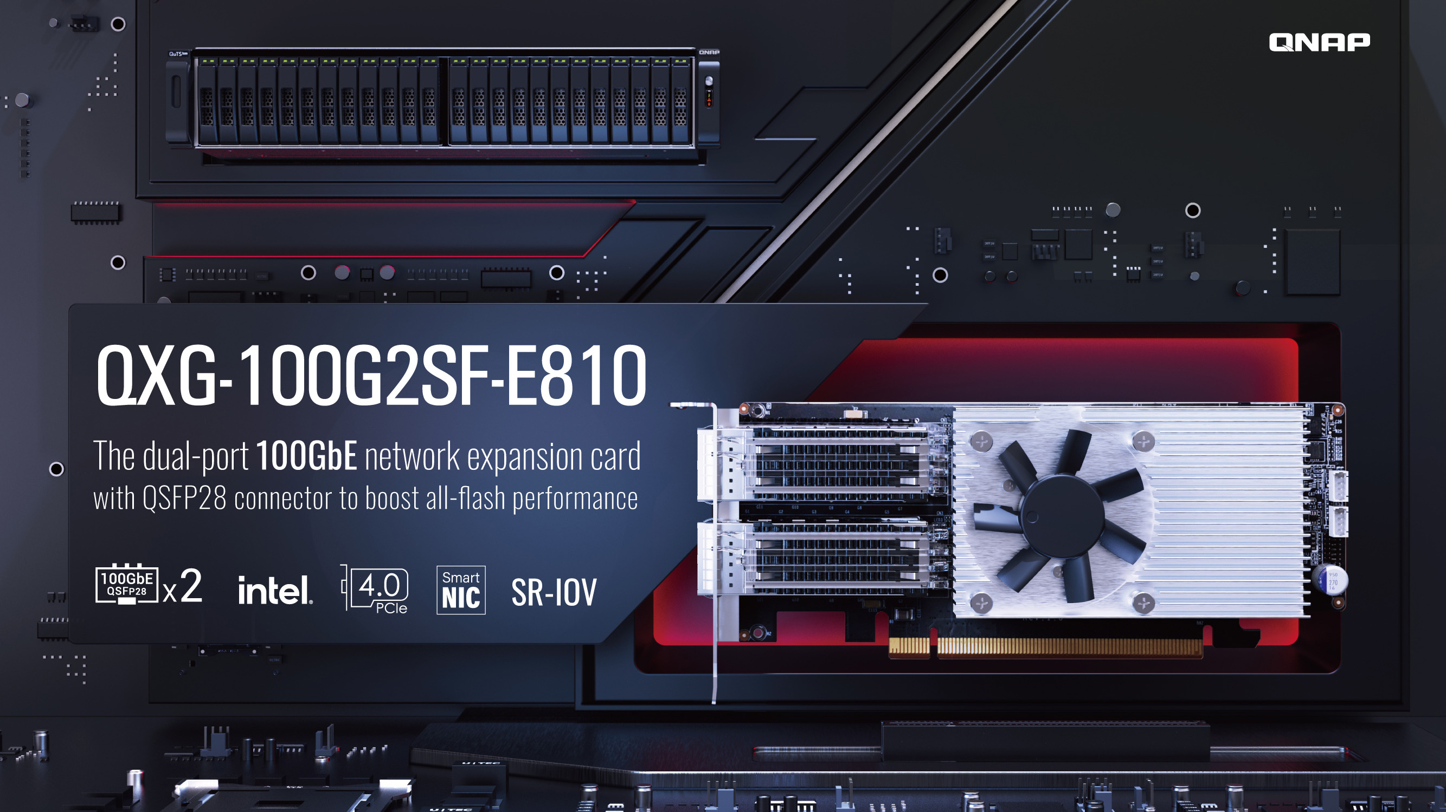

Slide 2
Storage Demands for Digital Transformation

Slide 3
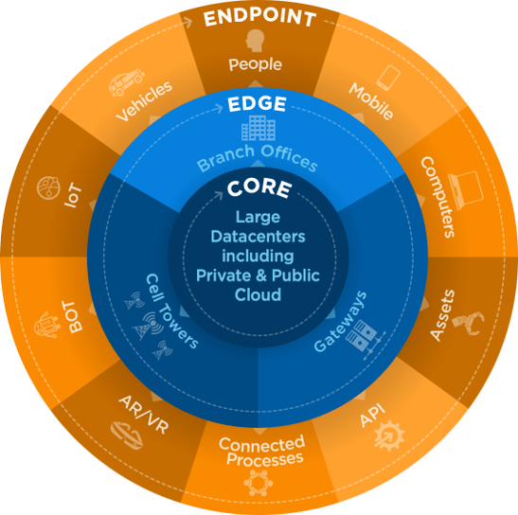
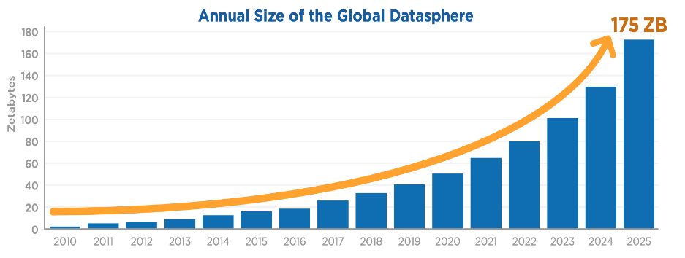
Big data wave causing rapid adoption of digital transformation in businesses
Digital transformation is based upon the large amount of raw data, which is needed to be instantly analyzed for making a meaningful business decision. Therefore, it is critical to store the data in a high-performing, low-latency all flash array (AFA).
Source： Data Age 2025, sponsored by Seagate with data from IDC Global DataSphere, Nov 2018

Slide 4
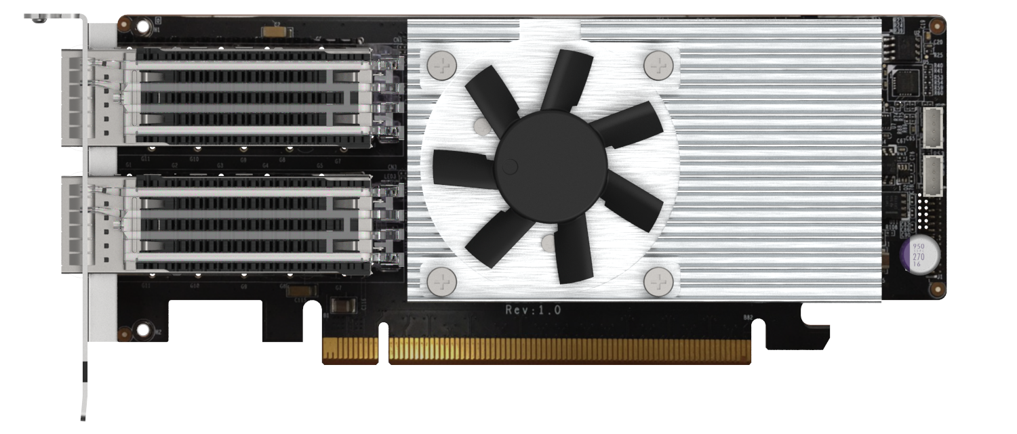
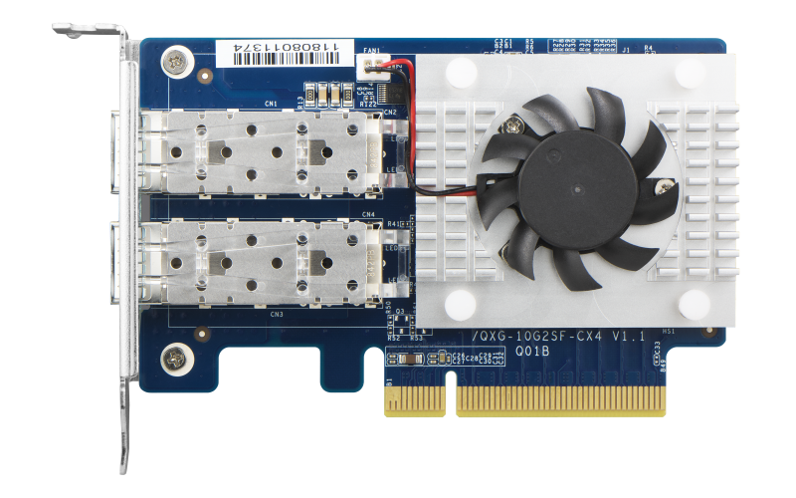
Rapid development of high-speed network technologies
GbE
QXG-100G2SF-E810
LAN-40G2SF-MLX
QXG-25G2SF-CX4
QXG-5G
QXG-10G
QXG-2G

Slide 5
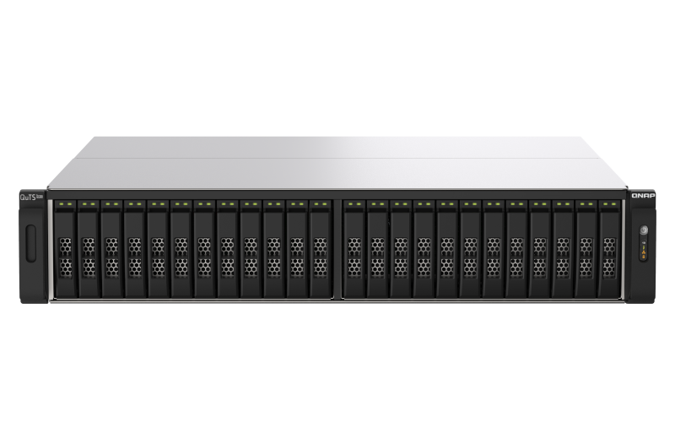
QNAP All-Flash Array (AFA) Series
With the ZFS file system, featuring data security and data reduction technologies
Increase storage efficiency and maximize ROI
Deduplication, inline compression, and data compaction
TS-h3088XU
TS-h2490FU
2U 30-bay 2.5-inch SATA SSD
ZFS file system
2U 24-bay 2.5-inch U.2 NVMe SSD
ZFS file system
TS-h3088XU-RP-W1270-64G
TS-h3088XU-RP-W1250-32G
TS-h2490FU-7302P-128G
TS-h2490FU-7232P-64G

Slide 6
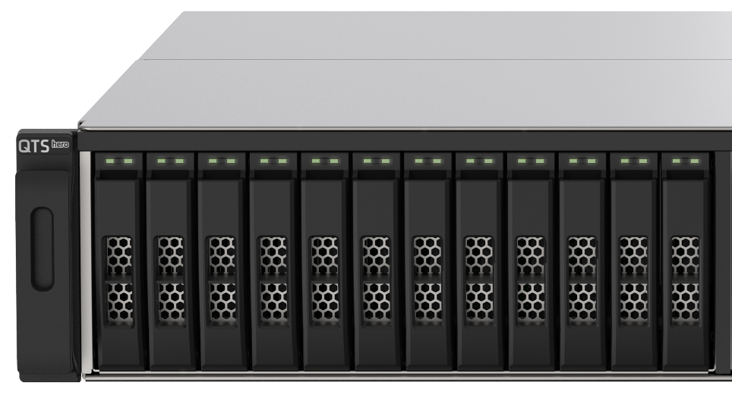
TS-h2490FU NAS SKUs
TS-h2490FU-7302P-128G
AMD EPYC 7302P 16-core/32-thread, 3.0 GHz (Max. 3.3GHz)
128GB DDR4 RDIMM ECC memory (8 x 16GB)
4 x SFP28 25GbE ports (25GbE/10GbE/1GbE)
TS-h2490FU-7232P-64G
AMD EPYC 7232P 8-core/16-thread, 3.1 GHz (Max. 3.2GHz)
64GB DDR4 RDIMM ECC memory (8 x 8GB)
2 x SFP28 25GbE ports (25GbE/10GbE/1GbE)

Slide 7
TS-h3088XU NAS SKUs
TS-h3088XU-RP-W1270-64G
Intel Xeon W-1270 8-core/16-thread, 3.4 GHz (Max. 5.0GHz)
64GB DDR4 UDIMM ECC memory (4 x 16GB)
2 x SFP28 25GbE ports (25GbE/10GbE/1GbE)
TS-h3088XU-W1250-32G
Intel Xeon W-1250 6-core/12-thread, 3.3 GHz (Max. 4.7GHz)
32GB DDR4 UDIMM ECC memory (2 x 16GB)
2 x SFP28 25GbE ports (25GbE/10GbE/1GbE)

Slide 8
100GbE Network Expansion Card

Slide 9
QXG-100G2SF-E810 view
A high-performance, active cooling module
2 x QSFP28 connectors with heatsink
PCI Express 4.0 x16 (backwards compatible with PCI Express 3.0)

Slide 10
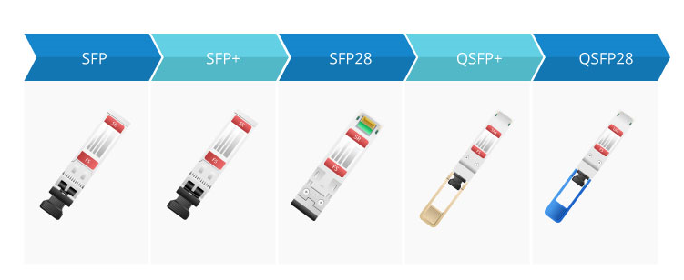
SFP, SFP+, SFP28, QSFP28
1 GbE
10 GbE
25 GbE
40 GbE
100 GbE

Slide 11
QXG-100G2SF-E810 low-profile design for general chassis including full-height/low-profile brackets
Pre-installed low-profile bracket
169.5 mm
Full-height bracket included
68.9 mm

Slide 12
QXG-100G2SF-E810 Specification
QXG-100G2SF-E810 | QXG-100G2SF-E810
Ethernet controller | Intel E800 Series Ethernet controller; E810-CAM2
PCI-Express interface | PCI-Express 4.0 x16 (support PCI Express 3.0)
Connector | QSFP28
Transmission speed | 100GbE, 50GbE, 25GbE, 10GbE
Supported operating systems | QuTS hero 4.5.2 and later QTS 4.5.2 and later Linux Windows 10 Windows Server 2016/2019
Dimension | 169.5 x 68.9 mm
Support cable & transceiver | CAB-DAC15M-QSFP28 (*coming soon later) CAB-DAC15M-QSFP28-B4 (*coming soon later)

Slide 13
New dual-port 100GbE network expansion card Supports multiple operating systems

Slide 14
Software Features

Slide 15
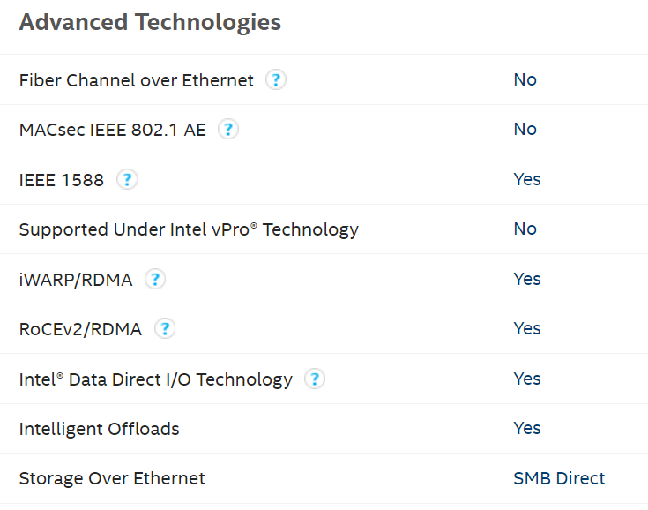
QXG-100G2SF-E810 Supports QoS, SR-IOV, iWRAP, RDMA, RoCE, etc.
https://ark.intel.com/content/www/us/en/ark/products/187410/intel-ethernet-controller-e810-cam2.html

Slide 16
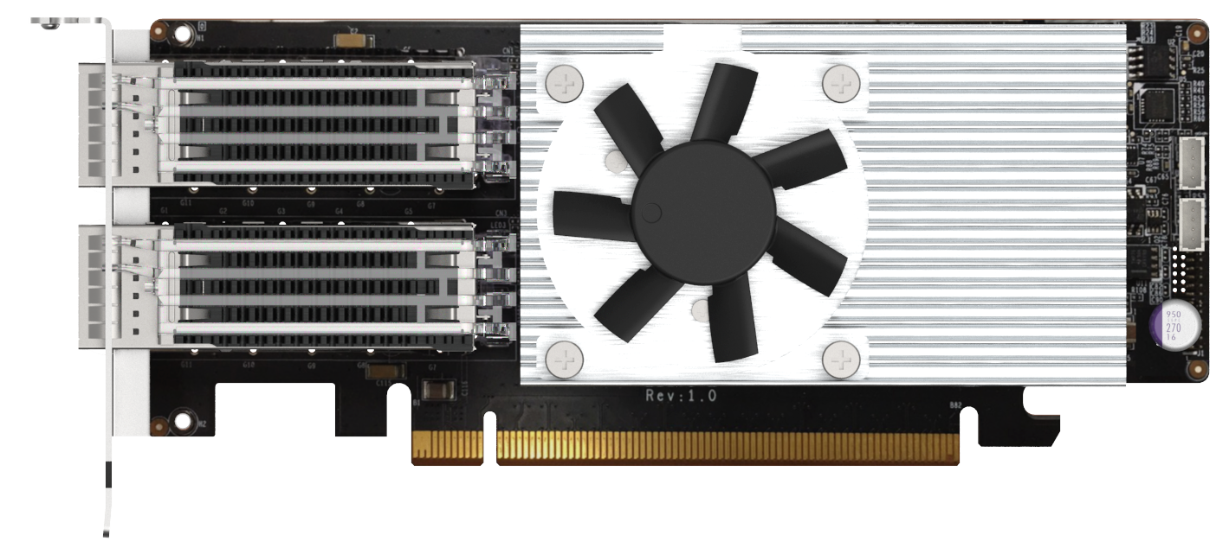
iWARP / RDMA, SR-IOV, and Link Aggregation Support for QXG-100G2SF-E810 in QTS coming soon
Support iWARP / RDMA, realize RDMA through IP network, can achieve low-latency, high-throughput direct memory-to-memory network communication, thereby eliminating unnecessary data movement.​
SR-IOV network I/O virtualization, which directly allocates the bandwidth resources of the physical network card to the virtual machine, can reduce network bandwidth loss and increase network efficiency by more than 20%, and is more stable, which also helps reduce hypervisor CPU is consumption. Note: Only certain NAS models support SR-IOV technology
When used with a high-speed 25/50/100 network switch, it can be configured with Failover fault-tolerant switching. When the network fails, two groups of 100GbE paths can reach a redundant/backup network through the switch to ensure uninterrupted service.​

Slide 17
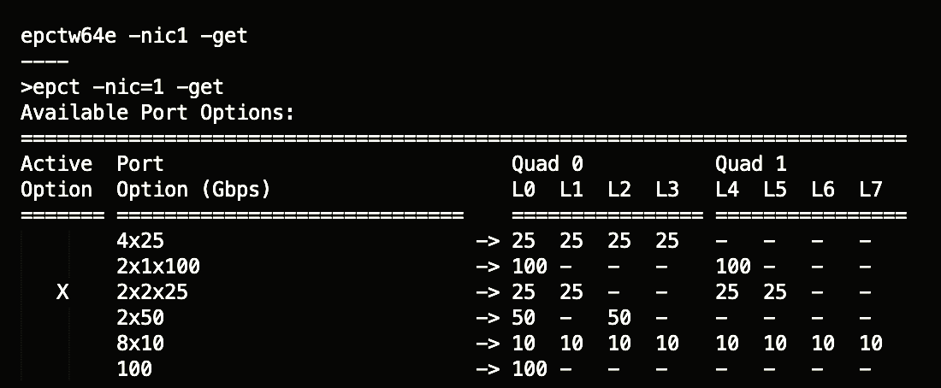
Split ports
QXG-100G2SF-E810 supports port splitting for the following port modes:
2 x 100GbE (Use a QSFP28-QSFP28 cable: CAB-DAC15M-QSFP28)
2 x 50GbE (Use a QSFP28-QSFP28 cable: CAB-DAC15M-QSFP28)
4 x 25GbE (Use a QSFP28 - 4 x SFP28 cable: CAB-DAC15M-QSFP28-B4)
8 x 10GbE (Use a QSFP28 - 4 x SFP28 cable CAB-DAC15M-QSFP28-B4)
How to use in Windows / Linux
Download Intel EPCT (Ethernet Port Config Tool)
*Support in later QTS / QuTS hero versions
*The left image takes Windows for example. Please refer to Intel Readme document for Linux commands.
*Restart after completing configurations

Slide 18
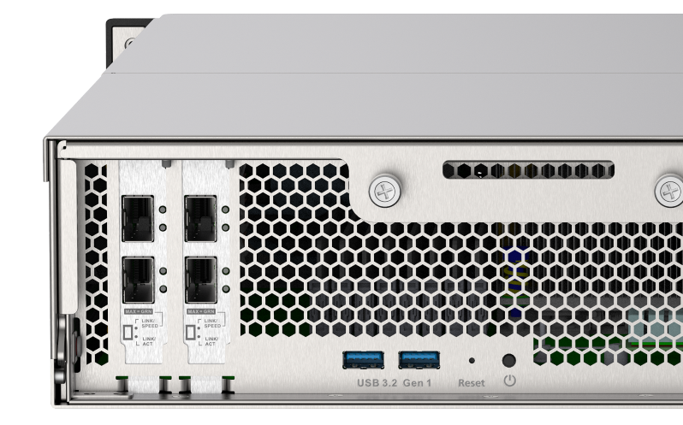
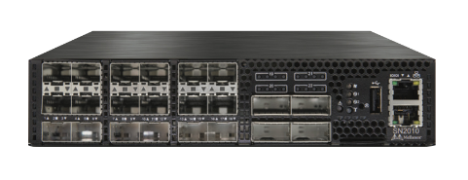
Upgrade TS-h2490FU to 100GbE for more powerful enterprise applications
Upgrade to 100G network environment with TS-h2490FU installed with QXG-100G2SF-E810 pairing with 100GbE switch
Supports splitting ports in later QTS/QuTS hero versions for more flexible options e.g. Connecting to a 25GbE switch or connecting to 4 x 25GbE / 8 x 10GbE devices
CAB-DAC15M-QSFP28
25GbE SFP28
CAB-DAC15M-QSFP28-B4
Mellanox 25 / 100 GbE Switch (SN2010)

Slide 19
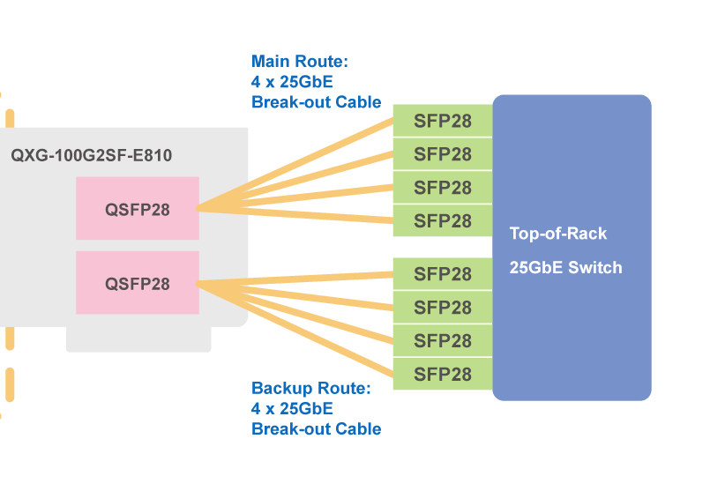
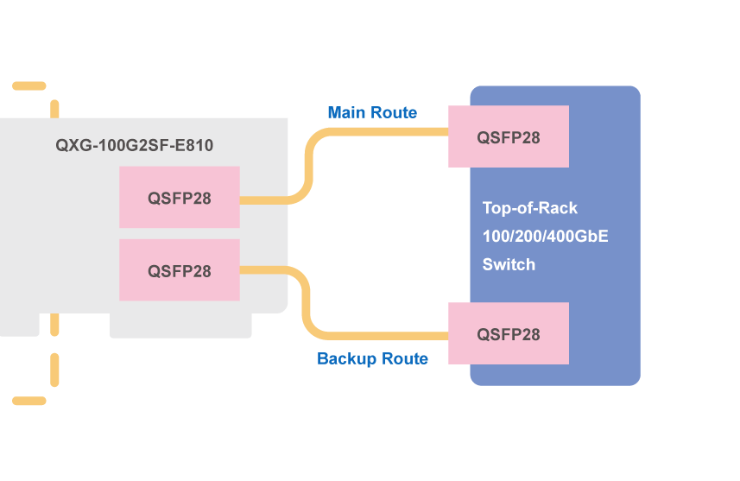
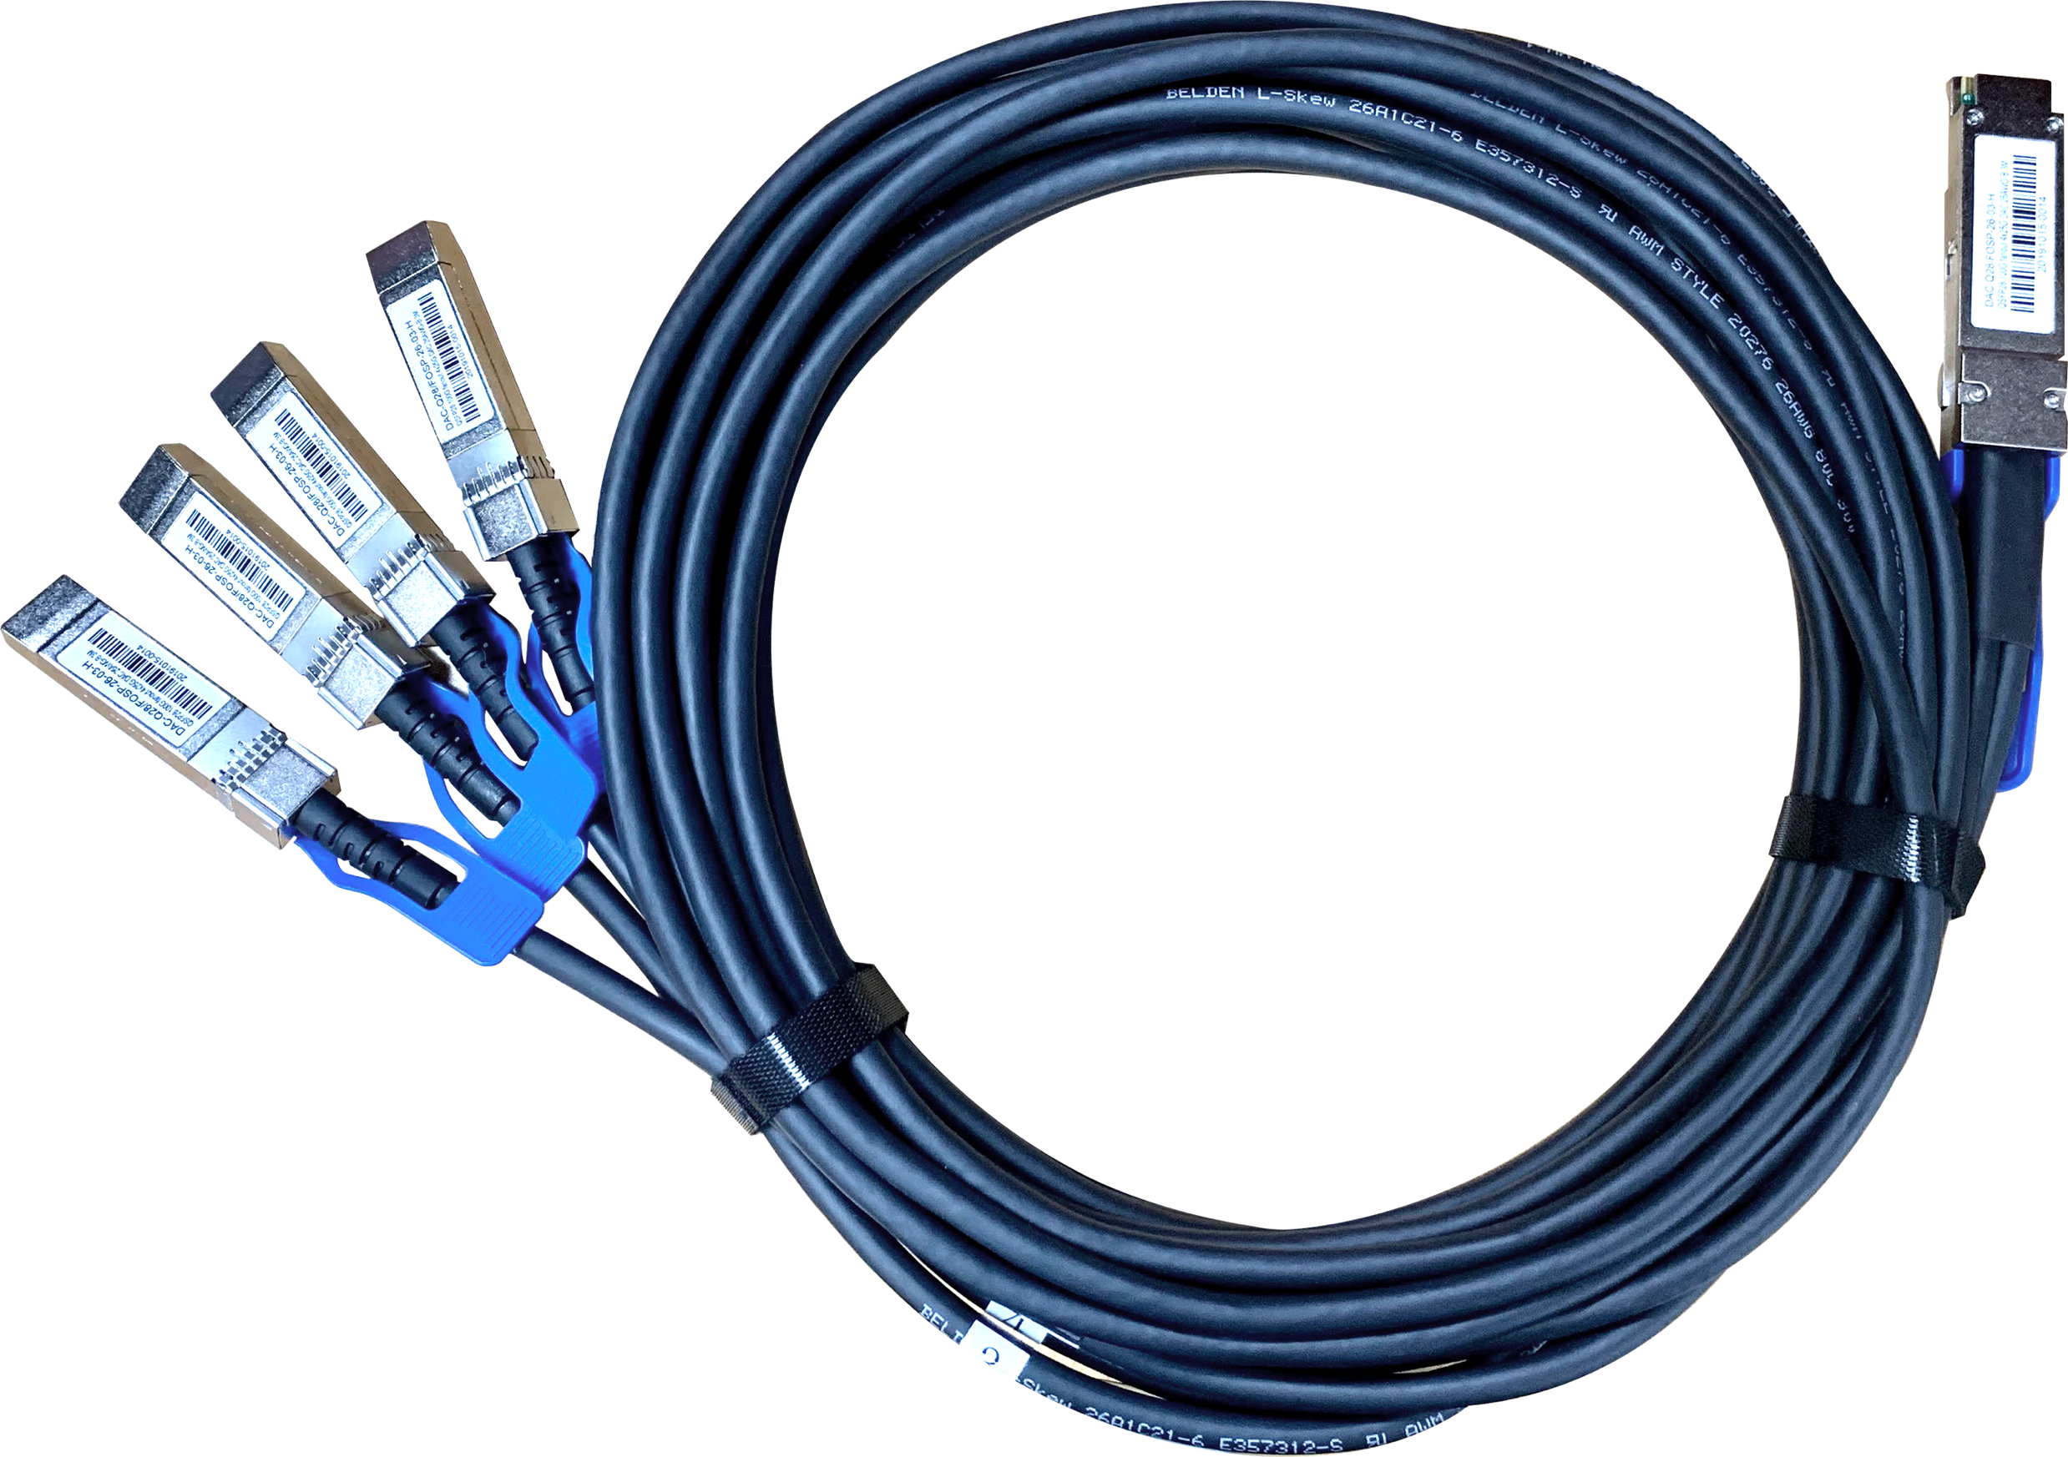
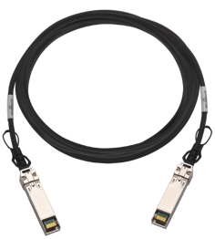
Pair with high-speed switches for high-performance, low-latency data centers
The QXG-100G2SF-E810 network expansion card can be connected to a switch either with a QSFP28 cable or a QSFP28 to (4) SFP28 cable. You can also configure network redundancy to achieve network failover via the switch for continuous service and high availability.
Use a QSFP28 – 4 SFP28 cable to connect to the 25GbE switch
CAB-DAC15M-QSFP28-B4
CAB-DAC15M-QSFP28
Use a QSFP28 cable to connect to the 25Gb switch
Upcoming
Upcoming

Slide 20
100GbE Performance

Slide 21
QXG-100G2SF-E810 transmission performance at near full-speed 99Gbps
1 x 100GbE iPerf Network Speed Test
10000
11905
11894
8000
6000
4000
2000
Test Environment: NAS | TS-h2490FU-7232P-64GB with QXG-100G2SF-E810
Client PC | OS: Ubuntu 20.04
CPU: Xeon Scalable
RAM: 64GB
NIC: QXG-100G2SF-E810
MTU 9000
(MB/s)
0
Read
Write

Slide 22
Best Accessory for AFA
Enter 100GbE Generation
Copyright© 2021 QNAP Systems, Inc. All rights reserved. QNAP® and other names of QNAP Products are proprietary marks or registered trademarks of QNAP Systems, Inc. Other products and company names mentioned herein are trademarks of their respective holders.​​​​

