Slide 2
More than 10K organizations protect data by Boxafe
See what the users said:
We were looking for a flexible backup solution for Office 365 and Gsuite for our customers. Boxafe is working fine.
Great to have Boxafe to protect our O365 environment.
It works great on the whole.
Backups have run now for all accounts and everything seems to work fine.

Slide 3
We know you are waiting for SharePoint backup
A huge amount of important data stored in our O365 SharePoint document libraries. It would be great to protect those files also.
It would be better to have whole SharePoint Online sites protected not only files in document libraries including calendars, posts, news etc.
Cannot backup SharePoint sites.
I would like to be able to backup SharePoint sites.
When can we expect SharePoint support?

Slide 4
Boxafe 1.3 now support SharePoint backup!

Slide 5
More than 250K Organizations are using SharePoint
Accessibility
Availability
Scalability
Service Continuity
Organizations use Microsoft SharePoint to create websites.
Sharing the files with document libraries.
Sharing the information on the pages.
Managing the project by the lists.
Notes:
https://blogs.office.com/2017/05/16/sharepoint-virtual-summit-showcases-growth-innovations-and-customer-success/

Slide 6
6 Reasons why you need to backup Microsoft SharePoint
Accidental Deletion
Malicious Deletion / Hacker
Ransomware Attack
Legal Compliance & Litigation Purpose
Keep previous data
Huge amount of files are stored in the document libraries.
Pages, calendar and apps are also important for the business.
Microsoft asks you to protect data
Every data loss has huge impact for the business!

Slide 7
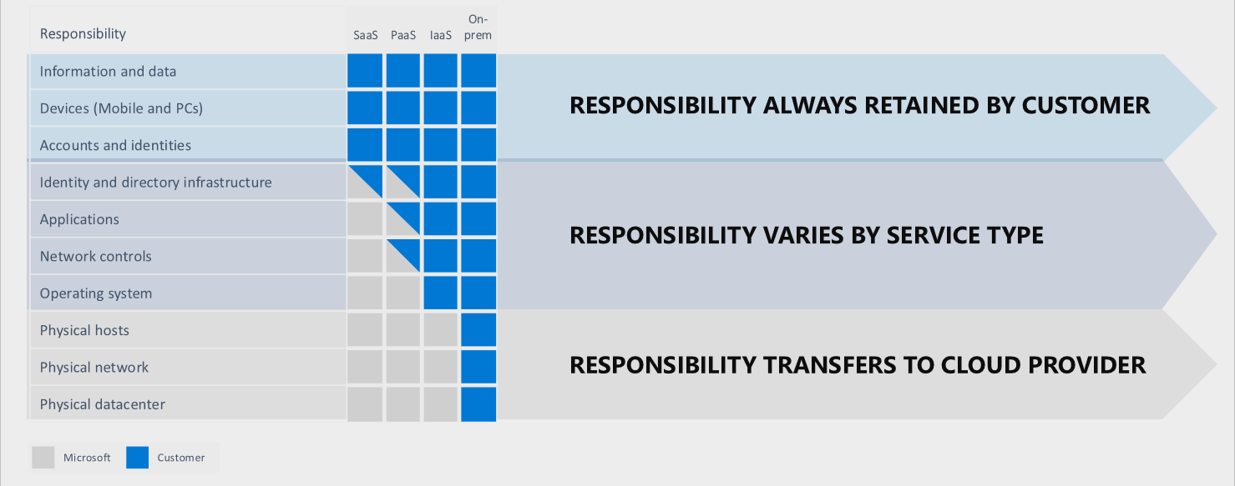
Microsoft’s Shared Responsibility Model
Microsoft tells you that it’s your responsibility to protect your data.
https://docs.microsoft.com/en-us/azure/security/fundamentals/shared-responsibility

Slide 8
Microsoft’s Standard Recovery Policy
Your data is not always protected by Microsoft!
30 days
(1 month)
14
days
Mail
Delete
Keep in recycle bin
Recoverable
Permanently deleted
Contacts
Delete
Keep in recycle bin
Recoverable
Permanently deleted
93 days
(3 months)
14
days
OneDrive
Delete
Keep in 1st and 2nd recycle bin
Recoverable
Permanently deleted
SharePoint
Delete
Keep in 1st and 2nd recycle bin
Recoverable
Permanently deleted

Slide 9
Google’s Standard Recovery Policy
Your data is not always protected by Google!
30 days
(1 month)
Gmail
Delete
Keep in trash
Permanently deleted
Calendar
Delete
Keep in trash
Permanently deleted
Contacts
Delete
Recoverable
Permanently deleted
25 days
My Drive / Shared Drive
Delete
Keep in trash
Recoverable
Permanently deleted

Slide 10
Boxafe safeguards your Business data!
Boxafe protects
Gmail
Calendar
My Drive / Shared Drive
Contacts
Outlook (mail, calendar, contacts)
OneDrive
SharePoint
with
Friendly UI
Security
Reliability
Data Centralization

Slide 11
Google Workspace
Comprehensive protection
Mail
Protect email data, attachments and label.
Calendar
Protect event’s information.
Contacts
Protect the inportant customer’s contact.
Drive
Backup data, metadata, permission of the files in my drive and shared drive.

Slide 12
Microsoft 365
Comprehensive protection
Mail
Protect email data, attachments and floder structure.
Calendar
Protect event’s information.
Contacts
Protect the inportant customer’s contact.
OneDrive
Backup data, metadata, permission of the files.

Slide 13
Microsoft SharePoint (beta)
Comprehensive protection
NEW
Boxafe backs up and restores data and its permission in the site content of the sites and the subsites including:
Document libraries
Page libraries
Lists
Site Asset
OneNote
If Microsoft 365 backup task was created, grant permissions for SharePoint Sites to backup SharePoint in Boxafe.

Slide 14
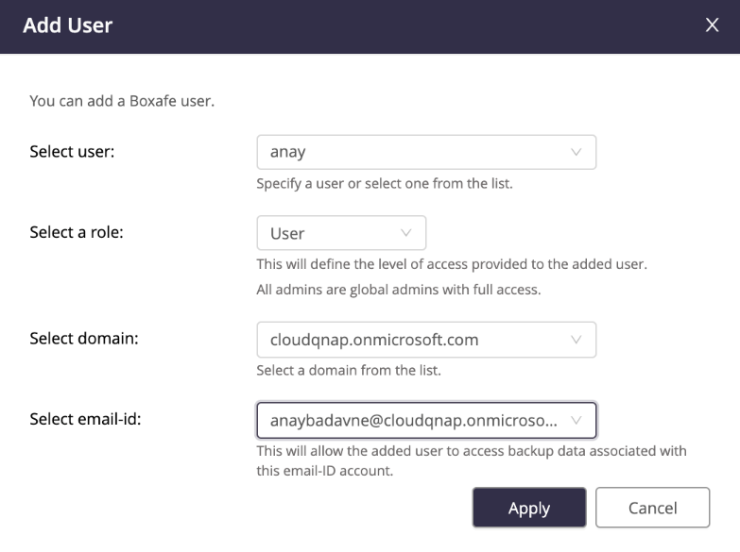
Multiuser solution for various Google Workplace / MS365 users
Backed up data cannot be accessed by unauthorized personnel.
Restoring data to the cloud can be done by user.

Slide 15
Data preview and search
Data preview before restore. Search for specific data by:
Mail: subject, from, to, cc, bcc.
Contacts: name, email, nicknames, occupations, phone numbers.
Calendar: organizer, title, event location.
Drive: type, owner, date modified, item name.

Slide 16
Select data for granular restore
Multiple select data to restore to the account. No need to restore full backup every time.
Restore to another account when the employee already left.

Slide 17
Schedule multi-version backup to reduce RPO
Boxafe makes differential backups and keep multiple versions.

Slide 18
Extend the Usage of Centralized Data
Export files to File Station and distribute files to different users simultaneously for further usage.
User A
User B
Backup
Project A
Project B
Project C
Project A
Project C
Project D
Re-arrange and move files
Qfiling
Project A
Project B
Project C
Project D

Slide 19
Demo

Slide 20
Boxafe Architecture Diagram
Backup/Restore API calls
Worker pool
Store data
Launch workers
Secure, fully optimized and versioned storage
database
Job queue / executor
file storage
Read data
Ad-hoc job
Web server
API Endpoint
User Interface

Slide 21
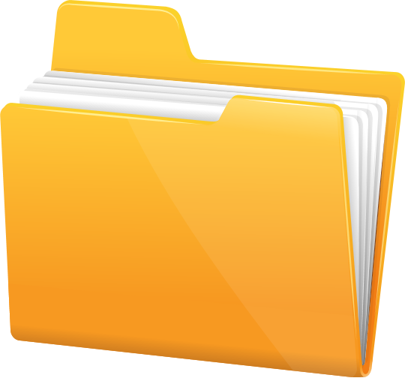
Gmail
Calendar
My Drive / Shared Drive
Contacts
Outlook (mail, calendar, contacts)
OneDrive
Document Library
Pages
List
Comprehensive Google Workspace and Microsoft 365 backup solution
Site Assets
Notes
SharePoint
Data preview for
granular restore
Multiuser access
Multi-version
backup
Data centralization

