Slide 2
SR-IOV Reduce network bandwidth loss

Slide 3
The network problem of enterprise
VM service requires immediate response
VM service requires a stable network

Slide 4
How to reduce the network bandwidth loss of VM?
VM service requires immediate response
VM service requires a stable network

Slide 5
SR-IOV- Single Root I/O Virtualization
A physical network card (Physical Function, PF) can virtualize multiple lightweight PCI-e physical devices (Virtual Function, VF), which can be allocated to virtual machines.
In fact, the VMs uses the VF on the physical network card directly and enjoy the network speed from the network card.
SR-IOV

Slide 6
SR-IOV Architecture

Slide 7
The network speed used by SR-IOV is enhanced 20%
 | VM NAS (Client) to NAS(server) None SR-IOV | VM (VF)NAS (Client) to NAS(server) - SR-IOV
NAS CPU Usage | 97% | 95% | Reduce CPU usag
VM OS CPU Usage | 13% | 12% | Reduce CPU usage
Transfer speed | 1GB/s | 1.21 GB/s | Enhance performance 20%
VM /NAS Client to Server data transfer test
Client
Server
Test environment setting | VM
TS-h868 (Client) / FW 4.5.1.1427 + NIC QXG-10G2SF-CX4 | OS : windows server 2016
TS-h668 (Server) / FW 4.5.1.1427 +NIC QXG-10G2SF-CX4 | Cores : 8 (NAS cores )
QVS 3.5.1_20200914 | Memory : 3GB
Build 8 VM ,8 VF in QXG-10G2SF-CX48 allocate 1 VF to 1 VM use

Slide 8
QAT technology doubles compression performance
 | ubuntu-18.04.1-desktop-amd64.iso (1.81GB) -None QAT | ubuntu-18.04.1-desktop-amd64.iso (1.81GB) - QAT
Compression Time | 122.64s | 62.28s | Double Compression Speed!
NAS CPU useage | 95% | 93% | CPU useage almost the same
VM1
VM2
VM3
VM4
VM5
VM6
VM7
VM8
Test environment setting | VM
Test model: TS-h886 | VM OS: ubuntu 18.04
QVS 3.5.3 | Cores : 8 (NAS cores )
 | Memory : 1GB
8 VM,each VM allocate 1 QAT VF compression test at the same time.

Slide 9
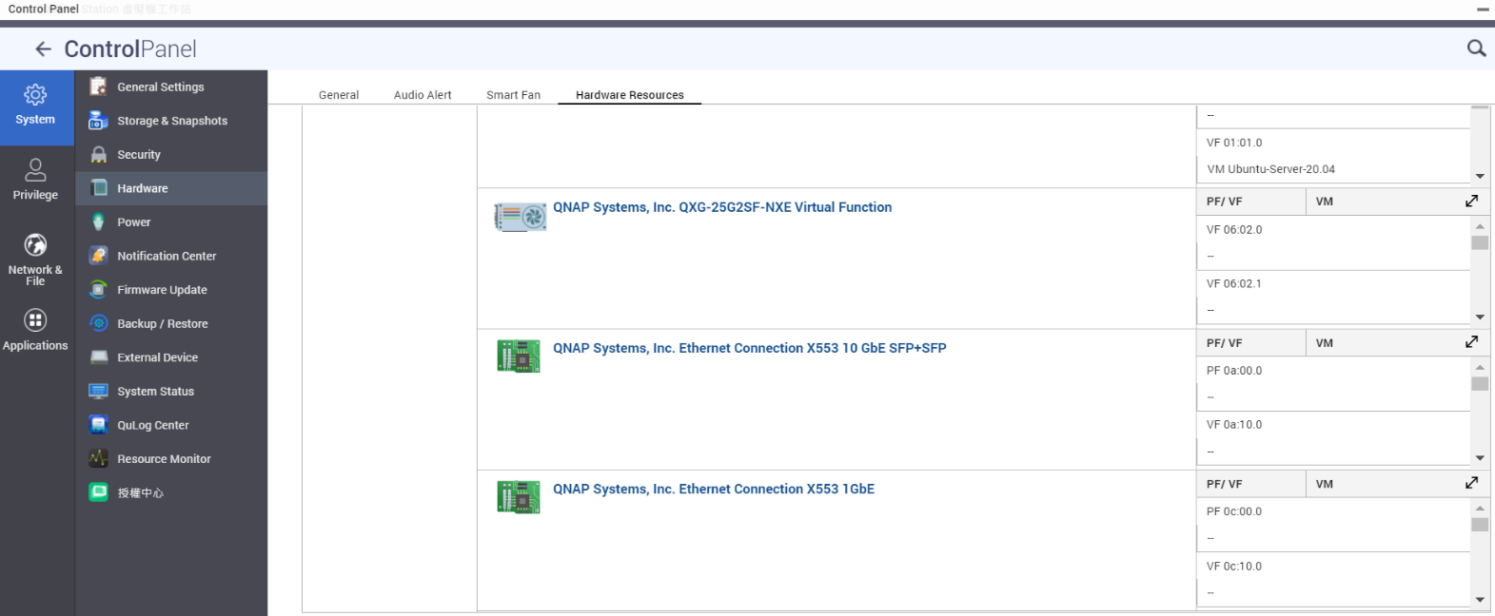
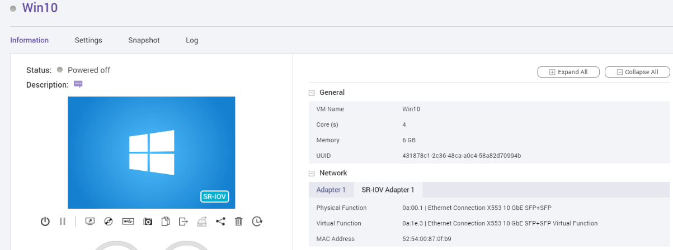
The visual UI is more easy to use

Slide 10
SR-IOV advantages and benefits for user
Advantage
Let the services on your virtual machine enjoy the physical network speed.
Benefits
If you need real-time service needs, such as ticket booking service, cash flow service, audio-visual service, you can directly enjoy the speed of the hardware network card, reducing network delay.
Reduce the usage of the host's CPU.
Increase network efficiency by at least 20%.

Slide 11
SR-IOV

Slide 12
SR-IOV Support list
SR-IOV support model list and BIOS Version :
TS-h686(Q05SAR01)/TS-h886(Q05SAR01)
TS-1886XU-RP(Q047AR03)/ TS-h1886XU-RP(Q047AR03)
TDS-16489U(QX31AR19)/TDS-16489U-R2(QX31AR19)
QGD-1602P(Q03OAR05)
TS-h2490FU(Q03XAR15)
QAT support model :
NIC Card :
QGD-1602P
Intel : LAN-10G2T-X550
Mellanox :LAN-10G2SF-MLX/LAN-40G2SF-MLX
Mellanox :QXG-10G2SF-CX4/QXG-25G2SF-CX4

Slide 13
SR-IOV notice
SR-IOV needs to be matched with a supported model, BIOS version and supported network card to support it.
SR-IOV support SW version QTS 4.5.2 & QVS 3.5.3.
QAT needs to install the corresponding virtual function driver in the Guest OS.
Currently, the downloadable driver version on the official website is Linux and FreeBS.
Intel driver download link - https://01.org/intel-quick-assist-technology/downloads
The VM Live Migration function cannot be used when using SR-IOV (Device Passthrough).
Because the physical device used by the VM will not recognize the original physical device ID after VM Live migration.

