Slide 1
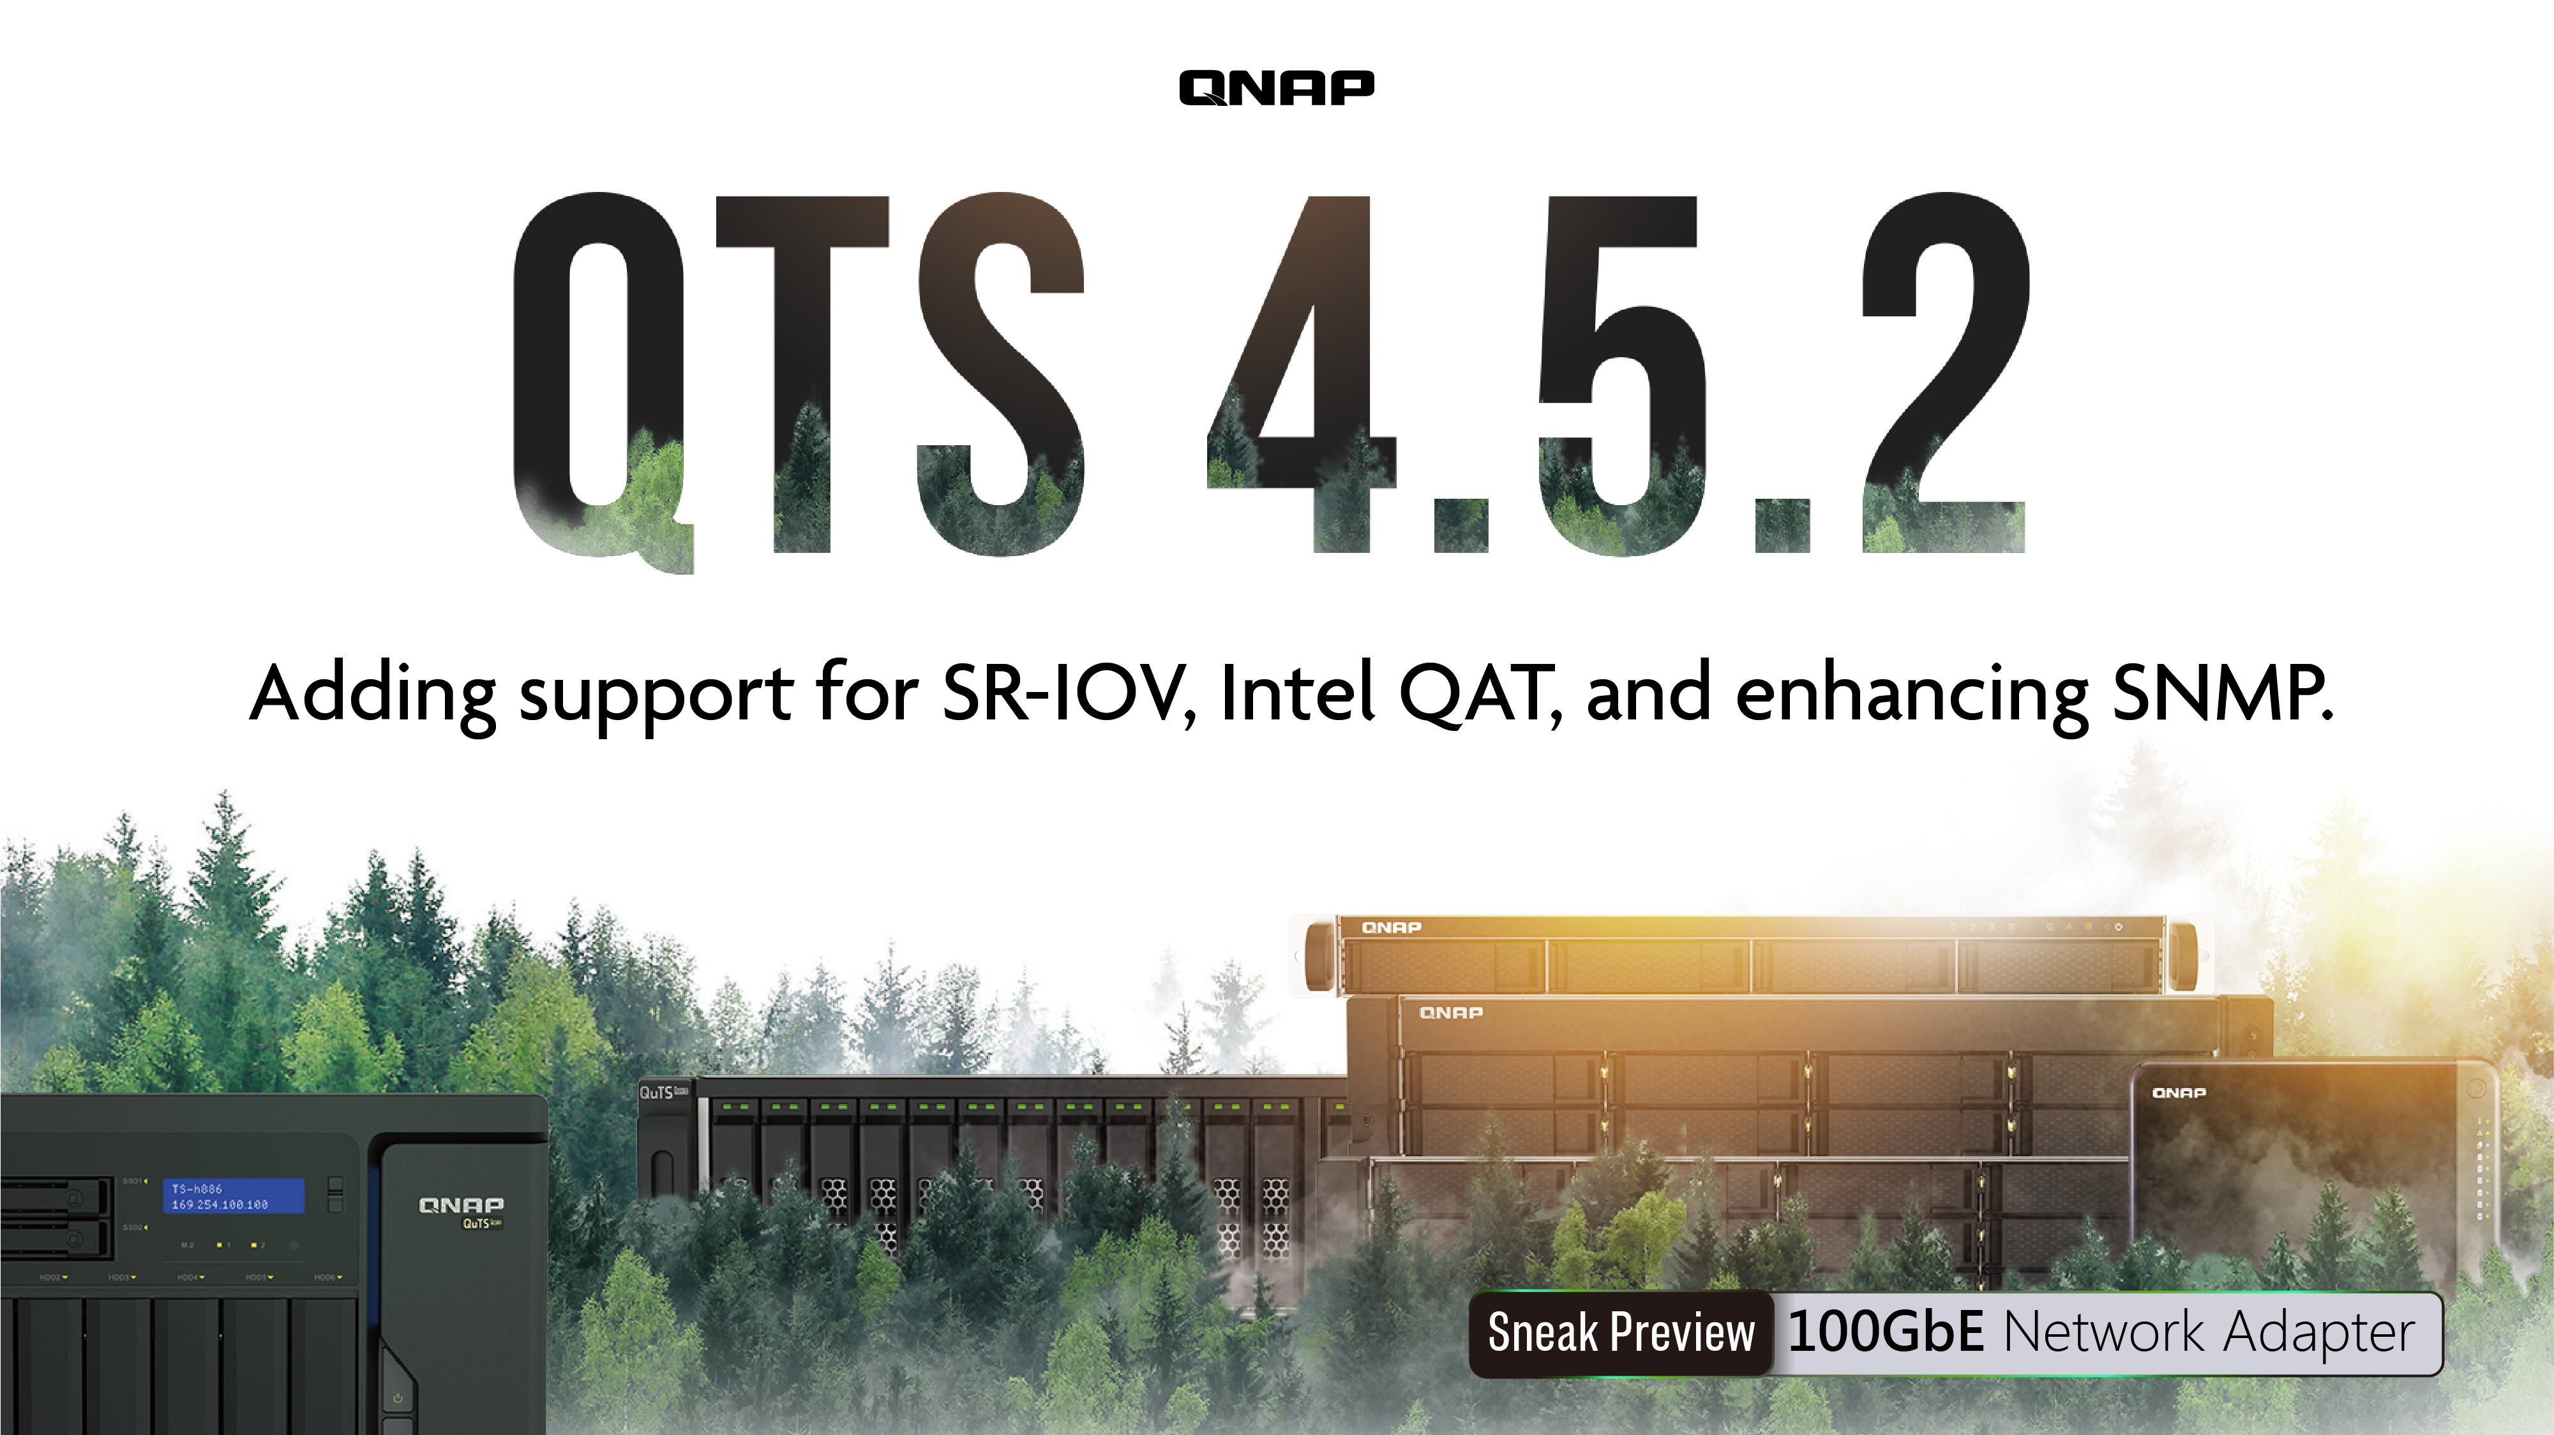

Slide 2
Agenda
SR-IOV & QAT
1
100GbE NIC
2
SNMP
3
Remotely manage multiple NAS on networks
Ecosystem & Zabbix 5
Live demo
Enhanced Management
4

Slide 3

SR-IOV
Reduce network bandwidth loss

Slide 4
The network problem of enterprise
VM service requires immediate response
VM service requires a stable network

Slide 5
How to reduce the network bandwidth loss of VM?
VM service requires immediate response
VM service requires a stable network

Slide 6
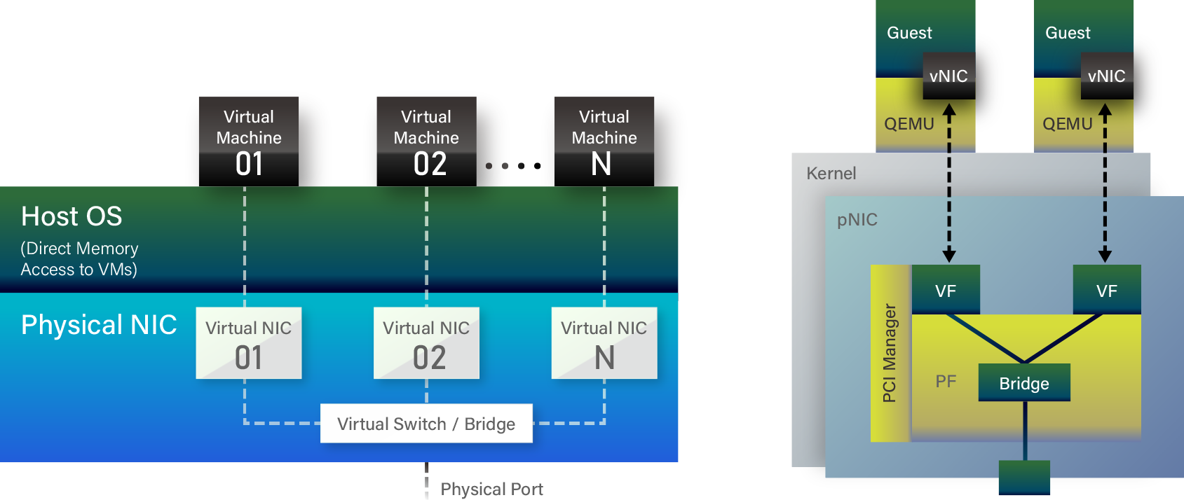
SR-IOV- Single Root I/O Virtualization
A physical network card (Physical Function, PF) can virtualize multiple lightweight PCI-e physical devices (Virtual Function, VF), which can be allocated to virtual machines.
In fact, the VMs uses the VF on the physical network card directly and enjoy the network speed from the network card.
SR-IOV

Slide 7
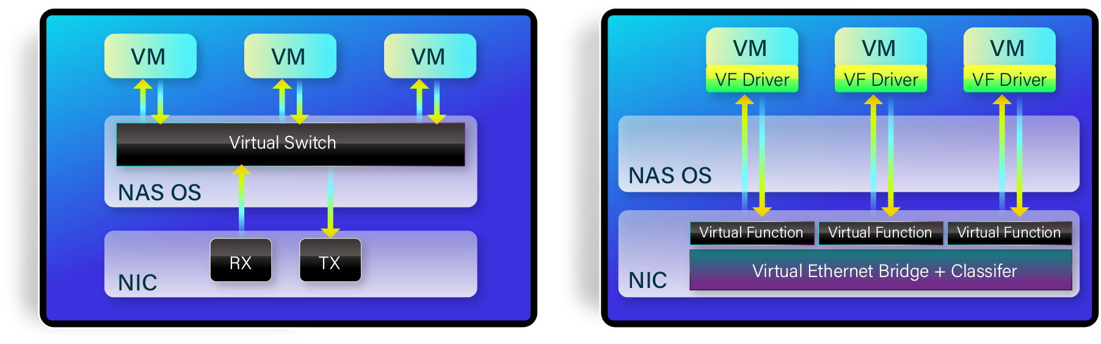
SR-IOV Architecture
Normal
SR-IOV

Slide 8
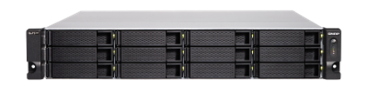


The network speed used by SR-IOV is enhanced 20%
 | VM NAS (Client) to NAS(server) None SR-IOV | VM (VF)NAS (Client) to NAS(server) - SR-IOV
NAS CPU Usage | 97% | 95% | Reduce CPU usage
VM OS CPU Usage | 13% | 12% | Reduce CPU usage
Transfer speed | 1GB/s | 1.21 GB/s | Enhance performance 20%
VM /NAS Client to Server data transfer test
Client
Server
Test environment setting | VM
TS-h868 (Client) / FW 4.5.1.1427 + NIC QXG-10G2SF-CX4 | OS : windows server 2016
TS-h668 (Server) / FW 4.5.1.1427 +NIC QXG-10G2SF-CX4 | Cores : 8 (NAS cores )
QVS 3.5.1_20200914 | Memory : 3GB
Build 8 VM ,8 VF in QXG-10G2SF-CX48 allocate 1 VF to 1 VM use

Slide 9
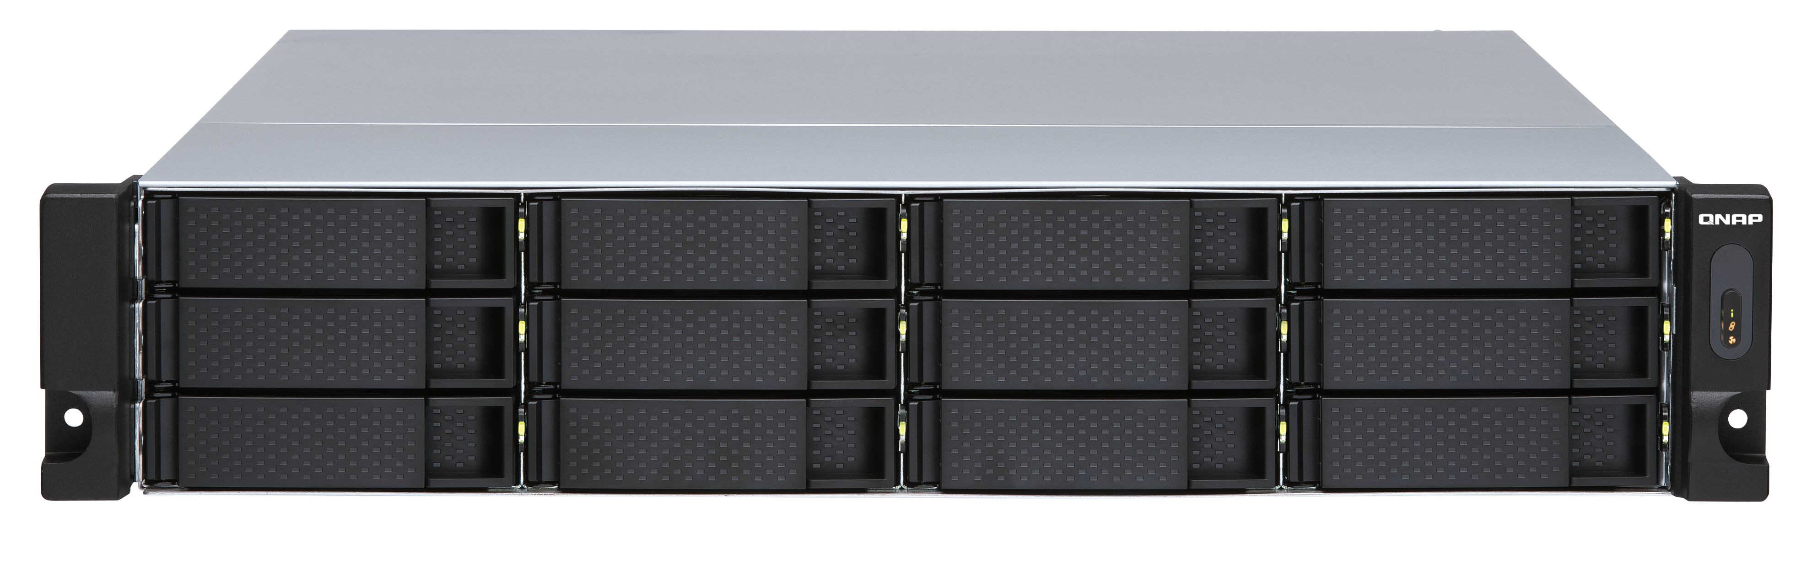
QAT technology doubles compression performance
 | ubuntu-18.04.1-desktop-amd64.iso (1.81GB) -None QAT | ubuntu-18.04.1-desktop-amd64.iso (1.81GB) - QAT
Compression Time | 122.64s | 62.28s | Double Compression Speed!
NAS CPU useage | 95% | 93% | CPU useage almost the same
8 VM,each VM allocate 1 QAT VF compression test at the same time.
VM1
VM2
VM3
VM4
VM5
VM6
VM7
VM8
Test environment setting | VM
Test model: TS-h886 | VM OS: ubuntu 18.04
QVS 3.5.3 | Cores : 8 (同NAS cores 數)
 | Memory : 1GB

Slide 10
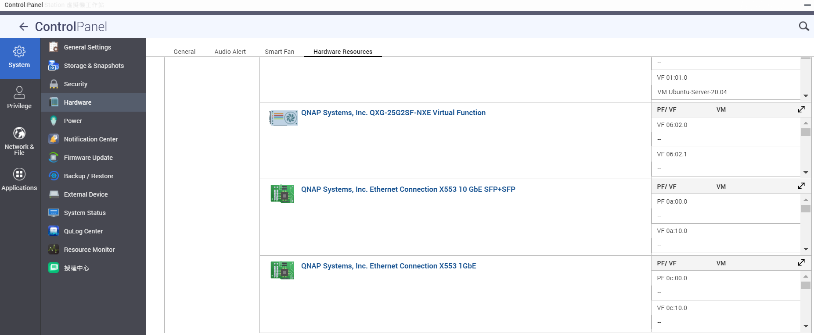
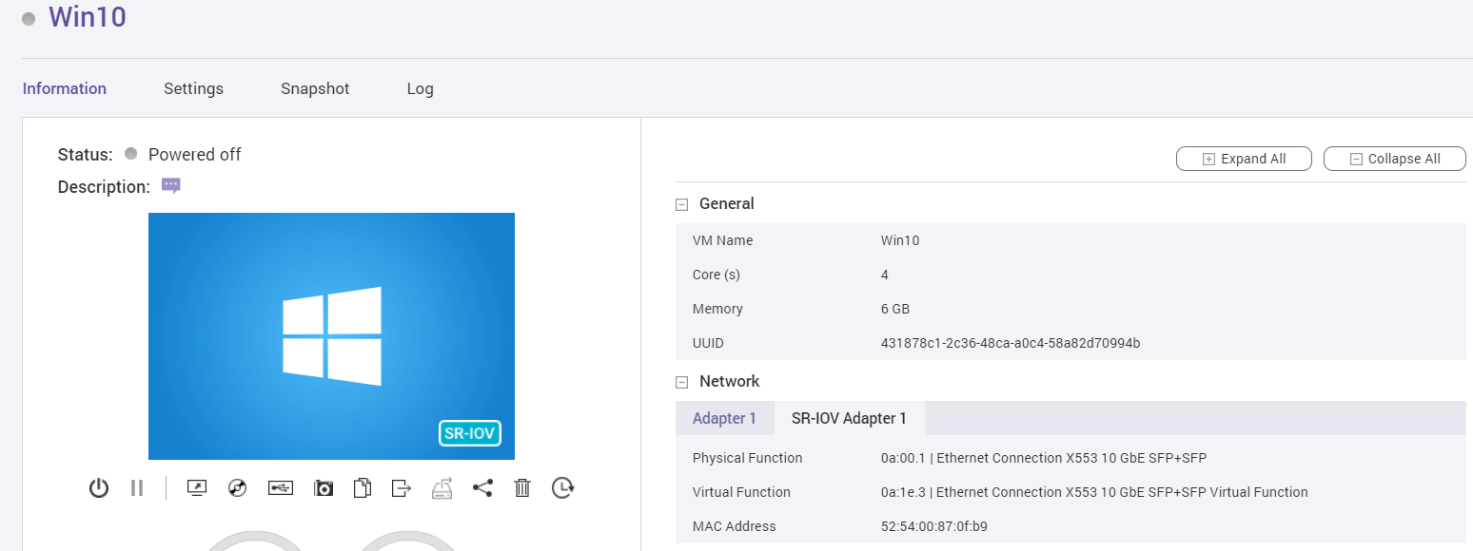
The visual UI is easier to use

Slide 11

SR-IOV advantages and benefits for user
Advantage
  Let the services on your virtual machine enjoy the physical network speed.
Benefits
  If you need real-time service needs, such as ticket booking service, cash flow service, audio-visual service, you can directly enjoy the speed of the hardware network card, reducing network delay.
  Reduce the usage of the host's CPU.
  Increase network efficiency by at least 20%.

Slide 12
SR-IOV

Slide 13
SR-IOV Support list
SR-IOV support model list and BIOS Version:
  TS-h686(Q05SAR01)/TS-h886(Q05SAR01)
  TS-1886XU-RP(Q047AR03)/ TS-h1886XU-RP(Q047AR03)
  TDS-16489U(QX31AR19)/TDS-16489U-R2(QX31AR19)
  QGD-1602P(Q03OAR05)
  TS-h2490FU(Q03XAR15)
QAT support model :
QGD-1602P
NIC Card :
  Intel : LAN-10G2T-X550
  Mellanox :LAN-10G2SF-MLX/LAN-40G2SF-MLX
  Mellanox :QXG-10G2SF-CX4/QXG-25G2SF-CX4

Slide 14
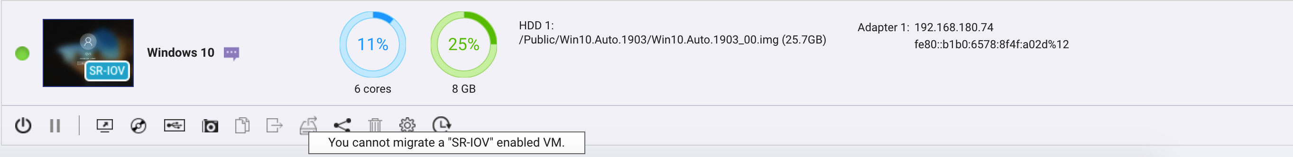
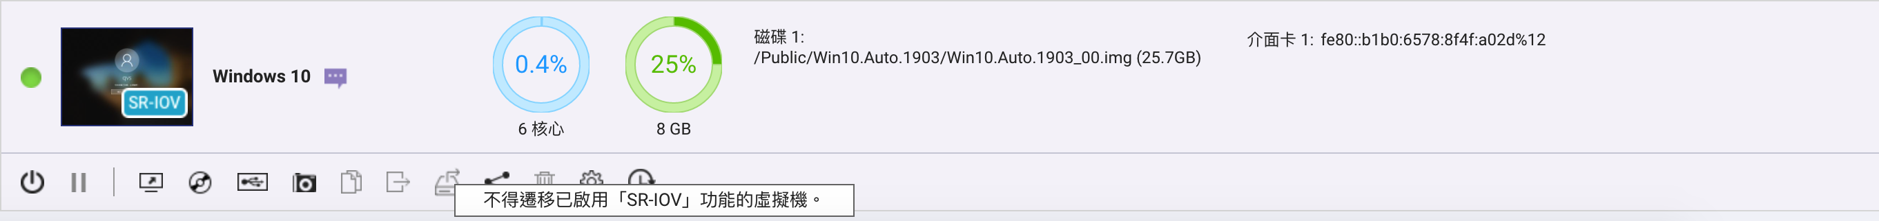

SR-IOV notice
SR-IOV needs to be matched with a supported model, BIOS version
and supported network card to support it.
SR-IOV support SW version QTS 4.5.2 & QVS 3.5.3 .
QAT needs to install the corresponding virtual function driver in the Guest OS
  *Currently, the downloadable driver version on the official website is Linux and FreeBSD
  Intel driver download link -https://01.org/intel-quick-assist-technology/downloads
The VM Live Migration function cannot be used when using SR-IOV
(Device Passthrough)
Because the physical device used by the VM will not recognize the original physical device ID after VM Live migration.

Slide 15
100GbE
Ultra-high-speed 100G network connectivity

Slide 16



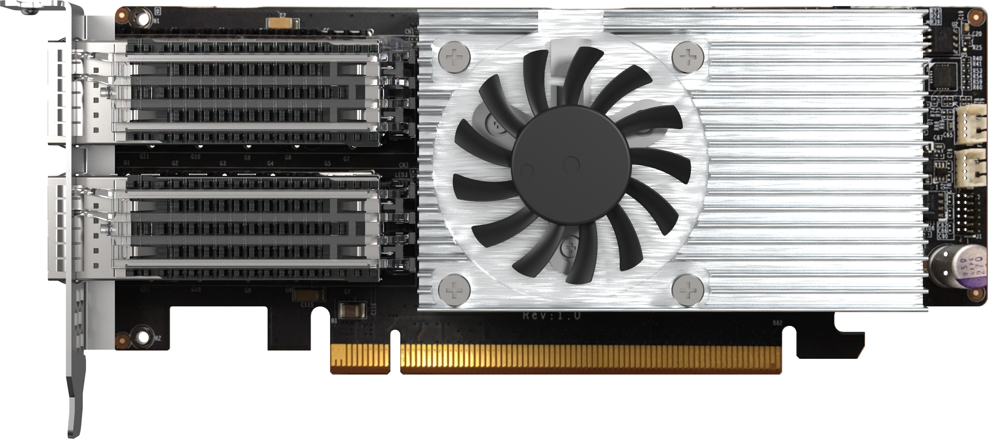
Dual-port 100GbE Network Interface Card
QXG-100G2SF-E810
The dual-port QXG-100G2SF-E810 100GbE network interface card with Intel® Ethernet Controller E810 supports PCIe 4.0 and provides up to 100Gbps bandwidth to overcome performance bottlenecks.
*Port config mode for 2 x 50GbE / 4 x 25GbE / 8 x 10GbE coming soon!
QXG-100G2SF-E810

Slide 17



QXG-100G2SF-E810 will support iWARP / RDMA, SR-IOV and Link Aggregation soon!
Support iWARP/RDMA, realize RDMA through IP network, can realize low-latency, high-throughput direct memory-to-memory network communication, thereby eliminating unnecessary data movement.​
SR-IOV network I/O virtualization, which directly allocates the bandwidth resources of the physical network card to the virtual machine, can reduce network bandwidth loss and increase network efficiency by more than 20%, and is more stable, which also helps reduce Hypervisor CPU is consumed.
​​Note: Only certain NAS models support SR-IOV technology​
Used with a high-speed 25/50/100 network switch, it can be configured with Failover fault-tolerant switching. When the network fails, two groups of 100GbE paths can reach a redundant/backup network through the switch to ensure uninterrupted service.​

Slide 18
New, Enhanced and Restructured SNMP MIB
Remotely monitor multiple NAS on networks

Slide 19

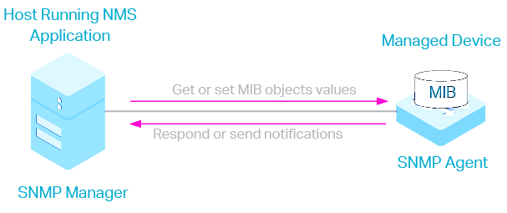
SNMP in a Nutshell
Simple Network Management Protocol (SNMP) is an Internet Standard protocol for collecting and organizing information about managed devices on IP networks and for modifying that information to change device behavior.
SNMP consists of three key components: managed devices, agents, and network-management systems (NMSs).
The protocol is a set of standards for communication with devices in a TCP/IP network.
Monitoring and management of devices such as routers, access servers, switches, cable modems, bridges, hubs, IP telephones, IP video cameras, computer hosts, and printers.

Slide 20

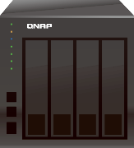

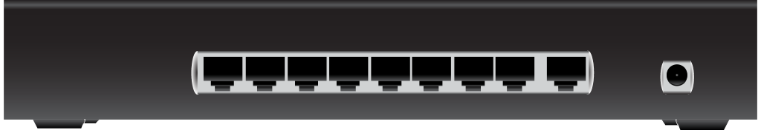


Basic networking Topology
Public NAS
Internet
  Two and multi-tier topology
    Firewall
    Switch
  Security handled by Firewall
  Devices and endpoints are connected with switches
  Public Devices/NAS
  Internal Devices/NAS accessible only in same or transperent subnet
Firewall
Switch
Switch
Internal NAS

Slide 21

Common problems with remote device monitoring without NMS
  No Realtime Data: Without NMS and protocols such as SNMP its hard-to-get real time status of the device and various parameters
  Cannot have more advance widgets to view, monitor and compare statistics of various devices at the same time.
  IT may have to login to each device manually to monitor and manage it. Which is not at all ideal for IT.
  Event notification configuration need to be done on each device separately, manually.
  Very little and cumbersome report generation capabilities.

Slide 22
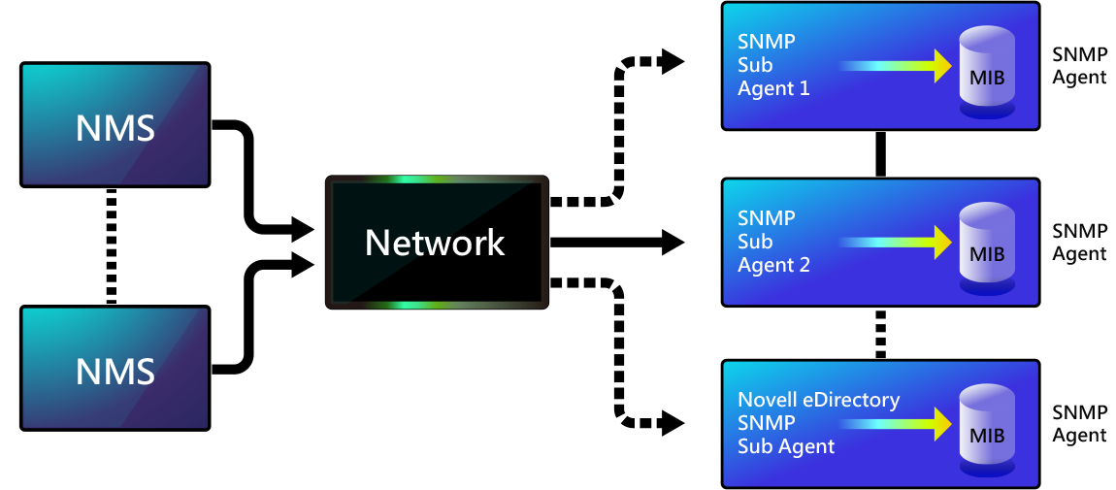
Network Management with SNMP

Slide 23

New SNMP MIB with QTS 4.5.2
  Whats New?
  New restructured, well-organized, more elaborate MIB
  Contains various new nodes such as storage, system, external, applications, services.
  Support added for monitoring installed applications and related metadata.
  Support added for fiber channel adapter and related information monitoring.
  Many new SNMP sensors added.
  Fixed issue with UPS SNMP community string.
  QTS SNMP implementation blocks write operations for security purpose.
  We do support read only operations hence providing ideal
  environment for Device monitoring
  Supports old MIB also, for the backward compatibility.

Slide 24
New OID and MIB Structure for QTS 4.5.2
Old OID and Alias​
  OID: .1.3.6.1.4.1.24681​
  OID Alias: .iso.org.dod.internet.private.enterprises.storage
NEW OID and Alias​
  OID: .1.3.6.1.4.1.55062.1​
  OID Alias: .iso.org.dod.internet.private.enterprise.qnap.qts​
OID | OID Alias
.1.3.6.1.4.1.55062.1 | .iso.org.dod.internet.private.enterprises.qnap.qts
.1.3.6.1.4.1.55062.1.10 | .iso.org.dod.internet.private.enterprises.qnap.qts.storage
.1.3.6.1.4.1.55062.1.12 | .iso.org.dod.internet.private.enterprises.qnap.qts.system
.1.3.6.1.4.1.55062.1.13 | .iso.org.dod.internet.private.enterprises.qnap.qts.external
.1.3.6.1.4.1.55062.1.14 | .iso.org.dod.internet.private.enterprises.qnap.qts.services
.1.3.6.1.4.1.55062.1.15 | .iso.org.dod.internet.private.enterprises.qnap.qts.applications
Note: Details of each category will be discussed in the demo session for easier understanding

Slide 25
New MIB structure across QNAP Devices
OID | OID Alias
.1.3.6.1.4.1.55062 | .iso.org.dod.internet.private.enterprises.qnap
.1.3.6.1.4.1.55062.1 | .iso.org.dod.internet.private.enterprises.qnap.qts
.1.3.6.1.4.1.55062.2 | .iso.org.dod.internet.private.enterprises.qnap.qutshero
.1.3.6.1.4.1.55062.3 | .iso.org.dod.internet.private.enterprises.qnap.qne

Slide 26
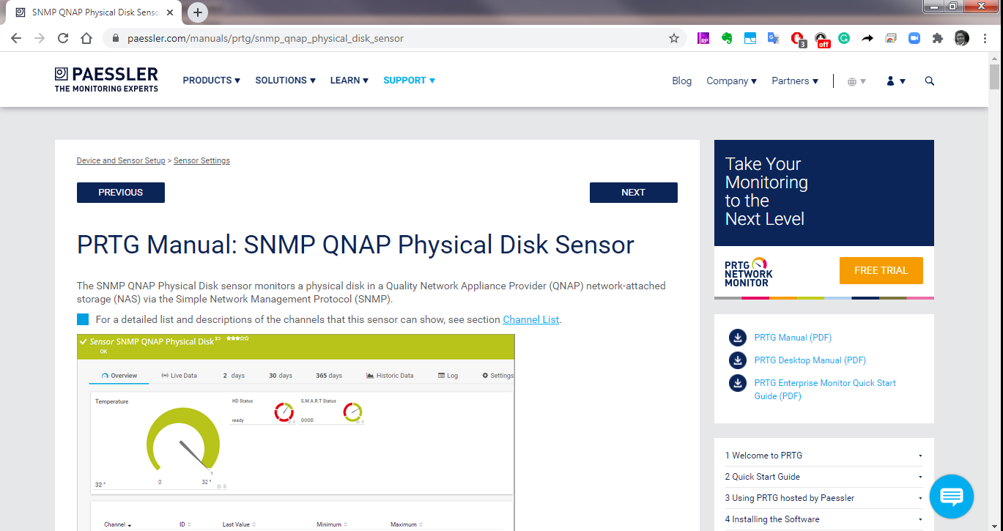
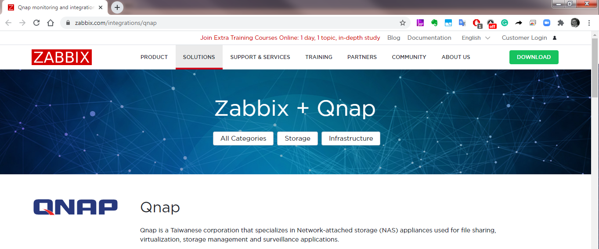

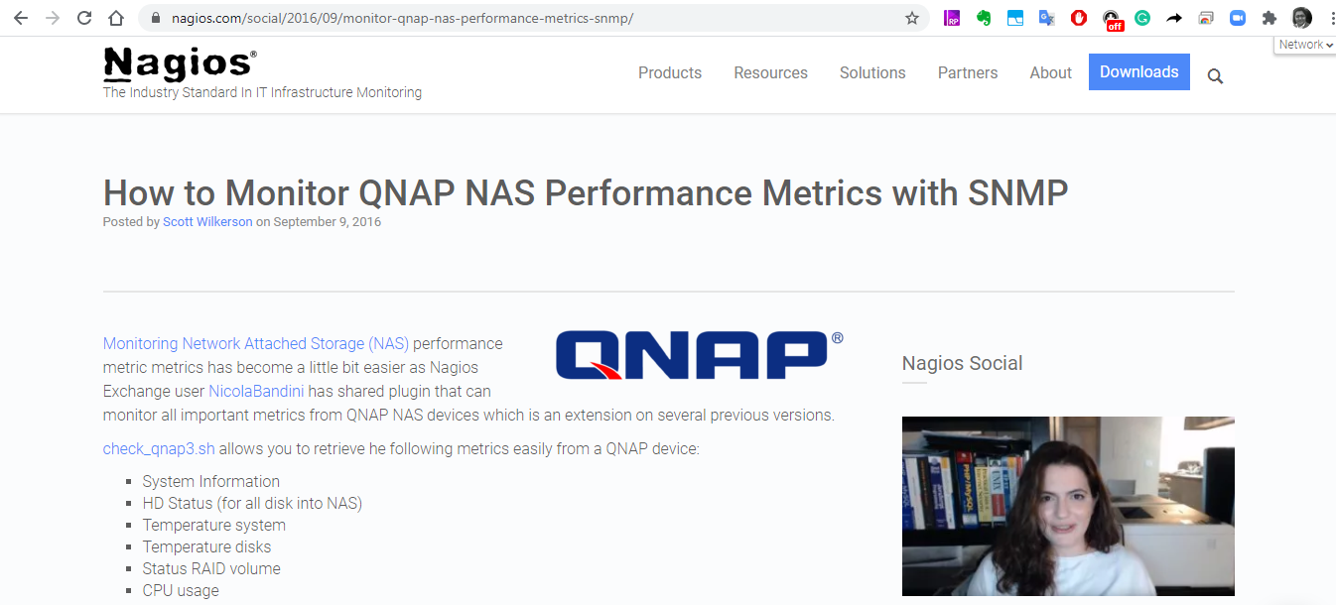


QNAP NMS Partner Ecosystem

Slide 27



Centralized monitoring with Zabbix usning SNMP
Zabbix installed on a NAS​
Allow NAS to access all devices​
Through SNMP, Zabbix can monitor all devices directly​
Generate reports by Zabbix​
PM
RD

Slide 28


Distributed Monitoring with Zabbix using SNMP
HQ
Branch
PM
Local Sales
RD
Notes:
Has a NAS for each department or office
Zabbix installed on each NAS, the one put in HQ become central monitoring Zabbix
The Zabbix install in department or brach office become sub monitoring proxy
Central Zabbix aggregates all data coming from sub Zabbix
Generate report from central Zabbix

Slide 29
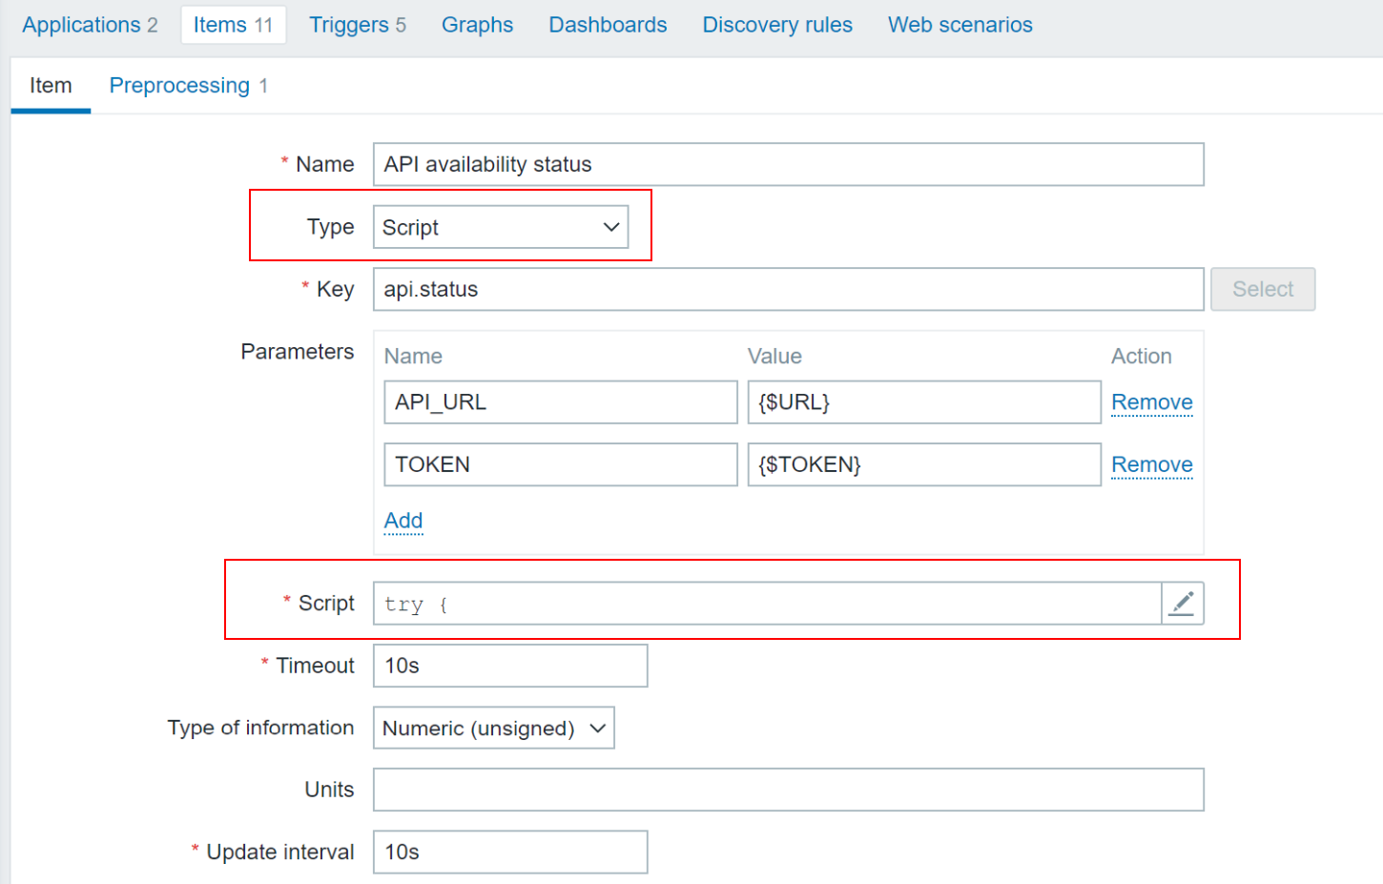
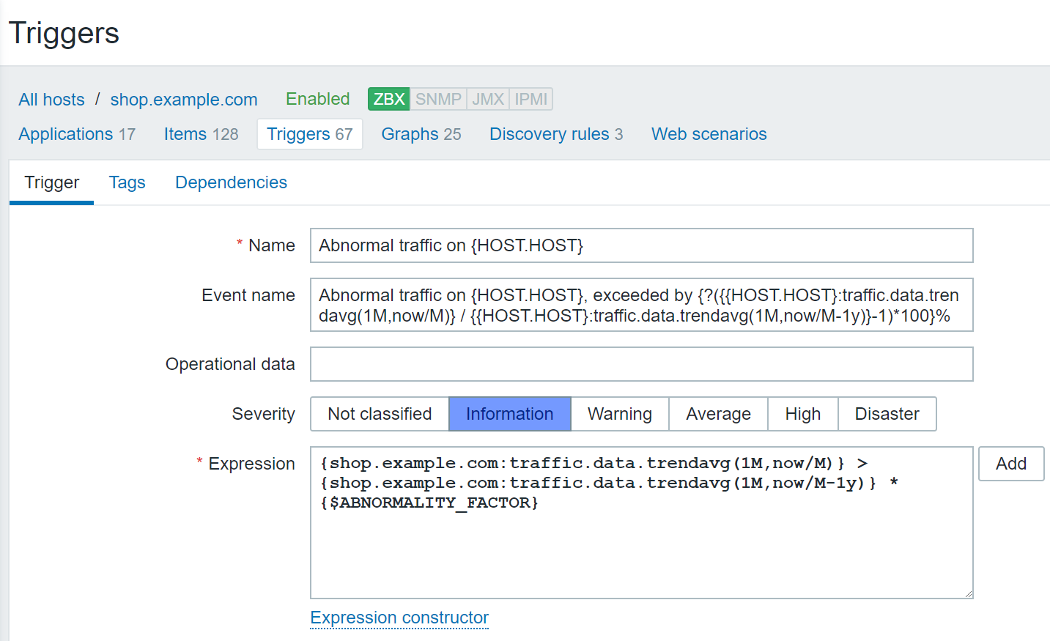
Whats New in Zabbix 5.2?
Synthetic monitoring
This functionality enables scripted scenarios for complex data collection and reliable multi-step availability monitoring. Support of the new metric type "Script".
Zabbix Insights
Get most of your history data! A new set of trigger functions enables long-term data analysis and allows to create powerful insights, detect anomalies and system misbehaviour. Example : "Total amount of network traffic increased by 28% in September"
Notes:
https://www.zabbix.com/whats_new_5_2

Slide 30
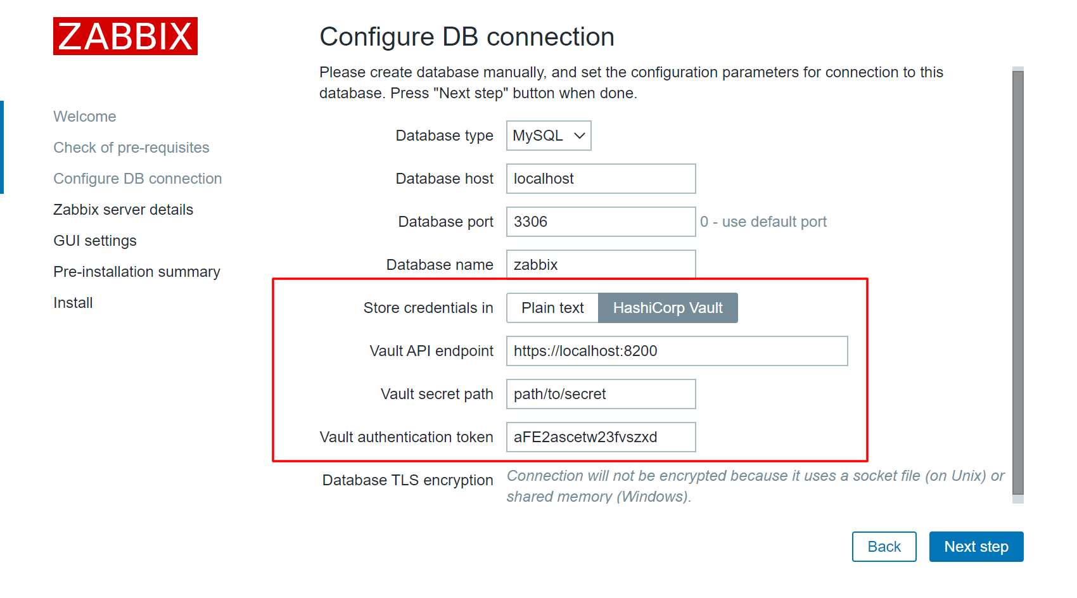
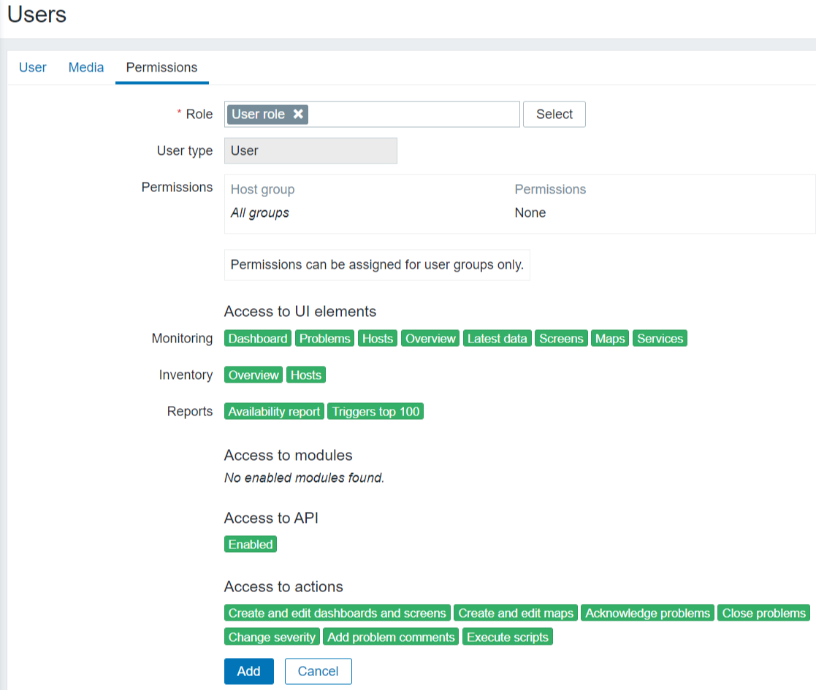
Whats New in Zabbix 5.2?
Storage of secrets in external Vault
Integration with HashiCorp Vault enables secure storage of all sensitive information with fine-grained control access to tokens, passwords, certificates, encryption keys, API tokens, user names, etc.
User roles to control permissions:
Now Zabbix supports flexible user roles for much more granular management of user rights to control access to various parts of Zabbix UI, API methods and user operations.
Notes:
https://www.zabbix.com/whats_new_5_2

Slide 31

Whats New in Zabbix 5.2?
Monitoring of IoT and industrial equipment:
Modbus and MQTT – the most common IoT protocols for sensors and industrial equipment monitoring are natively supported by Zabbix now
Create custom views:
Zabbix provides the ability to save named complex-filters and re-use them later with one-click. It makes possible to create different problem views for different services or data centres, for example, and switch between them instantly.
Load balancing for UI and API
Zabbix introduces the ability to scale Zabbix UI and API components across multiple nodes for speed, HA and redundancy.

Slide 32
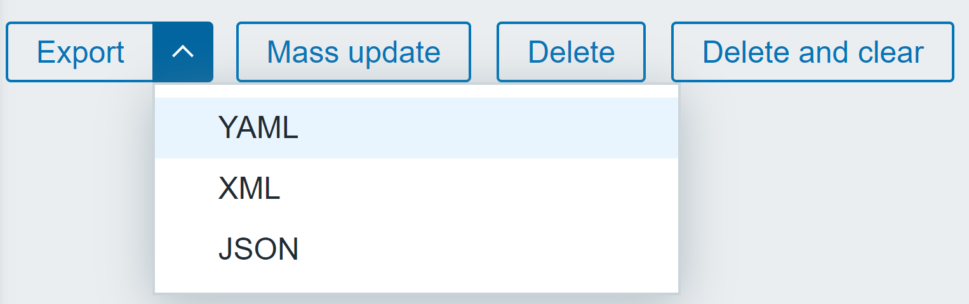
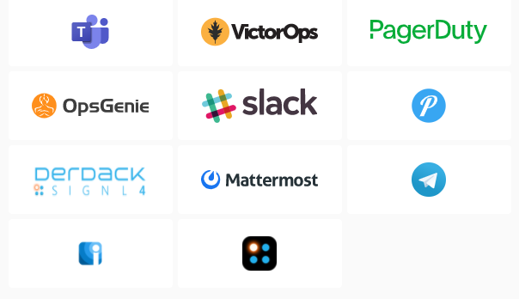
Whats New in Zabbix 5.2?
YAML for import/export:
Much more readable Yaml format becomes a new standard for templates and Zabbix import/export operations.
Built-in integrations with alerting systems
Zabbix 5.2 introduces a new set of out-of-the-box integrations with industry-standard alerting and notification systems including Slack, Pushover, Discord, Telegram, VictorOps, Microsoft Teams, SINGNL4, Mattermost, OpsGenie, PagerDuty, iLert
and many more...

Slide 33
New QTS SNMP MIB
SNMP MIB Client
Zabbix

Slide 34
Enhanced Management

Slide 35

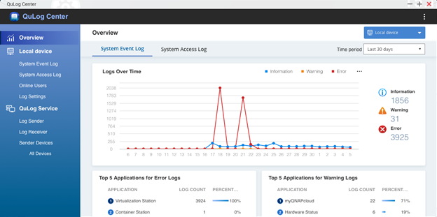
QuLog Center Active four major features
Proactive analysis
Quick filtering
Real-time monitoring
Unified management

Slide 36
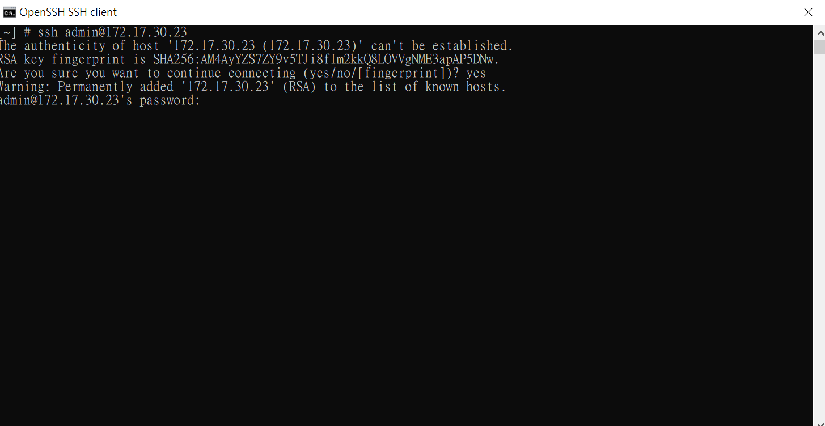
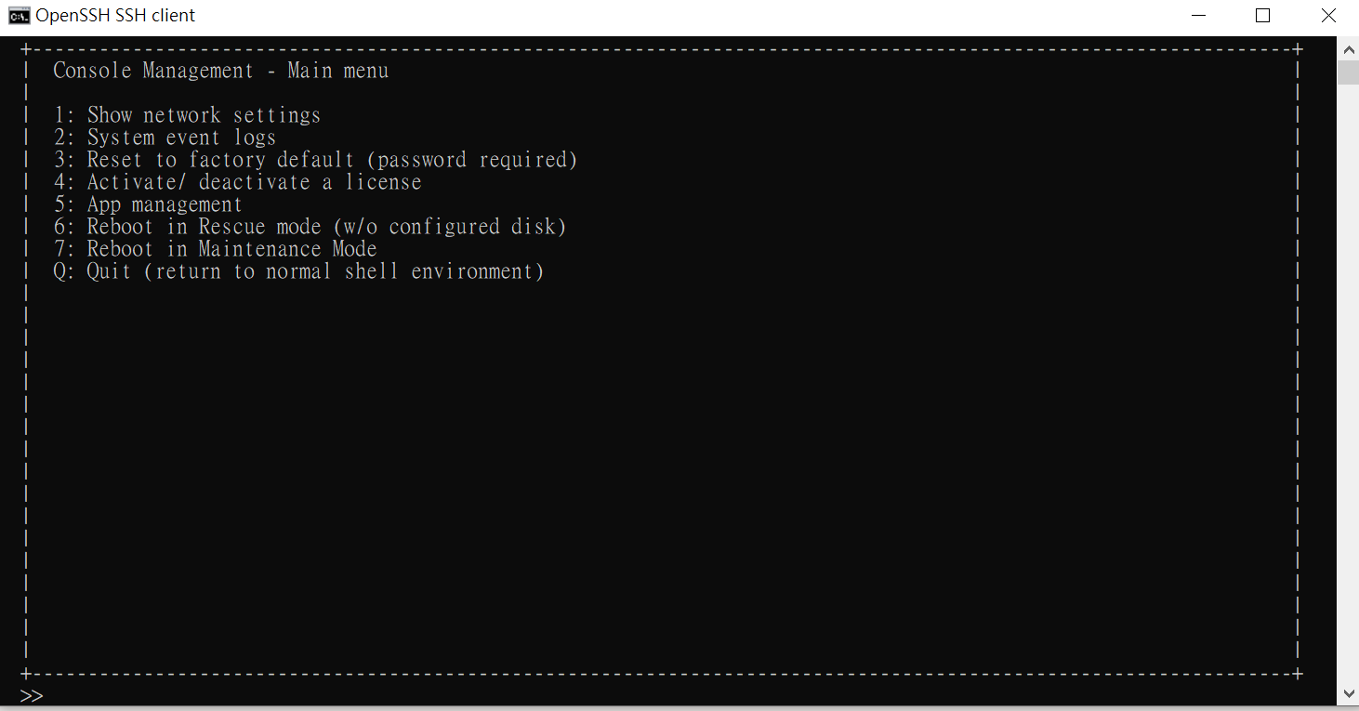
Console Management - Convenient NAS troubleshooting
When performing maintenance/troubleshooting, or if IT/support staff are unable to access QTS via HTTP/S, Console Management can be used to perform basic configuration and debugging. Console Management is available using SSH, Serial Console, or by connecting an HDMI display, keyboard, and mouse to the NAS.

Slide 37
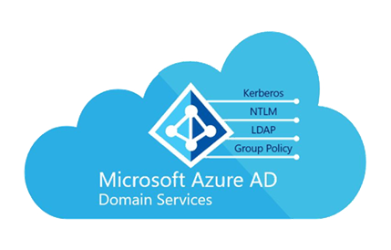
Add QNAP NAS into Azure AD Domain Service
Microsoft Azure AD DS provides managed domain services such as domain join, group policy, and Lightweight Directory Access Protocol (LDAP). By adding a QNAP NAS into Azure AD DS through site-to-site VPN connection or through Windows Server using Azure AD Connect, IT staff are free from deploying and managing domain controller locally, and have greater efficiency in managing user accounts and permissions for multiple NAS devices. It provides flexibility, scalability, and extreme convenience.
Note: Azure AD DS supports x86 (Intel or AMD processor) NAS.

Slide 38
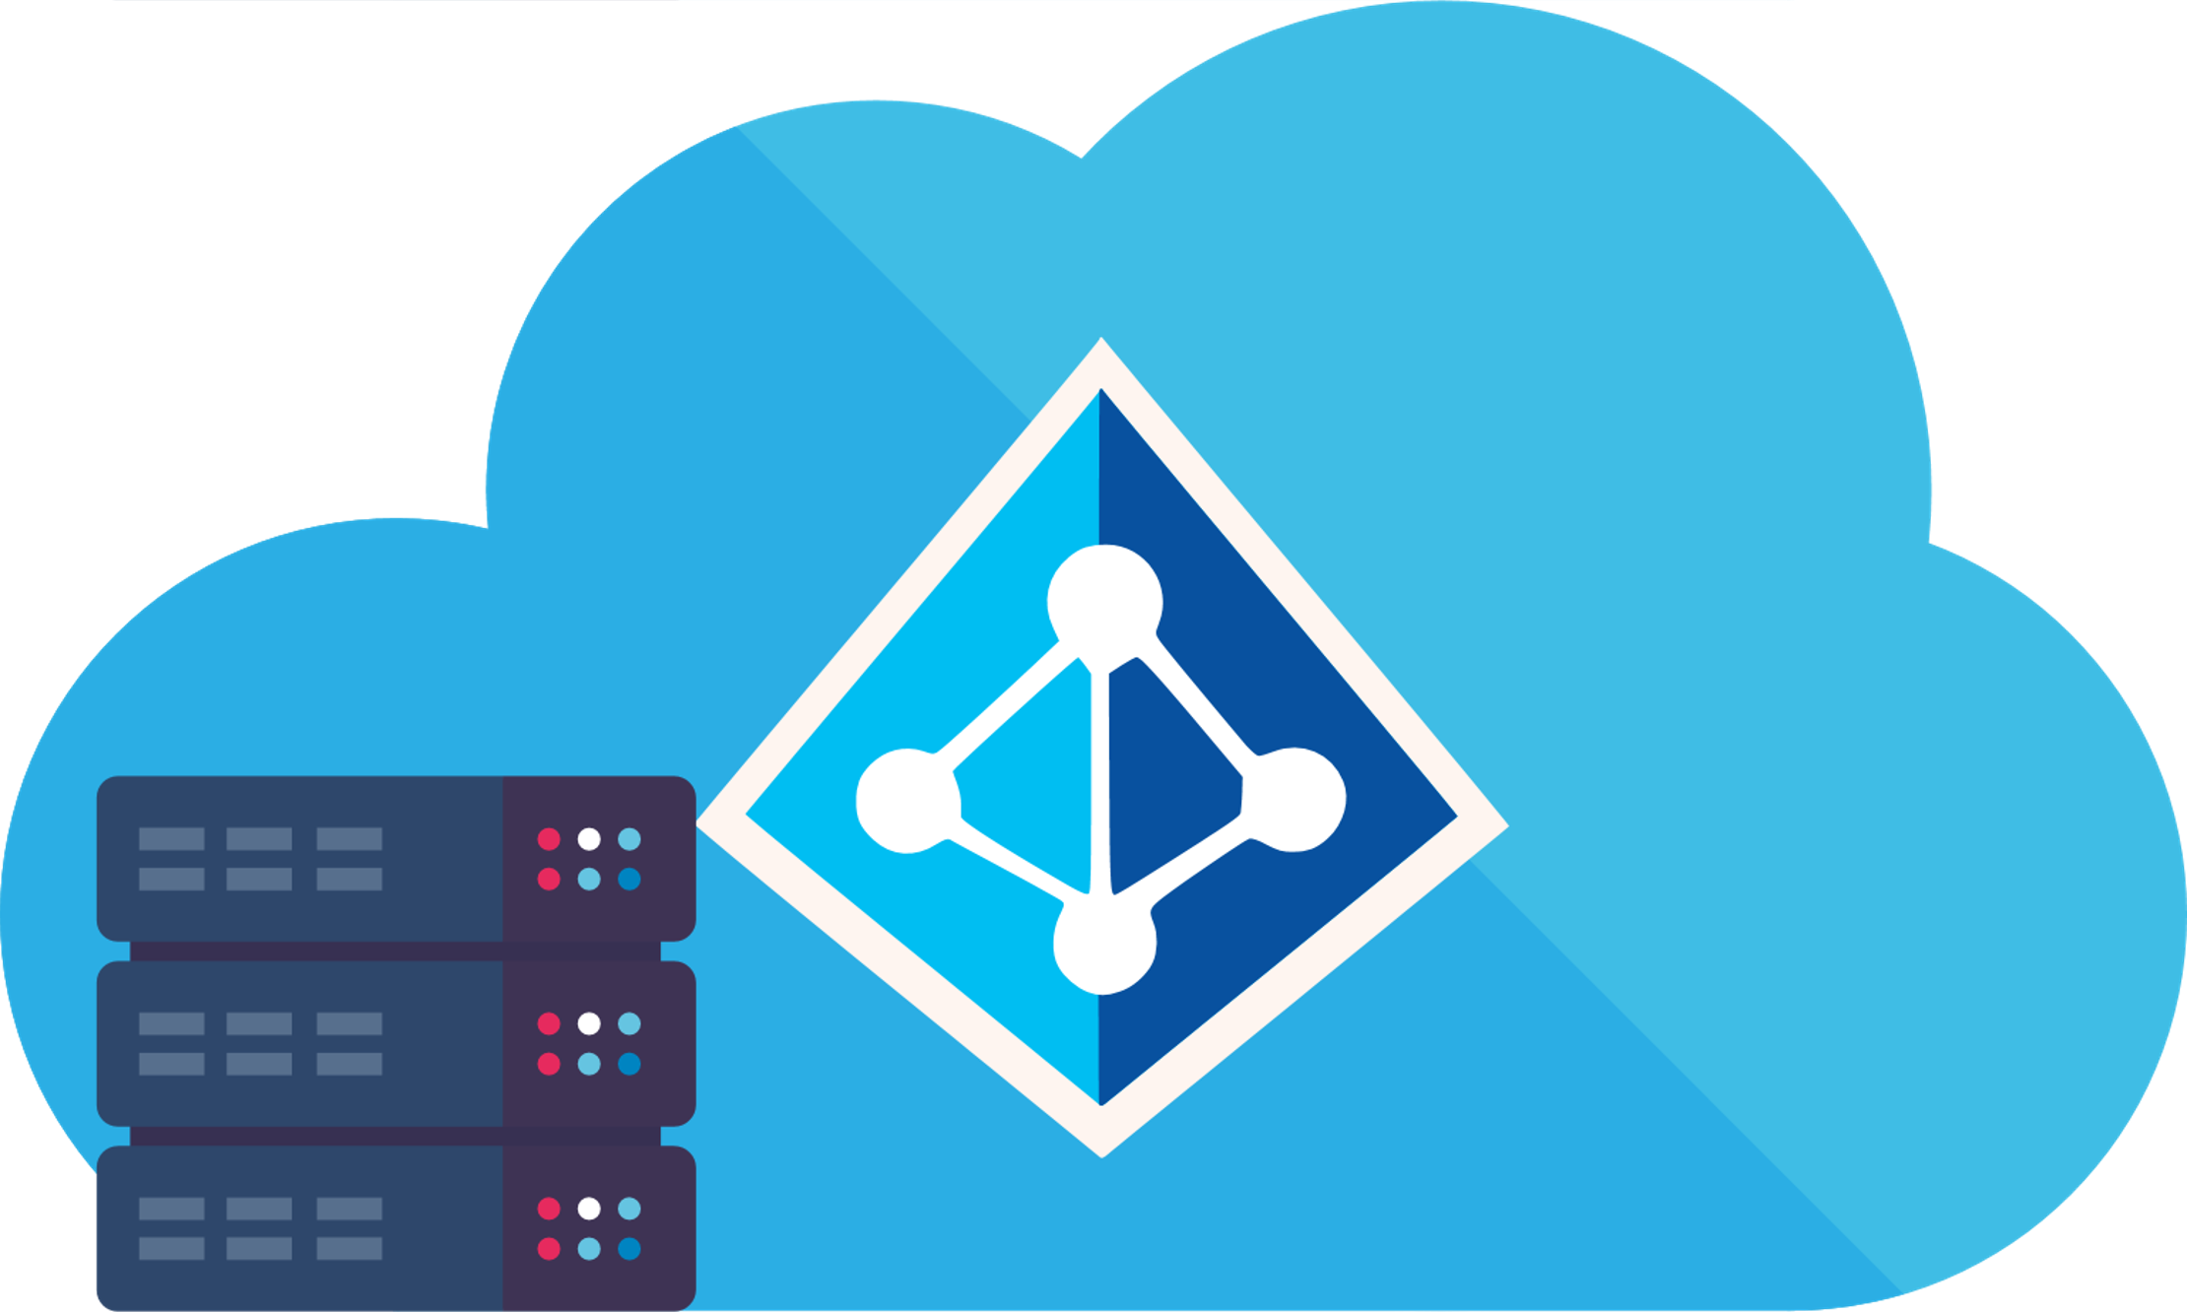




Azure AD DS and SSO
Azure AD Connect
SSO(Single Sign-On) providing users with a variety of independent services after logging in
Admin can manage the user's authority to use the service, but due to the authentication method (Oauth), it is only limited to Web Service

Slide 39
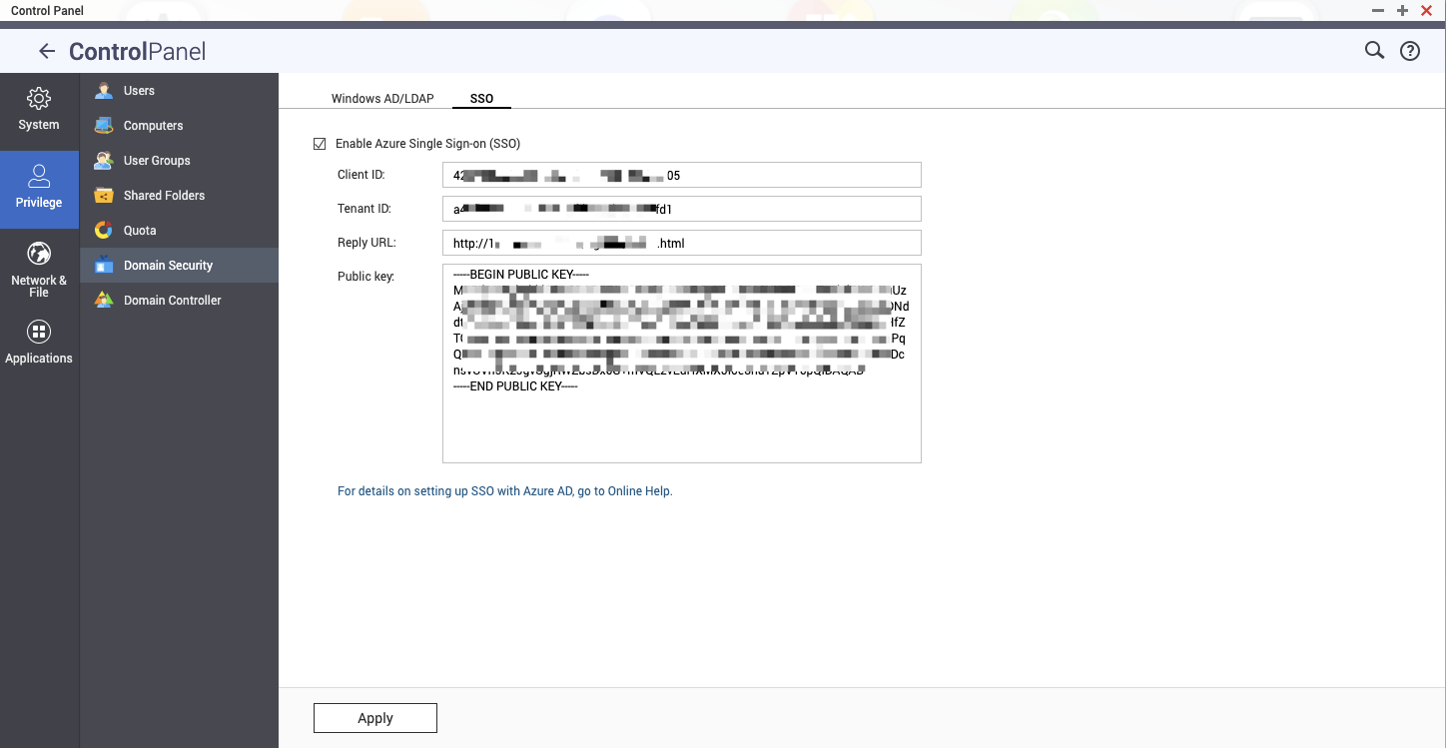
SSO NAS settings

Slide 40
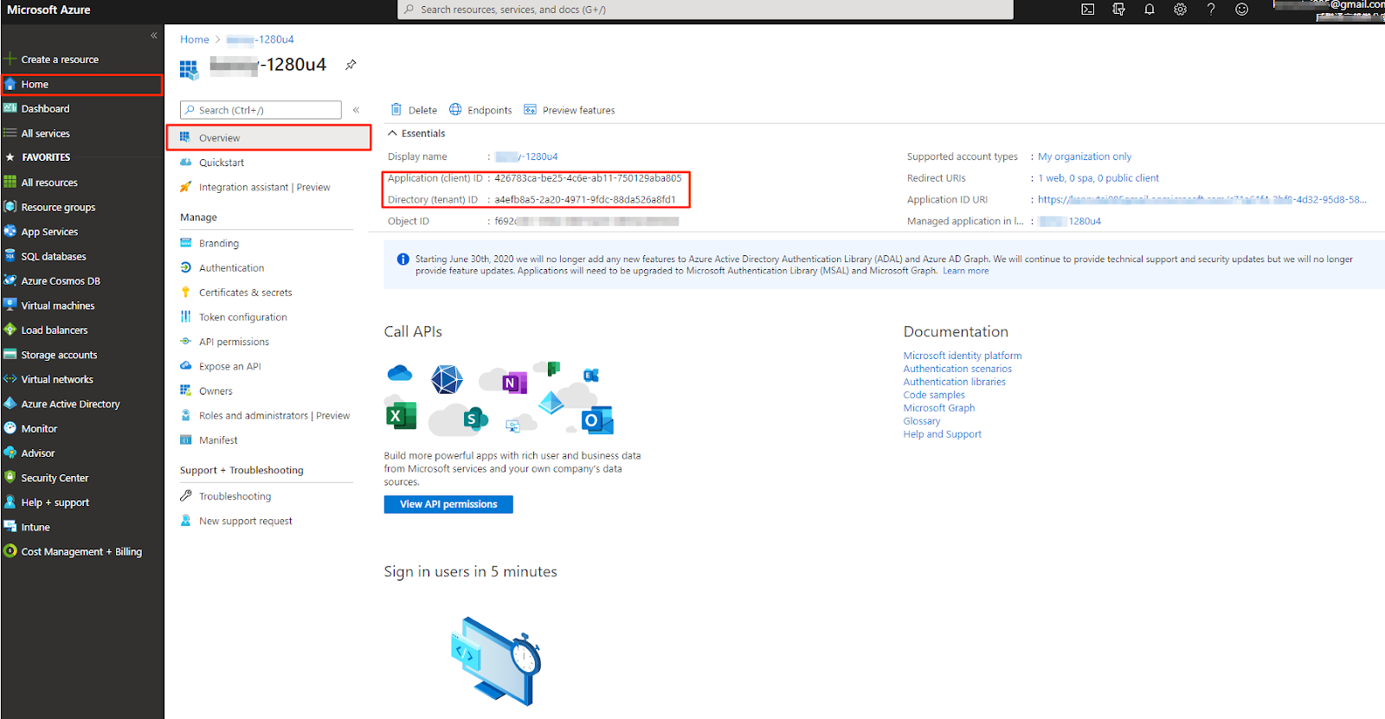
Microsoft Azure Client ID and Tenant ID

Slide 41
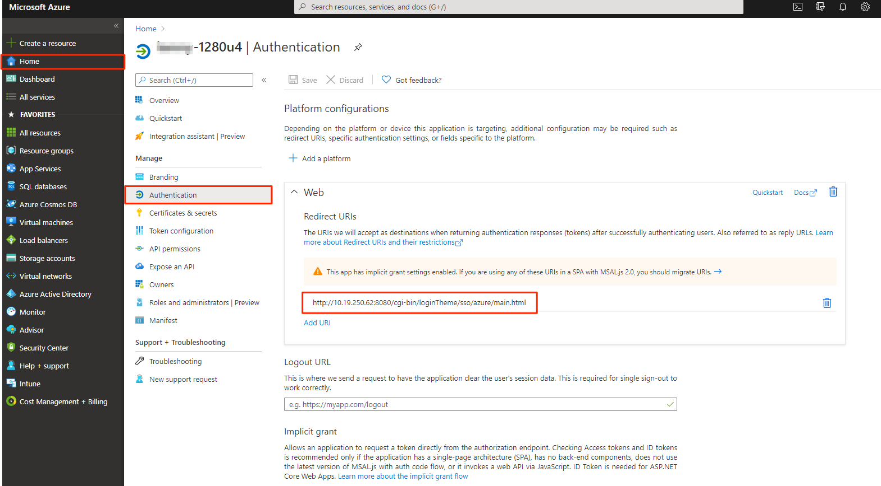
Microsoft Azure Authentication-Reply URLs

Slide 42
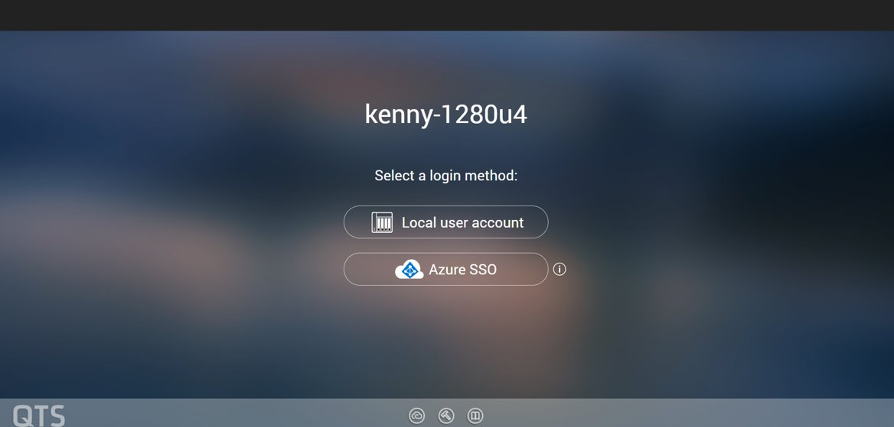
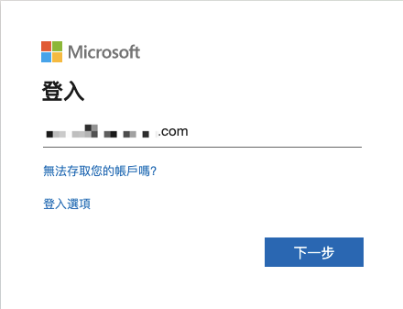
Azure SSO Login

Slide 43
Copyright© 2021 QNAP Systems, Inc. All rights reserved. QNAP® and other names of QNAP Products are proprietary marks or registered trademarks of QNAP Systems, Inc. Other products and company names mentioned herein are trademarks of their respective holders.​​​​​​​​

