Slide 2
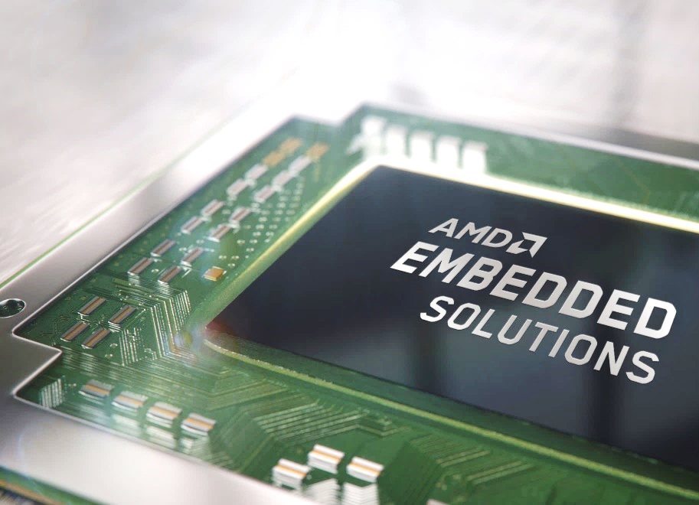
NAS for professionals and SMBs. The new TS-x73A AMD Ryzen 4/6/8-bay desktop NAS
2020/06 Launched the industry-first AMD V1500B Ryzen 8/12/16-bay TS-x73AU rackmount NAS series.
2020/11 Launched the 9-bay TS-h973AX desktop NAS​.
2021/02 Introducing the same powerful V1500B into 4-bay TS-473A, 6-bay TS-673A and 8-bay TS-873A desktop NAS​.
TS-x73A series
TS-h973AX
TS-x73AU series
TS-h2490FU
TS-x73 series
TS-x73U series
TVS-x63 series
TS-x63XU series

Slide 3
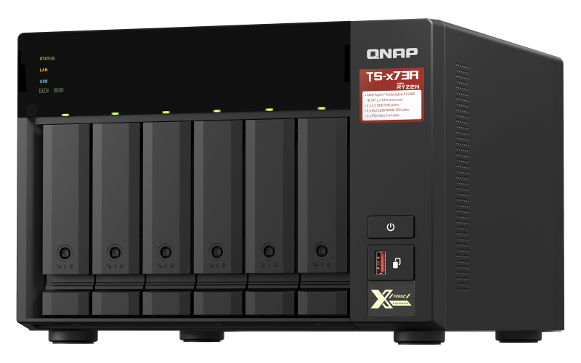
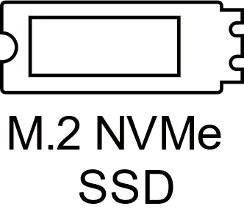
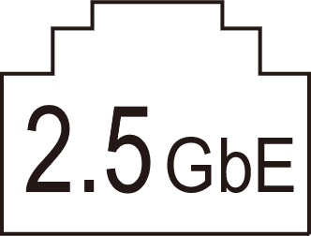
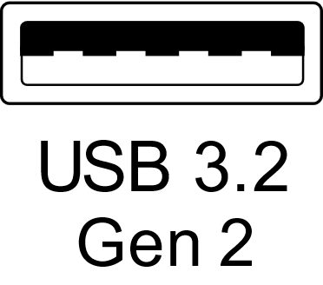
The new TS-x73A Ryzen NAS with many upgrades over previous generation TS-x73
Dual NAS OS support
Default is QTS, switchable to ZFS QuTS hero enterprise OS during setup
AMD Ryzen V1500B 4C / 8T 2.2GHz SoC
Next-gen AMD Ryzen embedded processor
M.2 PCIe NVMe SSD
Dual M.2 2280 NVMe SSD slots for performance
2.5GbE high-speed network
2 x 2.5GbE for fast data transfer speed
USB 3.2 Gen 2 10Gbps
3 x USB-A 10Gbps for quick backup with SSD or enclosure

Slide 4
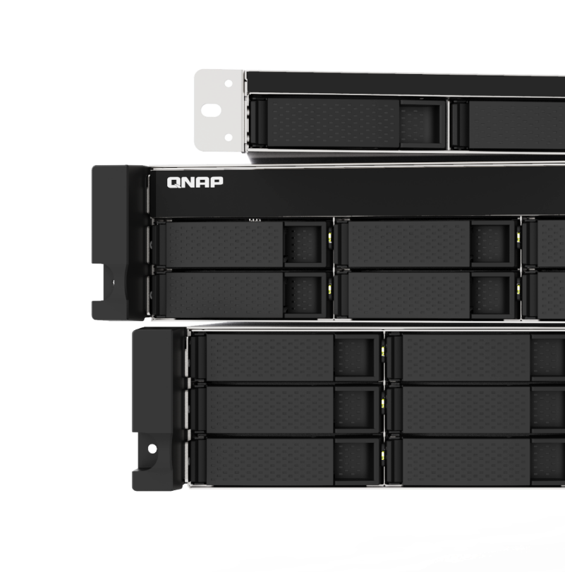
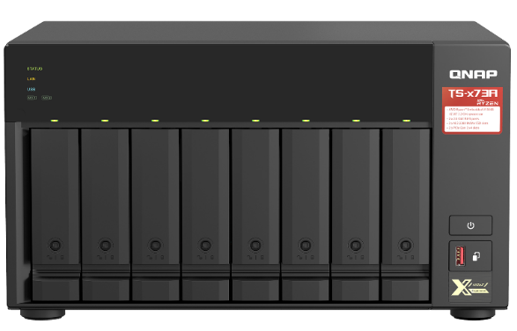
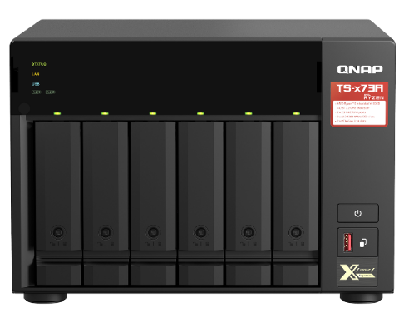
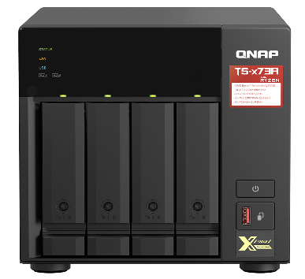
AMD long-term supported Zen core embedded SoC The low-power V1000 series V1500B 4C 8T 2.2 GHz
TS-x73A
Processor
V1500B
Cores
4
Threads
8
Base frequency
2.2 GHz
Turbo frequency
---
L2 cache
2MB
L3 cache
4 MB
Memory
TS-873A
DDR4
TDP
12 to 25 W
CPU family
Zen
TS-673A
TS-473A
Source https://www.amd.com/en/products/embedded-ryzen-v1000-series

Slide 5
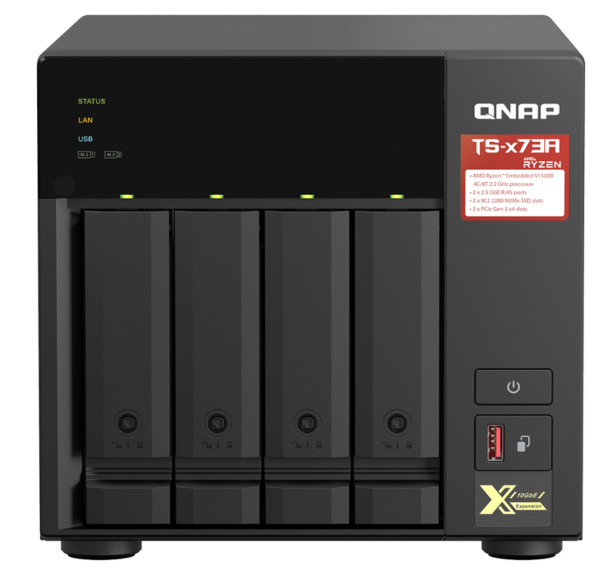
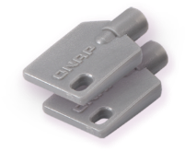
TS-473A front view
Lockable drive
Trays
(2 keys are included)
LED indicators:
System status, LAN, HDD, M.2 SSDs
4 x 3.5"/2.5” SATA
6Gb/s HDD/SSD bays
Power button
USB 3.2 Gen 2 Type-A 10Gbps port &
One-Touch Copy button

Slide 6
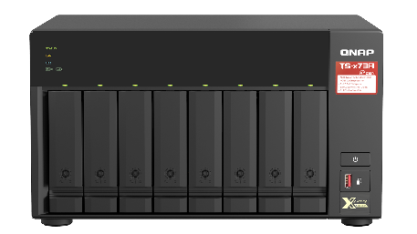
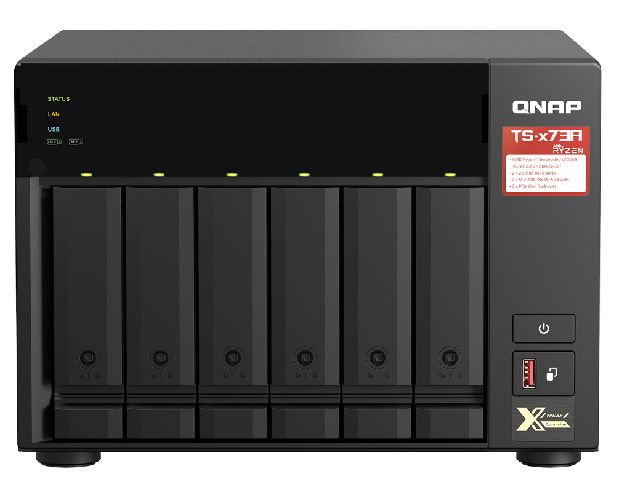
TS-673A / TS-873A front view
Lockable drive
Trays
(2 keys are included)
TS-873A
LED indicators:
System status, LAN, HDD, M.2 SSDs
6 or 8 x 3.5"/2.5” SATA 6Gb/s
HDD/SSD bays
Power button
USB 3.2 Gen 2 Type-A 10Gbps port & One-Touch Copy button
TS-673A

Slide 7
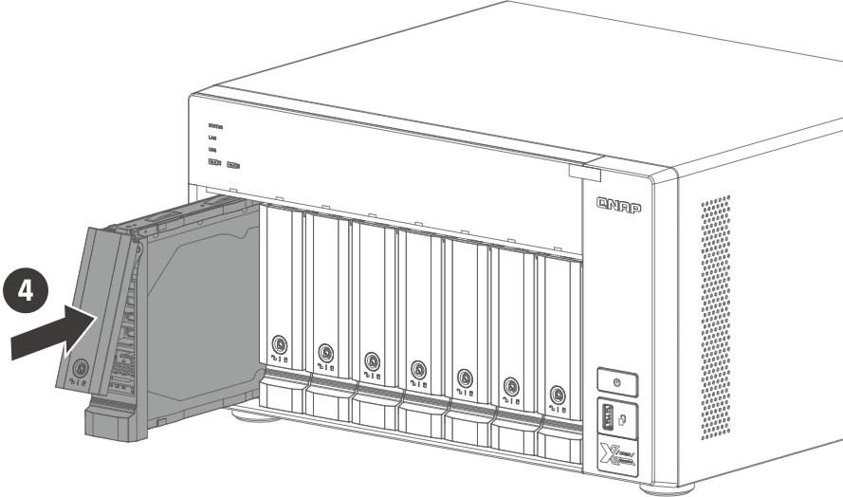
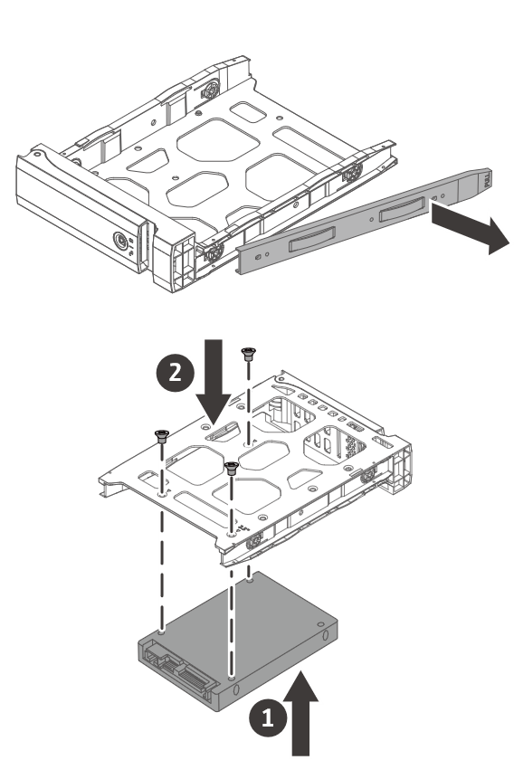
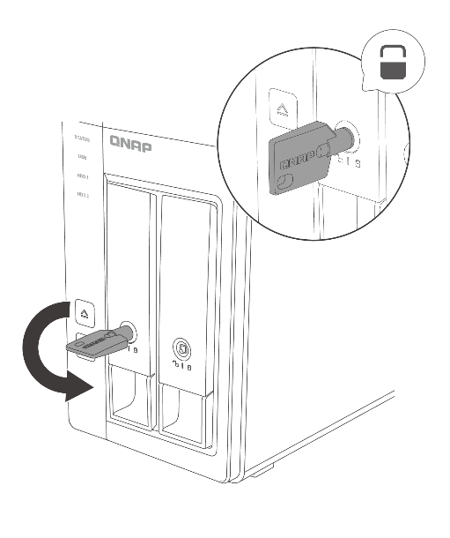
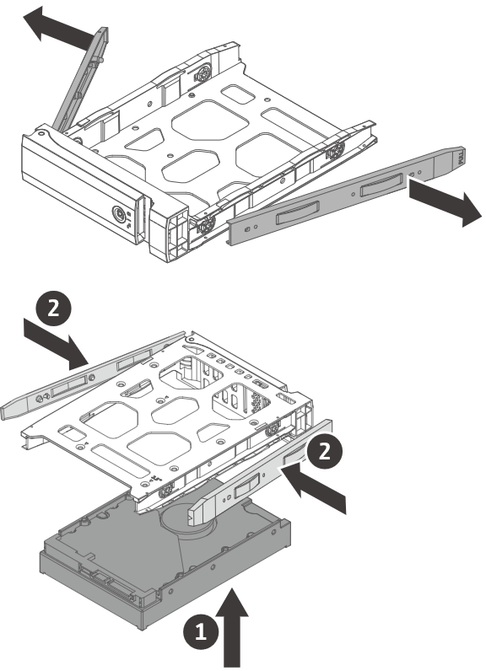
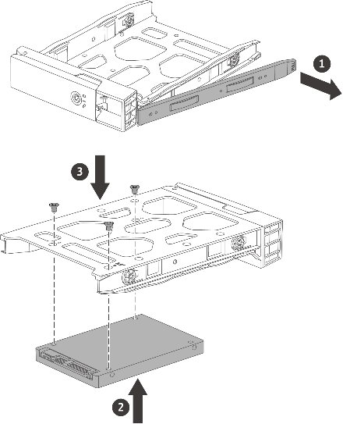
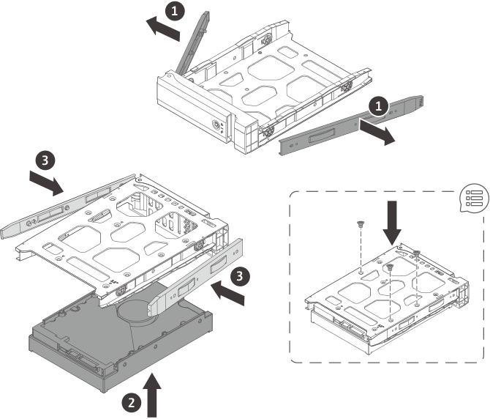
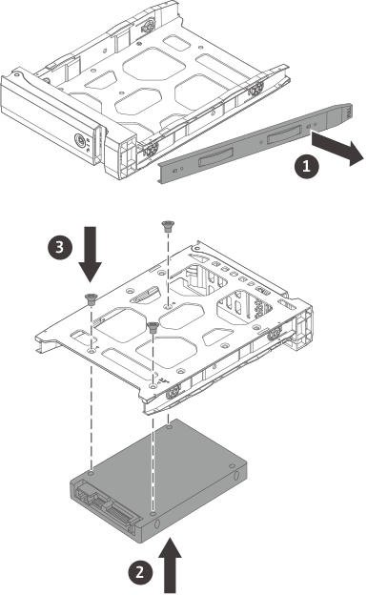
Easy installation of disks and lockable trays
Tool-less installation of 3.5-inch HDDs
3.5-inch HDD
2.5-inch SSD / HDD
Note: Use screws if transporting the NAS or if using some HDDs that vibrate more.

Slide 8
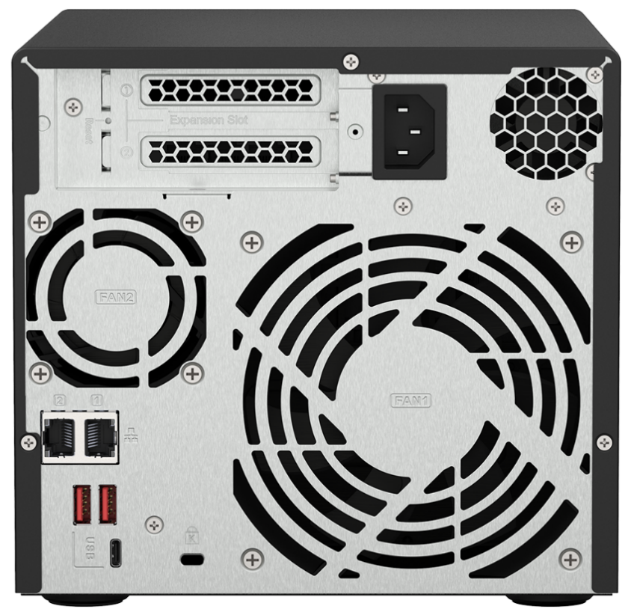
TS-473A rear view
2 x PCIe Gen3 x4
half-height slots
(10GbE/5GbE/2.5GbE, QM2 SSD, Fibre Channel, SATA, SAS expansion cards)
250W 100-240VAC PSU
2 x 2.5GbE LAN ports
(2.5G/1G/100M RJ45)
6CM CPU-side fan +
12CM disk-side fan
2 x USB 3.2 Gen 2 10Gbps Type-A port
Kensington security slot
1 x USB 3.2 Gen 1 5Gbps Type-C port

Slide 9
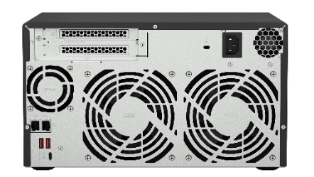
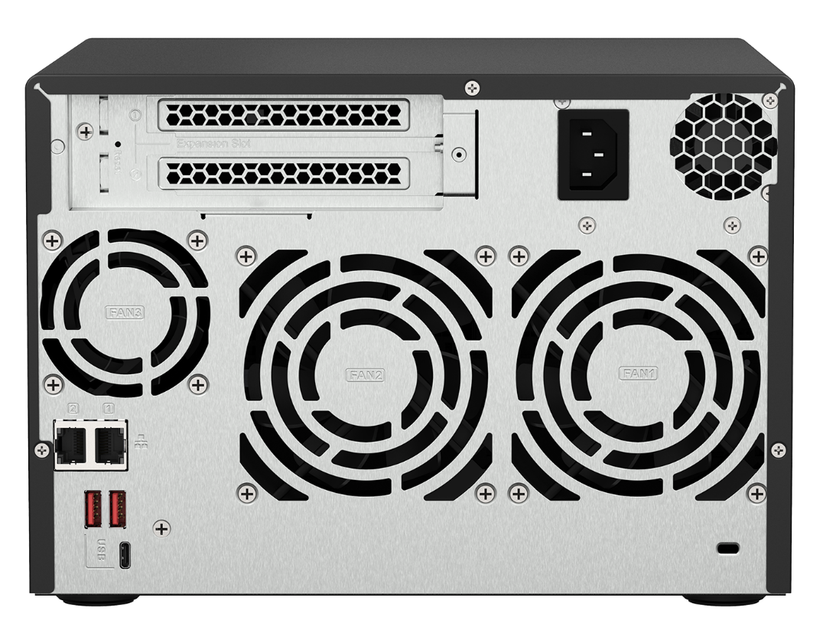
TS-673A / TS-873A rear view
2 x PCIe Gen3 x4
full-height slots
(10GbE/5GbE/2.5GbE,
QM2 SSD, Fibre Channel, SATA, SAS expansion cards)
TS-873A
250W 100-240VAC PSU
TS-673A: 6CM CPU-side fan + 2 x 9CM disk-side fan
TS-873A: 6CM CPU-side fan + 2 x 12CM disk-side fan
2 x 2.5GbE LAN ports
(2.5G/1G/100M RJ45)
2 x USB 3.2 Gen 2 10Gbps Type-A port
Kensington security slot
1 x USB 3.2 Gen 1 5Gbps Type-C port
TS-673A

Slide 10
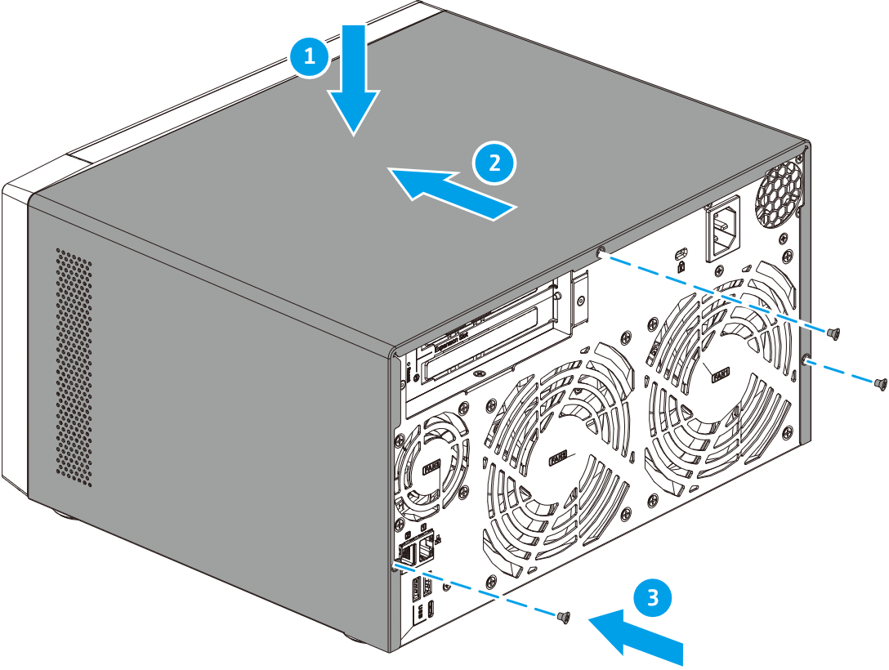
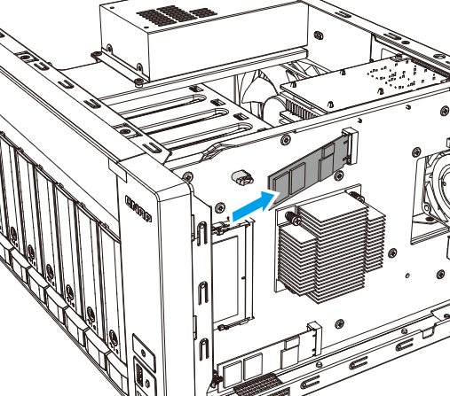
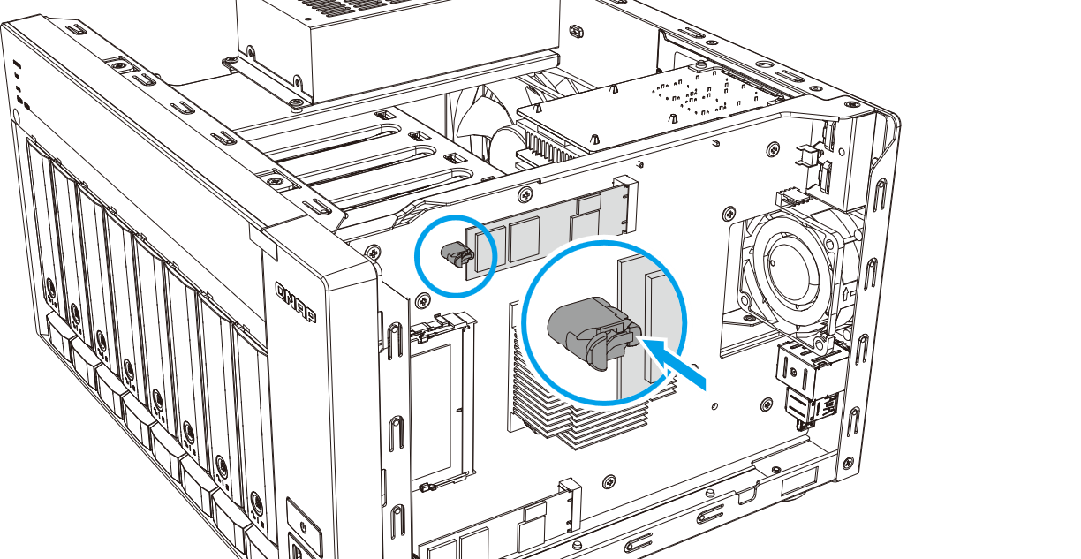
2 x M.2 NVMe PCIe SSD slots supporting SSD cache or Qtier auto tiering
1. Remove screws and cover
2. install M.2 NVMe SSD
2 x M.2 2280 PCIe Gen3 x1 NVMe SSD slots for SSD cache or Qtier auto tiering performance enhancement.
Improve random data access speeds with an SSD cache SSD caches accelerate IOPS performance and reduce latency for storage volumes. They are perfect for IOPS-demanding applications (including databases and virtualization) and can significantly improve overall workflows.
Maximize the value of SSDs with Qtier Technology Qtier™ Technology empowers TS-x73A with auto tiering that helps continuously optimize storage efficiency by automatically moving data between M.2 SSDs, 2.5-inch SSDs, and high-capacity HDDs based on the data's access frequency. Qtier™ 2.0 features IO-awareness that empowers SSD-tiered storage with a cache-like reserved space to handle burst I/O in real time, greatly maximizing the advantages of SSDs.
Note: Qtier is only supported in the QTS OS, not in the QuTS hero OS.
3. Tool-less installation

Slide 11
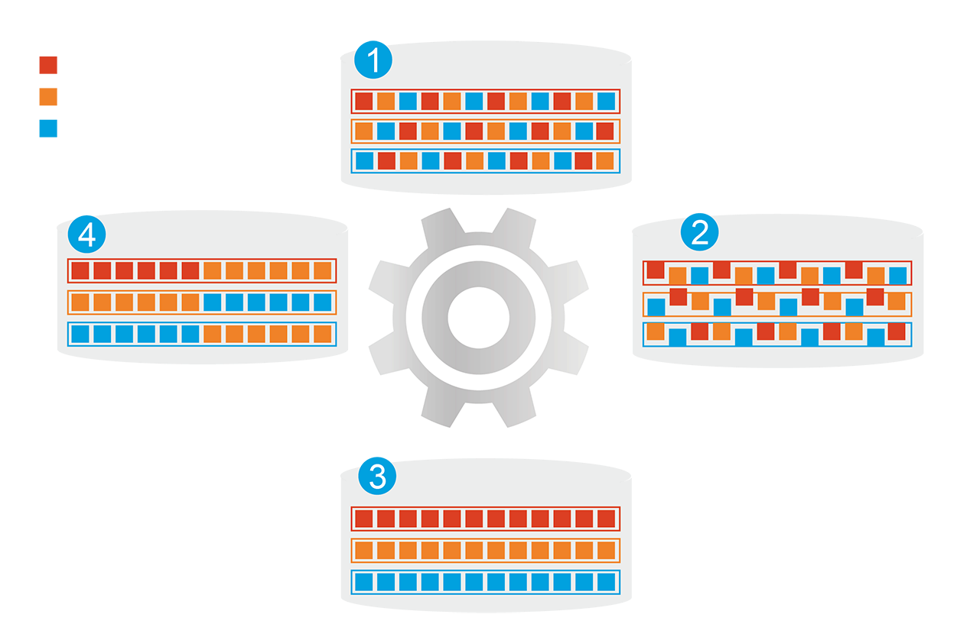
M.2 NVMe SSD and Qtier auto-tiering for speed and capacity​
1
分層前
頻繁存取資料效能未優化
Qtier
engine
Automatically moves data between different tiers​
熱資料
分層前
頻繁存取資料效能未優化
Hot data
Warm data
暖資料
SSD tier capacity is not limited by RAM size​
冷資料
Cold data
4
資料存取行為改變
2
開始分層
Qtier
引擎
開始分層
Before tiering
Frequently accessed data is not optimized.
Start tiering
After tiering
Data is optimized
Changes in data access pattern
3
分層後
頻繁存取資料效能已優化
分層後
頻繁存取資料效能已優化
Note: Qtier is only supported in the QTS OS, not in the QuTS hero OS.

Slide 12
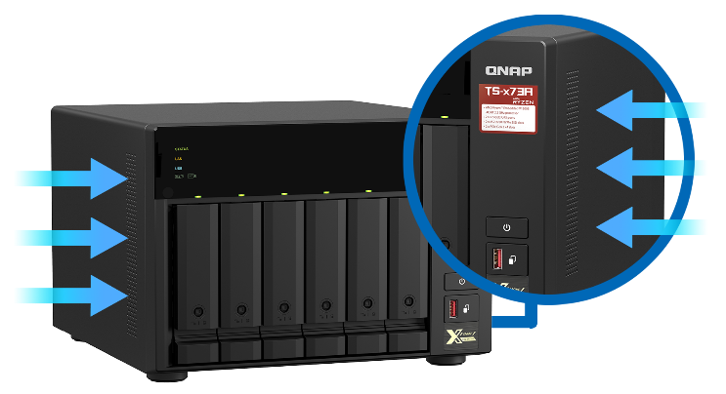
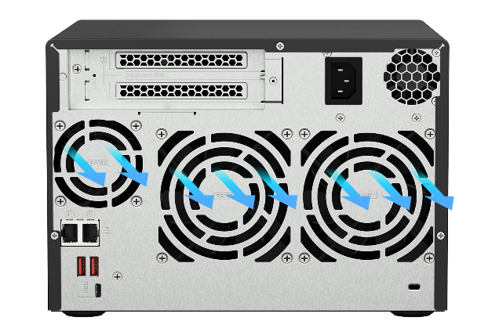
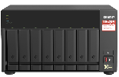
Compartmentalized smart cooling
Enhanced design over the previous generation to separately detects the CPU and hard drive temperatures for dynamically adjusting separate fan speeds for an quieter operations in the office.
Roadside
70
Loud speak
60
Quiet office
CPU side
HDD side
50
Library
40
Quiet outdoor
TS-873: 23.4 dB
30
23
TS-873A
20.3
TS-673: 23 dB
Broadcast room
20
TS-673A
Noise Test：Sound pressure is measured at the front bystander position with low fan speed.
Soud pressure (dB)

Slide 13
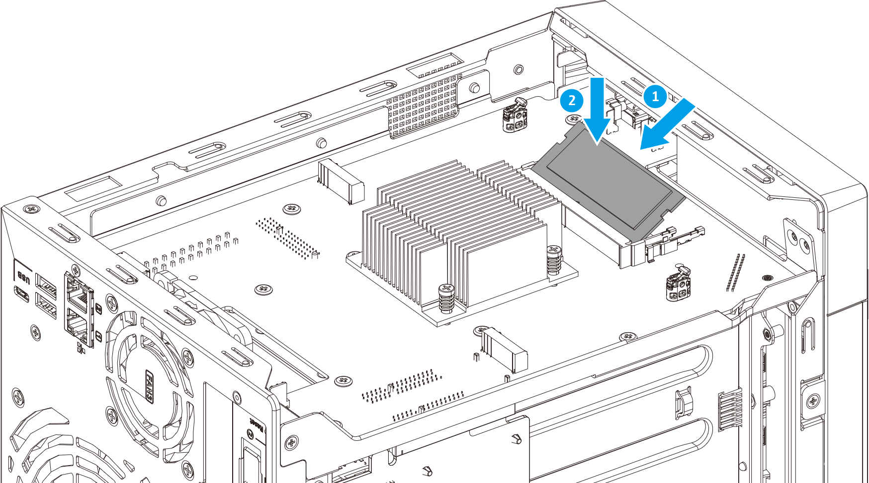
Large pre-installed 8GB DDR4 RAM, upgradeable to max 64GB and also optional ECC RAM support
NAS Model Numbers:
1. Remove the cover
2. Remove the old RAM (optional)
TS-473A-8G
8 GB RAM (1 x 8 GB)
TS-673A-8G
8 GB RAM (1 x 8 GB)
TS-873A-8G
8 GB RAM (1 x 8 GB)
2 x DDR4 SO-DIMM RAM slots for a max of 64 GB (2 x 32 GB), dual-channel design and optional ECC RAM support.
QNAP 8/16/32 GB RAM modules for easy upgrade and better multi-app or multi-user usage.
3. Install the new RAM
Note: Do not install ECC and Non-ECC RAM on the same NAS at the same time.

Slide 14
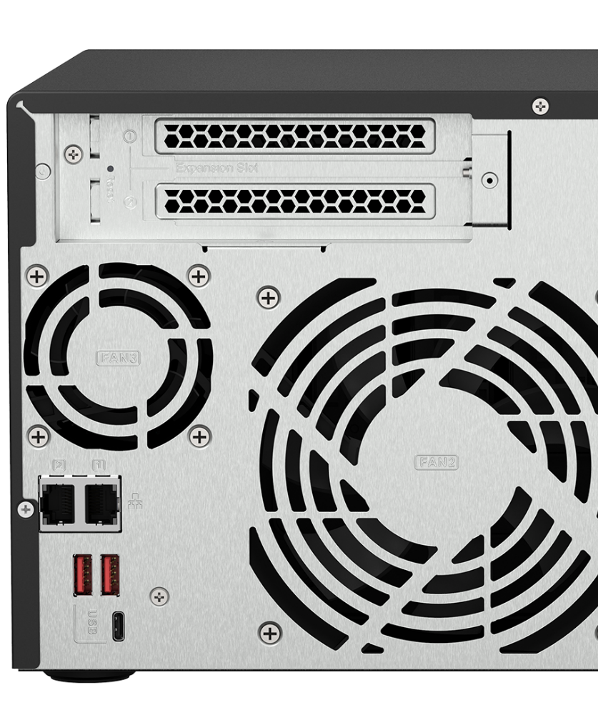
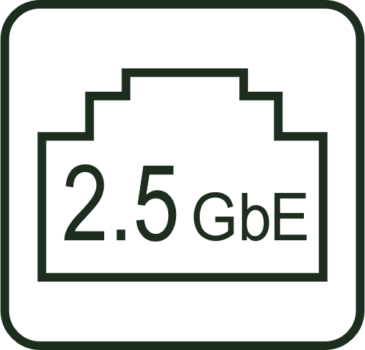
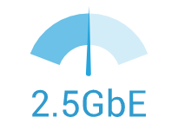
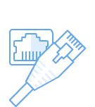
Built-in 2 x 2.5 GbE LAN ports, aggregated for maximum 5Gbps bandwidth
2.5GbE-supported motherboards, Wi-Fi 6 AP, switches, and LAN cards are now becoming popular
2.5GbE benefits
2 x 2.5GbE LAN ports (also 1GbE/100M)
2.5X the speed
Same cable
Use the same Cat.5e/ Cat.6/ Cat. 6A
LAN cables
1GbE → 2.5GbE
Huge leap in performance

Slide 15
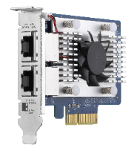
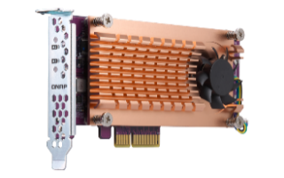
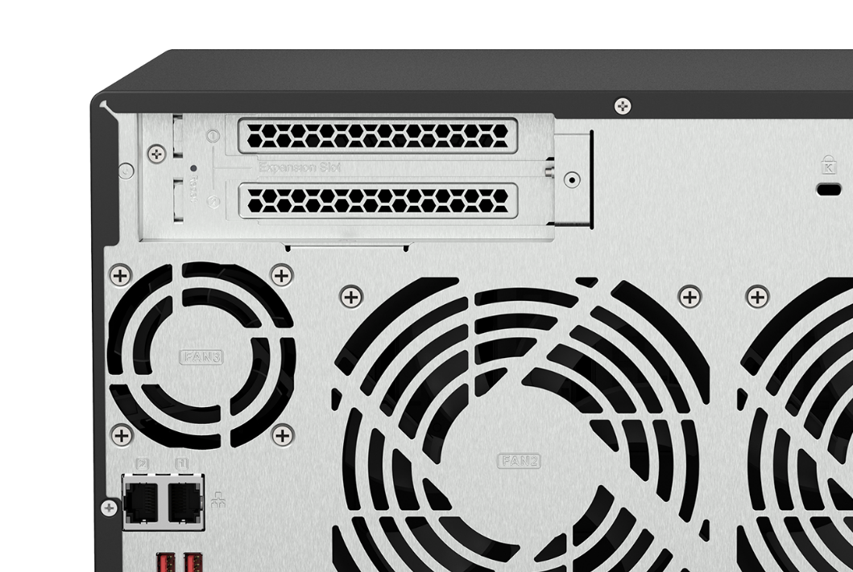
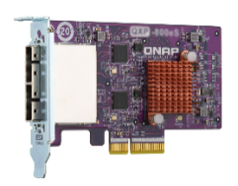
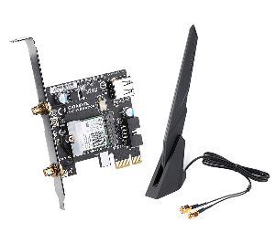
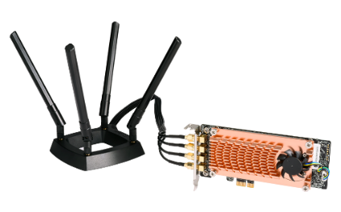
2 x PCIe slots for network, storage, and more
2 x PCIe Gen3 x4 expansion slots for various QNAP PCIe cards for more value-added applications.
QXG 10GbE/5GbE/2.5GbE
network expansion cards
2 x PCIe Gen3 x4
QM2 M.2 SSD cards
QXP SAS, SATA, USB
expansion cards
QXP Wi-Fi 6 & FC cards
QWA-AC2600 Wi-Fi AP card
Wi-Fi 5 2.4GHz/5GHz wireless AP

Slide 16
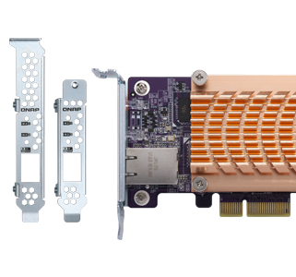
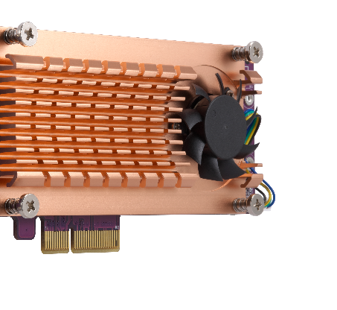
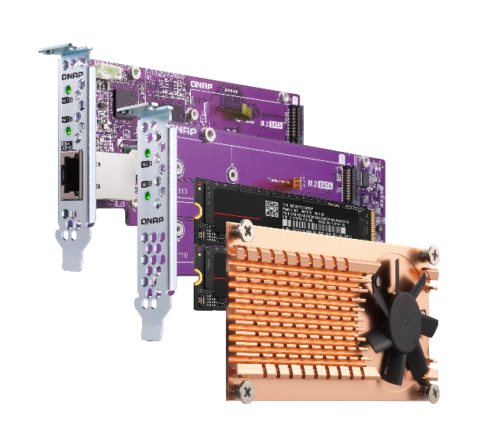
QM2 cards add support for SSD caching and 10GbE connectivity
QM2 M.2 SSD PCIe cards allow adding 2 or 4 M.2 NVMe / SATA SSDs to TS-x73A. Enable SSD caching or create RAID 5 group with the two on-board M.2 NVMe SSDs using Qtier.
Maximize the storage capacity and performance without occupying any 3.5” drive bays. Some QM2 models even combine M.2 SSD and 10GBASE-T connectivity into one solution.
Active cooling module
Compatible with
standard PCIe slots
Thermal sensors allow real-time temperature monitoring and adjust fan rotation speed
Low-profile PCIe card
including full-height bracket

Slide 17
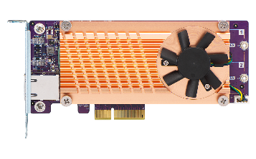
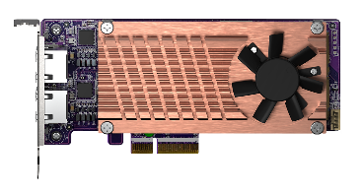
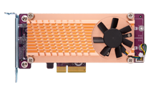
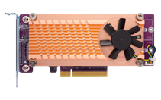
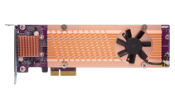
QM2 Series - Add more M.2 SSD slots to TS-x73A
NEW
QM2-2S10G1TA
QM2-2P10G1TA
QM2-2P2G2T
2 x M.2 SSD
+ 10GbE or 2.5GbE
Bandwidth: PCIe Gen2 x4
2 x M.2 SATA 6Gbps
+ 1 x 10GBASE-T
Bandwidth: PCIe Gen2 x4
2 x M.2 PCIe Gen2 x2
+ 1 x 10GBASE-T
Bandwidth: PCIe Gen3 x4
2 x M.2 PCIe Gen3 x2
+ 2 x 2.5GbE
QM2-2P-344
QM2-2P-384
Bandwidth: PCIe Gen3 x4
2 x M.2 PCIe Gen3 x4
Bandwidth: PCIe Gen3 x8
2 x M.2 PCIe Gen3 x4
2 x M.2 SSD
QM2-4P-342
QM2-4P-384
4 x M.2 SSD
Bandwidth: PCIe Gen3 x4
4 x M.2 PCIe Gen3 x2
Bandwidth: PCIe Gen3 x8
4 x M.2 PCIe Gen3 x4

Slide 18
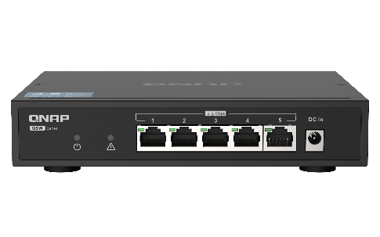
Budget-friendly unmanaged switches for multi-user environment
QSW-1105-5T (Unmanaged)
5 x 2.5GbE Multi-Gig RJ45
Fanless & metal housing
QSW-1208-8C (Unmanaged)
QSW-308-1C (Unmanaged)
8 x 10GbE Multi-Gig RJ45 / SFP+ combo
4 x 10GbE SFP+
1 x 10GbE Multi-Gig RJ45 / SFP+ combo
2 x 10GbE SFP+
8 x 1GbE RJ45

Slide 19
Layer-2 managed switches for multi-user environment and efficient deployment
Keep existing wiring for 2.5GbE
QSW-M1208-8C (Managed)
 | CAT 5e | CAT 6 | CAT 6A
100M | ✔ | ✔ | ✔
1G | ✔ | ✔ | ✔
2.5G | ✔ | ✔ | ✔
5G | ✔ | ✔ | ✔
10G | X | ✔(55m) | ✔
8 x 10GbE Multi-Gig RJ45 / SFP+ combo
4 x 10GbE SFP+
QSW-M1204-4C (Managed)
QSW-M804-4C (Managed)
4 x 10GbE Multi-Gig RJ45 / SFP+ combo
8 x 10GbE SFP+
4 x 10GbE Multi-Gig RJ45 / SFP+ combo
4 x 10GbE SFP+
QSW-M408-4C (Managed)
QSW-M408-2C (Managed)
4 x 10GbE Multi-Gig RJ45 / SFP+ combo
8 x 1GbE RJ45
2 x 10GbE Multi-Gig RJ45 / SFP+ combo
2 x 10GbE SFP+
8 x 1GbE RJ45

Slide 20
Optional 10GbE card for fast performance
2 x PCIe Gen3 x4 slots for many 10GBASE-T & 10GbE SFP+ cards
1 x 10GbE Windows file transfer
1000
800
827
775
600
400
200
0
(MB/s)
read
write
Test Environment: NAS | TS-873A-8G, QTS 4.5.2, 8 x Samsung 850 Pro SSD, RAID 5, LAN-10G2T-X550
Client PC | Windows 10 Pro, Intel Core i7-6700 3.4 GHz, 64GB RAM, LAN-10G2T-X550

Slide 21
QNAP 16Gb Fibre Channel card for FC SAN
QXP-16G2FC
Dual-port 16Gbps
FC card with 16Gb FC transceivers
Manage Fibre Channel connection using iSCSI & Fibre Channel app
16Gb FC transceiver
TRX-16GFCSFP-SR
16Gb/8Gb/4Gb

Slide 22
QNAP QXP-W6-AX200 Wi-Fi 6 card connects NAS wirelessly to a Wi-Fi 6 AX network
QNAP TS-873A NAS
Install the QXP-W6-AX200 PCIe Wi-Fi 6 card
QNAP QHora-301W
Wi-Fi 6 10GbE SD-WAN router

Slide 23
Performance

Slide 24
Connect to Dropbox, OneDrive, Google Drive and more
手機瀏覽
網頁瀏覽
Qfile
File Station
Local
NAS
Remote NAS
Cloud Storage

Slide 25
Easily make NAS your team collaboration portal with File Station
 | Edit with Office Online | View in Google Docs | Open with Google Chrome Extension
Requirement | CloudLink needs to be enabled | CloudLink needs to be enabled | Use Chrome with extension “Office Editing for Docs, Sheets & Slides” to open
Supported formats | .docx, .pptx, .xlsx | .doc, .ppt, .xls .docx, .pptx, .xlsx | .doc, .ppt, .xls .docx, .pptx, .xlsx
Capabilities | •File collaboration •Auto save to NAS in real time | •Document preview •Convert to Google docs for editing & saving in your Google Drive | •Document preview •Convert to Google docs for editing & saving in your Google Drive
Select the default open action based on your preference in Settings > Documents.
Save to NAS in real time
Multi-user online editing
檔案即時同步並回存至NAS中
支援多人線上編輯
 | 以 Office Online 編輯 | 在 Google Docs 中檢視 | 以 Google Chrome 擴充功能開啟
必要設定 | 啟用 MyQNAPCloud CloudLink | 啟用 MyQNAPCloud CloudLink | 以 Chrome 瀏覽器開啟，並安裝擴充功能：Office Editing for Docs, Sheets & Slides
支援格式 | .docx, .pptx, .xlsx | .doc, .ppt, .xls .docx, .pptx, .xlsx | .doc, .ppt, .xls .docx, .pptx, .xlsx
支援能力 | 文件共同編輯與同步至 NAS 檔案 | 文件檢視 可轉成 Google 文件進行編輯 | 文件檢視 可轉成 Google 文件進行編輯
到 設定>文件 裡，選擇你習慣的預設開啟方式吧！

Slide 26
Qsync 5.0 – Cross-device file sync for individuals and teams
Windows &
macOS
Space-Saving Mode!
If you own many devices, any file changed on one device will be automatically synchronized with the others.
For team works, any file changed will be automatically distributed to your teams’ devices, accelerating and streamlining your workflows.

Slide 27
Complete backup with 3-2-1 HBS 3
HBS 3 (Hybrid Backup Sync 3)
From local NAS
(via HBS 3)
From remote NAS ( via File Station )
Carry and use (QuDedup Extract Tool)
Backup/Restore
.qdff
Tokyo
Taipei
.qdff
TCP BBR
File Station with QuDedup
.qdff
New York
.qdff
CIFS / NFS / FTP
.qdff
Taipei
File Station with QuDedup
Access from Cloud
Beijing

Slide 28
HybridMount provides two modes for file-based cloud storage gateway
 | Network Drive Mount | File Cloud Gateway
Setup Method | Mount cloud drives and file servers | Select “File Cloud Gateway” mode and create a dedicated cache space
Connections | No limit | 2 free and perpetual connections. Purchase license for more connections
Access Performance | Depends on network speed | High performance thanks to caching
Access in File Station | Supported | Supported
Access through SMB / NFS / AFP | Not supported | Supported
Sync with the cloud | Sync only when browsing | Sync constantly for quick access
Integration with QTS apps | Not supported | Supported ...
Online collaboration
File data analysis
Slower
Internet
NAS
Cache
1
2
3
META
DATA
LAN
Faster
Notes:
網路磁碟 雲端掛載：Network Drive for Cloud Mounting
通過雲端認證建立網路磁碟雲端掛載：Mount a cloud storage with authorization

Slide 29
HybridMount - Cascade share the access permission to remote devices
The remote data mounted by SMB/NFS can be shared with other devices with folder permission to achieve a cascade share architecture.
To avoid local users accessing the remote data by VPN and to reduce the security concern and risk of VPN.
No longer need to manage user accounts in the remote server. The local admin retains full control over assigning different permissions to local users.
SMB/NFS
Notes:
Title: Hybridmount – Cascade share the access permission to remote devices
The remote data mounted by SMB/NFS can be shared with other devices by users with folder permission to achieve a cascade share architecture.
To avoid local users access the remote data by VPN and to reduce the security concern and risk of VPN.
No longer need to manage user accounts in the remote server. The local admin retains full control over assigning different permissions to local users.

Slide 30
Hyper Data Protector : All-in-one active backup solution for virtual machines
Supports VMware and Microsoft Hyper-V
Unlimited VM backups and license-free
Active backup solution
Restore at any time point
Constant monitoring
Hyper Data Protector
Microsoft Hyper-V

Slide 31
Boxafe: Comprehensive Backup Solution for Google Workspace and Microsoft 365
Keep important data in your hands
Move older data out of the cloud to reduce cost
Google™ Workspace
Microsoft 365®
Gmail
Backup all your emails and attachments in Gmail
Outlook
Backup all your emails and attachments in Outlook
Google Drive
Backup all your file versions in Google Drive and supports My Drive and Shared Drive
Contacts (People)
Backup all your contacts in Outlook People
Calendar
Backup all your events and attachments in Outlook Calendar
Contacts
Backup all your contacts in Google Contacts
OneDrive
Backup all your files in OneDrive and support SharePoint
Calendar
Backup all your events and attachments in Google Calendar

Slide 32
QmailAgent – email backup solution
Best Email Retention Solution
Collectively manage and back up your personal and business emails.
Easily auto back up all your emails and attachments.
Quickly search and gain access to specific messages.
Back up emails for disaster recovery.
Encryption service protects backed up private emails.

Slide 33
Install an NVIDIA graphics card to add HDMI output and improve VM / container performance
Virtualization
Station
Support graphic cards that do not need power cables, including NVIDIA® GTX 1650, 1050, or 1030 to add an HDMI output and boost performance of GPU-accelerated computing, virtual machines, and containers via GPU passthrough.
Container
Station
Ubuntu Linux Station
Note: 1. Supported video formats depend on the hardware and software specifications of the devices. Playback capability and quality may vary due to factors including the original file formats/quality, hardware and software limitations, and output devices.
2. When Virtualization Station uses graphics cards, the NAS will temporarily stop hardware transcoding acceleration for QTS (and vice versa).
3. Consult the Compatibility List for information on supported NAS and graphics cards.

Slide 34
All-in-one server to host virtual machines and containers
Virtualization Station
Container Station
QNAP’s Container Station exclusively integrates LXC and Docker lightweight virtualization technologies, allowing you to download apps from the built-in Docker Hub Registry.
Supports to run the Virtual machine such as Windows, Linux® , UNIX® and Android.
Container Station
Container
Application
Application
Application
Filesystem
Filesystem
Filesystem
Host OS
Hardware

Slide 35
Establish and run dual systems - Ubuntu & QuTS hero
Ubuntu Linux Station
INTERNET
Run QuTS hero and Ubuntu dual system, dual system application to enjoy.
One-click installation of multiple versions Ubunutu: 16.04 / 18.04 / 20.04
Ubuntu Software Center enjoy a variety of application downloads
Remotely access the Ubuntu Linux desktop through a browser /
Install a PCIe graphic card to add an HDMI output screen, and use a USB keyboard and mouse with it.

Slide 36
Smart and automatic file management
Qsirch 5
Qfiling 3
A powerful, Google™-like search tool
Search image, music, video, document, and email by keyword and filters.
5 advanced image search: search by face, text in image, things, color and map.
Supports Qfiling to perform archival tasks based on your search criteria.
Automatically filing and archiving
2 type of task: filing task, recycling task
3 type of scheduling rule: one-time, scheduling, real-time
9 editing module: AI face blur, encryption and decryption, video transcoding and so on
Source
Scheduling
Filter
Editing
Destination

Slide 37
Notification Center - diversity of active notification
Centralized setting
Multiple notification methods
Highly flexible
rule setting
Multi-language support
Double insurance
One interface to integrate all notification settings and operations
Meet your various notification scenarios
Easily filter important messages
Support 23 language & composed by professionals
Notification history and test function

Slide 38
QuLog Center proactively analyze and monitor connections
Proactive analysis
List the top 5 Applications for Error/Warning Logs
System access statistics such as connection types and logged in IP
Quick filtering
Categorize by APP name or date
Customize labels/styles/flags for advanced search
Real-time monitoring
View the online members and their connection types
Unified management
Consolidate detailed local and remote NAS record files
Set the size of the space for the record
Send NAS log files to a standard Syslog server
Notify specified notifications by Notification Center

Slide 39
Brand new surveillance app QVR Elite
Channel License Type Unlimited
QVR Pro Client
QVR Elite is subscription-based, with monthly, yearly, and 3-year subscription plans. You can build a robust surveillance system with a low-cost monthly price of US $1.99 per channel. You can alter the subscription based on your needs to reach higher cost efficiency.
Supported by the QVR Pro Client same as QVR Pro's client
Same features include Dynamic View Layout, Live and Playback at the same time, and e-map event display
Performance Evoluatioin
Standard MP4 file
At initial version, max recording channel is 128 channels, the next version we will increase it to 192 channels.
Supported by both QuTS hero and QTS
Record standard MP4 format, allowing for smooth playback on all devices
Notes:
https://www.qnap.com/zh-tw/software/qvr-elite

Slide 40
High-performance multimedia streaming platform
QuMagie AI smart photo albums and auto classification
Plex Server media streaming
CAYIN MediaSign Player
HEVC (H.265) video transcoding
Use Cinema28 for
multi-room streaming

Slide 41
With QTS / QuTS hero two systems, depending on your preference
The QTS operating system is preloaded. Businesses can switch to ZFS-based QuTS hero operating system with greater reliability based on the needs of different applications at any time.
Attention： 1. Since QTS and QuTS hero use different file systems, users must not insert the old hard disks between different operating systems to avoid data loss.
2. When using QuTS hero, we recommend to use SSD as your system drives to gain better performance.
a. Hot swap drives by installing 2.5” SATA SSD in two 3.5” drive bays b. M.2 NVMe SSD slots on motherboard do not supprt hot-swapping

Slide 42
Enterprise-level OS
ZFS-based QuTS hero

Slide 43
Powerful data reduction – Extend the SSD endurance
It only works with inline
processing before writing
ZFS file system with inline deduplication compression feature
It's the best choice to pair with the all-flash and SSD storage because it reduces the data size and pattern that need to be written to the SSD directly.
Write
Deduplication
Min Requirement：
16GB RAM
A
B
C
D
A
B
C
D
D
C
A
B
A
B
C
D
D
C
A
B
Original Data
Compressed Data
Deduplicated Data
SSD Pool
Compression
Deduplication
Write to SSDs as sequential as much as possible.

Slide 44
Silent data corruption & self-healing
Application
Application
Application
ZFS RAID
ZFS RAID
ZFS RAID
Avoid data silent corruption that occurred on running system

Slide 45
Three-layer backup solution Builds the most complete data backup protection
HBS 3 : File level, multi-version management
RPO : daily / schedule
Snapshot & Replica:
File level, multi-version management.
The most lightweight snapshot without affecting storage performance.
RPO : hourly / 24hr / 365 day
SnapSync*: Block level, Mirror the data copy and always kept up to date.
RPO : real-time
*SnapSync will be available on QuTS hero h4.5.2

Slide 46
SnapSync
Will be available on QuTS hero h4.5.2 (Mar 2021)
The most cost-effective backup, data protection and disaster recovery solution
Scheduled SnapSync: 5min~60min
Realtime SnapSync: RPO=0
Normal
Normal
Disaster Recovery (RPO=0)
By schedule
Snapshot send
Real-time Snapshot
Secondary NAS
Secondary NAS
Primary NAS
Primary NAS
(Round Trip Latency < 5ms)

Slide 47
Multiple Storage Expansion Solutions

Slide 48
Storage expansion: TR-002 / TR-004 USB RAID units
NAS with a USB port can support TR USB RAID enclosures
Integrated USB Type-C port for plug & play, supporting USB Type-A & Type-C hosts
NAS can connect max. 2 of TR-002/TR-004 enclosures
included
USB 3.2 Gen 1 or Gen 2 Type-C to Type-A cable
Optional
Type-C to Type-C cable
TR-002
TR-004
USB 3.2 Gen 2 10Gbps
USB 3.2 Gen 1 5Gbps

Slide 49
Storage expansion：TL-D800C USB JBOD units
NAS with a USB port can support TL USB JBOD enclosures
USB Type-C provide speed up to USB 3.2 Gen 2 10Gb/s
included
USB 3.2 Gen1 or Gen 2 Type-C to Type-A cable
Optional
Type-C to Type-C cable
TL-D800C

Slide 50
High-speed storage expansion with PCIe to SATA enclosures
Install a QNAP QXP SATA HBA on NAS to access the TL expansion units via PCIe Gen3 bandwidth
Each SFF-8088 cable provides 4 x SATA 6Gb/s = 24 Gb/s bandwidth. Connect multiple cables for up to 64 Gb/s performance
TL-D400S
TL-D1600S
TL-D800S

Slide 51
QXP SATA HBA and cables are included
+
+
+
+
TL-D400S
1 x QXP-400eS-A1164
PCIe to 4 x SATA 6Gb/s
1 x 1M SFF-8088 cable
TL-D800S
1 x QXP-800eS-A116
PCIe to 8 x SATA 6Gb/s
2 x 1M SFF-8088 cable
+
+
TL-D1600S
1 x QXP-1600eS
PCIe to 16 x SATA 6Gb/s
4 x 1M SFF-8088 to SFF-8644 cable

Slide 52
The most feature-rich and cost-effective choice AMD Ryzen QTS / QuTS hero NAS
QNAP TS-673A / TS-873A NAS
Other 6/8-bay NAS
Two 2.5GbE LAN ports Fast and cost-friendly Support 2.5G/1G/100M Multi-Gig | Built-in 1GbE LAN port
Pre-installed high-density 8GB DDR4 memory Available for using more software features and connections with smooth experience Expand the memory up to 64GB (ECC memory supported) | 4GB memory
USB 3.2 Gen2 Type-A and Gen1 Type-C ports Support speed up to 10Gbps for backup with external SSD/HDD | USB 3.2 Gen 1 Type-A port
Two PCIe slots for more features on NAS 2 x PCIe Gen3 x4 expansion slots allow installation of 10GbE network expansion card and QM2 M.2 SSD expansion card at the same time, or other host bus adapters for more applications | One PCIe Gen3 x4 slot
Support up to sixteen 16-bay rackmount or two 16-bay desktop expansion units Multiple QNAP SAS, SATA, USB JBOD or USB RAID expansions solutions | Max. of two 5-bay expansion units

Slide 53
Legend continues, and even grows
Ryzen V1500B 4C/8T 2.2 GHz, USB 3.2 Gen2, two PCIe slots
Copyright © 2021 QNAP Systems, Inc. All rights reserved. QNAP® and other names of QNAP Products are proprietary marks or registered trademarks of QNAP Systems, Inc. Other products and company names mentioned herein are trademarks of their respective holders.

