Slide 2
Agenda
1
The latest changes of Qsync 5.0
2
Qsync Overview

Slide 3
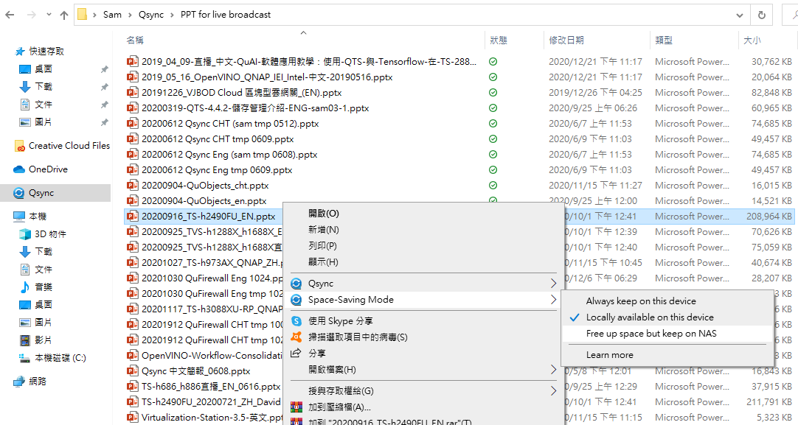
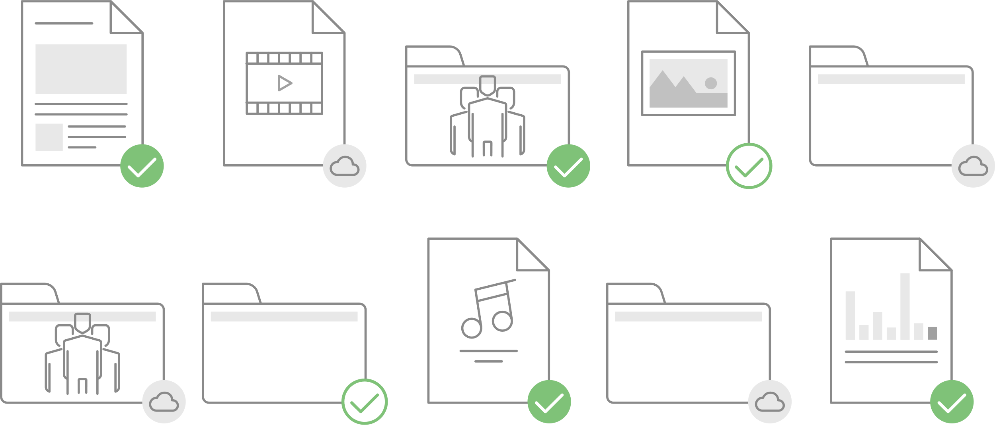
The latest release of Qsync 5.0 Windows & macOS space-saving mode!
Similar to Dropbox SmartSync that is only available to paid users.

Slide 4
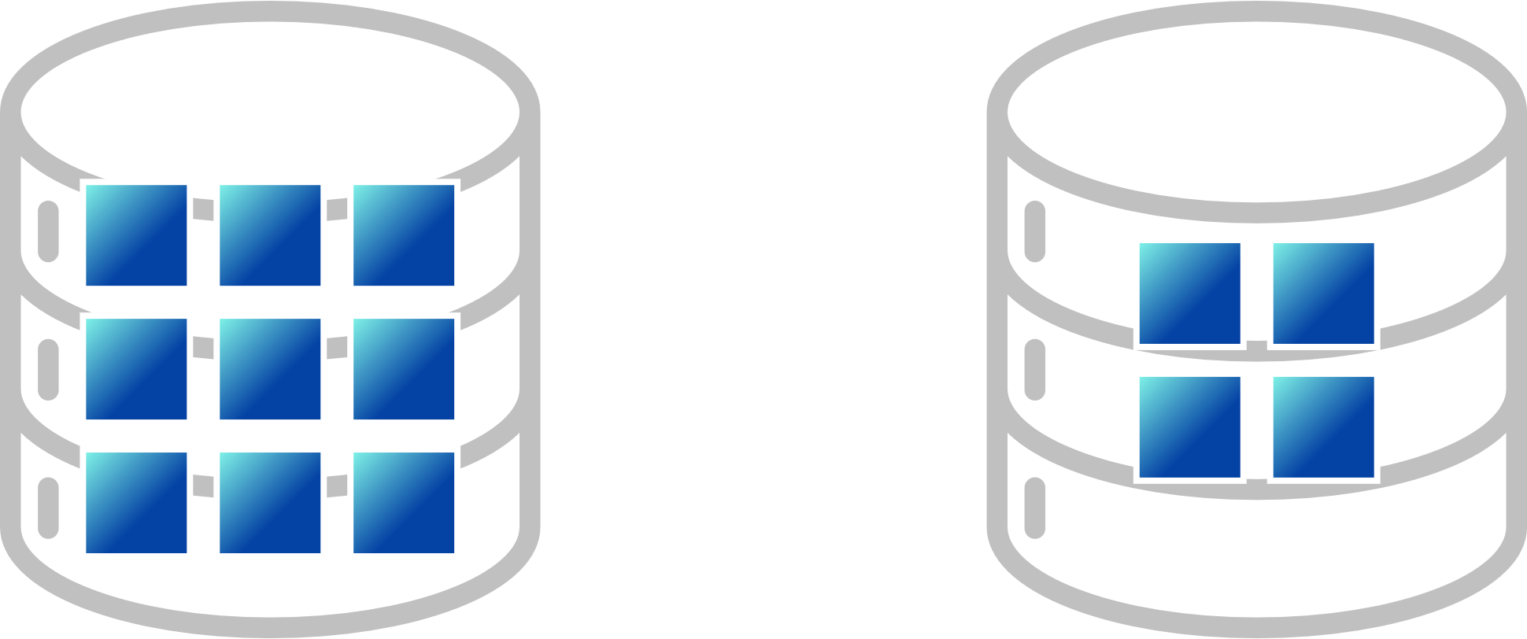
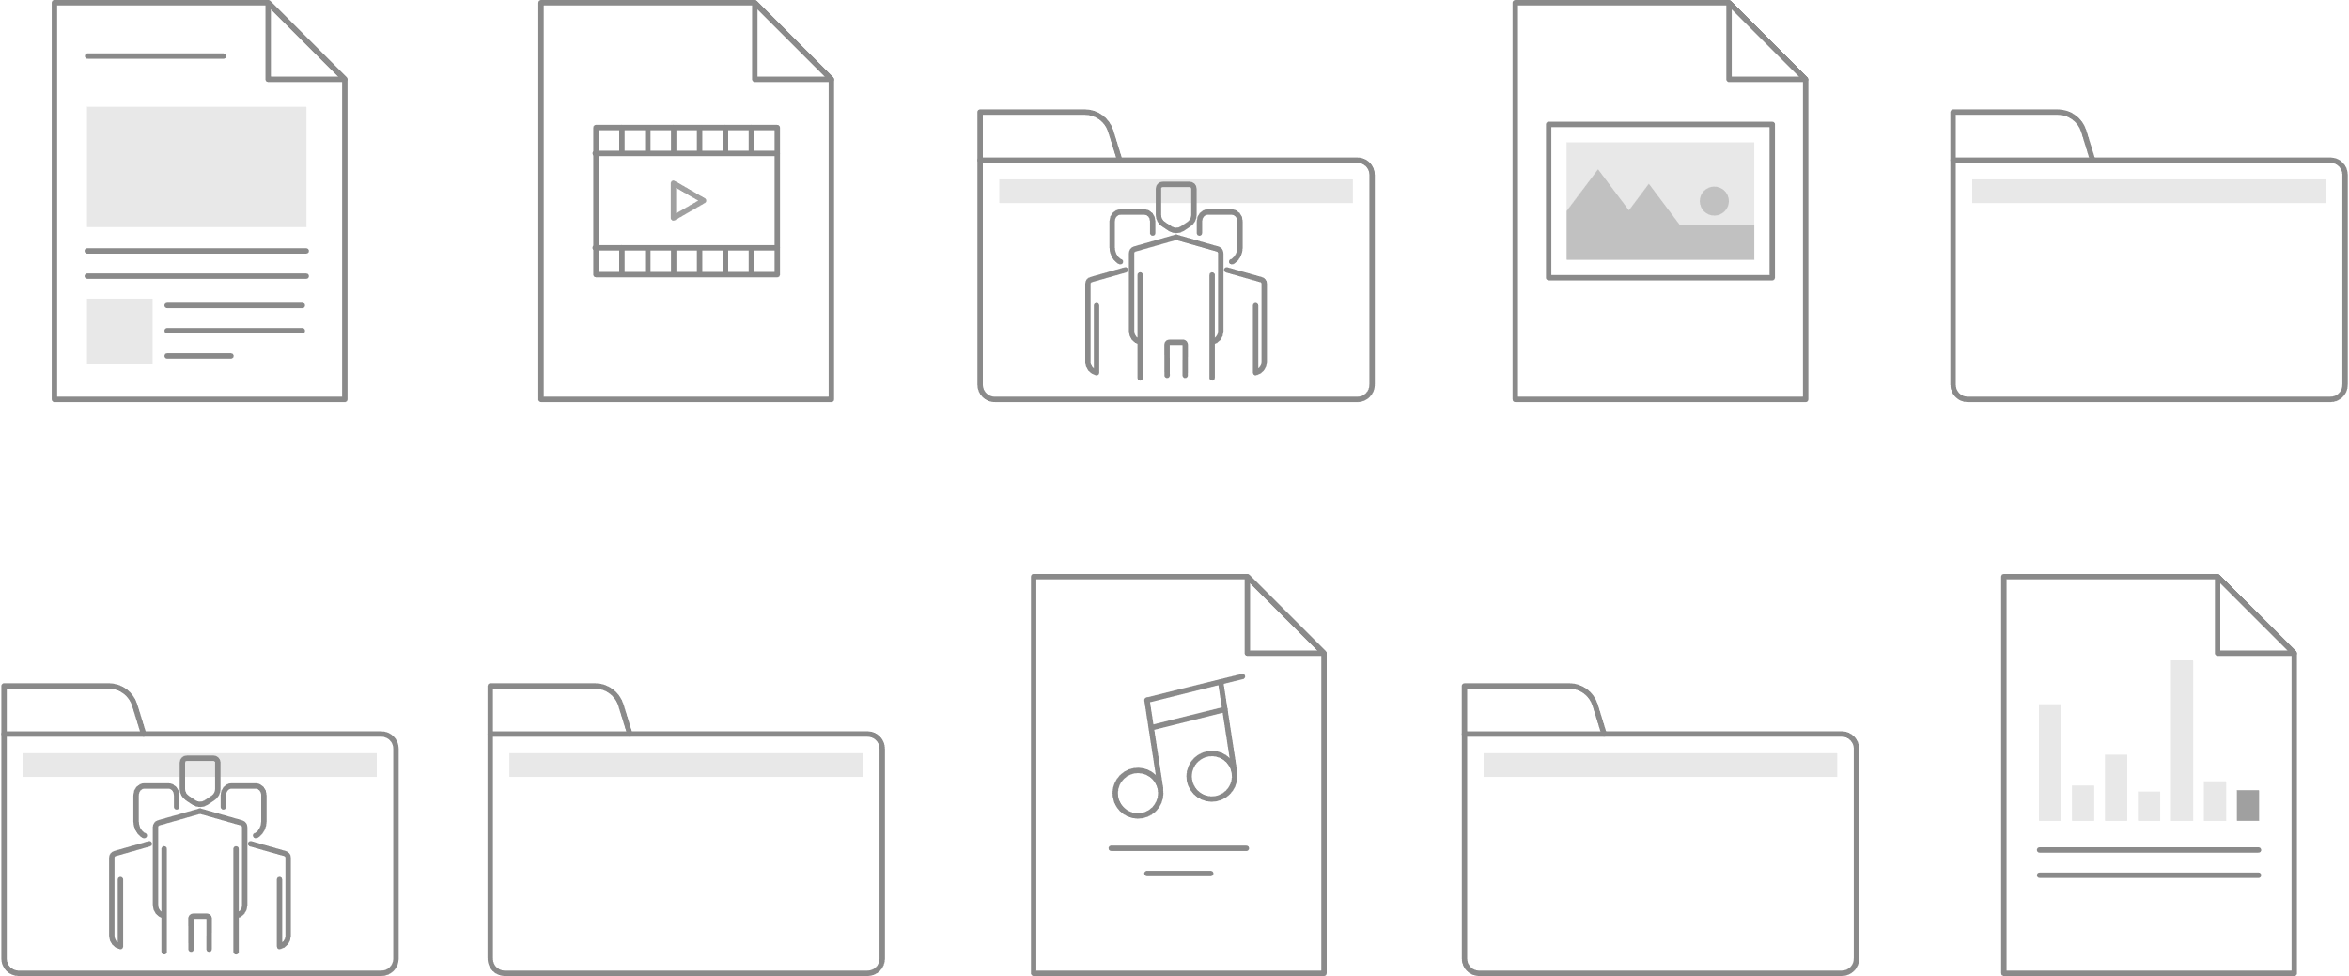
The improvements made possible by Space-Saving Mode
No longer have to worry about your storage space on computers and laptops is not enough even have too much team data. The space-saving mode allows you to view all files in the paired folder but without synchronize to your devices.
For the projects with frequent data changes or the folders that are paired for the first time, there is no need to wait for synchronization to complete one by one.
Reduce unnecessary synchronization amount and speed up operation experience.
Disk
Disk

Slide 5
Qsync Overview

Slide 6
Why do you need Qsync?
My phone is almost full; do I have to pay for iCloud / Google Drive?
(The photo upload of Qsync iOS will be supported soon in next version, of let Qfile app instead before release.)
How can I pass the work I've done to colleagues for further processing?
My family always asks what to do when there is not enough space on their mobiles. Can my NAS be used by the whole family? How can I share travel photos with everyone?
PC/laptop space is not enough but plugging/unplugging a portable hard drive is a hassle. And putting data on the cloud is not only slow but costs money for more space.​
How can the team members synchronize their activities to the same place and share the entire data with everyone?​
How can I synchronize my daily work to the NAS for safekeeping?​

Slide 7
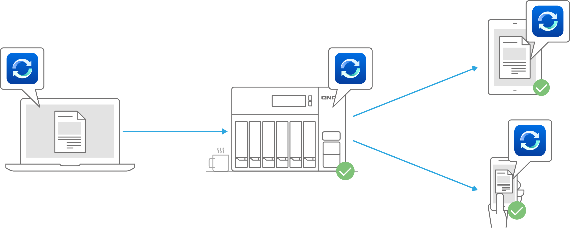
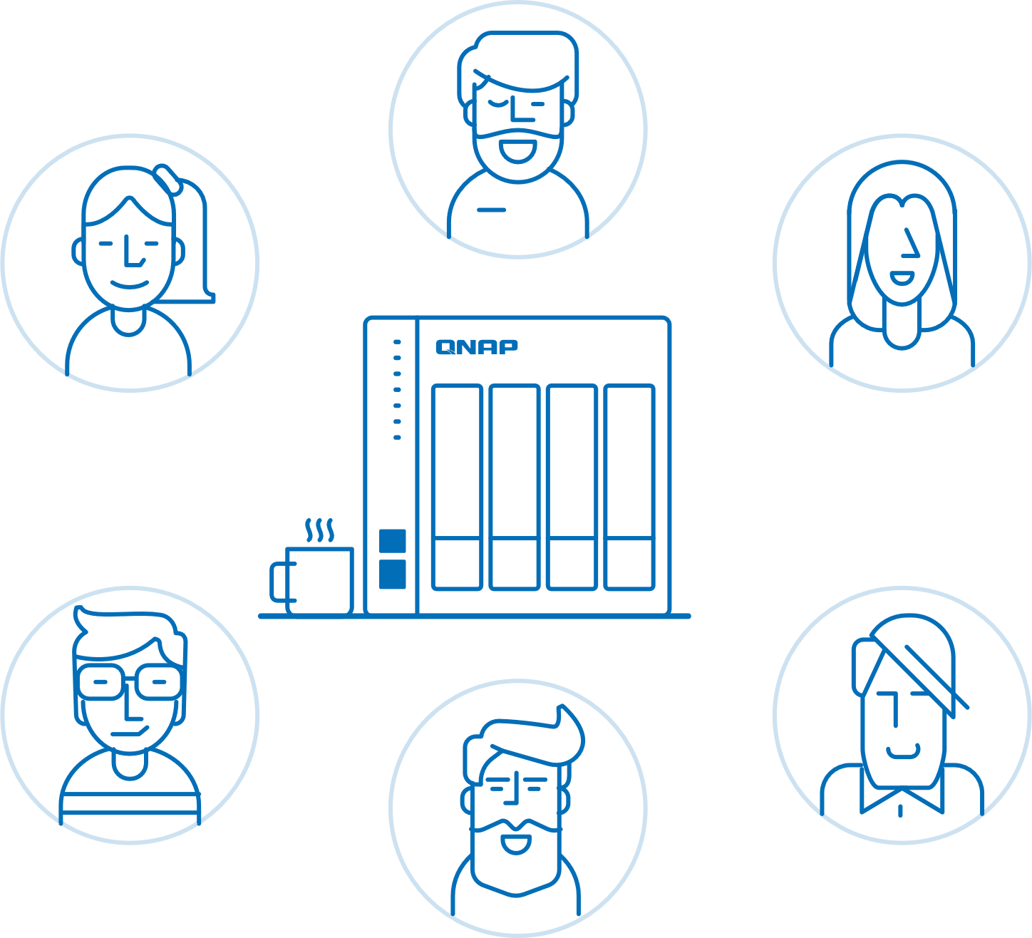
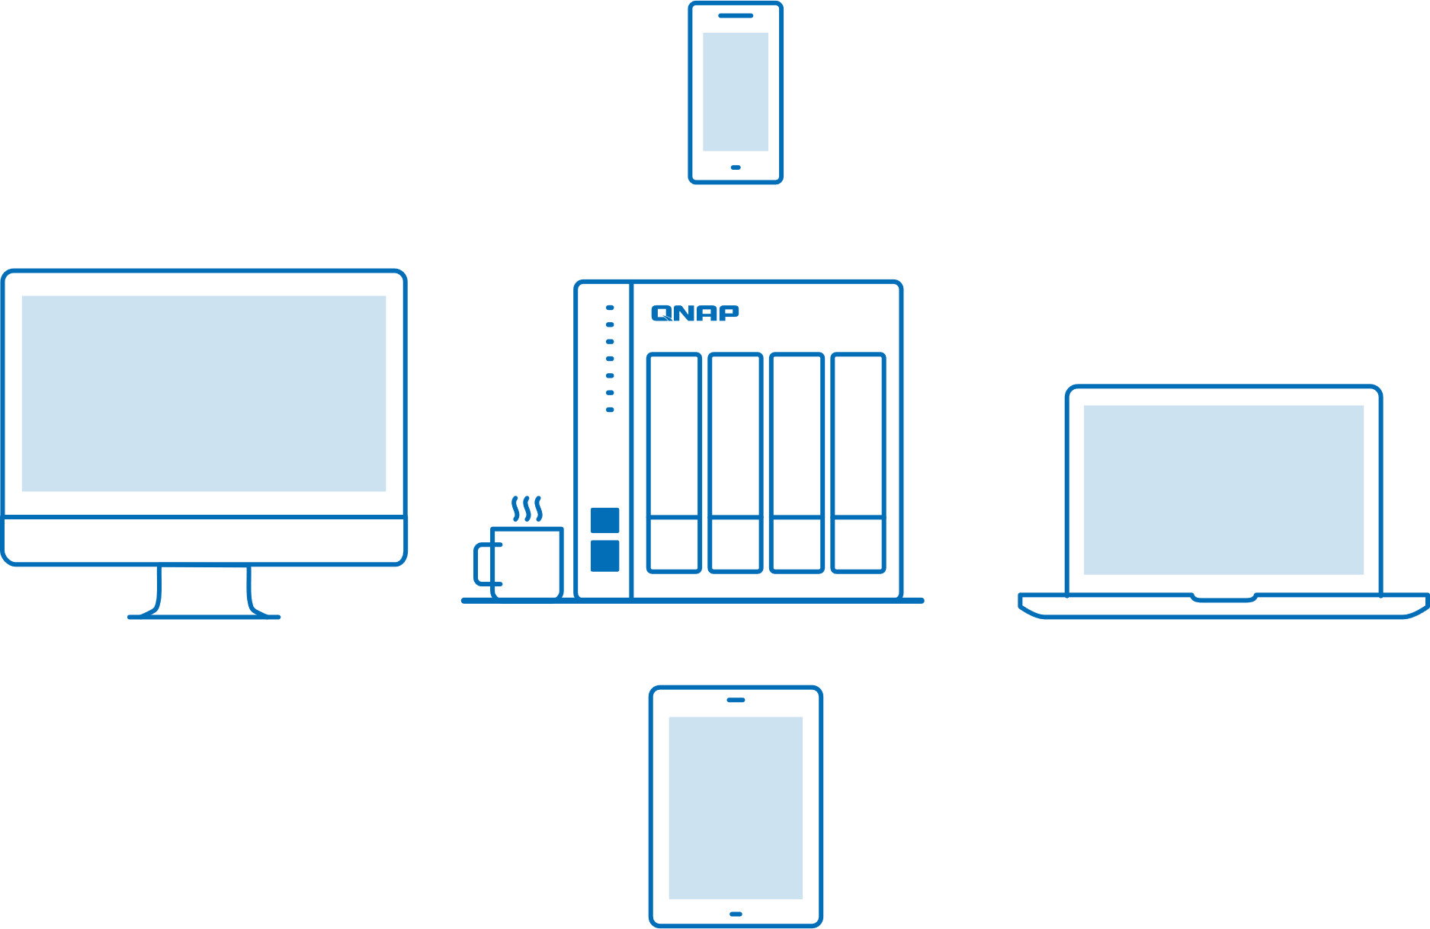
Cross-device file sync for individuals and teams
If you own many devices, any file changed on one device will be automatically synchronized with the others.
For team works, any file changed will be automatically distributed to your teams’ devices, accelerating and streamlining your workflows.

Slide 8
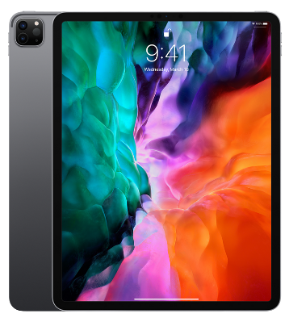
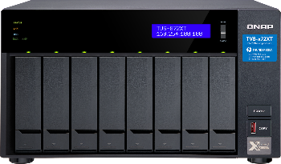
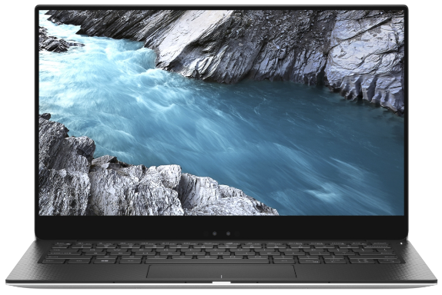
Individual user
User Scenario
Personal
Upload photos to NAS via Qsync, immediately saving storage space on your phone and easily sharing photos with your family and more friends.
Share with more friends​

Slide 9
Tips for you
1
One-way sync
2
Smart delete
Speed &
Flexibility
3
Power saving
Lower the sync frequency
WiFi only
Charging only

Slide 10
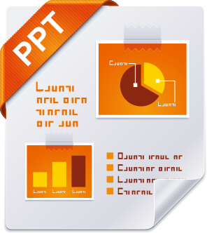
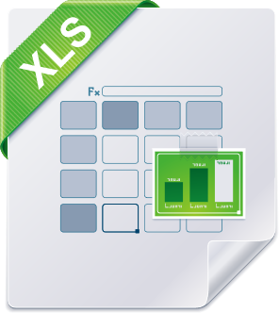
User Scenario
Family Sharing
Upload data to NAS through Qsync, immediately saving storage space of mobiles / computers / laptops, and also sharing various data / videos to your family and more friends.​
Do you still buy cloud space for each of your family members when their phone is running out of space?​
Shared space for family

Slide 11
Tips for you
Speed &
Flexibility
Everyone has his / her personal Qsync folder
Create a Team Folder for the whole family
Create a share link (file/folder) at any time to provide information to friends who is not a NAS user

Slide 12
Use with other apps to provide you a powerful photo management
Data upload / synchronization:
fast and convenient sharing.
Real-time organize photos automatically
AI-powered photo management;
face/objects intelligent auto-organization
Perform advanced searching and indexing for your data

Slide 14
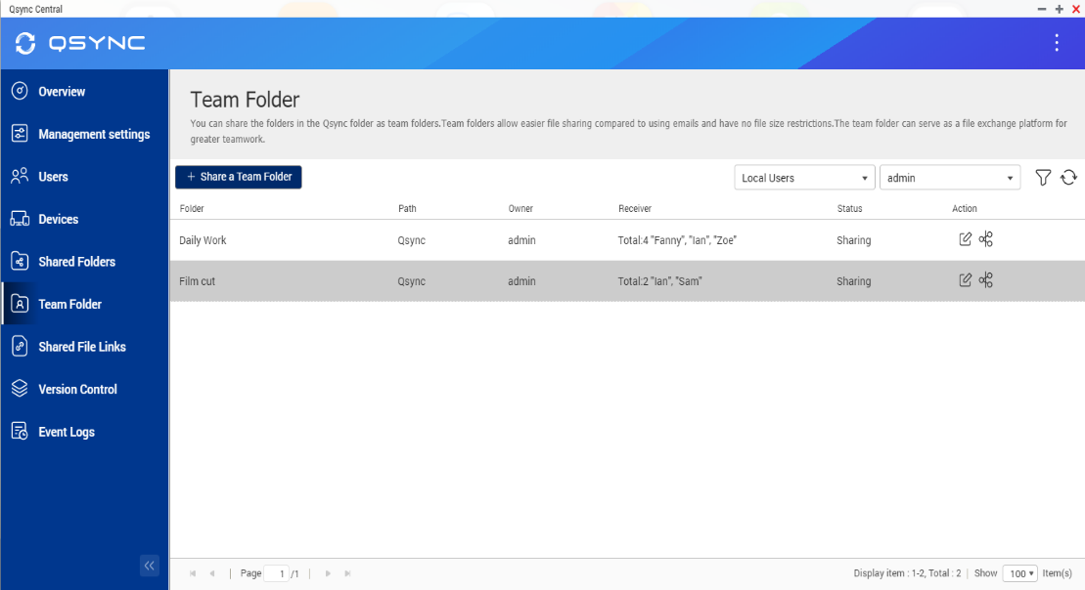
Use Case: Sync daily work How can I synchronize my daily work to the NAS for safekeeping?
Sync Personal data
You could sync data to a shared folder or your personal home folder.
Supports the sub-folder of a shared folder or the Qsync folder.
Sync teamwork
It’s more convenient to use the group folder in the Qsync folder.
You can also limit the access to specific users (only to your supervisors, for example).

Slide 15
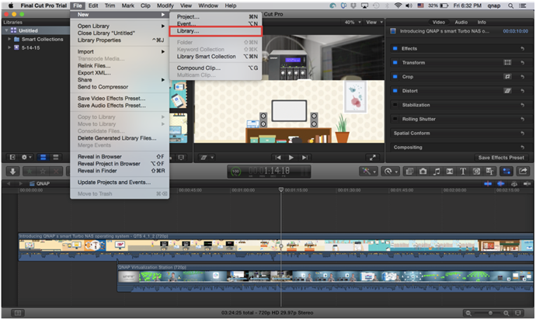
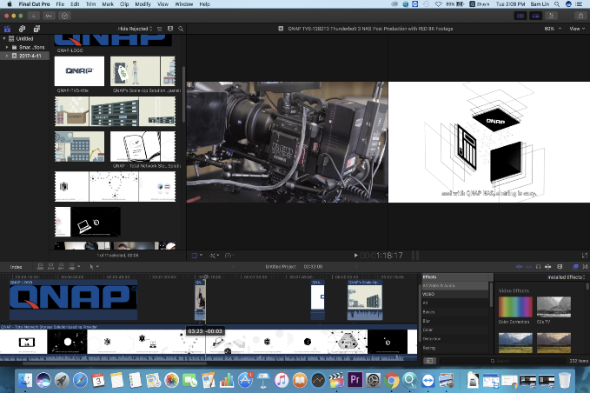
Use Case: How does the post-production team work How to hand over the work I have done to my colleagues for the next process
Set the Team folder for your partner responsible for the next process.
Sam: Editing
Ian:
VFX
Lisa: Color Grading
Alan: Sound
Zoe: Subtitle
Film cut
Animation
Color Correction
Audio
subtitle

Slide 16
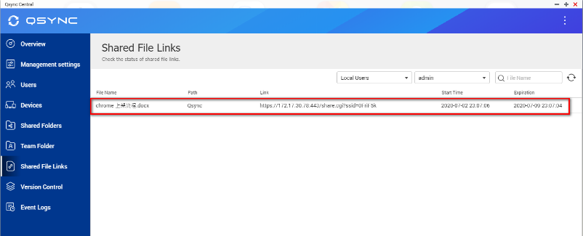
Scenario: New shared activity mode
(e.g. Diving & Snorkeling)
Traditional Activity:
Team sharing to carry out activities together:
Set the shared link for all members of the activity.

Slide 17
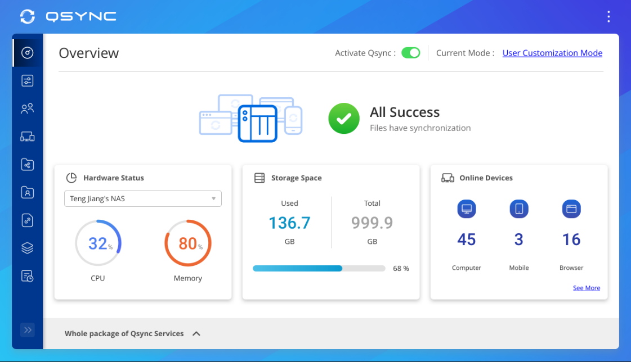
Centralized Management & Easy Deployment
No need to set machines one by one: we provide the flexible configuration and allow users to set their own permissions.
Synchronize rule
Filter setting
Conflict Policy

Slide 18
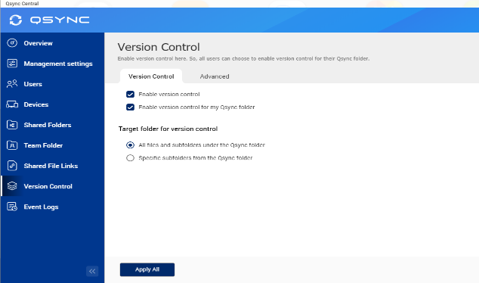
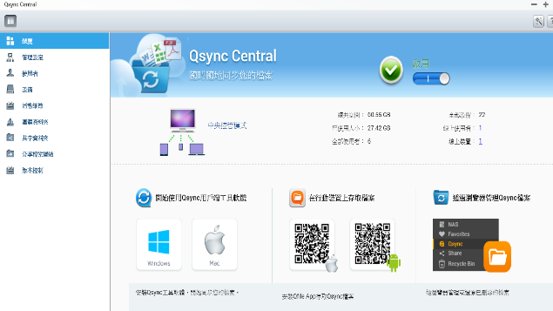
Safe file sync, version control & remote erase
Version Control (only available for Qsync folder but not for shared folder)
User could revert the file back to the previous versions.
IT manager
Easy to deploy and manage
User
Easy to use and could be reverted
Remotely Erase device
The manager could remotely erase the sync files of the device via Qsync Central if a user loses his/ her device.
Central Management: Shared Folder/ Team Folder/ Shared Link
IT manager can easily confirm the assignments and permissions of all shared folders and team folders, as well as the status of shared links.

Slide 19
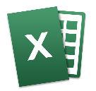
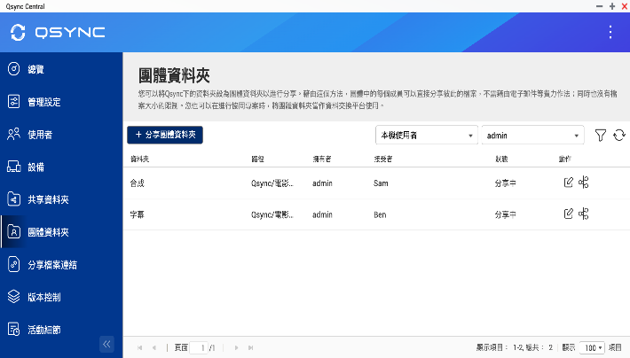
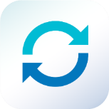
Team Folder: Increase collaboration efficiency
User could create and share the team folder
(Only for Qsync folder)
Cross-departmental teamwork, share the customer and vendor's files simultaneously.
No need to ask for IT creating the new shared folder, flexible to create the team folder for other users that increase collaboration efficiency and reduce management difficulty.

Slide 20
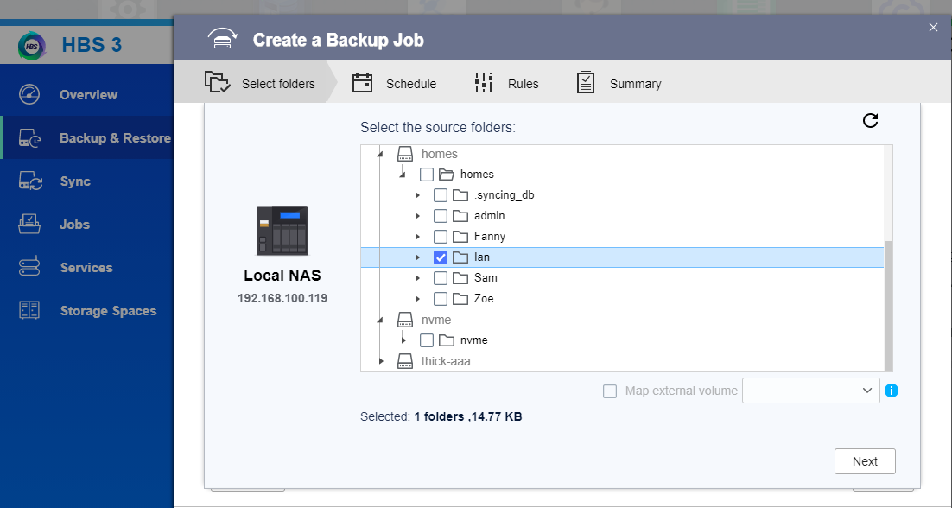
How to back up your Qsync data
HBS 3 (Hybrid Backup Sync)
Local
Remote
Cloud
Select the personal folder under "homes" folder. (includes Qsync)

Slide 21
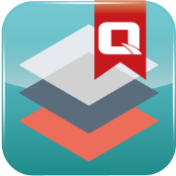
With advanced NAS features, your Qsync data also benefits
RAID
Protection
Snapshot
Avoid ransomware
Qtier, SSD Cache
Higher performance
Hybrid Backup Sync
more backup more protection
+
With QuTS hero, help you reducing more storage space
A
B
C
D
A
B
C
D
A
B
C
D
D
C
A
B
D
C
A
B
Original Data
Compressed Data
Deduplicated Data
Compression
Deduplication

Slide 22
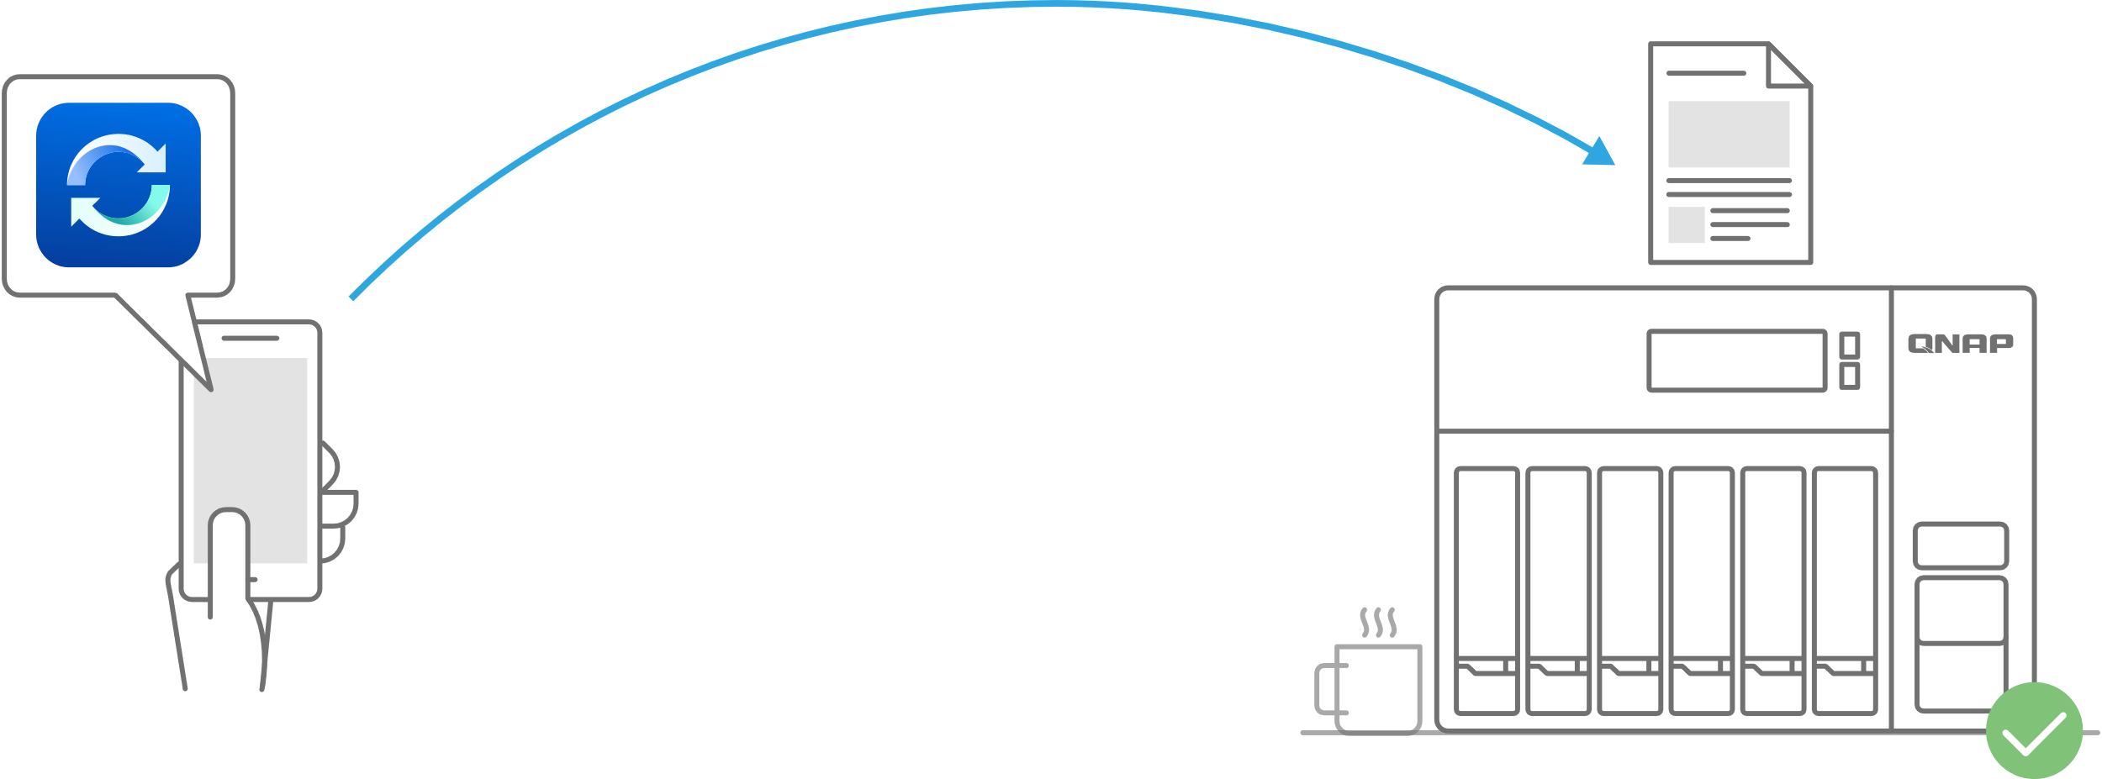
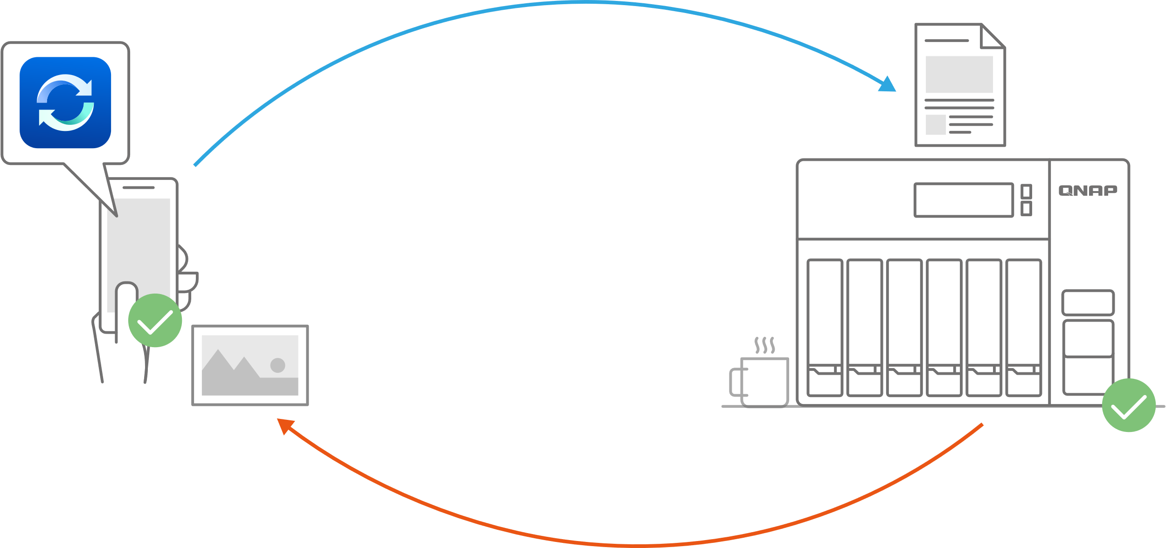
Utility & Mobile support sub-folder / one-way / two-way synchronization
Sub-folder
The user can set up synchronization in the sub-folder, but notice that when the sub-folder is set, this device cannot set to the upper layer (parent layer) and the next layer (child layer) as sync folders.
One-Way sync
One-Way sync Upload from device: The device is the source side and always get the latest data.
Download from NAS: Announced information to all member.
Two-Way sync
Standard synchronization process, both side will be the same.
Filter setting on device side
Specify the file extensions which users don`t want to sync.
Two-Way sync
Smart Delete
User could remove the local file but still keep those copies on the NAS to save the local storage space.

Slide 23
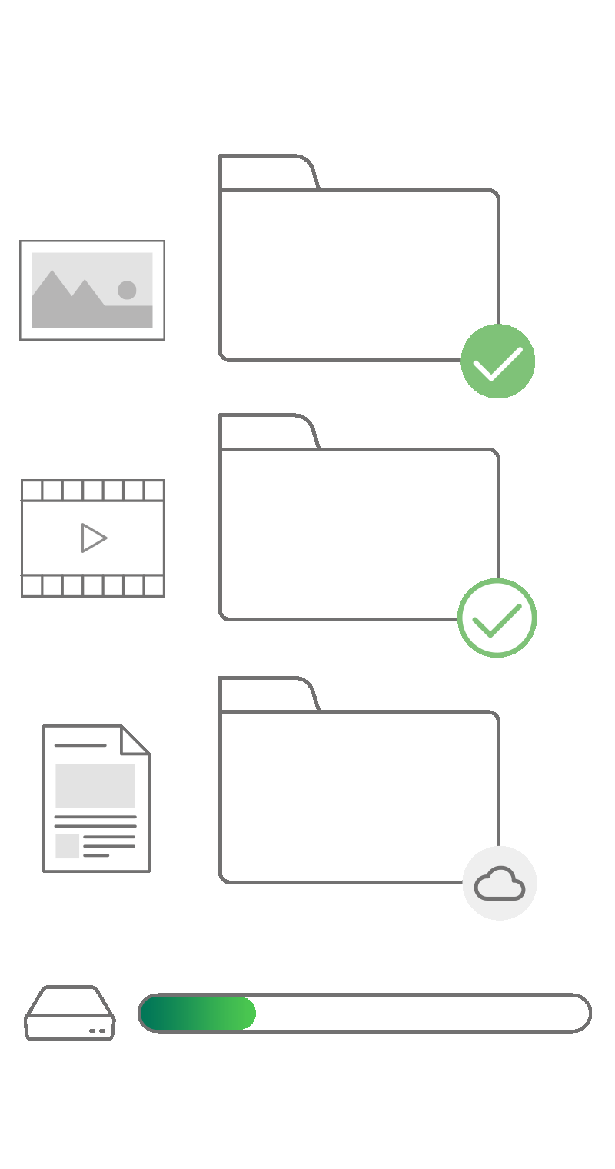
Windows/Mac utility support the space-saving mode
Files on-demand and self-activated on low storage
Always available
Always keep on this device
These Always Available files download to your device and take up space, but they are always there for you even when you are offline.
For Win users, turn on Storage Sense in Storage Settings.
For macOS users, configure the setting of space-saving mode of Mac Qsync, and set a periodicity schedule to free up space.
Locally available
NAS Only
Windows
Locally available on this device
These Locally Available file can be seen and edit on your PC, and also take up space. Users can manually or automatically change a file back to NAS-only if not enough space.
Free up space but keep on NAS
You can see the files/ folders on your computer, but the files/folders do not take up space. The file is not downloaded to your device until you open it.
macOS
(coming soon)
Status changing​
Notes:
https://www.dropbox.com/smart-sync

Slide 24
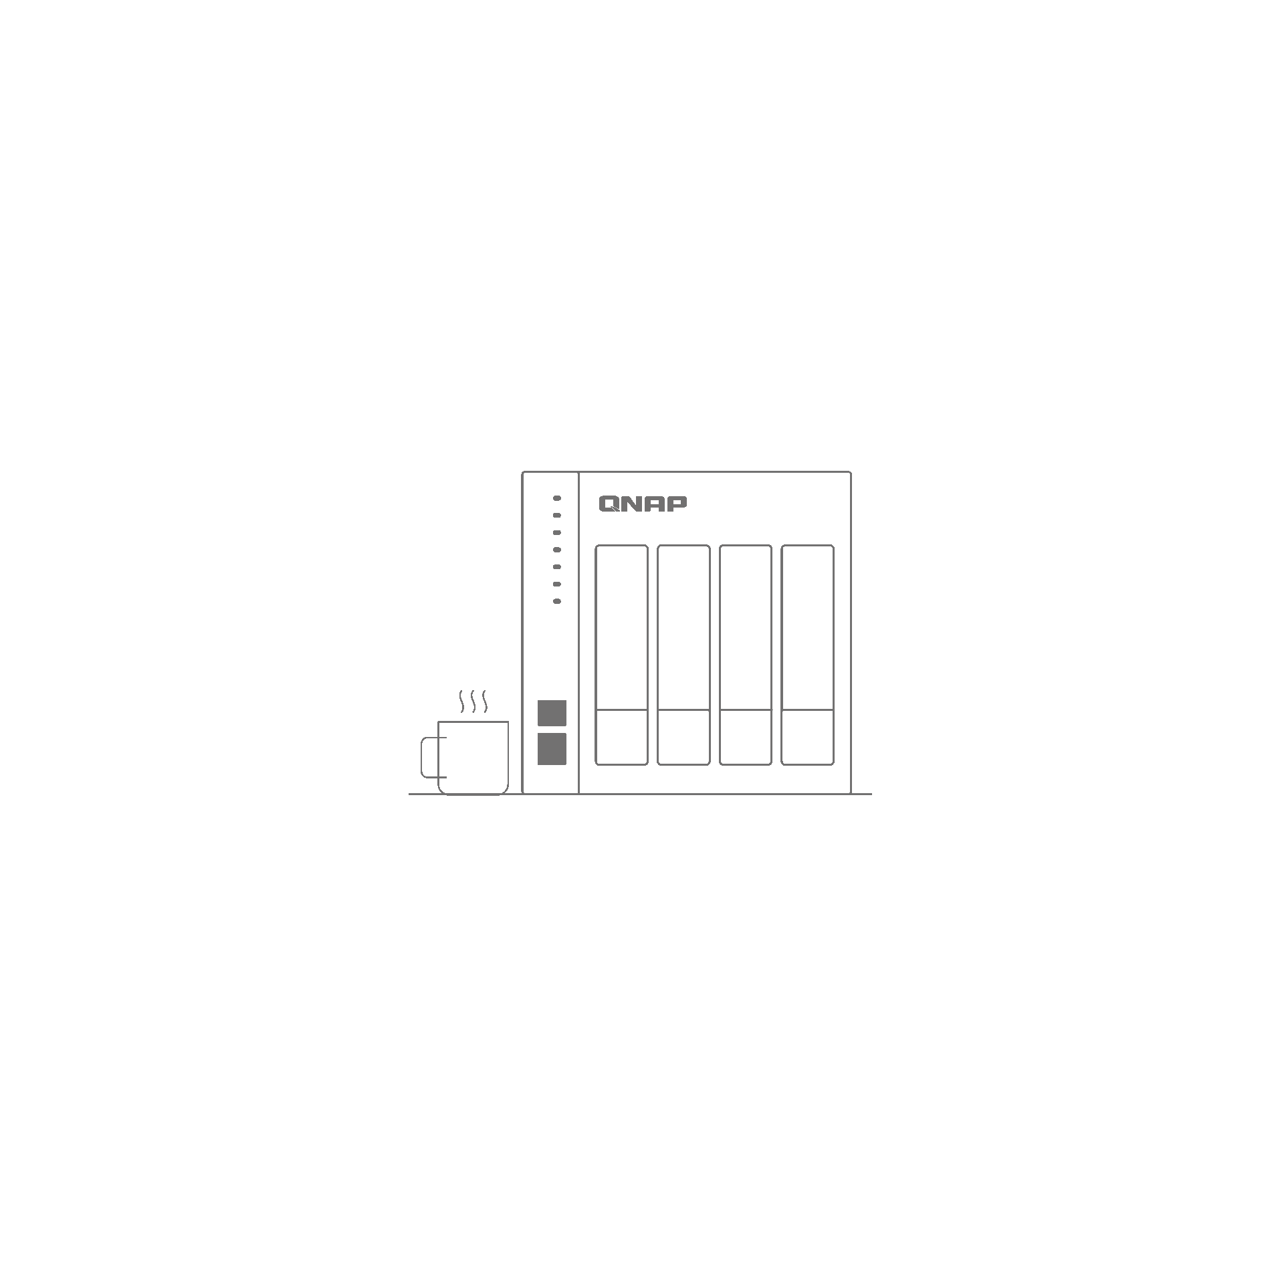
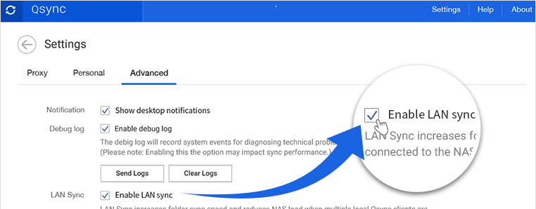
Start LAN sync to accelerate synchronization works
LAN sync
This feature could increase the synchronization efficiency when many Qsync clients in the same LAN are connected to the same NAS.

Slide 26
How to choose the right NAS?
 | Users | Processor | RAM | SSD Cache | Network
Home | 1-10 | Intel Celeron Dual core | 1~4G | Nice to have | 1GbE / 2.5GbE / 10GbE
SOHO | 11-50 | Intel Celeron Quad core | 4G | Nice to have | 1GbE x2 / 2.5GbE / 10GbE
SMB | 51-200 | Intel Core i5 Quad core | 16G | Yes | 10GbE x2 (Port Trunking)
SME | 201-500 | Intel Core i7 Quad core | 32G | Yes | 10GbE x2 (Port Trunking)
Enterprise | 501-1000 | Intel Xeon 4-core | 64G | Yes | 25GbE~
Enterprise | 1001-2000 | Intel Xeon 8-core | 128G | Yes | 25GbE x2 (Port Trunking)
Enterprise | 2001 and more | Intel Xeon / AMD EPYC 8-core~ | 128G~ | All-Flash Array Recommended | 25GbE x4 (Port Trunking)

Slide 27
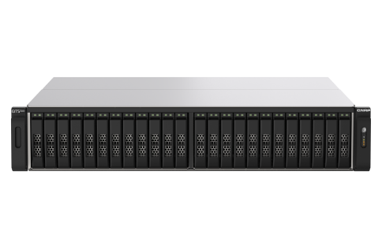
Recommended models
TS-453D
TVS-872XT
TS-h1283XU
TS-h2490FU
4 bay (4 x 3.5”)
Intel® Celeron® J4125 quad-core 2.0 GHz
4 & 8 GB RAM
8 bay (8 x 3.5”)
Intel® Core™ i5-8400T 6-core 1.7 GHz
16GB RAM
12 bay (12 x 3.5”)
Intel® Xeon® E-2236 6-core 3.3 GHz
Max 128GB RAM
24 bay (24 x 2.5”)
AMD EPYC 7302P 16-core 3.3 GHz
Max 4TB RAM

