Slide 1
Snapshot
Backup
Cross-drvices

Slide 2
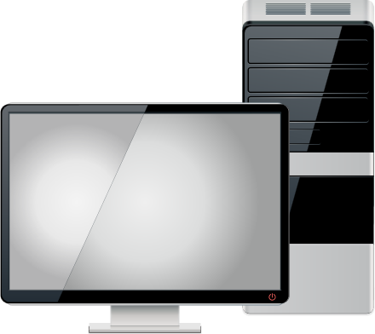
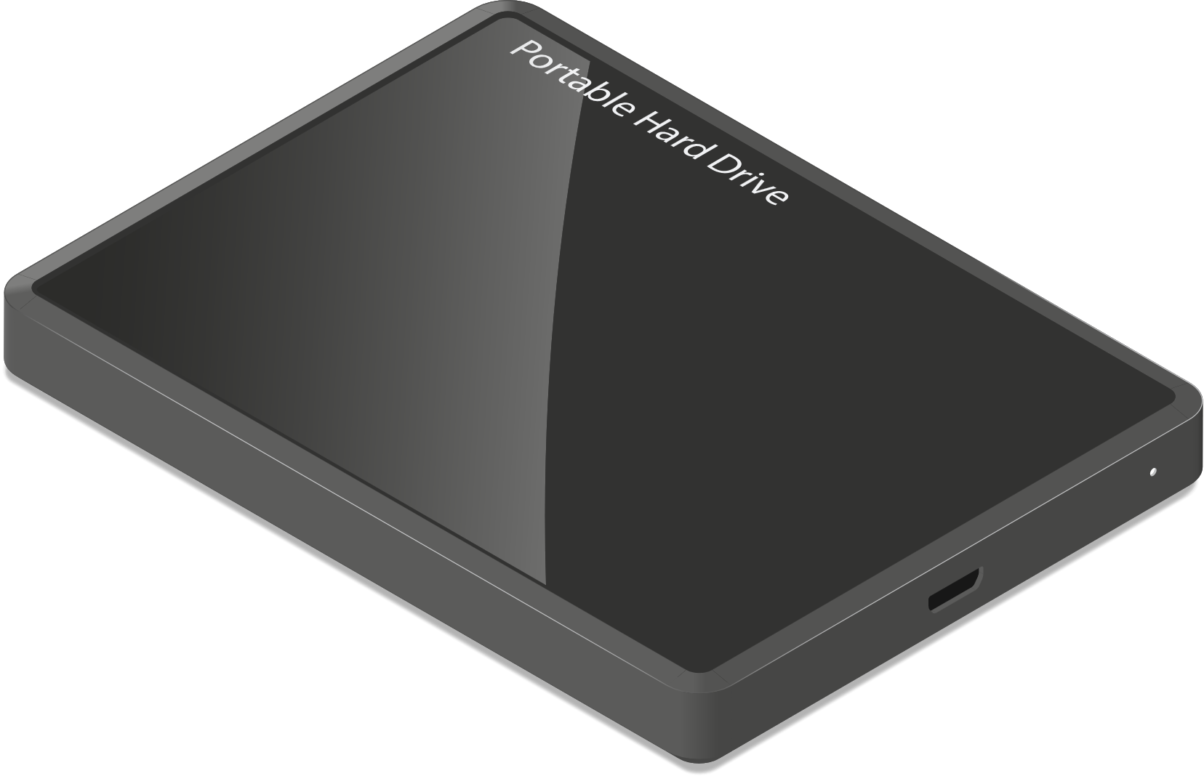
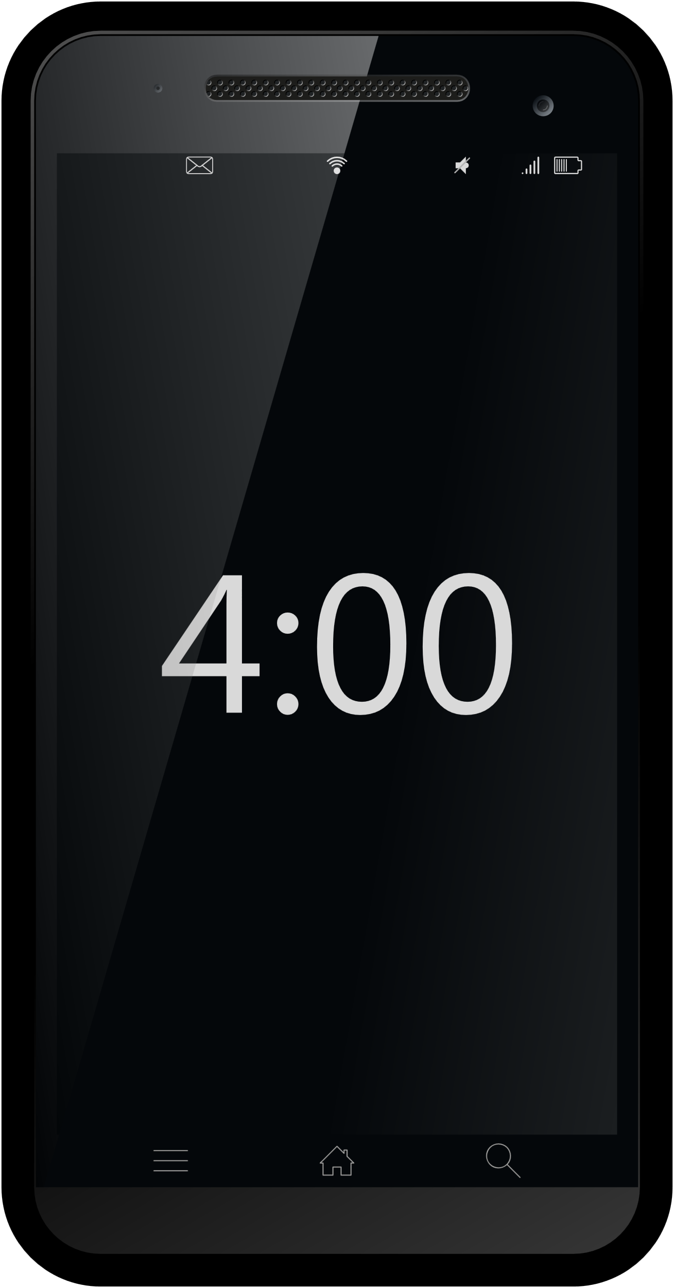
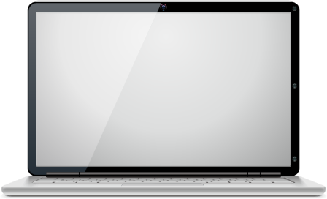
Back up each device with separate external hard drive
Backup each device with different external drive. It's hard to manage all backup version.
External
Hard Drive
Desktop
Smart Phone
External
Hard Drive
MacBook
External Hard Drive

Slide 3
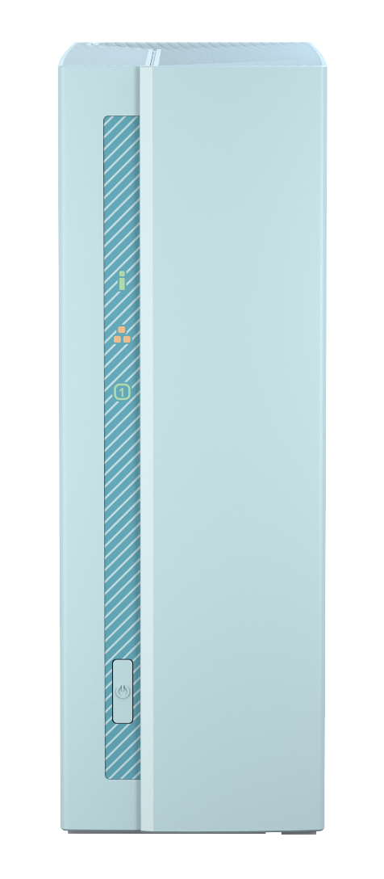
Back all your devices with just ONE TS-130
Save together
Cross devices backup and sharing
Protects you from Ransomware
External
Hard Drive
Desktop
External
Hard Drive
Smart
Phone
MacBook
External
Hard Drive

Slide 4
Home backup NAS
NAS basic opreation
File protection and sharing
Multi-media streaming
Photagrapher

Slide 5
Home Backup NAS

Slide 6
Personal cloud for home application
I want a entry NAS with…
Reasonable pricing
Fashion look
File sharing
Multi-media application
Personal backup (photos / computer data / MacBook Time Machine)

Slide 7
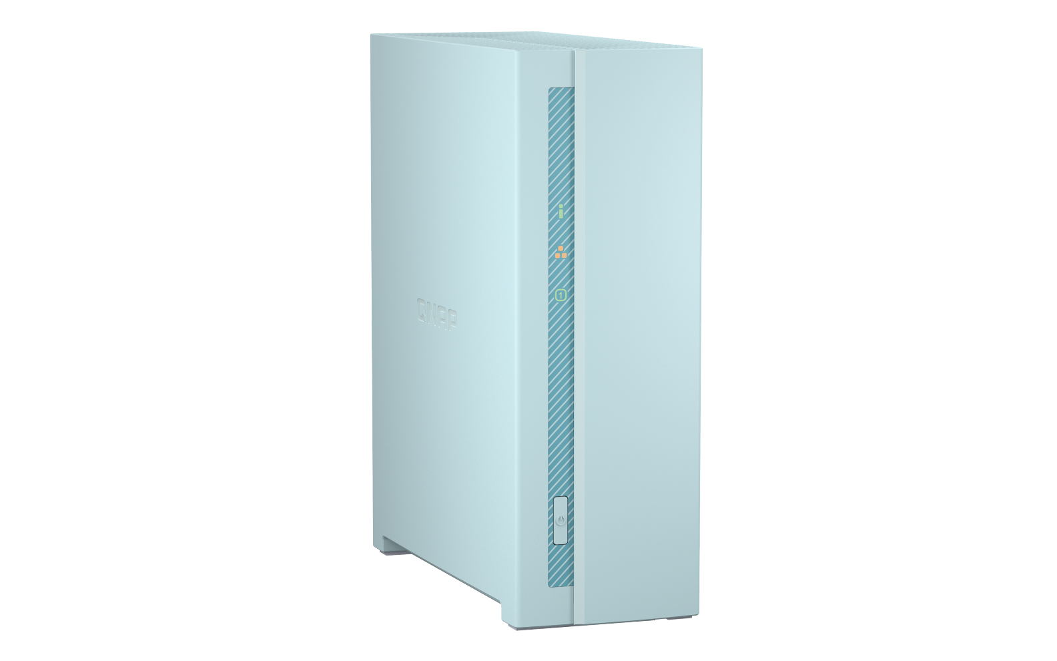
Built just for easy-use personal back up
Light color fits your home well
Great heat dipassion with quiet fan
Snapshot protects your data
Personal multi-media sharing
Support Plex server
Backup photos easilly

Slide 8
This Blue just fits your home well !
Nordic style
Country style
Japanese style
Notes:
請合成三種風格居家角落
北歐—俐落
鄉村--木頭
日式—空空沒東西

Slide 9
ARM 64 bit quad-core 1.4GHz processor
Realtek RTD1295 qurd-core 64-bit 1.4GHz processor
Built in 1GB DDR4 high-speed memory
Energy-efficent ARM® Cortex-A53
Disk stanby：3.45W
Operating Mode：7.29W

Slide 10
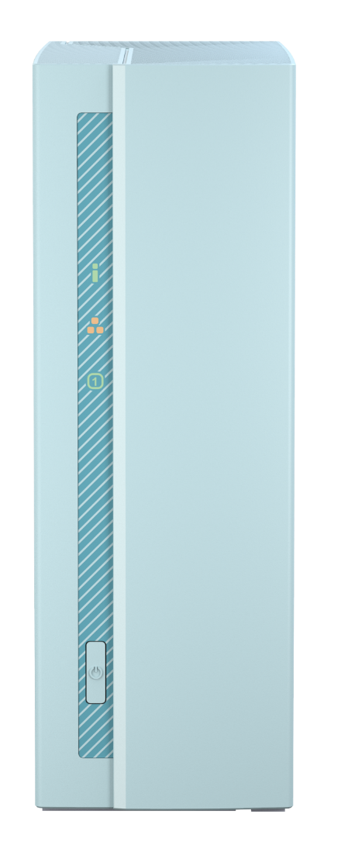
Efficient heat disspassion could handle 18TB hard disk
Quiet Smart fan
15.2dB @25 degree Celsius room temperature
Works well even room temperature is 40 degree Celsius
Support up to 18TB
Sound Level Test Environment: Refer to ISO 7779; Maximum HDD loaded; Bystander Position; Average data from 1 meter in front of operating NAS.

Slide 11
Less is better, simple good-looking design
6cm fan
66.1mm
LED:
Power/Status
Ethernet
Disk
Reset
187.5mm
USB 3.2 Gen1
& USB 2.0 port
GbE port
Power
157.6mm
AC input

Slide 12
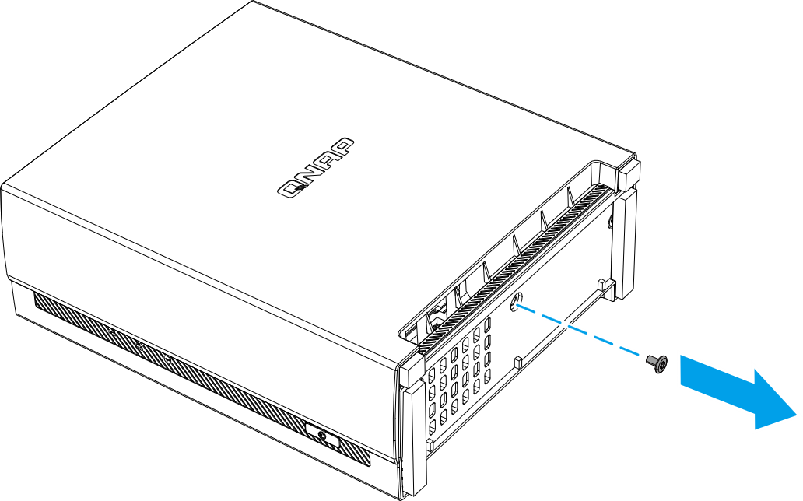
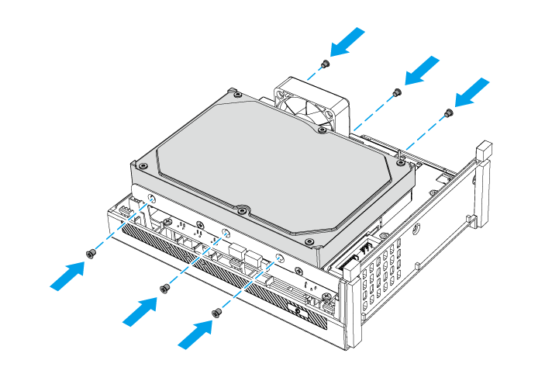
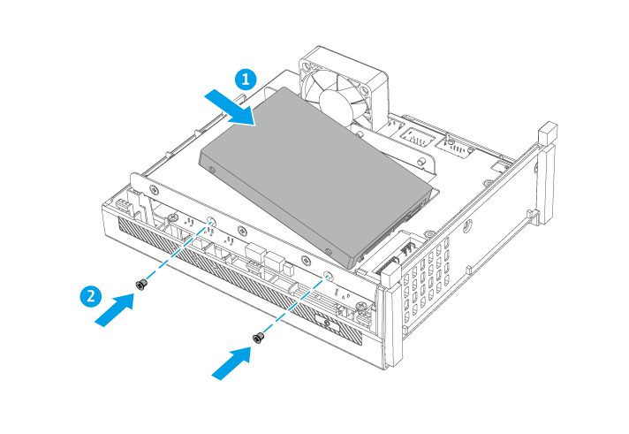
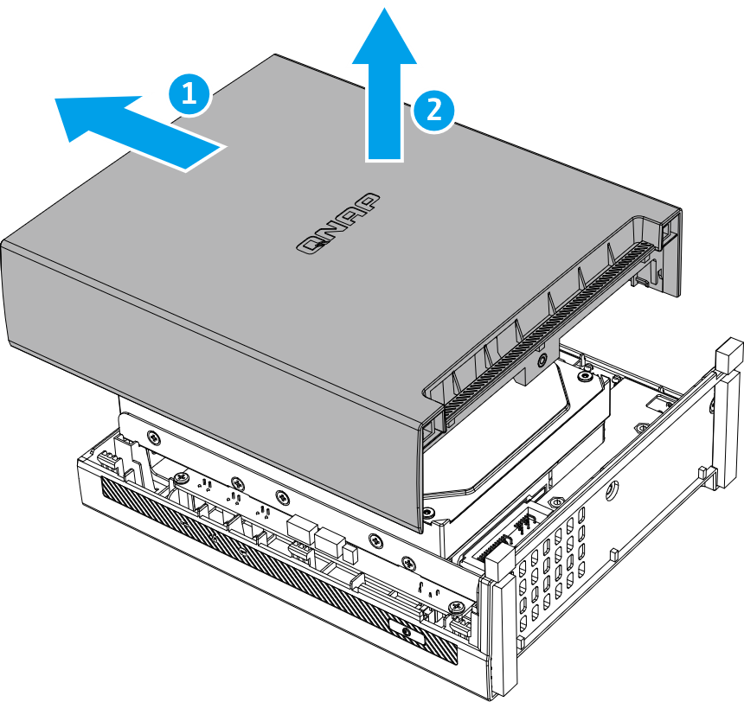
Support 2.5-inch and 3.5 inch SSD / HDD
1.
3.
3.5-inch HDD
2.5-inch HDD/SSD
2.
Notes:
新增開蓋方式

Slide 13
Performance – full speed 10 GB file transfer
Windows File Transfer with Encryption
Windows file transfer
100
113
112
113
110
50
(MB/s)
0
Download
Upload
Download
Upload
Test Environment: NAS: TS-130 OS: QTS 4.5.1 Volume type: Samsung SSD 850 PRO 512GB Client PC: Windows 10, Intel Core i7-6700 CPU,3.40GHz., 64GB RAM
Tested in QNAP Labs. ​
Figures may vary by environment.
Notes:
10G大檔案

Slide 14
Unboxing

Slide 15
NAS basic opreation

Slide 16
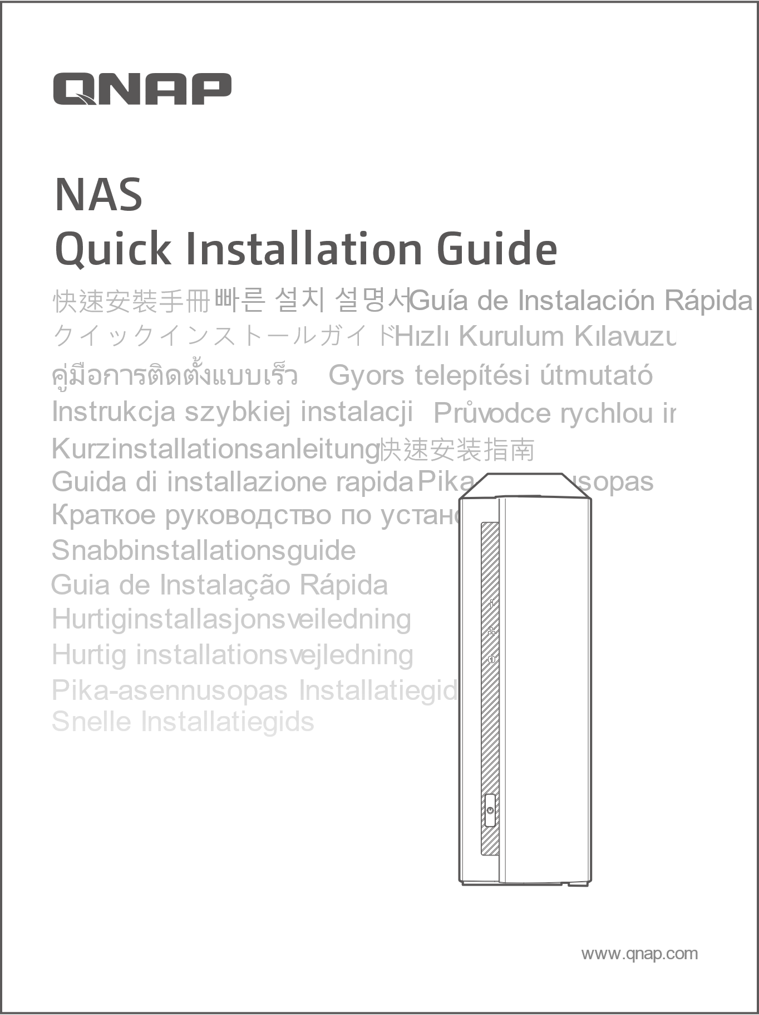
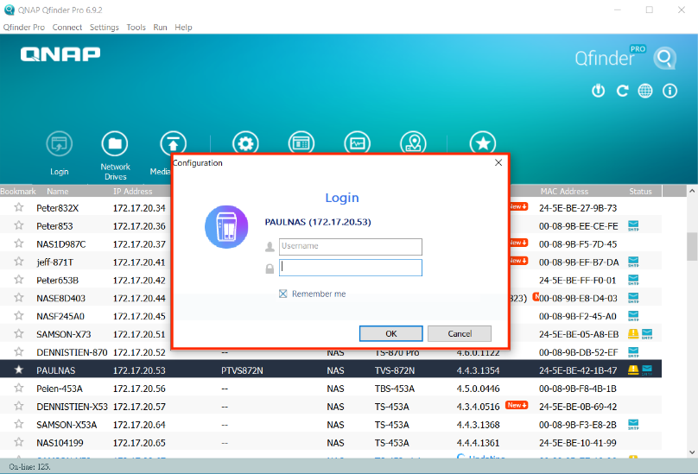
Scan QR code or use Qfinder Pro to initialize TS-130
Put disk in your TS-130, connect to power and ethernet. Finsh your first installation by scanning QR code or launch Qfinder Pro.
1. Scan QR code in Quick Installation Guide
2. Download Qfinder Pro to install on Computer

Slide 17
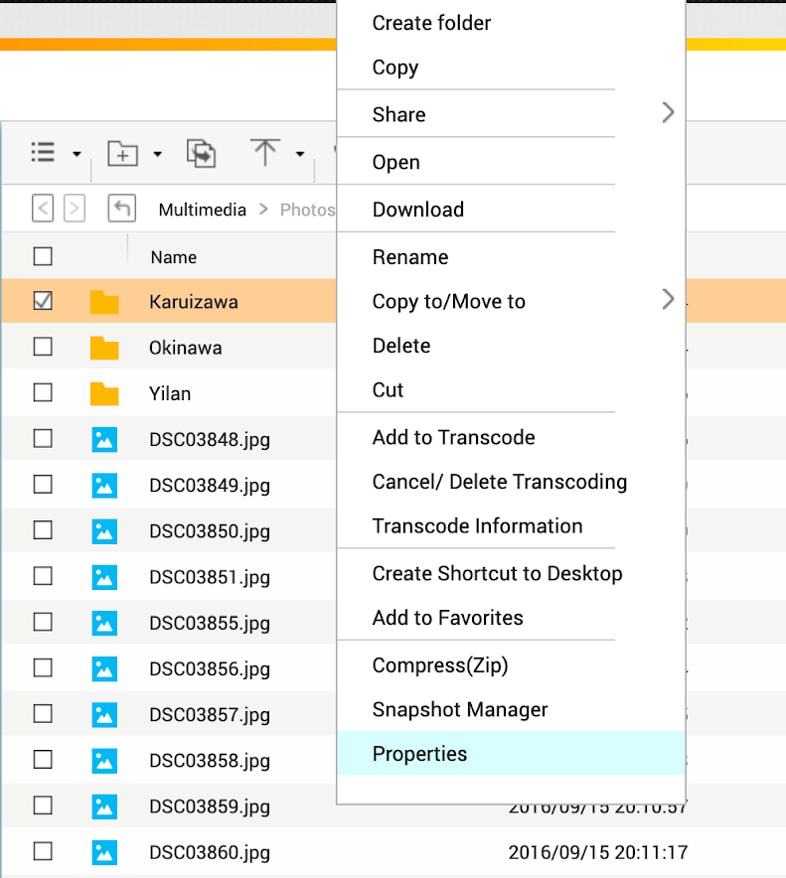
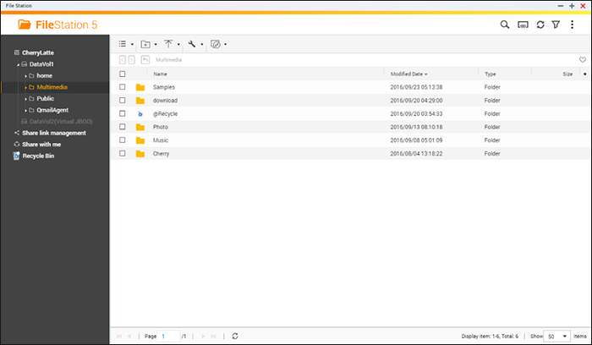
Find & manage all your files – File Station
Upload
Enter folder, drag your file to browser or click upload button to upload your file.
Download
Right click on files/folder to download or share.
Create link to share
Download

Slide 18
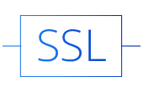
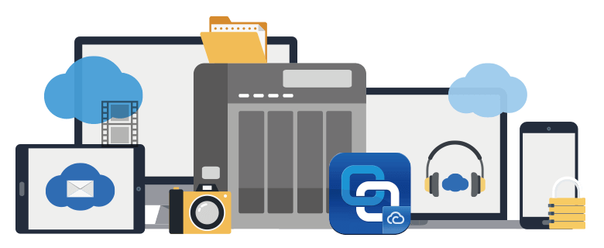
Remotely Access Your QNAP NAS from anywhere with myQNAPcloud Link
he myQNAPcloud Link app is integrated with myQNAPcloud and provides a perfect remote access service, linking you to your QNAP NAS from wherever you are. In the past if you wanted to access NAS device remotely, you needed to rely on the DDNS service and go through a series of complex, time-consuming registration and setting processes. myQNAPcloud Link spares you from these hassles, allowing you to connect to your NAS via the Internet with greater convenience.
Safe connection with SSL certificate
Access control

Slide 19
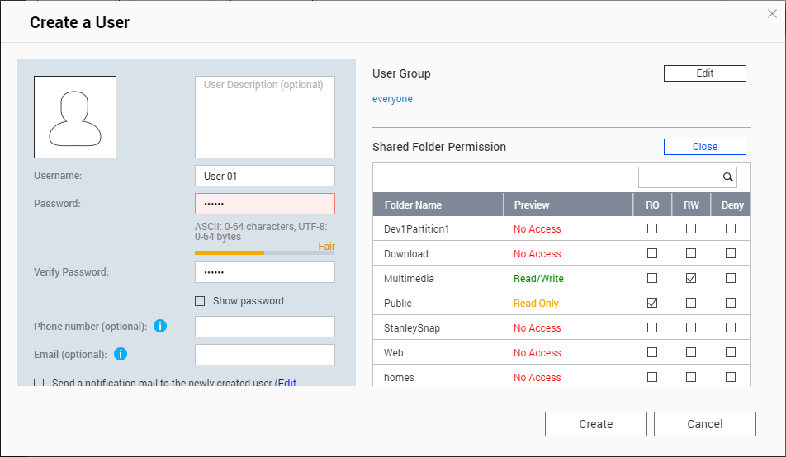
Set independent premission for each user. Share files with friends via myqnapcloud link.
User Group
Support up to 128 user accounts
Stand-alone premission setting for each users
You could set independent premission for each user. Stand-alone Read/Write access for each folder.

Slide 20
File protection & sharing

Slide 21
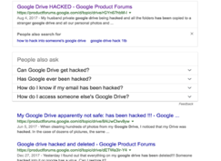
Public could is not safe as you thought
Service tern could be change/discontinued anytime
Flickr cancel 1TB free space, delete user file for over 1000+ photos, cost USD50 for unlimited space.
Google Photos cancel free upload space, charge USD120 for 2TB of space
Data leak
Leakage photos and videos saved on public cloud

Slide 22
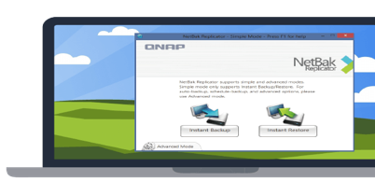
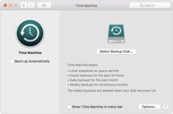
Complete backup solution against to the Ransomware
Create or schedulea a backup to scure your data!
macOS
Time Machine

Slide 23
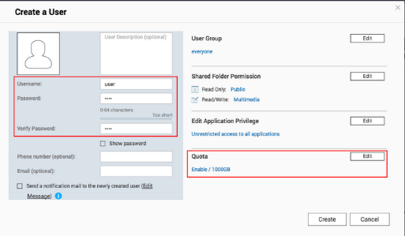
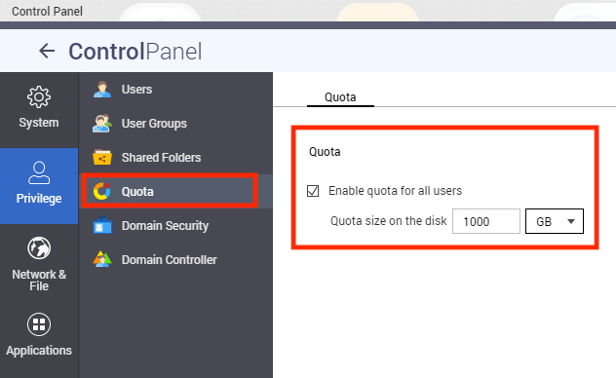
Apple Time Machine Backup
1. Create new user
You will need to create a new user/password for Time Machine backup use
https://www.qnap.com/en/how-to/tutorial/article/using-time-machine-to-back-up-macs-to-a-qnap-nas-via-smb-3/

Slide 24
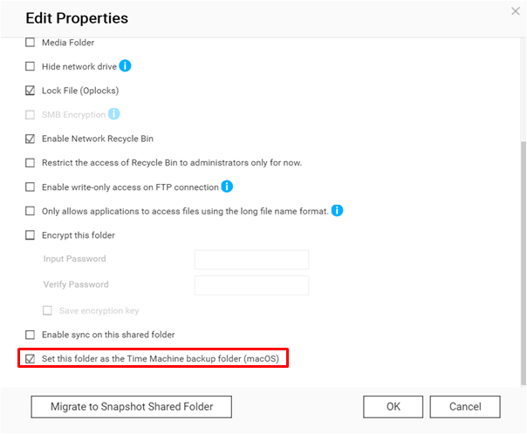
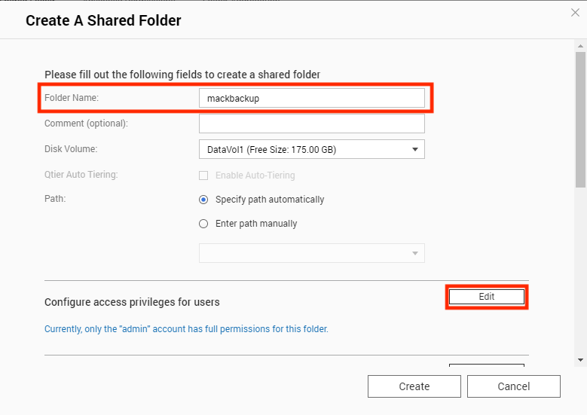
Apple Time Machine Backup
2. Create a share folder
Create new share folder for Time Machine backup
https://www.qnap.com/en/how-to/tutorial/article/using-time-machine-to-back-up-macs-to-a-qnap-nas-via-smb-3/

Slide 25
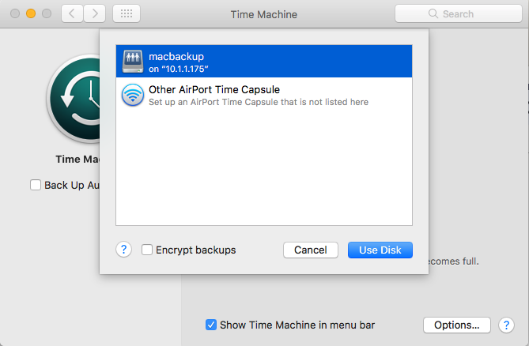
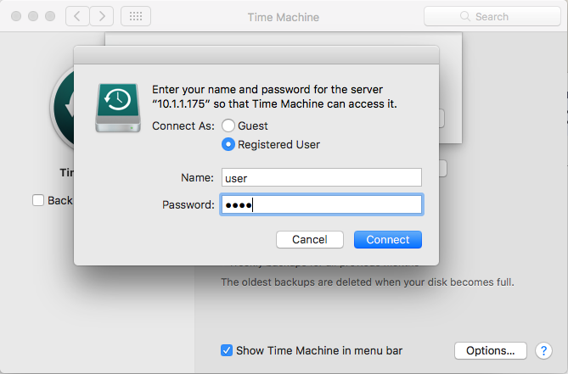
Apple Time Machine Backup
3. config Time Machine on your macOS
In Mac finder click”go” -> “Connect to server” , enter smb://<NAS name.local or IP address>, choose the folder you've created for backup
Start backup by input user/password
You'll see folder when open Time Machine
https://www.qnap.com/en/how-to/tutorial/article/using-time-machine-to-back-up-macs-to-a-qnap-nas-via-smb-3/

Slide 26
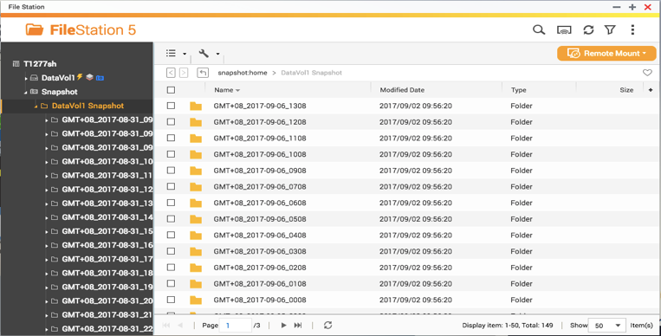
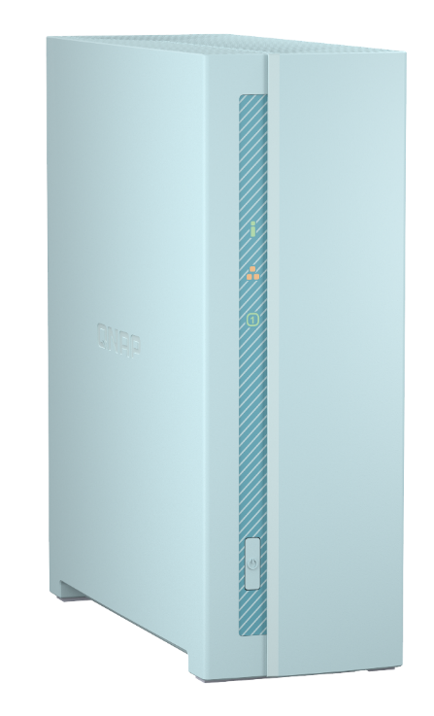
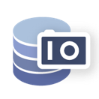
QNAP provide snapshot for Entey level NAS
Maxium snapshots
64
---------------------------------
-----------------------
Maxium snaoshots
of Disk / LUN
32

Slide 27
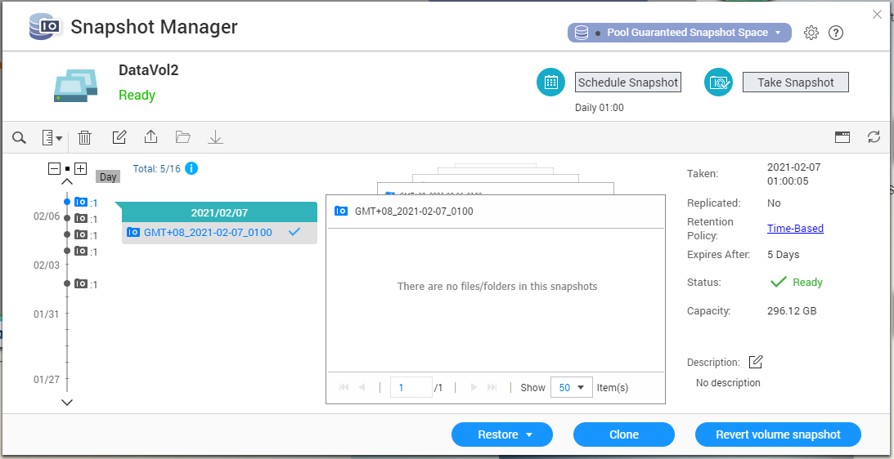
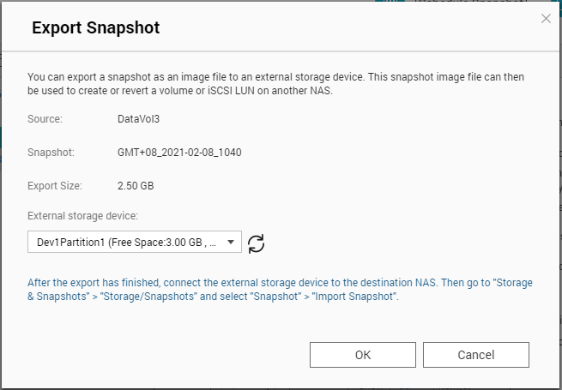
Take & manager snapshot via snapshot manager- Export

Slide 28
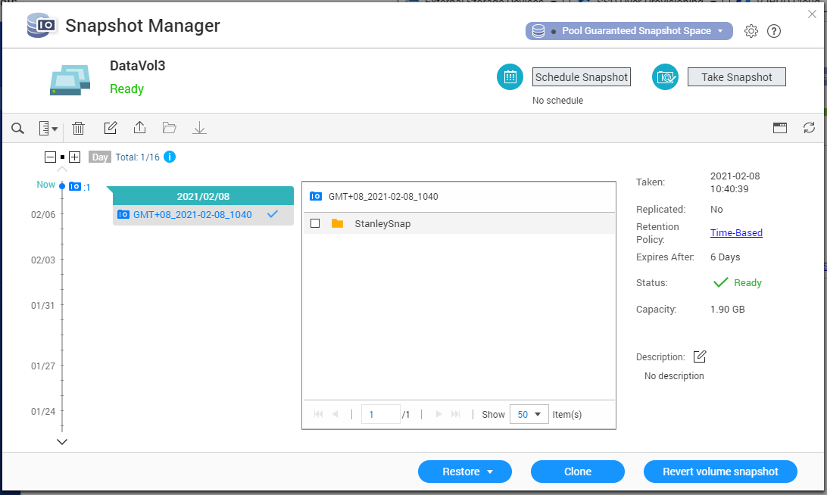
Take & manager snapshot via snapshot manager- inport

Slide 29
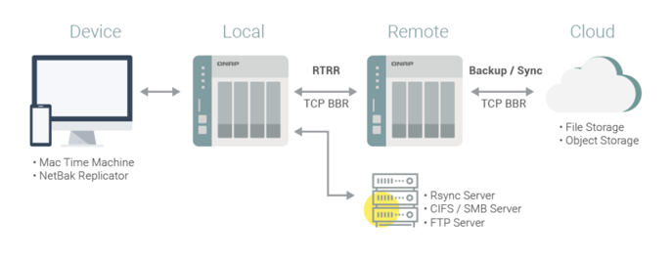
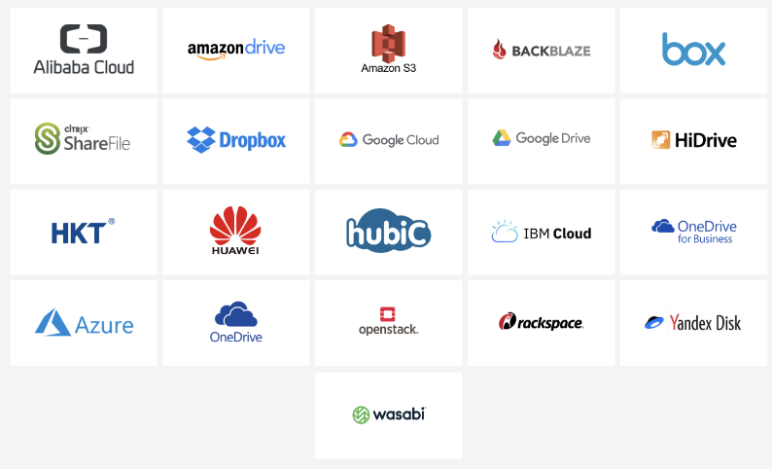
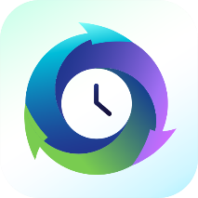
HBS 3 Multi-cloud backup, data deduplication, instant restoration and flexible synchronization
Hybrid Backup Sync consolidates backup, restoration and synchronization functions into a single QTS/QuTS hero app for you to easily transfer your data to local, remote and cloud storage spaces as a comprehensive data storage and disaster recovery plan.

Slide 30
HBS 3 Guide
Notes:
demo移除

Slide 31
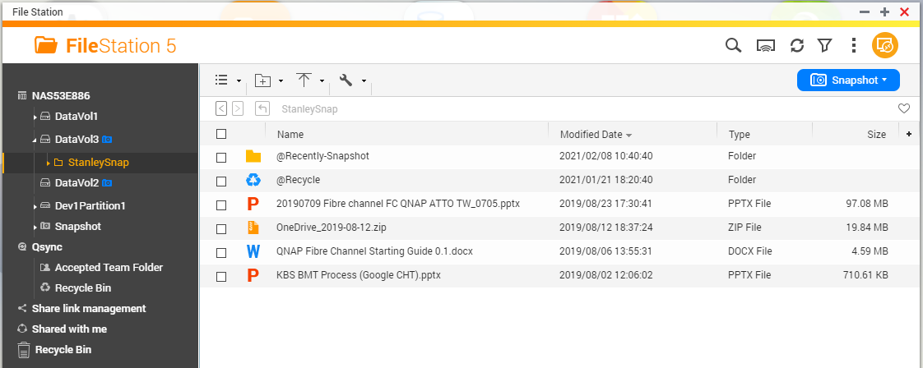
Backup to external drive / remote NAS / cloud storage via HBS 3
To backup folder - DataVol3

Slide 32
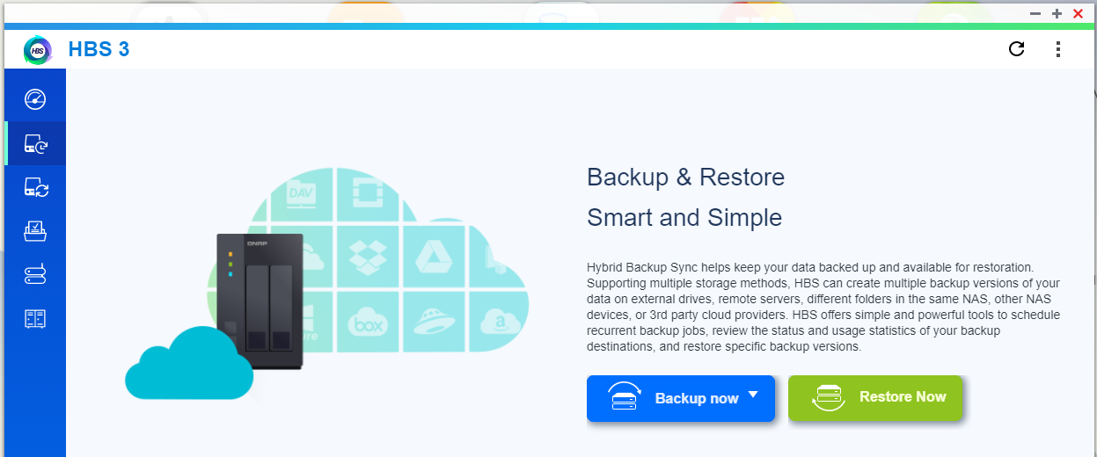
Backup to external drive / remote NAS / cloud storage via HBS 3
Open HBS 3 (Download from App center)

Slide 33
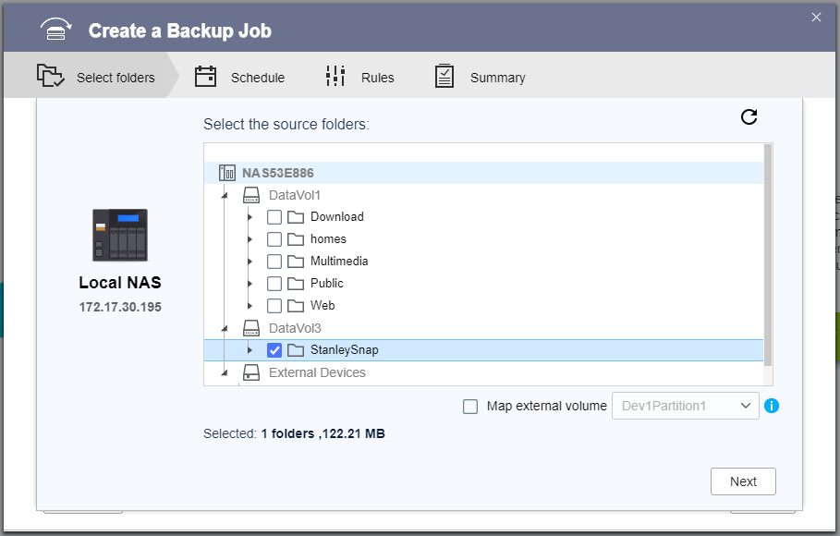
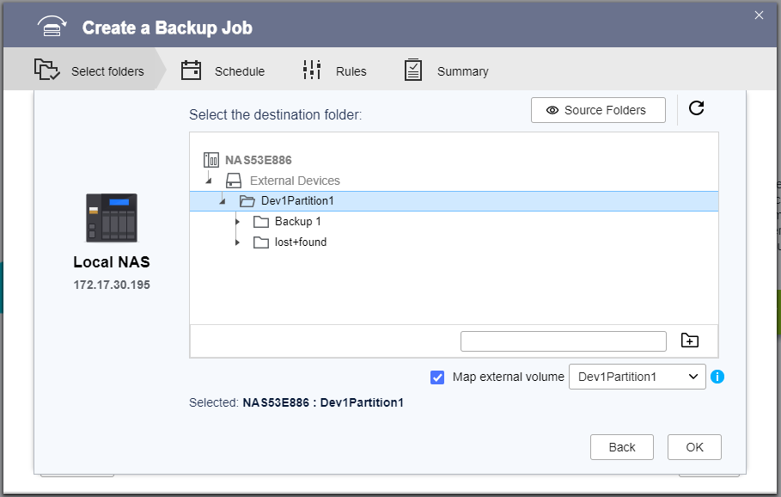
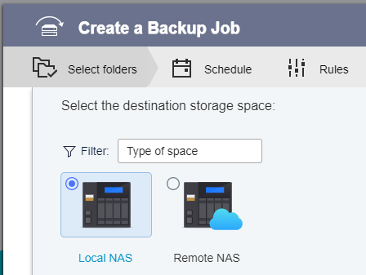
Create Backup job in HBS 3
1. Choose resource folder
4. choose destination folder
2. choose destination
3. External space

Slide 34
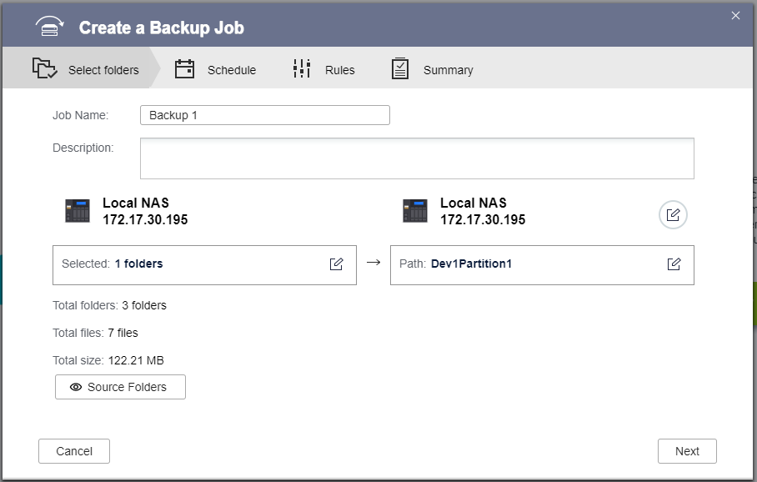
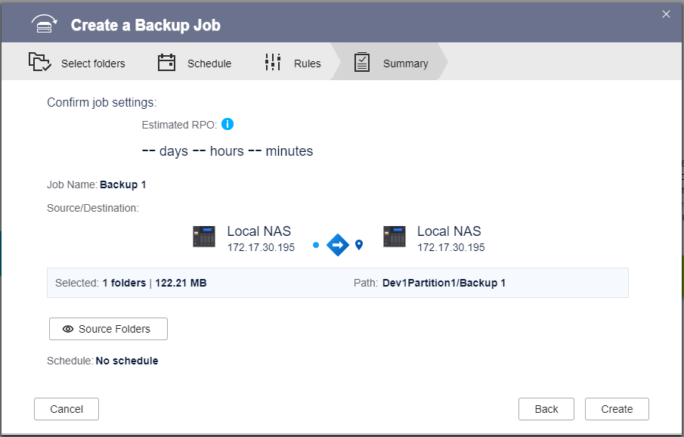
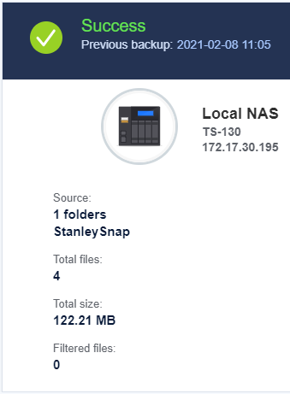
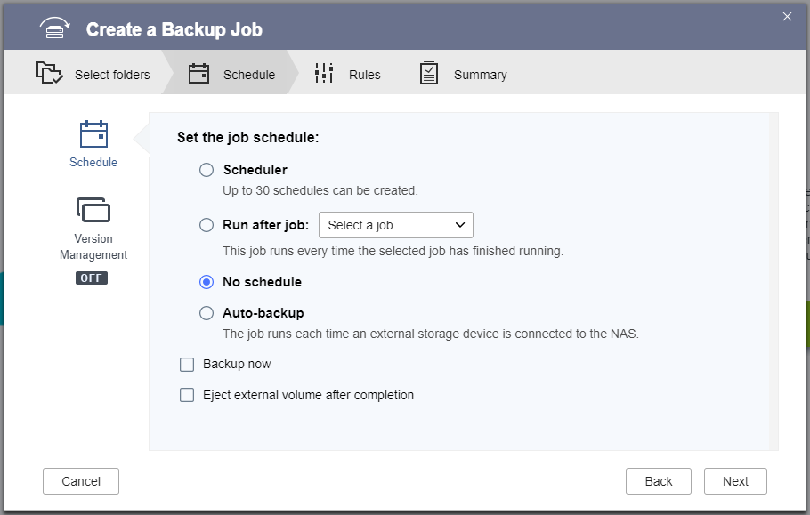
Schedule to make backup job
3.
1.
2.
Schedule backup

Slide 35
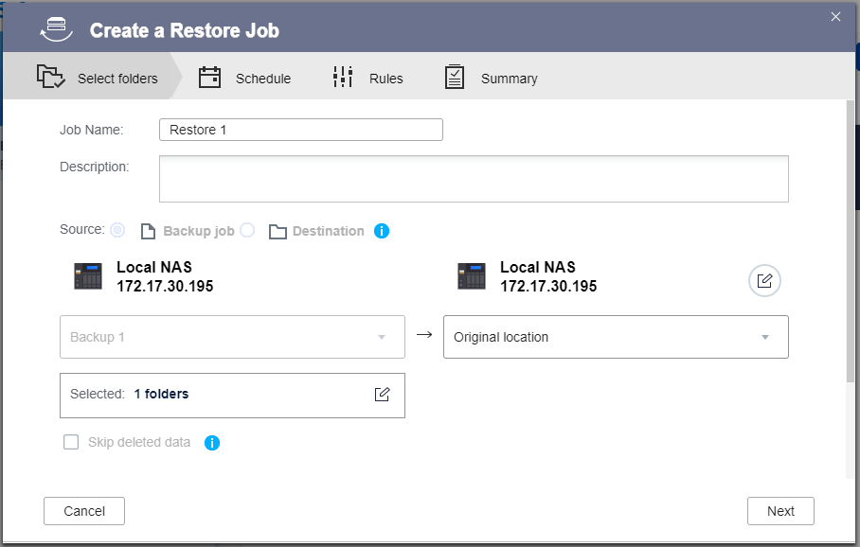
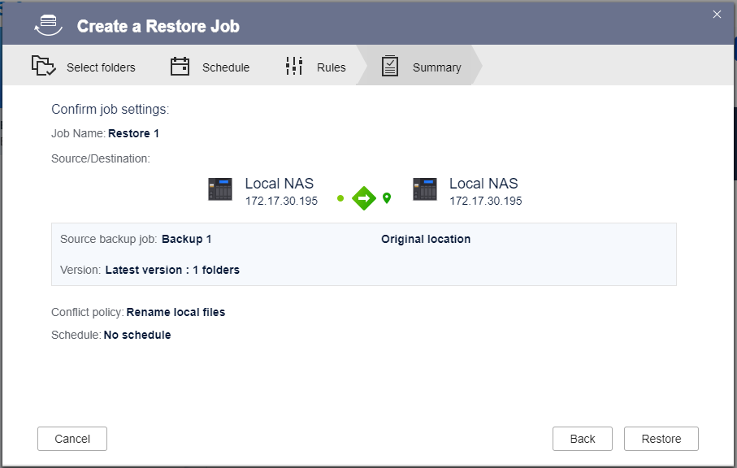
Restore your backup files from HBS 3
1. Create restore job in HBS 3
3. set local as Destination
2. Choose external drive
4. "Restore"

Slide 36
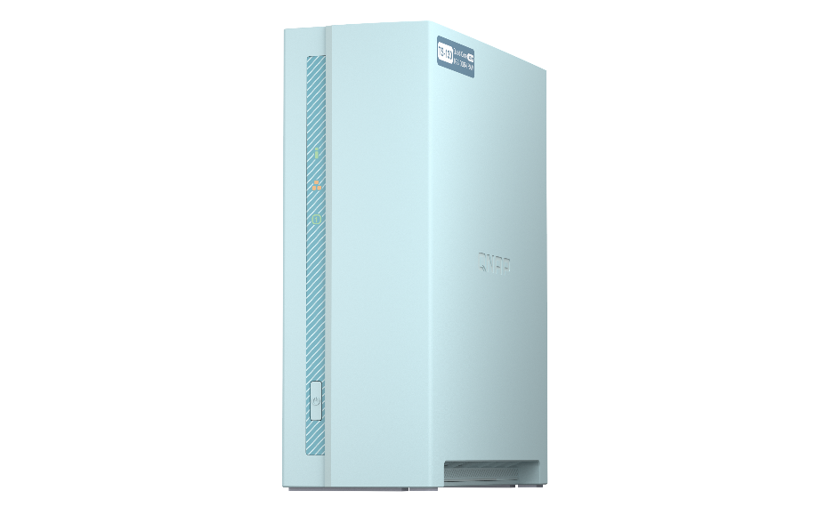
Data protection for 1-bay NAS
 | Backup file | Schedule | Destination | Purpose
HBS 3 | Shared-folders/ Files | Support | Local External drive Remote NAS Cloud stroage TR-004/002 | Backup/protect data
Snapshot | LUN/volume | Support local schedule (Manually export to external drive) | Local Remote NAS TR-004/002 | Protect your data from ransoware with export to extenal drive.
Notes:
質感

Slide 37
Multi-media

Slide 38
Set auto-upload for photos & videos on your phone
Support background upload!

Slide 39
Save your cellular data by setting up only WiFi upload
View uploading status
Stop or Pause anytime

Slide 40
Sync your phone and NAS with Qsync
Pair folder to sync
Sync photos to NAS
Auto-sync when WiFi connected or phone charging

Slide 41
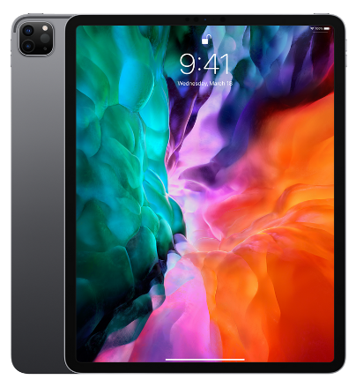
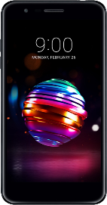
Sync up your file via Qsync
Sync to devices & Sharing to friends
One-Way sync
Upload from device: The device is the source side and always get the latest data.
Download from NAS: Announced information to all member
Two-Way sync
Standard synchronization process, both side will be the same.
Filter setting on device side
Specify the file extensions which users don`t want to sync.
Smart Delete
User could remove the local file but still keep those copies on the NAS to save the local storage space.

Slide 42
Qsync 5.0 space-saving mode
Windows
MACOS
Always available
Locally available
Online-only
Always keep on this device.
Available on this device
Free up space but keep on NAS
Changing status
https://www.qnap.com/zh-tw/how-to/tutorial/article/how-to-save-disk-space-with-qsync-space-saving-mode

Slide 43
Sort your photos in QuMagie album
Album mode
Folder mode

Slide 44
More function for QuMagie !
QuMagie mobile APP support「Auto upload」!
Backup
cross-device
Personal
album
Sharing photos
Suport iOS® Live Photo preview

Slide 45
Plex personal media center
Friendly UI
Support many devices
Access & play anytime
Support many formats
Sharing media
TS-130 does not support transcoding

Slide 46
New surveillance application - QVR Elite
Flexible subscription plan
Easily Monitor with QVR Pro Client
QVR Elite is subscription-based. You can build a robust surveillance system with a low-cost monthly price of US $1.99 per channel.
The QVR Pro Client software can be installed on Windows® and macOS®, allowing you to monitor from different platforms to take full control over monitored areas.
Includes 2 Free Channels
Records using the MP4 format
Expandable to 8 Channels for TS-130.
QVR Elite records video files in the universally-supported MP4 format, allowing for smooth playback on all your devices.

Slide 47
TS-130 fullfill all media entertainment and data protection needs for home users
Sharing your life moments
Selfie and sharing to social media
Save your memories

Slide 48
Small thing, Big surprise
Personal storage center
Copyright © 2021 QNAP Systems, Inc. All rights reserved. QNAP® and other names of QNAP Products are proprietary marks or registered trademarks of QNAP Systems, Inc. Other products and company names mentioned herein are trademarks of their respective holders.

