Slide 2
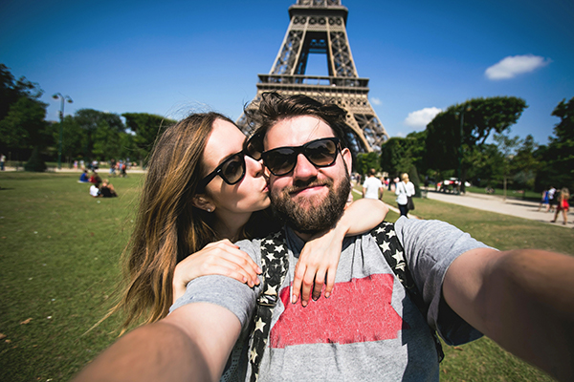
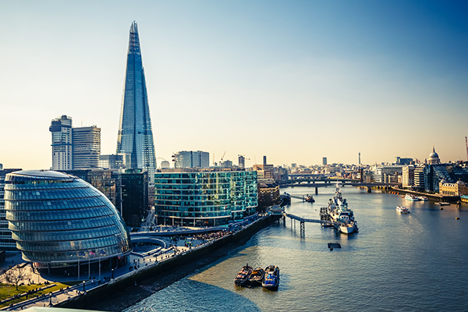
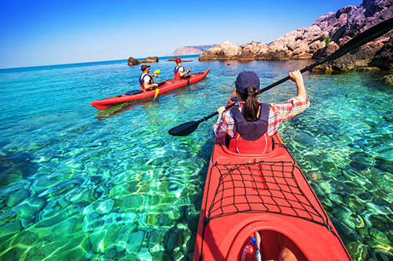
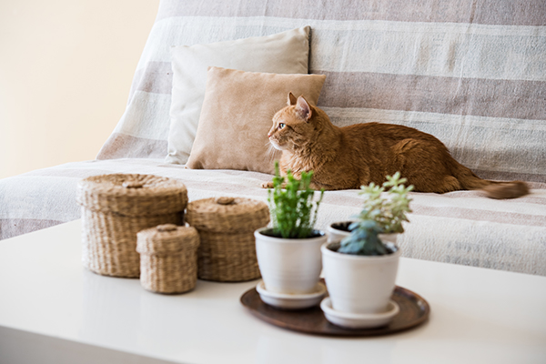
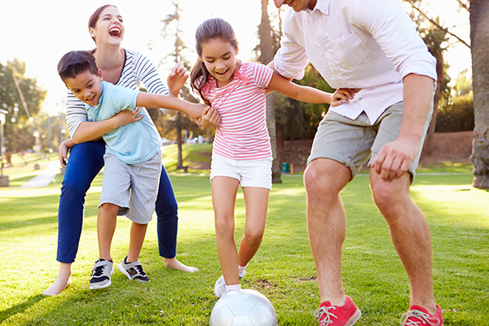
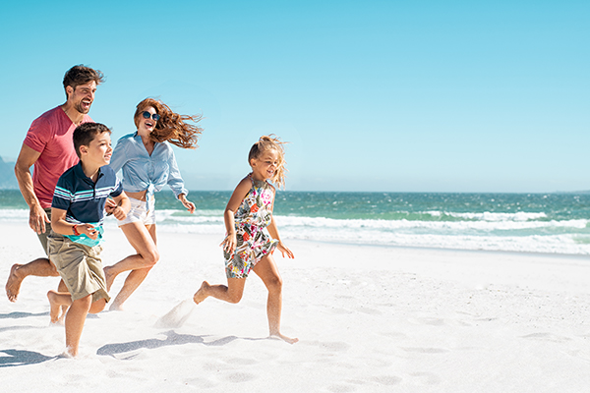
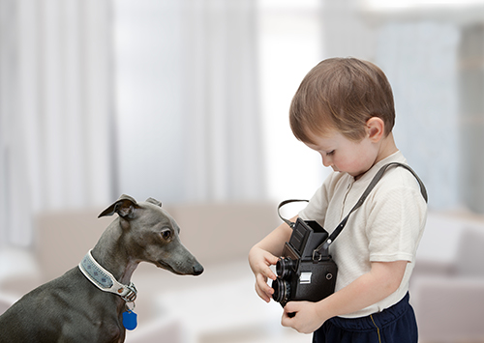
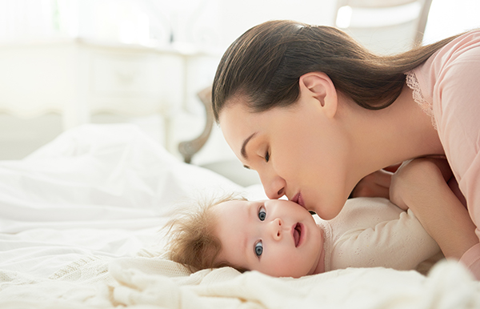
Agenda
1
Google Photos Limitation
2
QuMagie – QNAP's AI-powered Photo Management Solution
3
User Stories
4
New Features Introduction
5
Demo

Slide 3
Google Photos
Limitation

Slide 4
Google Photos Limitation
What is the Limitation?
The storage space will be restricted from unlimited high resolution photo backup to 15GB of free storage that shared across Google Photos, Google Drive, and Gmail. The policy will start from June 2021, and will have to pay monthly or annually for more storage space.
https://www.theverge.com/2020/11/11/21560810/google-photos-unlimited-cap-free-uploads-15gb-ending

Slide 5
Google Photos Limitation
Problems users will face
Excessive long-term maintenance cost
Storage space anxiety
Migrating photos to another platform

Slide 6
QNAP's AI-powered Photo Management Solution

Slide 7
QuMagie Introduction
What is QuMagie?
QuMagie is an AI-powered photo management solution with flexible storage space
QuMagie is a free application within QNAP NAS system
QNAP NAS
Mobile
Mobile
Browse, Manage Photos
Upload, Backup Photos
PC
手持裝置
手持裝置
Camera
QuMagie
Share Photos
Social Media
手持裝置
手持裝置
PC
QuMagie Core
Notes:
CHT: AI 智能相簿讓您聰明管理照片，搭配 NAS 彈性擴充儲存空間，隨拍即存不設限
ENG: The AI-powered photo management solution with flexible storage space

Slide 8
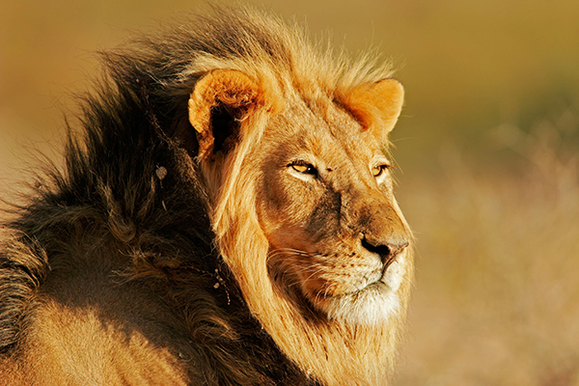
QuMagie Introduction
What is QuMagie Core?
The AI powered brain of QuMagie
Featured with face recognition and object classification
Lion
Face Recognition
Object Classification
Tree
Smart Albums
People
QuMagie Core
QuMagie
Notes:
CHT: AI 智能相簿讓您聰明管理照片，搭配 NAS 彈性擴充儲存空間，隨拍即存不設限
ENG: The AI-powered photo management solution with flexible storage space

Slide 9
QuMagie Introduction
What problems do QuMagie solve?
QuMagie not only does all the things Google Photos is doing...
Automatic face and object classification powered by AI
Access, download, upload, and share photos from anywhere with PC and mobile devices
Photo storage and management

Slide 10
QuMagie Introduction
What problems does QuMagie solve?
But QuMagie provides even more…
One-Time purchase experience
Can be deployed on-premise and on cloud (QuTScloud)
1
4
Flexible storage space utilization (different RAID configs)
2
Overall QNAP NAS ecosystem with multimedia, file management, and backup applications
5
For example, you can use QNAP Hybrid Backup Sync to backup photos from Dropbox, Google Drive to QuMagie
More powerful search, filter, and classification methods for you to find the photos
3

Slide 11
User Stories

Slide 12
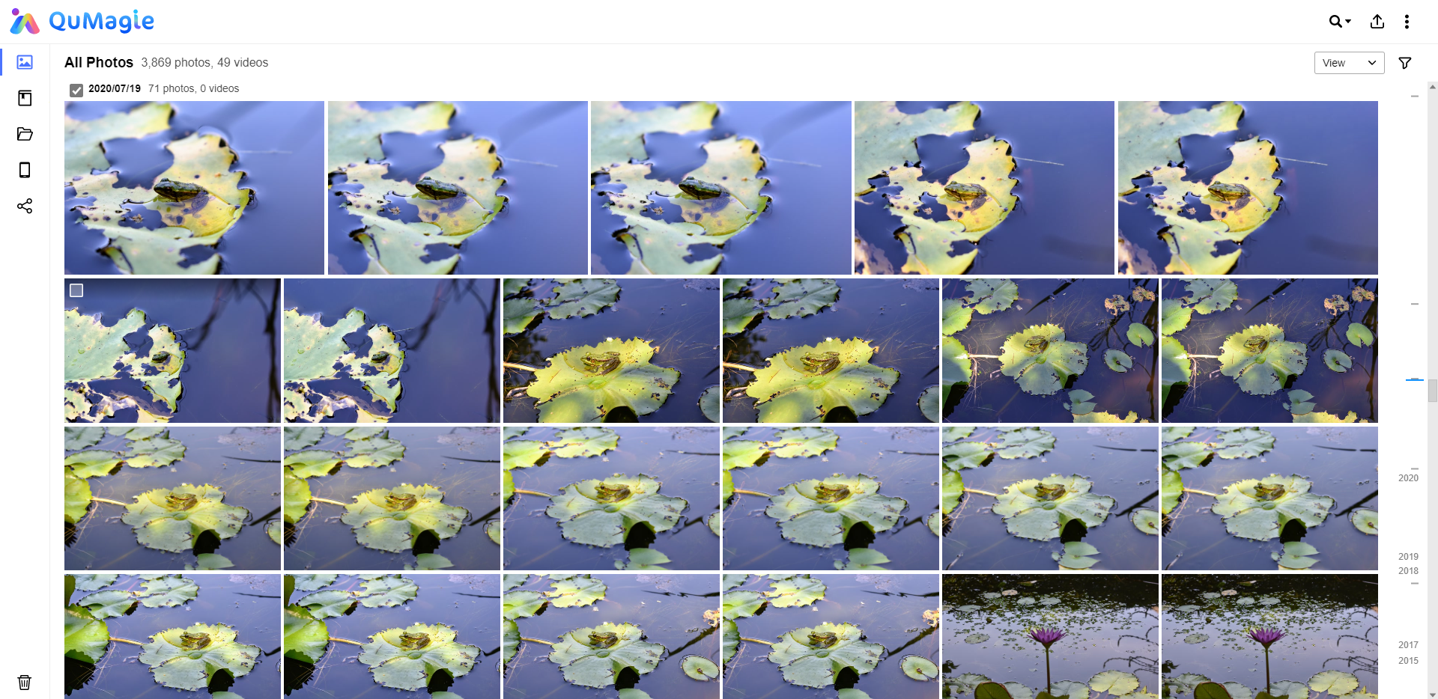
Locate Similar Photos Effortlessly
Target user
Wildlife/Nature/Landscape Photographer
Problem faced
It's hard to locate similar photos when I have a large photo database

Slide 13
Locate Similar Photos Effortlessly
1
Solution
Automatic detection of similar photos
With the function of detecting similar photos, I can view clusters of similar photos in Album Mode, and get to decide either to choose or to delete, thus saving time and space

Slide 14
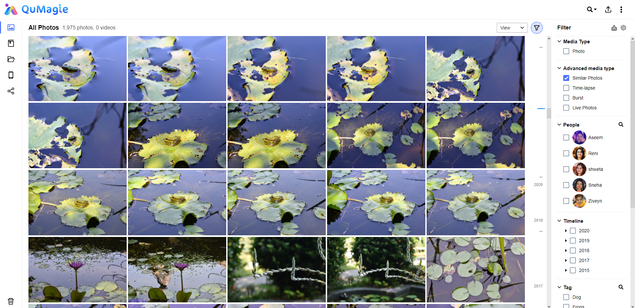
Locate Similar Photos Effortlessly
2
Solution
Filter out similar photos
I can also filter by choosing Similar Photos in Advanced Media Type in Photo Mode

Slide 15
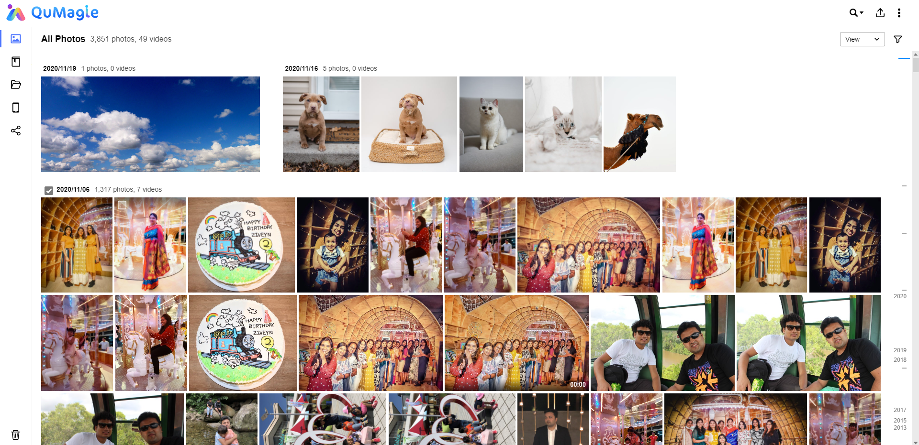
Advanced Filters For Quick Browsing
Target user
Individual user/family
Problem faced
There are too many family/personal photos accumulated over a period of time, it's hard to browse through and quickly find the photos you need

Slide 16
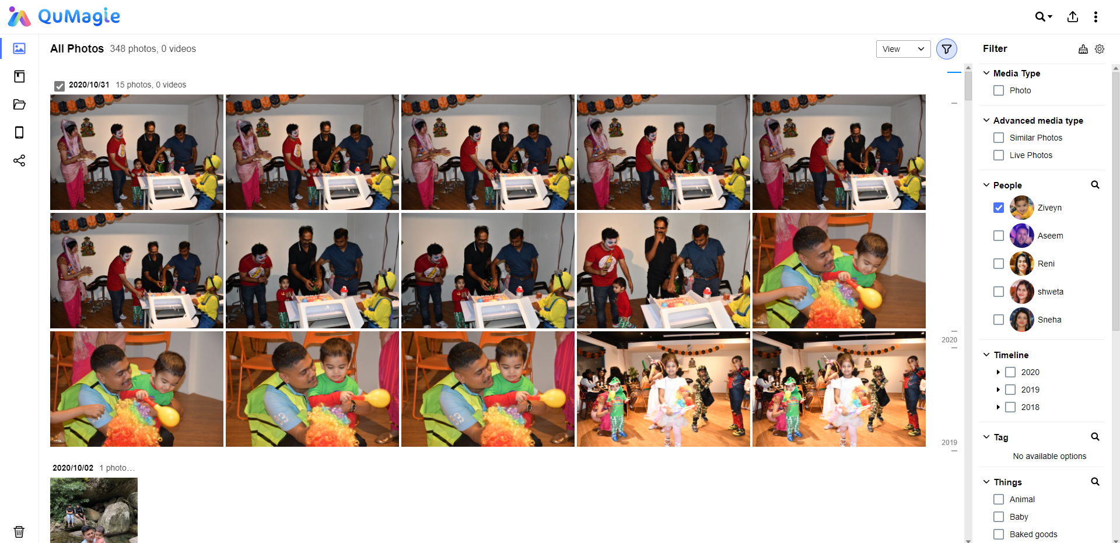
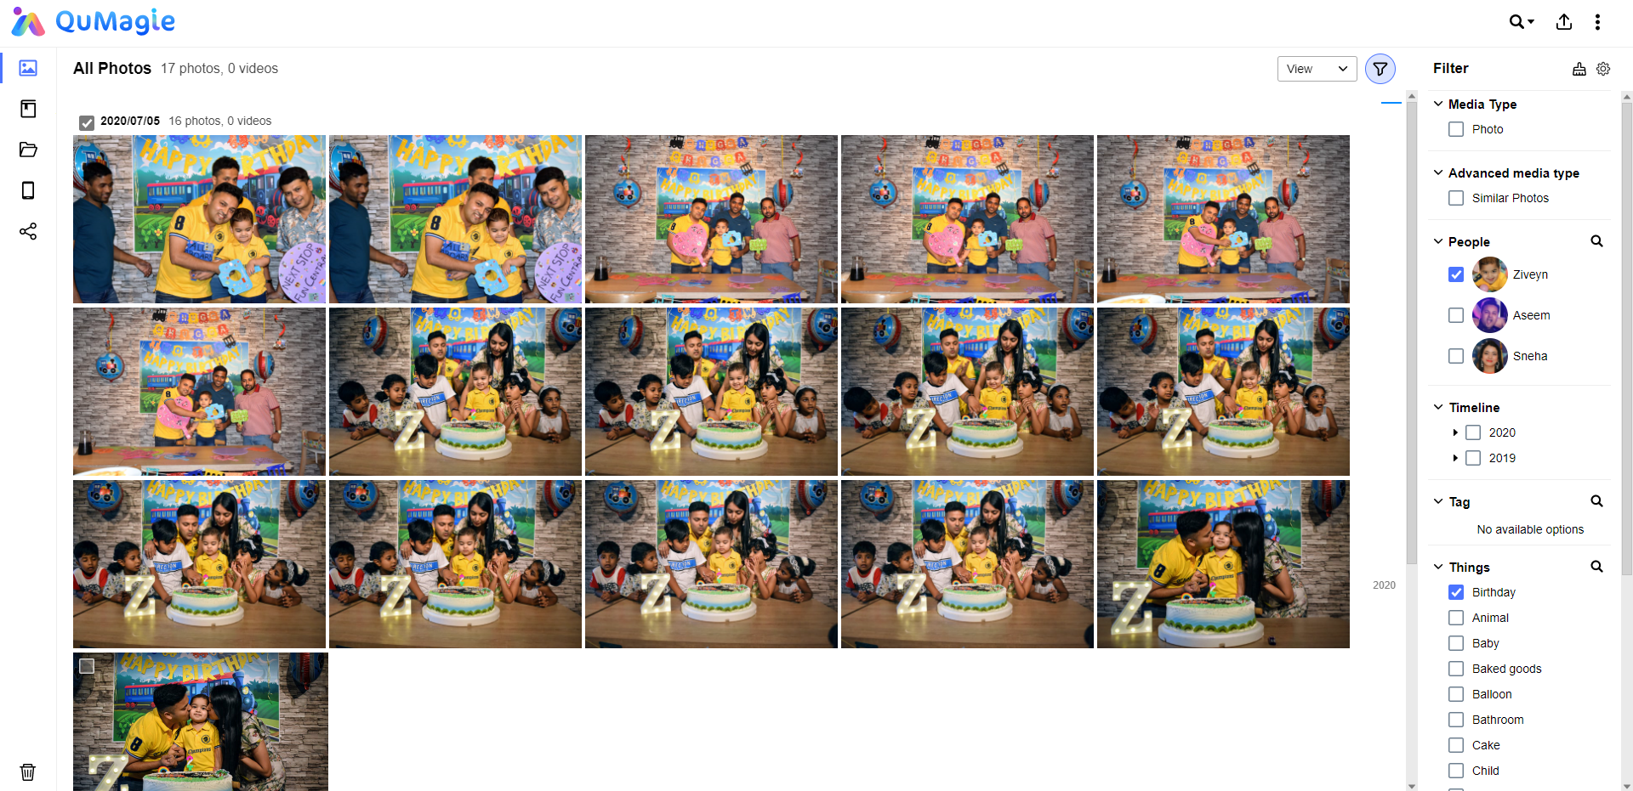
Advanced Filters For Quick Browsing
Solution
Filter them out
* Filter specific Person
* Filter specific AI categorized Things
* Filter specific Time, Media type, Tags, and Places

Slide 17
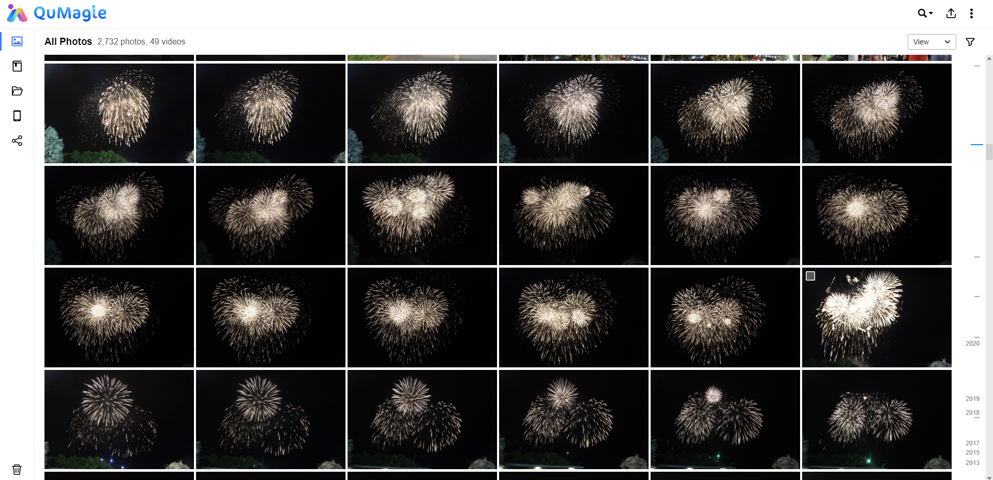
Burst & Time-Lapse Album Collection
Target user
Sports/Nature Photographers
Problem Faced
Burst photos always occupies too much visual space when browsing, must keep scrolling down to find the right photos

Slide 18
New Features to
Enhance User Experience

Slide 19
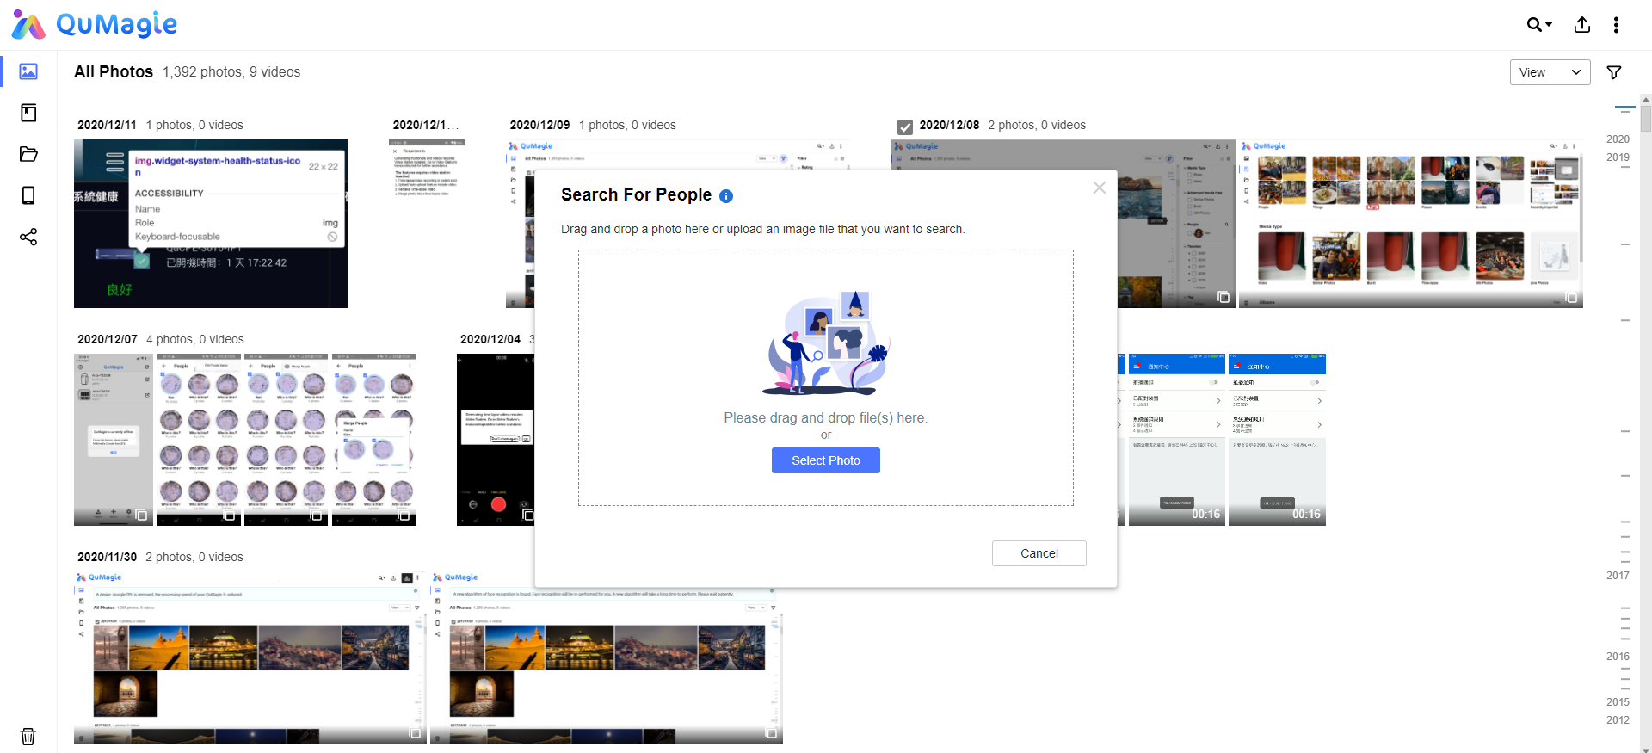
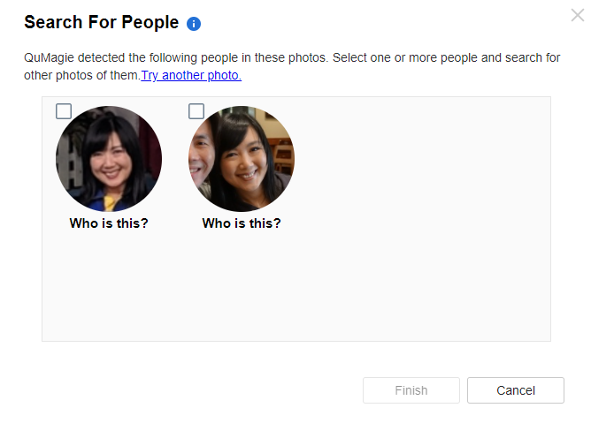
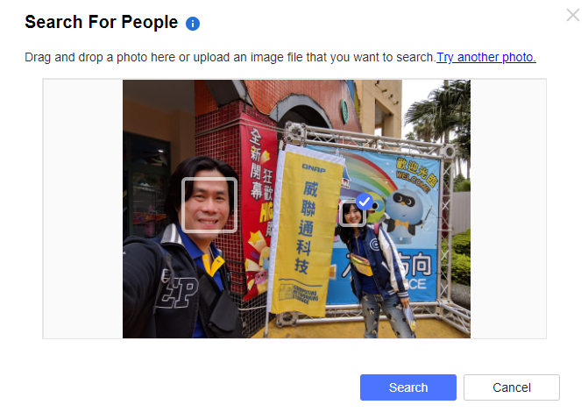
Search People With Face Search
A new way to remember
By using search for people. You only have to upload a photo of the person, QuMagie will help you find all the photos with that person

Slide 20
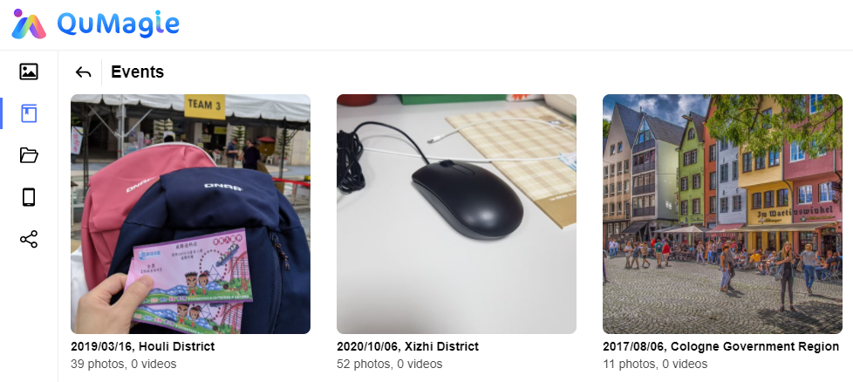
Smart Albums: Events
Automatic organization of important events
More than 10 photos taken in the specific date or location, QuMagie will automatically classify them in the Events Album

Slide 21
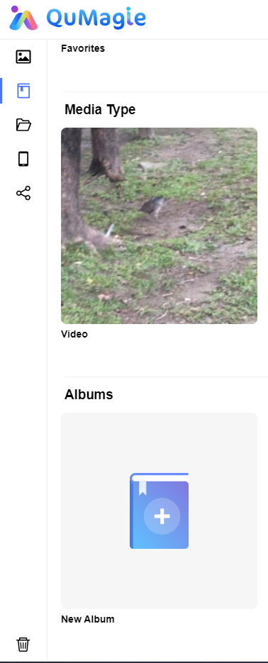
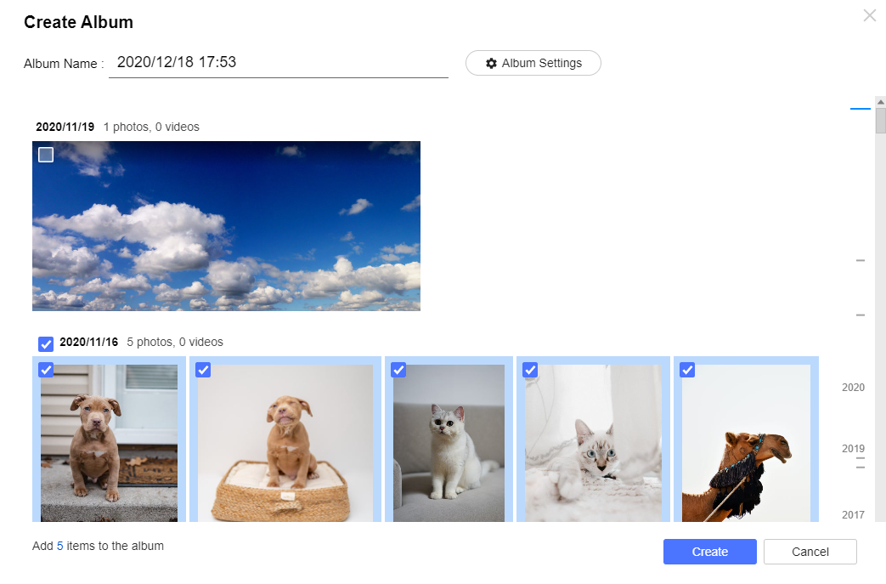
Simplified Album Creation
Create custom album with better user experience
You can create a new album in QuMaige by selecting photos and naming album first

Slide 22
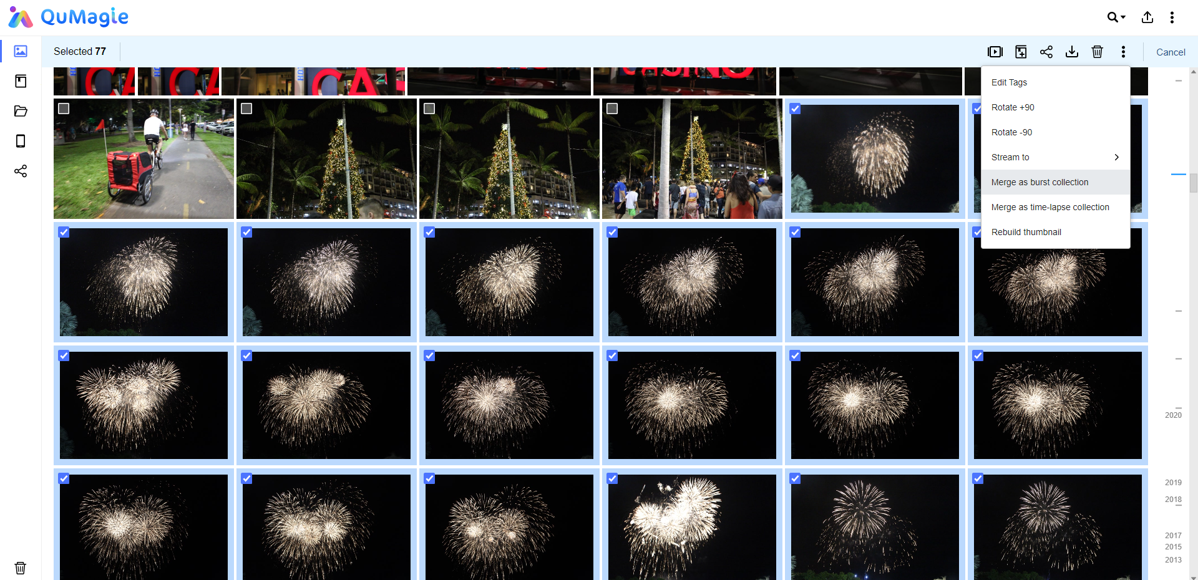
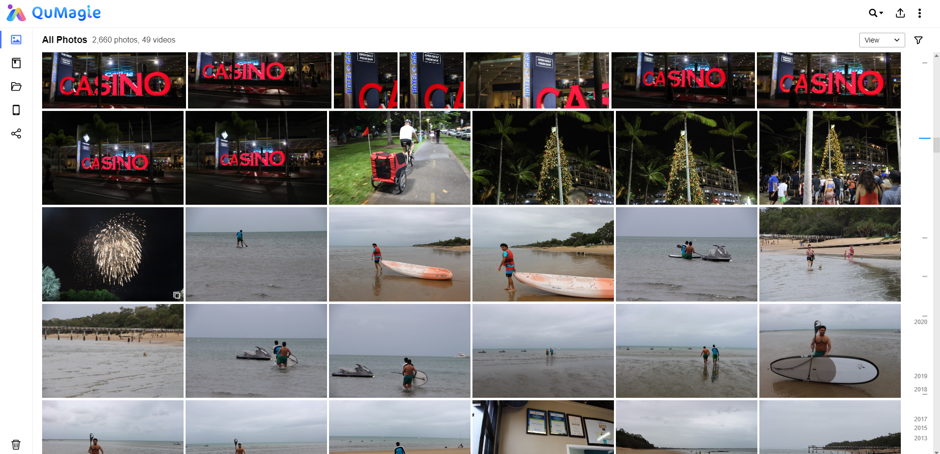
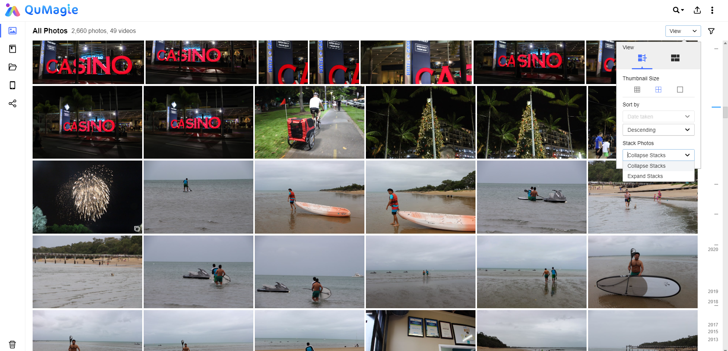
Burst & Time-Lapse Album Collection
Merge or Expand your collection
Merge similar photos as Burst Collection or Time-Lapse Collection (which will also appear in Album section)
Choose whether you want to collapse or expand

Slide 23
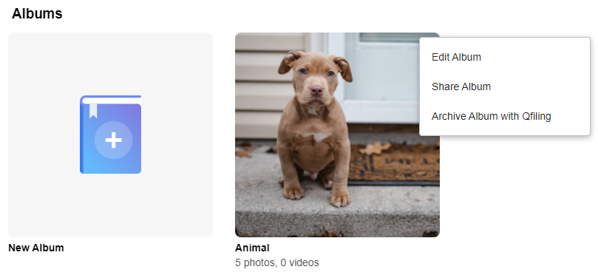
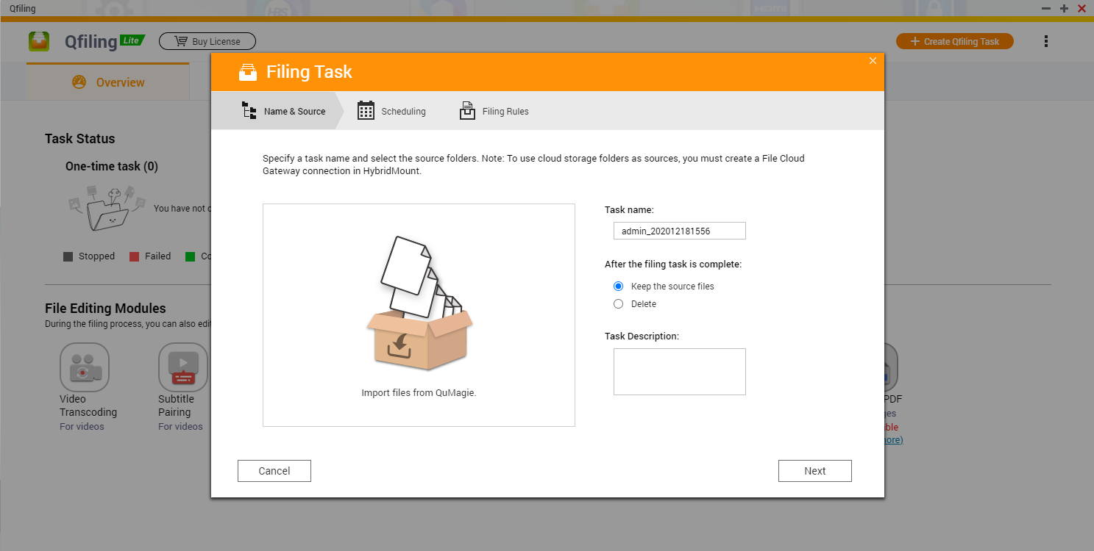
Archive Album Using Qfiling
Integration with Qfiling
You can directly archive QuMagie albums using Qfiling to save time

Slide 24
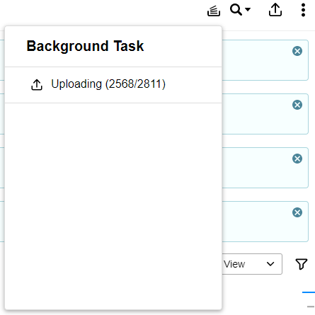
Background Task Notification
Anxiety-free background task notifier
No matter uploading or downloading files, you can always check on your background task notifier to see what's the current status

Slide 25
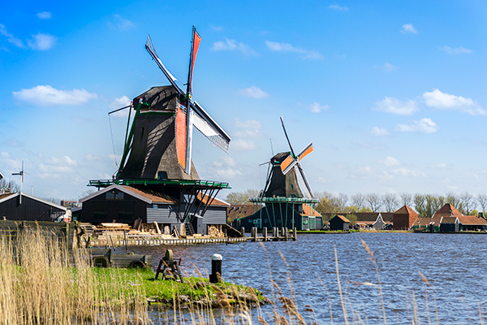
QuMagie Live

Slide 26
Copyright © 2021 QNAP Systems, Inc. All rights reserved. QNAP® and other names of QNAP Products are proprietary marks or registered trademarks of QNAP Systems, Inc. Other products and company names mentioned herein are trademarks of their respective holders.

