Slide 1
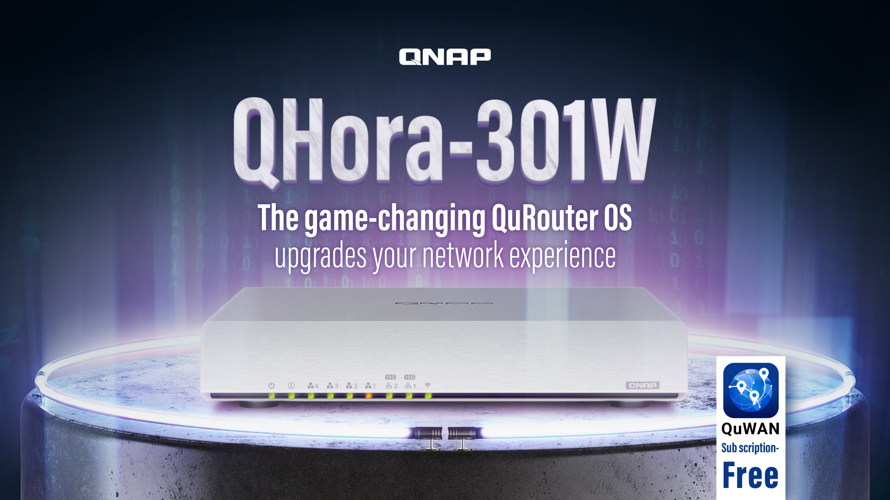

Slide 2
Agenda
The market exclusive functions cause a sensation
The new features of QuRouter OS
QHora-301W is your first step toward next generation networking
Dual 10GbE ports meets all your application scenarios
Enable subscription-free QNAP SD-WAN on QHora-301W

Slide 3

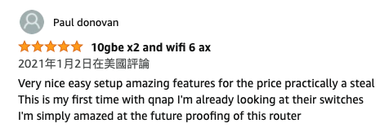

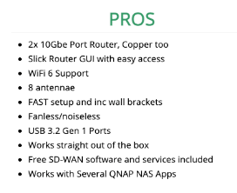

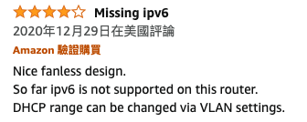
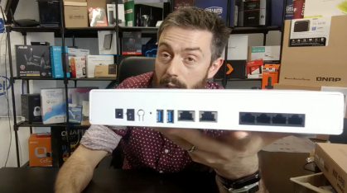


The market exclusive functions cause a sensation

Slide 4
The market exclusive functions
8 internal antennas for Wi-Fi 6 (802.11ax)
Dual-port 10GbE high speed routing
QNAP SD-WAN QuWAN
User friendly QuRouter OS

Slide 5
QuRouter OS
Upgrades your network experience

Slide 6


Enable 160MHz to boost wireless speed
QHora-301W supports 2x2 160MHz channels and provides up to 2.4Gbps theoretical wireless speed.
Stop buffering and start enjoying uninterrupted streaming media.
Say goodbye to character freezing & enjoy lagfree gaming.
＊＊The 160MHz channels can be enabled in areas governed by CE, IC, NCC, TELEC, OFCA safety regulations

Slide 7
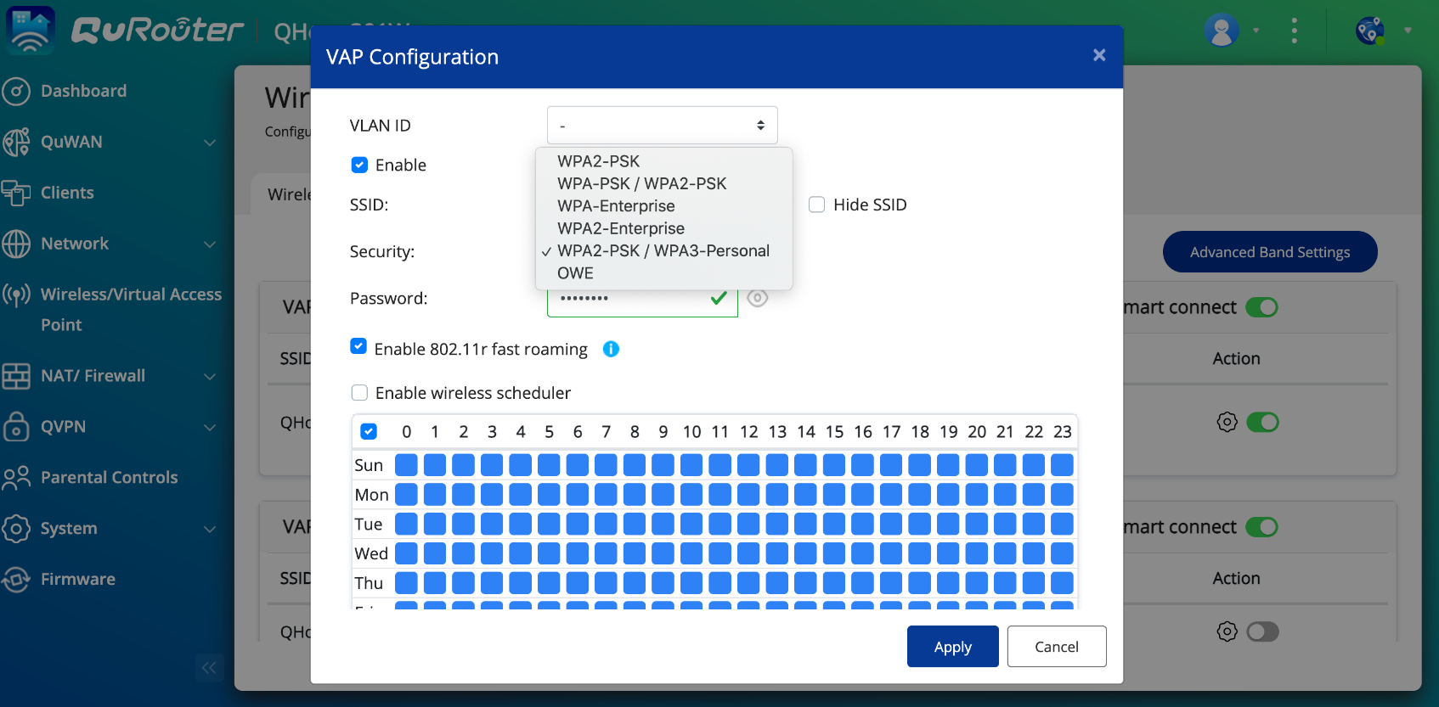





Select WPA3 or OWE to better protect your data transmission between devices and QHora-301W
Internet
QHora-301W
Server
PC

Slide 8
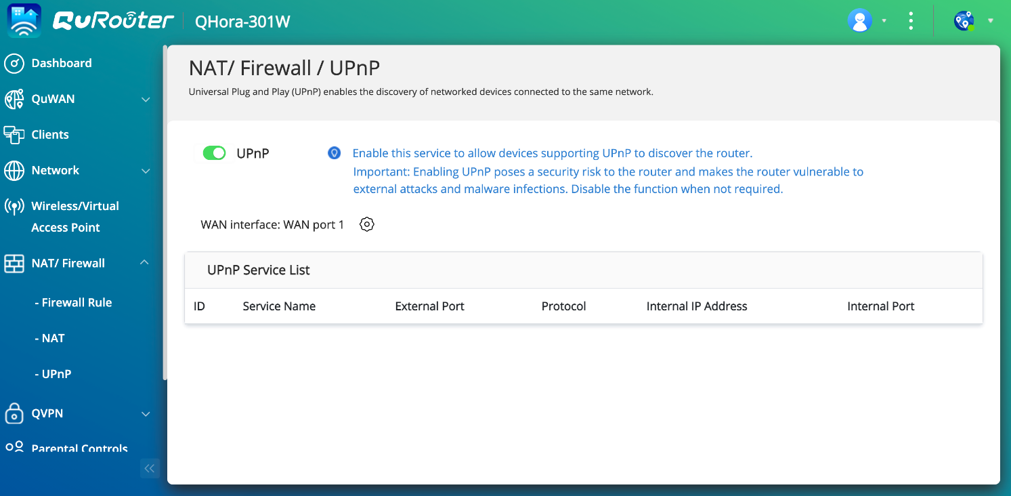
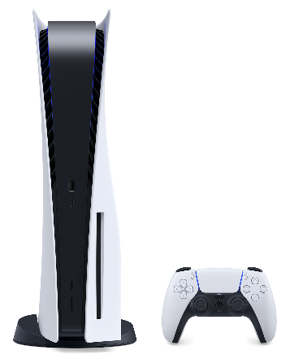


Enable UPnP to connect various services in one-click
Services under NAT , such as video entertainment, game consoles, and smart devices can automatically communicate with firewall through the UPnP protocol to establish port forwarding function. Users don't need to set the device one by one, it can connect to Internet automatically.
UPnP page provides a list of UPnP services, allowing you to fully manage the status of port opening。
UPnP function can be turned off when cybersecurity request of the network environemnt is high.
Internet
UPnP
QHora-301W
Notes:
讓各網絡裝置不經人手設定，就能自動互相連接及溝通。通用隨插即用(UPnP)功能支援多種類別裝置，包括網絡印表機、互聯網閘道及消費者電子裝置等。
家庭自動化、列印、圖片處理、音訊 / 視訊娛樂、廚房裝置、汽車網路和公共集會場所的類似網路。它可以充分發揮 TCP/IP 和網路技術的功能，不但能對類似網路進行無縫連線，而且還能夠控制網路裝置及在它們之間傳輸資訊。在 UPnP 架構中沒有裝置驅動程式，取而代之的是普通協議。
問：什麼是 UPnP？
答：通用即插即用 (UPnP) 是一種用於 PC 機和智慧裝置（或儀器）的常見對等網路連線的體系結構，尤其是在家庭中。UPnP 以 Internet 標準和技術（例如 TCP/IP、HTTP 和 XML）為基礎，使這樣的裝置彼此可自動連線和協同工作，從而使網路（尤其是家庭網路）對更多的人成為可能。
通用隨插即用（英語：Universal Plug and Play，簡稱UPnP）是由「通用隨插即用論壇」（UPnP™ Forum）推廣的一套網路協定。該協定的目標是使家庭網路（資料共享、通信和娛樂）和公司網路中的各種裝置能夠相互無縫連接，並簡化相關網路的實現。UPnP通過定義和發布基於開放、網際網路通訊網協定標準的UPnP裝置控制協定來實現這一目標。
UPnP這個概念是從隨插即用（Plug-and-play）衍生而來的，隨插即用是一種熱拔插技術。

Slide 9
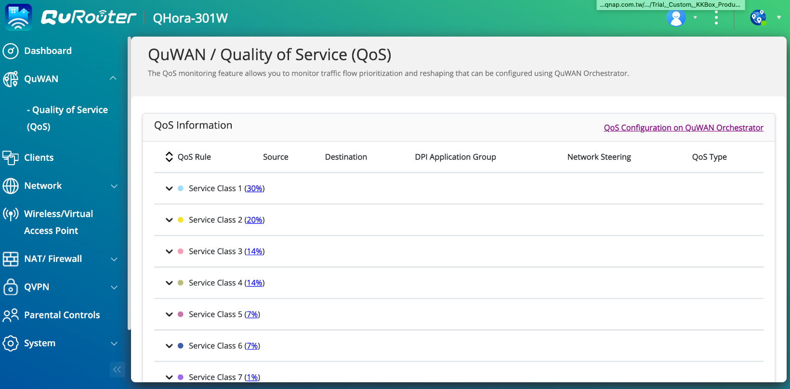


QHora-301W QoS reserves bandwidth for important applications
No interription during streaming or data backup even when bandwidth usage is full.
Application service level can be set on QuWAN Orchestrator.
QHora-301W has built-in DPI engine to automatically detect and distinguish applications, and reserve bandwidth for important applications.
QoS
50% VoIP
30% ERP
20% File transfer

Slide 10





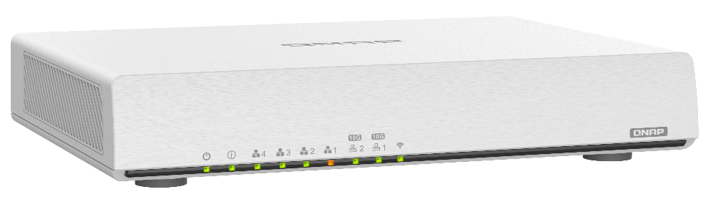
Watch region limited Netflix by enabling QVPN Client to connect to Cloud VPN Service
Connect QHora-301W to Cloud VPN service, such as ExpressVPN, CyberVPN or NordVPN by setting the OpenVPN protocol to direct network to a cross-region VPN Server, allowing you to easily watch region limited video streaming or news.
Setting VPN service on QHora-301W can eliminate the need of setting VPN for each home device.
OpenVPN
Cloud VPN Server
QHora-301W
** QVPN Client and QuWAN service cannot be enabled at the same time

Slide 11
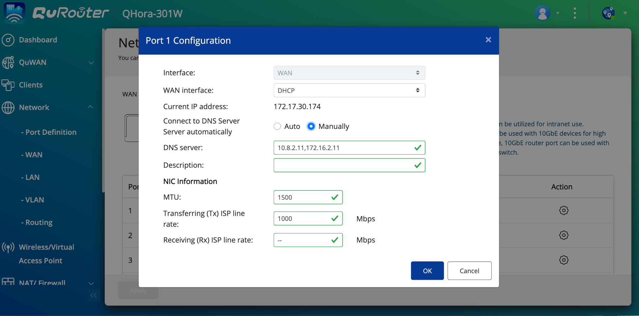
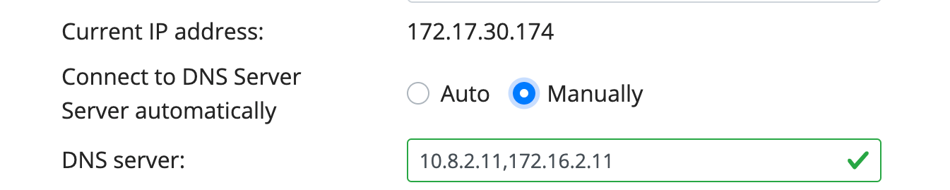
Set DNS on WAN
Manually configure DNS services to meet your special needs
Make the Internet environment faster and more customized
Notes:
最主要的原因，就是這些代管服務可以設定的紀錄筆數通常不多，如果要增加的話，通常必須額外付費，甚至根本就無法增加！對於有需要設置大量 subdomain 或 MX Record 的人來說，自己架設 DNS Server 是比較省事的方法，尤其如果自己擁有一台有一定穩定度的實體主機，在系統可以負荷的前提下，多架這個服務也是無傷大雅。

Slide 12
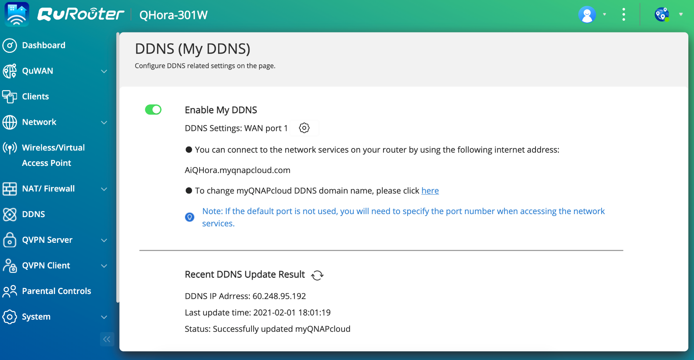
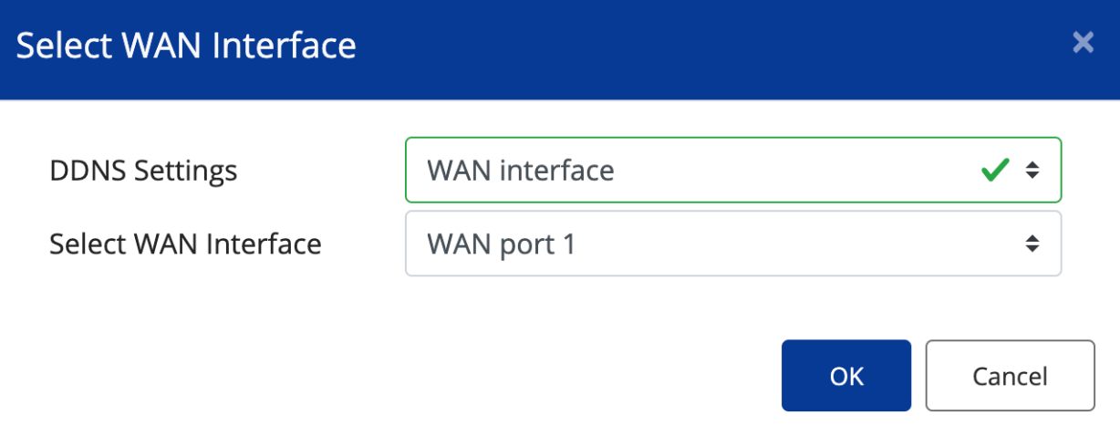
Specify the connection path of myQNAPcloud DDNS
You can choose static IP or specify WAN port for myQNAPcloud DDNS connection

Slide 13



Functions Coming soon...
VLAN setting on WAN and IPTV service
To better fulfill various services provided by regional ISP
IPv6 Support
IPv6 is extensively used in some areas such as Japan and China.
Classic Site to Site VPN settings
Allow QHora-301W to establish VPN connections with other routers or cloud service providers​

Slide 14
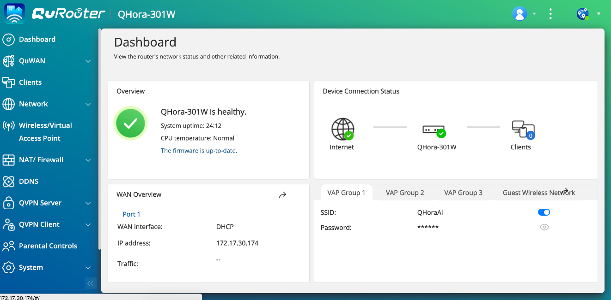
QuRouter OS fulfills all you need for SMB and home office networking
Spec | Status | Opetation Mode | Access Control | Security | QVPN | Advanced network setting | System setting | QuWAN SD-WAN
QHora-301W | Device status Wired network status Wireless status | Router Mode Access Point Mode | Parental controls: domain name filtering | Layer 3 firewall NAT UPnP | Can become VPN server or client Support remote access by using QBelt, L2TP and OpenVPN Client management Event log | WAN selection WAN/LAN port definition Tx/Rx status VLAN setting IPv4 static routing MyDDNS for myQNAPcloud | Restart, reset, nackup, audio alert setting Local account and QID management USB Setting：FTP server | Org, region, site and connection role selectio Max tunnel scale 30 QuWAN QoS

Slide 15

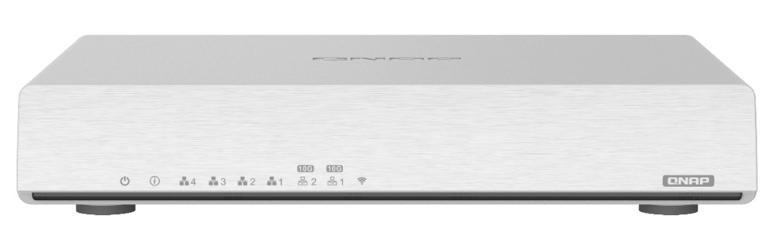
QuRouter OS Wireless Setting
Spec | Wi-Fi AP (Wi-Fi 6) | Wireless Network Management
QHora-301W | Dual-Band 5G (2475Mbps): 4x4 (80MHz), 2x2 (160MHz) 2.4G (1182Mbps): 4x4 (40MHz) | Supports IEEE 802.11ax (Wi-Fi 6) • Supports MU-MIMO • Supports band steering for dual-band (2.4GHz and 5GHz) access points • Transmission power (high, middle, and low) • 20/40/80/160 MHz bandwidth • Dynamic Frequency Selection (DFS) channels (Auto, custom) • RTS/CTS (Request to Send/Clear to Send) function • Dual-band 2.4G and 5G settings • Guest wireless • IEEE 802.3Q Virtual LAN (Supports wired and wireless connections) • Smart connect • SSID and password configuration • Wireless Protected Access (WPA2-PSK, WPA-PSK + WPA2-PSK, WPA-Enterprise, WPA2-Enterprise, WPA3, OWE) • Supports IEEE 802.11r fast roaming • Wireless scheduling • Wireless (Protected Setup (WPS) • Wireless client connection status and block lists

Slide 16



QuRouter Architecture
Orchestrator
QRouter OS
VAP (Multiple SSID)
802.1Q VLAN
Static Routing
Protocol Base Firewall
FTP Server
QuWAN SD-WAN
Wi-Fi 6
L2 Networking
L3 Networking
OFDMA
MU-MIMO
NAT offload
Crypto Engine
USB Mgmt
Linux kernel
QCN5054
AQR 113C
IPQ8072A
2.4G/5G Wi-Fi 6 AX3600
Dual 10GbE Ethernet Ports
9.4Gbps Forwarding Rate
Ipsec VPN HW Acceleration

Slide 17





Enterprise-grade Feature: Virtual Access Point
QHora-301W supports VAP (Virtual AP) function, allowing for running up to 6 virtual APs. Each VAP has its own SSID & access right profiles and customized routes/policy to WAN Internet.
By connecting to a wireless SSID, different group of users (or device clients) will be bridged to a different VLAN, such as office-intranet, home & guest network. Different VLAN group can have different network policy rule and can be seperated by using firewall.
VAP Set 1 (Smart Conenct)
SSID: Family (2.4G & 5G)
VLAN 10
VLAN 20
VAP Set 2
SSID: Work_1F (2.4G)
SSID: Work_2F (5G)
QHora-301W
VLAN 30
VAP Set 3
SSID: School (2.4G)
SSID: School (5G)

Slide 18
Demo
QuRouter OS

Slide 19
QHora-301W
QHora-301W is your first step toward next generation networking

Slide 20




New-gen Router Requires WiFi 6
High-speed connectivity
With the revolutionary combination of OFDMA, MU-MIMO and BSS Coloring technologies​
WiFi 6 technology provides higher network capacity and reduces latency in traffic-intensive environments​
Wi-Fi 6
1200 Mb/s
Wi-Fi 5
867 Mb/s
160MHz channels comparison
WiFi 6 is the next-gen WiFi standard
In 2020, more and more client devices began to support WiFi 6, including computers, mobile phones and tablets.

Slide 21
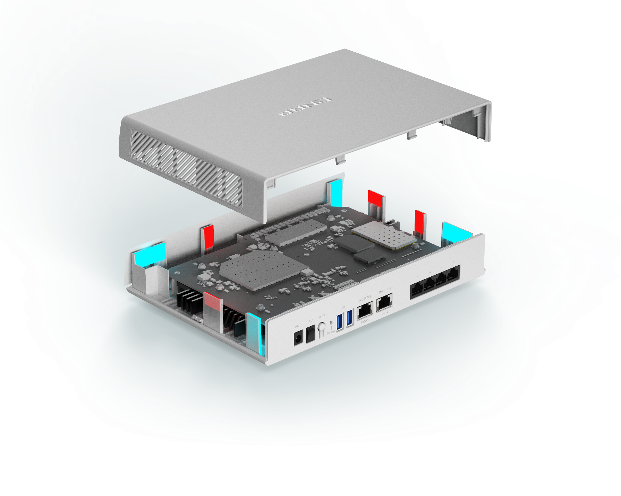
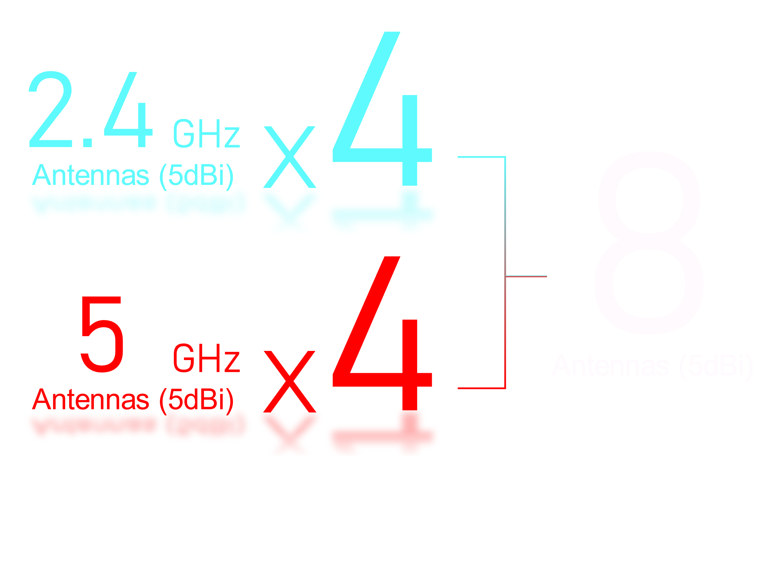
Eight Internal Antennas
Advantages
Not only Wi-Fi 5 has a built-in antenna, QHora-301W provides a built-in antenna for Wi-Fi 6​
It is easy to place and is in line with family design style​
Provide stable performance, users do not need to adjust the antenna angle by themselves​
High-power amplifiers & antennas help extend WiFi coverage throughout large homes & even backyards

Slide 22

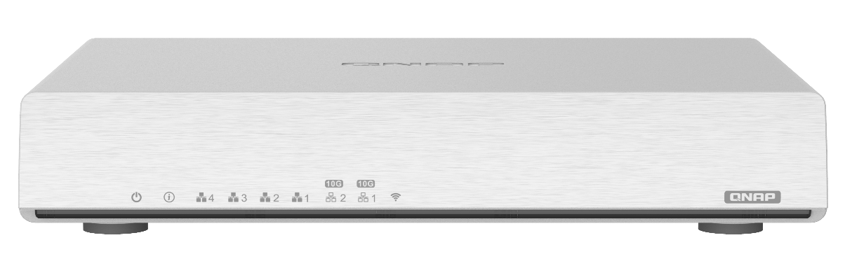



High-performance Wireless Network
WiFi 6 – Huge Gains in Multi-user Access Efficiency
An essential tool for IoT smart home
AX3600 Theoretical throughput
5G (2475Mbps): 4x4 (80MHz), 2x2 (160MHz)
2.4G (1182Mbps): 4x4 (40MHz)
The highest supported bandwidth is 160MHz (channels are opened to areas that governed by CE, IC, NCC, TELEC and OFCA safety regulations)​
2.4GHz
5GHz
20 MHz
40 MHz
80 MHz
160 MHz
Notes:
改 3600

Slide 23
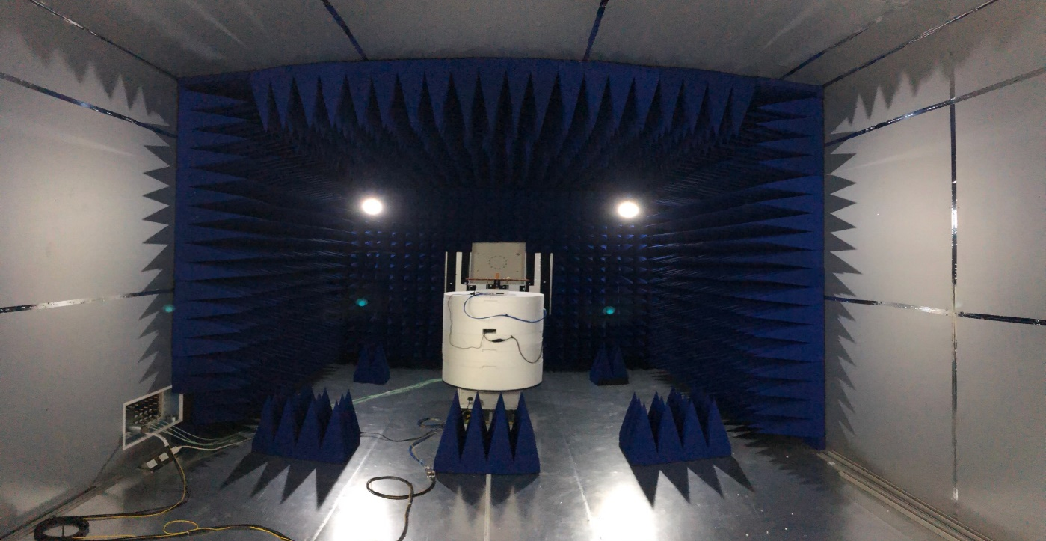
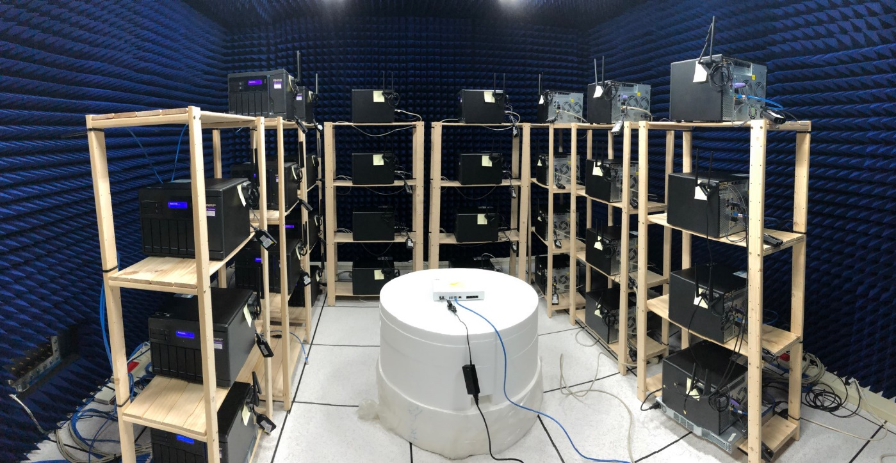
High-performance is tuned by High Standard Lab
Point to point test
Multiple client test

Slide 24

QHora-301W Wireless Performance
802.11ax / 5G
160MHz
80MHz
Tx
Rx
Tx
Rx
1700
(Mbps)
1600
(Mbps)
900
(Mbps)
850
(Mbps)
1800
1000
1700
900
1600
800
1500
700
2x2 Throughput
(Mbps)
2x2 Throughput
(Mbps)

Slide 25

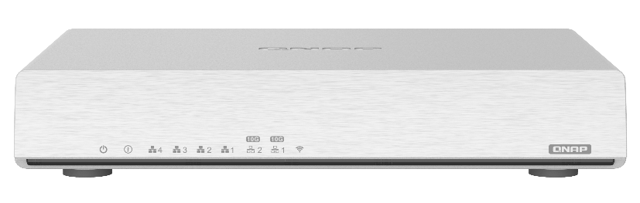
New-gen Router Requires Dual 10GbE Port
QHora-301W provides 10GbE port
Provide up to 9.6 Gbps NAT routing
Support high-speed internal and external network transmission
Meet the needs of remote backup of large business files
ＷＡＮ
QHora-301W
ＬＡＮ

Slide 26


New-gen Router needs to provide
SD-WAN service
Built-in SD-WAN solution (QuWAN), supporting full Mesh VPN for easy multi-site VPN deployment.
Subscription-Free
Flexible Deployment
Center Management
No need to purchase other devices for multi-site VPN
Auto VPN tunneling
Support network optimization to ensure connection quality
QuWAN Orchestrator
Notes:
對比傳統 vpn 所需要的東西

Slide 27
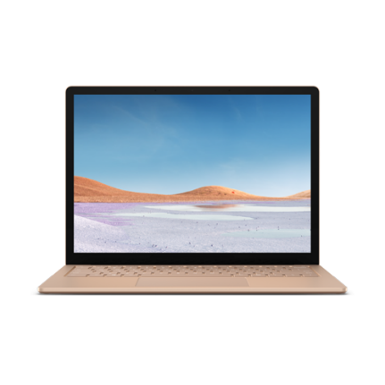






QuWAN is a complete SD-WAN solution
QNAP QuWAN is a complete SD-WAN solution that provides enterprise IT managers with a simple, fast, secure and efficient network connection structure. You can easily and quickly build a multi-site VPN network and centrally manage it from a cloud platform.
Auto VPN Network
QHora-301W
QVPN
QHora-301W
QVPN

Slide 28

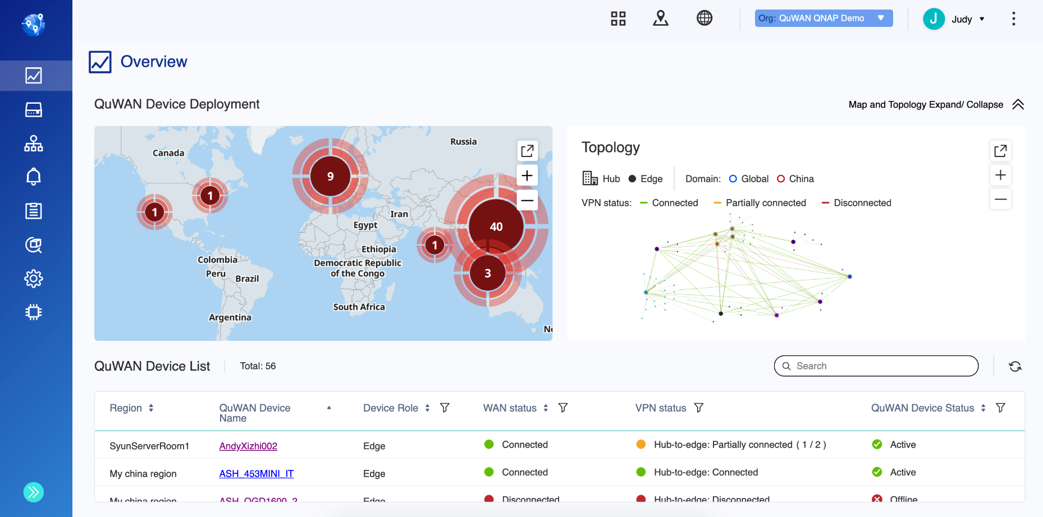
A centrally managed platform solves the management issues of multiple devices
01
Intuitive graphical user interface
Instant Notification
02
Geological location of each device
03
Overview connection status of all devices
04
Simultaneously execute various parameter settings

Slide 29

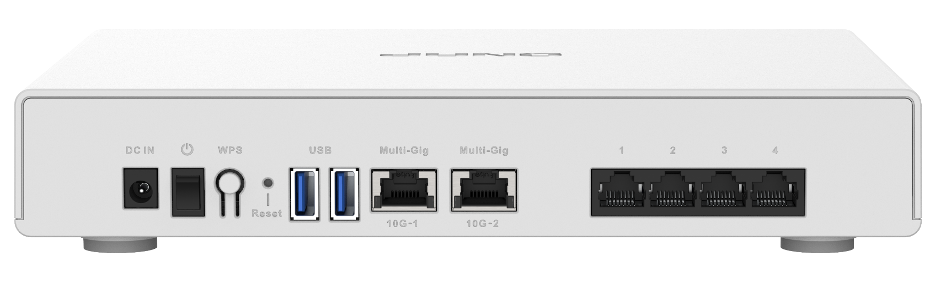
Hardware Appearance
10GbE Connectivity
8 x 5dBi
Internal Antennas
1GbE Connectivity
Status
Power
WiFi Enabled
Power Switch
Configurable Ports for WAN
12V DC Input
4 x 1 GbE Ports (1000/100/10Mbps)
WPS
Reset Button
2 x 10 GbE Ports
(10G/5G/2.5G/1G/100M)
2 x USB 3.2 Gen 1

Slide 30




Powerful Performance
Powered by Hawkeye v2 IPQ8072A quad-core 2.2GHz 64-bit processor ​
Can quickly handle 10G throughput network transmission
1GB system memory. QHora-301W can reliably support more concurrent users
4GB eMMC Flash Storage
Provide multiple functions on Qhora-301W. ex, QVPN, SD-WAN
RAM
1GB
2.2GHz
64-bit
Quad-core
Notes:
Qualcomm cpu page

Slide 31
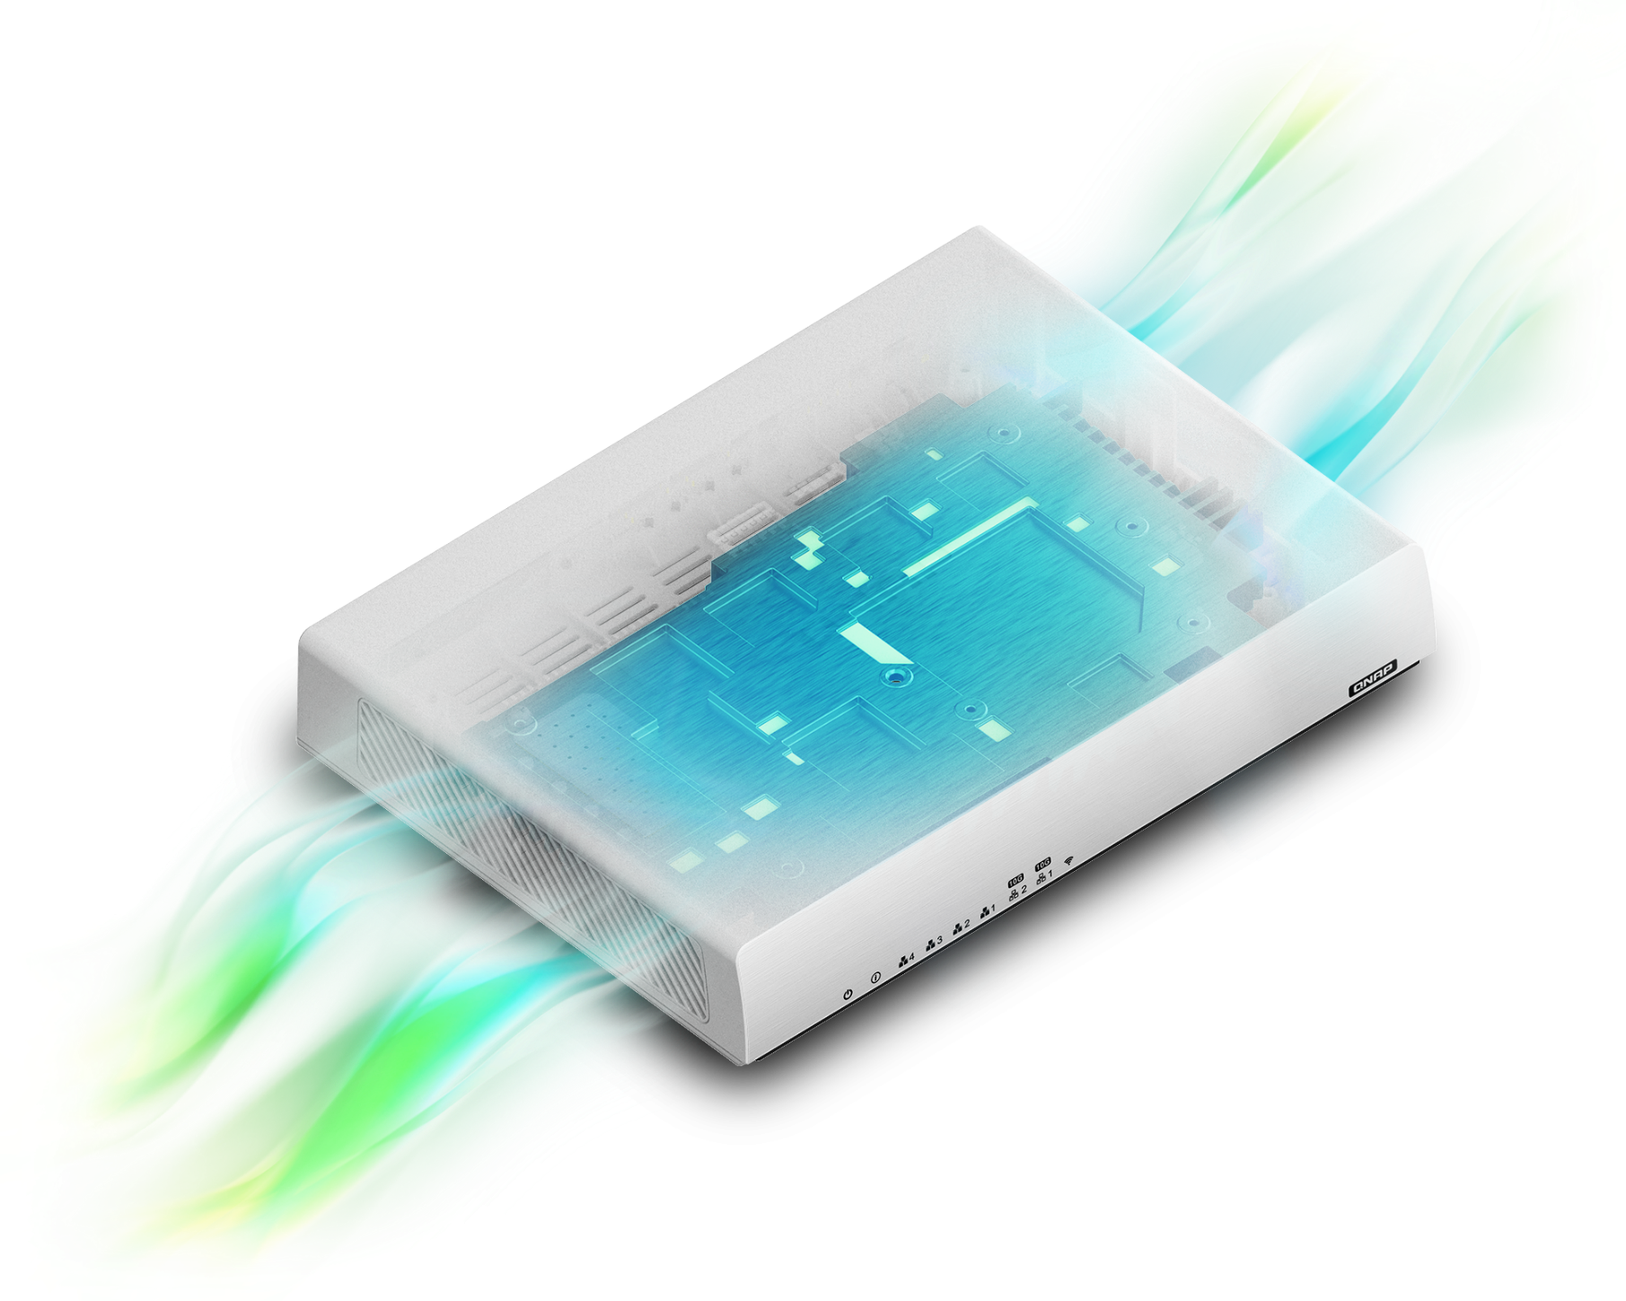
Fanless Design:
Silent Operation x Maintain Performance
Fanless with unique ventilated construction allows QHora-301W to maintain its throughput efficiency within 0-40°C operating temperature.
Quiet operation makes QHora-301W
the perfect home routing solution for worldwide use.

Slide 32
Hardware Spec
Function | QHora-301W
Network Interface (RJ45) | 4 x RJ-45 1GbE (WAN/LAN configurable) 2 x RJ-45 10GbE (10G/5G/2.5G/1G/100Mbps, WAN/LAN configurable)
Antenna | 8 Internal 5dBi Antennas
Processor | Qualcomm IPQ8072A Hawkeye 2 Quad-core 2.2 GHz 64-bit CPU
Memory | 1GB RAM
Flash Storage | 4GB eMMC
Wireless | Dual-band AX3600 5G (2475Mbps): 4x4 (80MHz), 2x2 (160MHz) 2.4G (1182Mbps): 4x4 (40MHz) WPS button
Mounting Support | VESA 75 x 75 mm (Optional third-party mounting kits are available for wall-mount, table mount and pole mount).
Fanless Design | Maintain consistent system performance within 0-40C operating temperature
SD-WAN Max VPN Tunneling | 30

Slide 33
Dual 10GbE ports meets all your application scenarios

Slide 34


Scenario 1:
2 x 10GbE LAN Connections
One of 1GbE WAN and Two of 10GbE LAN
Build a high-speed 10GbE Intranet network by connecting 2 x 10GbE ports to 10GbE devices in LAN environment.
Benefits: accelerate file access and sharing within LAN.
Wi-Fi 6
10G LAN
10G LAN
Multiple devices
1G WAN

Slide 35

Scenario 2:
1 x 10GbE WAN & 1 x 10GbE LAN Connections
High-speed inter-office VPN network with 10GbE Internet and 10GbE Intranet connectivity.
Benefits: streamlined cross-site file backup, synchronization and sharing.
10G LAN
10G LAN
NY
10G WAN
10G WAN
Taipei

Slide 36

Scenario 3:
Multi-WAN with SD-WAN & 2 x 10GbE LAN Connections
Two of 1GbE WAN
WAN optimization with WAN aggregation, WAN failover & load balancing, and flexible static routing to increase data transfer efficiency across WANs
Auto mesh VPN for easy multi-site VPN network deployment
Benefits: Secure cross-site VPN network with optimized WAN connections
10G LAN
Wi-Fi 6
10G LAN
Multiple devices
雙1G WAN

Slide 37

QHora-301W
Subscription-Free
SD-WAN QuWAN

Slide 38


Efficiently build multi-site VPN
Material creation site
Secure business data
As long as QHora-301W is connected to QuWAN Orchestrator, a private network can be established in the same organization
Germany
Data sharing
Japan
Development site
Editing site

Slide 39
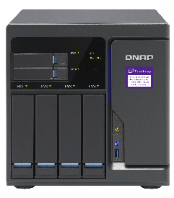

Flexible VPN Topology: Mesh VPN
Mesh VPN topology is suitable for a network architecture that requires fast and multiple route network.
It is recommended to use Public IP for being a Hub.
If you use Private IP to set for Hub, please make sure that the UDP Port 7788, 4500, 500, 5555 of the upper router is opened. (** Function will be released in QuWAN Orchestrator 2.1 or later version)
Hub can automatically form Mesh VPN with all other Hubs in the same domain.
Mesh
Branch
HQ
QHora-301W
Branch
Home Office

Slide 40
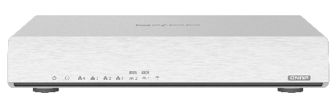

Flexible VPN Topology: Hub & Spoke
Hub & Spoke topology is suitable for a network architecture that requires fast deployment, extension and backup route.
All data transmission between edges will go through a hub
If your device uses private IP, it can connect to network topology as Edge
QHora-301W
QHora-301W
Edge
Hub
Edge

Slide 41



QuWAN Network Topology
Inter-Domain Link
To comply to China network regulation, user needs to apply for Inter-Domain Link by his or herself for the two domain to have VPN connection.
Inter-domain Link can only be set on hub.
**Inter-domain link will be supported in 2021 Q3
Organization
Global Domain
China Domain
USA
Japan
Beijin
Chongqing
Site
Site
Site
MPLS
Site
Site
Site
Edge
Hub
Hub
Hub
Hub
Edge
Site
Mesh
Mesh
Site
Site
Site
Site
Site
Edge
Hub
Hub
Hub
Hub
Edge
Hub & Spoke
Hub & Spoke
Notes:
Inter domain link 拉開明顯一點

Slide 42
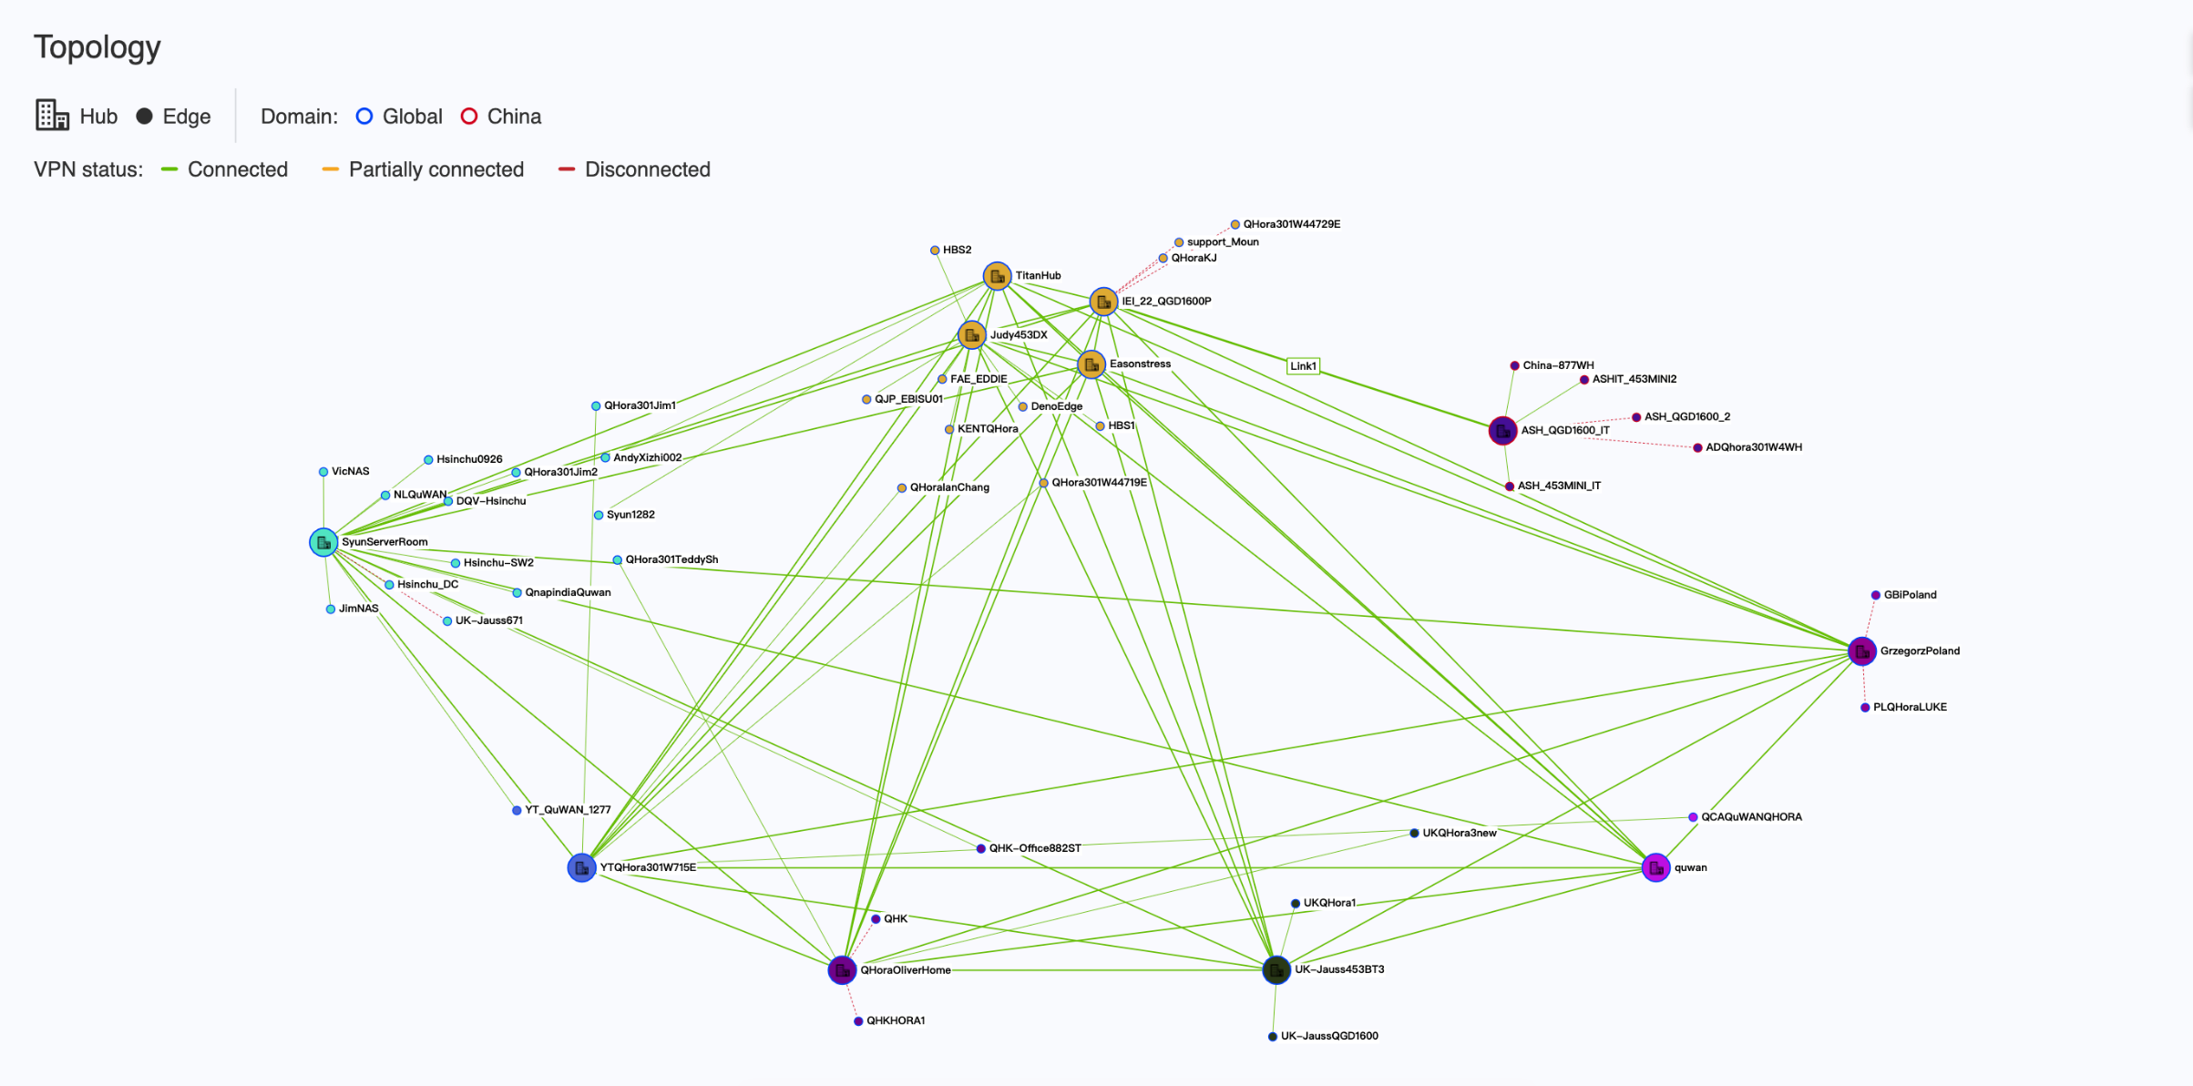
QuWAN Topology

Slide 43
QuWAN’s Features and Benefits
Auto Mesh VPN
WAN Optimization
Cloud Management
Cost Optimization
Intuitive Web Management
Networking Security

Slide 44
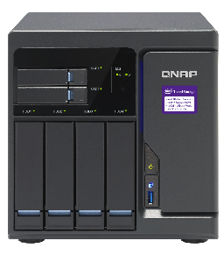


WAN aggregation to improve data transmission rate
WAN aggregation is effective in achieving a faster data transmission for remote backup and remotely mounted file system
10 G
ISP WAN 2
10 G
WAN Aggregation
QＨora-301W
QＨora-301W
ISP WAN 1

Slide 45



WAN Failover
Multi-site connection can form a backup system automatically that allow uninterrupted collaborative operations.
The central management platform sends warnings and notifications in real time
ISP WAN 2
10 G
10 G
Qhora-301W
Qhora-301W
ISP WAN 1

Slide 46
WAN Load Balancing
Using Multipath TCP (MPTCP) technology to automatically detect current network jitter, delay, and packet loss conditions, so that each packet takes the best network path to the destination, so as to achieve intelligent routing and uninterrupted connection for transmission
Maintain long-term and efficient transmission by distributing traffic through multiple WANs
Good Network Status！
ISP WAN 1
10 G
ISP WAN 2
ISP WAN 2
QHora-301W
High latency, jitter and packet loss！

Slide 47
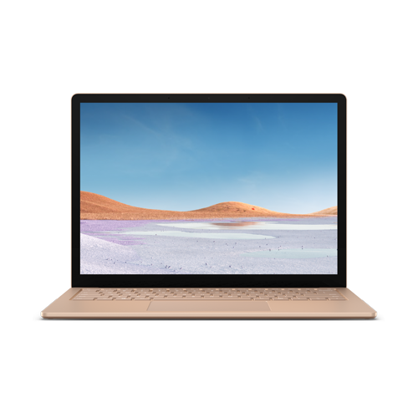

Connect Multiple Devices to SD-WAN Network with QVPN
QVPN is QNAP's VPN solution with a pair of server and client. Multiple devices such as PC, mobile phone and tablet can join and access to SD-WAN network for a more secure and reliable data transmission.
QVPN
QHora-301W
QVPN Client
QVPN
QHora-301W
QHora-301W
QVPN
QVPN Client
QVPN Client
** QVPN Server and client cannot be enabled at the same time.
** QuWAN service and L2TP on QVPN server cannot be enabled at the same time.

Slide 48
Enable QuWAN to manage QHora-301W through the cloud platform
QuWAN Orchestrator
Go to quwan.qnap.com and log in with QID to view the QHora-301W device, network and VPN connection status, organization-wise topology, connection method. You can also perform remote debugging through the cloud platform
Orchestrator
QHora-301W
QHora-301W
QHora-301W

Slide 49
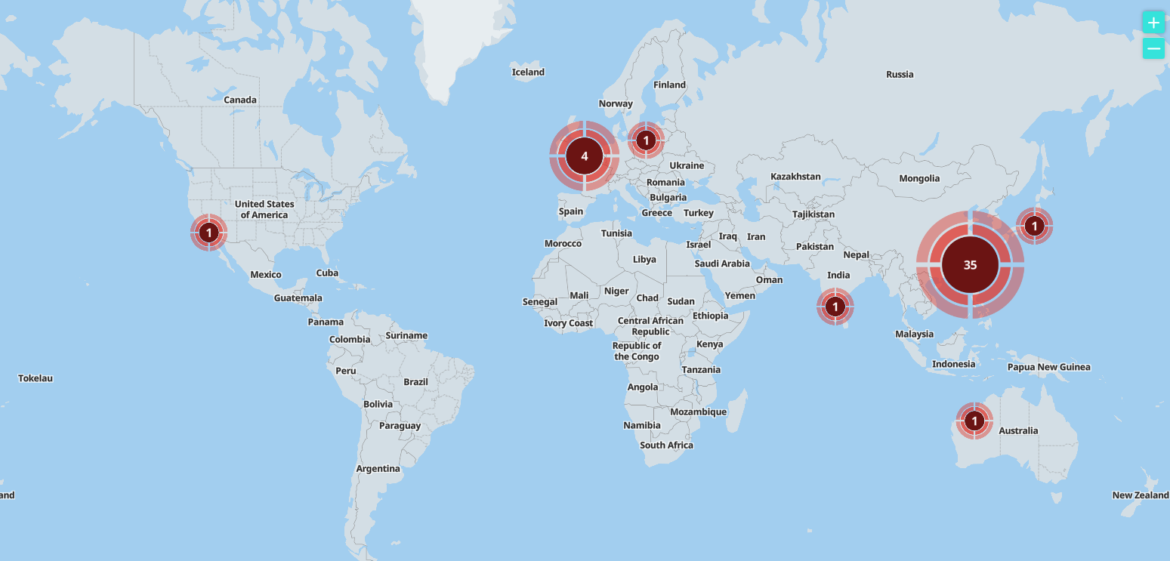
Geological location of each device

Slide 50
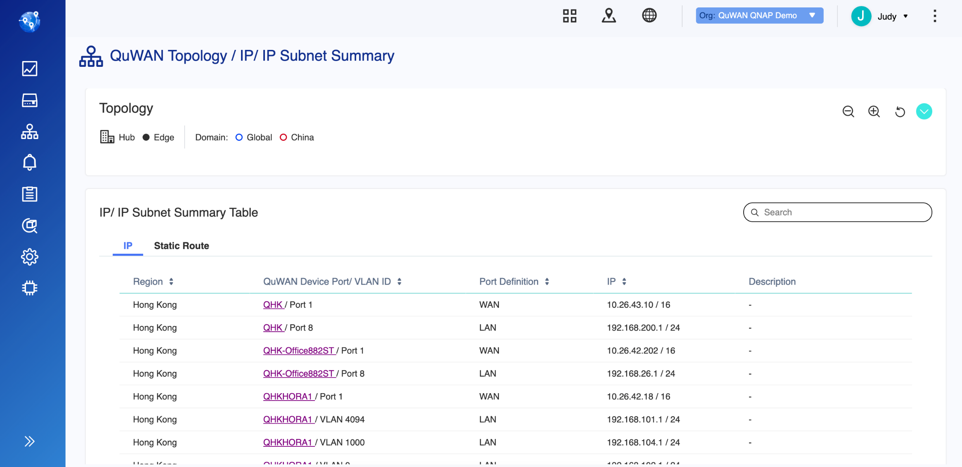
Device and Network Status

Slide 51
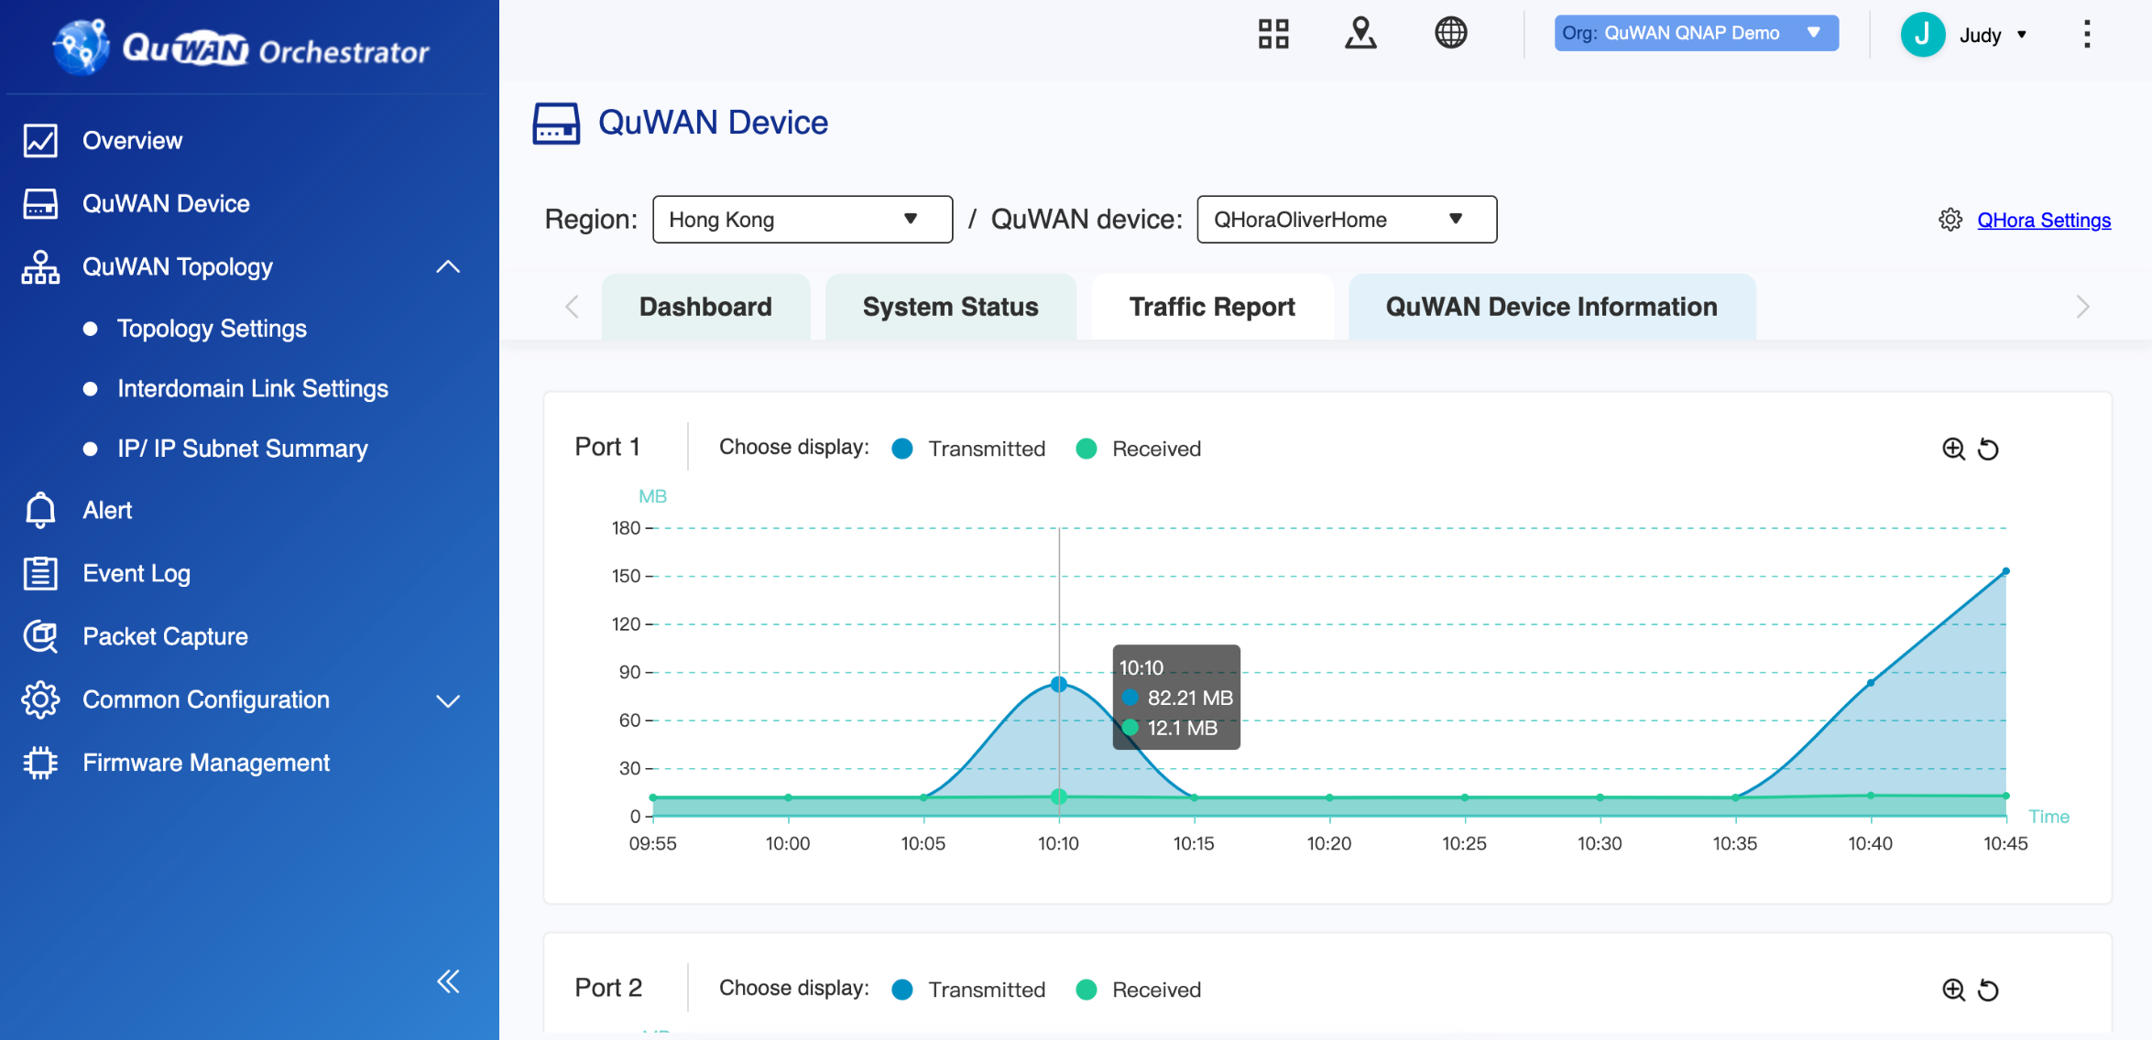
QHora-301W Traffic Report

Slide 52
Organizational IP Segment Allocation

Slide 53
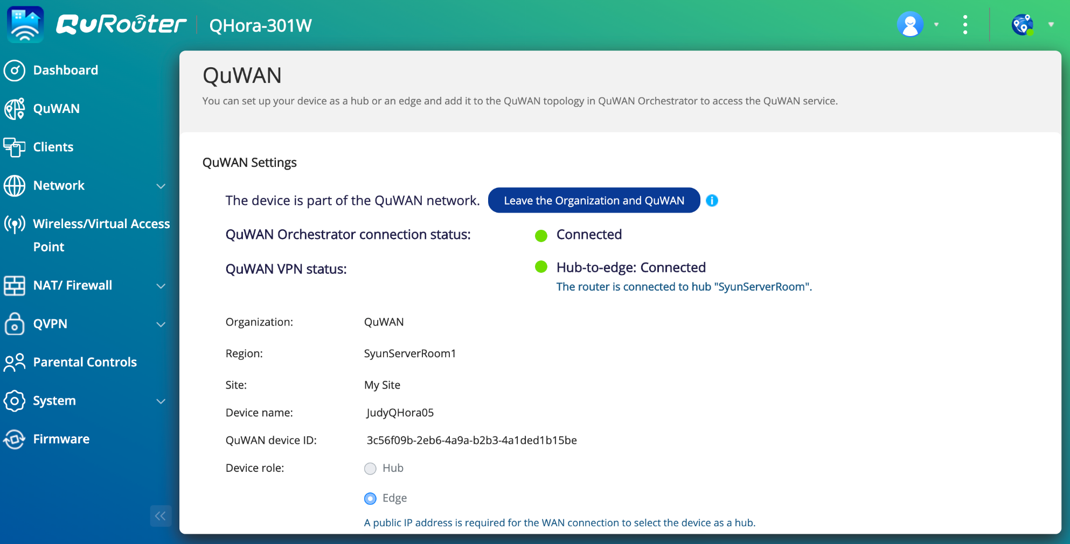
Enable QuWAN on QHora-301W
Just select the organization, region and connection role, and your QHora-301W can build VPN tunnel with other QuWAN devices within the same organization

