Slide 1
Notes:
Layer 2 Managed Switch supports 2.5GbE/10GbE, easy setup with different form factor design.

Slide 2
What problem SMB meet when deploying high speed network?
QSW-M2108R-2C

Slide 3
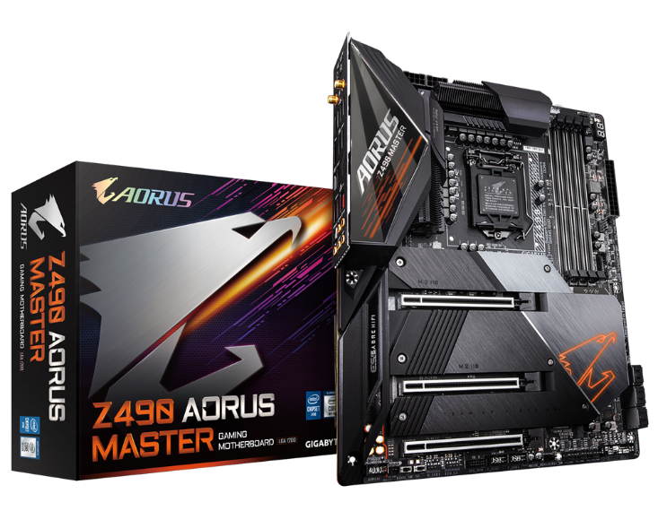
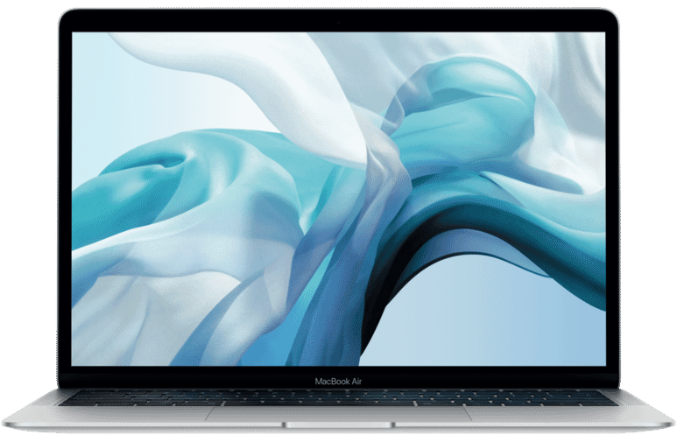
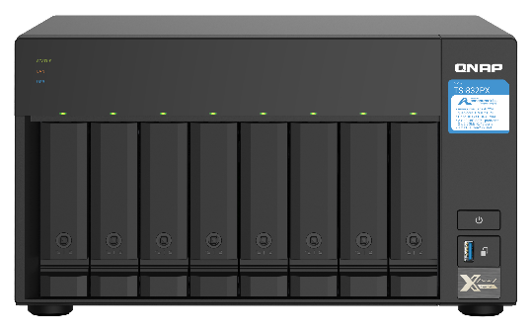
Slow network speed hinder efficiency of office work
Main board, laptop and NAS support 2.5/10GbE
Keep you stay with high speed network without latency
Gigabyte Z490 AORUS MASTER
Apple MacBook
QNAP TS-832PX

Slide 4
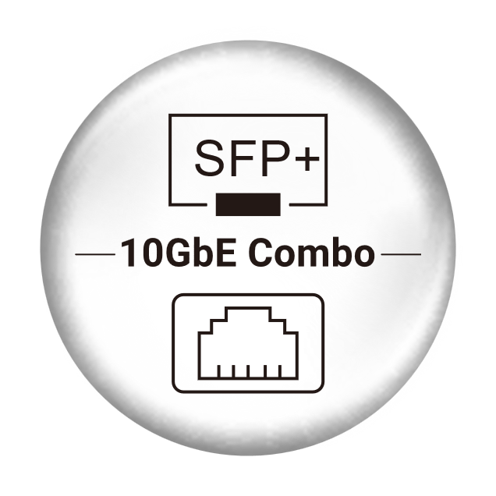
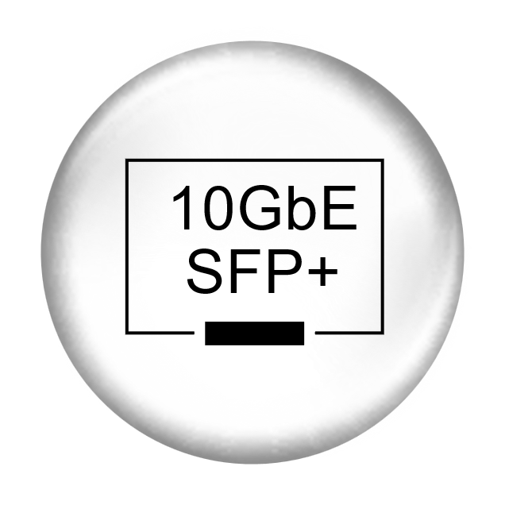
Full 2.5GbE managed switch can handle it

Slide 5
Other problems of network infrastructure for small businesses
Slow LAN speed
Limited budget
No dedicated IT Engineer
It is particularly a headache on sharing large files or making system backup.
SMB want to upgrade their network infrastructure but there is no suitable product at affordable price for them to choose.
The IT helper might have limited time and professional background to configure a managed Ethernet switch properly.

Slide 6
What SMB need?
Upgrade speed
Simple to setup
Affordable price
Must-have management
Multiple port speed
QSW-M2108-2S
QSW-M2108-2C
QSW-M2108R-2C

Slide 7
The solution to the problems from QNAP
QSW-M2108R-2C

Slide 8
QSW-M2108 Series：Base on the true demends
Core network can upgrade to 10GbE
Pragmatic port configuration，10GbE for the most needed connections ，2.5GbE for usual usage.
Time consumption of transferring 50GB Blu-ray Disc
1GbE
8'20"
100 MB/s
10GbE
50"
1000 MB/s
QSW-M2108-2S
QSW-M2108-2C
QSW-M2108R-2C

Slide 9
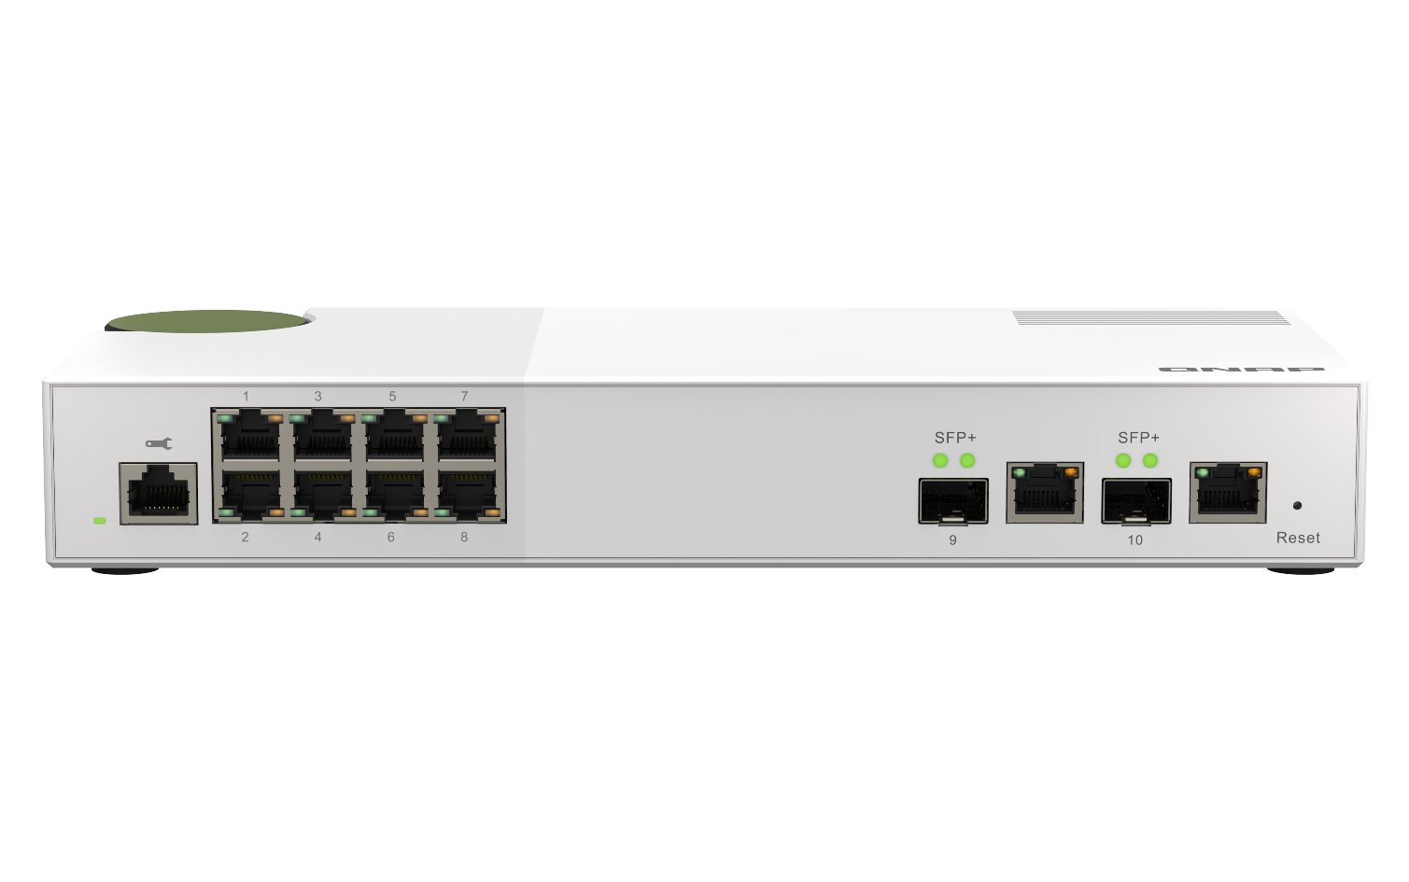
SMB Scenario-1
Internet
2.5G * 4
File Server
10G * 2
1G
1G * 3
NAS

Slide 10
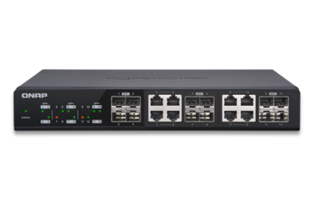
SMB Scenario-2
Internet
2.5G * 4
10G
Core switch
1G * 4
10G
NAS

Slide 11
Pragmatic port configuration, suitable for SB’s basic and expanded applications
Switching
bandwidth
80 Gbps
Suitable for SMB of basic or extention deploy.
QSW-M2108-2S
8 * 2.5GbE RJ45
2 * 10GbE SFP+
QSW-M2108-2C QSW-M2108R-2C
8 * 2.5GbE RJ45
2 * 10GbE SFP+/ NBASE-T Combo

Slide 12
10G NBASE-T downward compatible
10G
5G
2.5G
1G
100M

Slide 13
10G NBASE-T downward compatible
Upgrade the network based on original cabling
Re-cabling is not required, enjoy > 1Gbps with the original Cat5e cabling.
QSW-M2108R-2C
 | CAT 5e | CAT 6 | CAT 6A & CAT 7
100M | V | V | V
1G | V | V | V
2.5G | V | V | V
5G | V | V | V
10G | X | V(55m) | V
QSW-M2108-2C
QSW-M2108-2S
Note: QSW-2108M-2C

Slide 14
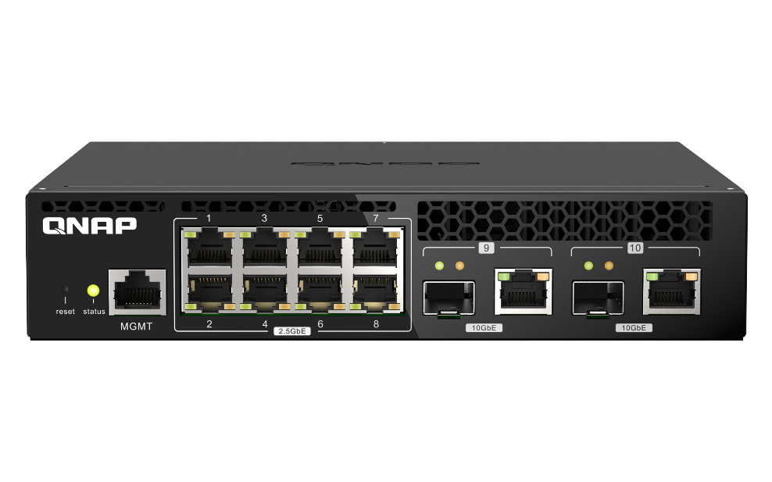
Optional for desktop or rack mount form
Desktop
Rack mount
QSW-M2108-2S
QSW-M2108R-2C
Desktop
QSW-M2108-2C

Slide 15
SMB-3
Core Switch
Internet
10G
10G
Room1
Room2
1G * 4
2.5G * 4
10G
1G * 4
2.5G * 4
10G
NAS
NAS
Note: Requires separate 2-in-1U rackmount kit. Please visit https://shop.qnap.com.

Slide 16
QSW-M2108 Hardware highlights
QSW-M2108R-2C

Slide 17
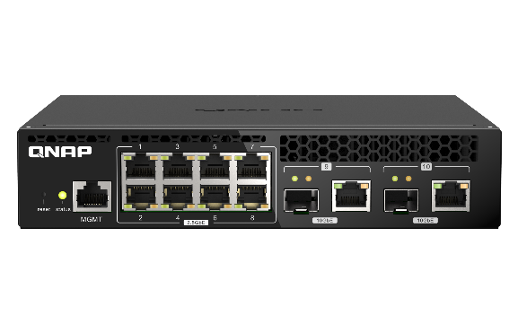
QSW-M2108 series hardware spec
QSW-M2108-2S
QSW-M2108-2C
QSW-M2108R-2C
Number of Port | 10 | 10 | 10
2.5 GbE RJ45 | 8 | 8 | 8
10 GbE SFP+ | 2 | - | -
10 GbE SFP+/RJ45 combo | - | 2 | 2
Switch bandwidth | 80Gbps | 80Gbps | 80Gbps
Fan design | With fan | With fan | With fan
Form factor | Desktop | Desktop | Rack mount

Slide 18
QSW-M2108-2S Device Mylar
Management port
8 x 2.5GbE RJ45 ports
2 x 10GbE SFP+ ports

Slide 19
QSW-M2108-2C Device Mylar
Management port
8 x 2.5GbE RJ45 ports
2 x 10GbE SFP+ /RJ45 combo ports

Slide 20
QSW-M2108R-2C Device Mylar
Management port
8 x 2.5GbE RJ45 ports
2 x 10GbE SFP+ /RJ45 combo ports

Slide 21
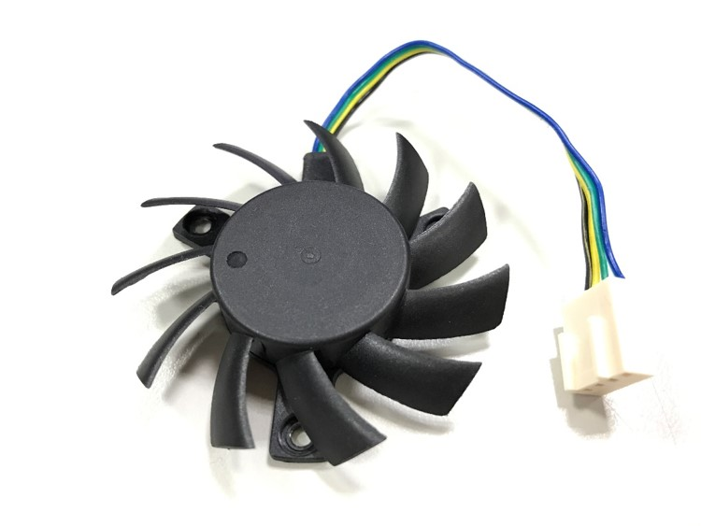
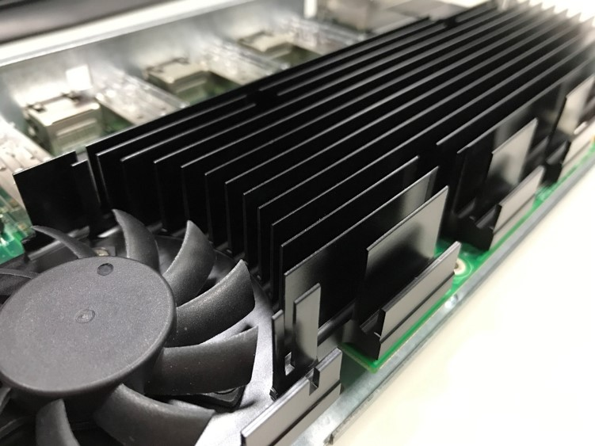
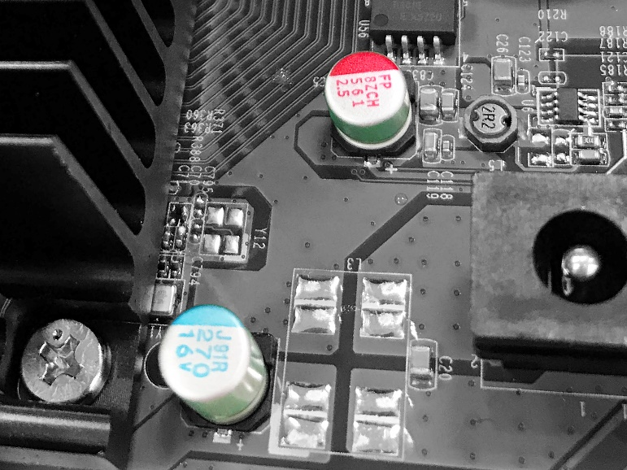
Optimized thermal design & quality components
PWM double ball bearing fan
Large conductive and directive heatsink
All solid capacitors
Notes:
智慧型調速，平衡系統溫度、能耗與噪音值。雙滾珠軸承確保長時使用壽命。
急速導出所有元件的熱，促進引流使風扇發揮最大功效！
壽命長、穩定度高、運作溫度範圍廣。杜絕液態電容電解液揮發、泄漏、易燃等風險。

Slide 22
Refined design for elegant desktop placement
Two kind of surface cover design、split 2.5GbE and 10GbE area.
With dark green power adaptor component，take lead office network not only flexibility of 2.5/10GbE, also shows modern and fashion design.

Slide 23
New rack mount kit
Single QSW-M2108R-2C install in 1U space of rack
Two QSW-M2108R-2C install in1U space of rack
Note1: QSW-M2108R-2C only
Note2: Requires separate 2-in-1U rackmount kit. Please visit https://shop.qnap.com.

Slide 24
QSW-M2108 Software highlights
QSW-M2108R-2C

Slide 25
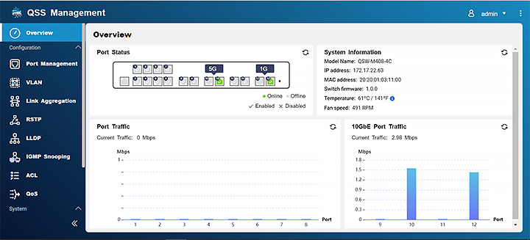
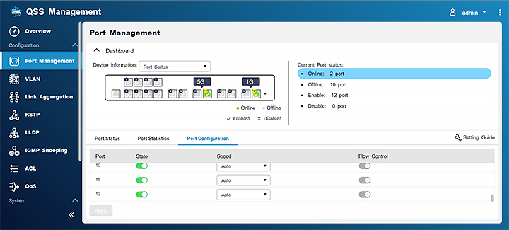
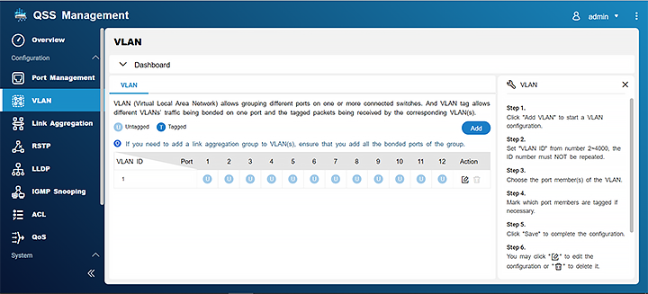
Easy to use GUI design
Rich functions and easy to use.
Straightforward web design lets user realize the setup logic quickly.

Slide 26
Split office network into different area
Virtual network (VLAN) can split office network.
Easy to manage, can set up routing to connect different networks.
Separate employee and guest network.

Slide 27
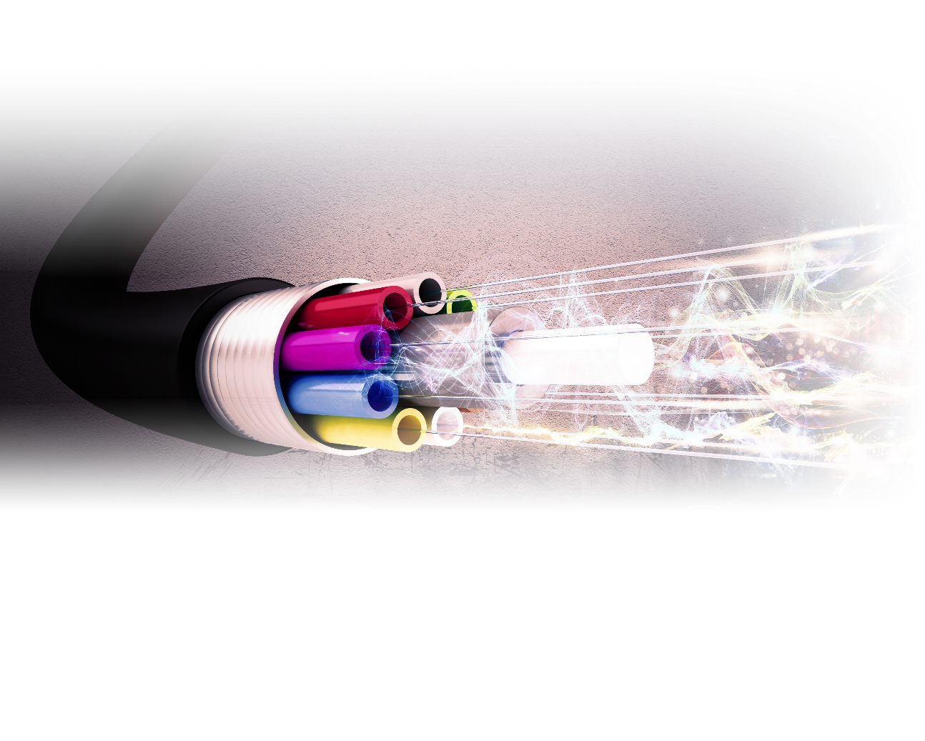
Raise network speed with multiple network cable
Link Aggregation (LAG) can aggregate multiple network cable into a single logical network.
Quick and direct to have a network more than 10GbE.

Slide 28
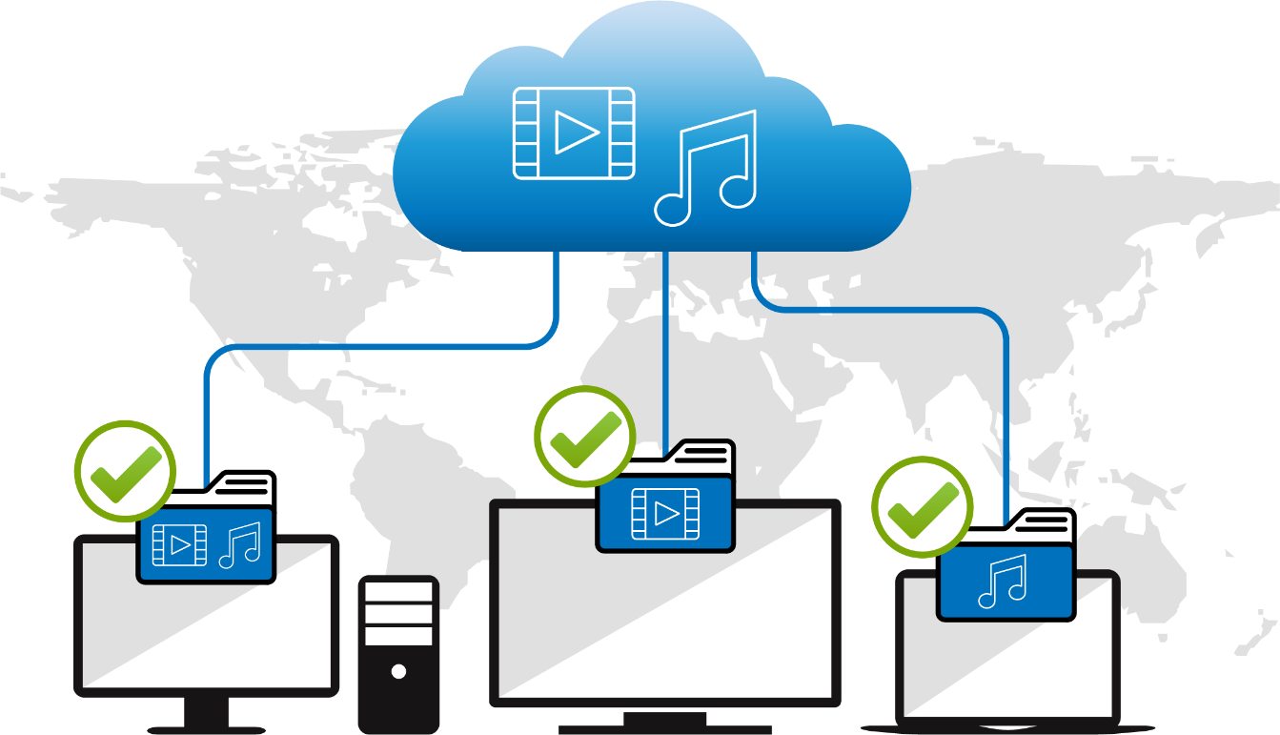
Deliver streaming to dedicate device specifically
IGMP snooping can record streaming request for each end point device.
Avoid packet lost or wrong stream broadcast.

Slide 29
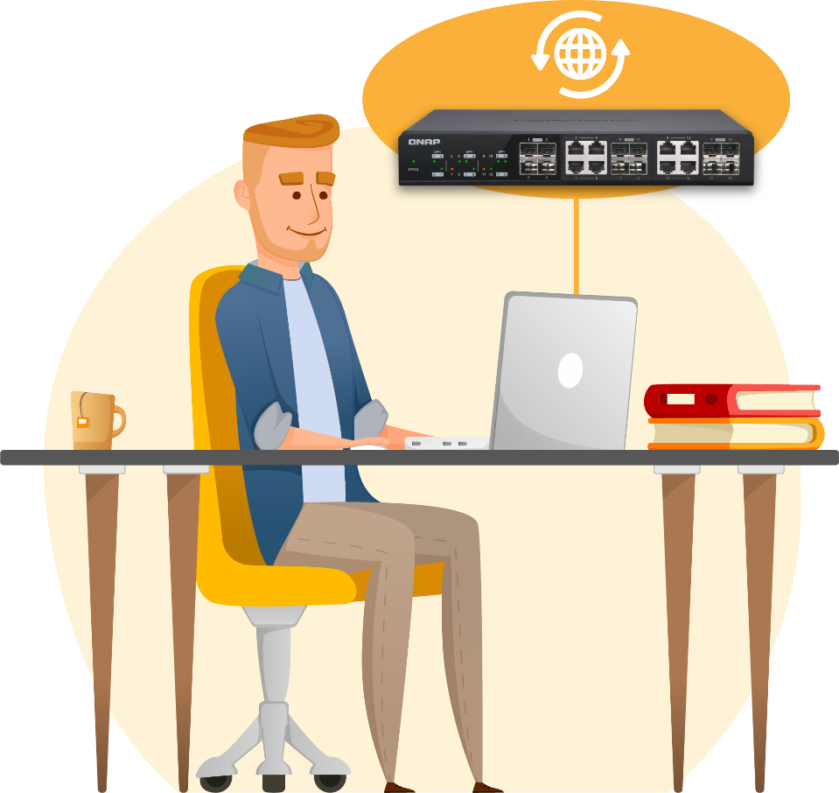
Firmware version live check
One-click update.
Firmware version auto detect.
Manual update

Slide 30
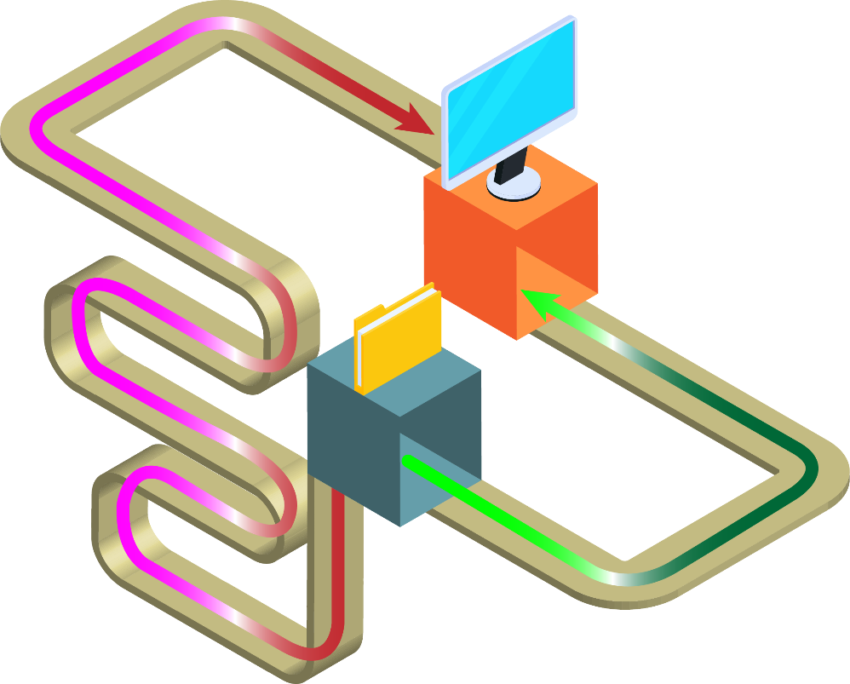
Always looking for best routing
Rapid Spanning Tree Protocol (RSTP) live check best networking route.
Always using most effective route for data transfer.

Slide 31
QSW-M2108 have more
Ethernet flow control (IEEE 802.3x) managing packet transfer, avoid packet lost.
Link Layer Discovery Protocol (LLDP), easy to know which devices are conneted.
Energy-Efficient Ethernet (IEEE 802.3az) and fan speed control, managing power consumption.

Slide 32
Perfectly integrated with QNAP high speed products

Slide 33
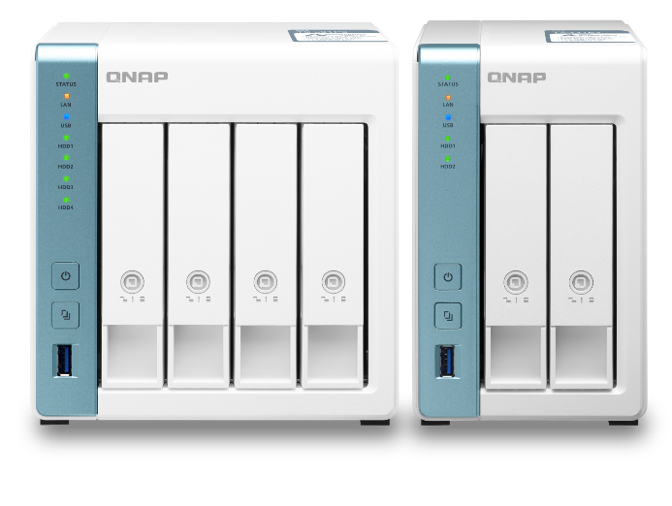
QNAP 2.5GbE teams give you perfect experience of high speed network
Professional high efficiency network storage
Digital home with high quality of streaming
Intel Celeron J4125 4 cores 2.0GHz, 2 x 2.5GbE, PCIe extend M.2 NVMe/ SATA SSD or 10GbE
Annapurna Labs AL-314 4 cores 1.7GHz, 1 x 10GbE SFP+, 1 x 2.5GbE
Annapurna Labs AL-314
4 cores 1.7GHz, 1 x 2.5GbE
TS-653D
TS-453D
TS-253D
TS-431X3
TS-231P3
TS-431P3

Slide 34
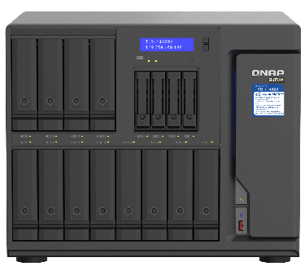
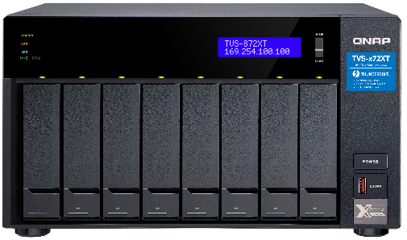
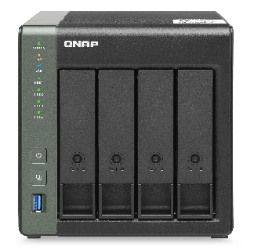
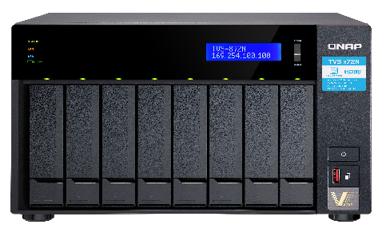
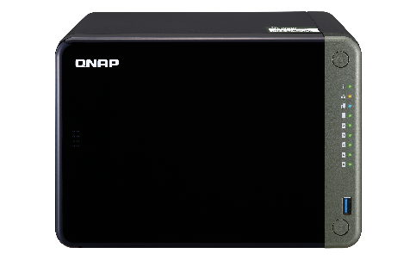
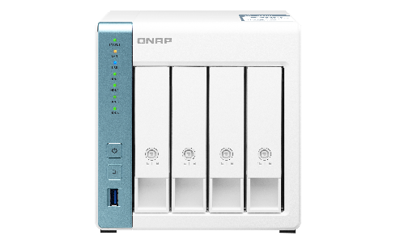
Tablet NAS with embedded 2.5/5/10GbE
With 10GbE BASE-T
｜
With 10GbE SFP+
TVS-h1688X /TVS-h1288X
TVS-872XT / TVS-672XT / TVS-472XT
TS-832PX
TS-431X3
10GbE + 2.5GbE
With 5GbE BASE-T
With 2.5GbE BASE-T
TVS-872N / TVS-672N
TS-h886 / TS-h686
TS-653D / TS-453D / TS-253D
TS-431P3 / TS-231P3

Slide 35
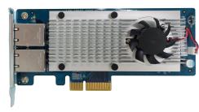
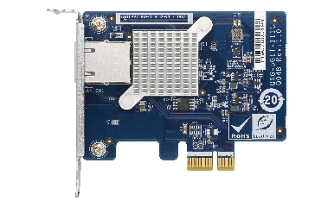
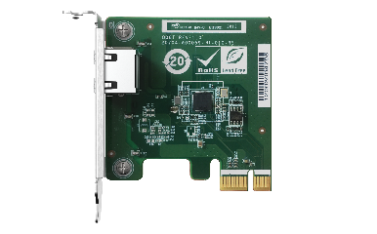
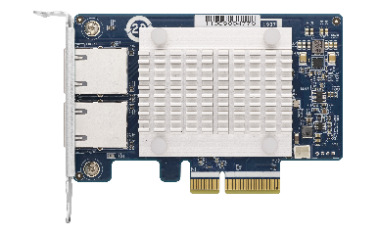
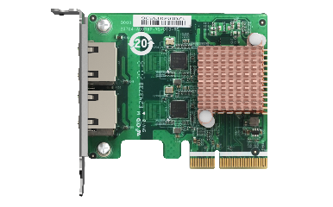
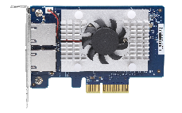
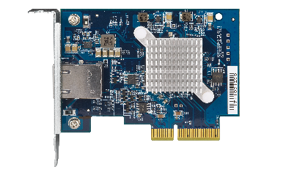
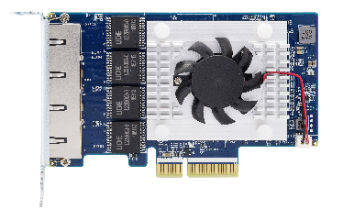
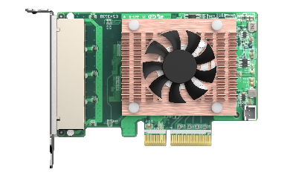
Network extention： rich PCIe network extension card
10GbE Series
5GbE Series
2.5GbE Series
QXG-10G2SF-CX4
LAN-10G2T-X550
QXG-5G Family
QXG-2.5G Family
1 x RJ45
1 x RJ45
2 x SFP+
2 x RJ45
2 x
RJ45
2 x
RJ45
QXG-10G2T-107
QXG-10G1T
4 x
RJ45
4 x
RJ45
2 x RJ45
1 x RJ45

Slide 36
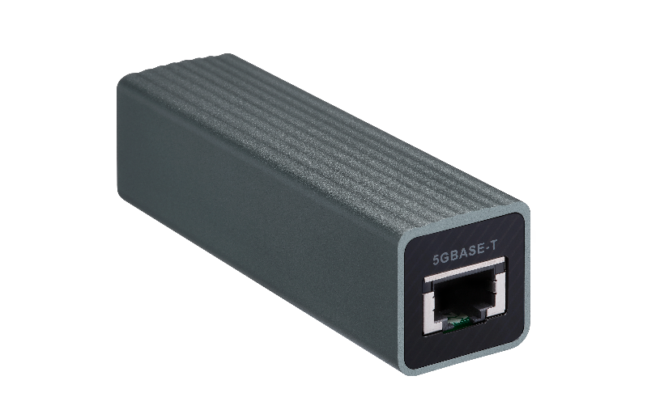
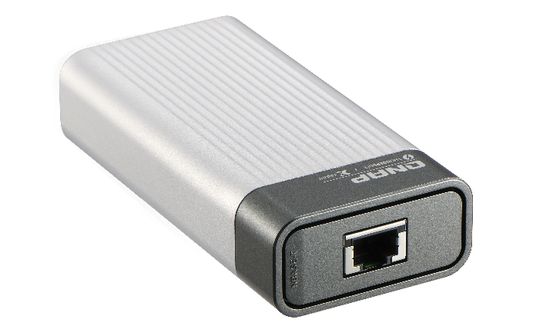
Network extention：hand carry adaptor
QNA-UC5G1T
QNA-T310G1T
USB 3.2 Gen 1
Thunderbolt 3
RJ45 NBASE-T
4 speed: 5G/2.5G/1G/100M
10GbE NBASE-T port
5 speed: 10G/5G/2.5G/1G/100M
USB Plug and play upgrade your PC/Laptop to 10GbE high speed network, through Thunderbolt
USB Plug and play upgrade your PC/Laptop to 10GbE high speed network
https://www.qnap.com/en/product/qna-uc5g1t
https://www.qnap.com/en/product/qna-tb-10gbe
Notes:
QSW-308

Slide 37
is your best choice!
Copyright© 2020 QNAP Systems, Inc. All rights reserved. QNAP® and other names of QNAP Products are proprietary marks or registered trademarks of QNAP Systems, Inc. Other products and company names mentioned herein are trademarks of their respective holders.​​​​
Notes:
QSW-308

