Slide 2
What is QuObjects ?
QuObjects can turn QNAP NAS into the same environment as AWS S3 (S3 Compatible)
It can be used to test object services on AWS S3 and enjoy a low-cost and high-performance test environment.

Slide 3
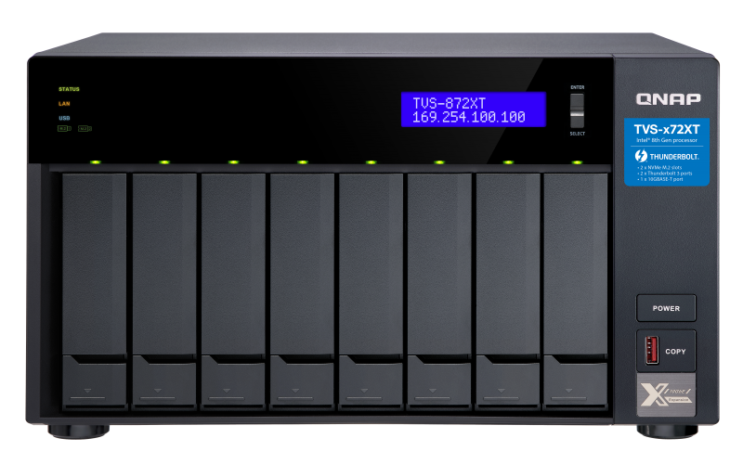
Object service development is more efficient
S3 Compatible
Enjoy local connection speed in the office
You can also directly connect to the public
cloud to enjoy the convenience
NAS in the office can be backed up quickly
HybridMountQuick on the cloud
HBS，Backup object storage

Slide 4
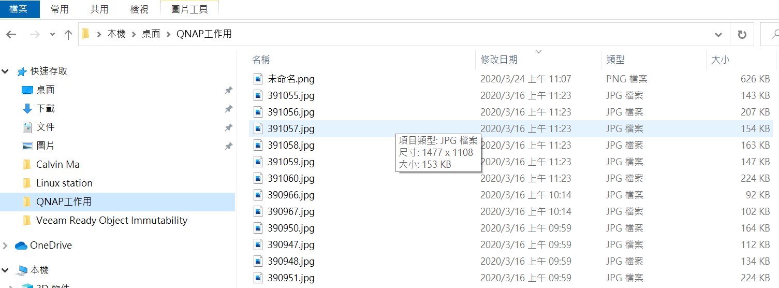
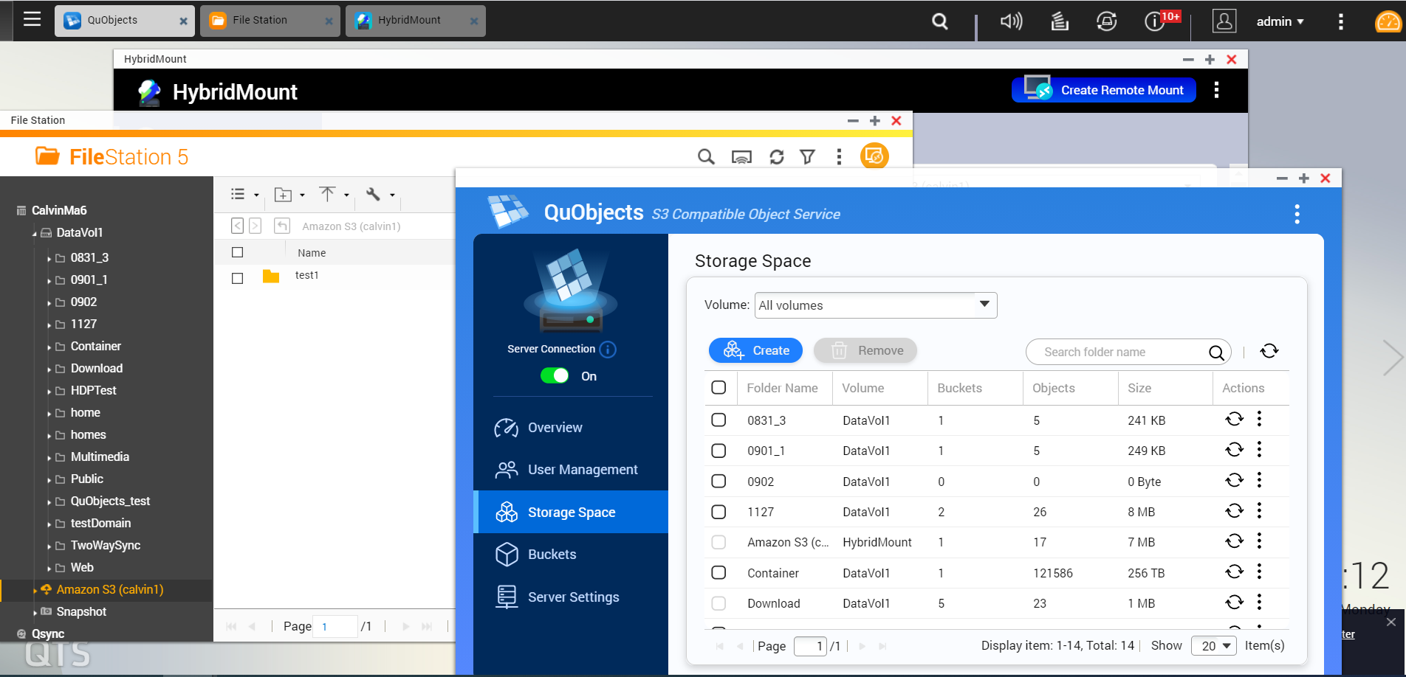
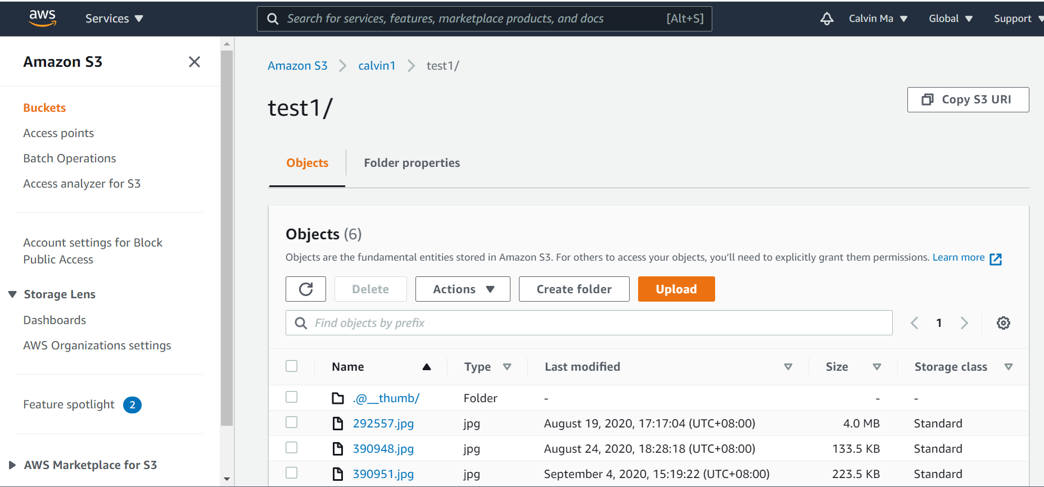
Desktop-NAS-Cloud data transmission window causes confusion.

Slide 5
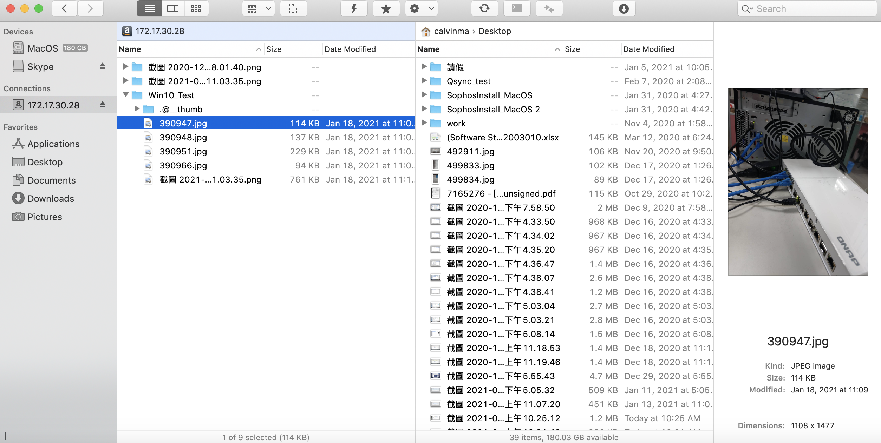
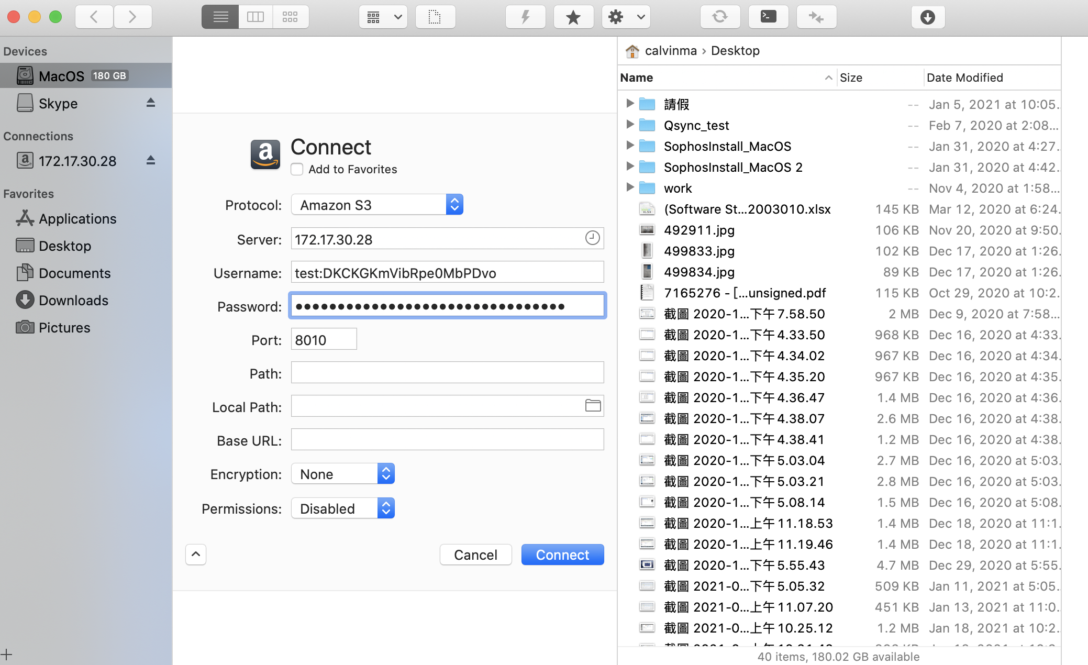
S3 Tool integrates multiple windows into one .Take Forklift 3 as an example.

Slide 6
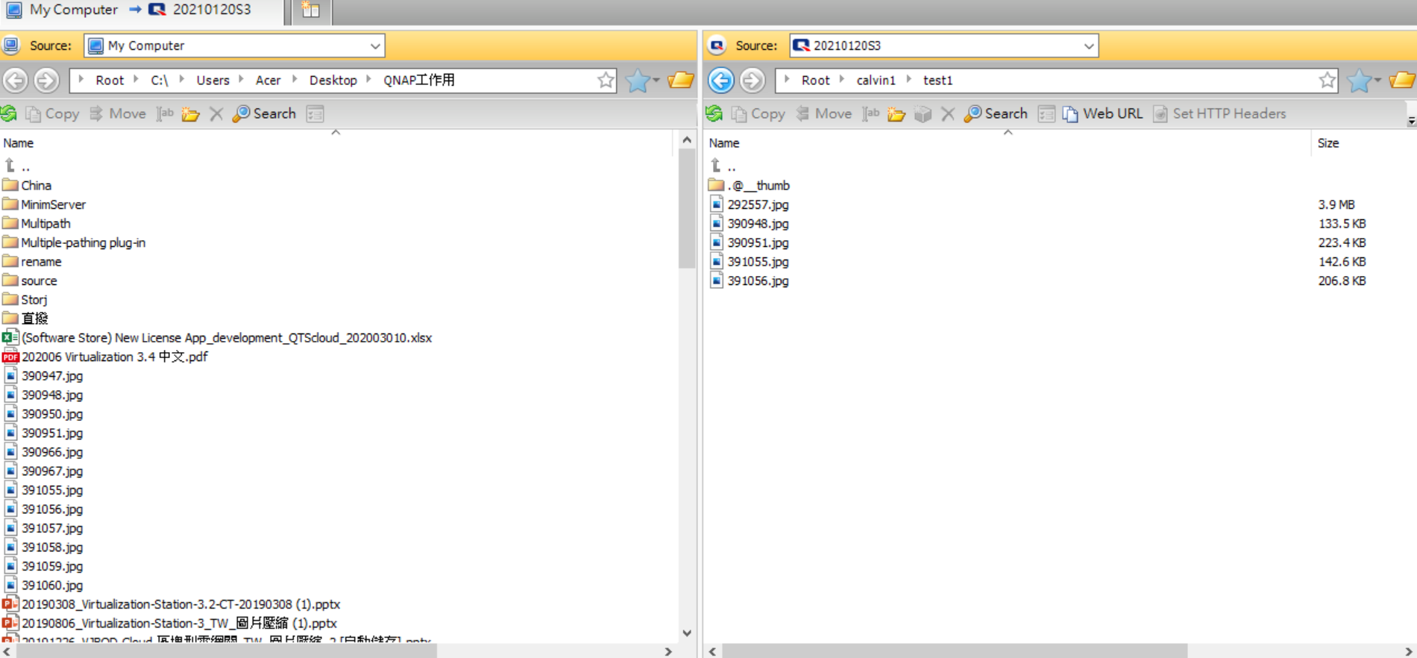
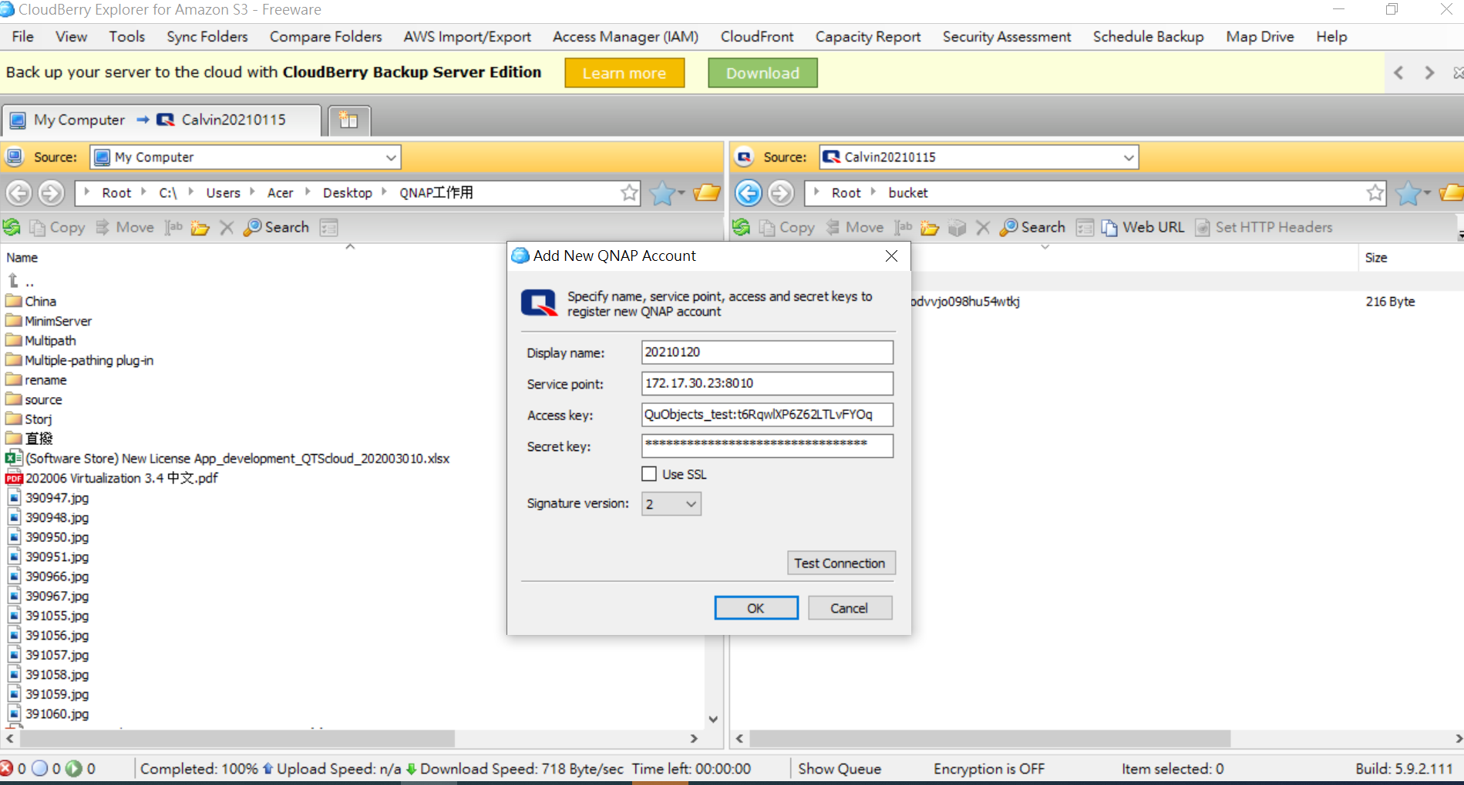
S3 to S3 Migration . Take CloudBerry as an example.

Slide 7
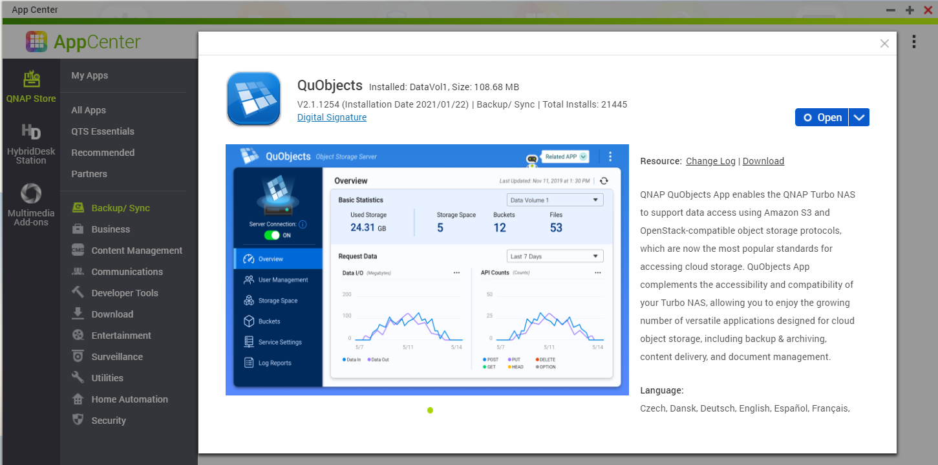
Operation steps-Download QuObjects from QNAP APP Center
Categorized in the backup/synchronization index

Slide 8
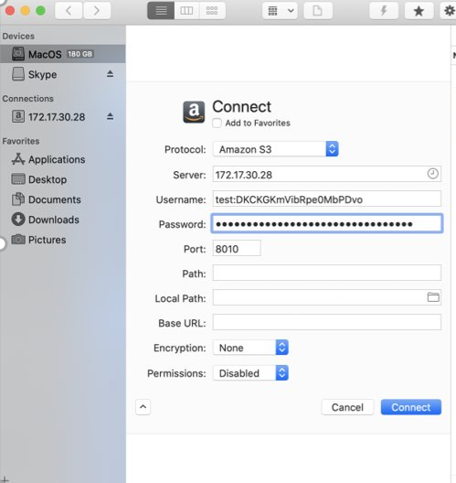
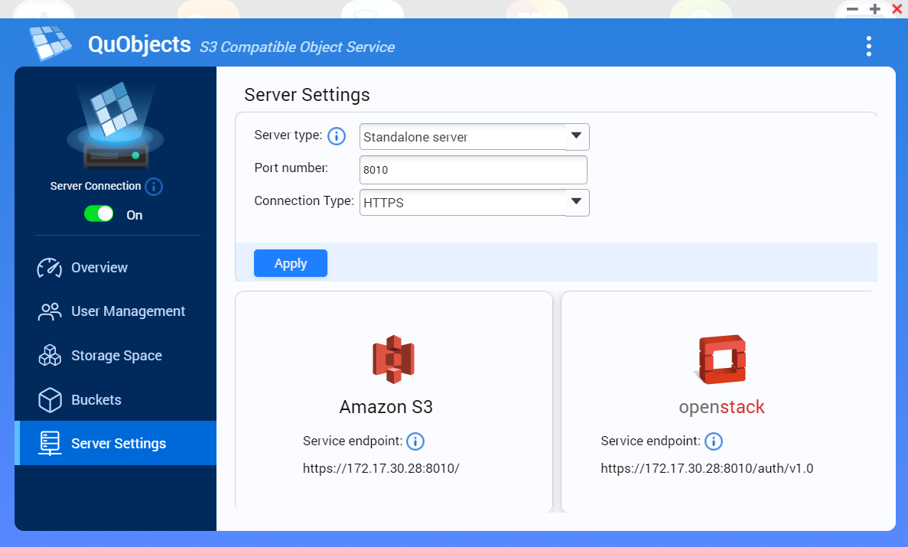
Connection operation - Only needs two steps to complete the connection
1
Step 1 : Enter the IP address and Port

Slide 9
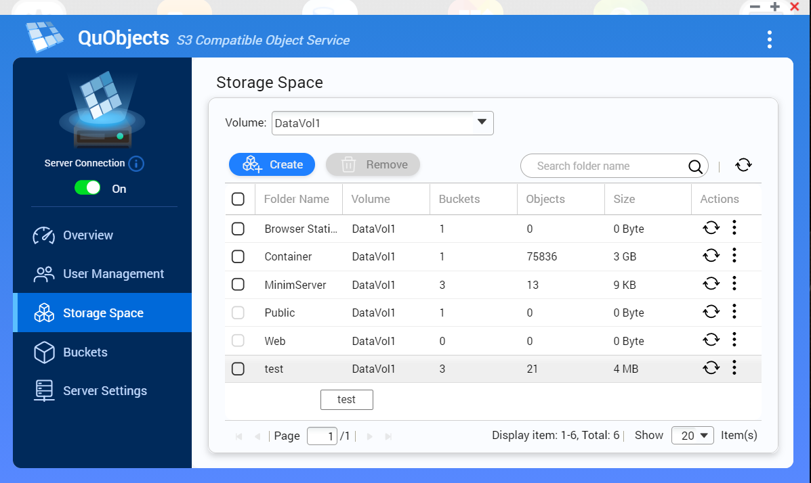
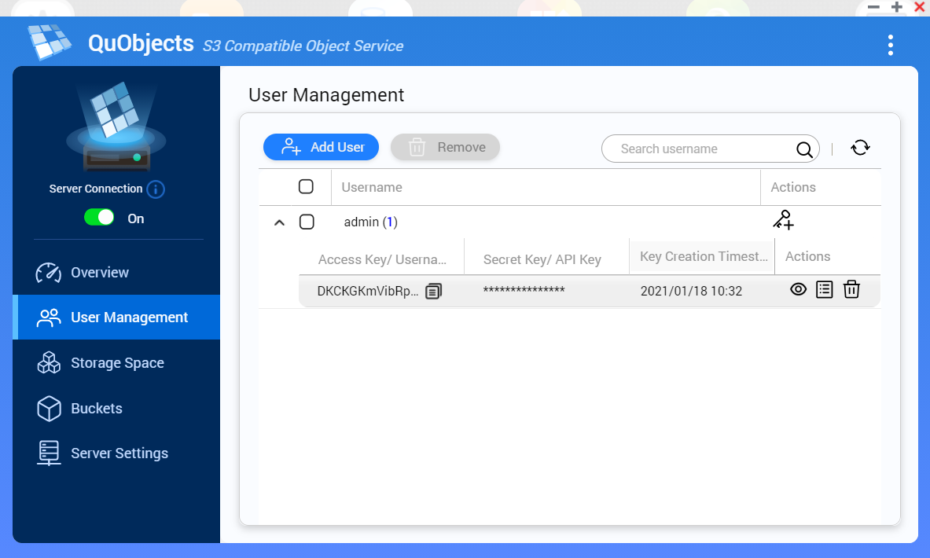
Connection operation-Only needs two steps to complete the connection
2
Step 2
Enter the storage space shared folder name + account , password

Slide 10
QuObjects support more S3 Tool connection
Tool name
Tool company | MSP360TM | BinaryNightsTM | IterateTM | EltimaTM
Support OS | windows/mac | MAC | windows/mac | MAC
QuObjects version | support now! | support now! | Next version update on end of Feb. | Next version update on end of Feb.
Tool company website link | https://www.msp360.com/explorer.aspx | https://binarynights.com/ | https://cyberduck.io/ | https://mac.eltima.com/file-manager.html
CloudBerry TM
Forklift 3 TM
CyberDuck TM
Commander One TM
The above-mentioned Tool name and trademark belong to Tool's company, all relevant information can refer to the official website link of the source Tool .

Slide 11
S3 Tool connect QuObjects

Slide 12
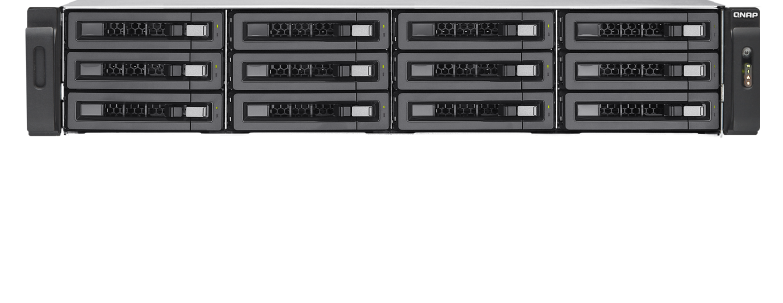
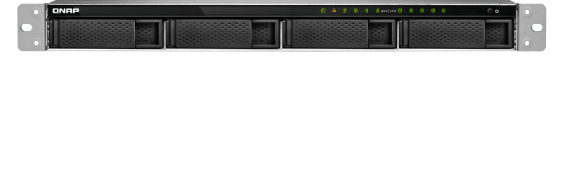
Cosbench Performance test - S3 good environment for object service testing!
Read/Write Rampup Time | Runtime | Selector | Driver | Worker | Container | Object | Object Size | Read | Write
30 | 300 | sequential | 2 | 16 | 1 | 1000 | 16MB | 2.5 GB/S | 935.91 MB/S
30 | 300 | sequential | 2 | 16 | 1 | 1000 | 32MB | 2.75 GB/S | 1.12 GB/S
30 | 300 | sequential | 2 | 16 | 1 | 1000 | 64MB | 2.88 GB/S | 1.19 GB/S
30 | 300 | sequential | 2 | 16 | 1 | 1000 | 4K | 1134.35 op/s | 601.36 op/s
Test environment: CosBench version: 0.4.2.c4 QuObjects version: 2.1.1254
Server:1885U: 32G ram, raid0 (SSD 500G*8), (office lan/ 25G lan)
Client : 977XU,40G ram, harddisk 1T,(office lan/ 25G lan)

Slide 13
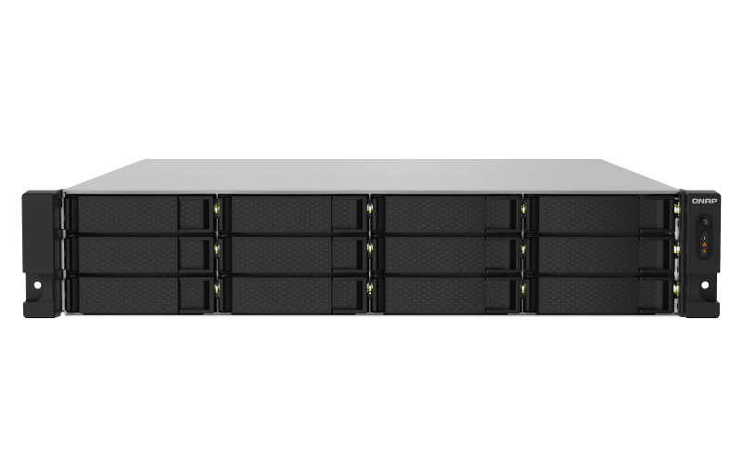
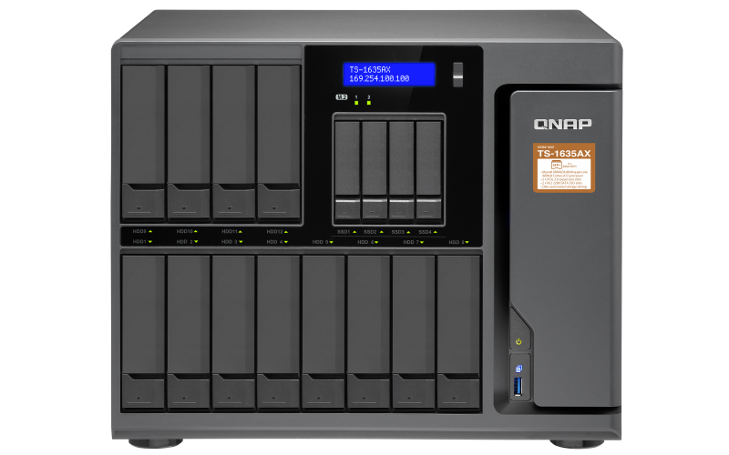
QuObjects can support QNAP ARM's model now
QuObject can support ARM 64-bit NAS (TS-x32 series and TS-1635AX)
TS-1232PXU-RP
TS-1635AX
Quad-core 1.7GHz rackmount NAS with 10GbE SFP+ and 2.5GbE ports and redundant power supply for SMB IT environments
Versatile, high-performance 16-bay desktop NAS, powered by the Marvell ARMADA 8040 processor

Slide 14
Customer feedback , We heard !
1. Support Standalone server https mode
2. Support ARM-Based series
3. Support Virtual hosted style access - Next version update on end of Feb.
The standalone server mode only exposes a HTTP interface. Unfortunately all of the S3 tools I have available require a HTTPS connection with no option to override. This makes the standalone server option pointless at the moment. I have not explored the Web Server option yet, as this will require me to make changes to my hosts file to ensure that traffic goes to my NAS correctly.From UK user
I'm really concerned about data privacy. I need to store client backup data using QuObjects, but I can only create an HTTP endpoint and not an HTTPS endpoint. I have a publicly signed, trusted certificate but the endpoint is only using HTTP and not HTTPS. I need to get this resolved before I use it in production. From USA user
希望可以支援ARM機種
from Taiwan user
the mazing feature is the speed of data upload and browsing as well . From Palestine user

Slide 15
Copyright© 2021 QNAP Systems, Inc. All rights reserved. QNAP® and other names of QNAP Products are proprietary marks or registered
trademarks of QNAP Systems, Inc. Other products and company names mentioned herein are trademarks of their respective holders.​​​

