Slide 2

Multipurpose enterprise SAS 12Gb/s expander JBOD: for Windows/ Linux server and NAS capacity expansion support (QTS / QuTS hero )
  4 x SAS 12Gb/s SFF-8644 wide ports
  Windows Server 2019 Cert.
  QNAP JBOD Manager utility for Windows – status monitoring
  Command line interface (CLI) - flexible usage
  Up to sixteen TL-R1620Sep-RP can be connected
Flexible daisy chaining modes – performance and security

Slide 3
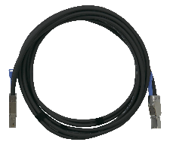
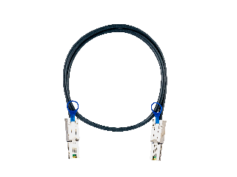
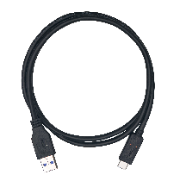
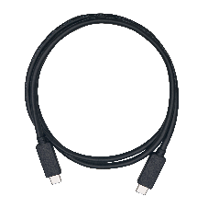
SAS full-duplex 12Gb/s Mini-SAS HD SFF-8644 for max 48Gb/s performance
Single-cable bandwidth
 | Cable | QNAP P/N
 | SAS 12Gb/s SFF-8644 Mini-SAS HD cable | CAB-SAS05M-8644 CAB-SAS10M-8644 CAB-SAS20M-8644 CAB-SAS30M-8644
 | SAS/ SATA 6Gb/s Mini-SAS SFF-8088 cable | CAB-SAS05M-8088 CAB-SAS10M-8088 CAB-SAS20M-8088 CAB-SAS30M-8088
 | USB 3.2 Gen 1 cable (5Gb/s) | Type A to C: CAB-U35G02MAC CAB-U35G10MAC
 | USB 3.2 Gen 2 cable (10Gb/s) | Type A to C: CAB-U310G10MAC Type C to C: CAB-U310G10MCC
SAS 12Gb/s
4 x 12Gb/s
48Gb/s
SAS 6Gb/s
4 x 6Gb/s
24Gb/s
USB 3.2 Gen 2x2
20Gb/s
USB 3.2 Gen 2
10Gb/s
SATA / eSATA
6Gb/s
USB 3.2 Gen 1
5Gb/s

Slide 4
Higher reliability, faster performance, and better availability for SAS drives
 | SAS SSD | SAS HDD | SATA SSD | SATA HDD
Price per TB | $$$$ | $$$ | $$ | $
RPM | --- | Up to 15, 000 | --- | Up to 7, 200
Capacity | Up to 15.36 TB | Up to 18 TB | Up to 4 TB | Up to 18 TB
MTBF | 2.5 M hours | 2.5 M hours | 2 M hours | 1.2 M hours
Workload | Process-intensive | Process-intensive | Light to normal | Light to normal
Speed | 12 Gb/s | 12 Gb/s | 6 Gb/s | 6 Gb/s
Latency | Lowest | Lower | Lower | Higher
Dual-port | Supported | Supported | - | -

Slide 5



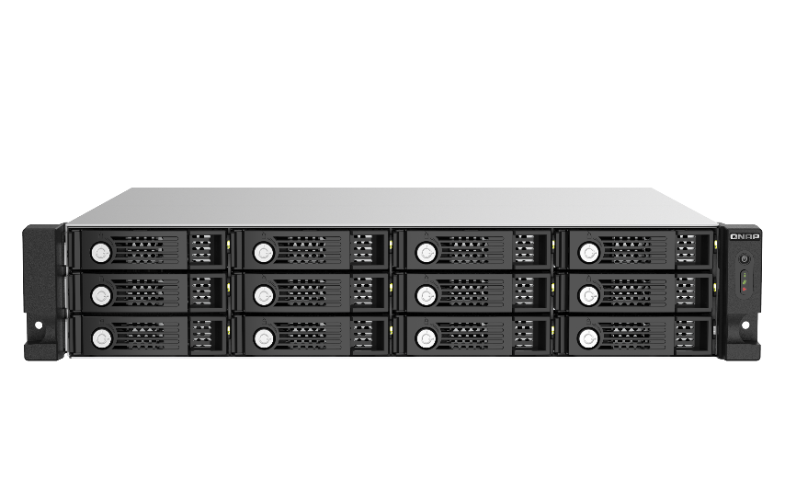
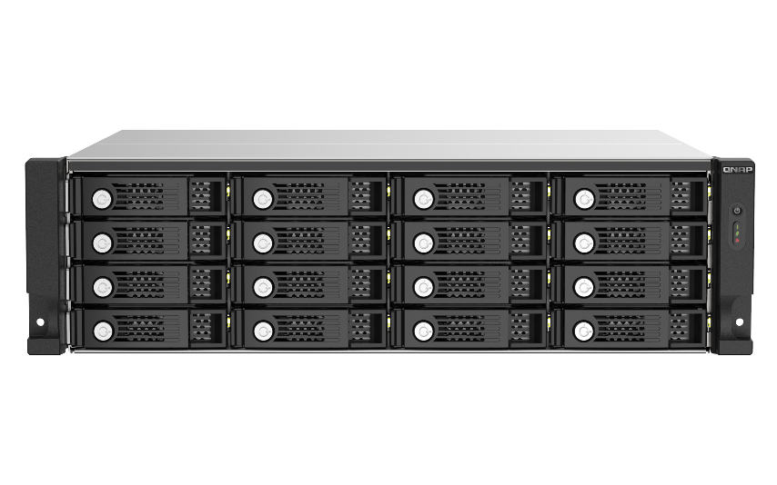
New generation of 12-bay & 16-bay SAS 12Gb/s JBOD Storage expansion
12 Bay
16 Bay
^{Built with a Broadcom®}
SAS expander, capable of connecting many drives with a single SAS cable and SAS JBOD enclosures to expand the NAS storage space.
TL-R1220Sep-RP
TL-R1620Sep-RP

Slide 6

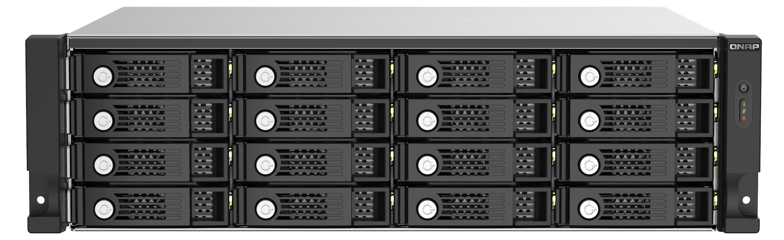
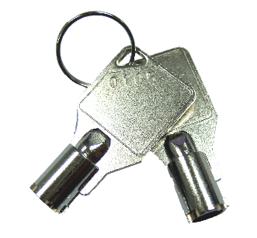
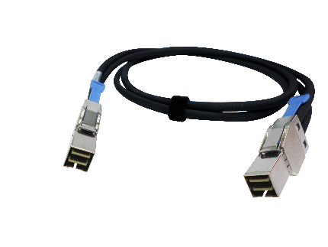
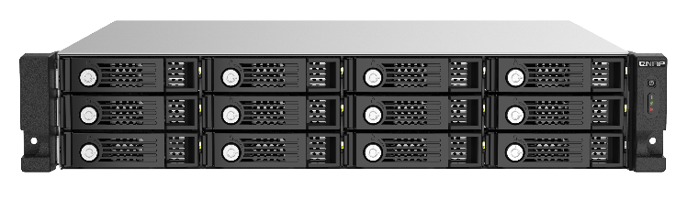

TL-R1220Sep-RP/ TL-R1620Sep-RP
SAS JBOD front view
Power Button
Status
Connection
Fan Error
Metal trays w/ lock
TL-R1620Sep-RP
Drive status
Bulit-in warning buzzer
TL-R1220Sep-RP
2 keys included
0.5-meter Mini-SAS HD cable included

Slide 7
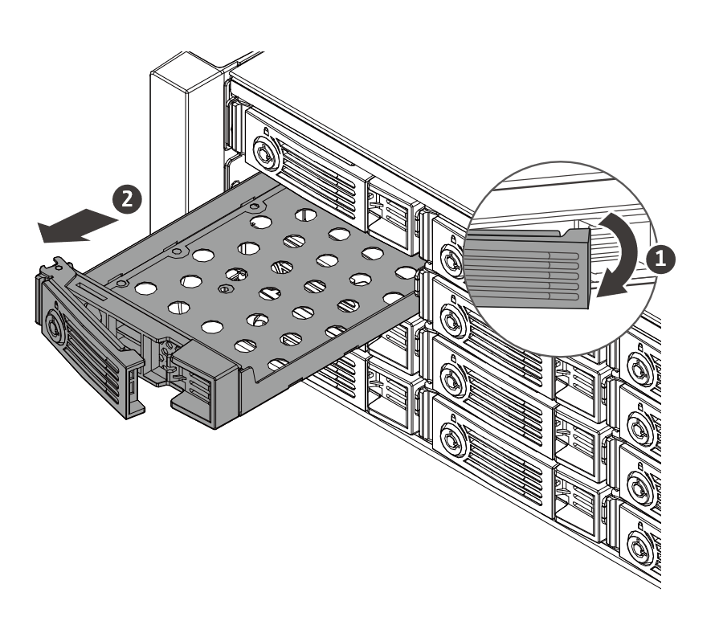
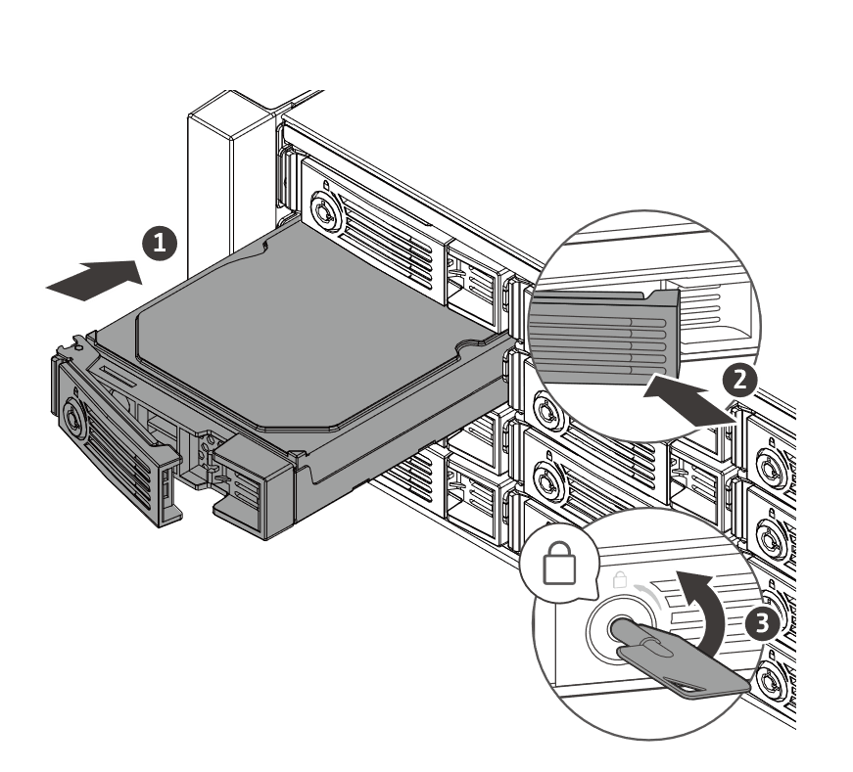
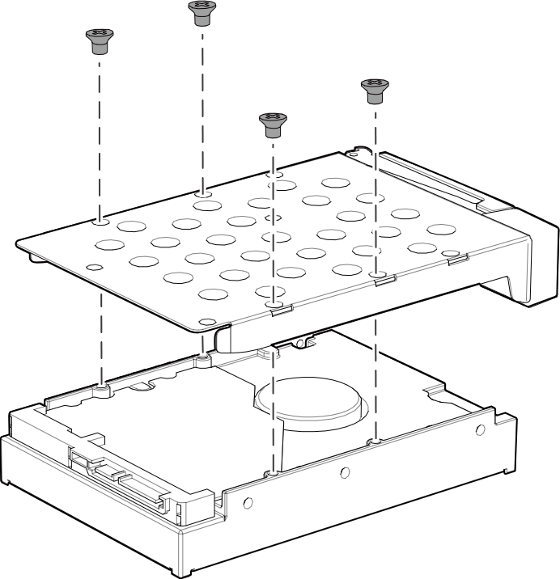
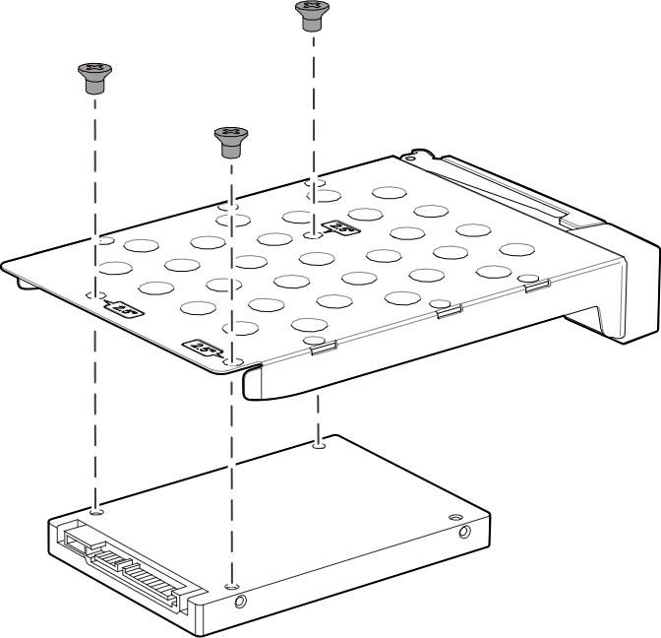
Support 3.5-inch and 2.5-inch SAS & SATA HDD/ SSD
STEP 01
STEP 02
STEP 03
3.5-inch HDD
2.5-inch HDD/ SSD

Slide 8
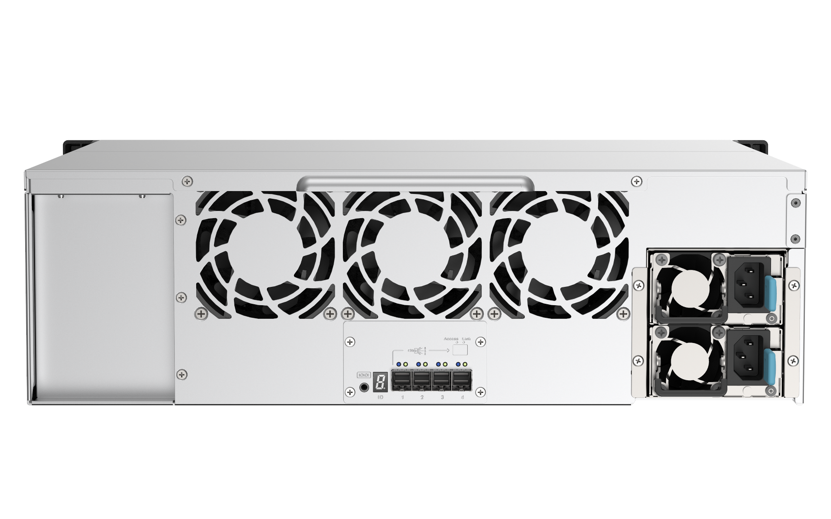

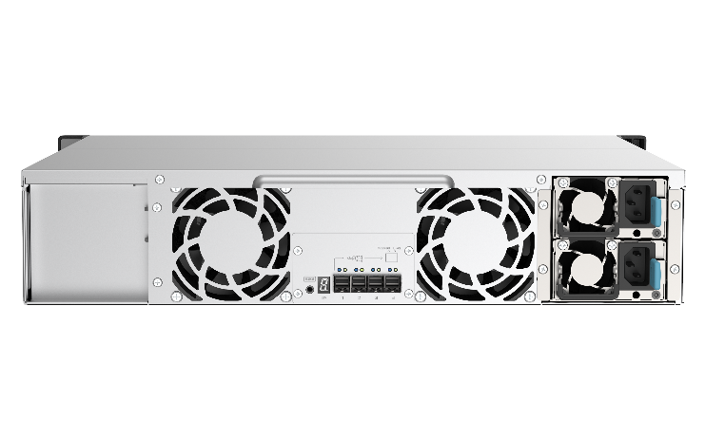
TL-R1220Sep-RP/ TL-R1620Sep-RP
SAS JBOD rear view
8cm Smart Fan
TL-R1620Sep-RP: 3
TL-R1220Sep-RP: 2
Redundant power supplies
TL-R1620Sep-RP: 2 x 550W
TL-R1220Sep-RP: 2 x 300W
4 x Mini-SAS HD
SFF-8644 SAS Wide-port
TL-R1620Sep-RP
HxWxD (131.3x482.2x425.3)
4 x 48Gb/s = 192Gb/s
JBOD address indicator
(1~9, a~g*)
TL-R1220Sep-RP
*QTS 4.5.2 / QuTS hero h4.5.2 will support displaying the a to g addresses.
HxWxD (88.65x482.2x423.8)

Slide 9
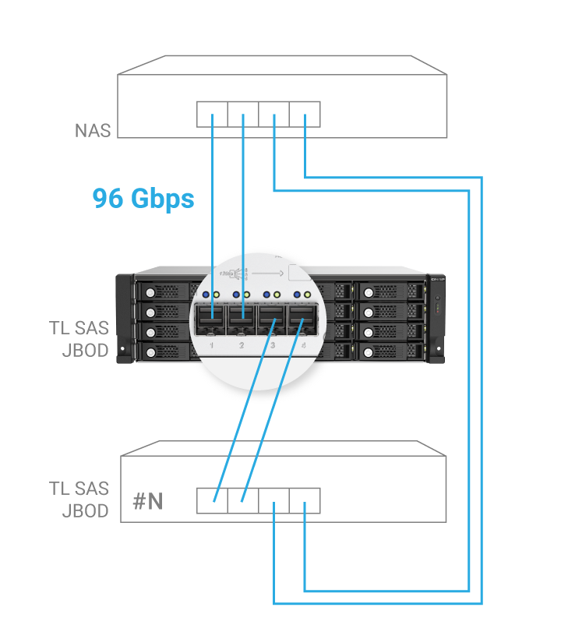

Up to 192Gbps with 4 Mini-SAS HD ports for intensive workloads in business storage
TL-R1220S-RP/ TL-R1620Sep-RP
TL-R1220S-RP/TL-R1620Sep-RP 搭載 28nm 低工耗 SAS35x28R SAS Expander 控制器, 可安裝 12 顆 12/ 6Gbps SAS/SATA HDD 或 SSD, 其具備 4 個 12 GB/s SAS 3.0 (x4 Lane) SFF-8644 SAS 寬連接埠 (Wide Port)。QNAP NAS 主機安裝 PCIe SAS 擴充卡, 可透過雙埠頻寬聚合與鏈狀串接多台 TL-R1220S-RP, 讓所有串接 JBOD 皆達到最高 96Gbps 連線頻寬。
Low power Broadcom SAS35x28R SAS Expander IC
12 or 16 x 12/ 6Gbps SAS/ SATA HDD or SSD
4 x 12 Gb/s SAS 3.0 (x4 Lane) SFF-8644 SAS wide ports, each port maximum 48Gb/s, totaling 192Gbps
Install 1 or more SAS expansion PCIe cards in the NAS and aggregate two ports for connecting multiple TL SAS JBOD units with up to 96Gbps.
TL-R1220S-RP/TL-R1620Sep-RP 搭載 28nm 低工耗 SAS35x28R SAS Expander 控制器, 可安裝 12 顆 12/ 6Gbps SAS/SATA HDD 或 SSD, 其具備 4 個 12 GB/s SAS 3.0 (x4 Lane) SFF-8644 SAS 寬連接埠 (Wide Port)。QNAP NAS 主機安裝 PCIe SAS 擴充卡, 可透過雙埠頻寬聚合與鏈狀串接多台 TL-R1220S-RP, 讓所有串接 JBOD 皆達到最高 96Gbps 連線頻寬。

Slide 10
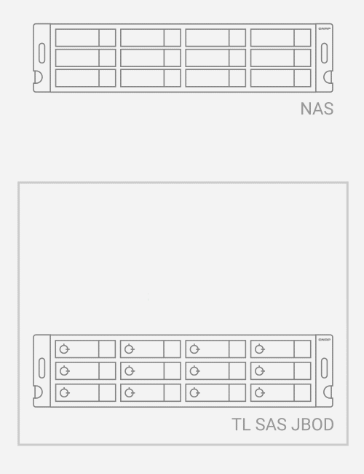
SAS DataBolt™ bandwidth optimizer technology aggregates bandwidth to provide 12Gb/s SAS performance to 6Gbs SSD/HDD
“DataBolt bandwidth optimizer technology aggregates bandwidth to provide 12Gb/s SAS performance to the host when using 6Gb/s and 3Gb/s SATA end devices, making it ideal for high-capacity and other storage applications.”
- Broadcom
Broadcom DataBoltTM technology aggregates the performance of two 6Gb/s HDD/SSD and passes the performance back along one 12Gb/s lane.
Note: The QNAP NAS requires QTS 4.5.1 / QuTS hero h4.5.1 (or later) with a PCIe SAS storage expansion card installed.

Slide 11


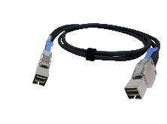

MiniSAS HD cable 48Gb/s connection,
NAS support up to 16 SAS JBOD
48Gb/s
QNAP
TL / REXP
SAS JBOD
SFF 8644-8644 Mini-SAS HD SAS 12Gb/s cable
Install SAS
HBA
Mini-SAS HD cable
48Gb/s
Windows Server
or NAS
…
QTS 4.5.1+ /QuTS hero h4.5.1+ up to
16 QNAP SAS JBOD
*Actual numbers that a system can support depends on OS, cable and JBOD. Please refer to the specifications.

Slide 12
Expand
Windows Server
strorage space

Slide 13


Install Broadcom SAS HBA or SAS RAID card on Windows Server
48 Gb/s
SFF 8644 to 8644
Mini-SAS HD SAS 12Gb/s cable
Connect multiple
TL SAS JBOD
Install Broadcom
SAS expansion card and QNAP JBOD Manager on server
Ultra-high Performance (up to 192Gb/s)
48Gb/s
Windows Server
Maximum number of JBOD a single unit can support depends on OS

Slide 14
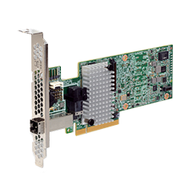
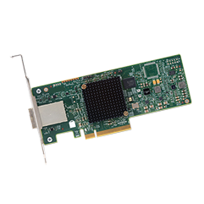
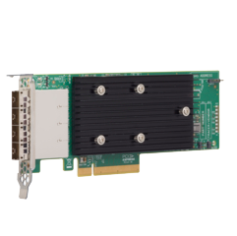
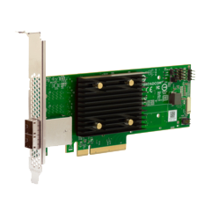
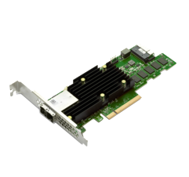
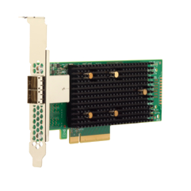

Windows Server paired with QNAP JBOD Manager
Widely support Broadcom SAS expansion card and QNAP TL JBOD
Broadcom model | MegaRAID 9380-4i4e | SAS 9300-8e | SAS 9305-16e | SAS 9500-8e | MegaRAID 9580-8i8e | SAS 9400-8e
RAID support | 0, 1, 5, 6, 10, 50, and 60 | Non-RAID HBA | Non-RAID HBA | Non-RAID HBA | RAID 0, 1, 5, 6, 10, 50 and 60 | Non-RAID HBA
Port | 4 + 4 ports (1 x SFF-8644 1 x SFF-8643) | 8 ports (2 x SFF-8644) | 16 ports (4 x SFF-8644) | 8 ports (2 x SFF-8644) | 8 + 8 ports (2 x SFF-8644 2 x SFF-8643) | 8 ports (2 x SFF-8644)
PCI Express | x8 PCI Express 3.0 | x8 PCI Express 3.0 | x8 PCI Express 3.0 | x8 PCI Express 3.0 | x8 PCI Express 4.0 | x8 PCI Express 3.1
Manufacturer Information | Site URL | Site URL | Site URL | Site URL | Site URL | Site URL

Slide 15
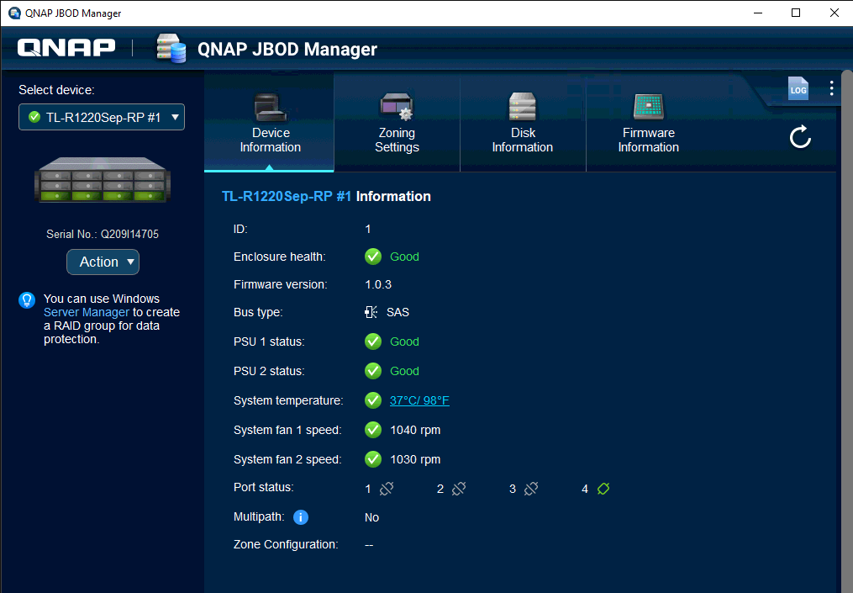
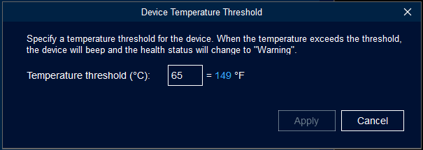
Windows Server monitoring management tool:
QNAP JBOD Manager
Device status
Get TL-R1220Sep-RP & TL-R1620Sep-RP information in real-time, including device health status, system temperature, system fan speed, connection status, Multipath I/O status and Zone configuration

Slide 16
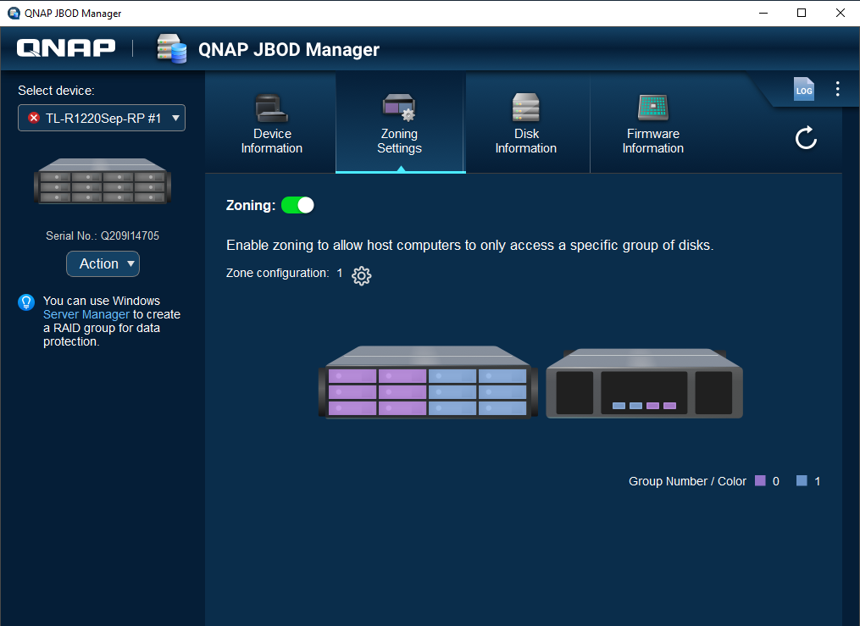


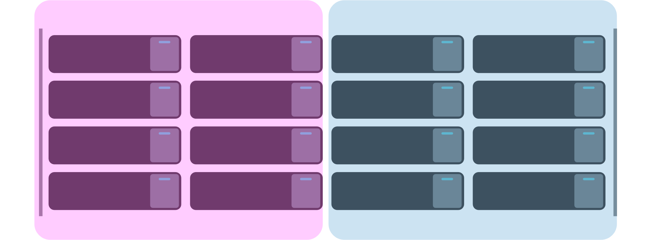
QNAP JBOD Manager support Drive-bay zoning setting - allows single JBOD to serve multiple servers
Zone Setting
SAS Zone setting can divide JBOD into multiple Zones and enable host servers to only access specific zone
Note:
(1) The utility can only divide the JBOD into 2 zones. For dividing into 4/ 8 zones, you need to configure the device via CLI
(2) H/W RAID cannot use zone setting
Host 1
Host 2
Notes:
One more thing, If you use the RAID expansion card, you cannot get the zoning information from JBOD, because the RAID card cannot deliever the final storage configuration.

Slide 17
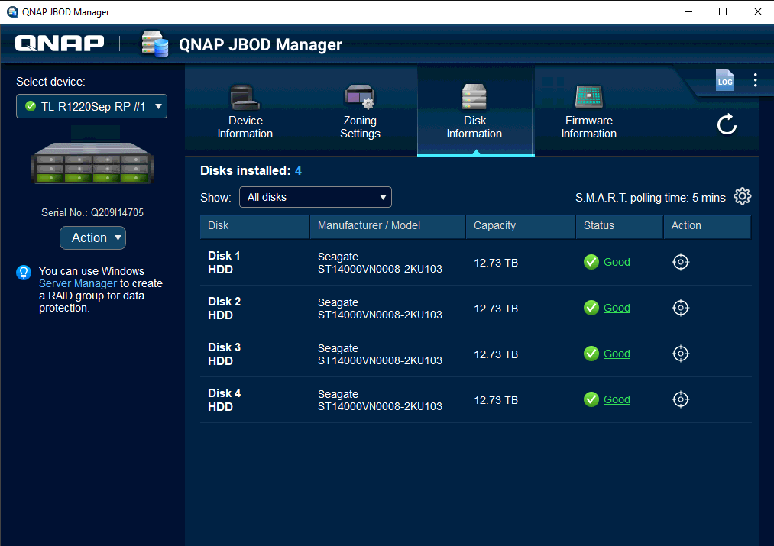
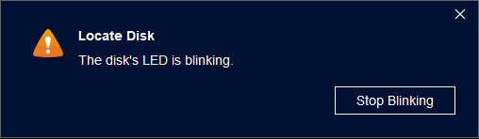
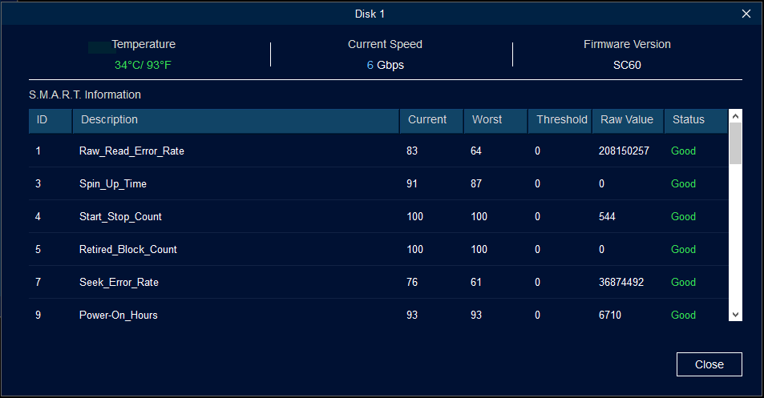
QNAP JBOD Manager Disk Information
Disk Information
Provide all disks' model, capacity, basic S.M.A.R.T information and allocation (Flashes for IT to distinguish)

Slide 18
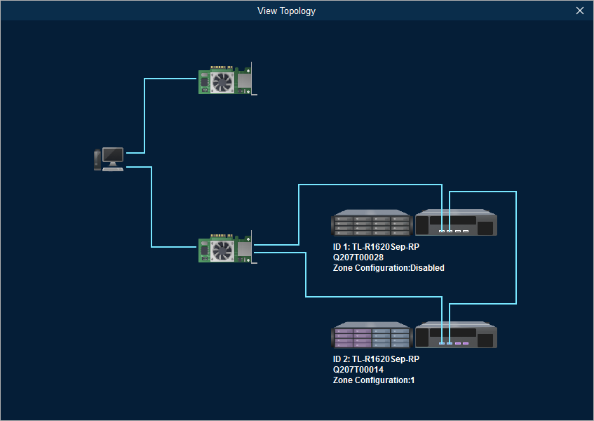
QNAP JBOD Manager View Topology
Topology
It will automatically generate visual topology and let you stay on top of connected devices and status
Note: This functoin can only support Broadcom SAS HBA. Broadcom RAID card cannot support topology due to its architecture

Slide 19
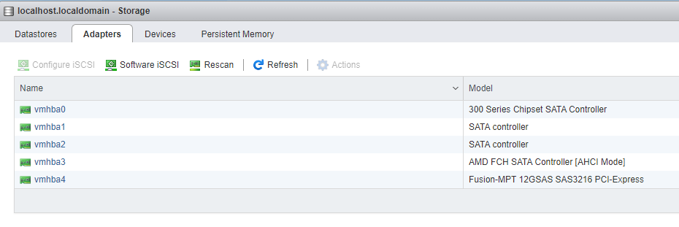
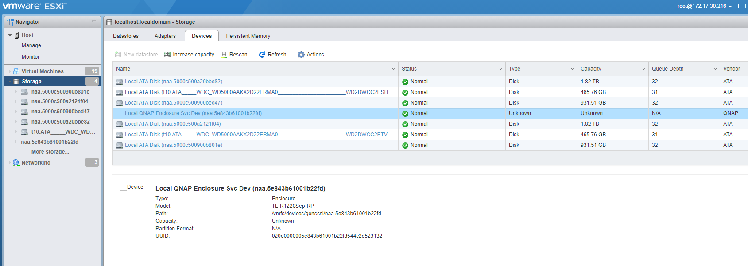
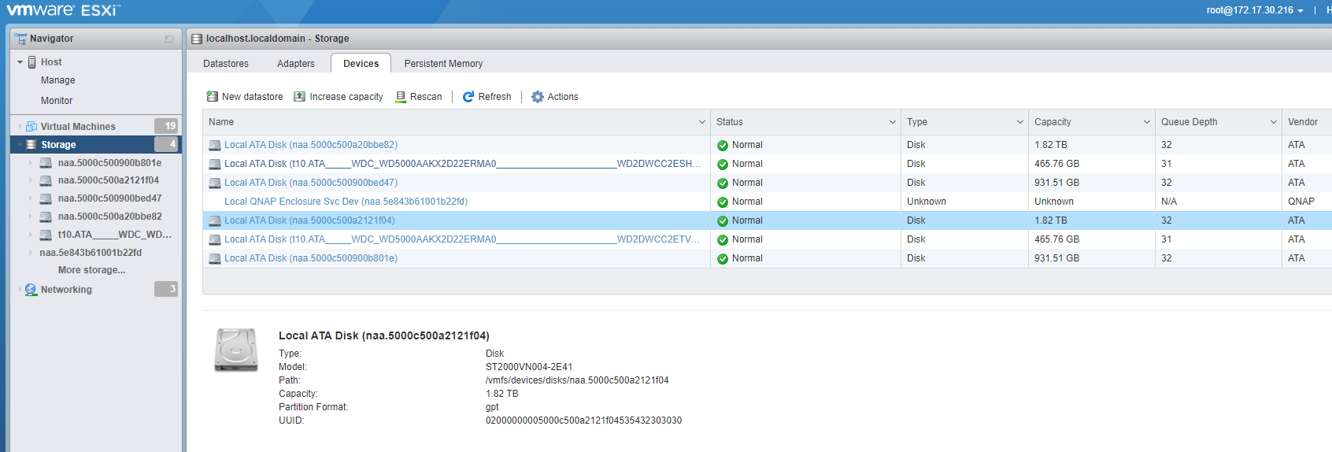
Support VMware datastore
Significantly expand capacity
VMware datastore
Through Broadcom LSI SAS HBA, you can easily connect SAS JBOD with VMware server, and expand Vmware capacity through VMFS type

Slide 21

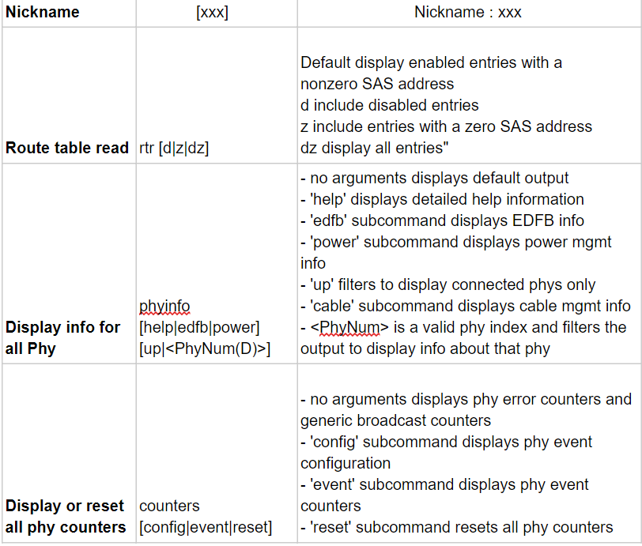
Command Line Interface
Nickname | [xxx] | Nickname : xxx
Route table read | rtr [d|z|dz] | Default display enabled entries with a nonzero SAS address d include disabled entries z include entries with a zero SAS address dz display all entries"
Display info for all Phy | phyinfo [help|edfb|power] [up|<PhyNum(D)>] | - no arguments displays default output - 'help' displays detailed help information - 'edfb' subcommand displays EDFB info - 'power' subcommand displays power mgmt info - 'up' filters to display connected phys only - 'cable' subcommand displays cable mgmt info - <PhyNum> is a valid phy index and filters the output to display info about that phy
Display or reset all phy counters | counters [config|event|reset] | - no arguments displays phy error counters and generic broadcast counters - 'config' subcommand displays phy event configuration - 'event' subcommand displays phy event counters - 'reset' subcommand resets all phy counters
Command Line Interface
You can connect your computer to the TL-R1220Sep-RP /TL-R1620Sep-RP via the console port, and use the command line interface (CLI) to configure the SAS JBOD (for example: set SAS Zoning to eight zones).
Note: A password is required to use the CLI. The default password is 00000000 (eight zeros).

Slide 22
Expand
QNAP NAS
storage space

Slide 23
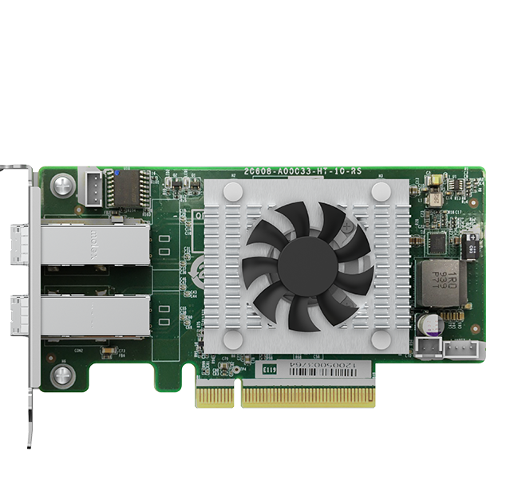
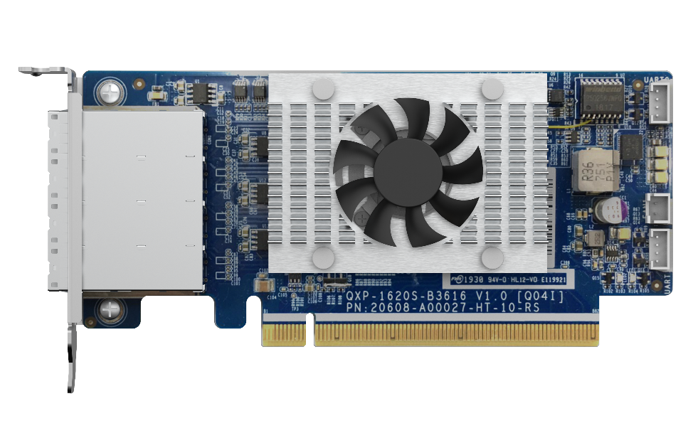
QNAP dual-port/quad-port
SAS 12Gb/s expansion cards
Dual-port SAS 12Gb/s
Quad-port SAS 12Gb/s
Broadcom®
SAS controller
QXP-820S-B3408
QXP-1620S-B3616W
PCIe Gen3 x8
PCIe Gen3 x16

Slide 24


Dual/Quad-port SAS-3 12Gb/s expansion card specfications
 | QXP-820S-B3408 | QXP-1620S-B3616W
SAS Controller | Broadcom SAS3408 | Broadcom SAS3616W Tri-mode
Drive interface | 12Gb/s SAS, 6Gb/s SATA up to 8.0 GT/s
SAS bandwidth | 2 x external Mini-SAS HD | 4 x external Mini-SAS HD
Connector interface | SFF-8644 | SFF-8644
Host PCIe band-width | PCIe Gen 3 x8 | PCIe Gen 3 x16
Dimensions | 129.65 x 68.9 mm; Low-profile | 149.65 x 68.9 mm; Low-profile
*SAS connector is a Wide-port, contain four SAS signals **Only been validated with passive cable, we offer different cable optional purchase selection of 0.5M/1M/2M/3M
 | SAS-12G2E | QXP-1620S-B3616W
SAS controller | Broadcom SAS3008 | Broadcom SAS3616W Tri-mode
Tri-mode | 12Gb/s SAS, 6Gb/s SATA, and PCIe (NVMe)* up to 8.0 GT/s
Ports | 8 external | 16 external
Connectors | Two (x4) SFF-8644 | Four (x4) SFF-8644
Host Bus Type | PCIe Gen 3 x8 | PCIe Gen 3 x16
Dimensions | 129.65 x 68.9 mm | 149.65 x 68.9 mm
Warranty | 1-Year Limited
Cable Support | CAB-SAS05M-8644, CAB-SAS10M-8644, CAB-SAS20M-8644, CAB-SAS30M-8644

Slide 25
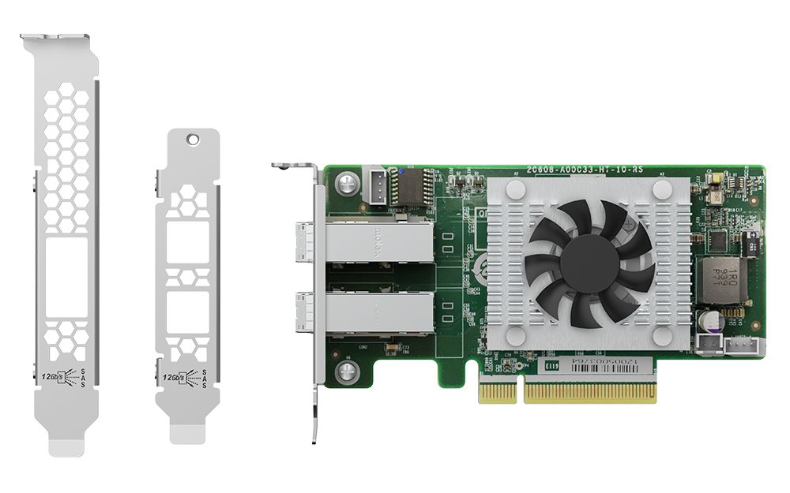
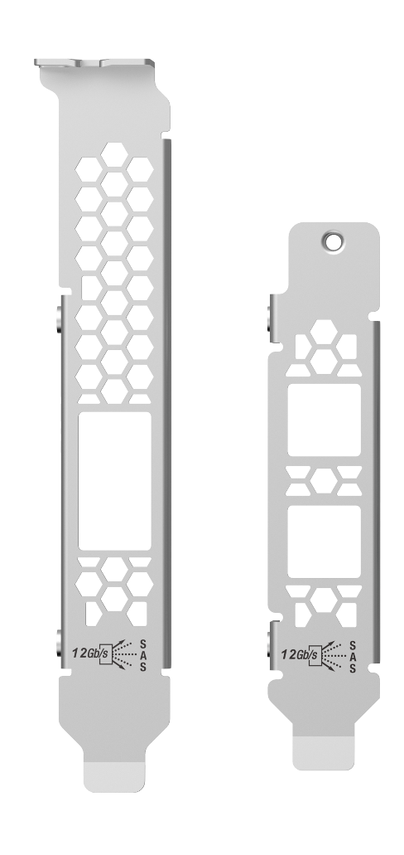
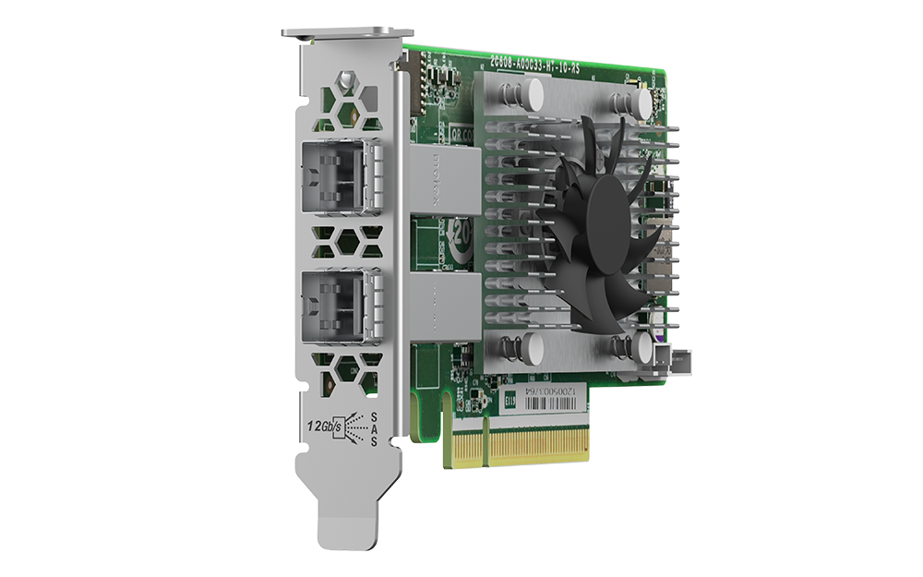
Low-profile design for various QNAP NAS models
QXP-820S-B3408
129.65 mm
Additional brackets are included for various NAS models
68.9 mm
PCIe Gen 3 x8 bandwidth (64Gbps)
Pre-installed
half-height bracket

Slide 26
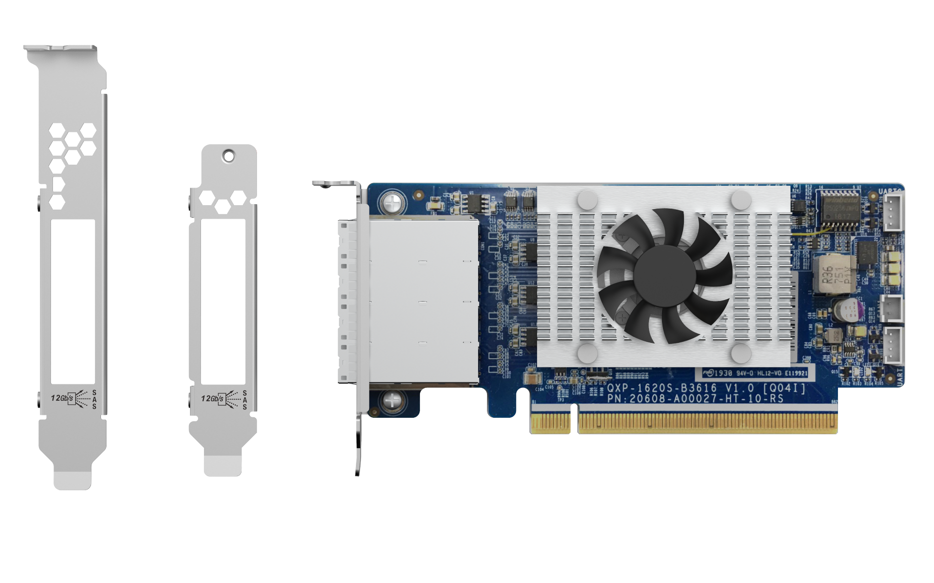
Low-profile design for various QNAP NAS models
QXP-1620S-B3616W
149.65 mm
Additional brackets are included for various NAS models
68.9 mm
Pre-installed
half-height bracket
PCIe Gen 3 x16 bandwidth (128Gbps)

Slide 27
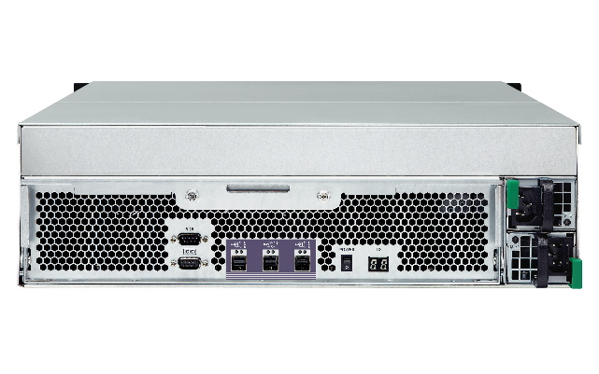
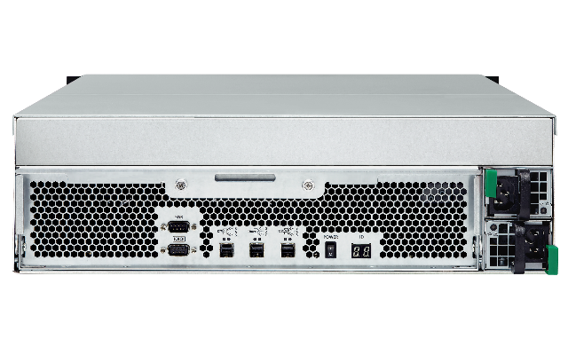
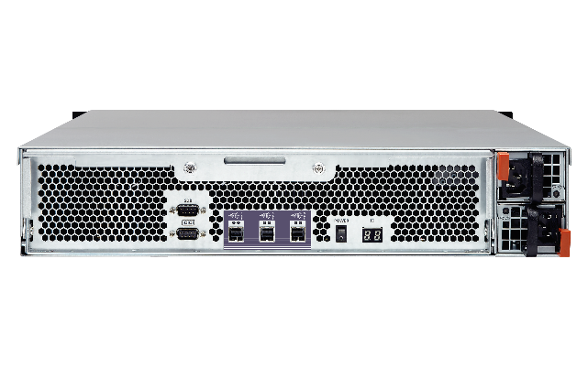
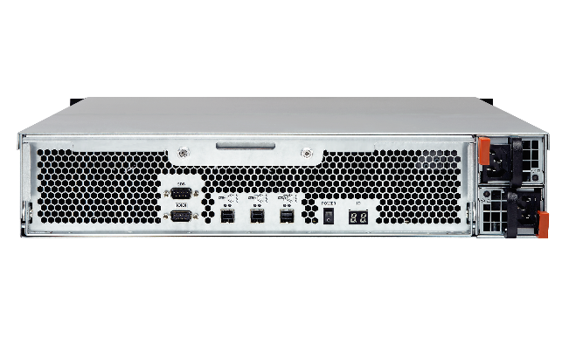
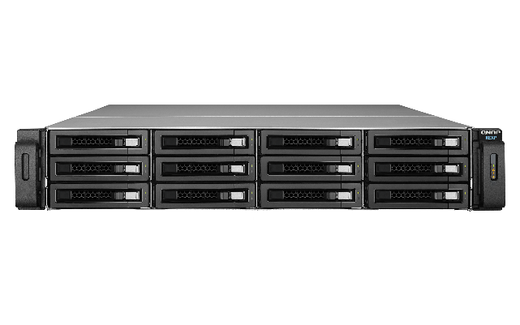
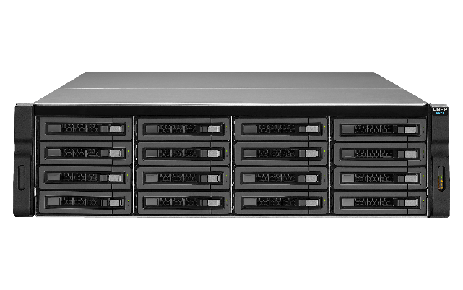
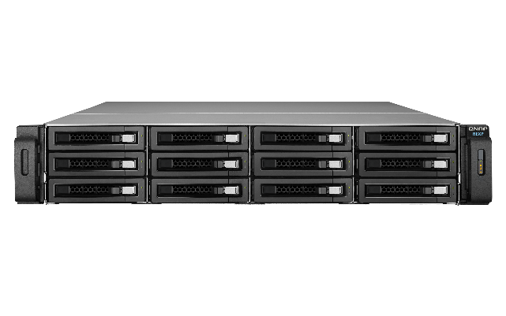

Compatible with QNAP REXP SAS JBOD series
NAS supports connecting multiple TL and REXP SAS JBOD enclosures together
SAS 6Gb/s JBOD enclosures
SAS 12Gb/s JBOD enclosures
REXP-1210U-RP
REXP-1610U-RP
REXP-1220U-RP
REXP-1620U-RP

Slide 28





Comparing the QNAP SAS JBOD generations
New!
New!
 | TL-R1620Sep-RP | REXP-1620U-RP | REXP-1610U-RP | TL-R1220Sep-RP | REXP-1220U-RP | REXP-1210U-RP
# of bays | 16 | 16 | 16 | 12 | 12 | 12
Drive interface | 2.5“/3.5” SAS 12Gbps, SAS/SATA 6Gbps | 2.5“/3.5” SAS 12Gbps, SAS/SATA 6Gbps | 2.5“/3.5” SATA 6Gbps | 2.5“/3.5” SAS 12Gbps, SAS/SATA 6Gbps | 2.5“/3.5” SAS 12Gbps, SAS/SATA 6Gbps | 2.5“/3.5” SATA 6Gbps
SAS ports | 4 x SAS 12Gbps wide ports (Mini-SAS HD SFF-8644) | 3 x SAS 12Gbps wide ports (Mini-SAS HD SFF-8644) | 3 x SAS 6Gbps wide ports (Mini-SAS HD SFF-8644) | 4 x SAS 12Gbps wide ports (Mini-SAS HD SFF-8644) | 3 x SAS 12Gbps wide ports (Mini-SAS HD SFF-8644) | 3 x SAS 6Gbps wide ports (Mini-SAS HD SFF-8644)
Dimension (HxWxD) | 3RU, 131.3 x 482.2 x 425.3 mm | 3RU, 130 × 442.4 × 528.3 mm | 3RU, 130 × 442.4 × 528.3 mm | 2RU, 88.65 x 482.2 x 423.8 mm | 2RU, 88 x 439 x 520 mm | 2RU, 88 x 439 x 520 mm
Key-lock tray | Key lock | Click latch | Click latch | Key lock | Click latch | Click latch
Optional rail kit | RAIL-B02 | RAIL-A03-57 | RAIL-A03-57 | RAIL-B02 | RAIL-A03-57 | RAIL-A03-57

Slide 29





QTS 4.5.1/ QuTS hero h4.5.1 are required for NAS to support TL SAS JBOD
TL SAS JBOD can be monitored and managed in the Storage & Snapshots manager. Advanced QTS / QuTS hero local disk management features are supported.
Enclosure & QTS Disk related features:
S.M.A.R.T test
Seagate IHM
Disk Scan
Disk Erase
Disk Performance Test
Compatible NAS for TL SAS JBOD
https: //www.qnap.com/compatibility-expansion
Notes:
NAS QTS / QuTS hero 4.5.1 支援 TL JBOD

Slide 30







Connect up to 16 JBOD to NAS
For expanding storage pool capacity
RAID & Storage Pool
All disks of TL SAS JBOD would be identified by Storage & Snapshots, and then configure as a RAID within a storage pool.
開啟儲存與快照總管 >
進入儲存 / 快照
選擇建立 >
新儲存池或新磁碟區
Note: Maximum capacity of single folder is 1PB

Slide 31



Easily create storage in QTS / QuTS hero
Different from the TR USB RAID series, TL SAS JBOD series is based on QNAP software RAID: supports all local RAID operations as well as RAID migration and RAID expansion. TL-R1220Sep-RP/TL-R1620Sep-RP can even be configured as RAID 50 / 60.
[Storage & Snapshot Manager] > [Storage / Snapshots]
Create or Expand the [Storage Pool]
Select TL JBOD and set up the RAID type
TL SAS JBOD allows you to create pool across NAS and JBOD.

Slide 32











Flexibly expand NAS storage, or use it to store backups
應用情境
TL SAS JBOD enclosure series can expand QNAP NAS storage capacity.
The JBOD enclosures support either the application data storage or the
snapshots storage from volumes and LUNs.
Be the Snapshot Vault
TS-h1683XU-RP
Be the Storage Expansion
TL-R1620Sep-RP
TS-h1683XU-RP

Slide 33
Demo

Slide 34
Cabling Suggestion

Slide 35



Optional QNAP Mini-SAS HD
SAS 12Gb/s cables of different lengths
Mini-SAS HD SFF-8644 to 8644 SAS 12Gb/s cable
CAB-SAS05M-8644
CAB-SAS10M-8644
CAB-SAS20M-8644
CAB-SAS30M-8644
SFF 8644-8644
0.5 meter
SAS 12Gb/s
SFF 8644-8644
1 meter
SAS 12Gb/s
SFF 8644-8644
2 meters
SAS 12Gb/s
SFF 8644-8644
3 meters
SAS 12Gb/s

Slide 36
TL SAS JBOD with 2 wide-port SAS-12G2E expansion cabling suggestion for multi-path & aggregation
X Multi-path
X Aggregation
X Multi-path
V Aggregation
V Multi-path
V Aggregation
V Multi-path
V Aggregation
SAS HBA
SAS HBA
SAS HBA
SAS HBA
SAS HBA
SAS JBOD #1
SAS JBOD #5
SAS JBOD #1
SAS JBOD #1
SAS JBOD #1
SAS JBOD #2
SAS JBOD #6
SAS JBOD #2
SAS JBOD #2
SAS JBOD #2
SAS JBOD #3
SAS JBOD #7
SAS JBOD #3
SAS JBOD #3
SAS JBOD #3
SAS JBOD #4
SAS JBOD #8
SAS JBOD #4
SAS JBOD #4
SAS JBOD #4
*QTS/QuTS hero only support 4-layers vertically
Maximum number of JBOD a single unit can support depends on OS
Notes:
WinServer / Vmware
都對external JBOD數量 & Capacity都有上限值

Slide 37
With a QXP-1620S or two SAS-12G2E, connect up to 16 JBODs for 4.6 PB raw capacity
1 x QXP-1620S or 2 x SAS-12G2E
X Multi-path
X Aggregation
SAS JBOD #1
SAS JBOD #5
SAS JBOD #9
SAS JBOD #13
QNAP NAS can connect up to 16 JBODs with a QXP-1620S-B3616W or two SAS-12G2E for maximum 4.6 PB of raw capacity
SAS JBOD #2
SAS JBOD #6
SAS JBOD #10
SAS JBOD #14
SAS JBOD #3
SAS JBOD #7
SAS JBOD #11
SAS JBOD #15
*raw capacity is calculated with 18TB x 16JBOD x 16bay = 4.6PB
SAS JBOD #4
SAS JBOD #8
SAS JBOD #12
SAS JBOD #16
*QTS/QuTS hero only support maximum 4-layer vertically.
Maximum number of JBOD a single unit can support depends on OS

Slide 38
TL SAS JBOD with QNAP SAS HBA expansion cabling suggestion for multi-path & aggregation
V Multi-Path
V Aggregation
V Multi-Path
V Aggregation
V Multi-Path
V Aggregation
SAS HBA
SAS HBA
SAS HBA
SAS JBOD #1
SAS JBOD #5
SAS JBOD #9
SAS JBOD #13
SAS JBOD #1
SAS JBOD #1
SAS JBOD #2
SAS JBOD #6
SAS JBOD #10
SAS JBOD #14
SAS JBOD #2
Maxium Band-width
4 x 48Gb/s
=192Gb/s
SAS JBOD #3
SAS JBOD #7
SAS JBOD #11
SAS JBOD #15
SAS JBOD #3
SAS JBOD #4
SAS JBOD #8
SAS JBOD #12
SAS JBOD #16
SAS JBOD #4
Maximum number of JBOD a single unit can support depends on OS
*QTS/QuTS hero only support maximum 4-layer vertically.
請幫忙畫成一串4台, 4x4 = 16台JBOD

Slide 39

5-year standard warranty included!
5-Year Standard Warranty
TL-R1220Sep-RP & TL-R1620Sep-RP include 5-Year Standard warranty.
Warranty service that comes in effect at the time of purchase.
Free repair and part replacement for products under normal use during warranty period. (Spare parts and consumables are excluded)

