Slide 1
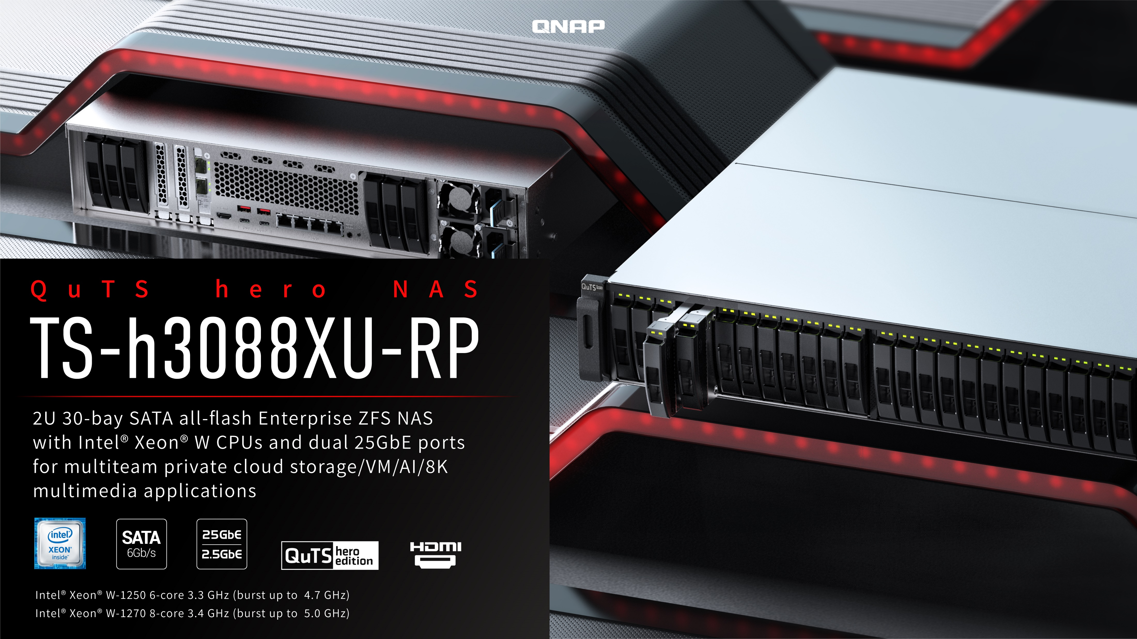

Slide 2


Enterprise-Grade Storage
Hardware Overview
QuTS hero h4.5.1
Accessories

Slide 3
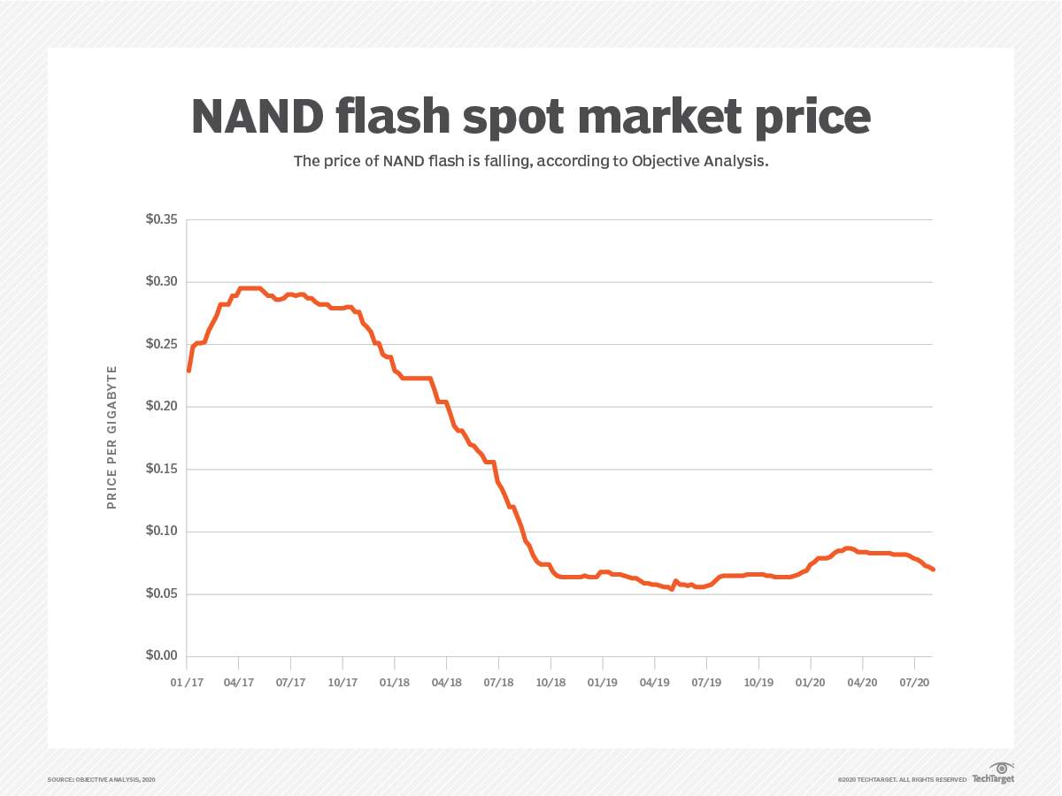
Businesses start to adapt all flash storage arrays (AFA) because SSD’s per-GB cost is dropping quickly.
Market research company Gartner predicts 2020 Q4 to 2021 Q2 enterprise SSD price will continue to fall by 10% ~ 15%．
Accompanying the falling prices of SSDs, businesses begin to buy more efficient all flash arrays (AFA) for Storage as a Service) 、hybrid cloud、AI、edge computing、Software Defined Storage (SDS) and other new types of storage functions.
Source: https: //searchstorage.techtarget.com/news/252487918/SSD-and-NAND-flash-prices-will-decline-through-start-of-2021

Slide 4

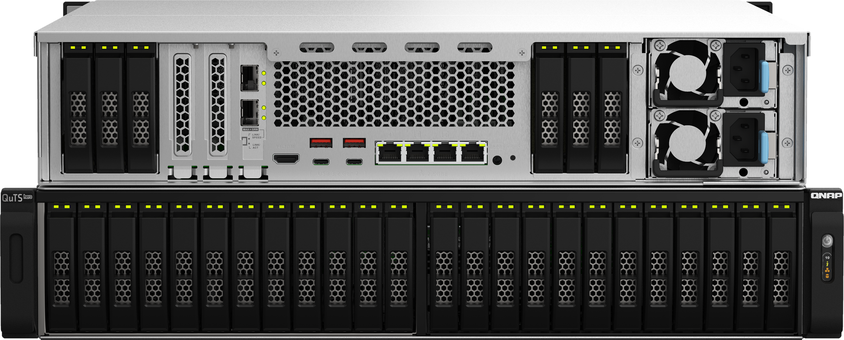
2U 30-bay all flash storage array (AFA)
Up to 596K / 345K IOPS 4K
random read & write performance
ZFS file system for data integrity
Data reduction technologies
  Increasing storage efficiency and ROI
  De-duplication、inline compression、data compaction
Unified Storage for iSCSI/ FC/ NFS/ CIFS/ FTP / S3 protocols
Storage and application servers
  Container Station and Virtualization Station for running virtualized operating systems and apps on the NAS
2U 30-bay
2.5-inch SATA SSD
ZFS file system

Slide 5


TS-h3088XU-RP available models
TS-h3088XU-RP-W1270-64G
Intel Xeon W-1270 8-core/16-thread, 3.4 GHz (Max. 5.0 GHz)
64GB DDR4 UDIMM ECC memory (4 x 16GB)
2 x SFP28 25GbE ports (25GbE/10GbE/1GbE)
TS-h3088XU-RP-W1250-32G
Intel Xeon W-1250 6-core/12-thread, 3.3 GHz (Max. 4.7 GHz)
32GB DDR4 UDIMM ECC memory (2 x 16GB)
2 x SFP28 25GbE ports (25GbE/10GbE/1GbE)

Slide 6
Supercharged with superb configurations over the competition
 | QNAP Wins | TS-h3088XU-RP | Other brand FS-series NAS
Processor | Ultra-high performance per core | Xeon W-1270 8-core 3.4 GHz, boost up to 5.0 GHz Xeon W-1250 6-core 3.3 GHz, boost up to 4.7 GHz | Intel Xeon D-1541 8-core 2.1 GHz, boost up to 2.7 GHz
Memory | More default RAM for more concurrent user connections and more apps | W-1270 SKU: 64GB W-1250 SKU: 32GB Supporting up to 128GB | Default 16GB Supporting up to 128GB
Storage | Higher single NAS capacity | 30 x 2.5-inch | 24 x 2.5-inch
Network | Best performance out of the box, save costs | 2 x 25GbE SmartNIC + 4 x 2.5GbE | 2 x 10GbE + 4 x 1GbE
PCIe # | Various SAS, QM2, or FC PCIe adapters | 3 (1 slot is pre-installed with a 2-port 25GbE NIC) | 1
Expansion | 4 x the raw capacity | Up to 286 drives (30 + 16 x TL-R1620Sep-RP 16-bay expansion units) | Up to 72 drives (24 + 2 x 24-bay expansion units)

Slide 7
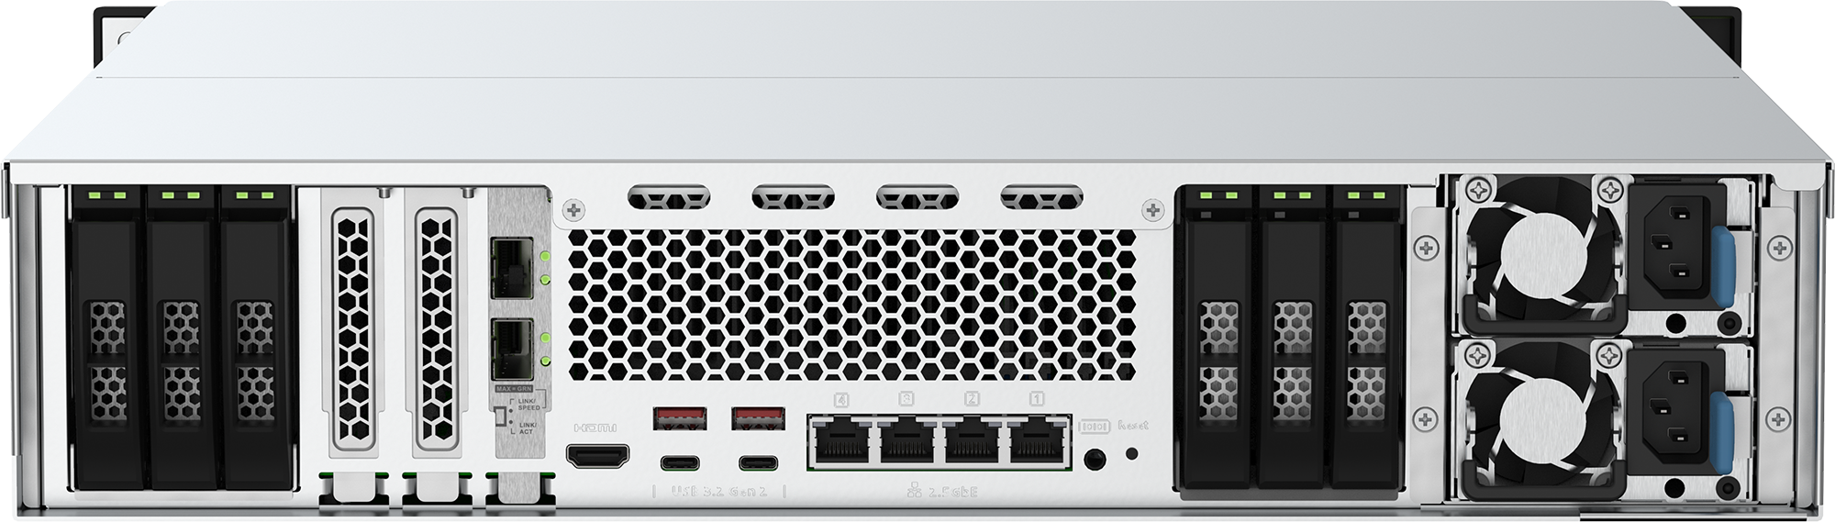

Shipped with 2 x 25GbE SFP28 ports
Bundled with Mellanox® ConnectX®-4 Lx dual-port 25GbE SmartNIC network card
SmartNIC with network offload capability for enhancing the network processing efficiency
  Remote Direct Memory Access (RDMA)
  RDMA over Converged Internet (RoCE)
Supporting iSCSI Extensions for RDMA (iSER), increasing VMware ESXi and VJBOD transfer performance
Link Aggregation for added bandwidth
TS-h3088XU-RP: 2 x 25GbE ports

Slide 8
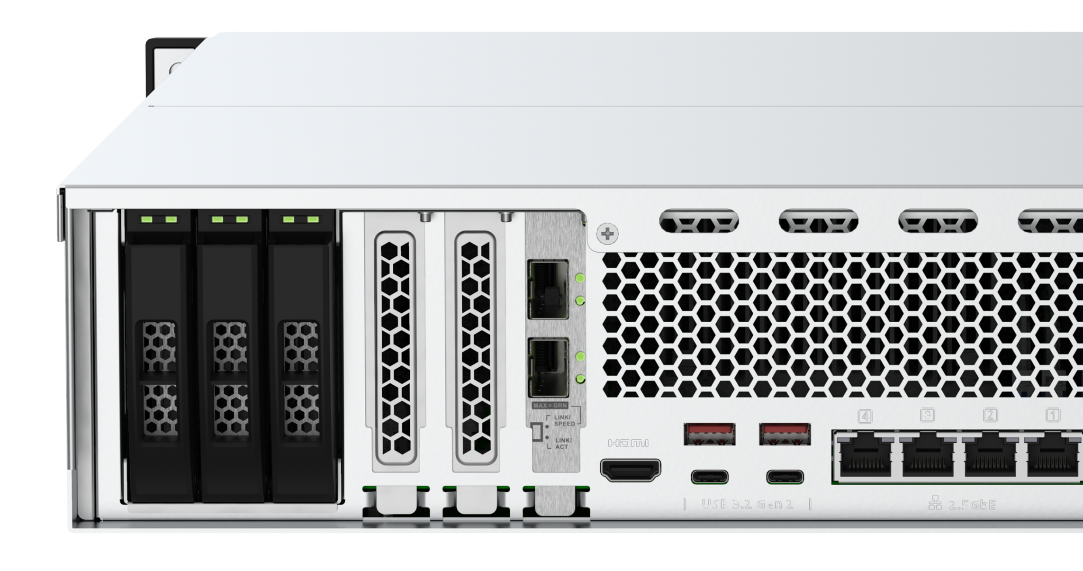
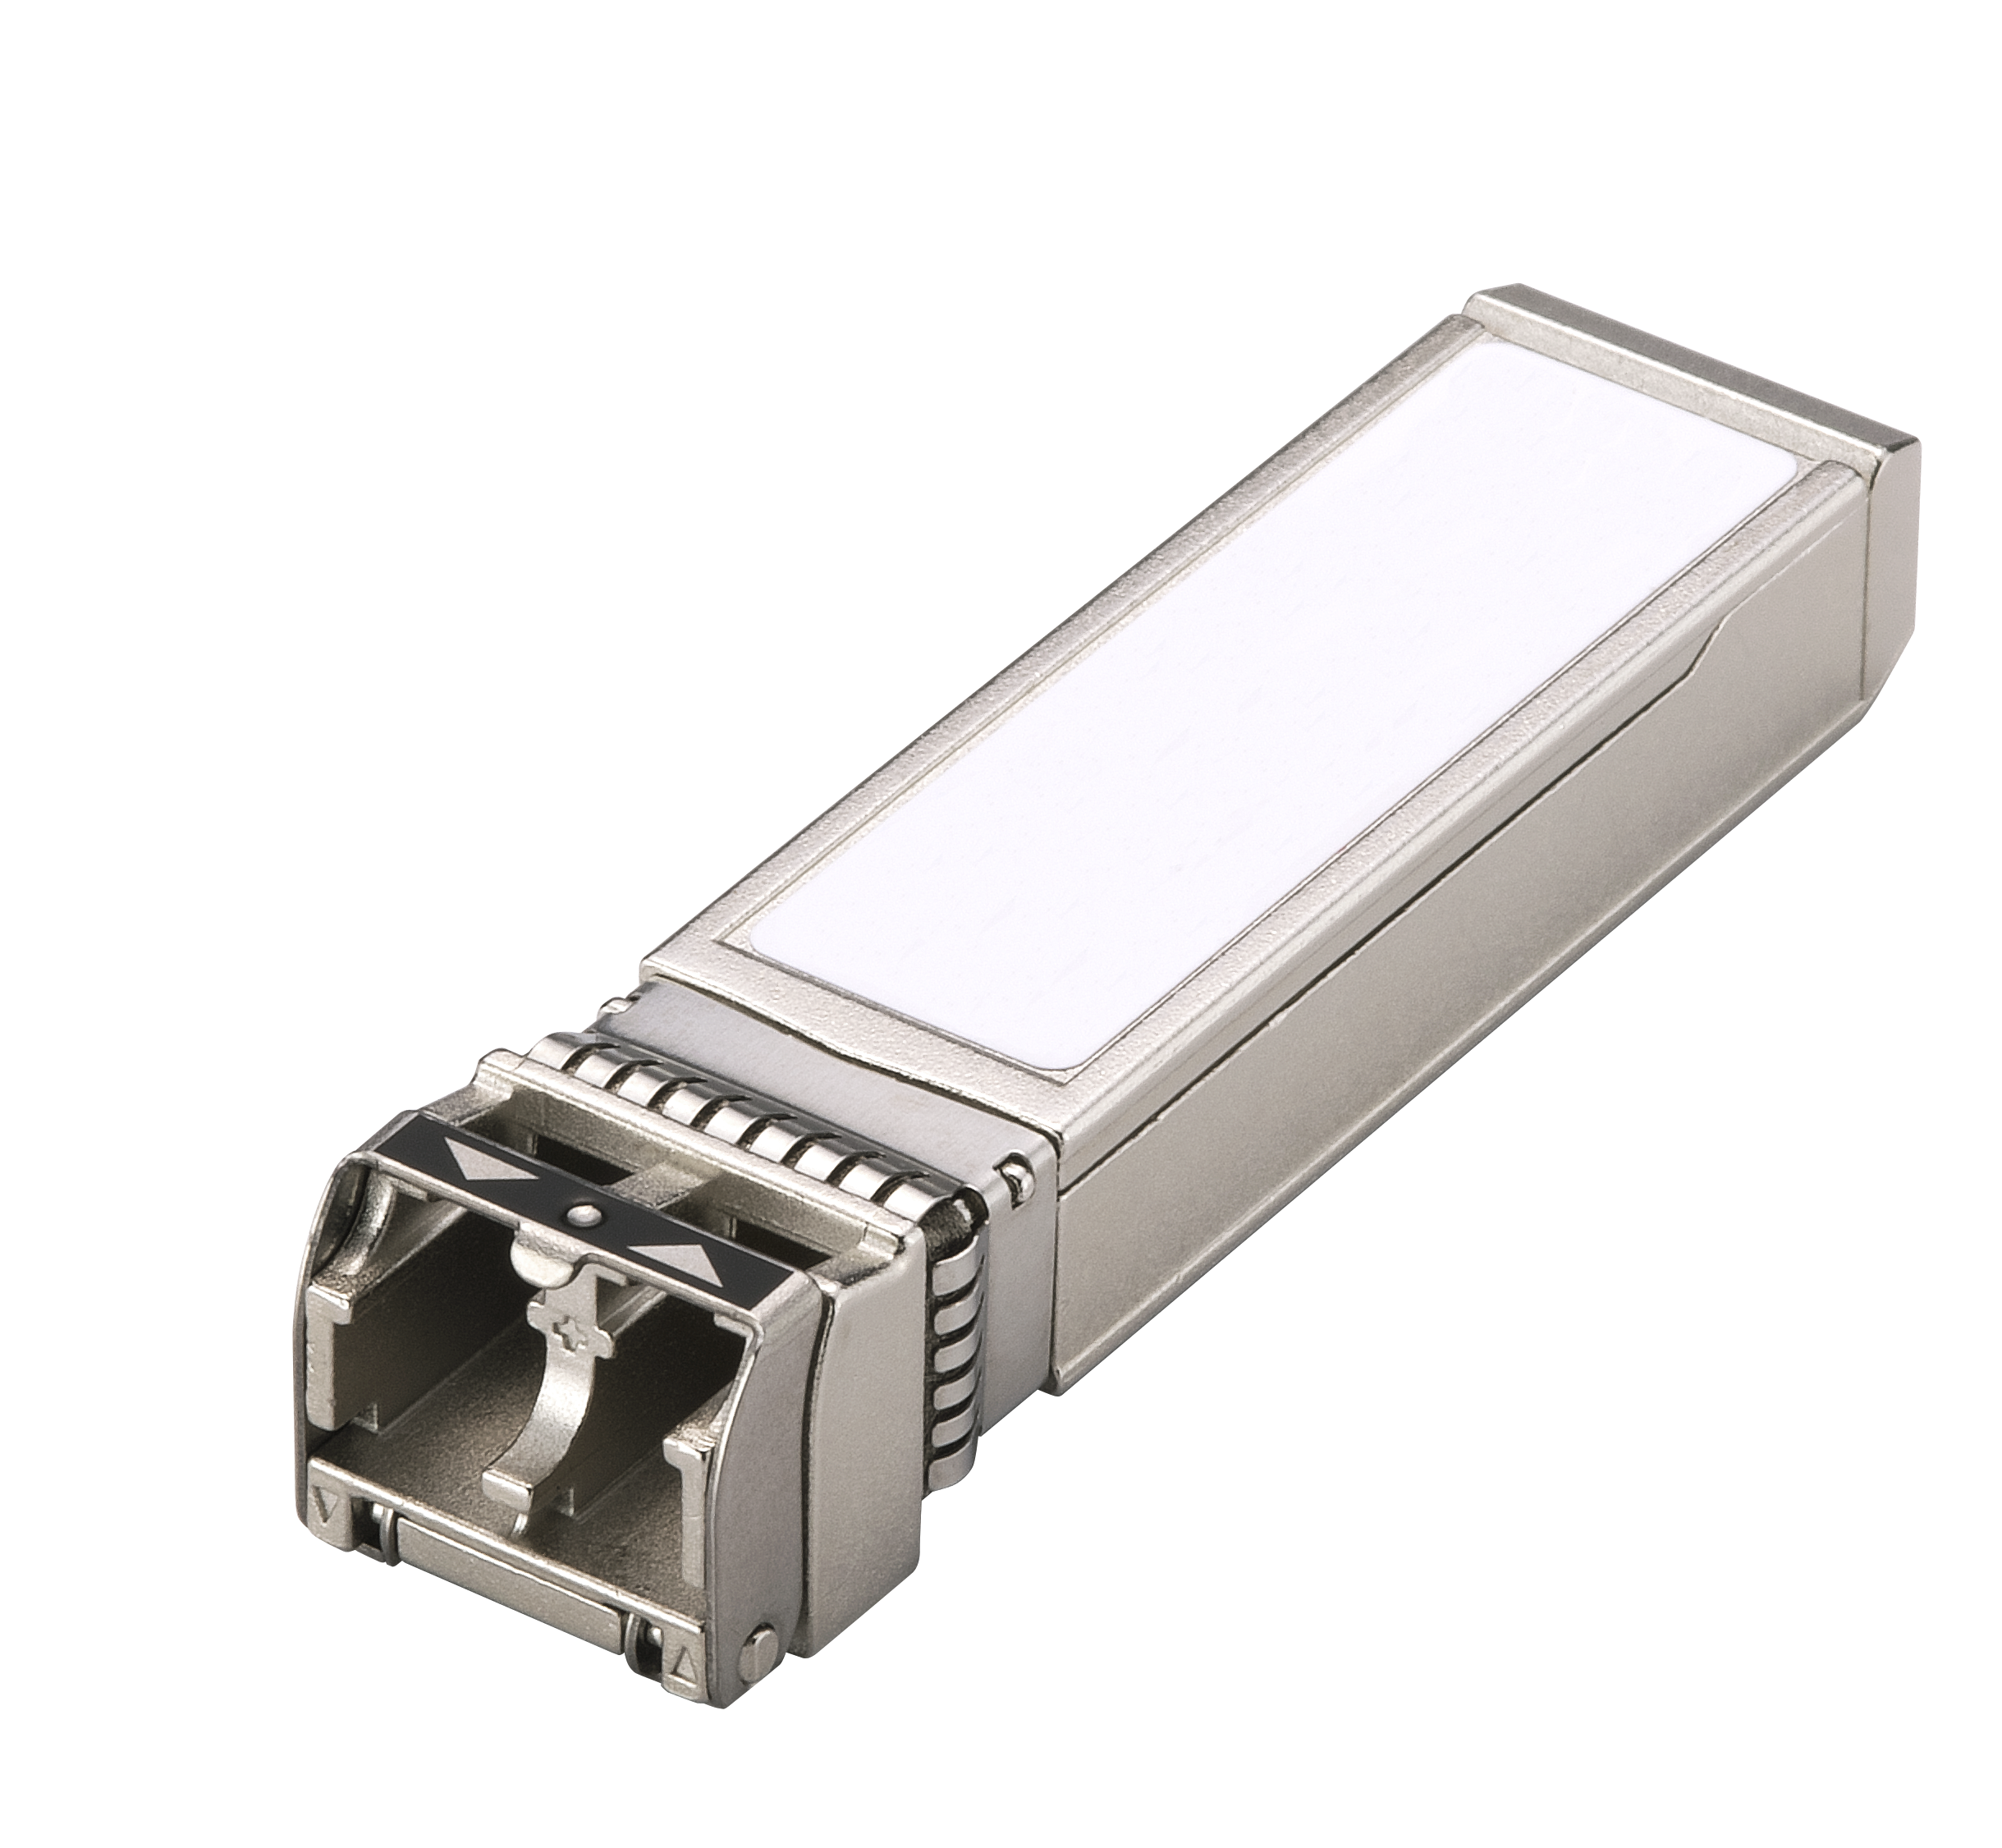

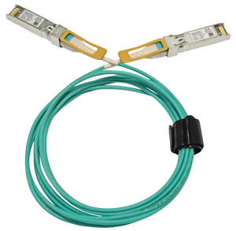
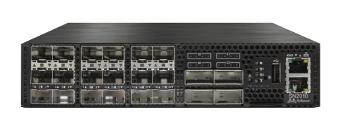
Flexible network speeds, 25GbE can be compatible with 10GbE/1GbE via transceivers
The 25GbE SmartNIC supports SFP28 transceivers
Compatible with 1GbE and 10GbE networks (requiring optional SFP/SFP+/SFP28 transceivers)
Auto-negotiation the link speed
25GbE SFP28 / 10GbE SFP+
Optional
Transceivers:
10GbE SFP+
1GbE SFP
DAC, AOC or
or LC fiber cables
Fiber optical cables
10GbE SFP+ / 25GbE SFP28
25GbE Switch

Slide 9
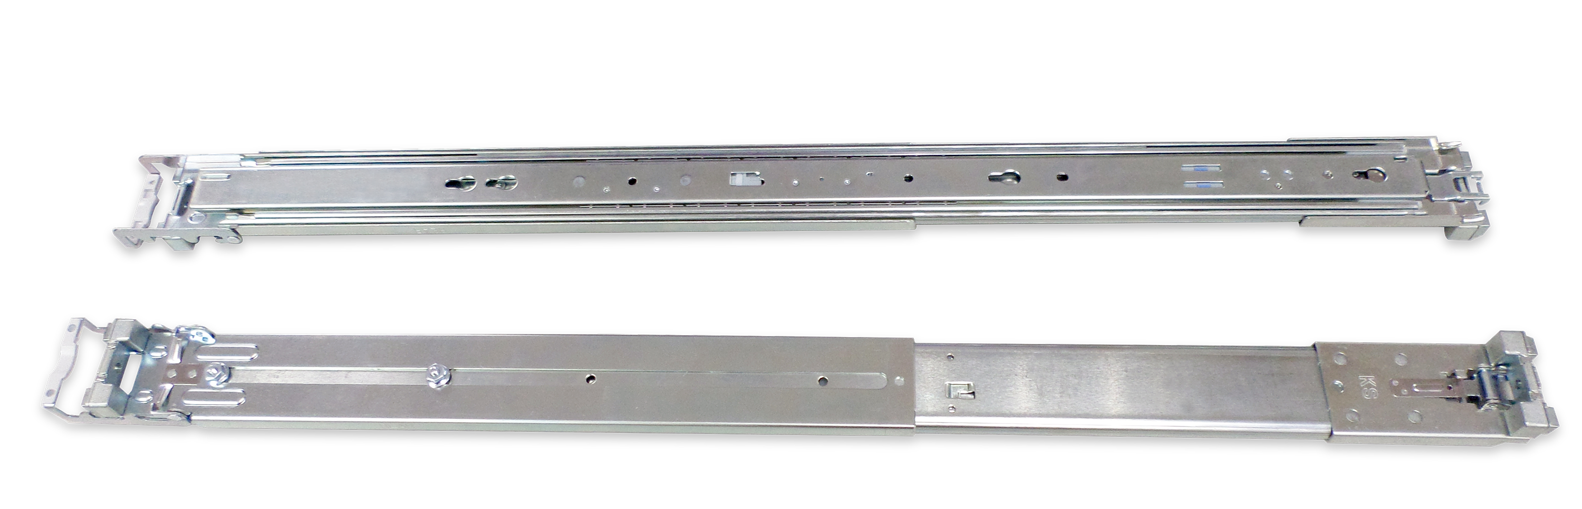
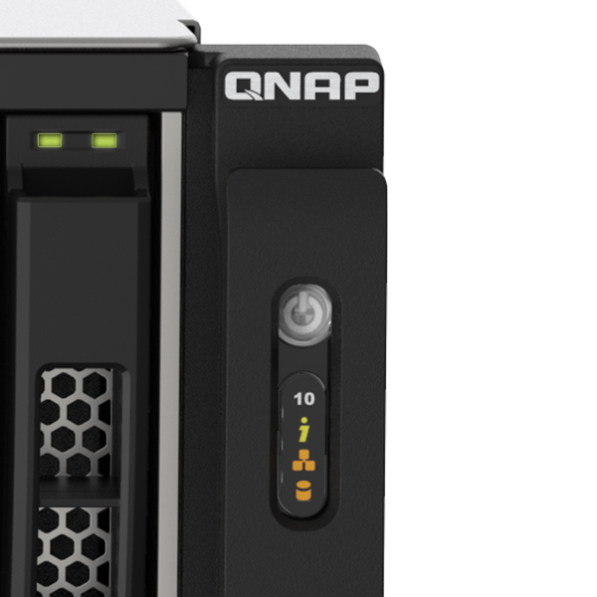
TS-h3088XU-RP NAS front side view
Optional Purchase
30 x 2.5-inch SATA 6Gbps SSD trays
  Supporting up to 15mm height SSD / HDD
RAIL-A03-57 Rail Kit
Power button
LED indicators
  System status
  Network status
  Expansion unit connection

Slide 10
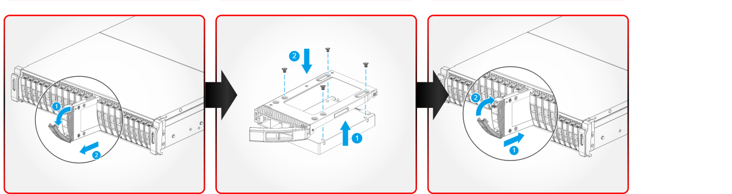
2.5-inch SATA SSD/HDD installation steps
1. Remove the drive tray
2. Use a screwdriver
3. Insert the drive tray

Slide 11
TS-h3088XU-RP NAS rear view
3 x PCIe Gen3 slots
Slot 1 : Gen3 x8
(Gen3 x4 if the slot 2 is occupied)
Slot 2 : Gen3 x4
Slot 3 : Gen3 x4
4 x 2.5GbE
COM port
2 x 25GbE ports
515.02 mm
(D)
Reset button
Slot 3
Slot 1
Slot 2
88.3 mm
(H)
2 x 550W PSU
2 x USB 3.2 Gen2 Type-A
2 x USB 3.2 Gen2 Type-C
HDMI 4K 1.4b
481.07 mm (W)

Slide 12
Geared for large businesses with high-performance components
4 x DDR4 UDIMM ECC RAM slots, up to 128GB
Slot 1
Slot 2
Slot 3
3 x PCIe Gen3 slots
Slot 1: Gen3 x8 (Gen3 x4 if the slot 2 is occupied)
Slot 2: Gen3 x4
Slot 3: Gen3 x4
Intel Xeon W 6-core and 8-core CPUs
Xeon® W-1250 6C / 12T
3.3 GHz processor (boost up to 4.7 GHz)
Xeon® W-1270 8C / 16T
3.4 GHz processor (boost up to 5.0 GHz)

Slide 13
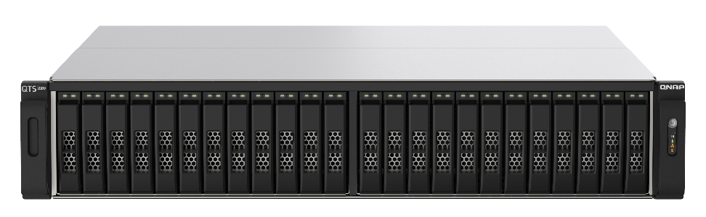
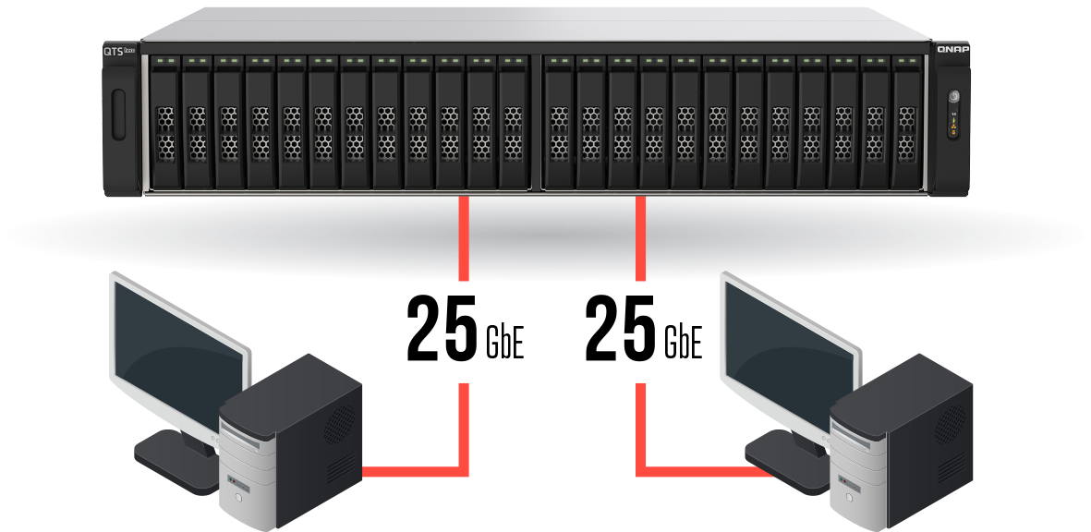


Performance Test Environment
2 workstations, connected to TS-h3088XU through 25G:
(1) Simultaneously read and write 8GB file (= 16GB totally)
Best configuration of storage
TS-h3088XU-RP-W1270
The front 24 SSDs configured as data pool 2 in RAID 6 or 60. (yields the best performance)
8 GB
8 GB
(2) Simultaneously read and write 64GB file (= 128GB totally)
Random I/O test 4K block size LUN
Sequential I/O test 128K block size LUN
The rear 6 SSDs configured as pool 1 in RAID 6
(as system and app pool/small data storage)
64 GB
64 GB

Slide 14

File size < RAM: cache hit
TS-h3088XU-RP-W1270
30 x Seagate Ironwolf Pro 125 3.84TB SSDs
RAM
Write to Disk later
Write to NAS
Transmission complete
SMB sequential / iSCSI Random
 | IOPS / throughput | CPU loading (%) | Latency
Seq. read 512K (MB/s) | 5438 | 16% | 24
Seq. write 512K (MB/s) | 4937 | 21% | 26
Random read 4K (IOPS) | 596,000 | 55% | 0.43
Random write 4K (IOPS) | 345,000 | 91% | 0.74
TS-h3088XU-RP-W1270
Simultaneously read and write 8GB file, the total amount is 16 GB still less than NAS RAM size.
Can get relatively high performance
Compared with the old Xeon-D AFA, the performance is improved more than 50%.
Notes:
效能表放大
AM
IOPS 粗體

Slide 15
File size > RAM: direct access to SSD
TS-h3088XU-RP-W1270
30 x Seagate Ironwolf Pro 125 3.84TB SSDs
Bigger than RAM
Write to NAS
Write to Disk
Transmission complete
SMB sequential / iSCSI Random
 | IOPS / throughput | CPU loading (%) | Latency
Seq. read 512K (MB/s) | 3867 | 60 % | 17
Seq. write 512K (MB/s) | 2226 | 75 % | 29
Random read 4K (IOPS) | 267,000 | 73 % | 0.96
Random write 4K (IOPS) | 236,000 | 91 % | 1.08
TS-h3088XU-RP-W1270
Simultaneously read and write 64GB file, the total amount is 128 GB, much larger than the RAM size.
The direct access performance of this SSD array.
Compared with the old Xeon-D AFA, the performance is improved more than 50%.
Notes:
y

Slide 16

Notes:
y

Slide 17
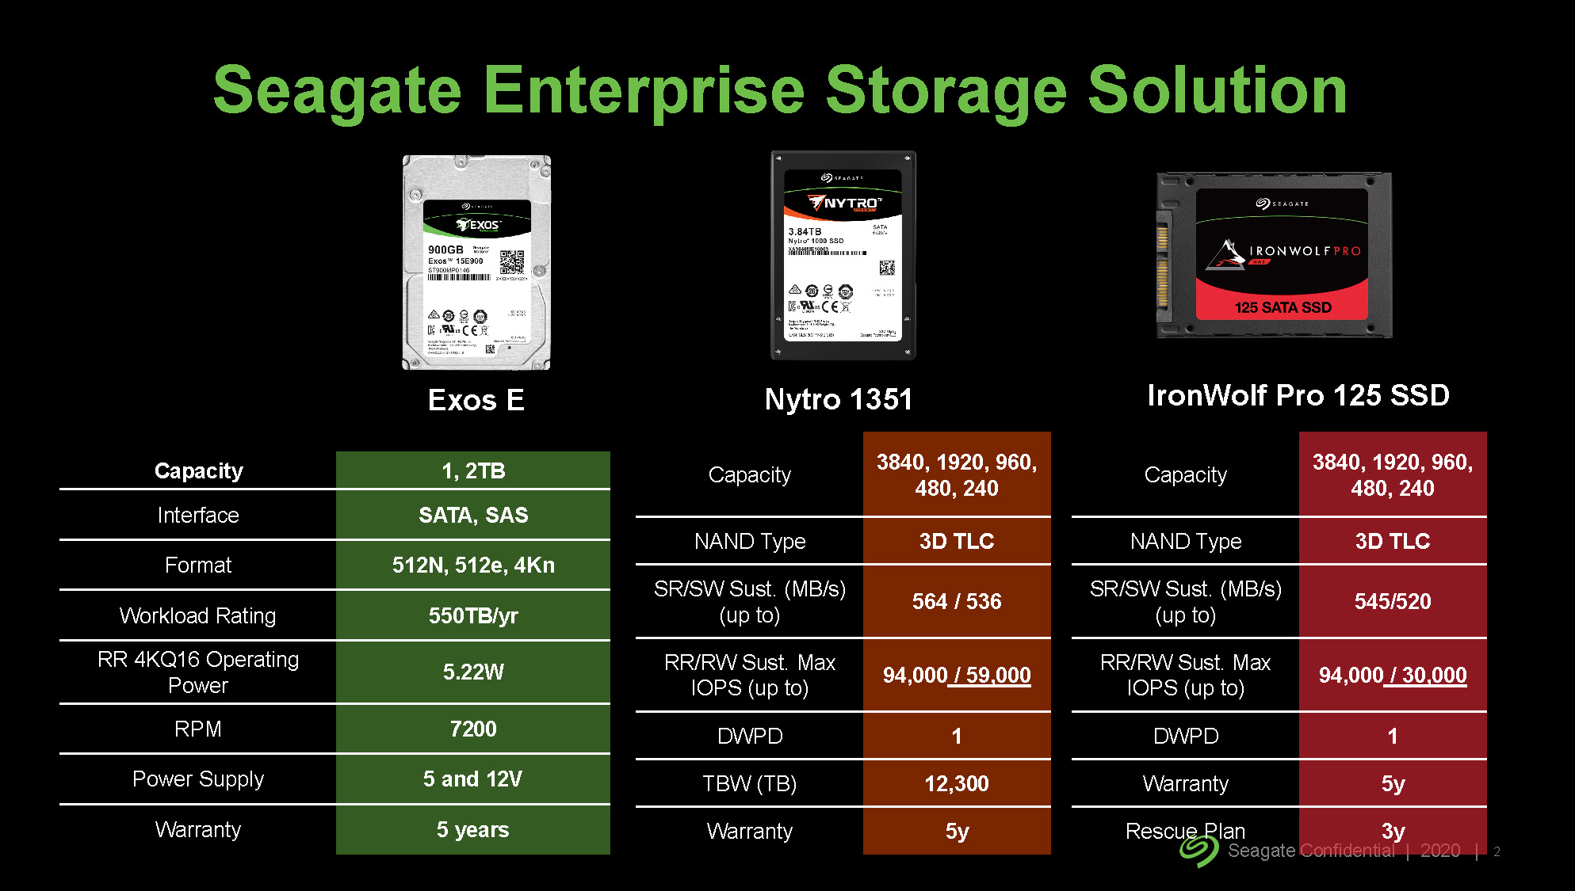
Notes:
y

Slide 18
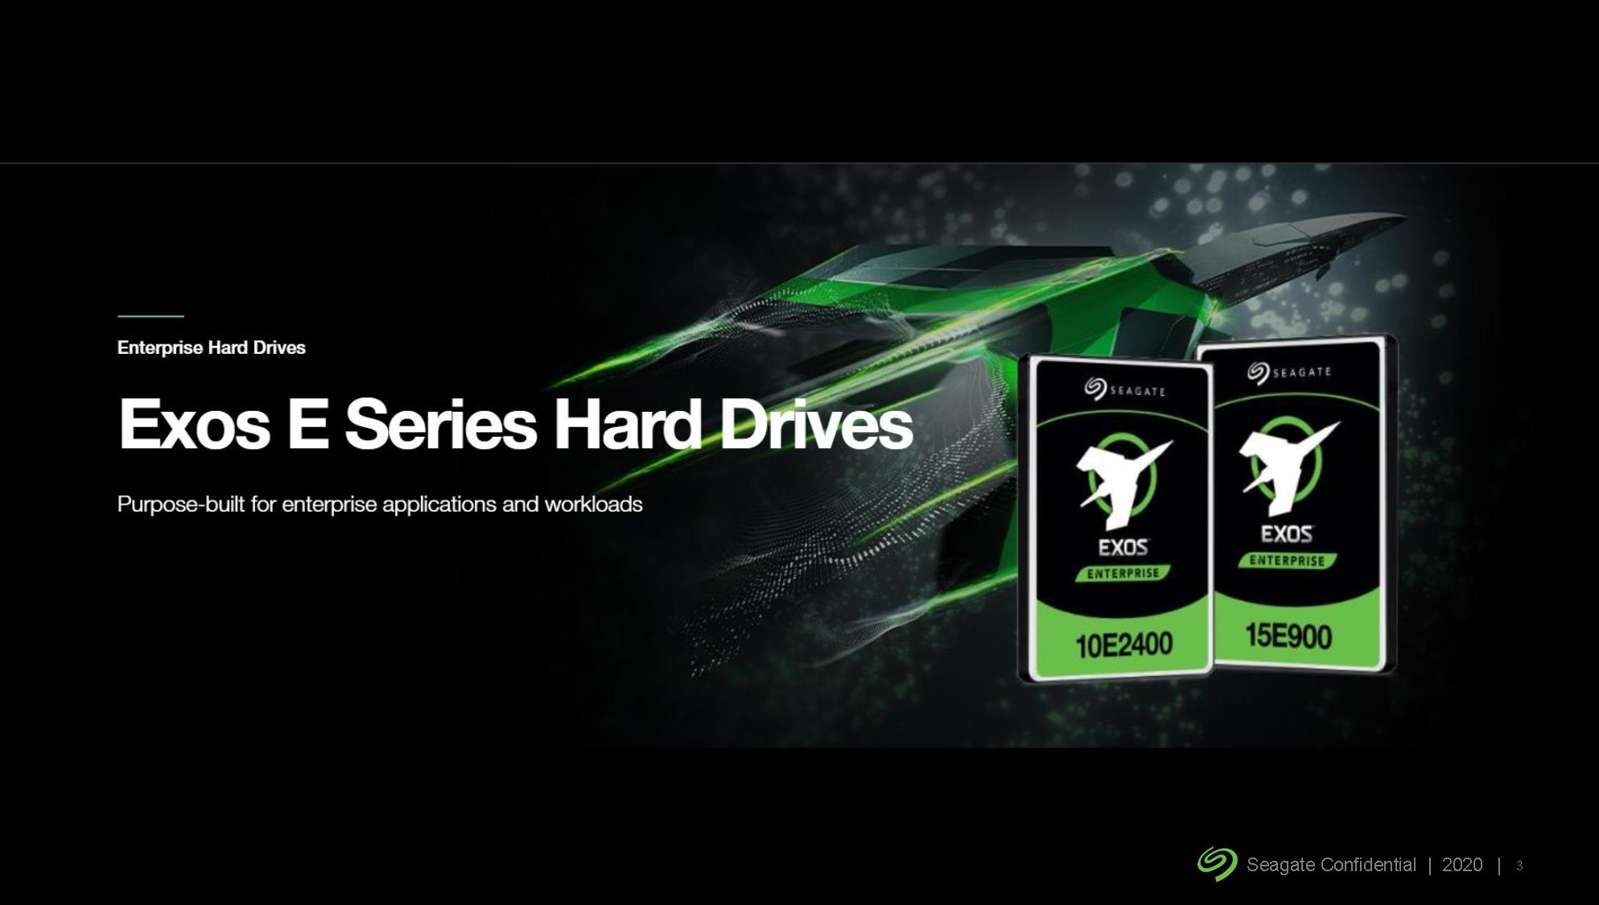
Notes:
y

Slide 19
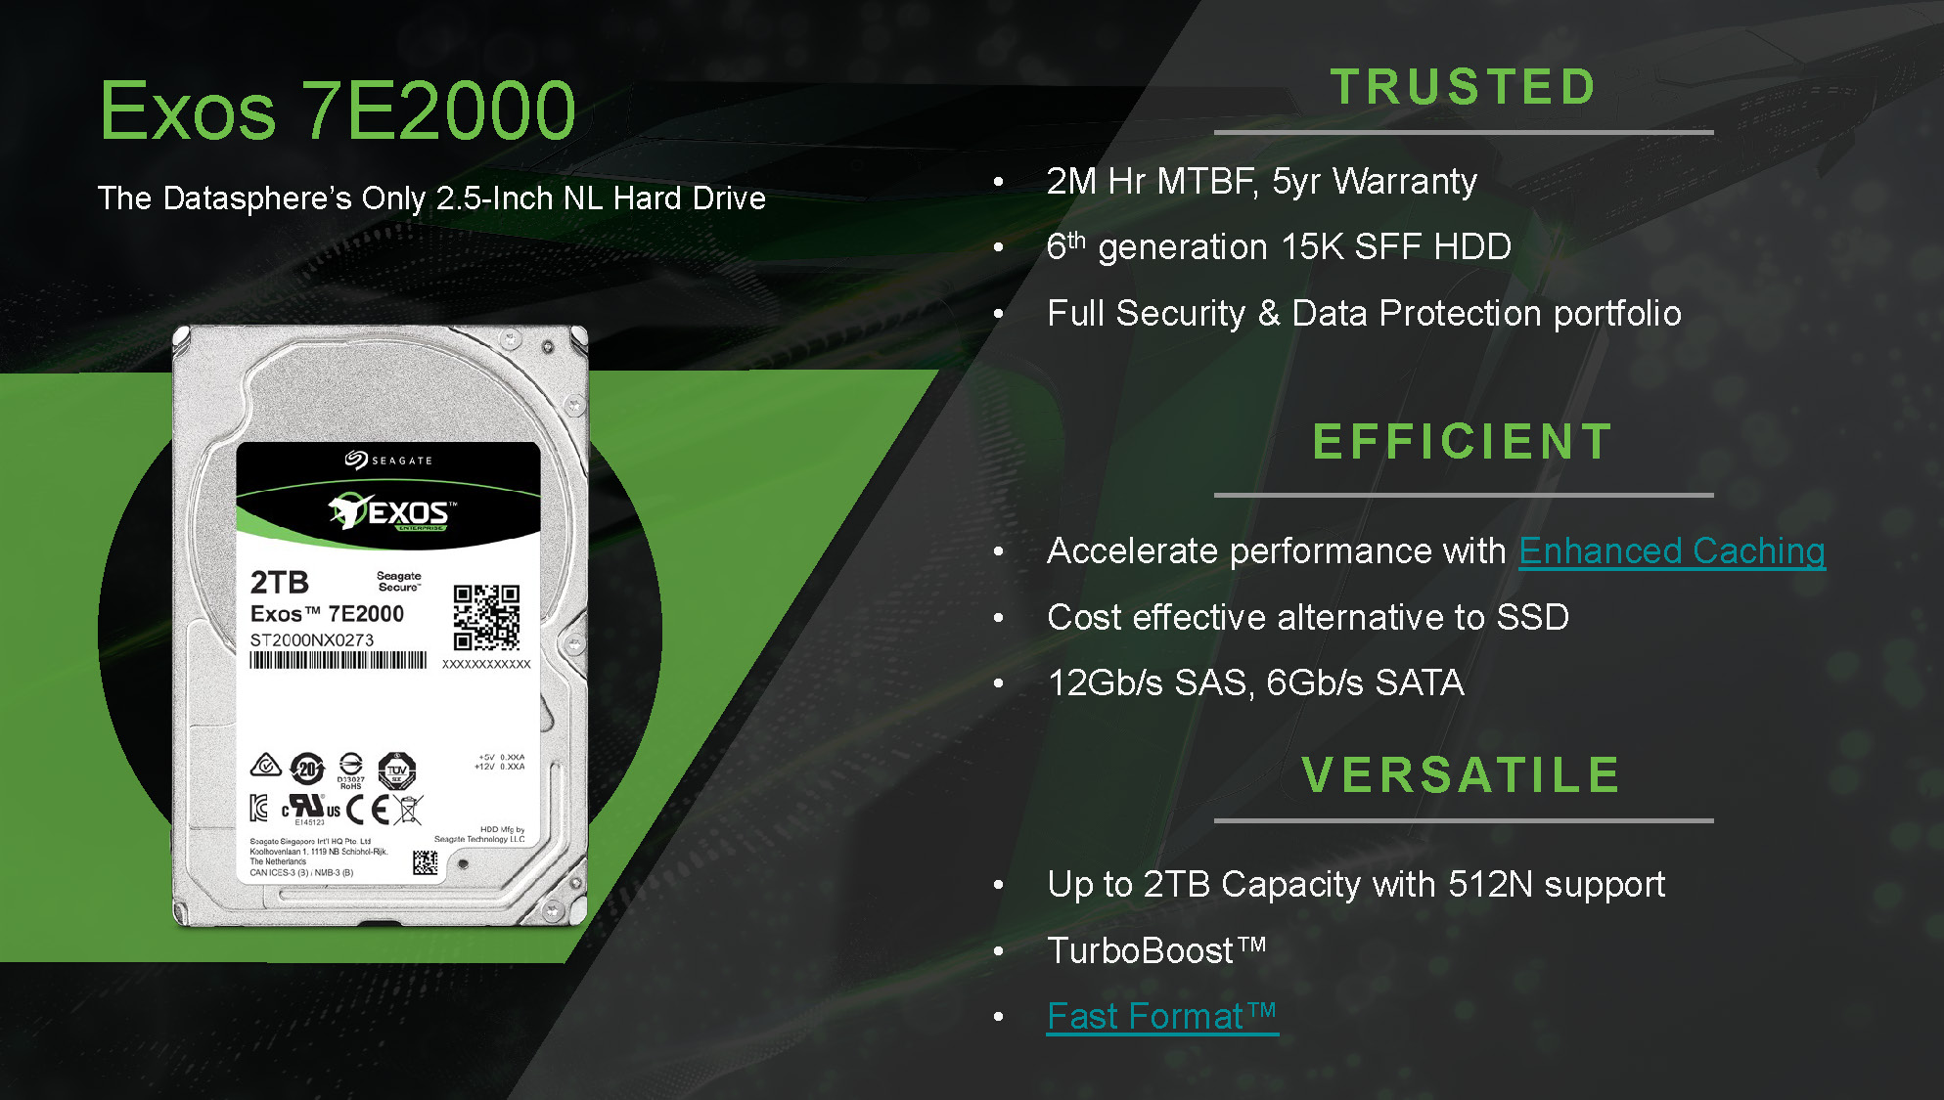
Notes:
y

Slide 20
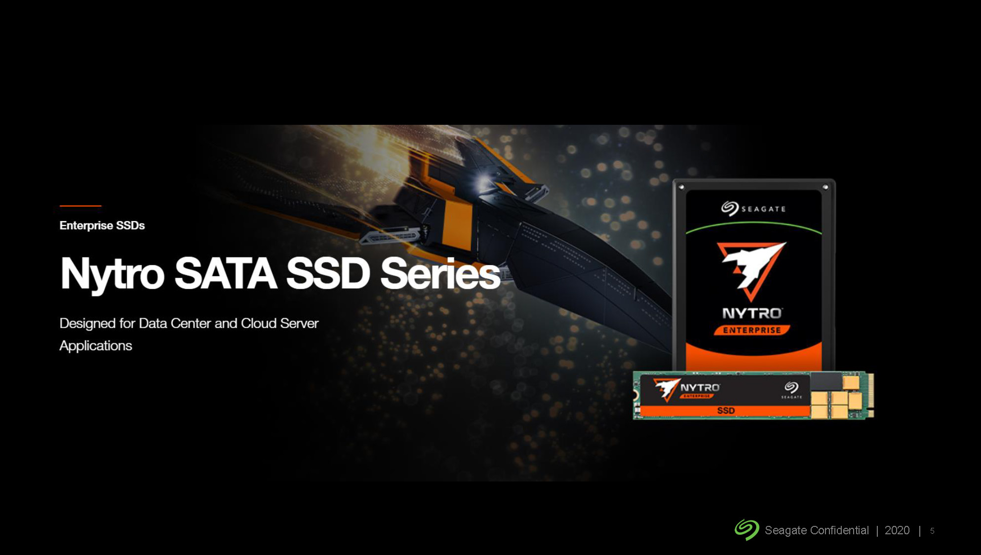
Notes:
y

Slide 21
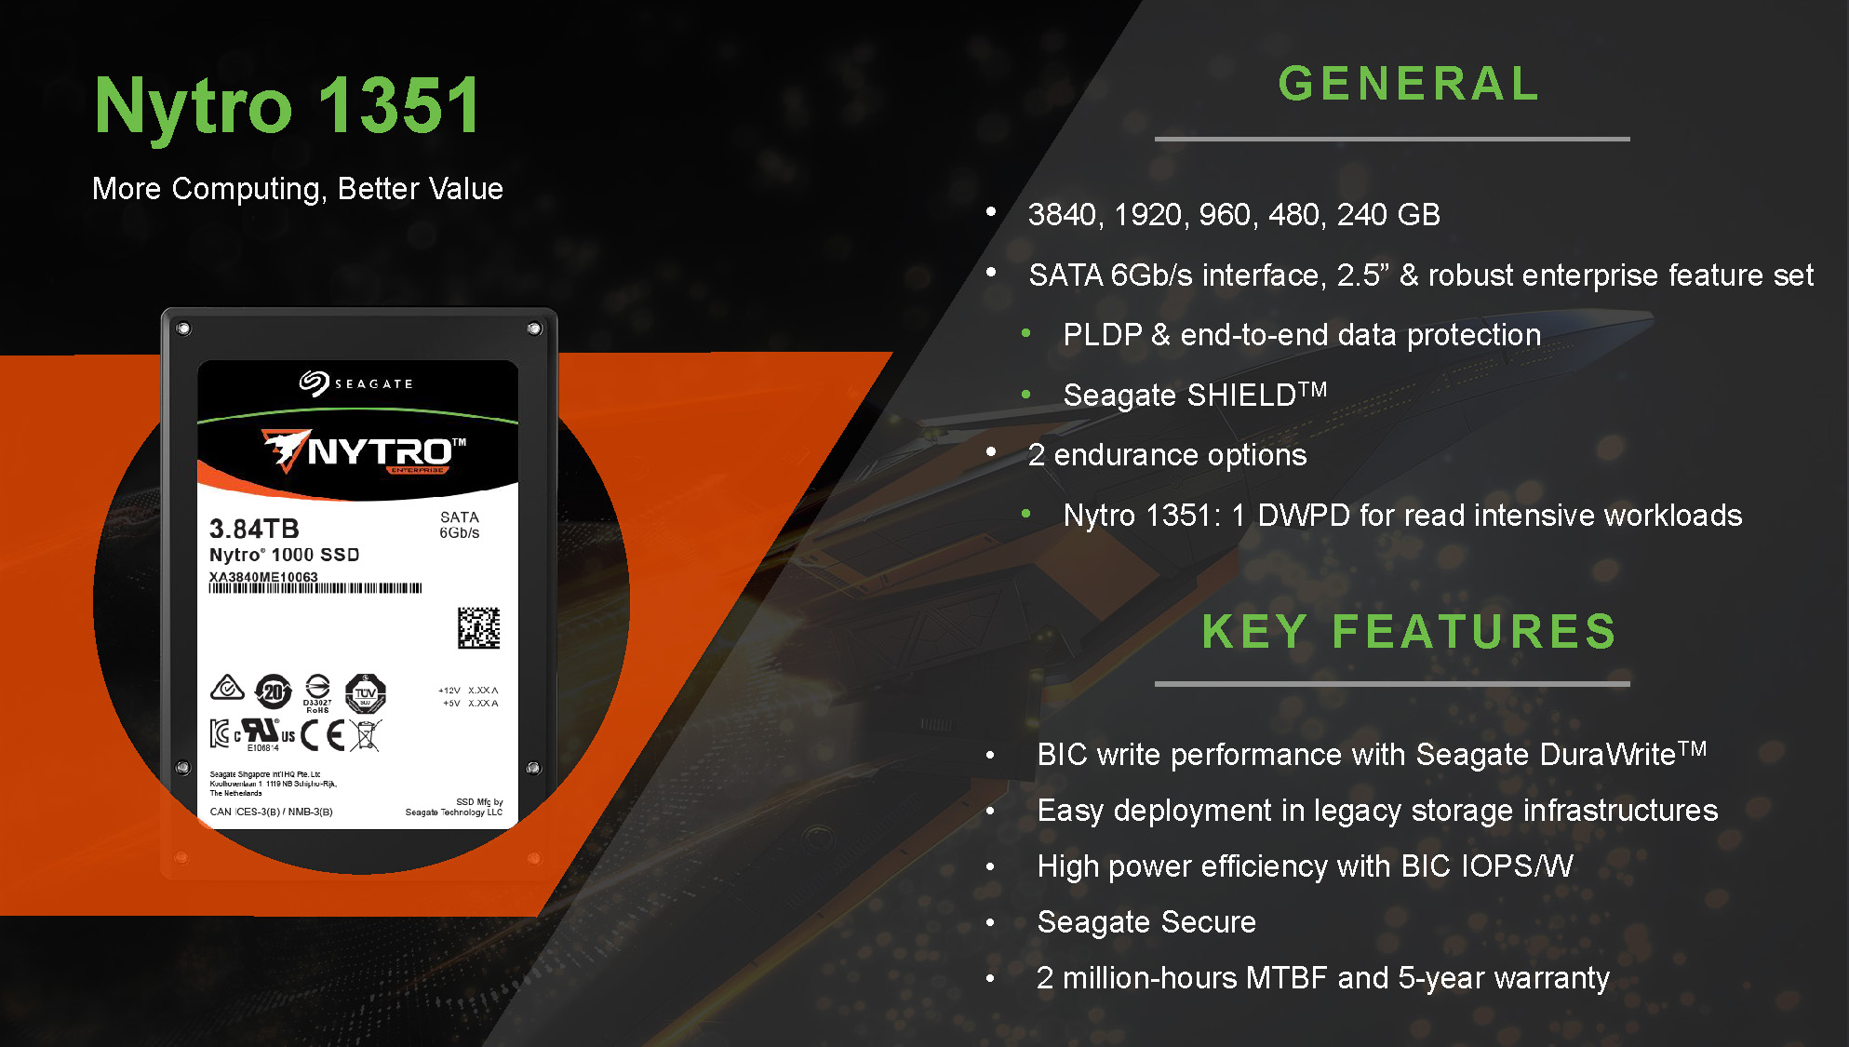
Notes:
y

Slide 22

Notes:
y

Slide 23
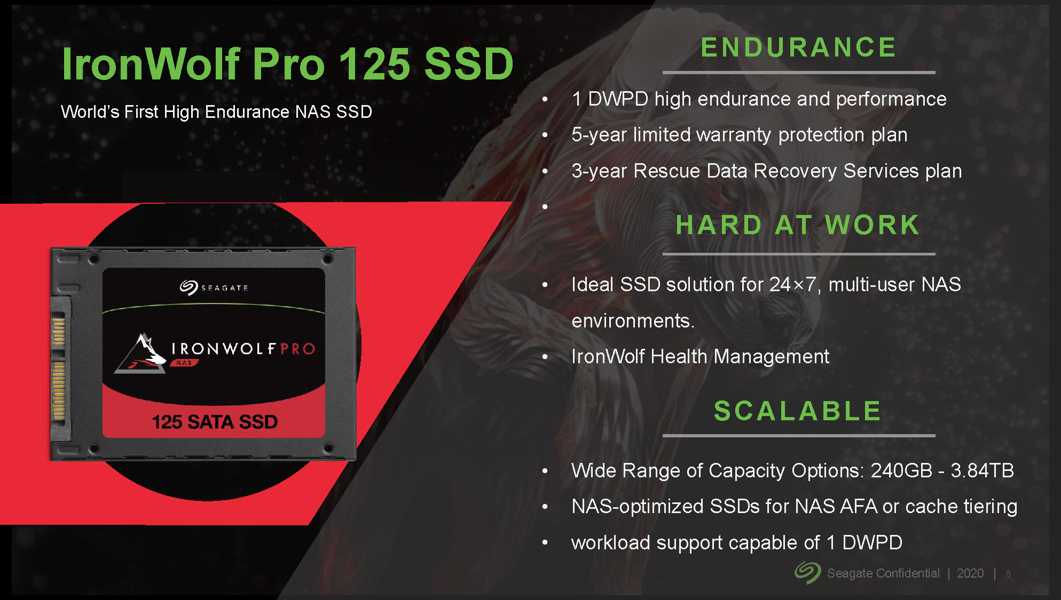
Notes:
y

Slide 24

Notes:
y

Slide 25
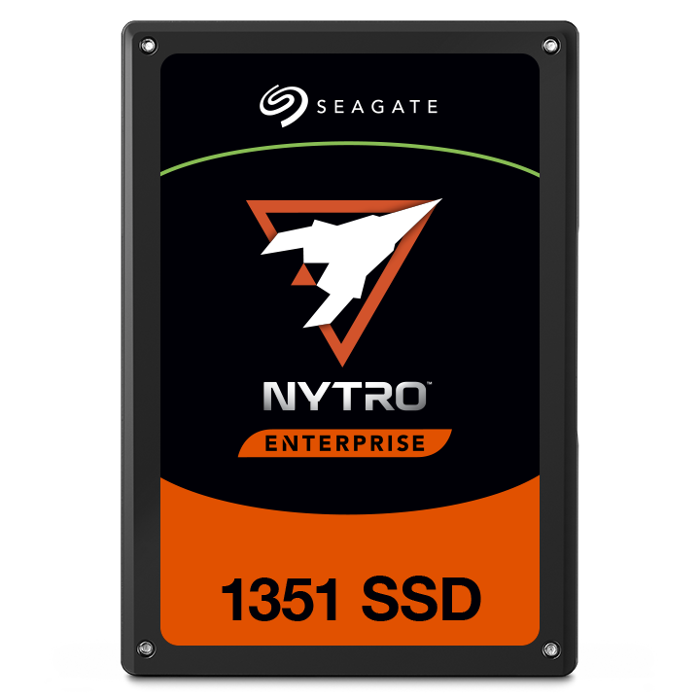
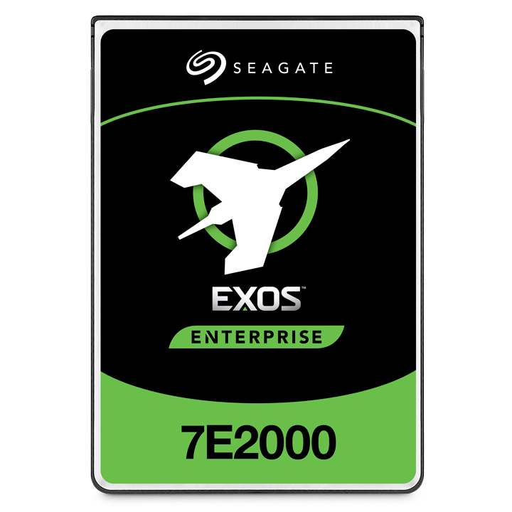
Flexible and economic
HDD + SSD hybrid configuration
Hybrid Configuration: 24 x HDDs + 6 x SSDs
24 x Seagate EXOS 7E2000 2TB HDDs
+ 6 x Seagate Nytro 1351 1.92TB SSDs
= US$ 6,098.52
All Flash Configuration: 30 x SSDs
30 x Seagate Nytro 1351 1.92TB SSDs
= US$ 12,492.6
For budget-limited enterprises, adopt a hybrid configuration to cut IT costs in half with same storage capacity.
Source:
1. https: //www.amazon.com/
2. https: //www.newegg.com/
Notes:
y

Slide 26
QuTS hero
operating system
Notes:
封面標打上ZFS logo. 頁面太空

Slide 27





ZFS file system:
Optimized operating system for AFA
TS-h3088XU-RP is shipped with the QuTS hero operating system which is based on the ZFS file system. It can provide the data integrity, safety, and efficiency required for all flash storage.
Inline Compression & Inline deduplication
Improve the SSD lifespan
Easily expanded to PB-level storage
Data self-healing
COW mechanism can avoid data loss that occurred on power outage.
Data Efficiency
Data Integrity
A nearly unlimited number of 65,536 snapshots​ (supports folder/LUN)​
New RAID Protection
WORM (write once read many)
SnapSync real-time data mirror
Snapshot Replica
HBS3
Data
Protection
Disaster Recovery
Notes:
色系調整，太黑

Slide 28
Data Efficiency

Slide 29
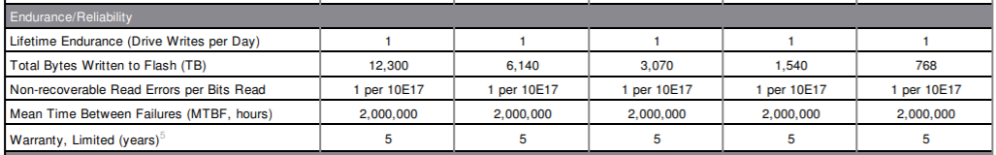
How to determine the SSD endurance
SSD life is ended when the total data written has reached the defined capacity.
How can the server prolong the SSD lifespan?
Example: 3.84TB SSD with 1DW/D for 7x24 5-year warranty
Lifespan = 3840(GB) * 1 (DW/D) * 365 (days) * 5 (years) = 7008 TBW
Data source: www.seagate.com

Slide 30





Powerful data reduction –
Extend the SSD endurance
It only works with inline
processing before writing
ZFS file system with inline deduplication compression feature
It's the best choice to pair with the all-flash and SSD storage because it reduces the data size and pattern that need to be written to the SSD directly.
Write
A
B
C
D
A
B
C
D
A
B
C
D
D
C
A
B
D
C
A
B
Original Data
Compressed Data
Deduplicated Data
SSD Pool
Compression
Deduplication
Write to SSDs as sequential as much as possible.

Slide 31





Storage Pool Over Provisioning
Improve the performance for fragmented pool (The scenario for small block)
w/o OP
w/ OP
A
B
C
D
F
G
H
I
10%
Pool free space
Pool free space
Reserved
space
E
1. Move Data C, Move Data B, then Data A
2. Free the space for writing Data E
1. Write Data E to reserved space, return ok.
2. Move Data I to keep same reserved size.
E
A
B
C
D
F
G
H
I
10%
E
Pool free space
Pool free space
Reserved
space

Slide 32
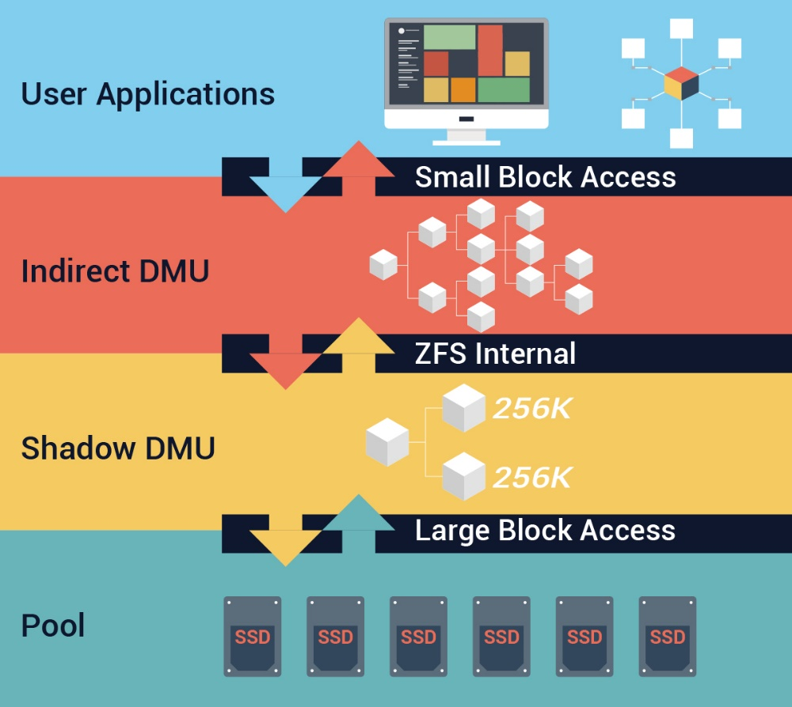
Write Coalescing
QNAP exclusive Write Coalescing algorithm that transform all random write to sequential writes along with reduced I/O.

Slide 33
Data Protection

Slide 34


Snapshot Protection (65,536)
Shared Folder Snapshot
LUN Snapshot
Snapshot Manager is operated based on shared folder.​ With [Clone], [Restore] & [Folder Revert] support.​​
NAS maximum 65,536
  Shared Folder
  iSCSI / FC LUN

Slide 35
RAID types with even higher security:
Triple Parity & Triple Mirror
Even if three hard disks are damaged at the same time, this RAID service can keep going (redundant tolerance of 3 sets of parity information)
3 sets of identical data for redundant tolerances, will give you 3 times the protection.
Triple Parity
Triple Mirror
A1
A2
Ap
Aq
Ar
A1
A1
A1
B1
Bp
Bq
Br
B2
A2
A2
A2
Cp
Cq
Cr
C1
C2
A3
A3
A3
Dq
Dr
D1
D2
Dq
A4
A4
A4
Er
E1
E2
Ep
Eq
Disk 1
Disk 2
Disk 3
Disk 4
Disk 5
Disk 1
Disk 2
Disk 3

Slide 36



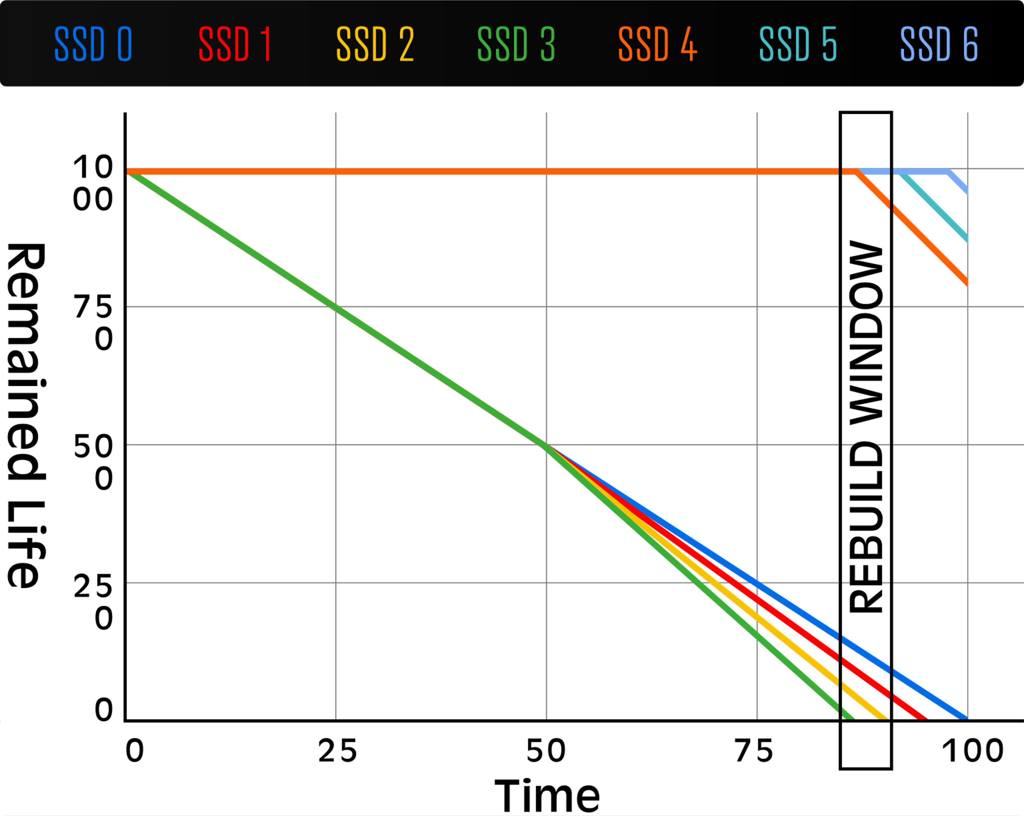
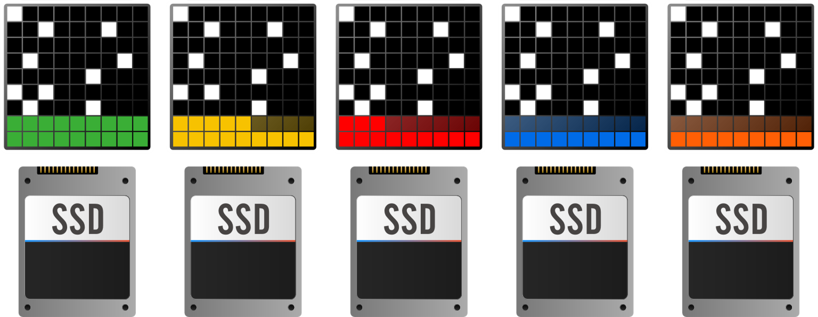
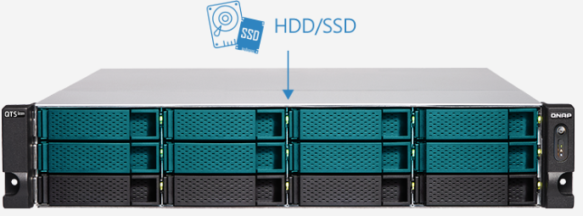
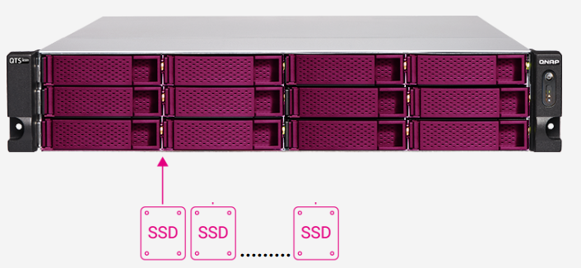
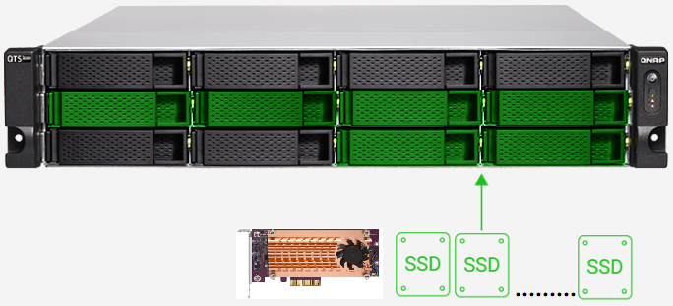
Patented QSAL technology: preventing multiple SSD malfunctioning at the same time
(QSAL will be available from Q4 2020)
Corresponding to SSD RAID 5 / 6 / 50 / 60 / TP(Triple Parity) will be enabled by default automatically.
QSAL
dynamic distribution
PM 手繪草圖說明, 再協助微調圖示

Slide 37


WORM (Write Once Read Many times)
WORM is used to avoid modification of saved data. Once this feature is enabled, data in shared folders can only be read and cannot be deleted or modified to ensure data integrity.
  Enterprise Mode : remove the shared folder through QTS hero UI or SSH commands (QCLI).
  Compliance Mode : Have to take the Storage Pool offline and remove the Pool if want to destroy data.

Slide 38
Data Integrity

Slide 39



Silent data corruption & self-healing
Application
Application
Application
ZFS RAID
ZFS RAID
ZFS RAID
Avoid data silent corruption that occurred on running system

Slide 40

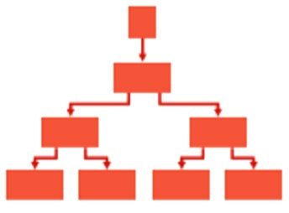
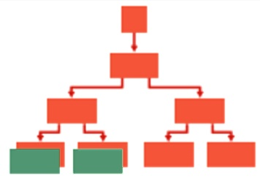
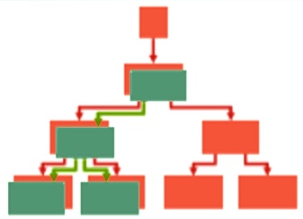
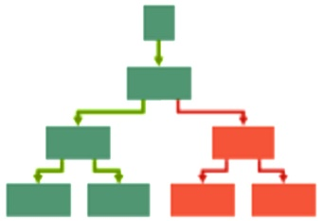

COW (copy on write) avoid data loss that occurred on power outage
ZFS has no need to use traditional journal to protect metadata, because they are never updated in-place.
COW mechanism will copy the written data to the new block and redirect the index to the new block after writing.
Original block Structure
Copy to new block when modifying
Redirect to new block
Delete the old block data

Slide 41
Disaster Recovery

Slide 42

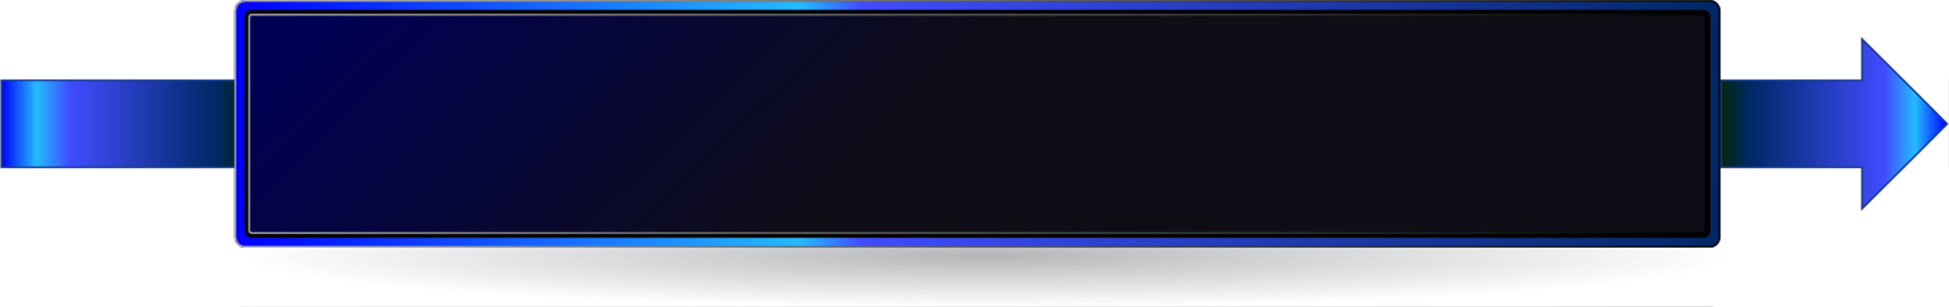



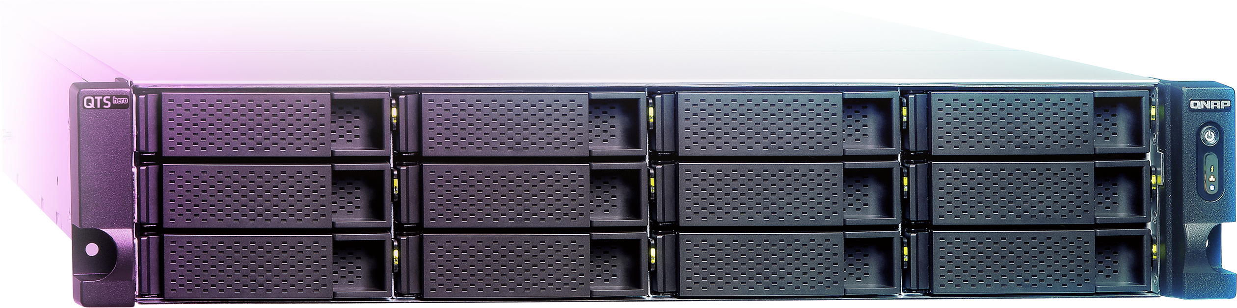
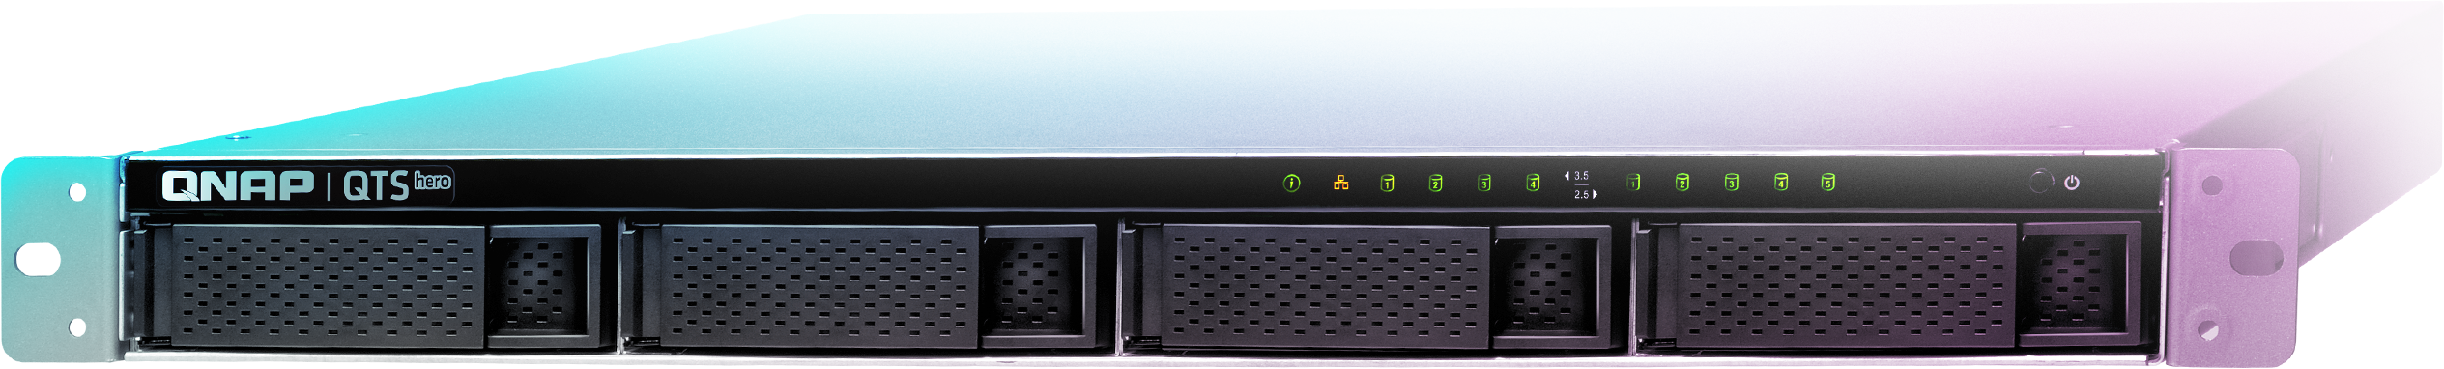
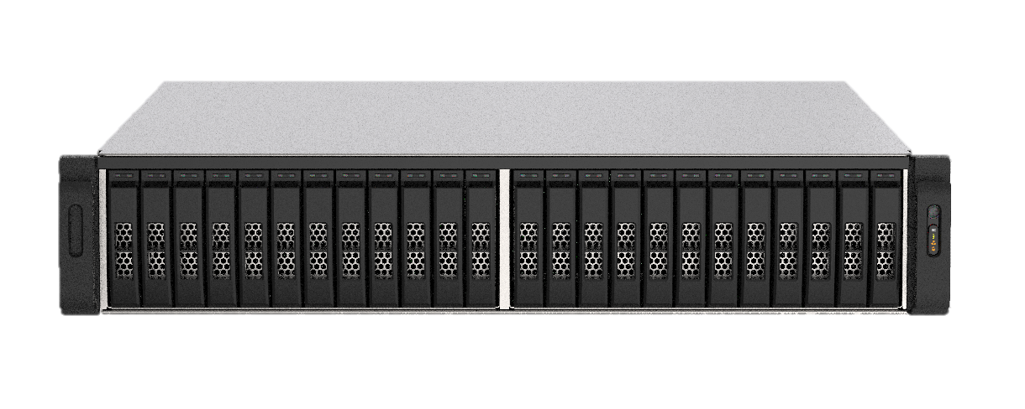
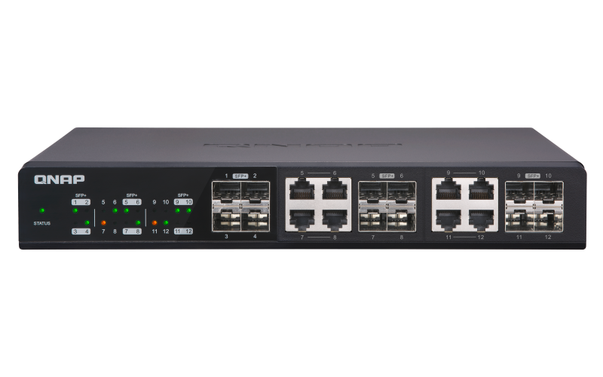
Three-layer backup solution
Builds the most complete data backup protection
HBS 3 :
File level, multi-version management
RPO : daily / schedule
Snapshot & Replica:
File level, multi-version management.
The most lightweight snapshot without affecting storage performance.
RPO : hourly
SnapSync:
Block level, Mirror the data copy and always kept up to date.
RPO : real-time
Notes:
標示標題出

Slide 43
Best Accompanying
Apps

Slide 44






Hyper Data Protector: All-in-one active backup solution for virtual machines
For AFA that is most suitable for virtualized applications, it is particularly important to has a solution be able to back up virtual machines.
Supports VMware, Microsoft Hyper-V
Unlimited VM backups and license-free
Active backup solution
Restore at any time point
Microsoft Hyper-V
Hyper Data Protector

Slide 45








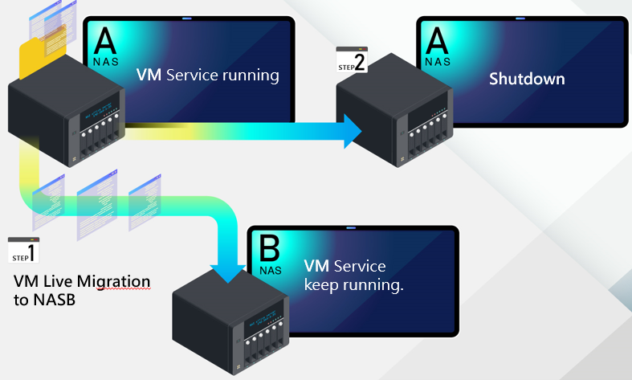
Virtualization Station and Container station for using NAS as an all-in-one appliance
Virtualization Station
Container Station
Supports two light virtualization technologies, LXC and Docker®. You can run a complete Linux® virtual machine on the QNAP NAS, and download thousands of applications from the Docker® Hub online collection
Virtualization Station allows you to create virtual machines on Turbo NAS to install Windows, Linux®, UNIX® and Android operating systems.
Container Station
Container
Application
Application
Application
Filesystem
Filesystem
Filesystem
Host OS
Supports Live Migration
Hardware

Slide 46


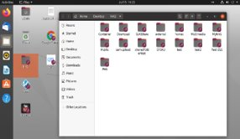
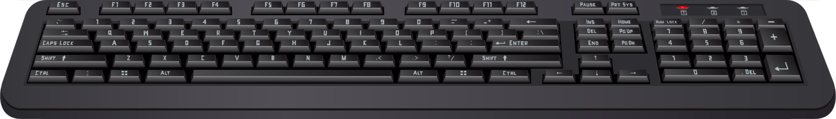
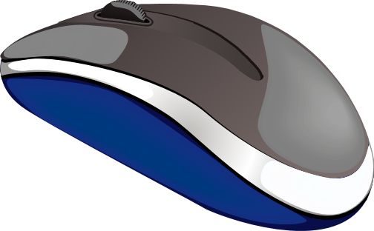

Establish and run dual systems -
Ubuntu & QuTS hero
Ubuntu Linux Station
Run QuTS hero and Ubuntu dual system, dual system application to enjoy.
One-click installation of multiple versions Ubunutu: 16.04 / 18.04 / 20.04
Ubuntu Software Center enjoy a variety of application downloads
Remotely access the Ubuntu Linux desktop through a browser / Directly use the HDMI output screen in the server-room for maintenance.

Slide 47
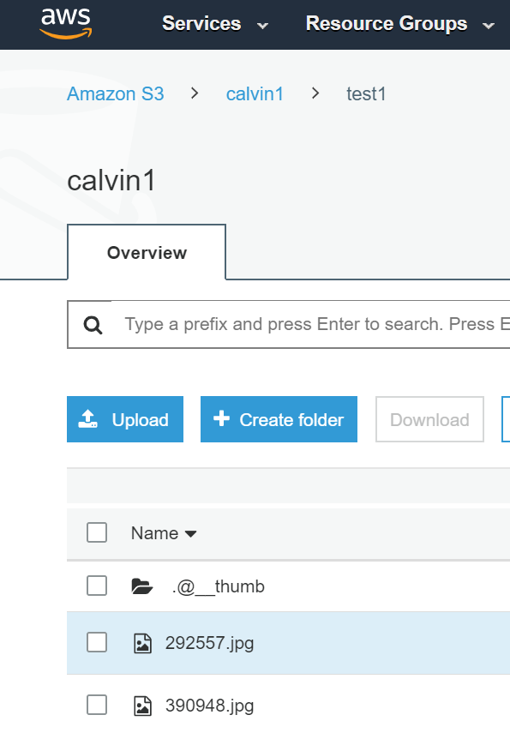


QuObject for simulating a S3 storage with NAS
Storage Space=Shared Folder
Buckets=Folder
bucket
Cloud service provider
Folder
File name
bucket
Object
bucket
bucket
Object
Object
Key
Object
Object
Object
Data
bucket
bucket
Object
Object
Metadata
Object
Object

Slide 48
Storage Capacity Expansion

Slide 49
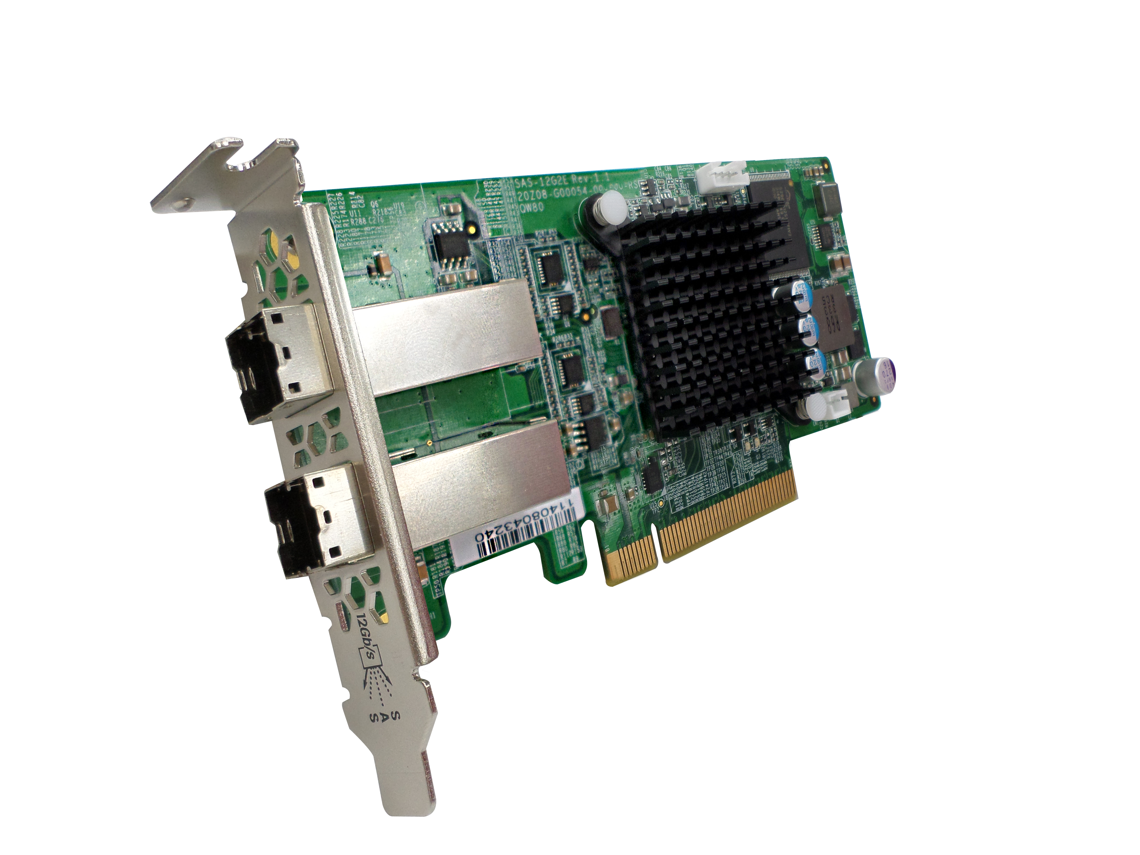

Expand capacity massively with SAS 12Gb/s JBOD expansion units
  SAS HBA (optional purchase)
 | SAS-12G2E | QXP-1620S-B3616W
SAS controller | Broadcom SAS3008 | Broadcom SAS3616W
PCI bus | PCIe Gen3 x8 | PCIe Gen3 x16
IOPS | 1X | 1.8X
Bandwidth | 6,000 MBps | 13,700 MBps
Port | External 8 port | External 16 port
Connector | 2 x SFF8644 | 4 x SFF8644
TL-R1620Sep-RP
TL-R1620Sep-RP
  Connect up to 16 QNAP SAS JBOD per host
    REXP-1620U-RP, REXP-1220U-RP
    TL-R1220Sep-RP, TL-R1620Sep-RP
  Each NAS host support up to 286 drives, 4~5PB of raw capacity
Note: The above data is for reference only based on IC vendor’s datasheets. Actual performance could be different due to host, expansion unit or drives.

Slide 50



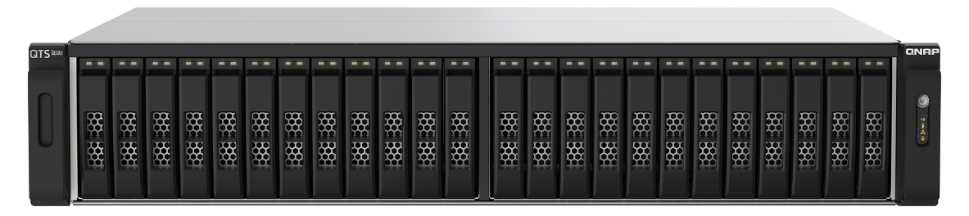

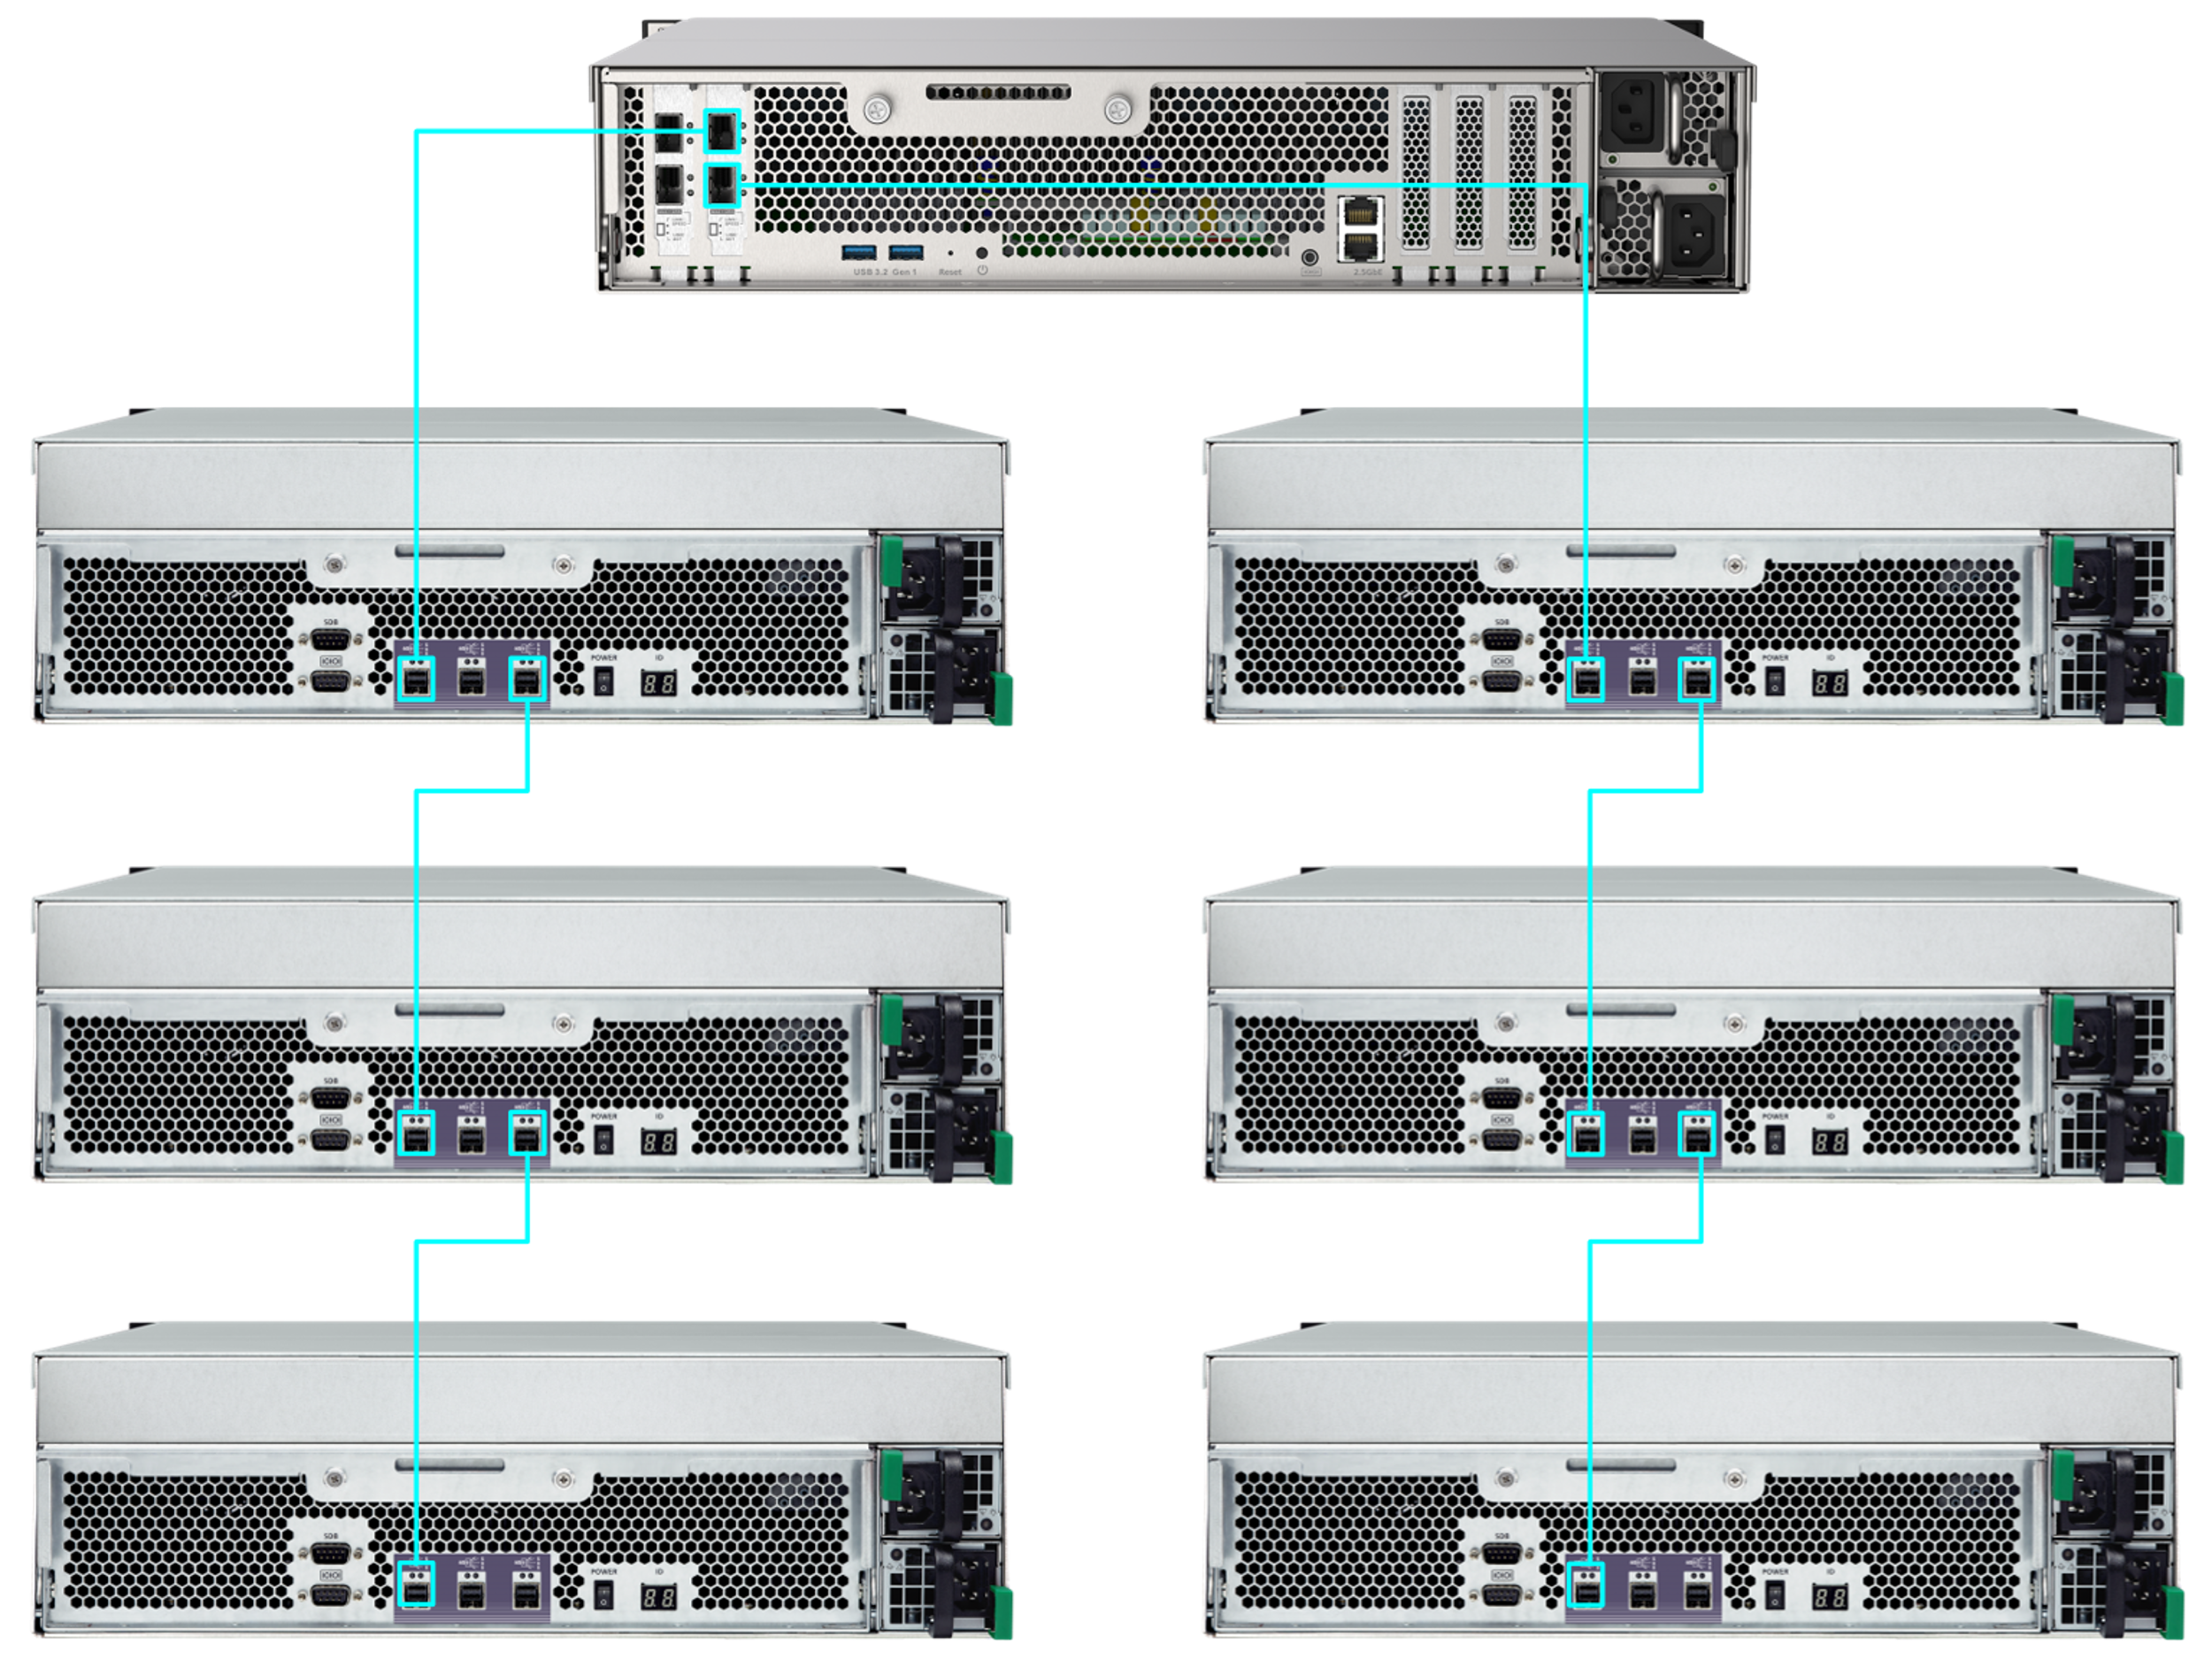

Amazing massive storage:
The best data carrier of big data analysis/edge computing/AI inference
200TB
Is not enough
Only PB-level shared folder is enough to store the huge data matrix.
Data
Model building
Model validation
Parameter adjustment
Deep Learning

Slide 51
Business-class accessories

Slide 52
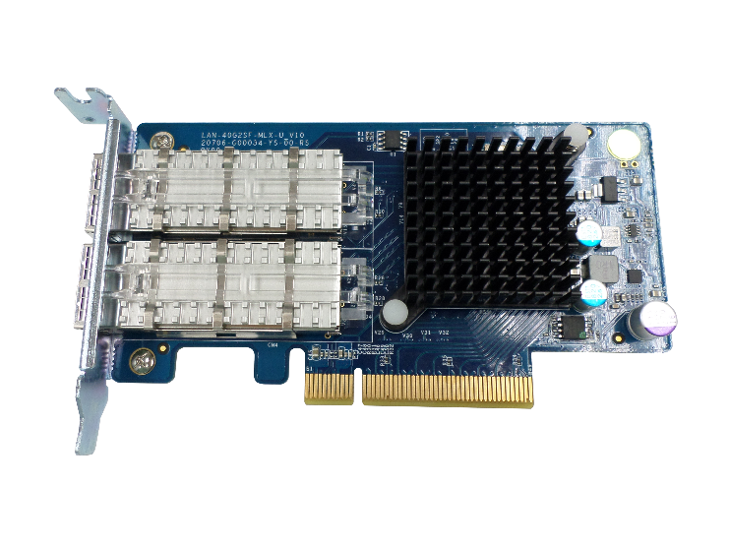
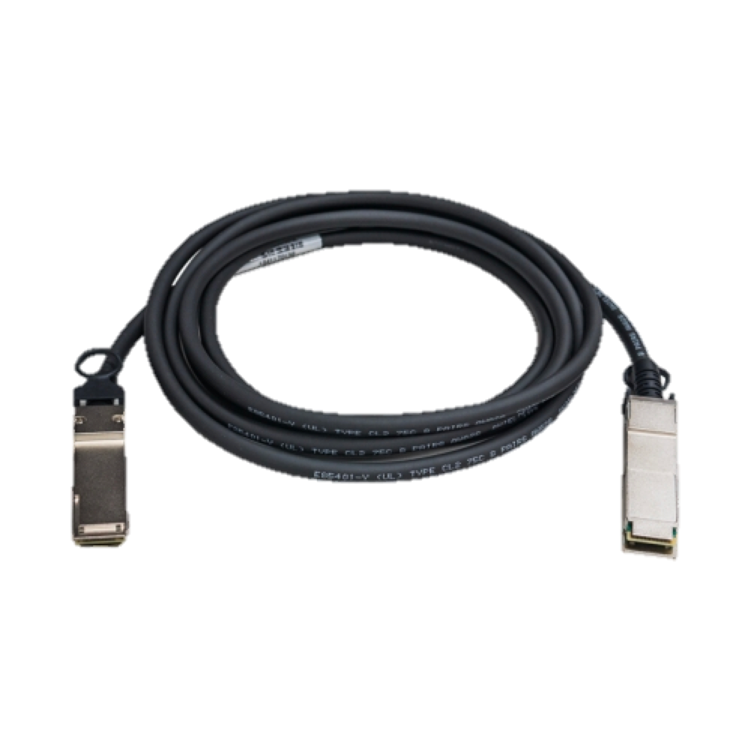

QNAP dual-port 40GbE SmartNIC cards
LAN-40G2SF-MLX
Thermal dissipation
Based on Mellanox ConnectX®-3 Pro network IC
2 x 40GbE QSFP+ ports
Supports iSER/RoCE offload
Optional
QSFP+ 40GbE
transceivers
and cables

Slide 53

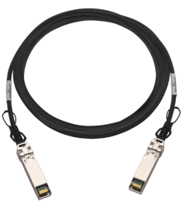
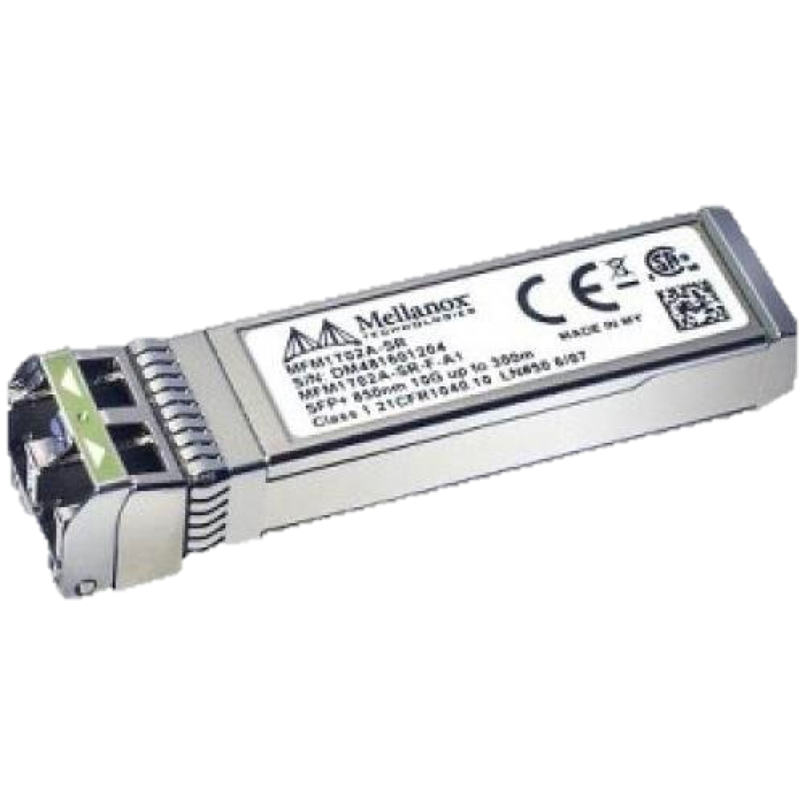
QNAP dual-port 25GbE SmartNIC cards
QXG-25G2SF-CX4
Thermal dissipation
Based on Mellanox ConnectX®-4 Lx network IC
2 x 25GbE SFP28 ports (compatible with 10GbE/1Gb)
Supports iSER/RoCE offload
Optional
SFP28 25GbE
transceivers
and cables

Slide 54
QNAP dual-port 10GbE SmartNIC cards
QXG-10G2SF-CX4
Thermal dissipation
Based on Mellanox ConnectX®-4 Lx network IC
2 x 10GbE SFP+ ports
Supports iSER/RoCE offload
Optional
SFP+ 10GbE cable or
TRX-10GSFP-SR-MLX transceiver
Notes:
QNAP 雙埠25GbE 擴充卡
QNAP Dual ports 25GbE NIC
採用Mellanox ConnectX®-4 Lx 網路晶片
Mellanox ConnectX®-4 Lx ethernet chip
2 x SFP28 ports
Supports 25GbE/10GbE
Supports iSER/RoCE hardware offload
需搭配SFP28 25/10GbE網路線
Compatible cable
SFP28 25/10GbE DAC cable
2019 一月上市
Soon to market on January/2019
晶片散熱模組
Cooling system

Slide 55
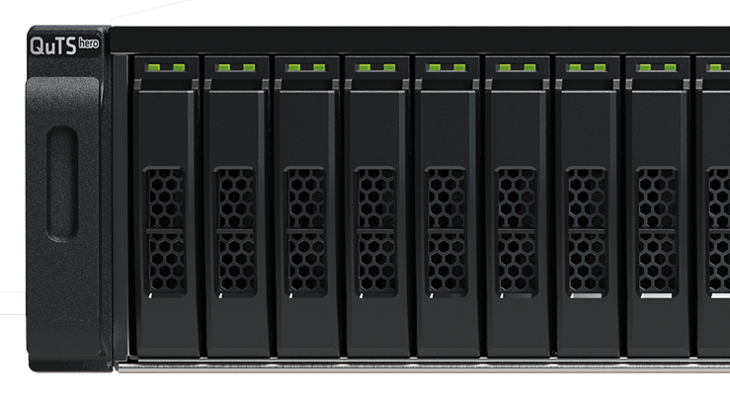

Fibre Channel SAN
32Gb & 16Gb storage solutions
QXP-32G2FC
2-port 32Gbps FC card
Designed for NAS, high-performance and efficient QNAP FC expansion cards*
* Installation on Windows are Linux hosts is not supported
QXP-16G2FC
2-port 16Gbps FC card
Includes optical FC transceivers
TRX-32GFCSFP-SR
  32Gb/16Gb/8Gb
TRX-16GFCSFP-SR
  16Gb/8Gb/4Gb
Note: cables are not included.

Slide 56




Enterprise-Grade 2U 30-bay SATA
25GbE all flash array (AFA) NAS
Copyright© 2020 QNAP Systems, Inc. All rights reserved. QNAP® and other names of QNAP Products are proprietary marks or registered trademarks of QNAP Systems, Inc. Other products and company names mentioned herein are trademarks of their respective holders.​​​​

Slide 57


