Slide 2
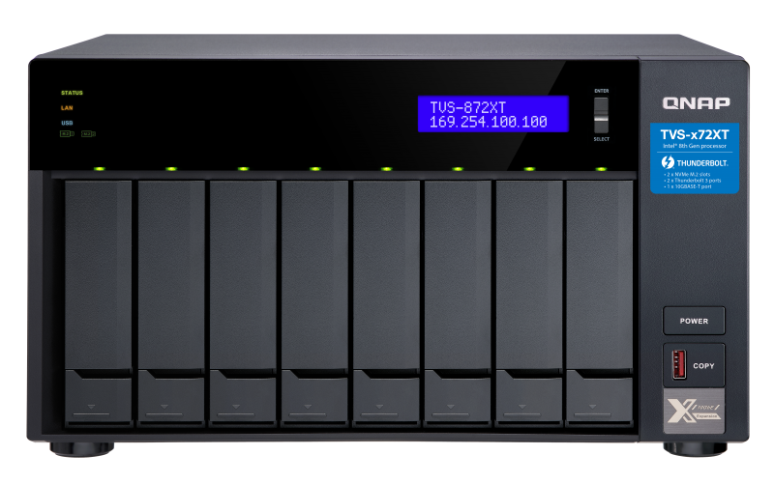
Backup job automation only supported local NAS on HBS 3 v13
HBS 3 provides “run once after job” function that customer can set tasks and schedules according to their needs, then the workflow will be automatically executed.
But this function only supported local NAS on HBS3 v13. You cannot link tasks between NAS.
Backup
Backup
Synchronization
Restoration
Synchronization
Restoration

Slide 3
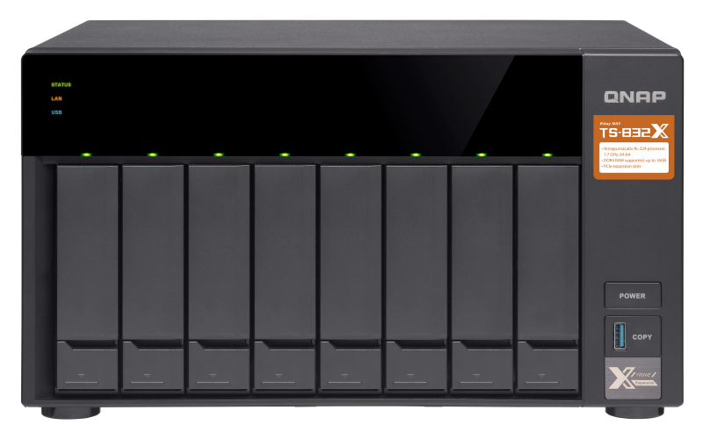
Big data migration to remote NAS taking too much time when syncing data to remote directly
Problems when IT staff migrating big data
A service provider generated millions of files every day in their environments and the size is almost 800GB. The user want to sync the data to remote NAS through Internet, but it is time consuming thus affecting daily operations
HBS3 Report
Duration：14h 23min 56sec
Total files：8,306,385
800G
WAN
Local NAS
Transfer through internet spends a lot of time
Remote NAS

Slide 4
Customer solved the time issue by using the "run once after job" function, but this function only supported jobs on local NAS
The customer created a daily backup job with QudDedup function and successfully dedup'd the data from 800GB to 20GB. And then a sync job is created with “Run once after job” schedule to sync 20GB data to remote NAS. Although some time is saved with job auto execution, he still needs to restore the data on remote NAS by himself.
WAN
Local NAS
Remote NAS
1
2
3
Create a daily backup job with QuDedup.
Create a sync job with run once after job schedule to sync data
Create a restore job
Manually restore
Sync task automatically executed
Manual
restore
QuDedup
Can not auto-restore
.qdff
.qdff
.qdff
800G
20G
20G
20G
800G

Slide 5
When the backup task is running, it is impossible to know which file is being transferred and the current transfer speed
IT staff want to know the current task status
During the task, sometimes the estimated remaining time provided by HBS 3 is super long. Although it should return to normal shortly, it is still quite surprising to see it. More detailed information could be provided, such as the file being transferred, its size, current transfer speed, etc.
HBS3 Report
Remaining time: 103d 15h 58min 25sec
Total file size: 460 GB
Local NAS
460GB file size…
103 days to transmit?!
Which file is being transferred right now?!
Remote NAS

Slide 6
Each file backup result must be recorded to maintain a proper audit trail
When error or warning messages are shown on HBS 3 dashboard, the auditor will ask IT whether these abnormal states are recorded, and the reason for the abnormal backup task.
Therefore, IT needs to download the HBS 3 syslog, find the entry one by one in the syslog, and then reply to the auditor. It takes a lot of time, and sometimes it may not be found.
Backup warning/error

Slide 7
Meet HBS v14

Slide 8
Tasks are continuously executed between NAS to help IT automate the backup/file transfer process
With backup process automation, when the first scheduled task ends, linked subsequent tasks will be triggered for execution until the entire process is completed. The automated process helps IT staff easily back up/move massive data.
WAN
Local NAS
Remote NAS
1
2
Create a sync job with run once after job schedule to sync data
3
Create a daily backup job with QuDedup.
When the remote NAS finishes receiving, it will automatically start the restore task and return the original data to the remote NAS
Sync task automatically executed
Sync task automatically executed
Restore automatically
QuDedup
.qdff
.qdff
20G
.qdff
800G
20G
20G
800G

Slide 9
Chain any tasks in sequence across NAS, and let the workflow automatically carries out
Backup Job
Restore Job
One-way sync
Two-way sync
Active sync

Slide 10
Versatile situations to configure your tasks and let the workflow automatically carries out
Big Data Migration
Backup to external device(USB)
Data migration after archiving to cloud
Lots of data dedup'd on local NAS and sync the data after. Finally, restore on remote NAS automatically
Back up the data to remote NAS and back up the data to external device after
Data migrate to data center and archive to cloud service provider (CSP) after
CSP
.qdff
Restore
Backup/Sync
Backup/Sync
One-way sync
Deduplication and Compression
.qdff
Backup/Sync
Backup/Sync

Slide 11
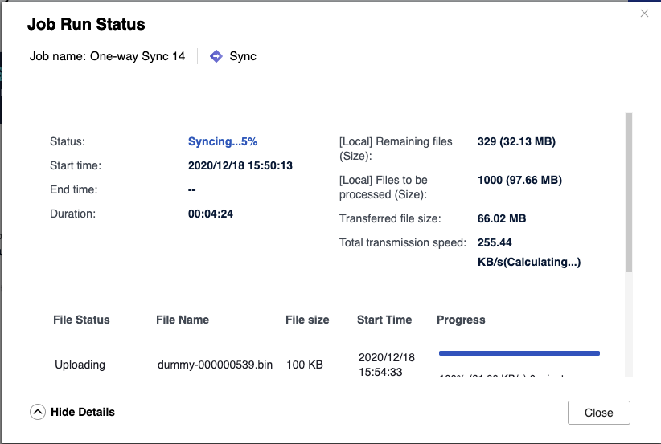
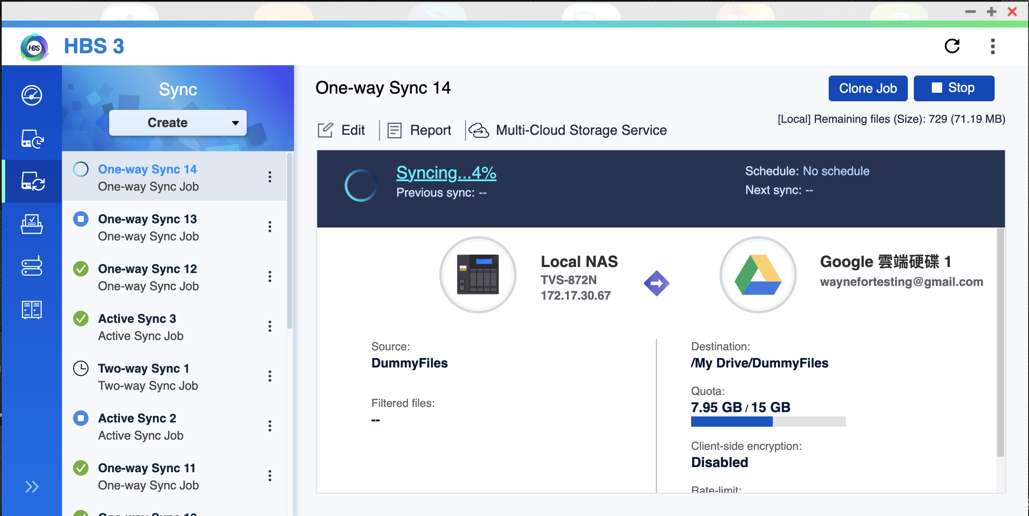
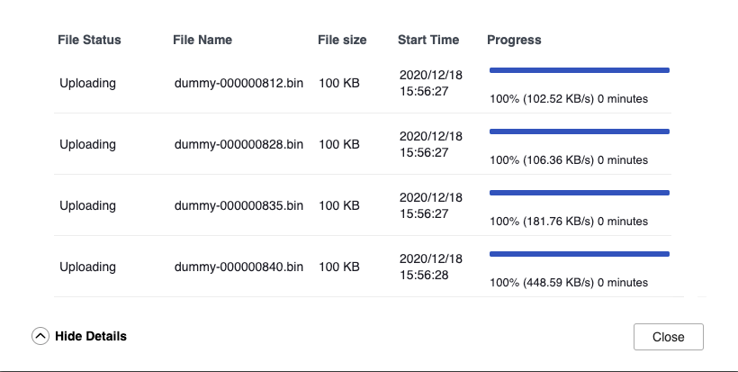
When job is running, click the status message to view the execution status and file status

Slide 12
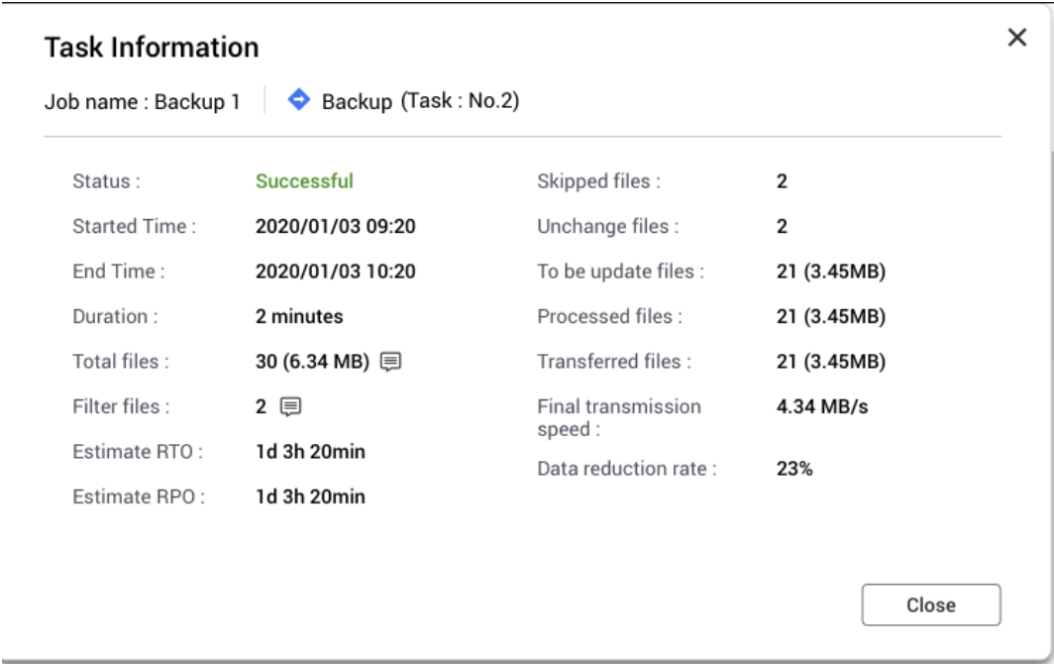
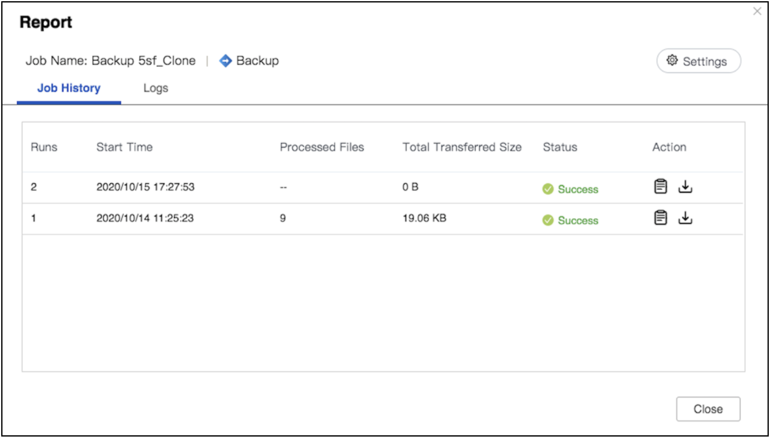
When a job finishes, you can view the summary of the current backup task report

Slide 13
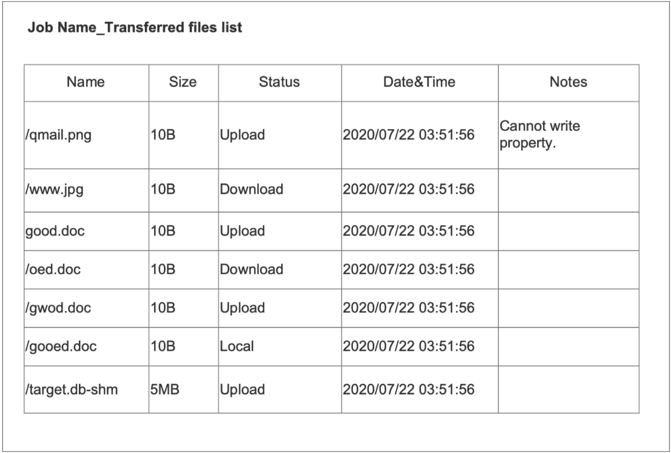
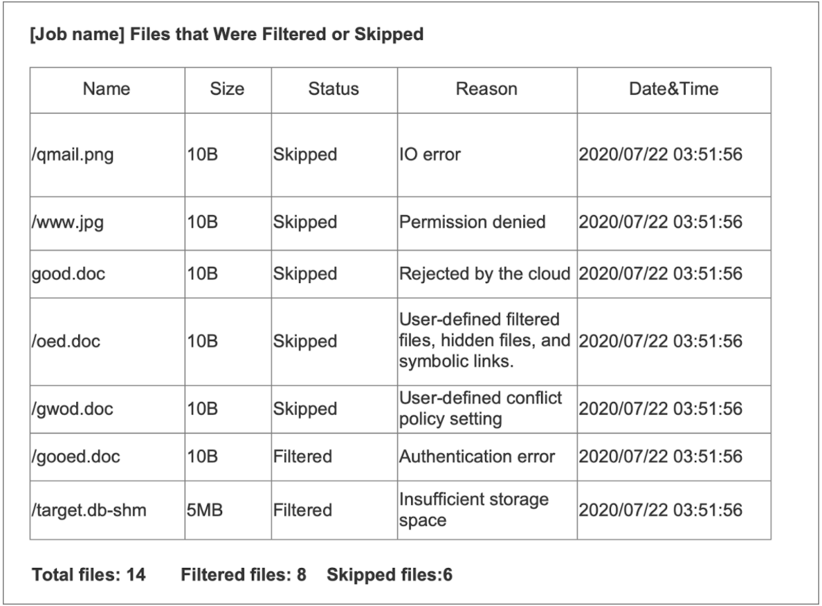
Each file has a transfer record: if the file transfer is abnormal, there is a record to follow
Notes: If the file has been uploaded or downloaded but incomplete, write the reason in the block.
Filtered files: Calculate the number of files with filters set by the user.
Skipped files: Calculate the number of files that the system skipped uploading due to some errors.

Slide 14
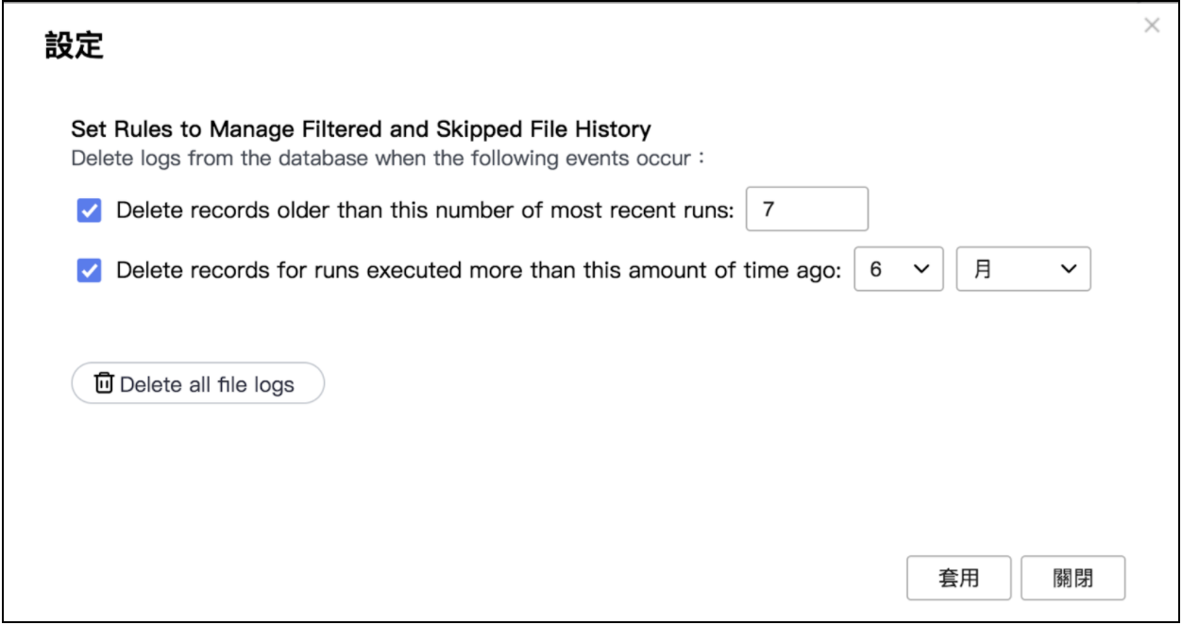
To avoid the log occupying all storage space, set the time limit of log keeping in Settings

Slide 16
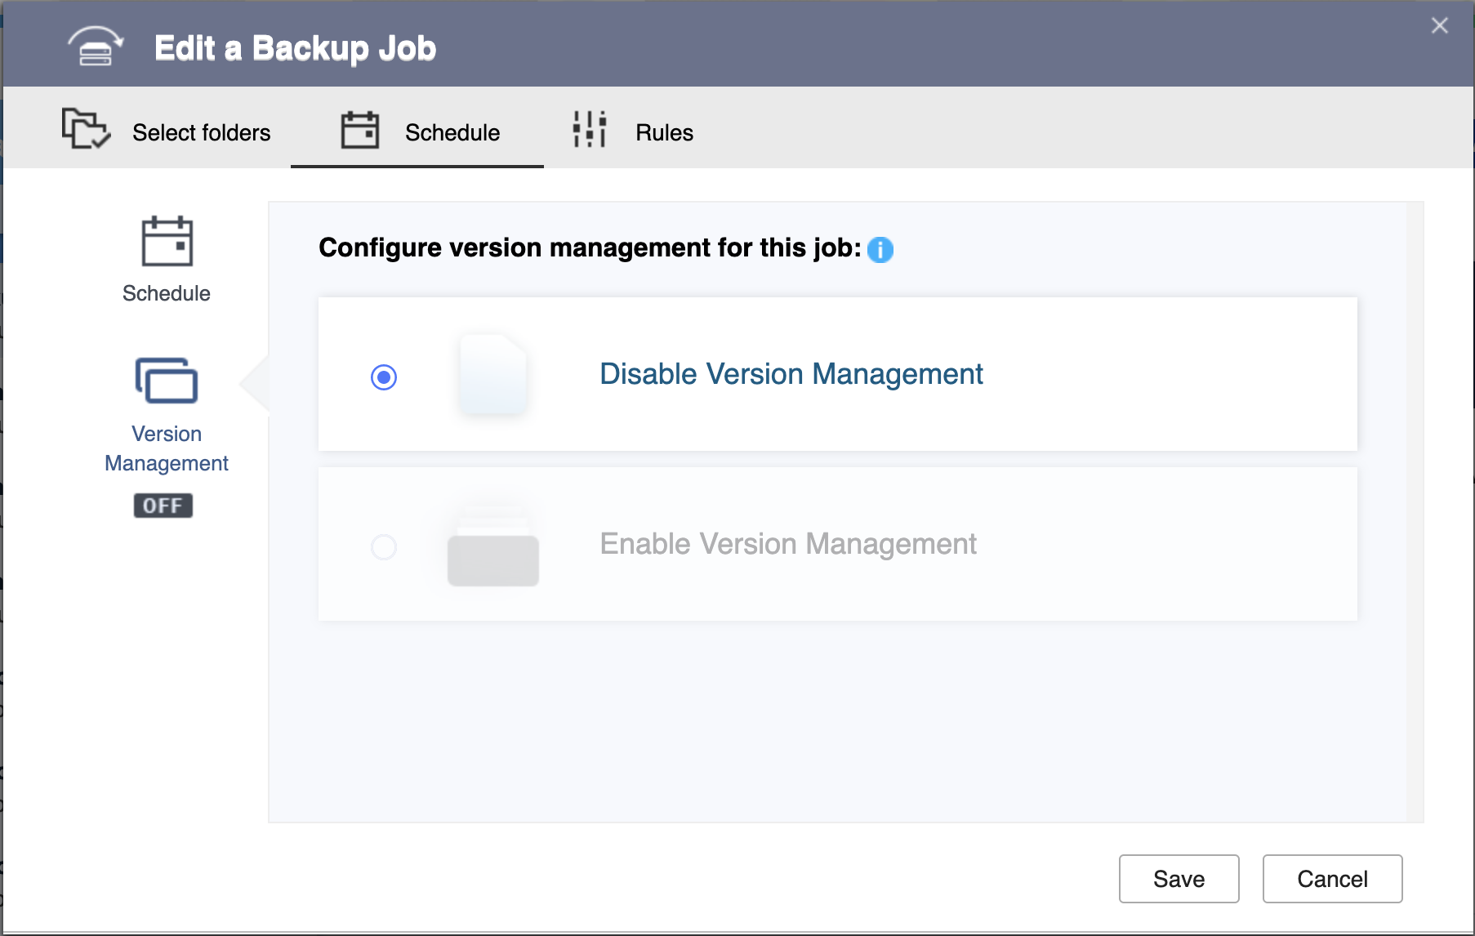
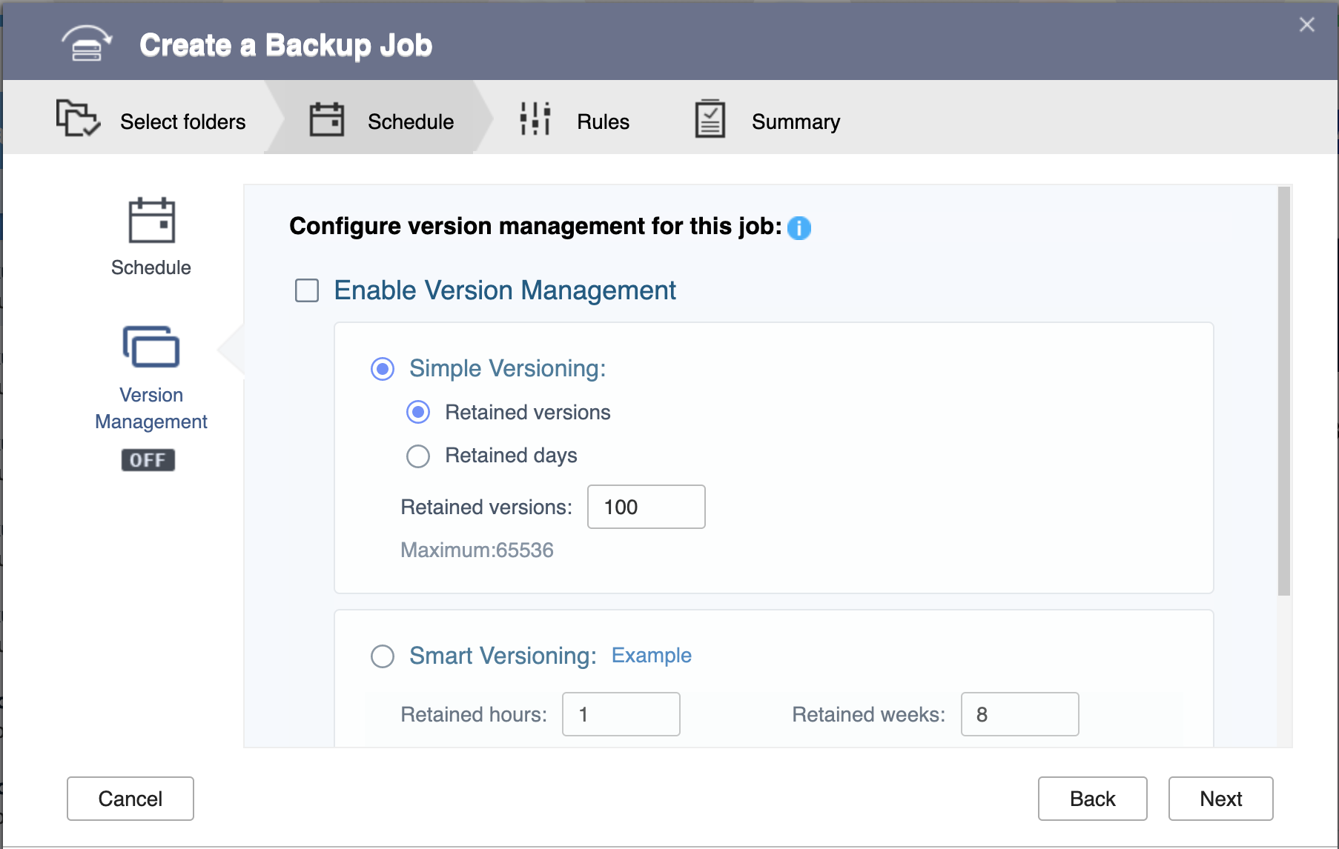
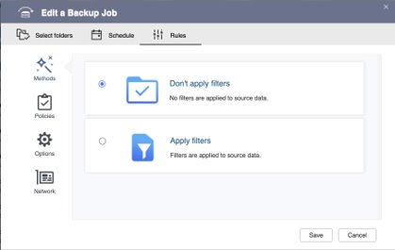
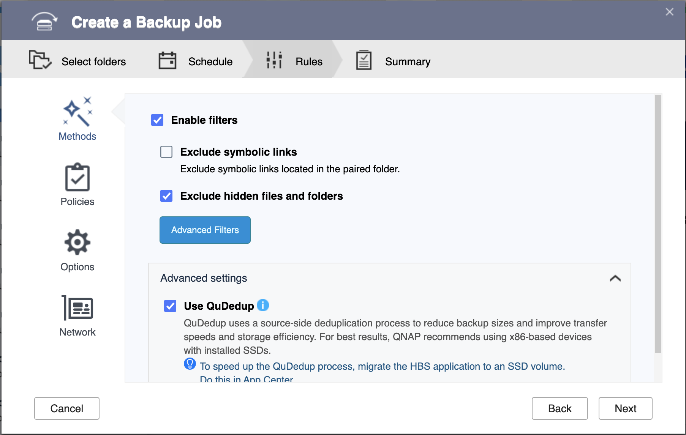
HBS 3 user interfacing fine-tune
1. The refreshed UI design creates a smooth and clean setting
HBS v13
HBS v14
2. The filter options frequently used by users are directly displayed on the Rules page, and the easy-to-use Advanced filters button creates an integrated and structured setting process.
HBS v13
HBS v14

Slide 17
Copyright © 2020 QNAP Systems, Inc. All rights reserved. QNAP® and other names of QNAP Products are proprietary marks or registered trademarks of QNAP Systems, Inc. Other products and company names mentioned herein are trademarks of their respective holders.

