Slide 1
Notes:
Hi welcome to QNAP live

Slide 2
Agenda
Network architecture and firewall usage
How to use QuFirewall
Demo
Applicable model

Slide 3
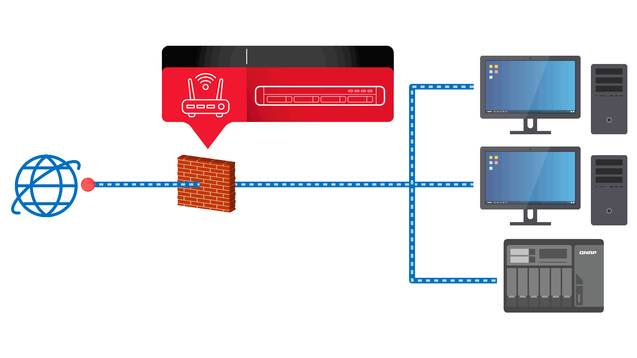
Firewall is an important element of network security
Comsumer
Enterprise: UTM / NGFW
User 1
User 2
Internet
Firewall
NAS
General deployment method for firewall

Slide 4
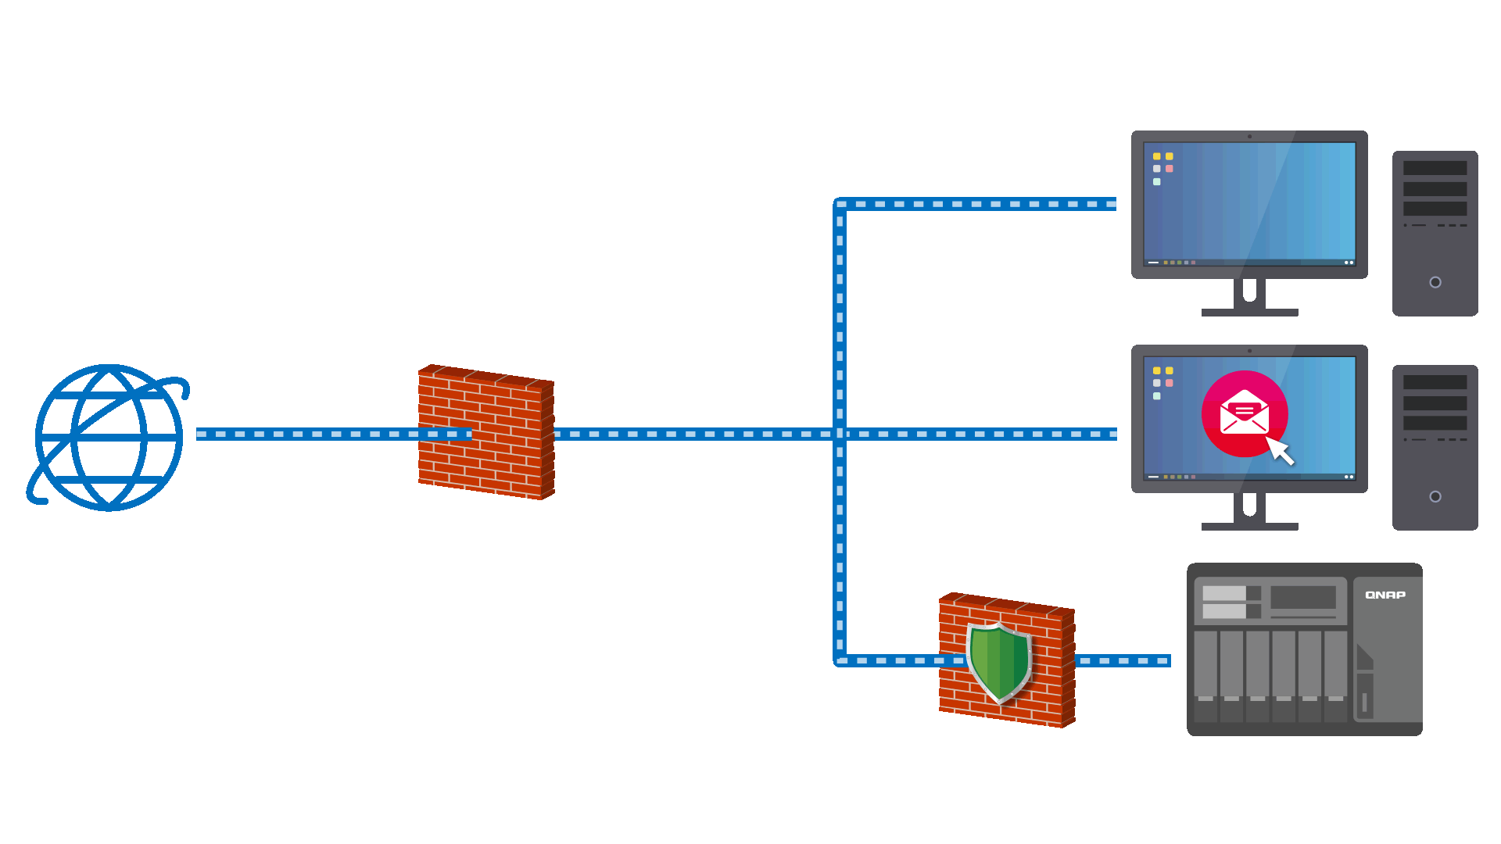
QuFirewall is the new application for protection against cyber attacks
Prevent network attacks from other virus-infected LAN devices
User 1
User 2
Internet
Firewall
NAS
QuFirewall

Slide 5
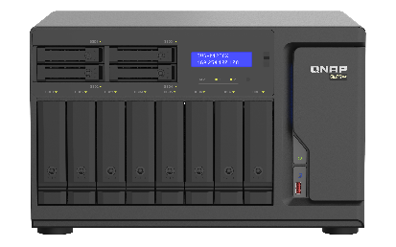
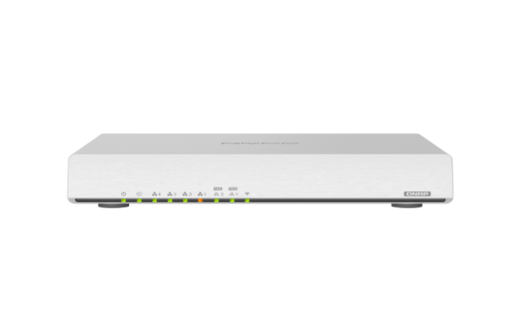
Attention: when using NAS for external services
Whether the public server is a NAS or any workstation, do not run it directly on the Internet.
PPPoE
Internet
ISP/ADSL
Make good use of the router’s NAT + Port Forwarding. (It’s better with the firewall feature)
QHora-301W
Wi-Fi 6 Dual 10G SD-WAN router
Internet
ISP/ADSL
NAT + Port Forwarding
Firewall (nice to have)

Slide 6
NAT & Port forwarding features from Router
QHora-301W
Wi-Fi 6 Dual 10G SD-WAN router
Mesh VPN: (create site to site VPN quickly and easily)
MultiWAN aggeration: (Not only bandwidth aggeration and failover, the connection between 2 sites can reach 2x speed.)
Firewall: (Currently supporting L3, and DPI & L7 firewall coming soon via system update)
NAT
(network address translation)
Port Forwarding
Internet
Internet
WAN: 60.251.180.100
WAN: 60.251.180.100: 16800
WAN: 60.251.180.100: 16888
LAN: 192.168.0.100 /24
LAN: 192.168.0.110: 443
LAN: 192.168.0.120: 8080
Intranet
Intranet

Slide 7
How to use the QuFirewall

Slide 8
Download and install QuFirewall
Download the QuFirewall app from App Center
Upgrade the NAS OS to QTS 4.5.1

Slide 9
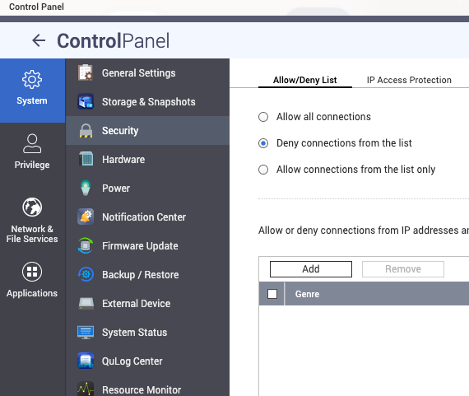
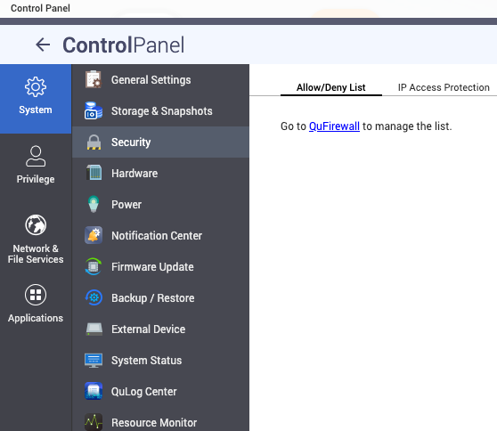
Corresponding changes
[ Control Panel > Security > Allow/Deny list ] will be controlled by QuFirewall
1
3
2

Slide 10
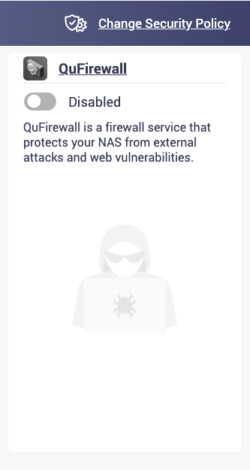
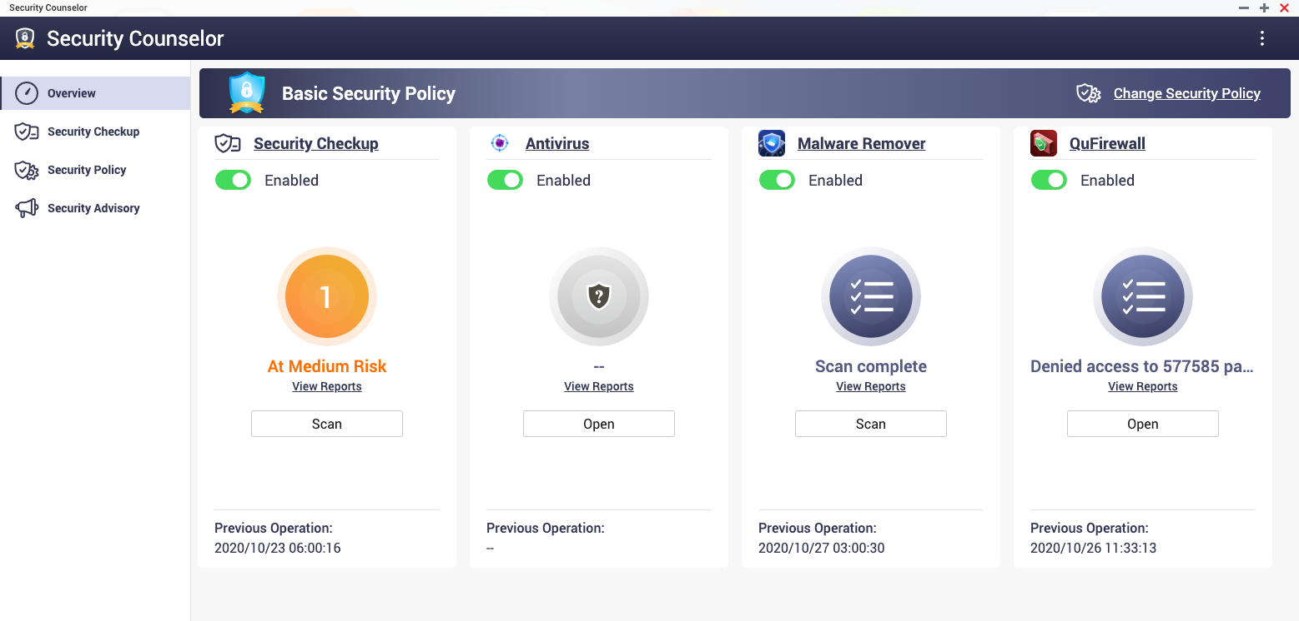
Corresponding changes
Security Counselor will ask you to install/enable QuFirewall for security management
1
2

Slide 11
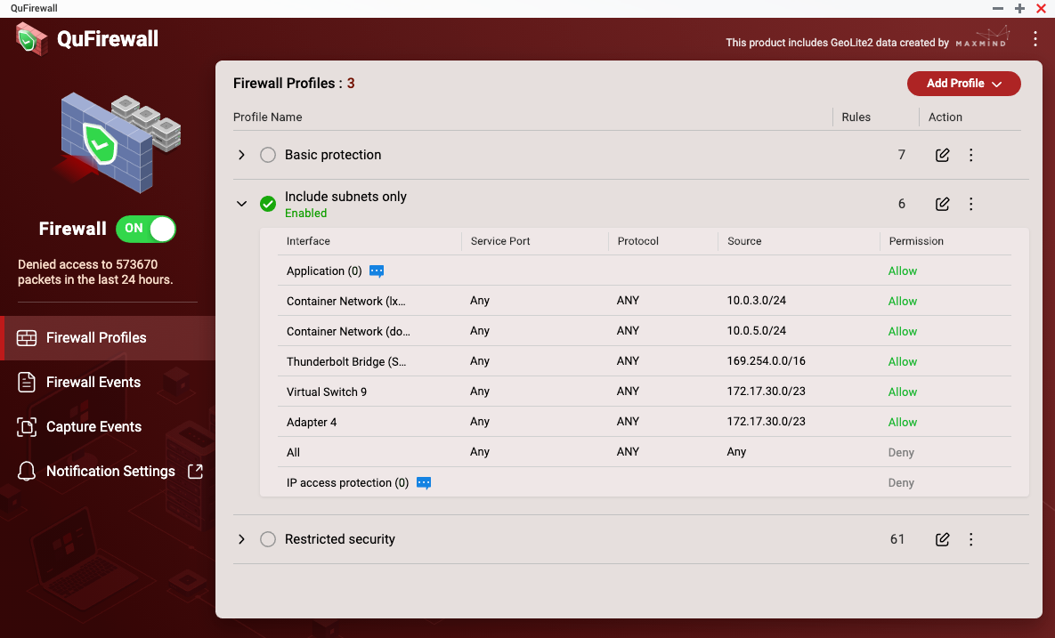
Three default profiles for users to get started

Slide 12
3 different initial profiles can be quickly applied
Restricted security
Include subnet only
Only local region IP address & limited services are allowed (HTTPS/HBS/Qbelt-VPN)
Basic Protection
Private LAN only and
same subnet
Only private LAN IP and local region IP address are allowed
(3rd-party apps are not supported)
Detect all subnet of each interface automatically

Slide 13
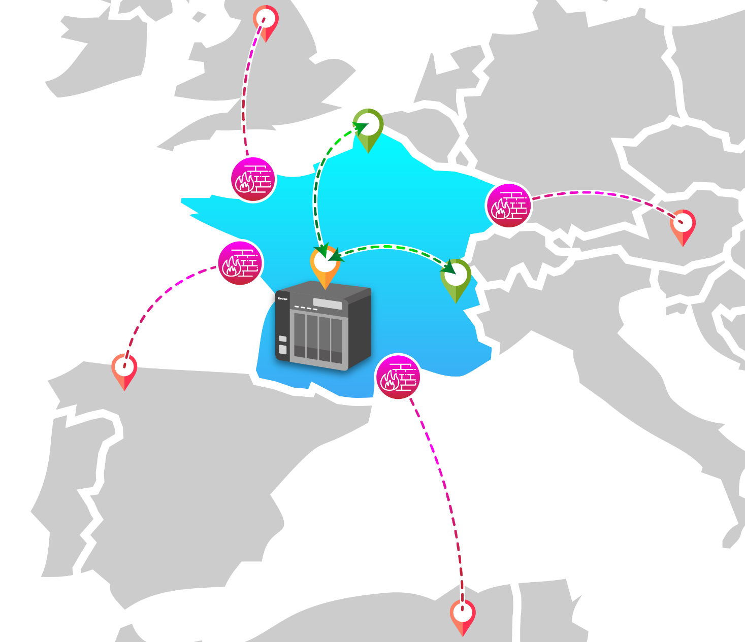
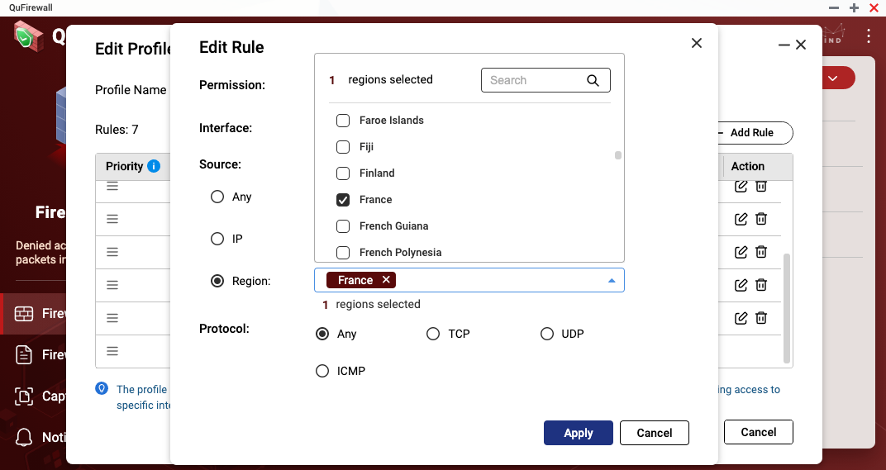
Limit the service range of NAS
Block all connections outside the service area (Suspicious / unserviceable)

Slide 14
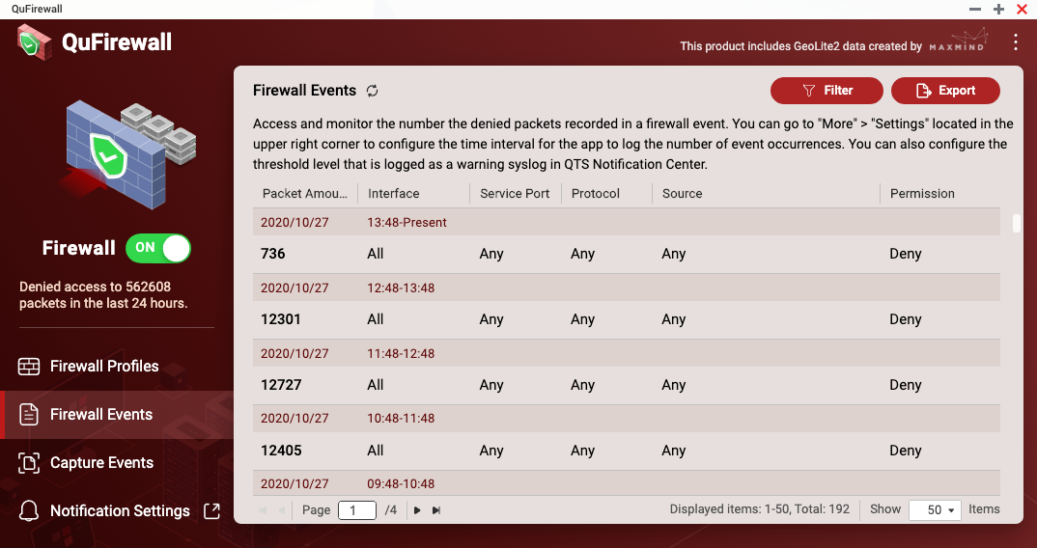
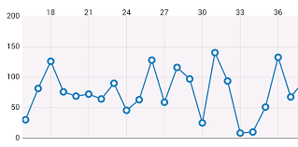
Check how many events have been triggered in the past period

Slide 15
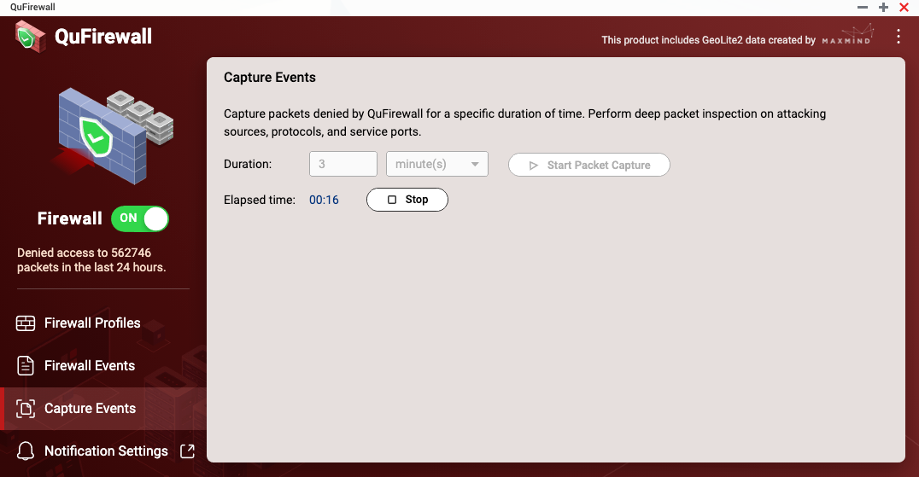
Capture the blocked packets in real time to view the network status

Slide 16
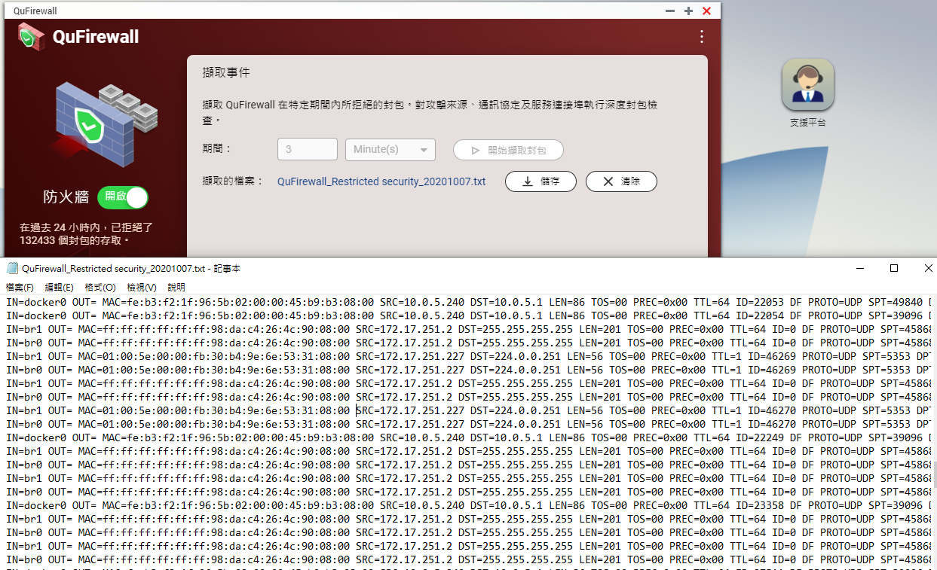
How to check packets and network status
SRC: Source IP (Connection)
DST: Destination IP (local)
LEN: Packet size
TOS: Type of service
PREC: Precedence priority
PROTO: Packet protocol
SPT: Source port number
DPT: Destination port number

Slide 17
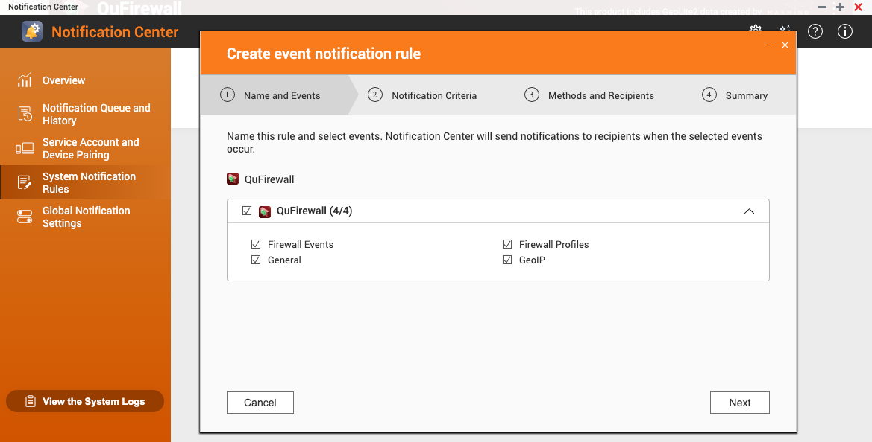
Proactive notifications of firewall settings changes and trigger events

Slide 19
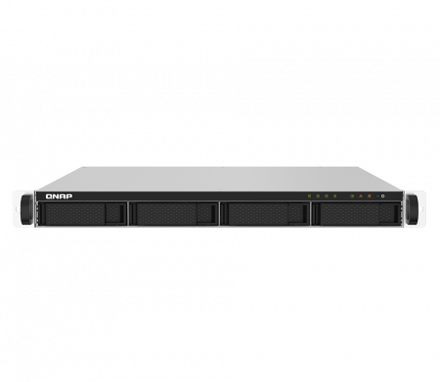
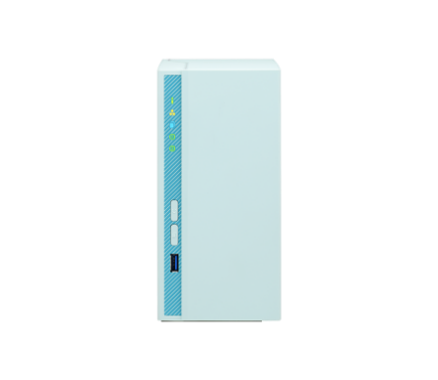
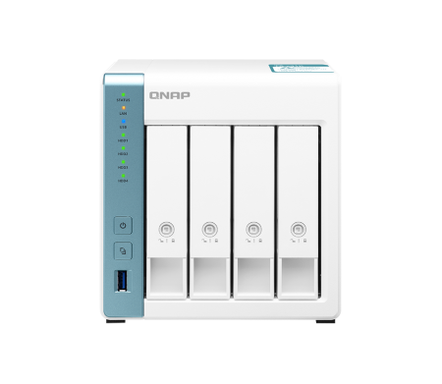
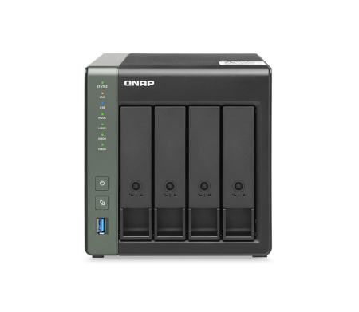
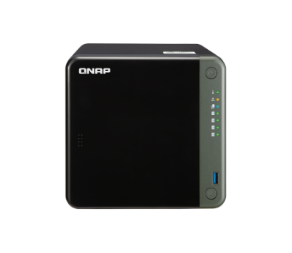
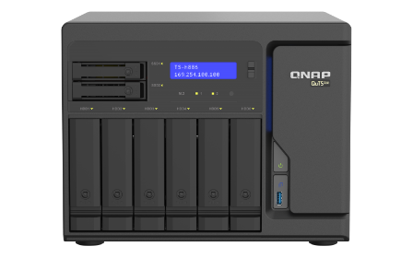
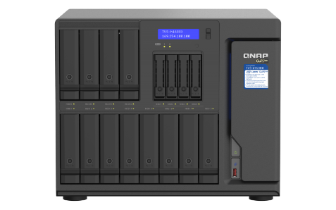
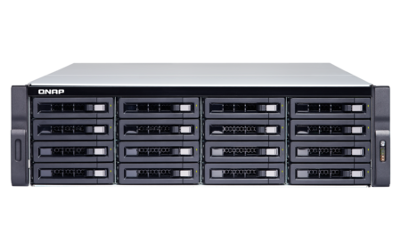
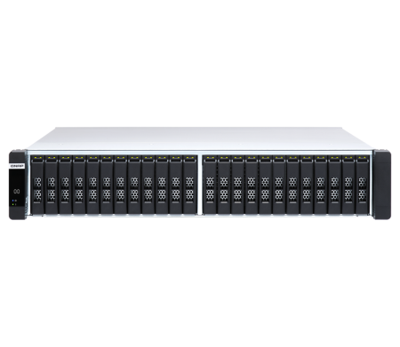
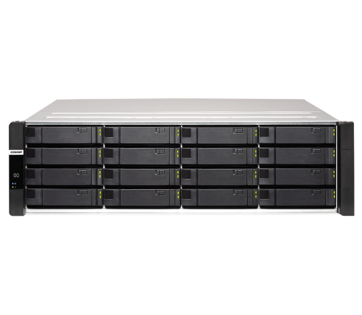
Applicable models
NAS can
Support
ARM based
QTS 4.5.1
x86 SMB
QuTS hero h4.5.1
QuTScloud c4.5.3
Enterprise

Slide 20
© 2020 Copyright is owned by QNAP Technology Co., Ltd. QNAP Technology reserves all rights. A trademark or mark used or registered by QNAP Technology Co., Ltd. The products and company names mentioned in the file may be trademarks owned by other companies.

