Slide 1
QuLog Center 新功能指南
主動分析數據、快速過濾與搜尋、即時查看連線狀態，輕鬆統合系統管理

Slide 2
Do you need to view system records only when something happens?
System records collection a lot, can be used more effectively? What are the commonly used services? What applications often go wrong? What connections are not normal? What IP is not a familiar source? Which accounts log in too often or fail too often?

Slide 3
Take a look at the brand new one. How QuLog Center is used

Slide 4
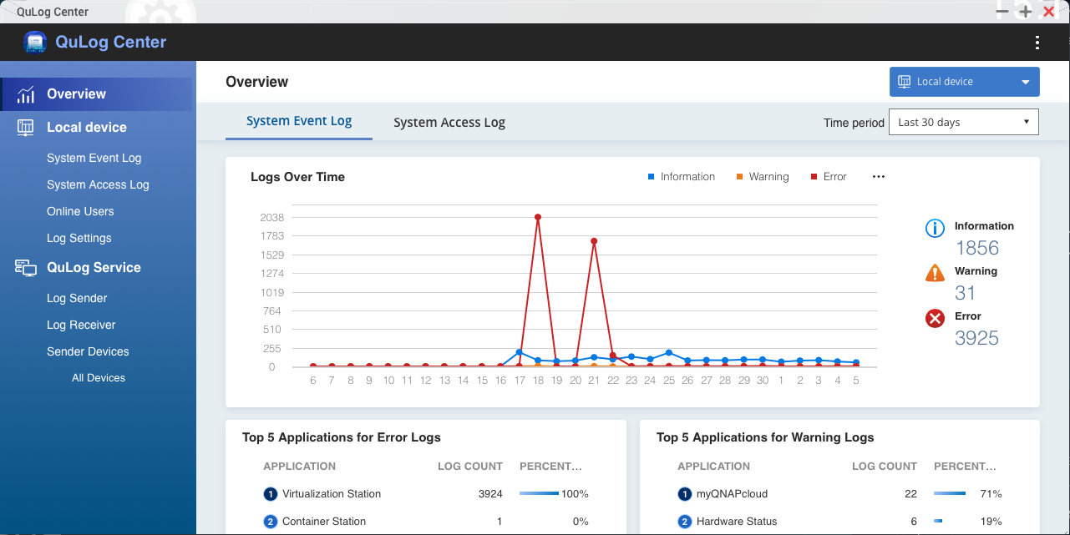
QuLog Center Active four major features
Proactive analysis.
Quick filtering.
Real-time monitoring.
Unified management.

Slide 5
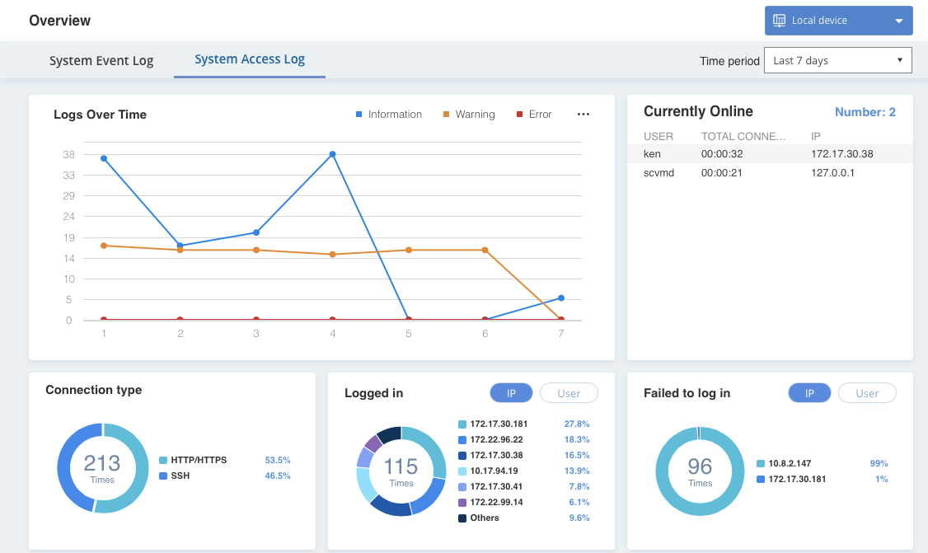
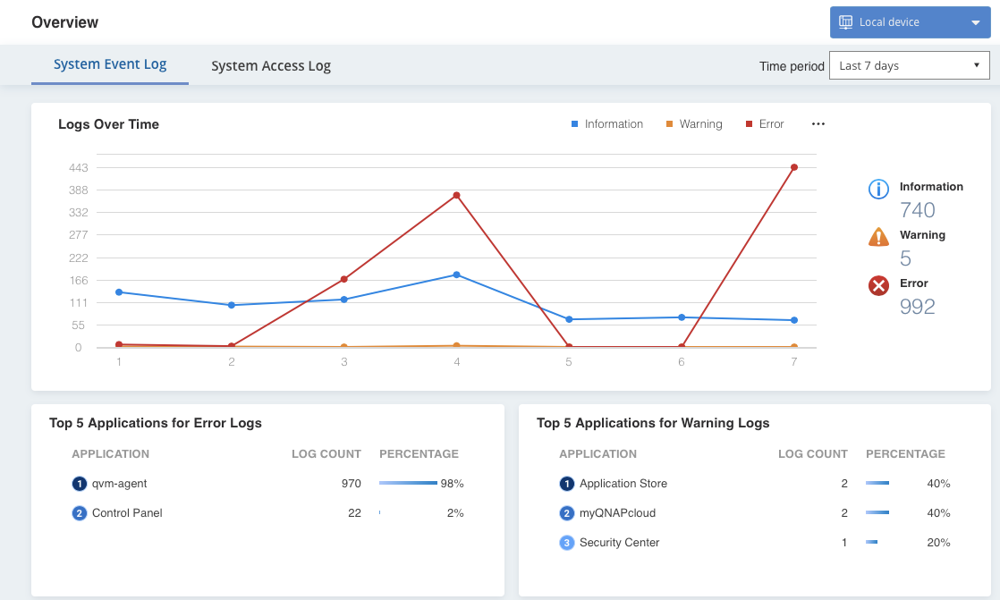
Proactively analyze a variety of statistics

Slide 6
List the top five events
Top 5 applications for Error logs
Top 5 applications for Warning logs

Slide 7
System access statistics
Connection types
Logged in
Failed to log in

Slide 8
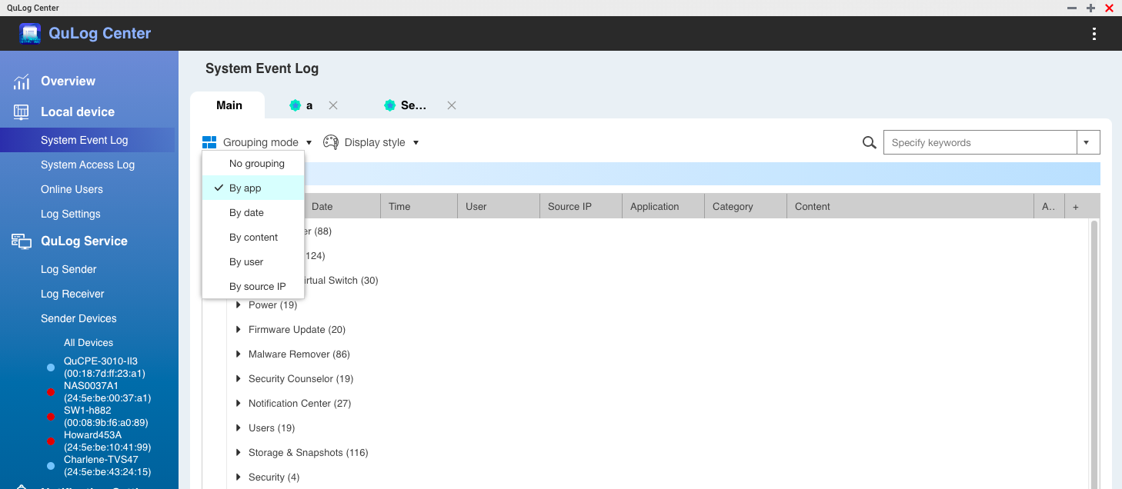
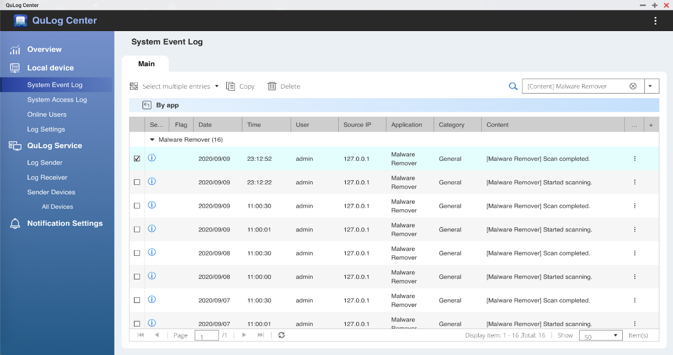
Quick filtering, combining with groups, etc
Categorize by App name or date

Slide 9
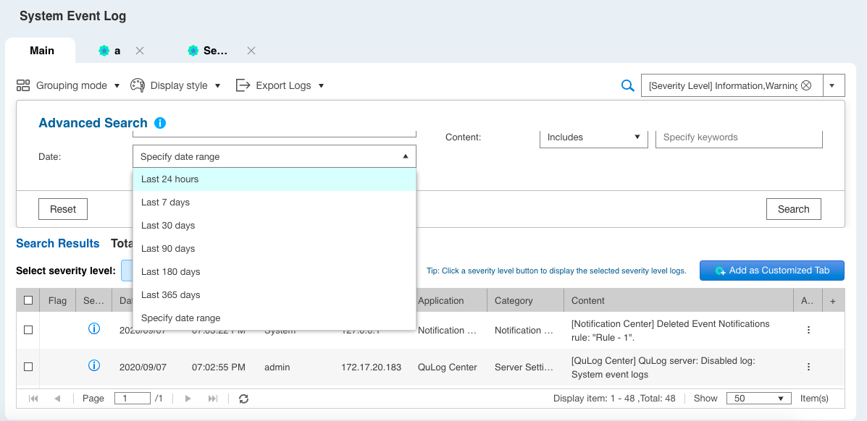
Custom tag/advanced search
After creating the filter criteria, you can save it as a custom label, and only look at the log you want to see

Slide 10
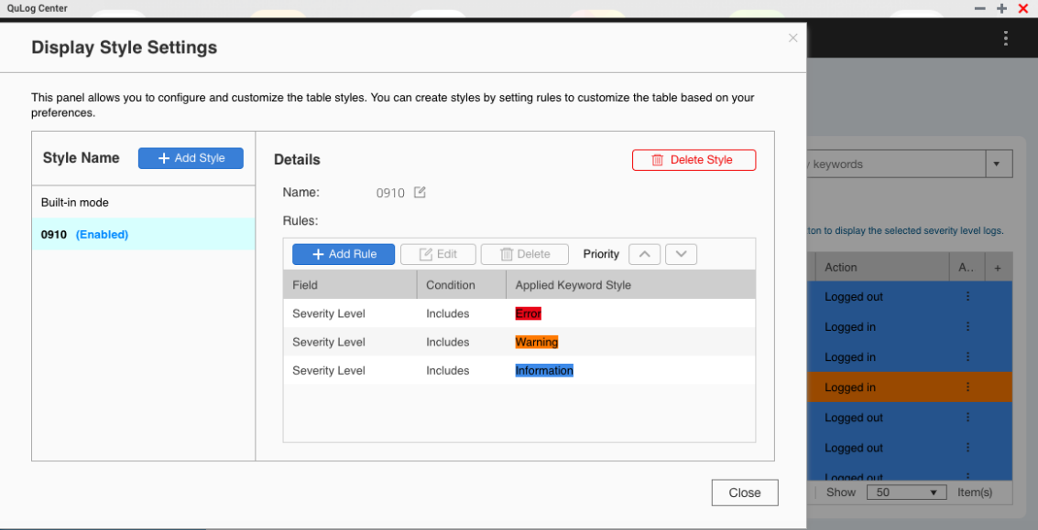
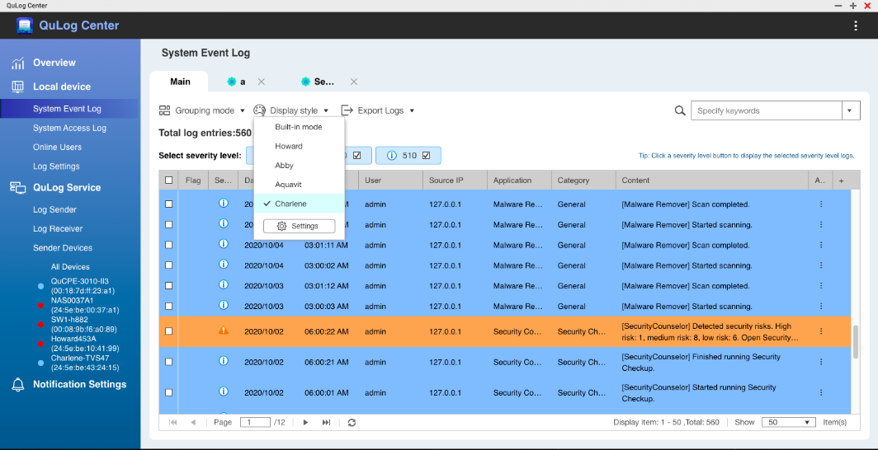
Custom style/flag
Define your own color for log content for example: the warning is yellow and the account number is chang's red. Flag the log for special attention.

Slide 11
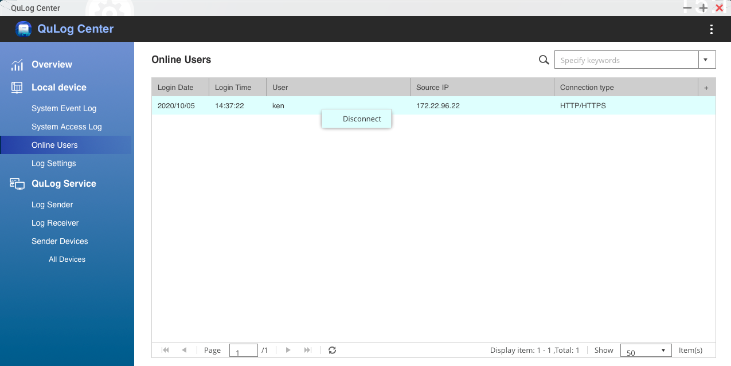
Monitor on-line members in real time
View the members of the connection and how it is connected.

Slide 12
示範

Slide 13
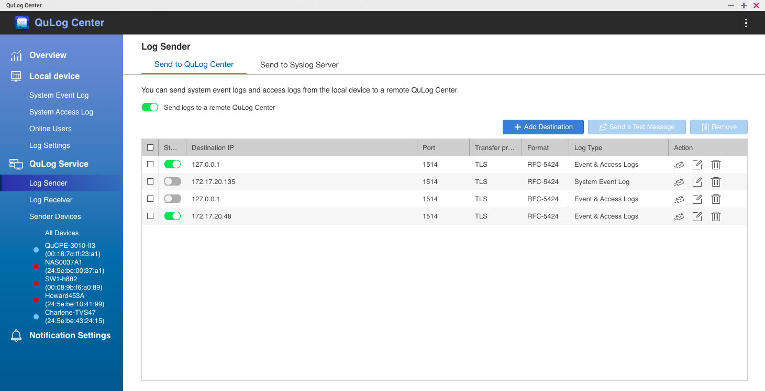
Integrated management to support local and remote host record file consolidation
Local Device
Detailed machine NAS record file.
QuLog Service
Receive other NAS record files.

Slide 14
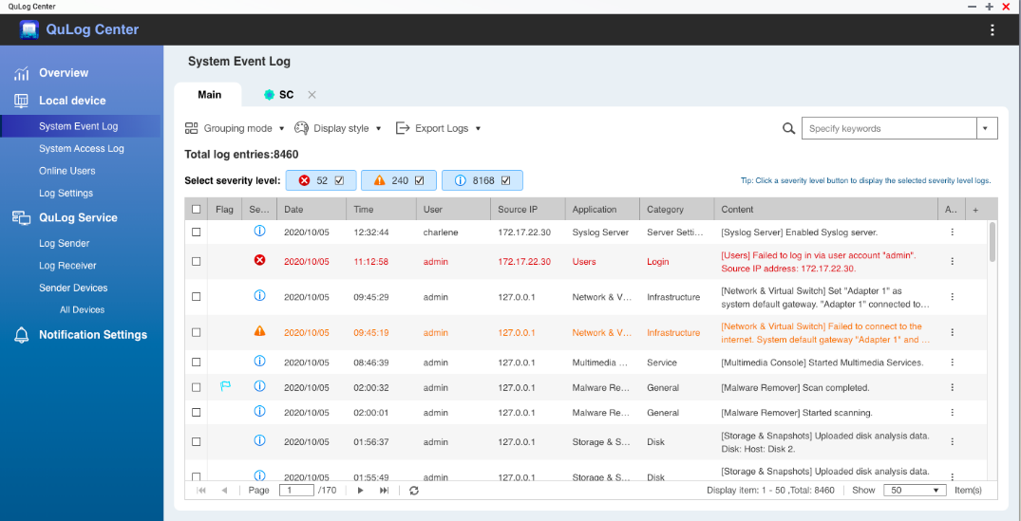
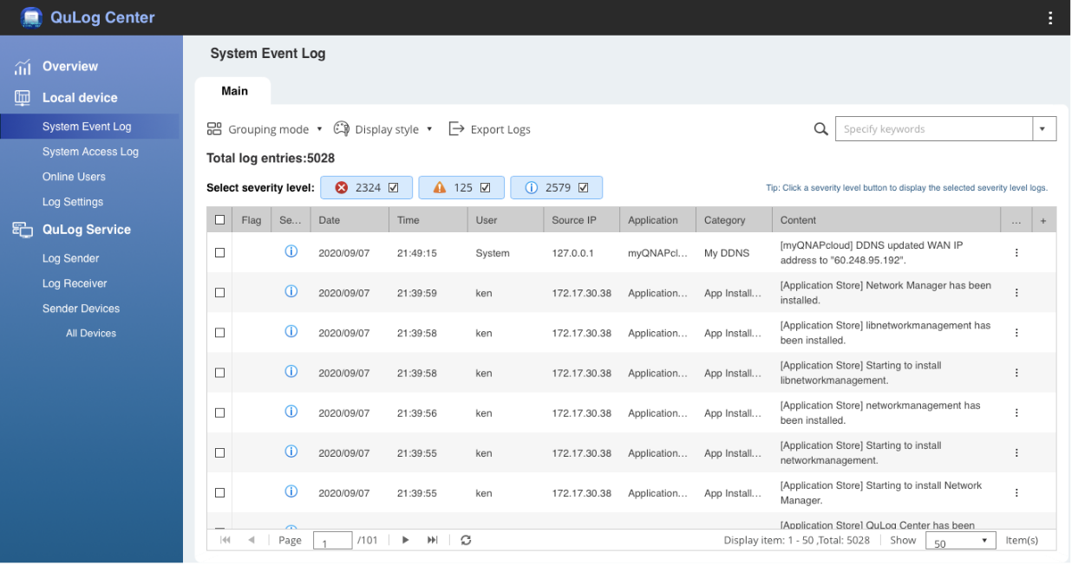
Local NAS unit
System event records. System access history. Online users. Record settings.

Slide 15
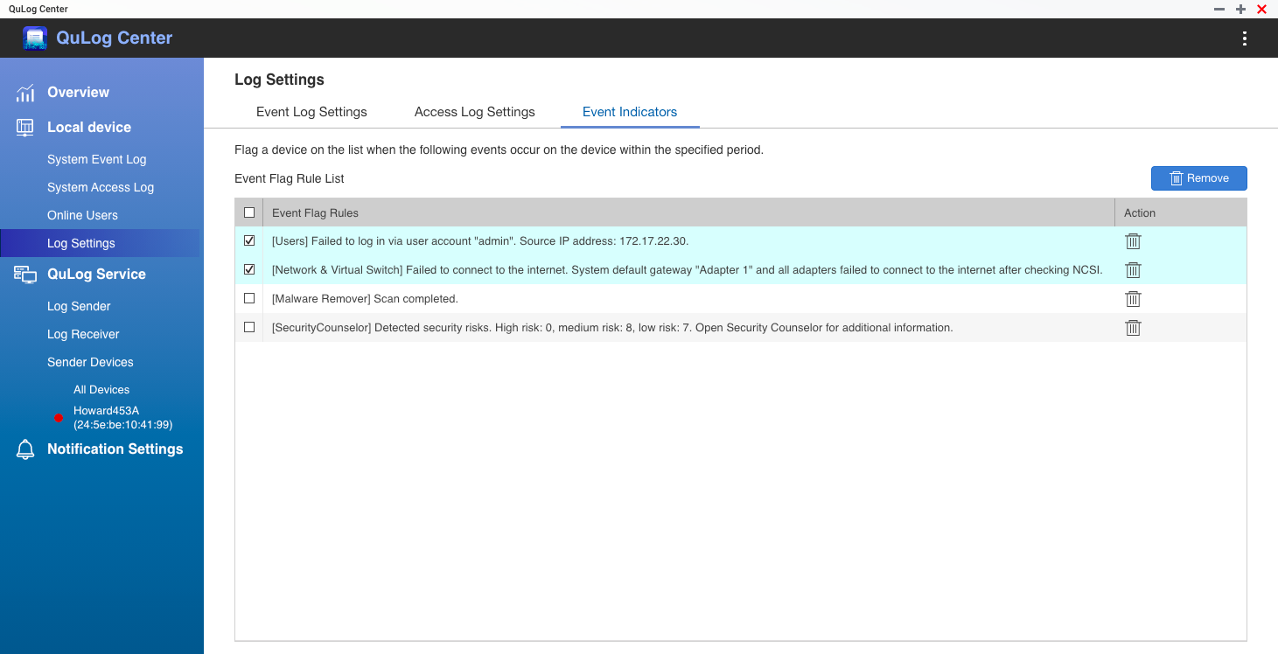
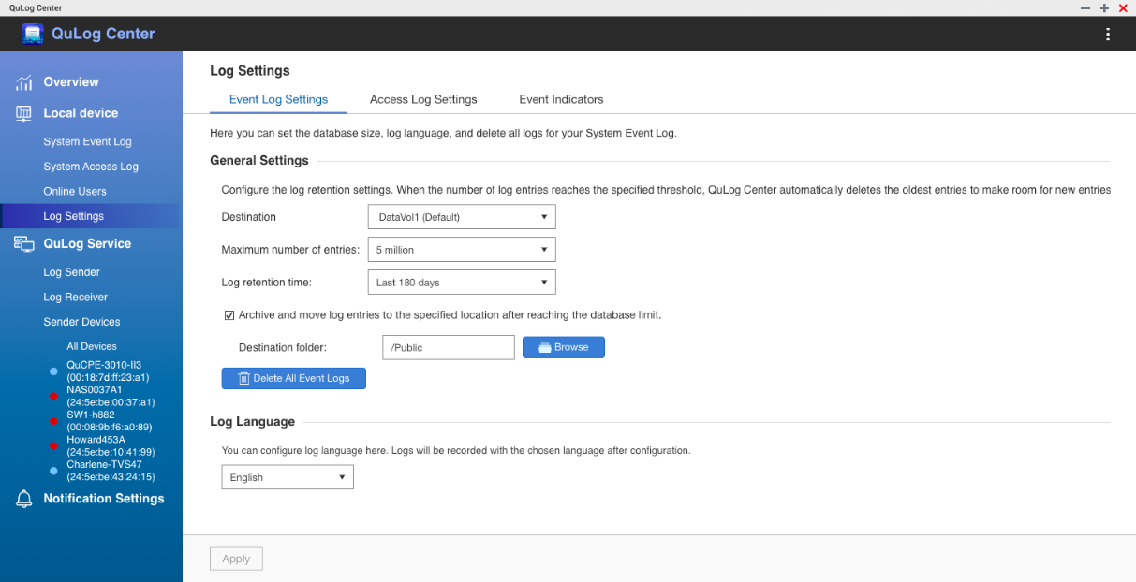
Set the size of the space for the record

Slide 16
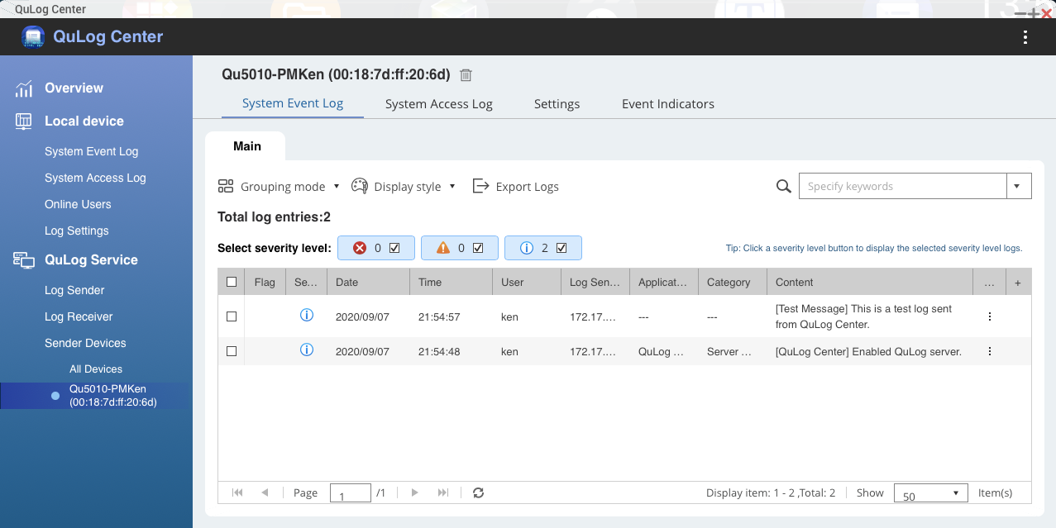
The delivery and receiving ends of QuLog Service
Send log
Send to QuLog Center
Send to Syslog Server
Receive log
Receive logs from remote QuLog Center

Slide 17
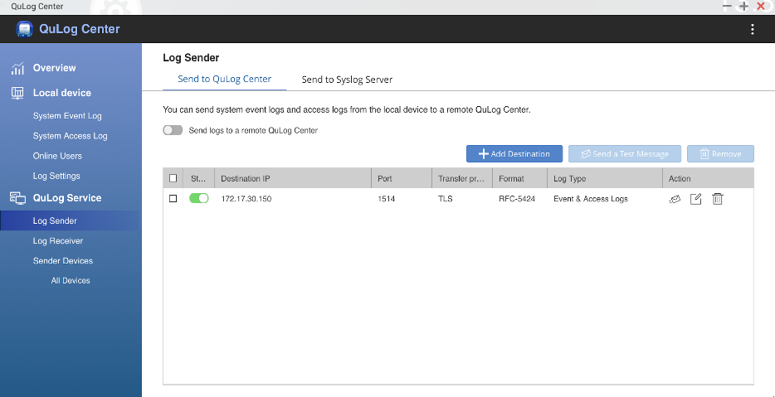
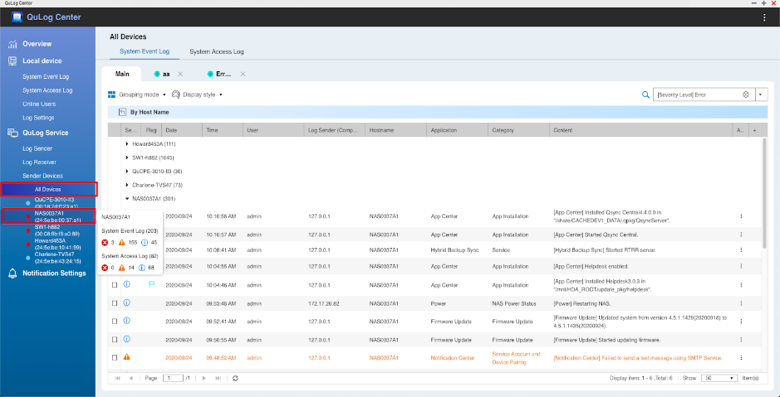
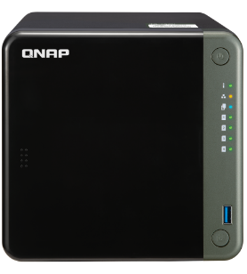
Transfer to another QuLog Center.
Transfer NAS log files to another QNAP NAS for centralized storage
QuLog Center

Slide 18
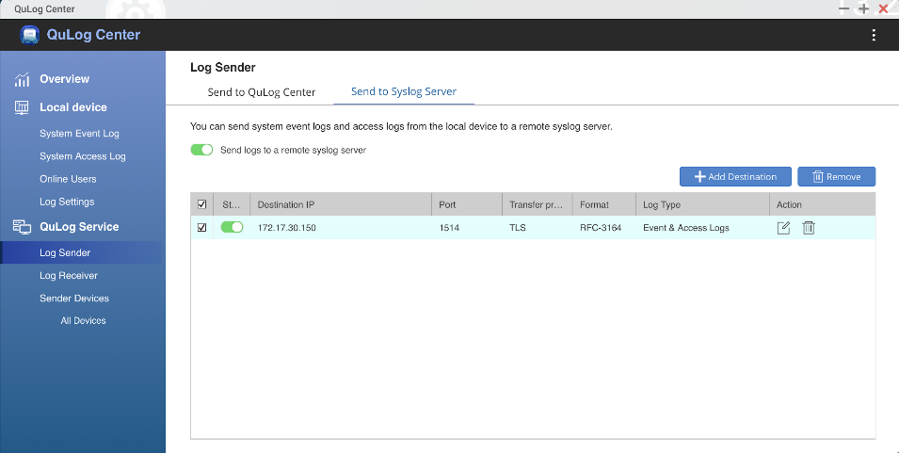
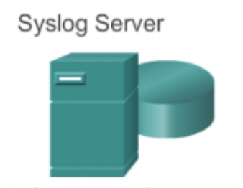
Delivered to Syslog Server.
Send NAS log files to a standard Syslog server for centralized storage
Syslog Server

Slide 19
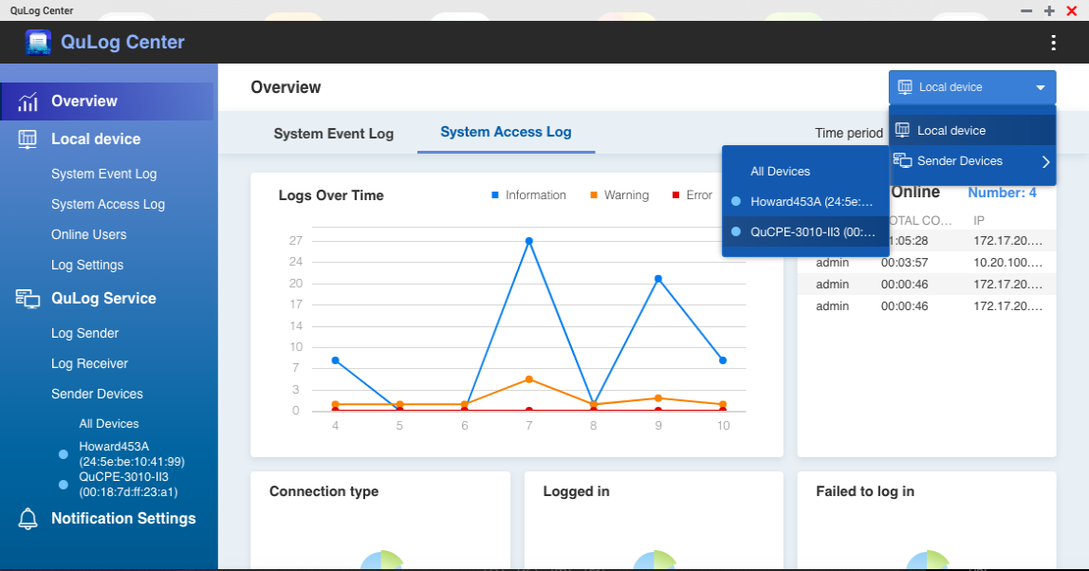
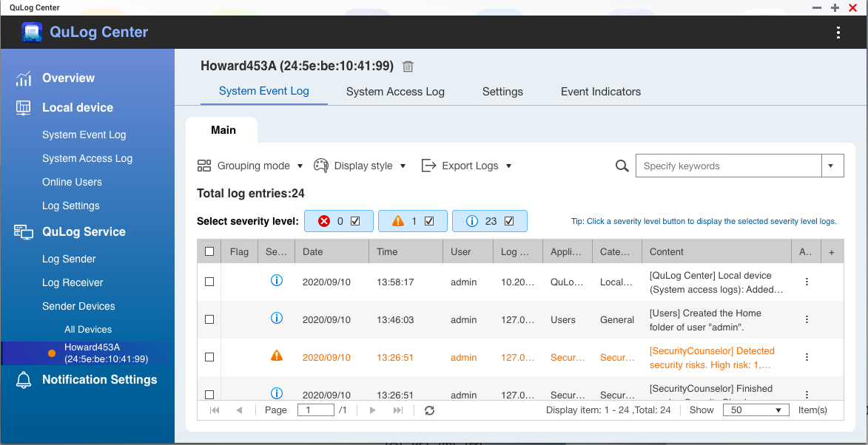
The Log Center for QNAP Multi-Devices
Collect multiple QNAP devices to one, and manage log centrally

Slide 20
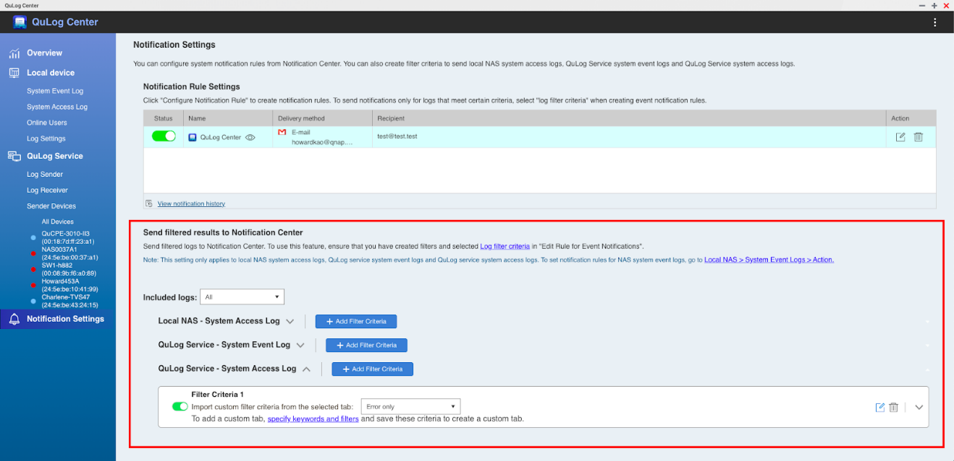
Support notification centers
The notification specifications specified can be notified by the notification center through QuLog Center. Local devices > system access records. QuLog Service > system event records or system access records.

Slide 21
Meet at QTS 4.5
You can use the latest QuLog Center in the following versions.
QTS 4.5.1
QuTS hero h4.5.1
QuTScloud c4.5.3

Slide 22
QNAP QuLog Center
是您最好的選擇.

