Slide 1
2.5 GbE
10 GbE
SSD

Slide 2
QNAP’s first AMD Ryzen V1500B 4C/8T 2.2GHz 9-bay desktop NAS
Since the first rackmount NAS TS-x73AU series with AMD Ryzen V1500B was announced in 2020 June, QNAP is now releasing 9-bay desktop NAS TS-h973AX with the same high-performing processor.
TS-x73AU series
TS-x73U series
TS-x63XU series

Slide 3
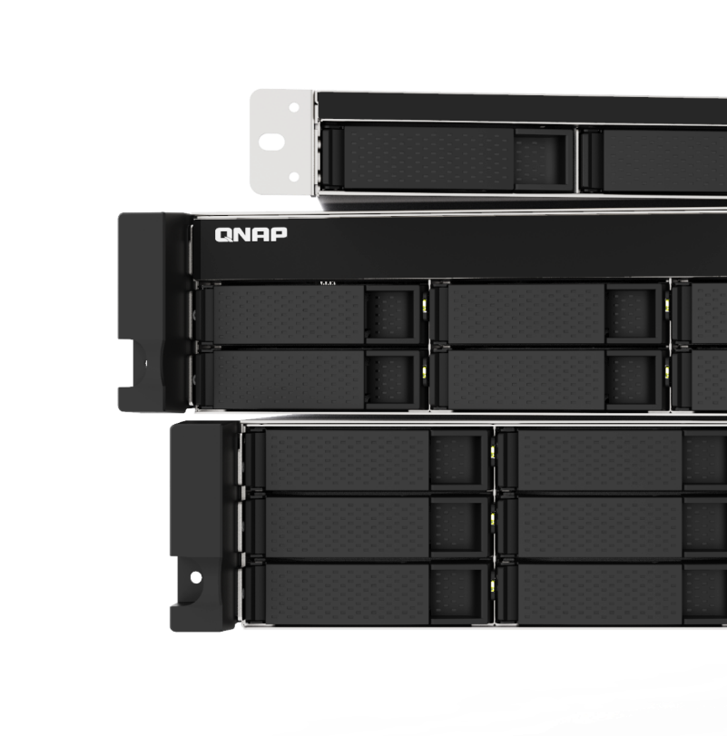
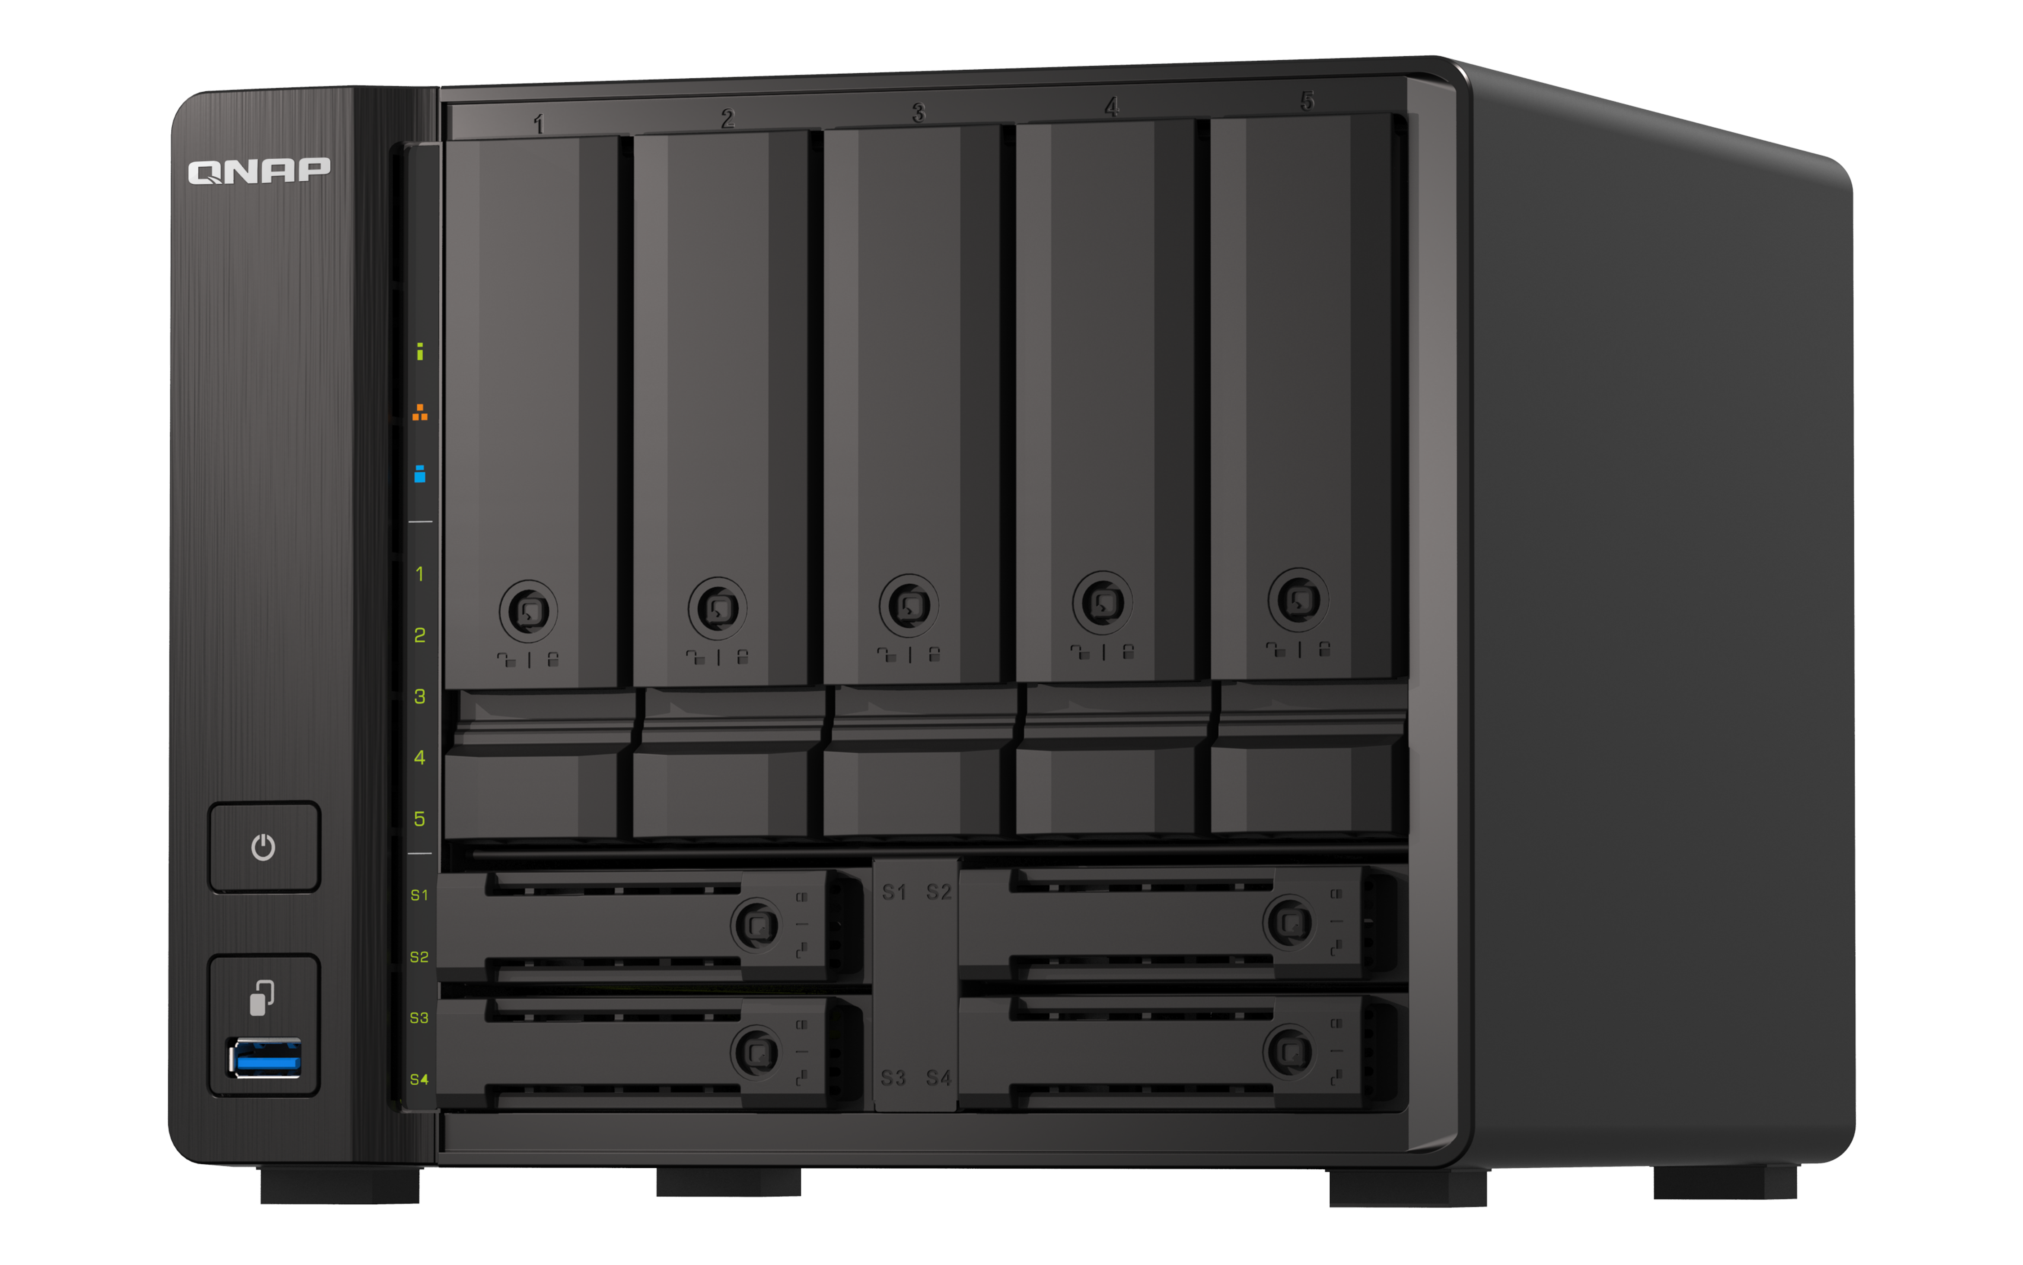
Performance-driven, AMD long-term supported embedded V1500B 4C8T 2.2 GHz processor w/ 25W TDP only
TS-h973AX
Processor
V1500B
Number of cores
4
Number of threads
8
Base frequency
2.2 GHz
Boost frequency
---
L2 cache
2MB
L3 cache
4 MB
Memory type
DDR4
TDP
12 ~ 25 W
CPU architecture
Zen
Source https://www.amd.com/en/products/embedded-ryzen-v1000-series

Slide 4
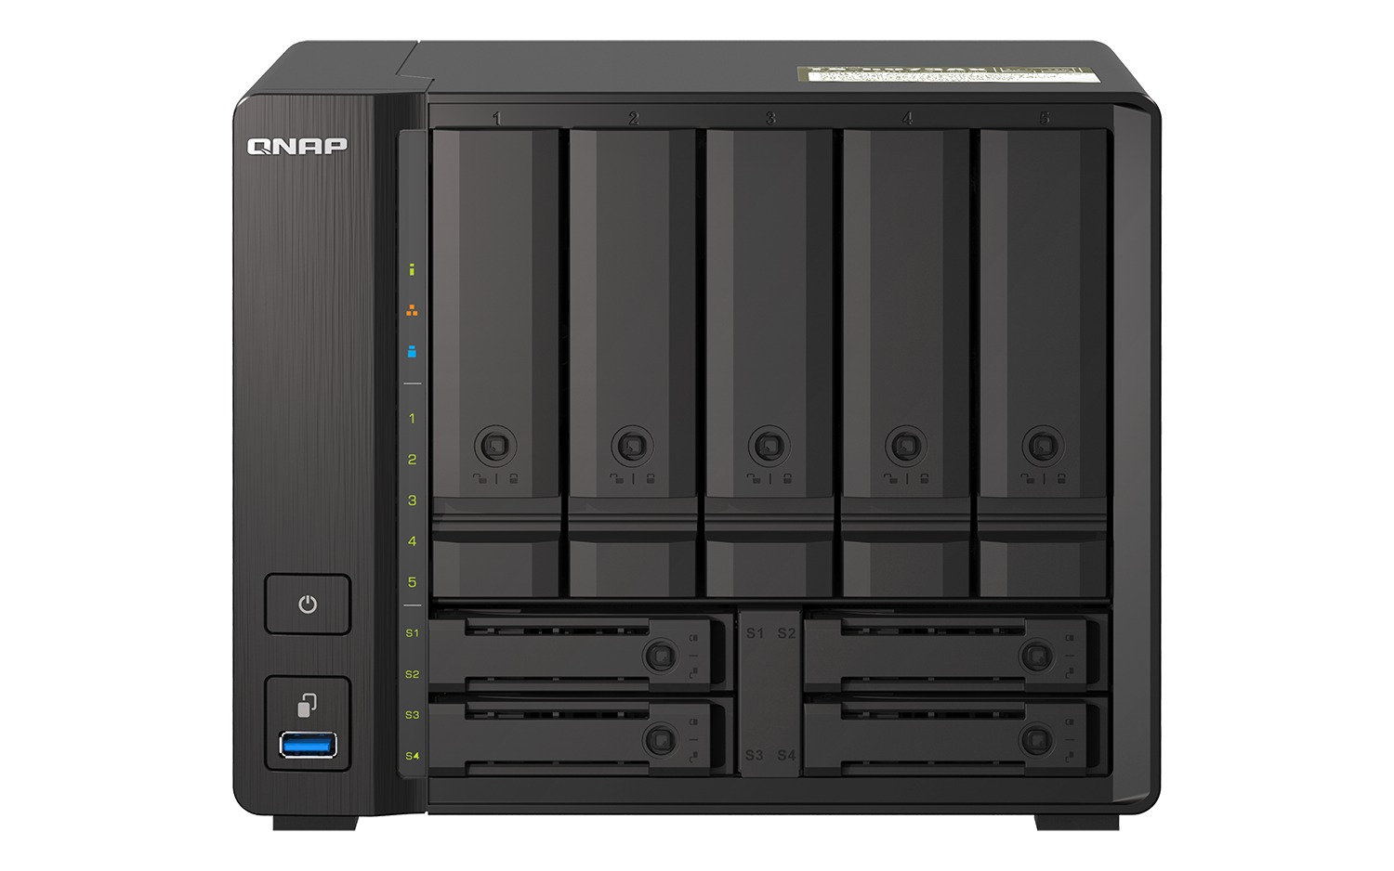
Why buy a 6-bay NAS when there’s a 9-bay option! The AMD Ryzen QuTS hero NAS with many advanced features
QNAP TS-h973AX 9-bay Ryzen NAS
Other 6-bay Ryzen NAS
2 x U.2 NVMe enterprise SSD bays 2 x 2.5-inch SATA SSD bays 9 hot-swappable drive bays: 5 x 3.5”/2.5” SATA + 2 x 2.5” SATA + 2 x 2.5” U.2 NVMe PCIe Gen3 x4 or SATA | Only 6 3.5”/2.5” hot-swappable SATA HDD/SSD bays
10GbE 10GBASE-T Multi-Gig LAN port Integrated, supporting 10G/5G/2.5G/1G/100M speeds | No 10GbE built-in
Dual 2.5GbE LAN ports Higher speed and no extra costs, supporting 2.5G/1G/100M speeds | Only 1GbE LAN ports
8GB and 32GB RAM SKU options At least twice more memory than the competition, providing more clients connections, applications, and better reliability | 4GB RAM by default
Notes:
怎麼選擇，你自己看著辦

Slide 5
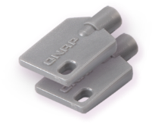
9-bay TS-h973AX front view
Lockable disk trays
(includes 2 keys)
5 x 3.5"/2.5” SATA
6Gb/s HDD/SSD bays
Warning: U.2 SSDs should not be installed in the SATA-only drive bays. Otherwise the connecter will be damaged.
LED indicators:
System, LAN, USB
SSD #1 & SSD #2:
2 x 2.5” U.2 NVMe PCIe Gen3 x4 / SATA 6Gb/s SSD bays
Power button
USB-A 3.2 Gen 2 port and copy button
SSD #3 & SSD #4
2 x 2.5” SATA 6Gb/s SSD bays

Slide 6
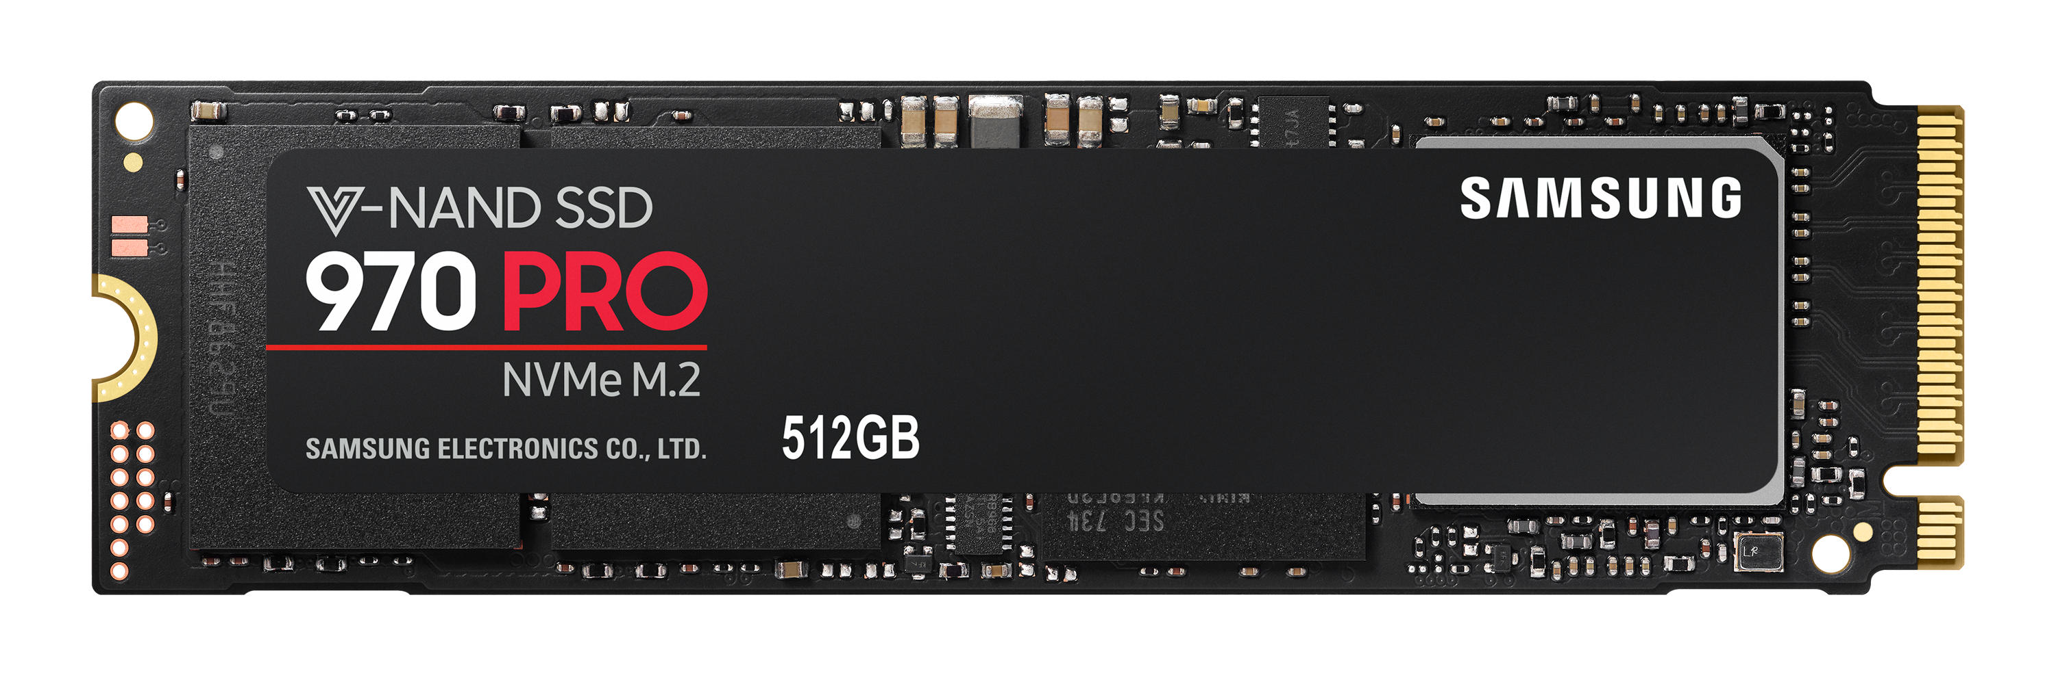
Mainstream SSD form factor, interface, and bandwidth
 | Form factor | Interface | Theoretical bandwidth
 | 2.5-inch (hot-swappable) | SATA | 6Gbps
 |  | SAS | 6Gbps 12Gbps
 |  | NVMe (U.2) | 16Gbps (PCIe 3.0 x2) 32Gbps (PCIe 3.0 x4)
 | M.2 | SATA | 6Gbps
 |  | NVMe | 16Gbps (PCIe 3.0 x2) 32Gbps (PCIe 3.0 x4) 64Gbps (PCIe 4.0 x4)
 | PCIe card (AIC) | NVMe | 16Gbps (PCIe 3.0 x2) 32Gbps (PCIe 3.0 x4) 64Gbps (PCIe 4.0 x4)
Although NVMe SSD’s theoretical bandwidth is very high, the actual performance and life expectancy (TBW / Tera Bytes Written) vary by models. It is critical to choose the right SSD for your workload.
Warranty
5-year or 1200TBW limited warranty
Seq. Read Speed
Up to 3,500 MB/s
*Performance may vary based on system hardware & configuration
Seq. Write Speed
Up to 2,700 MB/s
*Performance may vary based on system hardware & configuration

Slide 7
Bandwidth of NAS SSD port also limits the SSD speed
Even if your SSD is super fast, the actual performance can also be limited by the max bandwidth of the NAS SSD port.
Case 1: Total bandwidth 5Gbps (~ 600MB/s, limited by the NAS SSD port)
M.2 SSD: PCIe Gen3 x4 = 32Gbps
NAS M.2 SSD port: PCIe Gen2 x1= 5Gbps
M.2 NVMe SSD
Case 2: Total bandwidth 32Gbps (~3500MB/s)
M.2 SSD: PCIe Gen3 x4 = 32Gbps
NAS M.2 SSD port: PCIe Gen3 x4= 32Gbps
M.2 NVMe SSD

Slide 8
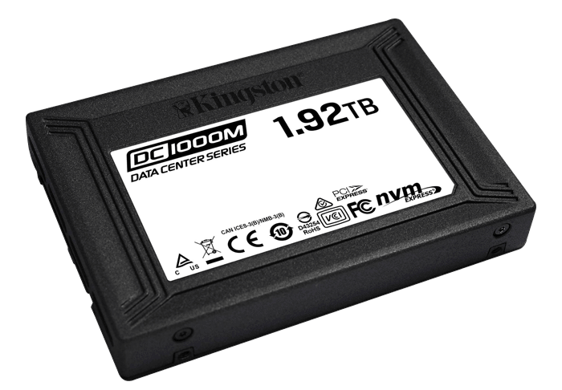
Two Combo Disk Bays for fast U.2 NVMe SSD
Enterprise U.2 NVMe SSD
Up to 7.68TB capacity
Power Loss Protection (PLP)
Low latency: read <300 µs /
write <1 ms
High I/O: read 485,000 /
write 210,000 IOPS
The two Combo Disk Bays can support either affordable 2.5-inch SATA SSDs or the high-performance 32Gbps (PCIe Gen3 x4) and large capacity 7.68TB U.2 NVMe SSDs.
SSD #1 & SSD #2:
2 x 2.5-inch U.2 NVMe PCIe Gen3 x4 SSDs
or 2 x 2.5-inch SATA 6Gb/s SSDs
SSD source: Kingston.com

Slide 9
TS-h973AX storage configuration recommendation
SSD #1 & SSD #2:
2 x 2.5” U.2 NVMe
PCIe Gen3 x4 / SATA
6Gb/s SSD slot
Disk #1~#5 5x 3.5”SATA 6Gb/s HDD
(2) Configure the 2nd and also the main storage pool via 5x 18TB HDD as RAID5, the storage capacity could more than 60 TB)
(3) Use 2x NVMe SSD for read cache + ZIL (ZFS Intent Log), provide efficient read performance, and provide the power-loss protection for synchronous write data.
SSD #3 & SSD #4
2 x 2.5” SATA 6Gb/s SSD
(1) Configure 1st pool via 2x SATA SSD as RAID 1, to be the system pool, attain optimal system performance and efficient app metadata management. It`s the data pool, default shared folder and apps are stored.

Slide 10
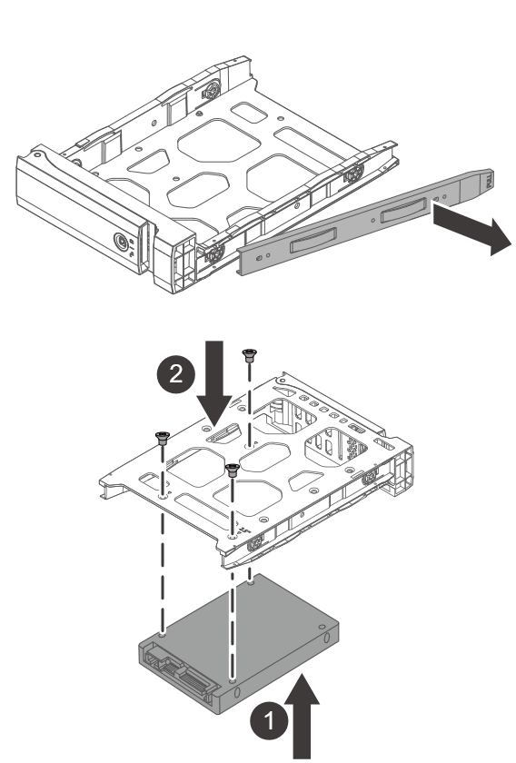
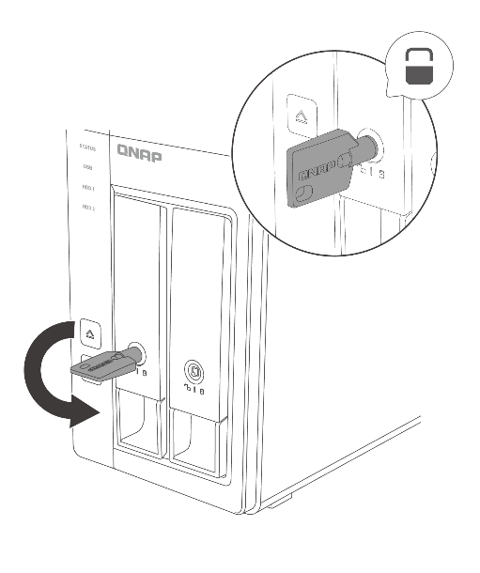
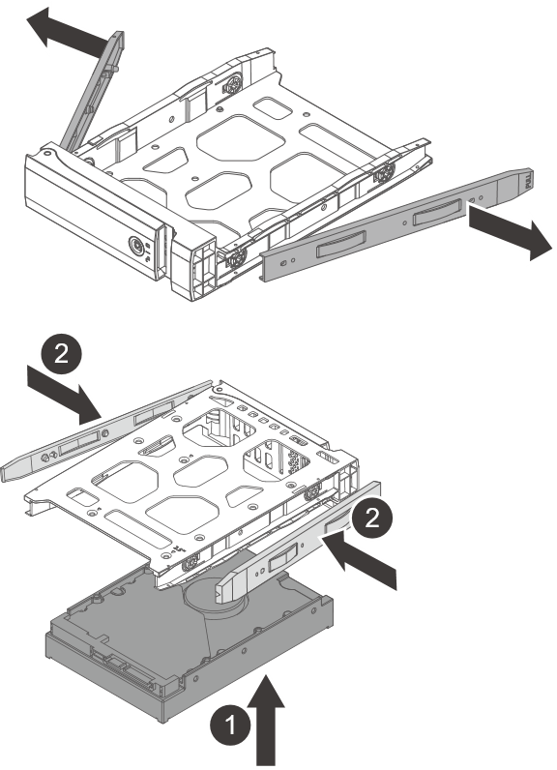
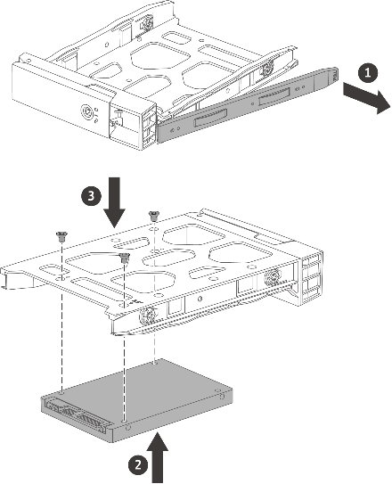
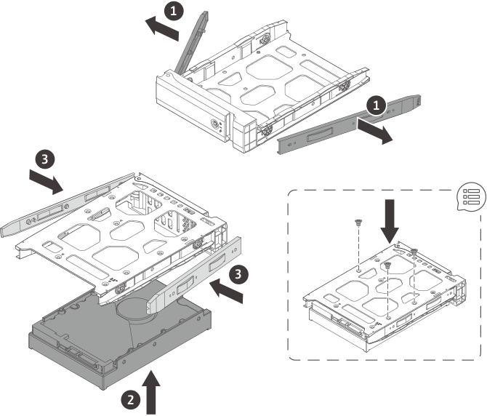
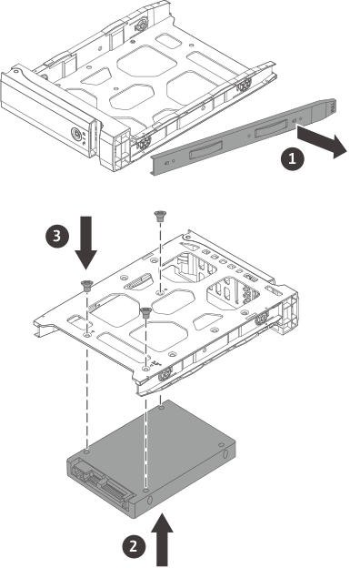
3.5-inch disk tray drive installation
3.5-inch tray for
3.5-inch HDD
3.5-inch tray for
2.5-inch SSD/HDD
Tool-less installation of 3.5-inch drives
Use screws during transportation

Slide 11
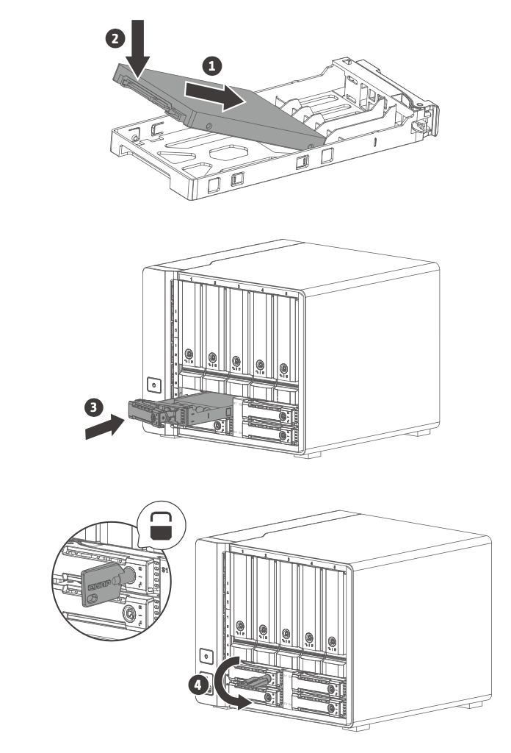
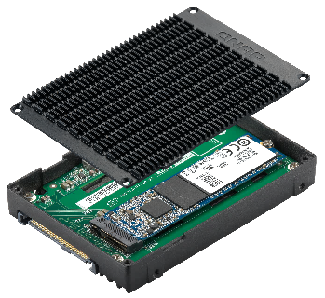
2.5-inch disk tray drive installation
2.5-inch tray for
2.5-inch SSD
Optional Accessory
QDA-UMP
Tool-less installation of 2.5-inch drives
Convert a M.2 2280 NVMe PCIe Gen3 x4 SSD into a U.2 NVMe PCIe Gen3 x4

Slide 12
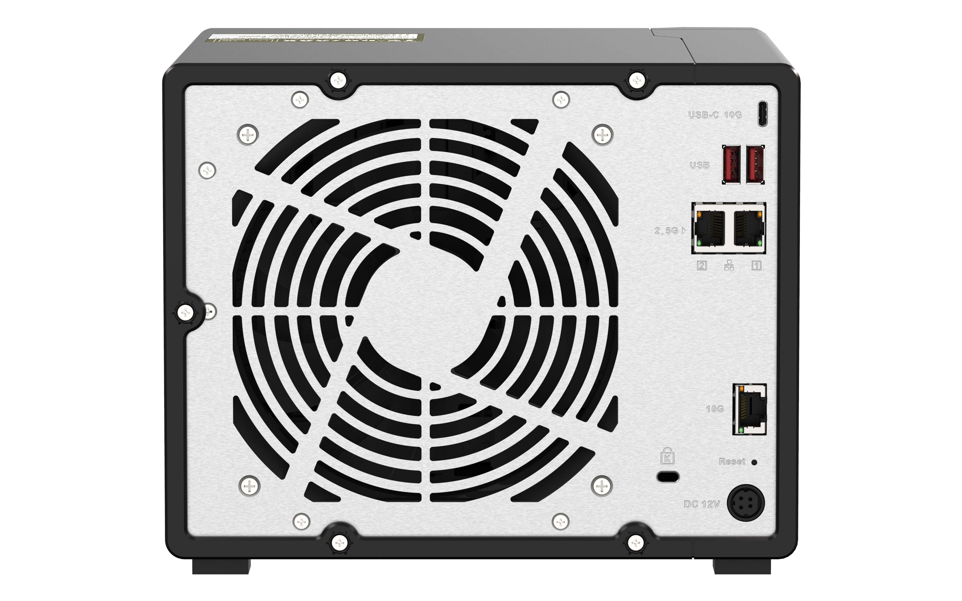
9-bay TS-h973AX rear view
3 x USB 3.2 Gen2 10Gbps ports
( 2 x Type-A + 1 x
Type-C )
2 x 2.5GbE ports
(2.5G/1G/100M)
14CM large and quiet smart fan
1 x 10GBASE-T port
(10G/5G/2.5G/1G/ 100M)
Kensington security slot

Slide 13
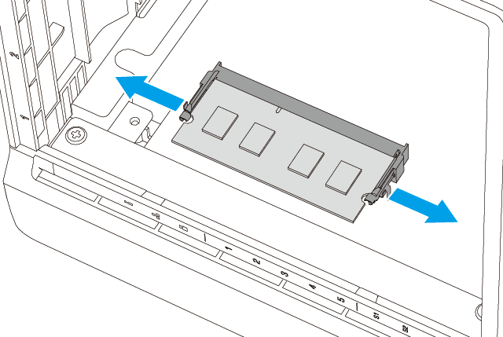
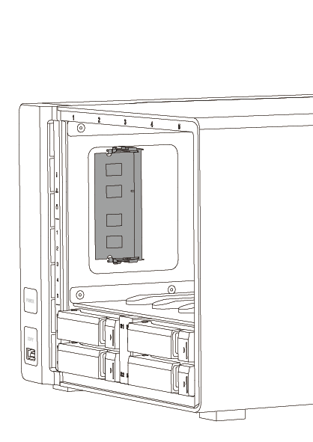
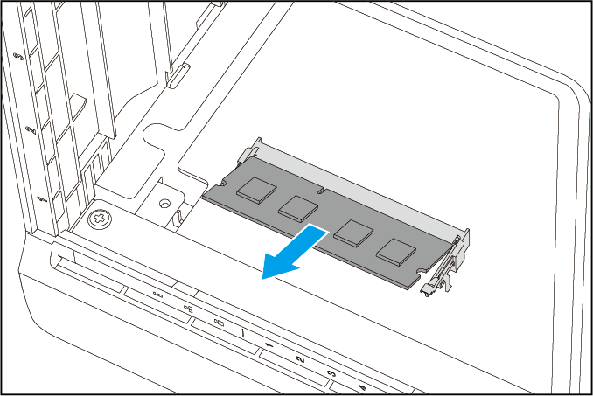
8GB and 32GB DDR4 default memory configuration for more apps and client connections
NAS SKUs
Step 2: pull the clippers
TS-h973AX-32G
32 GB RAM (2 x 16 GB)
Step 1: remove disk trays
TS-h973AX-8G
8 GB RAM (1 x 8 GB)
Dual-channel memory
Step 3: replace the RAM module
2 x DDR4 SO-DIMM memory slots for a total of 32 GB (2 x 16 GB)
Users can order and install additional QNAP 8/16 GB RAM modules to ensure the performance of multi-user connection and to run more apps or VMs

Slide 14
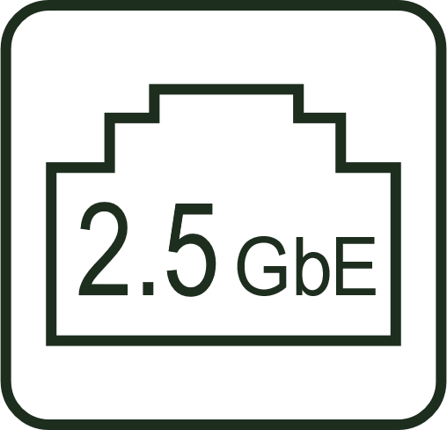
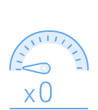
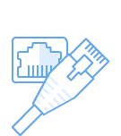
Invest in higher speeds now and save more! Dual 2.5GbE NAS for large file transfer and intensive access
2 x 2.5GbE ports
(2.5G/1G/100M/10M)
Many 2.5GbE-ready products now:
motherboards, Wi-Fi 6 AP/routers, NICs, switches
2.5GbE benefits
2.5X faster
Existing cables
2.5GbE offers 2.5X speed over 1GbE
Works with Cat.5e/
Cat.6/ Cat.6A cables

Slide 15
Integrated 10GBASE-T Multi-Gig for super efficient workflow
1 x 10GbE Windows File Transfer
1000
1167
800
929
600
1 x 10GbE Multi-Gig RJ45 (10G/5G/2.5G/1G/100M)
400
200
0
(MB/s)
Download
Upload
Test environment:
NAS | TS-h973AX-8G, QuTS hero h4.5.0, 5 x Seagate 1TB ST1000NM0033 HDD RAID 5, 2 x Samsung 850 Pro 512GB SSD, 2 x Kioxia XD5 960GB U.2 SSD, compression = On, deduplication = off.
Client PC | Windows 10 Pro, Intel Core i7-6700 3.4 GHz, 64GB RAM, LAN-10G2T-X550. 10GB file.

Slide 16
U.2 SSD and performance test

Slide 17
Enhance multi-user access and storage capacity

Slide 18
Enhance multi-user workflow with QNAP managed 10GbE switches
Same wiring infrastructure for 2.5GbE
QSW-M1208-8C (managed)
 | CAT 5e | CAT 6 | CAT 6A
100M | ✔ | ✔ | ✔
1G | ✔ | ✔ | ✔
2.5G | ✔ | ✔ | ✔
5G | ✔ | ✔ | ✔
10G | X | ✔(55m) | ✔
8 x 10GbE Multi-Gig RJ45 / SFP+ combo
4 x 10GbE SFP+
QSW-M1204-4C (managed)
QSW-M804-4C (managed)
4 x 10GbE Multi-Gig RJ45 / SFP+ combo
8 x 10GbE SFP+
4 x 10GbE Multi-Gig RJ45 / SFP+ combo
4 x 10GbE SFP+
QSW-M408-4C (managed)
QSW-M408-2C (managed)
4 x 10GbE Multi-Gig RJ45 / SFP+ combo
8 x 1GbE RJ45
2 x 10GbE Multi-Gig RJ45 / SFP+ combo
2 x 10GbE SFP+
8 x 1GbE RJ45

Slide 19
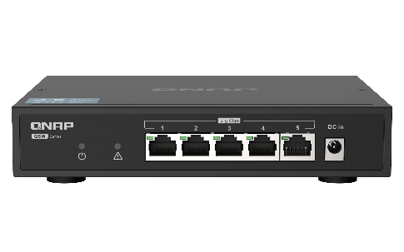
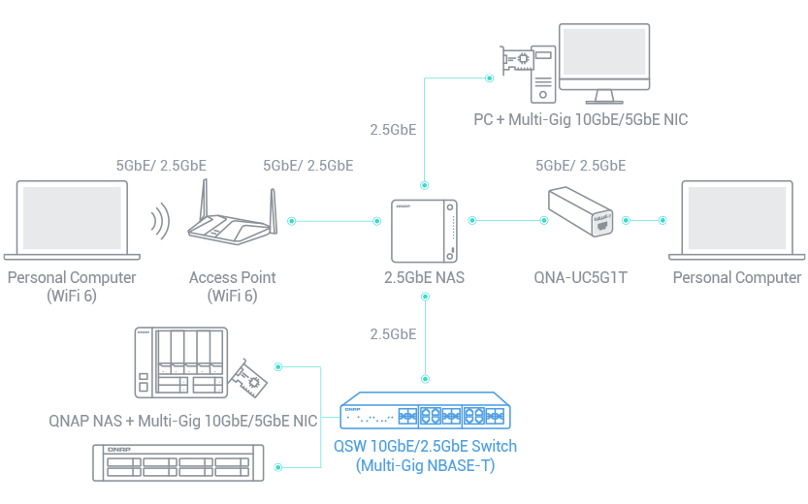
Less budget, faster speed! QNAP unmanaged 10GbE and 2.5GbE switches
QSW-1105-5T (unmanaged)
5 x 2.5GbE Multi-Gig RJ45
Fanless & metal housing
QSW-1208-8C (unmanaged)
QSW-308-1C (unmanaged)
8 x 10GbE Multi-Gig RJ45 / SFP+ combo
4 x 10GbE SFP+
1 x 10GbE Multi-Gig RJ45 / SFP+ combo
2 x 10GbE SFP+
8 x 1GbE RJ45

Slide 20
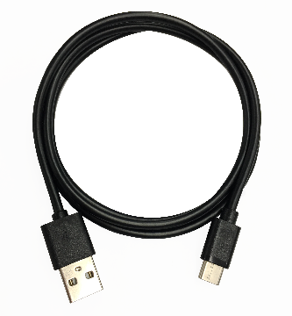
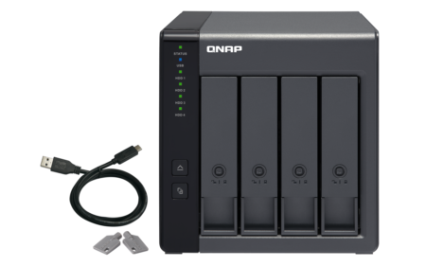
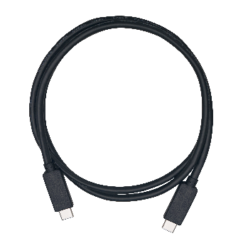
Storage expansion: TR-002 / TR-004 USB RAID units
NAS with a USB port can support TR USB RAID enclosures
Integrated USB Type-C port for plug & play, supporting USB Type-A & Type-C hosts
NAS can connect max. 2 of TR-002/TR-004 enclosures
included
USB 3.2 Gen1 or Gen2 Type-C to Type-A cable
Optional
Type-C to Type-C cable
TR-002
TR-004
USB 3.2 Gen2 (10Gbps)
USB 3.2 Gen1 (5Gbps)

Slide 21
Enterprise-grade OS
QuTS hero with ZFS file system
SSD optimization
Inline deduplication
Inline compression
65,536 snapshots

Slide 22
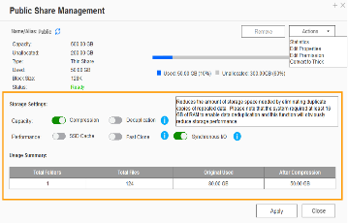
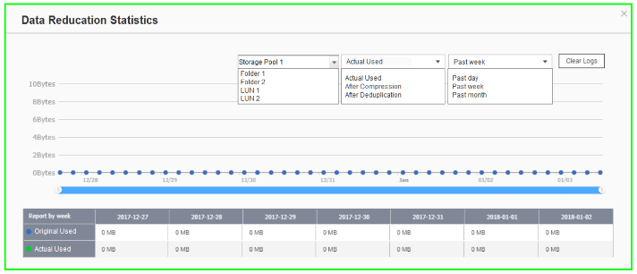
Powerful data reduction: Extend the SSD endurance
Only effective for inline data reduction
ZFS file system with inline deduplication & inline compression features.
The ZFS file system can be the best choice to pair with the all-flash and SSD storage because it reduces the data size and pattern that need to be written to the SSD directly.
Write
A
B
C
D
A
B
C
D
Deduplication minimum requirement : 16GB RAM
D
C
A
B
A
B
C
D
D
C
A
B
Original Data
Compressed Data
Deduplicated Data
SSD Pool
Compression
Deduplication
Write to SSDs as sequential as much as possible.

Slide 23
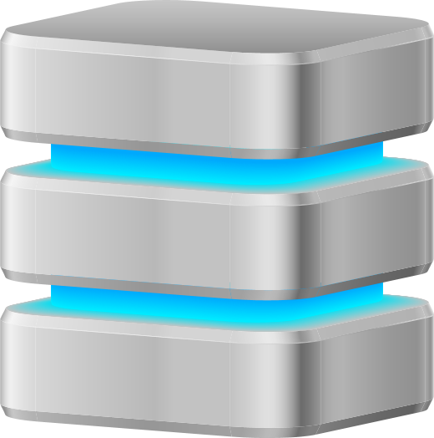
Silent data corruption & self-healing
Application
Application
Application
ZFS RAID
ZFS RAID
ZFS RAID
Avoid data silent corruption that occurred on running system

Slide 24
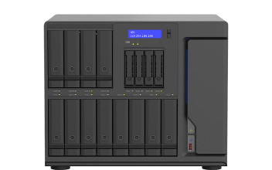
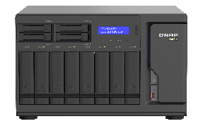
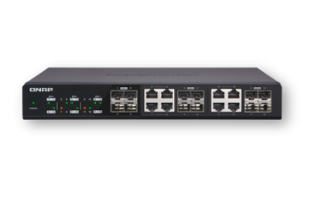
Three-layer backup solution : Provide you with the most complete data backup protection
HBS 3 : File level, multi-version management.
RPO : daily / schedule
Snapshot & Replica:
Block level, multi-version management; ZFS provides the most lightweight snapshot without affecting storage performance at all.
RPO : hourly
SnapSync: Block level, Mirror the data copy and always kept up to date.
RPO : Realtime

Slide 25
SnapSync
Will be available on QTS h4.5.2 (Dec 2020)
The most cost-effective backup, data protection and disaster recovery solution
Schedule SnapSync: 5min~60min
Realtime SnapSync: RPO=0
Normal
Normal
Disaster Recovery (RPO=0)
By schedule
Snapshot send
Real-time Snapshot
Secondary NAS
Secondary NAS
Primary NAS
Primary NAS
(Round Trip Latency < 5ms)

Slide 26
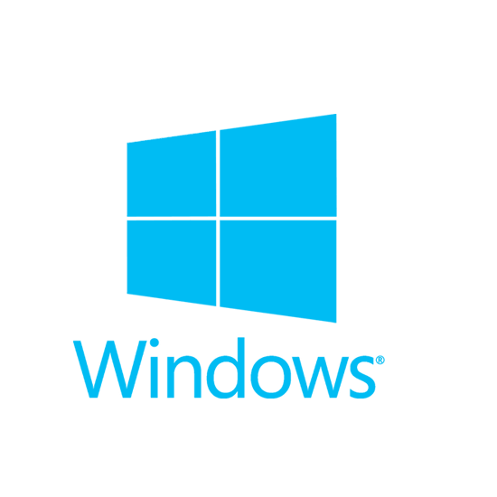
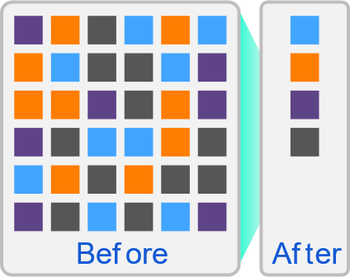
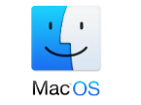
Complete Backup 3-2-1 with HBS 3.0
HBS 3 (Hybrid Backup Sync 3)
From local NAS
(via HBS3)
From remote NAS ( via File Station )
Carry & use (QuDedup Extract Too)
Backup/Restore
.qdff
Tokyo
Taipei
.qdff
TCP BBR
File Station with QuDedup(soon)
.qdff
NY
.qdff
CIFS / NFS / FTP
.qdff
Taipei
File Station with QuDedup(soon)
Access from Cloud
Beijing

Slide 27
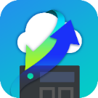
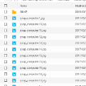
HybridMount File Gateway Seamless access public clouds
 | Network Drive for clouds | File Cloud Gateway
Setup Method | Mount a cloud storage with authorization | Select “File Cloud Gateway” mode and create a dedicated cache space
Connections | No limit | 2 free and perpetual connections. Purchase license for more connections
Access Performance | Depends on network speed | High performance thanks to caching
Access in File Station | Supported | Supported
Access through SMB / NFS / AFP | Not supported | Supported
Sync with the cloud | Sync only when browsing | Sync constantly for quick access
Integration with QTS Apps | Not supported | Supported ...
Online collaboration
File data analysis
Slower
Internet
NAS
Cache
1
2
3
META
DATA
LAN
Faster
Notes:
網路磁碟 雲端掛載：Network Drive for Cloud Mounting
通過雲端認證建立網路磁碟雲端掛載：Mount a cloud storage with authorization

Slide 28
HybridMount - Cascade share the access permission to remote devices
The remote data mounted by SMB/NFS can be shared with other devices with folder permission to achieve a cascade share architecture.
To avoid local users access the remote data by VPN and to reduce the security concern and risk of VPN.
No longer need to manage user accounts in the remote server. The local admin retains full control over assigning different permissions to local users.
SMB/NFS
Notes:
Title: Hybridmount – Cascade share the access permission to remote devices
The remote data mounted by SMB/NFS can be shared with other devices by users with folder permission to achieve a cascade share architecture.
To avoid local users access the remote data by VPN and to reduce the security concern and risk of VPN.
No longer need to manage user accounts in the remote server. The local admin retains full control over assigning different permissions to local users.

Slide 29
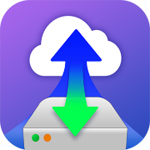
Enterprise LUN backup: VJBOD Cloud : block-based gateway
VJBOD Cloud Gateway
Initiator
Local user
iSCSI
Target
Cloud Object
Storage space
Initiator
iSCSI
Cloud LUN
Client
Application
Server
SMB/NFS/AFP/
FTP/WebDAV
Cloud Volume
/Shared folder
Snapshot
Local user
Snapshot

Slide 30
Hyper Data Protector : All-in-one active backup solution for virtual machines
Supports VMware, Microsoft Hyper-V
Unlimited VM backups and license-free
Active backup solution
Restore at any time point
Hyper Data Protector
Microsoft Hyper-V

Slide 31
Boxafe Comprehensive Backup Solution for Google™ Workspace and Microsoft 365®
Keep important data in your hands.
Move older data out of the cloud to reduce cost
Google™ Workspace
Microsoft 365®
Gmail
Backup all your emails and attachments in Gmail
Outlook
Backup all your emails and attachments in Outlook
Google Drive
Backup all your file versions in Google Drive and supports My Drive and Shared Drive
Contacts (People)
Backup all your contacts in Outlook People
Calendar
Backup all your events and attachments in Outlook Calendar
Contacts
Backup all your contacts in Google Contacts
OneDrive
Backup all your files in OneDrive and support SharePoint (coming soon)
Calendar
Backup all your events and attachments in Google Calendar

Slide 32
QmailAgent - email backup solution
Best Email Retention Solution
Collectively manage and back up your personal and business emails.
Easily auto back up all your emails and attachments.
Quickly search and gain access to specific messages.
Back up emails for disaster recovery.
Encryption service protects backed up private emails.

Slide 33
Virtualization Station and Container station create application storage all-in-one machine
Virtualization Station
Container station
Supports two light virtualization technologies, LXC and Docker®. You can run a complete Linux® virtual machine on the QNAP NAS, and download thousands of applications from the Docker® Hub online collection.
Virtualization Station allows you to create virtual machines on Turbo NAS to install Windows, Linux®, UNIX® and Android operating systems.
Container Station
Container
Application
Application
Application
Filesystem
Filesystem
Filesystem
Host OS
Hardware

Slide 34
Establish and run dual systems- Ubuntu Linux Station & QuTS hero
Ubuntu Linux Station
INTERNET
Run QuTS hero and Ubuntu dual system, dual system application to enjoy.
One-click installation of multiple versions Ubunutu: 16.04 / 18.04 / 20.04
Ubuntu Software Center enjoy a variety of application downloads
Remotely access the Ubuntu Linux desktop through a browser

Slide 35
Media management and cross-platform streaming
QuMagie AI photo albums
and auto classification.
Plex Server media streaming
CAYIN MediaSign Player
HEVC (H.265)
video transcoding
Use Cinema28 to stream media files to various meeting rooms

Slide 36
Smart and automatic file management
Qsirch
Qfiling
A powerful, Google-like search tool
Search image, music, video, document, and email by keyword and filters.
5 advanced image search: search by face, text in image, things, color and map.
Supports Qfiling to perform archival tasks based on your search criteria.
Automatically filing and archiving
Source
Scheduling
Filter
Editing
Destination
2 type of task: filing task, recycling task
3 type of scheduling rule: one-time, scheduling, real-time
9 editing module: AI face blur, encryption and decryption, video transcoding and so on

Slide 37
All new surveillance app - QVR Elite
Release ETA: The end of Oct.
Subscription-Based License: 1 Channel USD $1.99 /month (Discount Price for bulk purchase)
Channel License Type Unlimited
Just type the total channel number for the request, do not need calculate sku number for different license sku type.
One time activate license by input specific channel number directly.
QVR Pro Client
QVR Elite be supported by the QVR Pro Client that as same as QVR Pro's client. So it also has the Dynamic View Layout, Live and Playback at the same time, e-map event display features.
Performance Evoluation
At initial version, max recording channel is 128 channels, the next version we will increase it to 192 channels.
Standard MP4 file
QVR Elite record standard mp4 file. The standard mp4 file will very suitable for using HybridMont or backup software of QuTShero and QTS.
Notes:
說明:
自訂任意授權購買數量 >> 可以買任何數量不用計算
自訂授權啟用數量

Slide 38
With QuTS hero / QTS two systems, depending on your preference
The QuTS hero operating system is preloaded to provide you with the most complete data protection. But if you have an older NAS and want to automatically apply the disk settings to the new host, you can change to the QTS operating system when you first install NAS as needed.
Enabling the Qtier automatic tiering and partitioning application in QTS allows the NAS performance to automatically reach the highest utilization rate.
Attention: Since QTS and QuTS hero use different file systems, users must not insert the old hard disks between different operating systems to avoid data loss. When the two systems are different, the hard disk data can only be transferred between the two hosts through HBS 3. User can also choose to use the same operating system for system migration.

Slide 39
Same compact size
Much more powerful
2.5 GbE
10 GbE
SSD
Copyright© 2020 QNAP Systems, Inc. All rights reserved. QNAP® and other names of QNAP Products are proprietary marks or registered trademarks of QNAP Systems, Inc. Other products and company names mentioned herein are trademarks of their respective holders.​​​

