Slide 2
Problems by IT using virtual machine services
Virtual Machine service is too slow
The virtual machine service automatically stops running
Virtual Machine service is unstable
Virtual machine service security issues

Slide 3
IT maintenance process
Shutdown→Test Online→Shutdown again→Online
Update Firmware
Hardware device reboot
Update Hardware Device
Find issue Root Cause and test service
Switch to other hardware devices

Slide 4
Can the VM service run smoothly during IT maintenance?

Slide 5
The VM Live Migration make IT maintenance more flexible
VM Service running
Shutdown
VM Service keep running.
VM Live Migration to NASB

Slide 6
VM Live Migration Architecture

Slide 7
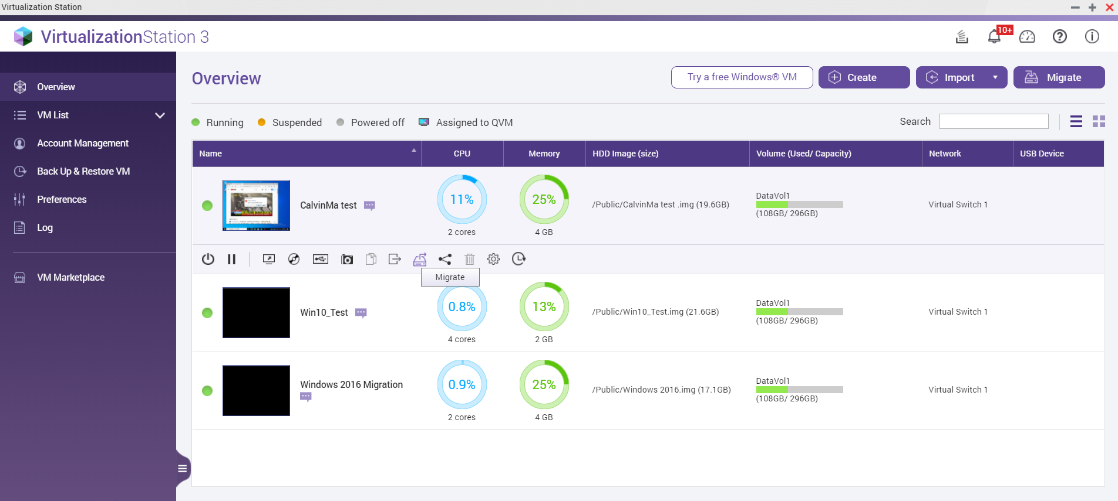
One NAS can do "Migrate in "and "Migrate out"
VM Migrate in
VM Migrate out

Slide 8
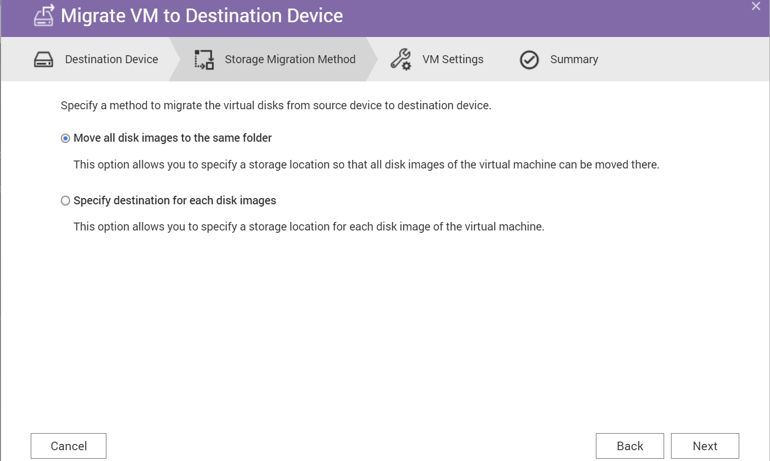
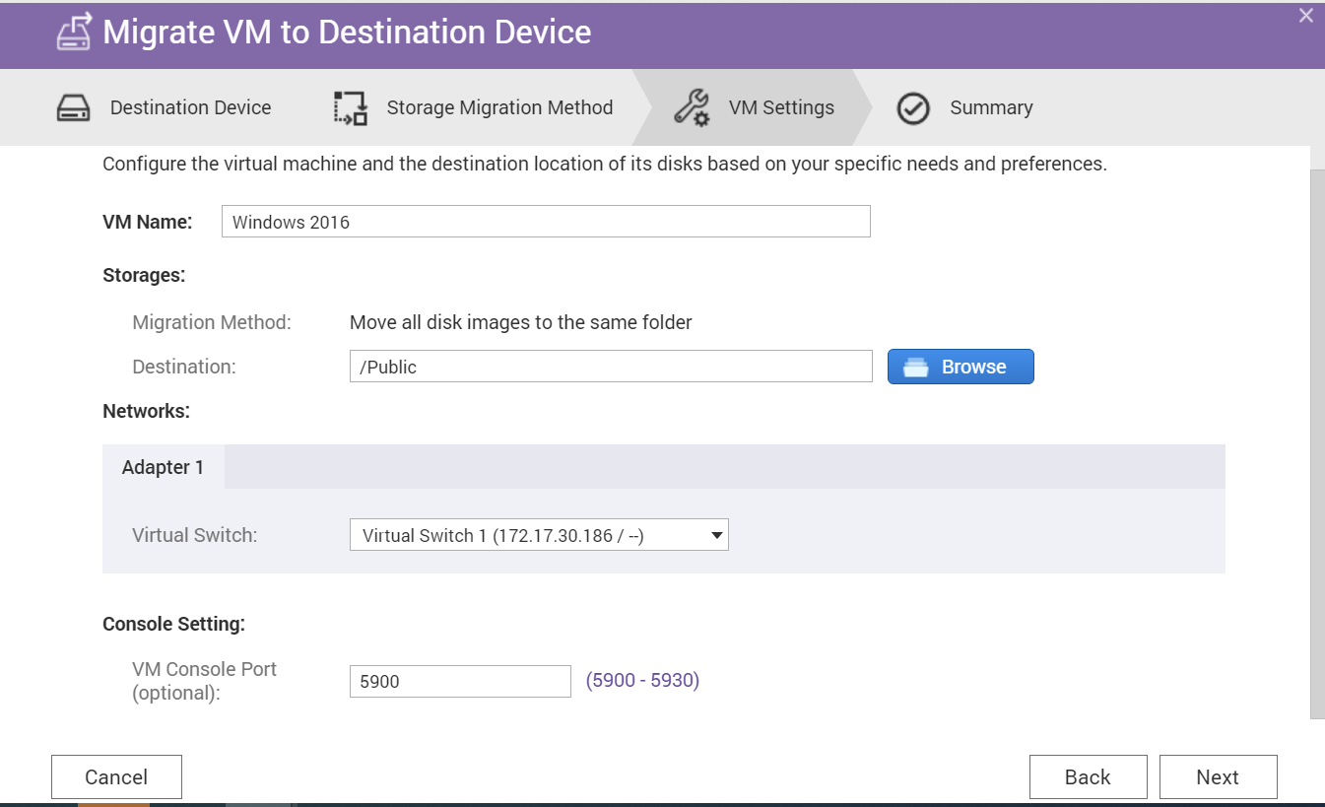
Simple UI operation in three steps to complete VM Live Migration

Slide 9
VM Live Migration advantages and benefits
Advantage
Virtual machine live migration ensures smooth service
Benefits
It can achieve the effect of IT maintenance without affecting the user's use of the services on the virtual machine
IT can flexibly maintain hardware and firmware upgrades and repairs, or periodically restart operations.
Business operations will not be affected by IT maintenance.
You don't need the same NAS model, the same number of hard drives and slot locations, you only need to correspond to the same CPU platform (Intel&Intel /AMD&AMD) to use.

Slide 10
VM Live Migration

Slide 11
Considerations-1
If the VM uses the Device Passthrough (PCIe/Blu-ray) function, live migration cannot be used.
Because the physical device used by the original VM was live migrated, the original physical device ID will not be recognized when the VM is migrated to the new NAS.
VM Live Migration function support models only support the same platform model of X86 architecture
Intel platform NAS VM Live Migration to Intel platform NAS
AMD platform NAS VM Live Migration to AMD platform NAS
Virtualization Station 3.5 is only compatible with QTS 4.5.1 or later version.

Slide 12
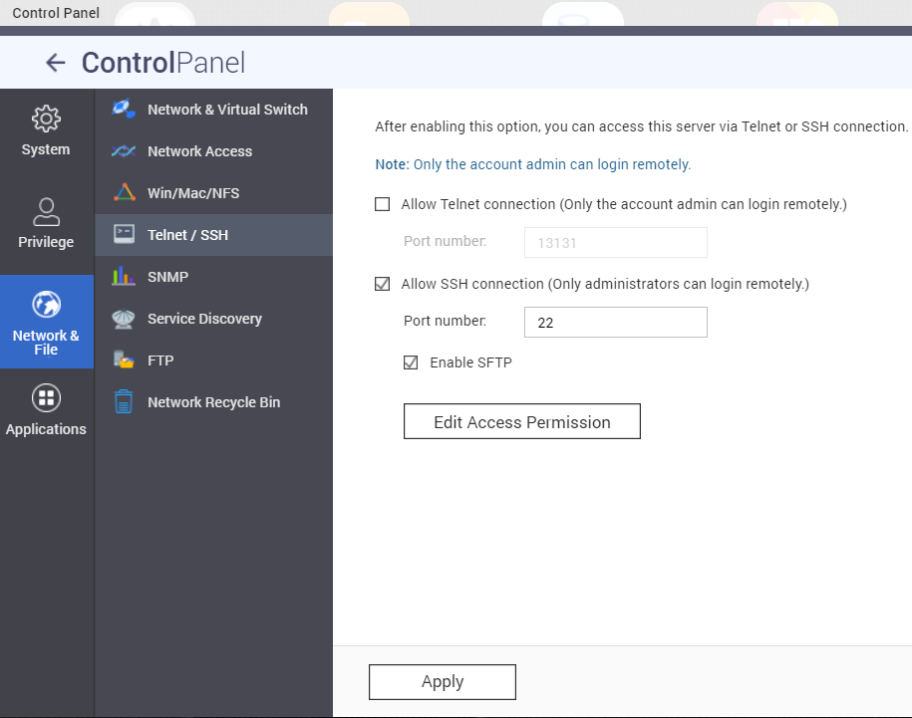
Considerations-2
VMs exported from Virtualization Station 3.5 are only compatible with Virtualization Station 3.5 and later versions.
Secure shell (SSH) service is required to migrate VMs. Ensure that SSH is enabled in "Control Panel > Network & File Services > Telnet / SSH" to prevent migration failure.
Ports 16500-16550 are required for VM migration. Ensure that these ports are not blocked to avoid migration failure.

Slide 13
Your Best Choice. Download Now!
Copyright© 2020 QNAP Systems, Inc. All rights reserved. QNAP® and other names of QNAP Products are proprietary marks or registered trademarks of QNAP Systems, Inc. Other products and company names mentioned herein are trademarks of their respective holders.​​​​​

