Slide 2
Discover Qfiling 3 in four faces
Qfiling 3 helps you to organize all your files
Start a Qfiling task in 3 steps
Demonstration
Examples of how to apply Qfiling in your workflow

Slide 3

Qfiling can help you!
Files are scattered everywhere and it is difficult to organize them!
After traveling,
organizing
thousands of photos can become a real headache.
The storage capacity is almost full, and I need quick help to remove
unnecessary files!

Slide 4





Qfiling core competencies
2
3
9
scheduling rules
editing modules
type of tasks
Flexible
With system logs, filing status is easily accessible
With recipes, tasks are done with one click
Scheduling for auto filing
Efficient
Total control
Fast

Slide 5











How do two types of Qfiling tasks work?
Select source
Source file filters
File editing
Select destination
Filing Task
Automatically origanize all your data!
NAS
NAS
Document
iSCSI
iSCSI
Image
USB
USB
File Filter
Batch Editing
Mobile
Mobile
Video
RDX
RDX
Destination Folder Structure & File Handling
Cloud
Recycling Task
Remove the data you don’t need.
DVD
File Filter
Cloud
Trash

Slide 6





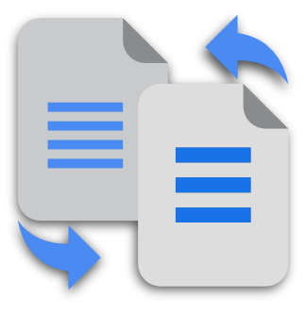
Qfiling 3 enables more possibilities
See what’s new on Qfiling 3:
Filing source
Task trigger
File editing
Filing the data of applications:
Real-time task
Face Blur & Pixelate
AI face recognition to blur or pixelate for privacy.
Archive Qsirch search results
Qfiling will monitor the source folder and automatically start the filing task when new files are added.
All newly-added files will be organized immediately.
Image Resize
Batch resize all images.
Archive QuMagie albums
Image Convert
Adjust the quality to reduce the size of images and convert the image formats.

Slide 7
Start a Qfiling Task!
Create Qfiling tasks in 3 steps
Easily access filing status
One click to create tasks with recipes

Slide 8


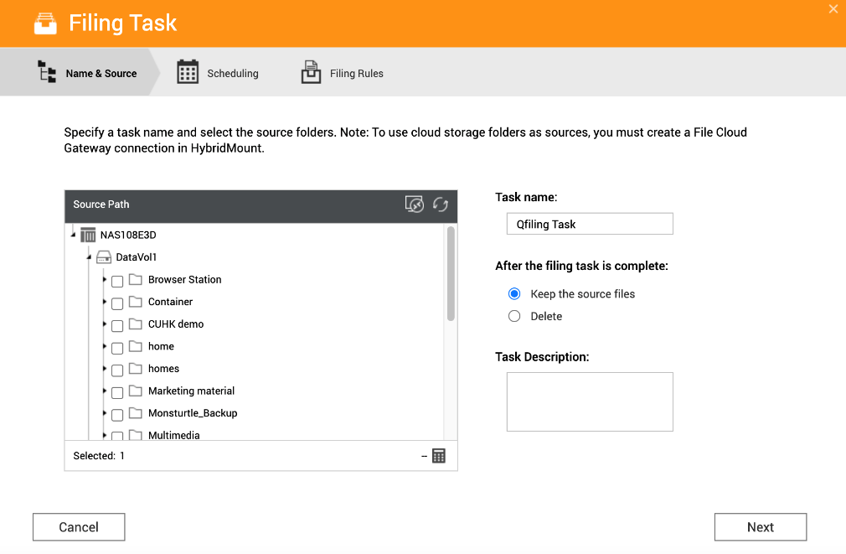

Create your Qfiling tasks in 3 steps
Select source
Scheduling
Filing rules
Manually Select
Support:
Local NAS
External Devices
USB, Mobile, DVD, RDX
Remote Storage
iSCSI, Remote NAS, Public Cloud
Free up source storage space by setting to “delete" the source files after the filing task is completed.

Slide 9

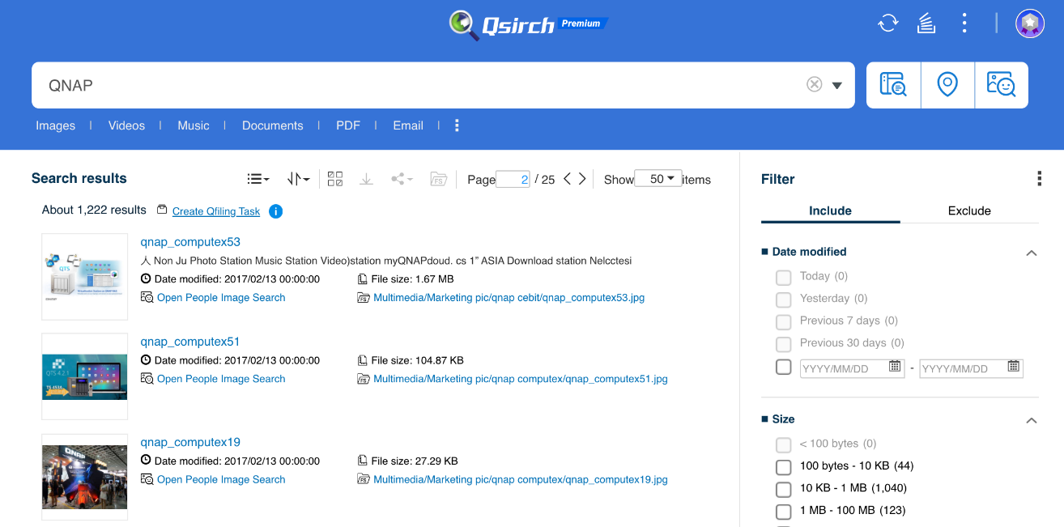
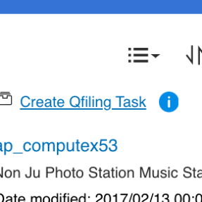
Create your Qfiling tasks in 3 steps
Select source
Scheduling
Filing rules
NEW
Archive Qsirch’s search results
* Qsirch 5.0 and higher is required.

Slide 10

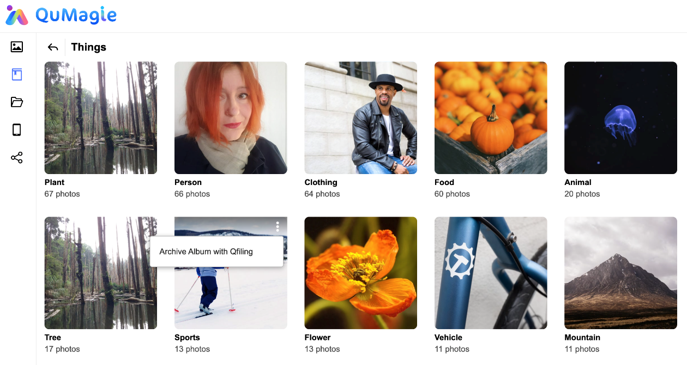
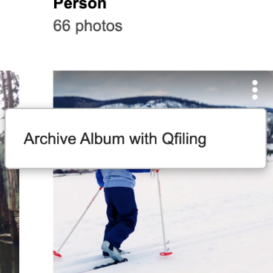
Create your Qfiling tasks in 3 steps
Select source
Scheduling
Filing rules
NEW
Archive QuMagie albums
* QuMagie 1.3 and higher is required.

Slide 11
Create your Qfiling tasks in 3 steps
Select source
Scheduling
Filing rules
Three type of scheduling tasks.
One-time task
The source data will be filed once.
Scheduled task
The filing task will auto start by schedule.
Real-time task
Qfiling will monitor your source folder and automatically start the filing task when new files are added. All newly-added files will be organized immediately.
NEW
Notes:
Only support the local folders and the folders mounted by HybridMount as the source.
Only the newly added files will be filed.

Slide 12


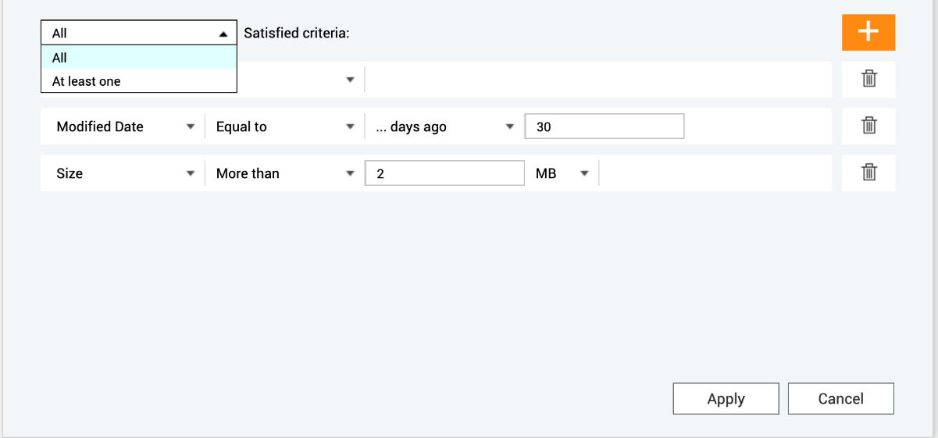
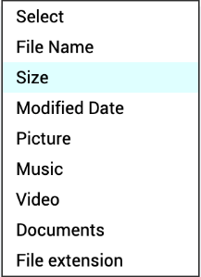
Create your Qfiling tasks in 3 steps
Select source
Scheduling
Filing rules
Filters
File editing
Select destination
Folder Structure
File handling
Select AND/OR logic.
Dozens of filter criteria help you pick the files you need!
Enable more filters by installing Qsirch.

Slide 13






Create your Qfiling tasks in 3 steps
Select source
Scheduling
Filing rules
Filters
File editing
Select destination
Folder Structure
File handling
9 file editing modules help to edit the files in batches when filing:
Watermark
Image2PDF
Image resize
Image convert
Face blur & pixelate
Video transcoding
Subtitle pairing
Encryption & Decryption
Compression

Slide 14
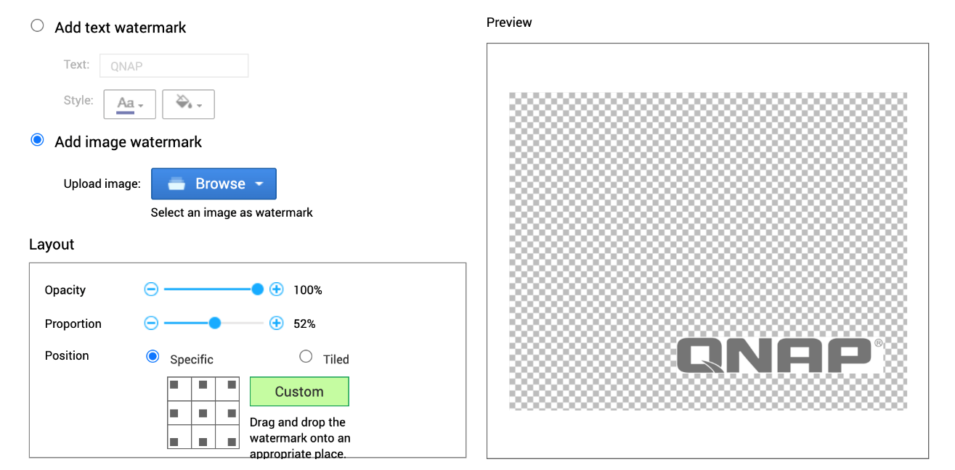
9 File batch editing modules
Watermark
Add text or image watermark to images and videos.

Slide 15
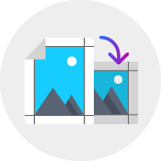


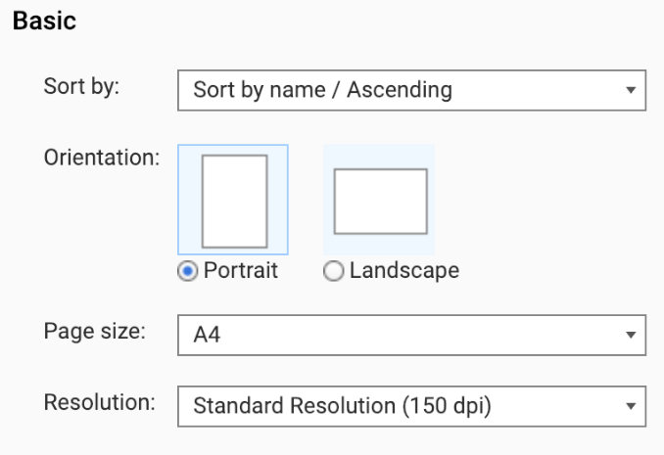
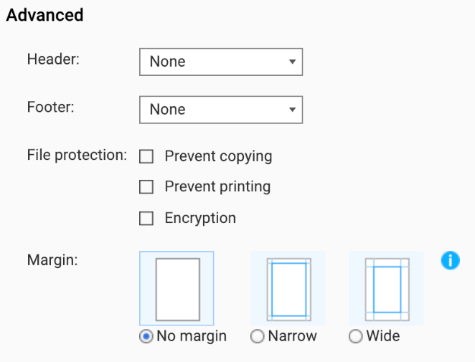

9 File batch editing modules
Image2PDF
Create customized layout
Protect and encrypt files before sharing them
Page size and orientation
Header and footer
Margin
File protection:
Copy prevention​
Printing prevention​
File encryption
Adjusts image resolutions for faster file sharing
Low Resolution
Standard Resolution
High Resolution

Slide 16














9 File batch editing modules
NEW
Face Blur & Pixelate
QNAP AI engine, QuMagie Core, will recoginize the faces in the photo.
Qfiling blur or pixelate the face areas of the photos with customized options.
Requirement: QTS 4.5.1, QuMagie Core 2.0.1, Multimedia Console 1.3.0 (or later).
Pixelate: You can customize the size of the pixel.
Blur
Grayscale

Slide 17
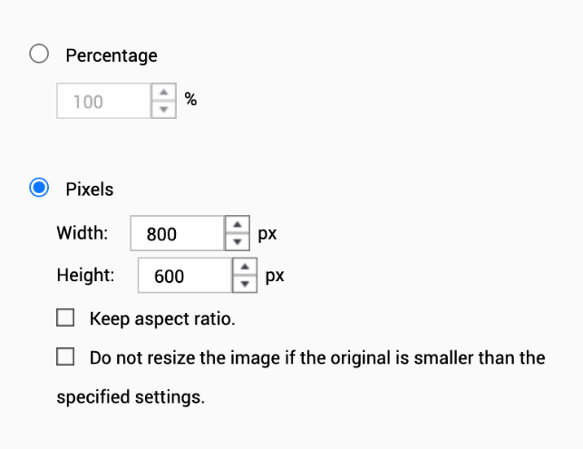

9 File batch editing modules
NEW
NEW
Image Resize
Image Convert
Convert the image to png/ jpg/ gif formats.
Adjust the quality to reduce the size of images.

Slide 18
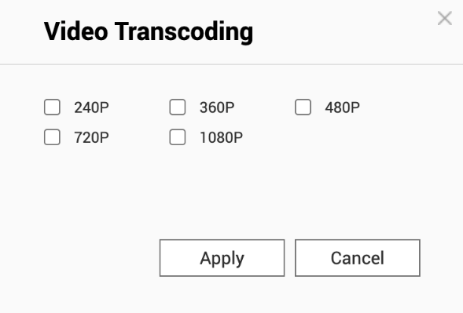
9 File batch editing modules
Video Transcoding
Subtitle Pairing
Transcode the video to different resolutions and mp4 format.
Move same-named subtitle files (.srt) together with their corresponding videos to destination folders.
Note: Subtitle pairing is not supported to real-time task.

Slide 19



9 File batch editing modules
Encryption & Decryption
Keep your data secure by encryption.
Encrypted file extension: .qenc
Encryption algorithm: AES 256
Password length: Up to 32 characters, special characters allowed.
Decrypt the data by 3 ways:
Qfiling
Create a filing task with decryption editing rule.
File Station
Right click on the files to decrypt in File Station.
QENC Decrypter
If you share the encrypted files to your friends who don’t have QNAP NAS, use QENC Decrypter to decrypt the files.

Slide 20
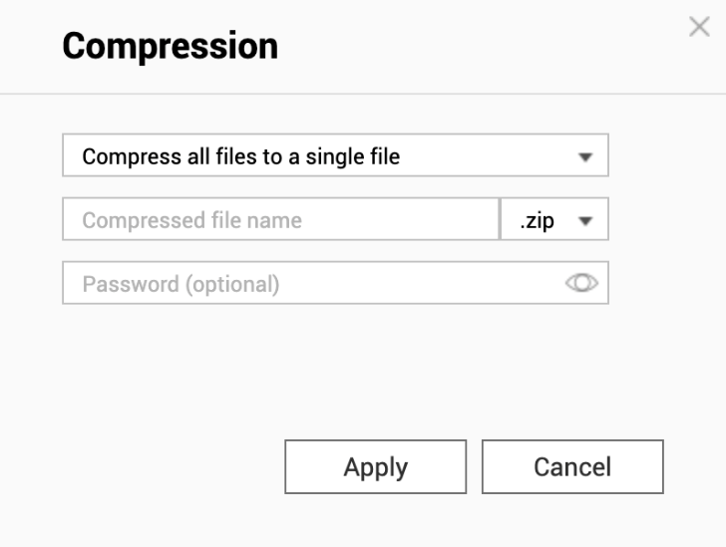
9 File batch editing modules
Compression
For all type of files, Qfiling help to compress the files in the destination folders.
Two mode of compression:
Compress all files to a single file
(not supported in real-time task).
Compress each file.

Slide 21
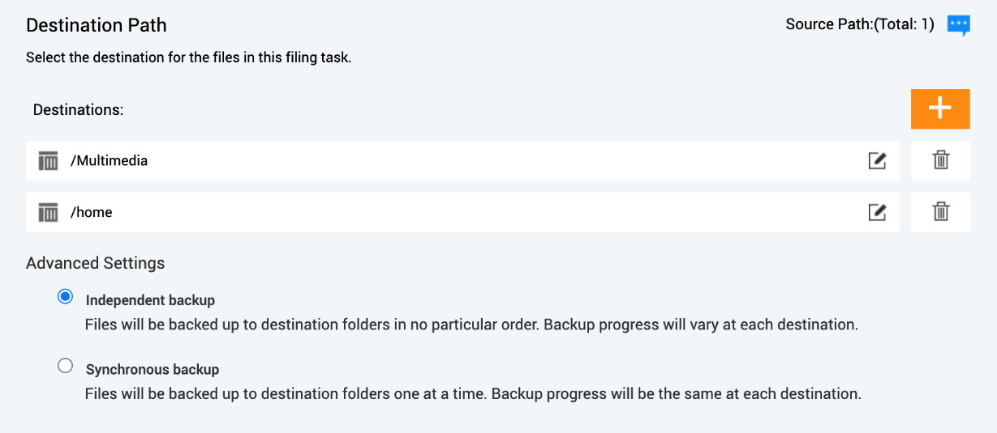
Create your Qfiling tasks in 3 steps
Select source
Scheduling
Filing rules
Filters
File editing
Select destination
Folder Structure
File handling
Select multiple destinations: one to local, one to mounted remote NAS.

Slide 22
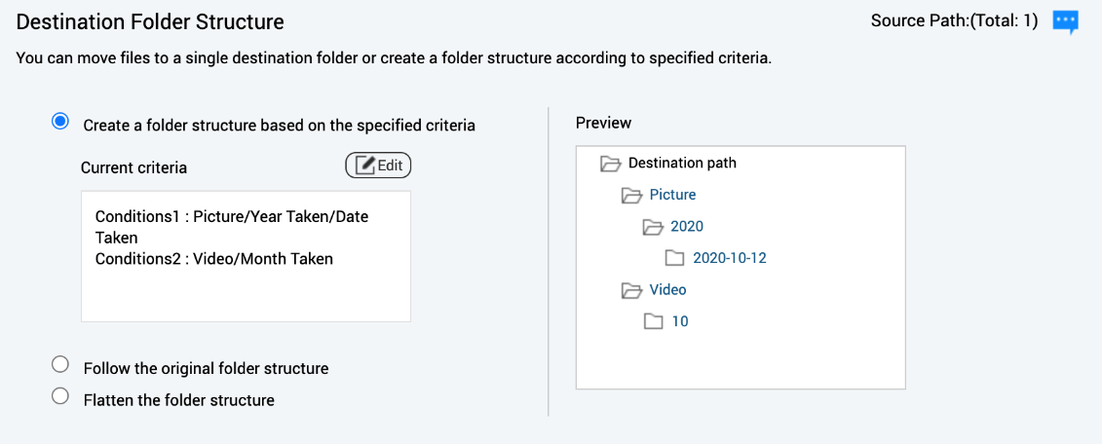
Create your Qfiling tasks in 3 steps
Select source
Scheduling
Filing rules
Filters
File editing
Select destination
Folder Structure
File handling
Three ways to specify the destination folder structure: select the best way to organize the files!
The file will be filed to the destination folder with the structure you've set.

Slide 23
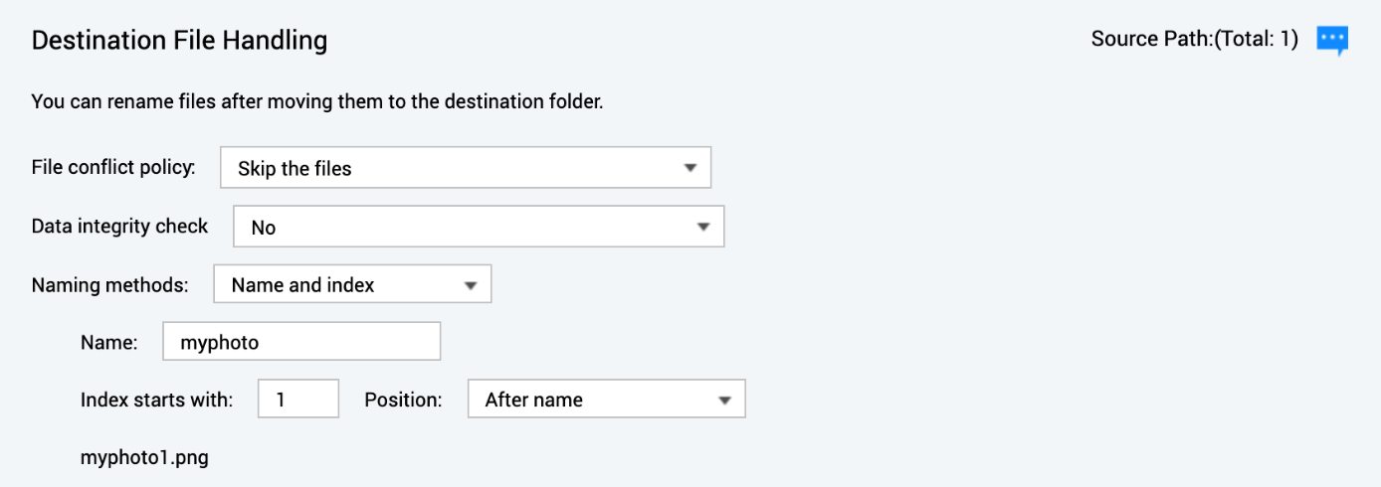
Create your Qfiling tasks in 3 steps
Select source
Scheduling
Filing rules
Filters
File editing
Select destination
Folder Structure
File handling
Setup the file conflict policy.
An easy way to batch rename all your files.

Slide 24
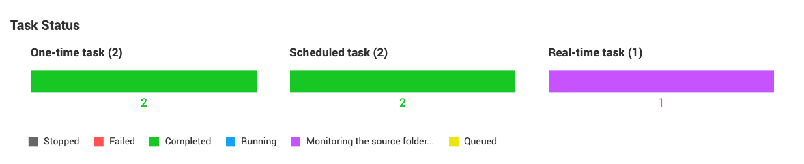
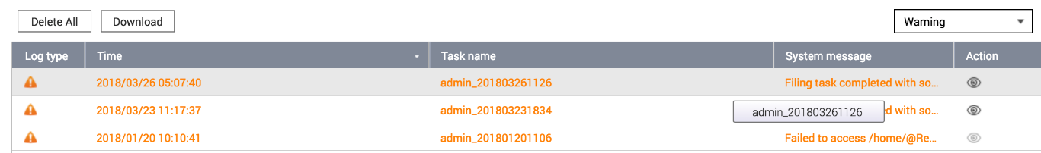
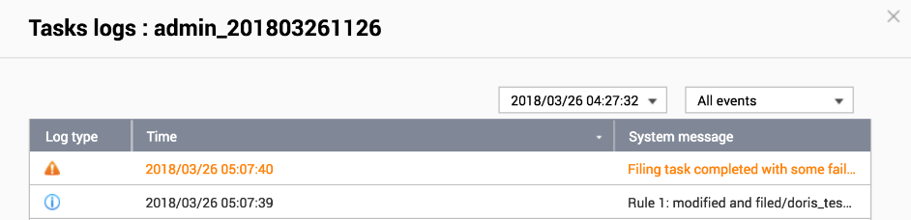
Filing status is easily accessible
Summary
System logs
Task logs

Slide 25
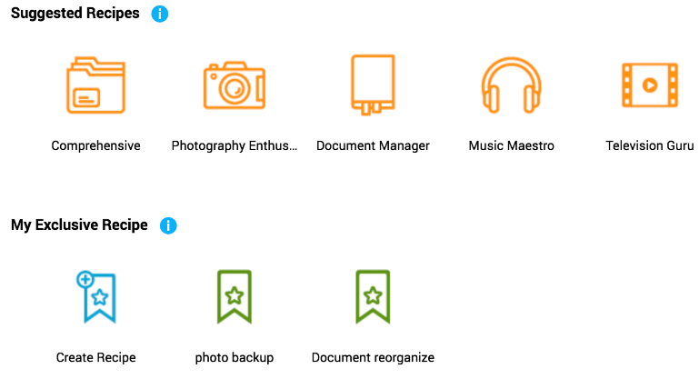
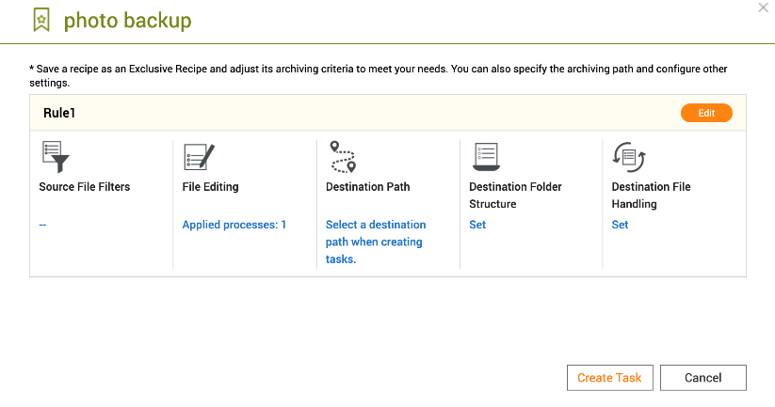

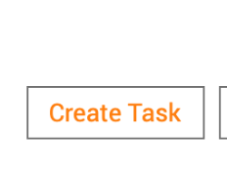
With recipes, tasks are done with just one click
Select a recipe
Create a task

Slide 27
Apply Qfiling in your workflow

Slide 28
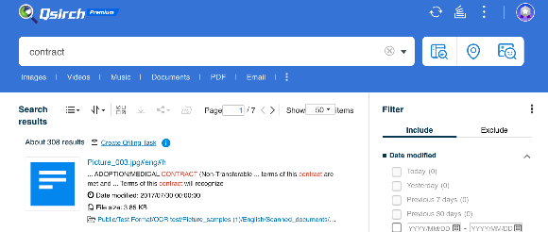
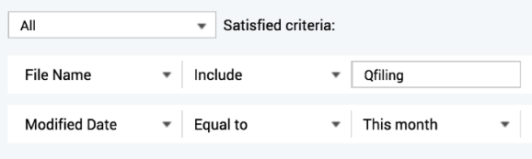
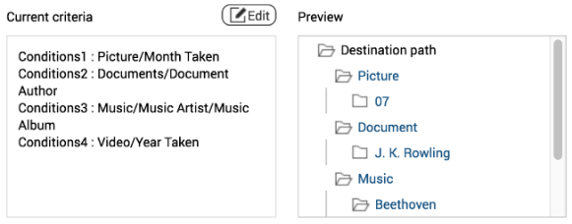
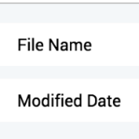
Archive the files with the keyword in the content in safe
Good assistant for office workers.
Encryption & Decryption
Compression
Task from Qsirch
File Editing
1
3
Create filing task by importing Qsirch search results.
Setting encryption and compression options.
Destination & Structure
Source File Filters
4
2
Automatically filter out specific files from multiple source folders.
Re-classify all kinds of files in the most suitable way.

Slide 29
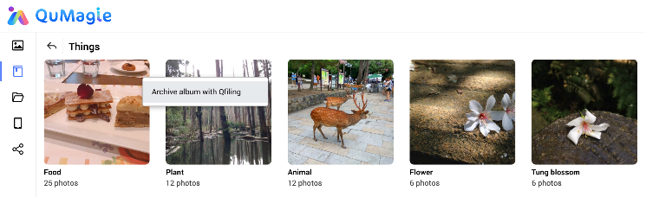
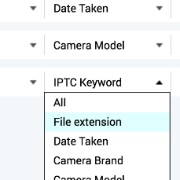
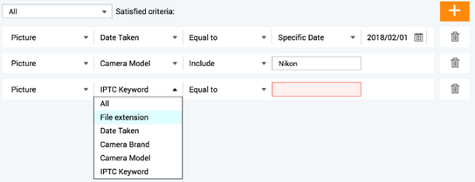
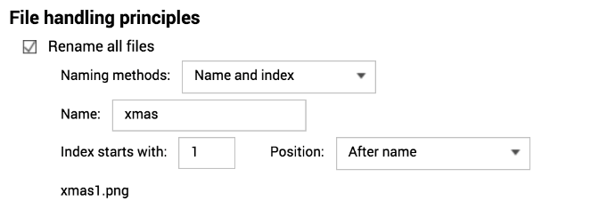
Archive the photos classified by QuMagie AI recognition
Best tool to organize photos.
Face blur & pixelate
Watermark
Task from QuMagie
File Editing
1
3
Create filing task by importing QuMagie AI or smart album.
Setting watermark, face blur option.
Destination & Structure
Source File Filters
4
2
Automatically filter out specific files.
Duplicated files are backed up only once. Batch renaming files is also possible!

Slide 30
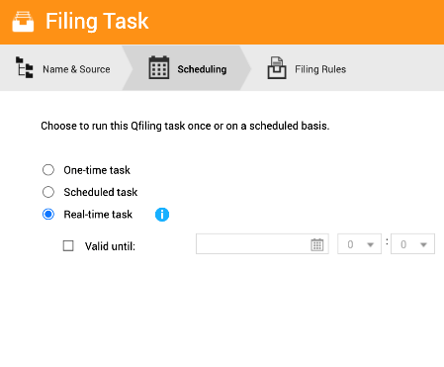
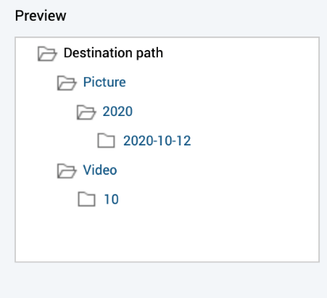




Automatically organize photos taken with your phone
Auto organize photos taken by mobile
When taking a photo by mobile, the photo will be filed to the folder you want automatically.
Auto
upload
Upload photo by Qfile
Create a real-time task
Destination Structure
1
2
3
Setup auto upload by Qfile to upload your photo to NAS.
Select “Auto upload” as source folder and create a real-time task.
The photo taken by the mobile will be filing to the folder with the structure you setup.

Slide 31
Qfiling License Plan
Lite | Plus | Premium
Free | $ 3.99 / NAS / month $ 39.99 / NAS / year | $ 10 / NAS / month $ 100 / NAS / year
One-time Task: 8 Scheduled Task: 8 Real-time Task: 8 Filing Recipe: 8 | One-time Task: 30 Scheduled Task: 30 Real-time Task: 30 Filing Recipe: 30 | One-time Task: 100 Scheduled Task: 100 Real-time Task: 100 Filing Recipe: 100

Slide 32



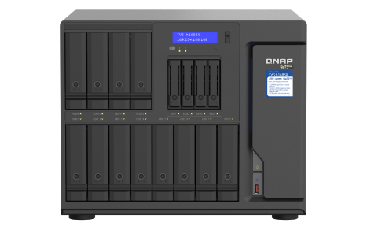

The best partner for efficient work
Enterprise
SMB
SOHO
High-capacity with exceptional performance
High-end business NAS for greater performance
High performance 4-core studio
TVS-h1688X
TVS - 872N
TS - 453D
16 bays,16-96 TB
Intel Xeon 6-core 3.3 GHz
32 GB RAM (up to 128 GB)
2 M.2 SATA 6Gb/s SSD slots for caching or caching pools to accelerate system performance.
QuTS hero operating system
8 bays, 4-64TB
Intel i3-8100T 4-core 3.1 GHz
8 GB RAM (up to 32 GB)
2 M.2 SATA 6Gb/s SSD slots for caching or caching pools to accelerate system performance.
4 bays, 4-24TB
Intel Celeron 4-core 2.0 GHz
8 GB/ 4 GB RAM

Slide 33
© 2020 Copyright is owned by QNAP Technology Co., Ltd. QNAP Technology reserves all rights. A trademark or mark used or registered by QNAP Technology Co., Ltd. The products and company names mentioned in the file may be trademarks owned by other companies.

