Slide 1
Notes:
QTScloud
A cloud-based OS let users quickly own a NAS service with cloud servers at any time.

Slide 2

1
Introduction
2
Use cases & Success Stories
3
Features
4
Pricing

Slide 3

Introduction to
QNAP Cloud NAS

Slide 4




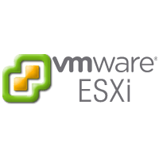




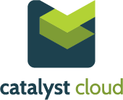

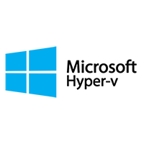
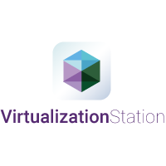


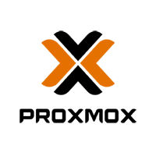


What is a Cloud NAS
A virtual appliance designed to work with and leverage cloud-based storage to give the functionality of a premise-based NAS
Uses cloud computing to simplify infrastructure and provide flexible deployment options while reducing costs.
AFP
Cloud NAS Solution
Virtual
CIFS/SMB
Machine
NFS
iSCSI
Compute
Storage

Slide 5
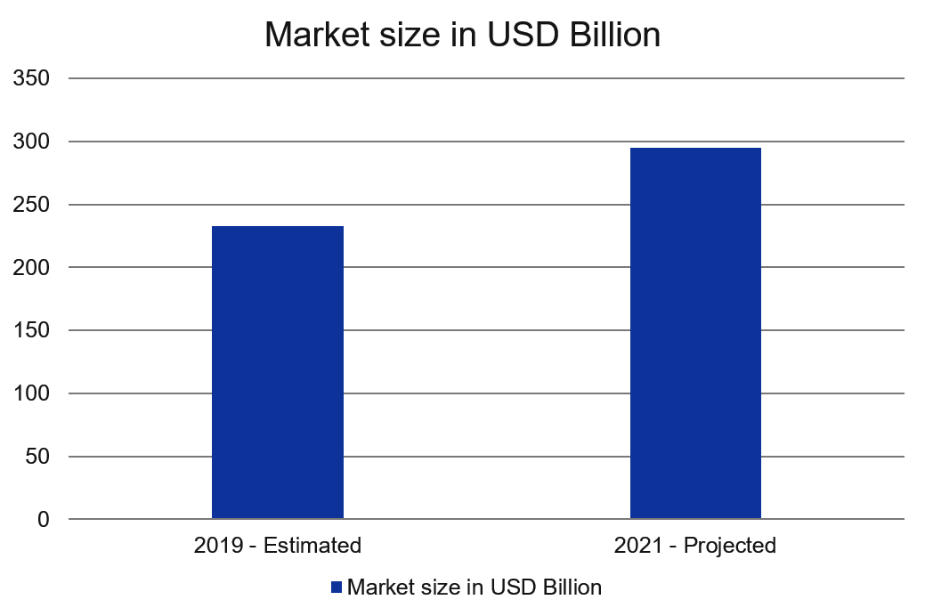

Trends in cloud market post Covid-19
The global impact of COVID-19 on cloud market size is expected to grow from USD 233 billion in 2019 to USD 295 billion by 2021, at a Compound Annual Growth Rate (CAGR) of 12.5%
12.5％
The market growth is attributed to increased usage of SaaS solutions as enterprises need to support remote workforce
Increasing adoption of digital payment, online shopping and OTT streaming services is expected to further aid the market growth

Slide 6


Is a Cloud NAS solution
Running on public cloud platforms or on premise data centers
That gives enterprises the control to run mission-critical applications and optimize their cloud data usage

Slide 7

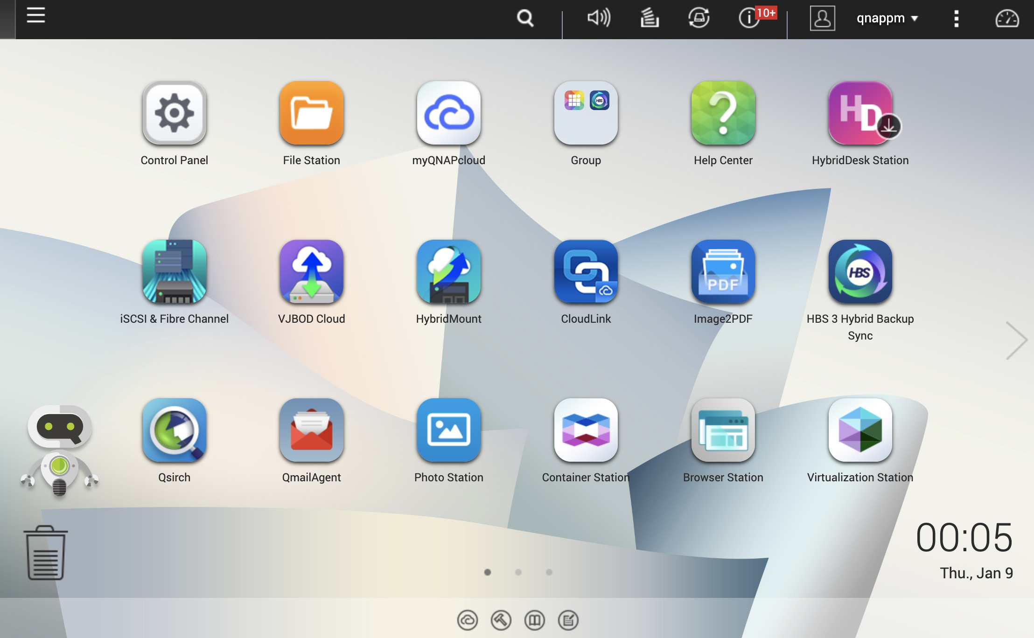

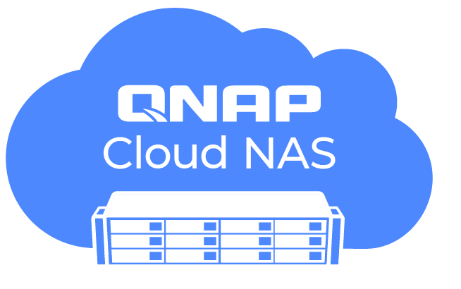
QuTScloud brings all the QTS experiences
QuTScloud Operating System
OS
Multimedia
Mobile Apps
Storage
IoT
WIN/MAC Utilities
Network
Notification
Full-text Search
Security
Licenses
& More…

Slide 8








Helps to optimize your data usage
After
Before
External
Customers
Branches
* Access data with File station or standard
protocols: SMB/ ClFS, NFS, AFP, iSCSl
Download file with Share Link or FTP
Share
Browse
Download
Search
* Make data searchable on object storage
with Qsirch.
* Pubilsh/Share photo/video contents
with QuMagie.
Internet
（via http/ https）
AWS, Azure,
AliCloud, DigitalOcean
AWS, Azure,
AliCloud, DigitalOcean
Backup & Sync
Backup & Sync
QNAP NAS
Local PC
QNAP NAS
Local PC
HQ

Slide 9

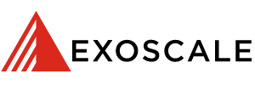

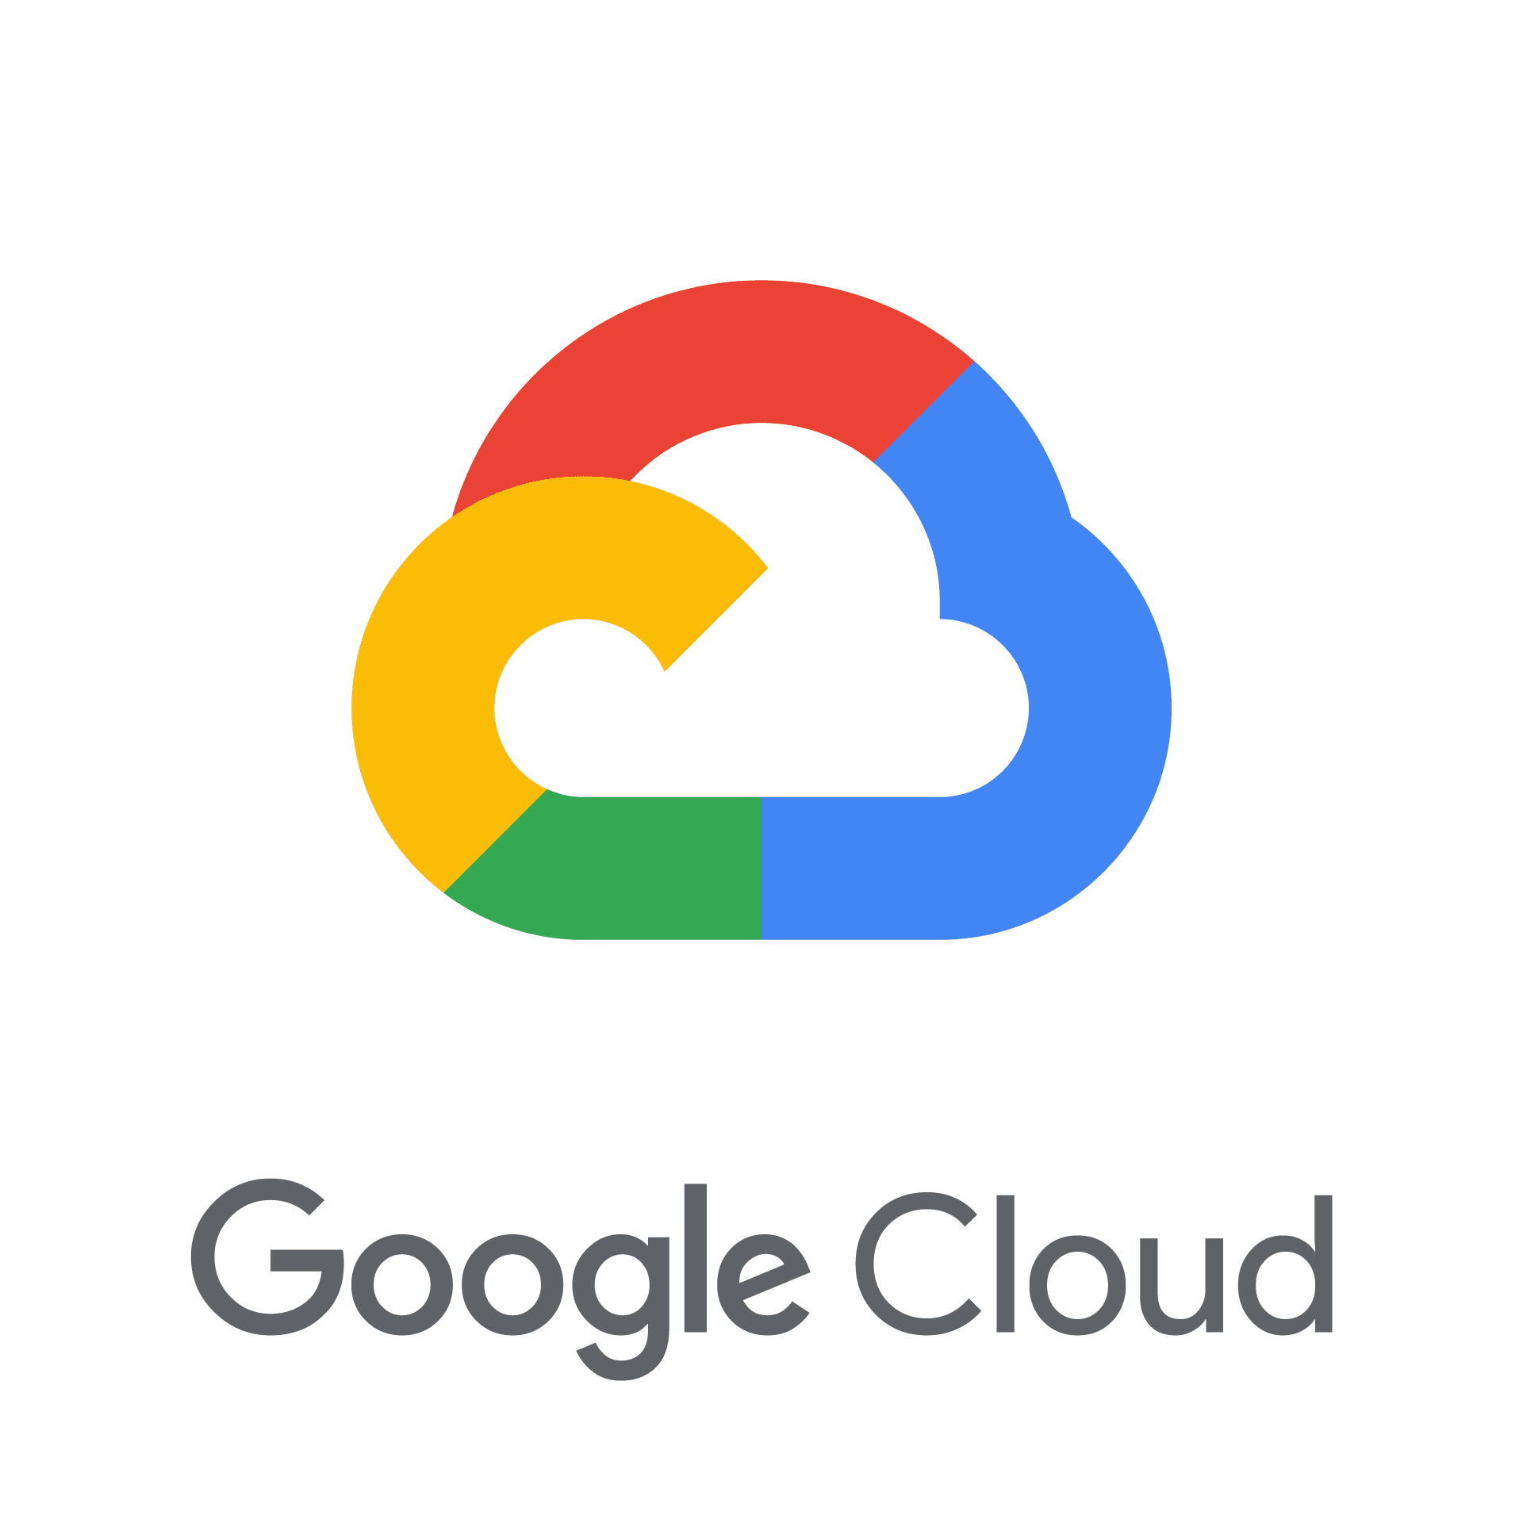




Whats NEW ???
On-premise
Virtualization Platforms
Cloud Platforms
VPS Providers
Start your Cloud NAS in less than $15 per month TCO

Slide 10
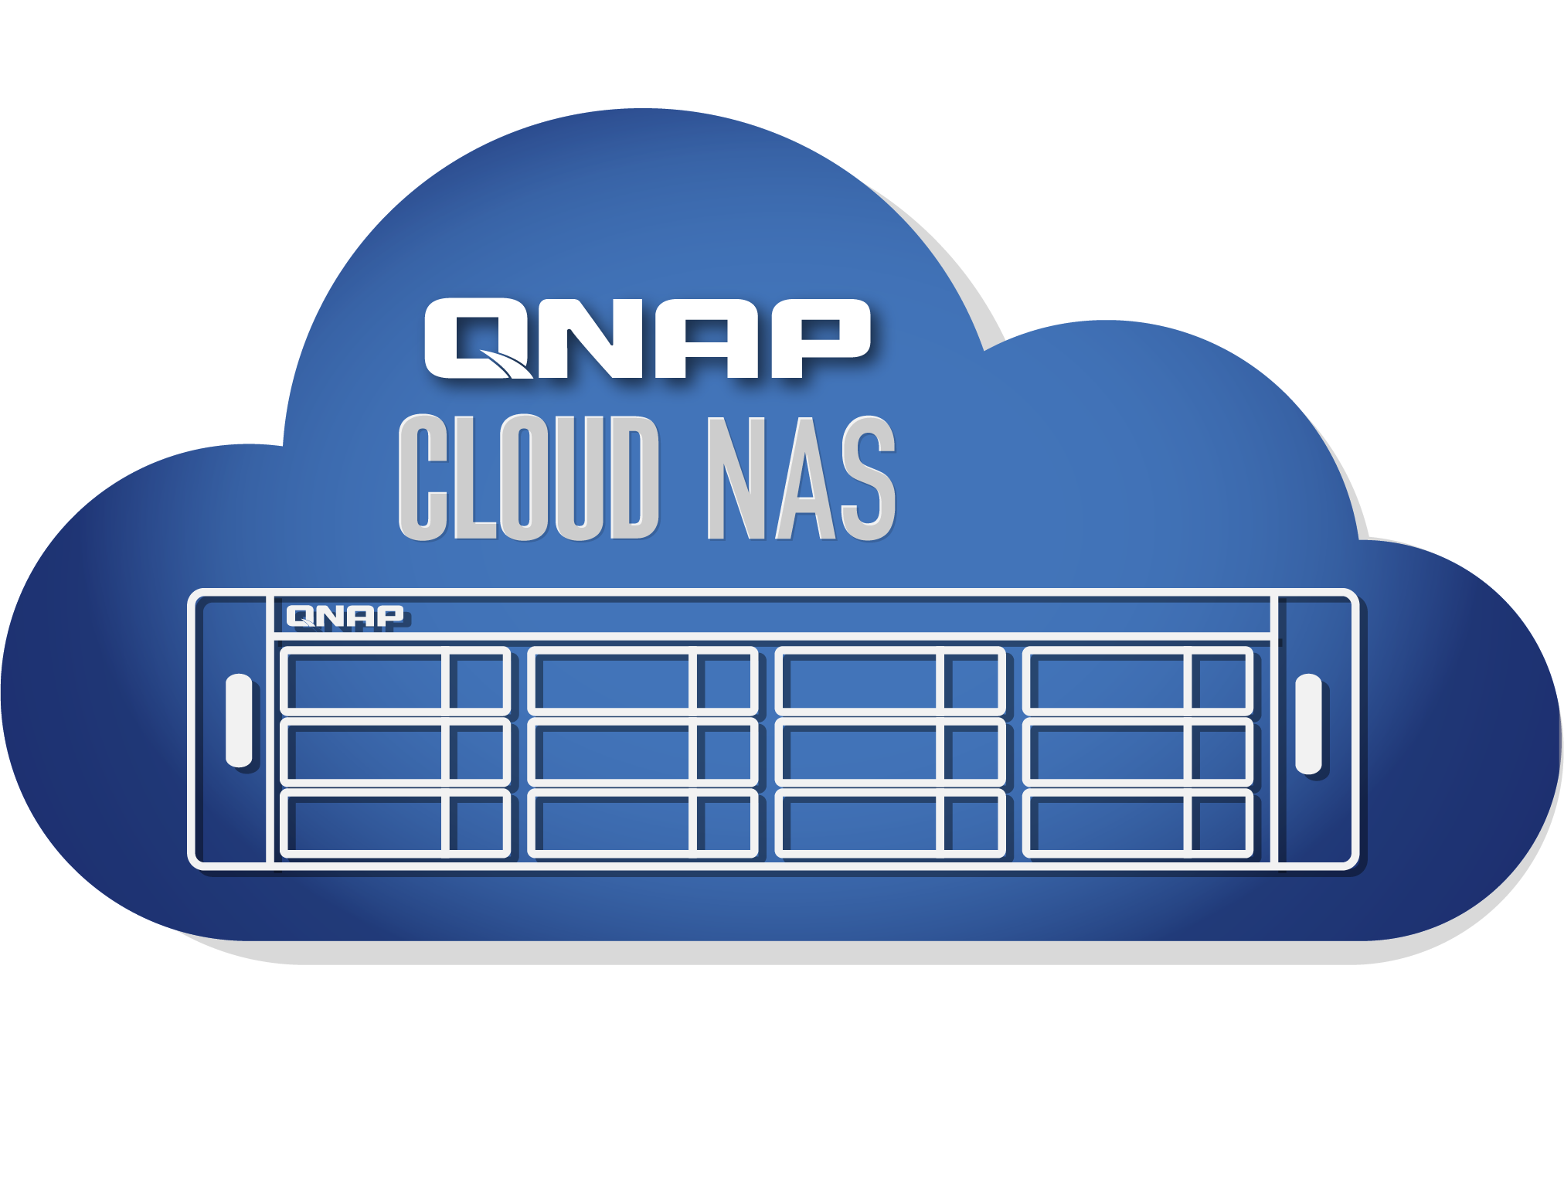













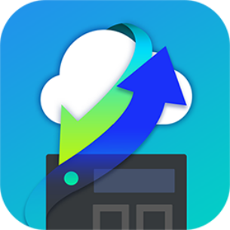





Minimize Total Cost Of Ownership with Contabo
With Contabo, QuTScloud provides the most COST EFFECTIVE Cloud NAS Solution in the world
Cloud File Storage
Mount external storage
Cloud Object Storage
With HybridMount
Start your Cloud NAS in less than $15 per month TCO
Mount additional object storage to your Contabo VM

Slide 11
Use cases & success stories of
Notes:
QTScloud
A cloud-based OS let users quickly own a NAS service with cloud servers at any time.

Slide 12



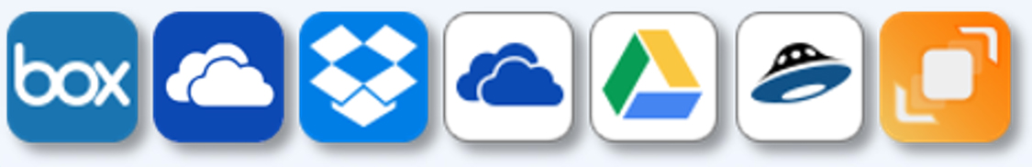


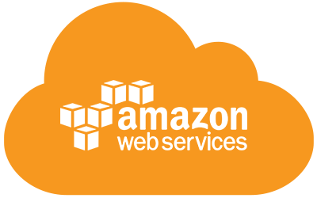


Centralized storage server on the cloud
Use Case
1
IT admins want to extend their infrastructure to the cloud to centrally store, manage and share all of their dissipated data
QuTScloud is a complete storage and file sharing on cloud that supports file sharing protocols like CIFS/SMB, NFS and iSCSI. The HybridMount acts a gateway to all the cloud storage platforms, allowing users to access all their dissipated data from within QuTScloud. Using Qfile mobile app, the user can access data at their fingertips.
Mount
Cloud File Storage
CIFS/SMB
NFS access
Application and Data Servers
Volume
CIFS,NFS, iSCSI
CIFS,NFS, iSCSI
Cloud Object Storage
Mount
Storage Pools
User desktops and devices

Slide 13



Success Story – Synapse IT (UK)
Background
Challenge
Use Wasabi Storage to store all the data
They use CentreStack to provide access to the Wasabi buckets
Customers that want to access photos or videos don’t have a good user interface to access their data
CentreStack
Data saved at Wasabi Storage

Slide 14





Success Story – Synapse IT (UK)
Solution
Use HM to mount the Wasabi Buckets on QuTScloud
Use QuMagie, Photo Station, Video Station to access the photos and videos stored on Wasabi
NFS/SMB
QuMagie
Video Station
HybridMount
Qfile, Qphoto,
Qvideo
QuTScloud on Digital Ocean
Data saved at Wasabi Storage

Slide 15

Success Story – Qvest Media (Germany)
Background
Challenge
Qvest provides online video editing solution (SaaS) hosted in AWS
Use Adobe Premiere running in a Windows VM on AWS
The videos are large in size. They want to drag and drop the videos into the Adobe Premier
Storing videos in S3 is not feasible as reading from S3 is extremely slow

Slide 16
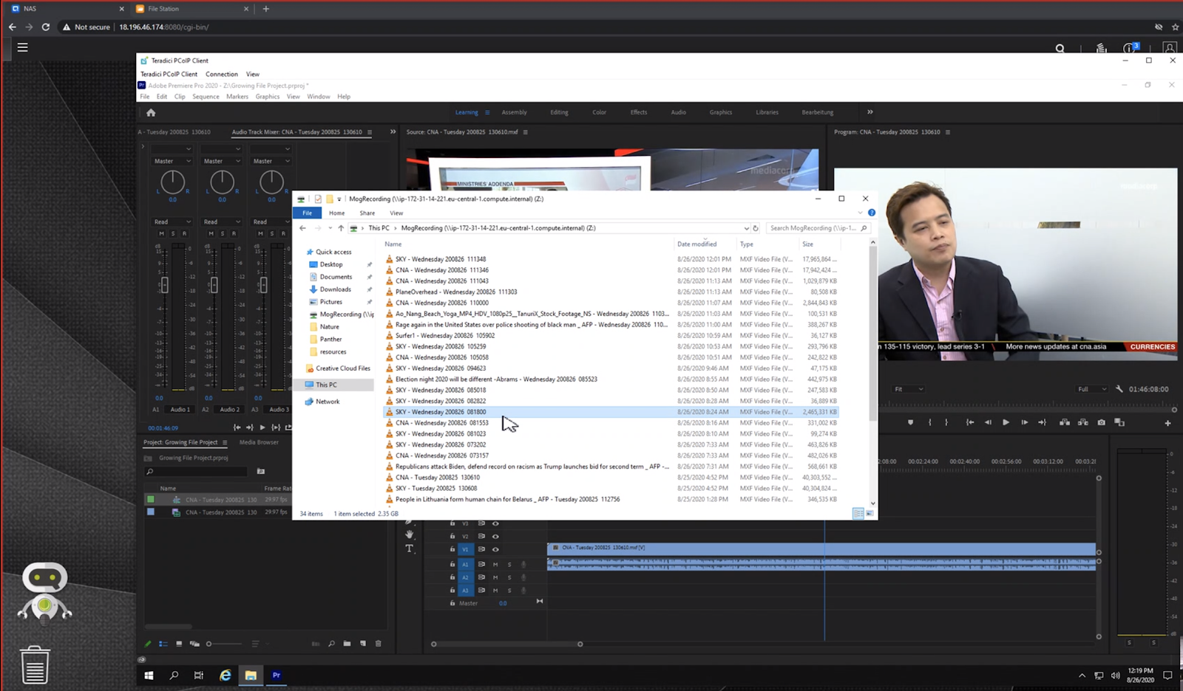
Success Story – Qvest Media (Germany)
Solution
Looking for a Cloud NAS solution that can help to store and read the videos from the AWS EBS volumes
Using QuTScloud on AWS and then using SMB to mount the storage to windows interface
Drag and Drop the videos to Adobe Premier. 100 Mbps read speed demonstrated.
Want to integrate QuTScloud APIs within their ecosystem

Slide 17
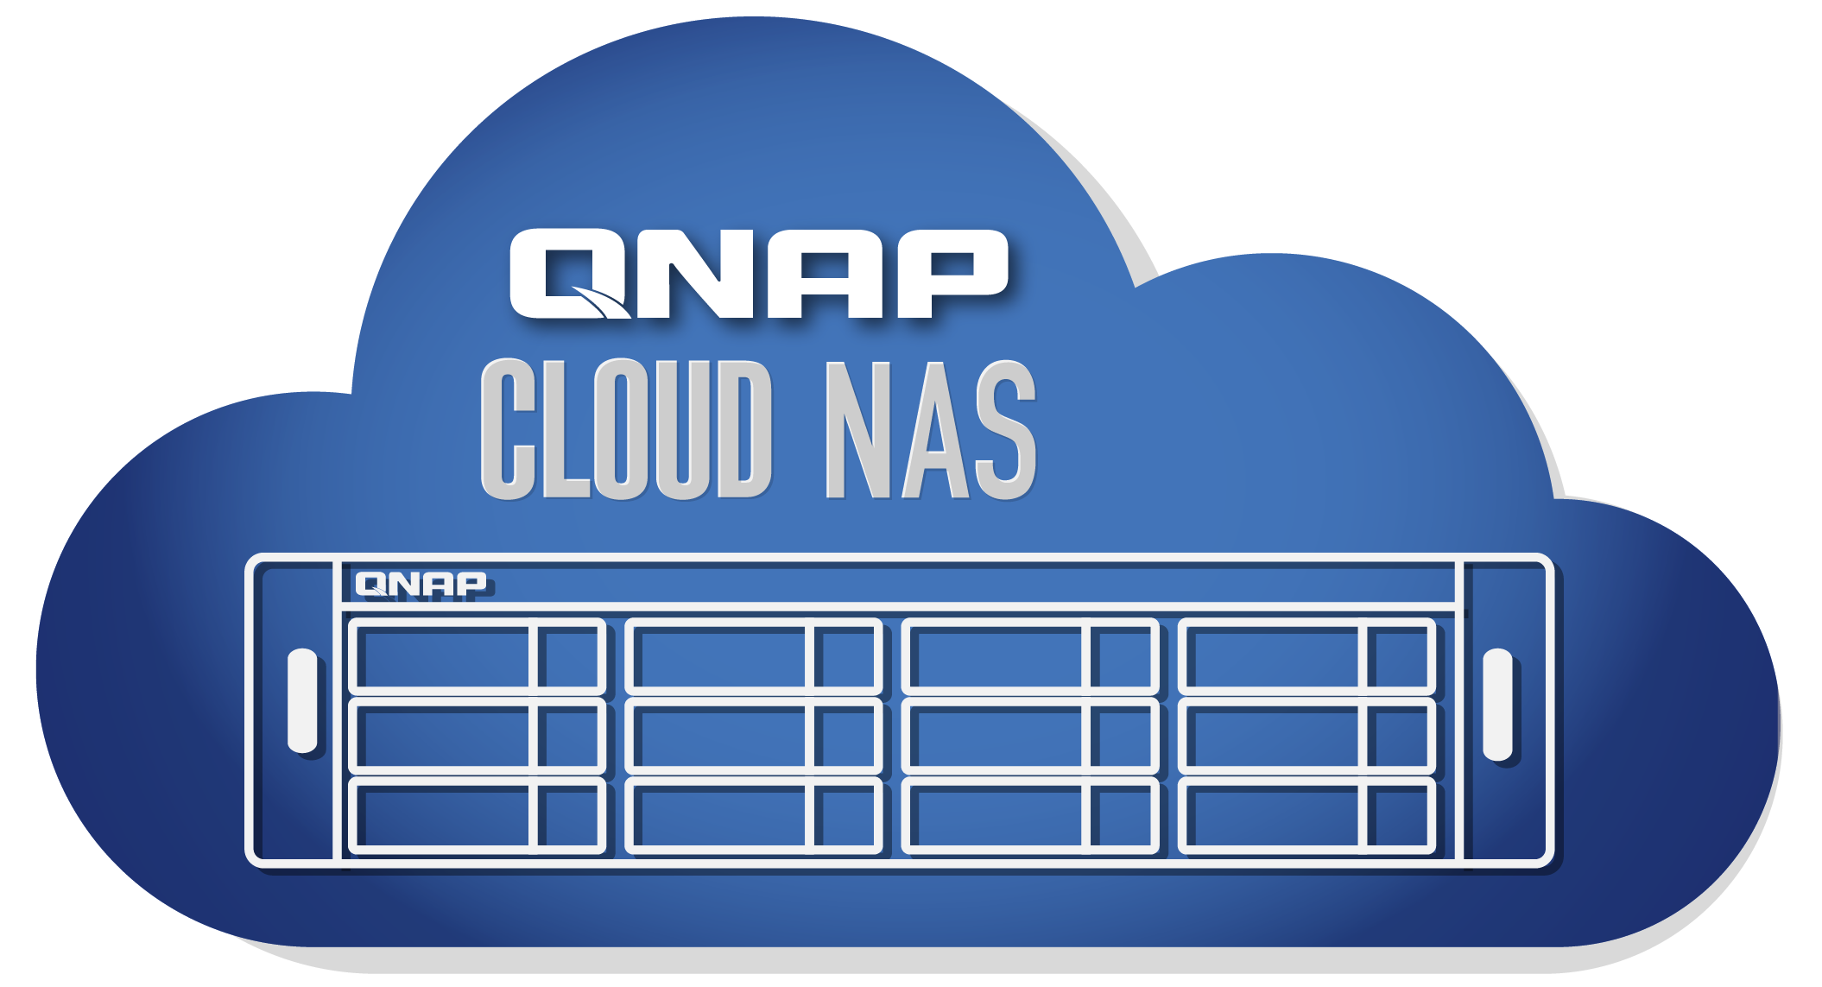

Multi-cloud backup and management for organizations
Use Case
2
Businesses demand a comprehensive 3-2-1 backup plan with one backup
On site and second backup in the Cloud
The IT team can setup on-site QNAP NAS as primary backup and QuTScloud as secondary backup. Using HBS3 the backups can be more fast and efficient.
Backup Repository A
Backup Repository B
Onsite Storage
Offsite Storage or Cloud

Slide 18
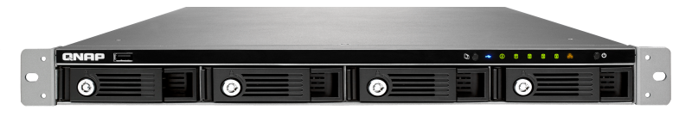

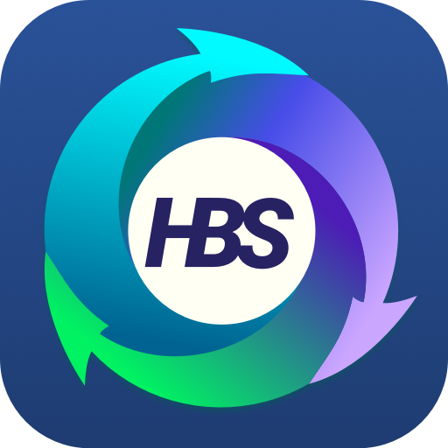


Success Story – Lion Re:Sources (UK)
Background
Challenge
Use several QNAP NAS to backup data from onsite to cloud using HBS
HBS has maximum 10 parallel channels to perform backup jobs
If the backup load increases or decreases, scaling up and down is not easy
/a
b
c
d
Backup Repository B
Backup Repository A
Onsite Storage
Offsite Storage or Cloud

Slide 19

Success Story – Lion Re:Sources (UK)
Solution
Use 10 QuTScloud hosted on VMware and use HBS to backup the data
Ease to scale up and down is the main reason for opting QuTScloud if the data load requirements change
VMware ESXi
Backup Repository A
Backup Repository B
Onsite Storage
Physical Servers/Data Centers
Offsite Storage or Cloud

Slide 20

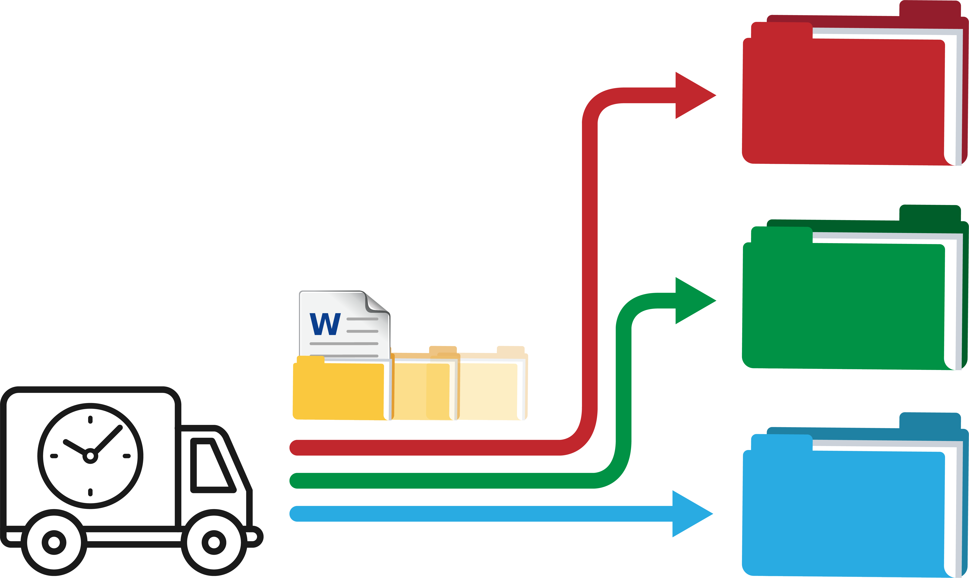
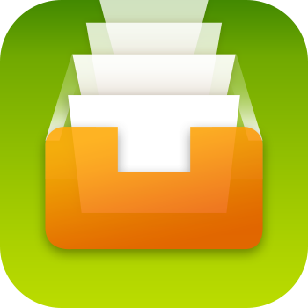
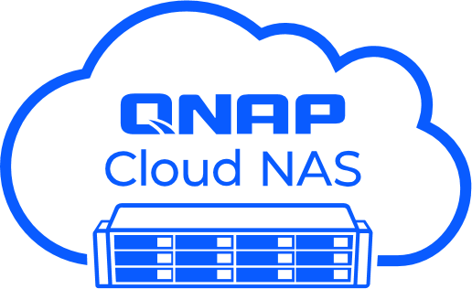
Efficiently organized cloud drive
Use Case
3
IT admins find it extremely difficult to organize the humungous number of files which becomes increasingly difficult with time as the data grows
QuTScloud enables IT admins to deploy and allocate work group users. Using Qfiling, the admins can automatically organize and categorize files based on their formats that can save their valuable time. Users can store, access and share files with other users using File Station web interface or Qfile mobile app
Share
Browse
Document
Image
Download
Video
HybridMount
Ｍount
Qfiling
Search

Slide 21
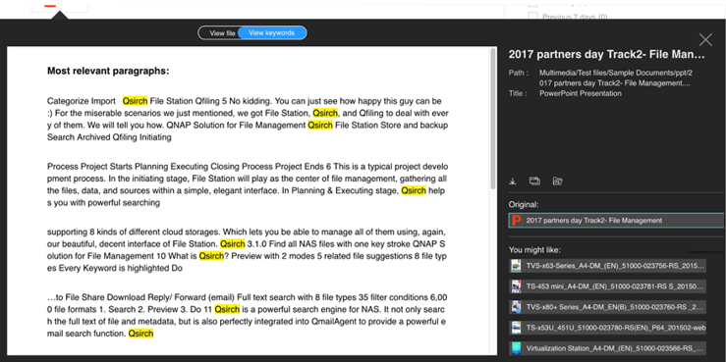


Comprehensive search engine for your enterprise files
Use Case
4
Large enterprises with numerous files want to perform content-based
search to quickly find their files already stored in the cloud.
QuTScloud's Qsirch is a GDPR compliant advanced search engine that comes with a full text indexing and searching allowing the user to locate files within seconds.
Quickly view key paragraphs, download or share the file after confirmation!
No need to install
other kits; files can be viewed directly!

Slide 22
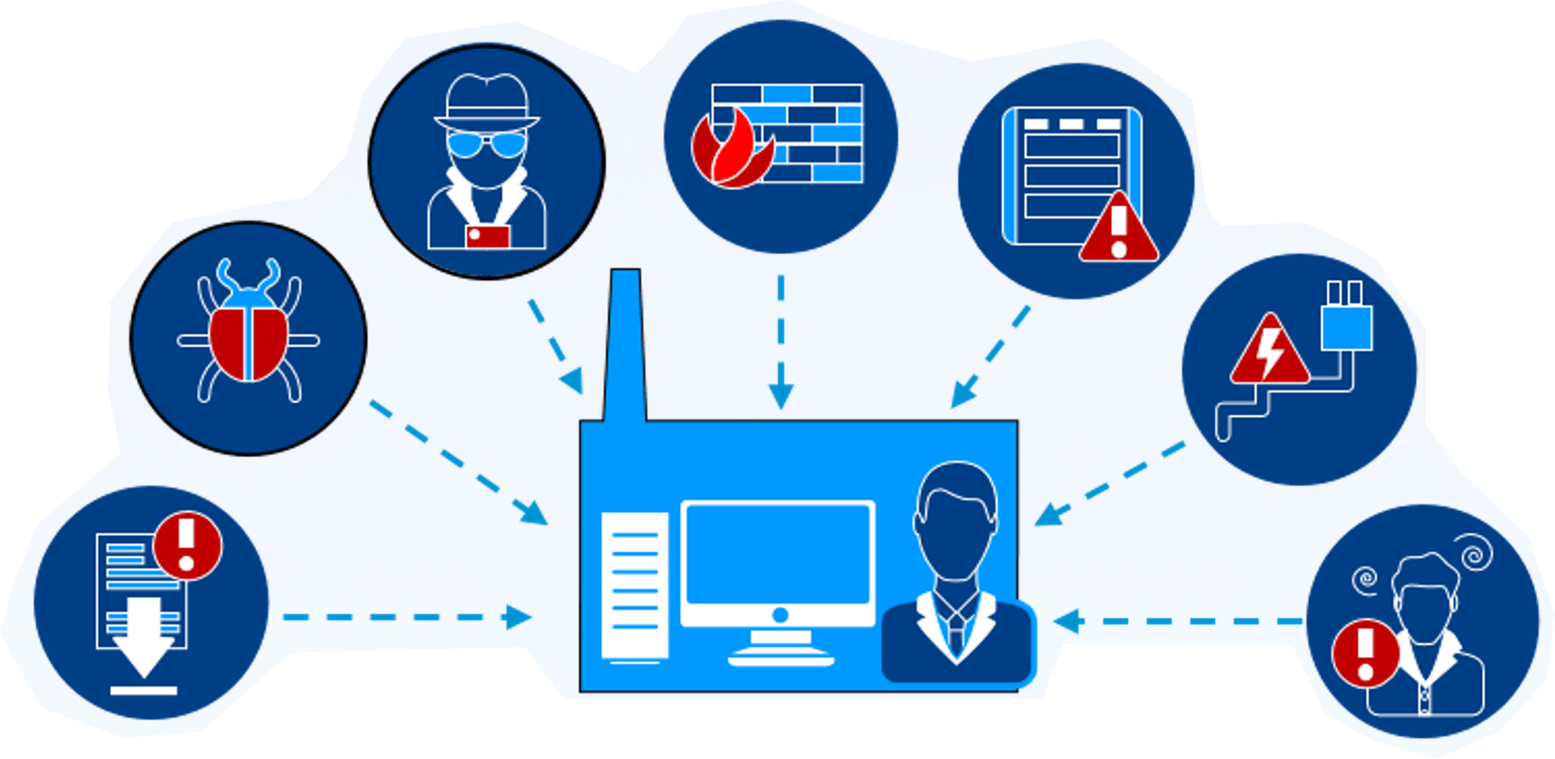
Disaster recovery on Cloud
Use Case
4
Efficient disaster recovery plan
Disaster strikes and all your on premise files are inaccessible. Even though you have file backup on AWS/Azure, but you will have to create accounts for thousands of employees to access those files in cloud storage. This can take a lot of time.
With all data backed up on QuTScloud, all employees can easily access all the backed up files instantly with access control features like LDAP/AD.
Fire or explosion
Hacker attacks
Server Faulure
Bugs or viruses
Power outage
Unexpected updates
Human errors

Slide 23
Live Demo
Notes:
QTScloud
A cloud-based OS let users quickly own a NAS service with cloud servers at any time.

Slide 24

Live Demo Contents
1
How to deploy QuTScloud on GCP
2
How to deploy QuTScloud on Contabo
3
How to deploy QuTScloud on Oracle Cloud
Notes:
Notification Center
Provide you with a variety of delivery options, allowing you to choose the most appropriate notification method based on different messages and use cases!

Slide 25
Features and comparison of
Notes:
QTScloud
A cloud-based OS let users quickly own a NAS service with cloud servers at any time.

Slide 26

Main features and benefits of QuTScloud
1
Storage Expansion
5
Real-time Mobile Notifications
2
6
Data Sharing and Management
Productivity apps for backup, management, and multimedia
3
7
Data Efficiency
Console Management
4
Data Protection
and Security

Slide 27
Storage Expansion with HybridMount for cost saving
Mount external storage to QuTScloud
Cloud File Storage
AWS
Mount external storage
Cloud Object Storage
With HybridMount
EBS
S3
Glacier
AWS Local Storage
Unified dashboard to manage all cloud storage

Slide 28

EBS vs Object storage cost comparison
Massive SAVINGS on storage cost using HybridMount storage expansion
EBS Storage Monthly Cost (US$)
Object Storage Monthly Cost (US$)
 | 2
500 GB | 62.5 | 50 | 25 | 11.5
1 TB | 128 | 102.4 | 51.2 | 23.55
5 TB | 640 | 512 | 256 | 117.76
10 TB | 1280 | 1024 | 512 | 235.52
50 TB | 6400 | 5120 | 2560 | 1177.6
100 TB | 12800 | 10240 | 5120 | 2304
500 TB | 64000 | 51200 | 25600 | 11315.2
1000 TB | 128000 | 102400 | 51200 | 22067.2
Storage
Provisioned IOPS SSD
General Purpose SSD
Magnetic
S3 Standard
54% savings over Magnetic
77% savings over General Purpose SSD
82% savings over Provisioned IOPS SSD

Slide 29








Data sharing and management
Data sharing
Privilege management
    SMB/CIFS
    NFS
    AFP
    iSCSI
    1. NAS local users
Standard protocols
Basic
Domain Security
    Active Directory authentication
    LDAP authentication
Social Media
Security – Password, Valid Date
SmartShare
Instant file sharing
File Preview
Online Office, Google Doc
Multimedia files

Slide 30
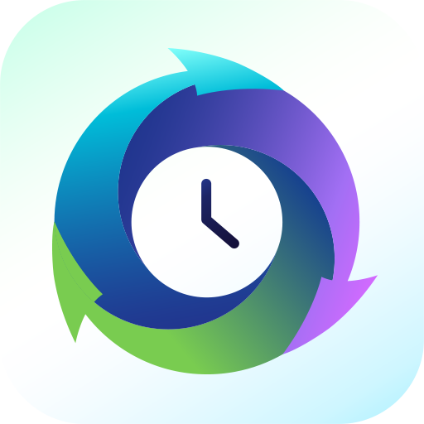

Data efficiency with deduplication
HBS 3 features QuDedup technology that empowers backup tasks with
source-side deduplication for greater time and storage savings.
Without QuDedup
With QuDedup
Notes:
The HBS3 application of QTScloud has QuDedupe functionality which deduplicates the data before performing the backup. So, if the customer uses HBS to backup data from QTScloud to any other destionation, then the network throughput will be lot more. Not just that, it will also save the space for the end customer as there won't be any duplicate data.

Slide 31

Data protection and security
Snapshots and versioning
    1. Fully supports all storage configurations at the storage pool level.
    2. Uses the mature ext4 file system for “out of volume”
Ransomware cannot overwrite snapshots which are stored out of volume
QNAP VPN Service
    1. Use QVPN to build a secure connection between your
    on-premises devices and your Cloud NAS.
    2. Supports versatile VPN protocol and QNAP's(Qbelt).
QNAP's proprietary VPN protocol to decrease the chance of being detected.

Slide 32
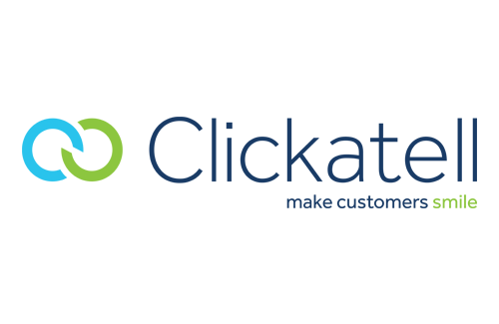


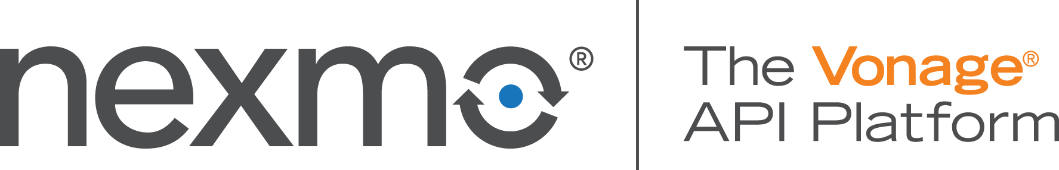




Real-time status notifications at your fingertips
Notification Center
Consolidates event and alert notification
Double assurance with notification history
Flexible to filter important messages
Multi-language support
Notifications via email, SMS, instant message, and push notifications.
Notes:
Notification Center
Provide you with a variety of delivery options, allowing you to choose the most appropriate notification method based on different messages and use cases!

Slide 33





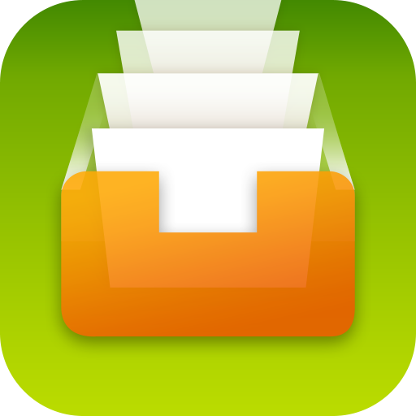
Productivity apps for backup, management, and multimedia
Backup
Management
Multimedia
$9.99/month
$99.99/year
$9.99/month
$99.99/year
HBS 3
Qsirch
QuMagie
Multi-site, multi-cloud backup streamlines 3-2-1 backup strategy
A powerful Google like full-text search engine
AI-powered intelligent photo management
$9.99/month
$99.99/year
$9.99/month
$99.99/year
Boxafe
Qfiling
Backups up Office 365 & Google G Suite data
Automates your file organization

Slide 34
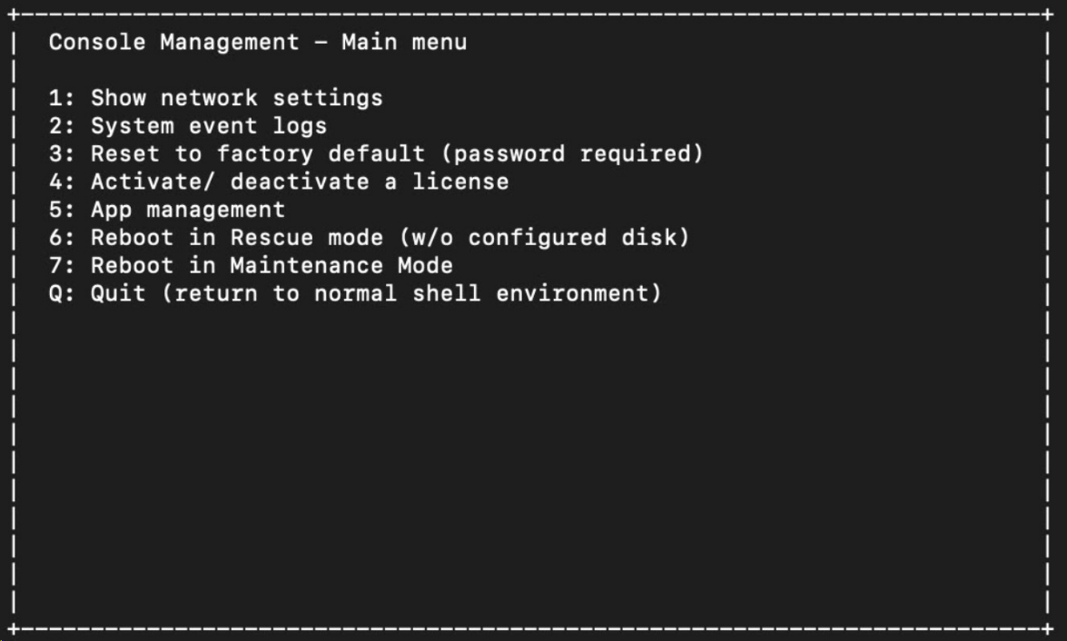

Console Management for Admins
Connect to the NAS console management via SSH or Serial Console
NAS admin can perform basic configuration and maintenance tasks
Default NAS password is MAC address in capitals without colon
Mac Address: 16:00:84:76:35:ef
Default Password: 1600847635EF

Slide 35
Pricing of
Notes:
QTScloud
A cloud-based OS let users quickly own a NAS service with cloud servers at any time.

Slide 36
QuTScloud Pricing
1
Core
2
Cores
4
Cores
6
Cores
8
Cores
12
Cores
16
Cores
24+
Cores
Monthly $ 8.99
Monthly $ 11.99
Monthly $ 19.99
Monthly $ 29.99
Monthly $ 39.99
Monthly $ 69.99
Monthly $ 99.99
Monthly $ 129.99
Yearly
$ 89.99
Yearly
$ 119.99
Yearly
$ 199.99
Yearly
$ 299.99
Yearly
$ 399.99
Yearly
$ 699.99
Yearly
$ 999.99
Yearly
$ 1299.99
Recommended for:
Recommended for:
Recommended for:
Recommended for:
Recommended for:
Recommended for:
Recommended for:
Recommended for:
  Total NAS Users: 1-5
  Concurrent Connections: Up to 10
  Total NAS Users: 6-10
  Concurrent Connections: Up to 10-20
  Total NAS Users: 10-20
  Concurrent Connections: 20-50
  Total NAS Users: 20-50
  Concurrent Connections: 50-100
  Total NAS Users:
  50-100
  Concurrent Connections: 100-200
  Total NAS Users:
  100-200
  Concurrent Connections:
  200-500
  Total NAS Users:
  200-500
  Concurrent Connections:
  500-1000
  Total NAS Users: 500+
  Concurrent Connections:
  1000+

Slide 37

Copyright© 2020 QNAP Systems, Inc. All rights reserved. QNAP® and other names of QNAP Products are proprietary marks or registered trademarks of QNAP Systems, Inc. Other products and company names mentioned herein are trademarks of their respective holders.​​​

