Slide 2

Enterprise SAS 12Gb/s expander JBOD units: dual usages supporting NAS and Windows / Linux server storage capacity expansion
Directly expanding NAS storage pool capacity
Windows Server 2019 certified JBOD hardware. In January 2021 it will officially support Windows Server monitoring utility with QNAP JBOD Manager for Windows and CLI flexible settings.

Slide 3
Enterprise-grade TL SAS JBODs with maximum 192Gbps via 4 x Mini-SAS HD SFF-8644 ports for the best performance and reliability.
Compatible with previous-gen QNAP REXP SAS JBOD series for the max. 16 total units combined for up to 4.6PB raw capacity.
With QTS 4.5.1 / QuTS hero h4.5.1 for the flexible connectivity, fail over, and performance gains.

Slide 4
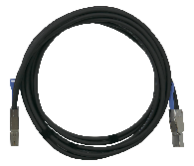
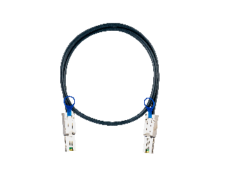
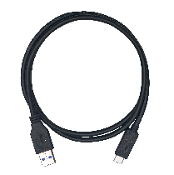
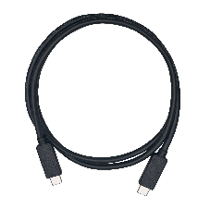
SAS full-duplex 12Gb/s Mini-SAS HD SFF-8644 for max 48Gb/s performance
Single-cable bandwidth
 | Cable | QNAP P/N
 | SAS 12Gb/s SFF-8644 Mini-SAS HD cable | CAB-SAS05M-8644 CAB-SAS10M-8644 CAB-SAS20M-8644 CAB-SAS30M-8644
 | SAS/SATA 6Gb/s Mini-SAS SFF-8088 cable | CAB-SAS05M-8088 CAB-SAS10M-8088 CAB-SAS20M-8088 CAB-SAS30M-8088
 | USB 3.2 Gen 1 cable (5Gb/s) | Type A to C: CAB-U35G02MAC CAB-U35G10MAC
 | USB 3.2 Gen 2 cable (10Gb/s) | Type A to C: CAB-U310G10MAC Type C to C: CAB-U310G10MCC
SAS 12Gb/s
4 x 12Gb/s
48Gb/s
SAS 6Gb/s
4 x 6Gb/s
24Gb/s
USB 3.2 Gen 2 x2
20Gb/s
USB 3.2 Gen 2
10Gb/s
SATA / eSATA
6Gb/s
USB 3.2 Gen 1
5Gb/s

Slide 5
Higher reliability, faster performance, and better availability for SAS drives
 | SAS SSD | SAS HDD | SATA SSD | SATA HDD
Price per TB | $$$$ | $$$ | $$ | $
RPM | --- | Up to 15000 | --- | Up to 7200
Capacity | Up to 15.36TB | Up to 18TB | Up to 4TB | Up to 18TB
MTBF | 2.5M hours | 2.5M hours | 2M hours | 1.2M hours
Workload | Process-intensive | Process-intensive | Light to normal | Light to normal
Speed | 12 Gb/s | 12 Gb/s | 6 Gb/s | 6 Gb/s
Latency | Lowest | Lower | Lower | Higher
Dual-port | Supported | Supported | --- | ---

Slide 6



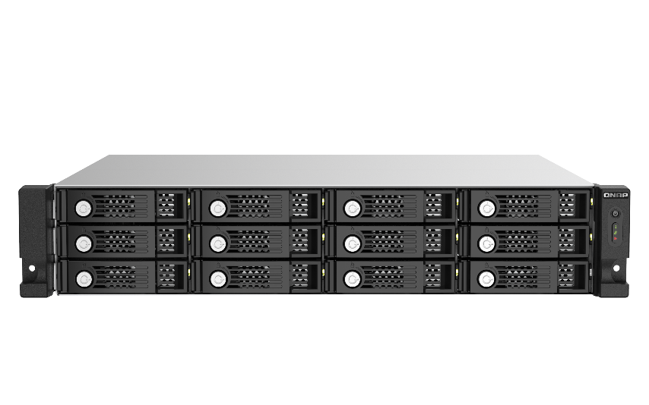
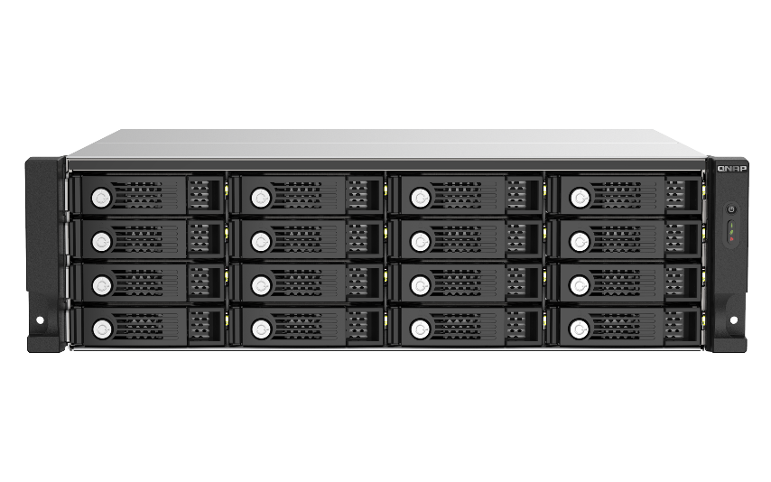
New generation of 12-bay & 16-bay SAS 12Gb/s JBOD Storage expansion
12 Bay
16 Bay
Built with a Broadcom®
SAS expander, capable of connecting many drives with a single SAS cable and SAS JBOD enclosures to expand the NAS storage space.
TL-R1220Sep-RP
TL-R1620Sep-RP

Slide 7

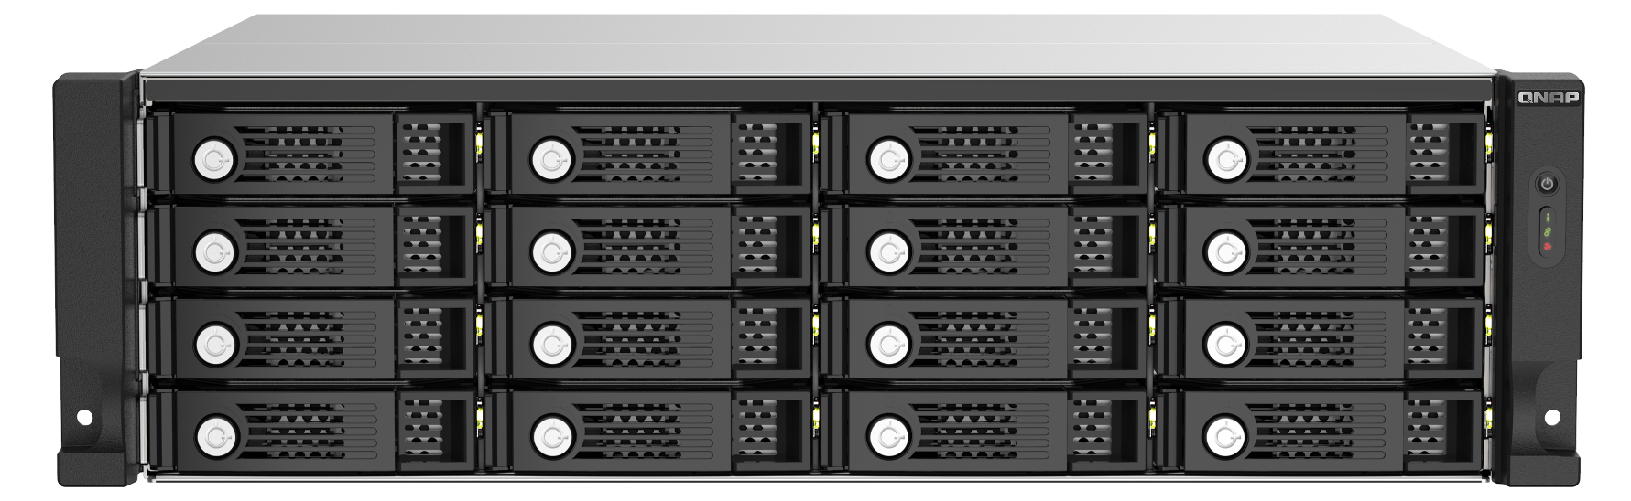

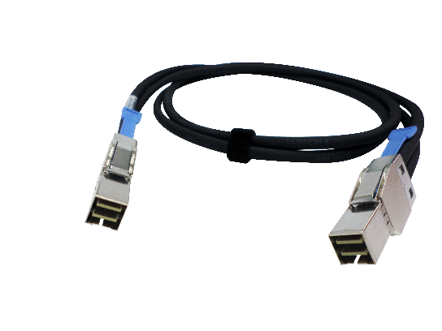
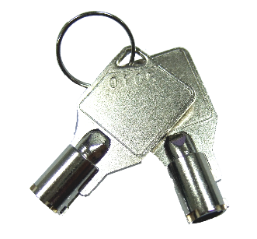
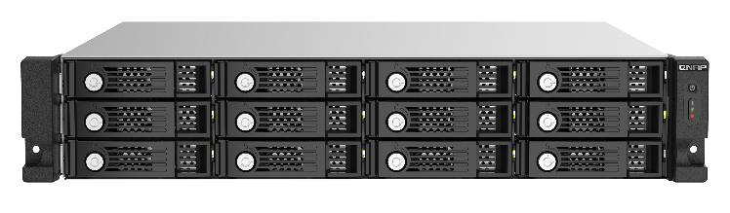

TL-R1220Sep-RP / TL-R1620Sep-RP
SAS JBOD front view
Power Button
Status
Connection
Fan Error
Metal trays & keys
TL-R1620Sep-RP
Drive status
Bulit-in warning buzzer
TL-R1220Sep-RP
2 Keys in package
0.5-meter Mini-SAS HD cable in package

Slide 8
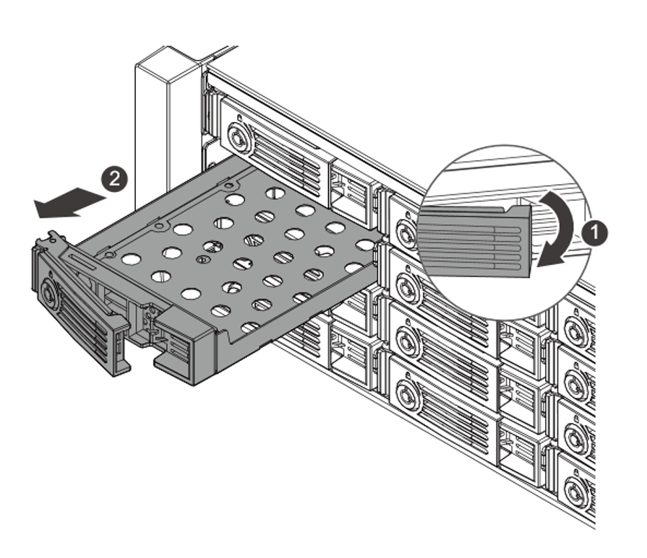
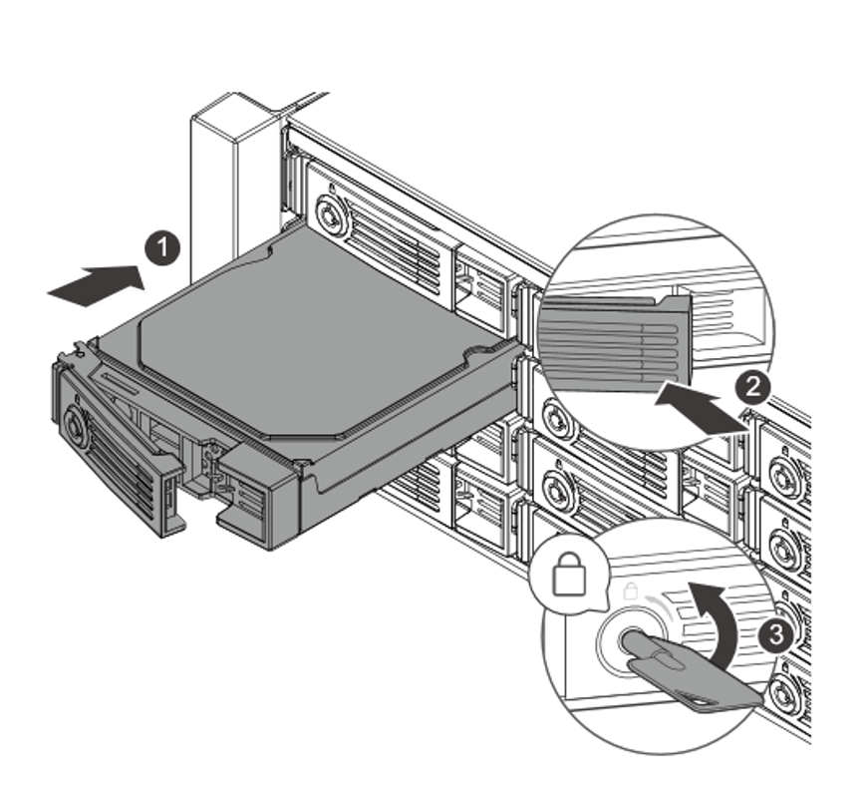
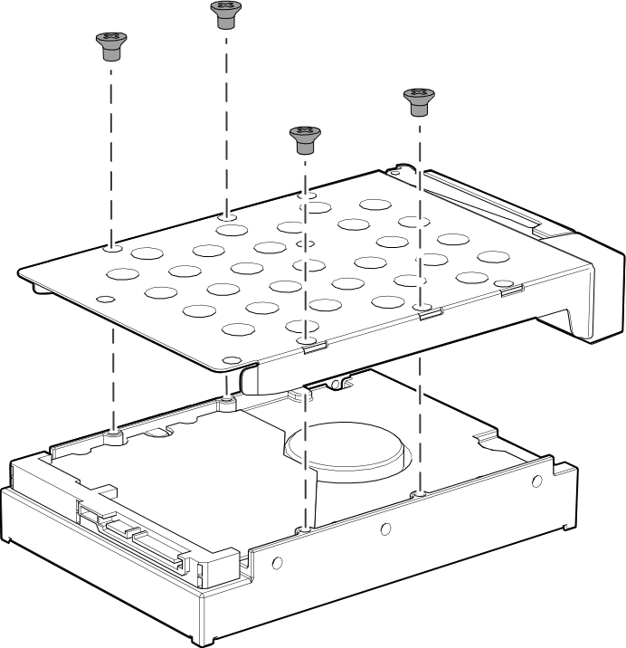
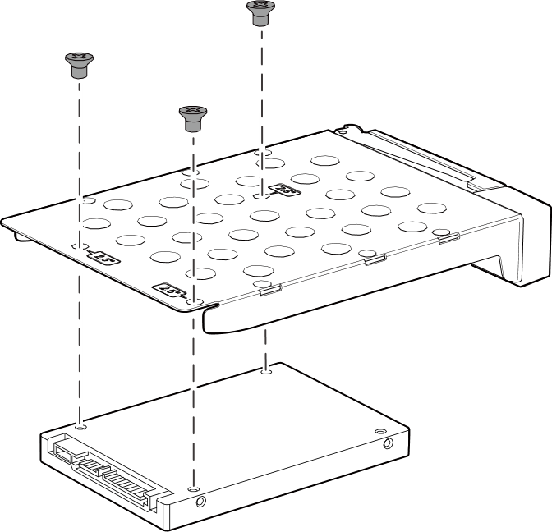
Support 3.5-inch and 2.5-inch SAS & SATA HDD / SSD
STEP 01
STEP 02
STEP 03
3.5-inch HDD
2.5-inch HDD / SSD

Slide 9
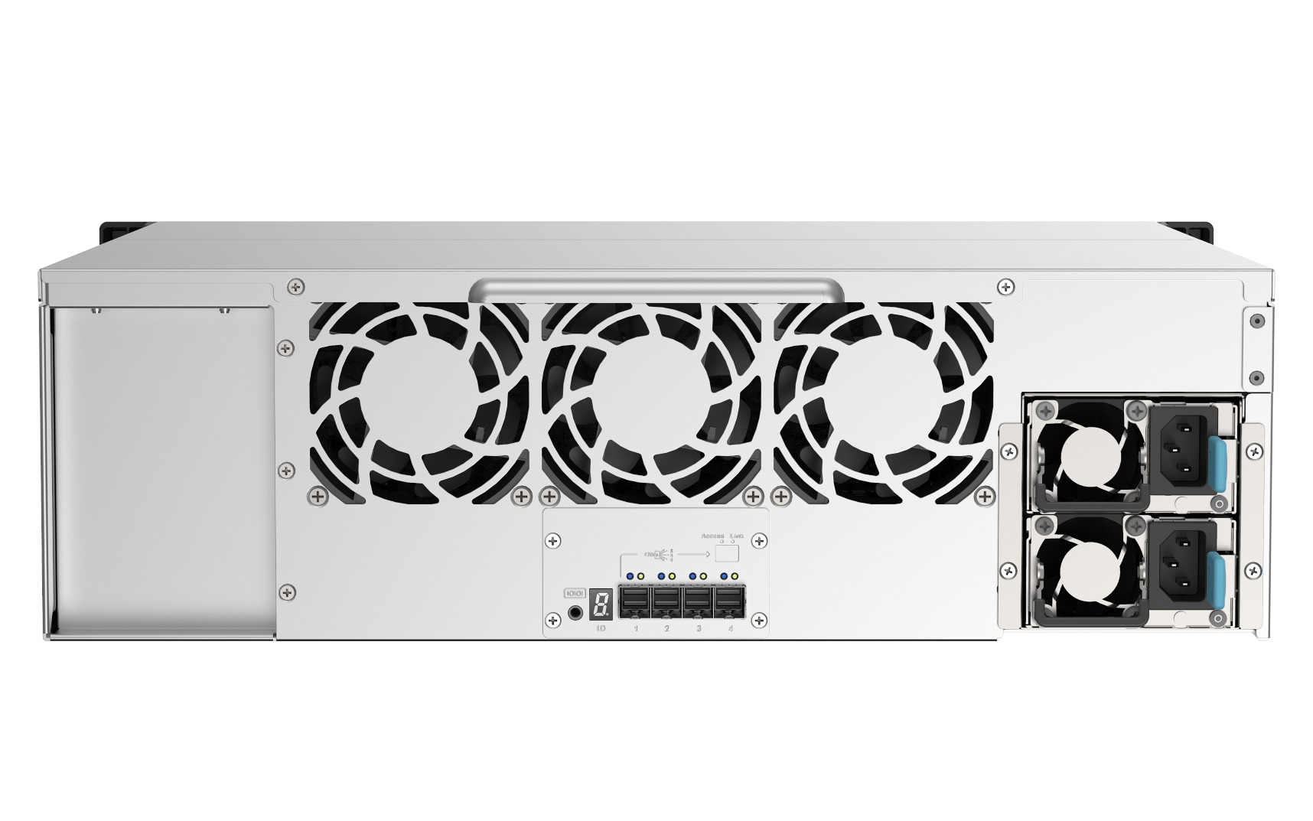
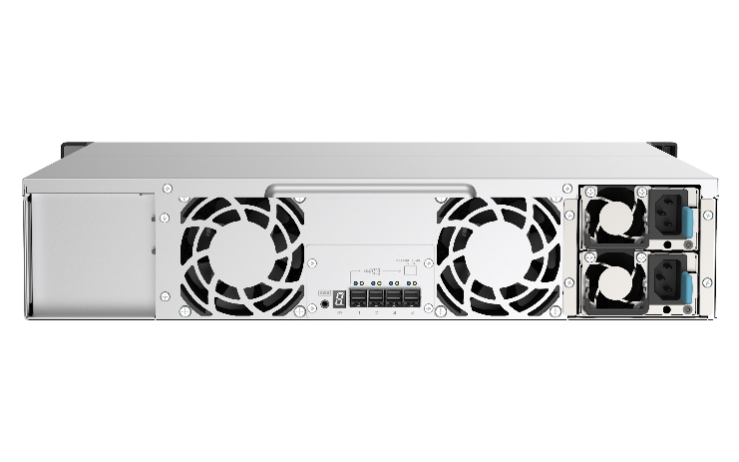
TL-R1220Sep-RP / TL-R1620Sep-RP
SAS JBOD rear view
8cm Smart Fan
TL-R1620Sep-RP: 3
TL-R1220Sep-RP: 2
Redundant power supplies
TL-R1620Sep-RP: 2 x 550W
TL-R1220Sep-RP: 2 x 300W
4 x Mini-SAS HD
SFF-8644 SAS Wide-port
TL-R1620Sep-RP
HxWxD (131.3 x 482.2 x 425.3 mm)
JBOD address indicator
(0~9, a~g*)
*QTS 4.5.2 / QuTS hero h4.5.2 will support displaying the a~g addresses.
TL-R1220Sep-RP
HxWxD (88.65 x 482.2 x 423.8 mm)

Slide 10
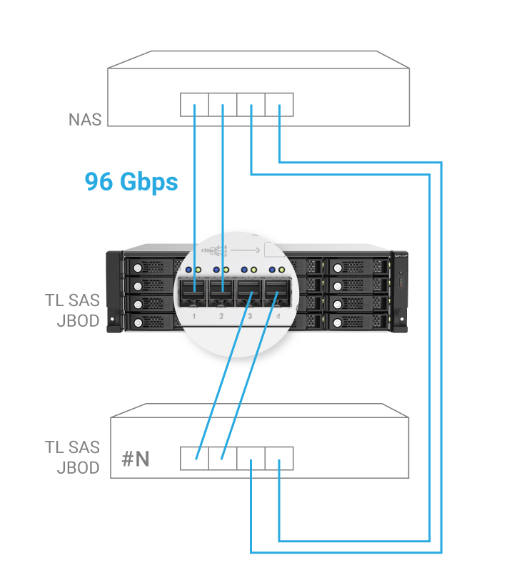
Up to 192Gbps with 4 Mini-SAS HD ports for intensive workloads in business storage
TL-R1220S-RP/TL-R1620Sep-RP
TL-R1220S-RP/TL-R1620Sep-RP 搭載 28nm 低工耗 SAS35x28R SAS Expander 控制器，可安裝 12 顆 12/ 6Gbps SAS/SATA HDD 或 SSD，其具備 4 個 12 GB/s SAS 3.0 (x4 Lane) SFF-8644 SAS 寬連接埠 (Wide Port)。QNAP NAS 主機安裝 PCIe SAS 擴充卡，可透過雙埠頻寬聚合與鏈狀串接多台 TL-R1220S-RP，讓所有串接 JBOD 皆達到最高 96Gbps 連線頻寬。
Low power Broadcom SAS35x28R SAS Expander IC
12 or 16 x 12/ 6Gbps SAS/SATA HDD or SSD
4 x 12 Gb/s SAS 3.0 (x4 Lane) SFF-8644 SAS wide ports, each port maximum 48Gb/s, totaling 192Gbps
Install 1 or more SAS expansion PCIe cards in the NAS and aggregate two ports and connect multiple TL SAS JBOD units with up to 96Gbps.
TL-R1220S-RP/TL-R1620Sep-RP 搭載 28nm 低工耗 SAS35x28R SAS Expander 控制器，可安裝 12 顆 12/ 6Gbps SAS/SATA HDD 或 SSD，其具備 4 個 12 GB/s SAS 3.0 (x4 Lane) SFF-8644 SAS 寬連接埠 (Wide Port)。QNAP NAS 主機安裝 PCIe SAS 擴充卡，可透過雙埠頻寬聚合與鏈狀串接多台 TL-R1220S-RP，讓所有串接 JBOD 皆達到最高 96Gbps 連線頻寬。

Slide 11
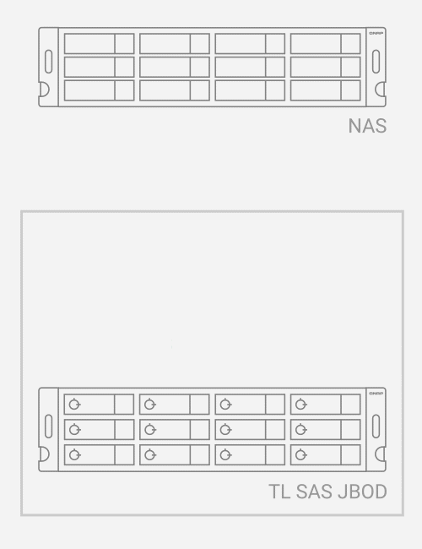
SAS DataBolt™ bandwidth optimizer providing up to 12Gbps for 6Gbps SSD/HDD system configuration
“DataBolt bandwidth optimizer technology aggregates bandwidth to provide 12Gb/s SAS performance to the host when using 6Gb/s and 3Gb/s SATA end devices, making it ideal for high-capacity and other storage applications.” - Broadcom
Broadcom DataBoltTM technology aggregates the performance of two 6Gb/s HDD/SSD and passes the performance back along one 12Gb/s lane.
Note: The QNAP NAS requires QTS 4.5.1 / QuTS hero h4.5.1 (or later) with a PCIe SAS storage expansion card installed.

Slide 12



MiniSAS HD SFF-8644 cable for max 48Gbps connection, up to 16 JBOD devices in total
48Gbps per port/cable
Mini-SAS HD
SFF-85644
SAS 12Gb/s cable
TL / REXP
SAS JBOD
NAS with
QNAP SAS
HBA
48Gbps per port/cable
Mini-SAS HD SFF-8644 cable
NAS
…
QTS 4.5.1 /QuTS hero h4.5.1 supporting max 16 TL or REXP SAS JBOD series

Slide 13
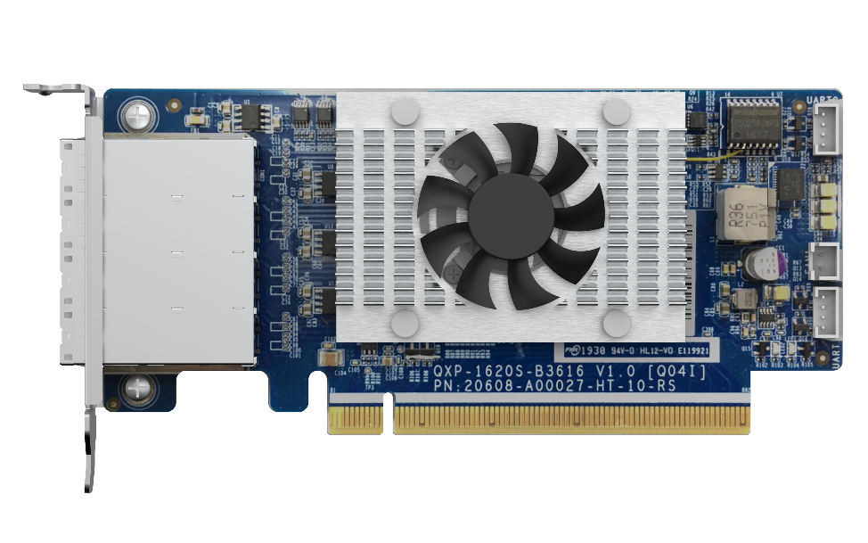
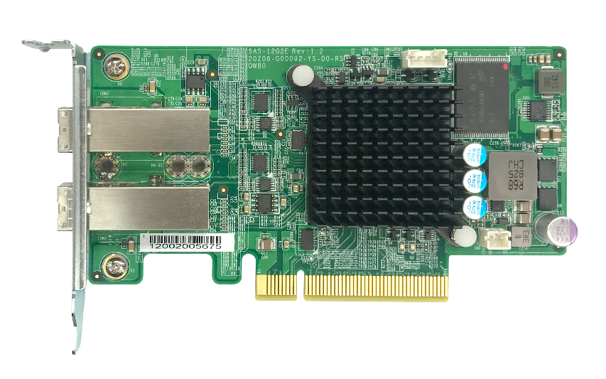
QNAP dual-port/quad-port
SAS 12Gb/s expansion cards
Dual-port SAS 12Gb/s
Quad-port SAS 12Gb/s
NEW!
Broadcom®
SAS controller
SAS-12G2E
QXP-1620S-B3616W
PCIe Gen3 x8
PCIe Gen3 x16

Slide 14


Dual/Quad-port SAS-3 12Gb/s Expansion card specfications
 | SAS-12G2E | QXP-1620S-B3616W
SAS Controller | Broadcom SAS3008 | Broadcom SAS3616W
Support mode | 12Gb/s SAS, 6Gb/s SAS/SATA
SAS port | 8 x SAS 12Gb/s | 16 x SAS 12Gb/s
Connector Interface | Two external Mini-SAS HD (SFF-8644) | Four external Mini-SAS HD (SFF-8644)
Host PCIe band-width | PCIe Gen 3 x8 | PCIe Gen 3 x16
Dimension | 129.65 x 68.9 mm; Low-profile | 149.65 x 68.9 mm; Low-profile
*SAS connector is a Wide-port, contain four SAS signals
**Only been validated with passive cable, we offer different cable optional purchase selection of 0.5M/1M/2M/3M
 | SAS-12G2E | QXP-1620S-B3616W
SAS controller | Broadcom SAS3008 | Broadcom SAS3616W Tri-mode
Tri-mode | 12Gb/s SAS, 6Gb/s SATA, and PCIe (NVMe)* up to 8.0 GT/s
Ports | 8 external | 16 external
Connectors | Two (x4) SFF-8644 | Four (x4) SFF-8644
Host Bus Type | PCIe Gen 3 x8 | PCIe Gen 3 x16
Dimensions | 129.65 x 68.9 mm | 149.65 x 68.9 mm
Warranty | 1-Year Limited
Cable Support | CAB-SAS05M-8644, CAB-SAS10M-8644, CAB-SAS20M-8644, CAB-SAS30M-8644

Slide 15
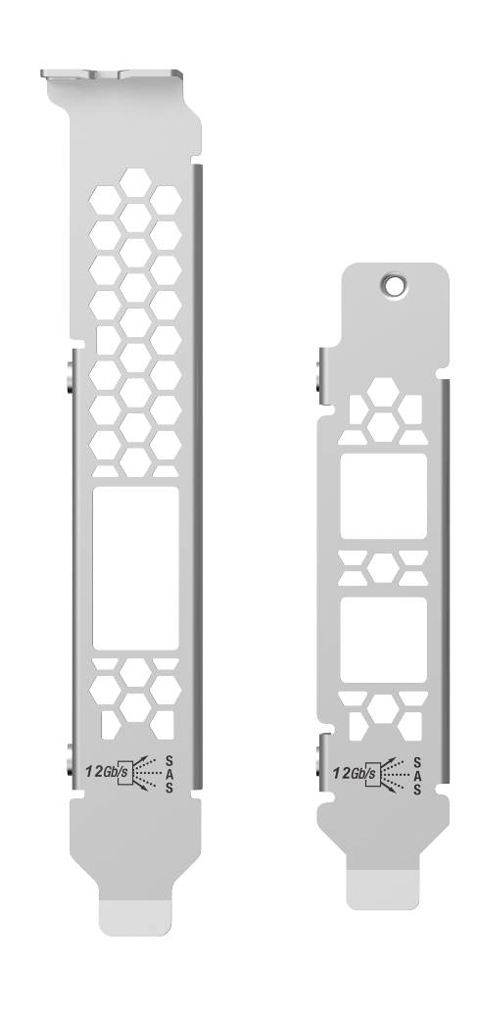

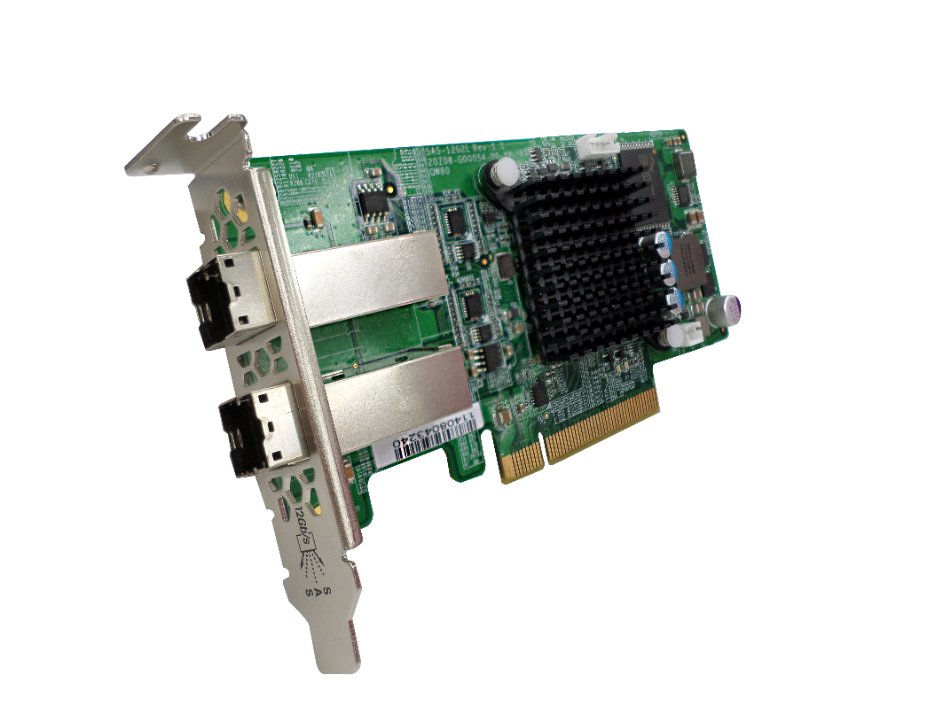

Low-profile design for various QNAP NAS models
SAS-12G-2E
129.65 mm
Additional brackets are included for various NAS models
68.9 mm
Pre-installed
Half-height bracket
PCIe Gen 3 x8 bandwidth (64Gbps)

Slide 16
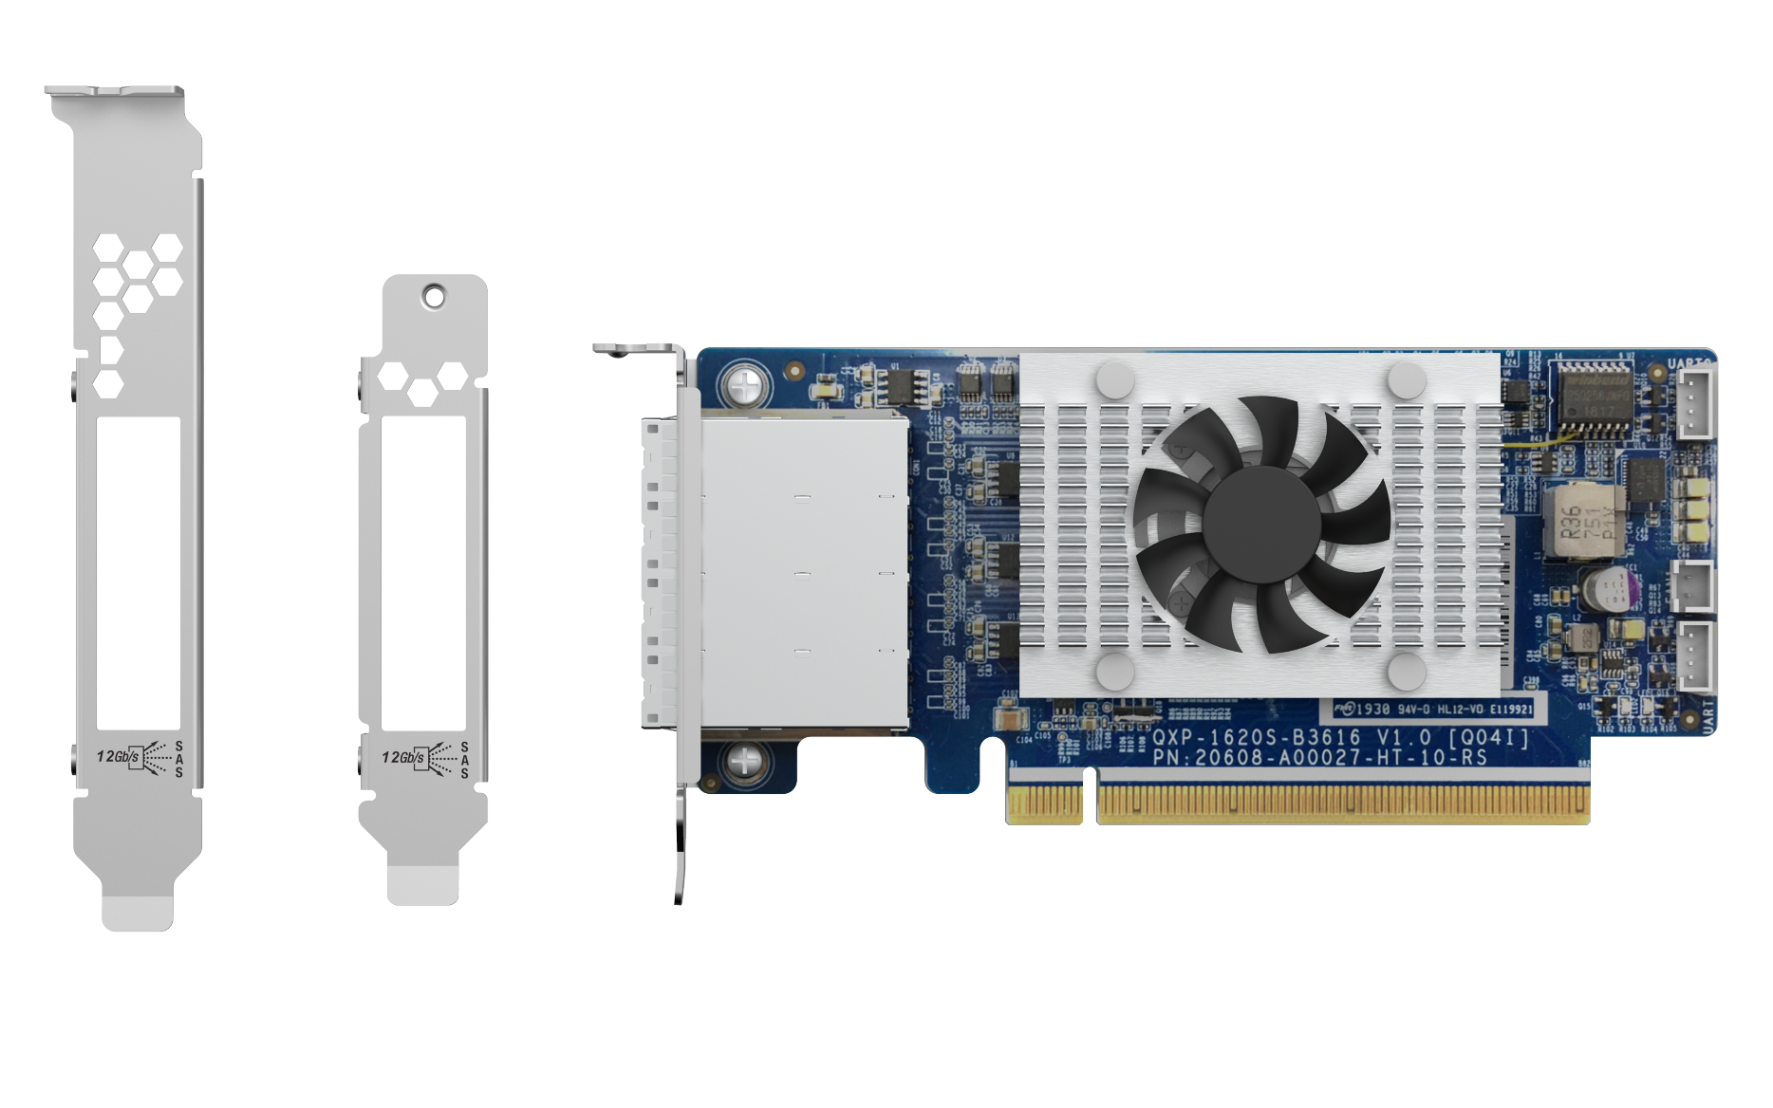
Low-profile design for various QNAP NAS models
QXP-1620S-B3616W
149.65 mm
Additional brackets are included for various NAS models
68.9 mm
Pre-installed
Half-height bracket
PCIe Gen 3 x16 bandwidth (128Gbps)

Slide 17
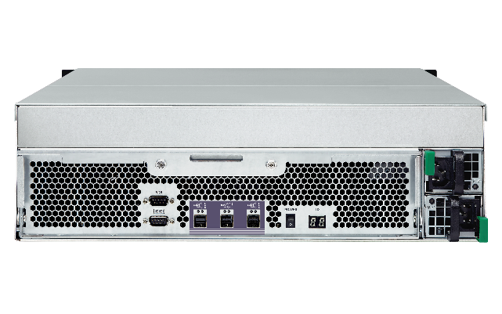
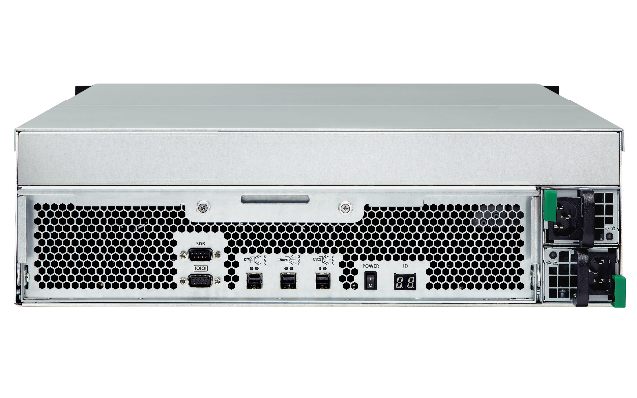
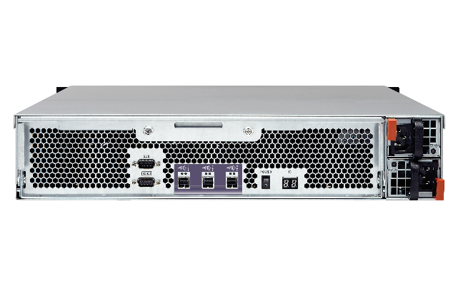
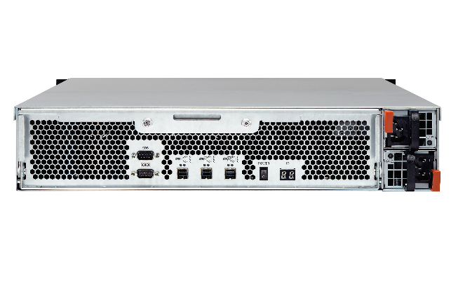
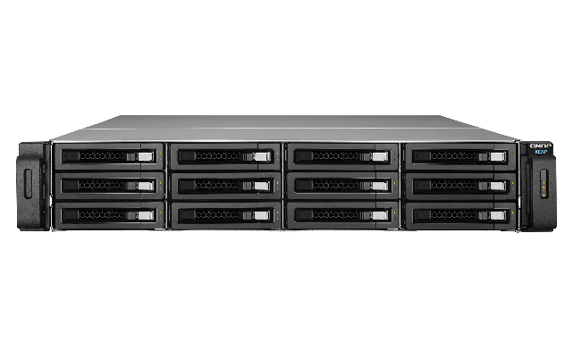
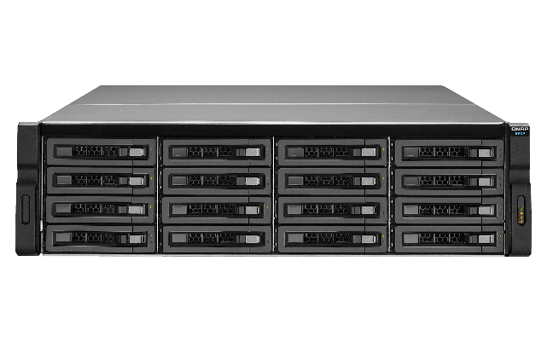
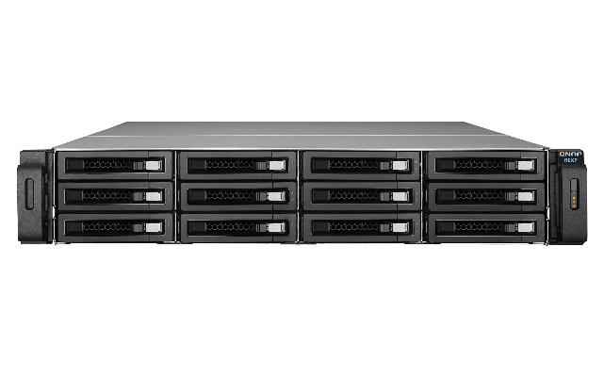
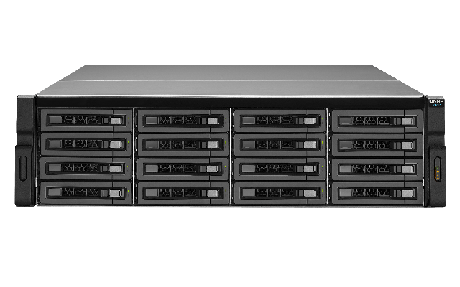
Compatible with QNAP REXP SAS JBOD series
NAS supports connecting multiple TL and REXP SAS JBOD enclosures together
SAS 6Gb/s JBOD enclosures
SAS 12Gb/s JBOD enclosures
REXP-1210U-RP
REXP-1610U-RP
REXP-1220U-RP
REXP-1620U-RP

Slide 18
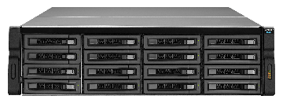
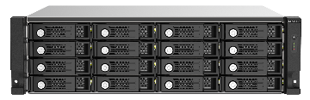



Comparing the QNAP SAS JBOD generations
New!
New!
 | TL-R1620Sep-RP | REXP-1620U-RP | REXP-1610U-RP | TL-R1220Sep-RP | REXP-1220U-RP | REXP-1210U-RP
# of bays | 16 | 16 | 16 | 12 | 12 | 12
Drive interface | 2.5“/3.5” SAS 12Gbps, SAS/SATA 6Gbps | 2.5“/3.5” SAS 12Gbps, SAS/SATA 6Gbps | 2.5“/3.5” SATA 6Gbps | 2.5“/3.5” SAS 12Gbps, SAS/SATA 6Gbps | 2.5“/3.5” SAS 12Gbps, SAS/SATA 6Gbps | 2.5“/3.5” SATA 6Gbps
SAS ports | 4 x SAS 12Gbps wide ports (Mini-SAS HD SFF-8644) | 3 x SAS 12Gbps wide ports (Mini-SAS HD SFF-8644) | 3 x SAS 6Gbps wide ports (Mini-SAS HD SFF-8644) | 4 x SAS 12Gbps wide ports (Mini-SAS HD SFF-8644) | 3 x SAS 12Gbps wide ports (Mini-SAS HD SFF-8644) | 3 x SAS 6Gbps wide ports (Mini-SAS HD SFF-8644)
Dimension (HxWxD) | 3U, 131.3 x 482.2 x 425.3 mm | 3U, 130 × 442.4 × 528.3 mm | 3U, 130 × 442.4 × 528.3 mm | 2U, 88.65 x 482.2 x 423.8 mm | 2U, 88 x 439 x 520 mm | 2U, 88 x 439 x 520 mm
Key-lock tray | Key lock | --- | --- | Key lock | --- | ---
Optional rail kit | RAIL-B02 | RAIL-A03-57 | RAIL-A03-57 | RAIL-B02 | RAIL-A03-57 | RAIL-A03-57

Slide 19
TL SAS JBOD with 2 wide-port SAS-12G2E expansion cabling suggestion for multi-path & aggregation
X Multi-path
X Aggregation
X Multi-path
V Aggregation
V Multi-path
V Aggregation
V Multi-path
V Aggregation
SAS-12G2E
SAS-12G2E
SAS-12G2E
SAS-12G2E
SAS-12G2E
SAS JBOD #1
SAS JBOD #5
SAS JBOD #1
SAS JBOD #1
SAS JBOD #1
SAS JBOD #2
SAS JBOD #6
SAS JBOD #2
SAS JBOD #2
SAS JBOD #2
SAS JBOD #3
SAS JBOD #7
SAS JBOD #3
SAS JBOD #3
SAS JBOD #3
SAS JBOD #4
SAS JBOD #8
SAS JBOD #4
SAS JBOD #4
SAS JBOD #4
*QTS/QuTS hero only support 4-layers vertically

Slide 20
With a QXP-1620S or two SAS-12G2E connect up to 16 JBODs for 4.6PB raw capacity
1 x QXP-1620S or 2 x SAS-12G2E
X Multi-path
X Aggregation
SAS JBOD #1
SAS JBOD #5
SAS JBOD #9
SAS JBOD #13
SAS JBOD #2
SAS JBOD #6
SAS JBOD #10
SAS JBOD #14
QNAP NAS could connect up to 16 JBODs with a QXP-1620S-B3616W or two SAS-12G2E for maximum 4.6PB of raw capacity
SAS JBOD #3
SAS JBOD #7
SAS JBOD #11
SAS JBOD #15
SAS JBOD #4
SAS JBOD #8
SAS JBOD #12
SAS JBOD #16
*raw capacity is calculated with 18TB x 16JBOD x 16bay = 4.6PB
*QTS/QuTS hero only support maxium 4-layer vertically.

Slide 21
TL SAS JBOD with QNAP SAS HBA expansion cabling suggestion for multi-path & aggregation
V Multi-Path
V Aggregation
V Multi-Path
V Aggregation
1 x QXP-1620S or 2 x SAS-12G2E
1 x QXP-1620S or 2 x SAS-12G2E
SAS JBOD #1
SAS JBOD #5
SAS JBOD #9
SAS JBOD #13
SAS JBOD #1
SAS JBOD #2
SAS JBOD #6
SAS JBOD #10
SAS JBOD #14
SAS JBOD #2
SAS JBOD #3
SAS JBOD #7
SAS JBOD #11
SAS JBOD #15
SAS JBOD #3
SAS JBOD #4
SAS JBOD #8
SAS JBOD #12
SAS JBOD #16
SAS JBOD #4
請幫忙畫成一串4台, 4x4 = 16台JBOD

Slide 22
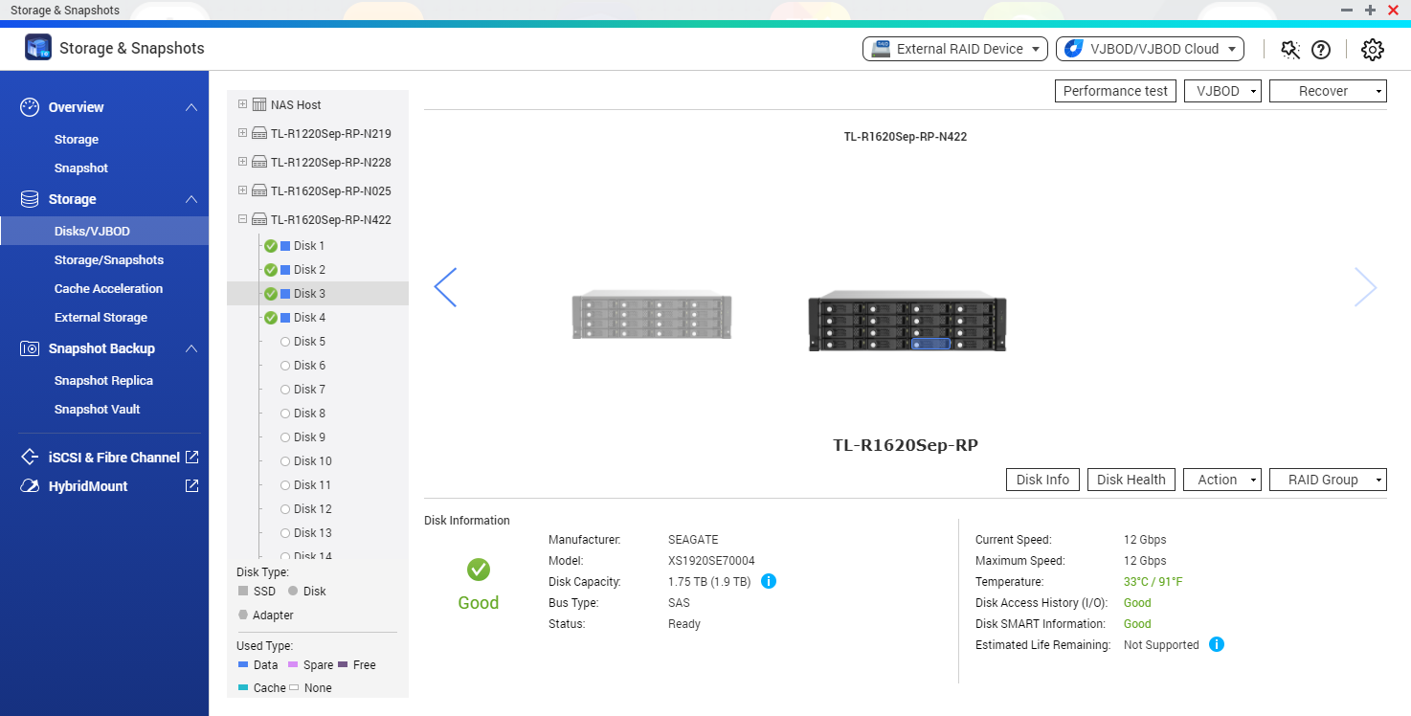




NAS QTS 4.5.1 / QuTS hero 4.5.1 are required for TL SAS JBOD support
TL SAS JBOD can be monitored and managed in the Storage and Snapshots manager. Advanced QTS / QuTS hero local disk management features are supported.
Enclosure & QTS Disk related features:
S.M.A.R.T test
Seagate IHM
Disk Scan
Disk Erase
Disk performance test
Compatiable NAS for TL SAS JBOD
https://www.qnap.com/compatibility-expansion
Notes:
NAS QTS / QuTS hero 4.5.1 支援 TL JBOD

Slide 23
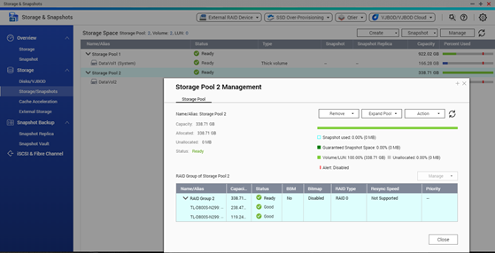
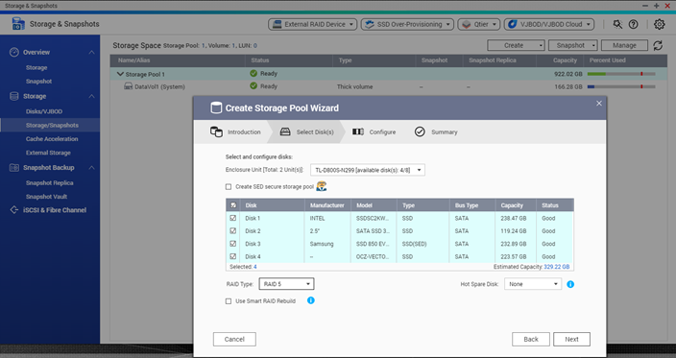


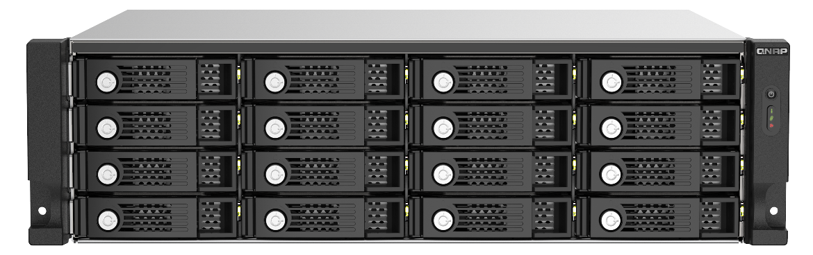



Expand NAS storage pool capacity
RAID & Storage Pool
All disks of TL SAS JBOD would be identified by Storage & Snapshots manager, then configure as a RAID within a storage pool.
開啟儲存與快照總管 >
進入儲存 / 快照
選擇建立 >
新儲存池或新磁碟區
選擇 TL 系列 JBOD 並指定
RAID 類型即完成建立

Slide 24


Easily create storage in QTS / QuTS hero
Different from the TR RAID series, TL SAS JBOD series is based on QNAP software RAID: supports all local RAID operations as well as RAID migration and RAID expansion. TL-R1220Sep-RP/TL-R1620Sep-RP can even be configured as RAID 50 / 60.
[ Storage & Snapshot
Manager ] > [ Storage / Snapshots ]
Expand the
[Storage Pool]
Select TL JBOD and set up the RAID type
TL SAS JBOD allows you to create pool across NAS and JBOD.

Slide 25

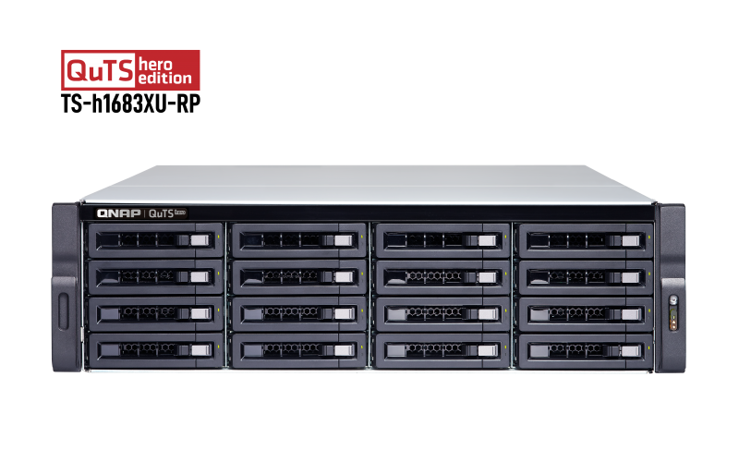

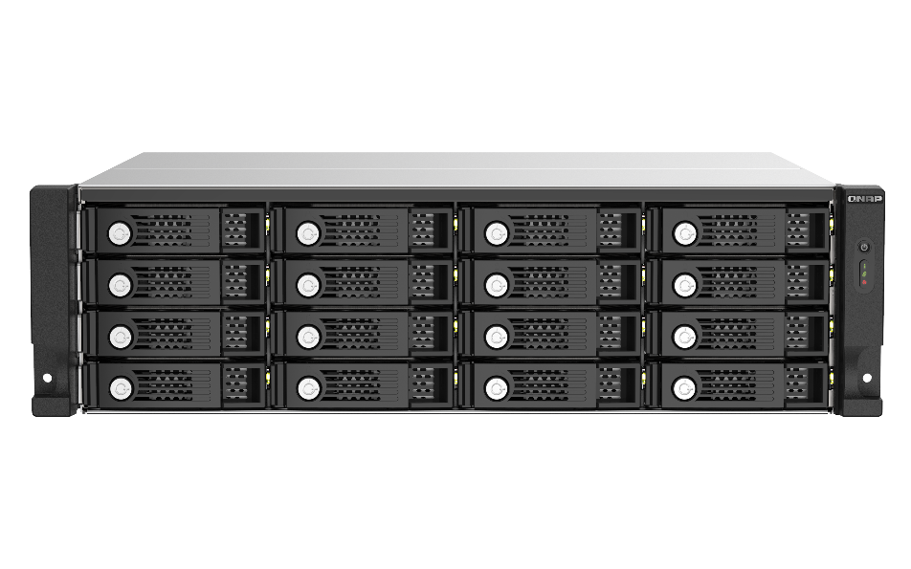








Flexible Storage Expansion or as a backup space
應用情境
TL SATA JBOD can expand QNAP NAS storage capacity. It supports either the configurations of the storage pool, or the snapshots storage from volume and LUN.
Based on the structure of software RAID, TL JBOD units are more suitable for expansion devices than TR series.
Be the Snapshot Vault
TS-h1683XU-RP
Be the Storage Expansion
TL-R1620Sep-RP
TS-h1683XU-RP

Slide 26
Demo

Slide 27
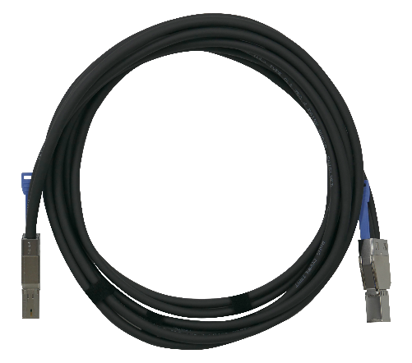
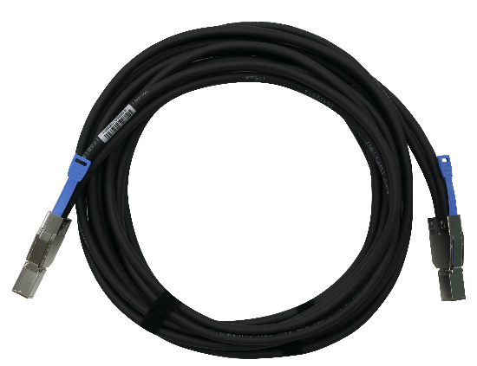
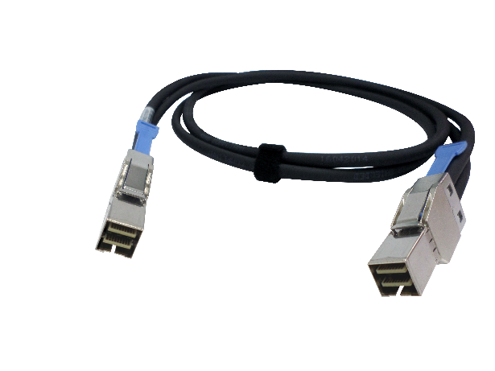
Optional QNAP SAS 12Gb/s cables of different lengths
Mini-SAS HD SFF-8644 to 8644 SAS 12Gb/s cable
CAB-SAS05M-8644
CAB-SAS10M-8644
CAB-SAS20M-8644
CAB-SAS30M-8644
SFF 8644-8644
0.5-meter
SAS 12Gb/s
SFF 8644-8644
1-meter
SAS 12Gb/s
SFF 8644-8644
2-meter
SAS 12Gb/s
SFF 8644-8644
3-meter
SAS 12Gb/s

Slide 28

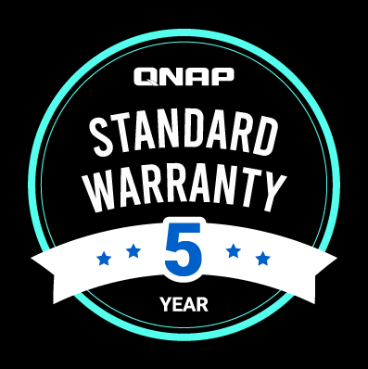
5-year standard warranty included!
5-Year Standard Warranty
TL-R1220Sep-RP/TL-R1620Sep-RP include 5-Year Standard warranty.
Warranty service that comes in effect at the time of purchase.
Free repair and part replacement for products under normal use during warranty period. (Spare parts and consumables are excluded)

