Slide 1
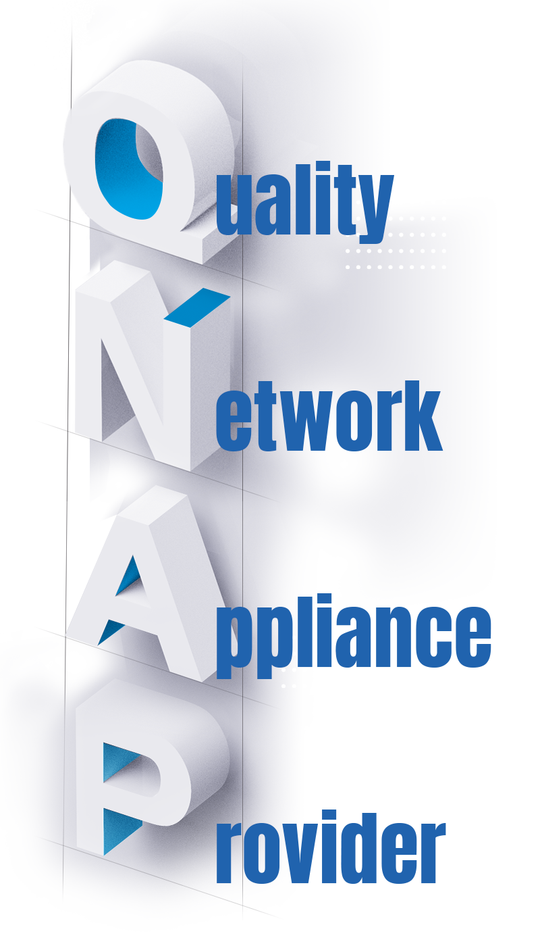
Company Profile

Slide 2
About QNAP
QNAP devoted to providing comprehensive solutions from software development, hardware design and in-house to manufacturing. Focusing on STORAGE, NETWORKING and SMART VIDEO INNOVATIONS, we strive to build a technology ecosystem upon subscription-based software and diversified service channels. QNAP envisions NAS as being more than a simple storage and has created a cloud-based networking infrastructure for users to host and develop artificial intelligence analysis, edge computing and data integration on their QNAP solutions.

Slide 3
+
1300
Employees Worldwide
Global Expansion Strategy
Headquartered in Taipei
15 subsidiaries in 28 countries
1300+ employees worldwide
600+ R&D engineers

Slide 4
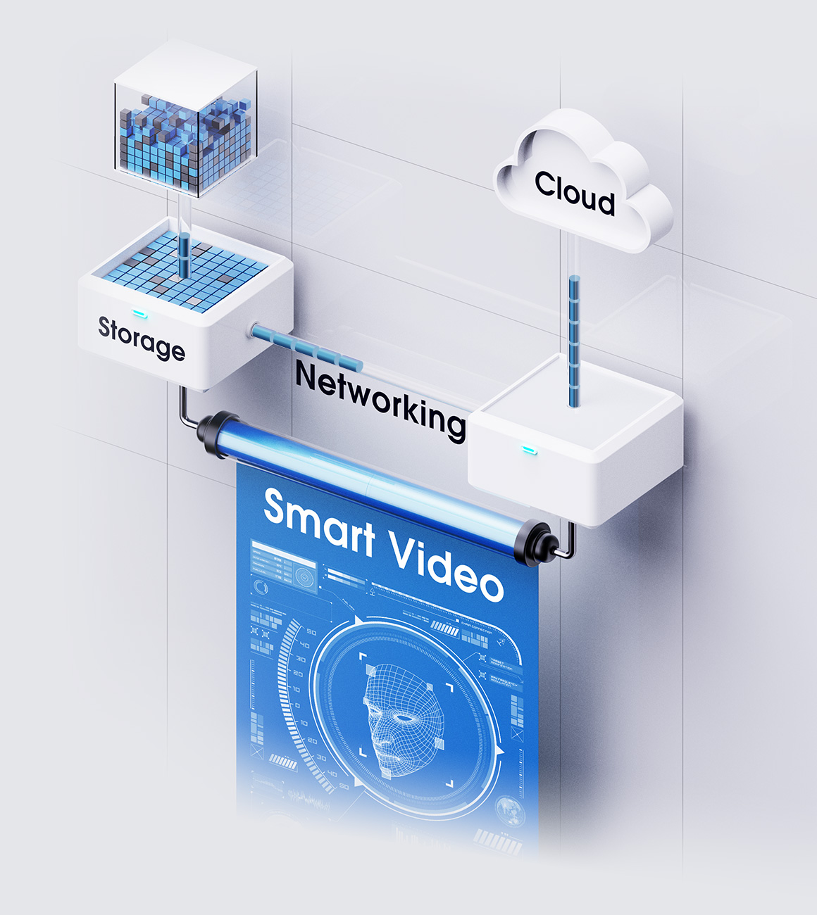
Innovate toward
Digital Transformation
The three pillars of QNAP to help its clients accelerate digital transformation: Intelligent Storage, Smart Networking, and Smart Video. QNAP complies with the trend to invest in new IT infrastructure technologies and devotes to providing our client future-proof total solutions.

Slide 5
Milestones in QNAP’s History
2019
Launched a Cloud Storage Gateway that integrates private and public cloud storage to fulfill hybrid cloud applications.
2018
Launched the TS-251B, the first home/SOHO multimedia NAS with PCIe expandability.
2017
Launched the world’s first Ryzen™-based NAS, the TS-x77 NAS series.
2016
Launched the dual-controller Enterprise ZFS NAS series ES1640dc and ES1640dc v2.

Slide 6
2015
Launched the world's first Thunderbolt™ 2 Turbo vNAS TVS-871T.
2014
Launched Virtualization Station. TS-469 Pro featured in PCWorld's 50 Best Tech Products of 2013
2011
Launched the high-end SMB Turbo NAS TS-x79 series with 10GbE LAN port.
2009
Added support for third-party cloud backup and virtualization integration services through iSCSI.
2008
Added support for RAID level migration and capacity expansion.
2006
2004
Integrated Multimedia Station and Download Station, QNAP takes the lead in multifunctional NAS.
QNAP founded.

Slide 7
QNAP
Business Units

Slide 8
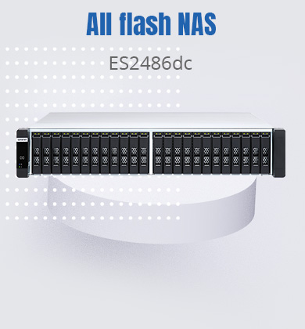
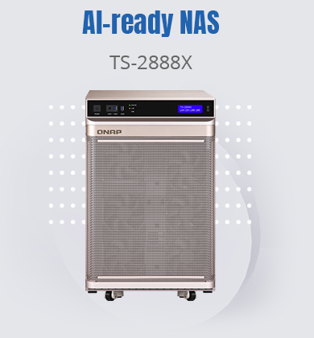
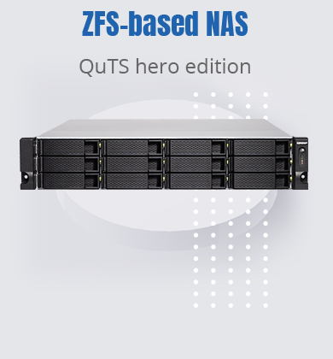
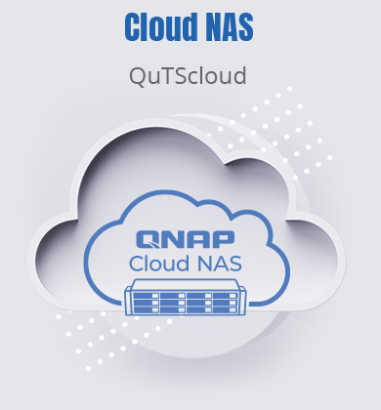
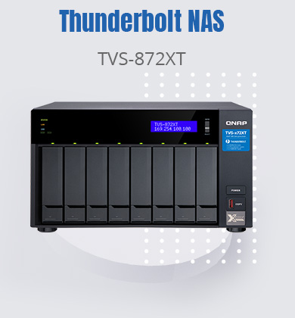
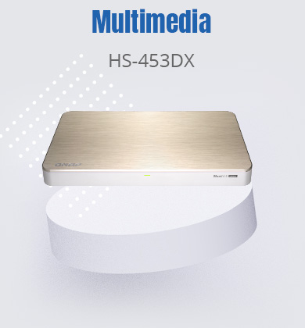
Ready for the future
QNAP has set the industry standard for providing powerful future-proof on-premise storage and innovative software solutions. QNAP is relentless in its pursuit of solutions that help businesses modernize their data experience and adopt multi-cloud strategies in the cloud era.
Business Unit

Slide 9
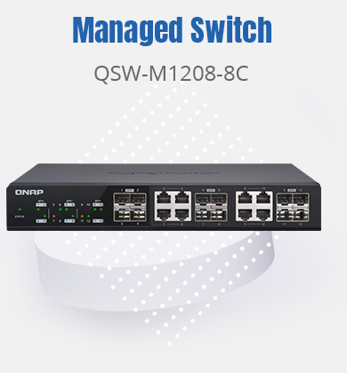
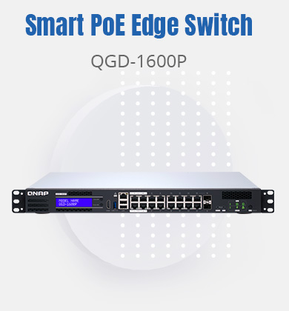
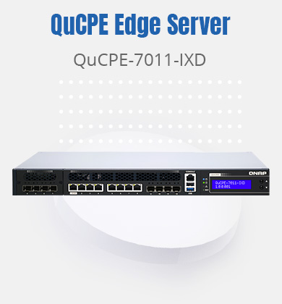
Shape the new IT landscape
Leverage QNAP’s strengths in storage virtualization, QNAP provides a revolutionary network virtualization solution along with a robust hardware portfolio to enable simple and centralized network deployment and management from edge to core to cloud.
Business Unit

Slide 10
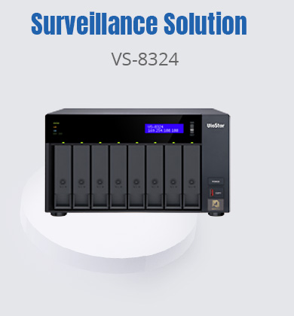
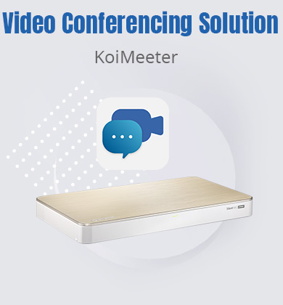
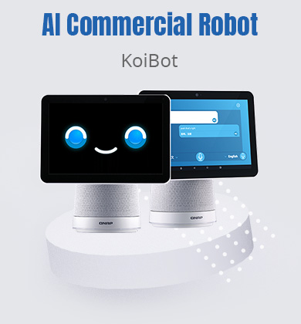
AI-powered video data analysis
Following the AI wave, video has become the next frontier for Big Data. QNAP provides AI value-added services by extracting maximum value from video data, helping businesses to enable intelligent services.
Business Unit

Slide 11
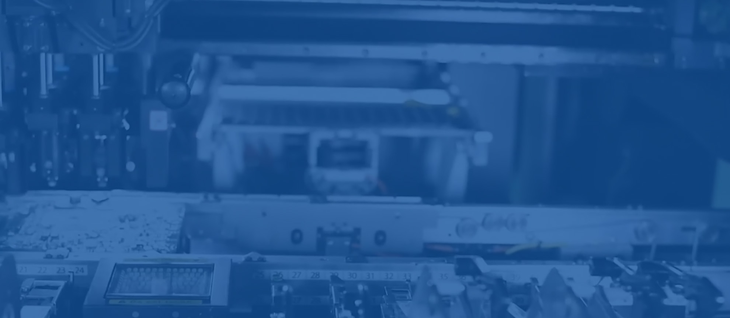
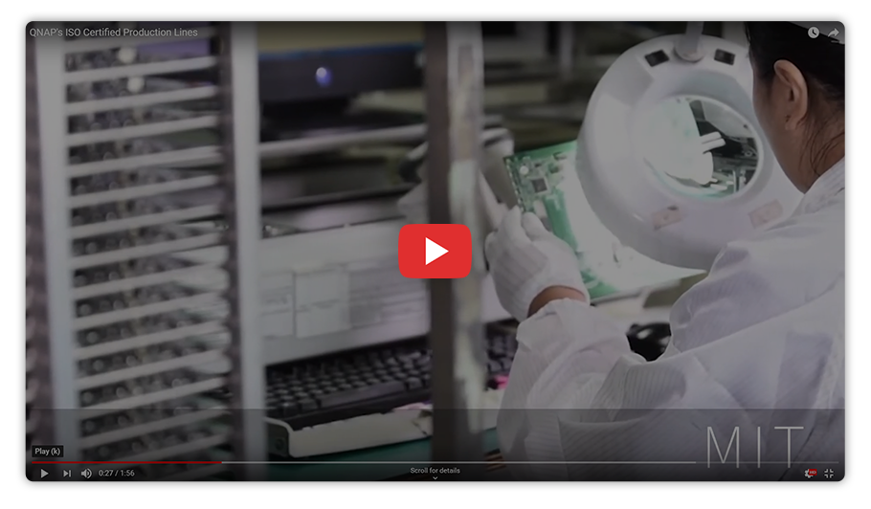
In-house
Manufacturing
QNAP offers high-quality storage, networking and smart video products based on the principles of usability, high security, and flexible scalability. QNAP’s own factory with full-process production lines are certified to ISO 9001 Quality Management Systems, ISO 14001 Environmental Management Systems, ISO 45001 Occupational Health and Safety Management Systems, and ISO 27001 Information Security Management Systems.

Slide 12
Follow QNAP

