Slide 1


Slide 2
Agenda
Difficulties encountered by SMBs and individual studios in the Work From Home era​
The market exclusive functions brought by QHora-301W fulfills your needs
Hardware advantages
Dual-port 10GbE meets all your application scenarios
High speed Wi-Fi 6 routing
The powerful QuRouter OS
Enable subscription-free QNAP SD-WAN on QHora-301W

Slide 3
Difficulties encountered by SMBs and individual studios in the Work From Home era​

Slide 4







Site-to-site VPN were only used by a few branches and remote officers
Intranet
Extranet
HQ
VPN
Remote Worker
Tokyo
Taipei
Remote Worker

Slide 5


During the pandemic, number of remote workers dramatically increased due to working from home
HQ
VPN
No one in office
Remote Worker
Remote Worker
Remote Worker

Slide 6
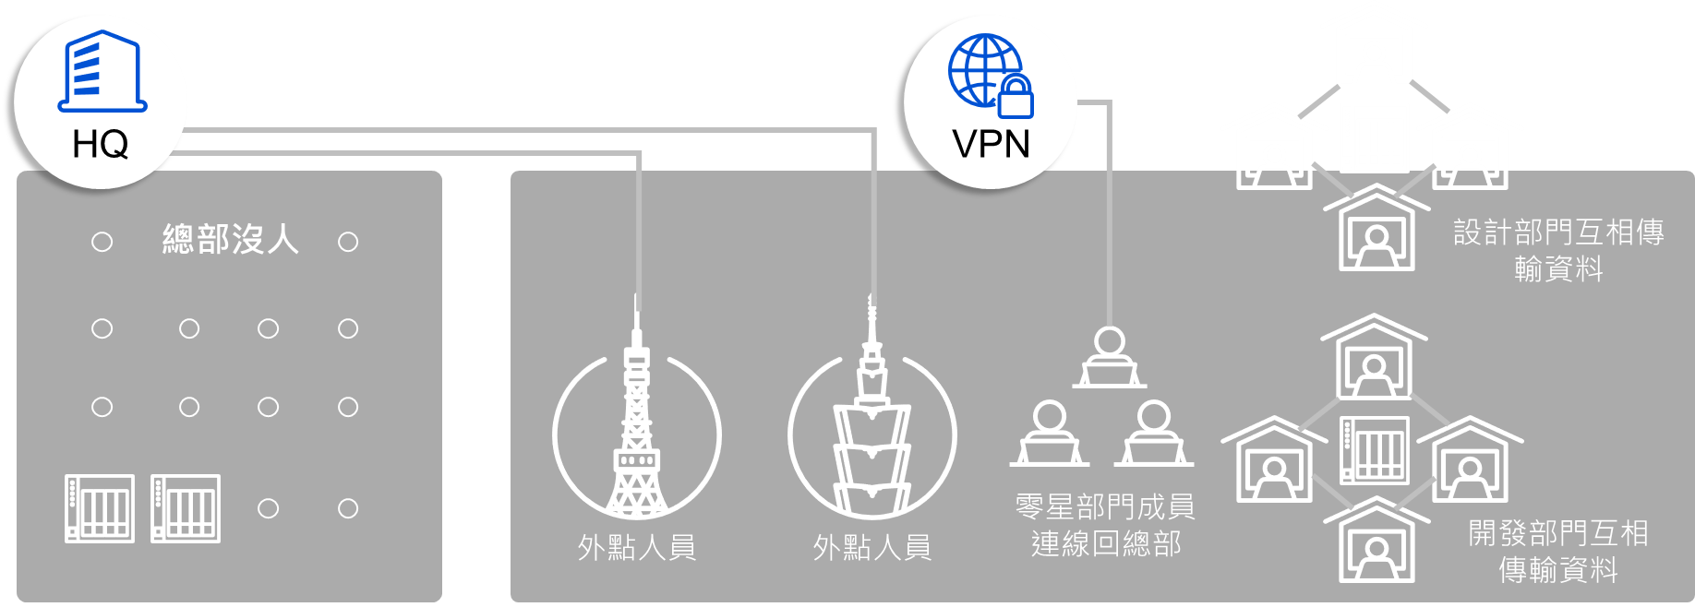
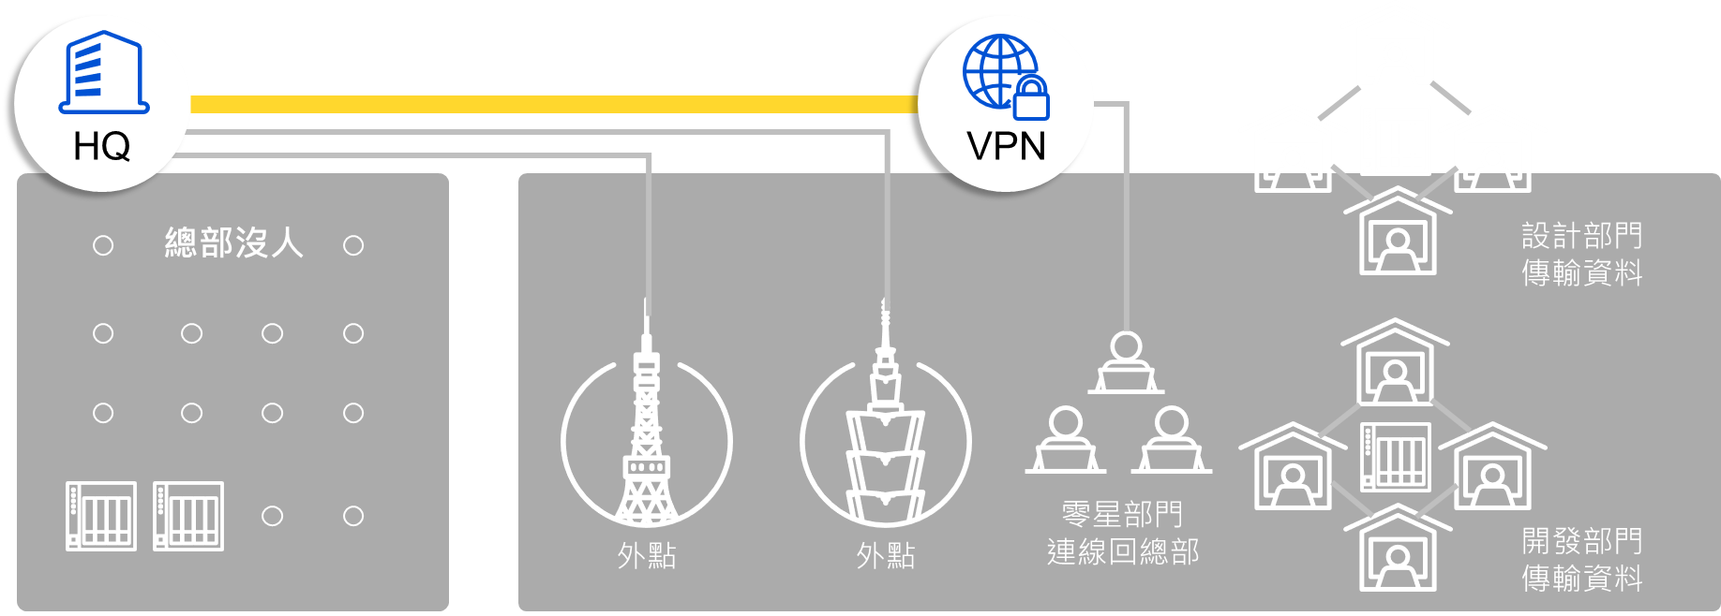
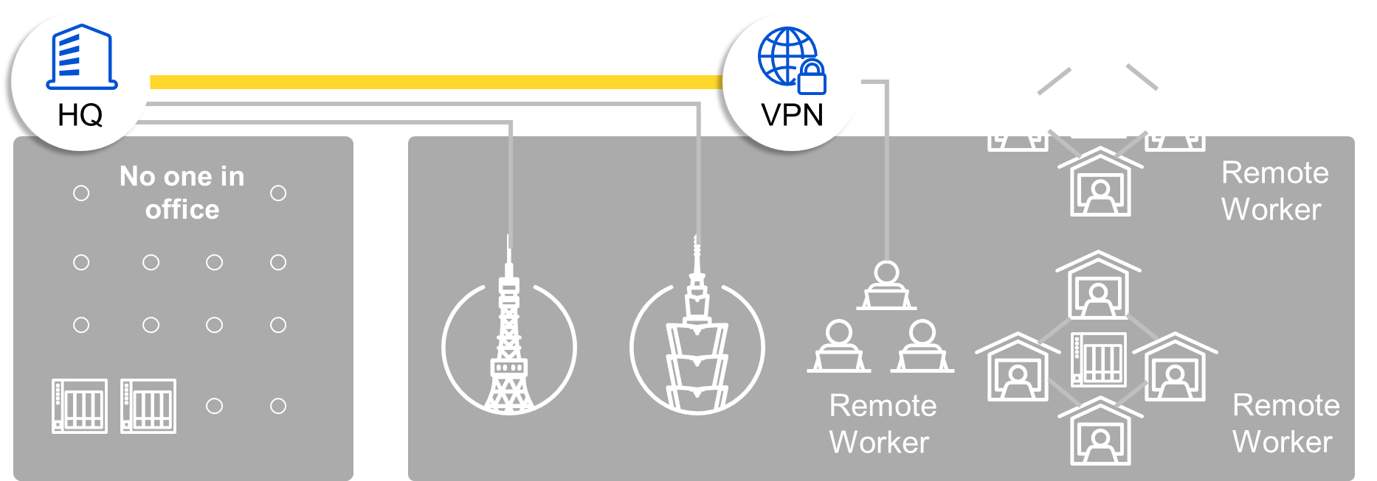
Distributed remote working style creates many issues
Machine delivery and maintenance is
time-consuming
Data security issues
VPN connection frequently crashed
Setting up site to site VPN is time consuming
HQ
VPN
IT admin cannot manage organization-wise network devices efficiently.
Current router only has one 10GbE, unable to do remote backup.
Wireless connection cannot afford the sudden increase of wireless device from home users

Slide 7
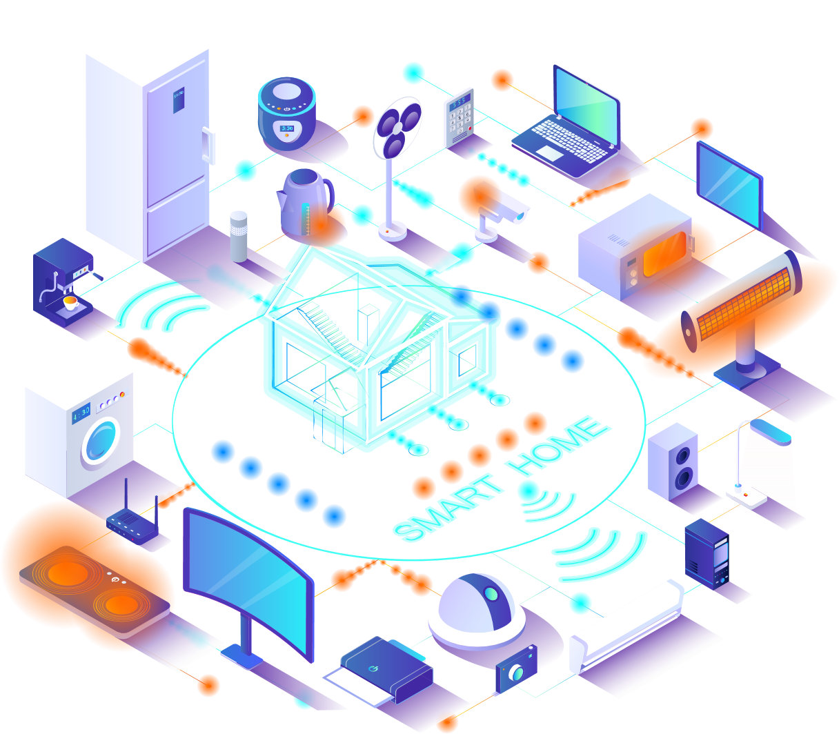
Existing Wi-Fi routers cannot handle the sudden increase in network equipment and transmission demand
Multiple devices can only take turns to connect to the network. This condition causes network congestion.
The transmission speed of existing routers is slow, and data cannot be backed up efficiently through wireless network.
Affect family members’ experience of watching movies or play games.
Notes:
如今，智慧設備大爆發，一個人可能就有十幾甚至幾十個 Wi-Fi 智慧設備。並且，隨著影片以及直播的興起，給 Wi-Fi 網路增加了許多壓力。有統計數據顯示，2017 年到 2022 年，全球移動數據流量預計將增加 7 倍，相當於每年增加一倍以上。在這些數據流量中，目前影片數據流量約占比 50%，但到 2022 年時這一比例將會增加至 80%。

Slide 8





Remote backup is needed but common Wi-Fi 6 router usually only has one 10GbE port
Common router
Only has one 10GbE
10GbE WAN corresponding to 2.5GbE and 1GbE LAN cannot play the high-speed internal and external network transmission speed
Slow
Common router

Slide 9


More work-from-home
More distributed remote workers
More remote clients connect and exchange traffic through a single or few VPN routers in HQ.
Increasing overload & performance bottleneck on the HQ site.
More network stability & reliability issues resulted from the overloaded VPN router in HQ site.
Intranet
Extranet
VPN
Server connects via VPN
VPN
Designers store files and images
VPN
PM get data
HQ
VPN
Sales use ERP
VPN connection
crashed
VPN
RD uses server to develop software
Purchasing dept. use ERP
VPN

Slide 10

Lack of effective ways to manage large number of external devices
IT administrators cannot manage equipment usage and connection status ​
Not every remote worker has the knowledge to set up and maintain the on-prem devices​
Device & network troubleshooting can be time-consuming​
Intranet
Extranet
IT Overload
VPN
Server connects via VPN
VPN
Designers store files and images
VPN
PM gets data
HQ
VPN
Salespersons use ERP
VPN
RD uses server to develop software
VPN
Procurement dept. use ERP

Slide 11

Setting up site-to-site VPN is time and labor consuming ​
Employees who need to exchange data frequently within the group would need to create site to site VPN network by themselves​. But setting up VPN is not easy, and special equipment may be required, hence, deploying a large mesh VPN solution can be very time and labor consuming.​
??
??
Router
Router
Router
Employee Productivity
Decreased!
Router

Slide 12


Enterprise level VPN solution is expensive
SMB start to look for VPN solutions on the market to solve these problems, but not every SMB can afford the high cost for extending or building a complete VPN solution.

Slide 13
QHora-301W
New Generation WiFi 6
and Dual 10GbE SD-WAN Router
Wireless connectivity: support WiFi 6 (802.11ax)
Flexible network deployment: Dual 10GbE ports
VPN deployment: built-in SD-WAN technology

Slide 14

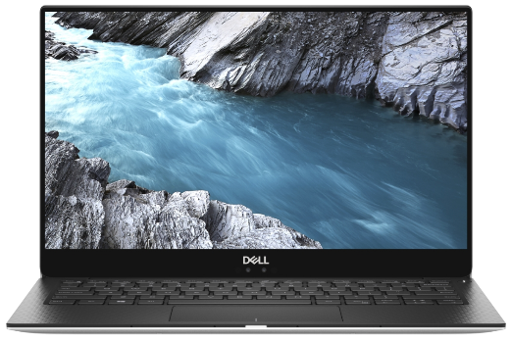


New-gen Router Requires WiFi 6
High-speed connectivity
Support WiFi 6 dual-band 802.11ax (2.4GHz & 5GHz), delivering max. 3600Mb/s transfer speeds. WiFi 6 is 1.38 times faster than WiFi 5.
Wi-Fi 6
1200 Mb/s
Wi-Fi 5
867 Mb/s
160MHz channels comparison
WiFi 6 is the next-gen WiFi standard
In 2020, most new client devices will support WiFi 6, including computers, mobile phones and tablets.

Slide 15


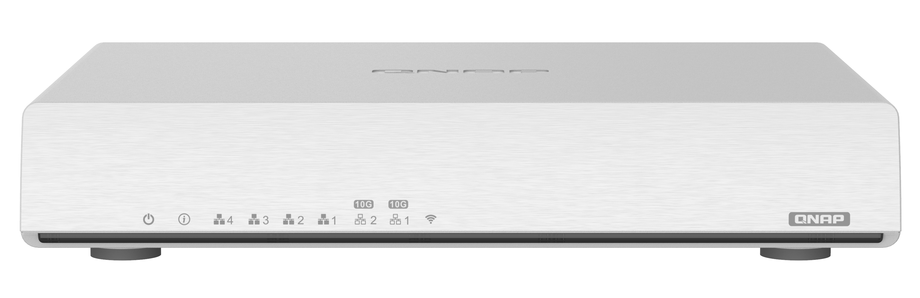
New-gen Router Requires WiFi 6
Traditional OFDM
Increased 4 X network efficiency
By using OFDMA & MU-MIMO, multiple sets of devices can transmit data at the same time, thereby improving network efficiency and reducing connection delay
Waiting…
Waiting…
User 1
(Message)
User 2
(Online
Shopping)
User 3
(Social Media)
OFDMA

Slide 16

New-gen Router Requires WiFi 6
1.25 X
Faster speed
1024-QAM package more information
By increasing the amount of data that can be carried in each packet, the speed will definitely increased.
Compared with Wi-Fi 5 (11ac) which uses 256-QAM, 1024-QAM can increase the rate by 1.25 times.
10bits
11ax
1024-QAM
1.25x
8bits
11ax
256-QAM

Slide 17
New-gen Router Requires Dual 10GbE Port
QHora-301W provides 10GbE port
Support high-speed internal and external network transmission
Meet the needs of remote backup of large business files
ＷＡＮ
QHora-301W
ＬＡＮ

Slide 18





New-gen Router needs to provide SD-WAN service
Built-in SD-WAN solution (QuWAN), supporting full Mesh VPN for easy multi-site VPN deployment.
Subscription-Free
Flexible Deployment
Center Managed
No need to purchase other devices for multi-site VPN
Auto VPN tunneling
Support network optimization to ensure connection quality
QuWAN Orchestrator
Notes:
對比傳統 vpn 所需要的東西

Slide 19
QHora-301W
Hardware Advantages

Slide 20
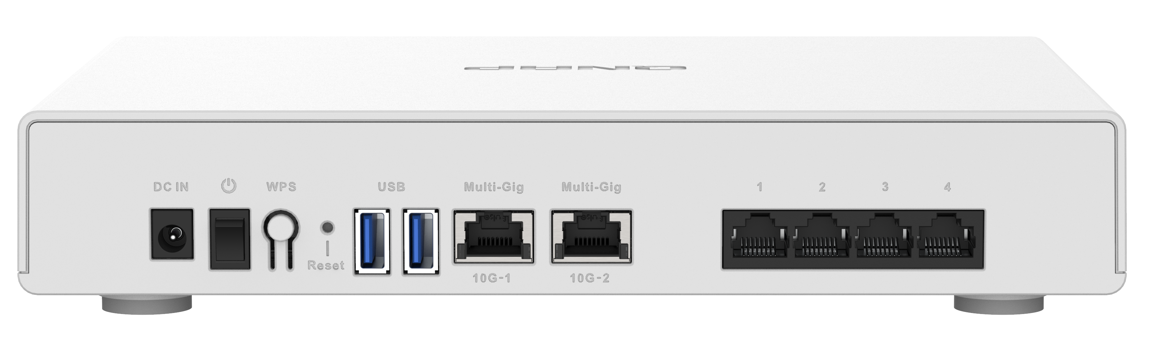
Hardware Appearance
10GbE Connectivity
8 x 5dBi
Internal Antennas
1GbE Connectivity
Status
Power
WiFi Enabled
Power Switch
Configurable Ports for WAN
12V DC Input
4 x 1 GbE Ports (1000/100/10Mbps)
WPS
Reset Button
2 x 10 GbE Ports
(10G/5G/2.5G/1G/100M)
2 x USB 3.2 Gen 1

Slide 21
Eight Internal Antennas
藍色: Four 2.4GHz Antennas (5dBi)
紅色: Four 5GHz Antenna (5dBi)
Professionally tuned
Powerful Performance

Slide 22




Powerful Performance
Powered by Hawkeye v2 IPQ8072A quad-core 2.2GHz 64-bit processor ​
Can quickly handle 10G throughput network transmission
1GB system memory. QHora-301W can reliably support more concurrent users
4GB eMMC Flash Storage
Provide multiple funcions on Qhora-301W. ex, QVPN, SD-WAN
RAM
1GB
2.2GHz
64-bit
Quad-core
Notes:
Qualcomm cpu page

Slide 23
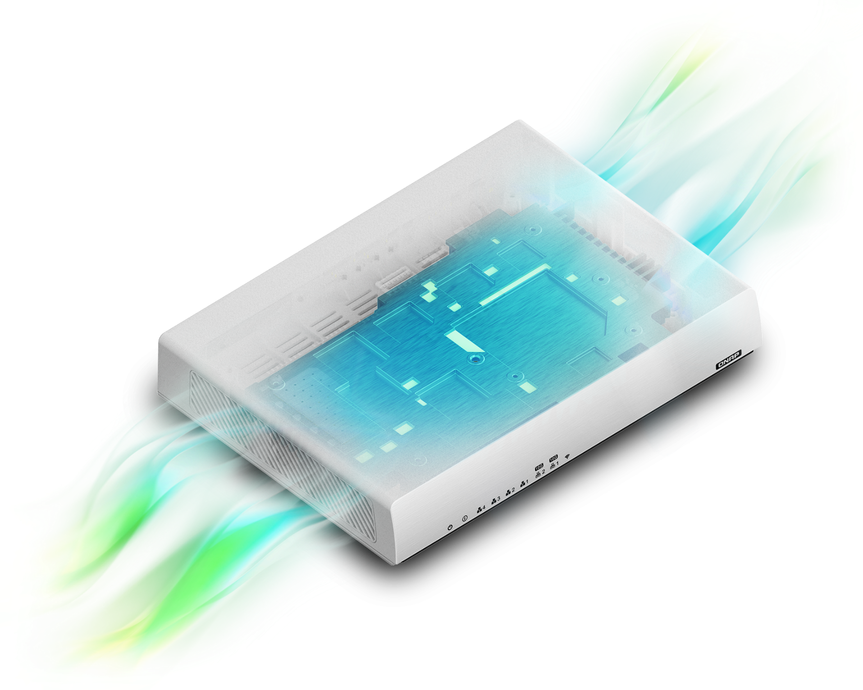
Fanless Design:
Quiet Operation x Maintain Performance
Fanless with unique ventilated construction allows QHora-301W to maintain its throughput efficiency within 0-40°C operating temperature.
Quiet operation makes QHora-301W
the perfect home routing solution for worldwide use.

Slide 24
Hardware Specifications
Function | QHora-301W
Network Interface (RJ45) | 4 x RJ-45 GbE ports (WAN/LAN configurable) 2 x RJ-45 10GbE ports (10G/5G/2.5G/1G/100Mbps, WAN/LAN configurable)
Antenna | 8 Internal 5dBi Antennas
Processor | Qualcomm IPQ8072A Hawkeye 2 Quad-core 2.2 GHz 64-bit CPU
Memory | 1GB RAM
Flash Storage | 4GB eMMC
Wireless | Dual-band AX3700 5G (2475Mbps): 4x4 (80MHz), 2x2 (160MHz) 2.4G (1182Mbps): 4x4 (40MHz) WPS button
Mounting Support | VESA 75 x 75 mm (Optional third-party mounting kits are available for wall-mount, table mount and pole mount).
Fanless Design | Maintain consistent system performance within 0-40C operating temperature
SD-WAN Max VPN Tunneling | 30

Slide 25
QHora-301W
Unboxing

Slide 26
Dual 10GbE ports meets all your application scenarios

Slide 27

Scenario One: 2 x 10GbE LAN Connections
Configuration: Two 10GbE LAN, One 1GbE WAN
Build a high-speed 10GbE Intranet by connecting 2 x 10GbE ports to 10GbE devices in LAN environment.
Benefits: accelerate file access and sharing within LAN.
WiFi 6
10G LAN
10G LAN
Multiple LAN Users
1G WAN

Slide 28
Scenario Two: 1 x 10GbE WAN & 1 x 10GbE LAN Connections
Configuration: One 10GbE WAN, One 10GbE LAN
High-speed inter-office VPN network with 10GbE Internet and 10GbE Intranet connectivity.
Benefits: streamlined cross-site file backup, synchronization and sharing.
10G LAN
10G LAN
10G WAN
10G WAN
New York
Taipei

Slide 29

Scenario Three: Multi-WAN with SD-WAN & 2 x 10GbE LAN Connections
Configuration: Multi-WAN with SD-WAN enabled; Two 10GbE LAN
WAN optimization with WAN aggregation, WAN failover & load balancing, and flexible static routing to increase data transfer efficiency across WANs
Auto mesh VPN for easy multi-site VPN network deployment
Benefits: Secure cross-site VPN network with optimized WAN connections
10G LAN
WiFi 6
10G LAN
Multiple LAN Users
Dual 1G WAN

Slide 30
Wi-Fi 6
High speed wireless transmission

Slide 31




High-performance Wireless Network
WiFi 6 – Huge Gains in Multi-user Access Efficiency​
802.11ax dual-band (2.4GHz & 5GHz)
Up to 160MHz channel bandwidth with maximum 3600 Mb/s total throughput​
MU-MIMO allowing for more concurrent WiFi clients
OFDMA technology and eight antennas increase WiFi signal coverage
Perfect solution for smart IoT home
2.4GHz
5GHz
20 MHz
40 MHz
80 MHz
160 MHz
***160MHz channel will be supported in 2020/Q4
Notes:
改 3600

Slide 32




Enterprise-grade Feature: Virtual Access Point
QHora-301W supports VAP (Virtual AP) function, allowing for running up to 6 virtual APs. Each VAP has its own SSID & access right profiles and customized routes/policy to WAN Internet. ​
By connecting to a wireless SSID, different group of users (or device clients) will be bridged to a different VLAN, such as office-intranet, home & guest network.
VLAN 10
VAP Set 1 (Smart Connect)
SSID: Family (2.4G & 5G)
VLAN 20
VAP Set 2
SSID: Work_1F (2.4G)
SSID: Work_2F (5G)
QHora-301W
VLAN 30
VAP Set 3
SSID: School (2.4G)
SSID: School (5G)

Slide 33
The Powerful
QuRouter OS

Slide 34


QuRouter Architecture
Orchestrator
QRouter OS
VAP (Multiple SSID)
802.1Q VLAN
Static Routing
Protocol Base Firewall
FTP Server
QuWAN SD-WAN
Wi-Fi 6
L2 Networking
L3 Networking
OFDMA
MU-MIMO
NAT offload
Crypto Engine
USB Mgmt
Linux kernel
QCN5054
AQR 113C
IPQ8072A
2.4G/5G Wi-Fi 6 AX3600
Dual 10GbE Ethernet Ports
9.4Gbps Forwarding Rate
Ipsec VPN HW Acceleration

Slide 35
The Powerful QuRouter OS
Fullfills all the functions you need just like other common router
Features​ | ​ | QuRouter OS | Common Router
Dashboard​ & Status | Device and system status​ WAN Status​ WiFi/Guest WiFi Status​ Connected devices info​ | v | v
Advanced Network Settings | Selectable WAN (1G & 10G) | v | v
VLAN​ Setting | 802.3Q VLAN (Support for wire and wireless interface)​ | v | v
Routing​ | IPv4 Static Routing​ | v | v
FIrewall​ | Protocol based firewall​ | v | v
NAT​ | IPv4 NAT​ Port Forwarding​ | v | v
Access Control | Parental control. Website and schedule control. | v | v
Wireless Settings | 2.5G/5G configurable SSID​ Up to 6 VAP (Multiple SSID)​ Guest WiFi​ 802.3Q VLAN supported​ | v | v
AP Mode | Set router to bridge mode for extending wireless coverage | v | v

Slide 36
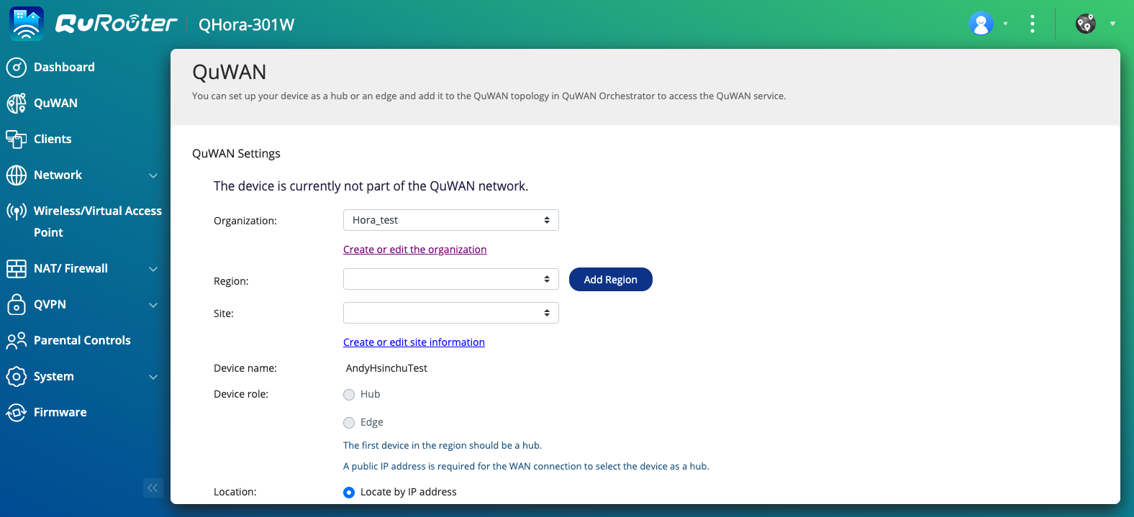
QuRouter OS has a friendly graphical router management
A user-friendly graphical web management interface helps users quickly grasp the network connection status.
Not only can you effectively manage the wired and wireless networked devices in the internal and external networks, but also perform advanced function settings such as firewall, VPN, security, and QuWAN network.

Slide 37
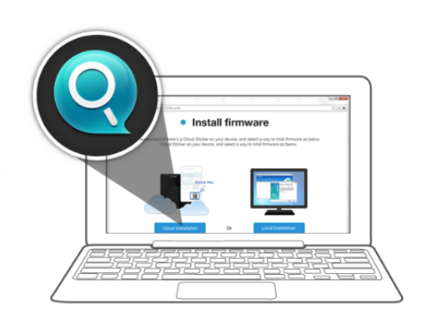
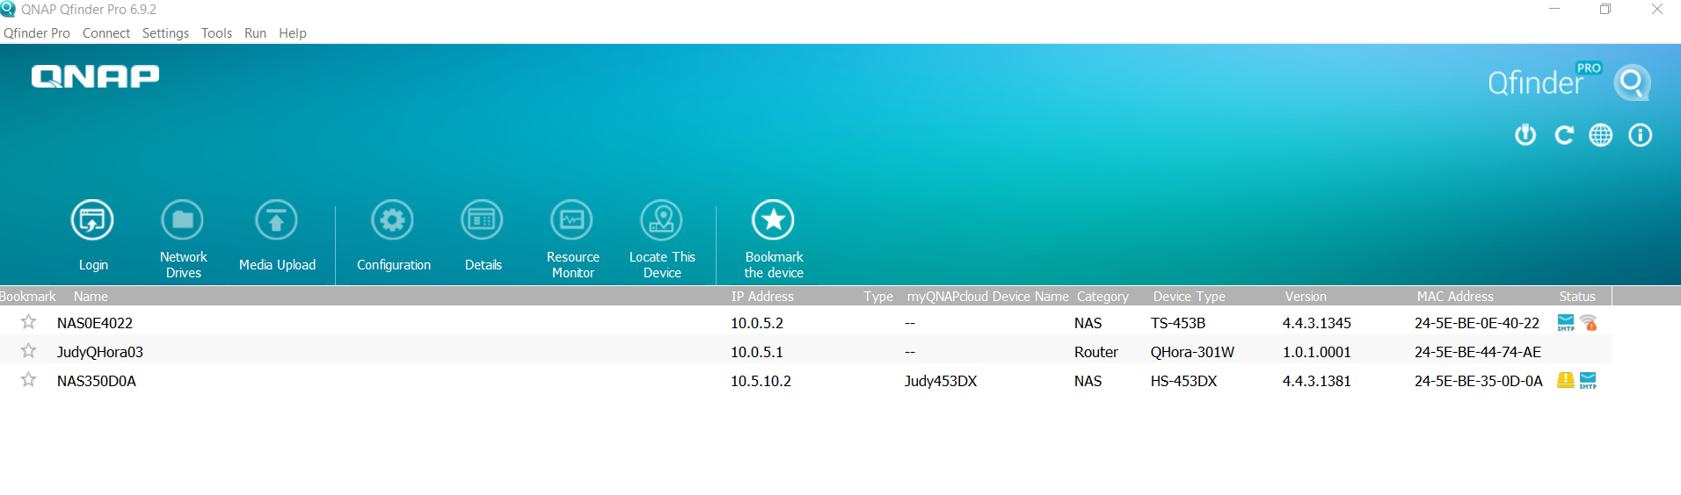
Use Qfinder Pro to find QHora-301W
It doesn’t matter if you forget the network settings. You can find your QHora-301W IP location in seconds through QNAP Qfinder Pro. The MAC information and firmware version are clear at a glance. You can also directly update QuRouter OS to the latest version through Qfinder Pro

Slide 38
Demo:
QuRouter OS

Slide 39

QHora-301W
is More Than
Just a Powerful Router

Slide 40
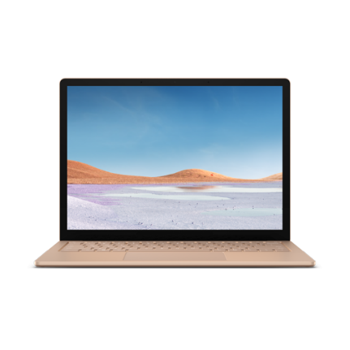
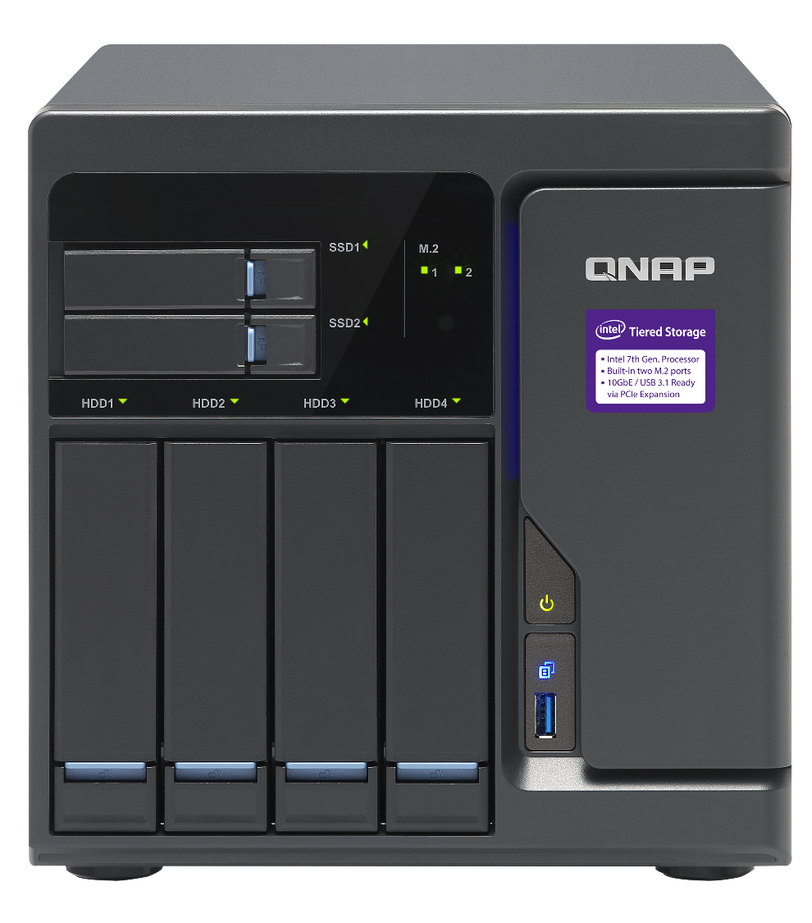



QuWAN is a complete SD-WAN solution
QNAP QuWAN is a complete SD-WAN solution that provides enterprise IT managers with a simple, fast, secure and efficient network connection structure. You can easily and quickly build a multi-site VPN network and centrally manage it from a cloud platform.
Auto VPN Network
QHora-301W
QVPN
QHora-301W
QVPN

Slide 41


Efficiently build multi-site VPN
Secure business data
As long as QHora-301W is connected to QuWAN Orchestrator, a private network can be established in the same organization
Material creation site
Germany
Data sharing
*** Maximum VPN tunnel scale: 30
Japan
Development site
Editing site

Slide 42
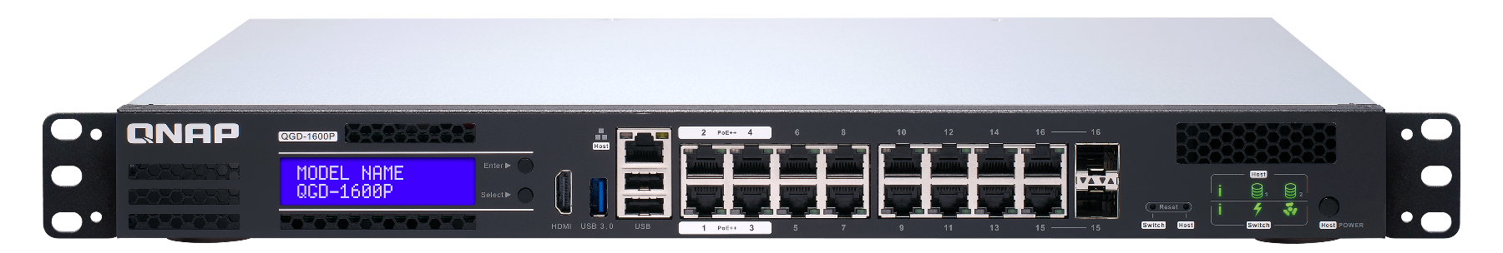
Flexible VPN Topology: Mesh VPN
Mesh VPN topology is suitable for a network architecture that requires fast and multiple route network.
Mesh VPN can be formed by multiple hubs automatically
Public IP is required for being hub
Mesh
Branch
HQ
QHora-301W
Home office
Home office

Slide 43
Flexible VPN Topology: Hub & Spoke
Hub & Spoke topology is suitable for a network architecture that requires fast deployment, extension and backup route.
All data transmission between edges will go through a hub
If your device uses private IP, it can connect to network topology as Edge
QHora-301W
QHora-301W
Edge
Hub
Edge

Slide 44
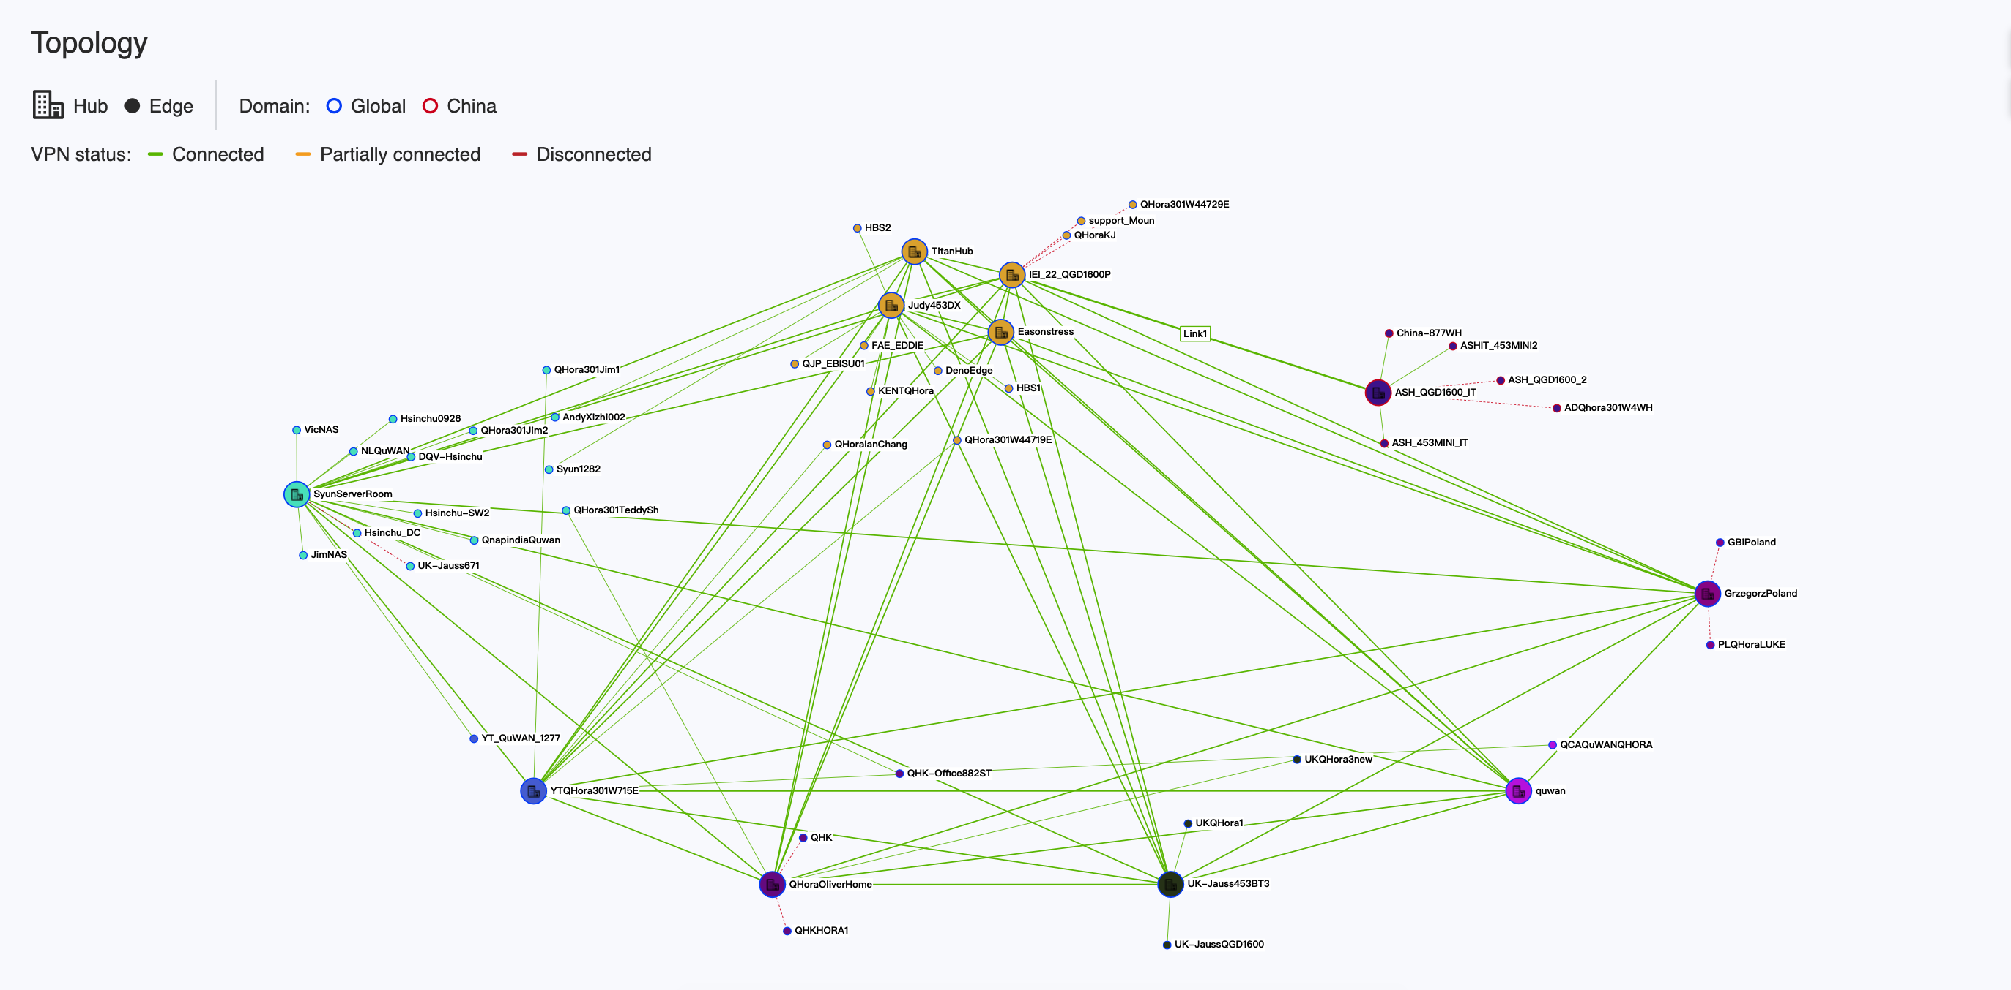
Network Topology Case

Slide 45
QuWAN’s Features and Benefits
Auto Mesh VPN
WAN Optimization
Cloud Management
Cost Optimization
Intuitive Web Management
Networking Security

Slide 46

WAN aggregation to improve data transmission rate
WAN aggregation is effective in achieving a faster data transmission for remote backup and remotely mounted file system
10 G
ISP WAN 2
10 G
WAN Aggregation
QＨora-301W
QＨora-301W
ISP WAN 1

Slide 47

WAN Failover
Multi-site connection can form a backup system automatically that allow uninterrupted collaborative operations.
The central management platform sends warnings and notifications in real time
ISP WAN 2
10 G
10 G
QHora-301W
QHora-301W
ISP WAN 1

Slide 48
WAN Load Balancing
Using Multipath TCP (MPTCP) technology to automatically detect current network jitter, delay, and packet loss conditions, so that each packet takes the best network path to the destination, so as to achieve intelligent routing and uninterrupted connection for transmission
Maintain long-term and efficient transmission by distributing traffic through multiple WANs
Good Network Status！
ISP WAN 1
10 G
ISP WAN 2
ISP WAN 2
QHora-301W
High latency, jitter and packet loss！

Slide 49


Deep Packet Inspection
Found blacklist packet
Match:
Pattern 3
Match:
Pattern 2
Match:
Pattern 1
Through using deep packet inspection technology, it can identify and control network services based on the characteristics of the application layer to achieve L7 firewall and intelligent QoS functions.
Blacklist specific applications to protect corporate network security.
DPI engine for content inspection
…
Packet Flow
** QoS and L7 Firewall is supported on 2021/Q1

Slide 50
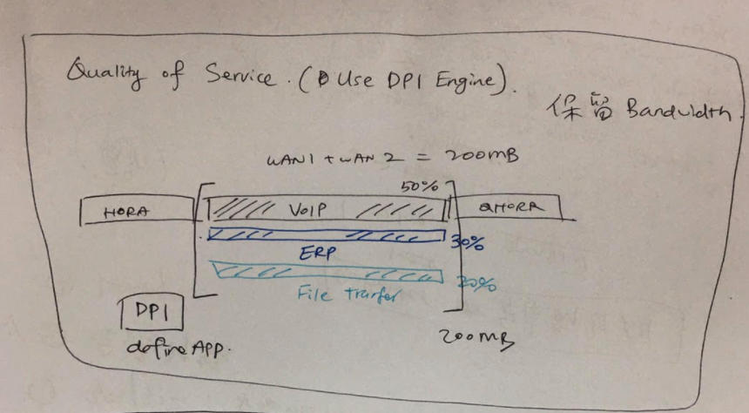
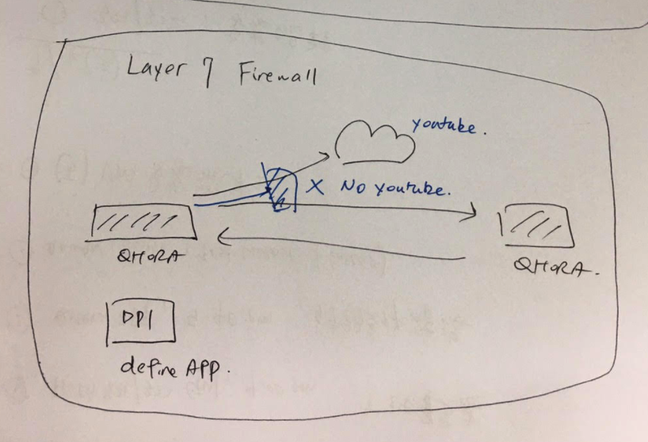


Intelligent QoS and L7 Firewall
Through the settings of different Service Classes, a certain percentage of the network bandwidth is reserved for important applications to keep important meetings online. For example: Streaming / VoIP
Create L7 firewall based on distinguishing application characteristics
​
QoS
QＨora-301W
50% VoIP
30% ERP
20% File transfer
QＨora-301W
QＨora-301W
** QoS and L7 Firewall will be supported on 2021/Q1

Slide 51
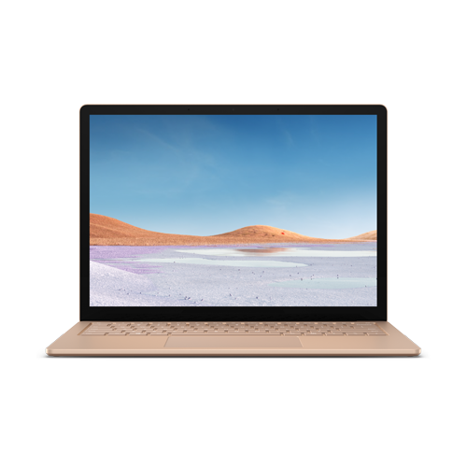

Connect Multiple Devices to SD-WAN Network with QVPN
QVPN is QNAP's VPN solution with a pair of server and client. Multiple devices such as PC, mobile phone and tablet can join and access to SD-WAN network for a more secure and reliable data transmission.
QVPN
QVPN Client
QVPN
QHora-301W
QHora-301W
QVPN
QVPN Client
QVPN Client

Slide 52
Enable QuWAN to manage QHora-301W through the cloud platform
QuWAN Orchestrator
Go to quwan.qnap.com and log in with QID to view the QHora-301W device, network and VPN connection status, organization-wise topology, connection method. You can also perform remote debugging through the cloud platform
Orchestrator
QHora-301W
QHora-301W
QHora-301W

Slide 53


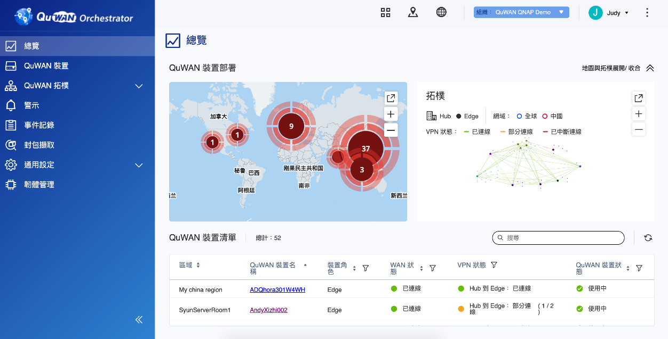
A centrally managed platform solves the management issues of multiple devices
01
Instant Notification
04
Intuitive graphical user interface
Simultaneously execute various parameter settings
IT Admin
02
Geological location of each device
05
Set once and apply to all. Save time to set device one by one.
03
06
Overview connection status of all devices
Remote troubleshooting (e.g. packet capture)

Slide 54
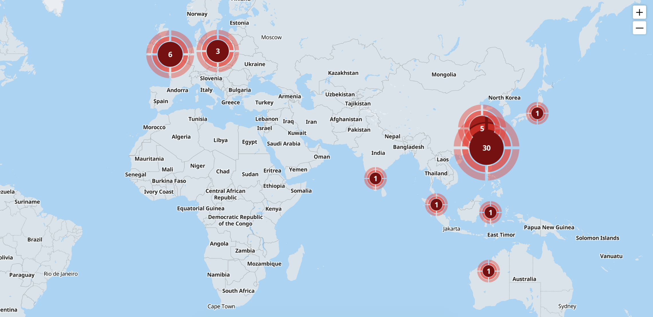
Geological location of each device

Slide 55
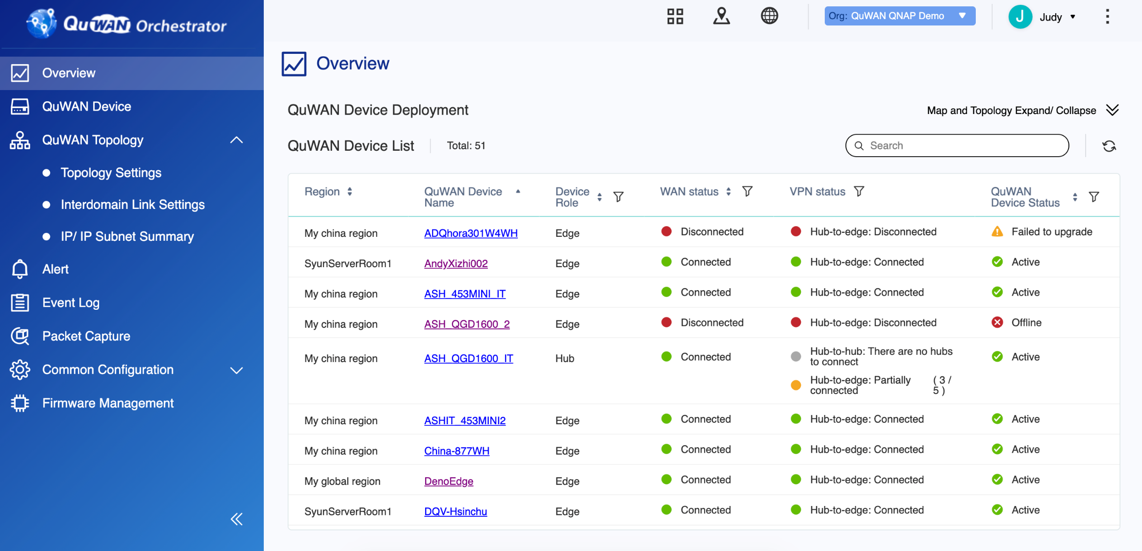
Device and Network Status

Slide 56
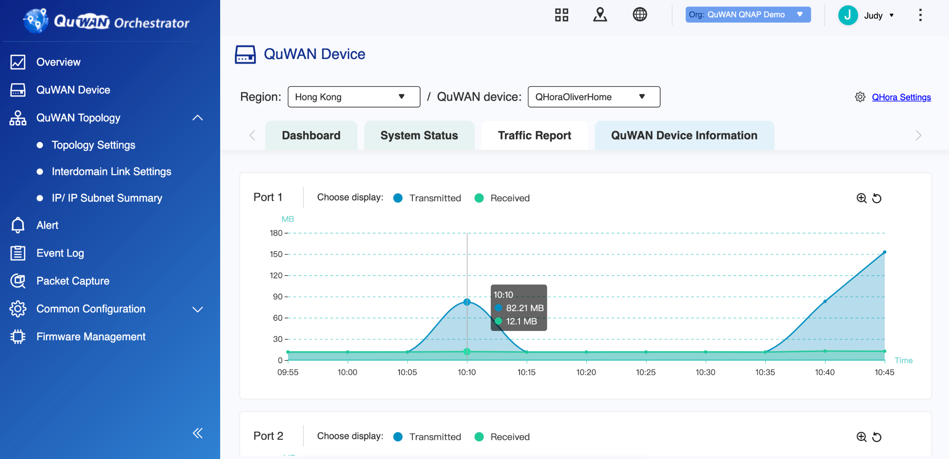
QHora-301W Traffic Report

Slide 57
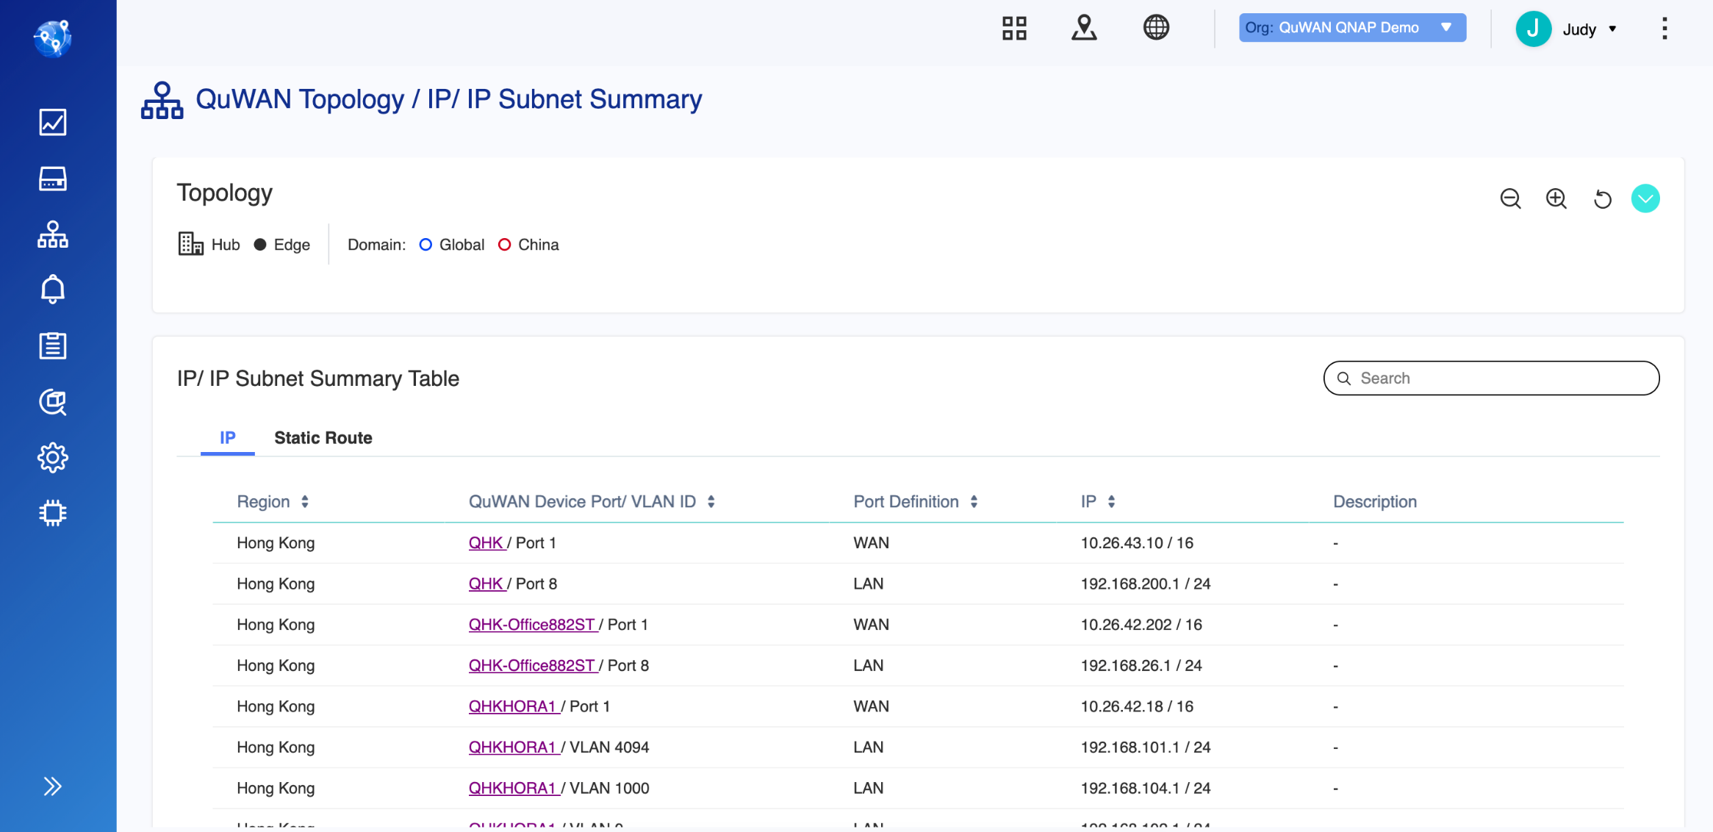
Organizational IP Segment Allocation

Slide 58
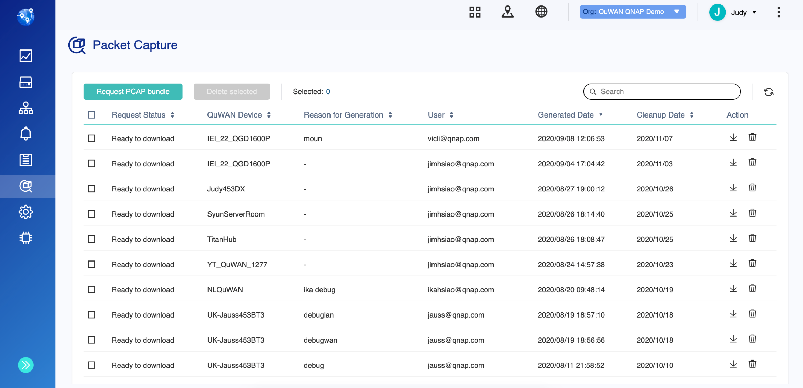
Remote Packet Capture Tool

Slide 59


QuWAN Network Topology
Organization
Domain
Region
One company can be an organization
QuWAN network is divided into two main domain: Global and China
Multiple regions can be created inside a domain.
Organization
Global Domain
China Domain
USA
Japan
Beijin
Chongqing

Slide 60



QuWAN Network Topology
Site
Usually One office or a smaller area within a region is called site.
Device
Each site can have one QuWAN
router enabled.
Organization
Global Domain
China Domain
USA
Japan
Beijing
Chongqing
Site
Site
Site
Site
Site
Site
Device
Device
Device
Device
Device
Device
Site
Site
Site
Site
Site
Site
Device
Device
Device
Device
Device
Device

Slide 61
QuWAN Network Topology
Hub & Edge
All Hubs under the same domain automatically form Mesh VPN connections.
Public IP is required for a device to be Hub.
First device deployed in a region needs to be a Hub. This Hub will serve as the primary Hub.
Hub
Organization
Global Domain
China Domain
Beijing
Chongqing
USA
Japan
Site
Site
Site
Site
Site
Site
Hub
Hub
Hub
Hub
Site
Site
Mesh
Site
Site
Mesh
Site
Site
Hub
Hub
Hub
Hub

Slide 62
QuWAN Network Topology
Hub & Edge
A device can connect to QuWAN network as an Edge using private IP.
An Edge needs to connect to a Hub under Hub & Spoke network structure.
Edge automatically connects to the primary Hub.
All data will be transferred through Hub.
Edge
Organization
Global Domain
China Domain
USA
Japan
Beijin
Chongqing
Site
Site
Site
Site
Site
Site
Edge
Hub
Hub
Hub
Hub
Edge
Site
Mesh
Mesh
Site
Site
Site
Site
Site
Edge
Hub
Hub
Hub
Hub
Edge
Hub & Spoke
Hub & Spoke

Slide 63
QuWAN Network Topology
Inter-Domain Link
To comply to China network regulation, user needs to apply for Inter-Domain Link by his or herself for the two domain to have VPN connection.
Inter-domain Link can only be set on hub.
Organization
Global Domain
China Domain
USA
Japan
Beijin
Chongqing
Site
Site
Site
MPLS
Site
Site
Site
Edge
Hub
Hub
Hub
Hub
Edge
Site
Mesh
Mesh
Site
Site
Site
Site
Site
Edge
Hub
Hub
Hub
Hub
Edge
Hub & Spoke
Hub & Spoke
Notes:
Inter domain link 拉開明顯一點

Slide 64
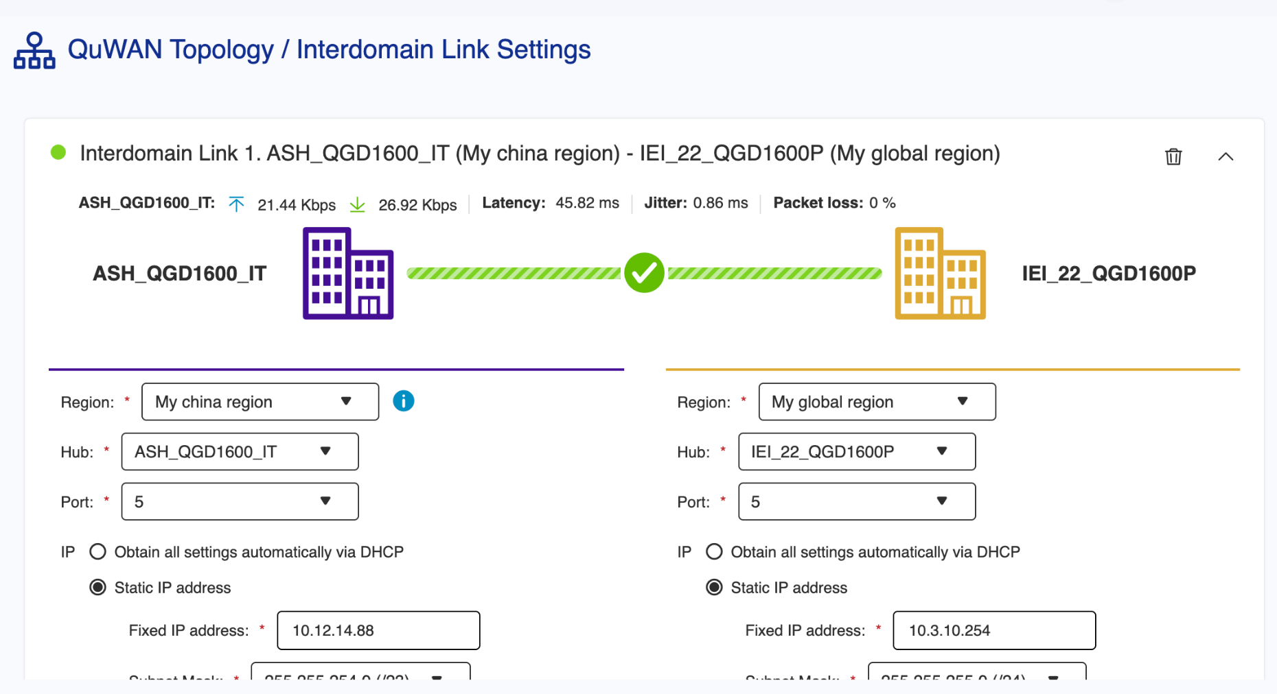
QuWAN Inter-Domain Link
QuWAN 專線設定
Set the applied MPLS to QuWAN Inter-Domain Link to establish a cross china and global domain private network between the two QuWAN Hubs
** Inter-Domain Link is supported on 2021/Q1

Slide 65
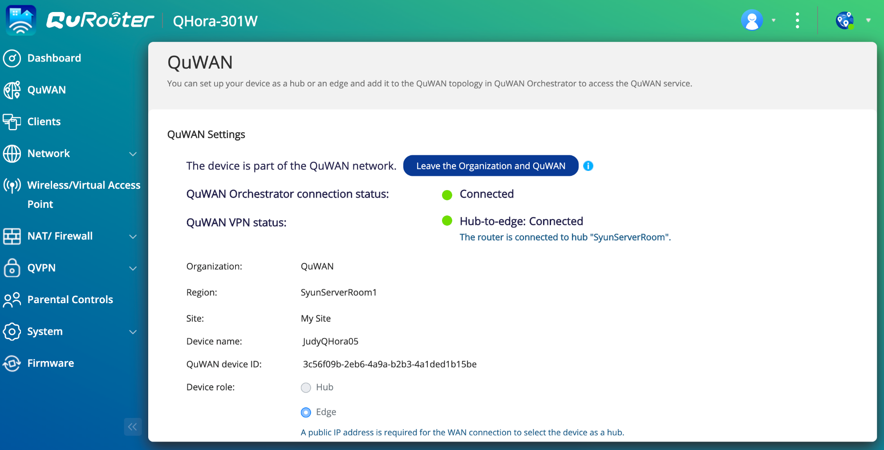
Enable QuWAN on QHora-301W
Just select the organization, region and connection role, and your QHora-301W can build VPN tunnel with other QuWAN devices within the same organization
***If your QHora-301W is a LAN device of another router, make sure to allow destination UDP Port 500, 4500, 5555, 7788

Slide 66
Demo:
Enable QuWAN on QHora-301W

