Slide 2
Agenda
Guardian 3rd Gen Smart Edge Switch
Beyond traditional IP Surveillance solutions
Guardian x QVR Pro solution
QNAP QGD-3014-16PT key functions
QNAP QGD-3014-16PT use cases

Slide 3
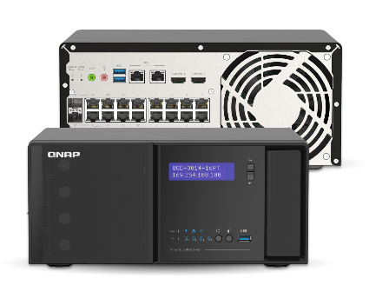
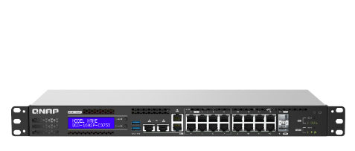
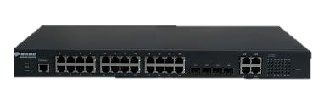
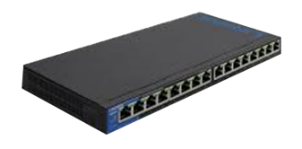
PoE Power Sourcing Equipment product evolution
3rd Generation
Guardian Smart edge PoE switch
QGD-3014-16PT
Intel Celeron® J4125
Built-in 8GB DRAM
Equipped with QTS OS
Secure IP Surveillance
Hybrid cloud storage
IEEE 802.3at/af
SD-WAN (QuWAN)
QGD-1602P
10GbE SFP+
Intel Atom® C3558/C3758
Intel QAT
Virtual machine with QTS
Hybrid cloud storage
IEEE 802.3bt Ready
SD-WAN (QuWAN)
2nd Gen
L2/ L3 Managed PoE Switch
1st Gen
Unmanaged PoE switch
QGD-1600P
Intel Celeron® J4125
Equipped with QTS
Virtual machine
Hybrid cloud storage
IEEE 802.3bt

Slide 4
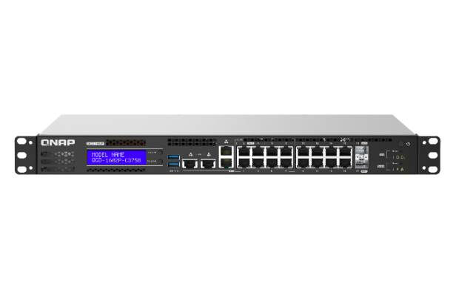
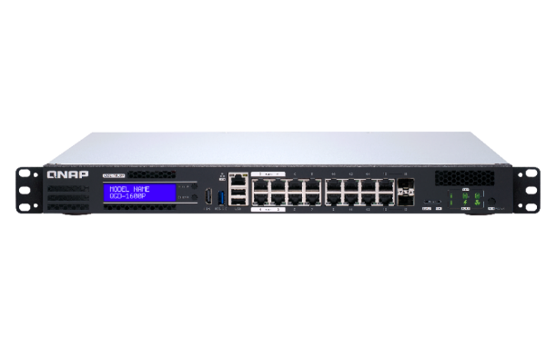
QGD-3014-16PT vs QGD-1602P / QGD-1600P
QGD-3014-16PT
QGD-1602P
QGD-1600P
Surveillance PoE switch
Intel® Celeron® J4125 4 cores
2.0 GHz processor
Intel® Atom® C3558/C3758 4/8 cores
2.2 GHz Processor
Intel® Celeron® J4125 4 cores
1.8 GHz Processor
14 x 1GbE RJ45 ports
2 x 1GbE RJ45/SFP Combo ports
8 x 1G/2.5GbE RJ45 ports
8 x 1GbE RJ45 ports
2 x 10GbE SFP+ ports
14 x 1GbE RJ45 ports
2 x 1GbE RJ45/SFP Combo ports
2 x 2.5G host ports
2 x 1G/2.5G/5GbE Host ports
2 x 1GbE Host ports
1 x 1GbE Host ports
16 x 802.3at PoE port (max 30W)
PoE budget: 140W
4 x 802.3bt PoE ports (Max 90W)
12 x 802.3af/at PoE ports
Power budget: 370W
4 x 802.3bt PoE ports (Max 60W)
12 x 802.3af/at PoE ports
Power budget: 360W
4 x 3.5 inch HDD bay
2 x M.2 SATA SSD
20GbE Internal bandwidth capability
2GbE Internal bandwidth capability
Built-in 8GB memory
Max 64GB memory
Max 8GB memory

Slide 5
Feedback of QGD IP Surveillance
Our store outlook is stylish, could you provide a solution with stylish-outlook ?
QGD form factor is Rackmount, do you have Desktop model?
Can QGD expands more HDD capacity like NAS? Since we don’t have budget to install additional NAS.

Slide 6
Guardian QGD-3014-16PT Innovative network surveillance solution

Slide 7
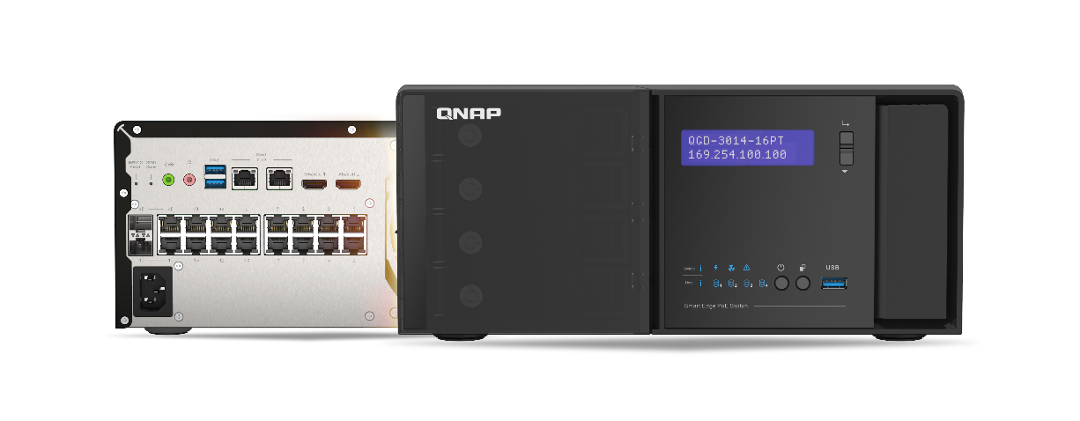
Beyond the traditional NVR solution
Network Surveillance
Network & Security
Cloud Management
Up to 5,000+ IP camera supports.
Full professional functions for surveillance.
Smart search and backup.
PoE+ Switch.
Advanced firewall protection.
Wi-Fi management.
Multiple-sites cloud management.
Encrypted authentication.
Strong encryption in backup.

Slide 8
Traditional IP Surveillance
Traditional NVR
Poor network design
No security awareness
Vendor lock-in of camera functions support.
No GPU acceleration.
Poor performance in Video-wall display.
Traditional storage architecture.
Can’t manage network, PoE and surveillance system in one place.
Not easy for multiple sites management and backup.
Multiple equipment maintenance.
Vulnerable from external access.
Remote management via by sniffer-able protocol.
Use FTP for multiple site backup.

Slide 9
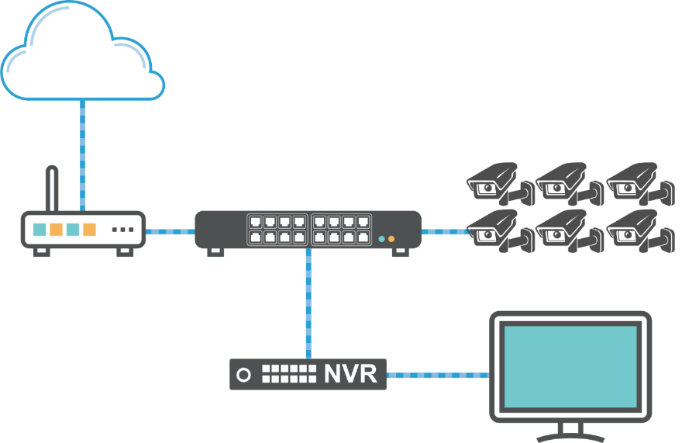
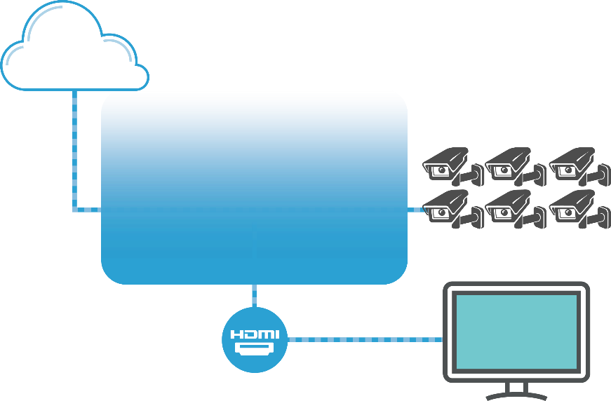
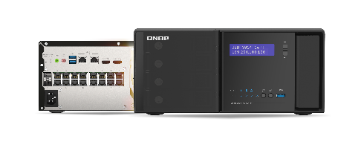
QGD-3014-16PT New IP surveillance solution
Traditional NVR architecture
Guardian architecture
Internet
Internet
Managed
Switch
IP Camera
Router
QVR Pro
PoE
IP Camera
Router
Guardian Smart PoE Switch
Monitor
Monitor
Cost up for multiple equipment.
Sophisticated layout which need maintenances.
Poor capability for future expansion.
NVR, Router, Switch, PoE all in One.
IEEE 802.3at PoE support plenty of IP camera.
Flexible design for expansion.
Notes:
https://www.unifore.net/ip-video-surveillance/network-video-surveillance-visio-icon-library-free-download.html

Slide 10
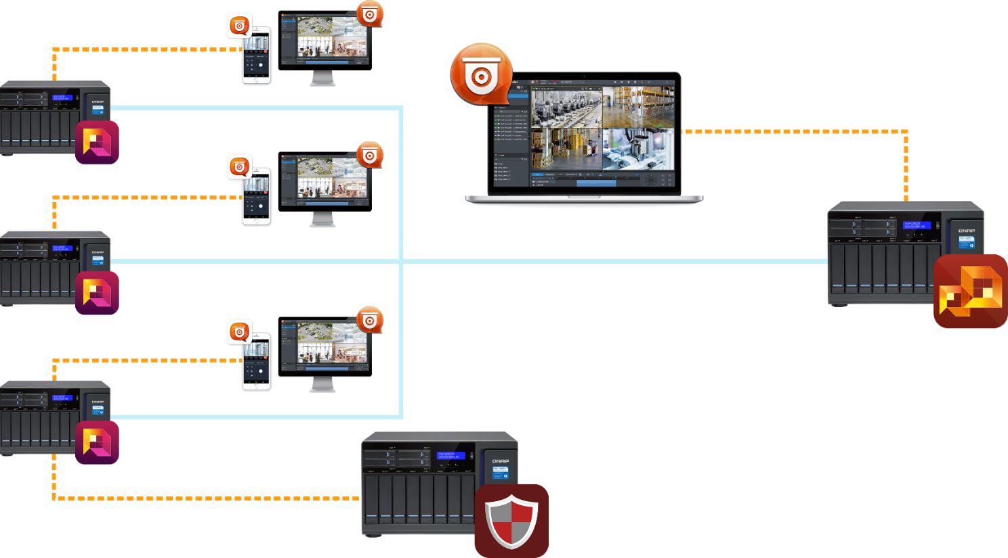
Corporations with multi-sites surveilance Guardian + QVR Pro total solutions
QVR Pro
QVR Pro Client
QVR Pro Client
QVR Center
Guardian QGD-3014-16PT
QVR Pro Client - Center
QVR Pro Client
Guardian QGD-3014-16PT
QVR Pro Client
QVR Center
Guardian QGD-3014-16PT
QVR Guard
QVR Guard
Notes:
►QVR Pro is the latest surveillance application. ►QVR Center is the central manage system of QVR Pro. ►QVR Guard is the failover application for protecting QVR Pro. ►QVR Pro Client is a cross-platform utility, it could let user see live, playback stream. 1.QVR Pro Client could connect to single QVR Pro separately. 2.QVR Pro Center could manage max 128 QVR Pro. 3.QVR Pro Client could connect to QVR Center to see all camera of managed QVR Pro 4.Each QVR Pro could be protected by QVR Guard.

Slide 11
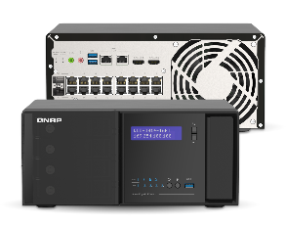
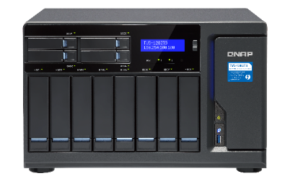
Multi-site surveillance Reliable, secure and encrypted data by SDWAN
A
C
QVR Pro
Internet
+
Intranet
QVR Pro
QGD-3014-16PT
QGD-3014-16PT
B
D
QVR Pro
QVR Pro
QGD-3014-16PT
QGD-3014-16PT
QVR Center

Slide 12
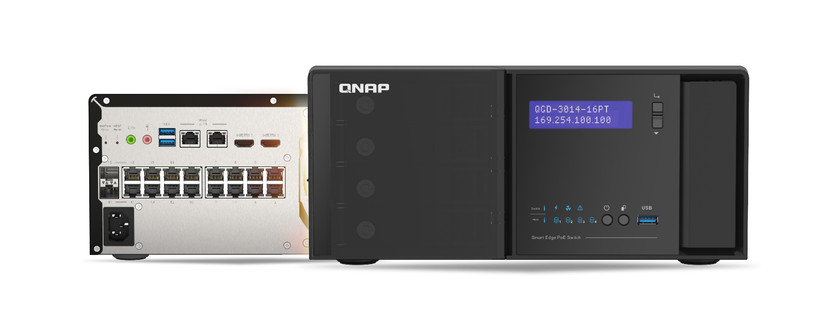
QGD-3014-16PT
Built-in 4 bay 3.5” HDD/SSD slot for more storages.
Desktop design for small / branch offices.
Stylish design fitting in for modern workplaces.
Notes:
https://www.qnap.com/solution/hbs3/zh-tw/

Slide 13
QSW-3014-16PT Hardware

Slide 14
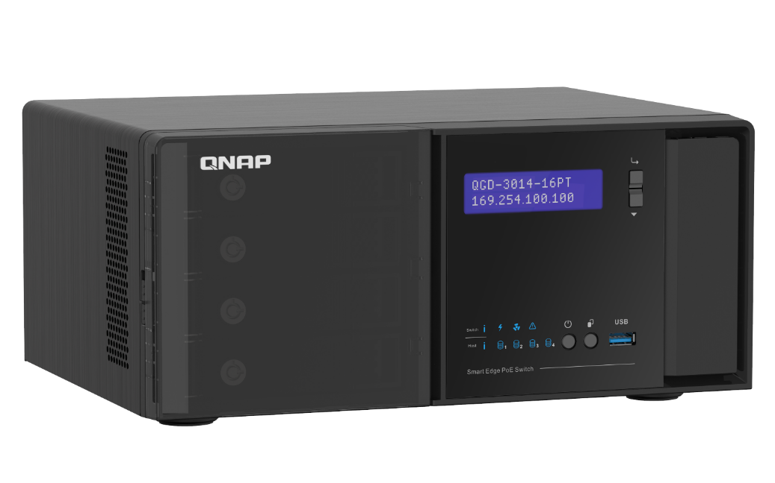
Stylish design
hairline-textured design
Toolless front panel
Desktop
Tower
Large display

Slide 15
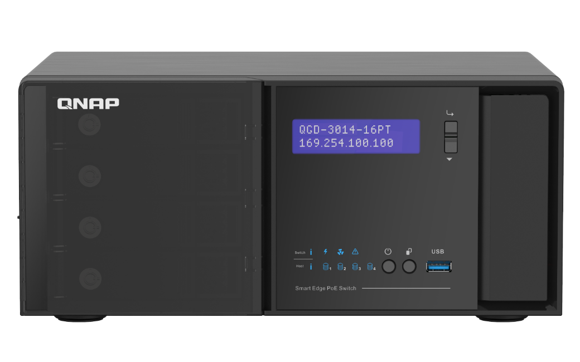
Intuitive LED indicators
System status
HDD status

Slide 16
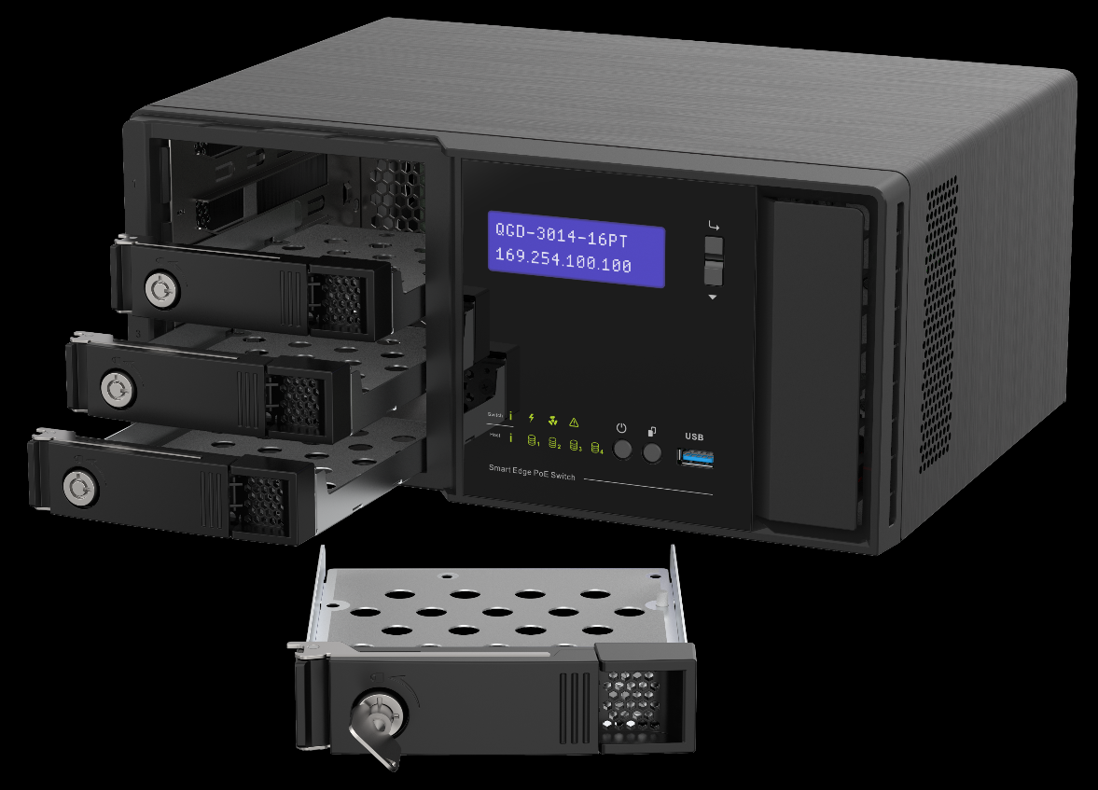
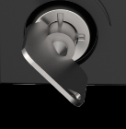
Metal 3.5/2.5” HDD tray with key
Key for locking HDD trays in place
Quicker HDD cooling with metal tray

Slide 17
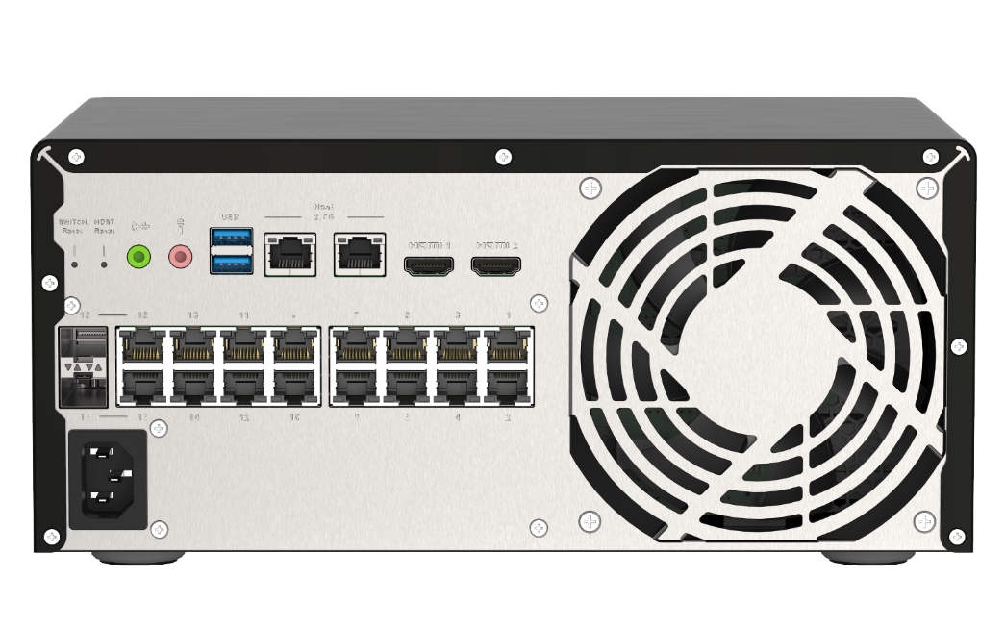
I/O and network switch ports (rear)
3.5mm audio I/O
Mic Input
USB 3.2 Gen 1
2.5GbE Host ports
HDMI 2.0
System Reset
Switch Reset
16 x PoE+ ports
SFP (/RJ45)
combo port
Power socket

Slide 18
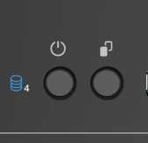
QGD-3014-16PT Hardware
Intel J4125 Quad-core
8GB RAM
Power Supply Total: 250W
CPU
RAM
System Power
Max: 90W
PoE Power Max:
140W
2 x M.2 SATA
2 x Internal
LAN GbE
4 x 3.5" HDD
Host power controller
System power controller
HDMI 2.0
USB 3.2 Gen 2
Host 2.5GbE
x 2
x 3
x 2
Switch
2 x GbE
Microchip VSC7425
PoE
Controller
16-port GbE RJ45 with 2port SFP combo
Power button

Slide 19
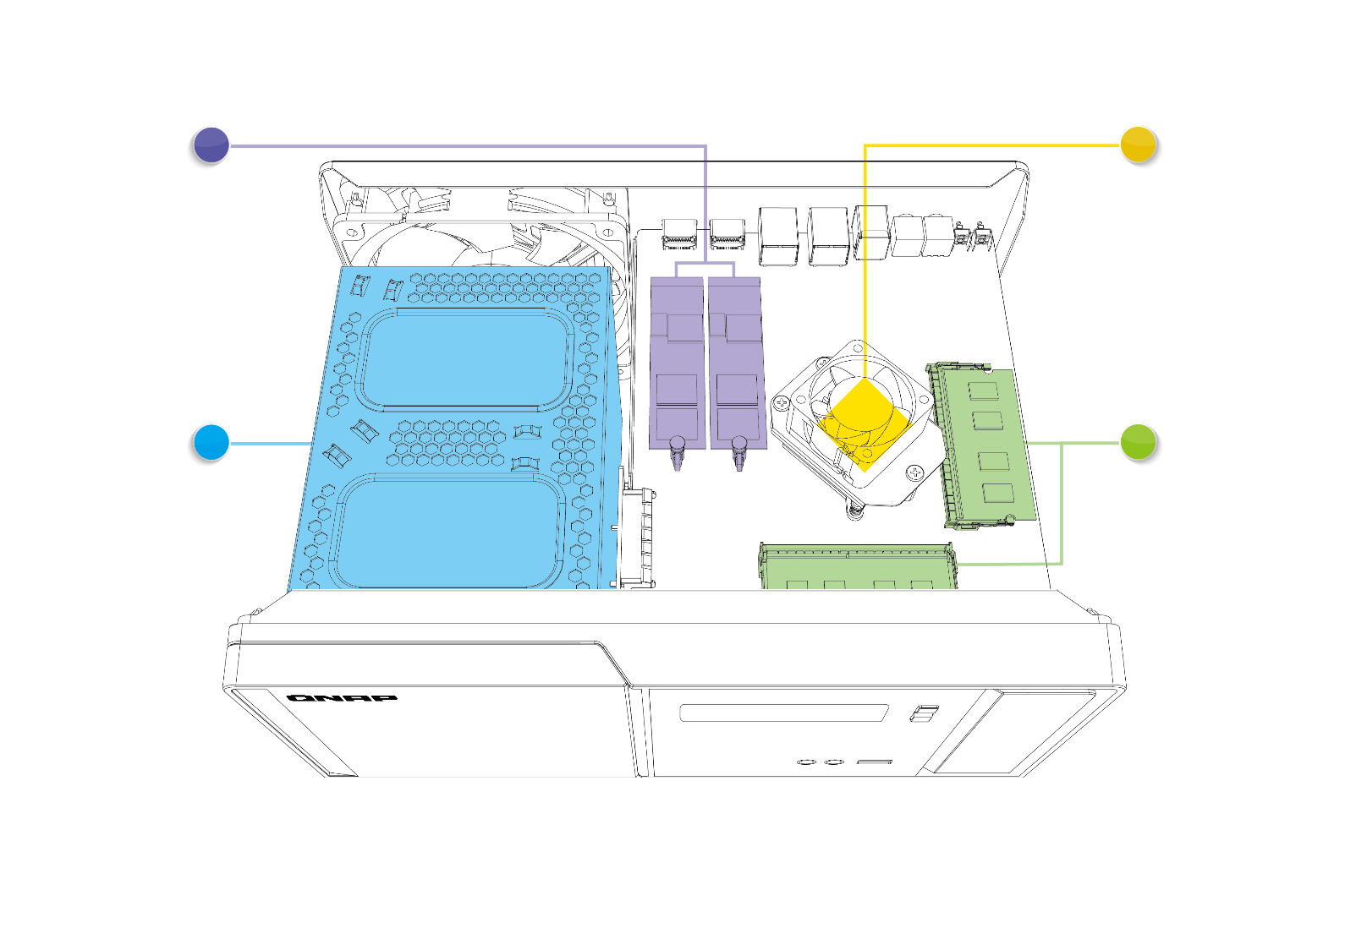
QGD-3014-16PT Inside
2 X M.2 SATA slots
Intel® Celeron ® Processor
Support M.2 SATA 2230 SSD for critical event recording.
Intel® Celeron® J4125 4 cores 2.0 GHz Processor.
4 X 3.5”/2.5" SATA 6Gb/s HDD/SSD slots
DDR4 DRAM
Support 2 x DDR4 SO-DIMM slots，Built-in 8GB (2 x 4GB dual channel).
Built-in 4 x 3.5" SATA HDD tray for surveillance recording.

Slide 20
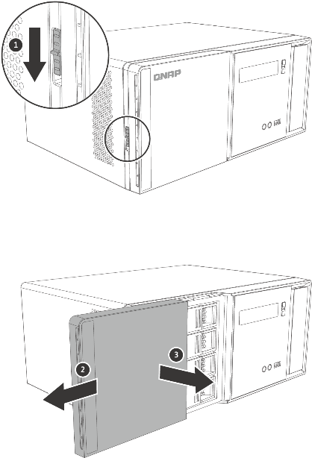
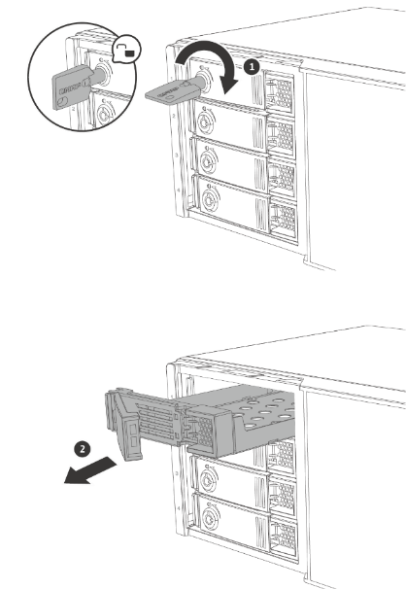
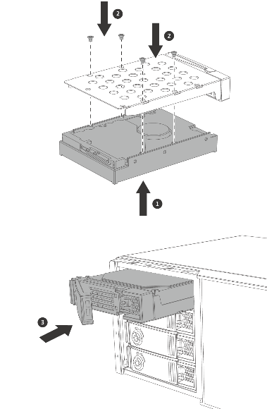
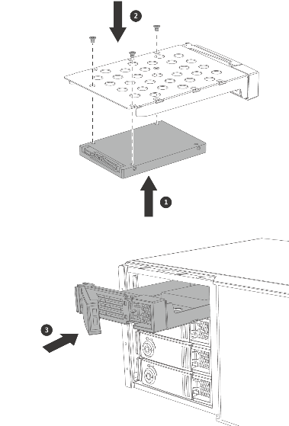
3.5” / 2.5” HDD installation
Step 1
Step 2
Step 3
Open the front panel.
Key to unlock and pull out
the tray.
Secure the four screws in the back of the hard drive tray.

Slide 21
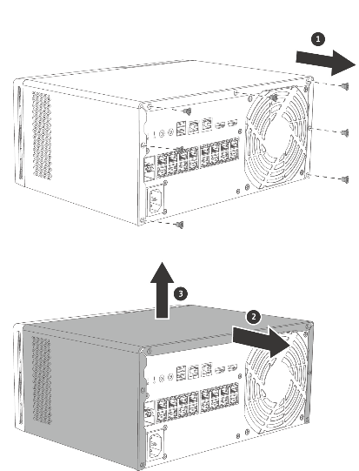
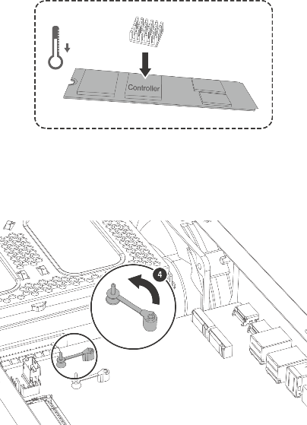
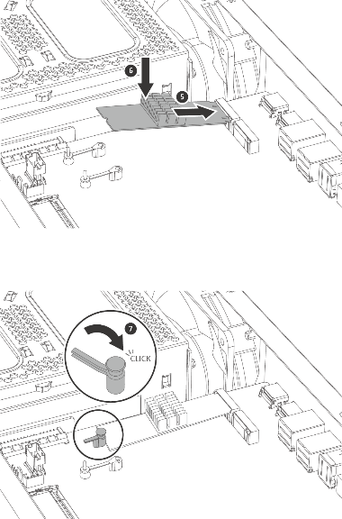
M.2 SATA SSD installation
Step 1
Step 2
Step 3
Remove the screws that secure the case cover to the chassis.
M.2 SSD with heatsink,
and unlock the screw.
Insert M.2 SSD and lock SSD.
Slide the cover to the right to detach it from the chassis.

Slide 22
Open surveillance platform QVR Pro

Slide 23
QNAP QVR Pro highlight
QVR Pro
Dewarp (fisheye)
Dedicated storage space
Easily Failover
Motion Detection
(Modeling Based)
QVR Pro
Client
Dynamic view
Status Monitoring
Up to 256 x QVR Pro
Central management
QVR Guard
Videowall
Up to 128CH recording
Multiple Notification Methods
Distributed storage Central manipulation
QVR Center
Advanced backup
Notes:
https://www.unifore.net/ip-video-surveillance/network-video-surveillance-visio-icon-library-free-download.html

Slide 24
QVR Pro – an open platform
Open platform support makes the upgrade / expansion flexible.
Support over 140 vendor and 5,000 also ONVIF based cameras.
Support over 100 storage disk, including 3.5” / 2.5” HDD/SSD, and M.2 SATA SSD.
QVR Pro

Slide 25
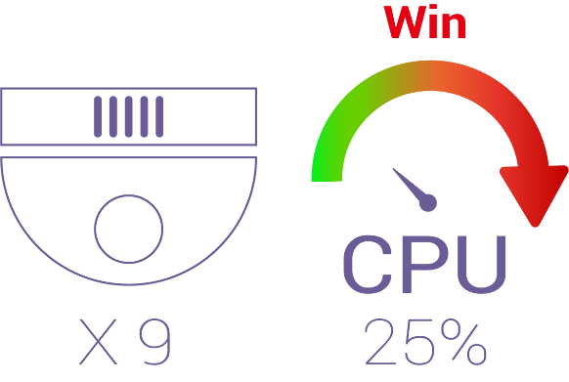
GPU acceleration benefit
Accelerate the multi-area/camera display
QVR Pro Client
Much lower cost without installing multiple computers for operators
Keep tasks smoothly running on CPU
Applicable to
Video Wall monitoring
Dewarp acceleration
High resolution playback
Notes:
建議：Nvidia 1060 above (TBC)

Slide 26
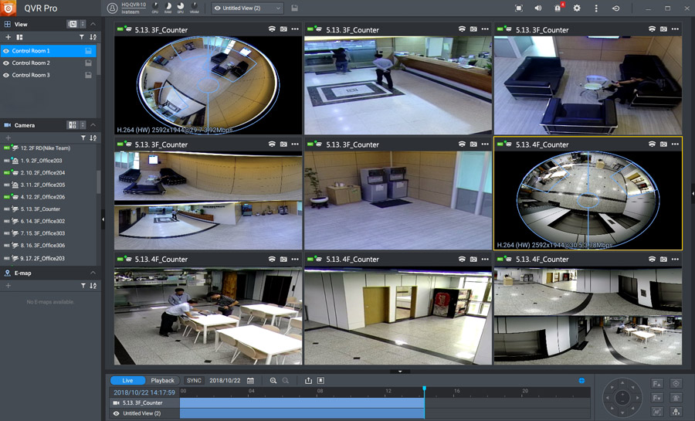
QVR Pro Qdewarp – Fisheye dewarp
One fisheye camera to monitor whole area
Dewarp up to 9 x focused area

Slide 27
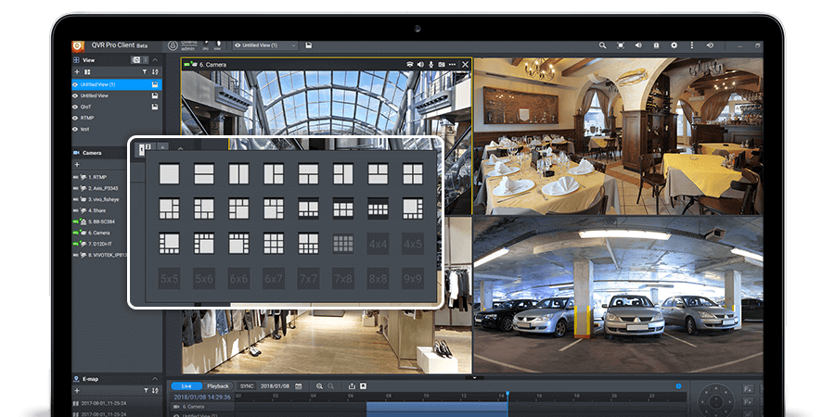
Dynamic Layout
Highly-customizable display panel with Templates.
Great for surveillance management of multiple locations.

Slide 28
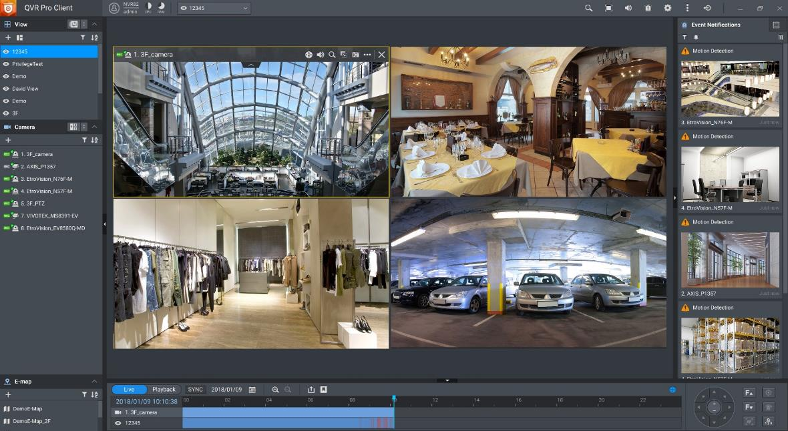
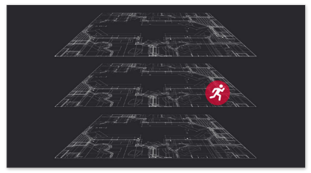
Multiple Notification Methods
Event notification provides multiple ways of being informed of emerging events
Flashing red borders of channels.
Alert buzzers.
Motion icon on the e-map.

Slide 29
Flexible Backup Hybrid Backup Sync (HBS) 3

Slide 30
4 bay HDD/SDD for multi-site backup
With 4-bay HDD, administrator can be flexible to rearrange storage for expansion.
With HBS3, data and surveillance data could be backup cross multiple sites.
HBS 3
HBS 3
HBS 3

Slide 31
Reduce the risk
Backup is a must for surveillance data.
Resume the surveillance task or events from backup server.
Encrypted and much reliable transfer.
HBS 3
HBS 3

Slide 32
Resilient & secure multi-site connections QuWAN

Slide 33
QuWAN constructs Intranet securely
QGD-3014-16PT support QNAP SDWAN solution (QuWAN).
QuWAN is a secure and zero-touch solution to constructing multi-sites intranet.
Office A
US
Office B
Japan
Office C
Germany

Slide 34
Great for multi-site surveillance
With QuWAN enabled
Surveillance – recording backup easier.
Backup with strong encryption.
QHora SD-WAN router
Server

Slide 35
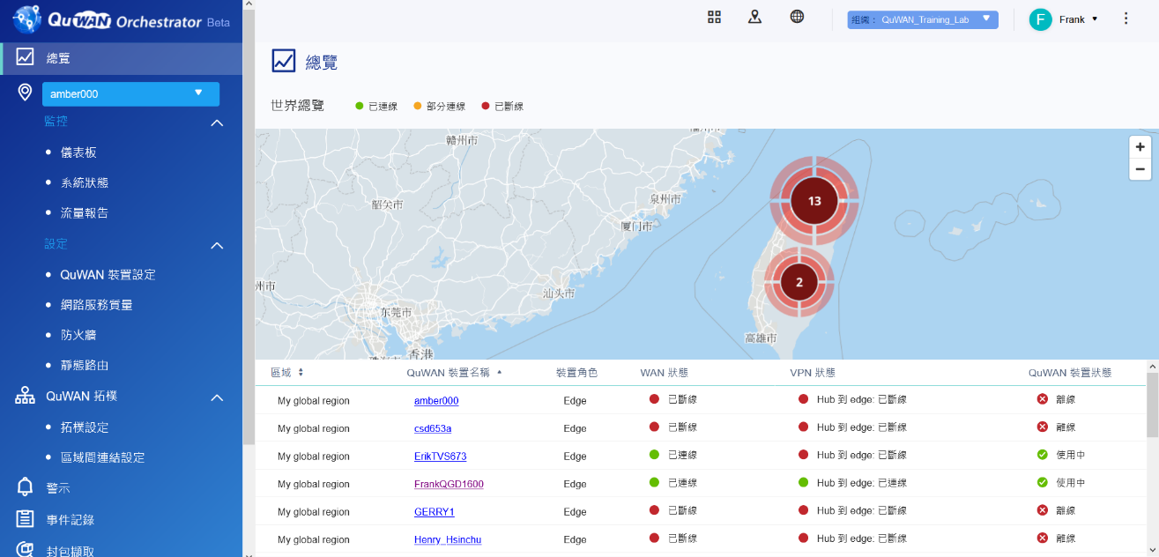
Cloud management of QuWAN
QuWAN Orchestrator (cloud management):
Monitor bandwidth, routing, etc. status of QGD-3014-16PT deployed in multiple sites.

Slide 36
Smart Switch & PoE management QuNetSwitch

Slide 37
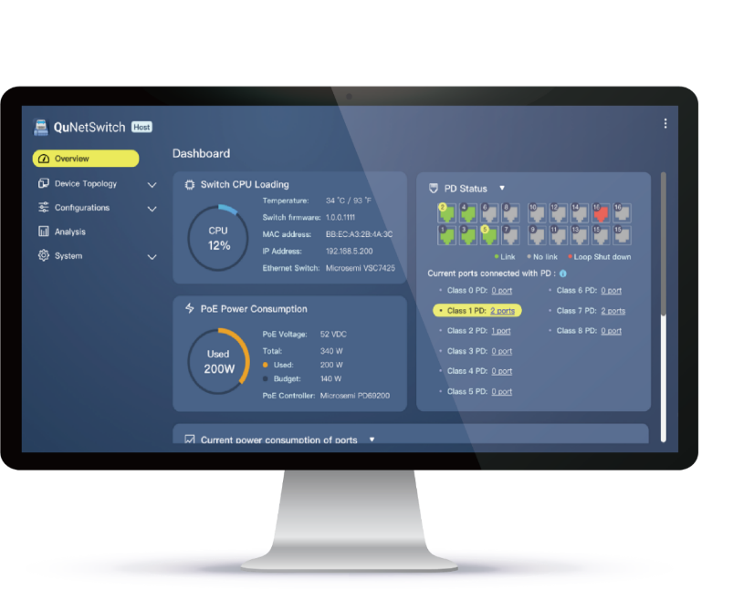
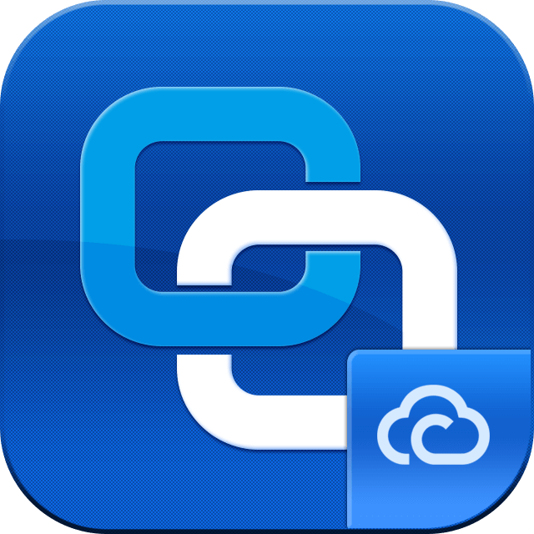
Remote management
Administrator could log on the management portal (myQNAPCloud) or Sign in
with smart link from anywhere.
All device status (heath status, etc.).

Slide 38
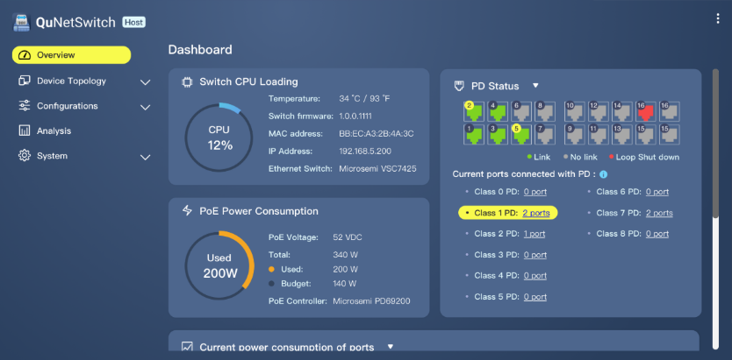
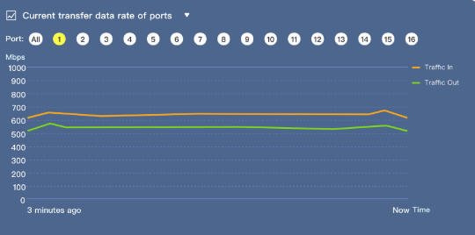
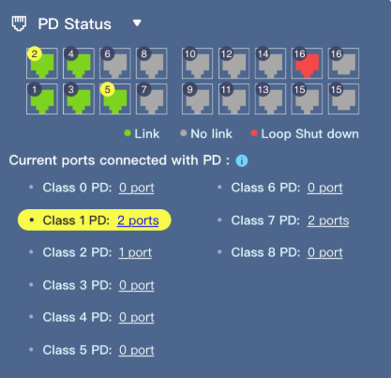
QuNetSwitch Intuitive graphical management interface
Intuitive and friendly web management interface that allows users to easily perform device monitoring, PoE and networking configuration, firmware updates, and advanced network management functions.
Visualization of all networking and PoE power status data

Slide 39
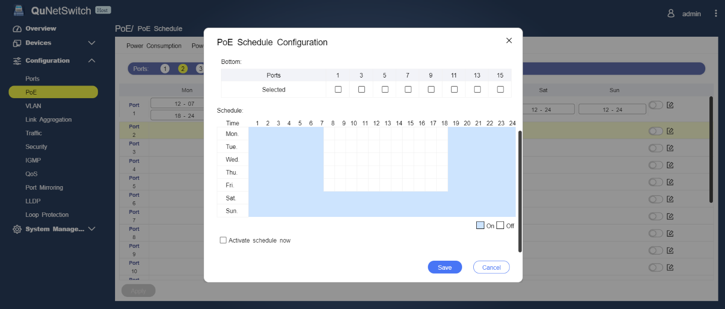
PoE schedule
PoE ports with calendar-like interface, granularly management with weekdays versus time for PoE device.

Slide 40
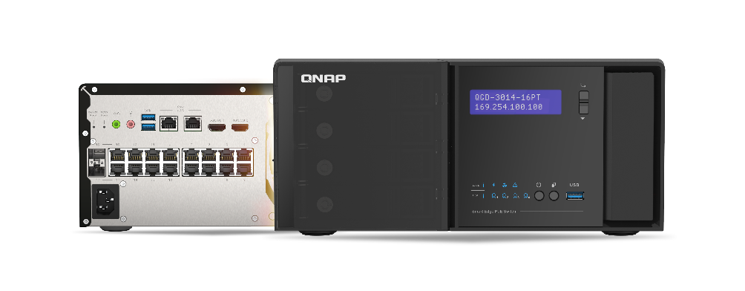
Guardian Smart PoE Network switch PoE features
Support IEEE 802.3at
PoE
Remote wake up of Camera
Scheduled on/off plan for PoE devices
Prioritize power consumption for PoE devices
Total PoE budget
140-watt PoE
Remote monitoring and management

Slide 41
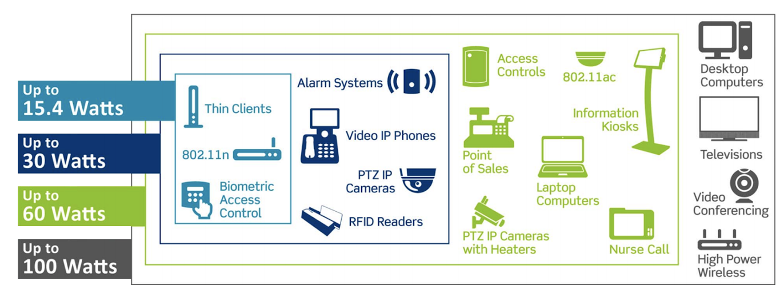
QGD-3014-16PT support 802.3at PoE
16 port PoE port with IEEE 802.3at.
Total PoE budge is up to 140 watt for PoE Powered Devices (PDs).

Slide 42
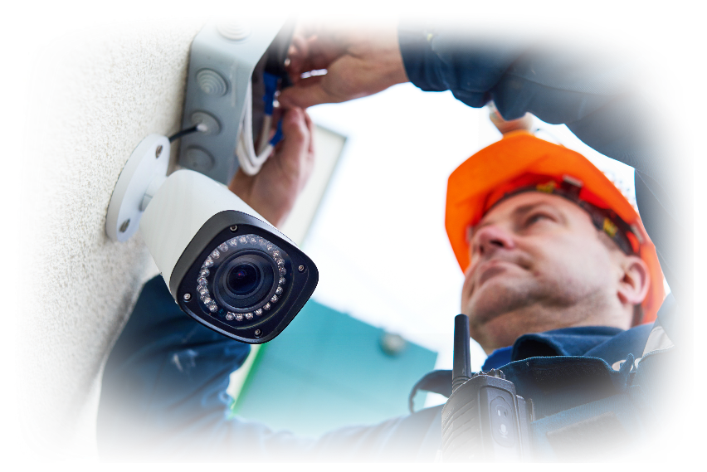
Remote PoE device control
Operator can remotely control the PoE.
e.g. Reboot the abnormal PoE camera or power-on the standby PoE camera remotely.

Slide 43
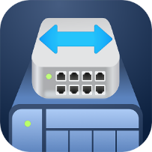
QuNetSwitch smart switch function 1/2
IGMP Snooping
VLAN
Optimizing multicast performance helps in-line media streaming, VoIP and other bandwidth-intensive applications that are sensitive to time delays.
Enhance network security by isolating traffic within the enterprise based on requirements such as administrators, general users, employees, or visitors.
Link Aggregation
QoS
Combine two physical lines to form a high-speed virtual data transmission path, increasing transmission speed and enhancing network connection reliability.
Different network usage priorities can be configured according to the port or VLAN group to ensure the quality of service and optimize network transmission efficiency.

Slide 44
QuNetSwitch smart switch function 2/2
Access-Control List (ACL)
Loop Detection and Protection
Support for access control mechanisms, you can set multiple access rules, specify specific protocols, IP addresses, subnet masks, and port access conditions.
When the network generates a loop, the network that generates the loop will be closed, effectively avoiding network interruption.
Port Mirroring
Jumbo Frame
Allows network administrators to capture data (packets) for specific ports to monitor the network or troubleshoot.
Support Jumbo frame huge packet selection, which helps improve overall data transmission efficiency.

Slide 45
QGD-3014-16PT Virtualization platform

Slide 46
Guardian X pfSense solution
QGD-3014-16PT supports the installation of pfSense firewall software as of virtual machines to effectively block external network intrusion threats.
Office A
US
Office A
Japan

Slide 47
Run virtual machines and containers: multiple applications in a box
Virtualization Station and Container Station lead a full range of hybrid virtual application solutions. For your versatile needs, you can rely on QNAP's complete virtualization application support. Choosing the right deployment strategy for your virtualization needs can be easy!
Virtualization Station
Container Station
Notes:
Virtualization Station 可讓您在 QGD-3014-16PT上運行多個 Windows®、Linux®、UNIX® 及 Android™ 虛擬機 (Virtual Machine)，並透過瀏覽器或 Virtual Network Computing (VNC) 連線管理虛擬機。企業組織可利用 NAS 上的多個虛擬機執行不同的伺服器應用。 Container Station 整合 LXC 與 Docker® 兩項輕量級技術。您可在 Docker Hub® 線上市集下載來自全球各地數以千計的應用程式，輕鬆匯入/匯出軟體容器與設定存取權，享有安裝簡便，可移動、有效率的諸多好處。

Slide 48
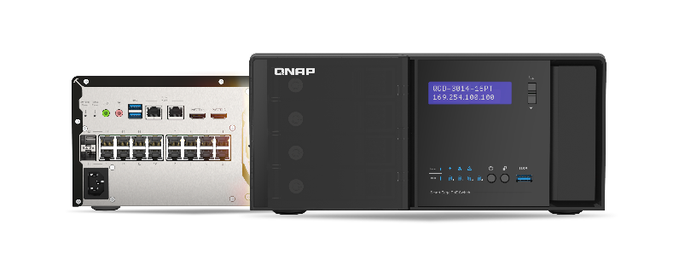
Guardian All-in-one VM solution
Traditional NAS + Switch
Guardian solution
RouterOS
VM
VM
RouterOS
VM
VM
Virtualization Station
Guardian vSwitch Mode VM Installer
Virtual Switch
Virtual Switch
NIC
NIC
WAN
LAN
Internet
LAN Networking Devices
Internet
LAN Networking Devices

Slide 49
QGD-3014-16PT Use cases

Slide 50
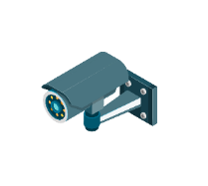
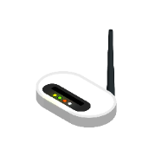
Guardian solution for SMB and workstation
PoE
Surveillance
Power multiple cameras and integrating QVR Pro solution
Wi-Fi PoE AP
PoE powered with installation of AP Controller software
Network device
IP Printer, VoIP Phone with network access management
Firewall
Protect internal network via firewall without making any IP address changes on other devices.
Remote Wake-up / Restart
Remotely restart devices while in abnormal operation or wake up the device.

Slide 51
Guardian solution for SMB and workstation
With HBS 3, backup important data between multiple QGD-3014-16PT.
Recover the data from backup server.
A
B
HBS 3

Slide 52
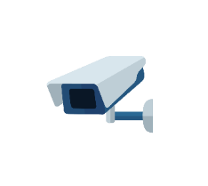
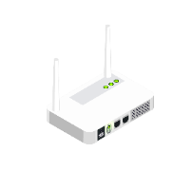
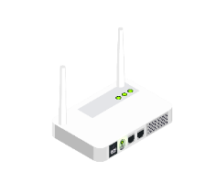
Guardian solution for Restaurant / Retail Store
PoE
Surveillance
Power Camera and management
Electronic menu
Provide power and networking capabilities
PoE
POS
Consumption behavior analysis and data storage
Wi-Fi Access
Power Wi-Fi AP with installation of AP controller
Digital Signage
Provide power and content management
Data/Surveillance storage/backup
Save customer data, work documents, letter materials

Slide 53
Guardian solution for Restaurant / Retail Store
D
QuWAN connects all branch as Intranet.
All linked storage server can be playing the backup role.
Cloud managed.
C
B
HQ
A

Slide 54
© 2020 Copyright is owned by QNAP Technology Co., Ltd. QNAP Technology reserves all rights. A trademark or mark used or registered by QNAP Technology Co., Ltd. The products and company names mentioned in the file may be trademarks owned by other companies.

