Slide 1
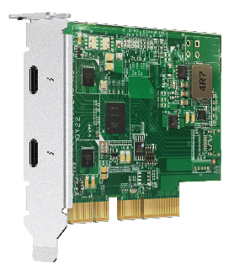
6-core Intel Xeon W-1250 10GbE NAS for businesses, professionals, and creators

Slide 2
Enterprise-grade OS
QuTS hero with ZFS file system
SSD optimization
Inline deduplication
Inline compression
65,536 snapshots

Slide 3

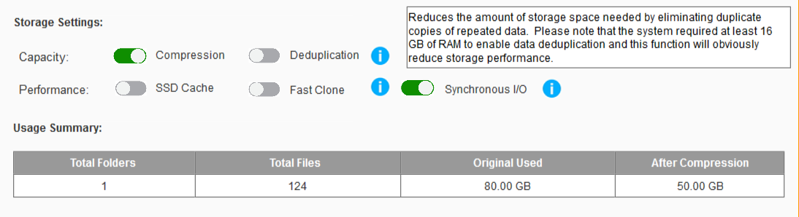

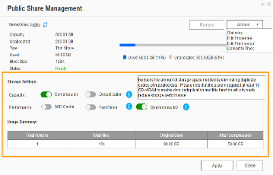
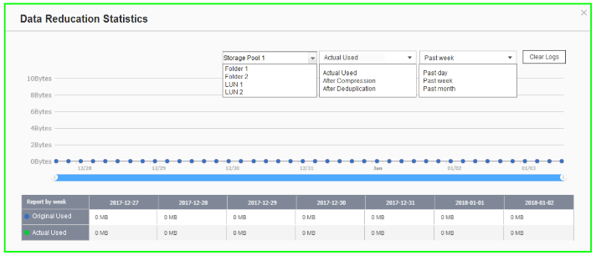


Powerful data reduction: Extend the SSD endurance
Only effective for inline data reduction
ZFS file system with inline deduplication & inline compression features.
The ZFS file system can be the best choice to pair with the all-flash and SSD storage because it reduces the data size and pattern that need to be written to the SSD directly.
Write
A
B
C
D
A
B
C
D
A
B
C
D
D
C
A
B
D
C
A
B
Original Data
Compressed Data
Deduplicated Data
SSD Pool
Compression
Deduplication
Write to SSDs as sequential as much as possible.

Slide 4





Amazing massive storage -
The best data carrier of big data analysis/edge computing/AI inference
Only PB-level shared folder is enough to store the huge data matrix .
200TB
Is not enough
Data
Model building
Model validation
Parameter adjustment
Deep Learning

Slide 5


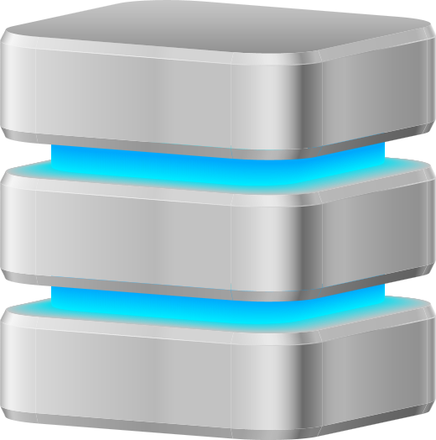
Silent data corruption & self-healing
Application
Application
Application
ZFS RAID
ZFS RAID
ZFS RAID
Avoid data loss that occurred on the running system

Slide 6




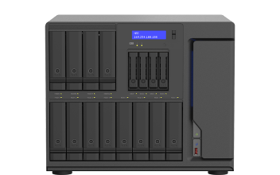
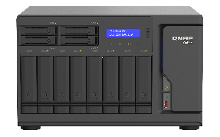
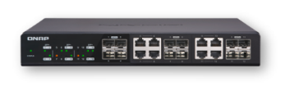
Three-layer backup solution :
Provide you with the most complete data backup protection
HBS 3:
File level, multi-version management
RPO : daily / schedule
Snapshot & Replica:
Block level, multi-version management; ZFS provides the most lightweight snapshot without affecting storage performance at all.
RPO : hourly
SnapSync:
Block level, Mirror the data copy and always kept up to date.
RPO : Realtime

Slide 7





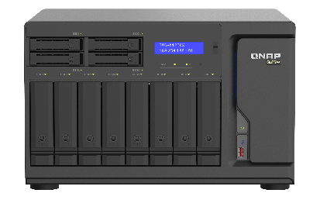
SnapSync
The most cost-effective backup, data protection and disaster recovery solution
Schedule SnapSync: 5min~60min
Realtime SnapSync: RPO=0
Production Server
Normal
Normal
Disaster Recovery (RPO=0)
By schedule
Snapshot send
Real-time Snapshot
Primary NAS
Secondary NAS
Primary NAS
Secondary NAS
(Round Trip Latency < 5ms)

Slide 8
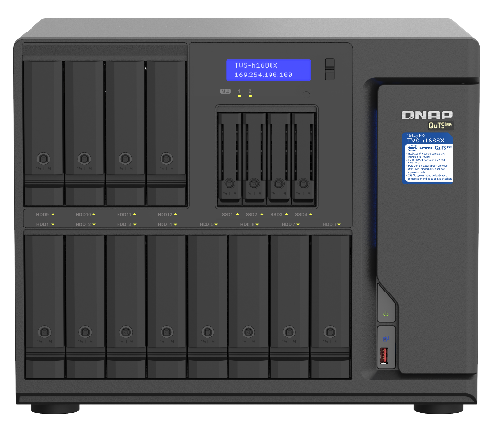
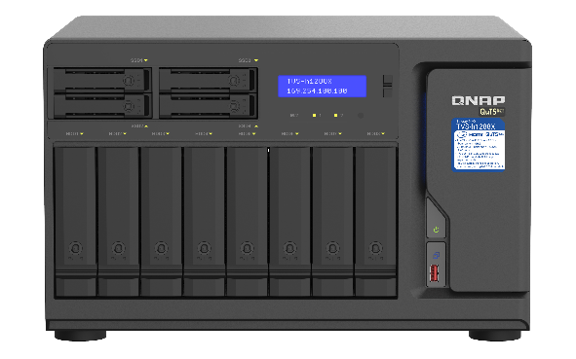
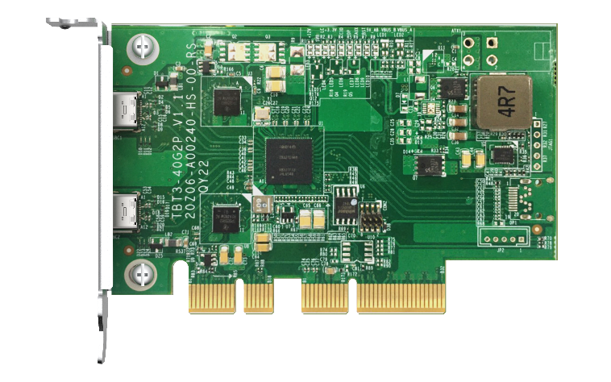
Optimize business efficiency with Xeon W hexa-core flagship NAS，optional Thunderbolt 3 for video editing
Upgrade to Thunderbolt 3 NAS
TVS-h1688X-W1250-32G
12 x 3.5” + 4 x 2.5”, SATA 6Gb/s
Intel Xeon W-1250 6 cores /12 threads 3.3 GHz CPU, boost up to 4.7 GHz
32GB DDR4 ECC RAM (2 x 16GB)
2 x M.2 NVMe PCIe Gen3 x4 SSD slots
2 x 10GBASE-T ports
4 x 2.5GbE ports
TVS-h1288X-W1250-16G
8 x 3.5” + 4 x 2.5”, SATA 6Gb/s
Intel Xeon W-1250 6 cores/12 threads 3.3 GHz CPU, boost up to 4.7 GHz
16GB DDR4 ECC RAM (2 x 8GB)
2 x M.2 NVMe PCIe Gen3 x4 SSD slots
2 x 10GBASE-T ports
4 x 2.5GbE ports
QXP-T32P
Dual-port Thunderbolt 3 card
Supports installing 2 x
QXP-T32P cards for a total of
4 x Thunderbolt 3 ports

Slide 9


Enterprise-class Xeon processor
Performance
Intel® Xeon® W-1250 6 cores / 12 threads processor
  3.3 GHz, boost up to 4.7 GHz
Integrated Intel UHD Graphics P630 with up to 1.20 GHz dynamic frequency for 4K processing and HDMI output

Slide 10
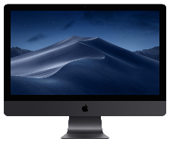
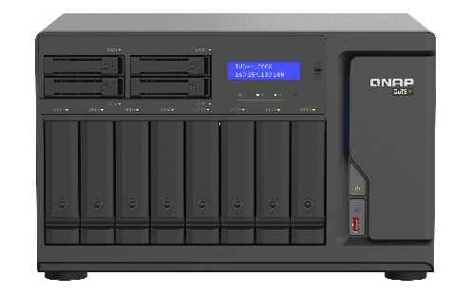

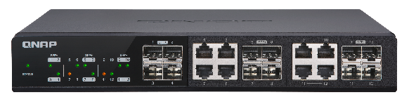


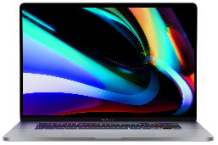



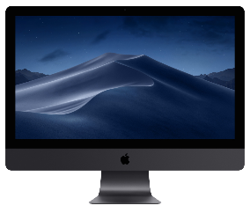


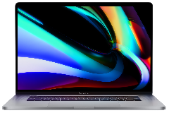


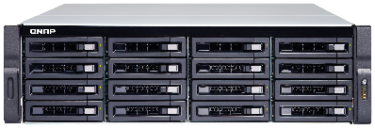
The flagship desktop NAS for Post-production
10G
QSW M1208 12 port 10GbE managed switch
LACP
1G
TVS-h1288X
Backup (with Dedup & BBR)
Multi-user collaborative editing
with DaVinci Resolve + PostgreSQL
Azure
AWS
Libraries for FCPX & Motion editors
Project for Adobe Creative Suite

Slide 11

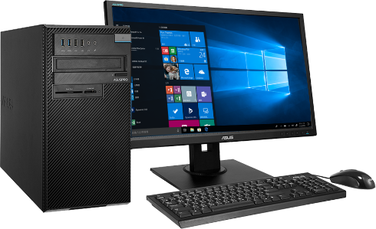
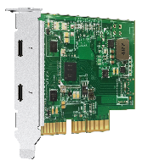
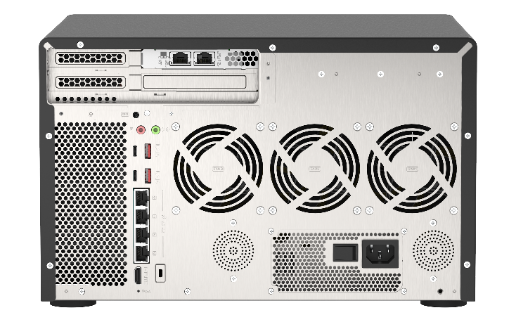
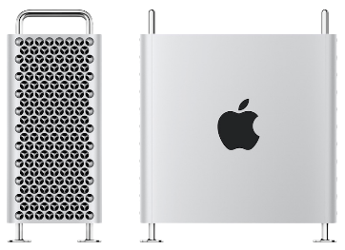

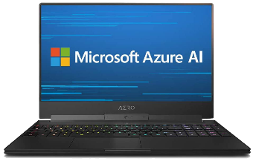
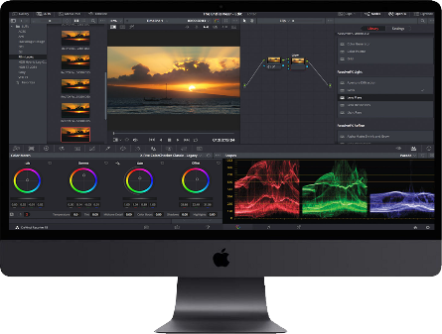

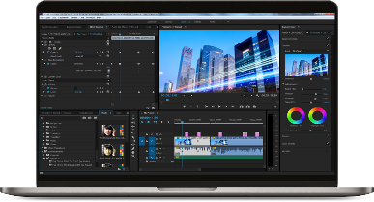
Multiple users can also directly connect to NAS for file sharing and video editing
QXP-T32P
Dual port thunderbolt 3 card
10G
Thunderbolt 3

Slide 12


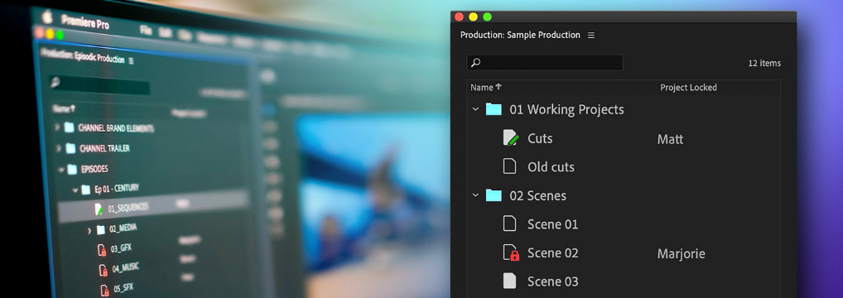


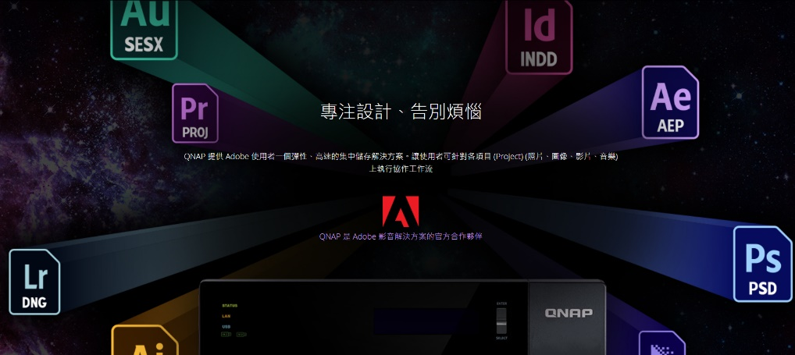

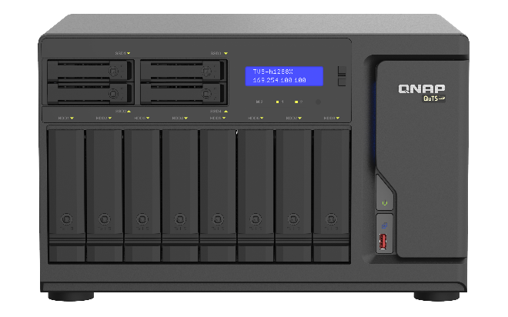

The popular Adobe Premiere now officially supports collaborative editing via NAS
MANAGE MULTI-PROJECT WORKFLOWS
DESIGNED FOR COLLABORATION
QNAP is the official partner of Adobe.

Slide 13

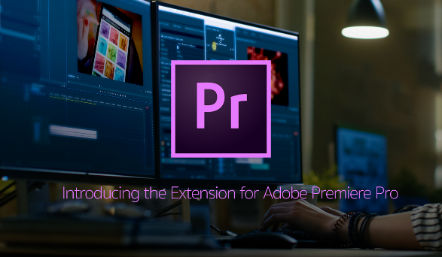
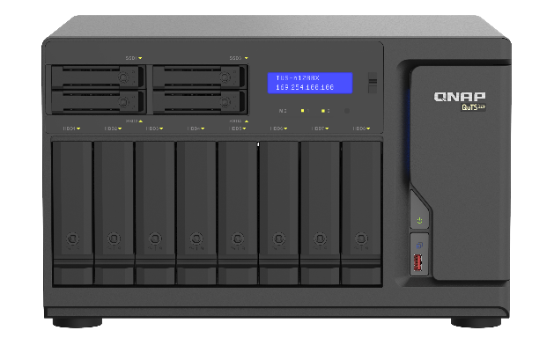

How to do collaborative editing in Adobe Premiere with TVS-h1288X
Notes:
So, every time when you add new media to the NAS, it’s suddenly available to everybody in the same network. And if you import something into the Production, just refresh the project then everybody can see those changes. So, whatever settings you set in the Production, remember to go into "Preferences for collaboration", "enable project blocking", and give yourself a username. And under the media, you have to make sure to disable three options
Write XMP ID to files on import
Write clip markers to XMP
Enable clip and XMP metadata linking
this will make sure you don’t end up with a whole lot of duplicate within anyone particular shared project and avoid the metadata or timeline mismatch.

Slide 14

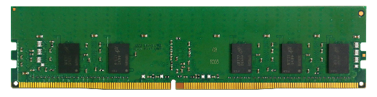
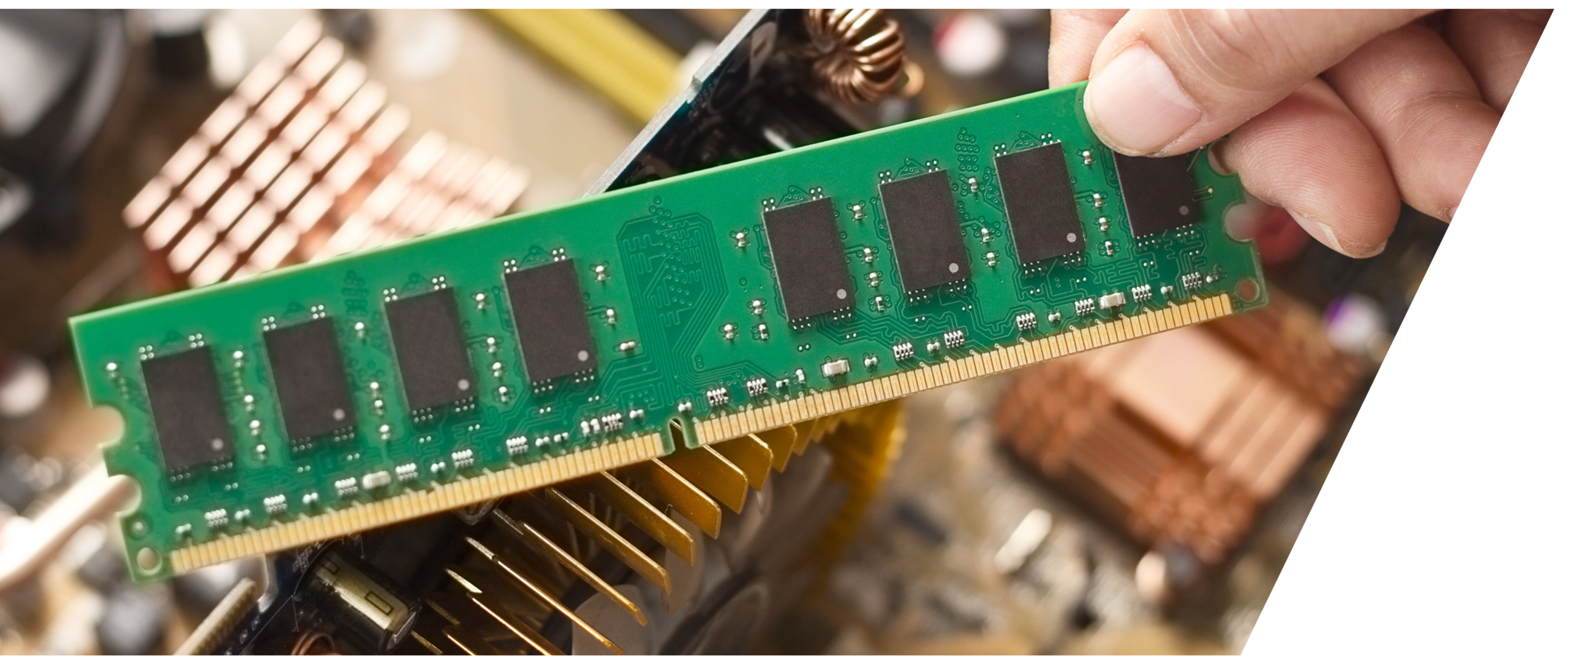
Up to 128GB ECC DDR4 memory
Higher reliability and data integrity
The NAS supports ECC memory for auto error correction.
Up to 128GB RAM (4 DIMMs)

Slide 15
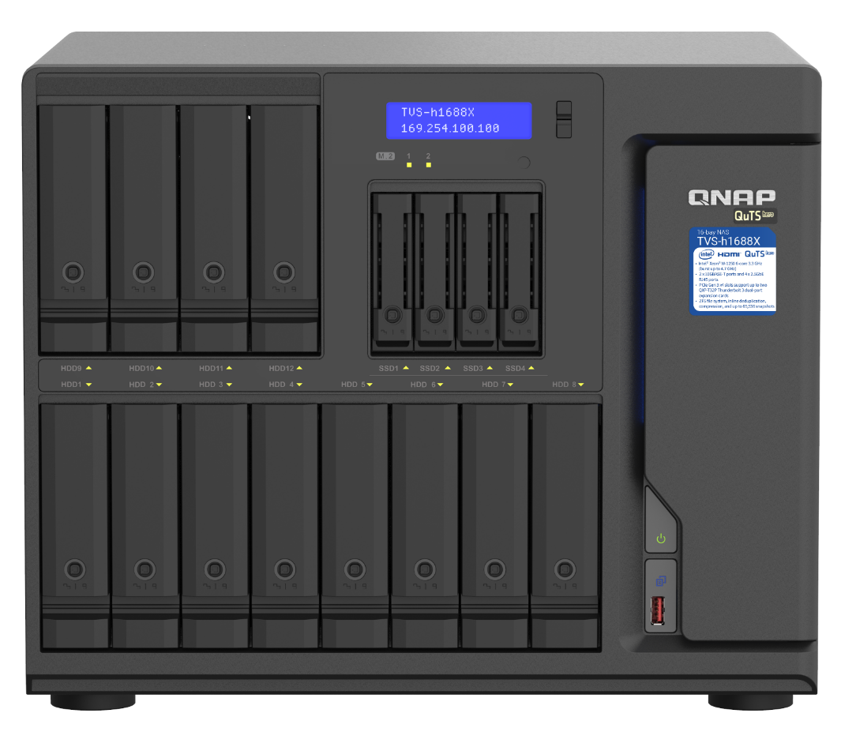
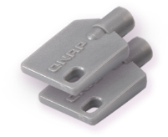
TVS-h1688X NAS front view
LCM info. display
4 x 3.5"/ 2.5”SATA
6Gb/s HDD/SSD slot
IR receiver
Supporting RM-IR004 remote controller
LEDs: drives, M.2 SSDs
4 x 2.5”SATA
6Gb/s SSD bays
High-speed system disks
8 x 3.5"/ 2.5”SATA
6Gb/s HDD/SSD bays
Lockable trays with 2 keys provided
Power button
USB 3.2 Gen 2 & copy button
TVS-h1688X

Slide 16

TVS-h1288X NAS front view
4 x 2.5”SATA
6Gb/s SSD bays
High-speed system disks
LCM info. display
IR receiver
Supporting RM-IR004 remote controller
LEDs: drives, M.2 SSDs
8 x 3.5"/ 2.5”SATA
6Gb/s HDD/SSD
Power button
USB 3.2 Gen 2 & copy button
Lockable trays with 2 keys provided
TVS-h1288X

Slide 17



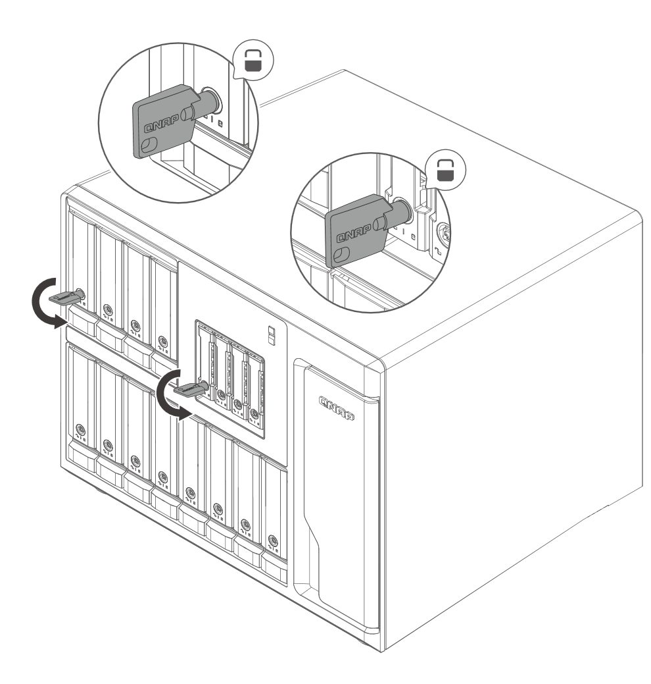
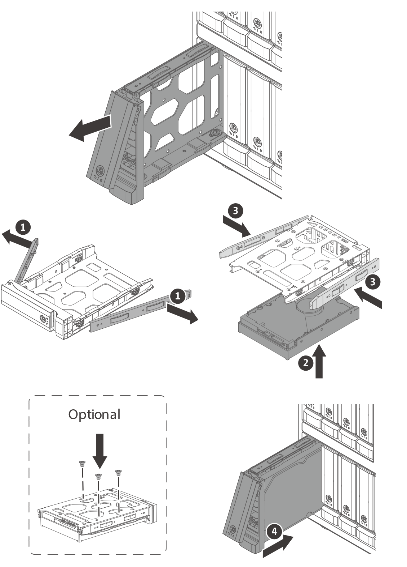
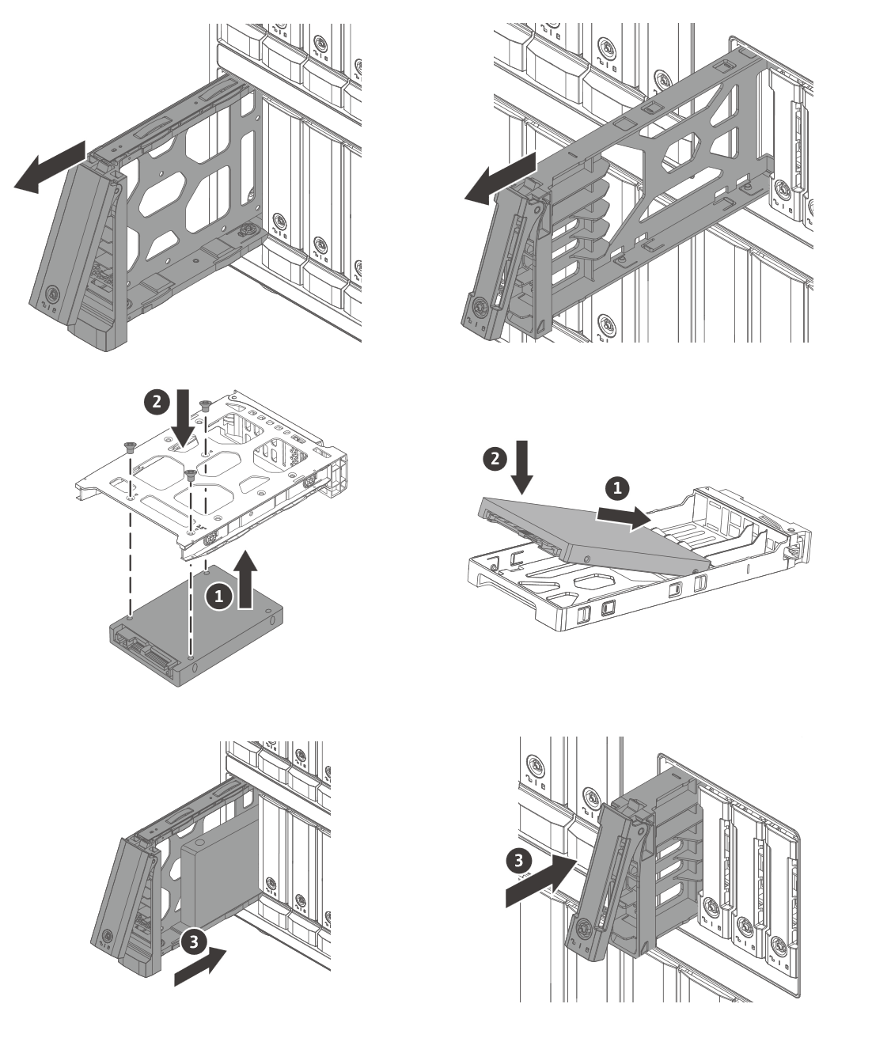
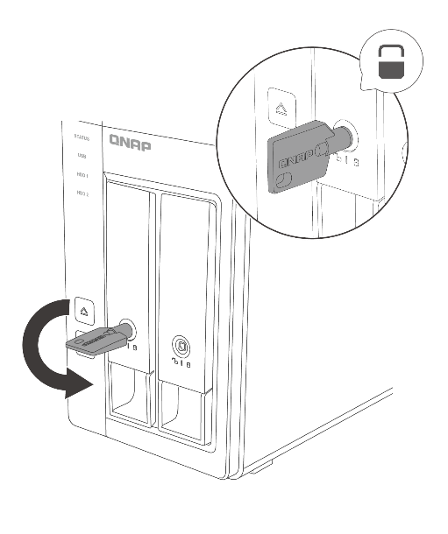
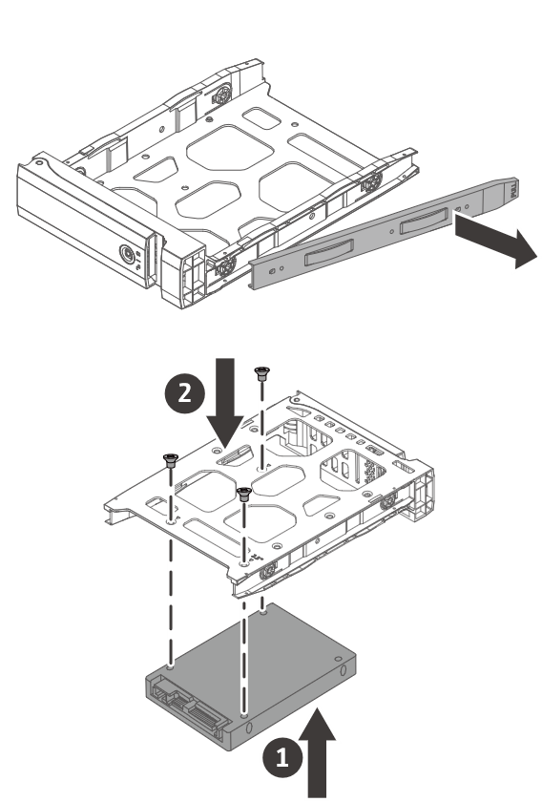
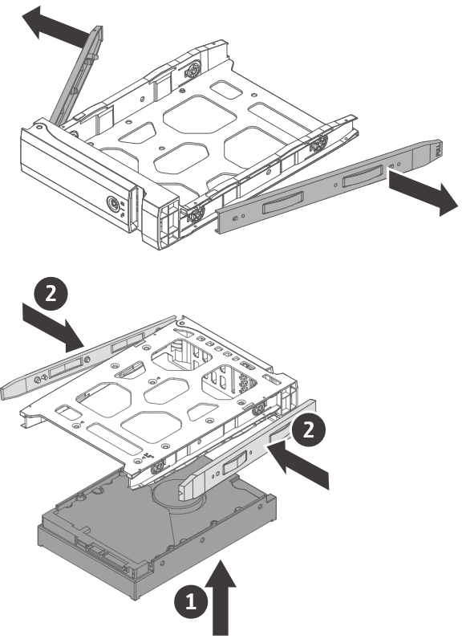
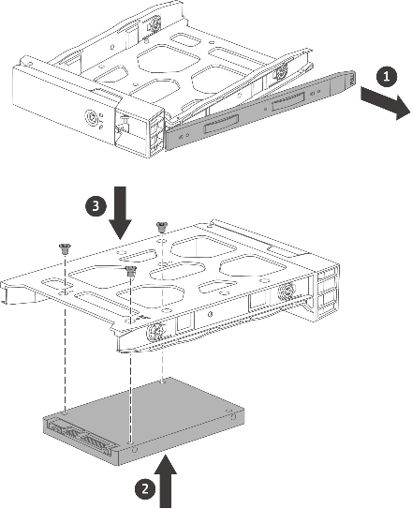





Quick & easy HDD/SSD installation
3.5-inch HDD
2.5-inch HDD / SSD
Tool-less installation of 3.5-inch HDDs
Use screws when transporting
the NAS with drives

Slide 18
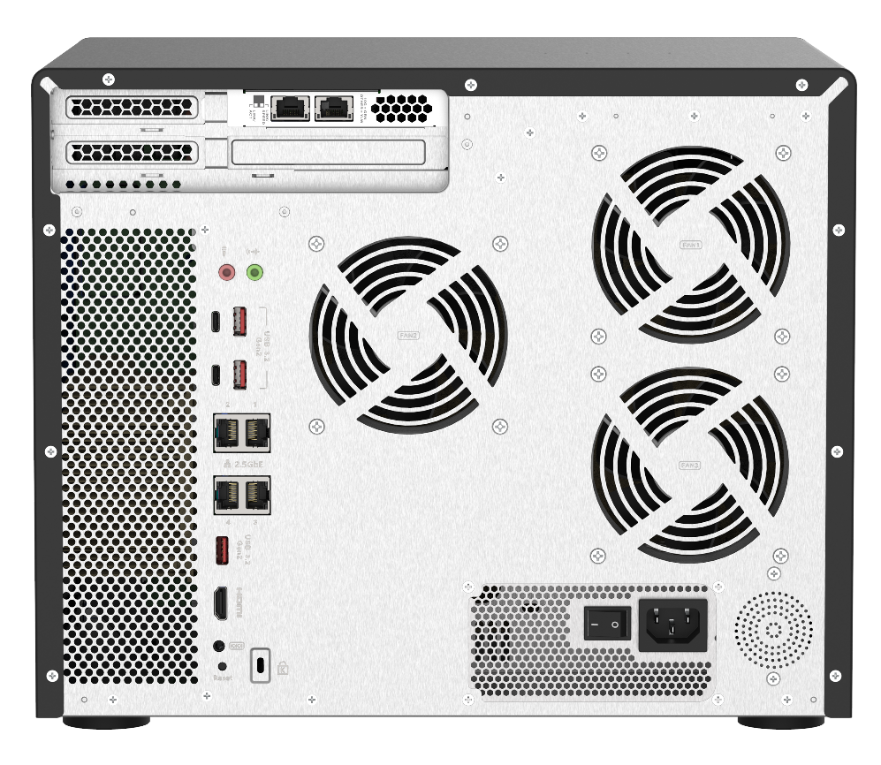
TVS-h1688X NAS rear view
PCIe slot1: PCIe Gen3 x8
Pre-installed Broadcom NetXtreme® E-Series BCM57416 2-port 10GBASE-T NIC
PCIe slot 2: PCIe Gen3 x4
PCIe slot 3: PCIe Gen3 x4
Audio input & output
Smart fans
5 x USB 3.2 Gen2 10Gbps ports
(3 x Type-A + 2 x Type-C)
4 x 2.5GbE ports
1 x 4K 30Hz HDMI v1.4b output port
Speaker for system status
550W power supply unit
TVS-h1688X

Slide 19

TVS-h1288X NAS rear view
PCIe slot 1: PCIe Gen3 x8
Pre-installed Broadcom NetXtreme® E-Series BCM57416 2-port 10GBASE-T NIC
PCIe slot 2: PCIe Gen3 x4
PCIe slot 3: PCIe Gen3 x4
Audio input & output
4 x USB 3.2 Gen2 10Gps ports (2 x Type-A + 2 x Type-C)
Smart fans
Speaker for system status
4 x 2.5GbE ports
1 x 4K 30Hz HDMI v1.4b output port
550W power supply unit
TVS-h1288X

Slide 20
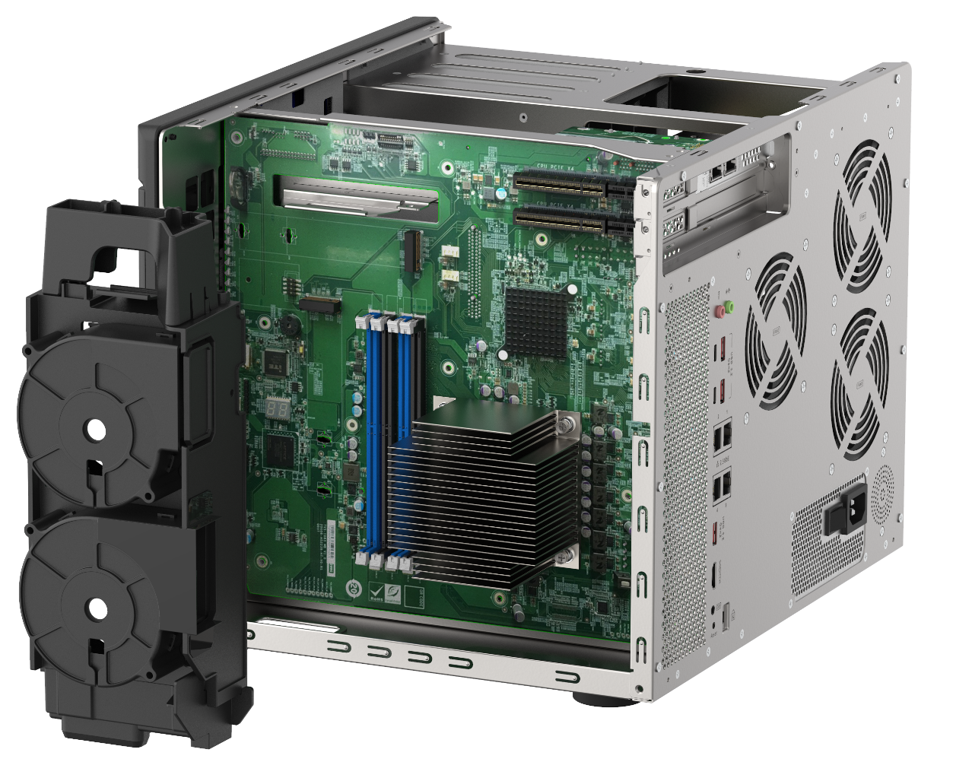
TVS-h1288X / TVS-h1688X internal HW specs
1 x PCIe Gen3 x8 slot (preinstalled with a 10GBASE-T card)
2 x PCIe Gen3 x4 slots
2 x M.2 22110/2280 NVMe PCIe
Gen3 x4
SSD slots
4 x DDR4 long-DIMM ECC dual-channel slots, up to 128GB support
Intel Xeon W-1250
6-core CPU
2 x 6CM CPU
cooling fan
TVS-h1688X
Notes:
修改筆記: 中英文數字間加空格

Slide 21

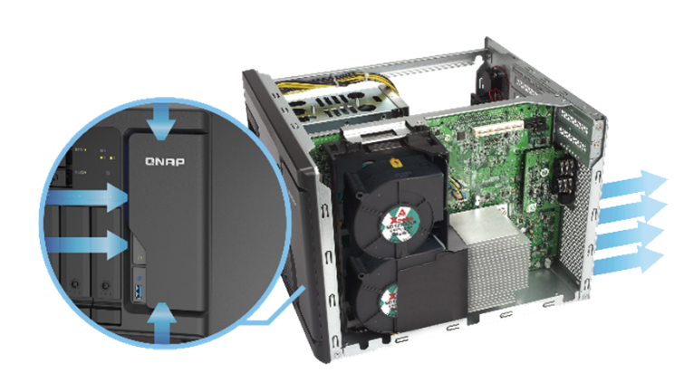
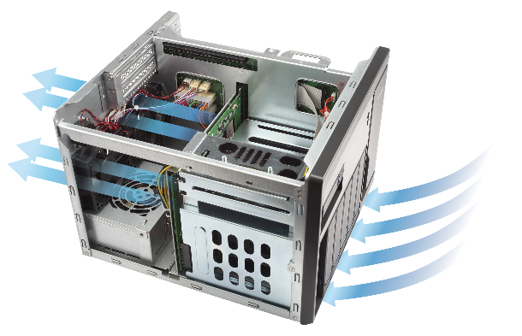
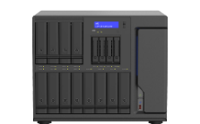
Compartmentalized smart cooling
Roadside
70
Separately detects the CPU and hard drive temperatures to dynamically adjust separate fan speeds for an quieter operations in the office.
Loud speak
60
Quiet office
50
CPU side
Disk side
Library
40
Quiet outdoor
30
TVS-h1688X
21.8
Broadcast room
20
Soud pressure (dB)
Sound pressure is measure at the front bystander position with low fan speed.

Slide 22
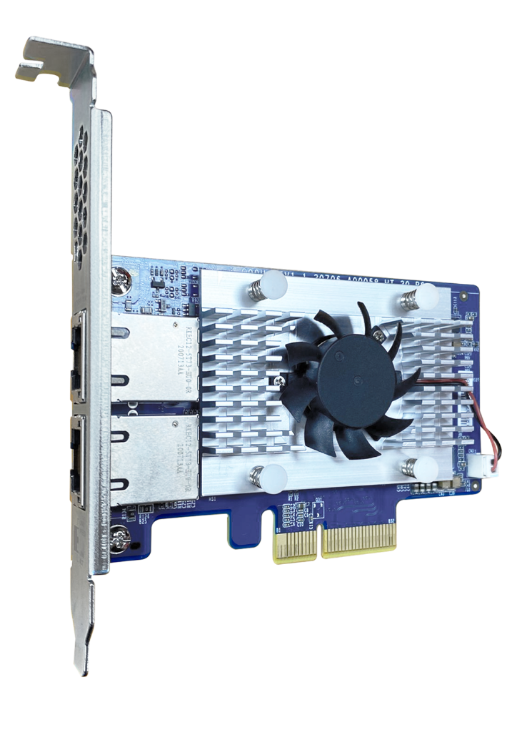

Shipped with a Broadcom BCM57416 2-port 10GBASE-T SmartNIC card
10GbE
NetXtreme®-E Series BCM57416 SmartNIC or similar PCIe 3.0 advanced network controller IC
2 x 10GBASE-T ports
Supports 10GbE/1GbE

Slide 23
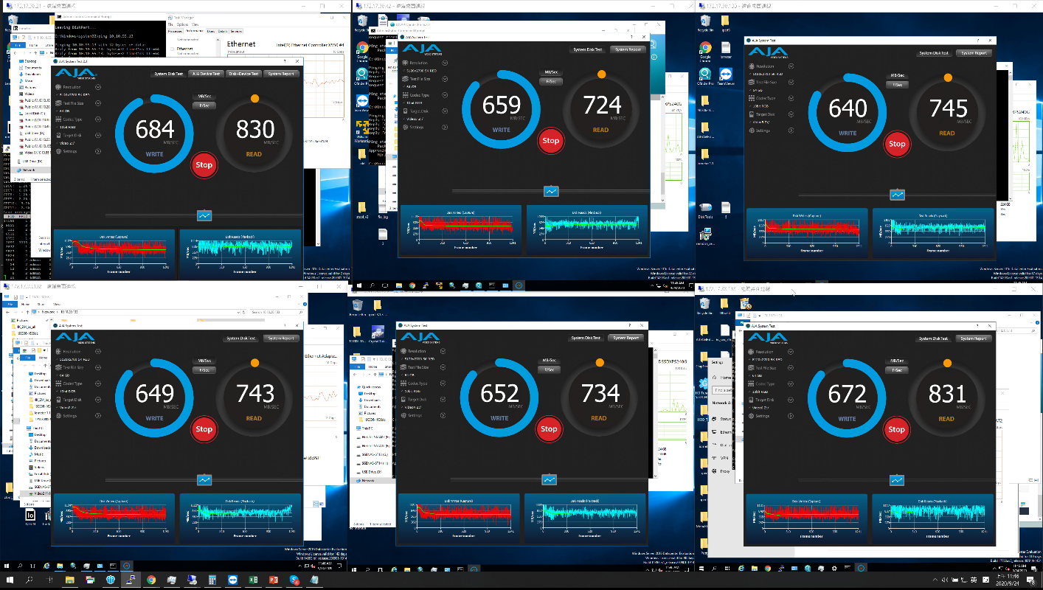
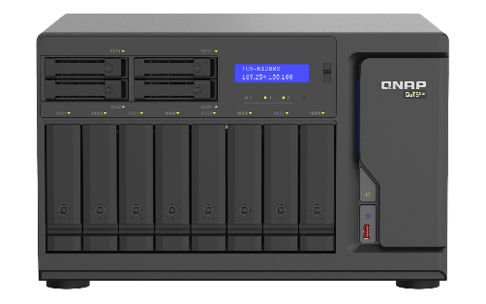

Up to 4000 MB/s network performance
The powerful 6-core Xeon W process in TVS-h1288X/h1688X NAS are geared for intensive workloads in businesses and multi-user editing environment.
10G
10G
10G
10G
10G
10G
6 client PCs concurrent access

Slide 24



QNAP QSW-M1208 managed 10GE switch for multi-10GbE aggregated multi-user editing
4 x 10GbE SFP+ ports
8 x 10GbE SFP+ & RJ45 Combo ports
QSW-M1208-8C
8 x 10GbE SFP+ ports
4 x 10GbE SFP+ & RJ45 Combo ports
4 x 10GbE SFP+ ports
4 x 10GbE SFP+ & RJ45 Combo ports
QSW-M1204-4C
QSW-M804-4C

Slide 25




Unlock business potential with quad 2.5GbE ports
Many 2.5GbE-ready products now: motherboards, Wi-Fi 6 AP/router, NICs, switches
2.5GbE benefits
Both models offer 4 x 2.5GbE ports for link aggregation and fail over (1GbE compatible)
2.5X faster
Existing cable
2.5GbE offers 2.5X speed over 1GbE
Works with Cat.5e/Cat.6/ Cat. 6A cables
寫入

Slide 26

2 x M.2 NVMe PCIe Gen3 x4 slots
Support 2 x M.2 22110/2280 NVMe PCIe Gen3 x4 SSD, each slot offering 3.2 GB/s bandwidth
Enhances the performance of multi-client random access and virtualizated applications
NVMe SSD v.s. SATA SSD
Samsung 970 EVO Plus
(Gen3 x4)
Samsung 860 Pro
(SATA 6Gb/s)
600,000
620,000
500,000
560,000
400,000
300,000
200,000
(IOPS)
100,000
100,000
90,000
0
TVS-h1688X
Random
Read
Random
Write
Random
Read
Random
Write
* Source: Samsung.com
Notes:
26

Slide 27



Dual-port Thunderbolt 3
Install QNAP Thunderbolt 3 Expansion card - QXP-T32P transform your
TVS-h1288X & TVS-h1688X into
Thunderbolt 3-ready-NAS!
QXP-T32P
QNAP Dual-port Thunderbolt 3 Expansion Card

Slide 28

Intel 11th-Gen Laptop CPU Tiger Lake built in Thunderbolt 4 and supports Thunderbolt 3
Intel 11th-gen Tiger Lake laptop CPU
Thunderbolt 3 X Thunderbolt 4
X
Intel Q4 20’ 11th-gen new laptop CPU - Tiger Lake natively supports Thunderbolt 4
Support Thunderbolt 3 device

Slide 29

Low-profile design, upgrade TVS-hx88X into Thunderbolt-ready-NAS instanlly!
106 mm
Pre-install half-height bracket
​ | QXP-T32P
Thunderbolt port​ | 2 x Thunderbolt 3​
PCI express​ | PCIe Gen3 x4​
Power | Bus powered
Dimension​ | 106 x 689 mm​
Bracket​ | Pre-install low-profile; Full height
68.9 mm
PCIe Gen 3 x4 interface

Slide 30
Not only a flagship desktop Xeon-W NAS， but also support up to 4 port Thunderbolt
Support up to TWO QXP-T32P
Upgrade Thunderbolt 3 NAS
QXP-T32P
Dual-port Thunderbolt 3 card
TVS-hx88X support up to 2
QXP-T32P for maxium 4
Thunderbolt 3 ports
TVS-h1688X-W1250-32G
12 x 3.5” + 4 x 2.5”, SATA 6Gb/s
Intel Xeon W-1250 6C/12T 3.3 GHz processor, burst up to 4.7 GHz
32GB DDR4 ECC RAM (2 x 16GB)
2 x M.2 NVMe PCIe Gen3 x4 SSD slot
2 x 10GBASE-T Ethernet ports
4 x 2.5GbE Ethernet ports
TVS-h1288X-W1250-16G
8 x 3.5” + 4 x 2.5”, SATA 6Gb/s
Intel Xeon W-1250 6C/12T 3.3 GHz processor, burst 4.7 GHz
16GB DDR4 ECC RAM (2 x 8GB)
2 x M.2 NVMe PCIe Gen3 x4 SSD slot
2 x 10GBASE-T Ethernet ports
4 x 2.5GbE Ethernet ports

Slide 31


Powerhouse for Mac video co-editing
1 for all
With direct CPU PCIe Gen3 x4 slots, transform TVS-hx88X into a co-editing powerhouse by adding up to two QXP-T32P cards.
QXP-T32P supports these two PCIe Gen3 x4 slots
TVS-h1288X
TVS-h1688X

Slide 32



Expand up to 4 ports with optional purchase Thunderbolt 3 Expansion card
Transform TVS-hx88X into Thunderbolt-Ready-NAS
4 Mac workstations could directly connect to NAS or extend connection via daisy chain.
AJA performance test

Slide 33






Flexible deploy Thunderbolt 3 expansion, support up to 4 Thunderbolt device Read&Write simultaneously
TVS-h1288X/h1688X supports 2 QXP-T32P on this two PCIe Gen3 x4

Slide 34




Thunderbolt 3 cable
Intel
Mellanox
Aquantia
Next-generation Thunderbolt™ 3 delivers bi-directional 20Gbps speed. Use a certified Thunderbolt™ 3 40Gbps cable (with the Thunderbolt icon and “3”) and a high-performance SSD to enjoy the highest possible performance and the best storage allocation for your NAS.
3
CAB-TBT305M-40G-LINTES
CAB-TBT315M-40G
CAB-TBT320M-40G-LINTES
USB Type-C to Type-C
0.5-meter passive cable
Thunderbolt Certified
USB Type-C to Type-C
1.5-meter active cable
Thunderbolt Certified
USB Type-C to Type-C
2-meter active cable
Thunderbolt Certified

Slide 35
Various accessories for capacity, function, and performance expansions

Slide 36



High-speed storage expansion with PCIe to SATA enclosures
Install a QNAP QXP SATA HBA on NAS to access the TL expansion units via PCIe Gen3 bandwidth
Each SFF-8088 cable provides 4 x SATA 6Gb/s = 24 Gb/s bandwidth. Connect multiple cables for up to 64 Gb/s performance
TL-D400S
TL-D1600S
TL-D800S

Slide 37








QXP SATA HBA and cables are included
+
+
+
+
TL-D400S
1 x QXP-400eS-A1164
PCIe to 4 x SATA 6Gb/s
1 x 1M SFF-8088 cable
TL-D800S
1 x QXP-800eS-A1164
PCIe to 8 x SATA 6Gb/s
2 x 1M SFF-8088 cables
+
+
TL-D1600S
1 x QXP-1600eS
PCIe to 16 x SATA 6Gb/s
4 x 1M SFF-8088 to SFF-8644 cables

Slide 38






Network expansion accessories
10GbE NIC
5GbE NIC
2 x SFP+
2 x RJ45
2 x RJ45
1 x RJ45
1/2/4 x RJ45
QXG-5G1T-111C
QXG-5G2T-111C
QXG-5G4T-111C
QXG-10G2SF-CX4
LAN-10G2T-X550
QXG-10G2T-107
QXG-10G1T
40/25GbE NIC
Fibre Channel
2.5GbE NIC
40Gb/s
25Gb/s
1/2/4 x RJ45
QXG-2G1T-I225
QXG-2G2T-I225
QXG-2G4T-I225
LAN-40G2SF-MLX
QXG-25G2SF-CX4
QXG-32G2FC / QXG-16G2FC

Slide 39


Performance expansion with QM2 SSD cards
QNAP QM2 M.2 SSD cards support 2 or 4 x M.2 NVMe SSDs for performance enhancement.
Keep the original storage configuration
QM2-4P-384
(Gen 3 x8 card)
4 x M.2 2280 PCIe Gen 3 x4 NVMe SSD port
QM2-2P-384
(Gen 3 x8 card)
2 x M.2 22110/2280 PCIe Gen 3 x4 NVMe SSD port
Note: QM2-4P-384 can only be installed in PCIe slot 1

Slide 40
QuTS hero
Safeguarding your business digital assets

Slide 41




















Complete Backup 3-2-1 with HBS 3.0
HBS 3 (Hybrid Backup Sync 3)
From local NAS (via HBS 3)
From remote NAS ( via File Station )
Carry and Use
(QuDedup Extract Tool)
Backup/Restore
.qdff
Tokyo
Taipei
.qdff
TCP BBR
File station with QuDedup(soon)
.qdff
NewYork
.qdff
CIFS / NFS / FTP
.qdff
Taipei
File station with QuDedup(soon)
Access from Cloud
Beijing

Slide 42




QuObjects allows your NAS be the object storage through S3 protocol
Sample of Object:
bucket
Cloud Service Provider
Folder
File name
bucket
Object
bucket
bucket
Object
Object
S3
Key
Object
Object
Object
Data
bucket
bucket
Object
Object
Metadata
Object
Object
QuObjects

Slide 43





















HybridMount provides two modes for file-based cloud storage gateway
 | Network Drive Mount | File Cloud Gateway
Setup Method | Mount cloud drives and file servers | Select “File Cloud Gateway” mode and create a dedicated cache space
Connections | No limit | 2 free and perpetual connections. Purchase license for more connections
Access Performance | Depends on network speed | High performance thanks to caching
Access in File Station | Supported | Supported
Access throughSMB / NFS / AFP | Partially supported | Supported
Sync with the cloud | Sync only when browsing | Sync constantly for quick access
Integration with QTS Apps | Not supported | Supported ...
Online collaboration
File data analysis
Slower
Internet
NAS
Cache
1
2
3
META
DATA
LAN
Faster

Slide 44




Enterprise LUN backup:
VJBOD Cloud block-based gateway
VJBOD Cloud Gateway
Initiator
Local user
iSCSI
Target
Cloud object
storage space
Initiator
iSCSI
Cloud LUN
Client
Application
Server
SMB/NFS/AFP/
FTP/WebDAV
Cloud Volume
/Shared folder
Snapshot
Local user
Snapshot

Slide 45







Hyper Data Protector : All-in-one active backup solution for virtual machines
Supports VMware, Microsoft Hyper-V
Unlimited VM backups and license-free
Active backup solution
Restore at any time point
Hyper Data Protector
Microsoft Hyper-V

Slide 46

Boxafe:
Comprehensive Backup Solution for Google™ Suite and Microsoft 365®
Keep important data in your hands.
Move older data out of the cloud to reduce cost
Google™ G Suite
Microsoft 365®
Gmail
Backup all your emails and attachments in Gmail
Outlook
Backup all your emails and attachments in Outlook
Google Drive
Backup all your file versions in Google Drive and supports My Drive and Shared Drive (coming soon)
Contacts (People)
Backup all your contacts in Outlook People
Calendar
Backup all your events and attachments in Outlook Calendar
Contacts
Backup all your contacts in Google Contacts
OneDrive
Backup all your files in OneDrive and support SharePoint (coming soon)
Calendar
Backup all your events and attachments in Google Calendar

Slide 47









All-in-one server to host virtual machines and containers
Virtualization Station
Container Station
Supports to run the Virtual machine such as Windows, Linux® , UNIX® and Android.
QNAP’s Container Station exclusively integrates LXC and Docker lightweight virtualization technologies, allowing you to download apps from the built-in Docker Hub Registry.
Container Station
Container
Application
Application
Application
GPU passthrough: allows you to use your QNAP NAS as a PC by connecting a keyboard, mouse, and HDMI display.
Filesystem
Filesystem
Filesystem
Host OS
Hardware

Slide 48



QNAP 32Gb/16Gb Fibre Channel adapters
QNA-32G2FC
Dual-port 32Gbps
FC adapter
Economically adds NAS to your FC SAN
* The FC adapter cannot be installed in Windows/Linux.
QNA-16G2FC
Dual-port 16Gbps
FC adapter
Optical FC transceivers included
TRX-32GFCSFP-SR
  32Gb/16Gb/8Gb
TRX-16GFCSFP-SR
  16Gb/8Gb/4Gb

Slide 49






Create FC-SAN Storage, backup and CDM (Copy Data Management)
2
Realtime backup FC LUN to the remote NAS
1
Connect to Fibre channel environment
Snapsync
VMware
SAN switch
ethernet switch
Hypervisor Host
Data analysis and management by mounting the clone LUNs through Ethernet
FC LUN
4
3
Snapshot
clone
Snapshot Clone
provide CDM service through iSCSI
iSCSI
LUN

Slide 50





Integrated Intel UHD graphics for high performance content sharing & streaming
4K HDMI v1.4b 30Hz output
Plex Server with transcoding
CAYIN MediaSign Player
HEVC (H.265) realtime transcoding
Use Cinema28 to stream content to various meeting rooms

Slide 51




Add an NVIDIA graphics card to accelerate the speed of AI and VM applications
The PCIe Gen3 x8 slot supports a compatible NVIDIA® graphics card, boosting imaging processing in NAS and performance of virtual machines via GPU passthrough.
550Ｗ PSU provides 1 x 6-pin and 1 x 8-pin (6-pin + 2-pin) power cables for a graphics card
8-pin
(1 x 6-pin + 1 x 2-pin)
1 x 6-pin
Maximum dimension of the PCIe card:
266 x 137 x 45 mm (with power cable and connector)

Slide 52

All New Surveillance App - QVR Elite
Release ETA: The end of Oct.
Subscription-Based License: 1 Channel USD $1.99 /month (Discount Price for bulk purchase)
Channel License Type Unlimited
Just type the total channel number for the request, do not need calculate sku number for different license sku type.
One time activate license by input specific channel number directly.
QVR Pro Client
QVR Elite be supported by the QVR Pro Client that as same as QVR Pro's client. So it also has the Dynamic View Layout, Live and Playback at the same time, e-map event display features.
Performance Evoluation
At initial version, max recording channel is 128 channels, the next version we will increase it to 192 channels.
Standard MP4 file
QVR Elite record standard mp4 file. The standard mp4 file will very suitable for using HybridMont or backup software of QuTShero and QTS.
Notes:
說明:
自訂任意授權購買數量 >> 可以買任何數量不用計算
自訂授權啟用數量

Slide 53

For enterprise, media studios,
and content creators
Copyright© 2020 QNAP Systems, Inc. All rights reserved. QNAP® and other names of QNAP Products are proprietary marks or registered trademarks of QNAP Systems, Inc. Other products and company names mentioned herein are trademarks of their respective holders.​​​​

