Slide 1
Notes:
[7/29]圖要換臉 - done

Slide 2
Agenda
Smart Robot Autonomy
KoiBot Key Features HW features SW features
KoiBot Key Applications
Smart Eduction
Smart Healthcare
JAG Technology solution
Smart Video Conference
Smart Reception
Notes:
貼心服務您的客人

Slide 3
KoiBot – 4 Key Elements for Smart Robot's Autonomy
Robot's Autonomy
Face Detection /
Recognition
Voice Service
Action
Video Calls
Notes:
[8/4] 動作
[7/29]標題 -
[7/29] 留圖跟標題, 說明移到後面pages
[7/29] 美工畫圖 : 大圓-自主性, 內有三個小圓 - 視訊，face recognition, Voice service
[7/29] move to the beginning , 破題
獲取環境信息
自主性” 聽聲辨位, 以臉追人, 互動

Slide 4
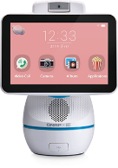
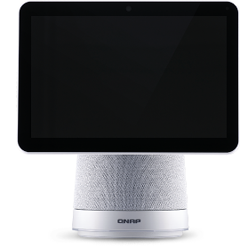
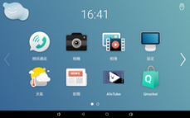
KoiBot – HW Evolution
 | AfoBot | KoiBot
Performance | 1 | +100%
Monitor 16:10 IPS TFT LCD 1280x800 Full HD | 8 inches | 10 inches
Microphone MEMS MIC (up to 5-7 Meters) | 2 | 4
Speaker 5W 4Ω Stereo Reflective Speaker | 1 | 2
I/O Interface | 1 x USB 2.0 Type A 1 x USB 2.0 Type C | 2 x USB 3.2 Type A 1 x USB 3.2 Type C (to HDMI output for TV) Reserved Mini-PIC-E slot (for 4G/5G)
Unique Function | Face Tracking | Face Tracking＋Sound Positioning
Notes:
[8/4] 效能 move to top
[7/29] 換比較表格
[7/27]Compared to afobot
4. I/O 連接埠 need to modify
Performece +200% , Gfx -- ask Haru
Demo 聽聲辨位, speaker

Slide 5
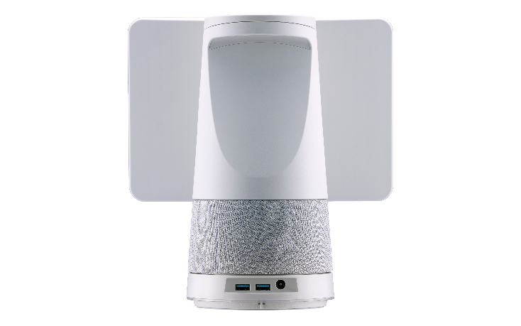
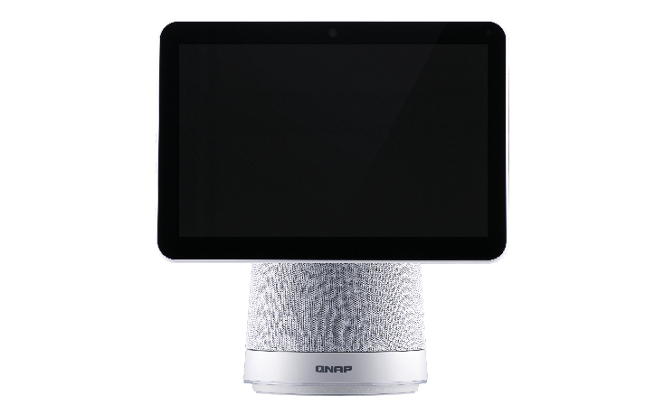
New Outlook
Wireless
IEEE 802.11 a/b/g/n/ac
Bluetooth 4.1
Camera
5MP camera, 2592 × 1944 @15fps, F2.2, FOV 103.5°
Monitor
Speaker
I/O Interface
2 x USB 3.2 Gen 1 Type A
LED
(1) Power Status
(2) Call Status
Notes:
[8/4] check KoiBot 二代群組

Slide 6
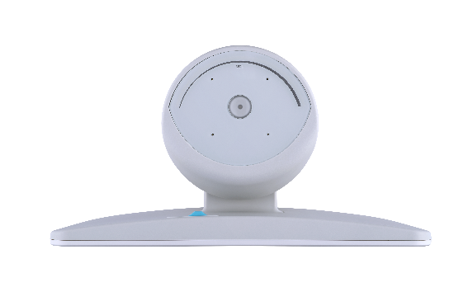
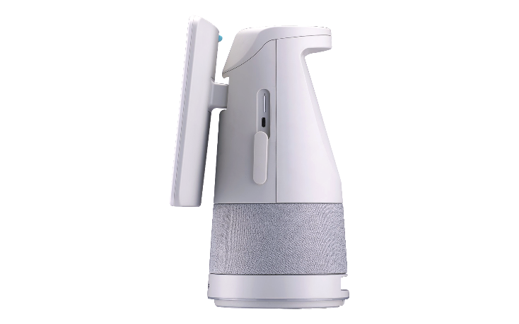
New Outlook
I/O Interface
(1)1 x USB 3.2 Gen 1 Type C (to HDMI output )
(2)1 x micro SD or Mini PCIe slot for 4G/5G (optional)
Microphone
Power Button
Volume Control Panel
(1) Volume indicator
(2) Touch Adjustment
Notes:
[8/4] check KoiBot 二代群組

Slide 7
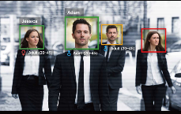
AI Face Recognition
Advantages
Applications
Built-in offline version (no internet needed).
Low computing resource utilization, high efficient engine.
Fast recognition (<1 sec).
Small Profile size (<0.5K).
Gender x Age.
Face tracking, real-time interaction.
Personal identity verification, access control and attendance management.
VIP / Blacklist notification.
Smart digital signage, accurate advertising promotion.
Notes:
[7/29] ＋應用情境
< 1 秒 : 從【辨識到人臉】後【識別出是誰的人臉】時間

Slide 8
AI Voice Service Gateway
QNAP total solution
Conversation
Skills
API
Internet
Services
Built-in ASR for specific fields (Offline).
STT Cloud solution from Google , 100+ languages.
Sound chip : Conexant (4-Mic).
Speaker power: 5W x2.
Text / API
Text / API
STT/ASR
Speech to Text
Audio
Conversation
Agent (NLU)
Text
TTS
Text to Speech
Text
Audio
WoV
Wake on Voice
Device Registration
Audio
API / GUI
Audio
Voice In
Device Controls
Voice Out
Opportunity
Chatbot developer.
Conversation Agent (NLU).
B2B SI (ex: Healthcare).

Slide 9
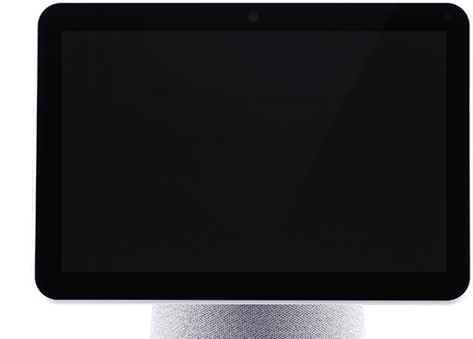
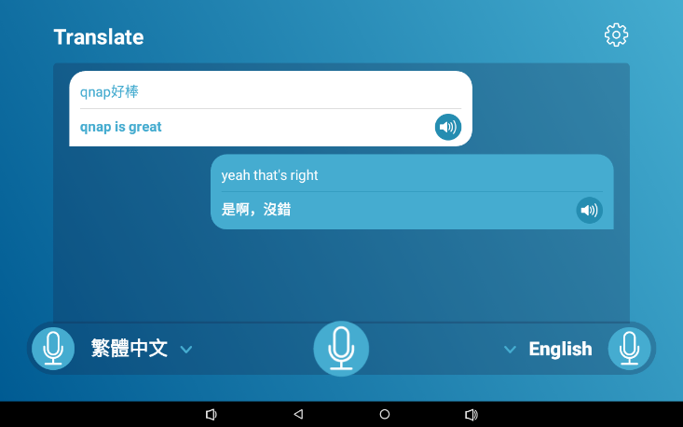
Translation
Software developer may
integrate or call through API.
Supprot Continuous Translation
Play voice after translation (click & auto)
23 common language choices by default, could be extended to 100+ languages
Instant translation
Notes:
[8/4] 翻譯

Slide 10
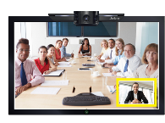
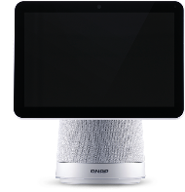
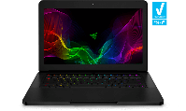
Video Call
NEW
INTRANET
INTERNET
Single Point - SIP
Multi-point - WebRTC
Support P2P SIP video call.
Compatible with existing video conference systems (Avaya/Poly/QNAP KoiMeeter)
Ensure privacy & security by using intranet.
All in one, easy to set up.
Device Directory Service
P2P/Relay Service
Call
Notification Service
HDMI
USB
NEW
KoiWeb
KoiMeeter/Avaya/Poly
Up to 4 peers
Notes:
[8/4] WebRTC + KoiWEb
[7/29] + benefit : 內網通信 ;huddle room
[7/29] 影片 ：call sip
full compatibility with SIP and WebRTC, providing users diverse and easy-to-use collaboration possibilities.
[⅞]

Slide 11
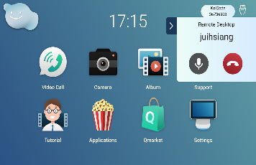
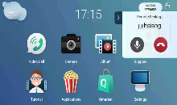
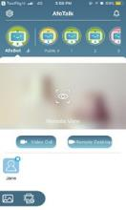
Remote Desktop
Unique feature
Remote assistance for settings.
Take over and demostrate.
Remotely monitor the progress of preschool education course training.
Mobile App to control KoiBot desktop remotely
Notes:
[8/4] 換桌面 二代
[7/29] 情境
[7/29] benefit

Slide 12
KoiBot Software Building Blocks
Dev or Integrate by QNAP
Android Core feature
Hardware from IEI
Video / Audio call service
Album
NLU Gateway
3rd party partner Apps
Call permission control
Face tracking
Camera
Information Agent
WebRTC lib
Storage (Cloud) Agent
Hot word detection
TTS Engine
STT Engine
OTA Update
AOSP
Launcher
Cloud Link Notification
Face detect &
recognition
Rotation (PTZ) Control
Android Framework
Bluetooth
Wi-Fi
USB3.2-A
USB3.2-C
5W speaker
F2.0 Camera
Stereo Mic x4
Hardware
Notes:
自然語言理解-Natural Language Understanding

Slide 13
KoiBot Software Building Blocks (B2B System Integrator Mode)
Dev or Integrate by QNAP
Android Core feature
Hardware from IEI
3rd party partner APPs
3rd party launcher
OTA Update
AOSP
STT/TTS
Gateway
P2P Video
SDK
Face Recognition SDK
Rotation (PTZ) SDK
Android Framework
Bluetooth
Wi-Fi
USB3.2-A
USB3.2-C
5W speaker
F2.0 Camera
Stereo Mic x4
Hardware

Slide 14
4 Key Applications
Smart Education
Smart Healthcare
Smart Video Conference
Smart Reception

Slide 15
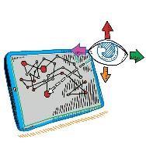
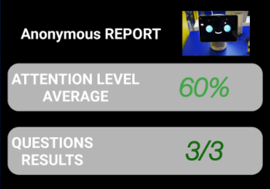
Smart Education
◉ Remote Desktop | ◉ 10" Monitor
◉ Video Call | ◉ Microphone Array
◉ Face Recognition | ◉ Stereo Speaker
◉ Instant Translation | ◉ Sound Positioning
Remote assistance, smart coaching.
Automatic turn to track child's position to increase interaction.
Attention level and statistics
Excellent performance to support Unity AR (augmented reality).

Slide 16
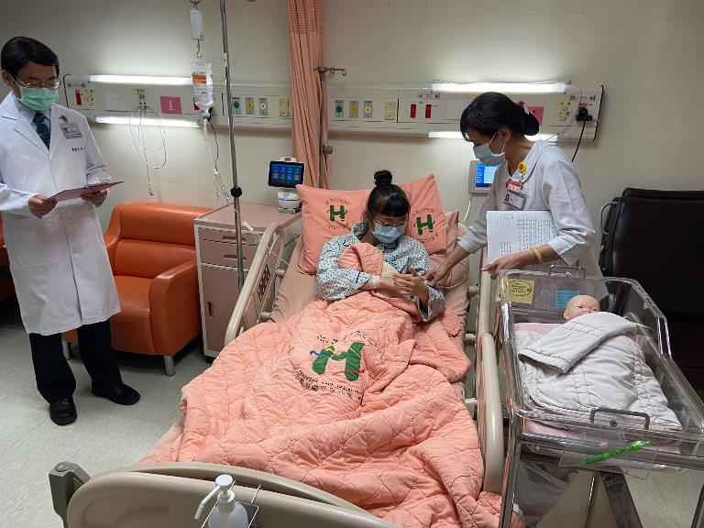
Smart Healthcare I
◉ Remote Desktop | ◉ 10" Monitor
◉ Video Call | ◉ Microphone Array
◉ Face Recognition | ◉ Stereo Speaker
◉ Instant Translation | ◉ Sound Positioning
Pill reminder.
Health education video playback.
Video diagnosis.
Physiological Measurement.
Automatically start video/audio interaction when abnormal.
Remote assistance.
Notes:
[8/4] + 匯嘉 photo

Slide 17
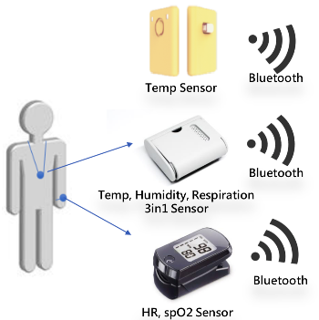
Smart Healthcare II
◉ Remote Desktop | ◉ 10" Monitor
◉ Video Call | ◉ Microphone Array
◉ Face Recognition | ◉ Stereo Speaker
◉ Instant Translation | ◉ Sound Positioning
General public
Long-term Care
Telehomecare
Community
Physiological Measurement.
Self-screening.
Online video visit.
Remote Diagnosis.

Slide 18
AI Remote Healthcare & Quarantine Ward Solution
Notes:
https://drive.google.com/file/d/19MZax-KcmuaUXGBQ_8w8MmZXQfsBH4v5/view?usp=sharing

Slide 19
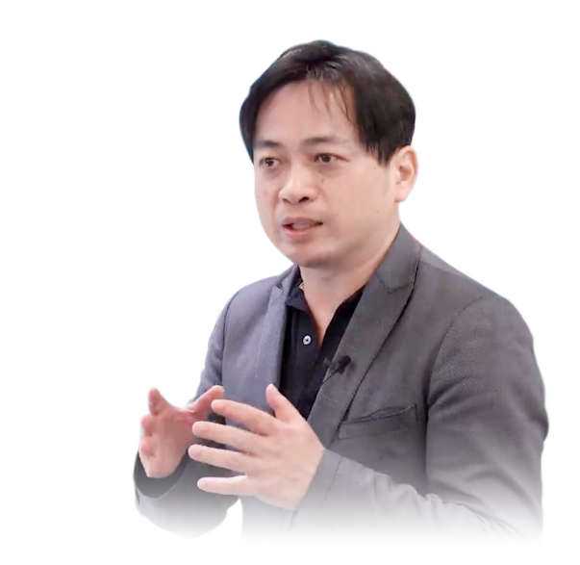
Alan Tso
JAG Technology Chairman

Slide 31
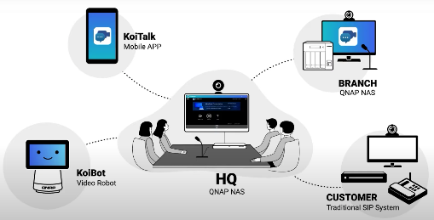
Smart Video Conference
◉ Remote Desktop | ◉ 10" Monitor
◉ Video Call | ◉ Microphone Array
◉ Face Recognition | ◉ Stereo Speaker
◉ Instant Translation | ◉ Sound Positioning
Small meeting room / Huddle room.
Compatible with Avaya / Poly / KoiMeeter SIP Call.
Automatically turn to track the speaker's face / sound source, and capture the speaker's image.
Sensitive microphone array and high-quality stereo speakers make distant communication easier.
Instant translation breaks language barriers.

Slide 32
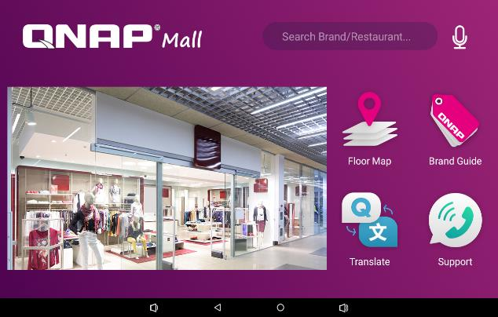
Smart Reception - Shopping Mall
◉ Remote Desktop | ◉ 10" Monitor
◉ Video Call | ◉ Microphone Array
◉ Face Recognition | ◉ Stereo Speaker
◉ Instant Translation | ◉ Sound Positioning
Greeting customers automatically.
Answer customers' inquiries.
AI instant translation.
Intelligent Digital Signage.
Voice Assistant
Customized QA
Logo
Floor Map
Brand Guide
Customer Service
Face Recognition Playback precision advertising
Instant Translation
Notes:
[7/29] 改為情境

Slide 33
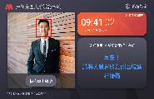
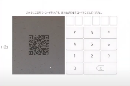
Smart Reception - Office Reception
◉ Remote Desktop | ◉ 10" Monitor
◉ Video Call | ◉ Microphone Array
◉ Face Recognition | ◉ Stereo Speaker
◉ Instant Translation | ◉ Sound Positioning
Visitor sign-in/out (QR Code / Face)
Visitor guidance (meeting room, waiting area ...)
Calling extension number / IM.
Notify related parties automatically
Digital signage.
Employee face recognition clock in.
Notes:
[7/29] 改為情境
[7/29] 該公司接待 - done
https://youtu.be/QwkXKXjwTNQ
https://www.youtube.com/watch?time_continue=30&v=iDL_-e2QKU0&feature=emb_title

Slide 34
More information
Please visit : https://www.qnap.com/solution/koibot/en-us/
Tutorial video
Cooperation consultation

