Slide 1

Hyper Data Protector
正式發行
免授權主動式虛擬機備份
一體機解決方案
支援VMware/Microsoft Hyper-V

Slide 2







The IT pain points of product selection
Complex pricing
Expensive license fee
Taking too much
time and efforts
Corporations need to pay for the license fee every year. The management may not like the idea.
Because of the difference between hardware and software, it may cost a lot of time and efforts to troubleshoot the issue.
Variety of products on the market and their charging are different between vendors

Slide 3



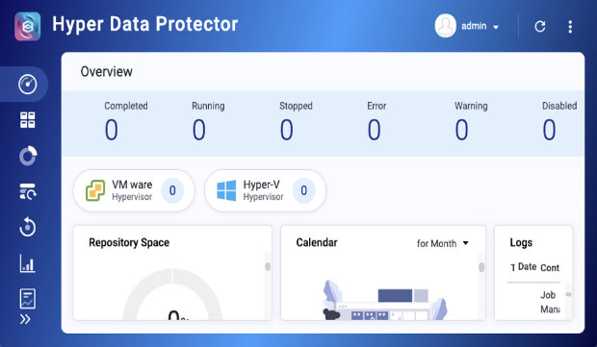

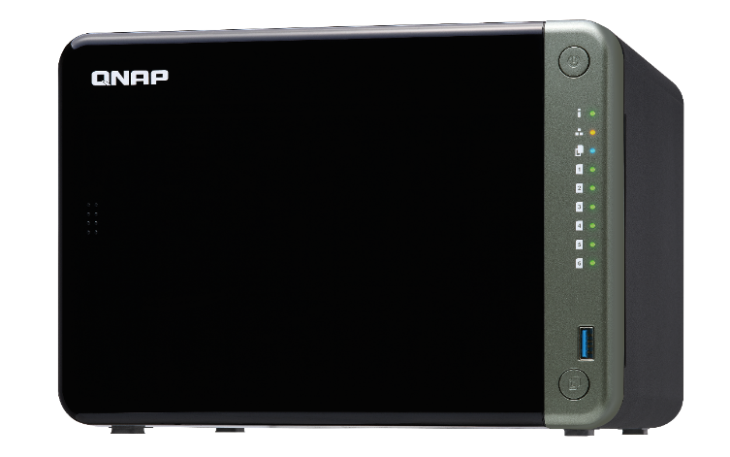
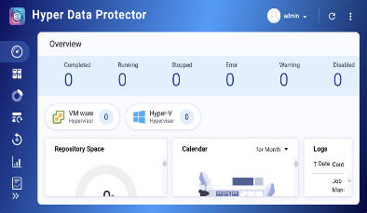

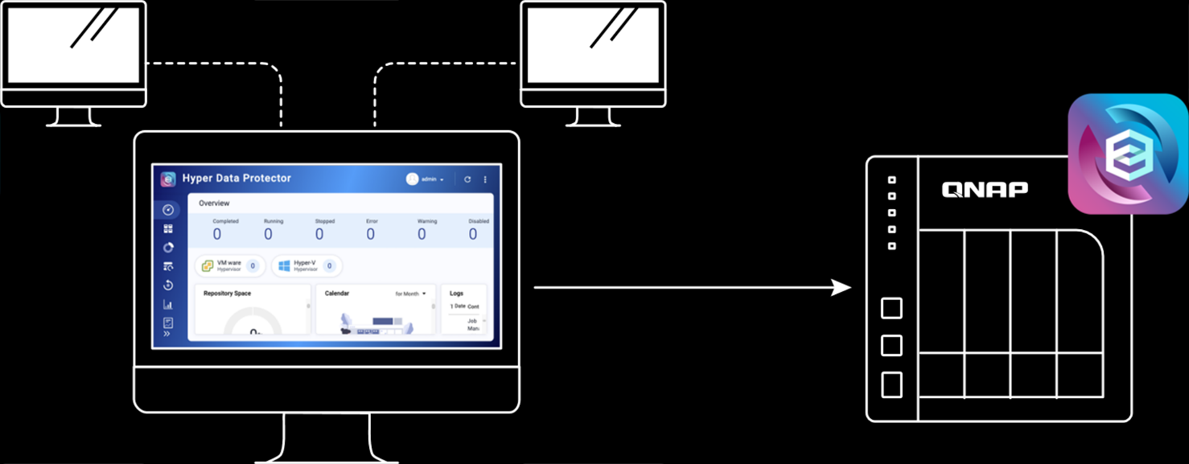
QNAP Hyper Data Protector –
All-in-one advantages
Unlimited VM backups and license-free for achieve cost, time and storage savings
All-in-one solution to avoid time spent on troubleshooting between hardware and software
QNAP NAS RAID hard disk data protection mechanism
QNAP NAS 3-2-1 backup mechanism

Slide 4








QNAP All-in-one active backup solution for virtual machines
Active Backup for VMs
Central Management
Container Station
APIs
Hyper Data Protector
Reduced backup data
QNAP Agent
Storage
Before
Deduplication
Incremental Backup
Recover
After

Slide 5

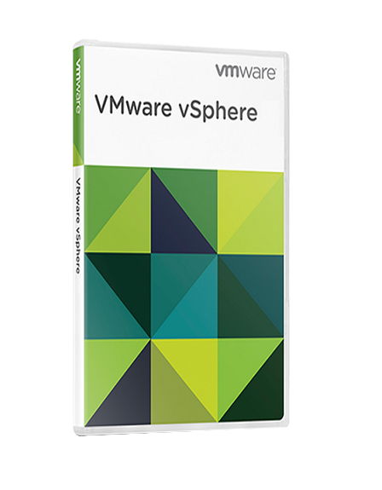
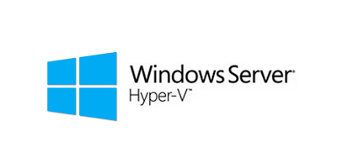
QNAP Hyper Data Protector supports platform
Hyper Data Protector is an active backup solution for VMware vSphere and Microsoft Hyper-V. It supports:
ESXi 6.0, ESXi 6.5, ESXi 6.7
Hyper-V 2016, Hyper-V 2019
vCenter
Note: Windows 10 Hyper-V not supported
(Feature roadmap – Windows server and PC backup solution)
VMware vSphere
Microsoft Hyper-V
6.0, 6.5, 6.7
Windows Server Hyper-V 2016
Windows Server Hyper-V 2019
Windows 10 Hyper-V not supported

Slide 6
Hyper Data Protector v1.1.0 Features
Central Management System
Multi-thread backup to reduce backup time
Reduce the storage usage
All-in-one active backup solution
Pull data from VM Server
When the installation or update is completed, HDP will determine the current NAS system resources for concurrent jobs of backup
Deduplication designed for virtual machines
Up to 90% reduction in duplicate data when copying VMs
Multi-Version backups
Backup data security management
High-speed backup network configuration
Up to 1,024 multi-version backups
Restore at any time point
NAS Data encryption
Transfer encryption with AES256
Support NAS high-speed network backup
NAS can support up to 40Gbps

Slide 7

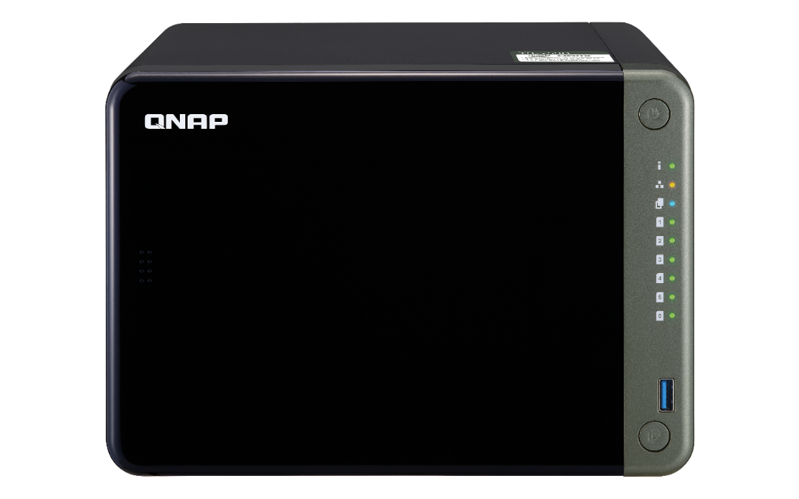







VMware / Hyper-V Centralized all-in-one active backup solution
All-in-one active backup solution with QNAP NAS
Pull data from VM Server
Central Management
Back up VMs in standalone networks
VMware
Hyper-V

Slide 8
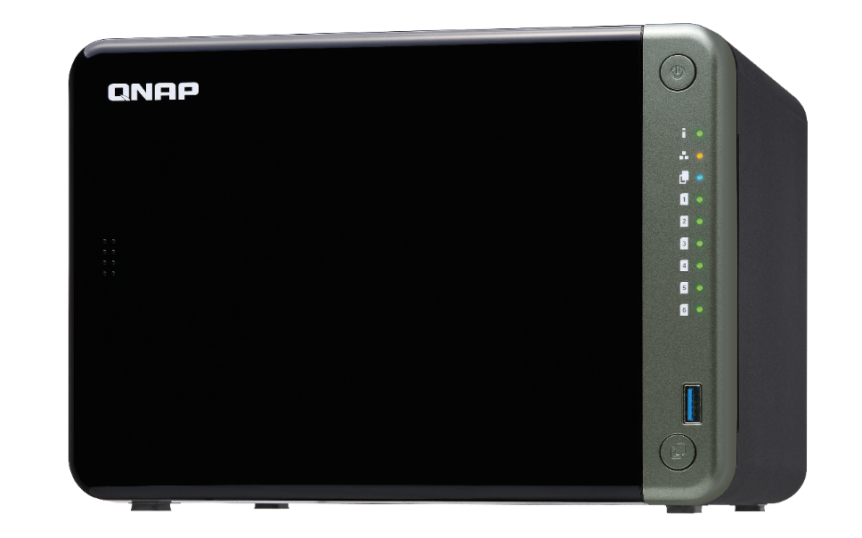

Supports Back up multiple VMs at the same time to reduce backup time
When the installation or update is completed, HDP will determine the current NAS system resources for concurrent jobs of backup
To back up a virtual machine at the same time, 250MB of system resources are required
CPU?
Memory?

Slide 9









Data compression and deduplication technology save your storage space
Compression ratio in actual testing：
QNAP HDP and well-known manufacturers have achieved compression ratio more than 80%.
For example, 32G VM becomes 5.77G after compression that greatly save backup storage
Offline Deduplication：
Reduce the storage of multi-version back up
Up to 90% reduction in duplicated data when clone VMs.
Compression
32GB
5.77G
Original Data
Deduplication
Deduplicated Data

Slide 10
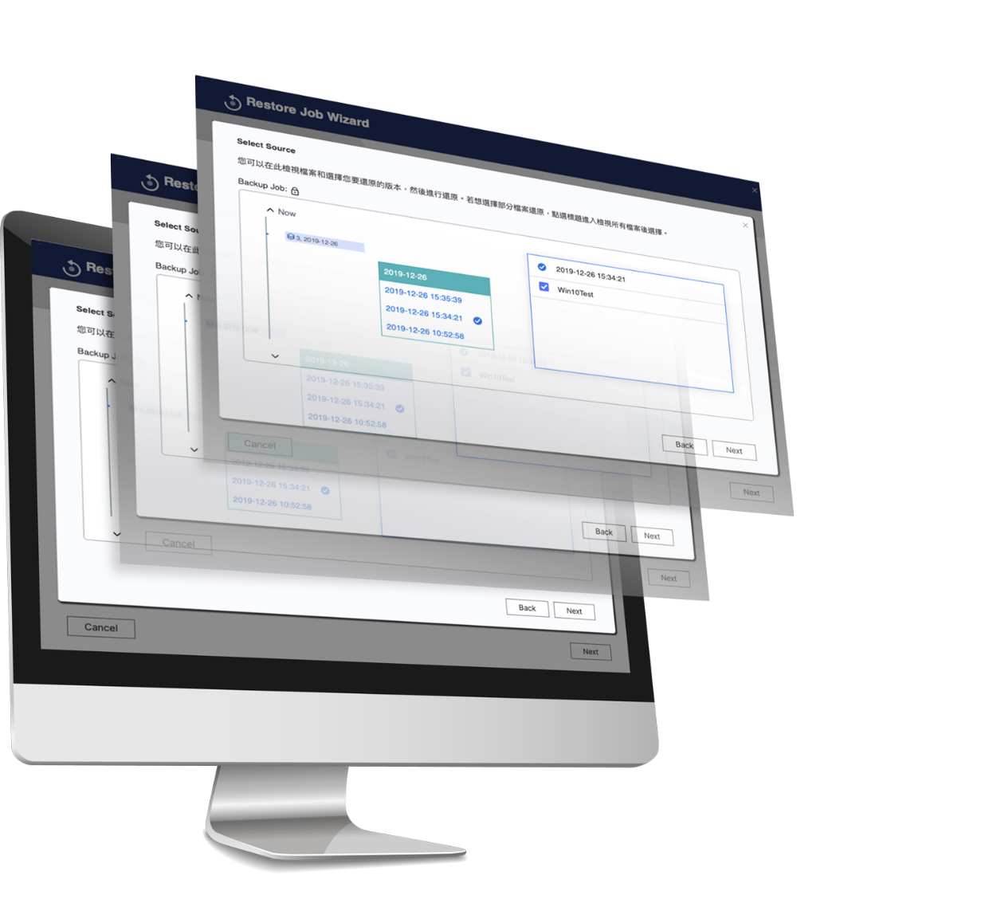
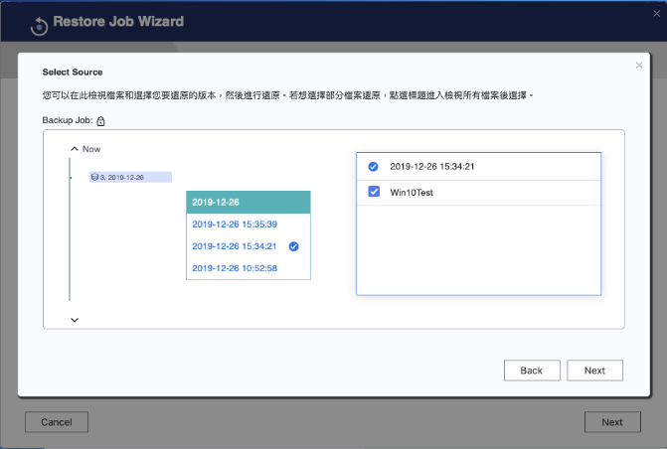

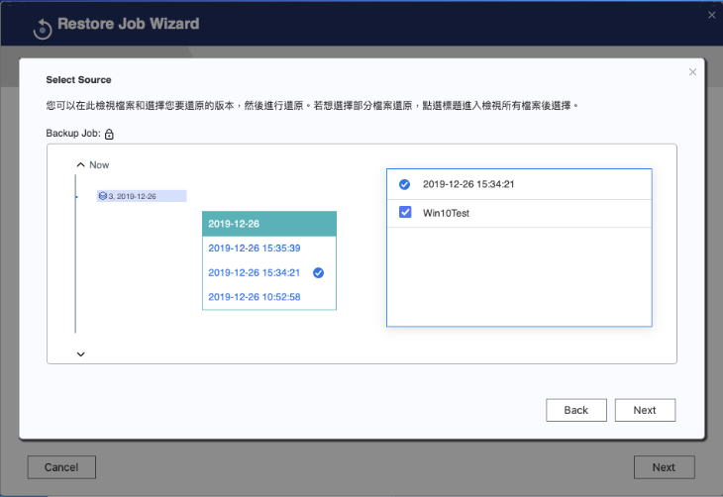
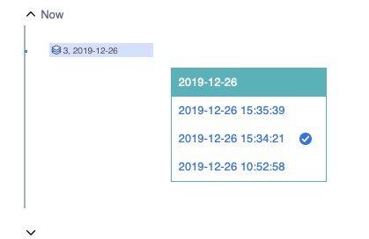
Up to 1,024 multi-version backups
Sequential version backup
Restore at any time point

Slide 11
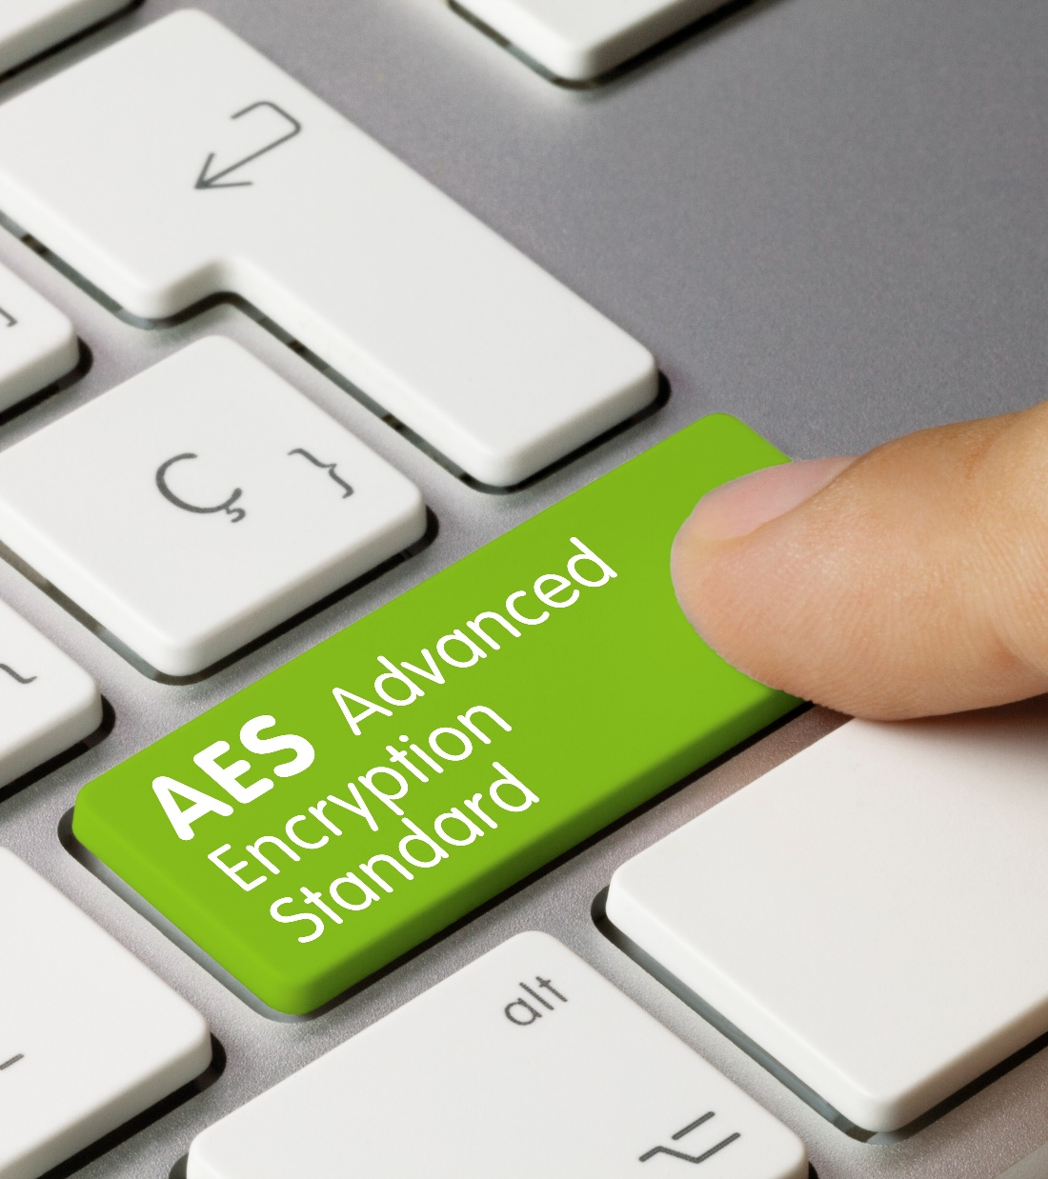
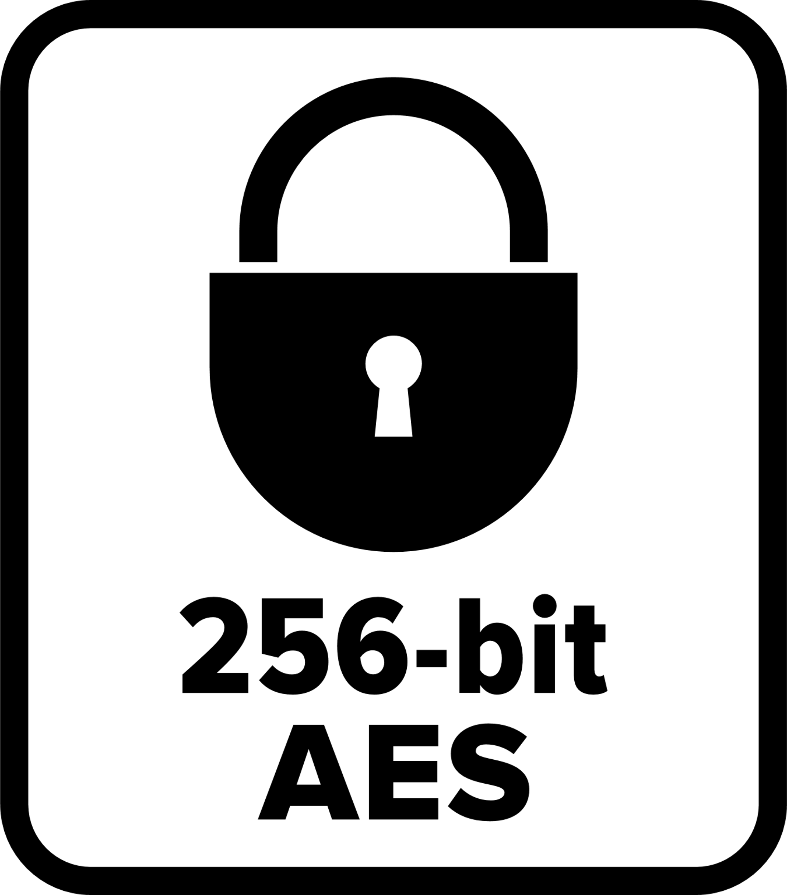

AES-256 encryption technology
Keep data safe
AES (Advanced Encryption Standard)
is a specification for the encryption of electronic data established by the U.S. National Institute of Standards and Technology (NIST)
256-bit Encryption

Slide 12
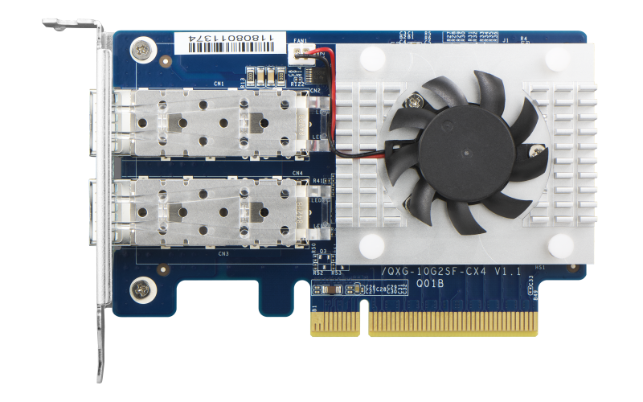
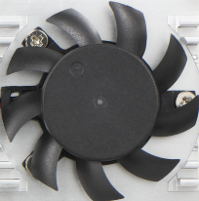
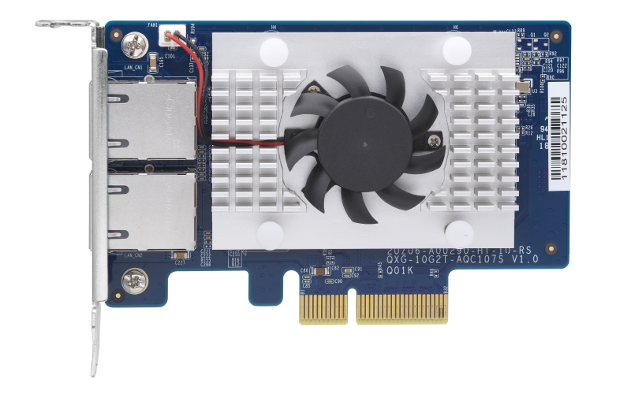
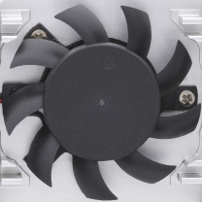
NAS high-speed network gives you more efficient data transmission
Support NAS high-speed
network backup
There are a variety of high-speed network cards, including 40Gbps, 25Gbps, 10Gbps, 5Gbps, 2.5Gbps, etc.
LAN-40G2SF-MLX
QXG-10G2T-107

Slide 13



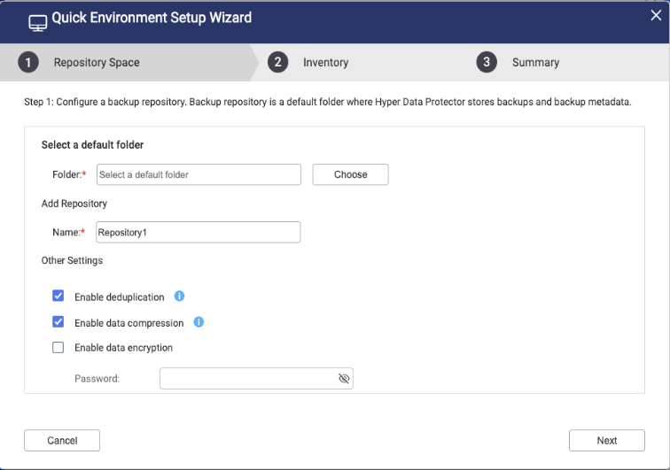
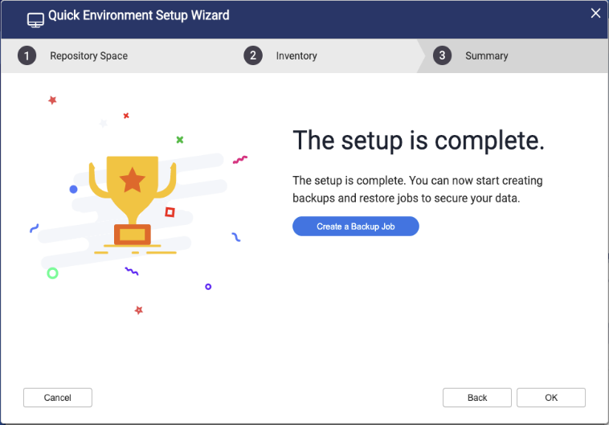
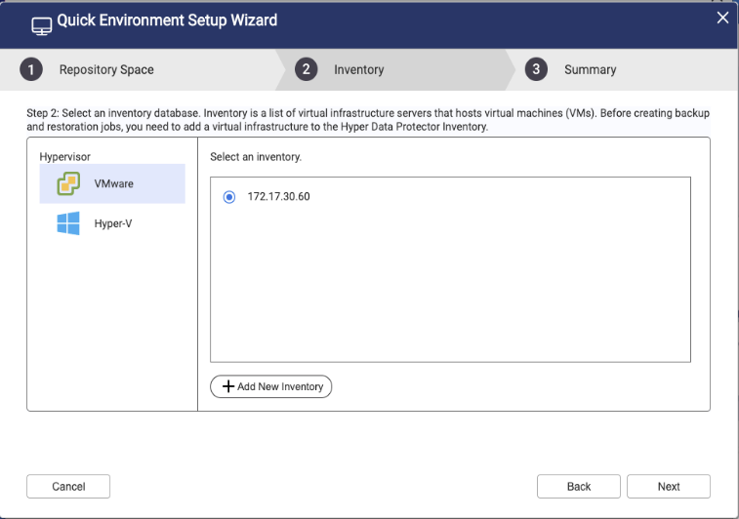
3-step wizard quickly guides you through initial environment setup
Quick environment setup wizard on quick start page when you first log in to HDP.
Configure repository space
Complete the initial setup of the backup environment
Add New Inventory
Notes:
分別飆出來

Slide 14
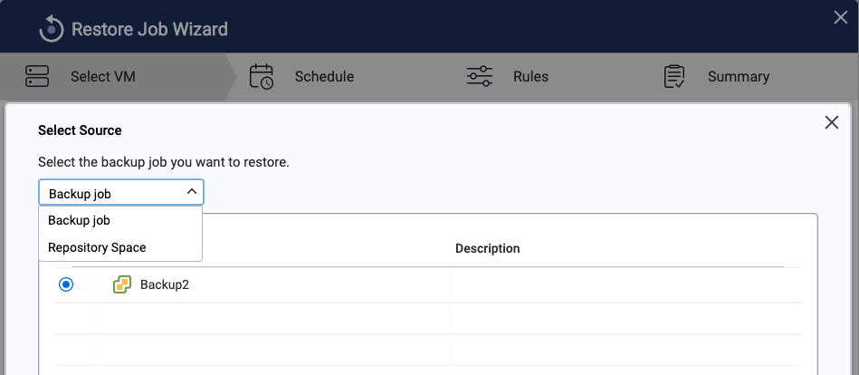
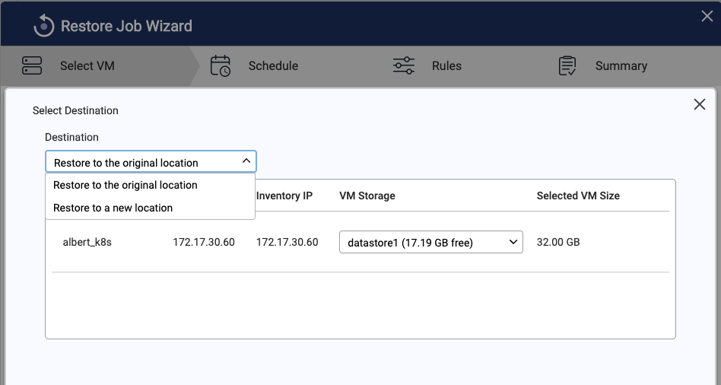
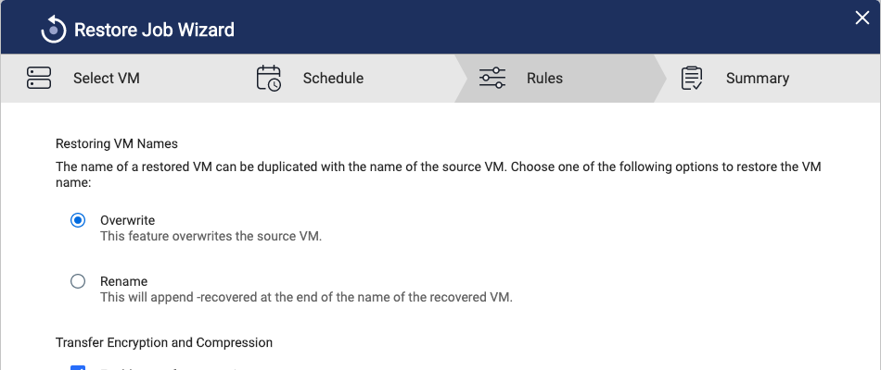
4-step restore wizard guides you through virtual machine recovery
Select Source
Select Destination
Restore Option
Form Backup job
From Repository
  Restore to original location
  Restore to new location
  Overwrite (Overwrites the source VM)
  Rename (Modify VM name after restore)
Windows 10 Hyper-V does not support restoring to new location

Slide 15
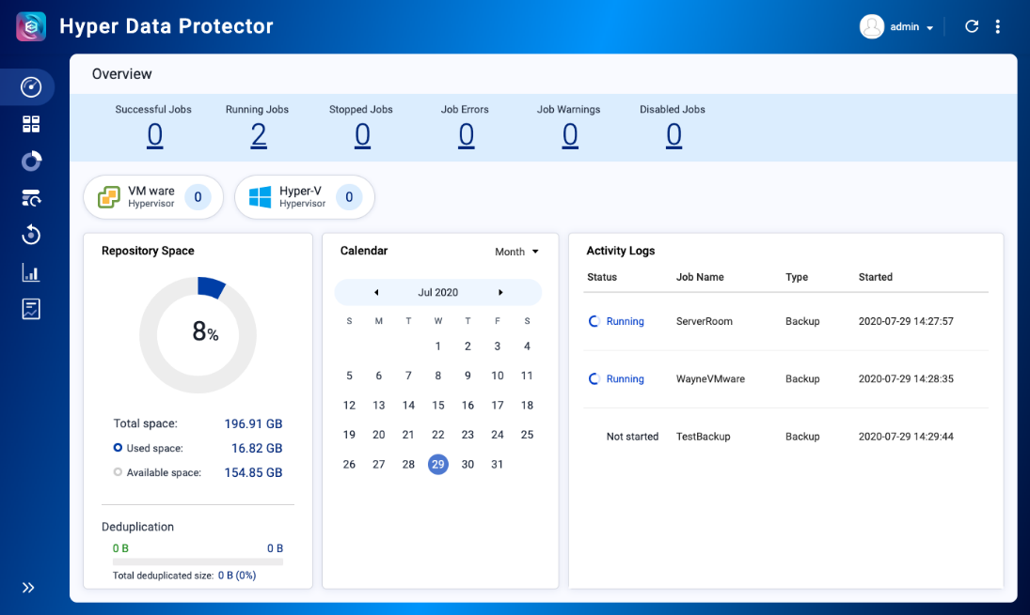
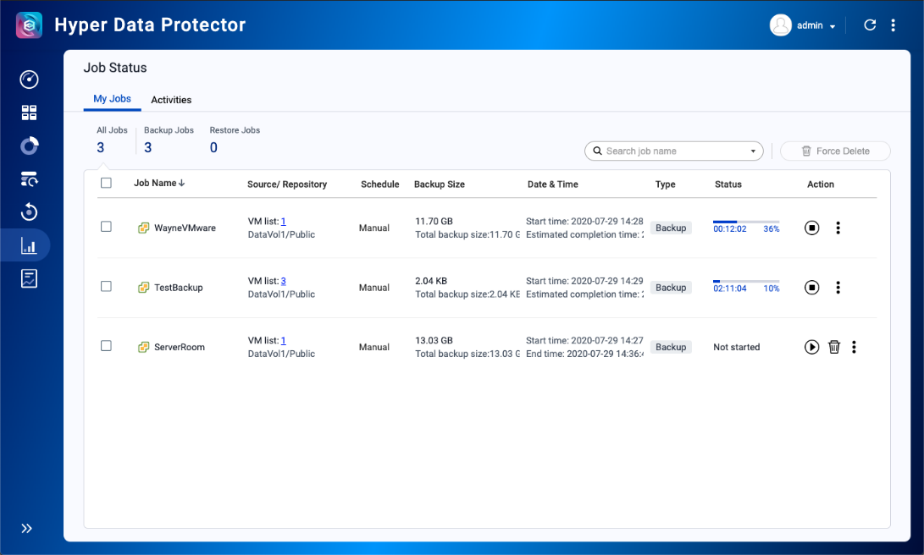
Intuitive & user-friendly interface for getting started quickly
Get job status in overview page
Quick and intuitive operation in job status page

Slide 16



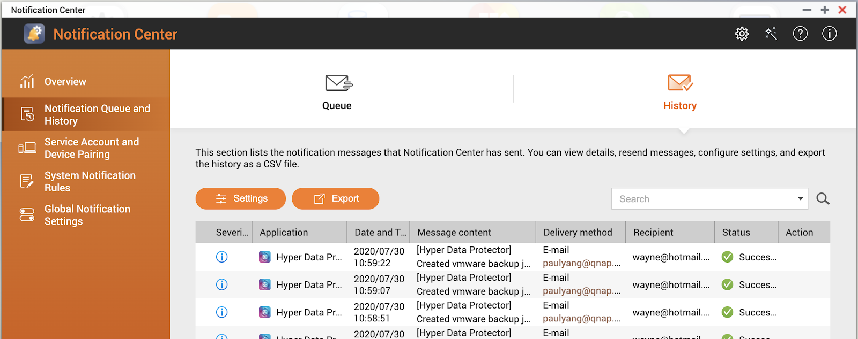

Integrated with Notification Center: stay updated about HDP status
Notification Center
  Email
  SMS
  Instant Messaging
  Push Service

Slide 17


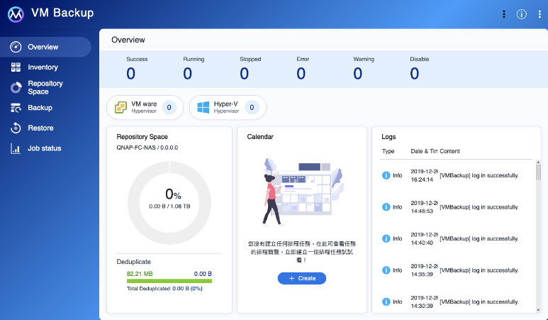

Slide 18
Voice of the customers we received from beta users
High-speed backup :
90% of Beta feedback users are satisfied with the HDP backup speed and complete the VM backup in expected time.
Reduce storage space :
80% of Beta feedback users are satisfied with deduplication and compression that can successfully reduce their storage space.
Easy-to-use interface :
More than 90% of Beta feedback users feel that our well-designed operation interface is easy to understand and easy to use.
Comments from Beta users ：
Very nice in a small company to have a backup recovery solution if the Master server fails
It's an excellent tool.
The product is very easy to use and a great solution for small businesses. I did notice it pushes older hard drives hard during a backup window but then again I am running an older NAS and drives. Product runs great even on a 4 year old NAS unit! Very happy overall and hoping that this can replace my Veeam server in my small business environment.
thanks for developing new technologies for QNAP

Slide 19

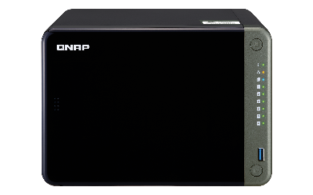
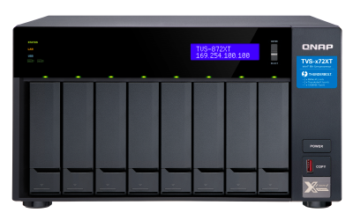
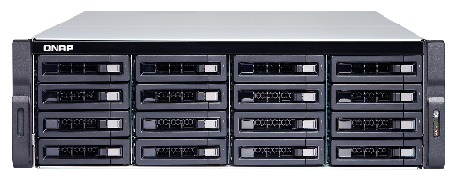
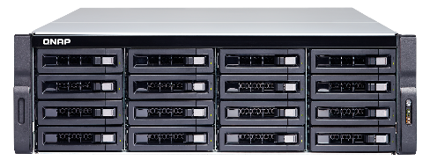
Recommended Model
HDP only supports QNAP NAS models with x86-based Intel or AMD processors
SMB Entry
SMB Mid-end
SMB High-end
Enterprise
TS-653D
TVS-872XT
TS-1683XU-RP
TDS-16489U R2
VMs: 30
Concurrent: 3 VMs
VMs: 100
Concurrent: 10 VMs
VMs: 200
Concurrent: 15 VMs
VMs: 500
Concurrent: 20 VMs
Intel® Celeron® J4125 quad-core 2.0 GHz processor
8 GB SO-DIMM DDR4 (2 x 4 GB)
6 Drive Bays
Intel® Core™ i5-8400T 6-core 1.7 GHz Processor
16 GB SODIMM DDR4 (2 x 8 GB)
8 Drive Bays
Intel® Xeon® E-2124 quad-core 3.3 GHz processor
64 GB UDIMM DDR4 ECC (4 x 16GB)
16 Drive Bays
E5-2620 v4 8-core 2.1 GHz processor x2
64GB RDIMM DDR4 (8 x 8GB)
16 Drive Bays
Only Hyper Data Protector is installed after device initialization
Notes:
建議的同時備虛擬機份數
Commvault system requirement: https://documentation.commvault.com/commvault/v11_sp8/article?p=system_requirements/commcell_sizing/commserve.htm
Veeam system requirement: https://helpcenter.veeam.com/docs/backup/vsphere/system_requirements.html?ver=100
Veeam Sizing and System Requirements: https://www.veeambp.com/backup_server_introduction/backup_server_sizing
TS1886 SMB
TSH-1283XU企業級

Slide 20
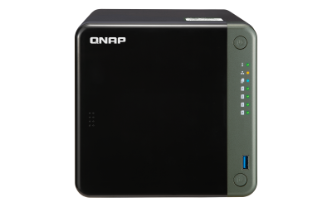
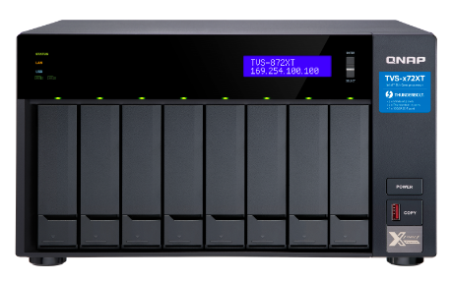
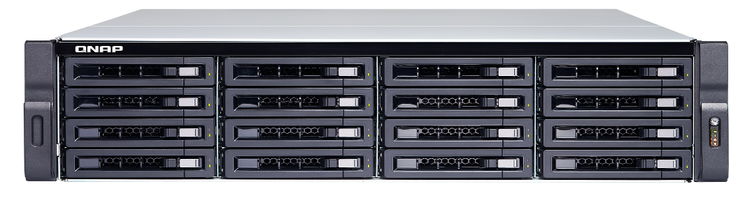
總結
QNAP NAS 提供Hyper Data Protector主動式備份中央控管系統
您的虛擬機備份最佳選擇

