Slide 2
ZFS Operating System
QuTS hero

Slide 3

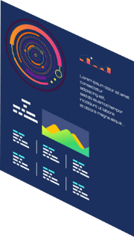


The 16/24 bays QuTS hero dedicated machine :
Why we choose ZFS file system for our enterprise NAS
Because we know that enterprises all value these ...
Enterprises have used a lot of All Flash solutions, and SSD consumption has become the key to IT cost structure
Digital transformation relies on massive data analysis and requires PB-level storage space
Corporation data cannot allow
unintentional error; it is essential to
ensure data integrity.
Instant disaster recovery capability & complete data backup protection are the competitiveness indexes of an enterprise

Slide 4





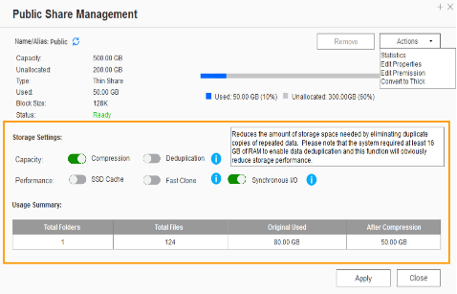



Powerful data reduction:
Extend the SSD endurance
Only available when inline process before writing
ZFS file system with inline deduplication compression features.
The ZFS file system can be the best choice to pair with the all-flash and SSD storage because it reduces the data size and pattern that need to be written to the SSD directly.
Write
A
B
C
D
A
B
C
D
A
B
C
D
D
C
A
B
D
C
A
B
Original Data
Compressed Data
Deduplicated Data
SSD Pool
Compression
Deduplication
Write to SSDs as sequential as much as possible.

Slide 5







Amazing massive storage:
The best data carrier of big data analysis/edge computing/AI inference
Only PB-level shared folder is enough to store the huge data matrix .
200TB
Is not enough
Data
Model building
Model validation
Parameter adjustment
Deep Learning

Slide 6




Silent data corruption & self-healing
Application
Application
Application
ZFS RAID
ZFS RAID
ZFS RAID
Avoid data slient corruption that occurred on running system

Slide 7

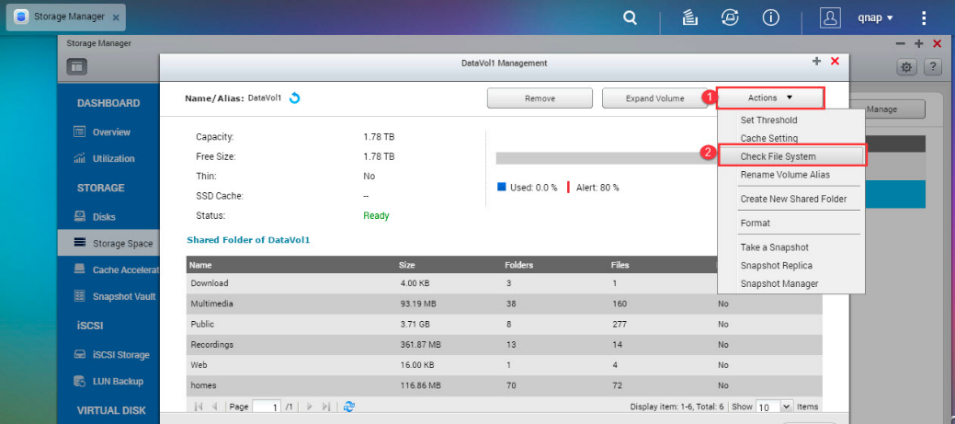
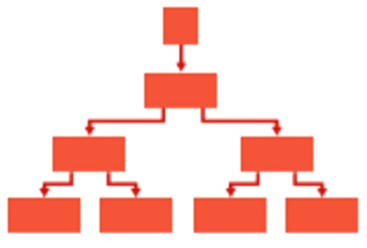
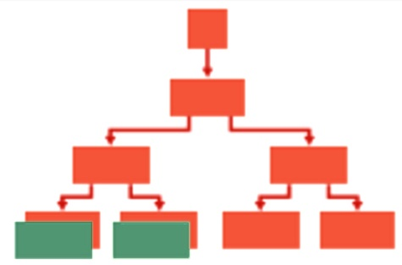


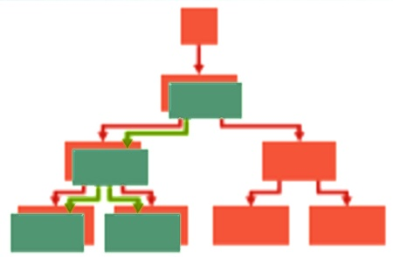
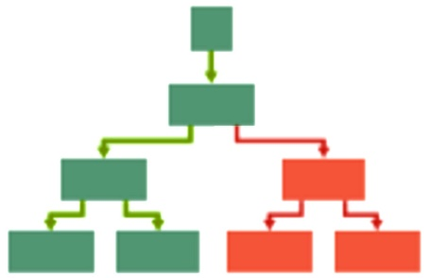
Need to check the file system?
COW (copy on write) avoid data loss that occurred on power outage
ZFS has no need to use traditional journal to protect metadata, because they are never updated in-place.​
ZFS does not need FSCK (file system check)​
Original block structure
COW new block when modifying
Redirect to new block after writing
Delete the old block data
No more file system checking

Slide 8
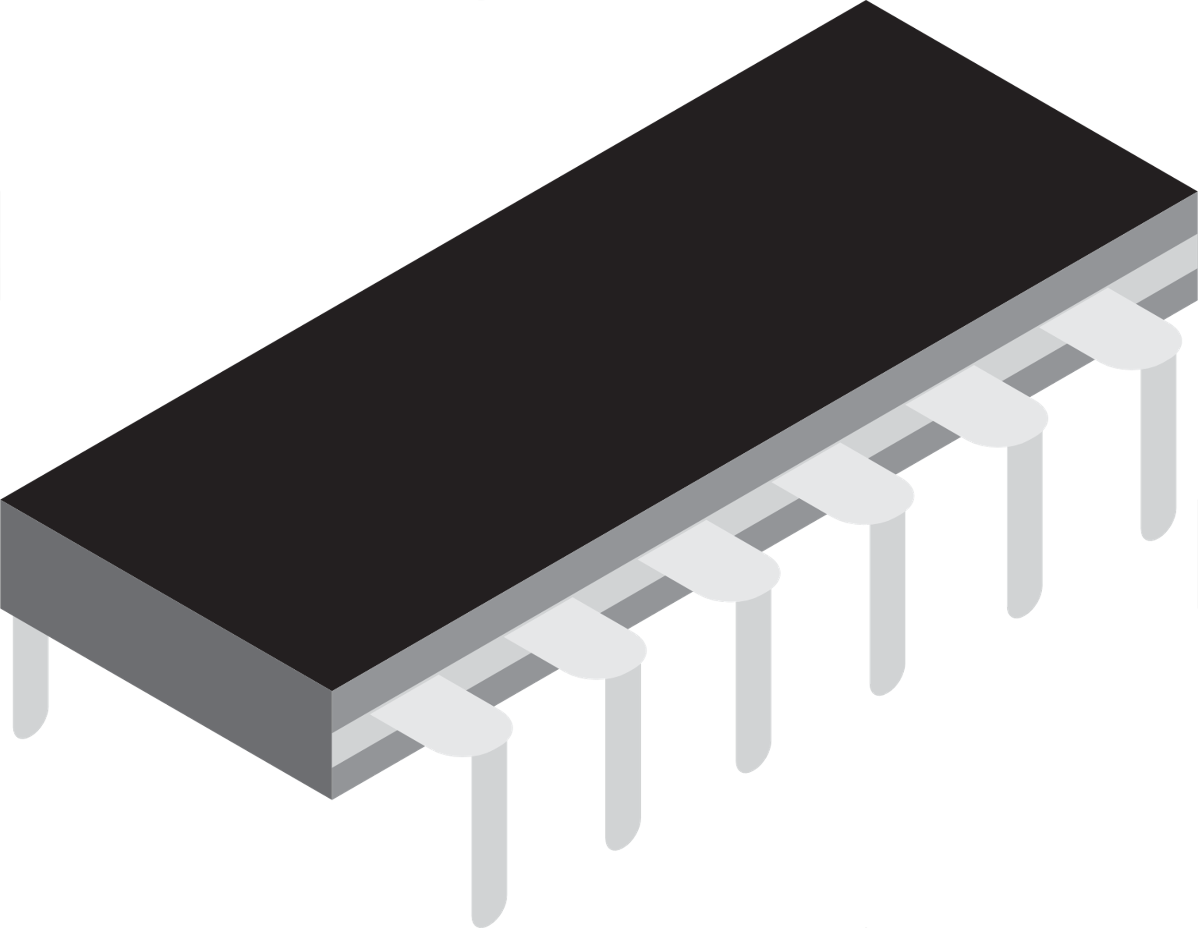
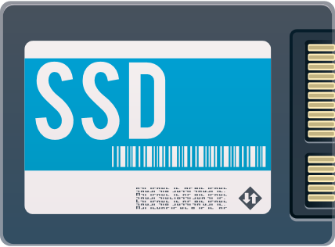
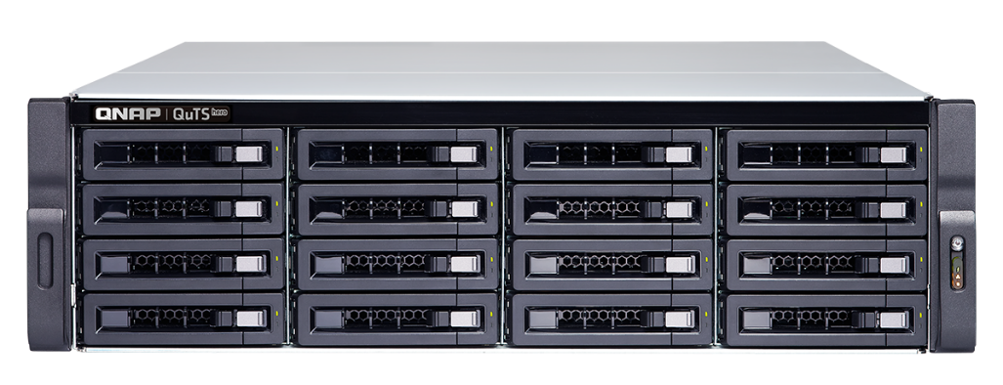
L2ARC cache, and ZIL which provide power loss protection
Layer-2 Adaptive Replacement Cache: (L2ARC) ​
RAM Cache
SSD write journal
ARC
RAID 1
Mirror
Ideal for SSD read cache​​
Large "hybrid" cache​​
Read performance enhancements​
SSD Read Cache
L2ARC
ZIL
Disk
ZFS Intent Log: (ZIL) ​
Ideal for SSD write log​
Write Data integrity​ (COW)
Provides the power loss protection for writing data.
Storage Pool

Slide 9








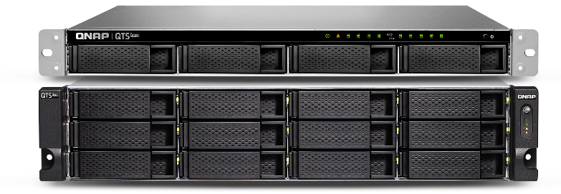
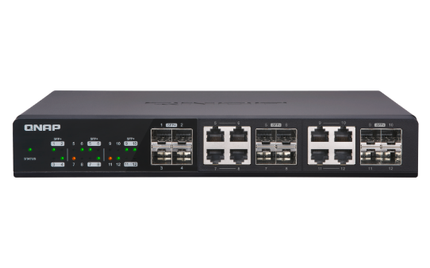

Three-layer backup solution :
Provide you the most complete data backup protection
HBS 3 :
File level, multi-version management
RPO : daily / schedule
Snapshot & Replica:
Block level, multi-version management, ZFS provides the most lightweight snapshot without affecting storage performance at all.
RPO : hourly
SnapSync:
Block level, Mirror the data copy and always kept up to date.
RPO : Real-time
QTS 4.4.x

Slide 10






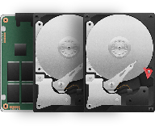
SnapSync – cost-effective unified replication solution built into QuTS hero for backup, data protection & disaster recovery
Schedule SnapSync: 5min~60min
Realtime SnapSync: RPO=0
Realtime SnapSync: RPO=0
Production Server
4
(Write ok)
Normal
Normal
Disaster Recovery (RPO=0)
1
Memory of
Primary NAS
(Write ok)
3
3
(Write ok)
By schedule
2
Snapshot send
2
Primary NAS
Secondary NAS
Primary NAS
Real-time Snapshot
Secondary NAS
Primary NAS
Secondary NAS
(Round Trip Latency < 5ms)

Slide 11





The benefit of SnapSync
Lowest RPO
Real time replication - Reduce downtime and protect against data loss
Cost Efficiency
Flexibility & Scalability
Reduce Cost & Network Bandwidth Utilization : built-in compress/dedup for transmission
Distribute big Amount of Data easily for enterprise data migration and copy
Data Independence &
Consistency
Reliability & Compliance
Data retention, compliance, and multi-version requirement
SnapSync
CDM (Copy Data Management) for Data analytics

Slide 12

WORM (Write Once Read Many times)
WORM is used to avoid modification of saved data. Once this feature is enabled, data in shared folders can only be read and cannot be deleted or modified to ensure data integrity.
  Enterprise Mode : remove the shared folder through QTS hero UI or SSH commands (QCLI).
  Compliance Mode : Have to take the Storage Pool offline and remove the Pool if want to destroy data.

Slide 13



Pool over-provisioning
Improve the performance for fragmented pool (The scenario when big block write to HDD )
w/o OP
w/ OP
A
B
C
D
F
G
H
I
Pool free space
Pool free space
Reserved
space
E
E
E
E
P1
P2
P3
Write Data E to reserved space then remove Data H (recycle planning) to keep same reserved size
Data E put discretely
A
E
B
E
C
E
D
F
G
H
I
E
P3
P1
P2
Pool free space
Pool free space
Reserved
space

Slide 14




Pool over-provisioning
Improve the performance for fragmented pool (The scenario when small block write to SSD)
w/o OP
w/ OP
A
B
C
D
F
G
H
I
10%
Pool free space
Pool free space
Reserved
space
E
1. Move Data C, Move Data B, then Data A
2. Write Data E
1. Write Data E to reserved space, return ok.
2. Move Data I to keep same reserved size.
E
A
B
C
D
F
G
H
I
E
10%
Pool free space
Pool free space
Reserved
space

Slide 15
QuTS hero NAS
The ZFS QNAP NAS

Slide 16

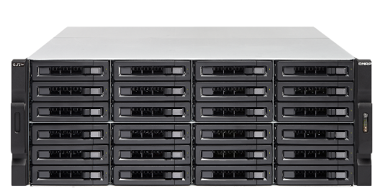
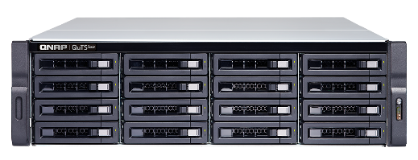


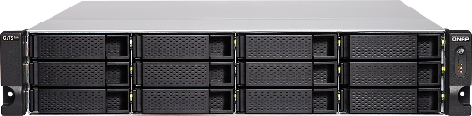
QuTS hero Rackmount NAS
1U
2U
3U
4U
GM-1000
TS-h1283XU-RP
TS-h1683XU-RP
TS-h2483XU-RP
TS-h977XU-RP
TS-h1277XU-RP
TS-h1886XU-RP

Slide 17

QuTS hero Desktop NAS
TS-h886
TS-h686

Slide 18



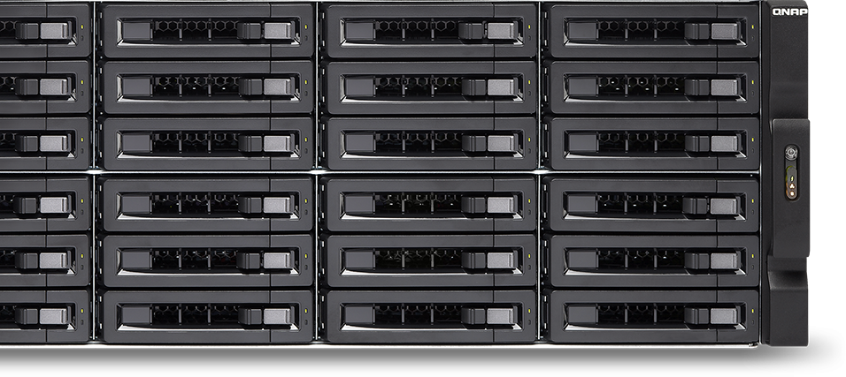
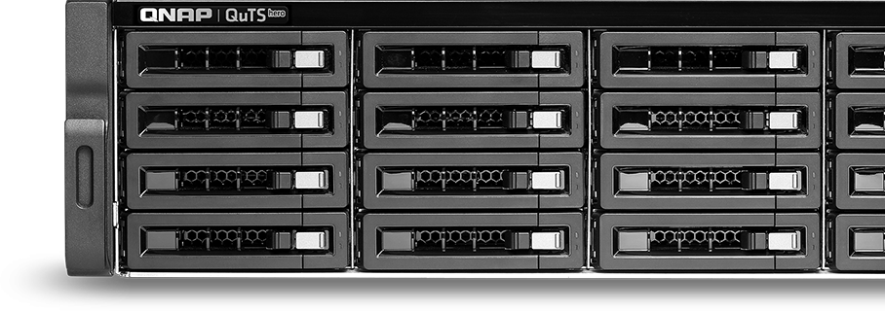

Slide 19

Intel Xeon E-2236 Enterprise Processor
Intel® Xeon® E-2236
  6-core / 12-thread processor
  3.4 GHz, max boost to 4.8 GHz

Slide 20
Support ECC Memory (Error Correcting Code)
Running reliably without data corruption
Intel Xeon processors support ECC which automatically detects and repairs single-bit error on-the-fly.
Supports up to 128GB

Slide 21



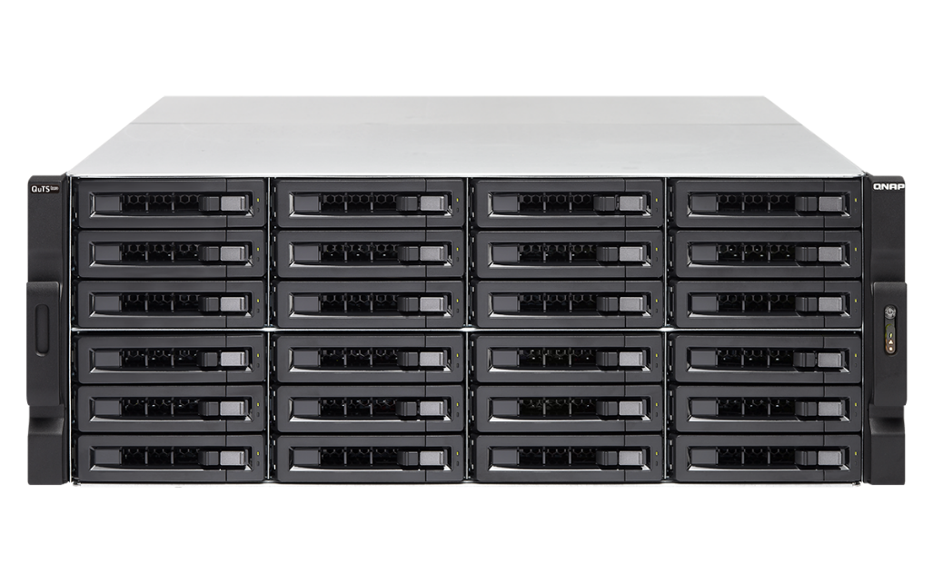
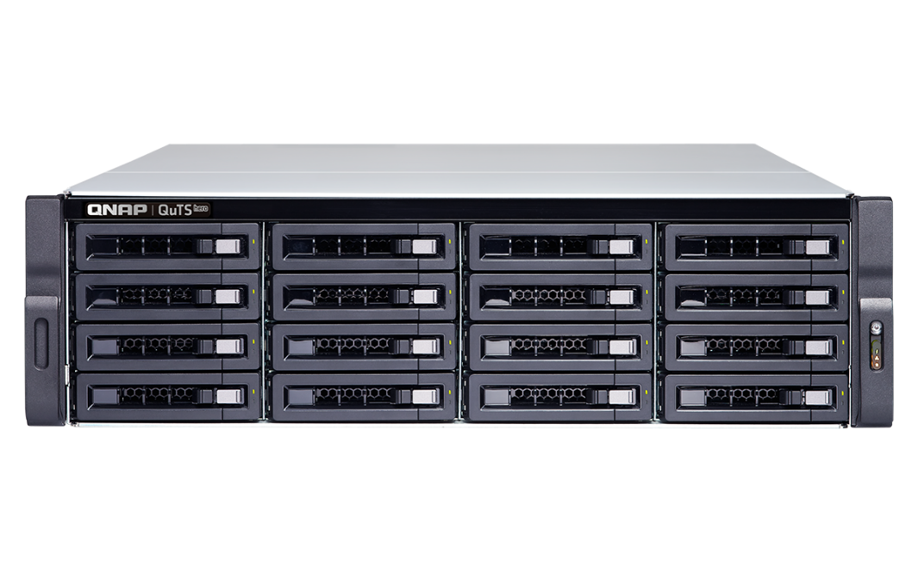
Specifications
Intel Xeon E-2236 6-core/12-thread, 3.4 GHz processor, max boost to 4.8GHz
128GB DDR4 ECC RAM
2 x 10GbE SFP+, 2 x 10Gbase-T LAN port
Intel Xeon E-2236 6-core/12-thread, 3.4 GHz processor, max boost to 4.8GHz
128GB DDR4 ECC RAM
2 x 10GbE SFP+, 2 x 10Gbase-T LAN port

Slide 22



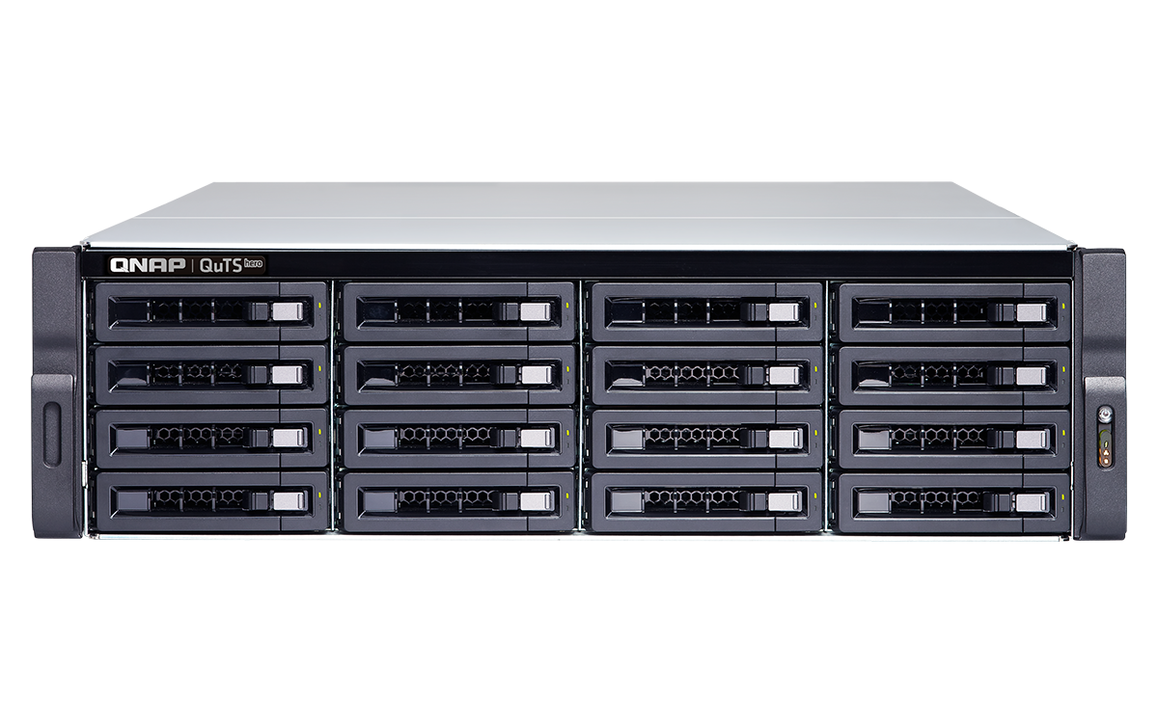
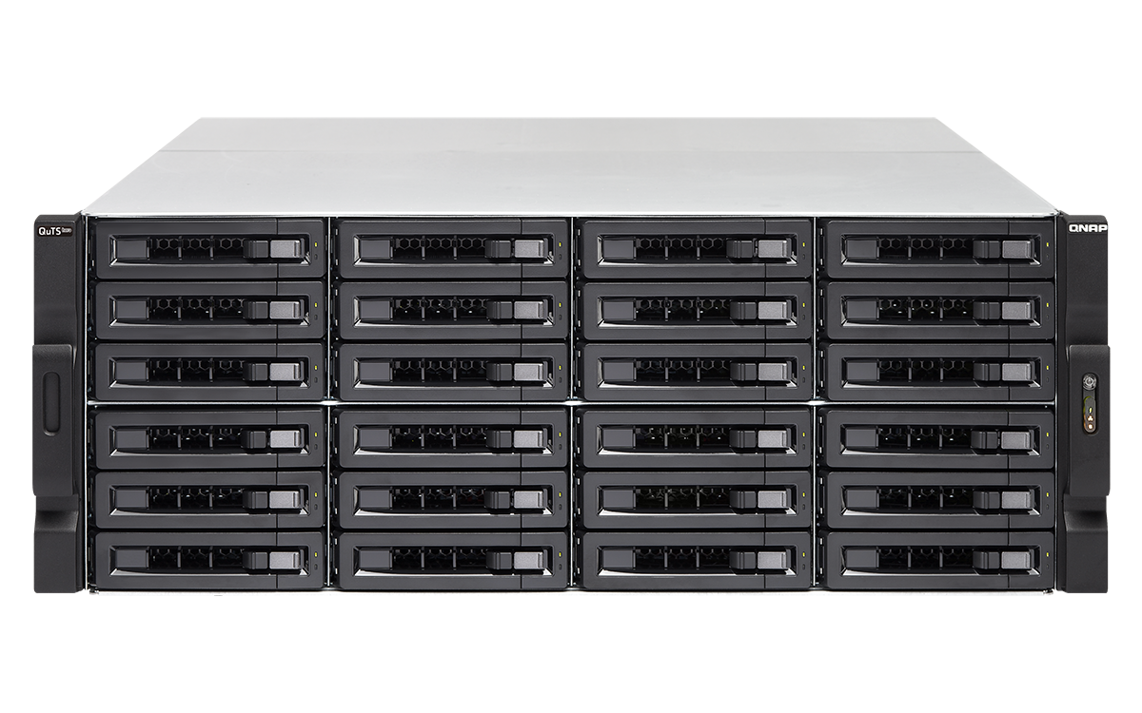

TS-h1683XU-RP/ TS-h2483XU-RP Front View
Power switch
LED indicators:
system status, network, external expansion enclosures, disks
4U
3U

Slide 23
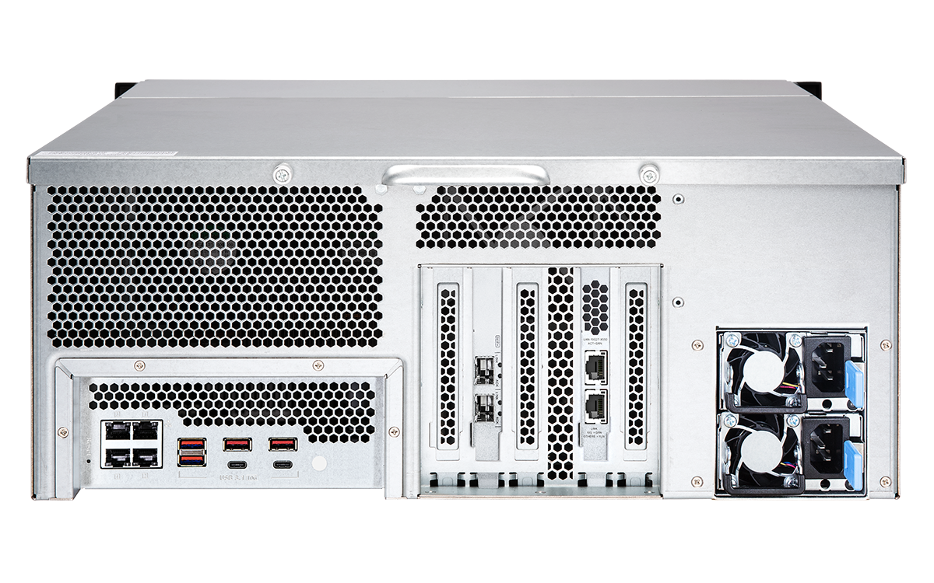


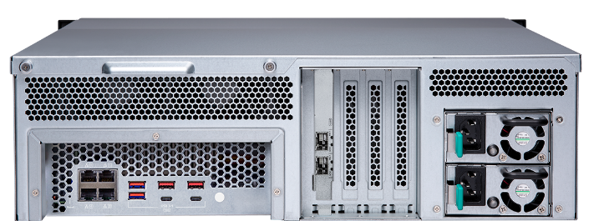
TS-h2483XU-RP/ TS-h1683XU-RP Rear View
2 x 10GbE SFP+ SmartNIC port
2 x 10Gbase-T port
TS-h2483XU-RP
Redundant
PSU
4 x 1GbE
ports
TS-h1683XU-RP
USB 3.2 Gen 2 (10G) Type-A & Type-C port

Slide 24

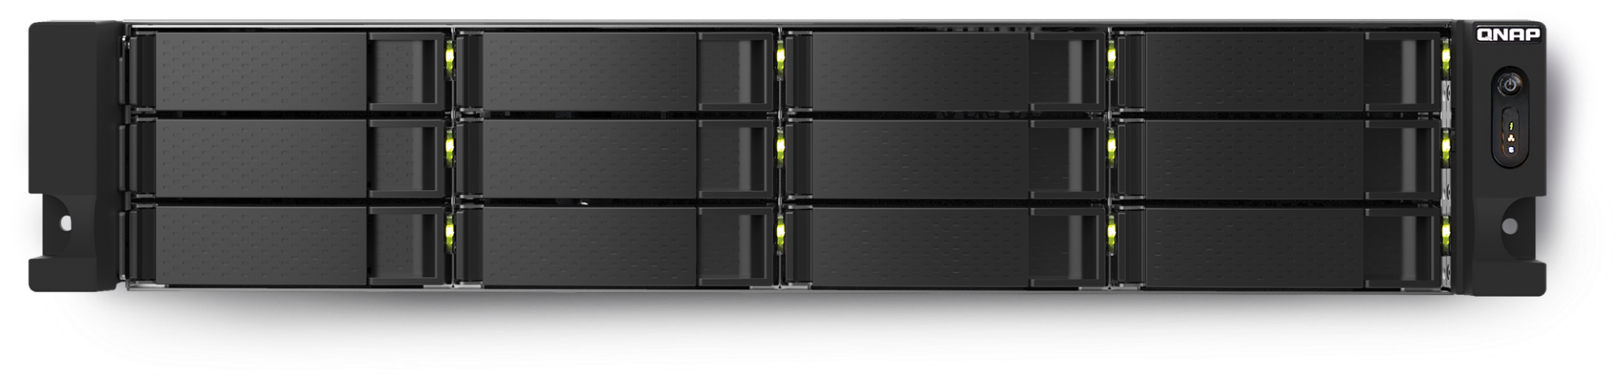


Notes:
CPU logo
QuTS hero
10Gbe

Slide 25
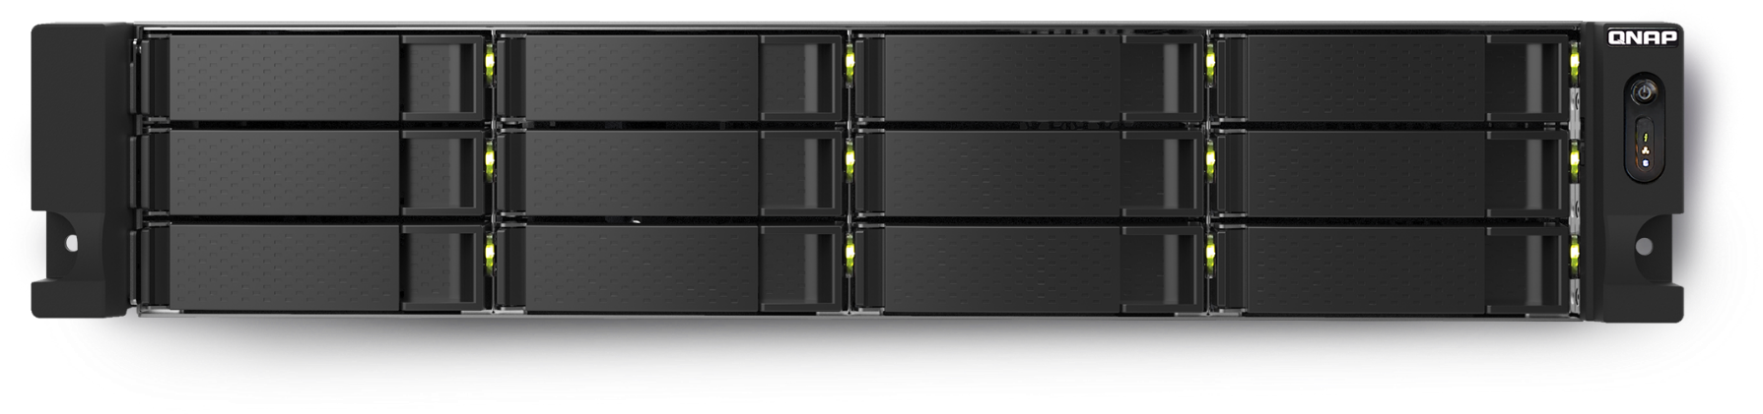
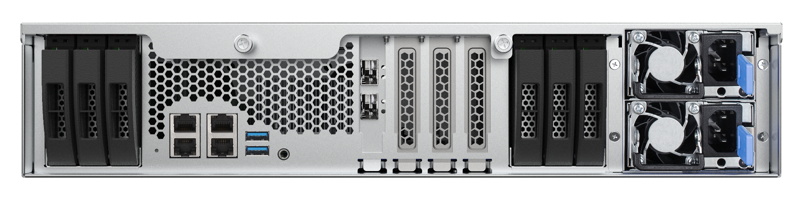
TS-h1886XU-RP
  Best NAS for SSD caching
  12 x 3.5”HDD slot
  Up to 192 TB raw capacity*
  *calculate by 16TB disk
  6 x2.5”SSD slot
  Free front HDD slots for storage capacity

Slide 26
Intel Enterprise Xeon D Processor
Intel® Xeon® D-1622
  4-core / 8-thread processor
  2.6 GHz, max boost to 3.2 GHz

Slide 27
Support ECC Memory (Error Correcting Code)
Running reliably without data corruption
Intel Xeon processors support ECC which automatically detects and repairs single-bit error on-the-fly.
Supports up to 128GB

Slide 28
TS-h1886XU-RP Rackmount NAS
Intel® Xeon® D-1622 4-core /
8-thread 2.6 GHz processor, max boost to 3.2 GHz
32GB DDR4 ECC RAM (2 x 16GB)
2 x 10GbE SFP+ port

Slide 29
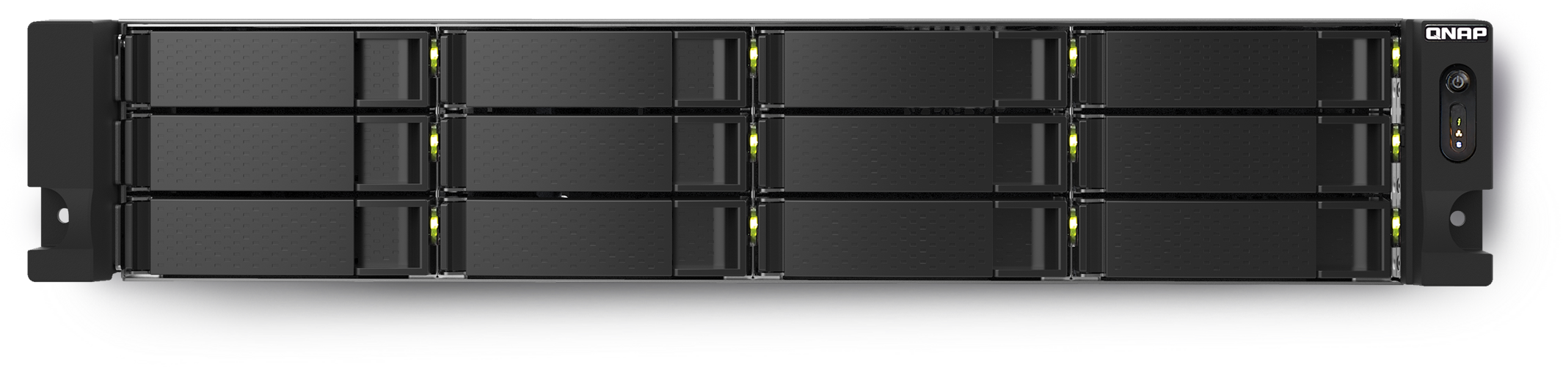
TS-h1886XU-RP Front View
12 x 3.5”/2.5” SATA 6Gb/s HDD port
Power Button
LED indicator:
System status, network, storage expansion, HDD

Slide 30
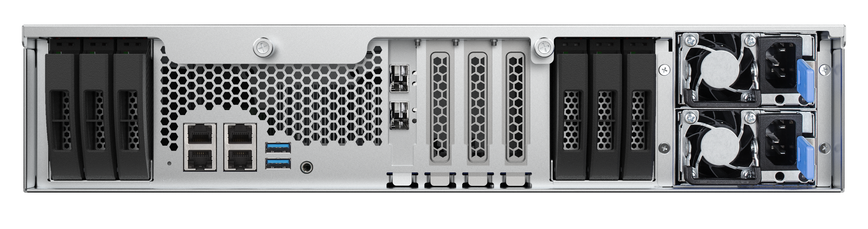

TS-h1886XU-RP Rear View
6 x 2.5”SATA 6Gb/s SSD port
550W redundant PSU
4 x 1 GbE port
3 x PCIe slot
2 x USB 3.2 Gen 1 port
2 x 10GbE SFP+ port

Slide 31

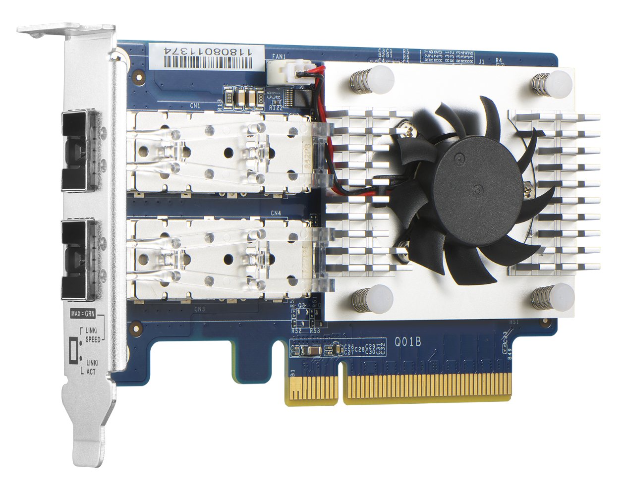
Broadcom BCM57412 NIC
NetXtreme®-E Series PCIe 3.0 network
2 x SFP+ 10GbE port
Supports RoCE v1/ v2

Slide 32

TS-h1886XU-RP Internal Design
PCIe slot X 4
DDR4 memory DIMM X 4
Intel Xeon D
processor
Air ductX2
Fan ( 6 cm 17K RPM )
X 3

Slide 33
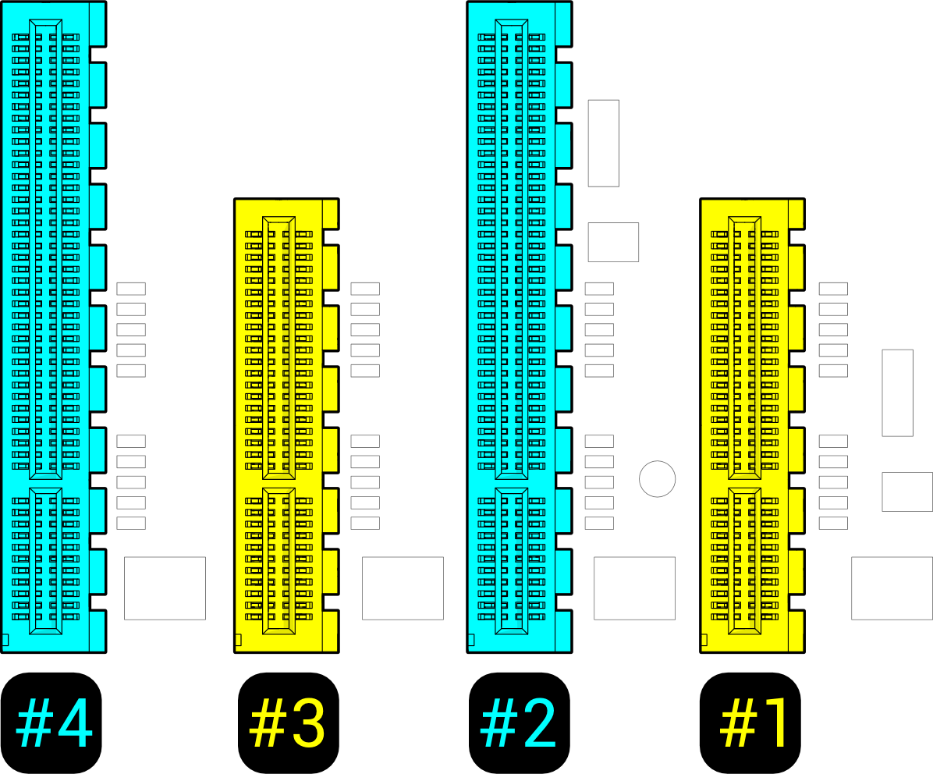
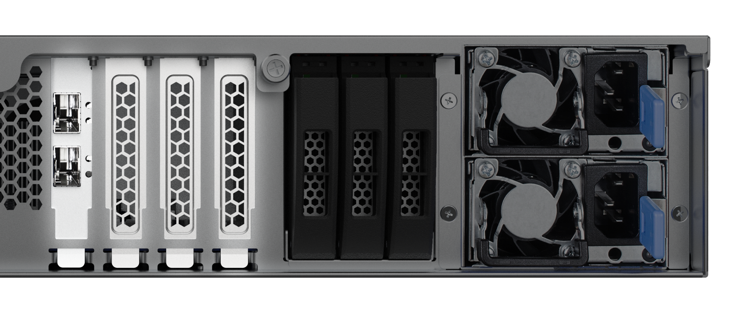




PCIe Slot Specification
Supports 4 x PCIe Gen3 slots
Versatile expansion ability
PCIe x8 or x4
PCIe x8 or x4
PCIe x4
PCIe x4
A 10GbE adapter is preinstalled in slot 4
Slot 2 and 4 provides the width of PCIe Gen.3 x8 when Slot 1 and 3 is not in use.

Slide 34



Versatile Expansion Possibilities
QNAP QM2
expansion card
40/25/10GbE
network adapter
Fibre channel adapter
USB 3.1 Gen 2
expansion card
SAS 12Gb/s
expansion card

Slide 35
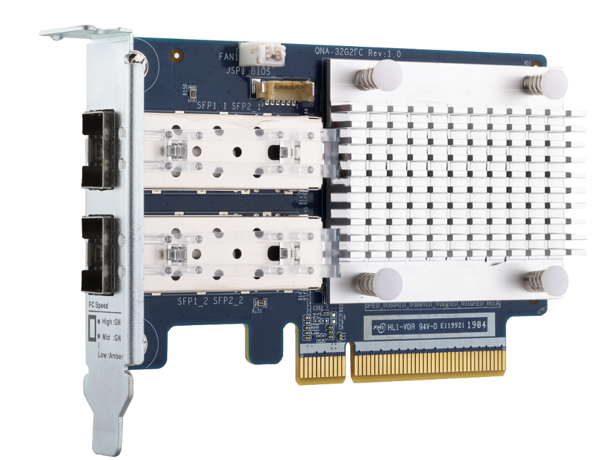

QNAP 32Gb/16Gb Fibre Channel HBA
QNA-32G2FC
Dual-port 32Gbps
FC adapter
High-speed yet economical QNAP FC storage adapters for QNAP NAS*
QNA-16G2FC
Dual-port 16Gbps
FC adapter
*Not supporting Windows/Linux hosts
Optional FC Transceiver
TRX-32GFCSFP-SR
  32Gb/16Gb/8Gb
TRX-16GFCSFP-SR
  16Gb/8Gb/4Gb

Slide 36


iSCSI & Fibre Channel User Scenario
Production Server (s)
Server
伺服器可以透過iSCSI 取資料
FC
Backup Server
LAN
QNAP NAS
QNAP NAS
SAN Fabric
SnapSync
LUN
LUN
Snapshot Replica for offsite backup
SAN Storage
Scheduled Snapshot for local protection (either LUN is access via iSCSI or FC)
SSD Cache
Overprovisioning
LUN
LUN
LUN
Notes:
Snapsync 的資料可以立即使用，降低load. No need to recover

Slide 37
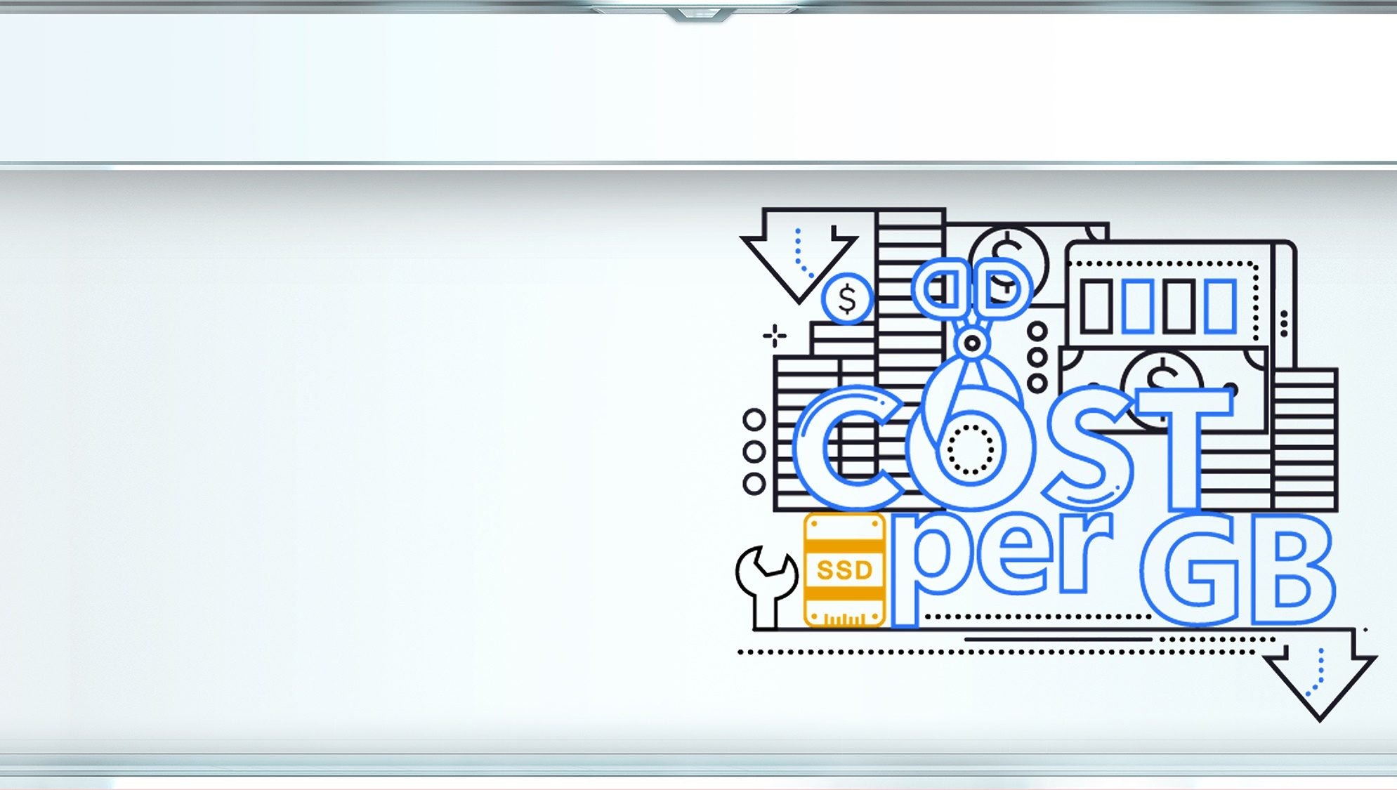
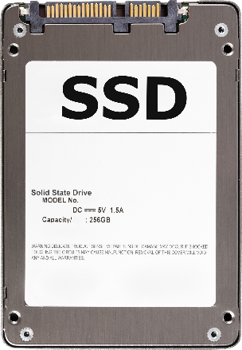


Improve System IOPS with SSD Cache
The economic way to improve system performance
Supports Read-only cache, Read cache and Write journal
Support more than a Folder/LUN at the same time
No interruption of storage services when replacing SSD

Slide 38








QNAP Cloud Gateway
File-based Cloud Gateway
HybridMount
Block-based Cloud Gateway
VJBOD Cloud
Multi-point file sharing and syncing
Local data cloud backup
Protocol conversion
Low-latency access
Multi-cloud management
Storage space transformation
Snapshot Protection
Local service uninterrupted

Slide 39
























QuTS hero cloud storage gateway and mount
VJBOD Cloud
Block-based Cloud Gateway
Cloud Storage​
Customer​
File System​
Object Storage
Object Storage
Object Storage
Block Access​
iSCSI
Target
LUNs
Dedicate​
Stored space​
Object Storage Connector
Ethernet
Snapshot
本地伺服器
Local​
Applications​
File Access​
VJBOD Cloud​
Volume​
(EXT4 File System)​
Dedicate​
Stored space​
Object Storage Connector
File Services​
Snapshot
SMB
HybridMount (Mode 1)
File based Cloud Gateway​
NFS
Cloud File​
Storage​
Cloud File​
Storage​
Cloud File​
Storage​
Dedicate​
Cache space​
File Access​
AFP
Virtual​
File System​
Object Storage Connector
Local Users​
File Access​
Dedicate​
Cache space​
FTP
Cache Engine
Cloud File Connector
Web
DAV
Local Disks/SSDs
Remote Storage
Qsync
HybridMount (Mode 2)
File Station Mount
WebDAV
Cloud​
File​
Connector​
File
Station
SMB
NAS
File Access​
File Access​
File Station Access​
Remote​
File​
Connector​
Qfile
FTP
Data Center

Slide 40

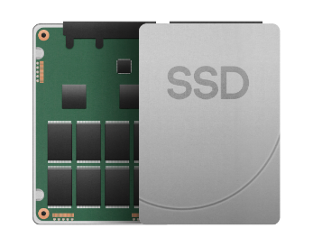
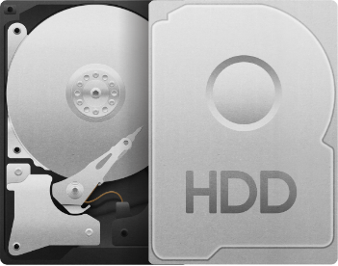







Cloud Gateway and NAS in a Box
Cloud File Storage
SSD volume for cloud gateway
HDD volume for local service
Cloud Object Storage
SMB, AFP, NFS, FTP, WebDAV

Slide 41
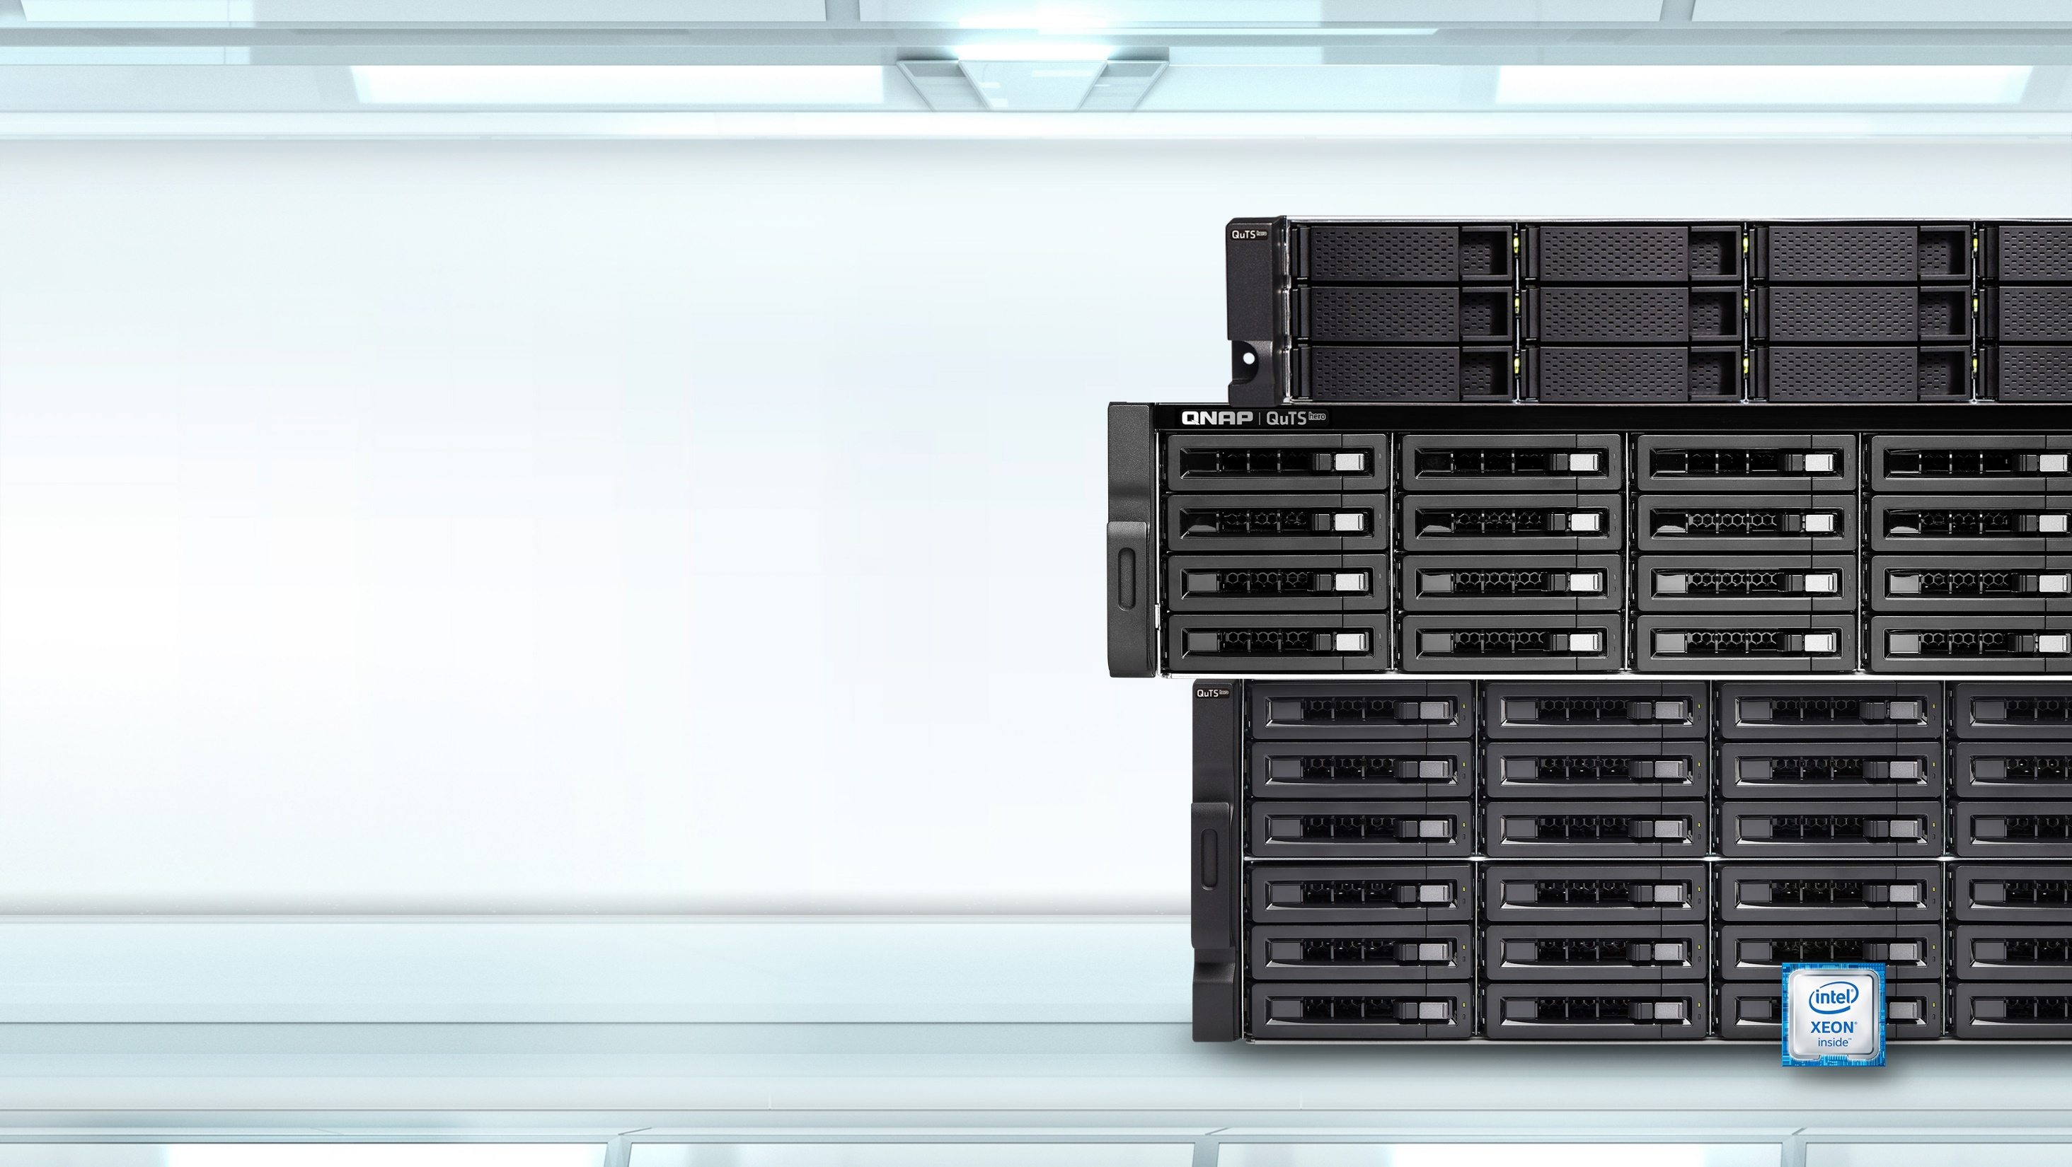



Copyright © 2020 QNAP Systems, Inc. All rights reserved. QNAP® and other names of QNAP Products are proprietary marks or registered trademarks of QNAP Systems, Inc. Other products and company names mentioned herein are trademarks of their respective holders.

Slide 42
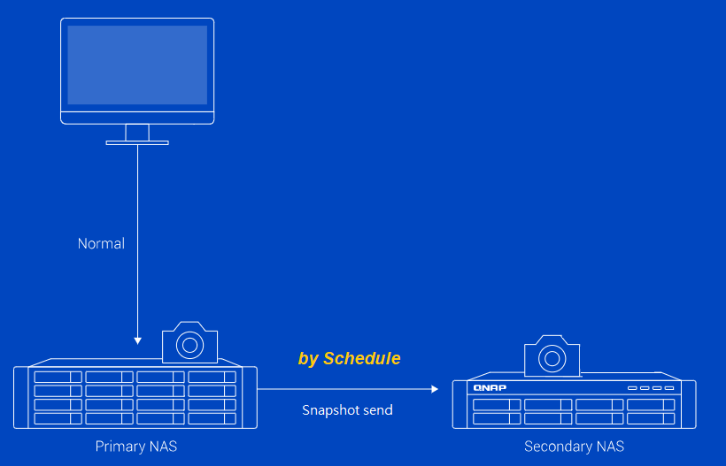
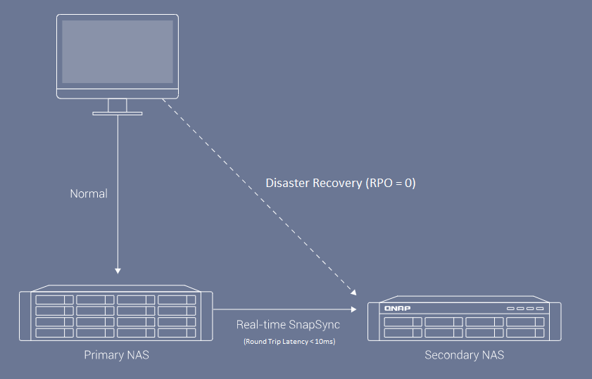
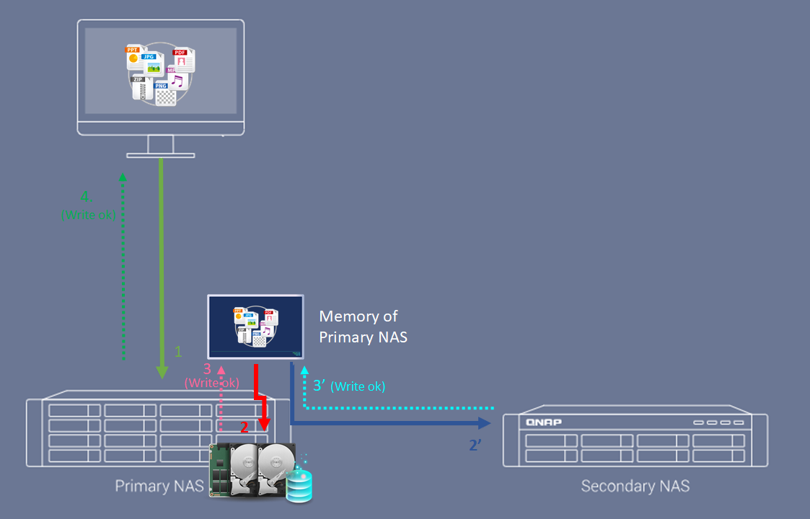
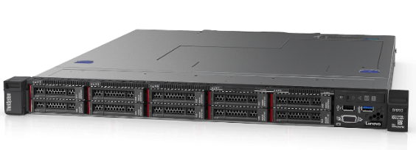
Snapsync – 最經濟高效的複合式備份，數據保護和災難復原解決方案
換成獨立圖示
Schedule Snapsync: 5min~60min
Realtime Snapsync: RPO=0
Production Server
(Round Trip Latency < 10ms)

Slide 43
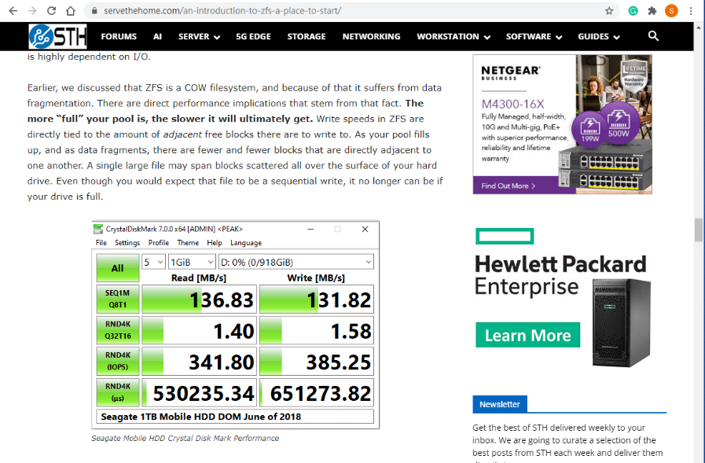

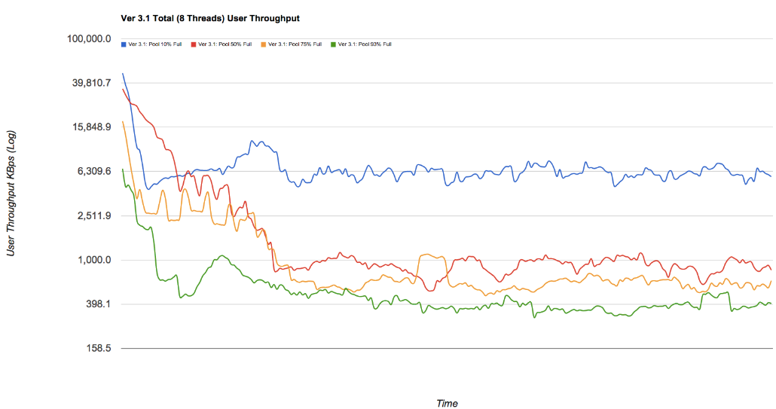
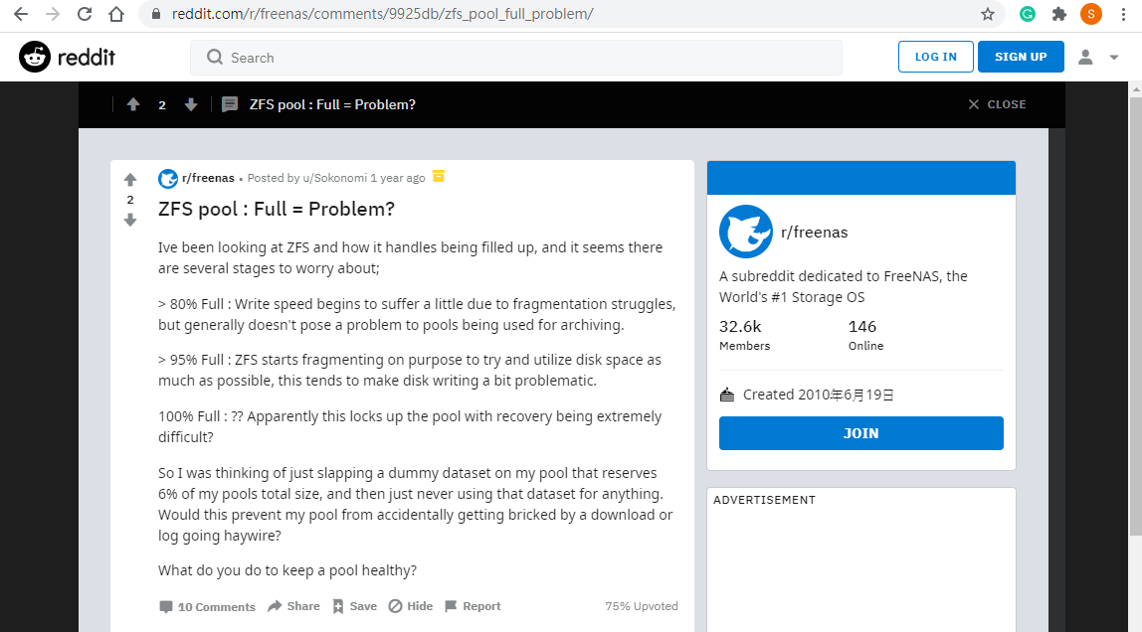
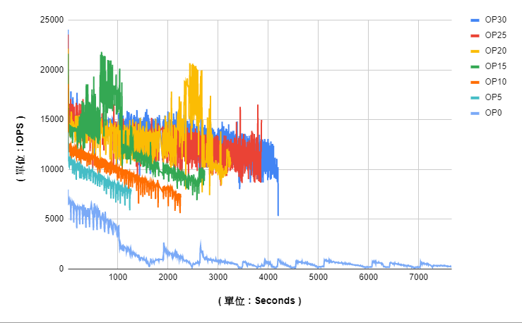

提供彈性化超額配置Pool over-provisioning
克服標準ZFS會遇到的容量寫得越多時的效能下降問題
示意圖(待換DQV數據)

Slide 44
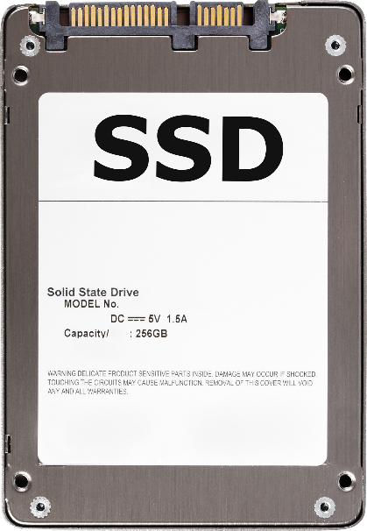
活用SSD​

