Slide 2
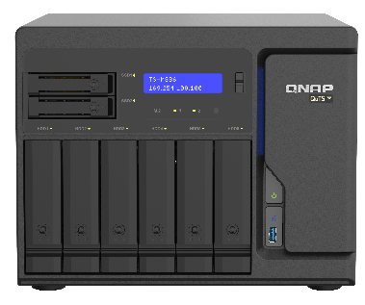
Voice of the customers we received
The R&D dept. produces a lot of data everyday; using 1Gbps cable for backup is too slow. how can I assign 10Gbps lines for the task?
I have set up the backup task last night, but it was failed at 10%; not until this morning I came to work did I realized this…
HQ NAS
I plugged in two 10Gbps cables, but HBS 3 only transfer data through the 1Gbps default gateway
Our company has 130TB of data and we transported the data through physical storage to the cloud, but HBS 3 can not recognize it for incremental backup

Slide 3
Summarize the problems from customers
Local → Local
Some physical network ports always at high load, but some are not (Poor efficiency).
Wanted to assign physical network port but have no idea how to do that .
Backup task be interrupted unexpectedly by network disconnection.
Local → Cloud
Transmit big data to cloud is time consuming.
Transmit big data through physical storage to cloud, but HBS 3 can not make incremental backup.

Slide 4
Backup needs to be fast and uninterrupted
Local → Local
Voice of the customer!!
Intelligent network optimize the existing.
Automatically select more available physical network port to avoid busy ports when job started.
Automatic switch to other physical network port when network interrupted, achieve uninterrupted backup process.
Assign HBS 3 backup flow manually.
Local → Cloud
Big data through cloud seeding to cloud can reduce the transmit time to two weeks.
Like normal backup operation of HBS 3, easy to achieve incremental backup.

Slide 5
Meet HBS 3
Latest QNAP NAS backup app (v12)

Slide 6
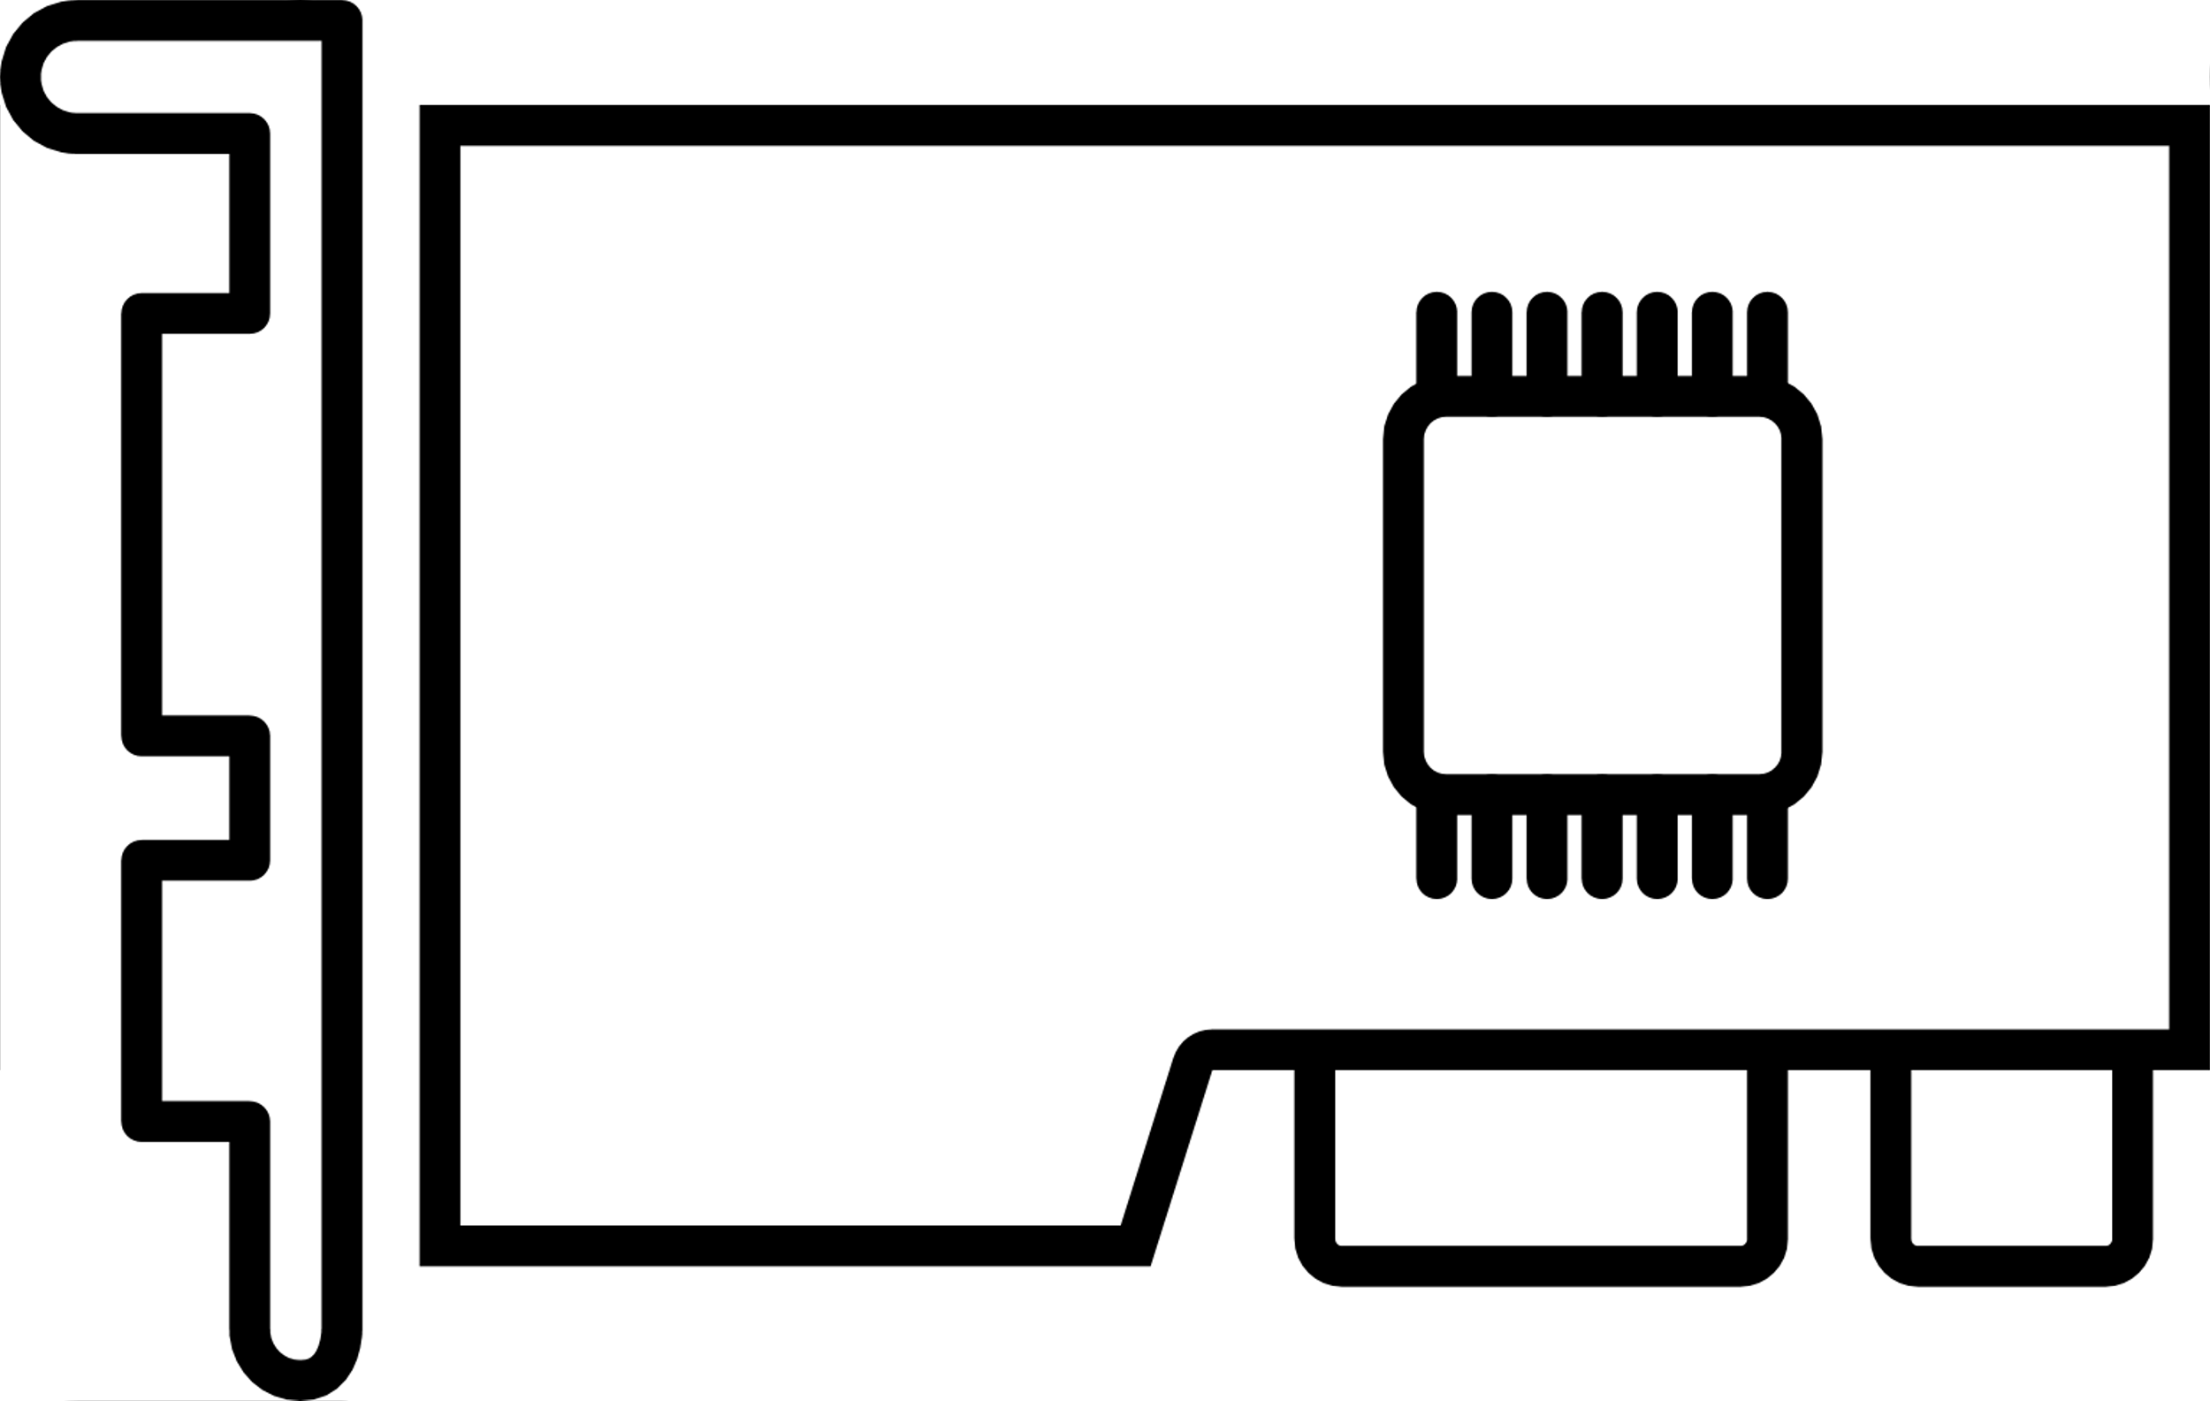
Intelligent network optimization architecture
Ask for the best physical network port
HBS 3
Job engine
HBS 3 Intelligent Network Analyzer
Provide the best physical network port
Analyze the best physical network port
Network Interface Assignment
eth0
eth1
eth2
ethN

Slide 7
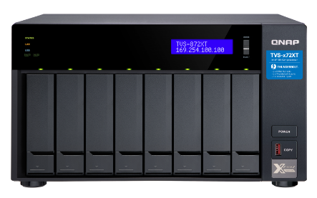
HBS 3 backup strategy always using default gateway as transmit port in the past few years
When backup job started, HBS 3 get the default gateway eth0(1 Gbps)
NAS default gateway is eth 0
The data flow through eth0 from NAS A to remote NAS B
eth0
1 Gbps
10Gbps
eth1
NAS A
NAS B
10Gbps
When eth0 disconnected then the job fails
Even NAS A has another active physical network port, still can not failover

Slide 8
Intelligent network optimization focus on Dedup Job to improve the behavior of HBS 3 transmission
HBS 3 Intelligent Network Analyzer
When job started, HBS 3 job engine ask for the best physical network port And the Intelligent Network Analyzer provide the best physical network path
When NAS A eth1 disconnected, the backup flow will failover to eth 0 to achieve continue process without interrupt When NAS A eth1 reconnecting, the backup flow will return to the best path eth1
eth0
1 Gbps
10Gbps
eth1
NAS A
NAS B
10Gbps
The data flow through eth1 from NAS A to remote NAS B
Dedup Job definition ：Backup job(click dedup function)

Slide 9
Intelligent network optimization can also failover on Non-Dedup Job
HBS 3 Intelligent Network Analyzer
When job started，HBS 3 job engine ask for the best physical network port
And the Intelligent Network Analyzer provide the best physical network path
When eth1 disconnected, the backup flow will failover to eth0 to achieve continue process without interrupt
eth0
FTP Rsync
1 Gbps
eth1
NAS A
10Gbps
The data flow through eth1 to remote server
Non-Dedup Job definition ：Backup job(without click dedup function), One-way sync, Active sync, Two-way sync

Slide 10
You can also assign physical network port manually
Default Gateway: eth0
HBS 3 assigned by manually: eth1
The default gateway will be chosen by using 1Gbps port, but you can assign other physical network port in HBS 3
eth0
172.17.20.117
CIFS/SMB
1 Gbps
eth1
172.17.20.12
HBS3 RTRR, Rsync, FTP
10Gbps

Slide 11
Intelligent network optimization

Slide 12
Hundred of Terabyte data transmit to cloud is time consuming
Big data transmission may take weeks or months by using backup software only.
For example：100TB data to cloud, upload speed is 20MB/s, it proximately take 58 days to finish.
Backup/Sync
Software
20MB/s
Daily increment
Cloud Service Provider
Transmission time：58 + ? days
10TB
(Day3)
4TB
(Day2)
100TB
(Day1)
Daily increment

Slide 13
The incremental backup problem when big data store in physical storage after transport to cloud data center
Store big data into external physical storage after shipping to cloud service provider, it may take two weeks to finish transmission. But the local backup software did not recognize cloud data, thus there has incremental problem.
AWS Snowball
Google Transfer appliance
Azure Databox…
Express delivery
Backup/Sync
Physical storage
Can not
incremental backup
Backup/Sync
Software
Cloud
Service Provider
10TB
(Day3)
4TB
(Day2)
Daily increment
100TB (Day1)

Slide 14
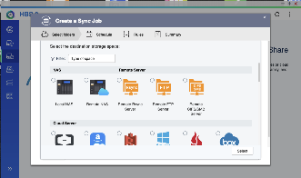
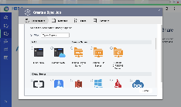
QNAP HBS 3 Cloud Seeding solution focus on hundred of Terabyte data transmission to cloud
Create CIFS/SMB storage space for physical storage devices in HBS 3, and backup/sync these data into physical storage through HBS 3
Express delivery the physical storage to cloud data center
AWS Snowball
Google Transfer appliance
Azure Databox…
Physical storage
Sync：Create a sync job to cloud Backup： Create a relink job to cloud
Cloud Service Provider

Slide 15
Normal cloud terabyte solution vs. HBS 3 Cloud Seeding
 | Transmit data through backup software directly | Transmit data through physical storage after transport to cloud | HBS 3 Cloud Seeding
Pros | Normal operation in backup software. Incremental backup | Two weeks to finish backup task No bandwidth occupation Not affect other internal system operations | Significant time saving No bandwidth occupation Not affect other internal system operations Normal operation in HBS 3 backup/sync HBS 3 can incremental backup
Cons | Really time consuming You never know when it will be finished, because of daily increment. Bandwidth occupation affects other internal system operations | Can not incremental backup

Slide 16
QuWAN x HBS 3 WAN aggregation with network acceleration
QNAP QuWAN (SD-WAN) x HBS 3 solution：
QuWAN WAN aggregation combine the bandwidth of different ISPs to get high bandwidth utilization for HBS 3.
For example using two extranet lines：
When one of the extranet line disconnected, the transmission can continue process without interrupt
QuWAN will automatically establish a VPN Tunnel when the extranet line is restored, WAN will be aggregated again and continue process without interrupt.
500MB
1Gbps
500MB
Headquarter
Branch office

Slide 17
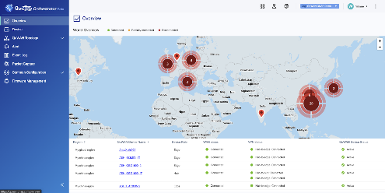
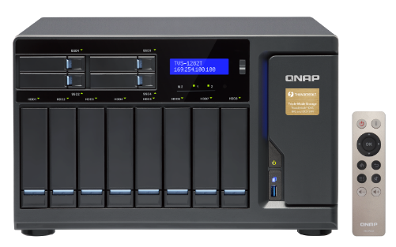
QuWAN Orchestrator x HBS 3 Real world infrastructure
QuWAN Orchestrator
Management platform
Taipei
Headquarters
Hsinchu
Branch Office
HBS 3
QuWAN agent
HBS 3
QuWAN agent
LAN1
WAN1
WAN1
LAN1
Internet
LAN2
WAN2
WAN2
LAN2
WAN
TVS-872XT
TVS-1282T
*Speed= WAN1 + WAN 2
LAN
LAN
Notes:
Page 17~18
https://docs.google.com/presentation/d/1OufKBQ0g74EP5iNQC7SOPUhyLnzXI5dgzePBvQOQubs/edit#slide=id.g8db0d62a84_0_706

Slide 18
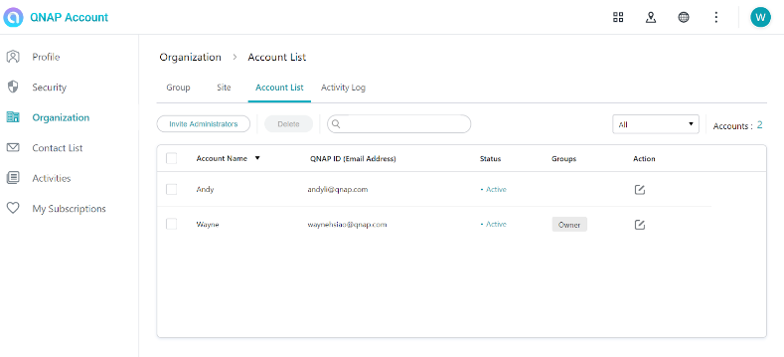
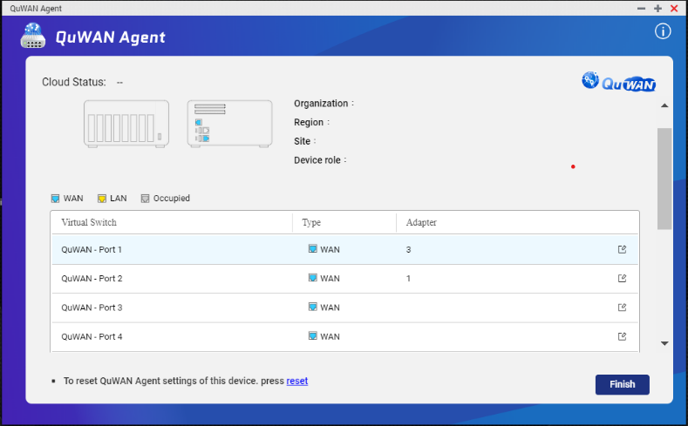
QuWAN configurations and accelerations
Step1
Login your QID in QNAP Account Center web site
Click organization and create an org.
Joined two NASs into your org. One as a hub, another as an edge
Step2
Both headquarter and branch office NAS install QuWAN agent app
QuWAN Port1, Port2 connect with LAN, and confirm with IT that these two LANs will correspond to different WAN1, WAN2
QuWAN Port8 connect with PC (for logging in to NAS)
Note: QuWAN can support up to 7 WANs for bandwidth aggregation (QuWAN Port1~Port7)
Notes:
Page 17~18
https://docs.google.com/presentation/d/1OufKBQ0g74EP5iNQC7SOPUhyLnzXI5dgzePBvQOQubs/edit#slide=id.g8db0d62a84_0_706

Slide 19
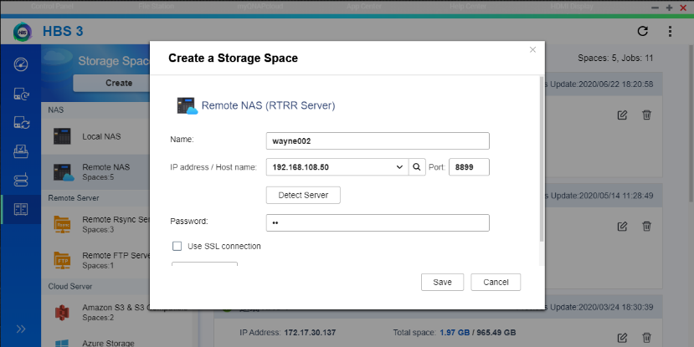
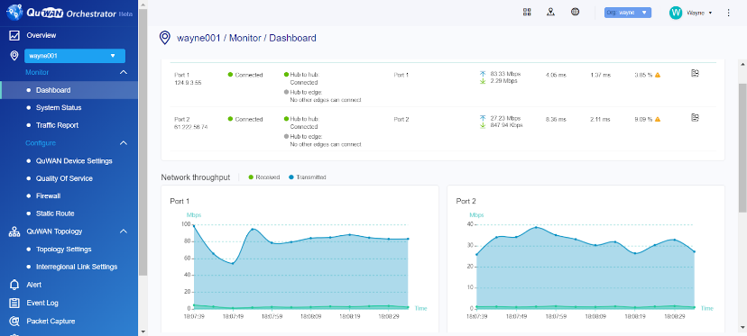
QuWAN configurations and accelerations
Step3
Create a remote storage space on HBS 3
The IP address is QuWAN Port8 LAN IP on the branch NAS
Create an RTRR task and start transferring data
Step4
Enjoy QuWAN WAN aggregation to achieve transmission acceleration
Notes:
Page 17~18
https://docs.google.com/presentation/d/1OufKBQ0g74EP5iNQC7SOPUhyLnzXI5dgzePBvQOQubs/edit#slide=id.g8db0d62a84_0_706

Slide 20
Copyright © 2020 QNAP Systems, Inc. All rights reserved. QNAP® and other names of QNAP Products are proprietary marks or registered trademarks of QNAP Systems, Inc. Other products and company names mentioned herein are trademarks of their respective holders.

