Slide 2
Why do we need 10GbE?
Network speed is everything in the audiovisual domain.
Without network speed, high performance hardware is useless.
Transfering Time
50G Blue-ray video
10GbE
43 Sec
1GbE
429 Sec
100
200
300
400

Slide 3
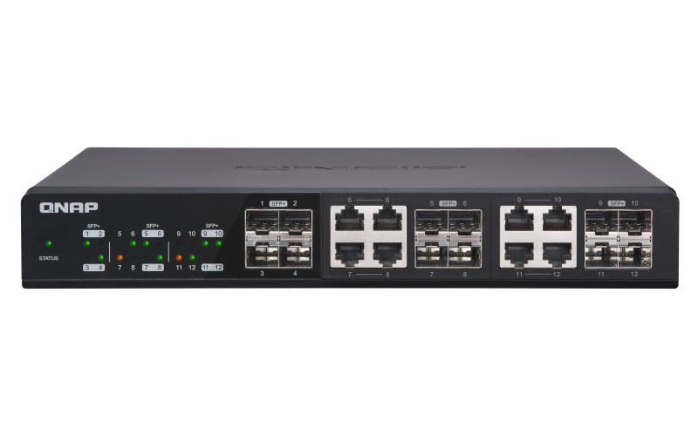
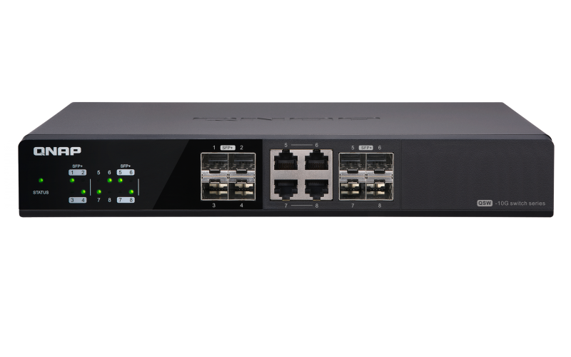
QNAP 10GbE unmanaged switches are already on the market
QSW-1208-8C
QSW-804-4C
Up to 12 port 10GbE
Up to 8 port 10GbE

Slide 4
We're making it better…
What we can do after having 10GbE unmanaged switches?
Only can check cable one by one when issue happen? What else?
Whole office shut down with one single PC affected by virus?
I like to have more then 10Gbps!
We heard what customers need!

Slide 5
Hardware highlights

Slide 6
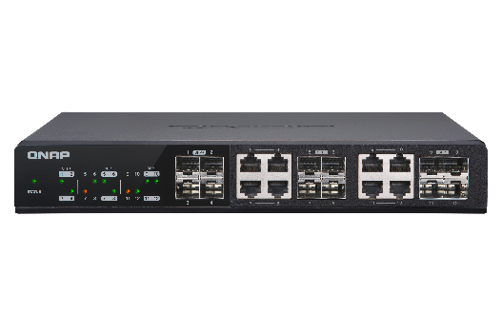
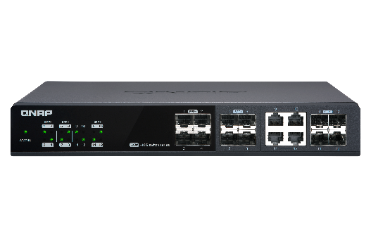
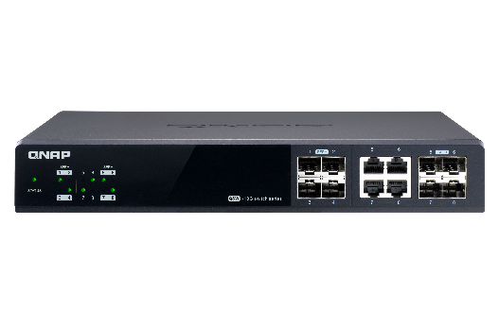
QSW-M12XX series HW spec
QSW-M1208-8C
QSW-M1204-4C
QSW-M804-4C
Number of Port | 12 | 12 | 8
10GbE SFP+ | 4 | 8 | 4
10GbE SFP+/RJ45 combo | 8 | 4 | 4
Switching capecity | 240 Gbps | 240 Gbps | 160 Gbps

Slide 7
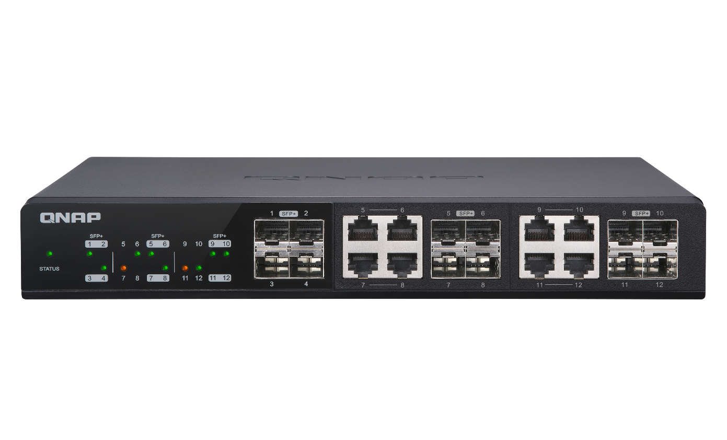
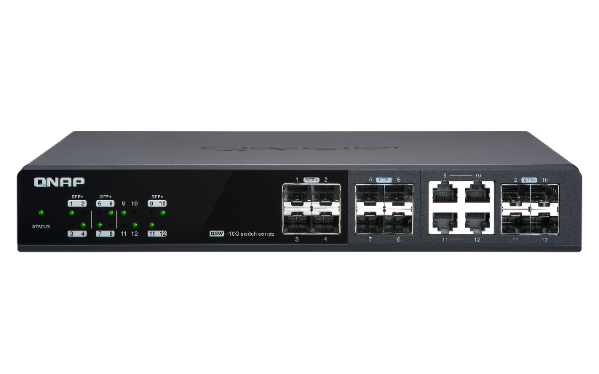
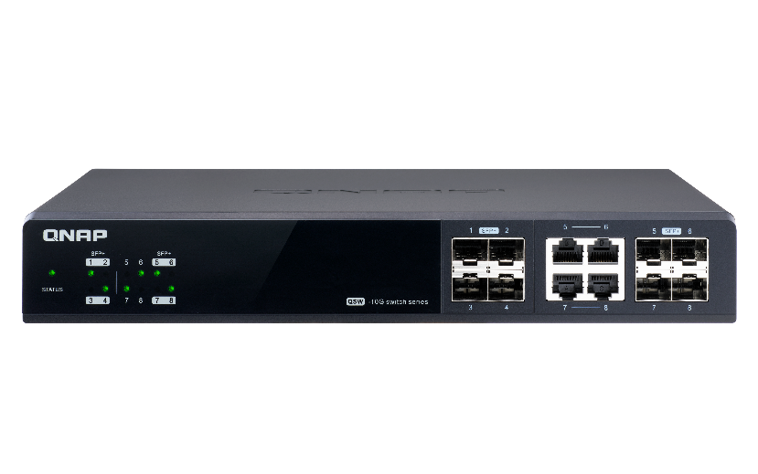
Device Mylar
4 * SFP+ port
8 * SFP+/RJ45 Combo port
QSW-M1208-8C
8* SFP+ port
4* SFP+/RJ45 Combo port
4*SFP+ port
4*SFP+/RJ45 Combo port
QSW-M1204-4C
QSW-M804-4C

Slide 8
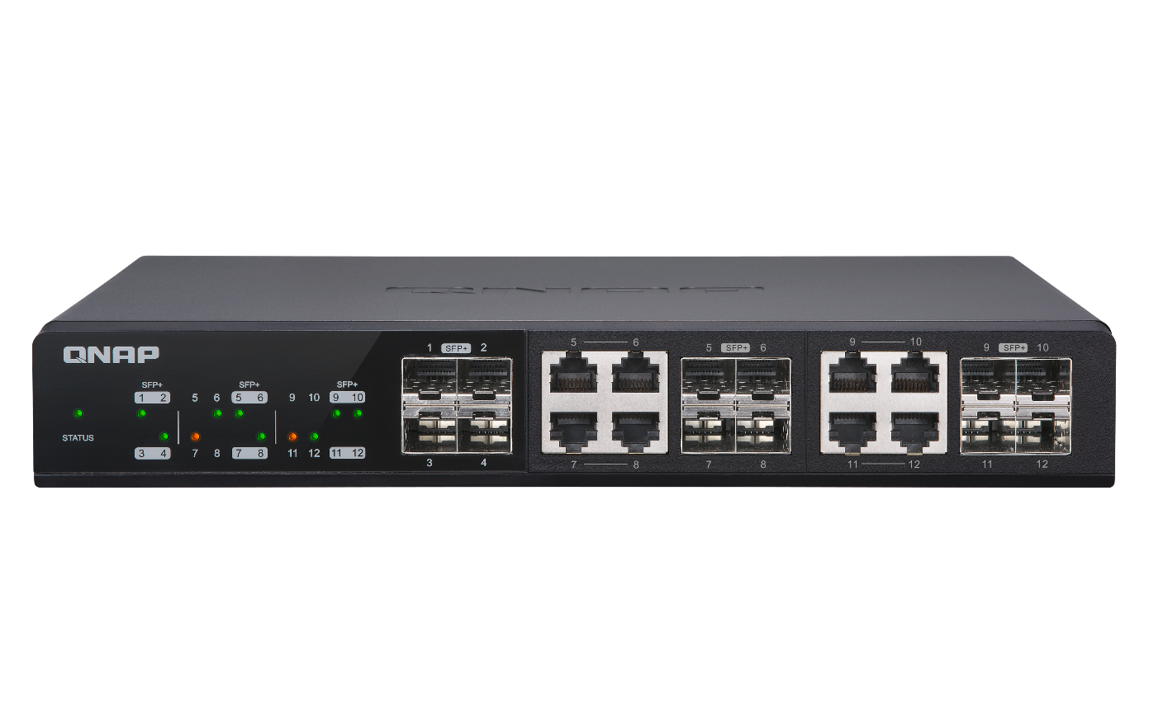
Intuitive identification of LED indicators
Status indicator
Standalone network indicator LED
Green：System is ready for use.
Oragne：System warning, e.g. high temperature or fan error.
Green：Link is up and operates at 10 Gbps.
Amber：Link is up and operates at 1 Gbps.

Slide 9
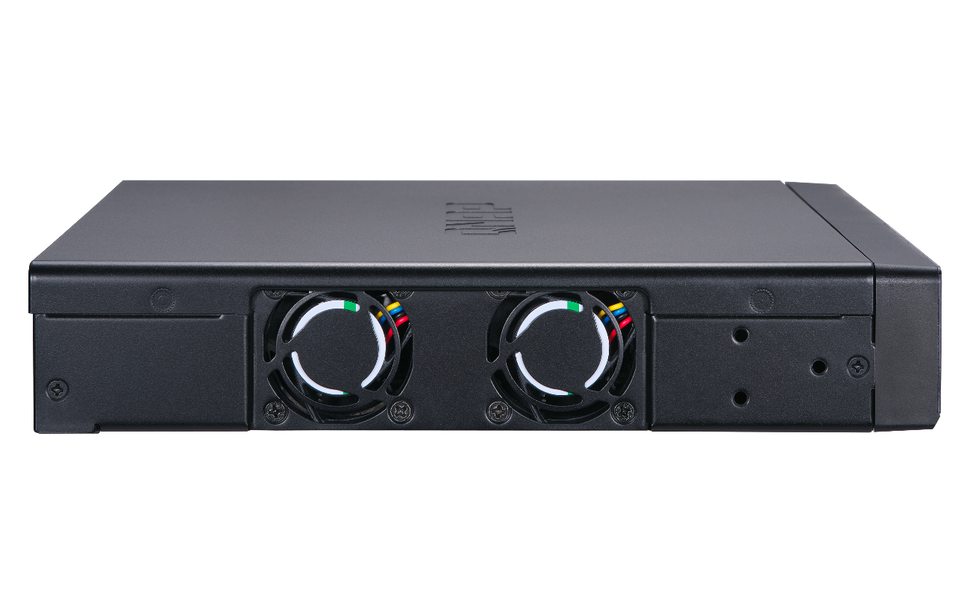
Dual fans
Improve heat dissipation
Deduce single device error
Deduce acoustic noise

Slide 10
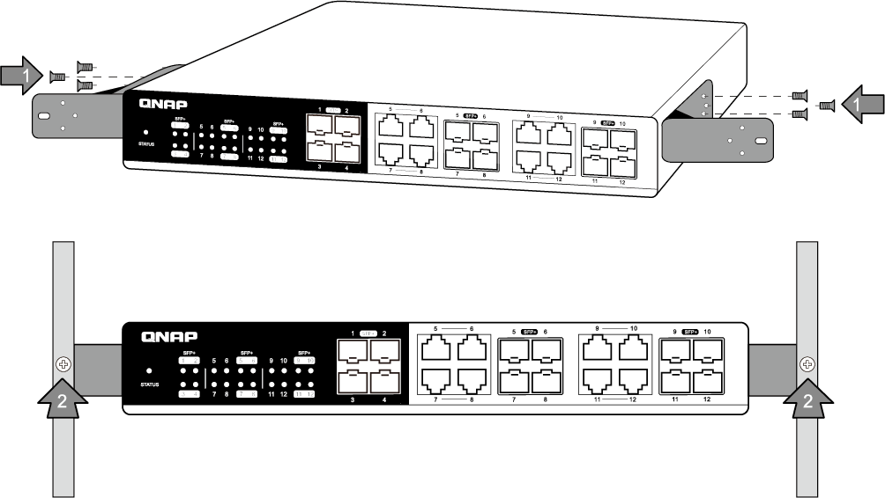
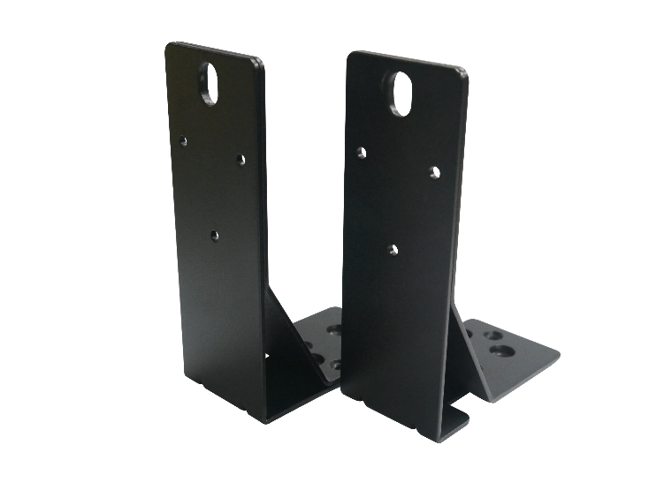
Rackmount brackets

Slide 11
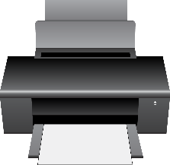
Flexible network speed
Fully support 10GbE SFP+ or SFP+/ NBASE-T, compatible with fiber and copper.
5GbE device can connect directly without pain.
1GbE
10GbE
2.5GbE
5GbE

Slide 12
QSwitch
Production Insight

Slide 13
Three Stages of Production
Hardware & Software Development
Verification
Production

Slide 14
Hardware & Software Development
Mechanical
Fan
Main System
Board & Chip
Connectors
Power Supply
Other parts
MCU
Design Verification

Slide 15
Design Verification
Functionality / Performance Test
Interoperability Test
Reliability Test

Slide 16
Reliability Test
Burn-in test: Up to 20 devices burn-in test for more than 1 month.
Hardware verification: Vibration test and shock test.
AC power on/off test: Up to 1000 times.
Acoustic noise test: Test the acoustic noise for different fan speeds.
Thermal measurement: Set the temperature to 0°C, 25°C, 35°C, 45°C and 55°C.

Slide 17
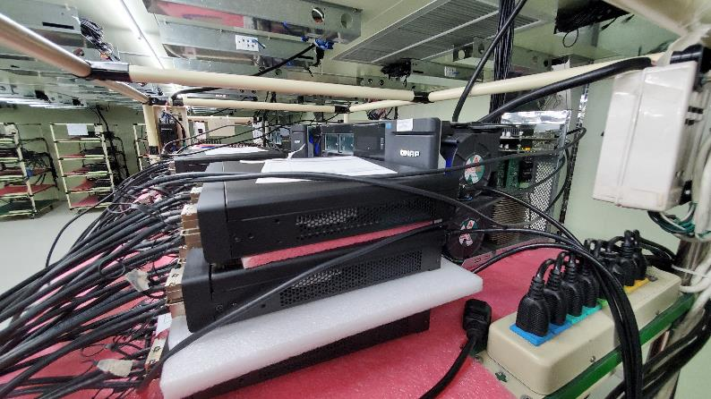
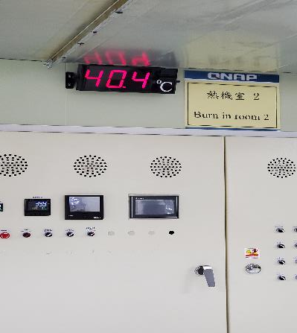
Thermal Measurement
Network performance test by different temperature environments.
Pass criteria: 0 frame drop.
25°C
35°C
45°C
55°C
Thermal test equiptment and device
Thermal monitor

Slide 18
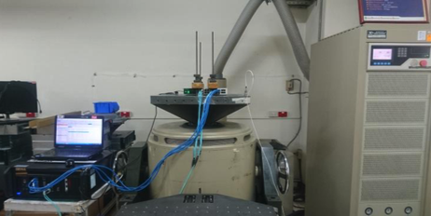
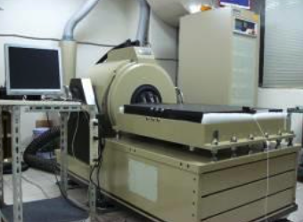
Hardware Verification
Vibration test: Use the random vibration mode to determine the device.
Shock test: Ensure that material can withstand the relatively infrequent, non-repetitive shocks or transient vibration encountered in handling, transportation and service environments.

Slide 19
Functionality / Performance Test
Network functionality measurement
Real production test
Simulation test

Slide 20
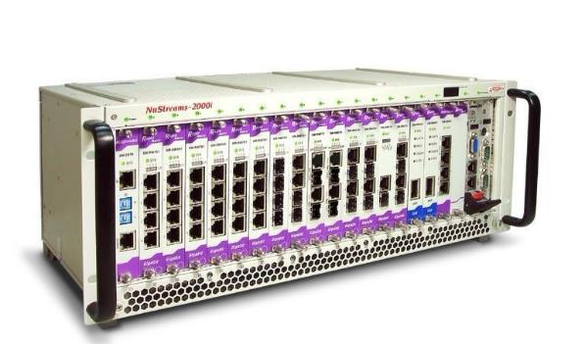
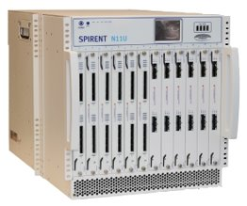
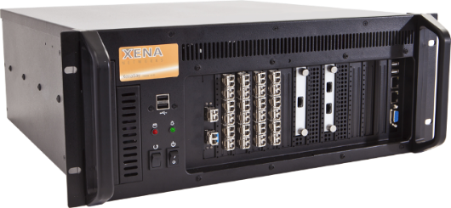
Network Test Equipements
3 high-performance test solutions
Nustreams-2000i
Spirent
XENA

Slide 21
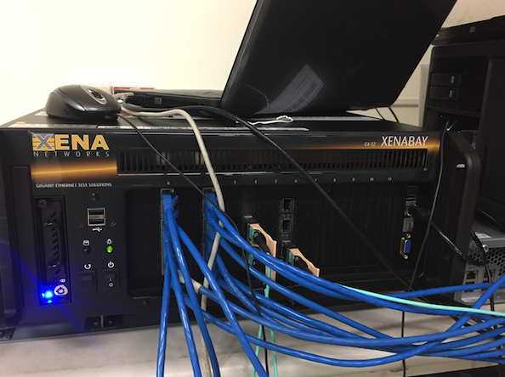
Benchmarking of QSwitch
Benchmarking Methodology：
RFC 2544 measures the performance characteristics of a network interconnecting devices, such as throughput, frame loss, latency, back-to-back or burst, and so on.
RFC 2889 LAN switch benchmarking methodology: Test for forwarding rate, congestion control, address learning and packet filtering capabilities.
Long-term stressful test: Full loading the QSwitch under 45°C environment for over 1 month to test the Switch reliability.

Slide 22
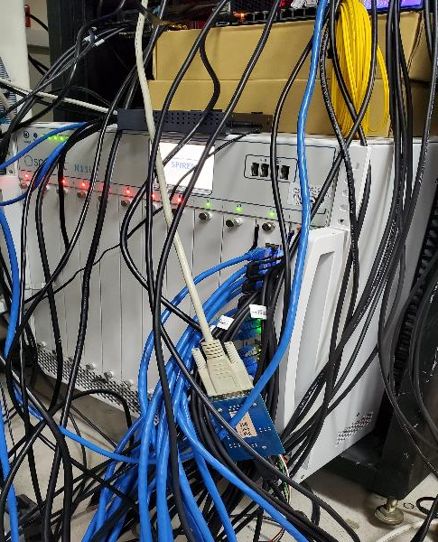
Function verification - Simulator testing
Using Spirent simulated real traffic, verified device availability.

Slide 23
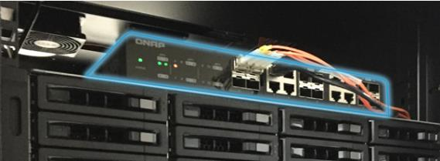
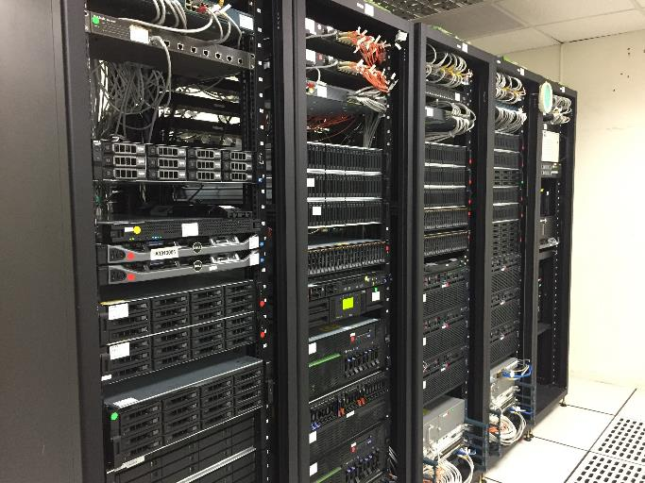
User Scenario verification- QNAP server room deployed
QNAP IT server room
QNAP Hsinchu main server room

Slide 24
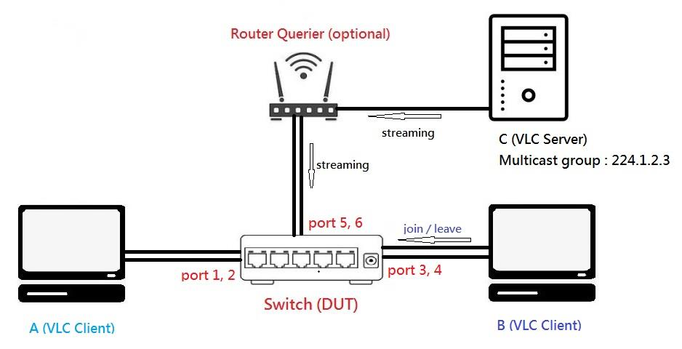
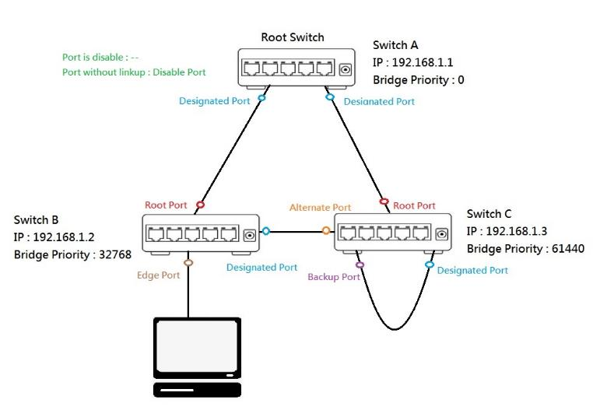
Protocol verification-QNAP internal testing
IGMP field trial topology – Cowork with QNAP NAS
RSTP field trial topology

Slide 25
Interoperability test
International certificate: FCC, CE, BSMI, CCC etc.
Compatibility: Tests between QNAP NAS and 10G network adapters and mainstream fiber transceiver modules.

Slide 26
Manufacturing Process
SMT E-Test
ASM
I/O Pre-Test
Burn-in
I/O Post-test
Packing
QC
Shipping

Slide 27
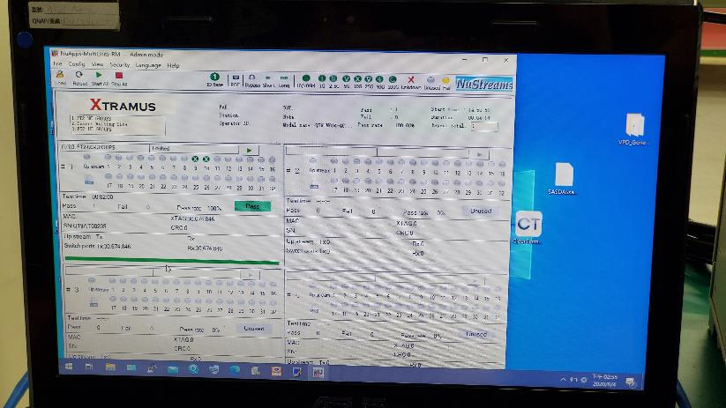
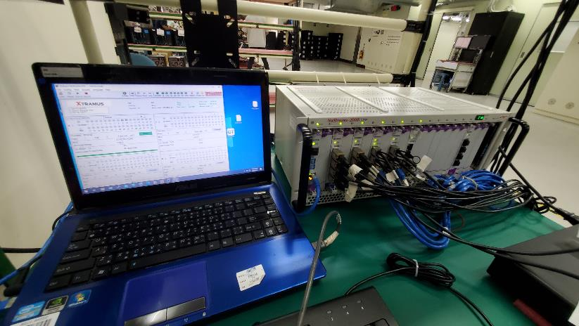
I/O Test
All the ports on the QSwitch are checked by the test gig.
0% of packet loss is accepted!

Slide 28
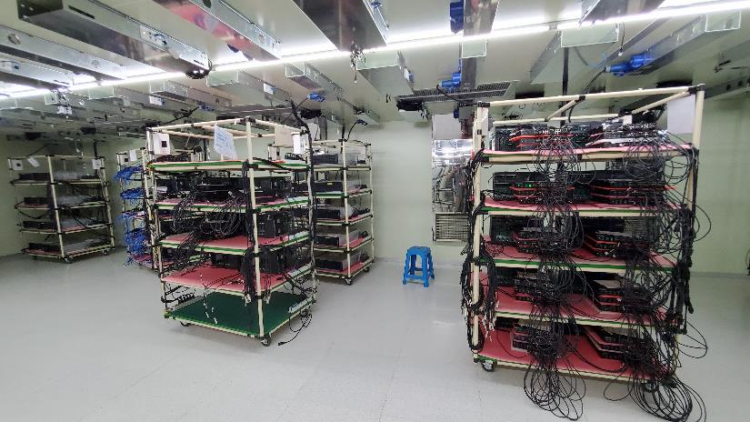
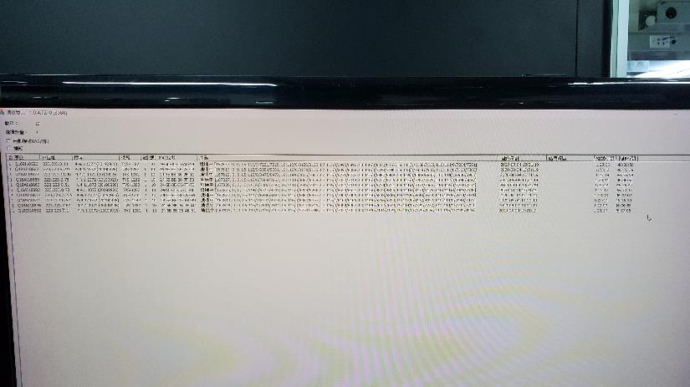
Burn-in Test
48-hour burn-in test

Slide 29
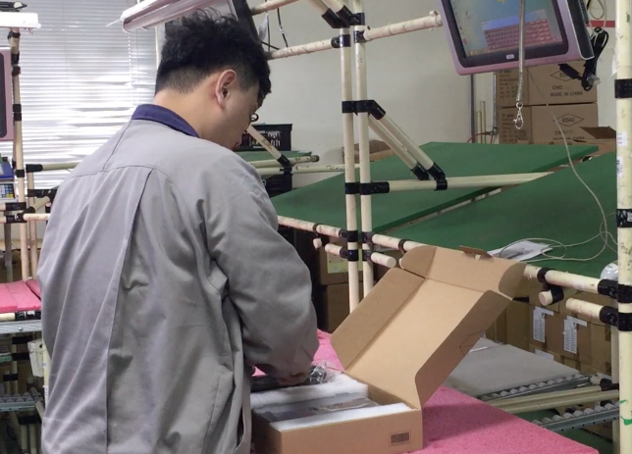
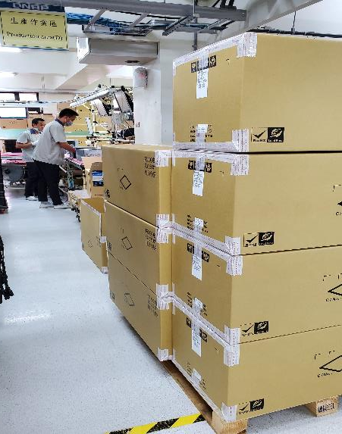
Packing and Quality Control
Dedicated packing and quality check

Slide 30
Software highlights

Slide 31
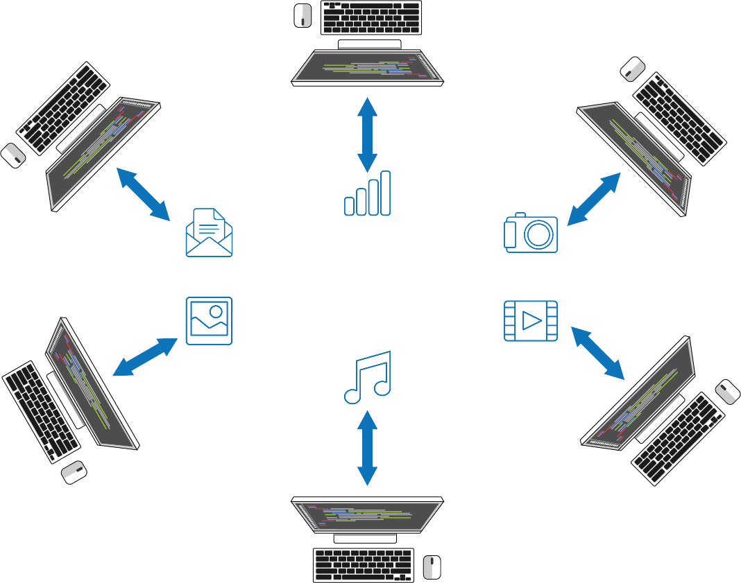
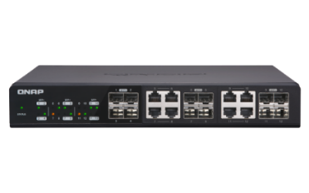
Management switch give user more information
More information can be checked on GUI.
Don't need check cable one by one.
Cowork with 3rd party monitor software, more easy for management.

Slide 32
Management switch manage network more easy and detailed
Divide network by using VLAN, avoid security issue explore.
Give different priority for different purpose.
Integrate VLAN and firewall, to have more complete security and flow management.
Notes:
https://www.qnap.com/zh-hk/how-to/tutorial/article/davinci-resolve-studio-%E5%A6%82%E4%BD%95%E5%9C%A8-qnap-nas-%E4%B8%8A%E5%A4%9A%E7%94%A8%E6%88%B6%E5%8D%94%E5%90%8C%E7%B7%9A%E4%B8%8A%E5%89%AA%E8%BC%AF

Slide 33
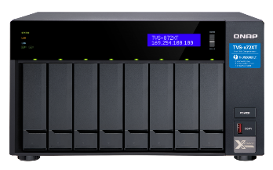
10GbE is not enough for NAS transfer
AV files getting larger, even 10GbE is not enough.
Need higher speed like 20GbE or upper.
20GbE
5GbE
10GbE
5GbE

Slide 34
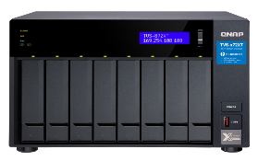
Studio office
Past
Simple network usage.
Fully 10GbE network bandwidth is enough.
Single NAS can cover all things.
Internet

Slide 35
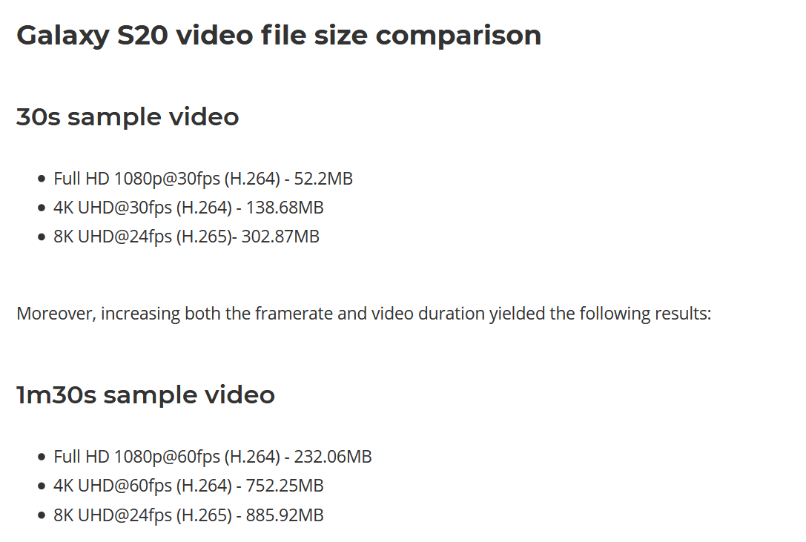
File size getting larger
To have high quality of video & documents, file sizes can be bigger.

Slide 36
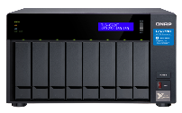
Studio office
Now
Some NAS need more than 10GbE bandwidth.
Separate department.
Need management funciton on switch to manage the entire network.
More than one switch.
Internet
20GbE

Slide 37
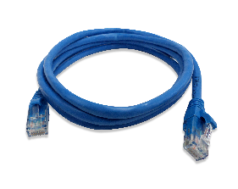
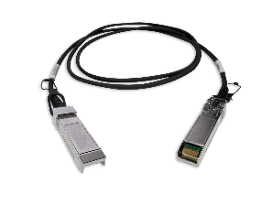
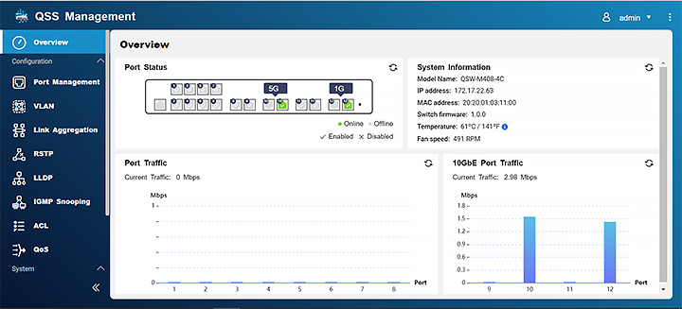
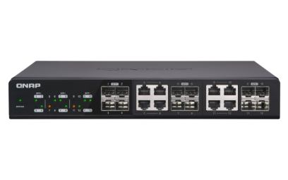
QSW-M1208 series brings powerful network for studio production
Fully SFP+ or SFP+/ NBASE-T, flexible with 10GbE network.
Link aggregation (LACP) bring you to more then 20GbE network speed.
Easy web management design.
10GbE + 10GbE = 20GbE

Slide 38
Rich management functions
VLAN
Link Aggregation Group (LAG)
Rapid Spanning Tree Protocol (RSTP)
Link Layer Discovery Protocol (LLDP)
IGMP snooping
Access Control Lists (ACL)
Quality of Service (QoS)
Simple Network Time Protocol (SNTP)

Slide 39
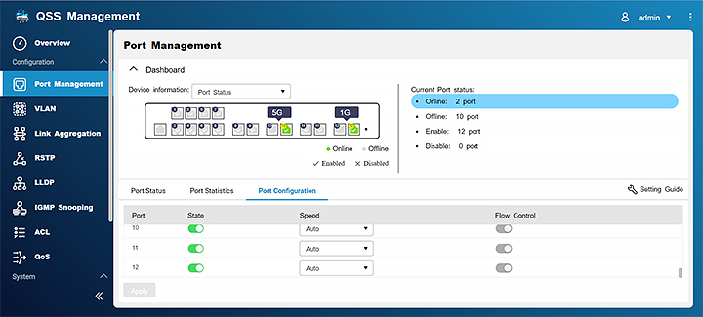
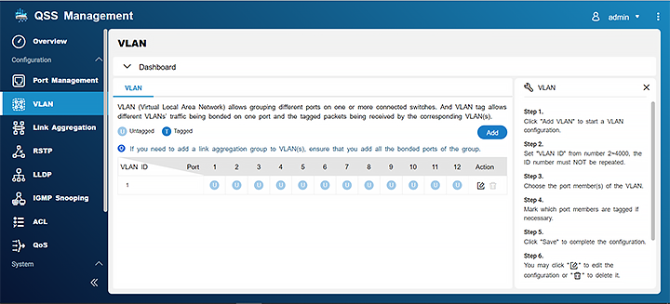
Easy to use GUI design
Rich functions and easy to use.
Straightforward web design lets user realize the setup logic quickly.

Slide 40
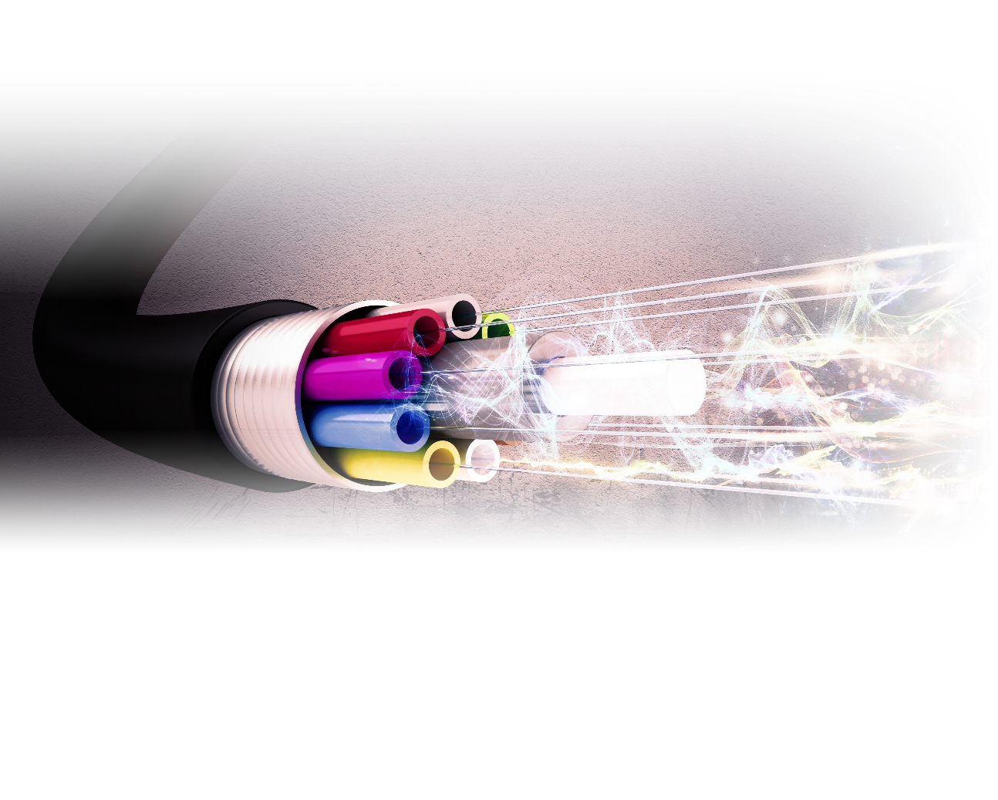
Raise network speed with multiple network cable
Link Aggregation (LAG) can aggregate multiple network cable into a single logical network.
Quick and direct to have a network more than 10GbE.

Slide 41
Split office network into different area
Virtual network (VLAN) can split office network.
Easy to manage, can set up routing to connect different networks.
Separate employee and guest network.

Slide 42
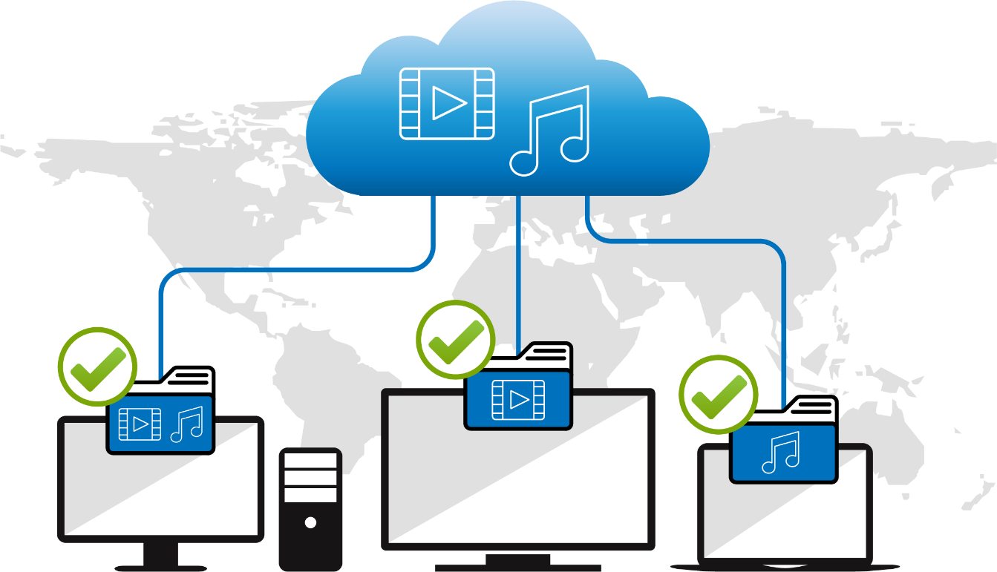
Deliver streaming to dedicate device specificly
IGMP snooping can record streaming request for each end point device.
Avoid packet lost or wrong stream broadcast.

Slide 43
Easy access control
Access Control List (ACL) can control access specifically.
To avoid security issue.
ACL

Slide 44
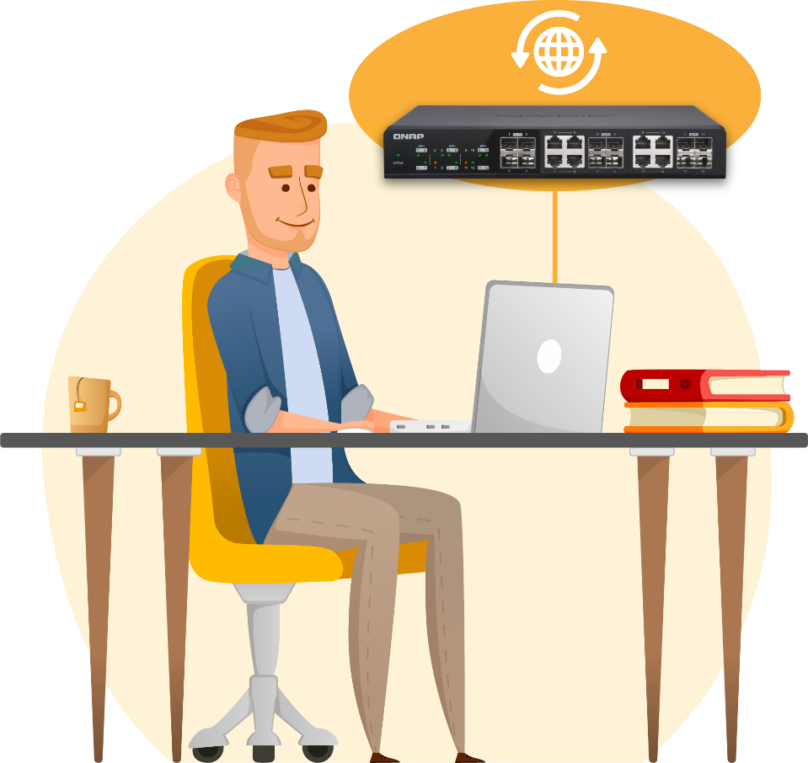
Firmware version live check
One-click update.
Firmware version auto detect.
Manual update

Slide 45
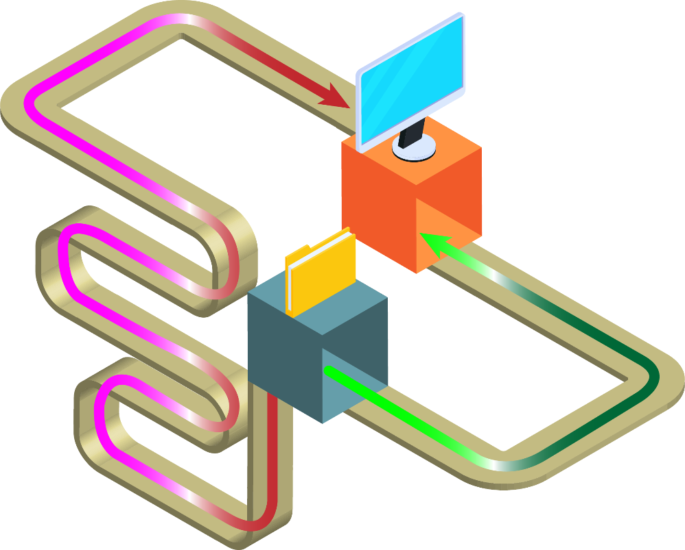
Always looking for best routing
Rapid Spanning Tree Protocol (RSTP) live check best networking route.
Always using most effective route for data transfer.

Slide 46
QSW-M1208 have more
Ethernet flow control (IEEE 802.3x) managing packet transfer, avoid packet lost.
Link Layer Discovery Protocol (LLDP), easy to know which devices are conneted.
Energy-Efficient Ethernet (IEEE 802.3az) and fan speed control, managing power consumption.

Slide 47
Perfectly integrated with QNAP 10GbE products

Slide 48
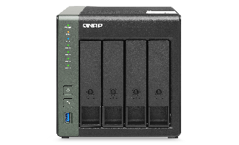
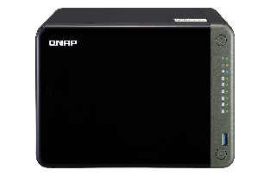
12 port 10GbE combo port give flexiable deployed
Embedded or extension 10G/5G/2.5G NAS
PC upgrade 2.5G/5G/10G
Laptop upgrade 5G
Base-T/SFP+
Base-T
High speed network connect to NAS/Server
Base-T
MacBook upgrade 10G
SFP+
Base-T

Slide 49
Tablet NAS with embedded 2.5/5/10GbE
With 10GbE BASE-T
｜
With 10GbE SFP+
TVS-x72XT Family
TS-x83PX Family
TS-431X3
TS-431KX
10GbE+2.5GbE
With 5GbE BASE-T
With 2.5GbE BASE-T
TVS-x72N Family
TS-hx86 Family
TS-x31P3 Family
TS-x53D Family

Slide 50
Rack mount network NAS with embedded 2.5/5/10GbE
With 10GbE BASE-T & SFP+
With 2.5GbE BASE-T
TS-451DeU
TS-x73AU
TS-h1283XU-RP
TS-h977XU-RP
TS-h1277XU-RP
TS-x53DU
GM-1002/1002
TVS-x72XU
TS-x32PXU
+ 2x 10GbE SFP+

Slide 51
Network extention： rich PCIe network extension card
10GbE series
5GbE series
2.5GbE series
QXG-10G2SF-CX4
LAN-10G2T-X550
QXG-5G Family
QXG-5G Family
1 x RJ45
1 x RJ45
2 x SFP+
2 x RJ45
2 x
RJ45
Coming soon
2 x
RJ45
QXG-10G2T-107
QXG-10G1T
4 x
RJ45
Coming soon
4 x
RJ45
2 x RJ45
2 x RJ45

Slide 52
Network extention：hand carry adaptor
QNA-UC5G1T
QNA-T310G1T
USB 3.2 Gen 1
Thunderbolt 3
RJ45 NBASE-T
4 speed: 5G/2.5G/1G/100M
USB Plug and play upgrade your PC/Laptop to 10GbE high speed network
10GbE NBASE-T port
5 speed: 10G/5G/2.5G/1G/100M
USB Plug and play upgrade your PC/Laptop to 10GbE high speed network, through Thunderbolt
https://www.qnap.com/en/product/qna-uc5g1t
https://www.qnap.com/en/product/qna-tb-10gbe
Notes:
QSW-308

Slide 53
© 2020 Copyright is owned by QNAP Technology Co., Ltd. QNAP Technology reserves all rights. A trademark or mark used or registered by QNAP Technology Co., Ltd. The products and company names mentioned in the file may be trademarks owned by other companies.

