Slide 2

Qsirch 5.0 upgrade file management and search solution
QNAP file management and search solution
Qfile
Auto upload
File Station
uploads
Qsync
data sync
Other backup way
NAS data
Data indexing
Exclude from indexing
More efficient indexing
Five intelligent image search
Filing and archive the search results
Data search and filter
Image
Video
Music
Document
PDF
Email
Data preview
Music, photo & video instant preview
Document and keyword preview
Share
Filing and archive the search results

Slide 3
More Efficient Indexing

Slide 4
Reduce memory usage when indexing
From Qsirch 4.3, a new JRE optimizes the memory usage of NAS.
Qsirch 4.3
Qsirch 4.1
The memory usage is reduced by 15-20% when indexing.
The memory is released when Qsirch is idle and can be used by other applications.
1
2
Indexing query
Idle
Idle

Slide 5

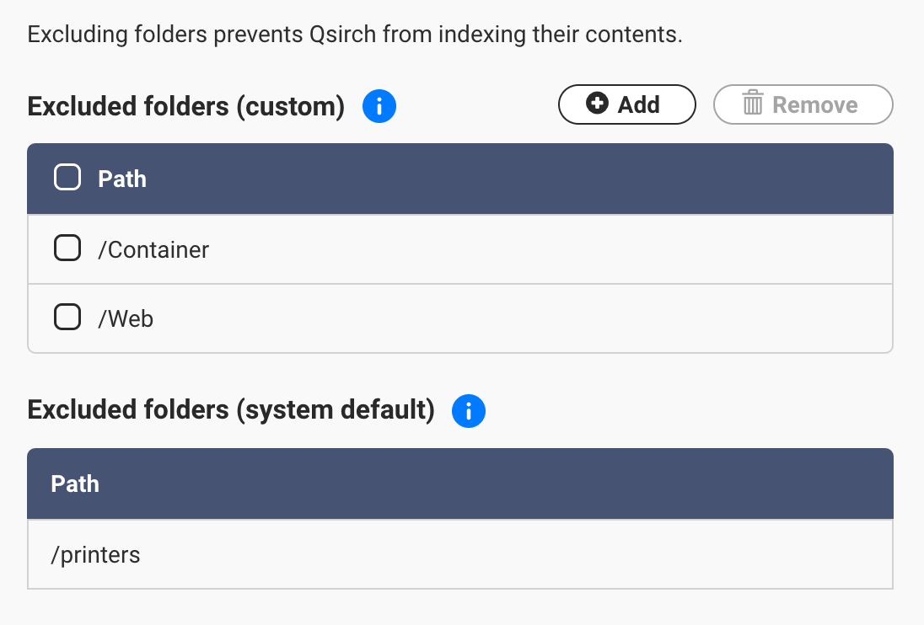
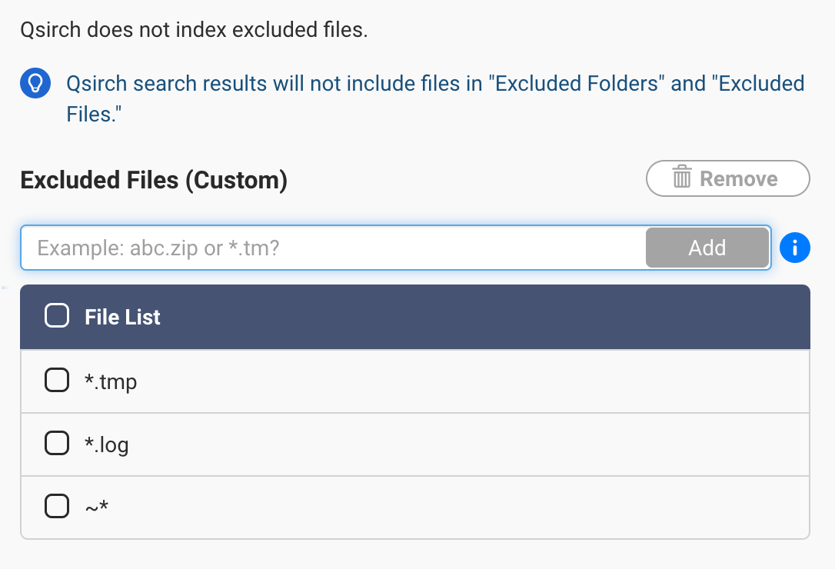
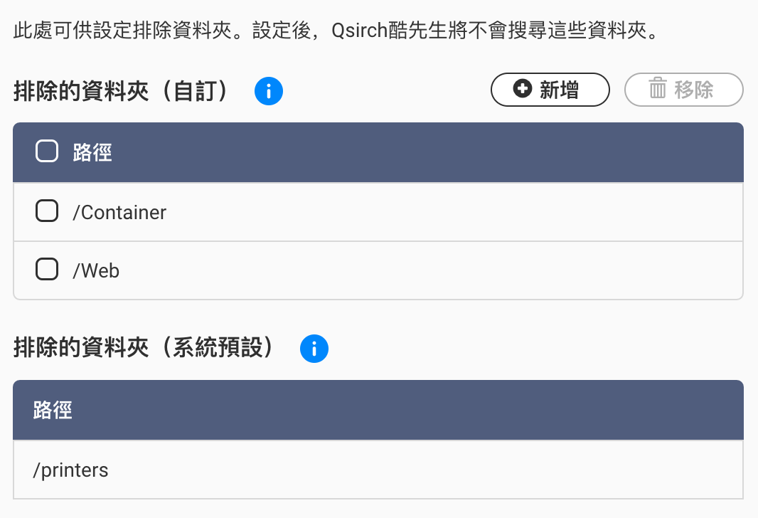
Exclude the unnecessary data from indexing
Select to exclude the unnecessary data from indexing to reduce the resource usage.
The elcuded data will not be shown in the search result.
Exclude Folders
Exclude Files

Slide 6
Five Intelligent Image Search

Slide 7



Intelligent Image Search
Search by people
Search text in image
OCR
Search by things
Search by color
Search by map

Slide 8
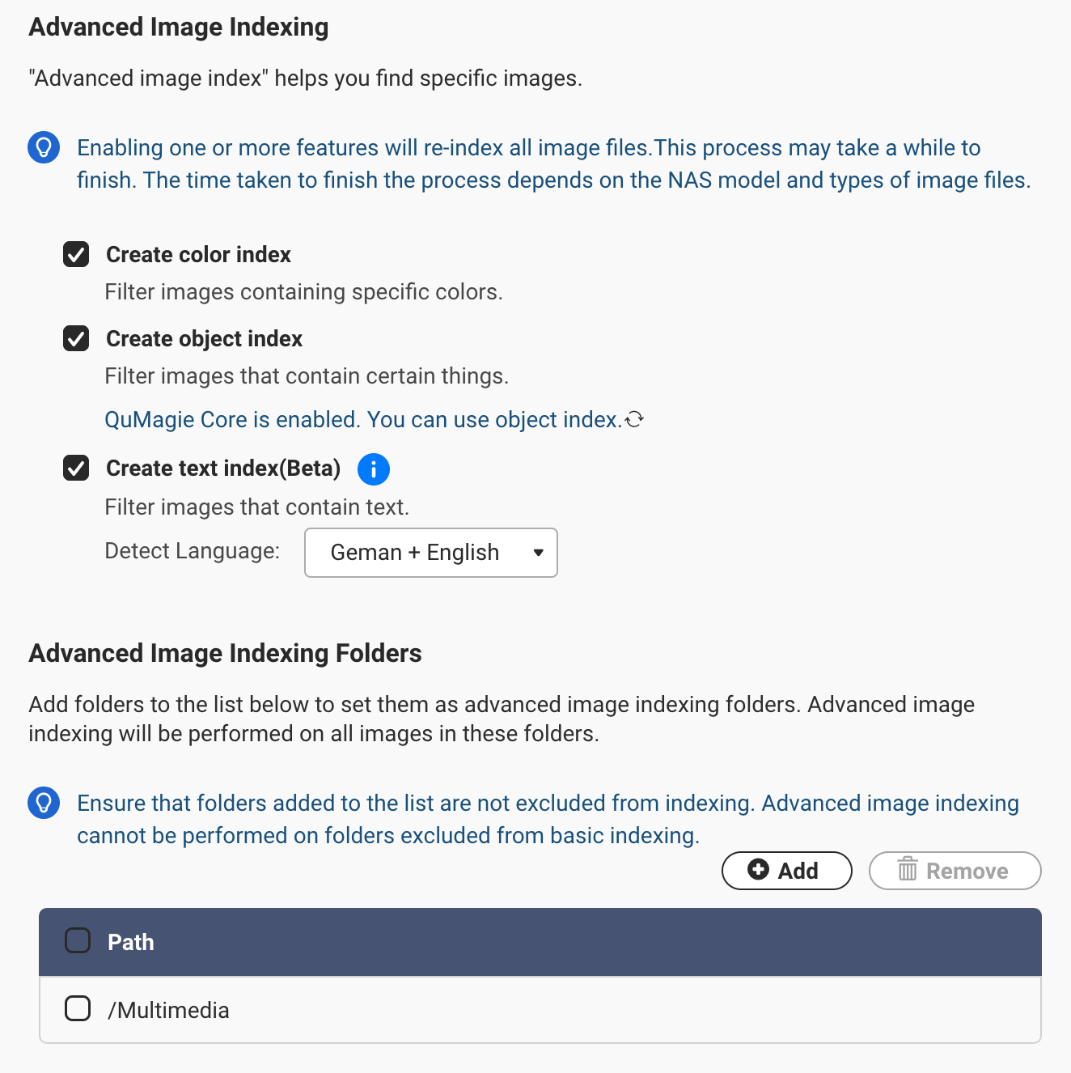
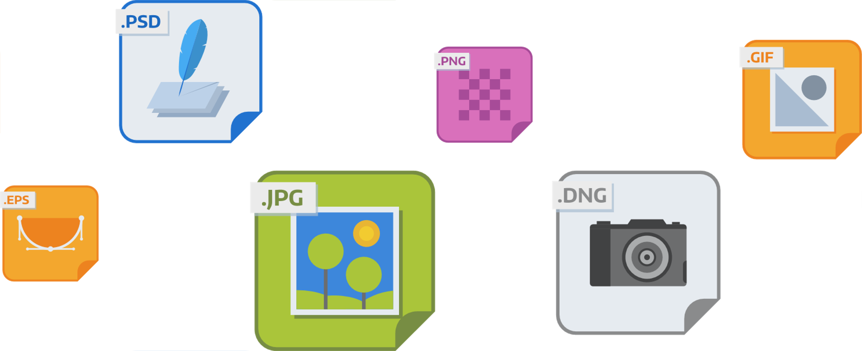
Enable advanced image index
Advanced image index might consume more resource and time.
Enable the advanced image search functions you need.
Add advanced image index folders

Slide 9


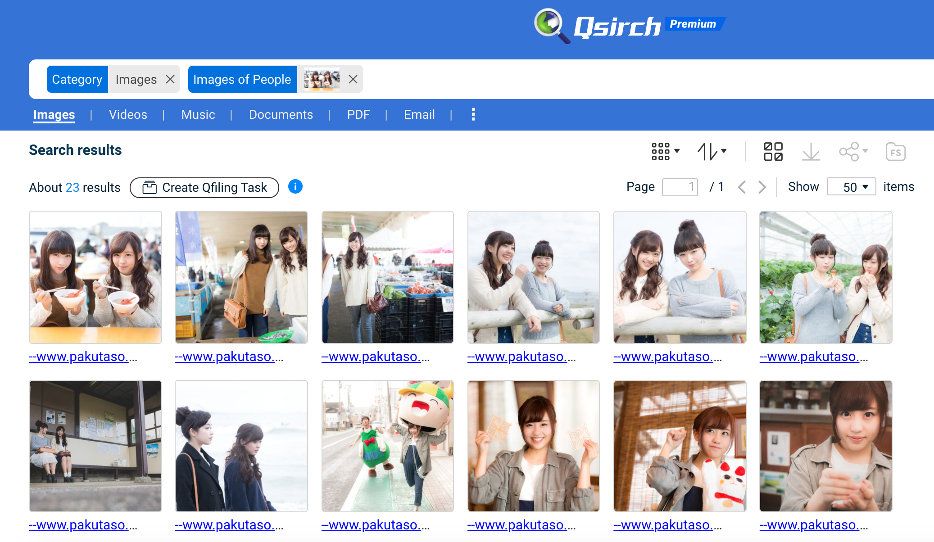
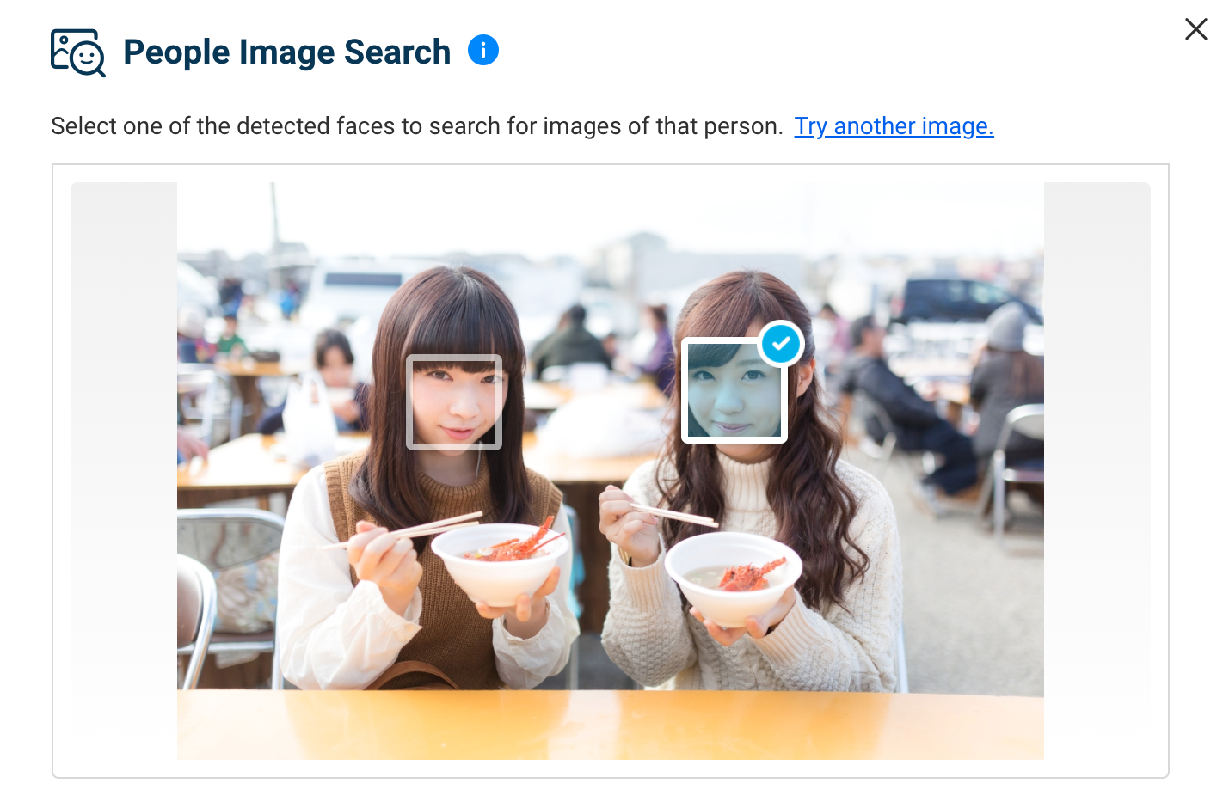

Search by people
Upload or select image included a person to search all his/her photos

Slide 10
For Sociable People
Can not find the photo taken with friends?
Upload or select image included the friend and Qsirch can help to find out all photos with your friend.

Slide 11
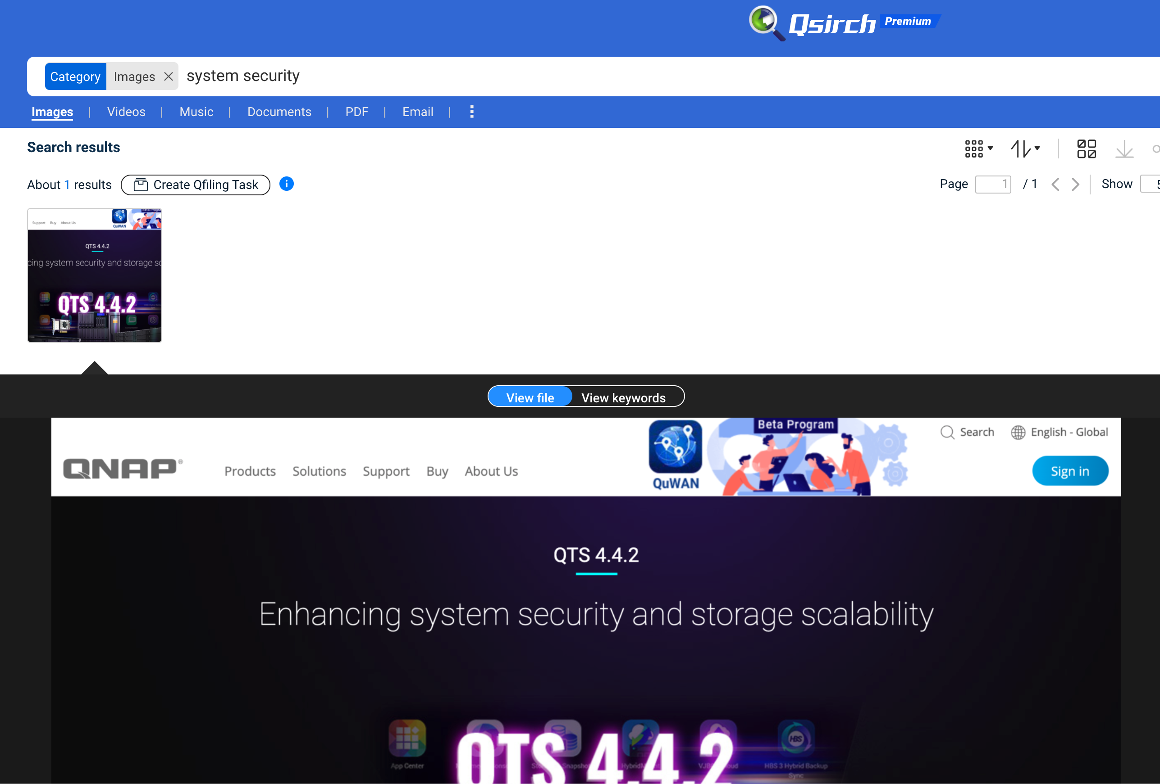
QCR helps to search text in the image
Search images with text which is automatically recognized by OCR.
Support multiple languages: English, Traditional Chinese, Simple Chinese, German, Frech, Italian, Japanese, Greek
Well recognization for printed words.

Slide 12
For Sales Person
Find a specific customer in the mess business cards
Upload the photos of business card to NAS and search by the keywords.

Slide 13
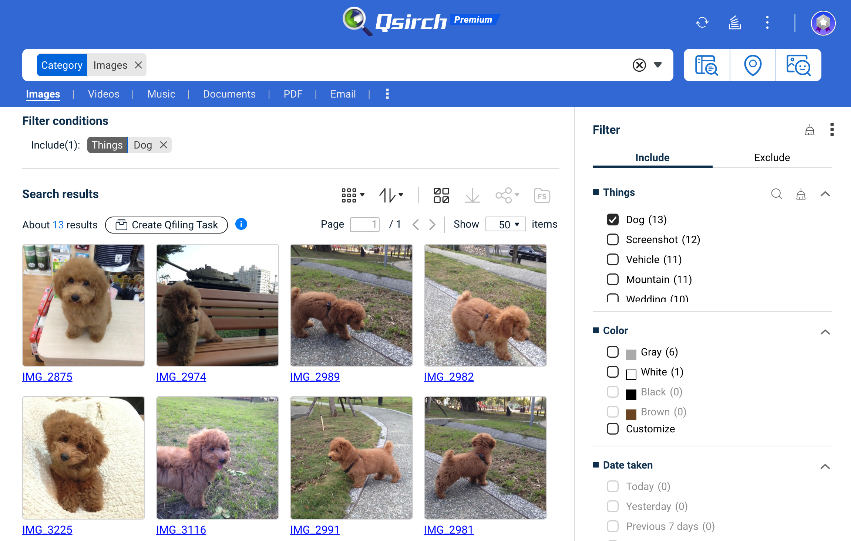
Search the things in the photo
QuMagie Core recognizes the things in photos by AI engine. Qsirch can search the photos by thing.
Search the photos by thing by keyword or filter.
QuMagie Core supports to recognize 390 things.

Slide 14
For Cataholic And Dogaholic
Find out your pet’s photo in a second
After backing photos to NAS, you can use keyword or filter to find out your pet’s photos.

Slide 15
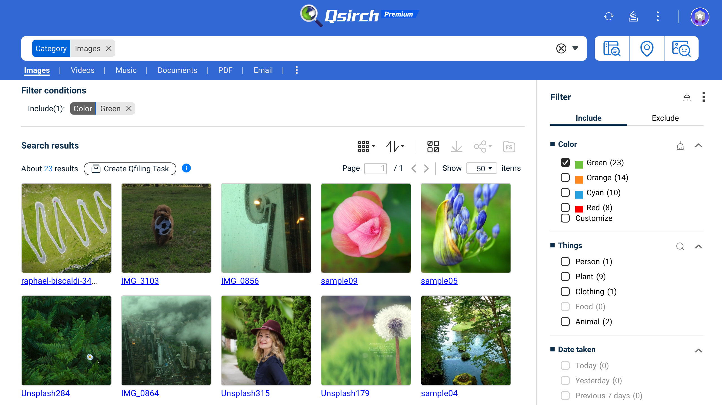
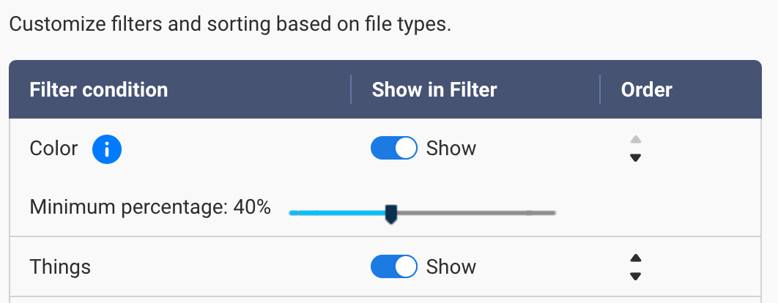
Filter out the photos by color
Setup the minimum percentage of colors in the filter results.

Slide 16
For Designer
Find out the elements in specific color
Select the specific color as a filter to search image you need.

Slide 17
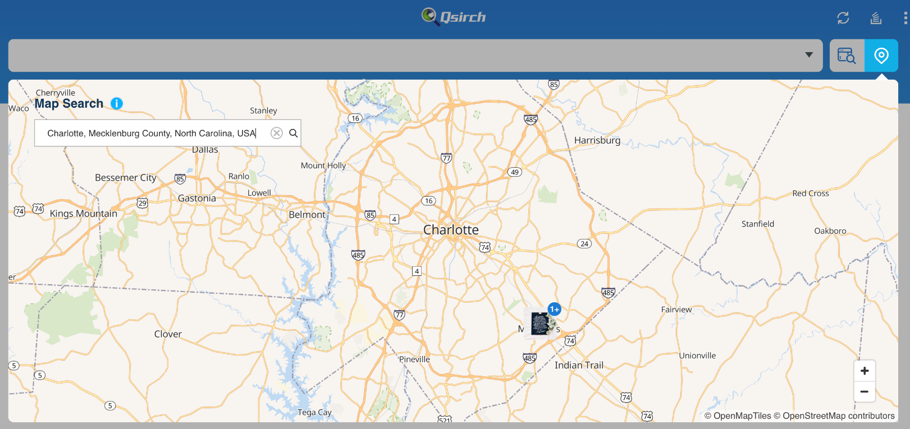
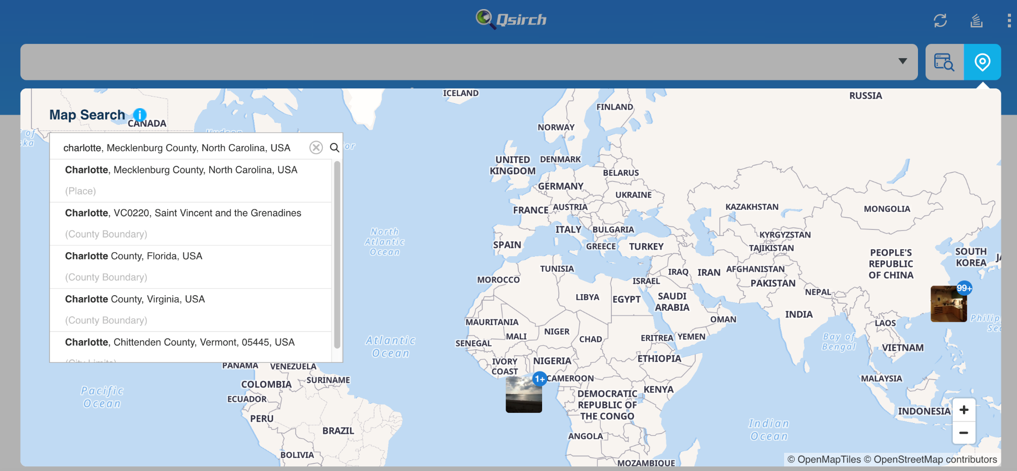
Map Search
Quickly find photos of a specific location
Categories present photos of the same location. You can also search, quickly view and specify locations/landmarks in the map!

Slide 18
For Traveler
See your footprints where you have traveled
The map search shows all your photo with GPS information on the map. You can quickly view the photos taken around the world.

Slide 19
Filing And Archive
The Search Results

Slide 20
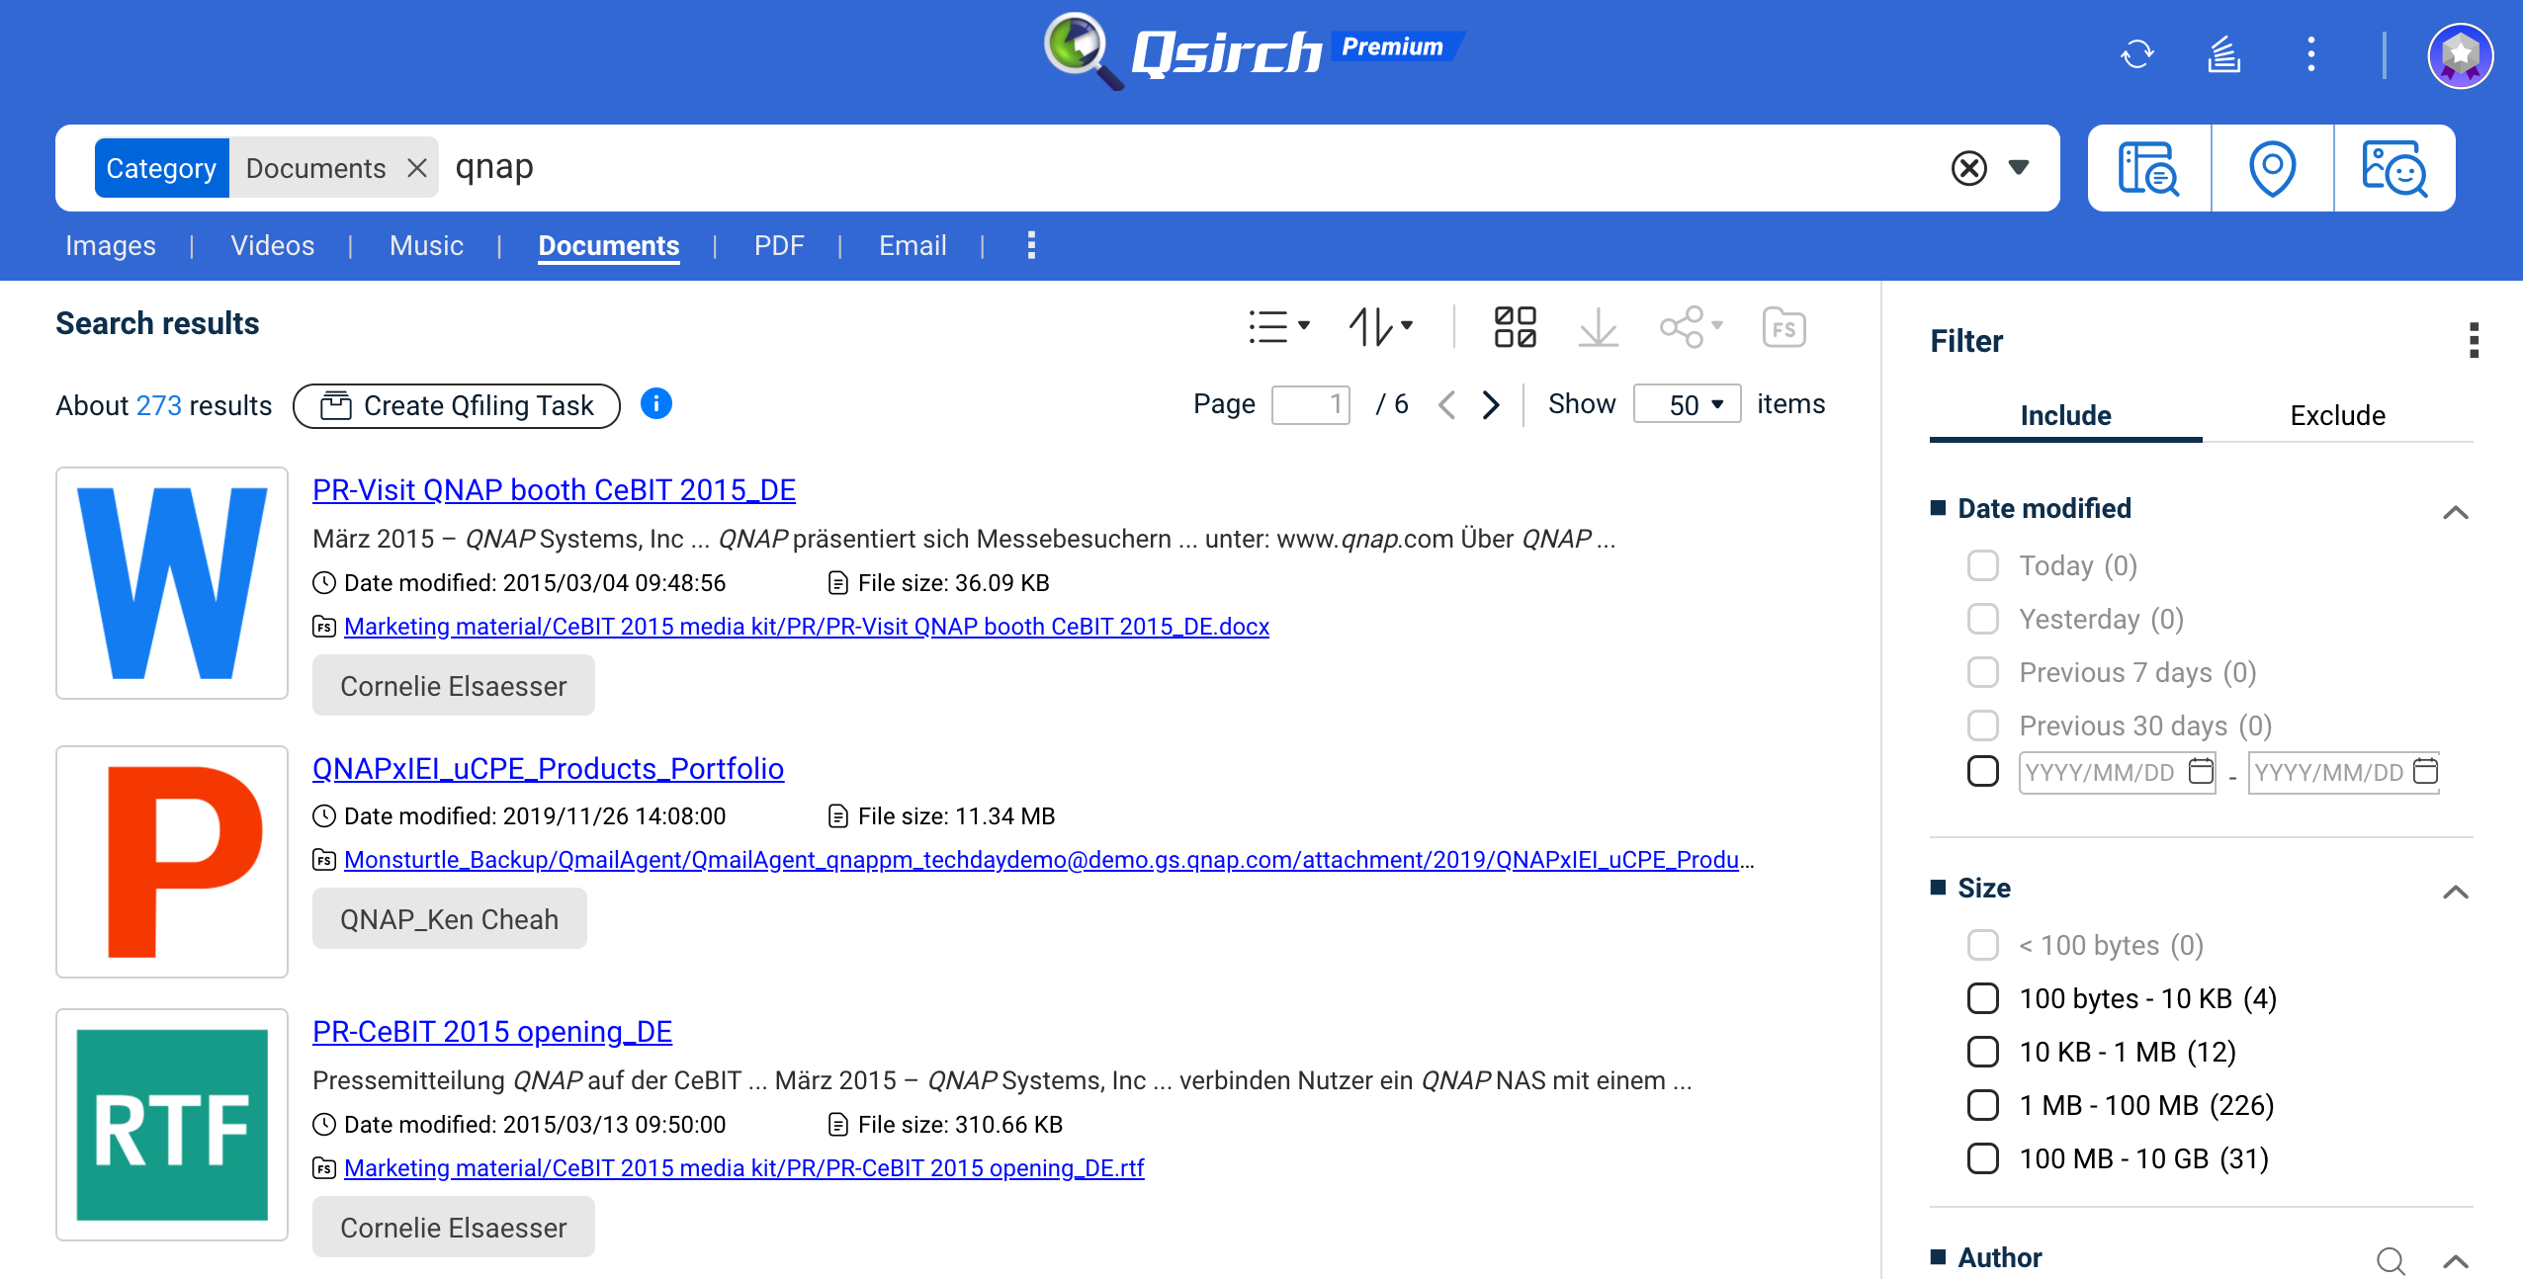
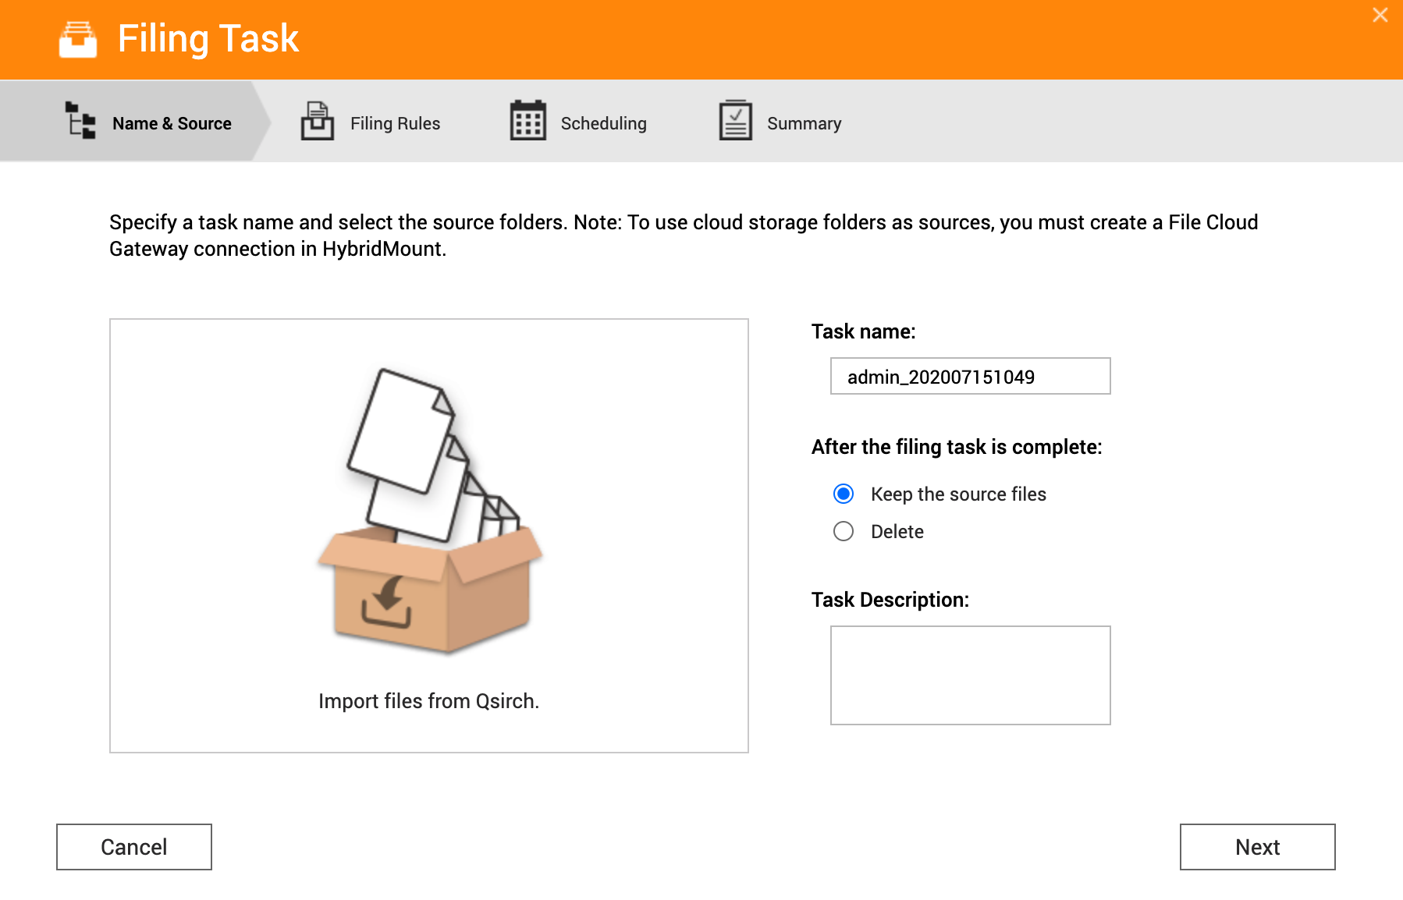
Filing and archive the search results by Qfiling
The search results might be scattered in many different folders. You can file these flatten data to specific folder structures.

Slide 21


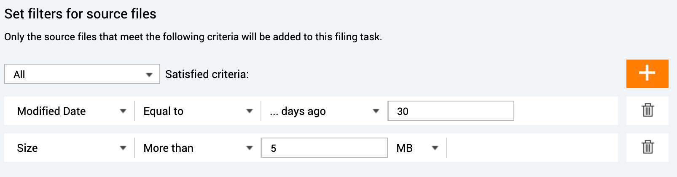

Editing modules and filing schedule help your data managed all the time
File Filters
Editing modules
Destination folder structure
Schedule
Select many filter rules including file size, modified date, and file extension with “and” / ”or” rule.
Watermark
Image2PDF
Video transcoding
Subtitle pairing
Encryption & Decryption
Compression
The file will be filing to the destination folder with structure you setup.
One-time task
The search results will be filing once.
Scheduled task
The filing task will auto start by schedule. In every task, Qsirch will search again and import the latest results as filing source.

Slide 22
Search “Contract”
For Data Protection Officer
Encrypt by Qfiling
Encrypt business confidential data to meet GDPR compliant
Use Qfiling to batch encrypt and archive the data with specific keywords.
Archive by Qfiling

Slide 24
Qsirch License Plans
 | Lite | Premium
 | Free | 3-month Free Trial
Full-text search | V | V
Filters | Access to 3 filters per file. | Access to all filters.
Advanced Image Search by color | V | V
Advanced Image Search by map | V | V
Advanced Image Search by object | V | V
Advanced Image Search by text | V | V
Advanced Image Search by people |  | V
Archive your search results |  | V

Slide 25



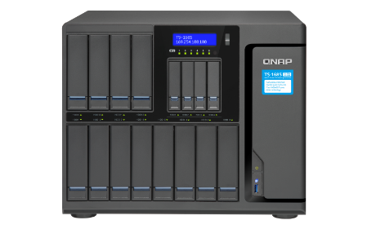
The best partner for efficient work
Enterprise
SMB
SOHO
High-capacity with exceptional performance
High-end business NAS for greater performance
High performance 4-core studio
TS-1685
TVS - 872N
TS - 453D
16 bays,16-96 TB
Intel Xeon 6-core 2.2 GHz
128 GB RAM
6 M.2 SATA 6Gb/s SSD slots for caching or caching pools to accelerate system performance.
8 bays, 4-64TB
Intel i3-8100T 4-core 3.1 GHz
8 GB RAM (up to 32 GB)
2 M.2 SATA 6Gb/s SSD slots for caching or caching pools to accelerate system performance.
4 bays, 4-24TB
Intel Celeron 4-core 2.0 GHz
8 GB/ 4 GB RAM

Slide 26
Qsirch 5.0 upgrade file management and search solution
QNAP file management and search solution
More efficient indexing
The memory usage is reduced by 15-20% when indexing.
Exclude folders or files from indexing to reduce resource usage.
Qfile
Auto upload
File Station
uploads
Qsync
data sync
Other backup way
NAS data
Data indexing
Exclude from indexing
Five intelligent image search
Data search and filter
OCR
Image
Video
Music
Document
PDF
Email
People
Text
Object
Color
Map
Data preview
Filing and archive the search results
Music, photo & video instant preview
Document and keyword preview
Search
Filter
Editing
Filing
Share
Filing and archive the search results
Setup schedule to achieve auto-archive

Slide 27


The most powerful NAS search engine!
Copyright© 2020 QNAP Systems, Inc. All rights reserved. QNAP® and other names of QNAP Products are proprietary marks or registered trademarks of QNAP Systems, Inc. Other products and company names mentioned herein are trademarks of their respective holders.​​​​​​​

