Slide 2
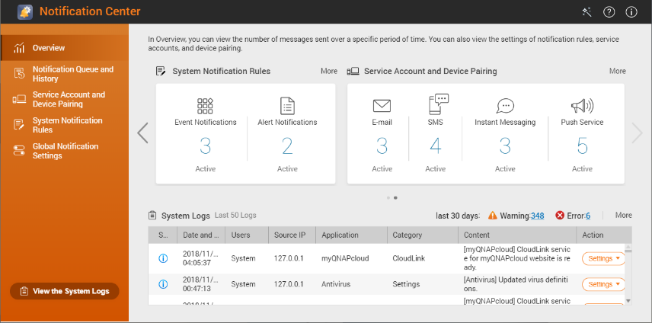
Diversity of Active Notification

Slide 3
Notification Center - Five Major Highlights
Support multiple notification methods
Meet your various notification scenarios
Centralized setting
Highly flexible rule setting
One interface to integrate all notification settings and operations
Easily filter important messages you want to receive
Double insurance
Multi-language support
Notification history and test function ensure you don't miss one message
Support 23 language & composed by professionals

Slide 4
I want to be able to set up and manage notifications for all NAS applications through one interface.

Slide 5
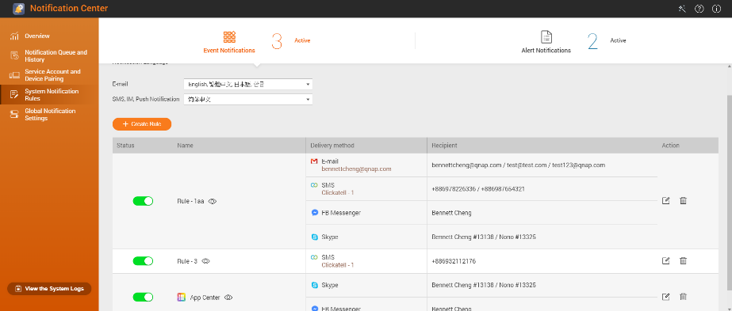
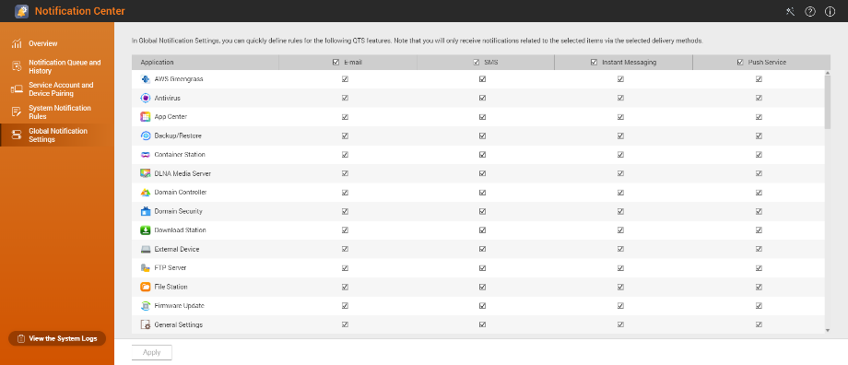
Centralized Notification Rule Configuration
Configure & Manage All Notification Rules
One-click to Turn Off Notification
Turn off notifications for specific apps and methods
Centralized monitoring and management

Slide 6
I'm really worried that important information might not be received. Is there a way to confirm that the notification is set or messages are sent correctly?

Slide 7
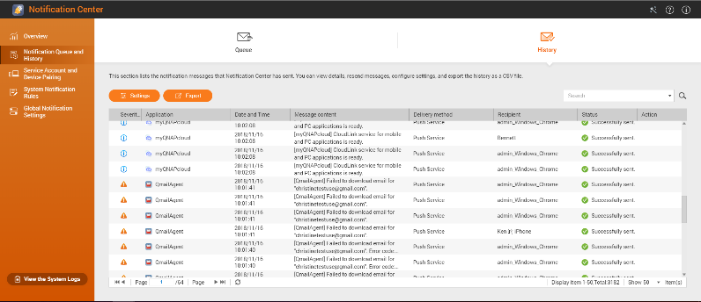
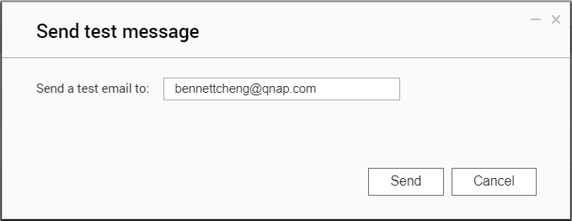
Dual mechanism to ensure that important messages are not missed
Two-Step Guarantee
Verify Your Settings
Monitor message transmission status
Test message sending function
Notification record

Slide 8
Provides you with a variety of delivery options, allowing you to choose the most appropriate notification method based on different messages and use cases!

Slide 9
Receive Push Notification with Your Phone
Get NAS-related push notification in Qmanager on your mobile phone (supports iOS and Android).
The messages can be sent to multiple mobile phones.

Slide 10
Use Qmanager to Pair with NAS
Install Qmanager from app store on your mobile phone.
Follow on-screen instructions to complete the paring.
Start receive push notification from the NAS.

Slide 11
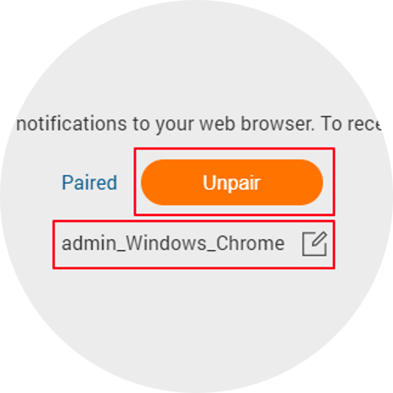
Receive Push Notification via Browser
Pair your NAS with the web browser
Supports Chrome 42, Safari (OS X 10.9), or Firefox 50 or later

Slide 12
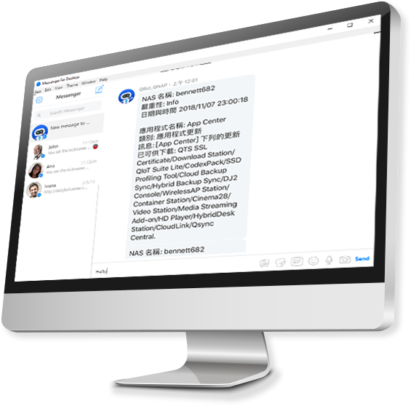
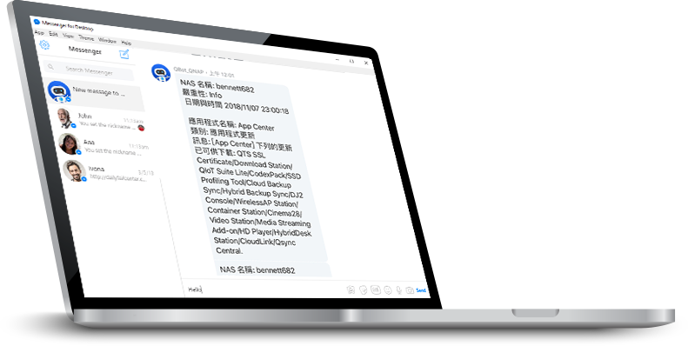
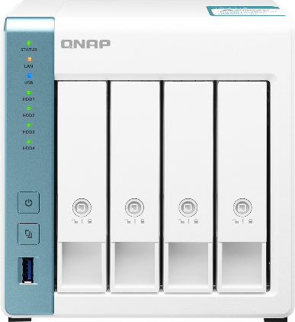
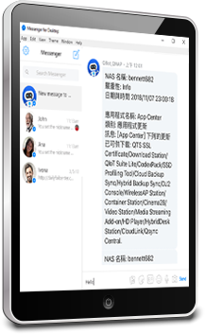
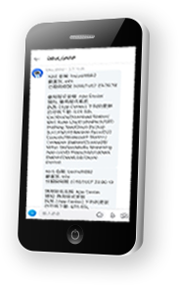
Daily messaging apps can be used as a NAS notification method

Slide 13
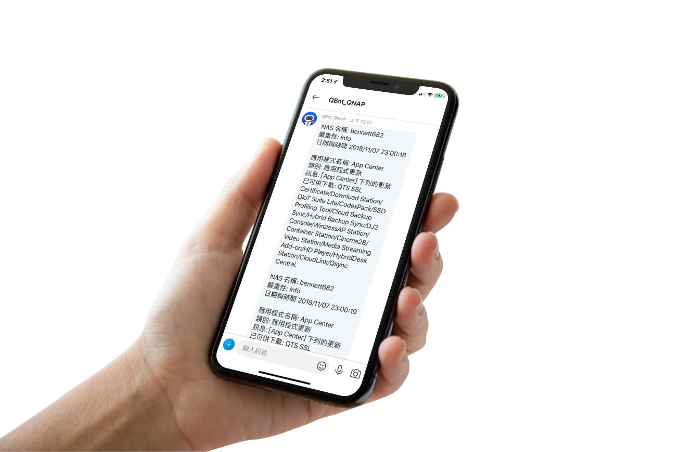
Three steps to pair your instant messaging account
Choose the messaging service you want to use
Add Qbot as your contact
Enter verification code in Qbot dialog to complete pairing

Slide 14
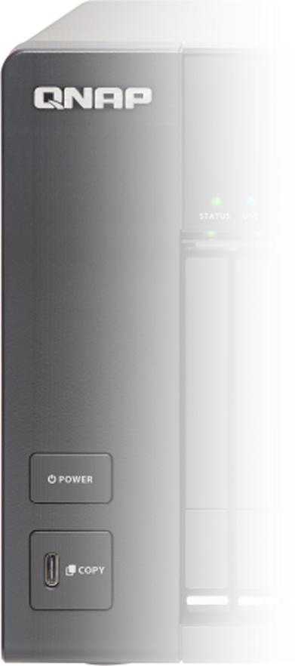
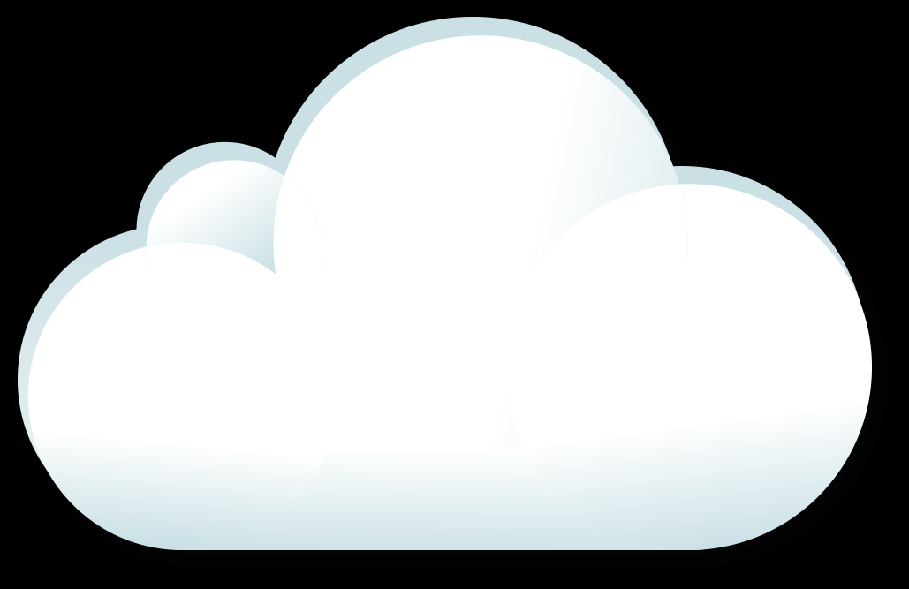
The structure of Notification Center: Instant messaging integrations
Notification Center
QNAP
IM Server
QTS
Apps
ChatBot Agent
QPKG
CloudLink
QPKG
QNAP
Chatbot
Endpoint
CloudLink
Server
QNAP NAS
QNAP Cloud
User's IM

Slide 15
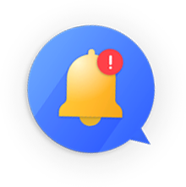
Provide you with world-class SMS services
Notification Center integrates world-class SMS service providers to provide high-security, high-reliability, and highly stable SMS notifications, so you can get notified with NAS issues in real time.

Slide 17
There are too many notifications and it is troublesome. Can I only receive important information I want?

Slide 18
Select the notification you want: Event and Alert notification
Event Notification
Select the event notification you want to receive based on the category of the applications or features.
Alert Notification
Select the log notification to receive based on the severity of the system log.

Slide 19
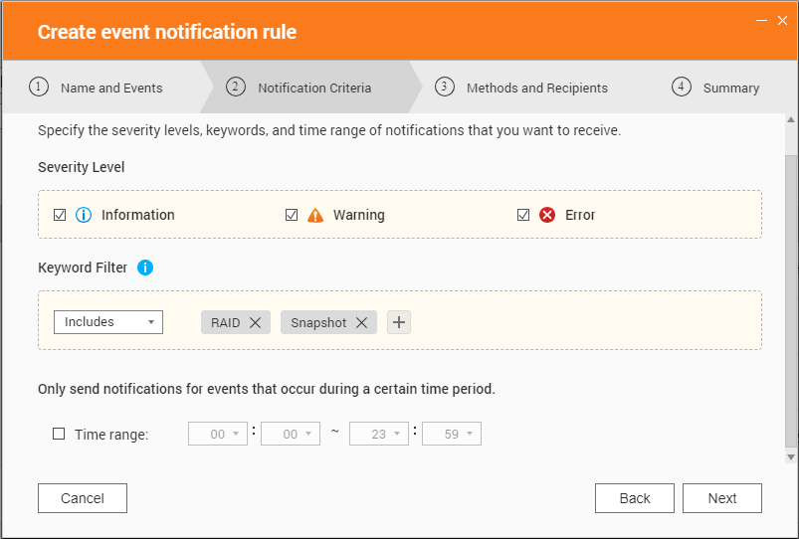
Highly flexible, highly customizable filter conditions
Detailed function settings to meet your notification needs
Severity level filter
You can directly select the message severity level and the system will help you quickly filter important notifications.
Keyword Filtering (multiple)
Specify to "Include" or "Exclude" specific keywords.
Specified time notification
Messages that occur within the time frame will be sent.

Slide 20
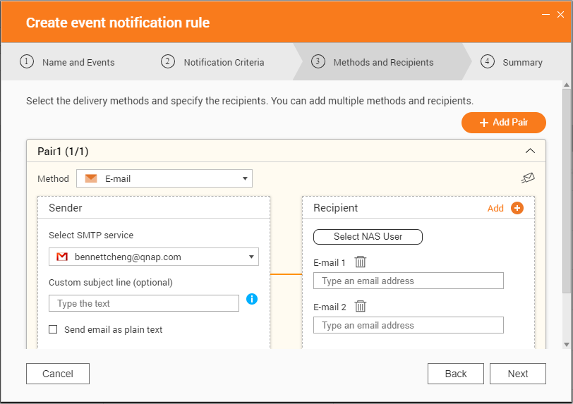
Highly flexible, highly customizable receiving conditions
Three major advantages
Supports simultaneous settings of multiple transmission pairs to avoid failure of a single transmission method!
No need to manually input recipients! Quickly select from NAS contact email & phone.
The number of recipients is no longer limited! Multiple recipients are now supported.

Slide 21
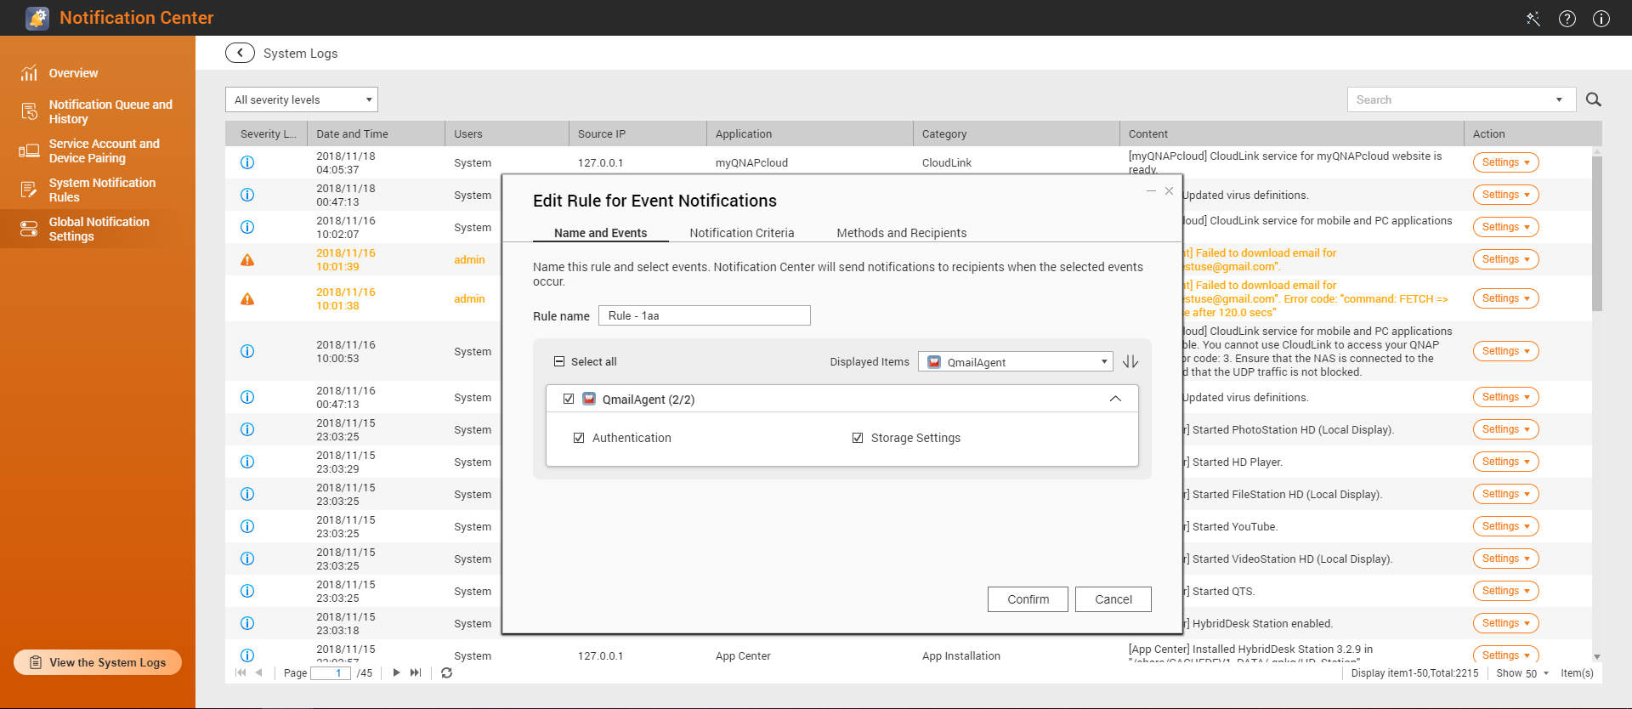
Never miss important logs: one-click notifications
For important logs, you can one-click create notification rules, and settings for important messages can be done intuitively.

Slide 22
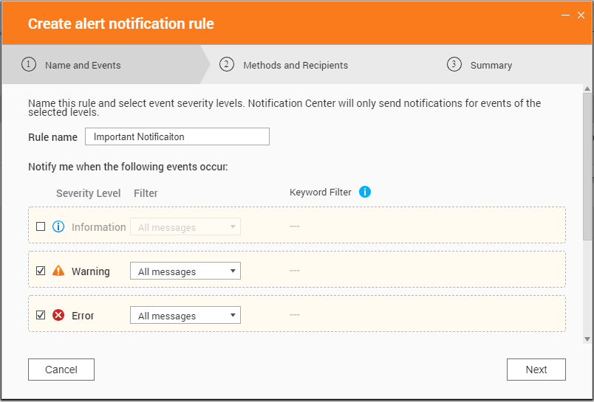
Use Case: Only receive important message
Suggested Settings:
I just want to make sure that important NAS error messages are delivered, and other event notifications are irrelevant to me!
Select “Alert Notification”
Select “Warning” and “Error” in the severity level. Select “All messages” in the filter
Configure notification methods and recipient information
Finish

Slide 23
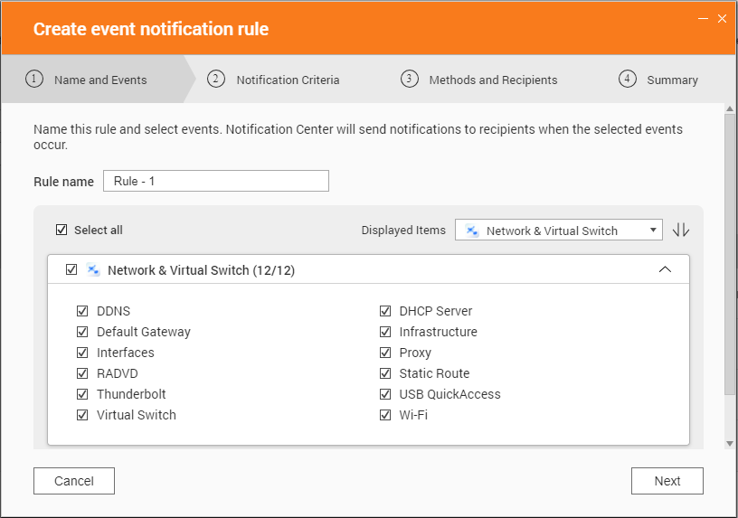
Use Case: Only receive message from specified apps
Suggested Settings:
Select “Event Notification”
Set notification criteria: severity level, keyword filtering, specified time. (Default is all message notifications)
Select the "Network and Virtual Switch" and "Storage and Snapshot " and the "Message Category"
Configure notification methods and receiver information
Finish
I only want to receive notifications about NAS "Network" and "Storage & Snapshots", and I want to receive them in "Chinese".

Slide 24
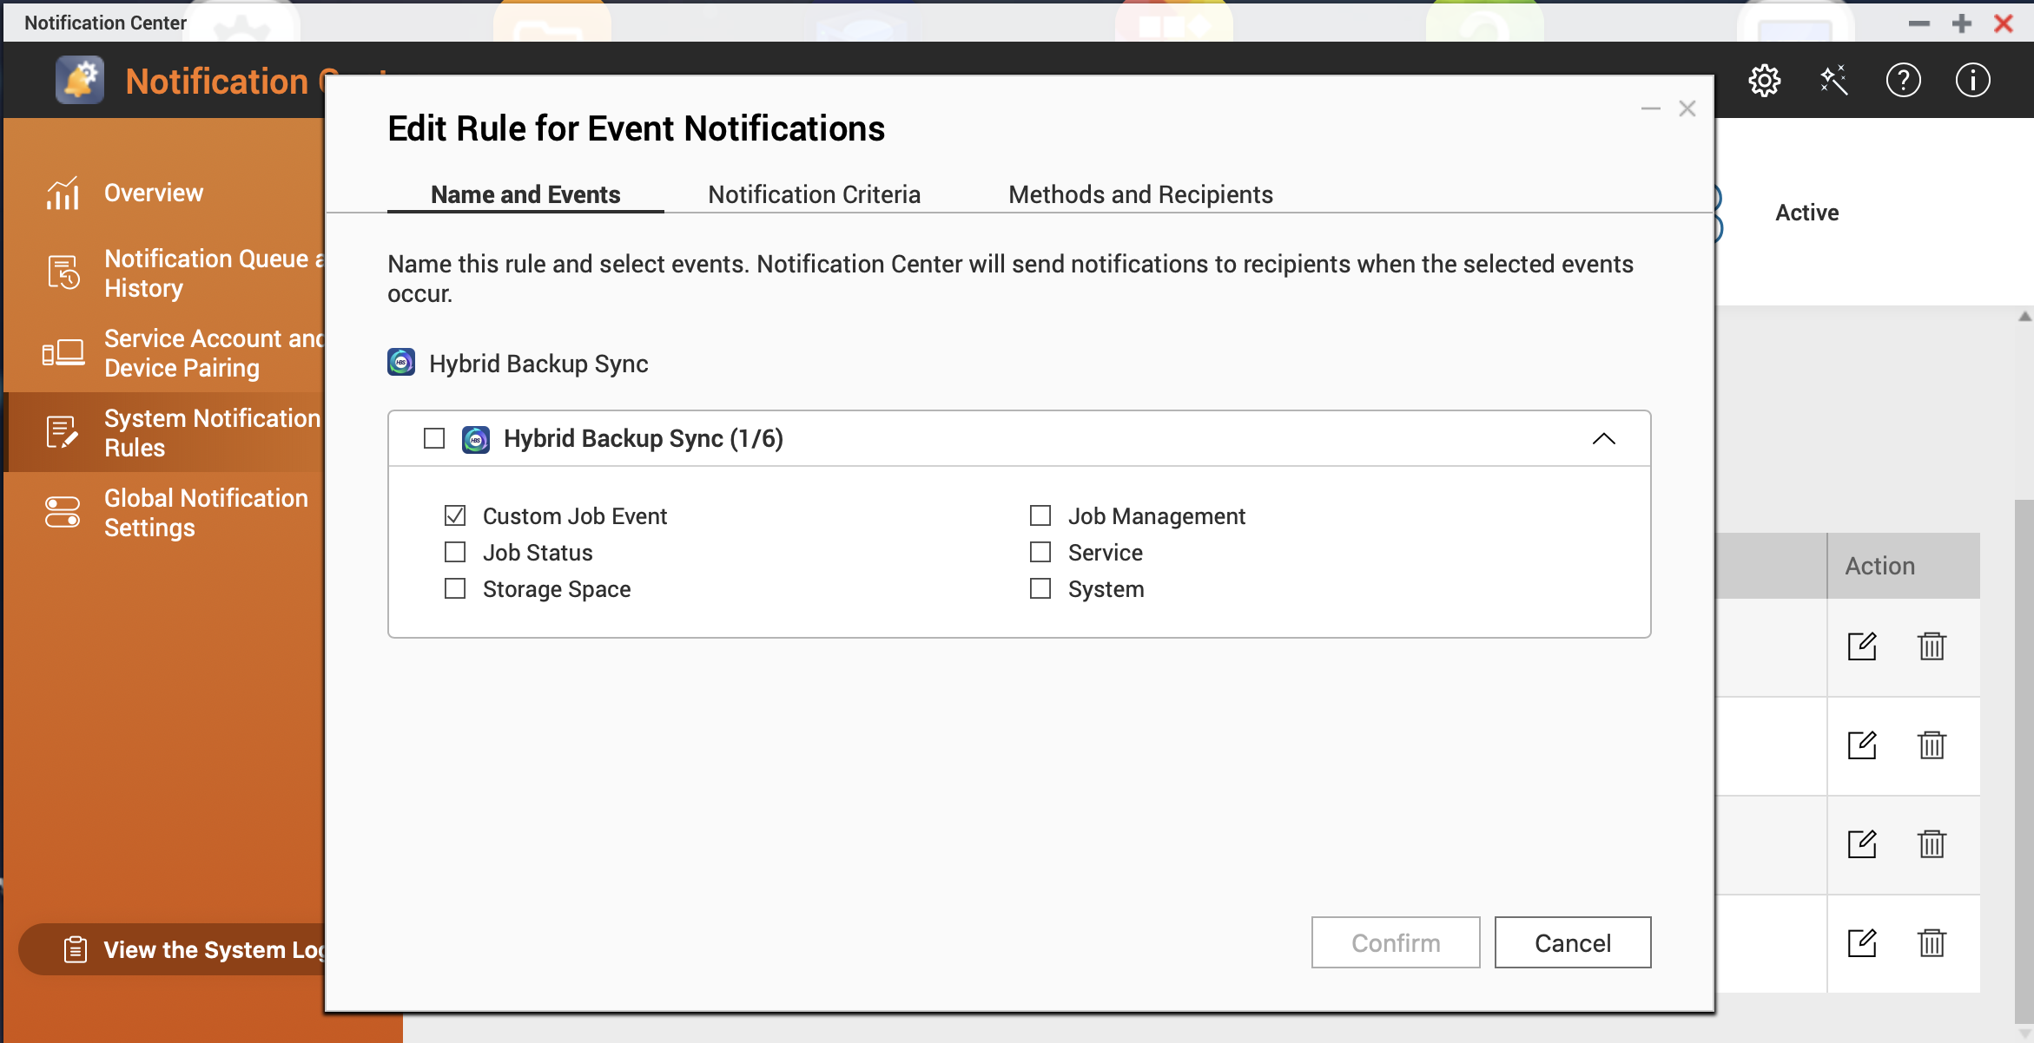
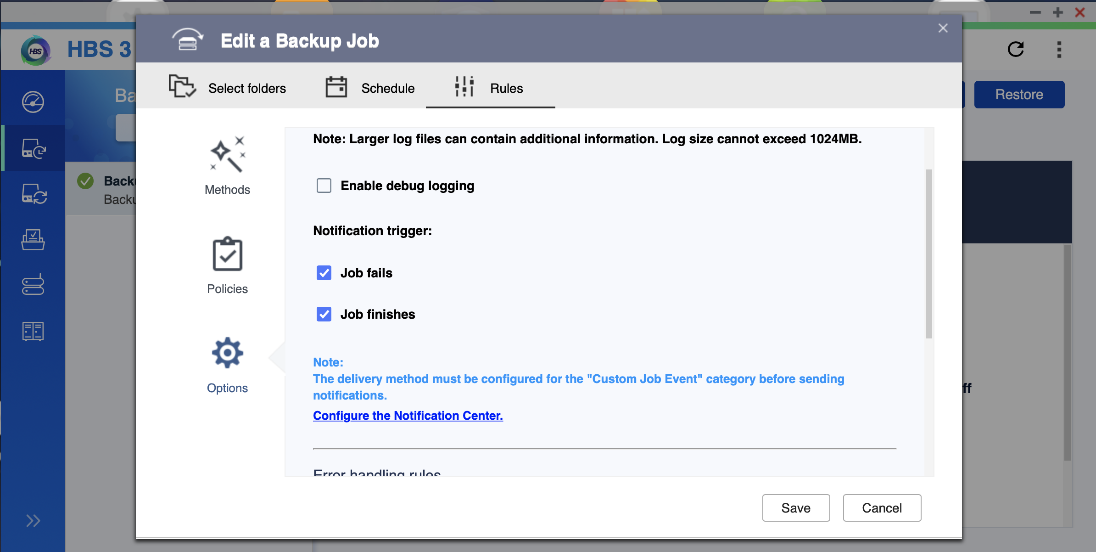
Use case: Receive HBS backup completion notification
Suggest Settings:
Launch “Notification Center” and open event rule page
Set HBS notification rules
Set receiver of notification
Finish
I want to receive HBS job finished to make sure the backup is completed.

Slide 25
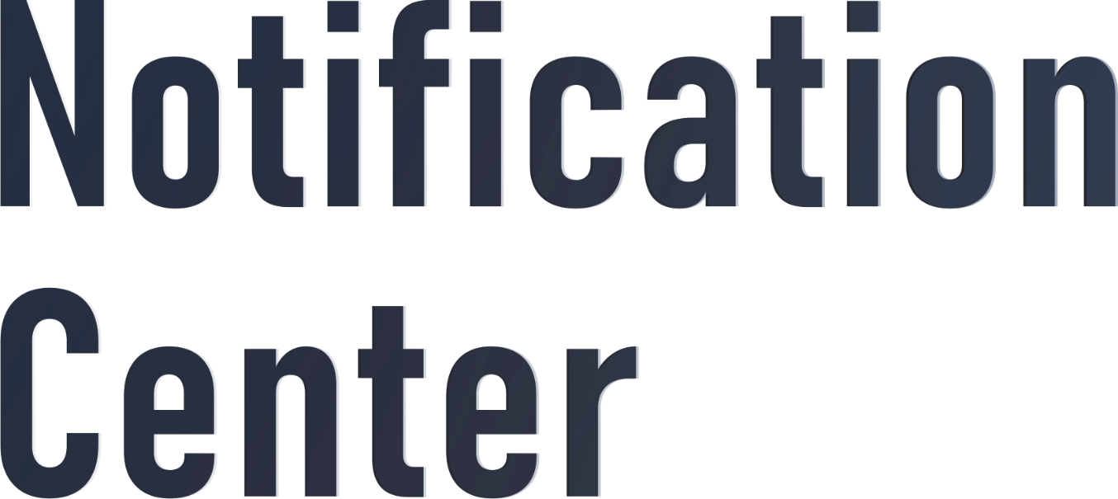
Copyright © 2018 QNAP Systems, Inc. All rights reserved. QNAP® and other names of QNAP Products are proprietary marks or registered trademarks of QNAP Systems, Inc. Other products and company names mentioned herein are trademarks of their respective holders.

