Slide 2
A new milestone with Gigabit+ level of WiFi 6 connectivity
The increasing trend of wireless-only environment
Gigabit+ level WiFi 6 wireless connectivity
QXP-W6-AX200 PCIe WiFi 6 card enables NAS and PC with high-speed WiFi 6 client connectivity
How to install and setup QXP-W6-AX200 on PC and NAS

Slide 3
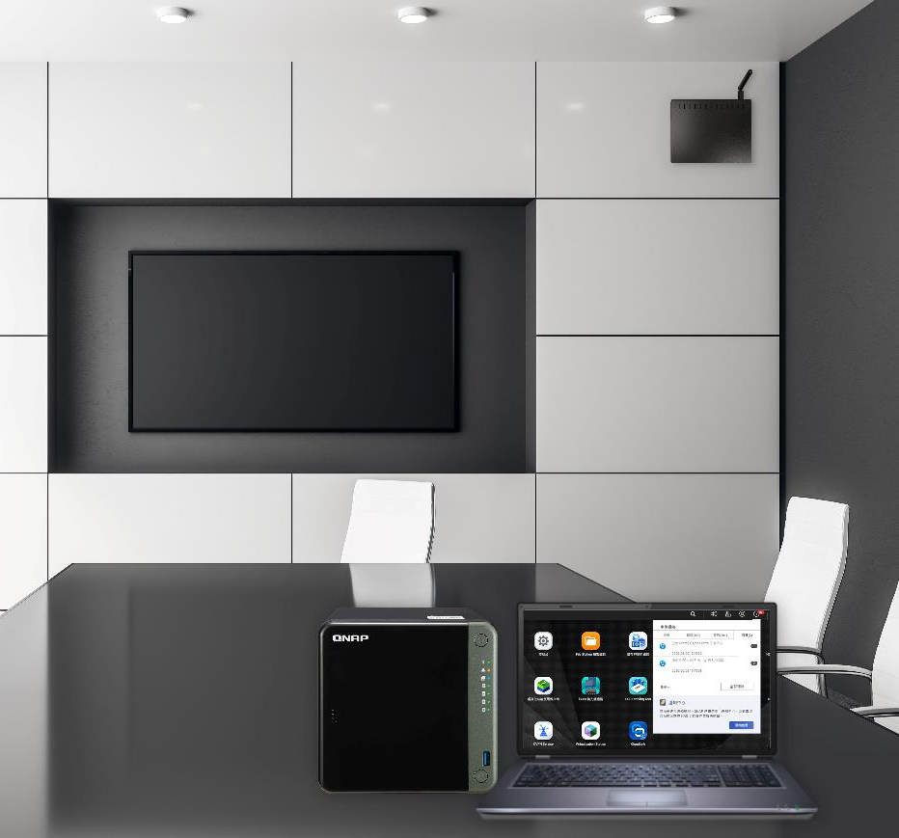
More WiFi only environments because of the simplicity of wireless connections
Laptops and mobile devices already have integrated wireless capability
Because all mobile devices now are equipped with Wi-Fi, hotel rooms and lobbies, show rooms, and conference centers no longer provide wired connection or provide it with a fee. More and more locations now provide WiFi-only connection.

Slide 4
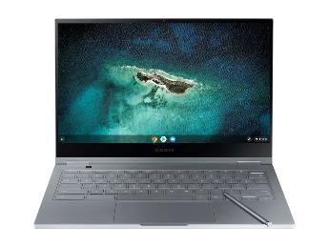
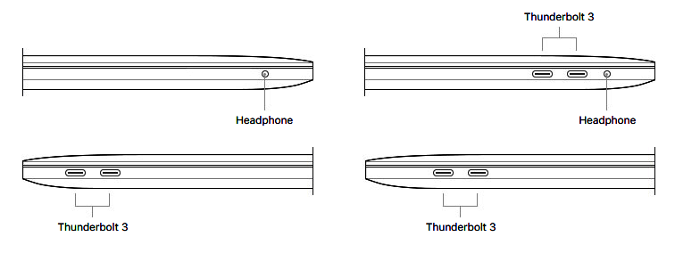
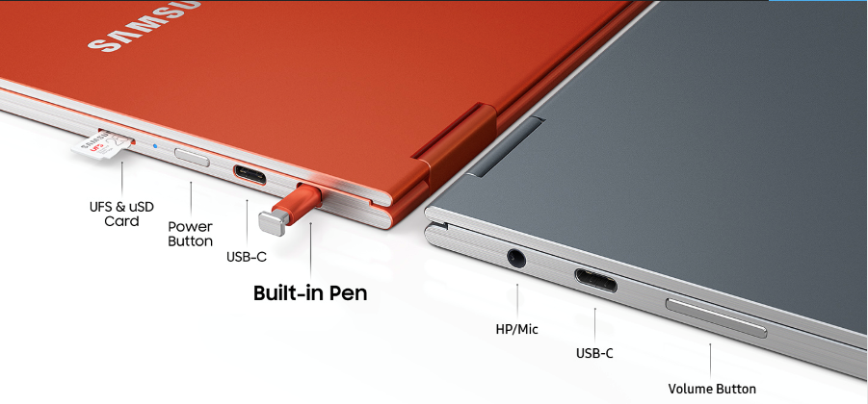
More and more laptops have removed RJ45 LAN port
Apple Macs
Windows computers
Chromebook

Slide 5
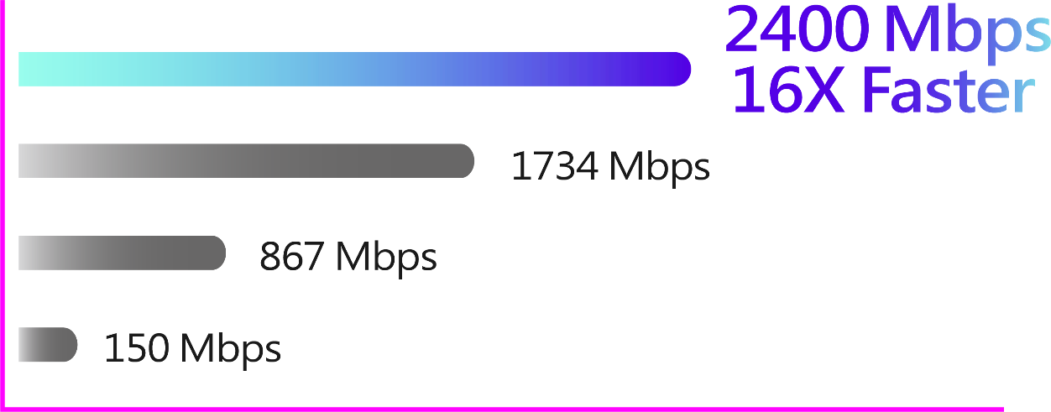
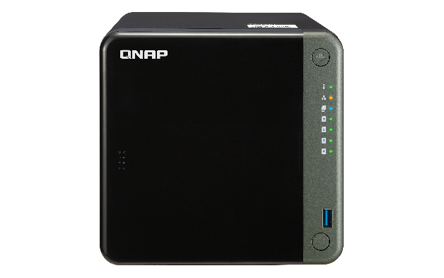
Next-gen WiFi 6 network with Gigabit+ speed
WiFi 6
2x2 802.11ax
WiFi 5
2x2 802.11ac wave2
WiFi 5
2x2 802.11ac
WiFi 4
1x1 802.11bgn
QXP-W6-AX200

Slide 6
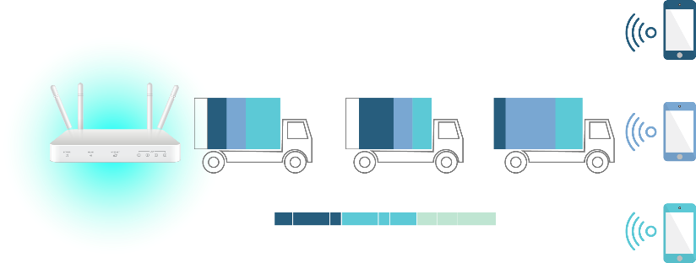
WiFi 6 is faster and lower in latency than WiFi 5
1.25 X
Faster Speed
4 X
Lower Latency
10bits/symbol
802.11ax l OFDMA
11ax
1024-QAM
1.25x
improvement
Client1
8bits/symbol
11ac
256-QAM
Client2
Transmitted data
Client3
Source: https://www.tp-link.com/bg/wifi6/

Slide 7
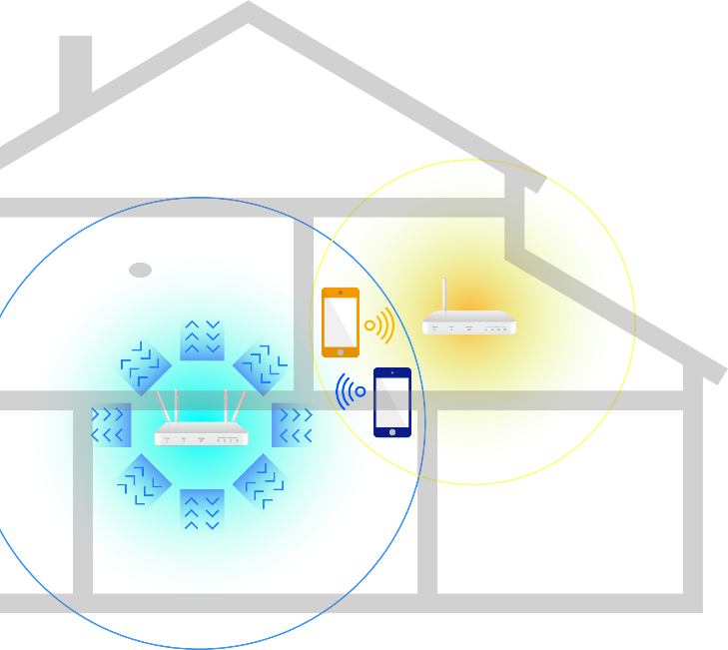
WiFi 6 with larger coverage, less interference, and higher capacity for more devices
8 x 8 MU-MIMO supports concurrent upload and download for more connected devices.
BSS (Basic Service Set) color can mark surrounding non-related wireless devices and ignore them and also avoid weak wireless signals to reduce the wireless interference for better wireless connection quality.
OFDMA (Orthogonal Frequency-Division Multiple Access) can divide each channel into small ones with narrower bands for higher wireless coverage thus reducing the number of wireless-dead zones.
125 %
More coverage
Fewer dead corners
More connections

Slide 8
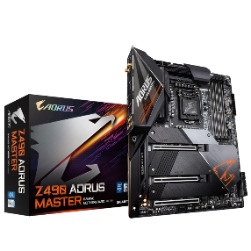
More devices are now shipped with WiFi 6
PCs / Motherboards
Phones /
iPad Pro
Laptops
Asus Chromebook Flip c436
Dell XPS 13 (2020)
HP Spectre x360
Lenovo Yoga c940
LG Gram 17
Microsoft Surface pro 7
Asus Mini PC PN62
Asus desktop PC S700TA
Acer Predator Helios 300
AMD B550 boards
Intel Z490 boards
Huawei P40 Pro
iPhone 11 series, SE
LG V60 ThinQ
Motorola Edge Plus
OnePlus 8 and 8 Pro
Samsung Galaxy S10, S20 series
Samsung Galaxy Note 10 series
Samsung Galaxy Fold
Xiaomi Mi 10 series

Slide 9
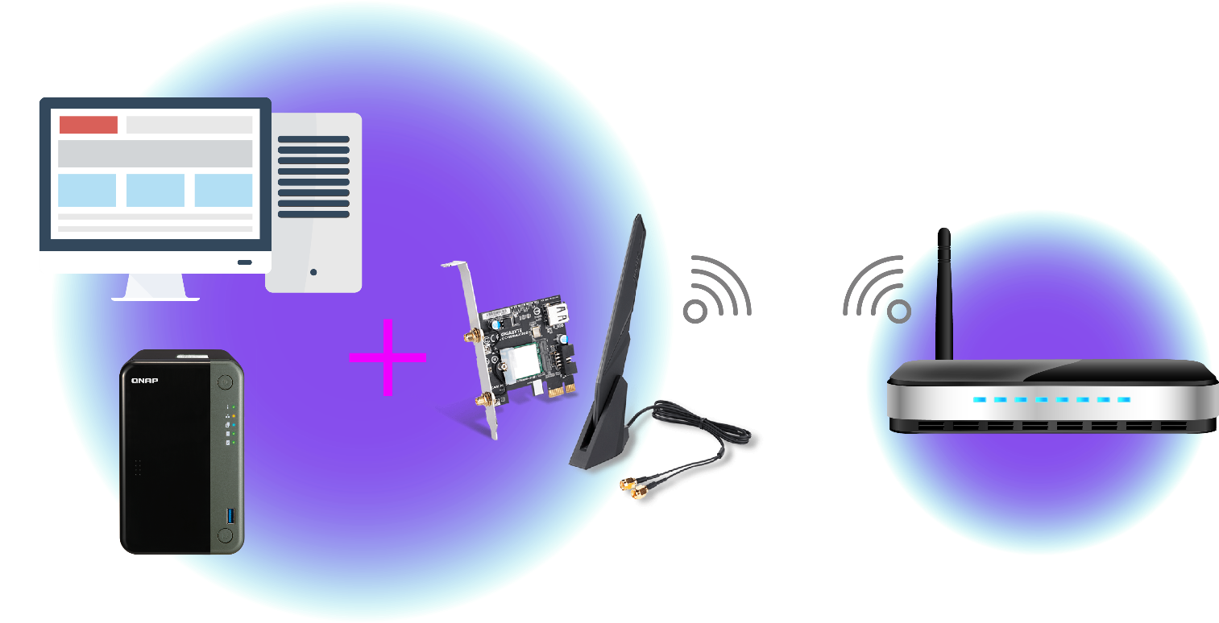
QXP-W6-AX200 enables your current PC and NAS with WiFi 6 wireless connectivity
Current Windows 10 /Linux PCs
PC / NAS installs the
QXP-W6-AX200 PCIe WiFi 6 card
WiFi6 router / access point
QNAP TS-253D NAS

Slide 10
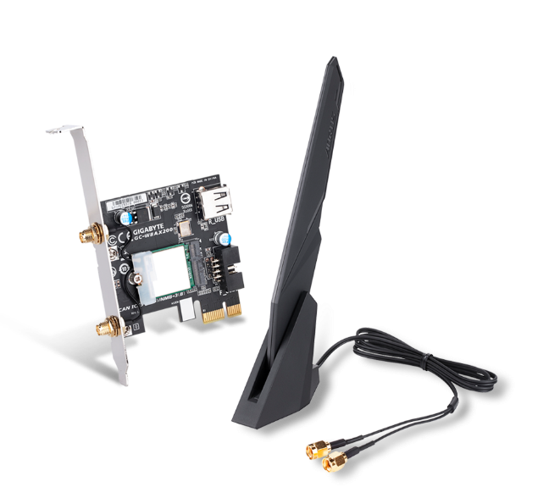
QXP-W6-AX200 WiFi 6 card package contents
2 extra half-height brackets for PC and NAS
Installation guide
WiFi 6 PCIe
Card and antenna
Internal USB cable for
BT 5.0 on PC
Windows 10
driver CD

Slide 11
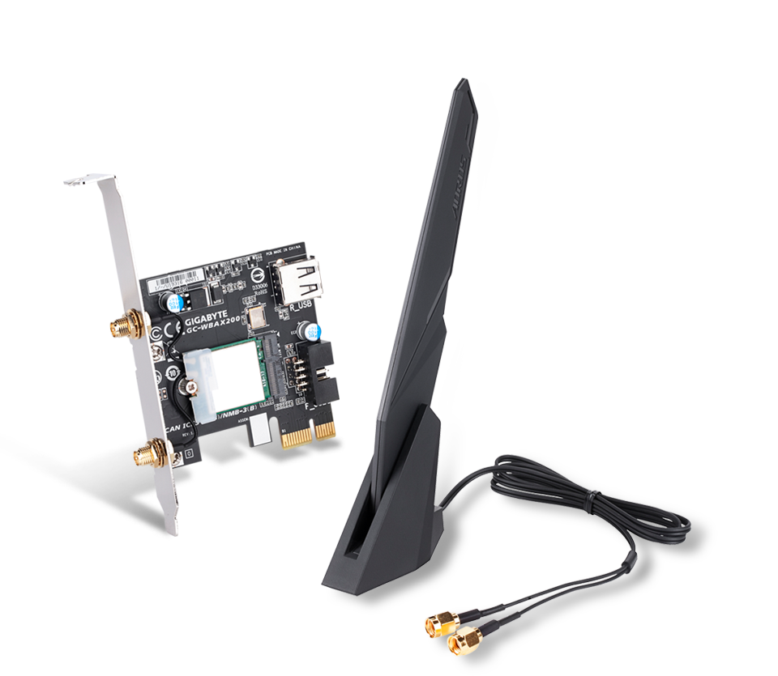
QXP-W6-AX200 WiFi 6 card overview
BT 5.0 USB connector for PC connection
(Choose from USB 2.0 Type-A and pin header)
AORUS high-performance dual-band antenna with 802.11ax 2.4GHz & 5GHz
2T x 2R antenna with smart antenna enhancement for the optimal wireless performance
Antenna with multiple angle tilt and magnetic base for the best placement and signal reception
Pre-installed full-height bracket
Gold-plated connectors for higher quality and durability
Intel WiFi 6 AX200 wireless module
Theoretical speed up to 2400Mbps
802.11 ax/ac/a/b/g/n
Bluetooth 5.0 for PC
PCIe 2.0 x1 interface

Slide 12
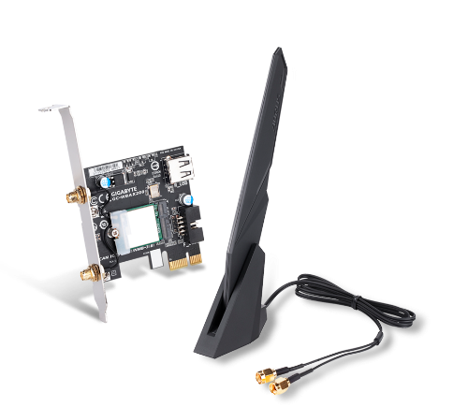
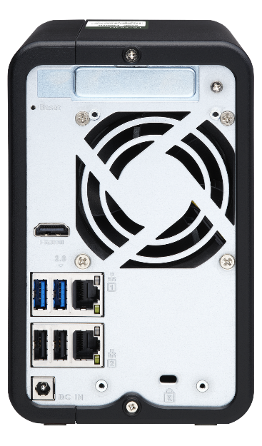
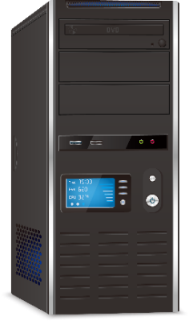
Supports NAS QTS / QuTS hero, Windows 10, and Linux operating systems
QXP-W6-AX200
QTS 4.4.3 + & QuTS hero
NAS with a PCIe slot* and 64-bit x86 and ARM CPU
Install the driver from Intel AX200 website
Supports Windows 10 64 bit /
Linux kernel 5.1+
*Refer to the QNAP website for the compatible NAS models. Some NAS models require a BIOS update.

Slide 13
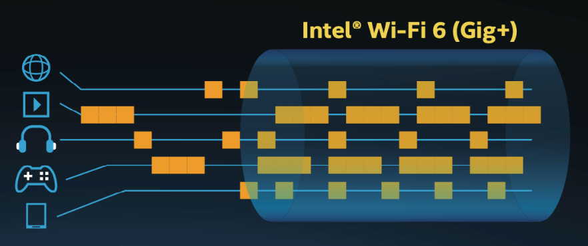
2x2 WiFi 6 and 160MHz for 3X data rates and 4X capacity
QXP-W6-AX200 WiFi 6 (802.11ax) card provides nearly 3X higher peak data rates and 4X capacity improvements with spatial reuse than a WiFi 5 (802.11ac) card in dense environments*.
2x2 160MHz channels, Upload/Download OFDMA, 1024QAM, and MU-MIMO deliver theoretical data rates in 2.4GHz up to 574Mbps, and in 5GHz up to 2402Mbps.
Source: https://www.intel.com/content/www/us/en/products/docs/wireless-products/gaming-with-wi-fi-6-infographic.html
*A WiFi 6 router is required to achieve the WiFi 6 performance and benefits. Actual wireless throughput and/or range will vary depending on your environments.

Slide 14
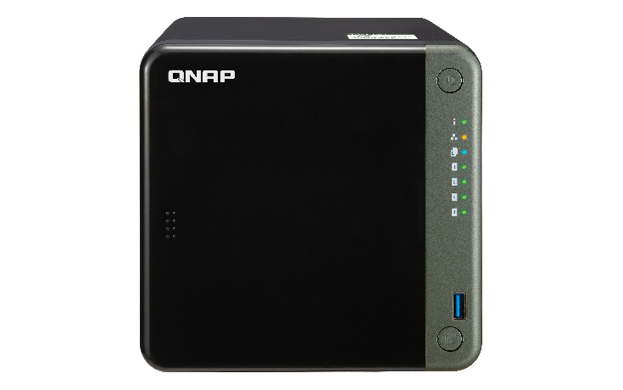
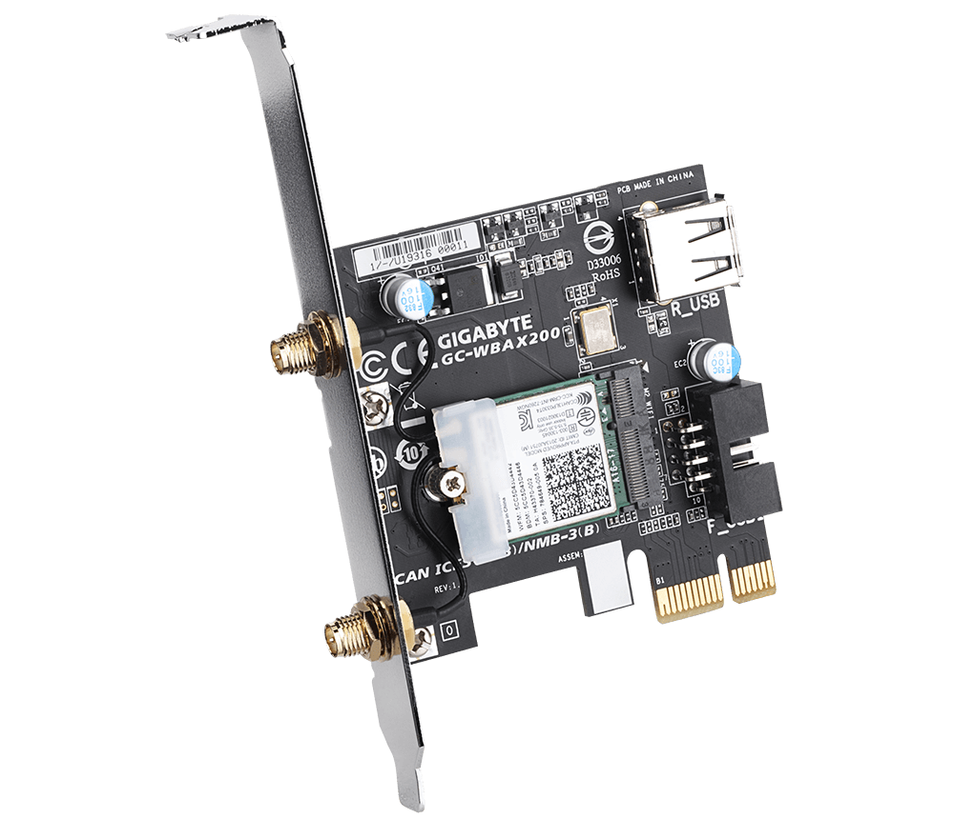
You can make your NAS wireless by installing PCIe AX200 or USB WiFi Dongles.
Two methods for setting up WiFi NAS
QNAP QXP-W6-AX200 PCIe supports
WiFi 6 (802.11ax)
USB Dongle only supports up to WiFi 5 (802.11ac)

Slide 15
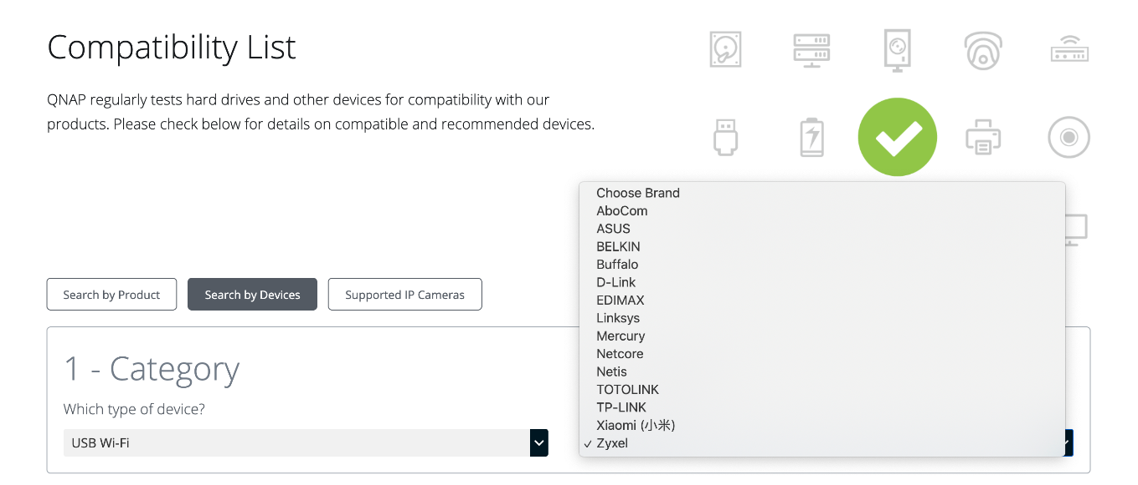
USB WiFi Dongle Caompatibility List
Go to QNAP website for USB WiFi Dongle Compatibility List
https://www.qnap.com/go/compatibility
可於 QNAP 官網查詢​

Slide 16
Transform your NAS to become WiFi 6 NAS
WiFi 6 AP
Direct cable connection
High speed wireless internet
Hotel
Library
Factory
Customer Office
Pure wireless office

Slide 17
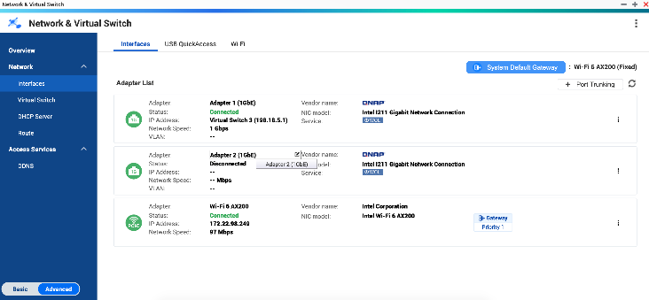
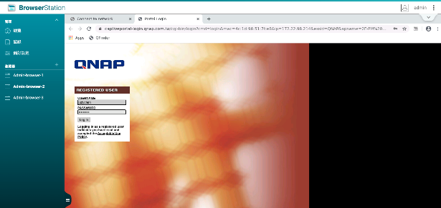
Ｈow to quickly setup QXP-W6-AX200
The QXP-W6-AX200 card can be activated on NAS using following two ways
Enable WiFi at [Network and Virtual Switch]
Log into Captive Portal via Browser Station
Enable WiFi via Qfinder Pro
Log into Captive Portal via host browser
Qfinder Pro Version
Windows v6.9.2
Mac v7.3.2
Linux v7.3.2
***If the connected WiFi AP has a mechanism that blocks request under NAT, the browser cannot be opened automatically. You need to enable Browser Station on the NAS to log into Captive Portal, or select another WiFi network that does not need to log into Captive Portal.
***Browser Station only supports on x86-based NAS with a minimum 4GB memory or above.
***Browser Station needs to be installed manually.

Slide 18
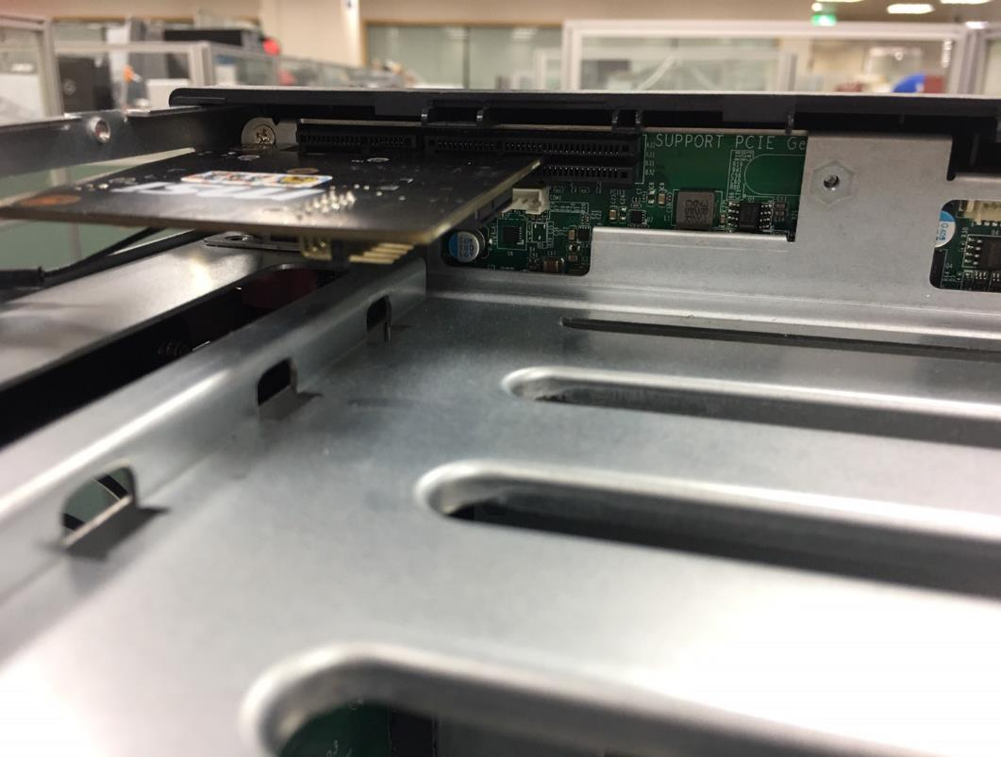
Network and Virtual Switch x Browser Station
Step 1
Install QXP-W6-AX200 on NAS PCIe slot.

Slide 19
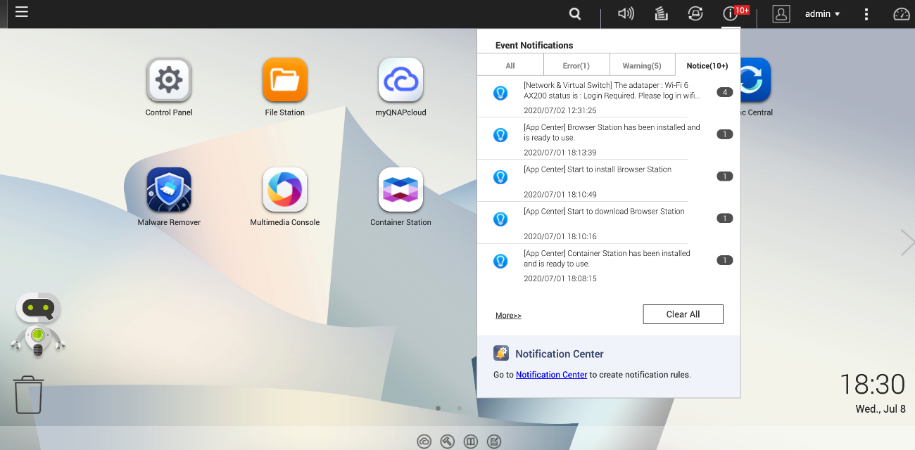
Network and Virtual Switch x Browser Station
Step 2
Turn on NAS. Connect PC and NAS directly using ethernet cable and log into QTS.
You can see system notification shows that PCIe WiFi 6 AX200 has been detected.
QTS FW needs to be 4.4.3 or above.

Slide 20
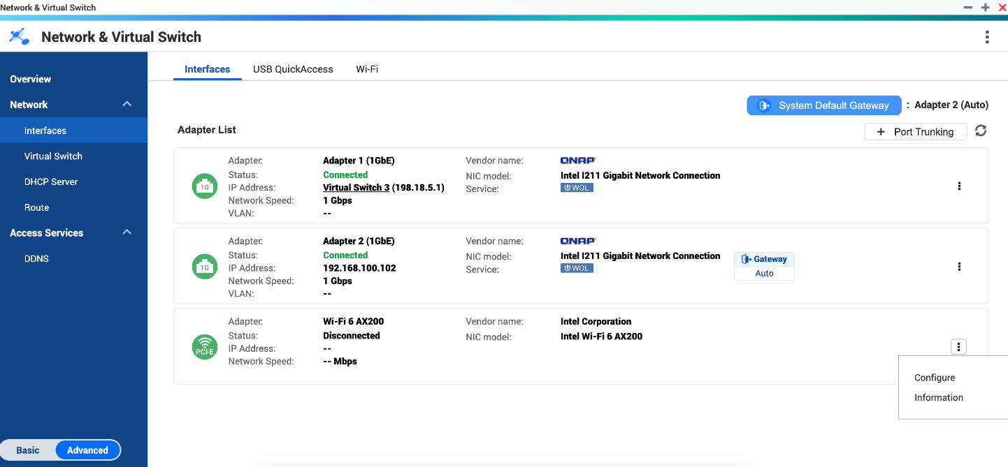
Network and Virtual Switch x Browser Station
Step 3
Go to Network and Virtual Switch page
Go to WiFi6 AX200 Setting.

Slide 21
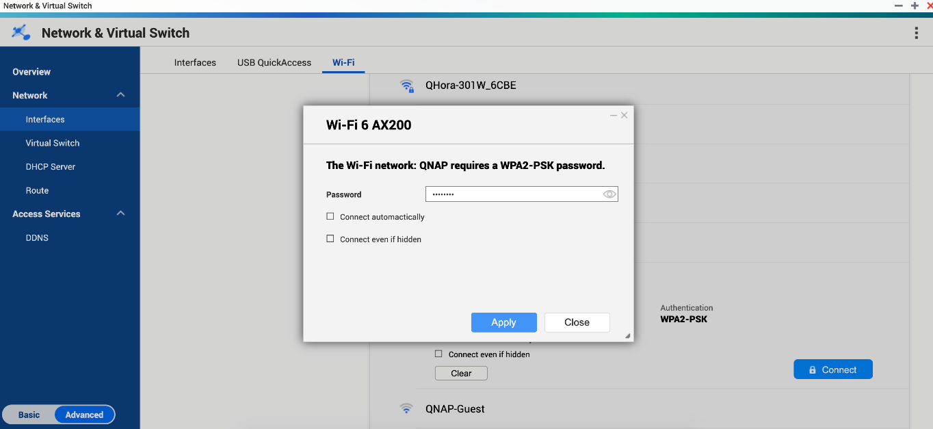
Network and Virtual Switch x Browser Station
Step 4
Enable WiFi and select a SSID to connect.
Enter WiFi password

Slide 22
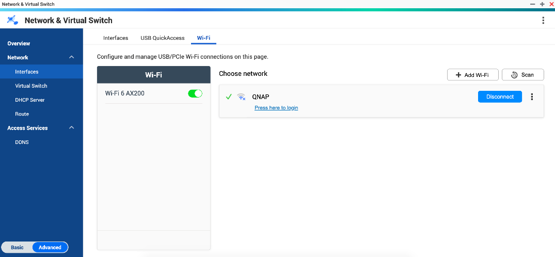
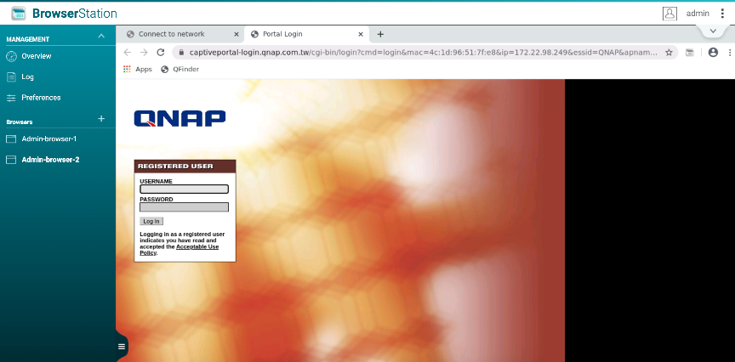
Network and Virtual Switch x Browser Station
Step 5
If log into Captive Portal is required, click the link under SSID, and a new browser tab will open automatically via Brower Station.
WiFi connection will complete after logging in.
***Browser Station only supports on x86-based NAS with a minium 4GB memory or above.

Slide 23
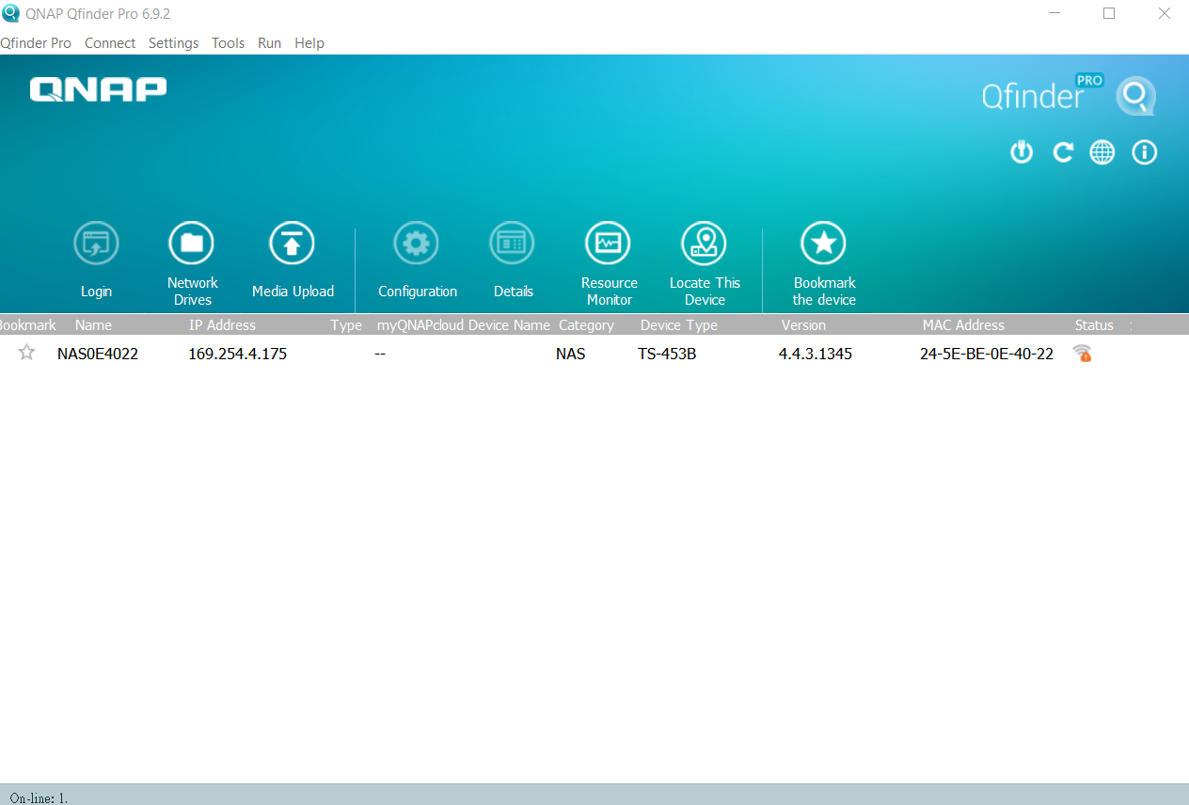
Setting up QXP-W6-AX200 via Qfinder Pro
Step 1
Install AX200 on NAS PCIe slot. Turn on NAS. Connect PC to NAS directly using ethernet cable.
Find NAS via Qfinder Pro
NAS Status will show a Wireless Icon indicating that AX200 is detected.

Slide 24
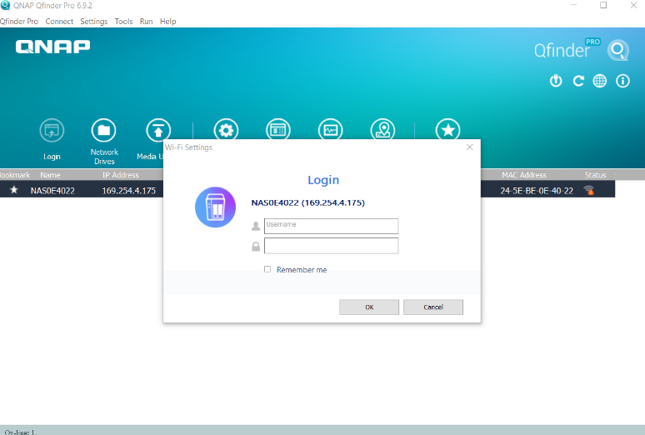
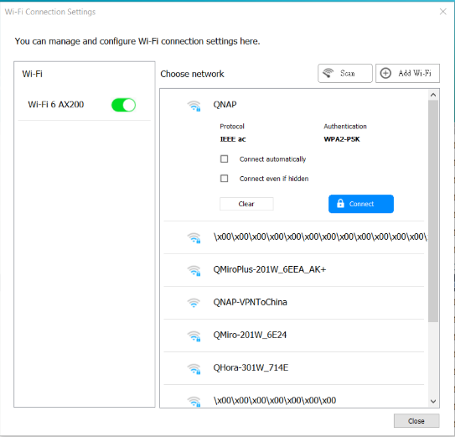
Setting up QXP-W6-AX200 via Qfinder Pro
Step 2
Click Wireless icon
Log into NAS and enable WiFi settings

Slide 25
Setting up QXP-W6-AX200 via Qfinder Pro
Step 3
Select SSID and connect

Slide 26
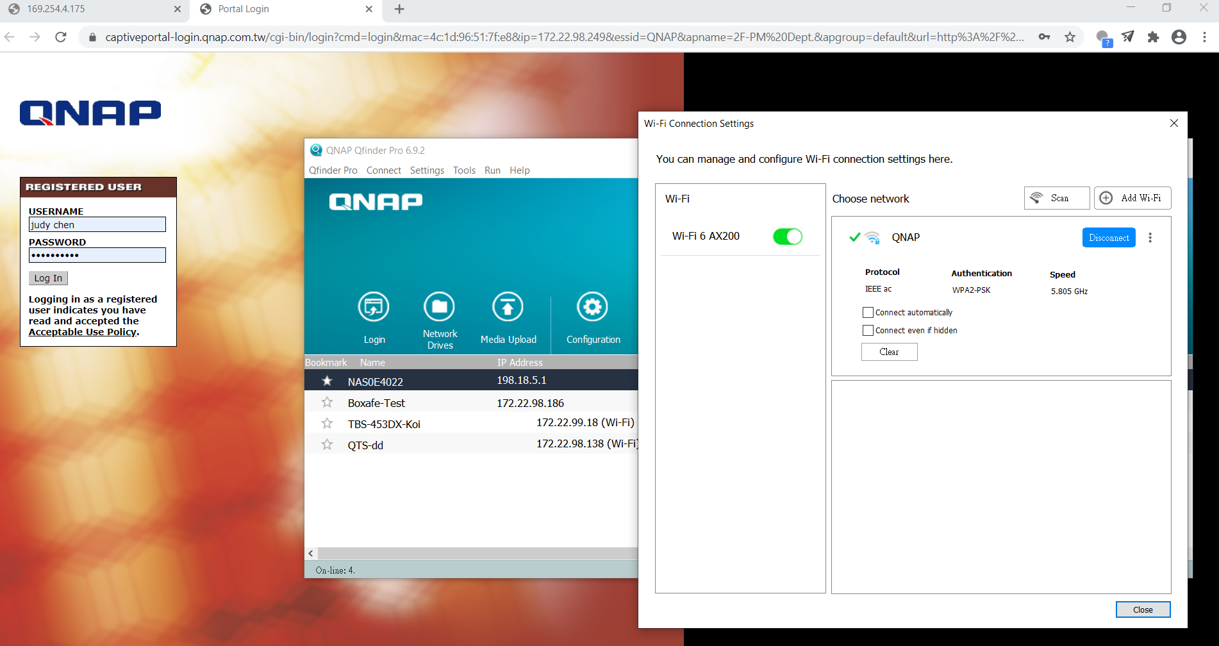
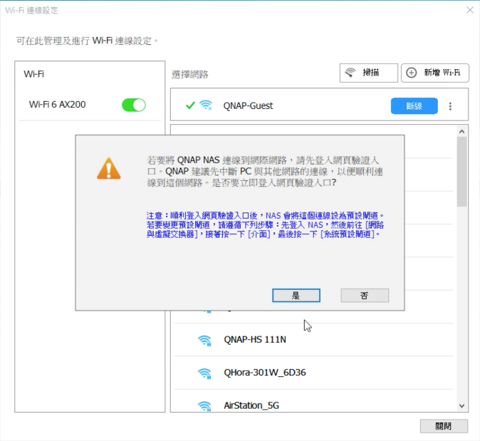
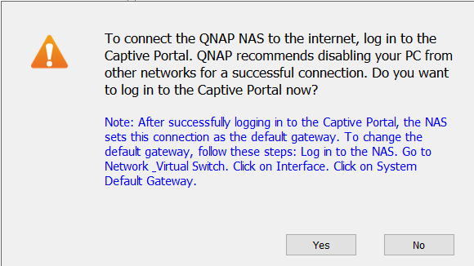
Setting up QXP-W6-AX200 via Qfinder Pro
Step 4
Click login after wireless connection completes. Captive portal page will be opened via host browser automatically.
***If the connected WiFi AP has a mechanism that blocks request under NAT, the browser cannot be opened automatically. You need to enable Browser Station on the NAS to log in to Captive Portal, or select another WiFi network that does not need to log in to Captive Portal.

Slide 27
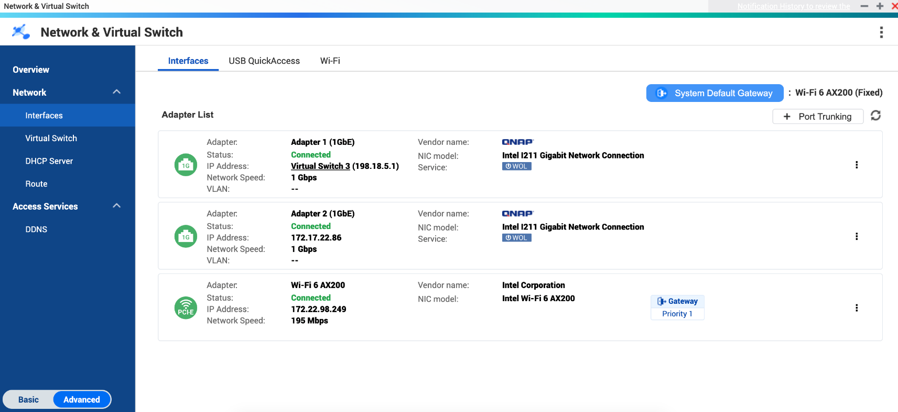
AX200 card becomes QTS default gateway automatically

Slide 28
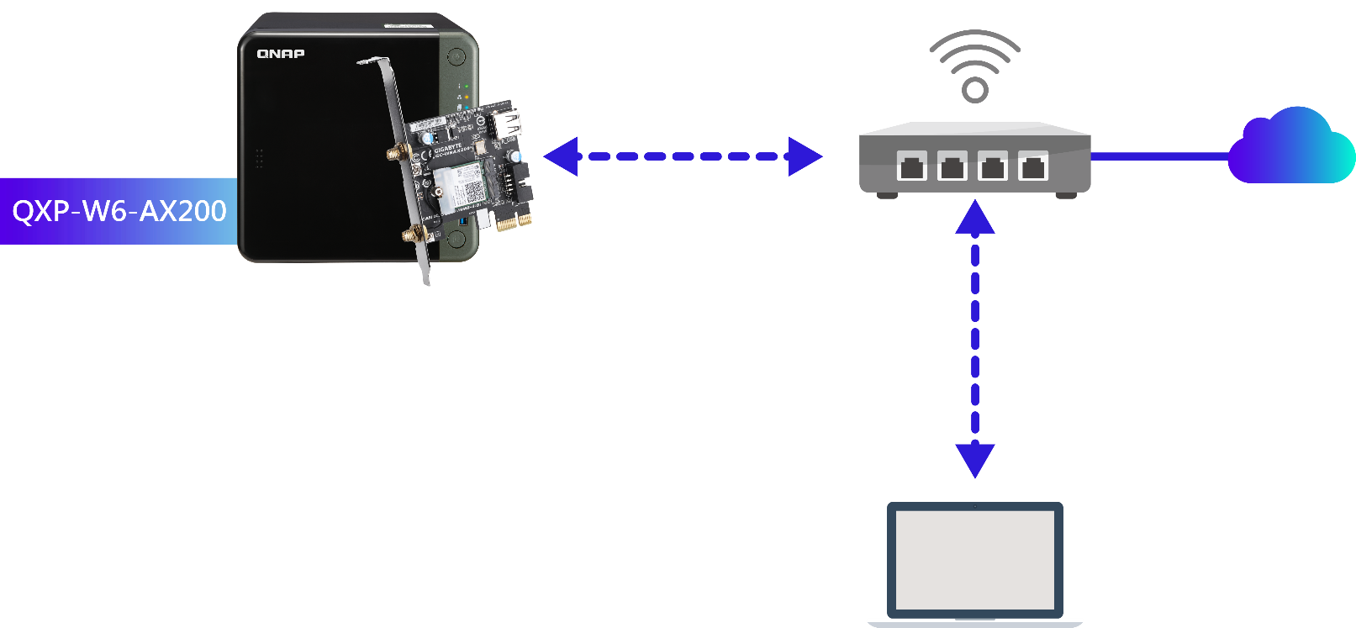
Access NAS via wireless connection
User Scenario 1
WiFi 6 Router
WiFi connection
Access NAS via wireless connection

Slide 29
Access Internet via mobile hotspot
User Scenario 2
WiFi 6
Phone Hotspot
4G/5G Internet

Slide 30
NAS can connect to Internet wirelessly via another NAS
User Scenario 3
Connect your NAS wirelessly to another NAS that is installed with QuWAN and QWA-AC2600 with WirelessAP Station. QuWAN provides network optimization, firewall and deep packet inspection on both wireless and wired networks to achieve high-speed and redundant transmission and security protection mechanisms​​
Internet
QNAP QWA-AC2600 card + WirelessAP Station app
Dual WAN for WAN optimization and failover

Slide 31
Transform your NAS to Wireless WiFi 6 Desktop
User Scenario 4
WiFi 6 NAS can turn into a high speed wireless desktop by connecting HDMI monitor and keyboard to NAS.
WiFi 6
WiFi 6 Router

Slide 32
QXP-W6-AX200 PCIe WiFi 6 card Enables NAS and PC with WiFi 6 Gigabit+ connectivity and more responsive performance on dense wireless network
Copyright © 2020 QNAP Systems, Inc. All rights reserved. QNAP® and other names of QNAP Products are proprietary marks or registered trademarks of QNAP Systems, Inc. Other products and company names mentioned herein are trademarks of their respective holders.

