Slide 1
4.0.0

Slide 2
Why do you need Qsync?
My phone is almost full; do I have to pay for iCloud / Google Drive?​
How to hand over the work I have done to my colleagues for the next process.
My family always asks what to do when there is not enough space on their mobile. Can my NAS be used by the whole family? How can I share travel photos with everyone?
PC/laptop space is not enough but plugging/unplugging a portable hard drive is a hassle. And putting data on the cloud is slow and costs money to buy the space.​
How can the team members synchronize their activities to the same place and share the entire data with everyone?​
How can I synchronize my daily work to the NAS for safekeeping?​
Notes:
Today I hope to give you a whole concept of how Qsync works and benefits. Actually, Qsync is synchronizing tool across your mobile phone, your laptop, your pad and PC. but it is not a pure backup tool, So, why you need the Qsync? Here I list 6 point of popular requirement, like when you iphone is almost full, ……… Those parts of white frame are good but actually are additional value, and the red frame parts are the real key point why you need the Qsync.

Slide 3
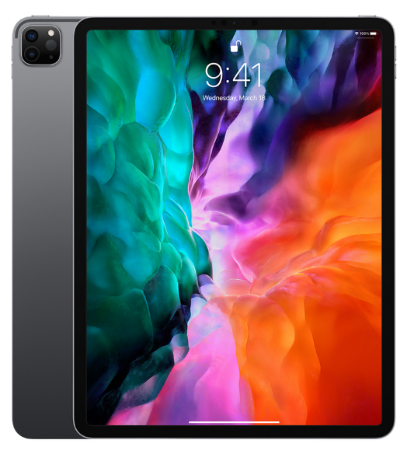
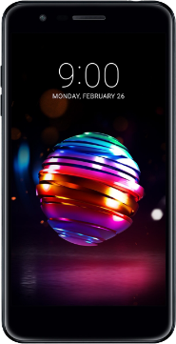
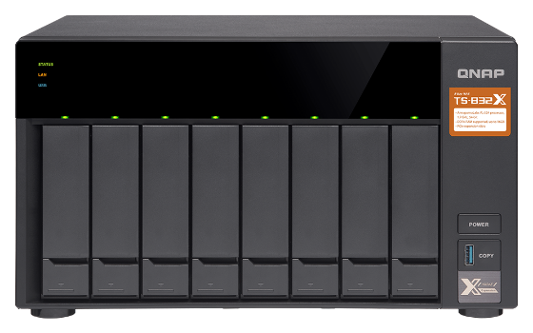
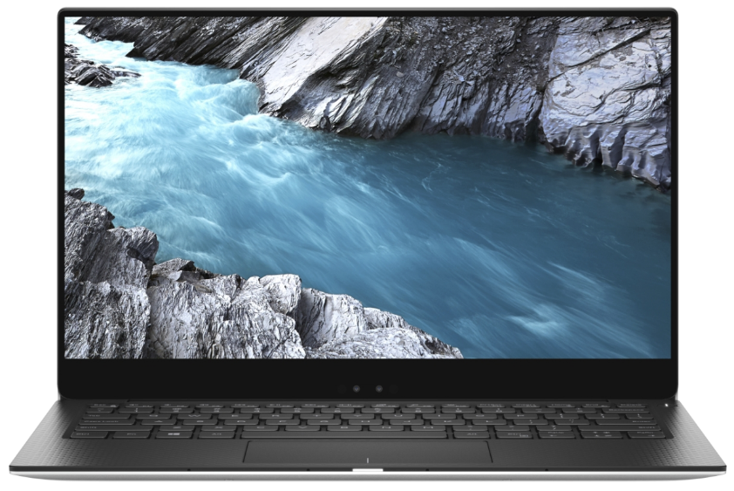
Personal user
User Scenario
Personal
Upload photos to NAS via Qsync, immediately save storage space on your phone and easily share photos with your family and more friends.
Share with more friends​

Slide 4
Operation Tips
One-way sync
1
Smart delete
2
Speed &
Flexibility
Power saving
3
Lower the sync frequency
WiFi only
Charging only

Slide 5
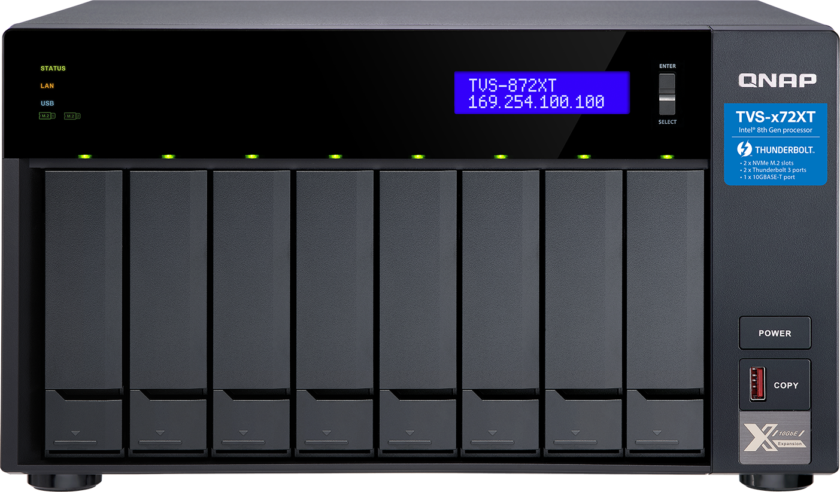
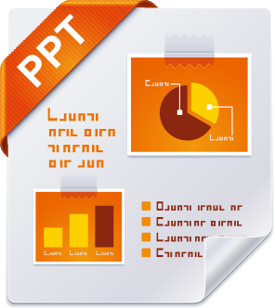
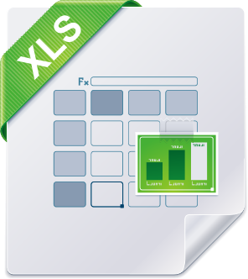
User Scenario
Family Shared
Upload data to NAS through Qsync, immediately save the storage space of mobile phone / computer / laptop, and also share various data / videos to your family and more friends.​
Do you still buy cloud space one by one for your family members when their phone is not enough space?​
Shared space for family

Slide 6
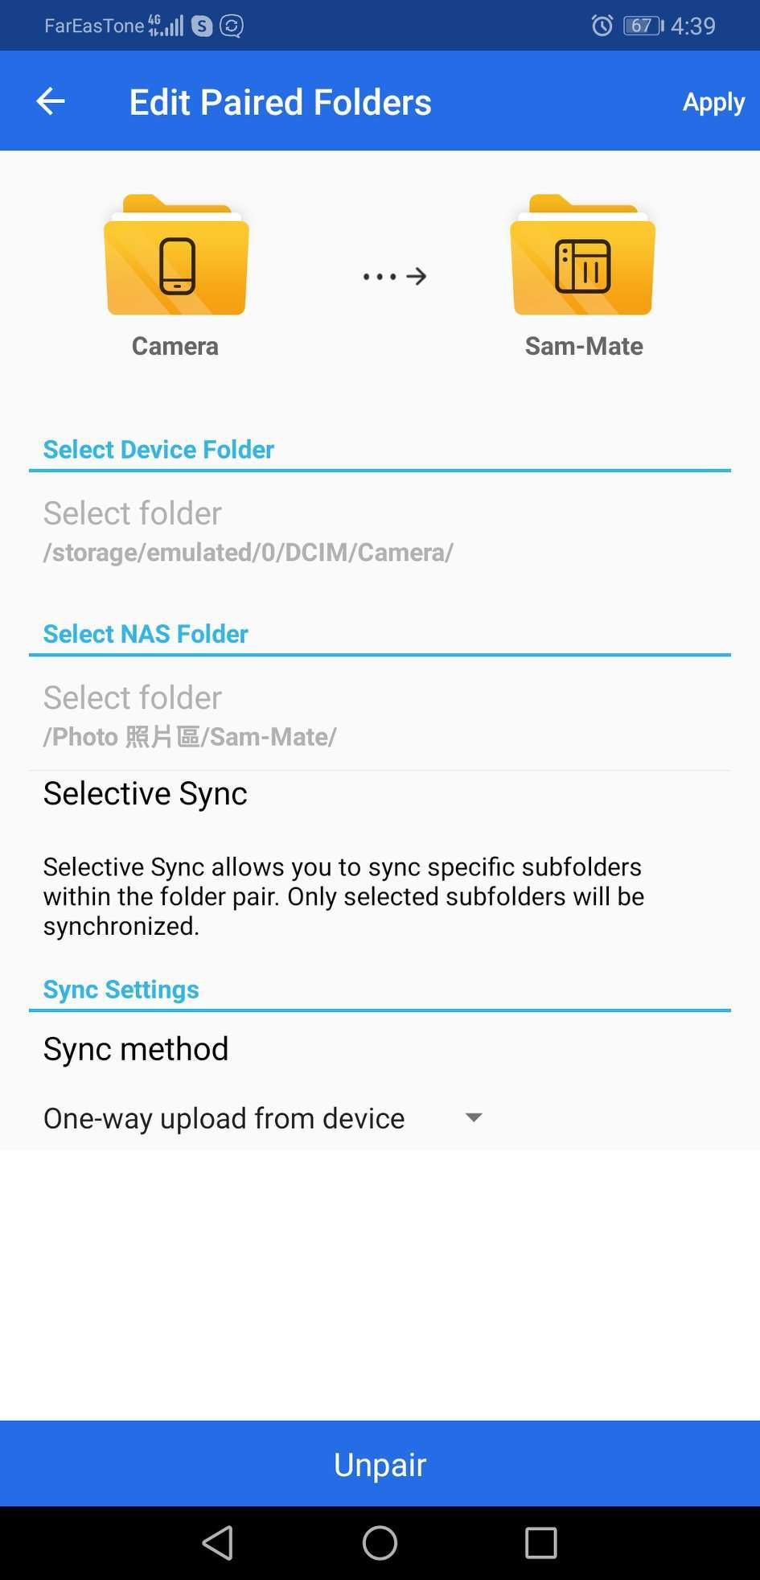
Operation Tips
Speed &
Flexibility
Everyone has personal Qsync folder
Create TeamFolder for family shared
Create a shared link (file/folder) at any time to provide information to friends who do not have account of the NAS
Notes:
Create the download links to share with friends who don’t have an account of the NAS.

Slide 7
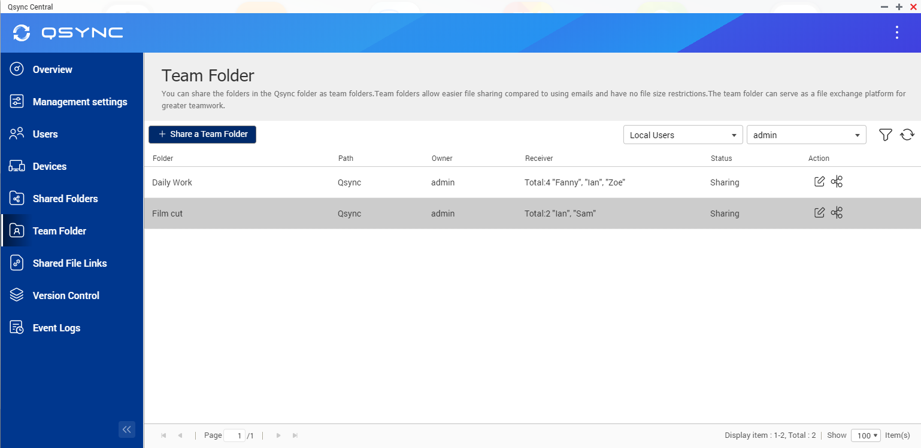
Use Case : Sync daily work
How can I synchronize my daily work to the NAS for safekeeping?
Sync Personal data
1
You could sync data to shared folder or personal home folder.
Supports the sub-folder of shared folder or Qsync folder.
Sync teamwork
2
It’s more convenient to use the group folder in the Qsync folder.
You can also limit the access to specific users (only to your supervisors)

Slide 8
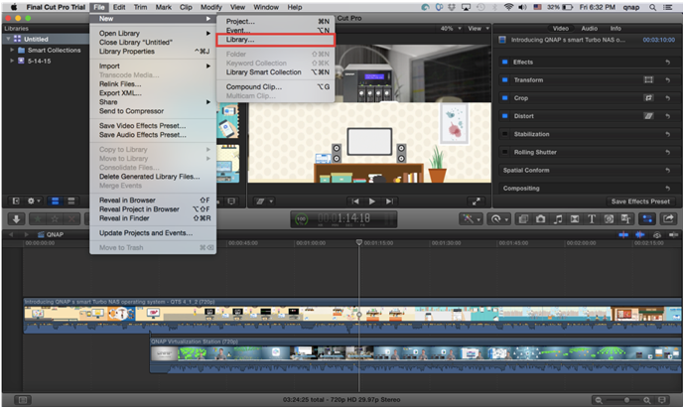
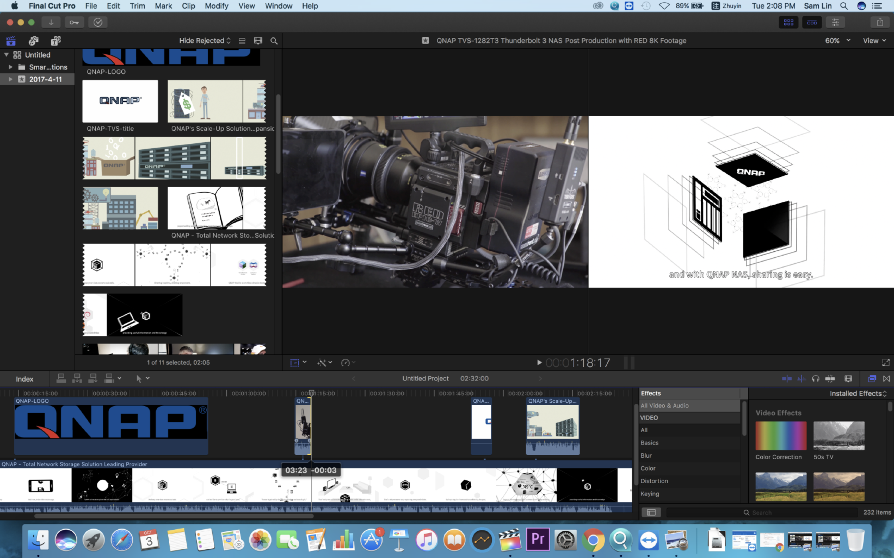
Use Case: How does the post-production team work
How to hand over the work I have done to my colleagues for the next process
Tip
Set the Team folder for your partner responsible for the next process.
Sam: Editing
Ian:
VFX
Lisa: Color Grading
Alan: Sound
Zoe: subtitle
Film cut
Animation
Color Correction
Audio
subtitle

Slide 9
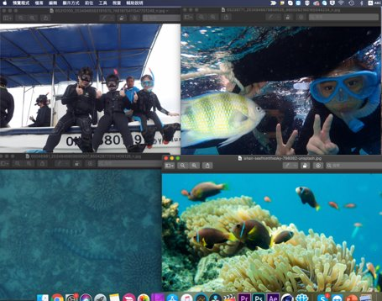
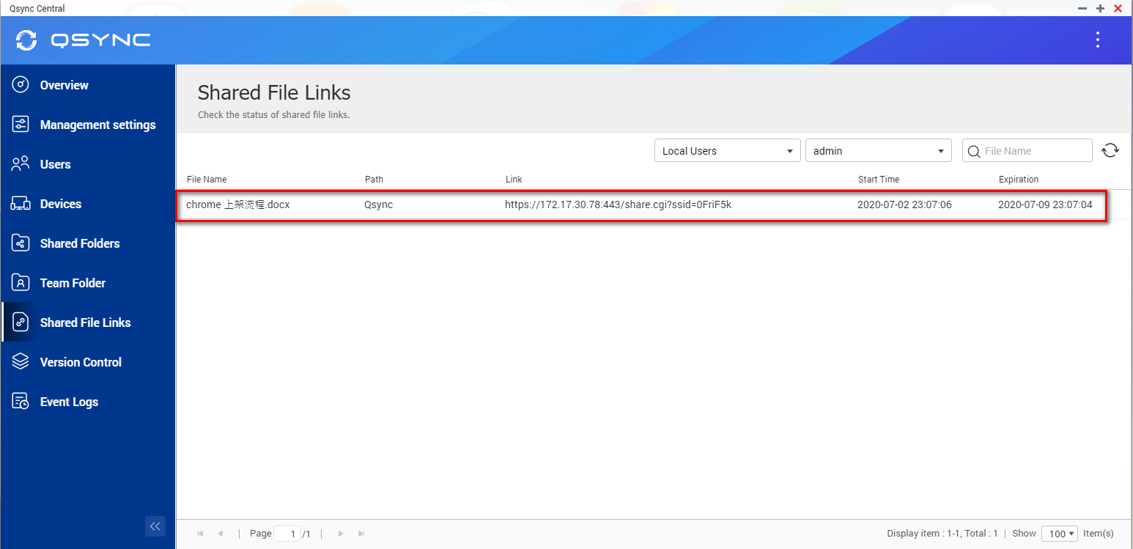
Use Case: New shared activity mode (e.g. Diving & Snorkeling)
1
Traditional Activity:
2
Team sharing to carry out activities together:
Set the shared link for all members of the activity.

Slide 10
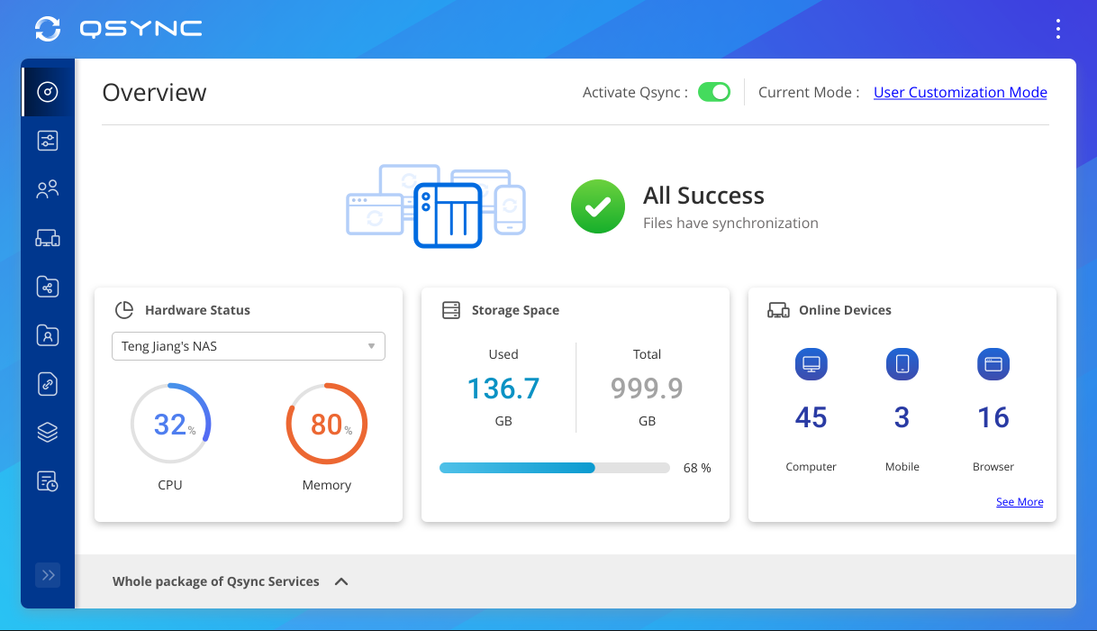
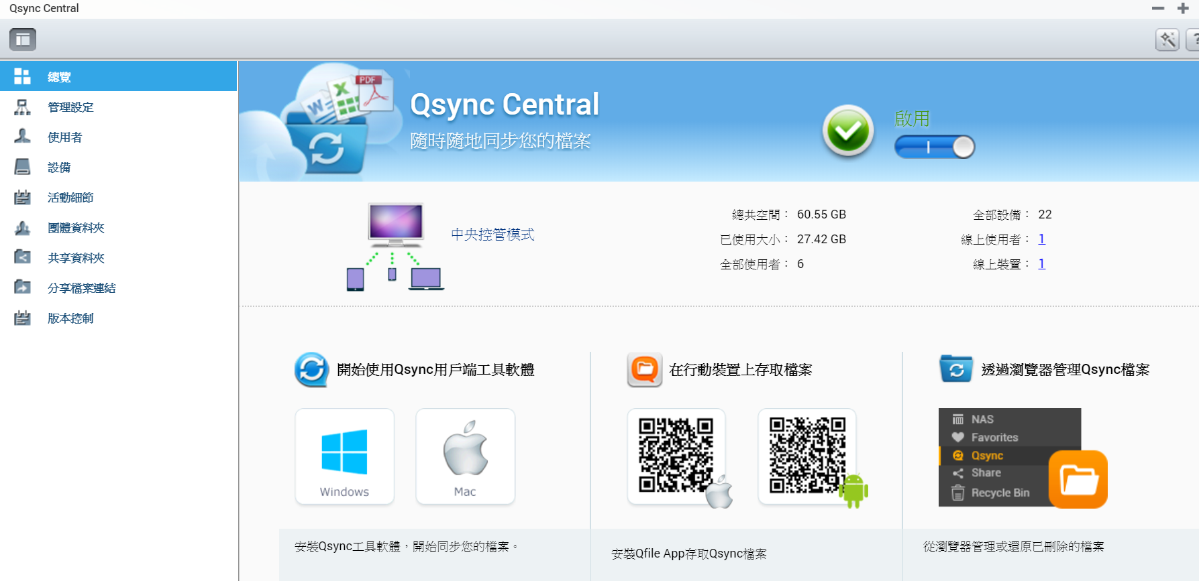
Centralized Management & Easy Deployment
No need to set machines one by one: we provide the flexible configuration, and allow users to set their own permissions
Synchronize rule
Filter setting
Conflict Policy

Slide 11
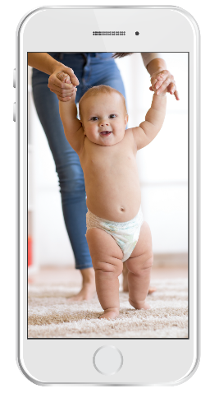
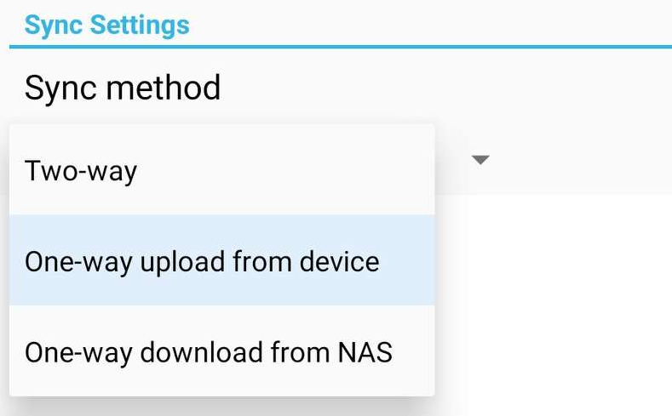
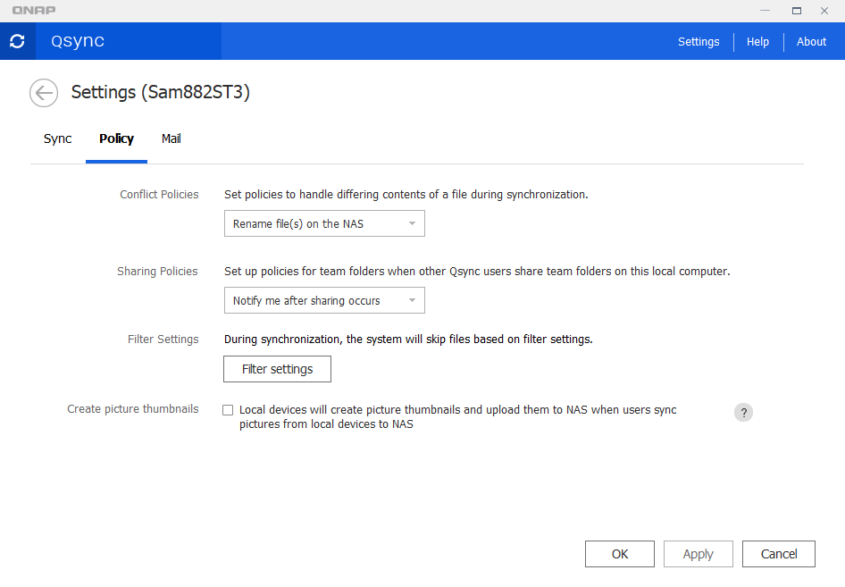
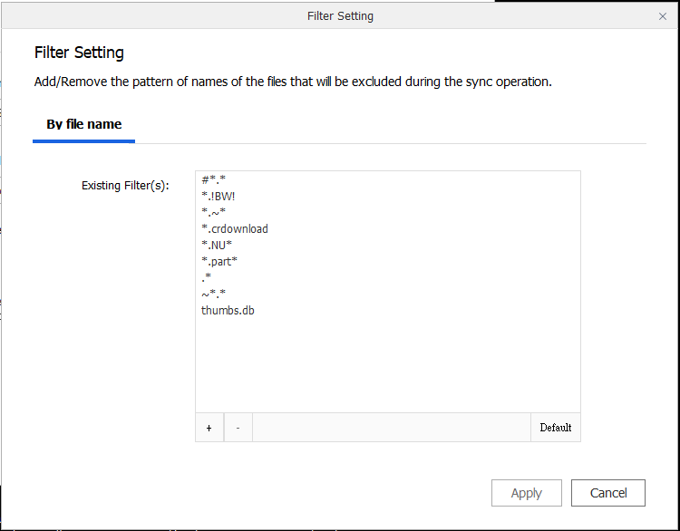
Utility & Mobile support sub-folder / one-way / two-way synchronization
Sub-folder
The user can set up synchronization in the sub-folder, but notice that when the sub-folder is set, this device cannot set to the upper layer (parent layer) and the next layer (child layer) as sync folders.
One-Way sync (only available for Android, and iOS will be coming soon)
Upload from device: The device is the source side and always get the latest data.
Download from NAS: Announced information to all member
Two-Way sync
Standard synchronization process, both side will be the same.
Filter setting on device side
Specify the file extensions which users don`t want to sync

Slide 12
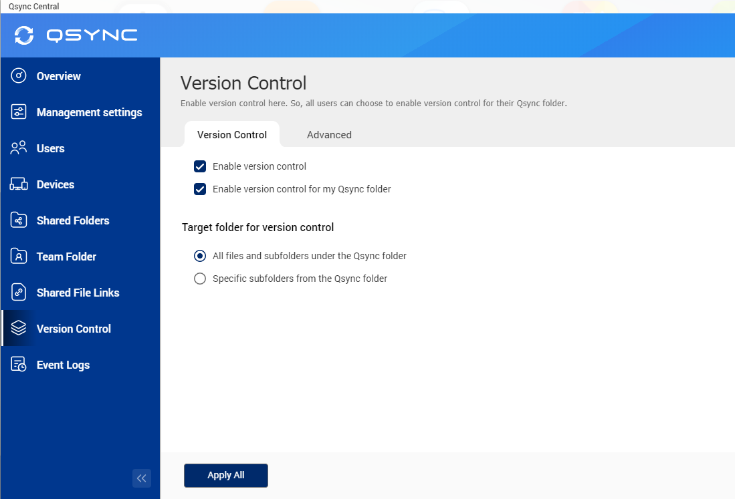
Safe file sync, version control & remote erase
Smart Delete
User could remove the local file but still keep those copies on the NAS to save the local storage space.
IT manager
Easy to deploy and manage
User
Easy to use and could be reverted
Version Control (only available for Qsync folder but not for shared folder)
User could revert the file back to the previous versions.
Remotely Erase device
The manager could remotely erase the sync files of the device via Qsync Central if user loses their device.

Slide 13
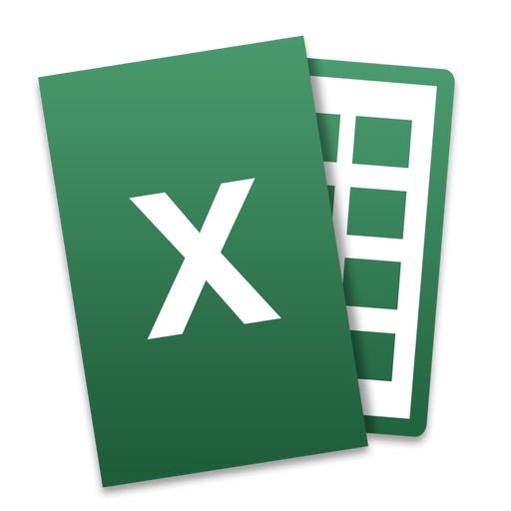
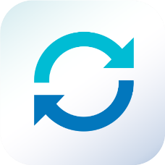
Team Folder : Increase collaboration efficiency
User could create and share the team folder.
Cross-departmental teamwork, share the
customer and vendor`s files simultaneously.
No need to ask for IT creating the new shared folder, flexible to create the team folder for other users that increase collaboration efficiency and reduce management difficulty

Slide 14
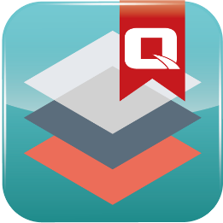
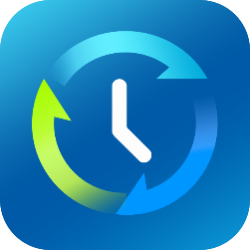
With advanced NAS features, your Qsync data also benefits
Snapshot
Avoid ransomware
Qtier, SSD Cache
Higher performance
Hybrid Backup Sync
more backup more protection
RAID
Protection
With QuTS hero, help you reducing more storage space
A
B
C
D
A
B
C
D
A
B
C
D
D
C
A
B
D
C
A
B
Original Data
Compressed Data
Deduplicated Data
Compression
Deduplication

Slide 15
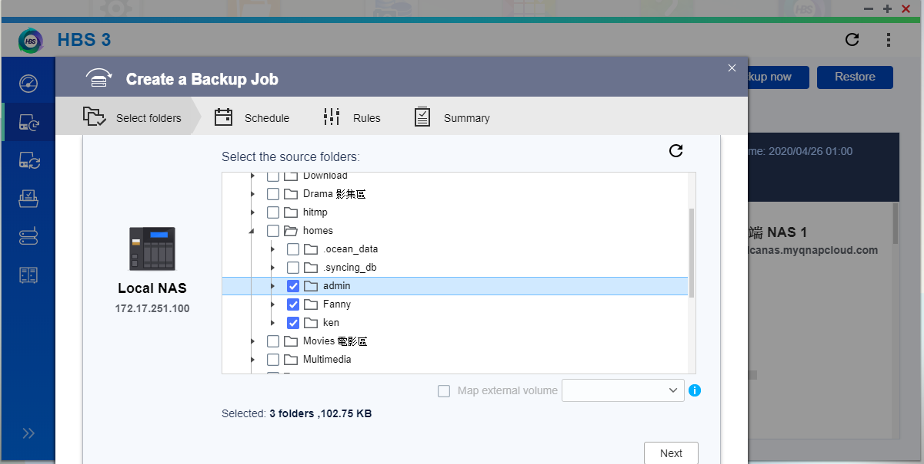
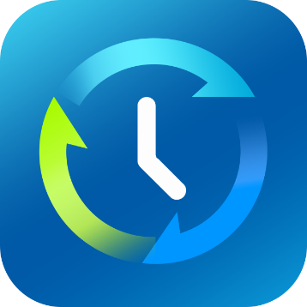
How to back up your Qsync data
Hybrid Backup Sync 3
Local
Remote
Cloud

Slide 17
How to choose the right NAS?​
 | Users | Processor | RAM | SSD Cache | Network
Home | 1-10 | Intel® Celeron® 2.41GHz Dual core | 1~4G | Nice to have | 1 GbE
SOHO | 10-50 | Intel® Celeron® Quad core 2.0GHz | 4G | Nice to have | 1GbE x2 / 2GbE / 10GbE
SMB | 50-200 | Intel® Core™ i5-7500 3.4 GHz | 16G | Y | 10GbE x2 (Port Trunking)
SME | 200-500 | Intel® Core™ i7-7700 3.6 GHz | 32G | Y | 10GbE x2 (Port Trunking)
Enterprise | 500-1000 | Intel® Xeon® 4-core | 64G | Y | 10GbE x4 (Port Trunking)
Enterprise | 1000-2000 | Intel® Xeon® 8-core | 128G | Y | 10GbE x4 (Port Trunking)

Slide 18
Recommended models
TS-453D
TVS-872XT
TS-h1283XU
4 bay (4 x 3.5”)
Intel® Celeron® J4125 quad-core 2.0 GHz
4 & 8 GB RAM
8 bay (8 x 3.5”)
Intel® Core™ i5-8400T 6-core 1.7 GHz Processor
16GB RAM
12 bay (24 x 3.5”)
Intel® Xeon® E-2236 6-core 3.3 GHz
Max 128GB RAM

Slide 19
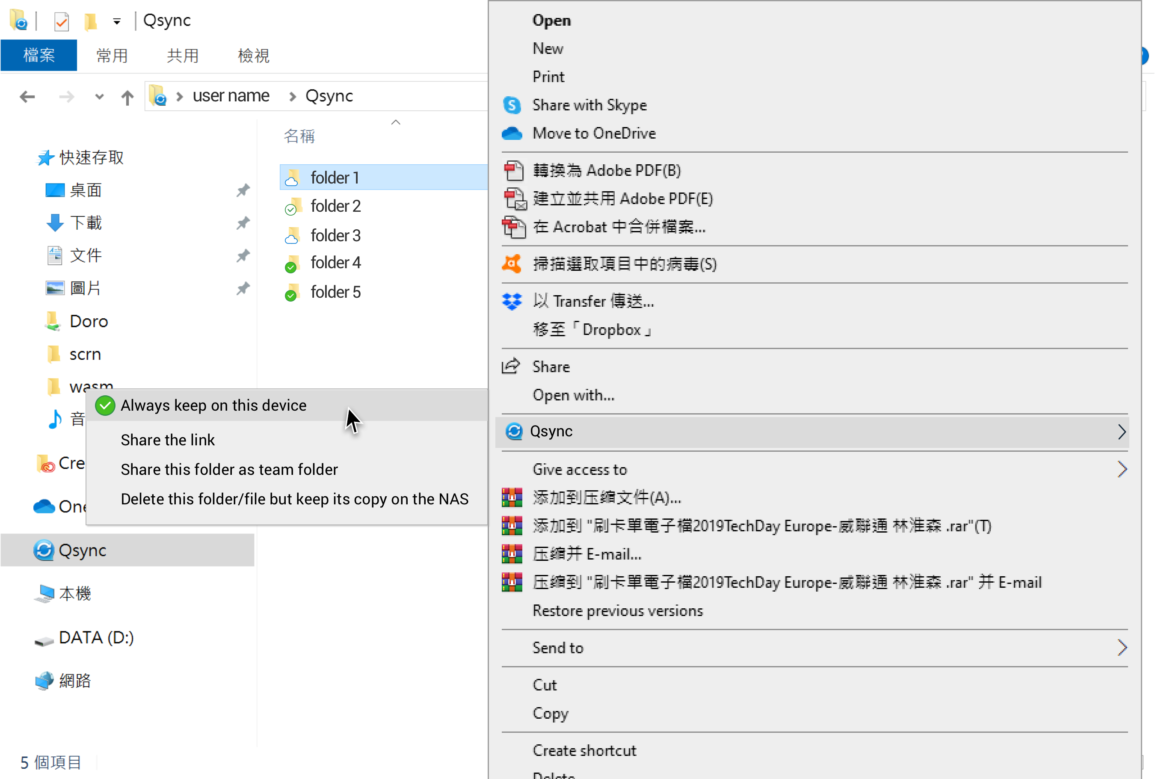
Feature roadmap 2020Q4
Space saving mode (similar as SmartSync of dropbox)

Slide 20
is your best choice !
Copyright© 2020 QNAP Systems, Inc. All rights reserved. QNAP® and other names of QNAP Products are proprietary marks or registered trademarks of QNAP Systems, Inc. Other products and company names mentioned herein are trademarks of their respective holders.​​​​
​
​​
​
​​​
​
​​
​
​​​​

