Slide 2
QNAP File Station x Microsoft 365
QNAP NAS is also a team workspace for collaboration!
Access anytime, anywhere
Work with team members
Familiar experience
With myQNAPcloud SmartURL, you can access documents on NAS and right-click to edit them anytime, anywhere.
The familiar Microsoft Office editing features you know and trust, so there’s nothing new to learn.
A shared document on private NAS can be co-edited by team members.

Slide 3
Click to use Microsoft Office SaaS
On-premises storage + SaaS on the cloud ➔
Secure online collaboration solution
Microsoft
Server
1
Store the document on on-premises NAS.
2
3
2
Securely transport file to Microsoft server for processing.
myQNAPcloud Link
secure transport
3
1
Save the processed file to on-premises NAS.

Slide 4
Microsoft original Office editing feature
The rich editing features provided by Microsoft
Same as Microsoft 365 Office for the web
Nothing new to learn

Slide 5
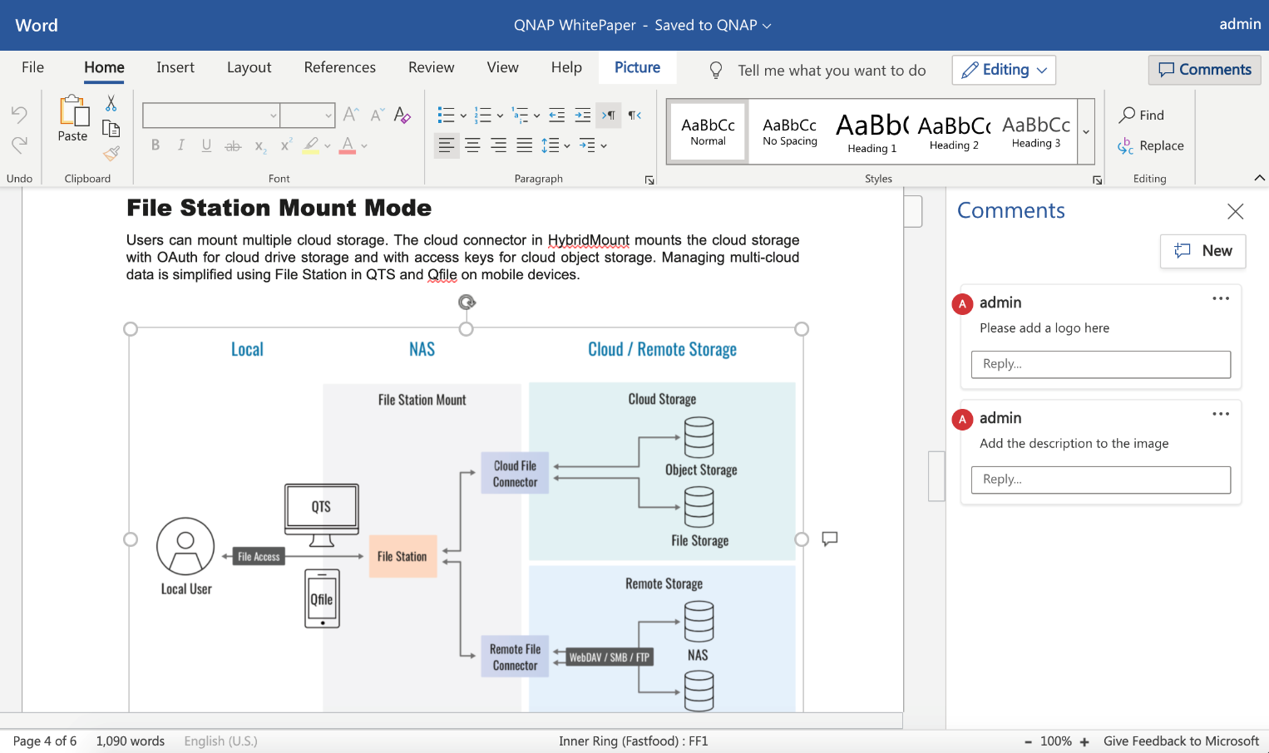
Support Microsoft formats without compatibility issues
docx
xlsx
pptx

Slide 6
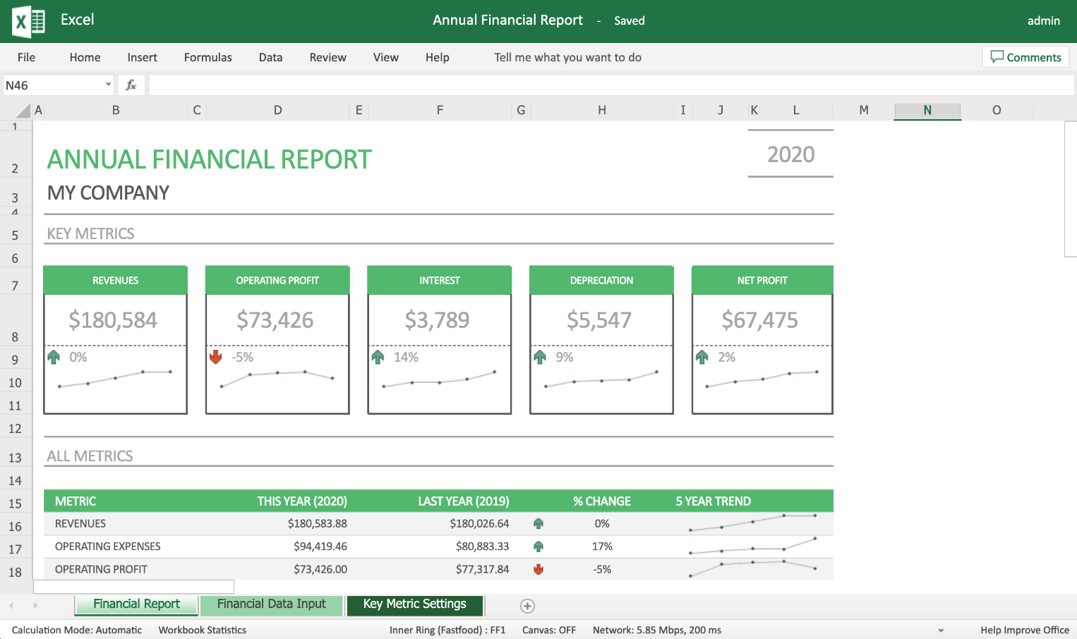
Support Microsoft formats without compatibility issues
docx
xlsx
pptx

Slide 7
Support Microsoft formats without compatibility issues
docx
xlsx
pptx
Notes:
app as a service
新增一頁資料流

Slide 8
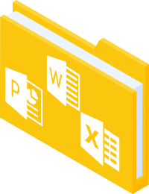
Begin using Office for the web for collaboration
1
Admin enable myQNAPcloud Link
2
Create the document
3
Create team shared folder
4
On-line collaboration

Slide 9
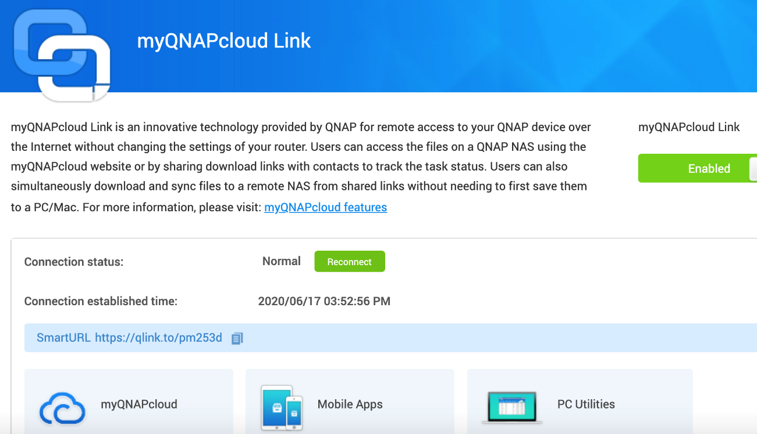
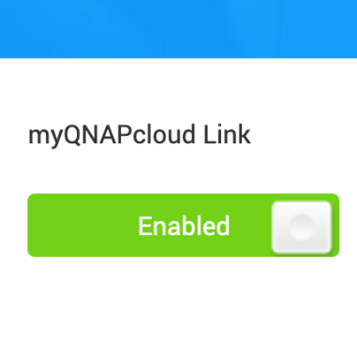
Easy to set up and use
Enable myQNAPcloud Link
Done by admin

Slide 10
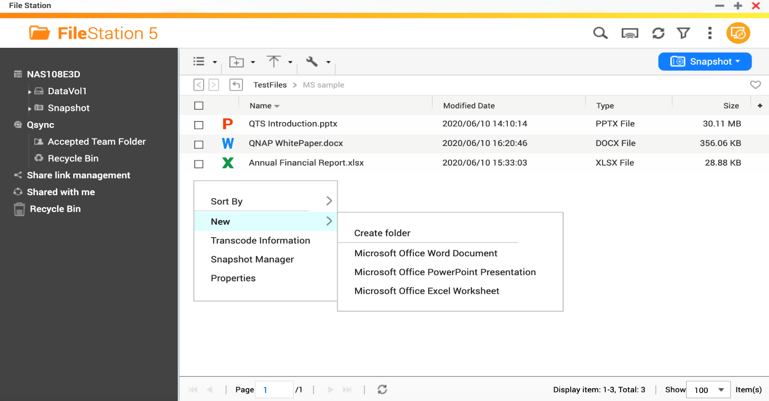
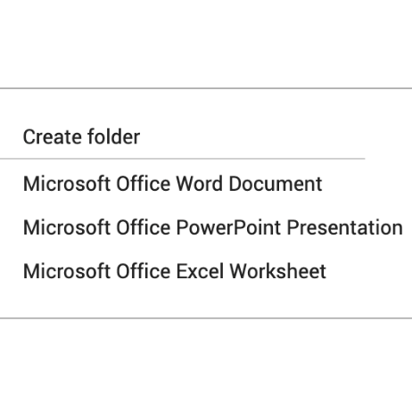
Create Microsoft Office file
Drag and drop to upload file from PC
Create new file

Slide 11
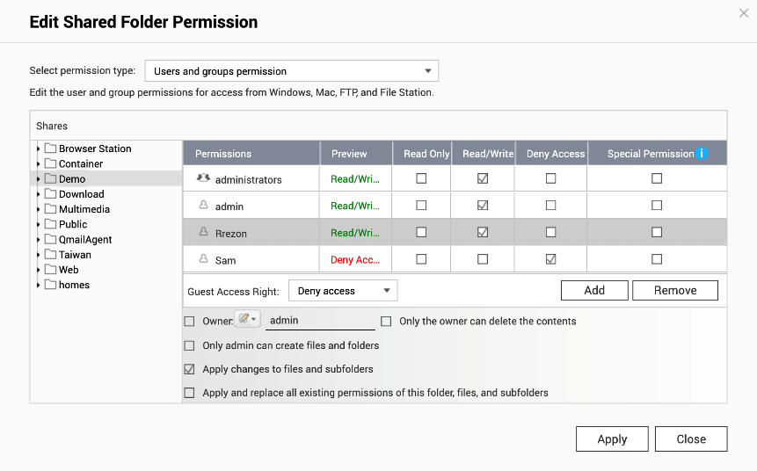
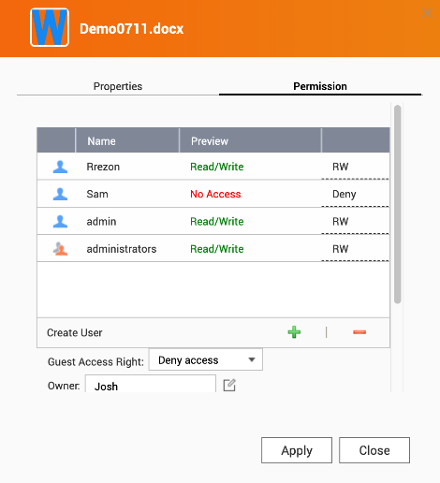
Create a shared folder for team collaboration
Share files in the shared folder
Advanced folder permission
Control Panel > Shared Folder > Edit shared folder permission
Control Panel > Shared Folder > Enable Advanced folder permission
File Station > File Properties > Permission
Support local users and domain users

Slide 12
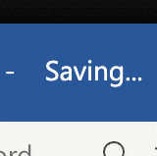
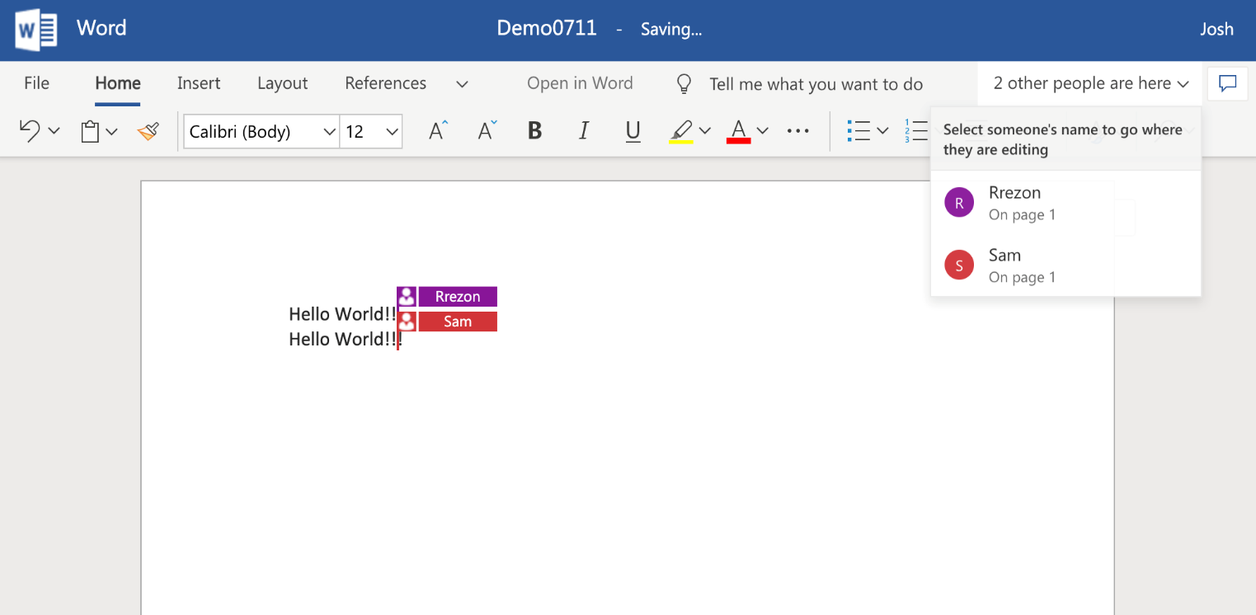
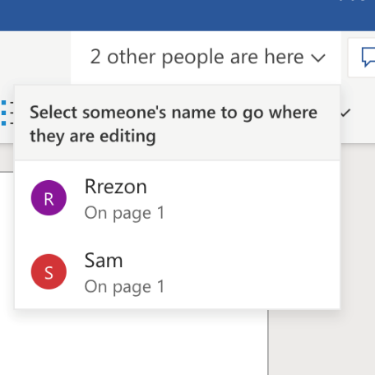
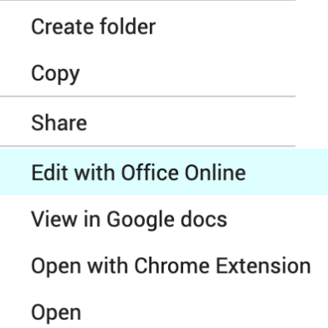
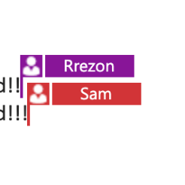
On-line collaboration with team members
Save back to NAS in real time
Co-authoring
by multiple users
Right-click and select “Edit with Office Online” start Microsoft Office in File Station
Office Online recommended number of concurrent editors is 10. The maximum is 99.

Slide 13
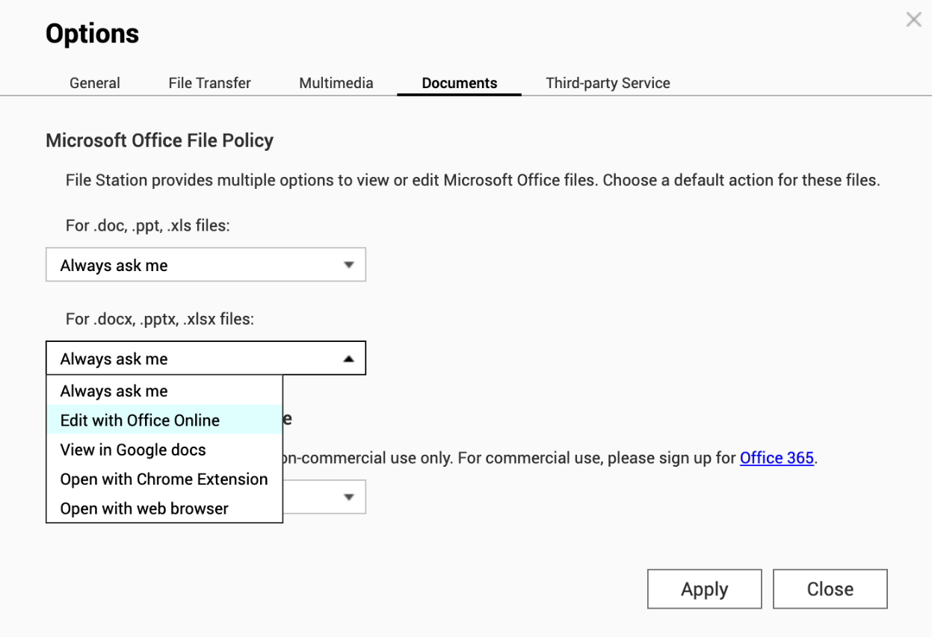
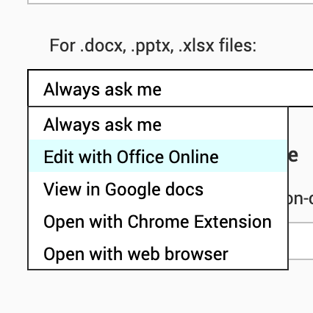
Setup the default action for opening documents
TIP
Setting up “Edit with Office Online” as a default action for opening Microsoft files.

Slide 15
Copyright © 2020 QNAP Systems, Inc. All rights reserved. QNAP® and other names of QNAP products are proprietary marks or registered trademarks of QNAP Systems, Inc. Other products and company names mentioned herein are trademarks of their respective holders.

Slide 16
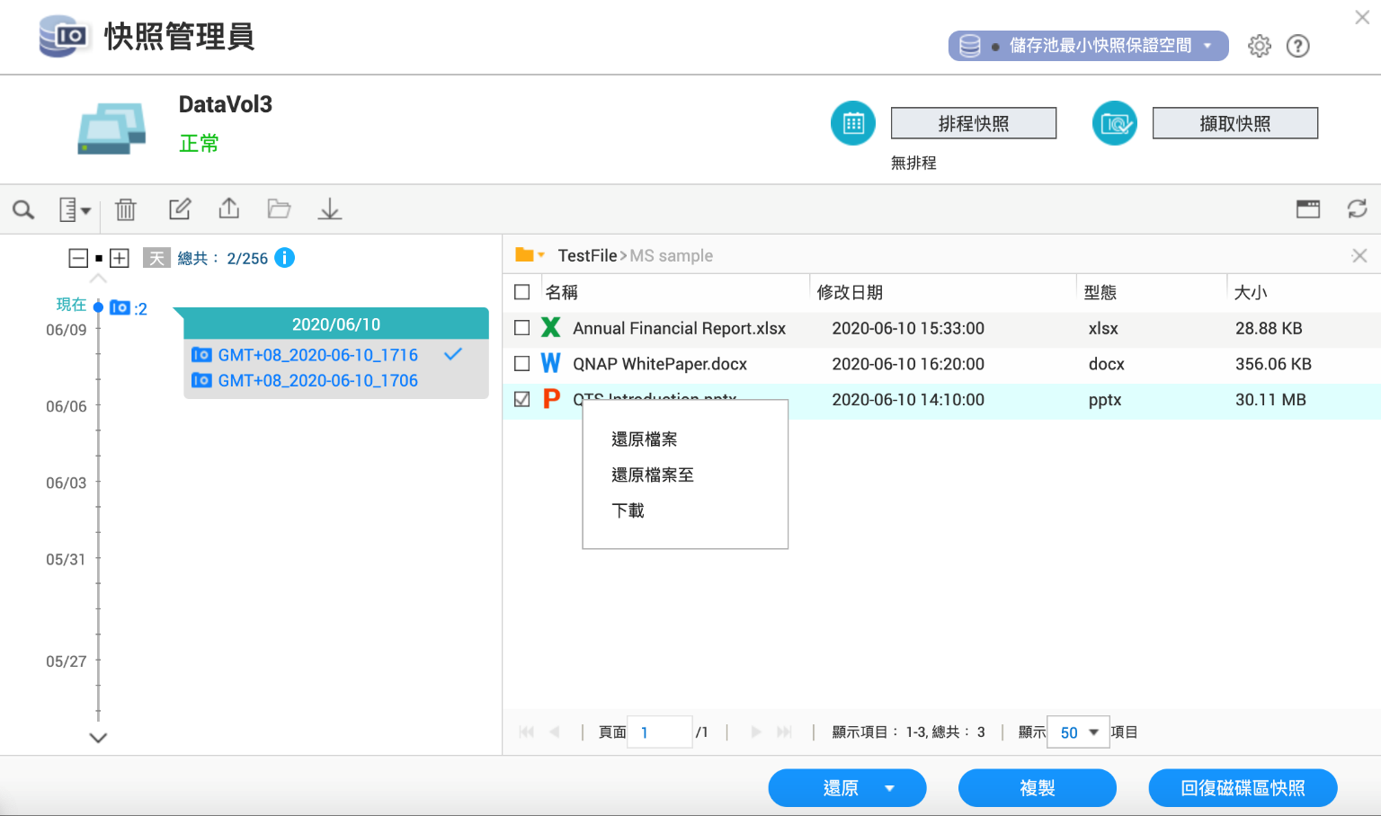
搭配快照，為文件進行多版本備份
小撇步
2
設定排程快照，為文件進行多版本備份，並依據時間版本進行還原
此功能由管理員操作

Slide 17
輕輕一點，Office 網頁版完整編輯功能馬上用！

